Slide 1
Same total photons, different detectors
Incident beam transmittance (%)
100 20 10 6.7 5
Integrated photons in spot
Exposure time (seconds) for 1° osc

Slide 2
What could be better than photon-counting?
Dead times:
1000 ns Oxford
200 ns Pilatus
Count rate (photons/s)
phi position (degrees)

Slide 3
What could be better than photon-counting?
Dead times:
1000 ns Oxford
200 ns Pilatus
Count rate (photons/s)
phi position (degrees)

Slide 4
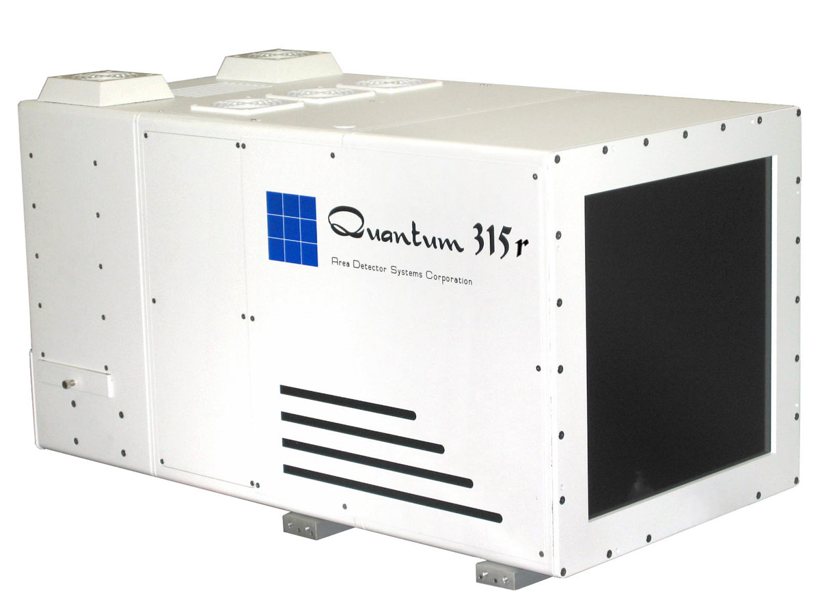
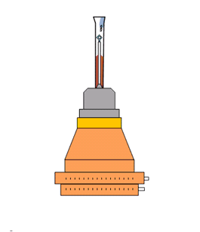
What is a “streak camera”?

Slide 5
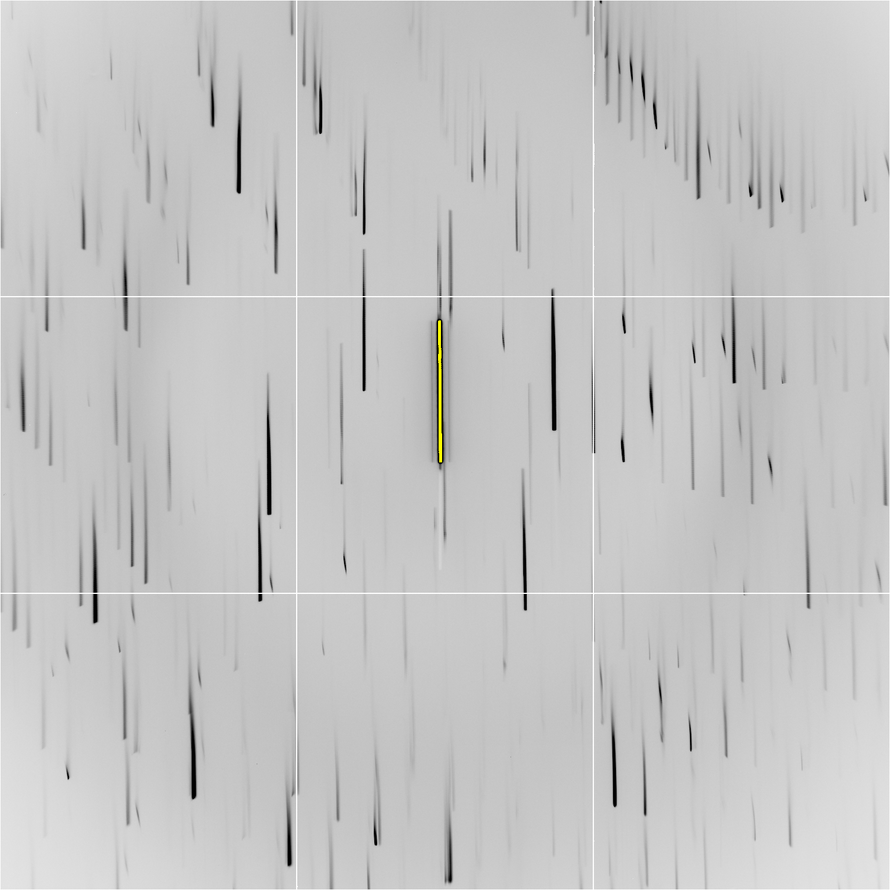

Slide 7
Individual spots at 768 kGy/s
Intensity (photons)
Dose (kGy)

Slide 8
Individual spots at 768 kGy/s
Intensity (photons)
Dose (kGy)

Slide 9
Individual spots at 768 kGy/s
Intensity (photons)
Dose (kGy)

Slide 10
Individual spots at 768 kGy/s
Intensity (photons)
Dose (kGy)

Slide 11
Individual spots at 768 kGy/s
Intensity (photons)
Dose (kGy)

Slide 12
Individual spots at 768 kGy/s
Intensity (photons)
Dose (kGy)

Slide 13
Individual spots at 768 kGy/s
Intensity (photons)
Dose (kGy)

Slide 14
Double-tap: no dark progression at 675 kGy/s
Intensity (photons)
Dose (kGy)

Slide 15
Double-tap: no dark progression at 675 kGy/s
Intensity (photons)
Dose (kGy)

Slide 16
Slow wiggle

Slide 17
Dose rate: same spot, same xtal
Intensity (photons)
Dose (kGy)

Slide 18
Dose rate: same spot, same xtal
Intensity (photons)
Dose (kGy)

Slide 19
Dose rate: same spot, same xtal
Intensity (photons)
Dose (kGy)

Slide 20
Dose rate: same spot, same xtal
Intensity (photons)
Dose (kGy)

Slide 21
Dose rate: same spot, same xtal
Intensity (photons)
Dose (kGy)

Slide 22
Dose rate: same spot, same xtal
Intensity (photons)
Dose (kGy)

Slide 23
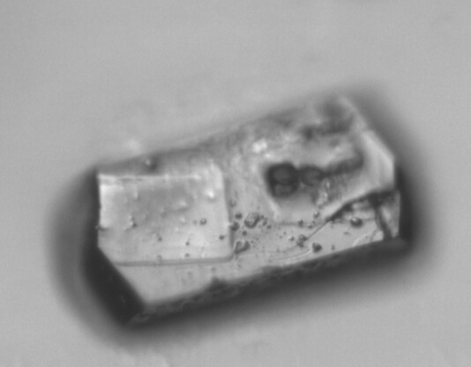
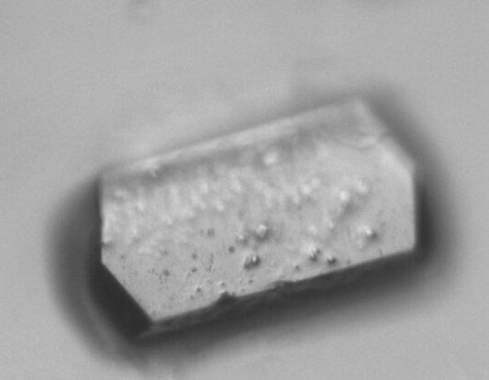
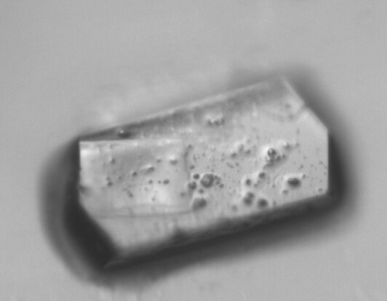
Xtal12 before & after
morphological dose-rate effect?
110 kGy/s
720 kGy/s

Slide 24
Xtal4_t1
Solvent “reaction” at 764 kGy/s

Slide 25
xtal4_t2
Solvent “reaction” at 764 kGy/s

Slide 26
xtal5_t1
Crystal “shrinks?” at 764 kGy/s

Slide 27
xtal5_t2
Crystal “shrinks?” at 764 kGy/s

Slide 28
xtal12
Double tap: 0.4 s on + 1 s off + on again

Slide 29
xtal13
Double tap: 0.4 s on + 1 s off + on again

Slide 30
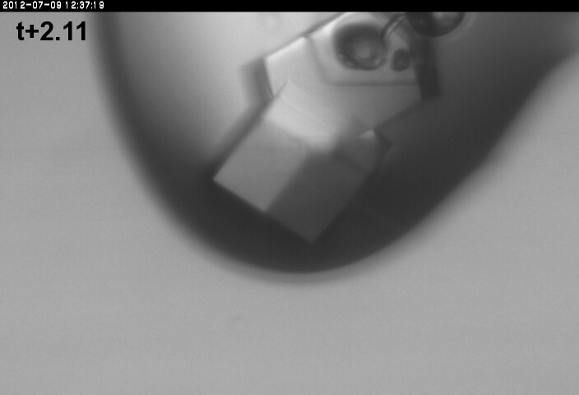
xtal13
Double tap: 0.4 s on + 1 s off + on again

Slide 31
xtal14
Double tap: 0.4 s on + 1 s off + on again

Slide 32
xtal15
Double tap lite: 5 s on + 12.6 s off + on again

Slide 33
xtal16

Slide 34
xtal17

Slide 35
xtal18

Slide 36
xtal24big

Slide 37
Xtal24big_t2

Slide 38
Xtal5_t1 graph

Slide 39
Xtal5_t1 graph
Spot intensity
seconds

