Slide 1
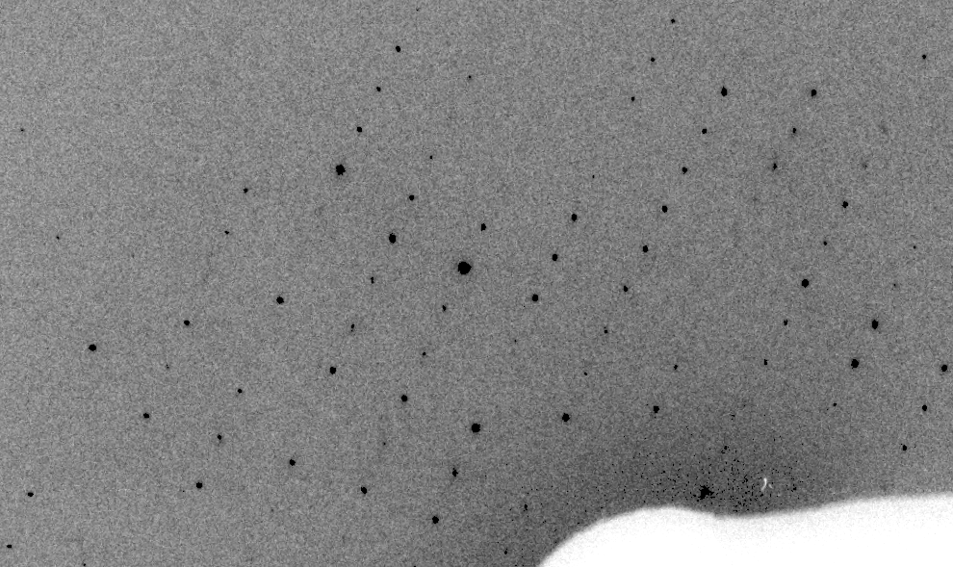
Simulation of XFEL stills

Slide 2
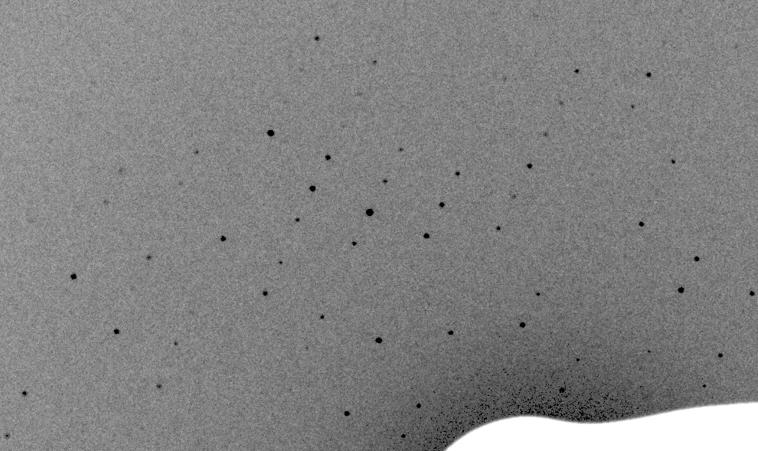
Simulation of XFEL stills

Slide 3
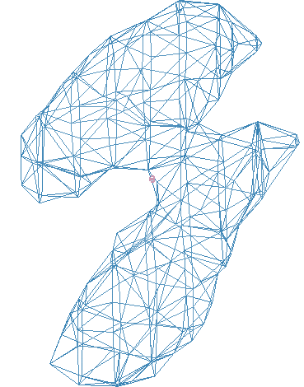
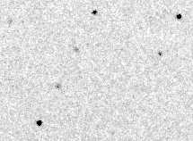
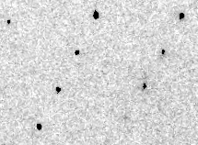
Simulation of XFEL stills
phix
phiy
phiz
real
VS
phix
phiy
phiz

Slide 4
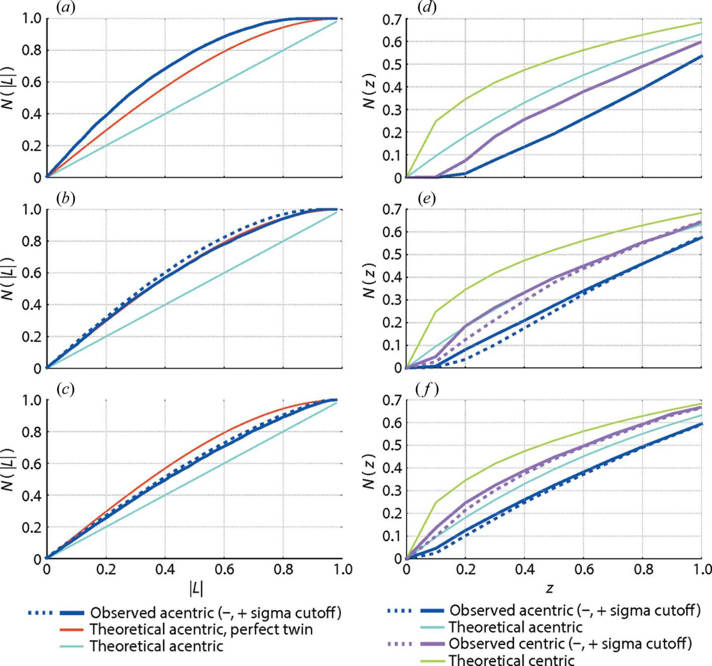
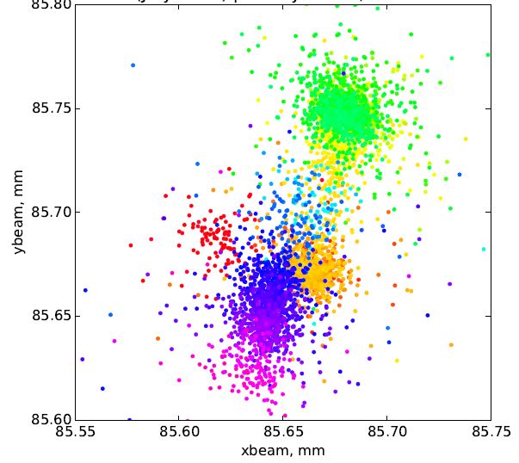
Simulation of XFEL stills
Sauter (2015). JSR 22, 239.
Color is
time
Beam center from autoindexing

Slide 5
Simulation of XFEL stills
Sauter (2015). JSR 22, 239.
Color is
time
Beam center from autoindexing

