Slide 1
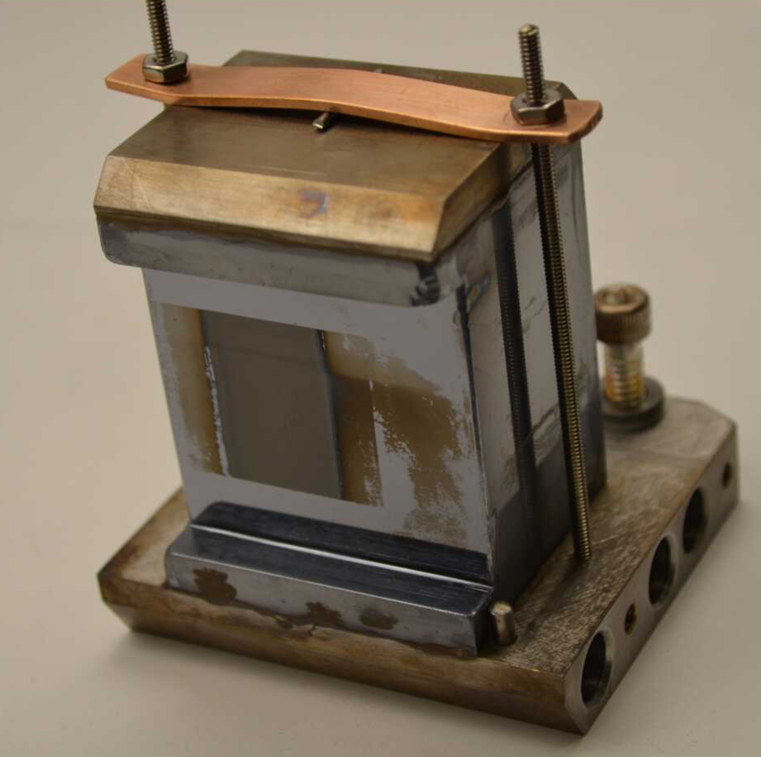
8.3.1
C1
Failed
Jan 4 2023
Silicon
cracked

Slide 2
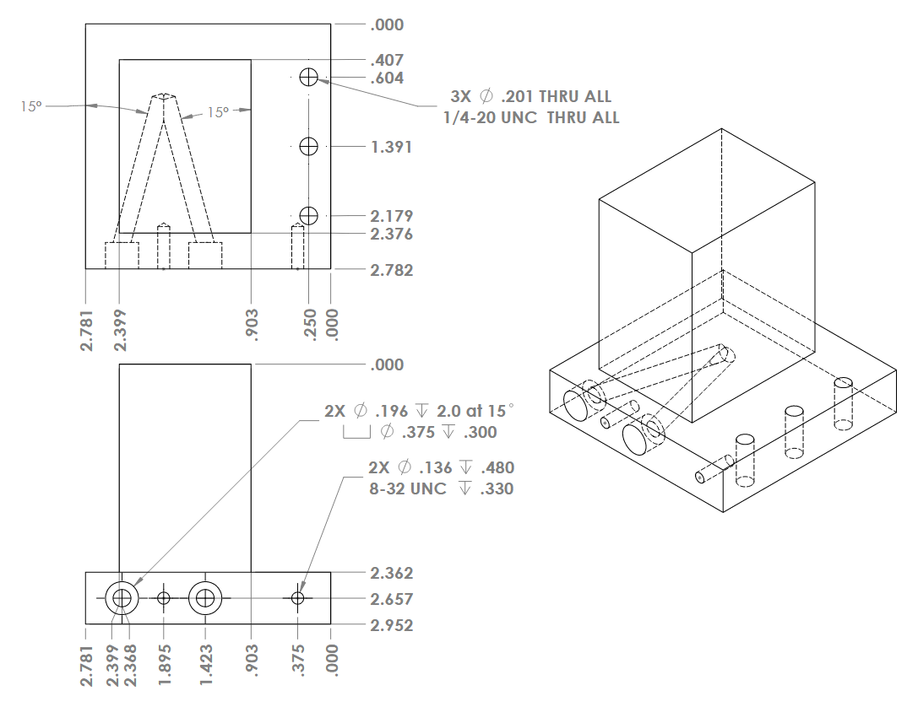

Slide 4
50 lb

Slide 5
Thermo
couples

Slide 7
Transient Heat Test
Temperature (C)
Time (minutes)

