Slide 1
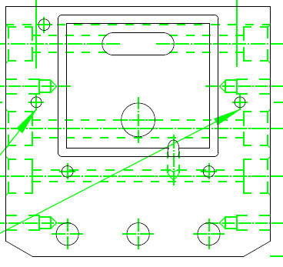
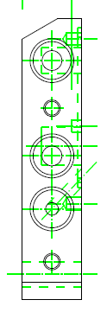
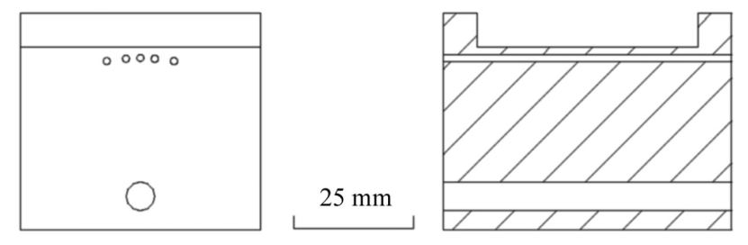
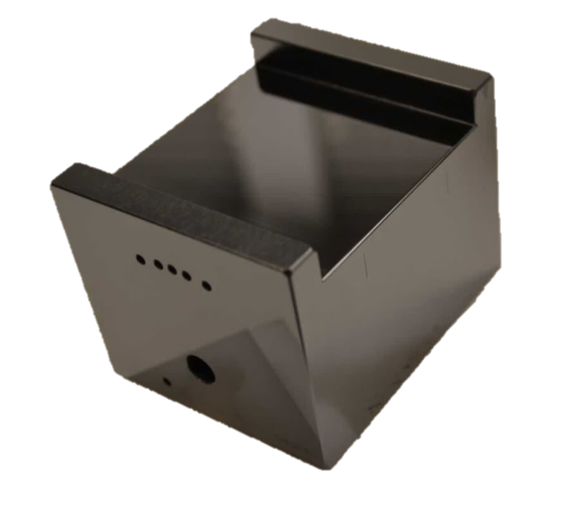
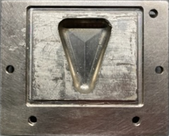

Slide 2
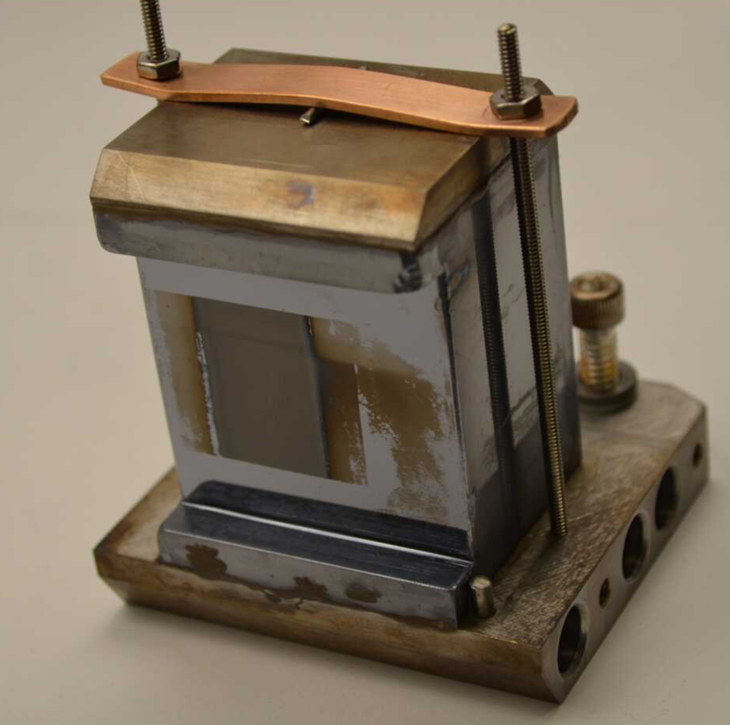
8.3.1
C1
Failed
Jan 4 2023
Silicon
cracked

Slide 3
Current best “spare”

Slide 4
“French Glue” is no longer available

Slide 5
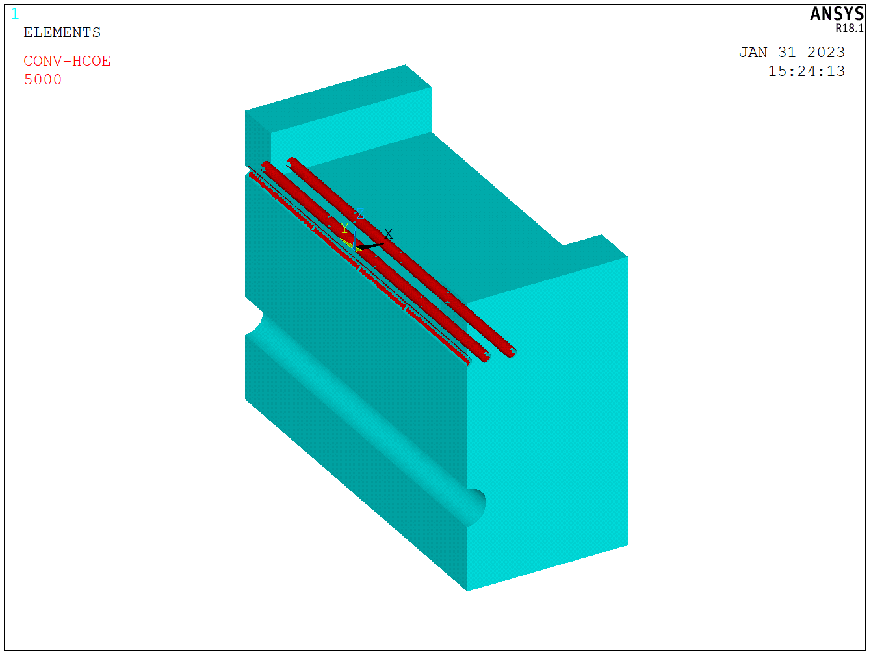
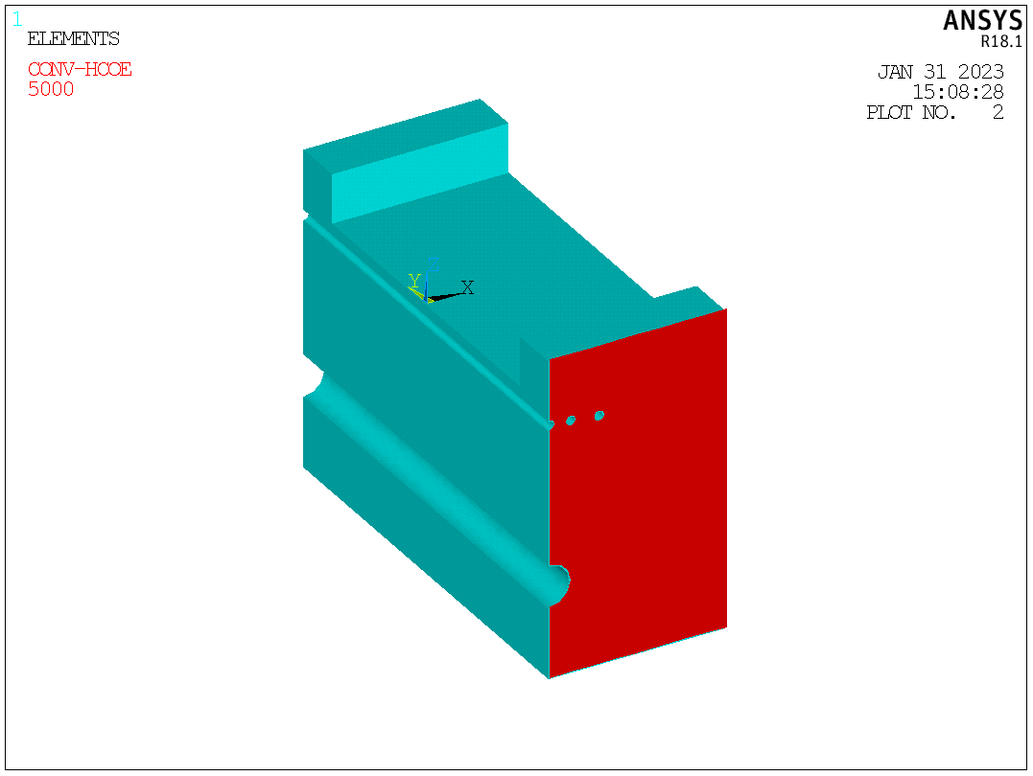
COOLED ON CHANNELS
COOLED ON ONE SIDE

Slide 6
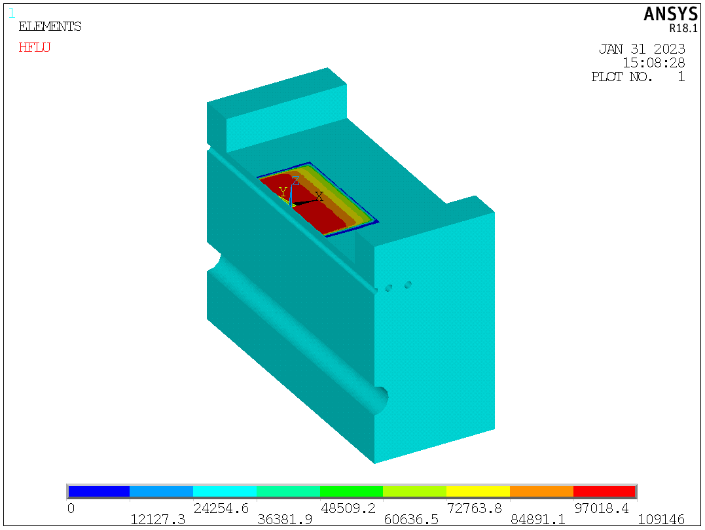
HEAT LOAD ~ 40 W
PEAK POWER DENSITY
~0.1 W /mm^2
(ESTIMATED BY
DANIELE, JAN 2022)

Slide 7
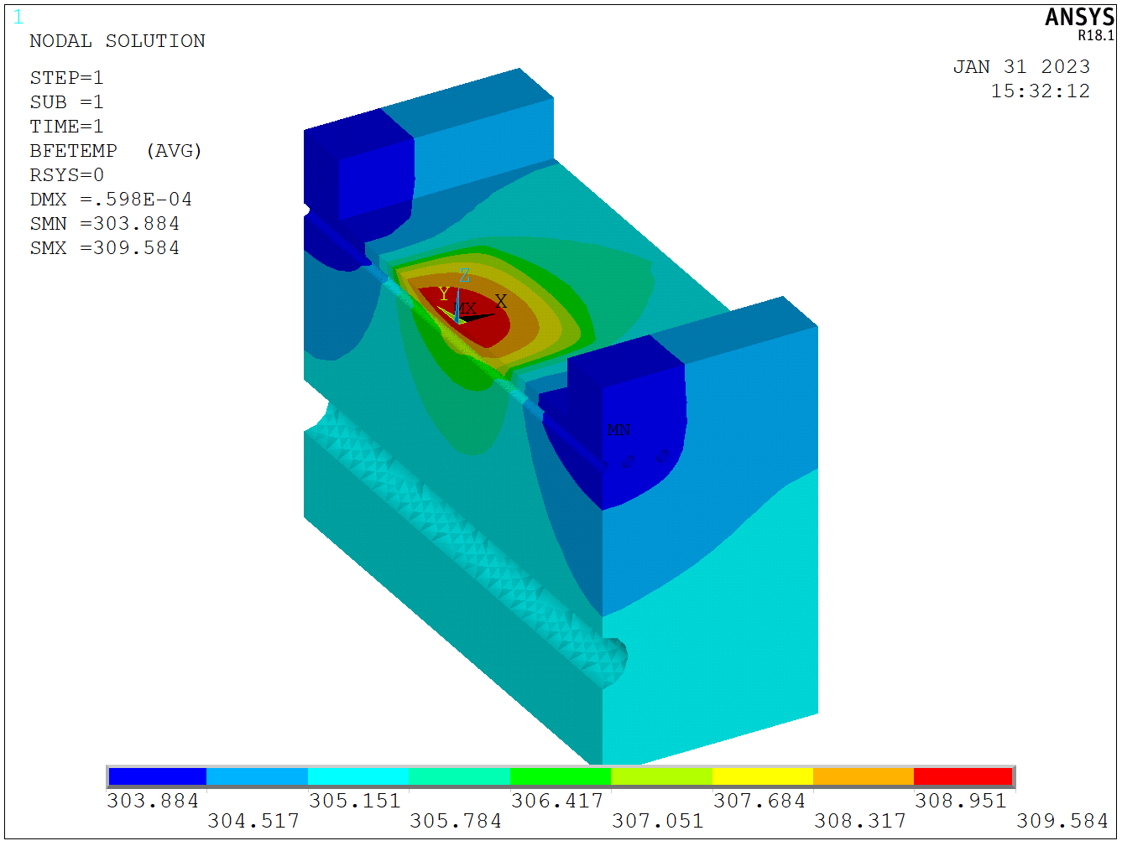
STEADY-STATE TEMPERATURE DISTRIBUTION
COOLED ON CHANNELS
COOLED ON ONE SIDE

Slide 8
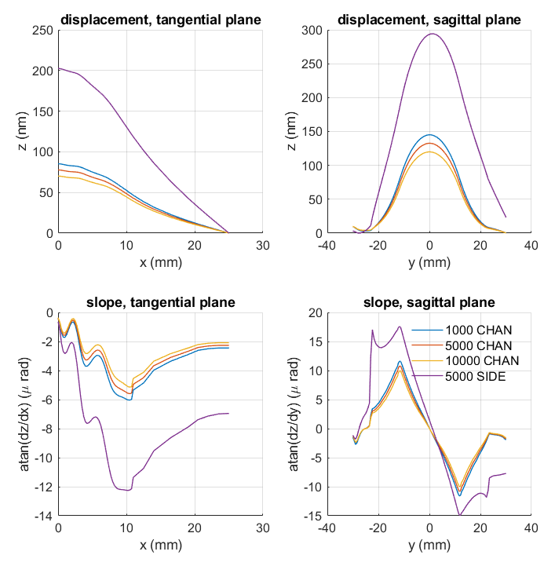
HEAT BUMPS
NOTE: RIPPLES ARE DUE TO VARIATION IN THERMAL CONDUCTIVITY DUE TO CHANNELS (VOIDS IN MATERIAL)
NOT DUE TO COOLING OR PRESSURE

Slide 9
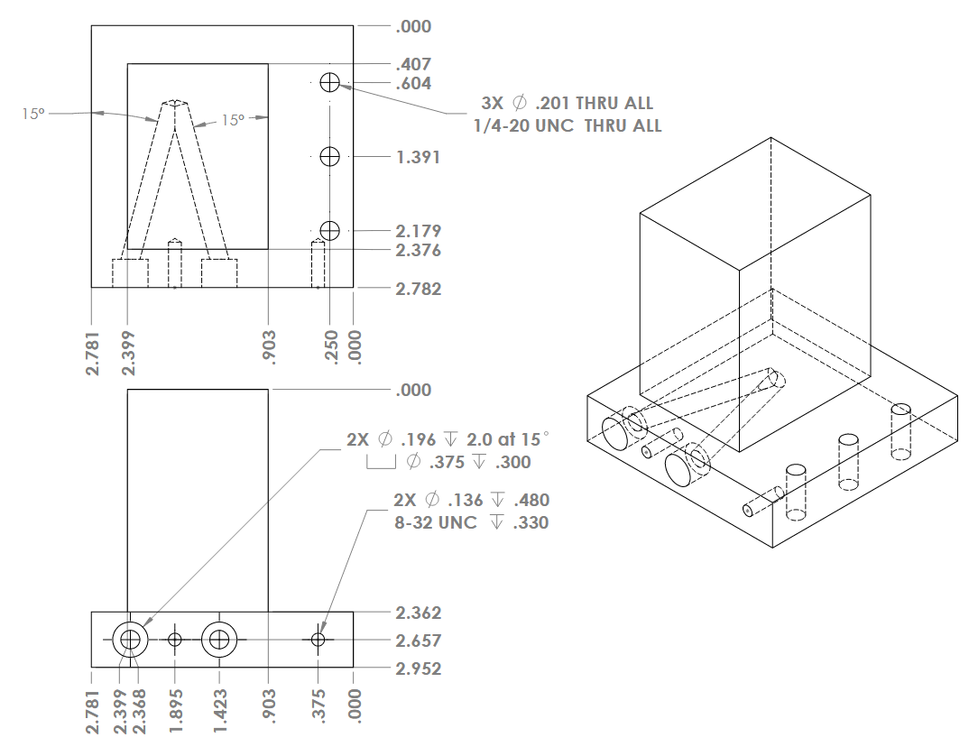

Slide 10
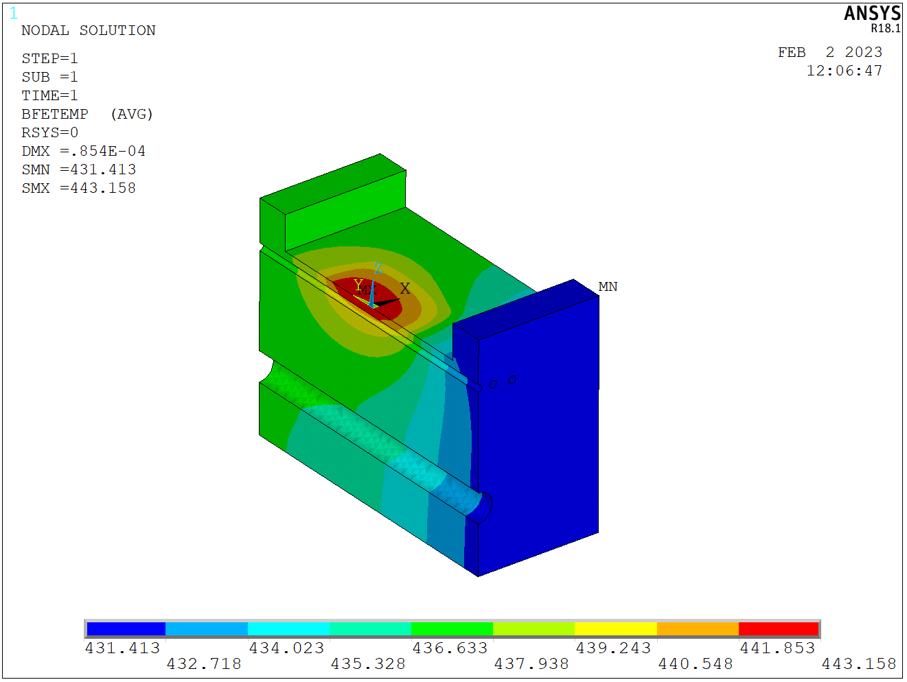
Worst-case Scenario: 150 W/m^2K

Slide 11
Epotecny E707 glue is no longer available
Masterbond E33 failed 2x in 3 months
Solder not reproducible

Slide 13
70 lb

Slide 15
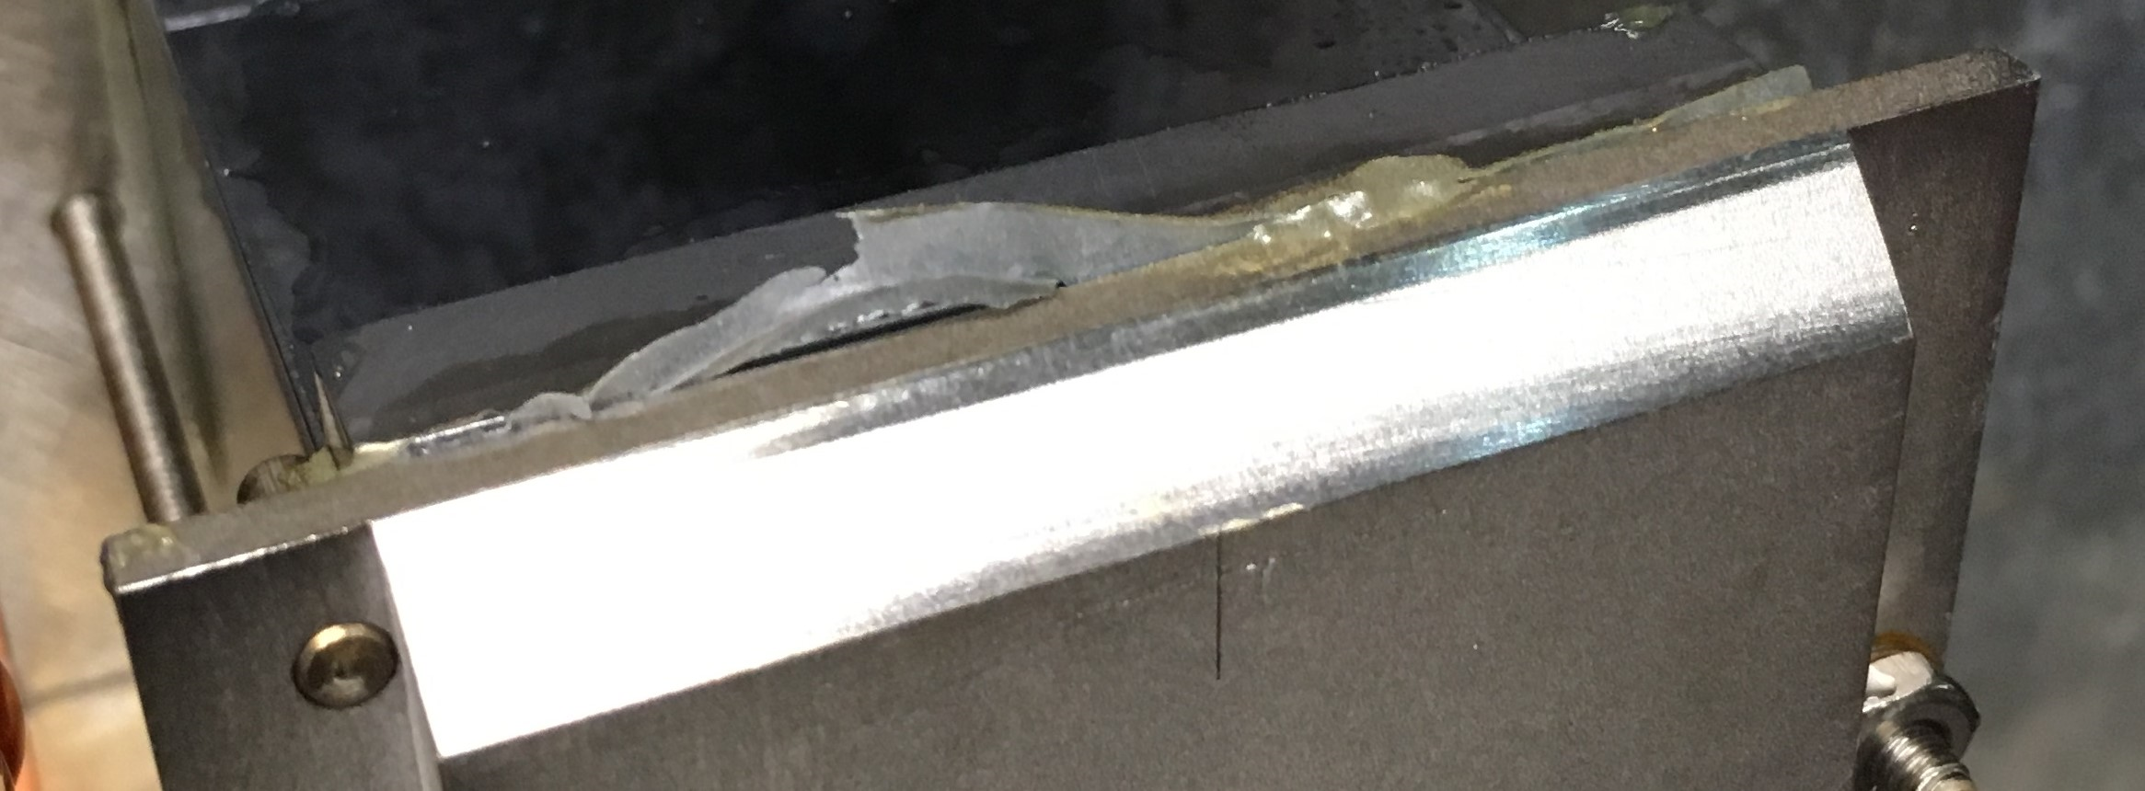
MasterBond E33

