Slide 1
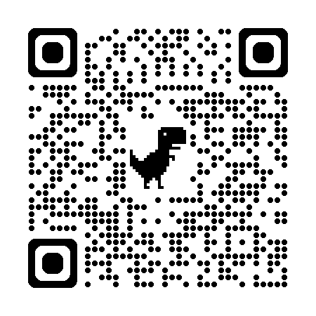
“rectified” Simulated Annealing
Default simulated annealing in phenix
Run score on result
Run score on starting model
Probe difference map
Atom by atom: is worse? Move it back
Iterate
Parallel seeds and temperatures
https://github.com/jmholton/rectified_simulated_annealing

Slide 2
Long-range traps from rectified SA
wE=21.4
Match ground-truth
swapped relative
To ground truth

Slide 3
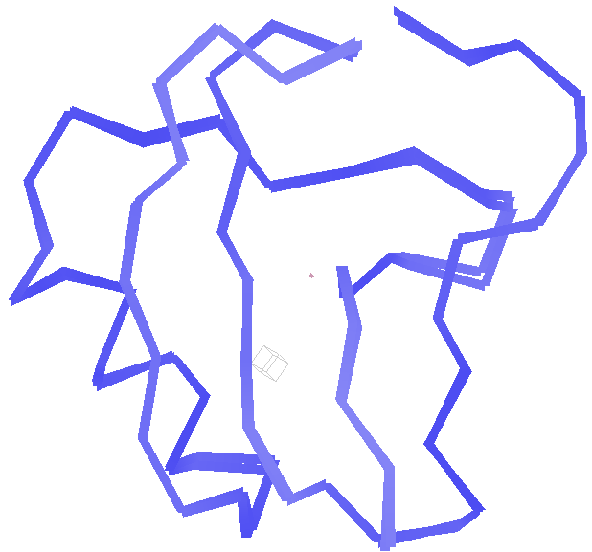
best.pdb
wE=18.2
Match ground-truth
Nothing
swapped relative
To ground truth

