Slide 1
Non-isomorphism in lysozyme
Dear James
The story of the two forms of lysozyme crystals goes back to about 1964 when it was found that the diffraction patterns from different crystals could be placed in one of two classes depending on their intensities. This discovery was a big set back at the time and I can remember a lecture title being changed from the 'The structure of lysozyme' to 'The structure of lysozyme two steps forward and one step back'. Thereafter the crystals were screened based on intensities of the (11,11,l) rows to distinguish them (e.g. 11,11,4 > 11,11,5 in one form and vice versa in another). Data were collected only for those that fulfilled the Type II criteria. (These reflections were easy to measure on the linear diffractometer because crystals were mounted to rotate about the diagonal axis). As I recall both Type I and Type II could be found in the same crystallisation batch . Although sometimes the external morphology allowed recognition this was not infallible.
The structure was based on Type II crystals. Later a graduate student Helen Handoll examined Type I. The work, which was in the early days and before refinement programmes, seemed to suggest that the differences lay in the arrangement of water or chloride molecules (Lysozyme was crystallised from NaCl). But the work was never written up. Keith Wilson at one stage was following this up as lysozyme was being used to test data collection strategies but I do not know the outcome.
An account of this is given in International Table Volume F (Rossmann and Arnold edited 2001) p760.
Tony North was much involved in sorting this out and if you wanted more info he would be the person to contact. I hope this is helpful. Do let me know if you need more.
Best wishes
Louise

Slide 2
Non-isomorphism in lysozyme
Structure factor (e⁻)
Johnson’s ratio

Slide 3
Non-isomorphism in lysozyme
Structure factor (e⁻)
Johnson’s ratio

Slide 4
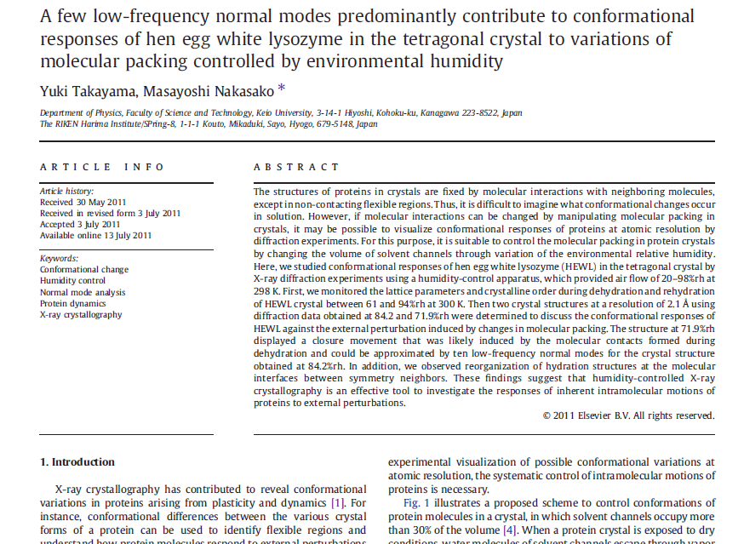

Slide 5
Non-isomorphism in lysozyme
RH 84.2% vs 71.9%
RMSD = 0.18 Å
R_{iso} = 44.5%

Slide 6
Non-isomorphism in lysozyme
RH 84.2% vs 71.9%
RMSD = 0.18 Å
R_{iso} = 44.5%

Slide 7
Magdoff & Crick (1955) “Ribonuclease II. Accuracy of measurement and shrinkage”, Acta Cryst. 8, 461-8.
Crick & Magdoff (1956) “The theory of the method of isomorphous replacement for protein crystals”, Acta Cryst. 9, 901-8.

Slide 8
Elastic deformation = non-isomorphism

Slide 9
Elastic deformation = non-isomorphism

Slide 10
Plastic deformation = poor diffraction

Slide 11
Plastic deformation = poor diffraction

Slide 12
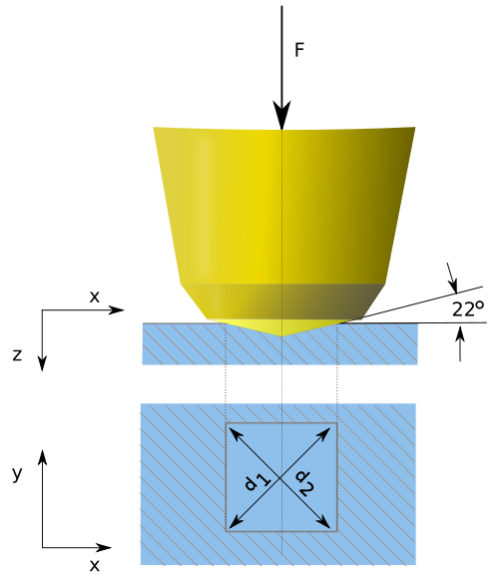
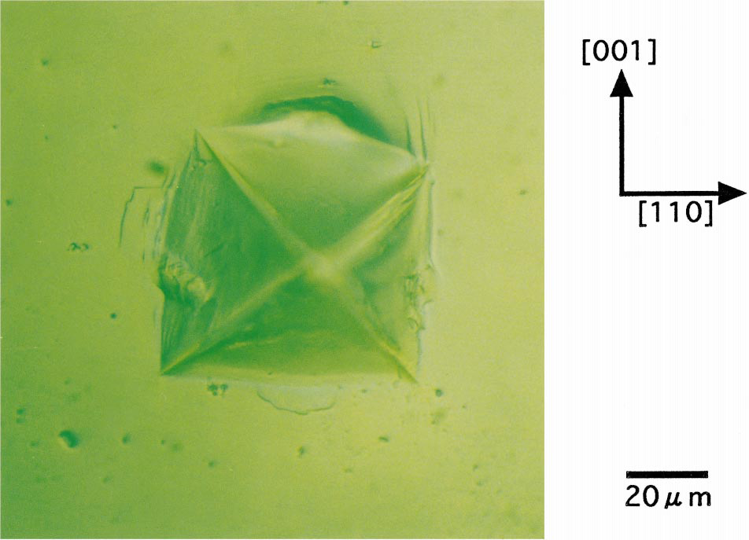
Vicker’s hardness
Tachibana et al. (1999) J. Cryst. Growth 198, 661-664.
Koizumi et al. (2009) Physical Review E 79, 61917.

Slide 13
Non-isomorphism in lysozyme
3aw6
3aw7
RH 84.2% vs 71.9%
RMSD = 0.18 Å
R_{iso} = 44.5%

Slide 14
Non-isomorphism in lysozyme
Dear James
The story of the two forms of lysozyme crystals goes back to about 1964 when it was found that the diffraction patterns from different crystals could be placed in one of two classes depending on their intensities. This discovery was a big set back at the time and I can remember a lecture title being changed from the 'The structure of lysozyme' to 'The structure of lysozyme two steps forward and one step back'. Thereafter the crystals were screened based on intensities of the (11,11,l) rows to distinguish them (e.g. 11,11,4 > 11,11,5 in one form and vice versa in another). Data were collected only for those that fulfilled the Type II criteria. (These reflections were easy to measure on the linear diffractometer because crystals were mounted to rotate about the diagonal axis). As I recall both Type I and Type II could be found in the same crystallisation batch . Although sometimes the external morphology allowed recognition this was not infallible.
The structure was based on Type II crystals. Later a graduate student Helen Handoll examined Type I. The work, which was in the early days and before refinement programmes, seemed to suggest that the differences lay in the arrangement of water or chloride molecules (Lysozyme was crystallised from NaCl). But the work was never written up. Keith Wilson at one stage was following this up as lysozyme was being used to test data collection strategies but I do not know the outcome.
An account of this is given in International Table Volume F (Rossmann and Arnold edited 2001) p760.
Tony North was much involved in sorting this out and if you wanted more info he would be the person to contact. I hope this is helpful. Do let me know if you need more.
Best wishes
Louise

Slide 15
Dehydration: 1934
and 2014?
= 1.5 μL
100 μm
= 1.0 nL
2 mm
= 1.0 pL
10 μm
= 1.0 fL
1 μm

Slide 16
X-ray Data Sets
Singular values & vectors
data
set
h,k,l | structure factors (F)
 | #1 | #2 | #3 | #4
5,3,4 | 523.7 | 559.8 | 579.9 | 603.2
5,4,4 | 168.2 | 166.6 | 177.2 | 196.1
5,5,4 | 34.9 | 26.4 | 19.2 | 17.3
6,1,4 | 305.7 | 301.1 | 298.1 | 296.3
6,2,4 | 353.0 | 353.9 | 356.2 | 366.9
6,3,4 | 300.9 | 285.3 | 273.5 | 259.4
6,3,5 | 223.8 | 226.3 | 234.6 | 251.4
… | … | … | … | …
h,k,l | 100% | 17 % | 13 % | 9 %
 | 1st | 2nd | 3rd | 4th
5,3,4 | -1.46 | -0.02 | 1.84 | -0.72
5,4,4 | -0.88 | -0.29 | -0.34 | 0.15
5,5,4 | -0.42 | -0.65 | 1.02 | 1.47
6,1,4 | -0.90 | -0.85 | 1.44 | -0.40
6,2,4 | -1.20 | -0.37 | 0.67 | 0.01
6,3,4 | -0.75 | 0.31 | 0.48 | 0.00
6,3,5 | -0.75 | -0.85 | 0.72 | -0.82
… | … | … | … | …
value
vector
Singular value decomp.
SVD
-0.68
-0.24
0.32 …
CC1
Data sets
Positioned
in
“Correlation
Space”
Correlation
Coefficients
CC1 CC2 CC3
CC2
data set #1
data set #2
data set #3
CC3

Slide 17
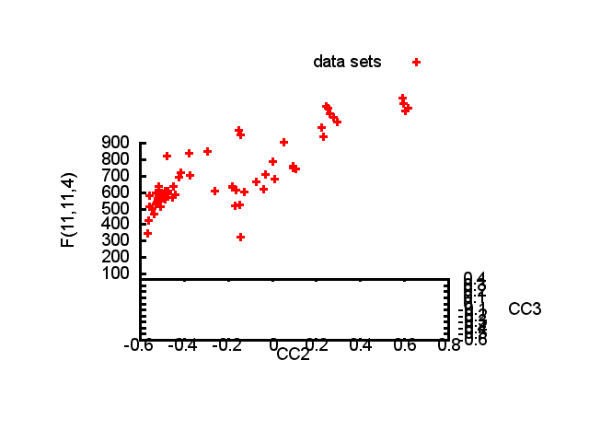

Slide 18
Structure factor (electrons)
Correlation to 2nd & 3rd singular vectors

Slide 19
Structure factor (electrons)
Correlation to 2nd & 3rd singular vectors

Slide 20
Structure factor (electrons)
Correlation to 2nd & 3rd singular vectors

Slide 21
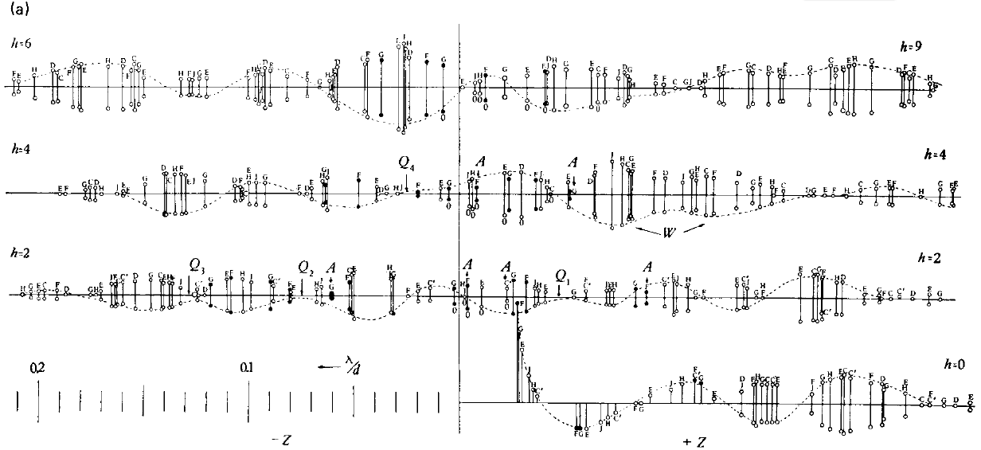
Bragg’s “minimum wavelength principle”
Perutz (1985). “Early Days of Cryst…” Methods in Enzymology, Vol. 114, 3-18.
Bragg & Perutz (1952)."external form haemoglobin I", Acta Cryst. 5, 277-283.

Slide 22
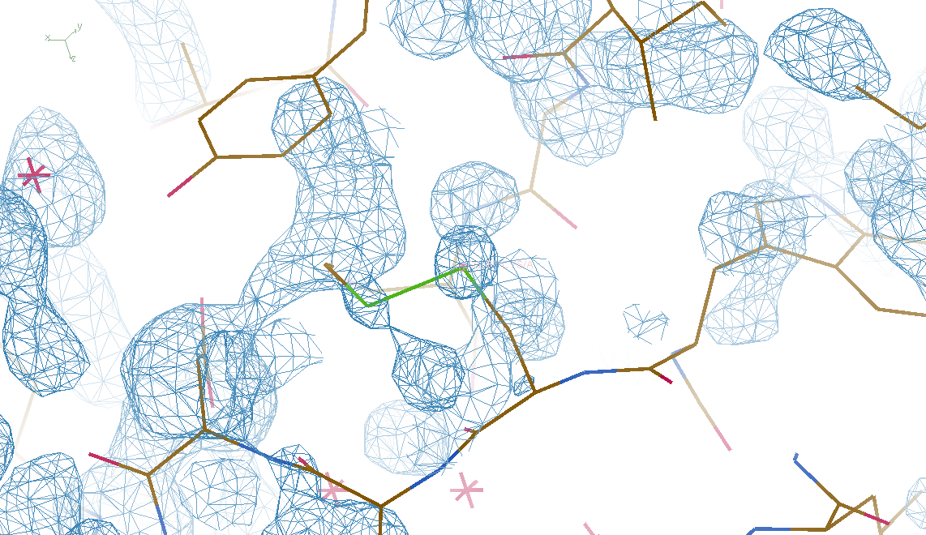
DMMULTI – fake data 4 deg rotation: 8 “xtals”: before
CC = 0.02

Slide 23
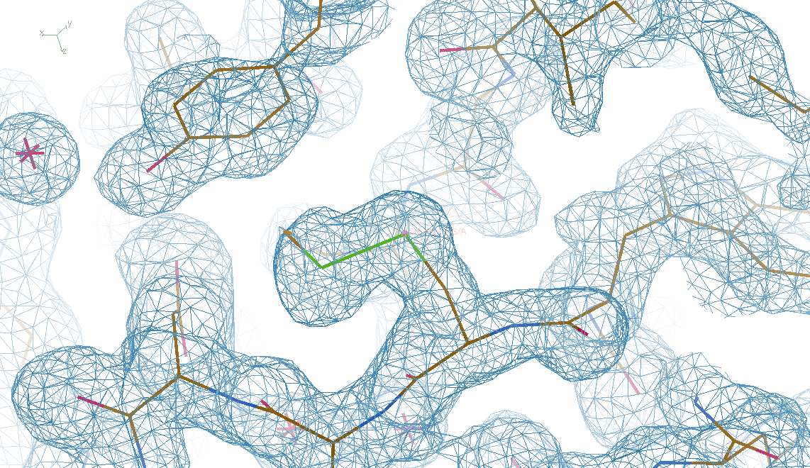
DMMULTI – fake data 4 deg rotation: 8 “xtals”: after
CC = 0.8

Slide 24
non-isomorphism

Slide 25
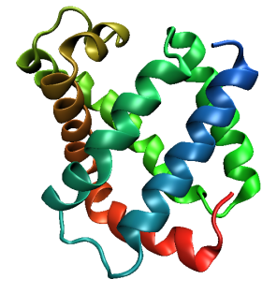
Same structure, different cell
0.5% cell change → 15%
Crick & Magdoff (1956) “theory method isomorphous replacement”, Acta Cryst. 9, 901-8.

Slide 26
Same structure, different cell
0.5% cell change → 15%
Crick & Magdoff (1956) “theory method isomorphous replacement”, Acta Cryst. 9, 901-8.

Slide 27
Same cell, rotated protein
0.5° rotation → 16%
Crick & Magdoff (1956) “theory method isomorphous replacement”, Acta Cryst. 9, 901-8.

Slide 28
Same cell, rotated protein
0.5° rotation → 16%
Crick & Magdoff (1956) “theory method isomorphous replacement”, Acta Cryst. 9, 901-8.

Slide 29
Uniform stretch
5% change → 0%

Slide 30
Uniform stretch
5% change → 0%

Slide 31
Non-isomorphism in lysozyme
RMSD = 1.70 Å
Δcell = 0.7 %
R_{iso} = 44.5%
RMSD = 0.18 Å
3aw6
3aw7
RH: 84.2%
vs 71.9%

Slide 32
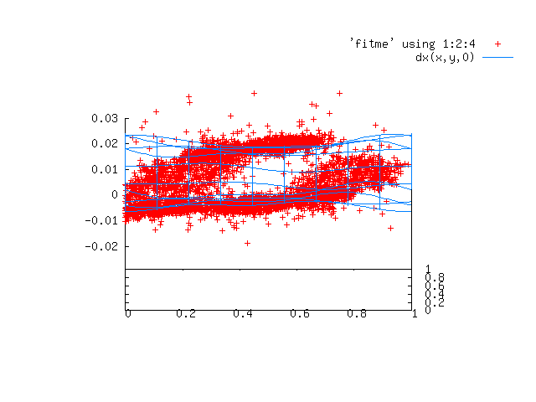

Slide 33
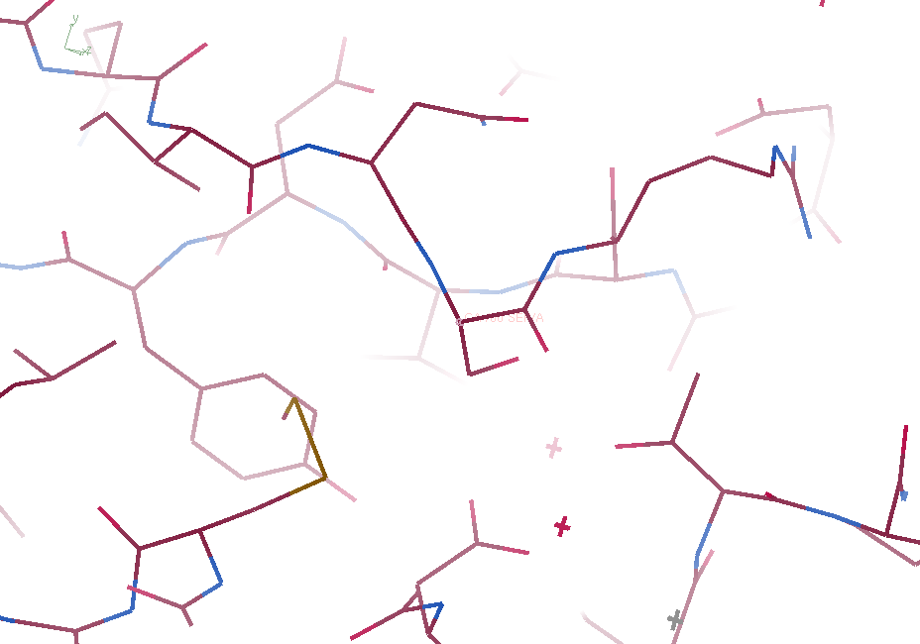
3aw6

Slide 34
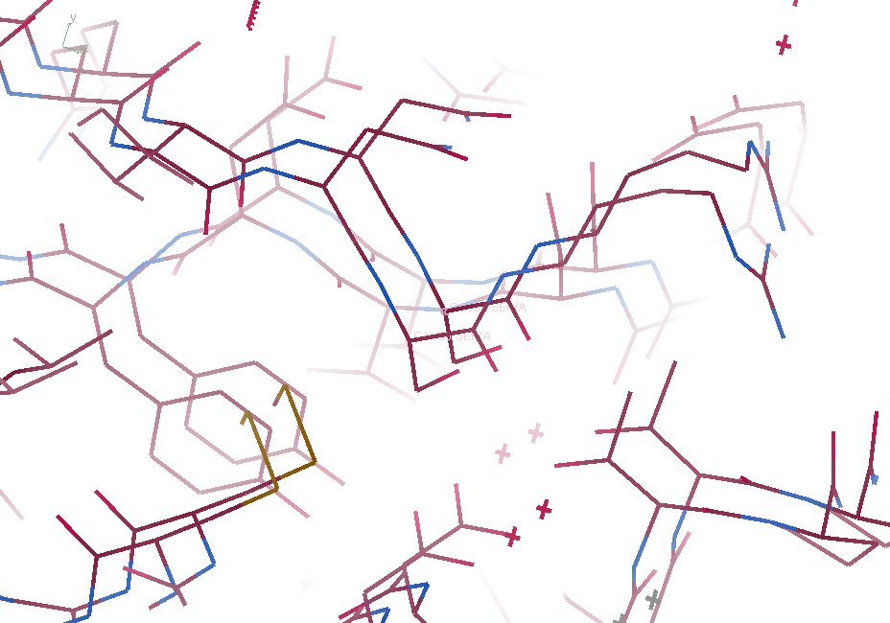
3aw6 3aw7

Slide 35
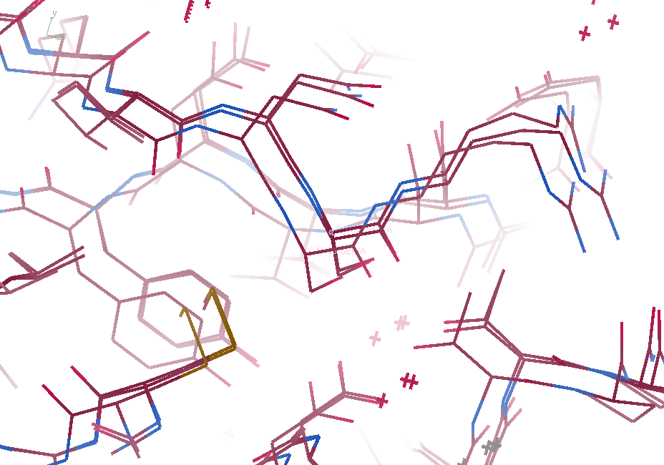
3aw6, 3aw7, “bent” 3aw7

Slide 36
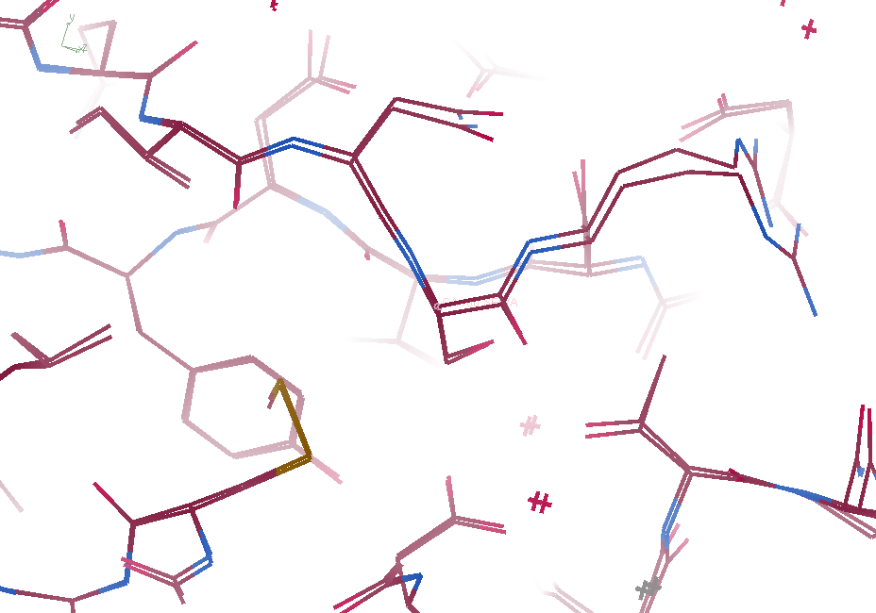
3aw6, “bent” 3aw7

Slide 37
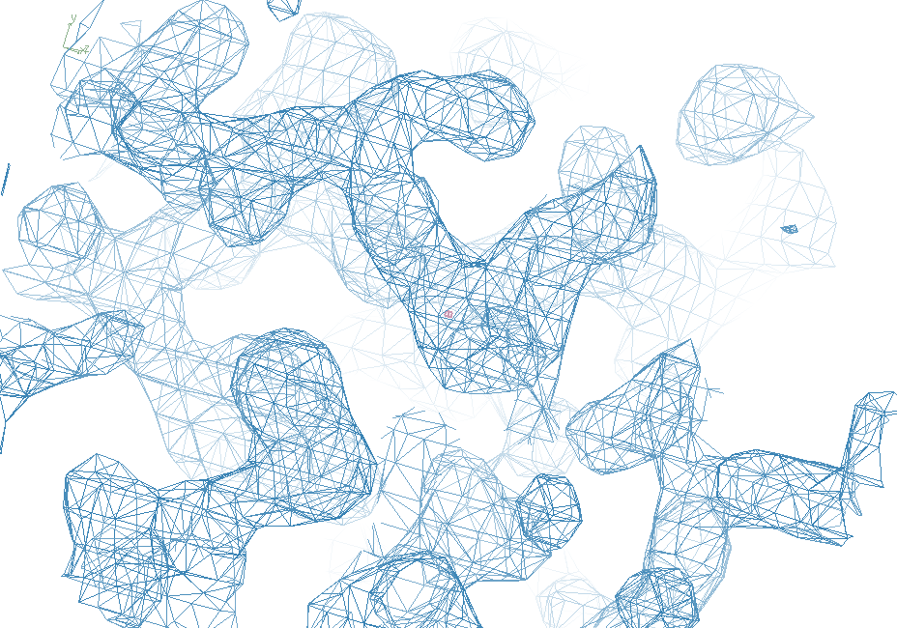
3aw6

Slide 38
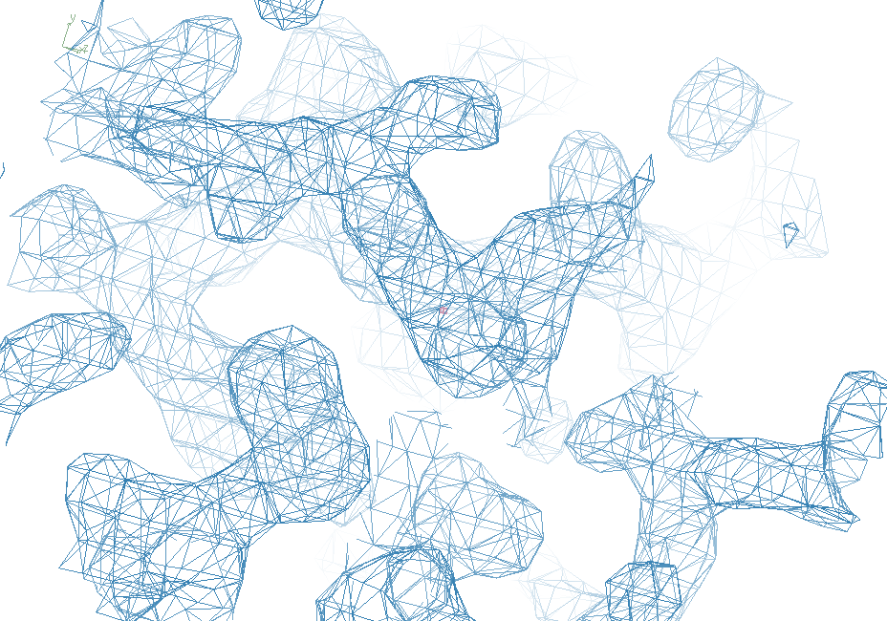
“bent” 3aw7

Slide 39
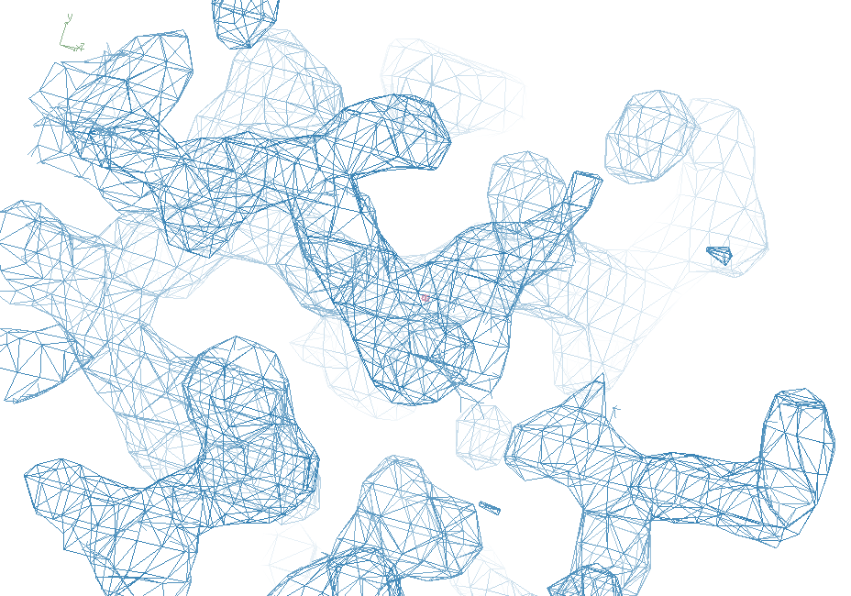
3aw7

Slide 40
Structure Factor Equation
F_{hkl} = f_{atom} exp(-2π i (hx + ky + lz))
Σ
dF_{hkl}
dh
= f_{atom} (-2π i hx) exp(-2π i (hx + ky + lz))
Σ

Slide 41
Bragg’s “minimum wavelength principle”
Perutz (1985). “Early Days of Cryst…” Methods in Enzymology, Vol. 114, 3-18.
Bragg & Perutz (1952)."external form haemoglobin I", Acta Cryst. 5, 277-283.

Slide 42
DMMULTI – fake data 4 deg rotation: 8 “xtals”: before
CC = 0.02

Slide 43
DMMULTI – fake data 4 deg rotation: 8 “xtals”: after
CC = 0.8

Slide 44
X-ray Data Sets
Singular values & vectors
data
set
h,k,l | structure factors (F)
 | #1 | #2 | #3 | #4
5,3,4 | 523.7 | 559.8 | 579.9 | 603.2
5,4,4 | 168.2 | 166.6 | 177.2 | 196.1
5,5,4 | 34.9 | 26.4 | 19.2 | 17.3
6,1,4 | 305.7 | 301.1 | 298.1 | 296.3
6,2,4 | 353.0 | 353.9 | 356.2 | 366.9
6,3,4 | 300.9 | 285.3 | 273.5 | 259.4
6,3,5 | 223.8 | 226.3 | 234.6 | 251.4
… | … | … | … | …
h,k,l | 100% | 17 % | 13 % | 9 %
 | 1st | 2nd | 3rd | 4th
5,3,4 | -1.46 | -0.02 | 1.84 | -0.72
5,4,4 | -0.88 | -0.29 | -0.34 | 0.15
5,5,4 | -0.42 | -0.65 | 1.02 | 1.47
6,1,4 | -0.90 | -0.85 | 1.44 | -0.40
6,2,4 | -1.20 | -0.37 | 0.67 | 0.01
6,3,4 | -0.75 | 0.31 | 0.48 | 0.00
6,3,5 | -0.75 | -0.85 | 0.72 | -0.82
… | … | … | … | …
value
vector
Singular value decomp.
SVD
-0.68
-0.24
0.32 …
CC1
Data sets
Positioned
in
“Correlation
Space”
Correlation
Coefficients
CC1 CC2 CC3
CC2
data set #1
data set #2
data set #3
CC3

Slide 46
Structure factor (electrons)
Correlation to 2nd & 3rd singular vectors

Slide 47
Structure factor (electrons)
Correlation to 2nd & 3rd singular vectors

Slide 48
Structure factor (electrons)
Correlation to 2nd & 3rd singular vectors

Slide 49
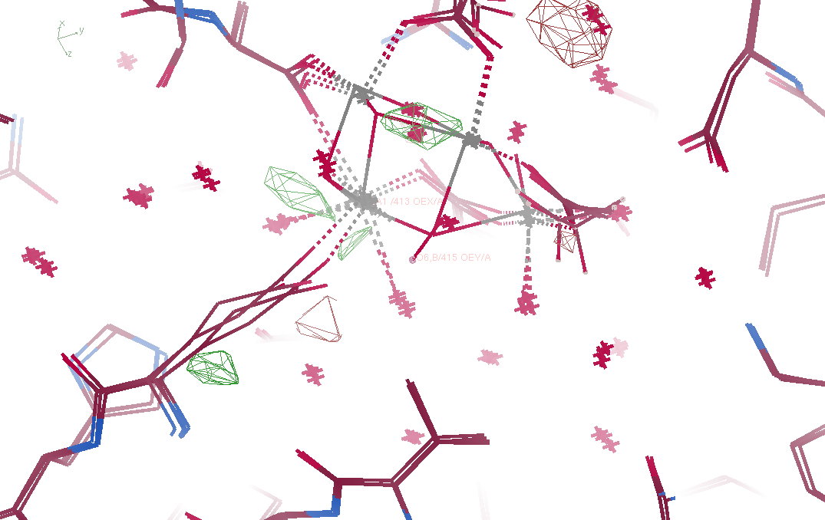
Fo – Fc maps

Slide 50
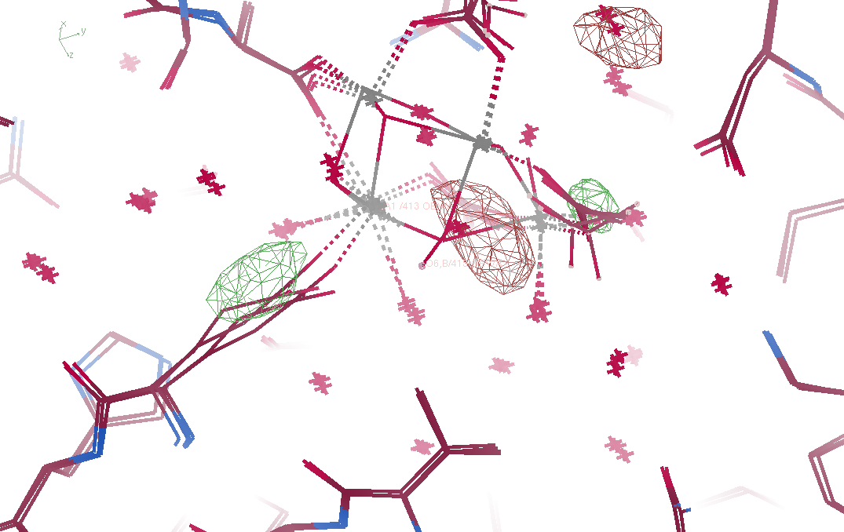
Fo – Fo maps

Slide 51
Non-isomorphism in lysozyme
Dear James
The story of the two forms of lysozyme crystals goes back to about 1964 when it was found that the diffraction patterns from different crystals could be placed in one of two classes depending on their intensities. This discovery was a big set back at the time and I can remember a lecture title being changed from the 'The structure of lysozyme' to 'The structure of lysozyme two steps forward and one step back'. Thereafter the crystals were screened based on intensities of the (11,11,l) rows to distinguish them (e.g. 11,11,4 > 11,11,5 in one form and vice versa in another). Data were collected only for those that fulfilled the Type II criteria. (These reflections were easy to measure on the linear diffractometer because crystals were mounted to rotate about the diagonal axis). As I recall both Type I and Type II could be found in the same crystallisation batch . Although sometimes the external morphology allowed recognition this was not infallible.
The structure was based on Type II crystals. Later a graduate student Helen Handoll examined Type I. The work, which was in the early days and before refinement programmes, seemed to suggest that the differences lay in the arrangement of water or chloride molecules (Lysozyme was crystallised from NaCl). But the work was never written up. Keith Wilson at one stage was following this up as lysozyme was being used to test data collection strategies but I do not know the outcome.
An account of this is given in International Table Volume F (Rossmann and Arnold edited 2001) p760.
Tony North was much involved in sorting this out and if you wanted more info he would be the person to contact. I hope this is helpful. Do let me know if you need more.
Best wishes
Louise

Slide 52
Dehydration: 1934
and 2017?
= 1.5 μL
100 μm
= 1.0 nL
2 mm
= 1.0 pL
10 μm
= 1.0 fL
1 μm

Slide 53
“deconform” cypA 100K
R factor (%)
Number of conformers

Slide 54
“deconform” cypA 300K
R factor (%)
Number of conformers

Slide 55
… but does it work for membrane proteins?
CCP4BB:
“We used it for a large membrane protein complex and diffraction improved from ~7 to 2.7 A. The crystal is fished out and put into mother liquor solution in the button, sealed with dialysis membrane and the button is then placed into about 5 mls of mother liquor with slightly higher PEG concentration. Then you just exchange outside buffer every day or so for solutions containing higher concentrations of PEG. We went from ~9 to 30 % PEG4000 in about a week. You can easily observe crystal under microscope and if it cracks - you went too far/too quickly with PEG and need to use a bit less next time. Also, this method allows you to control all other components of the dehydrating solution - we needed to decrease salt concentration at the same time as increasing PEG. You can also introduce/increase cryo-protectant concentration at the same time. With these crystals, otherwise excellent dehydration machines already mentioned did not work, possibly because the process had to be really slow.”
Efremov, R. G. & Sazanov, L. A. (2011)."Structure of the membrane domain of respiratory complex I", Nature 476, 414-420.
“To improve diffraction properties, crystals were slowly cooled to 4 C, placed into micro-dialysis buttons, and mother liquor was exchanged by dialysis for 0.1 M sodium acetate (pH 4.8), 0.15 M sodium tartrate (pH 5.0), 30% PEG4000, 0.1% sodium cholate and 12.5% glycerol over a period of 5 days.”

Slide 56
Hygrostatic gradients
high
water activity
low
jet
loop

