Slide 1
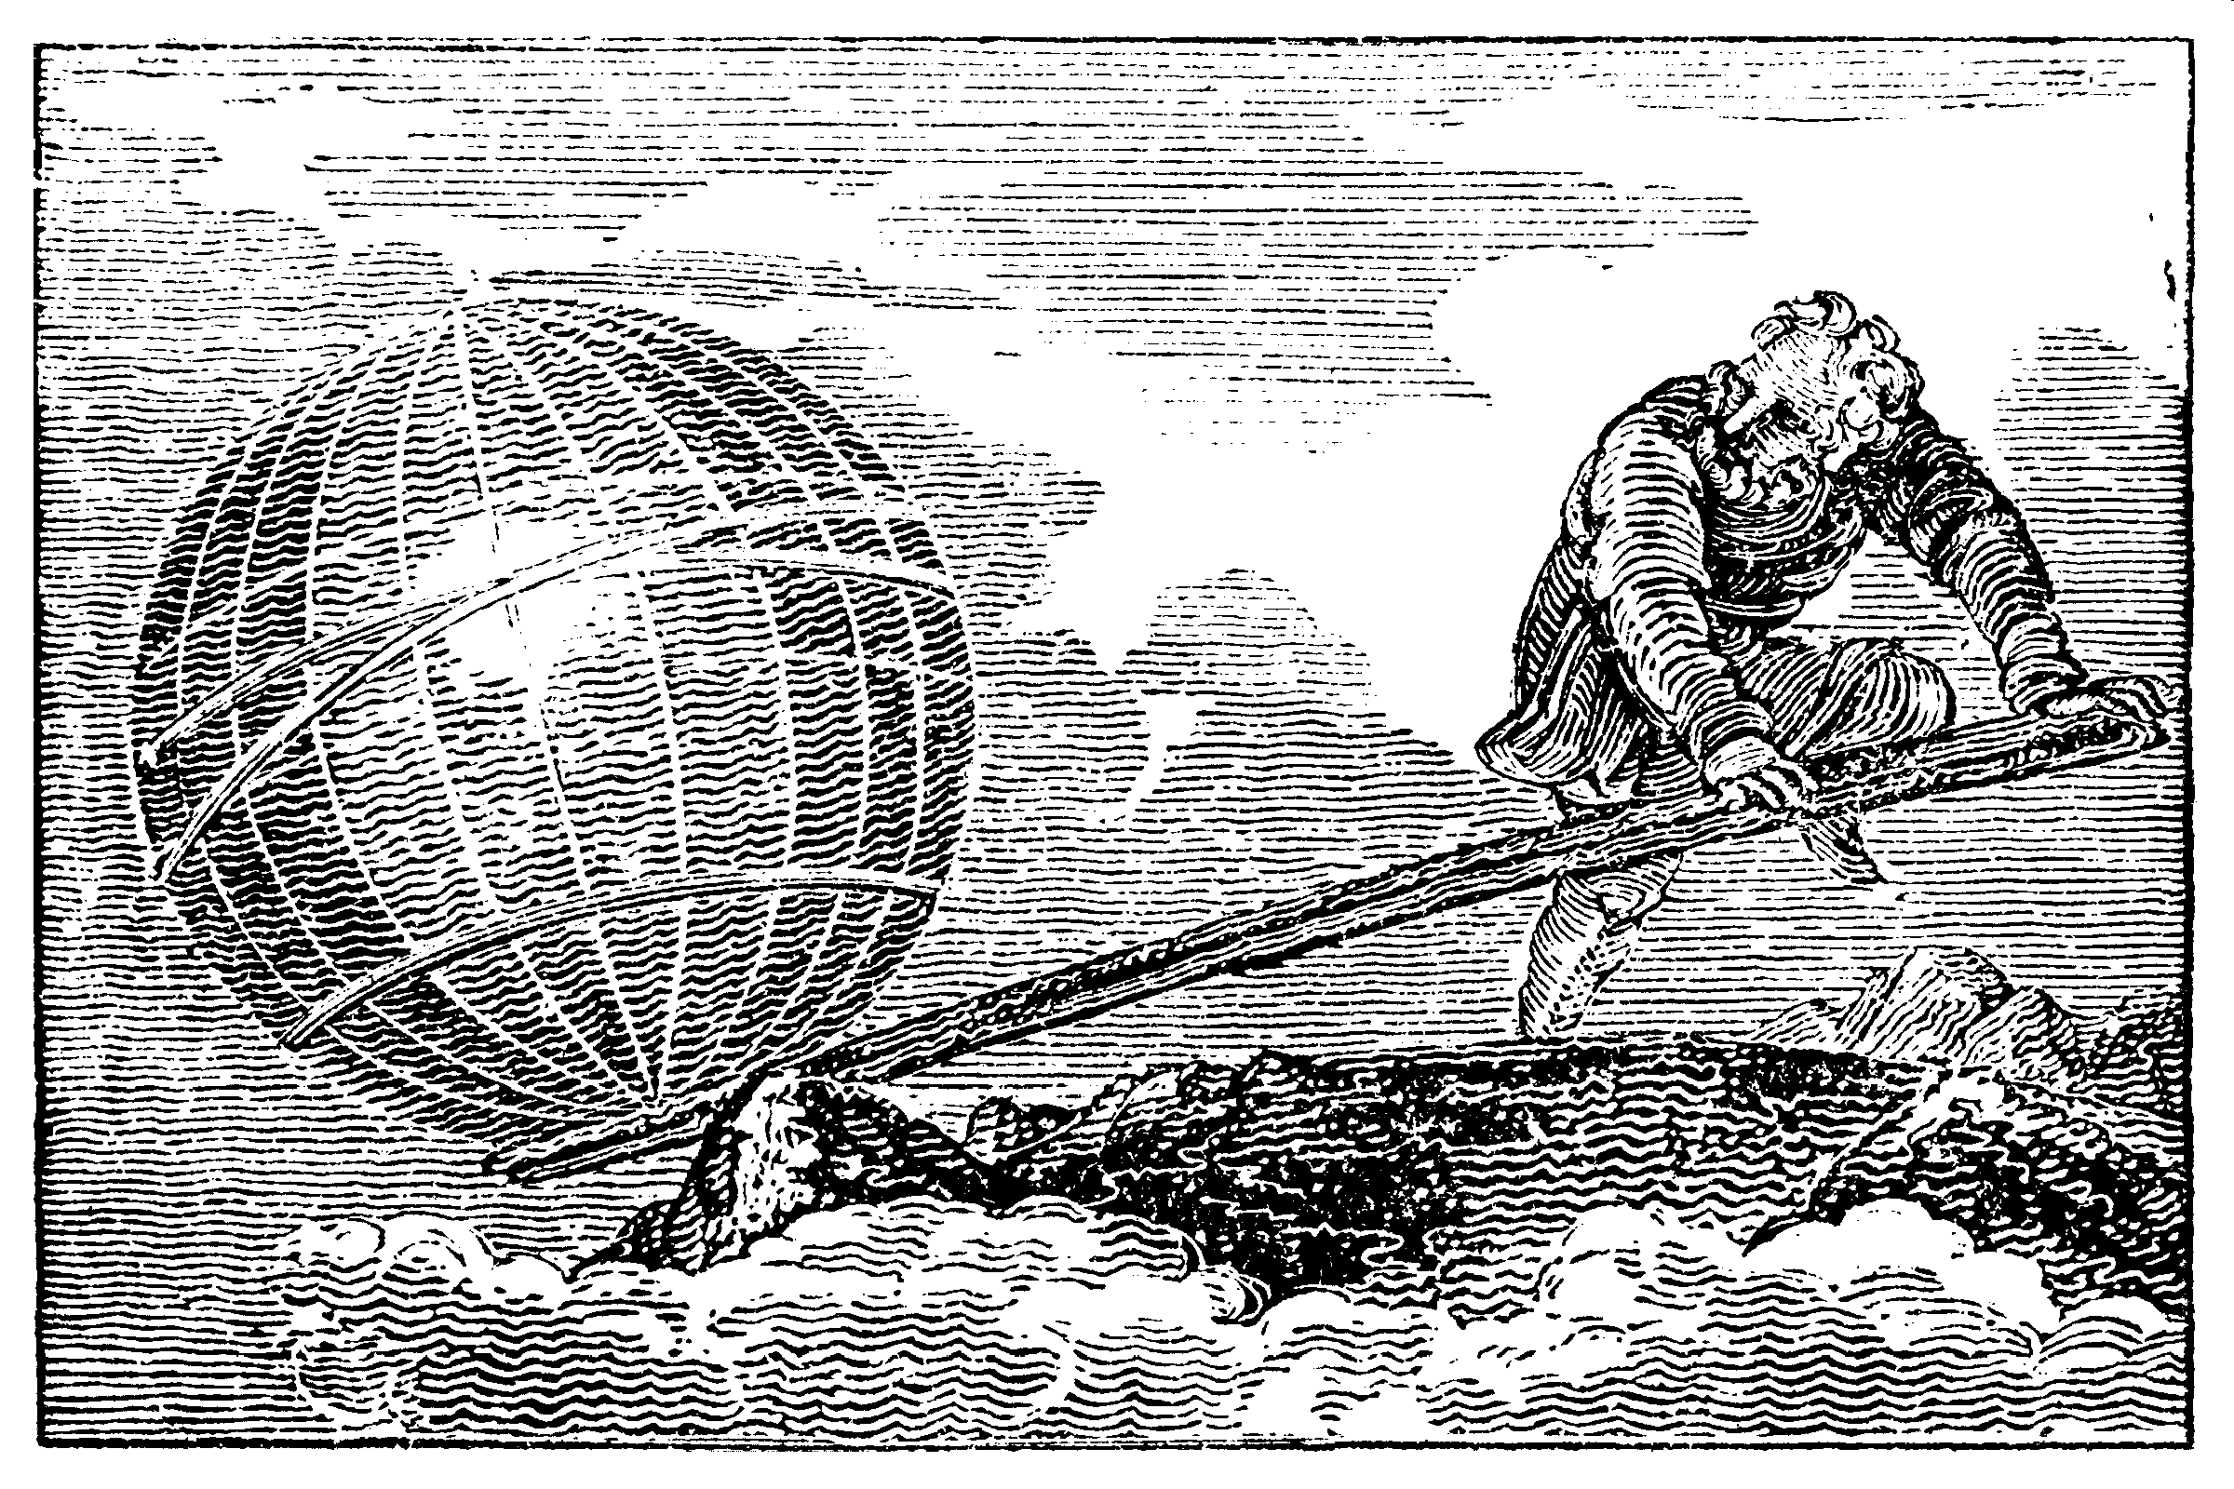
Anything is possible … with the right tools.

Slide 2
Hot debate:
AD 1872
When a horse gallops, is there ever a moment where all four hooves leave the ground?
required new electric shutter technology: Muybridge and Stanford

Slide 3
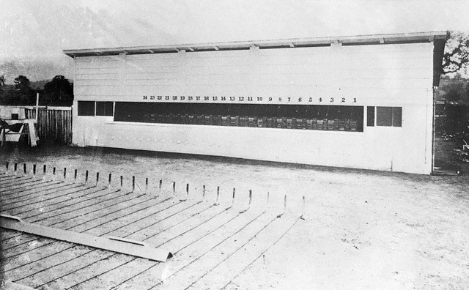
Muybridge’s multi-camera

Slide 4

Muybridge’s galloping horse (1878)

Slide 5

a “crystal” of horses

Slide 6
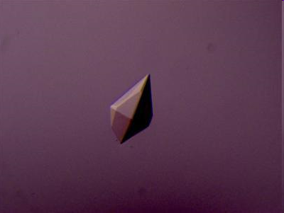
Protein crystal
~10¹³ molecules

Slide 7
Protein crystal reality
McPherson, A., Malkin, A. J., Kuznetsov, Y. G. & Plomp, M. (2001)."Atomic force microscopy applications in macromolecular crystallography", Acta Cryst. D 57, 1053-1060.

Slide 8
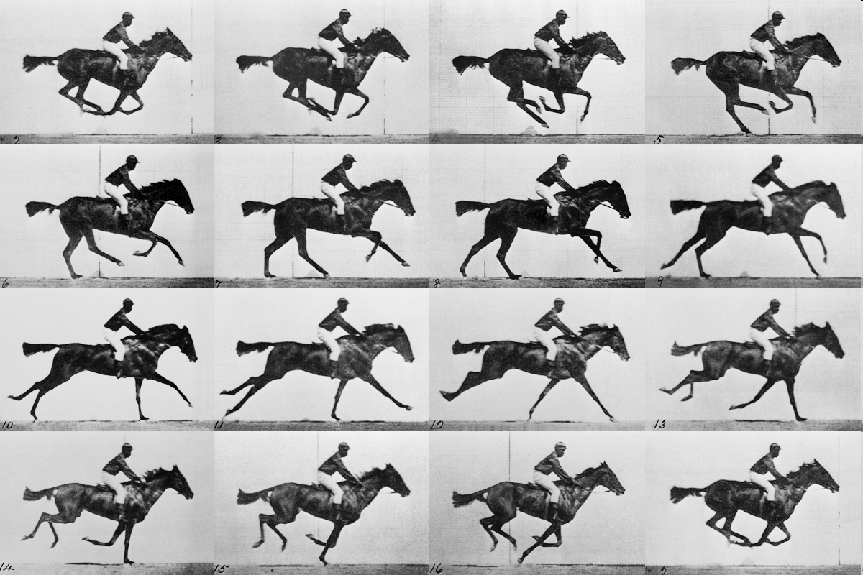
realistic “crystal” of horses

Slide 9
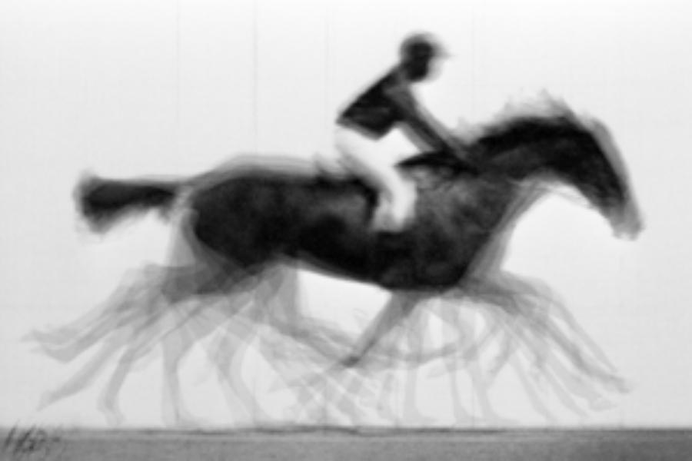
average structure: galloping horse

Slide 10
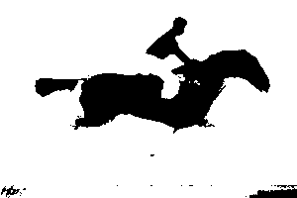
average structure: 1-sigma contour

Slide 11
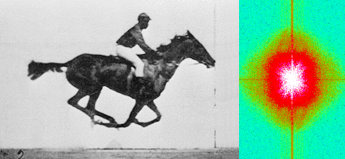
Muybridge’s galloping horse (1878)
“Time-resolved” diffraction
Real space
reciprocal

Slide 12
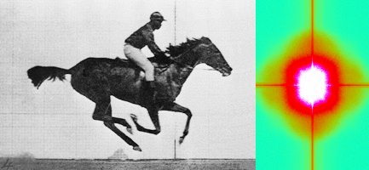
Muybridge’s galloping horse (1878)
Average intensity
Real space
reciprocal

Slide 13
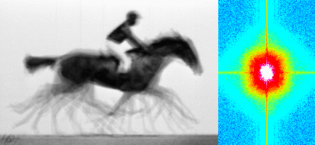
Muybridge’s galloping horse (1878)
Average electron density
Real space
reciprocal

Slide 14
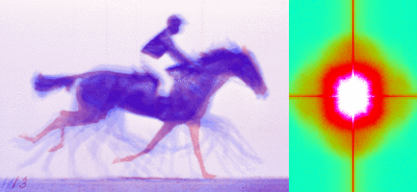
Muybridge’s galloping horse (1878)
Sum(intensity) – Sum(density) = diffuse scatter
Real space
reciprocal

Slide 15
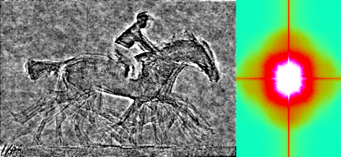
Muybridge’s galloping horse (1878)
F_{incoh} – F_{coherent} with density phases
Real space
reciprocal

Slide 16
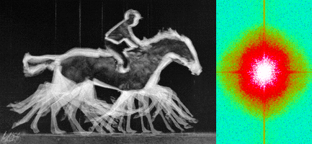
Muybridge’s galloping horse (1878)
RMS variation in density
Real space
reciprocal

Slide 17
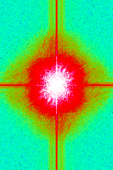
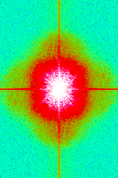
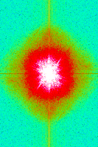
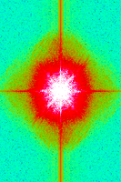
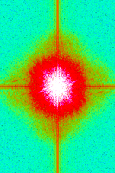
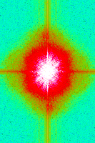
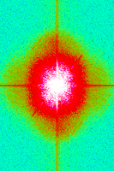
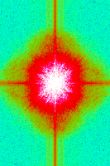
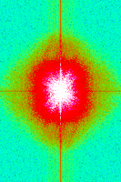
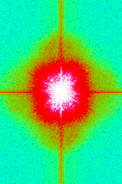
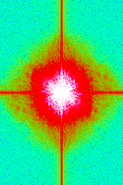
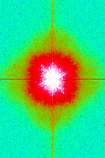
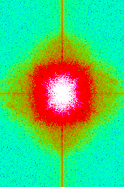
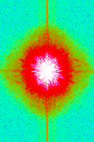
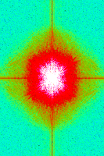
Supporting a model with data

Slide 18
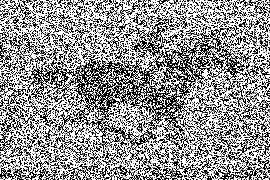
not enough signal

Slide 19
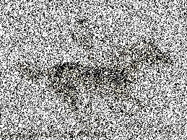
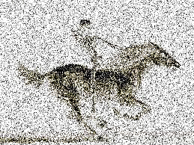
brighter light

Slide 20
even brighter

Slide 21
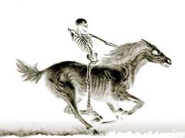
very bright light

Slide 22
Correct structure

Slide 23
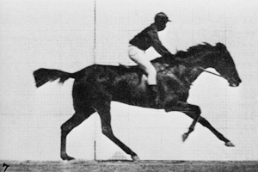
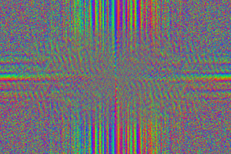
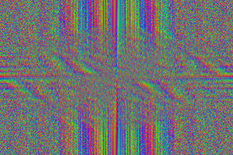
The “phase problem”

Slide 24
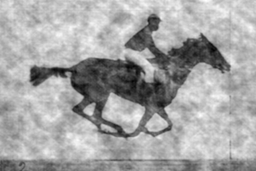
The “phase problem”
Phases
Amplitudes

Slide 25
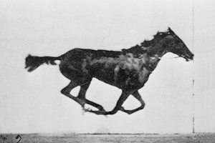
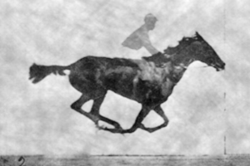
The “phase problem”
Phases
Amplitudes

Slide 26
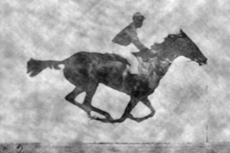
The “phase problem”
Phases & Amplitudes
Amplitudes
2F_{obs}-F_{calc}

Slide 27
The “phase problem”
Phases
Amplitudes

Slide 28
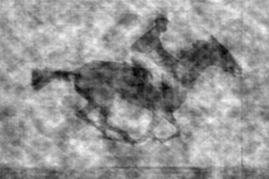
The “phase problem”
Phases & Amplitudes
Amplitudes
2F_{obs}-F_{calc}

Slide 29
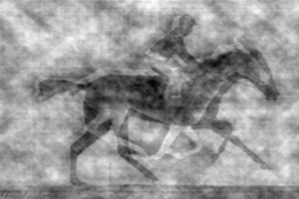
The “phase problem”
Phases & Amplitudes
Amplitudes
2mF_{obs}-F_{calc} (σ_{A} weighting)

