Slide 1
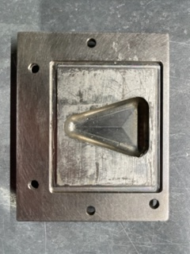
65.3 mm
2.3 mm
2.3 mm
52.7 mm
2.4 mm

Slide 2
0.2
1.063
0.15
1.4
4x ~1 mm thick
For solder lake formation
2.072
0.125
1.4
0.584
2.569

Slide 3
0.2
0.2
1.063
0.15
1.4
2.072
0.125
1.6
2x sets 0.2 mm thick
for bonding
0.384
0.238
2.569

Slide 4
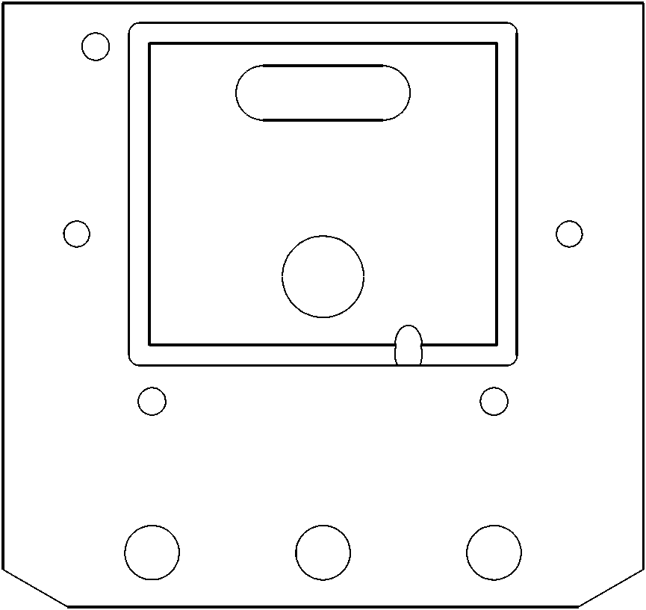
for bonding
0.15
1.4
0.125

Slide 5
for bonding

Slide 6
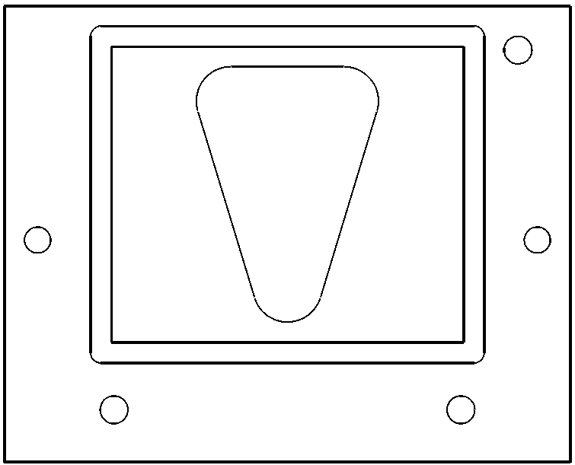
0.2
for bonding
1.063
0.15
1.4
2.072
0.125
1.6
0.384
2.569

Slide 7
drill &
tap
for
Removal
For solder lake formation
0.125

Slide 8
2X
fold
1 mm
1 mm
fold
fold
Thru holes
xtal
footprint
fold
for lake formation

Slide 9
drill & tap
for removal
for solder lake formation

Slide 10
2X
1 mm
1 mm
Thru holes
xtal
footprint
for solder lake formation

Slide 12
7.5
50
45
60
15
75
70

Slide 13
10
50
10
30
cut
30
fold
fold
68
fold
fold
68
68
68
cut
cut
50
cut
~142
15
15
110
fold
~60-70+
70

Slide 14
30
50
30
10
10
68
fold
fold
68
fold
fold
68
68
cut
cut
cut
50
~142
15
15
70
fold
~60-70+
70

Slide 15
0.25”
0.287”

