Slide 1
non-isomorphism

Slide 2
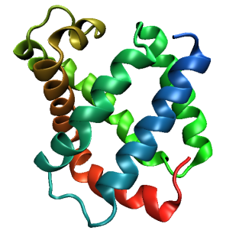
Same structure, different cell
0.5% cell change → 15%
Crick & Magdoff (1956) “theory method isomorphous replacement”, Acta Cryst. 9, 901-8.

Slide 3
Same structure, different cell
0.5% cell change → 15%
Crick & Magdoff (1956) “theory method isomorphous replacement”, Acta Cryst. 9, 901-8.

Slide 4
Same cell, rotated protein
0.5° rotation → 16%
Crick & Magdoff (1956) “theory method isomorphous replacement”, Acta Cryst. 9, 901-8.

Slide 5
Same cell, rotated protein
0.5° rotation → 16%
Crick & Magdoff (1956) “theory method isomorphous replacement”, Acta Cryst. 9, 901-8.

Slide 6
Uniform stretch
5% change → 0%

Slide 7
Uniform stretch
5% change → 0%

Slide 8
Non-isomorphism in lysozyme
RMSD = 1.70 Å
Δcell = 0.7 %
R_{iso} = 44.5%
RMSD = 0.18 Å
3aw6
3aw7
RH: 84.2%
vs 71.9%

Slide 9
“map bender” procedure
Convert to fractional coordinates
Basis functions: spatial sin waves

Slide 10
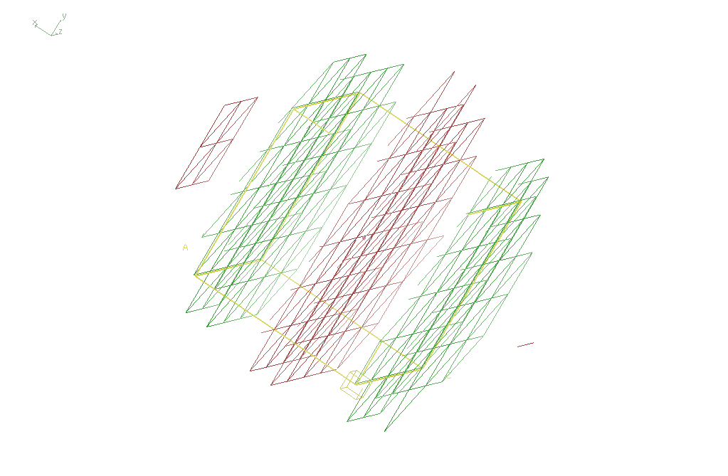
Basis function 1 0 0

Slide 11
“map bender” procedure
Convert to fractional coordinates
Basis functions: spatial sin waves
Repeats with unit cell
Low-order h,k,l indices first
Fit function to Δx vs x,y,z across P1 cell
Repeat with Δy, Δz
Apply to PDB file and interpolate map grid
Usually 3-5 orders comparable to LSQ

Slide 12
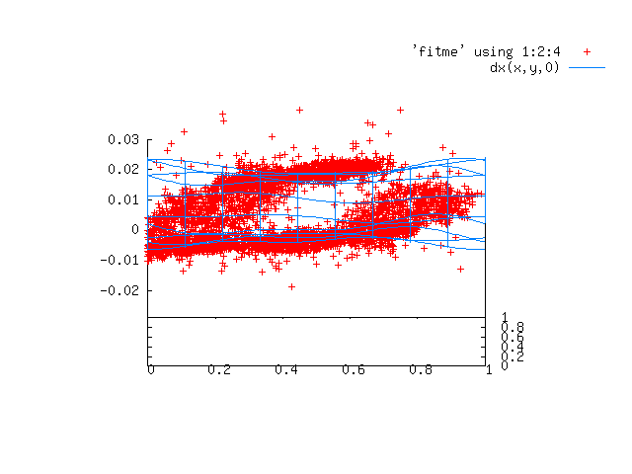

Slide 13
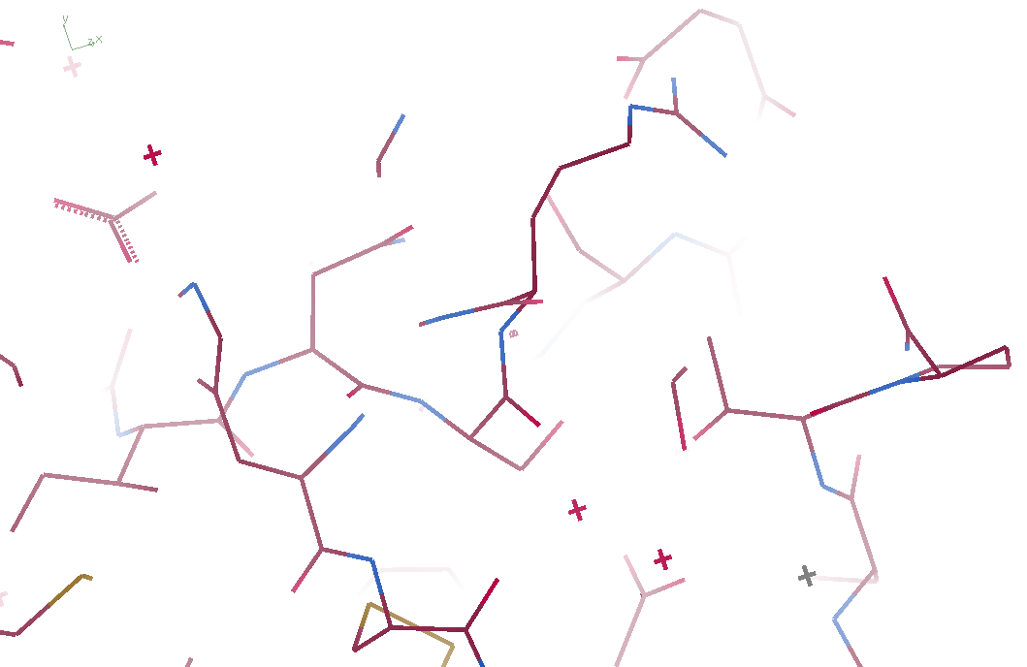
3aw6

Slide 14
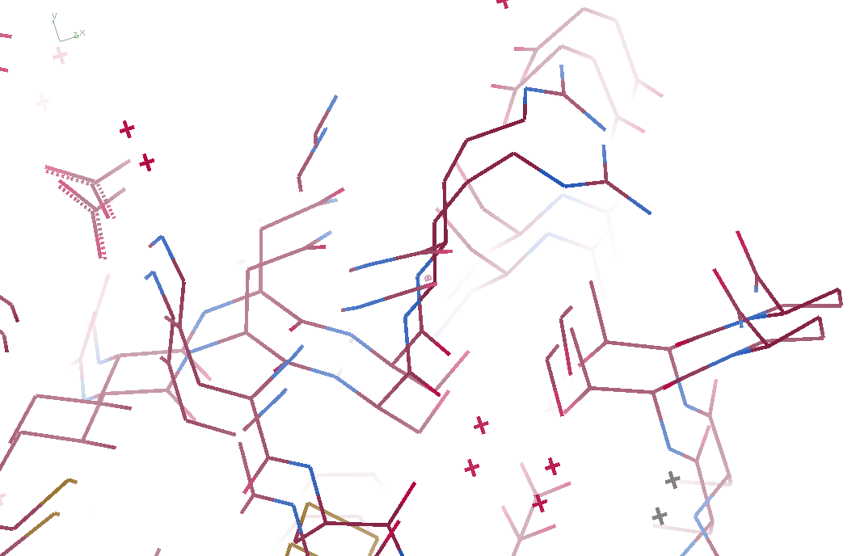
3aw6 3aw7

Slide 15
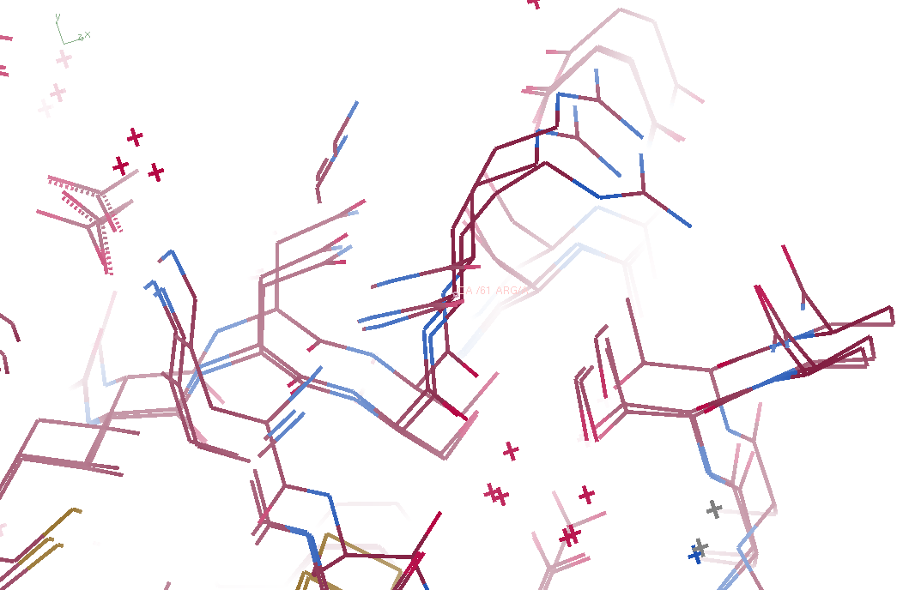
3aw6, 3aw7, “bent” 3aw6

Slide 16
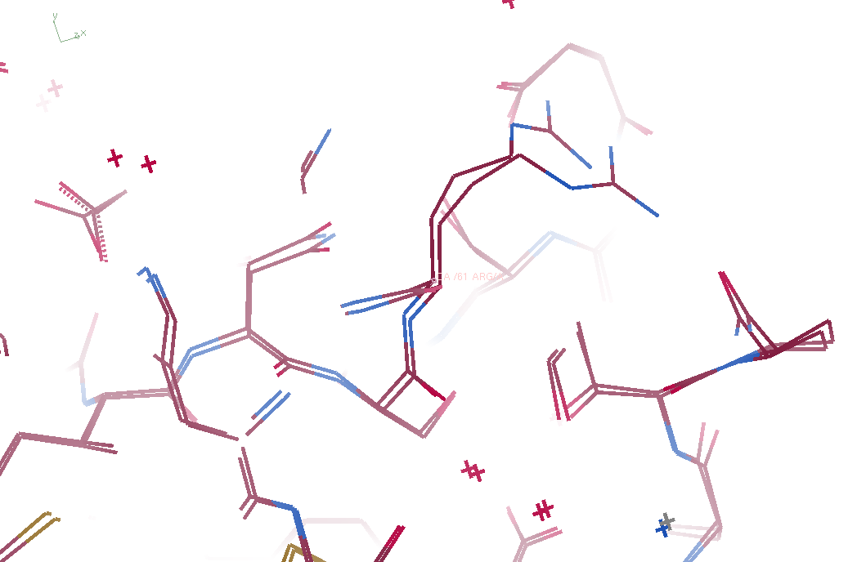
3aw7, “bent” 3aw6

Slide 17
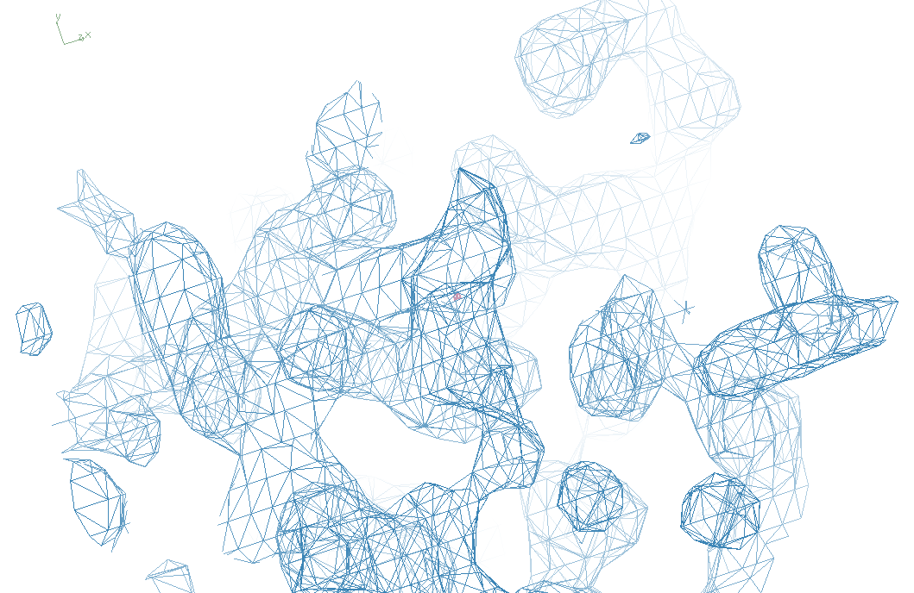
3aw6

Slide 18
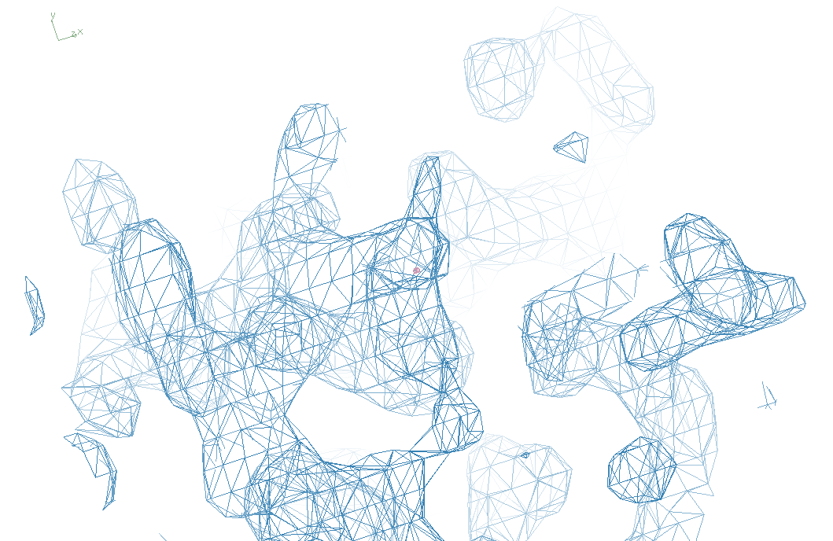
“bent” 3aw7

Slide 19
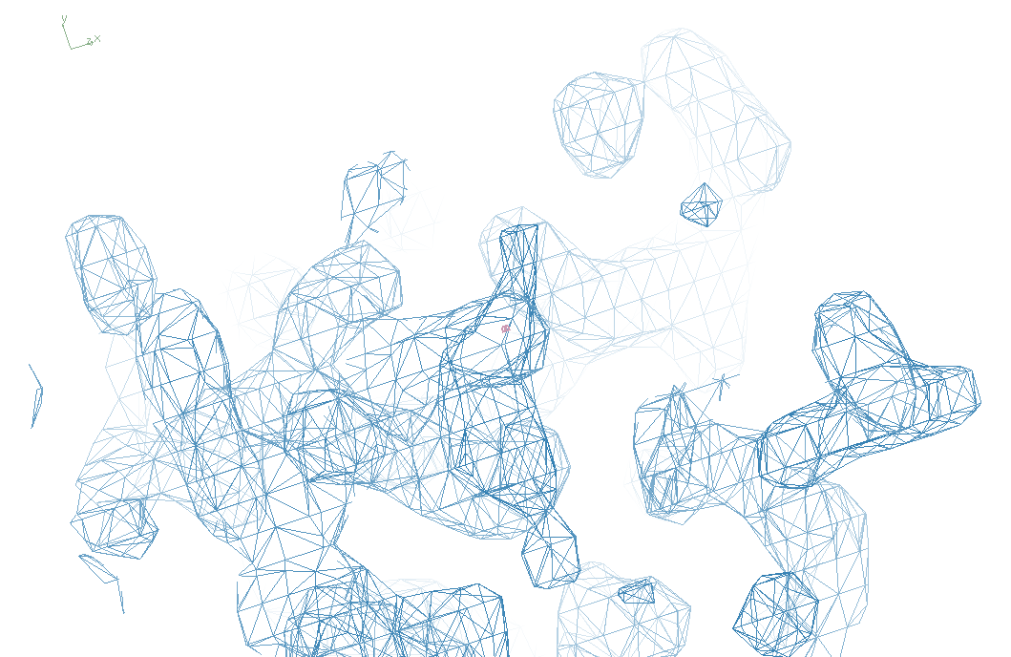
3aw7

Slide 20
Structure Factor Equation
F_{hkl} = f_{atom} exp(-2π i (hx + ky + lz))
Σ
dF_{hkl}
dx
= f_{atom} (-2π i hx) exp(-2π i (hx + ky + lz))
Σ

Slide 21
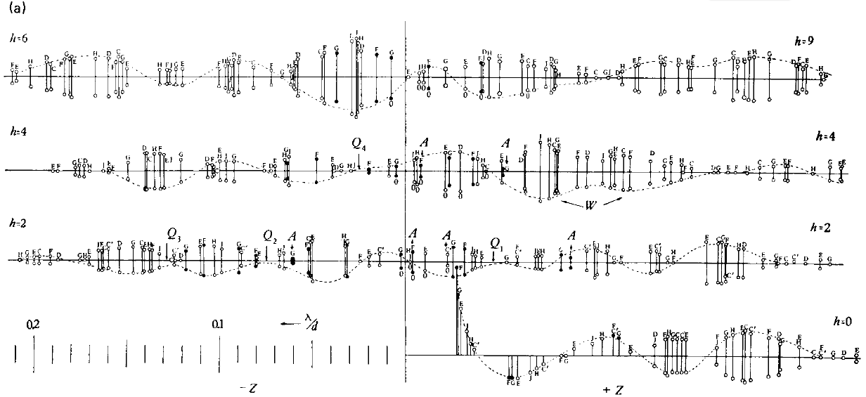
Bragg’s “minimum wavelength principle”
Perutz (1985). “Early Days of Cryst…” Methods in Enzymology, Vol. 114, 3-18.
Bragg & Perutz (1952)."external form haemoglobin I", Acta Cryst. 5, 277-283.

Slide 22
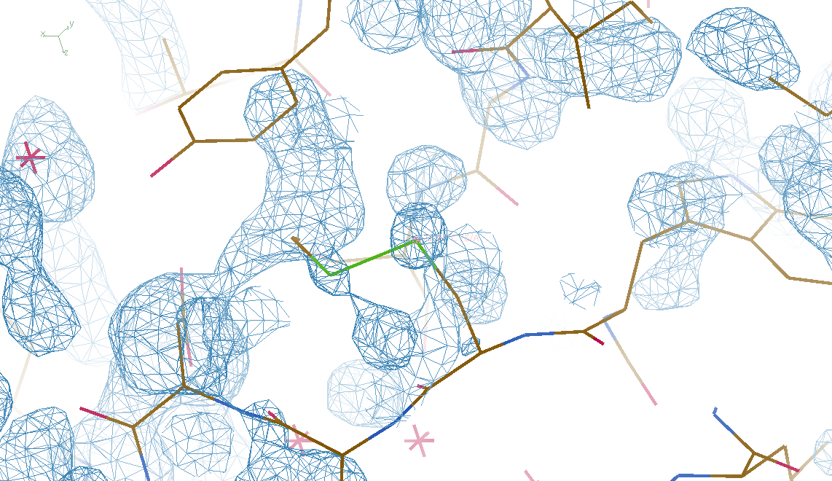
DMMULTI – fake data 4 deg rotation: 8 “xtals”: before
CC = 0.02

Slide 23
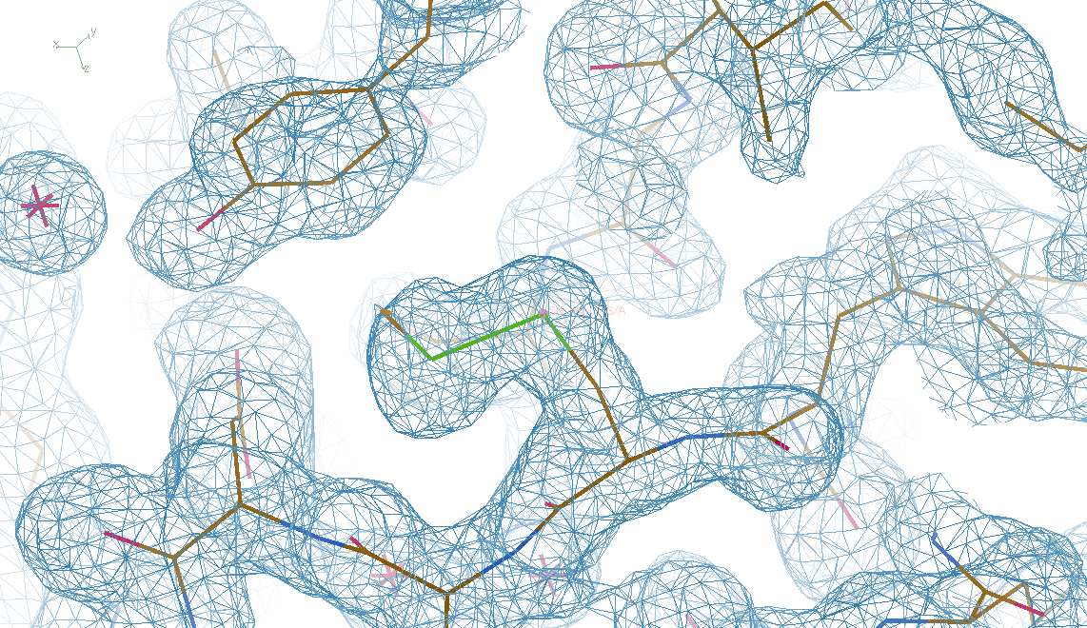
DMMULTI – fake data 4 deg rotation: 8 “xtals”: after
CC = 0.8

Slide 24
X-ray Data Sets
Singular values & vectors
data
set
h,k,l | structure factors (F)
 | #1 | #2 | #3 | #4
5,3,4 | 523.7 | 559.8 | 579.9 | 603.2
5,4,4 | 168.2 | 166.6 | 177.2 | 196.1
5,5,4 | 34.9 | 26.4 | 19.2 | 17.3
6,1,4 | 305.7 | 301.1 | 298.1 | 296.3
6,2,4 | 353.0 | 353.9 | 356.2 | 366.9
6,3,4 | 300.9 | 285.3 | 273.5 | 259.4
6,3,5 | 223.8 | 226.3 | 234.6 | 251.4
… | … | … | … | …
h,k,l | 100% | 17 % | 13 % | 9 %
 | 1st | 2nd | 3rd | 4th
5,3,4 | -1.46 | -0.02 | 1.84 | -0.72
5,4,4 | -0.88 | -0.29 | -0.34 | 0.15
5,5,4 | -0.42 | -0.65 | 1.02 | 1.47
6,1,4 | -0.90 | -0.85 | 1.44 | -0.40
6,2,4 | -1.20 | -0.37 | 0.67 | 0.01
6,3,4 | -0.75 | 0.31 | 0.48 | 0.00
6,3,5 | -0.75 | -0.85 | 0.72 | -0.82
… | … | … | … | …
value
vector
Singular value decomp.
SVD
-0.68
-0.24
0.32 …
CC1
Data sets
Positioned
in
“Correlation
Space”
Correlation
Coefficients
CC1 CC2 CC3
CC2
data set #1
data set #2
data set #3
CC3

Slide 25
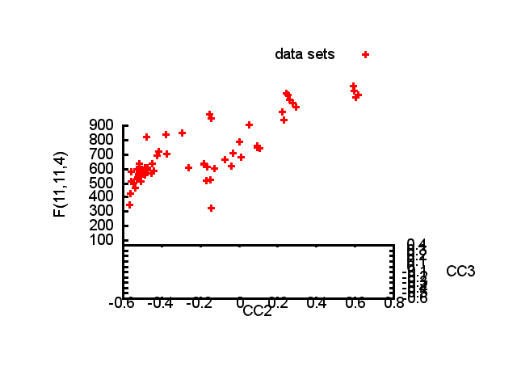

Slide 26
Structure factor (electrons)
Correlation to 2nd & 3rd singular vectors

Slide 27
Structure factor (electrons)
Correlation to 2nd & 3rd singular vectors

Slide 28
Structure factor (electrons)
Correlation to 2nd & 3rd singular vectors

Slide 29
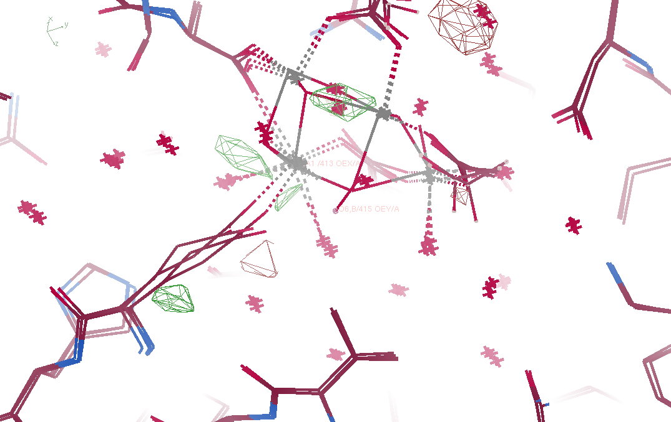
Fo – Fc maps

Slide 30
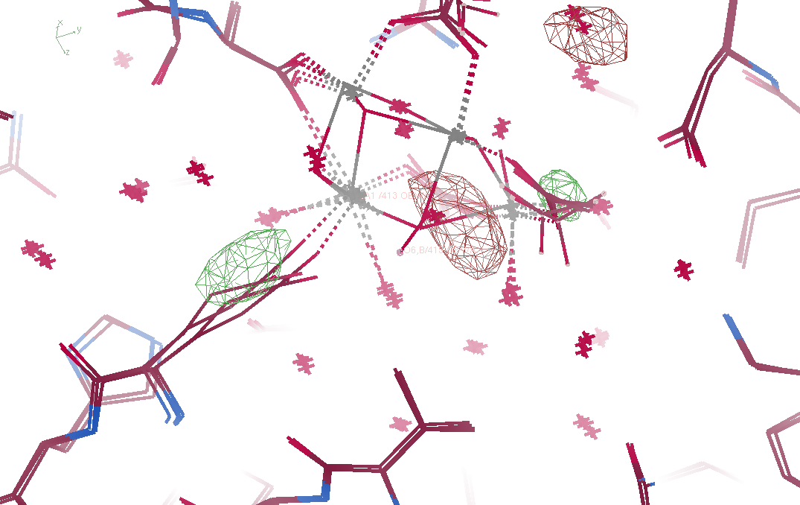
Fo – Fo maps

Slide 31
Non-isomorphism in lysozyme
Dear James
The story of the two forms of lysozyme crystals goes back to about 1964 when it was found that the diffraction patterns from different crystals could be placed in one of two classes depending on their intensities. This discovery was a big set back at the time and I can remember a lecture title being changed from the 'The structure of lysozyme' to 'The structure of lysozyme two steps forward and one step back'. Thereafter the crystals were screened based on intensities of the (11,11,l) rows to distinguish them (e.g. 11,11,4 > 11,11,5 in one form and vice versa in another). Data were collected only for those that fulfilled the Type II criteria. (These reflections were easy to measure on the linear diffractometer because crystals were mounted to rotate about the diagonal axis). As I recall both Type I and Type II could be found in the same crystallisation batch . Although sometimes the external morphology allowed recognition this was not infallible.
The structure was based on Type II crystals. Later a graduate student Helen Handoll examined Type I. The work, which was in the early days and before refinement programmes, seemed to suggest that the differences lay in the arrangement of water or chloride molecules (Lysozyme was crystallised from NaCl). But the work was never written up. Keith Wilson at one stage was following this up as lysozyme was being used to test data collection strategies but I do not know the outcome.
An account of this is given in International Table Volume F (Rossmann and Arnold edited 2001) p760.
Tony North was much involved in sorting this out and if you wanted more info he would be the person to contact. I hope this is helpful. Do let me know if you need more.
Best wishes
Louise

Slide 32
Dehydration: 1934
and 2017?
= 1.5 μL
100 μm
= 1.0 nL
2 mm
= 1.0 pL
10 μm
= 1.0 fL
1 μm

Slide 33
“deconform” cypA 100K
R factor (%)
Number of conformers

Slide 34
“deconform” cypA 300K
R factor (%)
Number of conformers

