Slide 1
Simulation and back again
James Holton
Taylor Womack

Slide 2
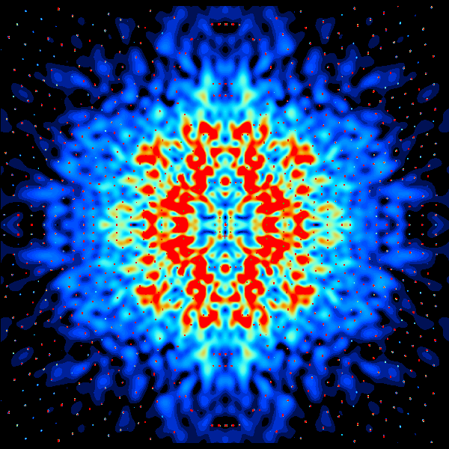
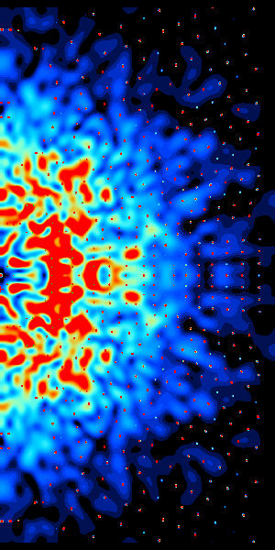
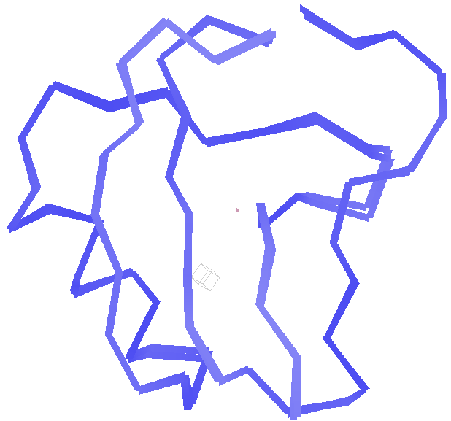
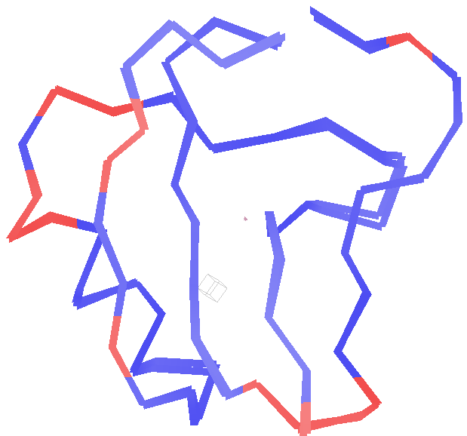
?
?

Slide 3
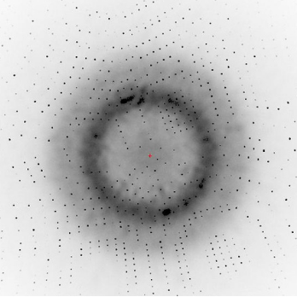
Simulation: State of the Art

Slide 4
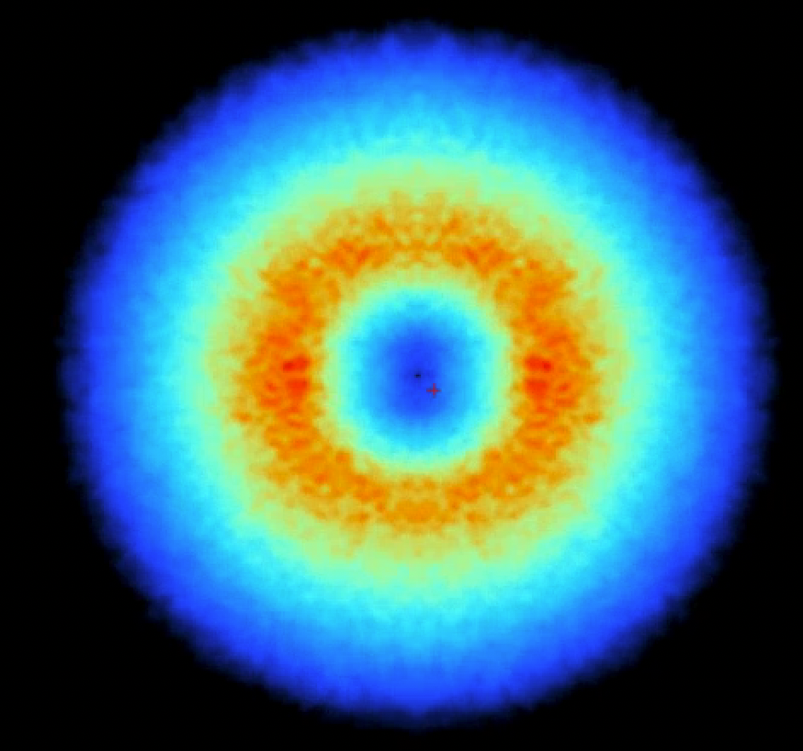
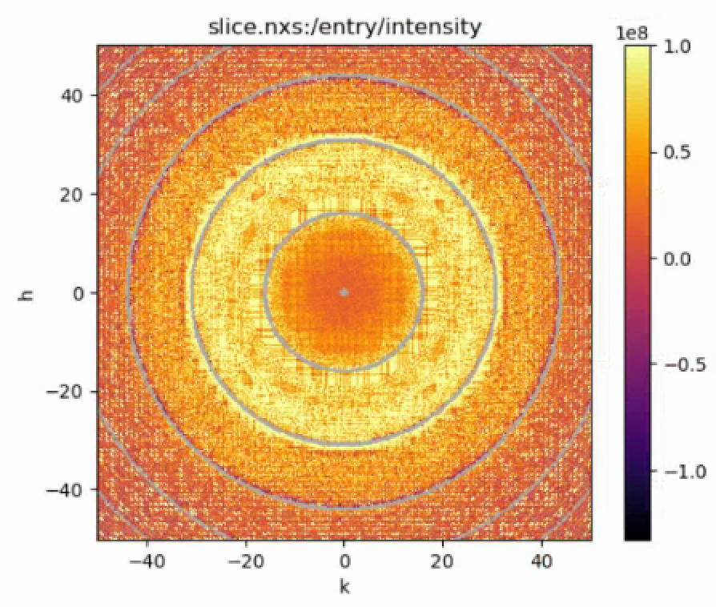
Ground truth in
MDX2 output

Slide 5
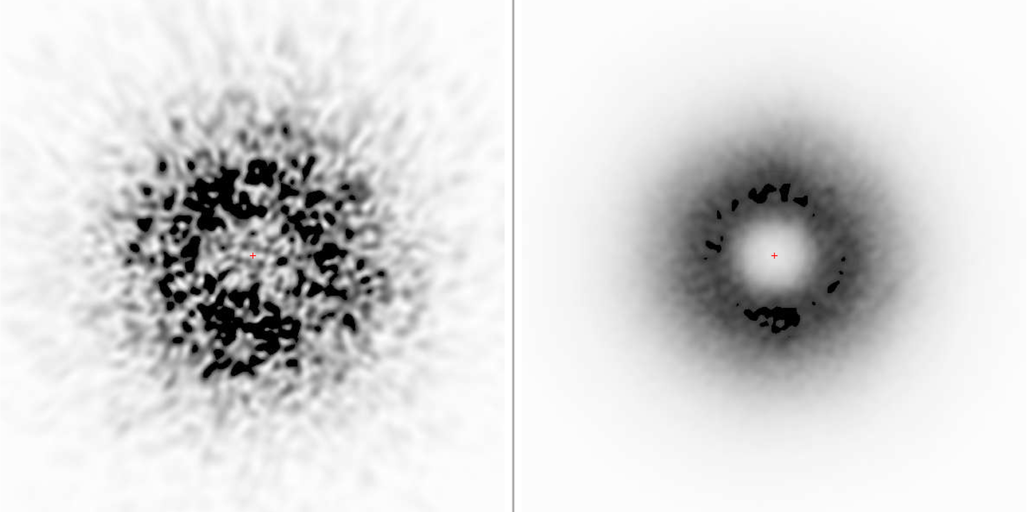
Increasing complexity
Two conformers
200 conformers

Slide 6
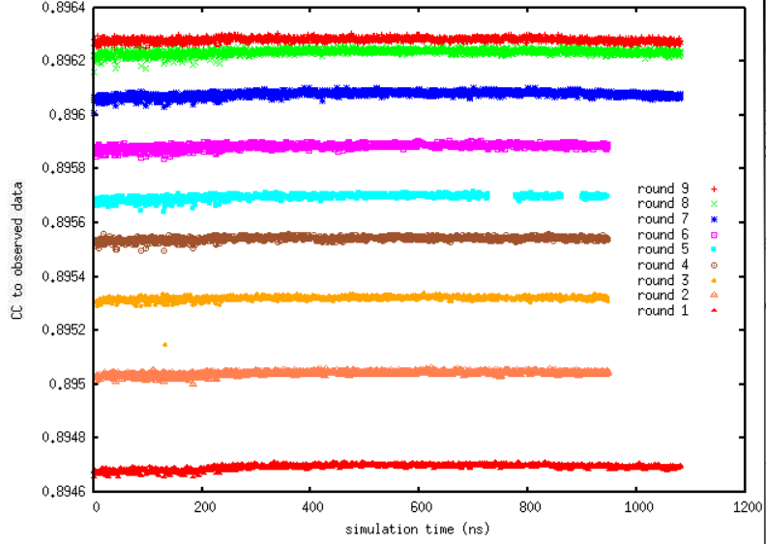
“minus-one” analysis to improve CC

Slide 7
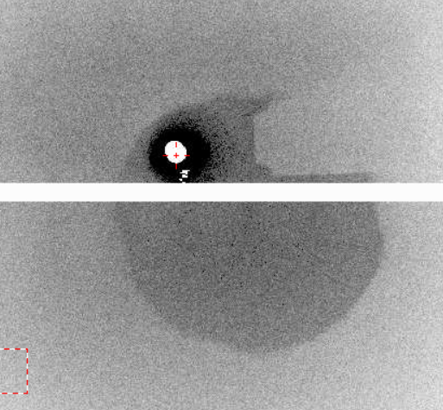
Next 3 months:
Simulation:
Upstream-of-sample background
Absorption/shadows
With Real Data:
XDS pixel definitions of Bragg vs DS
Solution to weighting problem in DS fit

Slide 8
Beyond 3 months:
Simulation:
“uninteresting” diffuse components
Detector gain mapping
With Real Data:
New DS collimator
DS “restraints” on MD simulation

