Slide 1
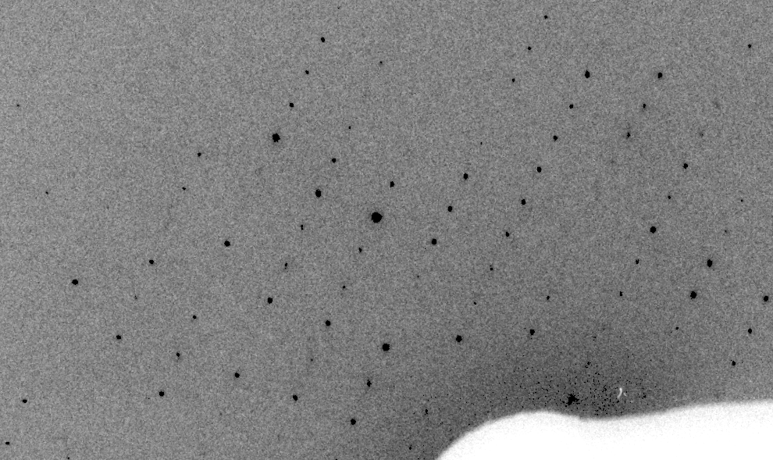
Real XFEL still
Lyubimov et al. (2016).
eLife 5, e18740.

Slide 2
XFEL: “fit” simulation to reality
Dispersion
Divergence
Mosaicity
Wavelength
Unit cell parameters (3)
Crystal orientation (3)
Mosaic domain size (3)
Beam center (2)
Beam direction (2)
Detector distance

Slide 3
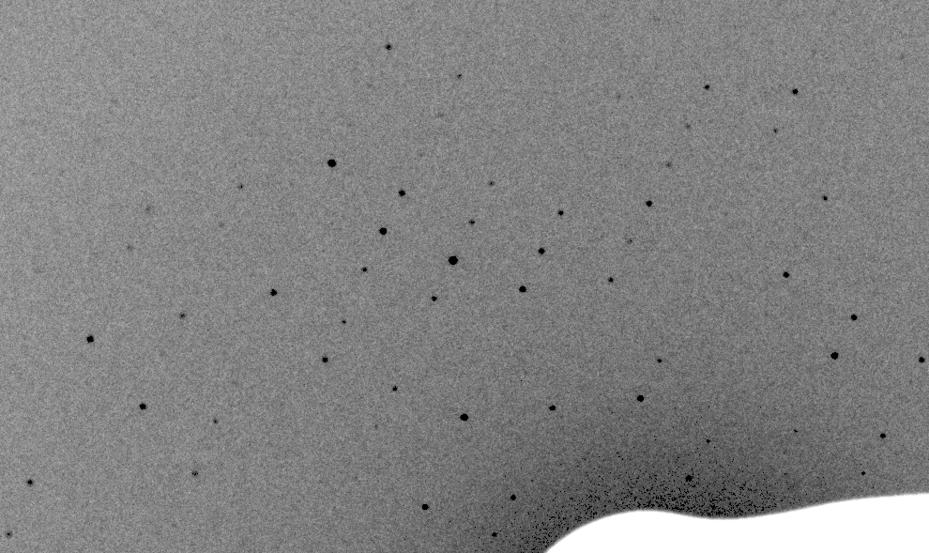
Simulation of XFEL still
Lyubimov et al. (2016).
eLife 5, e18740.

Slide 4
Real XFEL still
Lyubimov et al. (2016).
eLife 5, e18740.

Slide 5
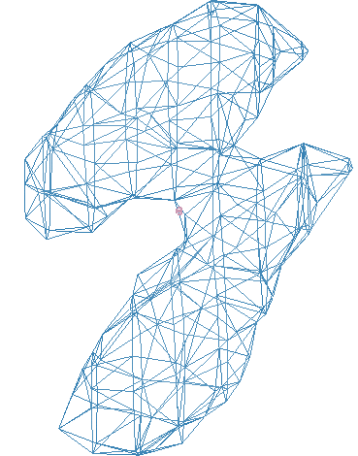
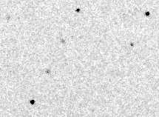
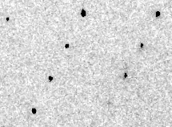
Simulation of XFEL still
phix
phiy
phiz
real
VS
phix
phiy
phiz

Slide 6
Fitting individual “mosaic domains”
Fraction pixels predicted
Best of
262,140 trials
Angle about y axis (°)

Slide 7
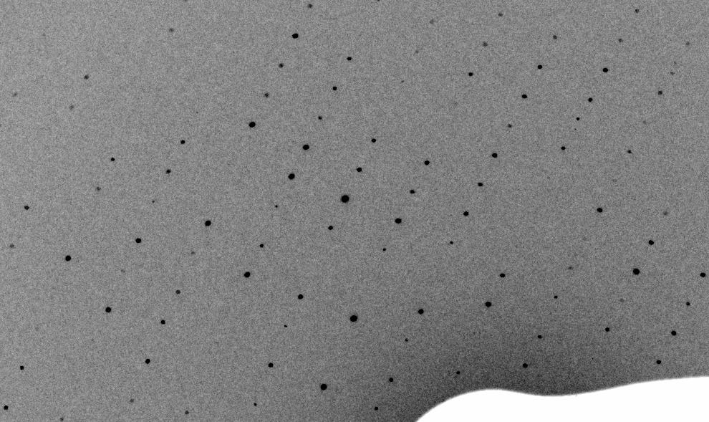
3-domain Simulation of XFEL still

Slide 8
Real XFEL still

Slide 9
1-domain Simulation of XFEL still

Slide 10
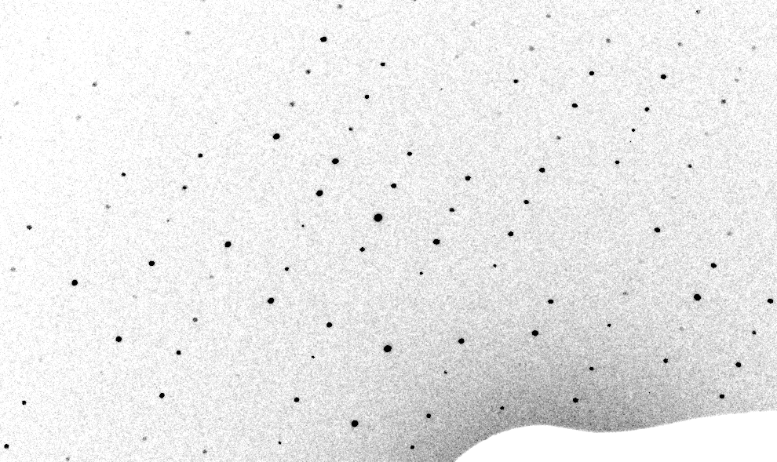
3-cluster mosaic simulation

Slide 11
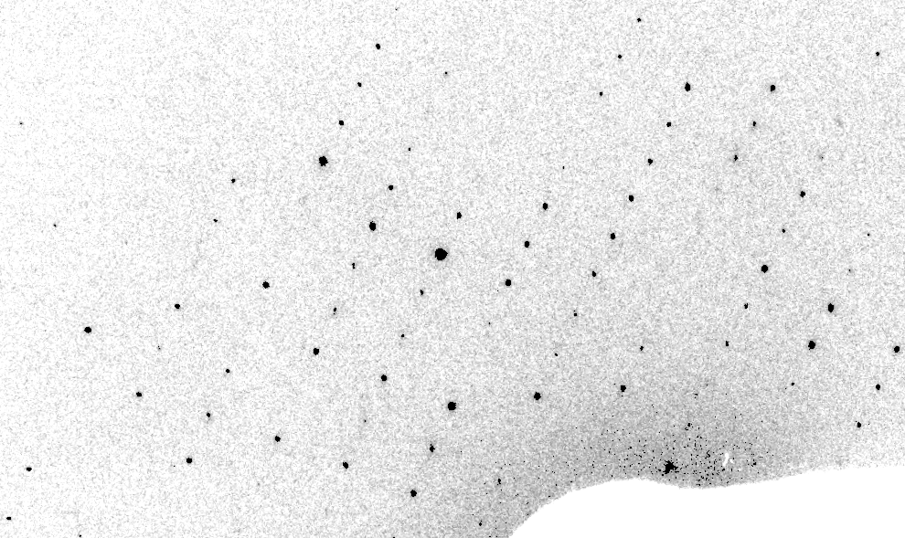
Real XFEL still
Lyubimov et al. (2016).
eLife 5, e18740.

Slide 12
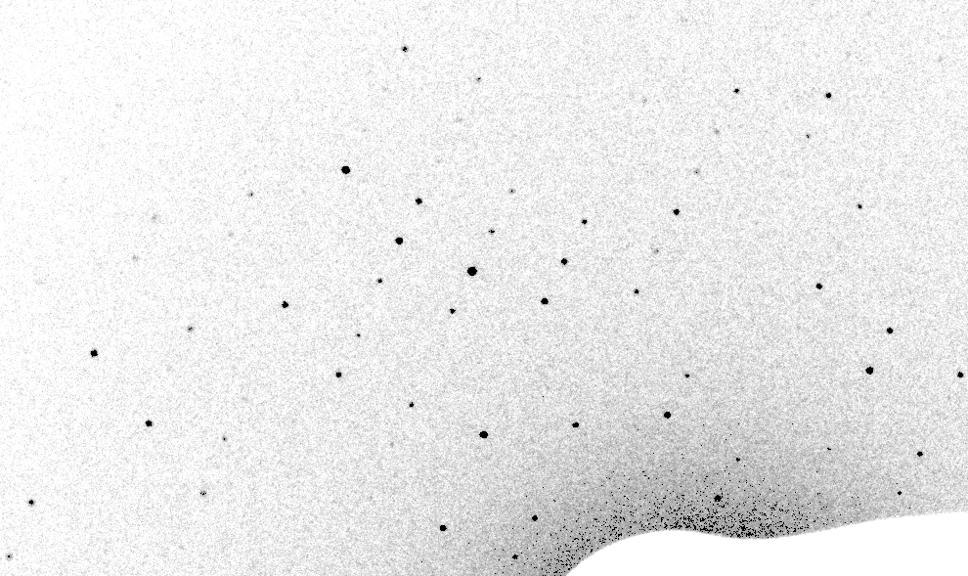
1-cluster Simulation of XFEL still

Slide 13
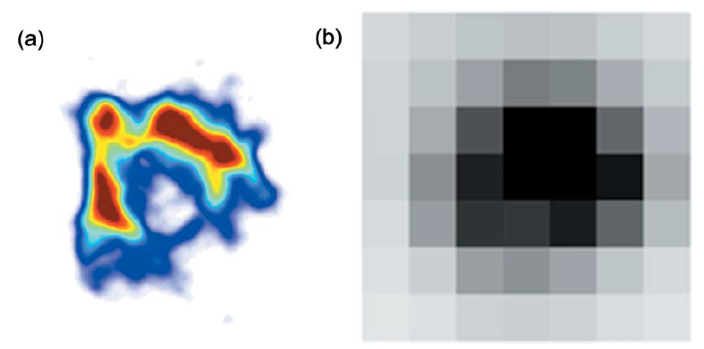
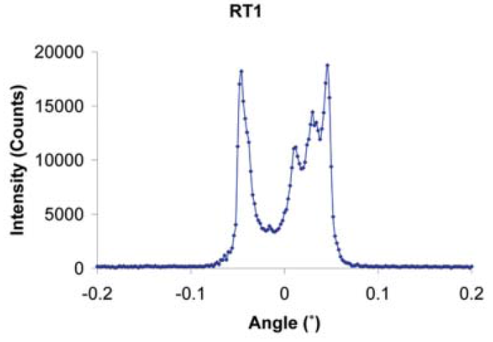
The true nature of “mosaic spread”
Any function can be approximated by a family of Gaussians
Lovelace JJ, Murphy CR, Pahl R, Brister K & Borgstahl GEO (2006)."Tracking reflections through cryogenic cooling with topography", J. Appl. Cryst. 39, 425-432.

Slide 14
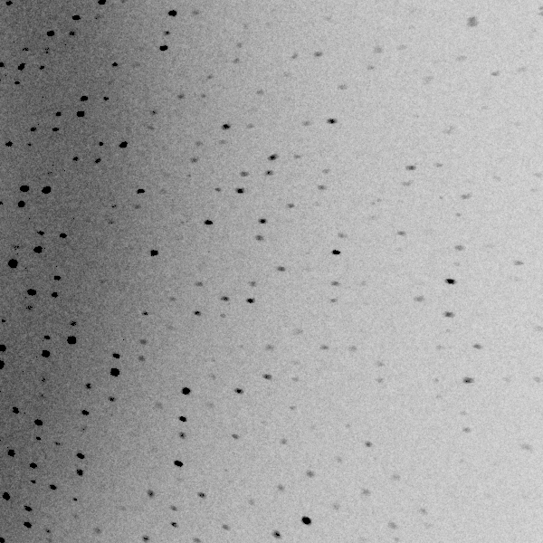
3 domains within 1°

Slide 15
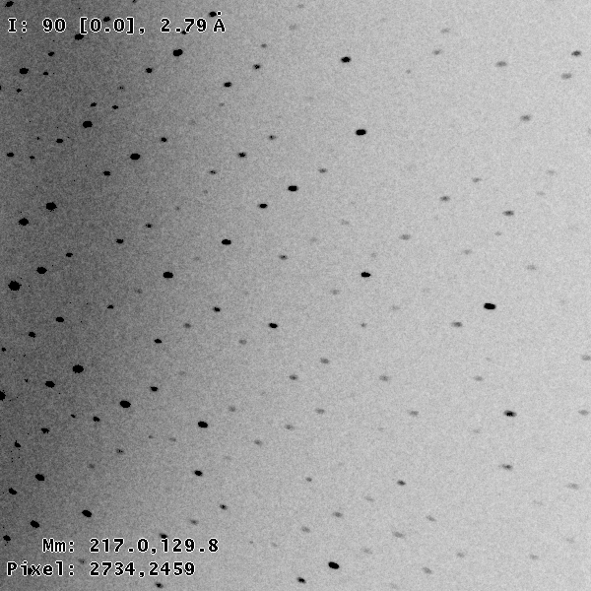
3 domains within 0.2°

Slide 16
Texture sufficient for poor stats
500 images Results from iota: cctbx & prime
texture | 1 cluster | 3 clusters
R_{true}* | 4% | 16%
*Agreement with F value fed into simulation

Slide 17
Texture sufficient for poor stats
500 images Results from iota: cctbx & prime
texture | 1 cluster | 3 clusters
R_{true}* | 4% | 16%
R_{merge} | 23% | 66%
*Agreement with F value fed into simulation

Slide 18
Texture sufficient for poor stats
500 images Results from iota: cctbx & prime
texture | 1 cluster | 3 clusters
R_{true}* | 4% | 16%
R_{merge} | 23% | 66%
I/σ | 32 (1.1) | 19 (1.2)
*Agreement with F value fed into simulation

Slide 19
Texture sufficient for poor stats
500 images Results from iota: cctbx & prime
texture | 1 cluster | 3 clusters
R_{true}* | 4% | 16%
R_{merge} | 23% | 66%
I/σ | 32 (1.1) | 19 (1.2)
CC_{1/2} | 99 (69) | 99 (58)
*Agreement with F value fed into simulation

Slide 20
Texture sufficient for poor stats
500 images Results from iota: cctbx & prime
texture | 1 cluster | 3 clusters
R_{true}* | 4% | 16%
R_{merge} | 23% | 66%
I/σ | 32 (1.1) | 19 (1.2)
CC_{1/2} | 99 (69) | 99 (58)
resolution | 1.55 | 1.94
*Agreement with F value fed into simulation

