Slide 1
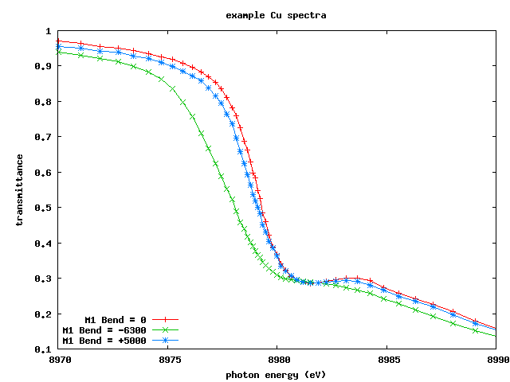
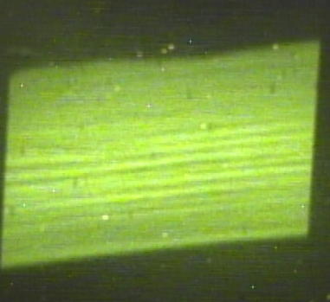
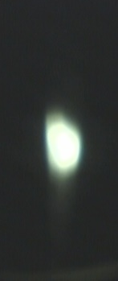
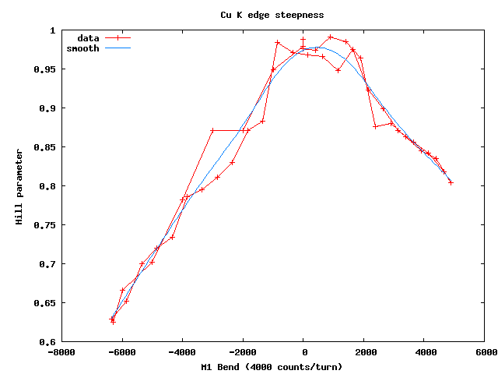
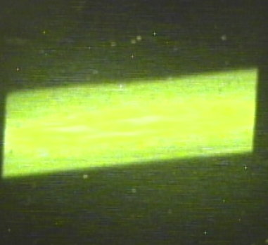
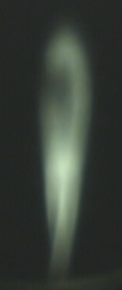
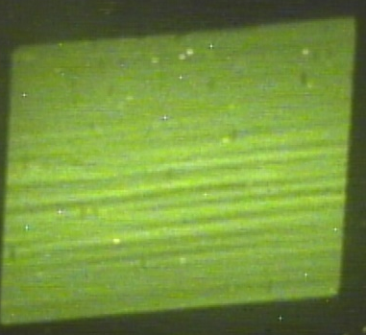
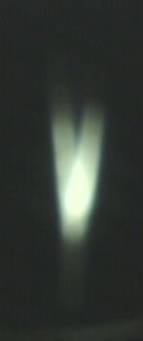
Bend = 0
Bend = +5000
edge steepness
Bend = -6700
M1 Bend

Slide 2
BL 8.3.1
Optics &
diagnostics
sample
YAG
shutter
YAG
Cu
foil
7▫
YAG
diag
Izero
Imono
Out
pinhole
C2
M1
M2
C1
div
slits
SB8
Al foil
Stack
Removes
Si(111)

Slide 3
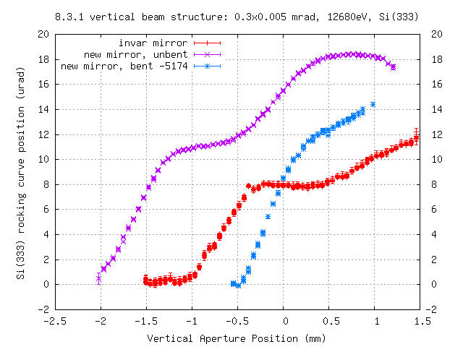

Slide 4
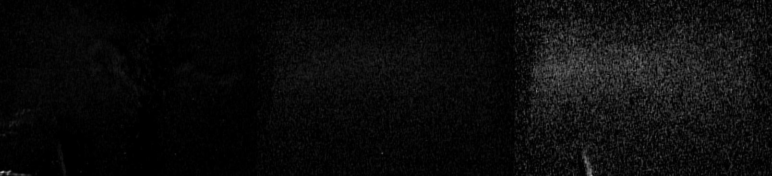
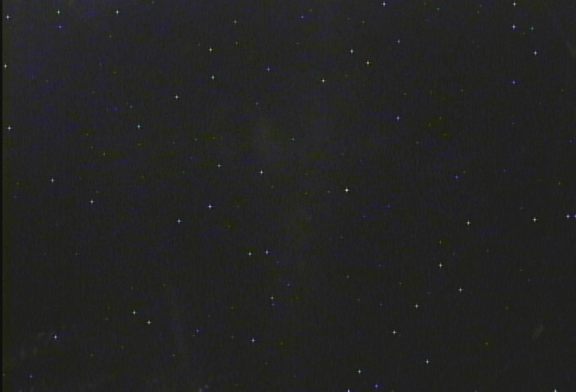
Mono= -2 mm
Mono= 0 mm
Mono= +2 mm
Sweeping
Theta2
over
Si(333)
Rocking
Curve
Unscaled mono = 0 mm

Slide 5
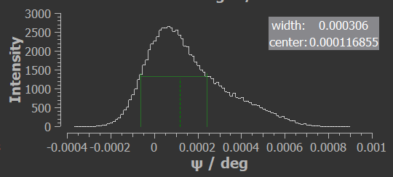
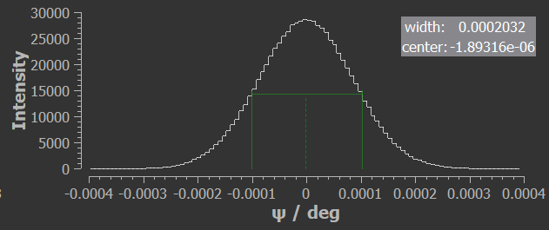
Ray-UI
cylinder ~ 14 urad width at base
parabola
~7 urad

