Slide 1
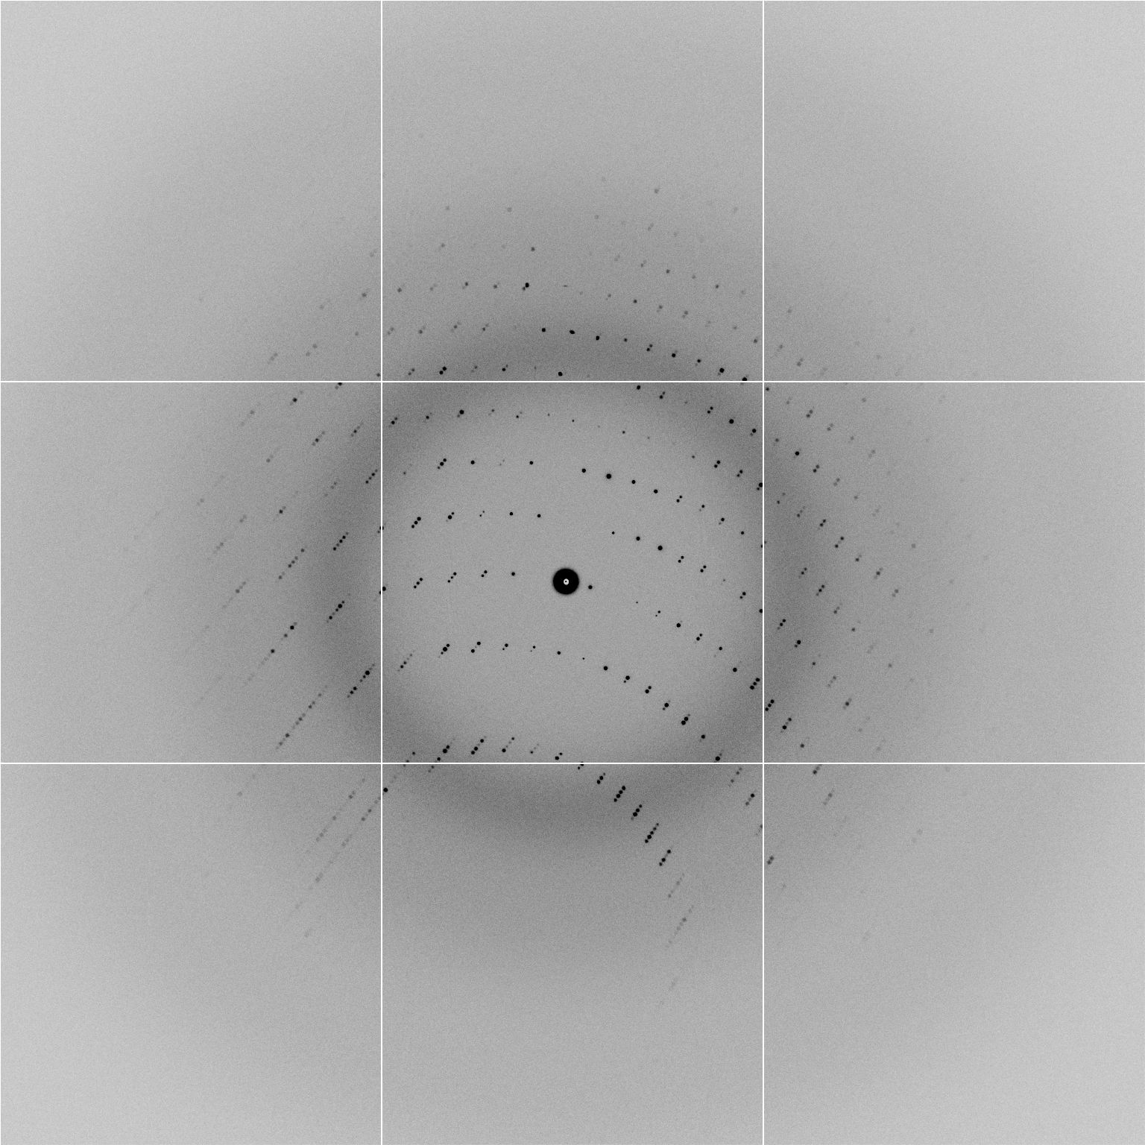
100% SeMet incorporation
Trivial to solve

Slide 2
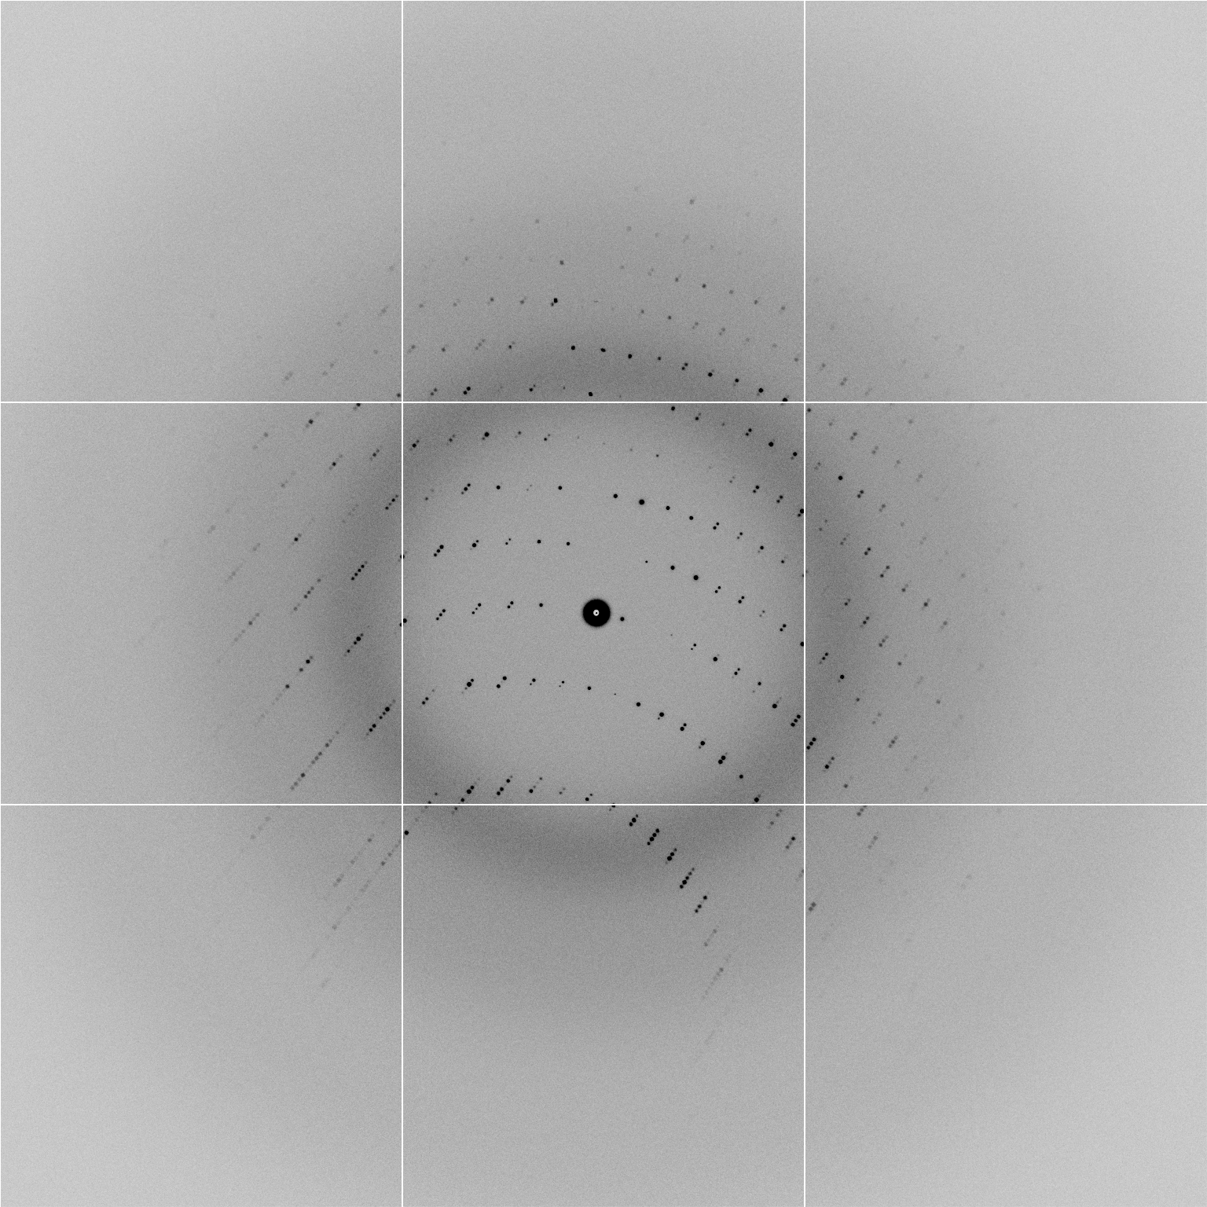
100% S -Met incorporation
Impossible to solve

Slide 3
Exchanging Se for S
correlation coefficient
fraction Sulfur

Slide 4
ARP/wARP performance
correlation coefficient
fraction Sulfur

Slide 5
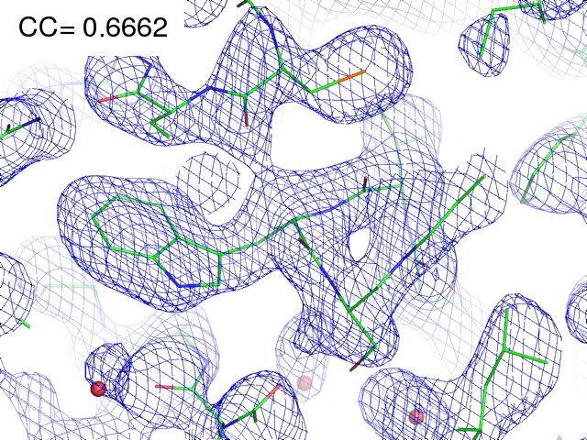
29% Se 71% S

Slide 6
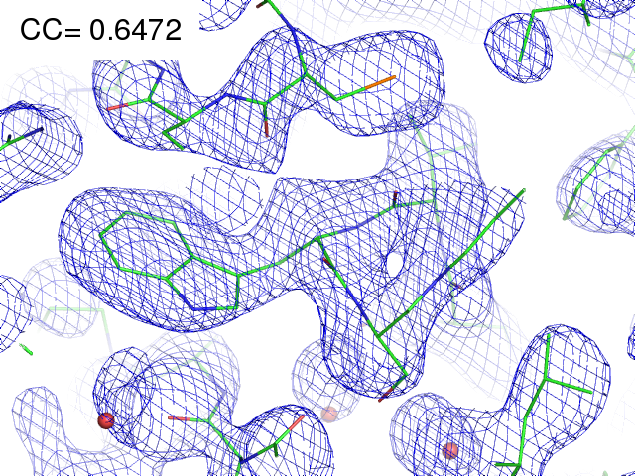
28% Se 72% S

Slide 7
ARP/wARP performance
correlation coefficient
fraction Sulfur

Slide 8
ARP/wARP performance
correlation coefficient
fraction Sulfur

Slide 9
ARP/wARP performance
correlation coefficient
fraction Sulfur

Slide 10
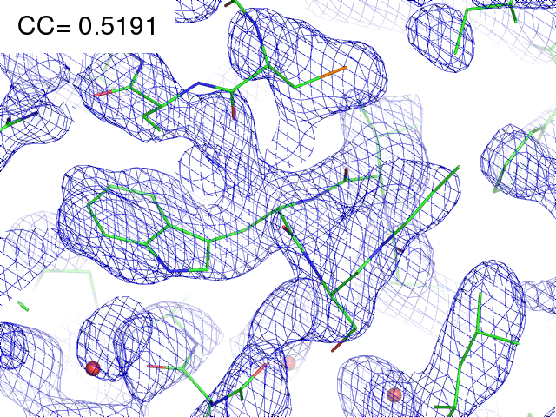
21% Se 79% S

Slide 11
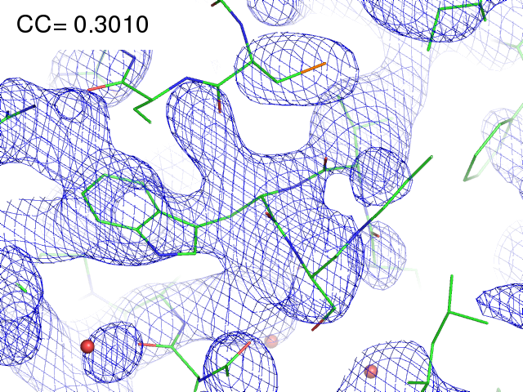
11% Se 89% S

