Slide 1
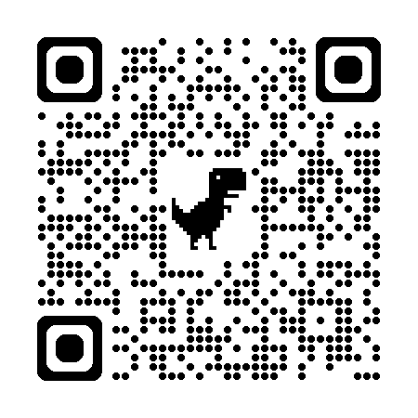
Acknowledgements
https://bl831.als.lbl.gov/~jamesh/powerpoint/WCSBW_2025.pptx
James Fraser Nevan Krogan
Paul Adams John Tainer Greg Hura Nick Sauter
Pavel Afonine, Tom Terwilliger, Nigel Moriarty, Dorothee Liebschner
Dale Tronrud, Helen Ginn
Aina Cohen
UCSF LBNL SLAC
ALS 8.3.1: TomAlberTron
NIH NIGMS R01 GM124149 (Holton)
NIH NIAID P50 AI150476 (Krogan)
NIH NIGMS P30 GM124169 (Adams)
DOE-BER IDAT (Hura)
NIH NIGMS P30 GM133894 (Hodgson)
The Advanced Light Source is supported by the Director, Office of Science, Office of Basic Energy Sciences, Materials Sciences Division, of the US Department of Energy under contract No. DE-AC02-05CH11231 at Lawrence Berkeley National Laboratory.

Slide 2
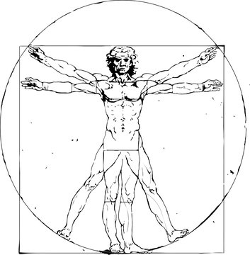
The UNTANGLE Challenge
best.pdb
refme.mtz
(simulated)
11) Build better than the best:
as-good or better wE, R_{free} as best.pdb
alternate mechanism ensemble
$1000
https://github.com/jmholton/UnTangle

Slide 3
The UNTANGLE Challenge
best.pdb
refme.mtz
(simulated)
11) Build better than the best:
as-good or better wE, R_{free} as best.pdb
alternate mechanism ensemble
$1000
https://github.com/jmholton/UnTangle

Slide 4
The UNTANGLE Challenge
best.pdb
refme.mtz
(simulated)
11) Build better than the best:
as-good or better wE, R_{free} as best.pdb
alternate mechanism ensemble
10) Recover best.pdb from refme.mtz
true phases, auto-building allowed
no cheating (don’t use best.pdb as guide)
Prove: true ensemble is unique and recoverable
$1000
$500
https://github.com/jmholton/UnTangle

Slide 5
Map Noise: R factors matter via Parseval’s Theorem
$$\frac{ρ}{σ\left(ρ\right)}≈\frac{e^{−}}{7R}$$
e⁻ number of electrons in peak
7 number of electrons in typical atom
R R_{iso} or R_{free}
ρ electron density peak
σ rms deviation expected

Slide 6
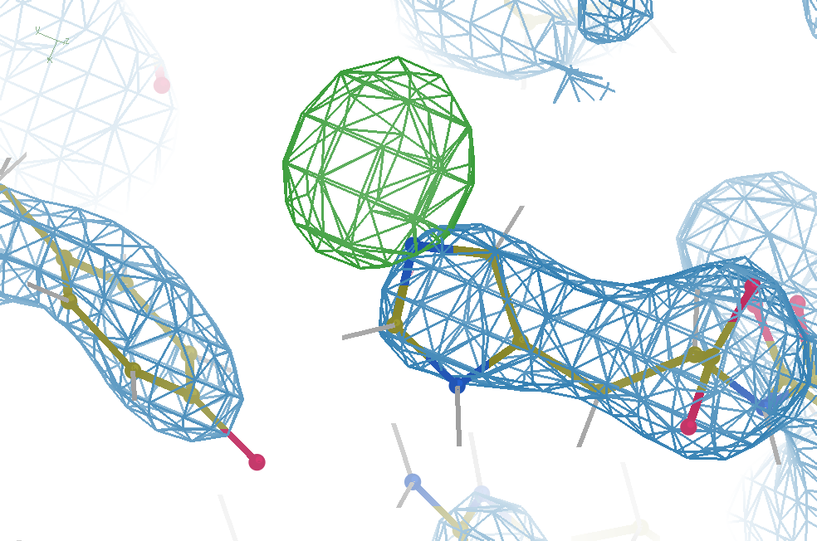
Hydrogen: visible at 3.5 Å resolution!
R_{work} = 0.04
R_{free} = 0.05
6σ = 1 e⁻
cut at 5 Å :
R_{free} = 0.01
Simulation:
Realistic noise
“untangled” model

Slide 7
R_{work}: 0.0823
R_{free}: 0.1106
bond: 0.014 Å
angle: 1.92°
Real Data
1.2 σ
48-copy ensemble
3 params
per observation
MoPro: 1.15
Clash: 0.49
Cβdev: 20
Rota: 1.7%
Rama: 0.03%
reso: 1.0 Å
6σ

Slide 8
Over-Fitting data
Map density
position

Slide 9
Over-Fitting data
Map density
position

Slide 10
Over-Fitting data
Map density
position

Slide 11
Over-Fitting data
R_{work} ≈ 0
N_{params}= N_{obs}
Map density
position

Slide 12
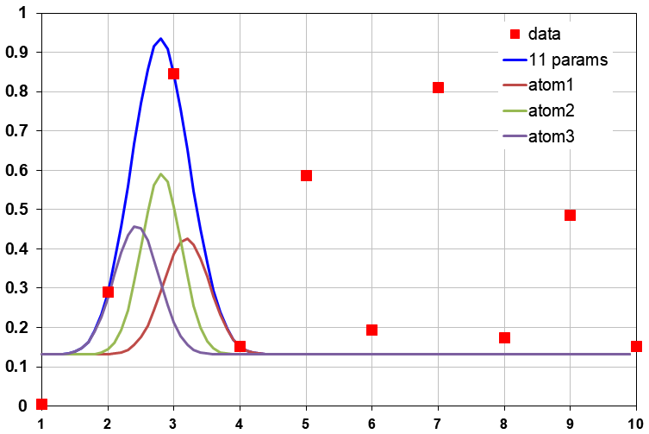
Under-Fitting data
R_{work} > 0
N_{params}> N_{obs}
Map density
position

Slide 13
R_{work}: 0.0823
R_{free}: 0.1106
bond: 0.014 Å
angle: 1.92°
under-fitting:
R_{work} > 0
MoPro: 1.15
Clash: 0.49
Cβdev: 20
Rota: 1.7%
Rama: 0.03%
reso: 1.0 Å
6σ

Slide 14
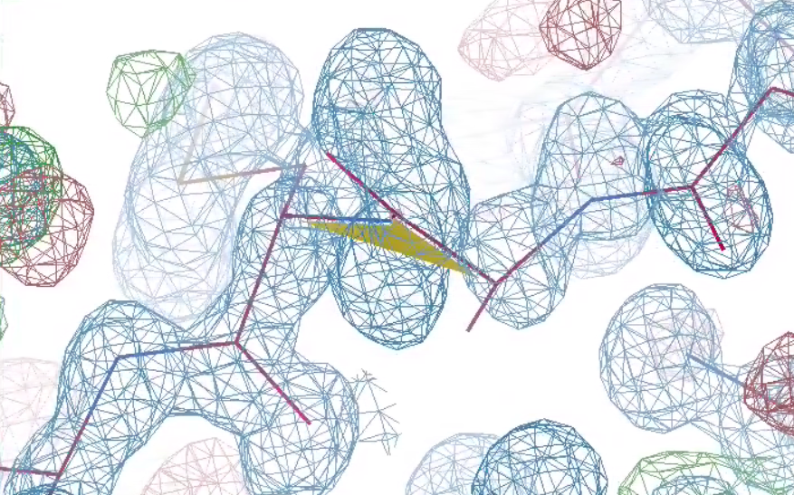
What is holding this back?
1 member of 48-copy
ensemble
R_{work}: 0.0823
R_{free}: 0.1106
bond: 0.014 Å
angle: 1.92°
MoPro: 1.15
Clash: 0.49
Cβdev: 20
Rota: 1.7%
Rama: 0.03%
reso: 1.0 Å
30°
peptide
bond twist

Slide 15
Why does ensemble refinement suck? (3 parameters/observation and R_{work} still high!)
The chains are “tangled”

Slide 16
What do you mean, “tangled”?
Ground Truth
Local Minimum

Slide 17
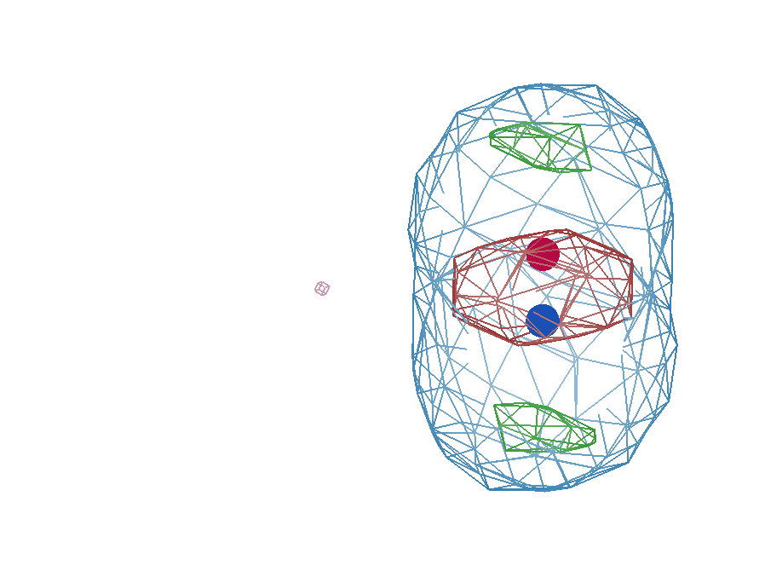
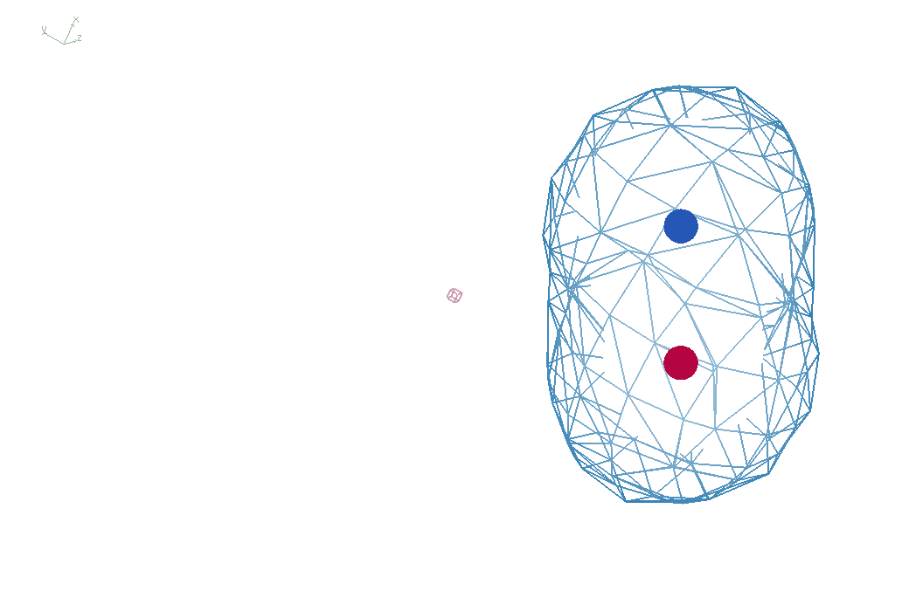
It takes two to tangle
density
fit
Chemical
strain
energy
A
A
B
B
B
A
tangled
barrier
untangled

Slide 18
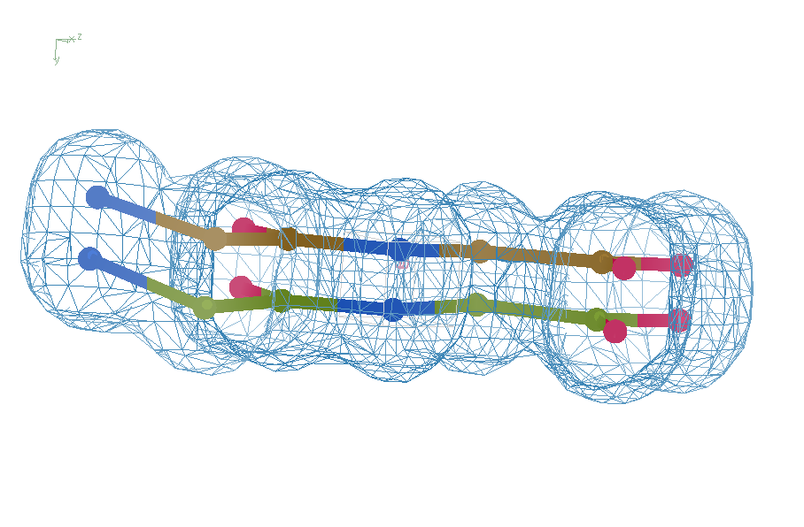
Refine from right answer
R = 0.8%
rms bond = 0.0002

Slide 19
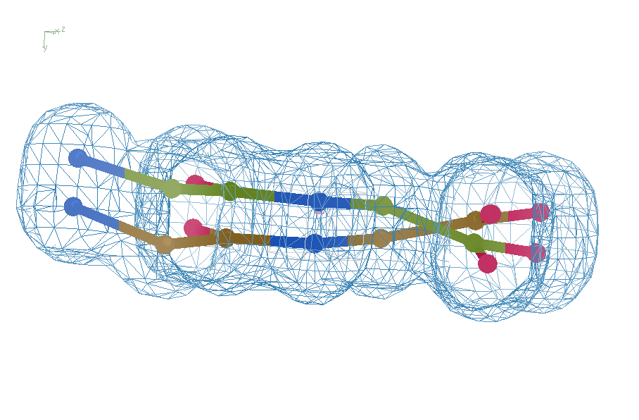
Refine from wrong starting point
R = 7.07%
rms bond = 0.001

Slide 20
Sim challenge data
Ala39
-0.2σ
wE=18.2
N-C_{α}
bond
-0.3σ
0.8σ
angle
A B conformers

Slide 21
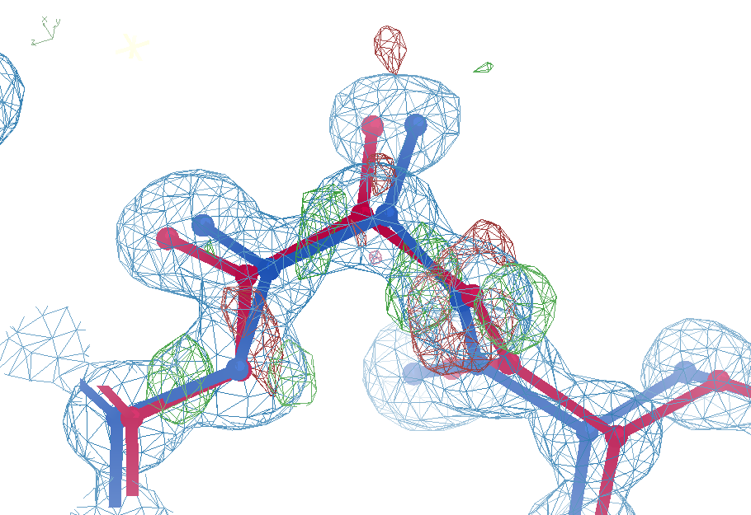
Sim challenge data: “otw39”
Ala39
+11σ
wE=63.5
N-C_{α}
bond
-9σ
It’s a TRAP!
5σ
angle
A B conformers

Slide 22
UNTANGLE: sim-data Ground Truth
As simple as possible:
2 conformers
50:50 occupancy
Accessible
64 residues
78 waters
Every chance of success
1.0 Å reso
“one thing wrong”
flat bulk solvent
no false outliers
phenix, refmac, shelxl
clear score
Experimental error only
perfect phases

Slide 23
Impact
Tangling happens at all resolutions
Alt confs are there, even if not built
worse at poor resolution
6 Å = high param/obs; R_{work} >> 0
“wrong” ways to think
Observations vs parameters (unless polynomials)
Combinatorial explosion
protein folding: not combinatorial
Alphafold is proof

Slide 24
verified Score sheet
wE | R_{work} | R_{free} | method
185 | 20.6 | 21.4 | Alphafold2
109.6 | 8.87 | 9.44 | Phenix.ensemble_refine
97.3 | 8.84 | 9.27 | qFit best
91.7 | 3.64 | 4.27 | manual
80.5 | 4.31 | 4.75 | lotswrong
65.2 | 6.35 | 6.93 | Amber24
54.6 | 5.87 | 6.57 | single conf w aniso B
33.5 | 2.94 | 3.32 | One thing wrong: Ala39
23.5 | 2.95 | 3.31 | One thing wrong: Val1
21.4 | 3.12 | 3.48 | Rectified Simulated Annealing
18.1 | 17.9 | 18.4 | Phenix autobuild
18.2 | 2.79 | 3.14 | best (ground truth)

Slide 25
verified Score sheet
wE | R_{work} | R_{free} | method
185 | 20.6 | 21.4 | Alphafold2
109.6 | 8.87 | 9.44 | Phenix.ensemble_refine
97.3 | 8.84 | 9.27 | qFit best
91.7 | 3.64 | 4.27 | manual
80.5 | 4.31 | 4.75 | lotswrong
65.2 | 6.35 | 6.93 | Amber24
54.6 | 5.87 | 6.57 | single conf w aniso B
33.5 | 2.94 | 3.32 | One thing wrong: Ala39
23.5 | 2.95 | 3.31 | One thing wrong: Val1
21.4 | 3.12 | 3.48 | Rectified Simulated Annealing
18.1 | 17.9 | 18.4 | Phenix autobuild
18.2 | 2.79 | 3.14 | best (ground truth)

Slide 26
wE score: key concepts
sqrt()
erf()
Energy ↔ dev/sigma ↔ Probability
Probability outlier is not noise
“clip” energy to tolerate real outliers
Not so sharp transition to outlier
Tighter Non-bond (Lennard-Jones)

Slide 27
Statistical Potential
$$E={\left(\frac{v−v0}{σ}\right)}^{2}$$
E “energy”
v model value
v₀ ideal value
σ rms deviation expected
1 x 6σ ← 40x 1σ
1 x 6σ ≈ 36x 1σ
Outlier problem:
solution: weight by
“probability its not noise” : wE

Slide 28
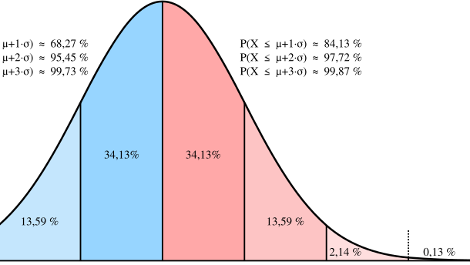
Probability that it’s not noise
erf()
←68%→
← 95% →
-1σ 0 1σ 2σ 3σ

Slide 29
Probability that it’s not noise
$$Pnn={\operatorname{erf}\left(\left|\frac{v−v0}{σ\sqrt{2}}\right|\right)}^{Nthings}$$
P_{nn} probability
v-v₀ deviation from ideal
σ rms deviation expected
erf() integral of a Gaussian
N_{things} number of trials
erf($1.0/\sqrt{2}$) = 68%
${\text{erf}\text{(}1.0/\sqrt{2}\text{)}}^{10}$ = 2%
erf($2.0/\sqrt{2}$) = 95%
${\text{erf}\text{(}2.0/\sqrt{2}\text{)}}^{10}$ = 63%
${\text{erf}\text{(}4.0/\sqrt{2}\text{)}}^{10,000}$ = 53%

Slide 30
New Untangling Ideas!
Variable Labels - Tronrud
ROPE - Ginn
phenix.create_alt_conf - Terwilliger
Rectified Simulated Annealing
Bespoke harmonic restraints in MD

Slide 31
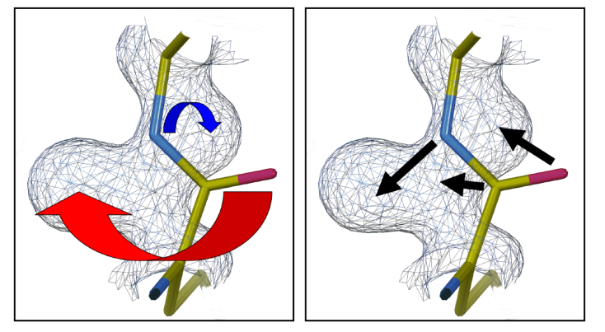
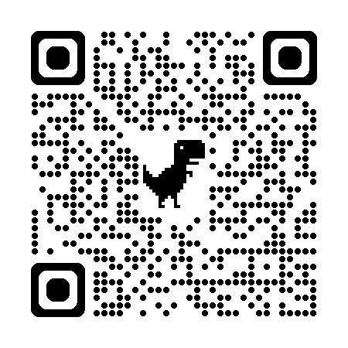
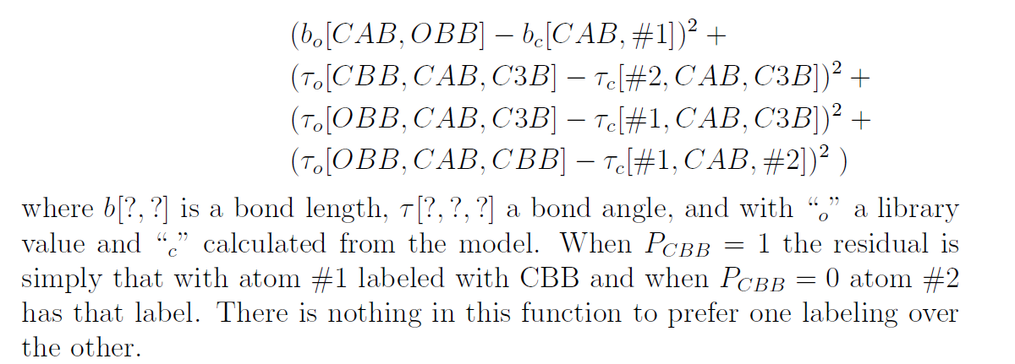
Tronrud’s “Variable Labels” proposal
New ideas!
unimplemented

Slide 32
New tools!
Helen Ginn ROPE-based program
GUI showing both conformers A and B and bonds drawn between them according to the following rules:
good geometry, for
or
bad geometry, for
or
good geometry, for
or
bad geometry, for
or
Conformer A
Helen wE = 18.6
Conformer B
“best”: wE = 18.2
This indicates the bottom atom conformers need untangling. Clicking on the atoms flips the conformers over right to the end of the chain.

Slide 33
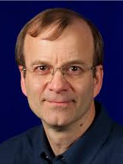
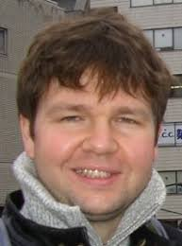
New Tools!
Tom
Terwilliger
phenix.holton_geometry_validation test.pdb
phenix.create_alt_conf phenix_autobuild.pdb refme.mtz \
nproc=48
phenix.refine \
model.pdb refme.mtz \
main.number_of_mac=10 \
fit_altlocs_method=masking \
ordered_solvent=true \
include_altlocs=true \
ordered_solvent.mode=every_macro_cycle_after_first \
refine_oat=true
Pavel Afonine

Slide 34
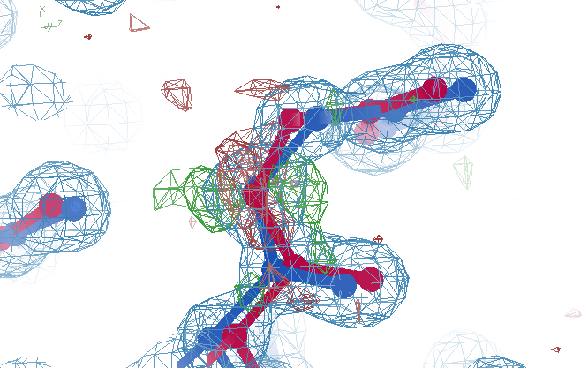
Better than the best?
Ala39
wE=17.2
A B conformers

Slide 35
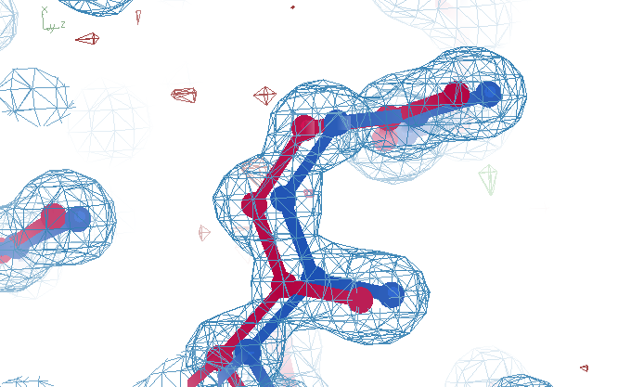
best?
Ala39
wE=18.2
A B conformers

Slide 36
verified Score sheet
wE | R_{work} | R_{free} | method
185 | 20.6 | 21.4 | Alphafold2
109.6 | 8.87 | 9.44 | Phenix.ensemble_refine
97.3 | 8.84 | 9.27 | qFit best
91.7 | 3.64 | 4.27 | manual
80.5 | 4.31 | 4.75 | lotswrong
65.2 | 6.35 | 6.93 | Amber24
54.6 | 5.87 | 6.57 | single conf w aniso B
33.5 | 2.94 | 3.32 | One thing wrong: Ala39
23.5 | 2.95 | 3.31 | One thing wrong: Val1
21.4 | 3.12 | 3.48 | Rectified Simulated Annealing
18.1 | 17.9 | 18.4 | Phenix autobuild
18.2 | 2.79 | 3.14 | best (ground truth)

Slide 37
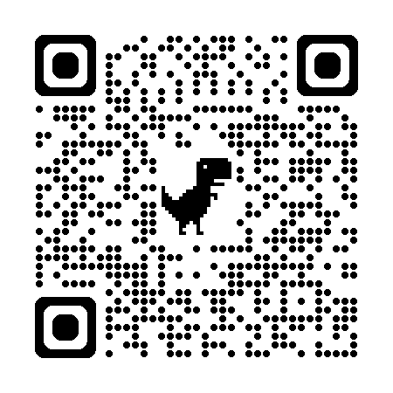
“rectified” Simulated Annealing
Default simulated annealing in phenix
Run score on result
Run score on starting model
Probe difference map
Atom by atom: is worse? Move it back
Iterate
Parallel seeds and temperatures
https://github.com/jmholton/rectified_simulated_annealing

Slide 38
Long-range traps from rectified SA
wE=21.4
Match ground-truth
swapped relative
to ground truth

Slide 39
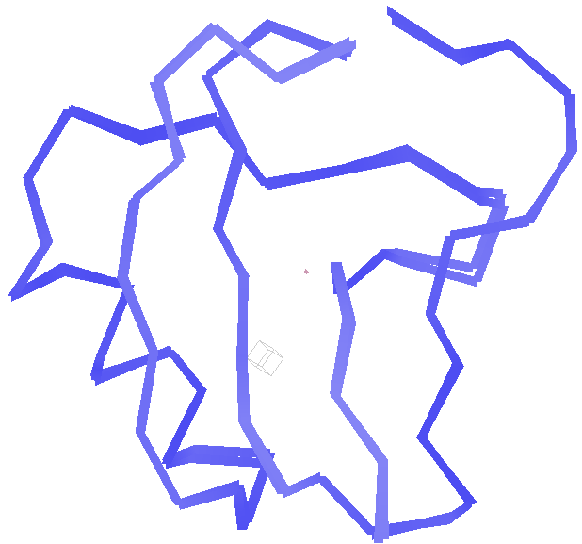
best.pdb
wE=18.2
Match ground-truth
Nothing
swapped relative
to ground truth

Slide 40
verified Score sheet
wE | R_{work} | R_{free} | method
185 | 20.6 | 21.4 | Alphafold2
109.6 | 8.87 | 9.44 | Phenix.ensemble_refine
97.3 | 8.84 | 9.27 | qFit best
91.7 | 3.64 | 4.27 | manual
80.5 | 4.31 | 4.75 | lotswrong
65.2 | 6.35 | 6.93 | Amber24
54.6 | 5.87 | 6.57 | single conf w aniso B
33.5 | 2.94 | 3.32 | One thing wrong: Ala39
23.5 | 2.95 | 3.31 | One thing wrong: Val1
21.4 | 3.12 | 3.48 | Rectified Simulated Annealing
18.1 | 17.9 | 18.4 | Phenix autobuild
18.2 | 2.79 | 3.14 | best (ground truth)

Slide 41
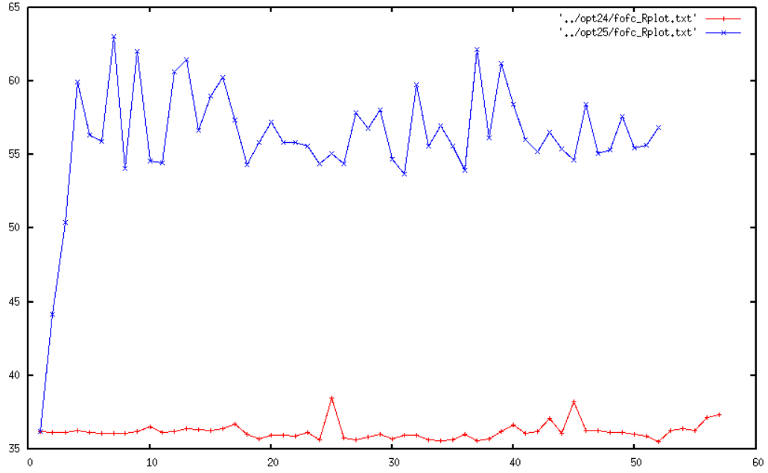
Molecular Dynamics of crystals
65
60
55
50
45
40
35
unrestrained
R_{free} (%)
restrained
Time (ns)

Slide 42
“bespoke” harmonic restraints in MD
A
A
or
B
B
Stays tangled
agnostic

Slide 43
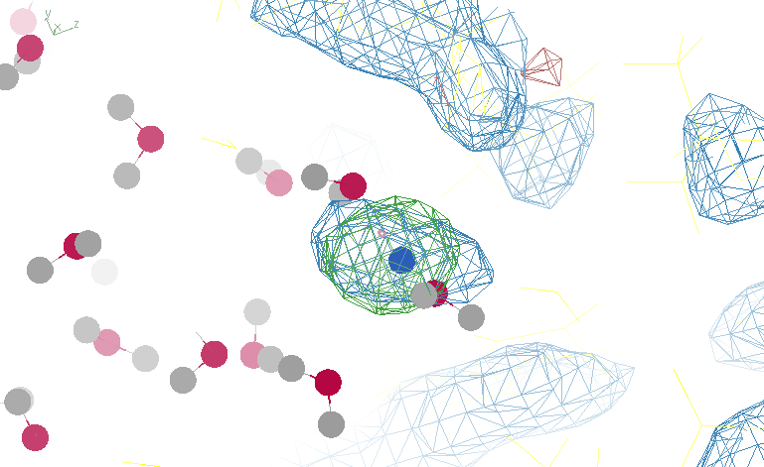
Reference point with too-low weight

Slide 44
Real Data
1.2 σ
6σ

Slide 45
“bespoke” harmonic restraints in MD
Reference points at density centroids
Random alt-loc assignment (at first)
Harmonic weight = e- density (at first)
0.5 ns run – average ASU density
F_{obs}-F_{calc} difference map
update weights (green=more ; red=less)
Re-discover nearest reference points
Release very bad restraints: grow back?
Reduce all weights by ~1%
iterate
https://github.com/jmholton/bespoke_amber_restraints

Slide 46
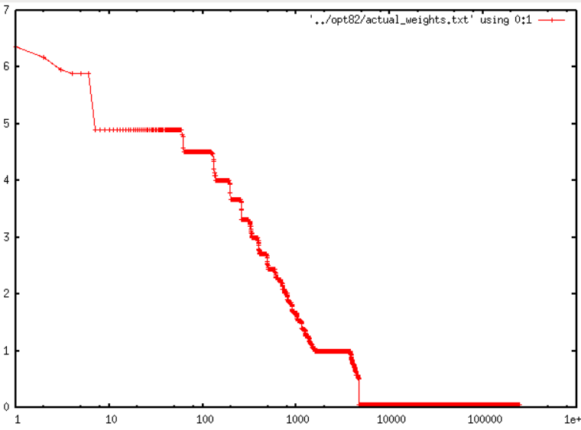
Less than 2% of atoms need restraints
7
6
5
4
3
2
1
0
R_{free} = 27%
no X-ray term!
?
Restraint weight (kcal/Å²)
1.8%
1 10 100 1000 10000 1e5 1e6
Sorted atom count

Slide 47
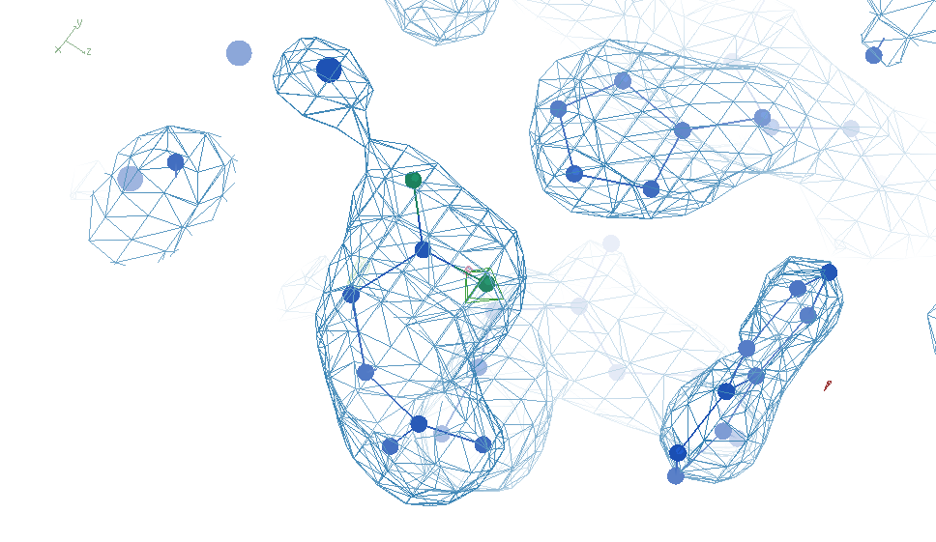
Most-challenged restraint

Slide 48
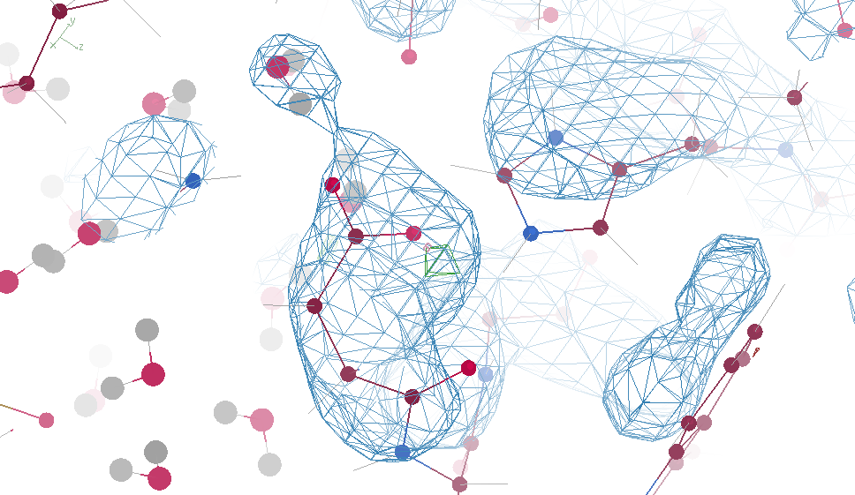
“flying” MD snapshot

Slide 49
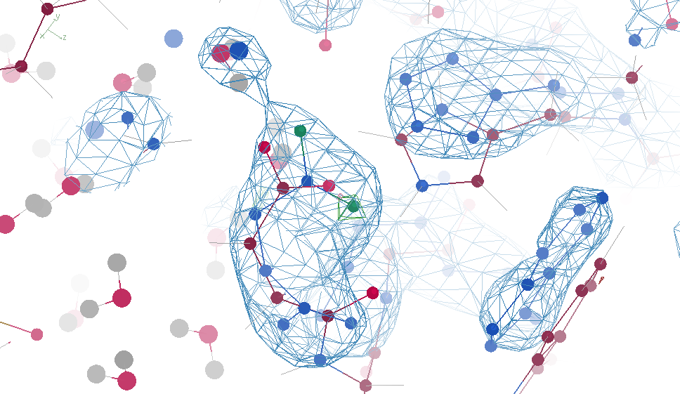

Slide 50
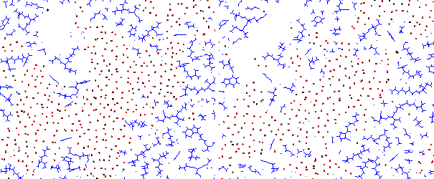
Solved, but weird, problem! Vacuum bubbles at 10k atm
Bespoke restraints
No restraints

Slide 51
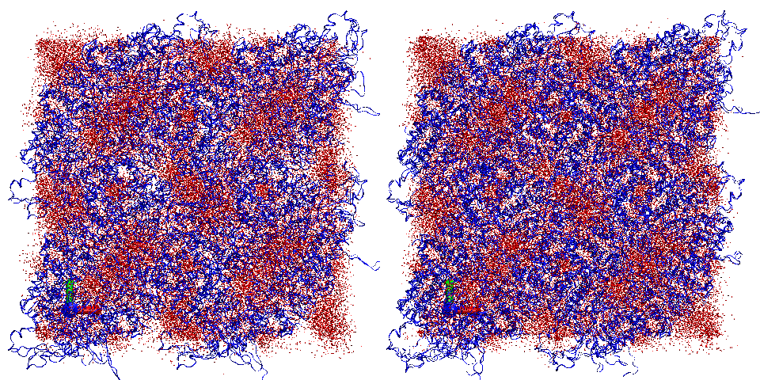
Restraints lead to “sloshing”
sparse restraints without alignment
No restraints

Slide 52
Summary
https://bl831.als.lbl.gov/~jamesh/powerpoint/WCSBW_2025.pptx
Main barrier: tangled ensemble
Recover underlying ensemble
Might be required!
Rfree < 3% → single e⁻
Not over-fitting
Weighted E scoring function
Probability its not noise
$1000
$500

Slide 53
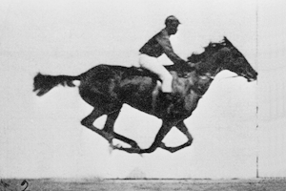
Muybridge’s galloping horse (1872)

Slide 54
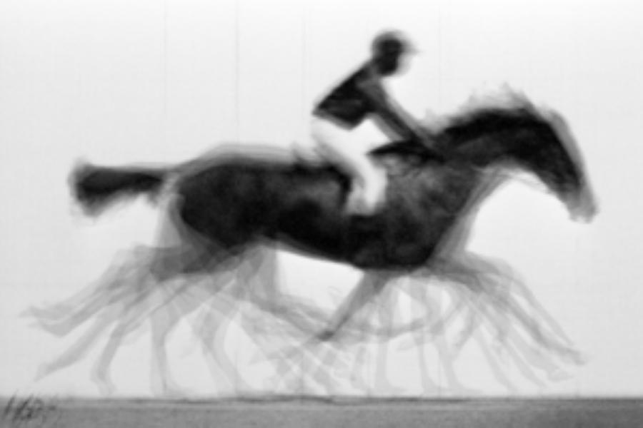
average structure: galloping horse

Slide 55
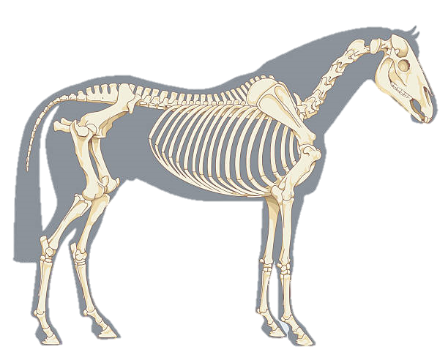
Horses have bones
+/- 0.01

Slide 56
Differences & Similarities
horse
molecule
~2 m
Stiff backbone
Bone sigma ~ 1 mm
4 joints/leg
Continuous angle
No torision
Concerted motion
no steric clashes
~100 Å
Stiff backbone
Bond sigma = 0.01 Å
0-4 chi angles
Angle sigma ~ 1°
Rotamers
Concerted motion
no steric clashes

Slide 57
Horses have bones

Slide 58
Muybridge’s galloping horse 0

Slide 59
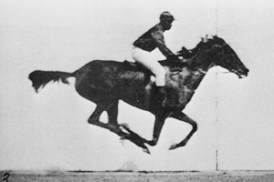
Muybridge’s galloping horse 1

Slide 60
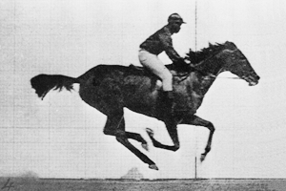
Muybridge’s galloping horse 2

Slide 61
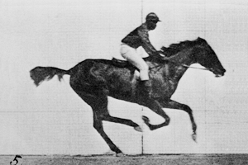
Muybridge’s galloping horse 3

Slide 62
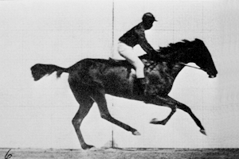
Muybridge’s galloping horse 4

Slide 63
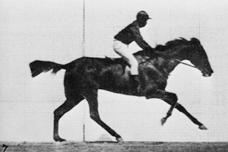
Muybridge’s galloping horse 5

Slide 64
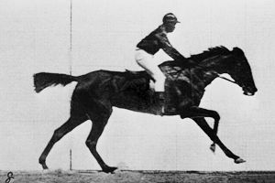
Muybridge’s galloping horse 6

Slide 65
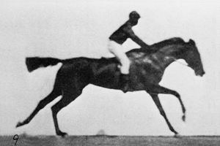
Muybridge’s galloping horse 7

Slide 66
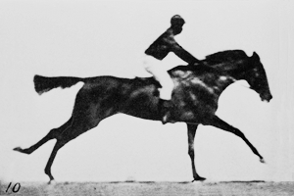
Muybridge’s galloping horse 8

Slide 67
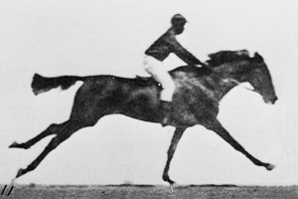
Muybridge’s galloping horse 9

Slide 68
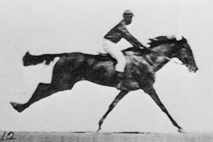
Muybridge’s galloping horse 10

Slide 69
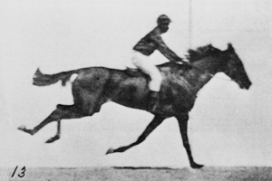
Muybridge’s galloping horse 11

Slide 70
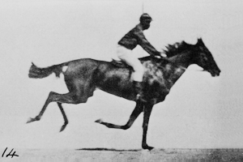
Muybridge’s galloping horse 12

Slide 71
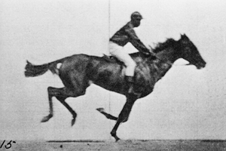
Muybridge’s galloping horse 13

Slide 72
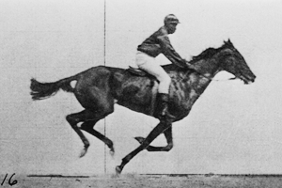
Muybridge’s galloping horse 14

Slide 73
ensemble refine ???
A solution exists!
But ensemble refine
will fail to find it

Slide 74
Future improvements
https://bl831.als.lbl.gov/~jamesh/powerpoint/WCSBW_2025.pptx
All-outlier score (not just worst)
Density score (not just R_{free})
Better Sigma(I) simulation
More realistic ground truth
Bespoke MD restraint tool kit
Tronrud’s Variable Labels

Slide 75
verified Score sheet
wE | R_{work} | R_{free} | method
185 | 20.6 | 21.4 | Alphafold2
109.6 | 8.87 | 9.44 | Phenix.ensemble_refine
97.3 | 8.84 | 9.27 | qFit best
91.7 | 3.64 | 4.27 | manual
80.5 | 4.31 | 4.75 | lotswrong
65.2 | 6.35 | 6.93 | Amber24
54.6 | 5.87 | 6.57 | single conf w aniso B
33.5 | 2.94 | 3.32 | One thing wrong: Ala39
23.5 | 2.95 | 3.31 | One thing wrong: Val1
21.4 | 3.12 | 3.48 | Rectified Simulated Annealing
18.1 | 17.9 | 18.4 | Phenix autobuild
18.2 | 2.79 | 3.14 | best (ground truth)

Slide 76
wE score: key concepts
sqrt()
erf()
Energy ↔ dev/sigma ↔ Probability
Probability outlier is not noise
“clip” energy to tolerate real outliers
Not so sharp transition to outlier
Tighter Non-bond (Lennard-Jones)

Slide 77
“clip” for tolerating true outliers
clip(E) $=\left\{\begin{matrix}E, if E<10 \\ 10+\log\left(E\right)−log⁡(10)\end{matrix}\right.$
Statistical Energy
$$E={\left(\frac{v−v0}{σ}\right)}^{2}$$
10
wE
Colloquially:
OK! OK! Its an outlier! Let’s not agonize about it
N=10
5
N=10,000
10σ vs 10.1σ not more important
than 3.3σ vs 3.0σ
0
3
6
8
max sigma deviate

Slide 78
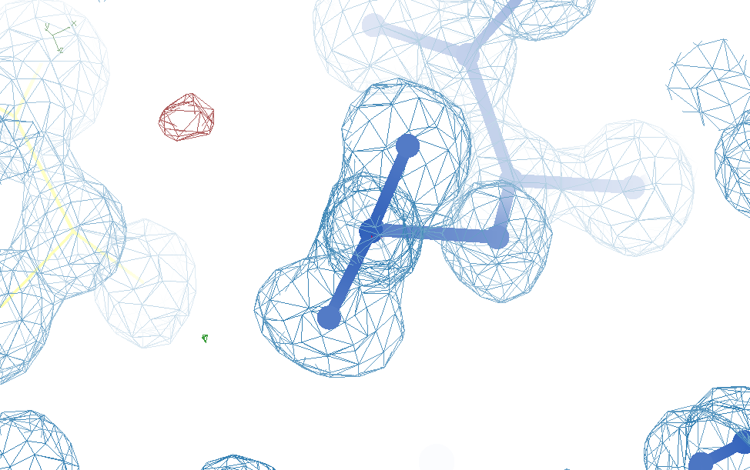
Glu32
Genuine outlier
in ground truth
real data
-80°
Torsion outlier

Slide 79
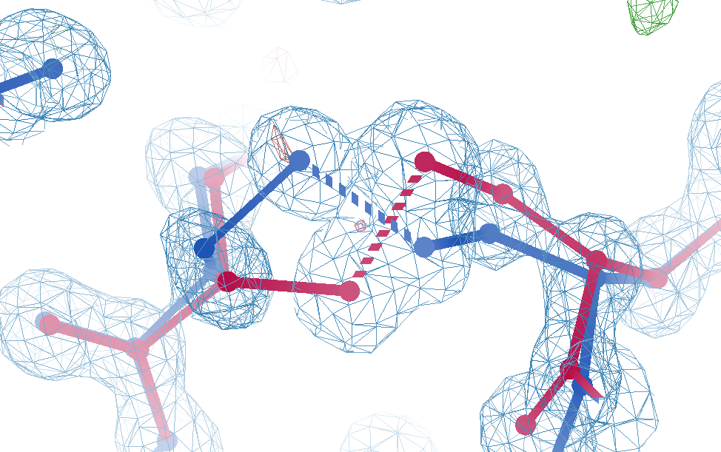
Cys12
Genuine outlier
in ground truth
real data
-107°
torsion outlier
A B conformers

Slide 80
wE score: key concepts
sqrt()
erf()
Energy ↔ dev/sigma ↔ Probability
Probability outlier is not noise
“clip” energy to tolerate real outliers
Not so sharp transition to outlier
Tighter Non-bond (Lennard-Jones)

Slide 81
Probability that it’s not noise softer
$${Pnn}^{soft}=1−2^{\left({\left(\frac{\left|v−v0\right|}{σ_{P50}}\right)}^{5}\right)}$$
1
P_{nn} probability
v-v₀ deviation from ideal
σ rms deviation expected
inverf() inverse erf()
N_{things} number of trials
P
N=1
0.5
N=1 soft
$$σ_{P50}=$$
$$\sqrt{2} \text{inverf}\left({0.5}^{1/{N_{things}}}\right)$$
N=10,000
soft
N=10,000
0
1
2
3
4
5
6
max sigma deviate

Slide 82
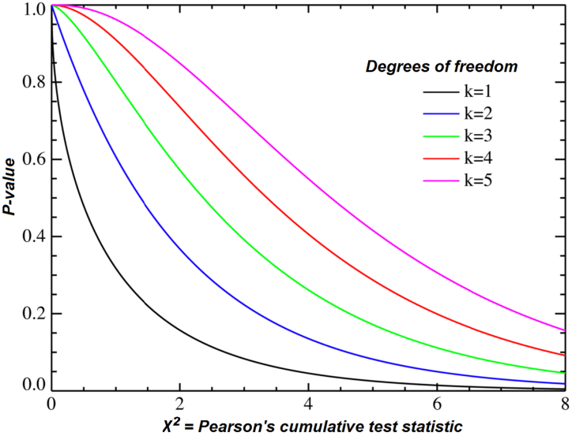
Probability that it’s not noise average/sum of N_{things}
χ² test
N_{things}
Probability
That its
Gaussian
tie breaker

Slide 83
wE score: key concepts
sqrt()
erf()
Energy ↔ dev/sigma ↔ Probability
Probability outlier is not noise
“clip” energy to tolerate real outliers
Not so sharp transition to outlier
Tighter Non-bond (Lennard-Jones)

Slide 84
wE scoring function
Statistical potential
bonds, angles, planes, torsions, chiral
Lennard-Jones vdW
non-bond and clashes
Probability -> σ dev
- Rota, rama
Peptide bond
σ → 4°
C_{β}dev
σ = 0.05 Å
4
2
van der Waals
Phenix/refmac
0
Energy
-1
1
2
3
4
5
Atomic separation (Å)

Slide 85
weighted Energy scoring function
$$=\sum{w_{avg}\left\langle E\right\rangle +}w_{max}max\left(clip\left(E\right)\right)$$
wE
validation types
phenix.holton_geometry_validation
$$w_{max}=\text{P}\text{nn}max\left(clip\left(E\right)\right)$$
10
$$w_{avg}=χ^{2}\left(\sum{E}\right)$$
wE
N=10
5
N=10,000
N_{bonds}
$$E={\left(\frac{v−v0}{σ}\right)}^{2}$$
max() = worst outlier
0
clip(E) $=\left\{\begin{matrix}E, if E<10 \\ 10+\log\left(E\right)−log⁡(10)\end{matrix}\right.$
3
6
8
max sigma deviate

Slide 86
UNTANGLE scoring function
$$score=wE+{\left(\frac{Rfree−σ_{R}}{σ_{R}}\right)}^{2}$$
score UNTANGLE Challenge score
wE weighted energy avg + worst
σ_{R} experimental error (2%)
https://github.com/jmholton/UnTangle

Slide 87
https://bl831.als.lbl.gov/~jamesh/powerpoint/WCSBW_2025.pptx
The last Å between prediction and reality
Because: the future of crystallography has alternate conformations
Single-conf models
poor resolution
Low signal/noise
Phase Problem
Dynamics?
Mechanism?
Small signal?
Overlapping states?

Slide 88
The last Å: near, but far
ATOM 122 N LEU A 13 -3.244 25.808 19.998 1.00 16.96 N
ATOM 123 CA LEU A 13 -2.877 25.448 21.355 1.00 15.29 C
ATOM 124 C LEU A 13 -2.792 23.966 21.561 1.00 17.54 C
ATOM 125 O LEU A 13 -1.814 23.493 22.143 1.00 16.35 O
ATOM 126 CB LEU A 13 -3.907 26.164 22.268 1.00 18.72 C
ATOM 127 CG LEU A 13 -3.577 25.982 23.738 1.00 21.19 C
ATOM 128 CD1 LEU A 13 -2.283 26.820 24.019 1.00 19.43 C
ATOM 129 CD2 LEU A 13 -4.702 26.474 24.639 1.00 24.65 C
ATOM 130 N SER A 14 -3.677 23.149 20.979 1.00 15.96 N
ATOM 131 CA SER A 14 -3.646 21.711 21.061 1.00 18.26 C
ATOM 132 C SER A 14 -2.373 21.203 20.360 1.00 18.71 C
ATOM 133 O SER A 14 -1.747 20.315 20.930 1.00 17.47 O
ATOM 134 CB SER A 14 -4.875 21.077 20.419 1.00 17.62 C
ATOM 135 OG ASER A 14 -4.825 19.665 20.388 0.50 20.89 O
ATOM 136 OG BSER A 14 -6.027 21.408 21.164 0.50 18.67 O
ATOM 137 N LYS A 15 -2.045 21.772 19.215 1.00 18.03 N
ATOM 138 CA LYS A 15 -0.799 21.361 18.555 1.00 18.12 C
ATOM 139 C LYS A 15 0.446 21.707 19.351 1.00 18.81 C
ATOM 140 O LYS A 15 1.400 20.948 19.411 1.00 17.77 O
ATOM 141 CB LYS A 15 -0.700 22.034 17.177 1.00 14.49 C
ATOM 142 CG LYS A 15 -1.727 21.368 16.256 1.00 16.12 C
ATOM 143 CD LYS A 15 -1.663 22.147 14.936 1.00 19.40 C
ATOM 144 CE ALYS A 15 -2.725 21.614 13.986 0.50 17.42 C
ATOM 145 CE BLYS A 15 -1.750 21.211 13.750 0.50 17.01 C
ATOM 146 NZ ALYS A 15 -2.346 21.674 12.559 0.50 18.61 N
ATOM 147 NZ BLYS A 15 -3.052 20.513 13.741 0.50 18.76 N

Slide 89
The last Å: near, but far
ATOM 122 N LEU A 13 -3.000 26.000 20.000 1.00 16.96 N
ATOM 123 CA LEU A 13 -3.000 25.000 21.000 1.00 15.29 C
ATOM 124 C LEU A 13 -3.000 24.000 22.000 1.00 17.54 C
ATOM 125 O LEU A 13 -2.000 23.000 22.000 1.00 16.35 O
ATOM 126 CB LEU A 13 -4.000 26.000 22.000 1.00 18.72 C
ATOM 127 CG LEU A 13 -4.000 26.000 24.000 1.00 21.19 C
ATOM 128 CD1 LEU A 13 -2.000 27.000 24.000 1.00 19.43 C
ATOM 129 CD2 LEU A 13 -5.000 26.000 25.000 1.00 24.65 C
ATOM 130 N SER A 14 -4.000 23.000 21.000 1.00 15.96 N
ATOM 131 CA SER A 14 -4.000 22.000 21.000 1.00 18.26 C
ATOM 132 C SER A 14 -2.000 21.000 20.000 1.00 18.71 C
ATOM 133 O SER A 14 -2.000 20.000 21.000 1.00 17.47 O
ATOM 134 CB SER A 14 -5.000 21.000 20.000 1.00 17.62 C
ATOM 135 OG ASER A 14 -5.000 20.000 20.000 0.50 20.89 O
ATOM 136 OG BSER A 14 -6.000 21.000 21.000 0.50 18.67 O
ATOM 137 N LYS A 15 -2.000 22.000 19.000 1.00 18.03 N
ATOM 138 CA LYS A 15 -1.000 21.000 19.000 1.00 18.12 C
ATOM 139 C LYS A 15 0.000 22.000 19.000 1.00 18.81 C
ATOM 140 O LYS A 15 1.000 21.000 19.000 1.00 17.77 O
ATOM 141 CB LYS A 15 -1.000 22.000 17.000 1.00 14.49 C
ATOM 142 CG LYS A 15 -2.000 21.000 16.000 1.00 16.12 C
ATOM 143 CD LYS A 15 -2.000 22.000 15.000 1.00 19.40 C
ATOM 144 CE ALYS A 15 -3.000 22.000 14.000 0.50 17.42 C
ATOM 145 CE BLYS A 15 -2.000 21.000 14.000 0.50 17.01 C
ATOM 146 NZ ALYS A 15 -2.000 22.000 13.000 0.50 18.61 N
ATOM 147 NZ BLYS A 15 -3.000 21.000 14.000 0.50 18.76 N

Slide 90
R-factor Gap small vs macro molecules
Publication criterion for chemical crystallography:
Model-data difference < error in data
R1 < 2*R_{sigma}
R1 = F_{o} vs F_{c} for I/σ(I) > 3
R_{sigma} = <σ(I)>/<I>
There are no PDB entries that pass this test!
Holton et al. (2014) "The R-factor gap", FEBS J. 281, 4046-4060.

Slide 91
Map Noise: R factors matter via Parseval’s Theorem
$$\frac{ρ}{σ\left(ρ\right)}≈\frac{e^{−}}{7R}$$
e⁻ number of electrons in peak
7 number of electrons in typical atom
R R_{iso} or R_{free}
ρ electron density peak
σ rms deviation expected

Slide 92
Hydrogen: visible at 3.5 Å resolution!
R_{work} = 0.04
R_{free} = 0.05
6σ = 1 e⁻
cut at 5 Å :
R_{free} = 0.01
Simulation:
Realistic noise
“perfect” model

