Slide 1
Acknowledgements
Robert Stroud James Fraser
Paul Adams John Tainer Greg Hura Nick Sauter
Aina Cohen Art Lyubimov Sabine Hollatz
UCSF LBNL SLAC
ALS 8.3.1: TomAlberTron
UC Multicampus Research Programs and Initiatives (MRPI)
NIH NIGMS R01 GM124149
NIH NIGMS P50 GM082250
NIH NIGMS P30 GM124169
NIH NIGMS R01 GM117126
Integrated Diffraction Analysis Technologies (IDAT)
Plexxikon, Inc.
Synchrotron Radiation Structural Biology Resource (SLAC)
The Advanced Light Source is supported by the Director, Office of Science, Office of Basic Energy Sciences, Materials Sciences Division, of the US Department of Energy under contract No. DE-AC02-05CH11231 at Lawrence Berkeley National Laboratory.

Slide 2
Acknowledgements
Robert Stroud James Fraser
Paul Adams John Tainer Greg Hura Nick Sauter
Aina Cohen Art Lyubimov Sabine Hollatz
UCSF LBNL SLAC
ALS 8.3.1: TomAlberTron
UC Multicampus Research Programs and Initiatives (MRPI)
NIH NIGMS R01 GM124149
NIH NIGMS P50 GM082250
NIH NIGMS P30 GM124169
NIH NIGMS R01 GM117126
Integrated Diffraction Analysis Technologies (IDAT)
Plexxikon, Inc.
Synchrotron Radiation Structural Biology Resource (SLAC)
The Advanced Light Source is supported by the Director, Office of Science, Office of Basic Energy Sciences, Materials Sciences Division, of the US Department of Energy under contract No. DE-AC02-05CH11231 at Lawrence Berkeley National Laboratory.

Slide 3
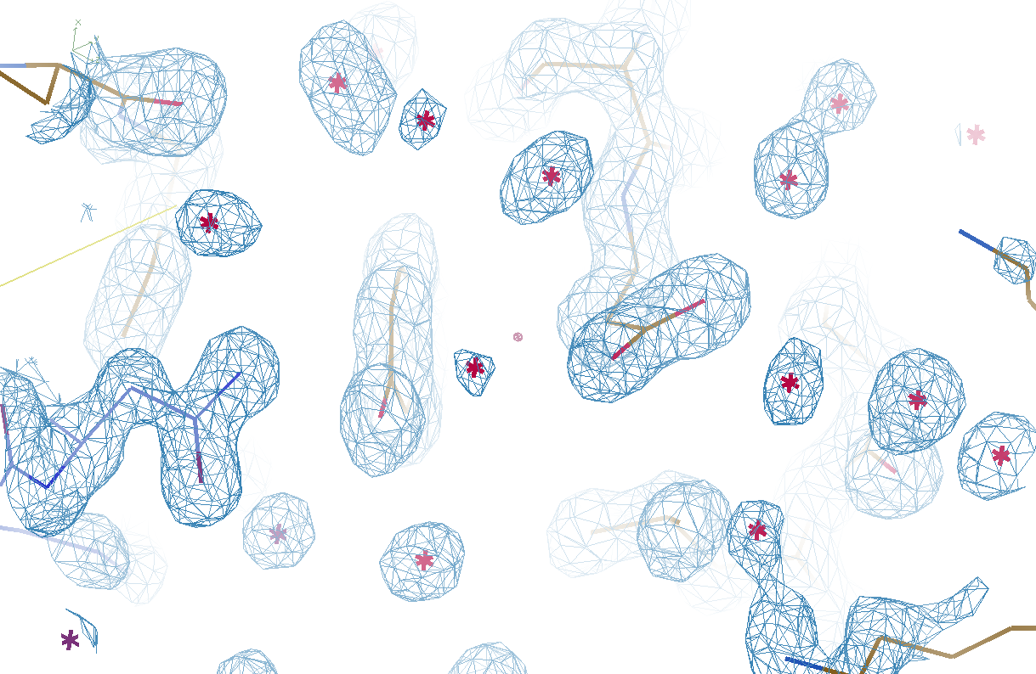
Which waters are real?

Slide 4
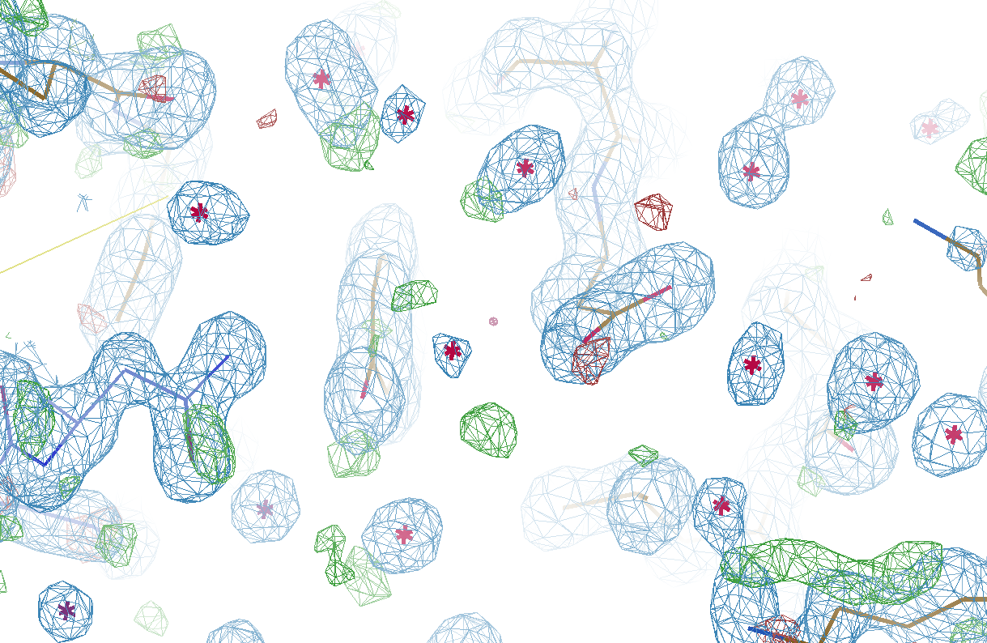
Which waters are real?

Slide 5
Is it real, or just “noise”?
Amplitude errors
Phase errors
Phase bias
Model bias
Evil

Slide 6
map error: simplest possible case
electron density (e⁻/Å³)
fractional coordinate

Slide 7
map error: simplest possible case
electron density (e⁻/Å³)
fractional coordinate

Slide 8
map error: simplest possible case
electron density (e⁻/Å³)
fractional coordinate

Slide 9
map error: simplest possible case
electron density (e⁻/Å³)
fractional coordinate

Slide 10
map error: simplest possible case
electron density (e⁻/Å³)
fractional coordinate

Slide 11
map error: simplest possible case
electron density (e⁻/Å³)
fractional coordinate

Slide 12
map error: simplest possible case
electron density (e⁻/Å³)
fractional coordinate

Slide 13
map error: simplest possible case
electron density (e⁻/Å³)
fractional coordinate

Slide 14
map error: 3-atom case
electron density (e⁻/Å³)
fractional coordinate

Slide 15
map error: 3-atom case
electron density (e⁻/Å³)
fractional coordinate

Slide 16
map error: 3-atom case
electron density (e⁻/Å³)
fractional coordinate

Slide 17
map error: 3-atom case
electron density (e⁻/Å³)
fractional coordinate

Slide 18
map error: 3-atom case
electron density (e⁻/Å³)
fractional coordinate

Slide 19
map error: 3-atom case
electron density (e⁻/Å³)
fractional coordinate

Slide 20
map error: 3-atom case
electron density (e⁻/Å³)
fractional coordinate

Slide 21
map error: 3-atom case
electron density (e⁻/Å³)
fractional coordinate

Slide 22
map error: 3-atom case
electron density (e⁻/Å³)
fractional coordinate

Slide 23
map error: 3-atom case
electron density (e⁻/Å³)
fractional coordinate

Slide 24
map error: 3-atom case
electron density (e⁻/Å³)
fractional coordinate

Slide 25
map error: asymmetric case
electron density (e⁻/Å³)
fractional coordinate

Slide 26
map error: asymmetric case
electron density (e⁻/Å³)
fractional coordinate

Slide 27
map error: asymmetric case
electron density (e⁻/Å³)
fractional coordinate

Slide 28
map error: asymmetric case
electron density (e⁻/Å³)
fractional coordinate

Slide 29
map error: asymmetric case
electron density (e⁻/Å³)
fractional coordinate

Slide 30
map error: asymmetric case
electron density (e⁻/Å³)
fractional coordinate

Slide 31
map error: asymmetric case
electron density (e⁻/Å³)
fractional coordinate

Slide 32
map error: asymmetric case
electron density (e⁻/Å³)
fractional coordinate

Slide 33
map error: asymmetric case
electron density (e⁻/Å³)
fractional coordinate

Slide 34
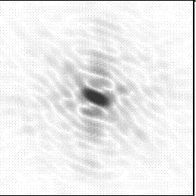
Molecular Replacement
correct structure and intensities
?
http://www.ysbl.york.ac.uk/~cowtan/fourier/coeff.html

Slide 35
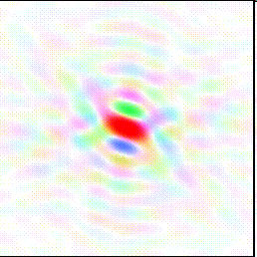
Molecular Replacement
Available model and intensities

Slide 36
Molecular Replacement
correct structure and intensities
?

Slide 37
Molecular Replacement
use something similar as a starting model

Slide 38
Model Building
current model is missing something

Slide 39
Model Building
phases from available model

Slide 40
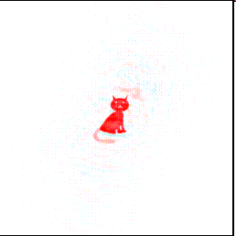
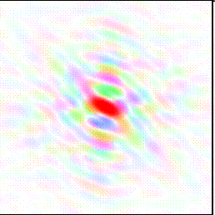
Model Building
missing bits show up, even if not in available model!

Slide 41
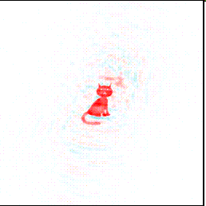
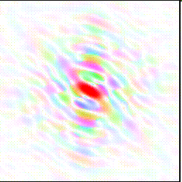
Model Building
missing bits show up better in F_{obs} + (F_{obs} - F_{calc}) map

Slide 42
“water shed” procedure
Occupancy refine waters – to convergence
For each water:
Eliminate water from model
Re-refine to convergence (with occ)
Each water = different CPU (use a cluster)
Control: keep all – same refi protocol
Sort results on R_{work}
Post-elim R better than control?
Yes: New reference – goto 1.
No: done
For speed: worst waters > 5 Å apart

Slide 43
Original
3si4
R_{work} = 0.17023
R_{free} = 0.19309

Slide 44
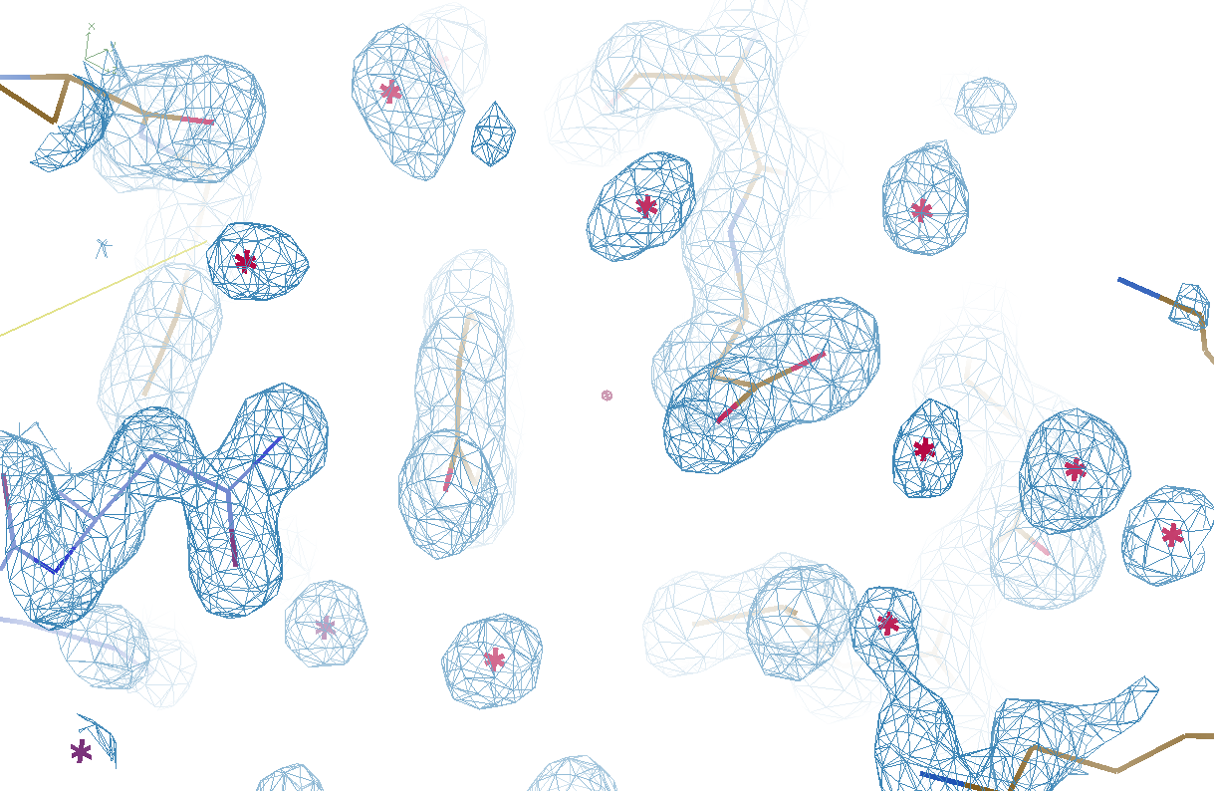
Watershed-ed
3si4
R_{work} = 0.17727
R_{free} = 0.19281

Slide 45
Refined
3si4
R_{work} = 0.17023
R_{free} = 0.19309

Slide 46
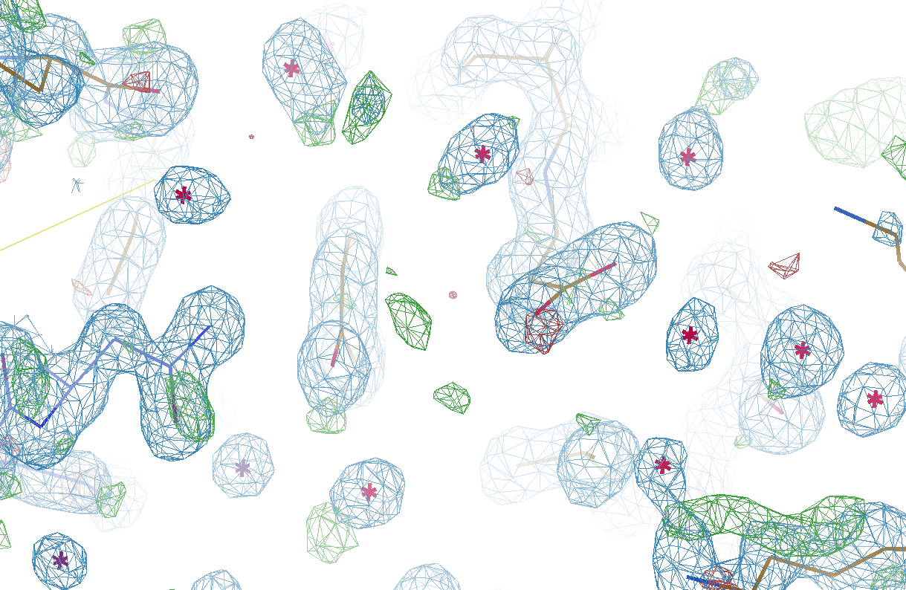
Watershed-ed
3si4
R_{work} = 0.17727
R_{free} = 0.19281

Slide 47
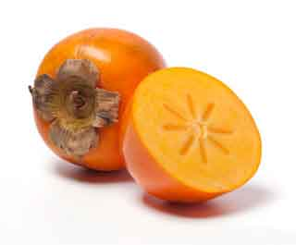
Got waters to shed?
https://github.com/fraser-lab/
holton_scripts/blob/master/watershed/
You will need:
refmac_opts.txt file
Contains all keywords for refmac run
Lots of CPUs! supports SMP, PBS, SGE
Future: why stop at water?
PRSMN
https://bl831.als.lbl.gov/~jamesh/powerpoint/WCPCW_watershed_2019.pptx

