Slide 1
Acknowledgements
Robert Stroud James Fraser
Nick Sauter John Tainer Aina Cohen Ana Gonzalez
UCSF LBNL SLAC
ALS 8.3.1 creator: Tom Alber
UC Multicampus Research Programs and Initiatives (MRPI)
UCSF Program for Breakthrough Biomedical Research (PBBR)
one-time NIH-DOE Inter-agency agreement (IAA)
GM117126 to Sauter (DIALS)
Integrated Diffraction Analysis Technologies (IDAT)
Plexxikon, Inc.
Synchrotron Radiation Structural Biology Resource (SLAC)
The Advanced Light Source is supported by the Director, Office of Science, Office of Basic Energy Sciences, Materials Sciences Division, of the US Department of Energy under contract No. DE-AC02-05CH11231 at Lawrence Berkeley National Laboratory.

Slide 2
How low can you dose?
Stay below World Record
Look up dose rate
http://bl831.als.lbl.gov/damage_rates.pdf
Know your limits
10 MGy/Å reso, 5 = SeMet, 20 kGy?
R-factor Gap
A perfect model would blow up
Resolution: optimum cutoff is 0 Å
http://bl831.als.lbl.gov/~jamesh/
powerpoint/WCPCW_lodose_2017.pptx

Slide 3
What do I do?
You only have a few small crystals…
Should you:
Collect 360° from each?
Collect 10° from each at 36x exposure?
Glue 36 xtals together, then collect 360° ?
Glue together and do 12960° ?
http://bl1231.als.lbl.gov/~jamesh/dose_slice/results.html

Slide 4
Self-calibrated damage limit
Where:
⟨I⟩_{DL} - average damage-limited intensity (photons/hkl) at a given resolution
10⁵ - converting R from μm to m, r_{e} from m to Å, ρ from g/cm³ to kg/m³ and MGy to Gy
r_{e} - classical electron radius (2.818 x 10⁻¹⁵ m/electron)
h - Planck’s constant (6.626 x 10⁻³⁴ J∙s)
c - speed of light (299792458 m/s)
f_{decayed} - fractional progress toward completely faded spots at end of data set
ρ - density of crystal (~1.2 g/cm³)
R - radius of the spherical crystal (μm)
λ - X-ray wavelength (Å)
f_{NH} - the Nave & Hill (2005) dose capture fraction (1 for large crystals)
n_{ASU} - number of proteins in the asymmetric unit
M_{r} - molecular weight of the protein (Daltons or g/mol)
V_{M} - Matthews’s coefficient (~2.4 Å³/Dalton)
H - Howells’s criterion (10 MGy/Å)
θ - Bragg angle
⟨ƒ_{a}²⟩ - number-averaged squared structure factor per protein atom (electron²)
⟨M_{a}⟩ - number-averaged atomic weight of a protein atom (~7.1 Daltons)
B - average (Wilson) temperature factor (Å²)
μ - attenuation coefficient of sphere material (m⁻¹)
μ_{en} - mass energy-absorption coefficient of sphere material (m⁻¹)
No flux
No symmetry
No exposure time
Holton & Frankel (2010) Acta D 66 393-408.

Slide 5
The number of photons scattered
before crystal is dead
is independent
of data collection time
1 um³ = 10⁵ photons (roomT)
1 um³ = 10⁶ photons (synch)
1 um³ = 10⁸ photons (XFEL)
(synch)
Henderson, 1990; Gonzalez & Nave, 1994; Glaeser et al., 2000; Sliz et al., 2003; Leiros et al., 2006; Owen et al., 2006; Garman & McSweeney, 2006; Garman & Nave, 2009; Holton, 2009

Slide 6
Dose slicing
unacceptable
damage
N
photons
crystal’s useful life
N
photons
unacceptable
read noise
N
photons

Slide 7
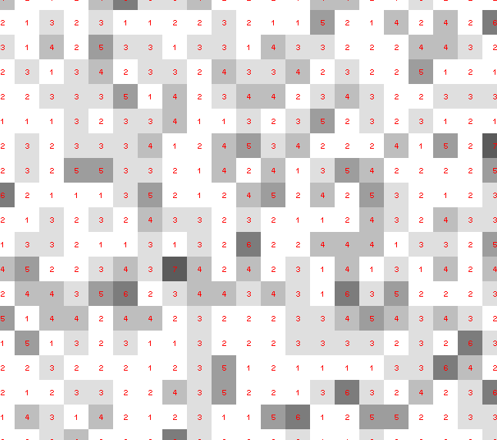
Dose slicing: is that a spot?

Slide 8
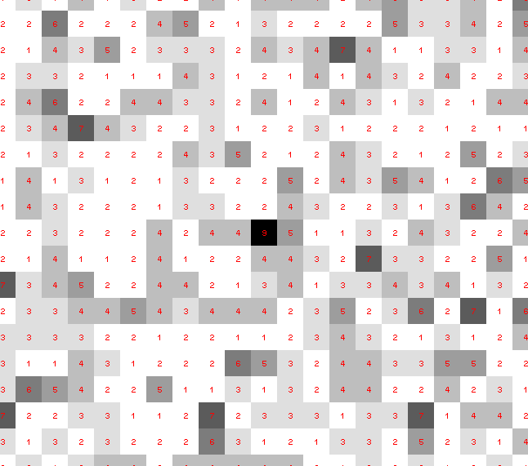
Dose slicing: is that a spot?

Slide 9
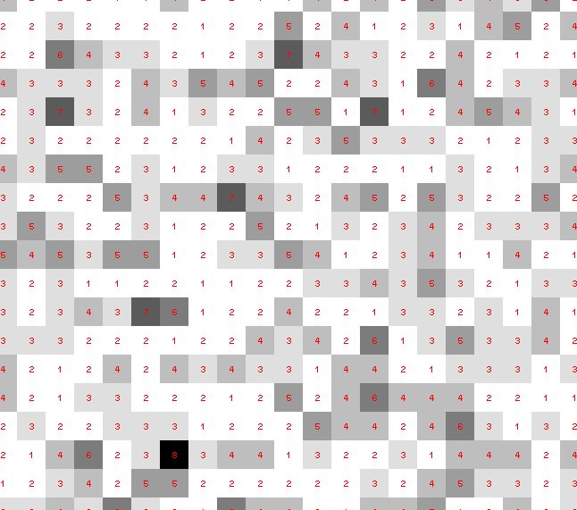
Dose slicing: is that a spot?

Slide 10
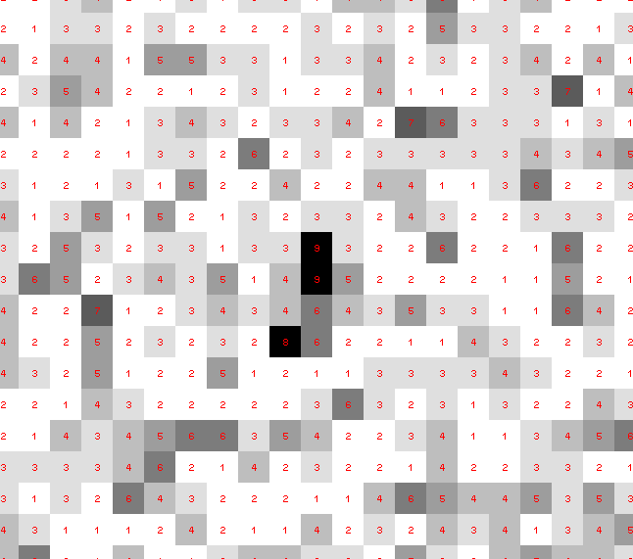
Dose slicing: is that a spot?

Slide 11
Dose slicing: is that a spot?

Slide 12
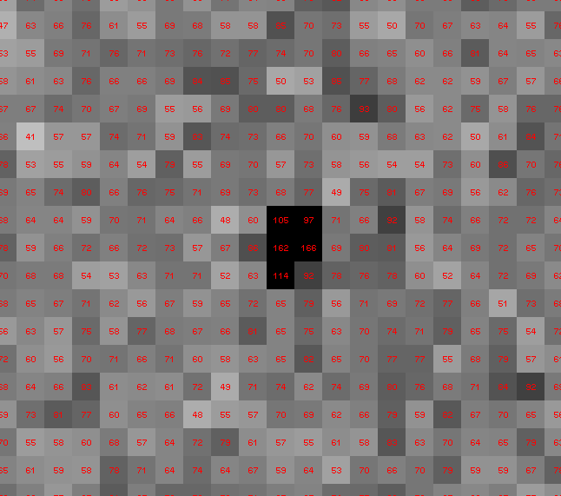
Dose slicing: is that a spot?

Slide 13
“true” resolution limit
CC vs right answer
Resolution (Å)

Slide 14
“true” resolution vs strategy
Dose slice collection scenario
fine | coarse | glue | Glue & fine
3.17700 | 3.14057 | 3.17604 | 3.12086
301,640,334 photons/xtal

Slide 15
processing procedure | resolution limit
 | fine | coarse | glue | glue&fine
XDS/XSCALE | 3.17700 | 3.14057 | 3.17604 | 3.12086
XDS/aimless | 3.16251 | 3.15922 | 3.16675 | 3.12162
XDS/noscale | 3.27289 | 3.15617 | 3.38929 | 3.12162
MOSFLM-defaults | x | x | x | x
MOSFLM-cheat | 3.19755 | 3.18166 | 3.20354 | 3.19755
HKL2000-defaults | x | x | x | x
HKL2000-expert | 3.21803 | 3.12646 | 3.11551 | 3.21803
HKL2000-cheat | 3.16119 | 3.10338 | 3.10338 | 3.16300
DIALS-defaults | x | x | 3.42125 | x
DIALS-expert | 3.10296 | 3.09547 | 3.07653 | 3.08465
d*Trek | ? | ? | 4.34076 | ?
EVAL15 | 3.14352 | 3.10383 | 3.09936 | 3.14105
EVAL15-sadabs | 3.13920 | 3.10797 | 3.10171 | 3.13700

Slide 16
MGy reaction reference
~45 global damage Owen et al. (2006)
10/Å global damage Howells et al. (2009)
5 Se-Met Holton (2007)
4 Hg-S Ramagopal et al. (2004)
4 R-C-COOH Garman et al. (2015)
3 S-S Murray et al. (2002)
1 Br-RNA Olieric et al. (2007)
~1? Cl-C ???
0.5 Mn in PS II Yano et al. (2005)
0.06 putidaredoxin Corbett et al. (2007)
0.02 Fe in myoglobin Denisov et al. (2007)
Radiation Damage World Records
Holton (2009) J. Synchrotron Rad. 16 133-42

Slide 17
what the is a MGy?
http://bl831.als.lbl.gov/
damage_rates.pdf
Holton J. M. (2009) J. Synchrotron Rad. 16 133-42

Slide 18
How long will my crystal last?
synch line type flux beamsize flux density dose max xtal min site
ph/s μm ph/μm2/s rate lifetime lifetime
ALS 4.2.2 MAD 1e12 75x80 1.7e+08 124 kGy/s 4 m 16 s
ALS 5.0.1 mono 2e11 100 2.5e+07 13 kGy/s 39 m 2.6 m
ALS 5.0.2 MAD 1.5e12 100 1.5e+08 76.3 kGy/s 6.6 m 26 s
ALS 5.0.3 mono 3e11 100 3.8e+07 19.4 kGy/s 26 m 1.7 m
ALS 8.2.1 MAD 3.5e11 100 4.5e+07 22.7 kGy/s 22 m 88 s
ALS 8.2.2 MAD 3.5e11 100 4.5e+07 22.7 kGy/s 22 m 88 s
ALS 8.3.1 MAD 9e11 70 2.3e+08 119 kGy/s 4.2 m 17 s
ALS 12.3.1 MAD 2e11 65x90 3.4e+07 17.4 kGy/s 29 m 1.9 m
ALS 12.3.1 ML 4.0e13 65x90 6.8e+09 6.89 MGy/s 4.4 s 0.29 s
SSRL 1-5 MAD 1.7e10 200 4.2e+05 202 Gy/s 41 h 2.8 h
SSRL 7-1 mono 2.6e11 200 6.5e+06 3.09 kGy/s 2.7 h 11 m
SSRL 9-1 mono 3.9e10 200 9.8e+05 463 Gy/s 18 h 72 m
SSRL 9-2 MAD 4.8e11 200 1.2e+07 5.7 kGy/s 88 m 5.8 m
SSRL 11-1 MAD 3.9e11 200 9.8e+06 4.63 kGy/s 1.8 h 7.2 m
SSRL 11-3 mono 2.6e10 200 6.5e+05 302 Gy/s 28 h 1.8 h
SSRL 12-2 MAD 4e12 90x5 8.9e+09 5.01 MGy/s 6 s 0.4 s
SSRL 12-1 MAD 4e12 5x5 1.6e+11 90 MGy/s 0.35 s 22 ms
SSRL 12-1 ML 3e14 5x5 1.1e+13 6.4 GGy/s 5 ms 300 us
APS 24-ID-C MAD 1.3e13 20x60 1.1e+10 5.23 MGy/s 5.7 s 0.38 s
APS "typical" MAD 1.5e12 80 2.3e+08 119 kGy/s 4.2 m 17 s
synch line type flux beamsize flux density dose max xtal min site
ph/s μm ph/μm2/s rate lifetime lifetime

Slide 20
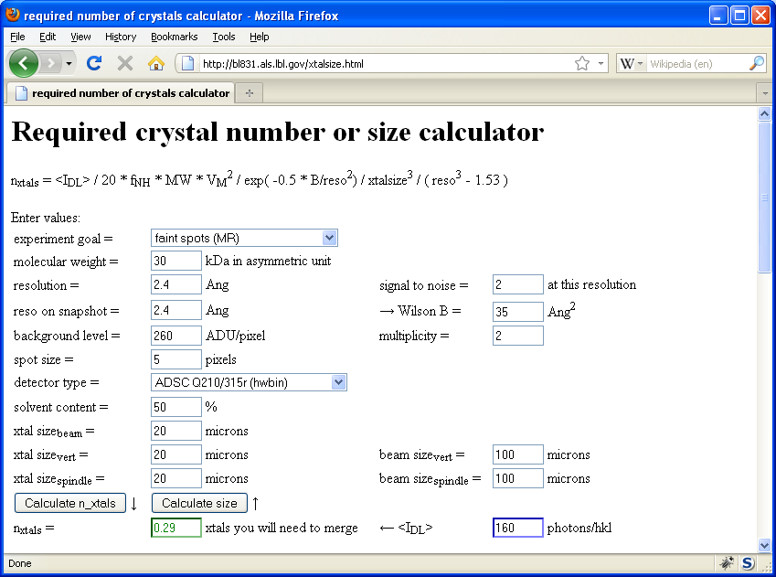
Holton & Frankel (2010) Acta D 66 393-408.

Slide 21
How low can you dose?
Stay below World Record
Look up dose rate
http://bl831.als.lbl.gov/damage_rates.pdf
Know your limits
10 MGy/Å reso, 5 = SeMet, 20 kGy?
R-factor Gap
A perfect model would blow up
Resolution: optimum cutoff is 0 Å
http://bl831.als.lbl.gov/~jamesh/
powerpoint/WCPCW_lodose_2017.pptx

Slide 22
Optimum resolution cutoff is:
Too optimistic: add nothing but noise
Too pessimistic: series-termination error
Happy medium?
Simulate:
Random atoms, compute F²
Add Gaussian noise, RMS = 1
Truncate
Subtract “right” map, RMS difference

Slide 23
Optimal resolution cutoff
Error in map (rms e⁻)
Resolution cutoff (Å)

Slide 24
Optimal resolution cutoff
Correlation Coefficient
Resolution cutoff (Å)

Slide 25
Optimal resolution cutoff
Correlation Coefficient
Resolution cutoff (Å)

Slide 26
Optimal resolution cutoff
Error in map (rms e⁻)
Resolution cutoff (Å)

Slide 27
Wilson Plot
2
log( intensity )
8
2.2 1.6 1.3 1.1 1.0 0.9 0.85 0.8 0.75 0.7
resolution (Å)

Slide 28
Optimum resolution cutoff is:
0.0 Å

Slide 29
“R-factor Gap” for macromolecules
Publication criterion for chemical crystallography:
R1 < 2*R_{sigma}
R1 = F_{o} vs F_{c} for I/σ(I) > 3
R_{sigma} = <σ(I)>/<I>
There are no PDB entries that pass this test!
Holton et al. (2014) "The R-factor gap", FEBS J. 281, 4046-4060.

Slide 30
What if we knew everything?
How would we store it?
30,000 conformers will crash coot
Take an MD simulation of a crystal
Average electron density of cell
Build conventional model
Look at “true” difference
Build noise-limited model
Drop into real data

Slide 31
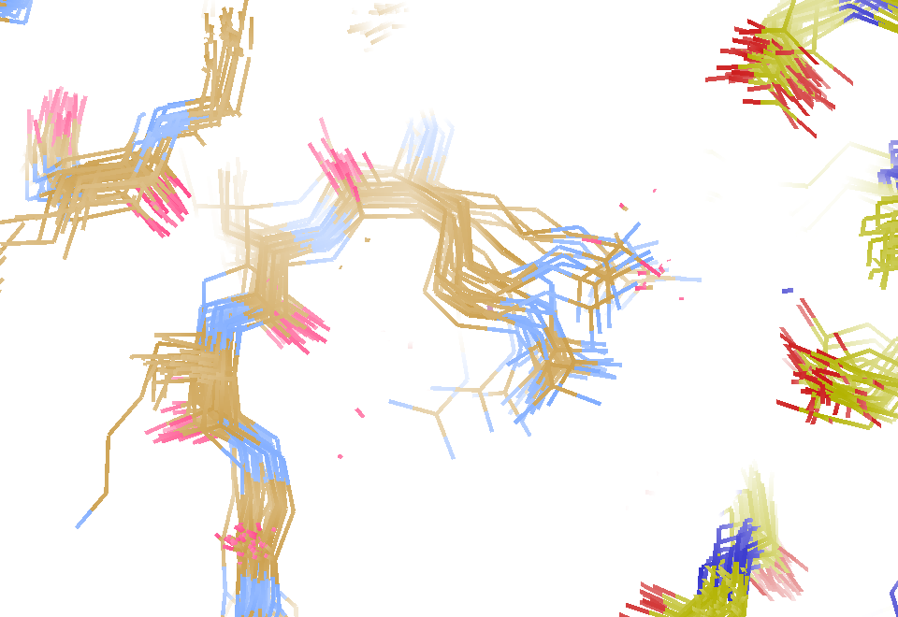
MD simulation: 30 conformers from 24,000
Cerutti et al. (2010).J. Phys. Chem. B 114, 12811-12824.

Slide 32
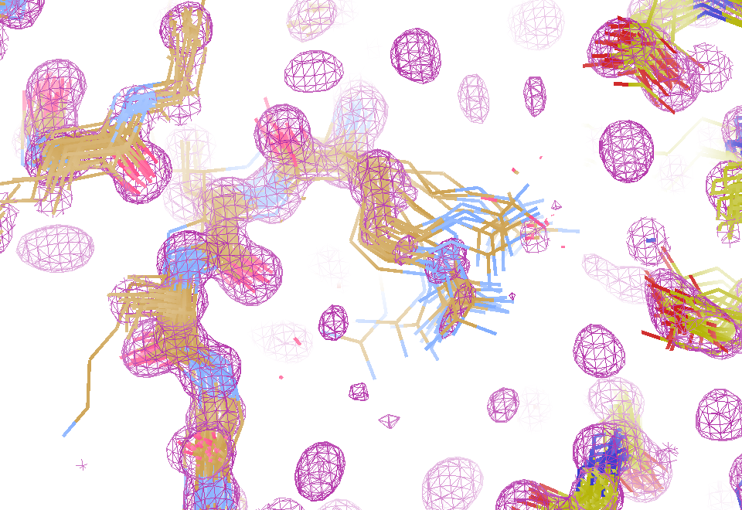
Electron density from 24,000 conformers

Slide 33
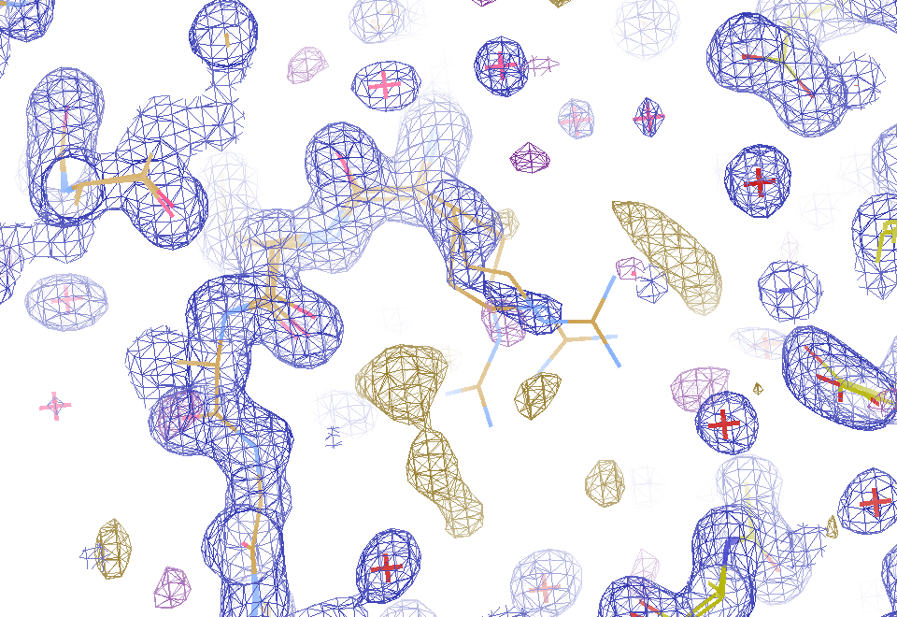
2F_{sim}-F_{calc} and F_{sim}-F_{calc} maps
1.0 Å data
R_{cryst}= 0.137
R_{free} = 0.159
1 “sigma” 2F_{sim}-F_{c}
2.5 “sigma” F_{sim}-F_{c}

Slide 34
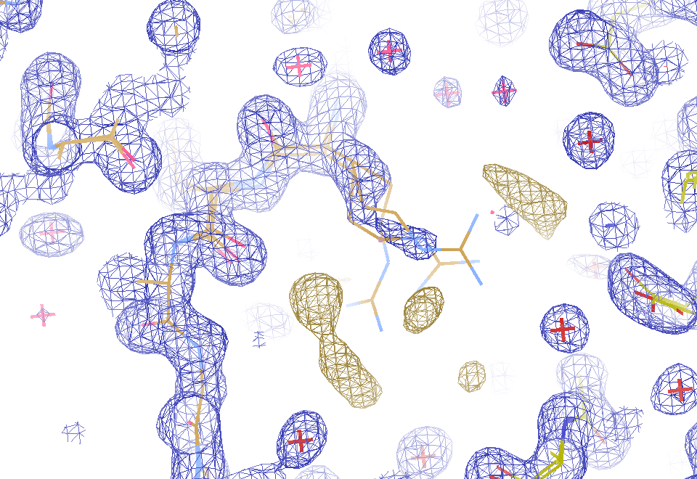
2F_{sim}-F_{calc} and (F_{sim} Φ_{sim}) - (F_{calc} Φ_{calc}) maps
1.0 Å data
R_{cryst}= 0.137
R_{free} = 0.159
1 “sigma” 2F_{sim}-F_{c}
F_{right} – (2F_{sim}-F_{c})

Slide 35
30 conformers from 24,000

Slide 36
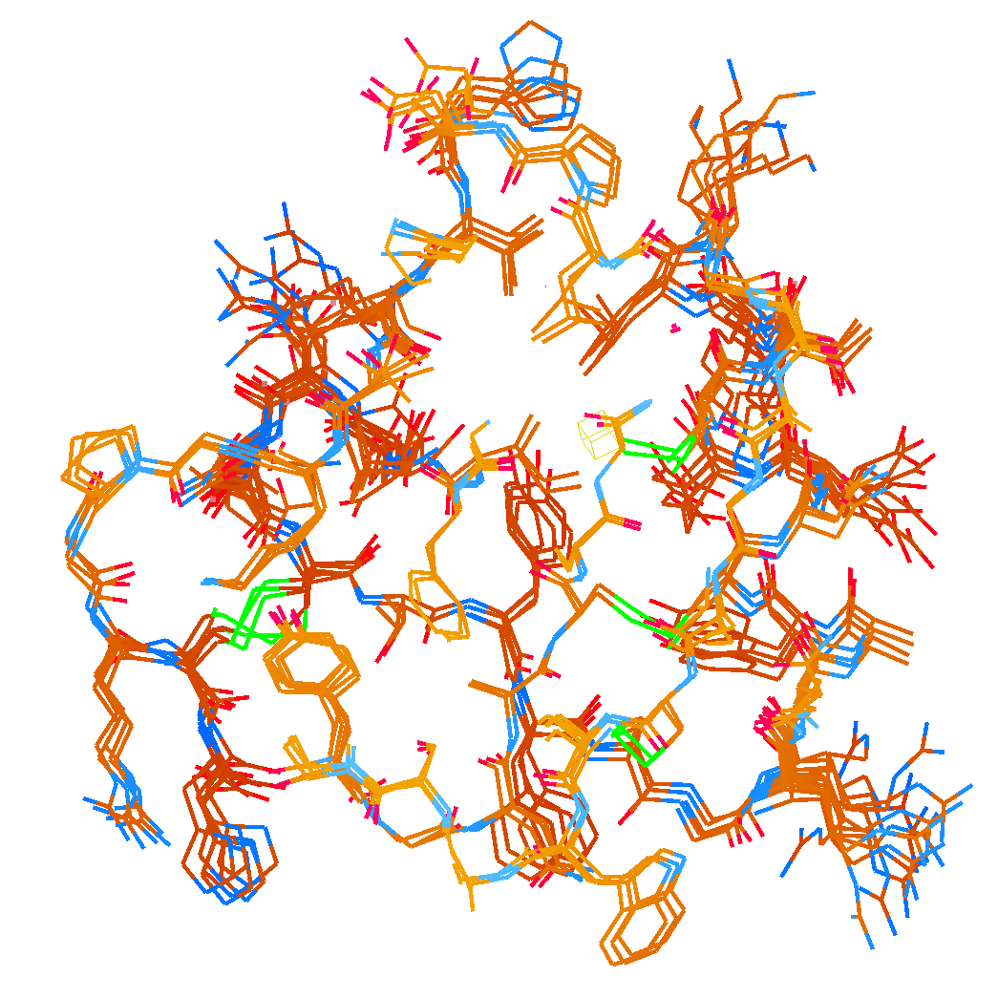
How many conformers are there?
Answer: 2-14
R_{cryst} = 0.0441
R_{free} = 0.0516
vs F_{sim}

Slide 37
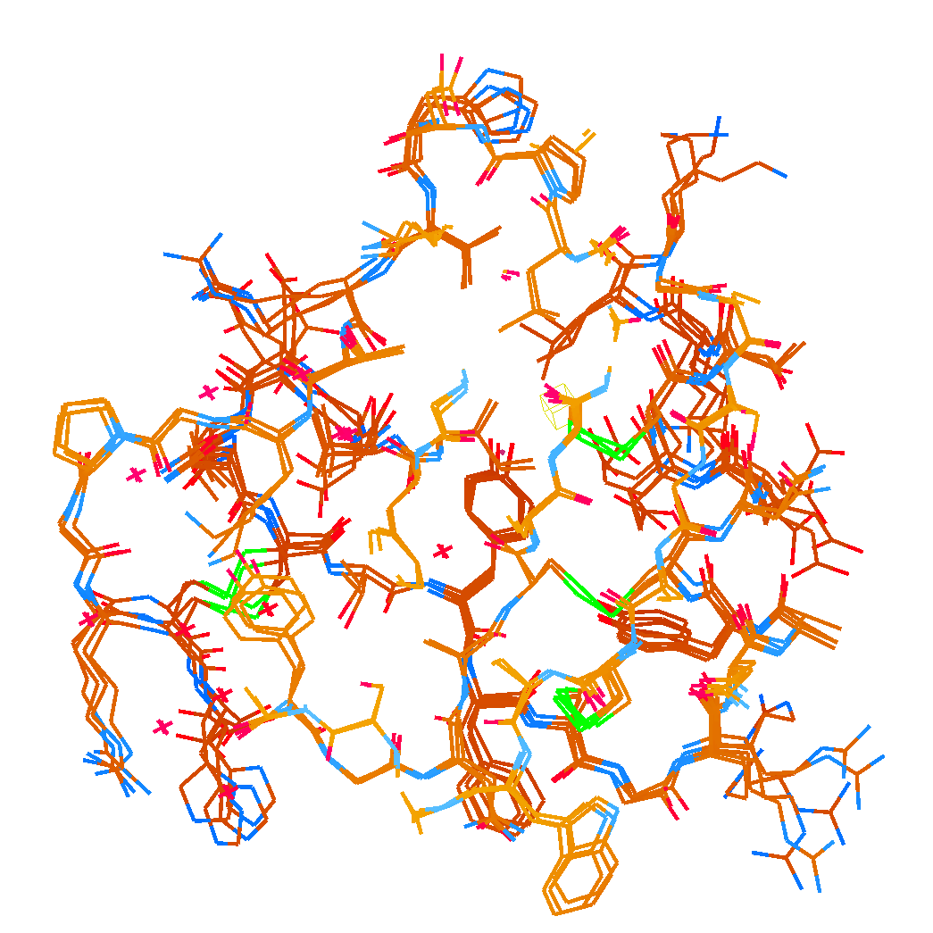
How many conformers are there?
Answer: 1-7
R_{cryst} = 0.1546
R_{free} = 0.1749
vs F_{obs}
1aho:
R_{cryst} = 0.1630
R_{free} = n/d

Slide 38
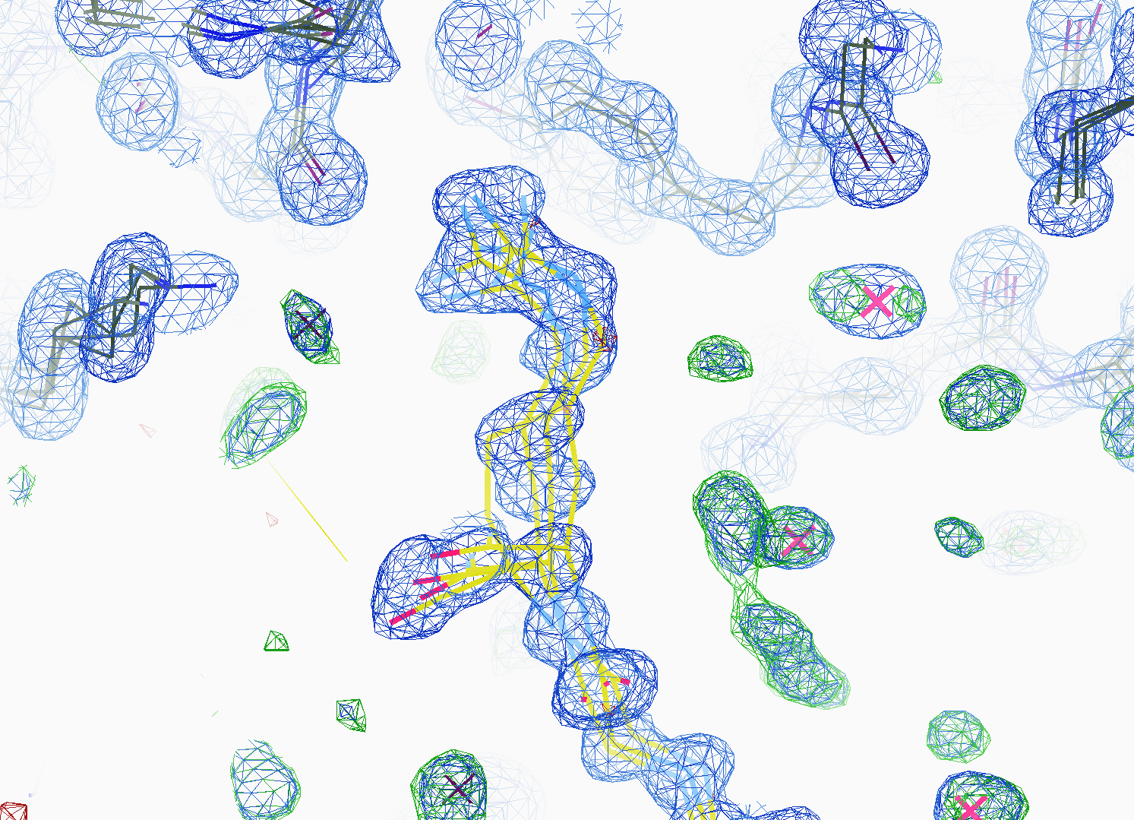
How many conformers are there?
All difference
features
are in
the solvent!
real data

Slide 39
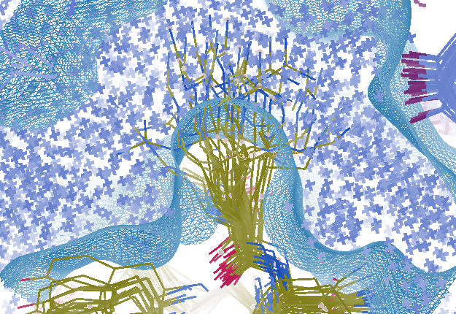
Combined multi-conformer & explicit solvent
R_{work} = 0.0309
R_{free} = 0.0678
vs F_{sim}
Problem: diverges with more cycles

Slide 40
How low can you dose?
Stay below World Record
Look up dose rate
http://bl831.als.lbl.gov/damage_rates.pdf
Know your limits
10 MGy/Å reso, 5 = SeMet, 20 kGy?
R-factor Gap
A perfect model would blow up
Resolution: optimum cutoff is 0 Å
http://bl831.als.lbl.gov/~jamesh/
powerpoint/WCPCW_lodose_2017.pptx

Slide 41
Fractional error
^{mult >} (—)²
~3%
<ΔF/F>

Slide 42
Can you count to 1,000,000 ?
sqrt(1,000,000)
1,000,000
Theoretically:
= 0.1%
R_{meas} ≈ 0.1% ?
ISa = 1000
In reality:
ISa ~ 33
R_{meas =} ≈ 3%
sqrt(1,000)
1,000
= 3%
photon
spot
> 1000 is a waste!

Slide 43
Threshold of a revolution in phasing
Current
technology
Goal
Solve-able proteins (%)
Required signal-to-noise (I/σ)

Slide 44
Threshold of a revolution in phasing
Source of error | realistic simulation | No SHSSS | Perfect detector
Photon counting | + | + | +
Shutter jitter | + | + | -
Beam flicker | + | + | -
Sample absorption | + | + | -
Radiation damage | + | + | -
Imperfect spindle | + | + | -
vignette | + | + | -
Corner correction | + | + | -
SHSSS | + | - | -
R_{meas} (∞-10 Å) | 2.8% | 0.7% | 0.7%
I/σ asymptotic | 26.8 | 74.2 | 81.0
Holton et al (2014) "R-factor gap", FEBS Journal 281, 4046-4060.

Slide 45
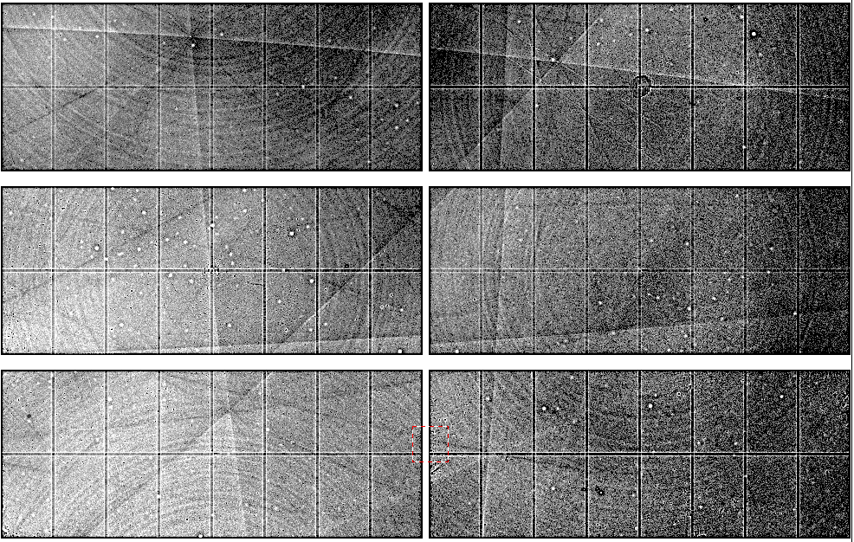
Pilatus: subtract smooth baseline
~3x10⁵ photon/pixel
Bragg
glitch
“tree rings”
Pick-up tool mark
oxygen
inclusions
1% high
average
1% low

Slide 46
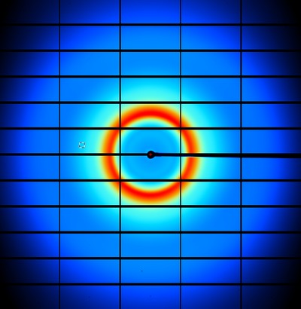
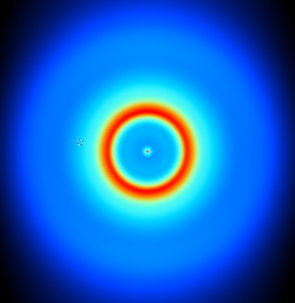
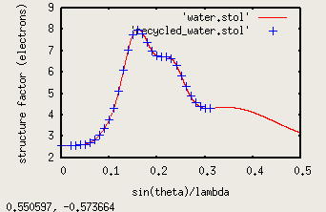
nonBragg extracts background
spot remover
Flux
Exposure
Density
Thickness
Gain, offset

Slide 47
Phasing success vs Figure of Merit
Adjusting:
Solvent content
Resolution
SDfac Sdadd
Cycles of dm
“mode”
“scheme”
NCS radius
NCS cycles
Phase blur
Correlation to final map
FOM from “dm”
http://cxidb.org/id54-SfjMJjaBny/id-54.html http://cxidb.org/id55-BWuBDSUrBy/id-55.html
Hunter et al. (2016)."Selenium anomalous phasing XFEL", Nature Comm. 7, 13388.

Slide 48
R_{iso} vs dose
R_{iso} ≈ 0.7 %/MGy
R_{iso} (%)
change in dose (MGy)
data taken from Banumathi, et al. (2004) Acta Cryst. D 60, 1085-1093.

