Slide 1
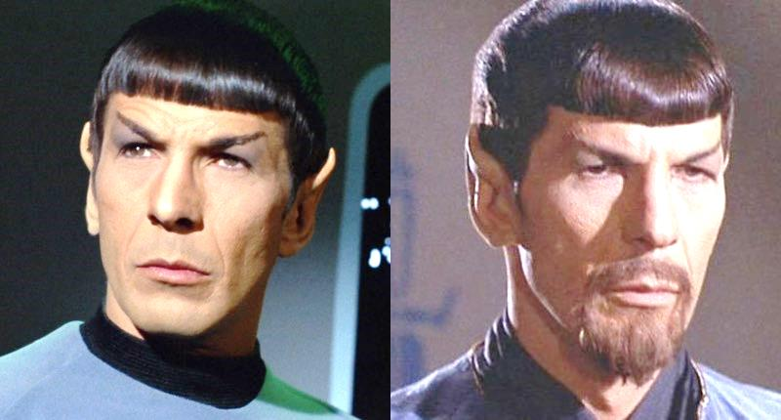
Twinning?!?
Evil
and pseudo symmetry

Slide 2
Definitions:
Twinning:
  Two (or more) crystals of the same species joined together with different orientations
Twin law:
  Symmetry operator that rotates one crystal lattice onto the other (common: k,h,-l)
Twin fraction ( α ):
  Mixing ratio: Iobs_{hkl} = α I_{hkl} + (1-α) I_{kh-l}
Thanks to: Andrea Thorn

Slide 3
Types of twinning
Merohedral
  Twin law is symmetry operator for lattice,
  but not the true point group
Pseudo-merohedral
  Twin law not symmetry operator for lattice
Non-merohedral
  Lattices don’t perfectly overlap
4. Epitaxial
  Crystals randomly stuck together
Thanks to: Andrea Thorn

Slide 4
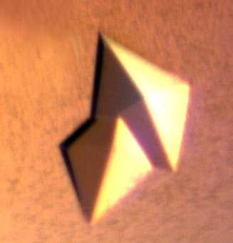
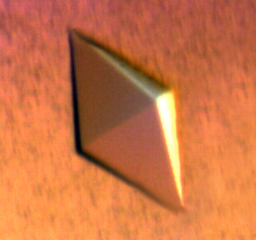

Can you tell by looking?
Macroscopic twin
Microscopic twin
Disecting apart might give a single crystal!
Crystal looks fine, but is twinned.
Images property of Andrea Thorn
and Claudia Egerer-Sieber

Slide 5
Merohedral twinning
Twin law:
Symmetry operator of the crystal system, but not the crystal‘s point group
Crystal lattice
Reciprocal lattice
symmetry looks higher
Intensity distribution is different
Thanks to: Andrea Thorn

Slide 6
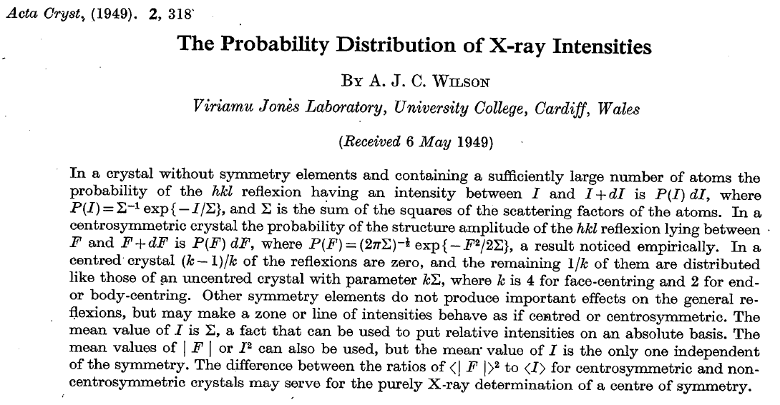
Twinning: how can you tell?

Slide 7
Make a histogram of your data
Counts/bin
Spot intensity

Slide 8
Make a histogram of your data
Counts/bin
Spot intensity

Slide 9
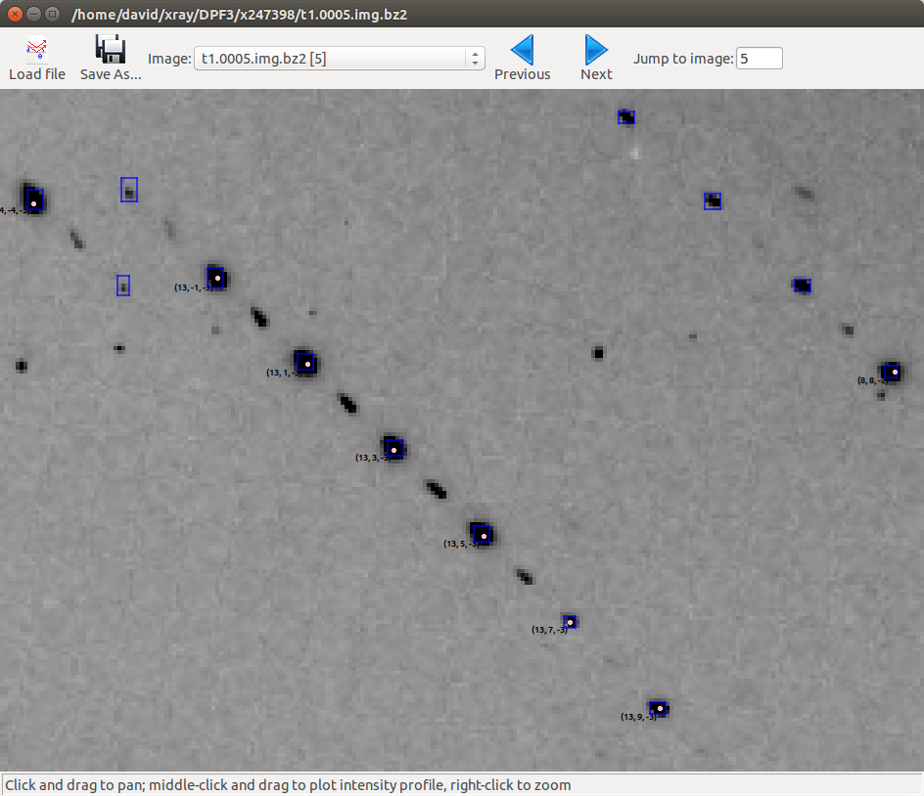
Pseudotranslation → alternating spots
https://dials.github.io/documentation/tutorials/centring_vs_pseudocentring.html

Slide 10
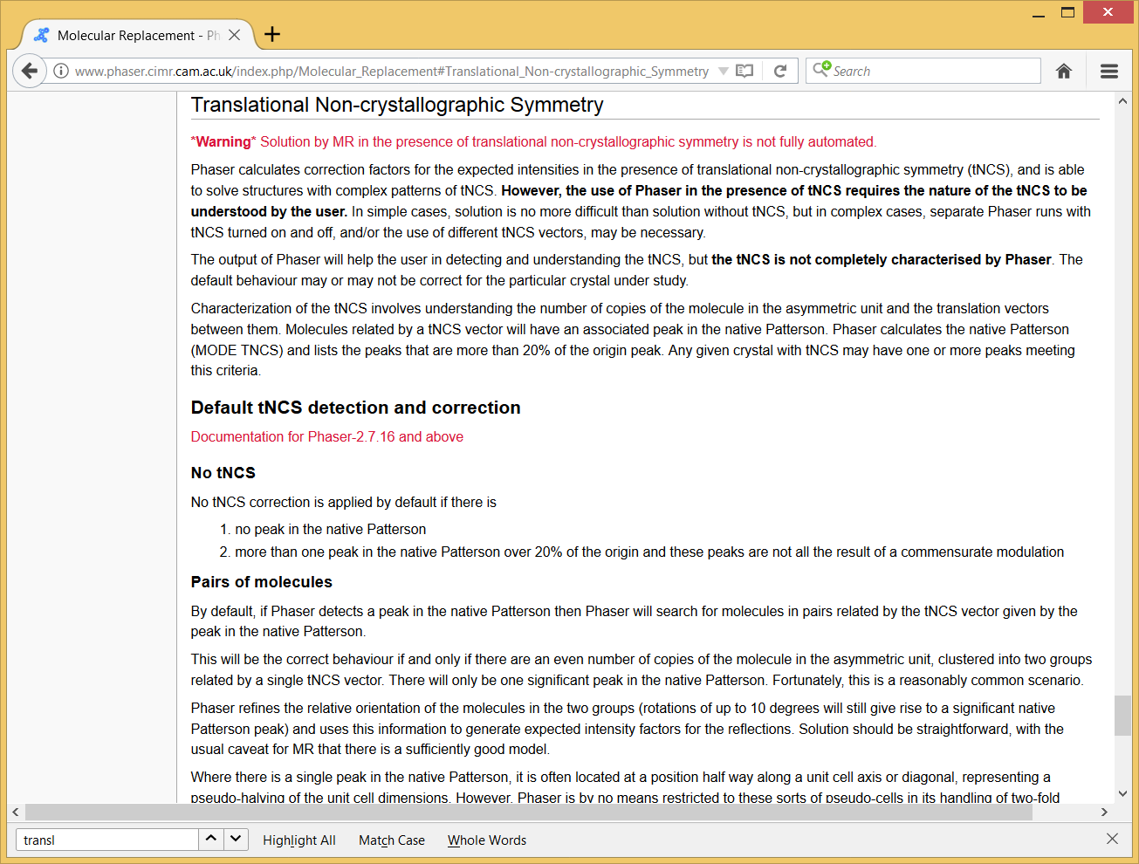
Aside:
Pseudo-translation NCS kills Phaser

Slide 11
The “H test” for twinning
Two intensities I₁and I₂ are related by twin law:
(For acentric reflections:)
Cumulative propability distribution
Drawback: Perfect twins are not detectable
Thanks to: Andrea Thorn

Slide 12
Cumulative distribution of H
1.0
0.8
N (H)
0.5
α=0.4
α=0.3
α=0.2
α=0.1
α= 0
0.4
0.2
0 0.1 0.2 0.3 0.4 0.5
H
Thanks to: Andrea Thorn

Slide 13
Yeates-Padilla “L-Test“
The reflections with the intensities I_{A} and I_{B} are close to each other in reciprocal space:
If α=0.5:
Thanks to: Andrea Thorn

Slide 14
Yeates-Padilla “L-Test“
This test shows the expected cumulative distributions for perfect twins and untwinned data. Partial twins will be between the curves.
1.0
0.8
0.6
N (|L|)
acentric reflections, perfect twin
acentric reflections, untwinned
Centric, untwinned
0.4
0.2
Available using using POINTLESS
CTRUNCATE or DETWIN in CCP4
0
0 0.2 0.4 0.6 0.8 1.0
|L|

Slide 15
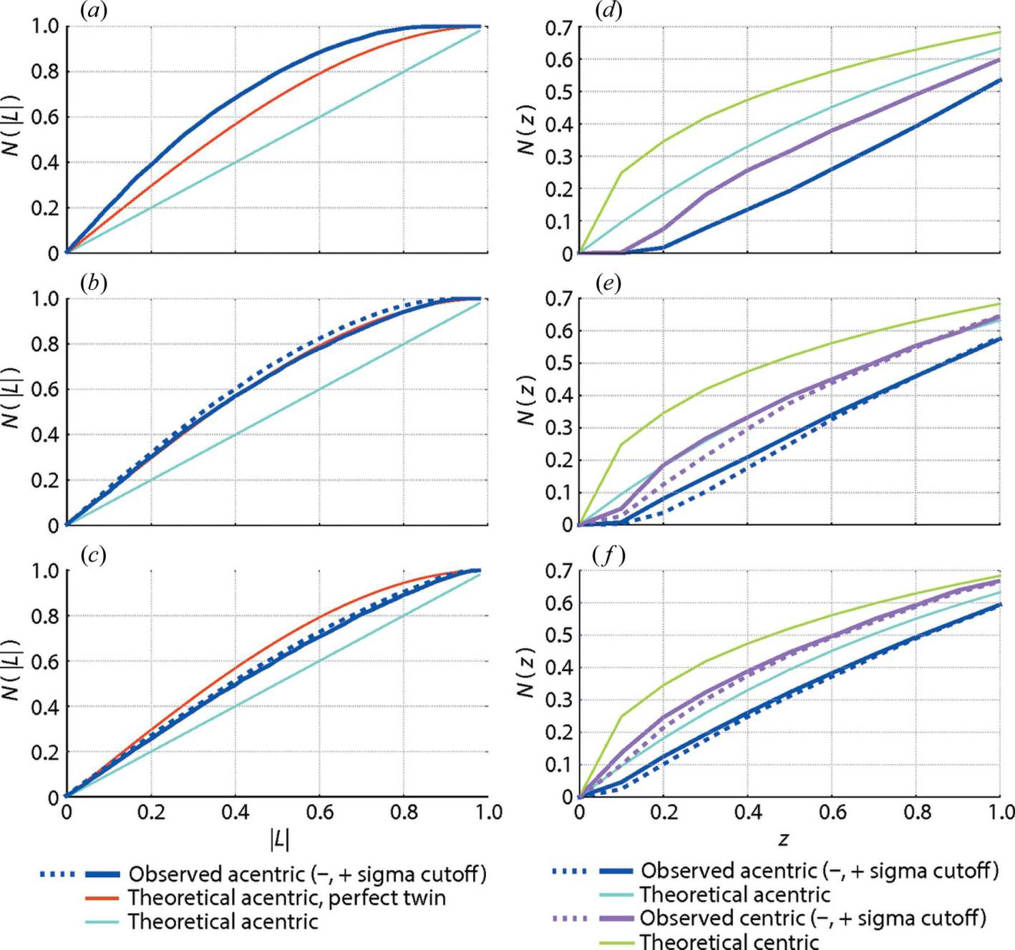
Apparent “twinning” of XFEL data
Sauter (2015). JSR 22, 239.
Beam center from autoindexing

Slide 16
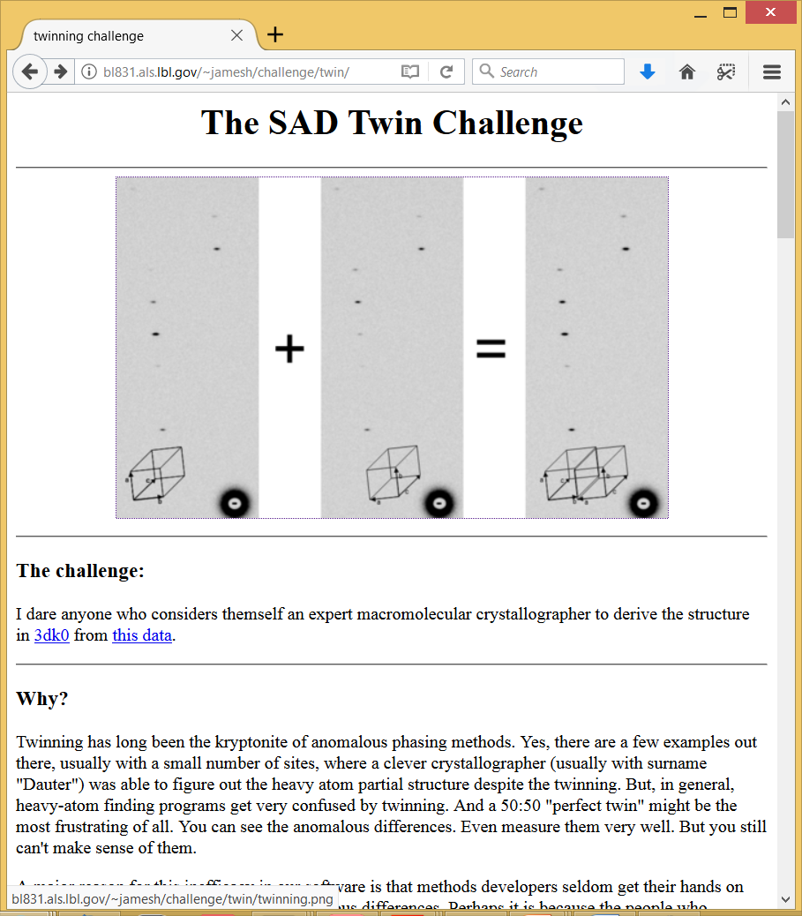

Slide 17
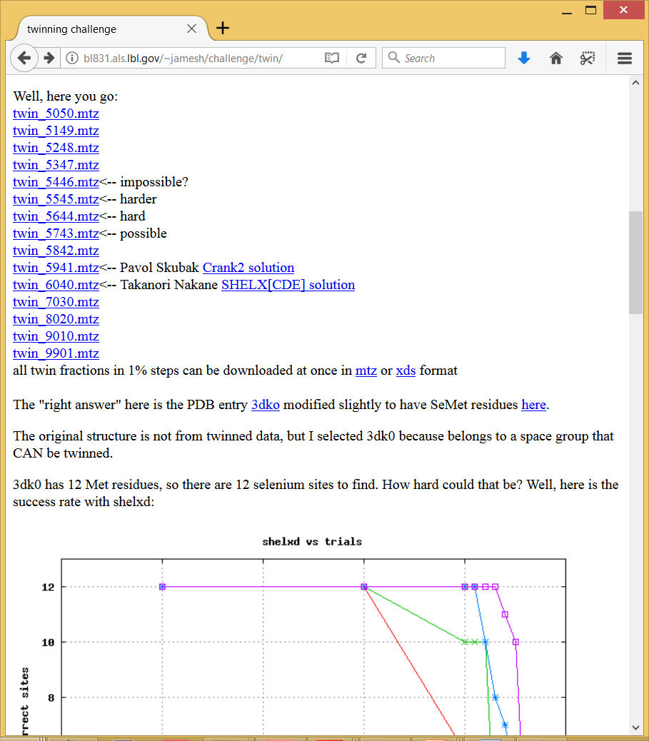

Slide 18
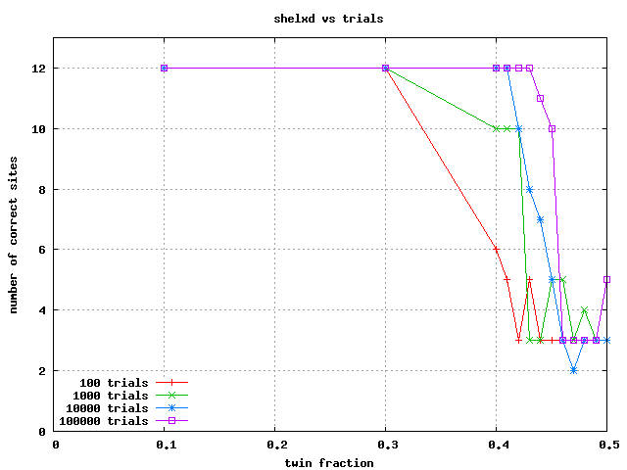

Slide 19
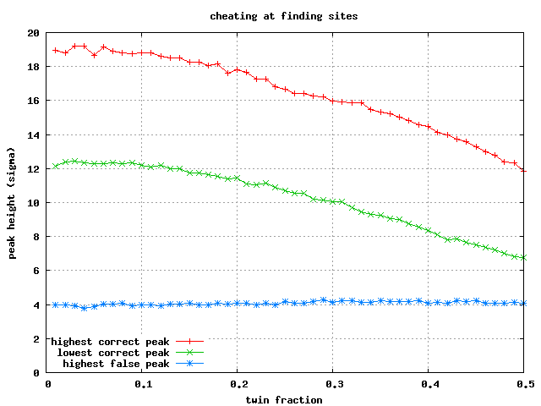

Slide 20
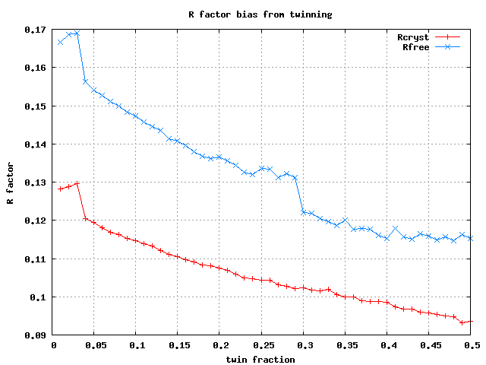

Slide 21
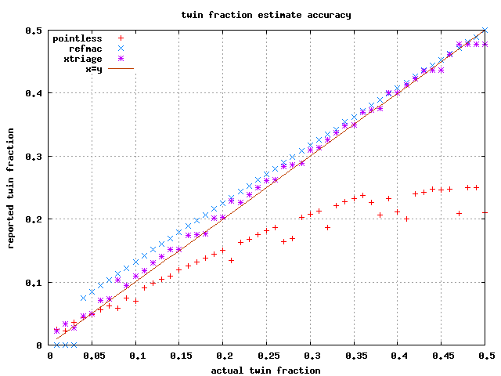

Slide 22
Twinning: how can you tell?
Intensity distribution is abnormal
  H test, L test
R_{merge} for higher symmetry
  < 50% → might be twin
  < 10% → could be 50:50 twin
one of the “usual suspects”
  P622, P6, P321, P312, P422, P43
  http://www.ccp4.ac.uk/html/twinning.html
4. can’t solve it

Slide 23
Find the twin law?
refine in REFMAC
  Automatically checks all possible twin laws!
copy twin law into other programs:
phenix.refine, etc.
Pick R_{free} flags in highest symmetry
i.e. P622 if true SG is P3
Do not “twin refine” if not twinned
control: swap non-twin operator

Slide 24
Reticular merohedry
Most common case:
Obverse/reverse twinning in R3x
Crystal lattice
Reciprocal lattice
R3 looks like P3₁ R32 looks like P3₁21
1/3 reflections missing, but not conventional
systematic absences
Thanks to: Andrea Thorn

Slide 25
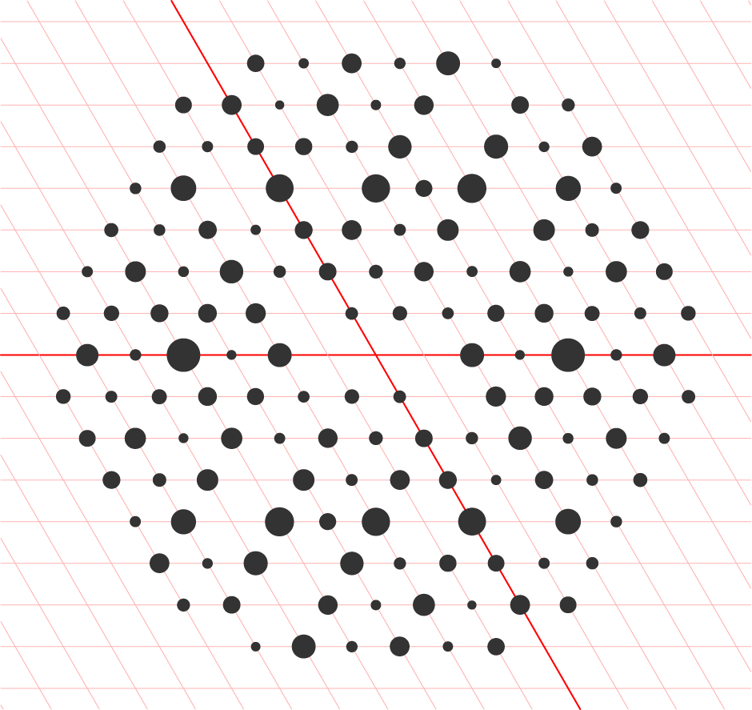
Pseudo-merohedral twinning
Twin law belongs to higher crystal system than true SG
Crystal lattice
Reciprocal lattice
Can happen if true unit cell can be transformed into higher-symmetry crystal system.
Thanks to: Andrea Thorn

Slide 26
Other pseudo-merohedral twin examples
True SG | Pseudo SG | Geometric notes | Twin operator | Example structures
P2₁ | P222₁ | Β=90° | h,-k,-l | Cocaine hydrolytic Fab (Larsen 2002) α-amino-acid ester hydrolase (Barends 2003) PLP-dependent catalytic Fab (Golinelli-Pimpaneau, 2005)
P2₁ | C222₁ | a = c | l,-k,h | Deoxyhaemoglobin (Ito 1995) 50S ribosome subunit (Ban 1999) GdP capsid-stabilizing protein phage λ (Yang et al. 2000) Ortithine 5’ monoPO4 decarboxylase (Wittmann 2007) Aclacinomycin oxidoreductase (Sultana 2007) Dihaem c-type cytochrome DHC2 (Heitmann 2008)
P2₁ | C222₁ | c*cos(β) = -a/2 | -h,-k,h+l h,-k,-h-l | Peroxiredoxin 5 (Declercq 2001) Poly Ig-binding frag (Hamburger 2004) ϒδ T-cell ligand T10 (Rudolph 2004)
C2 | F222 | C*cos(β) = -a/2 | -h,-k,h+l | Acetyl-CoA synthase (Lehtio 2005) THATCH domain HIP1R(Brett 2006)

Slide 27
Twinning: what do I do?
Integrate with low-symmetry SG
  Yes, all possible ones
try to solve it
  Yes, in all possible SGs
  MR: good chance if copies = 1
  MAD: maybe
  S-SAD: no way
  MIR: if you’re lucky
Thanks to: Andrea Thorn

Slide 28
Choanoflagelate Ras – 5WDR
Estimated twin fraction alpha from cumulative N(|L|) plot :
0.129 (+/-0.013)
< |L| >: 0.432 (0.5 untwinned, 0.375 perfect twin) Estimated twin fraction alpha from < |L| > :
0.122
< L^2 >: 0.258 (0.333 untwinned, 0.2 perfect twin) Estimated twin fraction alpha from < L^2 > :
0.113
analysis by Christine Gee

Slide 29
Zanuda run
Step 2. Refinements in subgroups. There are 5 subgroups to test.
| >> 1 | P 1 | 0.0000 | -- | 0.3126 | 0.3207 |
| 1 | P 1 | 0.1152 | 0.2852 | 0.2991 | 0.3314 |
| 2 | P 1 21 1 | 0.1152 | 0.2871 | 0.2960 | 0.3265 |
| 3 | C 1 2 1 | 1.4200 | 0.3925 | 0.3702 | 0.4100 |
| 4 | C 1 2 1 | 1.3816 | 0.3896 | 0.3688 | 0.4202 |
| 5 | C 2 2 21 | 1.4337 | 0.4045 | 0.3727 | 0.4141 |
| << 2 | P 1 21 1 | 0.1152 | 0.2871 | 0.2960 | 0.3265 |
Step 3. Refinement of the best model.
Candidate symmetry elements are added one by one.
| >> 2 | P 1 21 1 | 0.1152 | 0.2871 | 0.2960 | 0.3265 |
| 1 | P 1 | 0.1240 | 0.2849 | 0.2990 | 0.3324 |
| 2 | P 1 21 1 | 0.1341 | -- | 0.2939 | 0.3290 |
| 5 | C 2 2 21 | 1.3778 | -- | 0.3694 | 0.4248 |
| << 2 | P 1 21 1 | 0.1341 | -- | 0.2939 | 0.3290 |
R-factor in the original subgroup is NOT the best.
The original spacegroup assignment seems to be incorrect.
Final twin fraction: 0.47 operator: l, −k, h
analysis by Christine Gee

Slide 30
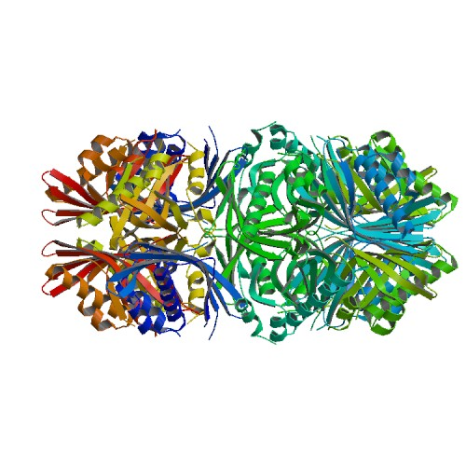
Twinning Or Static Disorder?
5Ig5
CamKii
analysis by Christine Gee

Slide 31
Data scaled & solved as P3₁21
Cell: 113.97 113.97 241.64 90 90 120
Reso Compl I/Sig R-meas CC1/2 CCano
8.82 98.6 28.52 3.9% 99.8* 19*
6.29 99.4 19.04 5.8% 99.7* 5
5.15 99.6 13.16 9.1% 99.2* 6
4.46 99.4 14.80 8.1% 99.3* 7
4.00 99.6 10.67 11.8% 99.0* 4
3.65 99.8 6.38 23.1% 95.1* 4
3.38 99.7 3.63 42.1% 87.7* 5
3.16 99.7 1.90 83.8% 63.2* 2
2.98 89.3 1.06 144.0% 34.5* 1
total 97.9 8.26 14.4% 99.4* 4
analysis by Christine Gee

Slide 32
P3₁21
P3₁
< |L| >: 0.473
< L^2 >: 0.303
Estimated twin fraction
from cumulative N(|L|) plot:
0.040 (+/-0.005)
from < |L| > 0.035
from < L^2 > 0.032
The L-test suggests that the data are not twinned
< |L| >: 0.494
< L^2 >: 0.325
Estimated twin fraction
from cumulative N(|L|) plot:
0.007 (+/-0.001)
from < |L| > 0.007
from < L^2 > 0.007
The L-test suggests that the data are not twinned
analysis by Christine Gee

Slide 33
P3₁
phenix.xtriage
The largest off-origin peak in the Patterson function is 3.15% of the height of the origin peak. No significant pseudotranslation is detected.
The results of the L-test indicate that the intensity statistics behave as expected.
No twinning is suspected.
The symmetry of the lattice and intensity however suggests that the input space group is too low.
Analysis of twin law h,-h-k,-l
Estimation of twin fraction:
via mean |H|:
0.433
via cum. dist. of H:
0.439
Britton analyses
Estimated twin fraction:
0.419
analysis by Christine Gee

Slide 34
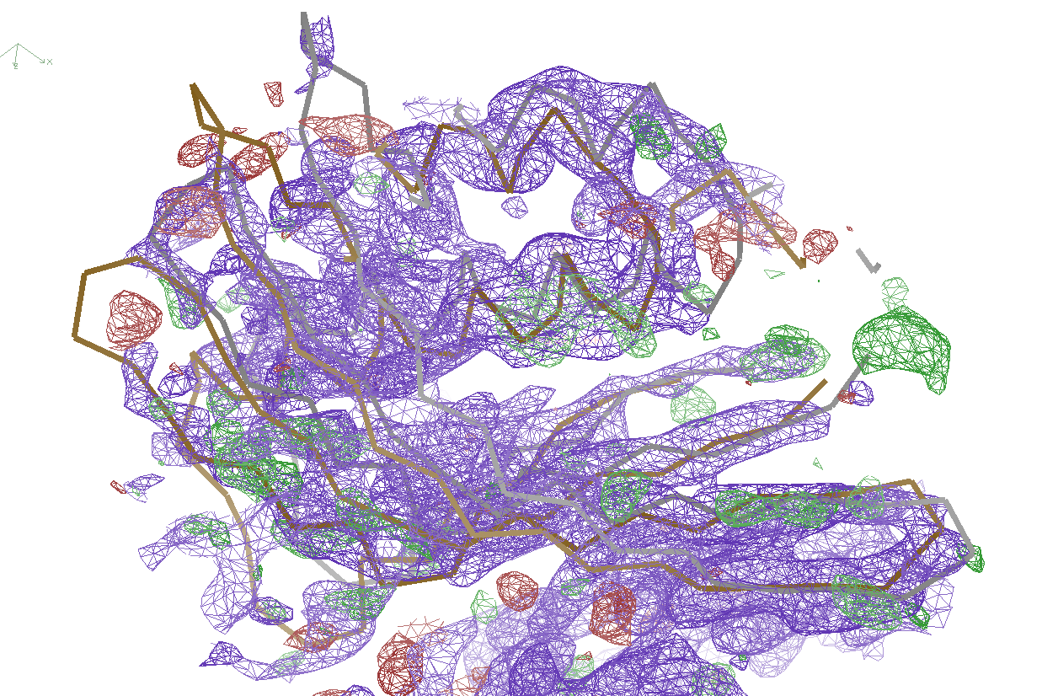
P3₁21 and static disorder
analysis by Christine Gee

Slide 35
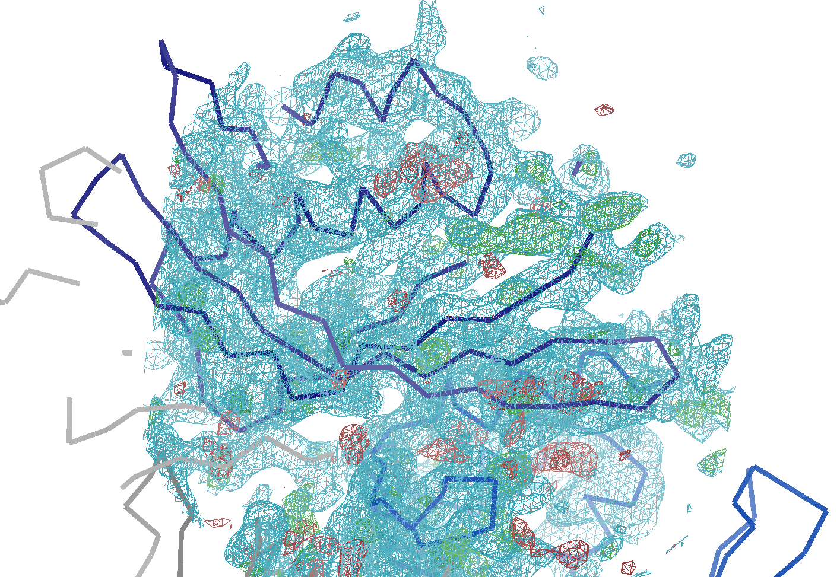
P3₁ and twinned
analysis by Christine Gee

Slide 36
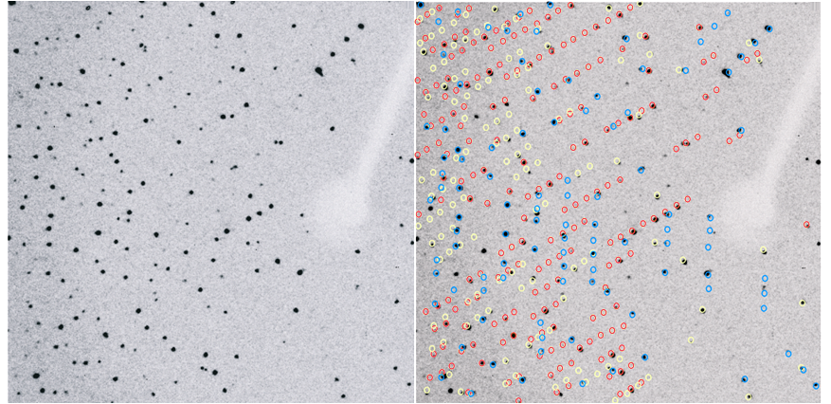
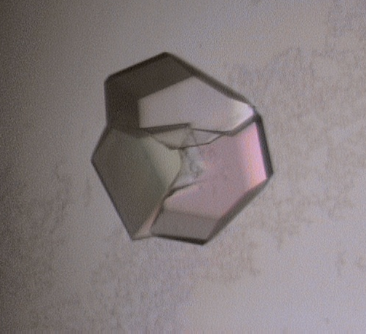
Non-merohedral twinning
Diffraction image
Images courtesy of
Madhumati Sevvana

Slide 37
Non-merohedral twinning
For indexing, leave out partial overlaps at first.
Find a cell that fits a reasonable fraction of spots.
Use the not-yet-indexed reflections to find an alternative orientation of the same cell; repeat as necessary. (FECKLESS will search for any new cell.)
Something like this can be done with
  XDS (use omitted reflections)
  MOSFLM & FECKLESS (multi keyword in auto-indexing)
  CELL_NOW (proprietary)
  DIALS
Thanks to: Andrea Thorn

Slide 38
Twinning Summary
“Twins cannot be detected without prior suspicion.“
-Andrea Thorn
Many tests, but all can be fooled
Try all possible space groups: Zanuda
Pick R_{free} flags using highest possible symmetry
Solve a twinned structure → job prospects good

Slide 39
Further reading
Bernhard Rupp, Biomolecular Crystallography: Principles, Practice, and Application to Structural Biology, 2004
Yeates Server: http://nihserver.mbi.ucla.edu/Twinning
Simon Parsons, Introduction to twinning, Acta Cryst. (2003). D59, 1995-2003
Zbigniew Dauter, Twinned crystals and anomalous phasing, Acta Cryst. (2003). D59, 2004-2016
Thanks to: Andrea Thorn

Slide 40
Pseudotranslation → alternating spots

Slide 41
Trick Question:
What is the space group?
a = 63 b = 63 c = 63
α = 90 β = 90 γ = 90

Slide 42
There are 16 different “beam centers”
Origin
Beam Y
Beam X

Slide 43
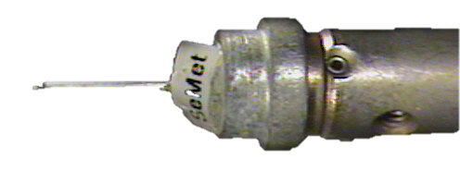
There are 16 different “beam centers”
Origin
Beam Y
Beam X

Slide 44
There are 16 different “beam centers”
Origin
Beam X
Beam Y

Slide 45
There are 16 different “beam centers”
Beam Y
Beam X
Origin

Slide 46
There are 16 different “beam centers”
Origin
Beam Y
Beam X

Slide 47
There are 16 different “beam centers”
Origin
Beam X
Beam Y

Slide 48
There are 16 different “beam centers”
Beam Y
Beam X
Origin

Slide 49
There are 16 different “beam centers”
Origin
Beam Y
Beam X

Slide 50


There are 16 different “beam centers”
Cameraman
View
Origin
Beam
View
Beam Y
Beam X

Slide 51
There are 16 different “beam centers”
Origin?
Origin?
Origin?
Origin?
Origin?
Origin?
Origin?
Origin?

Slide 52
There are 16 different “beam centers”
Xbeam, Ybeam
Ybeam, Xwidth – Xbeam
Xwidth-Xbeam, Ywidth-Ybeam
Ybeam, Xbeam
Xbeam, Ywidth-Ybeam
Xbeam, Ybeam-Ywidth
Xbeam, -Ybeam
Xwidth-Xbeam, Ybeam
Xwidth-Xbeam, Ywidth-Ybeam
Xwidth-Xbeam, Ybeam-Ywidth
Xwidth-Xbeam, -Ybeam
Xbeam, Ybeam
Xbeam, Ywidth-Ybeam
Xbeam, Ybeam-Ywidth
Xbeam, -Ybeam
Xwidth, Ywidth
= size of detector
Can be in pixels
or mm
Can also be:
17. “wrong”

