Slide 1
Acknowledgements
Robert Stroud James Fraser John Spence
Chris Nielsen Clemens Schulze-Briese Aina Cohen Ana Gonzalez
UCSF LBNL SLAC
ALS 8.3.1: TomAlberTron
UC Multicampus Research Programs and Initiatives (MRPI)
NIH NIGMS R01 GM124149
NIH NIGMS P30 GM124169
Integrated Diffraction Analysis Technologies (IDAT)
Plexxikon, Inc.
Synchrotron Radiation Structural Biology Resource (SLAC)
The Advanced Light Source is supported by the Director, Office of Science, Office of Basic Energy Sciences, Materials Sciences Division, of the US Department of Energy under contract No. DE-AC02-05CH11231 at Lawrence Berkeley National Laboratory.

Slide 2
PowerPoint File available:
http://bl831.als.lbl.gov/
~jamesh/powerpoint/
Uruguay_datacoll_2017.pptx

Slide 3
The “success rate” of data collection
100 s/dataset
200 days/year
~150 beamlines
~26,000,000 datasets/year
~10,000 PDBs in 2016

Slide 4
signal vs noise
“If you don’t have
good data,
then you have
no data at all.”
-Sung-Hou Kim

Slide 5
signal vs noise
easy
hard
impossible

Slide 6
signal vs noise
easy
hard
impossible
threshold of “solvability”

Slide 7
signal vs noise
“If you don’t have
good data,
then you must
learn statistics.”
-James Holton

Slide 8
Adding noise

Slide 9
Adding noise
1² + 1² = 1.4²

Slide 10
Adding noise
1² + 1² = 1.4²
3² + 1² = 3.2²
σ_{total}² = σ₁² + σ₂²

Slide 11
Adding noise
1² + 1² = 1.4²
3² + 1² = 3.2²
σ_{total}² = σ₁² + σ₂²

Slide 12
Adding noise
1² + 1² = 1.4²
3² + 1² = 3.2²
σ_{total}² = σ₁² + σ₂²

Slide 13
Adding noise
1² + 1² = 1.4²
3² + 1² = 3.2²
10² + 1² = 10.05²

Slide 14
MR simulation
corrupted model
Correlation coefficient to correct density
Rmsd from perfect search model (Å)

Slide 15
The
“threshold of solvability” is sharp!
How can we predict success/failure?
Know Thy Experiment

Slide 16
Where do photons go?
Protein
1A x-rays
Transmitted (98%)
beamstop

Slide 17
Elastic scattering

Slide 18
Elastic scattering

Slide 19

Where do photons go?
Protein
1A x-rays
elastic scattering (6%)
Transmitted (98%)
beamstop

Slide 20
Elastic scattering

Slide 21
Inelastic scattering

Slide 22
Where do photons go?
Protein
1A x-rays
elastic scattering (6%)
Transmitted (98%)
beamstop

Slide 23
Where do photons go?
Protein
1A x-rays
elastic scattering (6%)
Transmitted (98%)
beamstop
inelastic scattering (7%)

Slide 24
Where do photons go?
Protein
1A x-rays
elastic scattering (6%)
Transmitted (98%)
beamstop
inelastic scattering (7%)
Re-emitted (99%)
Absorbed (~0%)

Slide 25
Photoelectric absorption

Slide 26
Photoelectric absorption
e⁻
+

Slide 27
Fluorescence
+

Slide 28
Fluorescence
e⁻
+

Slide 29
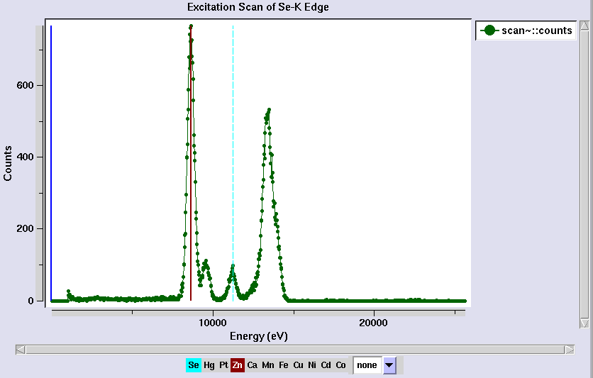
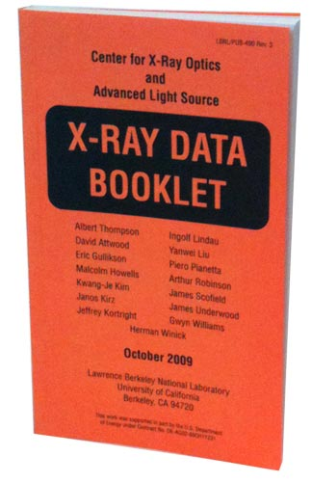
Metal identification

Slide 30
Auger emission
+

Slide 31
Auger emission
e⁻
++

Slide 32
Sample atoms

Slide 33
Sample atoms

Slide 34
Primary ionization
e⁻
+

Slide 35
Secondary ionizations
e⁻
e⁻
+
e⁻
e⁻
+
+
+
+
+
e⁻
e⁻

Slide 36
Ionization track
e⁻
e⁻
e⁻
e⁻
+
e⁻
+
+
+
e⁻
e⁻
+
+
+
+
+
e⁻
+
e⁻
e⁻

Slide 37
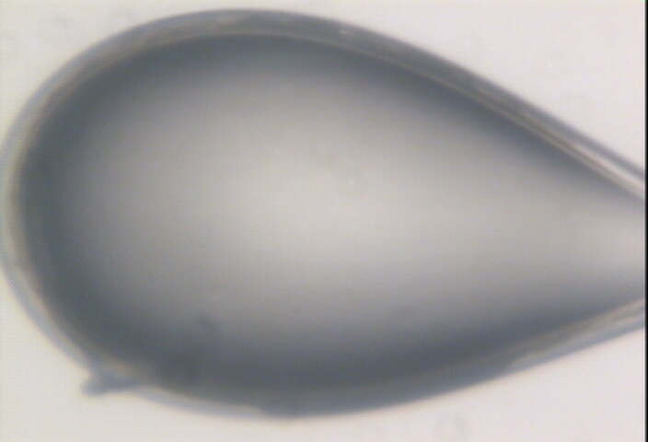

Slide 38
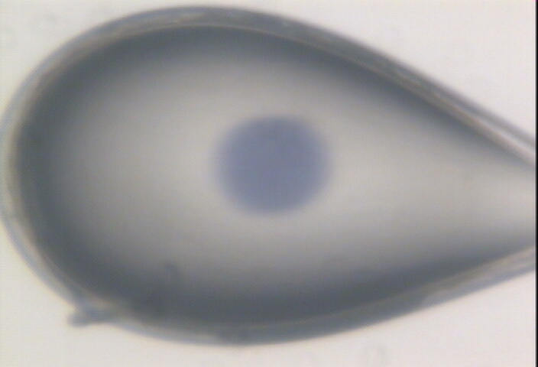

Slide 39
Where do photons go?
Protein
1A x-rays
elastic scattering (6%)
Transmitted (98%)
beamstop
inelastic scattering (7%)
Re-emitted (99%)
Absorbed (~0%)

Slide 40
Where do photons go?
Protein
1A x-rays
elastic scattering (6%)
Transmitted (98%)
beamstop
inelastic scattering (7%)
Photoelectric (87%)
Re-emitted (99%)
Absorbed (~0%)

Slide 41
Where do photons go?
Protein
1A x-rays
elastic scattering (6%)
Transmitted (98%)
beamstop
inelastic scattering (7%)
Photoelectric (87%)
Re-emitted (99%)
Absorbed (~0%)
Re-emitted (~0%)
Absorbed (99%)

Slide 42
Where do photons go?
Protein
1A x-rays
elastic scattering (6%)
Transmitted (98%)
beamstop
inelastic scattering (7%)
Photoelectric (87%)
Re-emitted (99%)
Absorbed (~0%)
Re-emitted (~0%)
Absorbed (99%)
useful/absorbed energy: 7.3%

Slide 43
What do we want?
Resolution
Mosaicity
Nice, round spots
No overlaps
No twinning
Lots of crystals
…

Slide 44
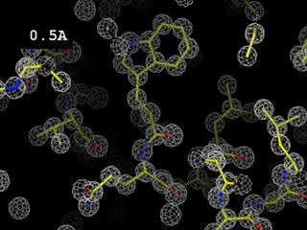

Slide 45
What do we want?
Resolution
Mosaicity
Nice, round spots
No overlaps
No twinning
Lots of crystals
…
2. Phases

Slide 46
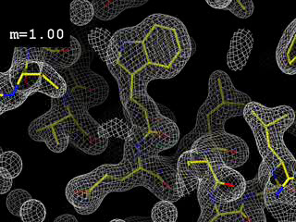
Phases
http://bl831.als.lbl.gov/~jamesh/movies/dephase.mpeg

Slide 47
And the dominant source of error is…
Resolution
  Disorder (including Radiation Damage)
  Background
Phases
  Non-isomorphism (including Radiation Damage)
  Vibration (beam, xtal, spindle, etc.)
  Detector calibration

Slide 48
What is “disorder”?

Slide 49
What is “disorder”?

Slide 50
What is “disorder”?

Slide 51

What is “disorder”?
order
order
B-factor
disorder

Slide 52
“B” factors
ATOM 122 N LEU A 13 -3.244 25.808 19.998 1.00 16.96 N
ATOM 123 CA LEU A 13 -2.877 25.448 21.355 1.00 15.29 C
ATOM 124 C LEU A 13 -2.792 23.966 21.561 1.00 17.54 C
ATOM 125 O LEU A 13 -1.814 23.493 22.143 1.00 16.35 O
ATOM 126 CB LEU A 13 -3.907 26.164 22.268 1.00 18.72 C
ATOM 127 CG LEU A 13 -3.577 25.982 23.738 1.00 21.19 C
ATOM 128 CD1 LEU A 13 -2.283 26.820 24.019 1.00 19.43 C
ATOM 129 CD2 LEU A 13 -4.702 26.474 24.639 1.00 24.65 C
ATOM 130 N SER A 14 -3.677 23.149 20.979 1.00 15.96 N
ATOM 131 CA SER A 14 -3.646 21.711 21.061 1.00 18.26 C
ATOM 132 C SER A 14 -2.373 21.203 20.360 1.00 18.71 C
ATOM 133 O SER A 14 -1.747 20.315 20.930 1.00 17.47 O
ATOM 134 CB SER A 14 -4.875 21.077 20.419 1.00 17.62 C
ATOM 135 OG ASER A 14 -4.825 19.665 20.388 0.50 20.89 O
ATOM 136 OG BSER A 14 -6.027 21.408 21.164 0.50 18.67 O
ATOM 137 N LYS A 15 -2.045 21.772 19.215 1.00 18.03 N
ATOM 138 CA LYS A 15 -0.799 21.361 18.555 1.00 18.12 C
ATOM 139 C LYS A 15 0.446 21.707 19.351 1.00 18.81 C
ATOM 140 O LYS A 15 1.400 20.948 19.411 1.00 17.77 O
ATOM 141 CB LYS A 15 -0.700 22.034 17.177 1.00 14.49 C
ATOM 142 CG LYS A 15 -1.727 21.368 16.256 1.00 16.12 C
ATOM 143 CD LYS A 15 -1.663 22.147 14.936 1.00 19.40 C
ATOM 144 CE ALYS A 15 -2.725 21.614 13.986 0.50 17.42 C
ATOM 145 CE BLYS A 15 -1.750 21.211 13.750 0.50 17.01 C
ATOM 146 NZ ALYS A 15 -2.346 21.674 12.559 0.50 18.61 N
ATOM 147 NZ BLYS A 15 -3.052 20.513 13.741 0.50 18.76 N

Slide 53
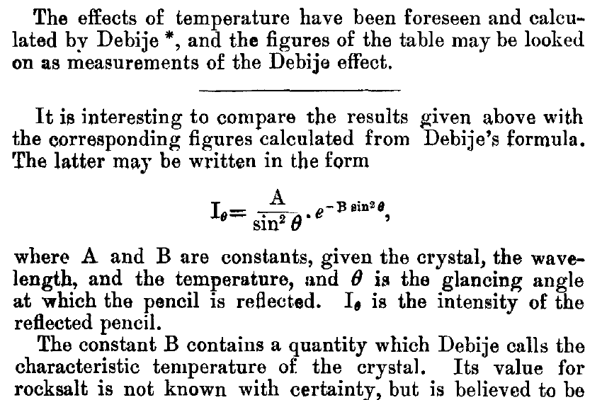
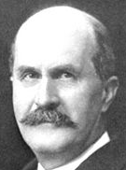
The B factor
Bragg, W. H. (1914)."XCVII. The intensity of reflexion of X rays by crystals", Philosophical Magazine Series 6 27, 881-899. Published May 1 1914

Slide 54
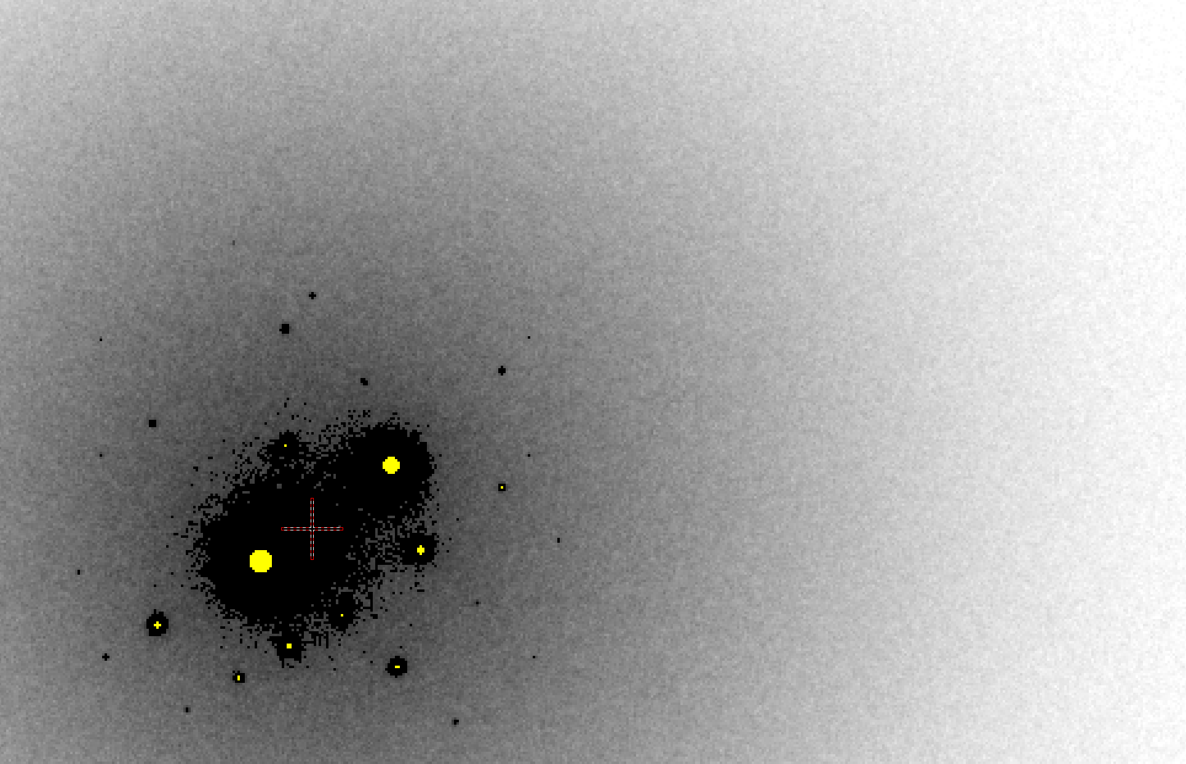
B factor from image analysis
B = 500

Slide 55
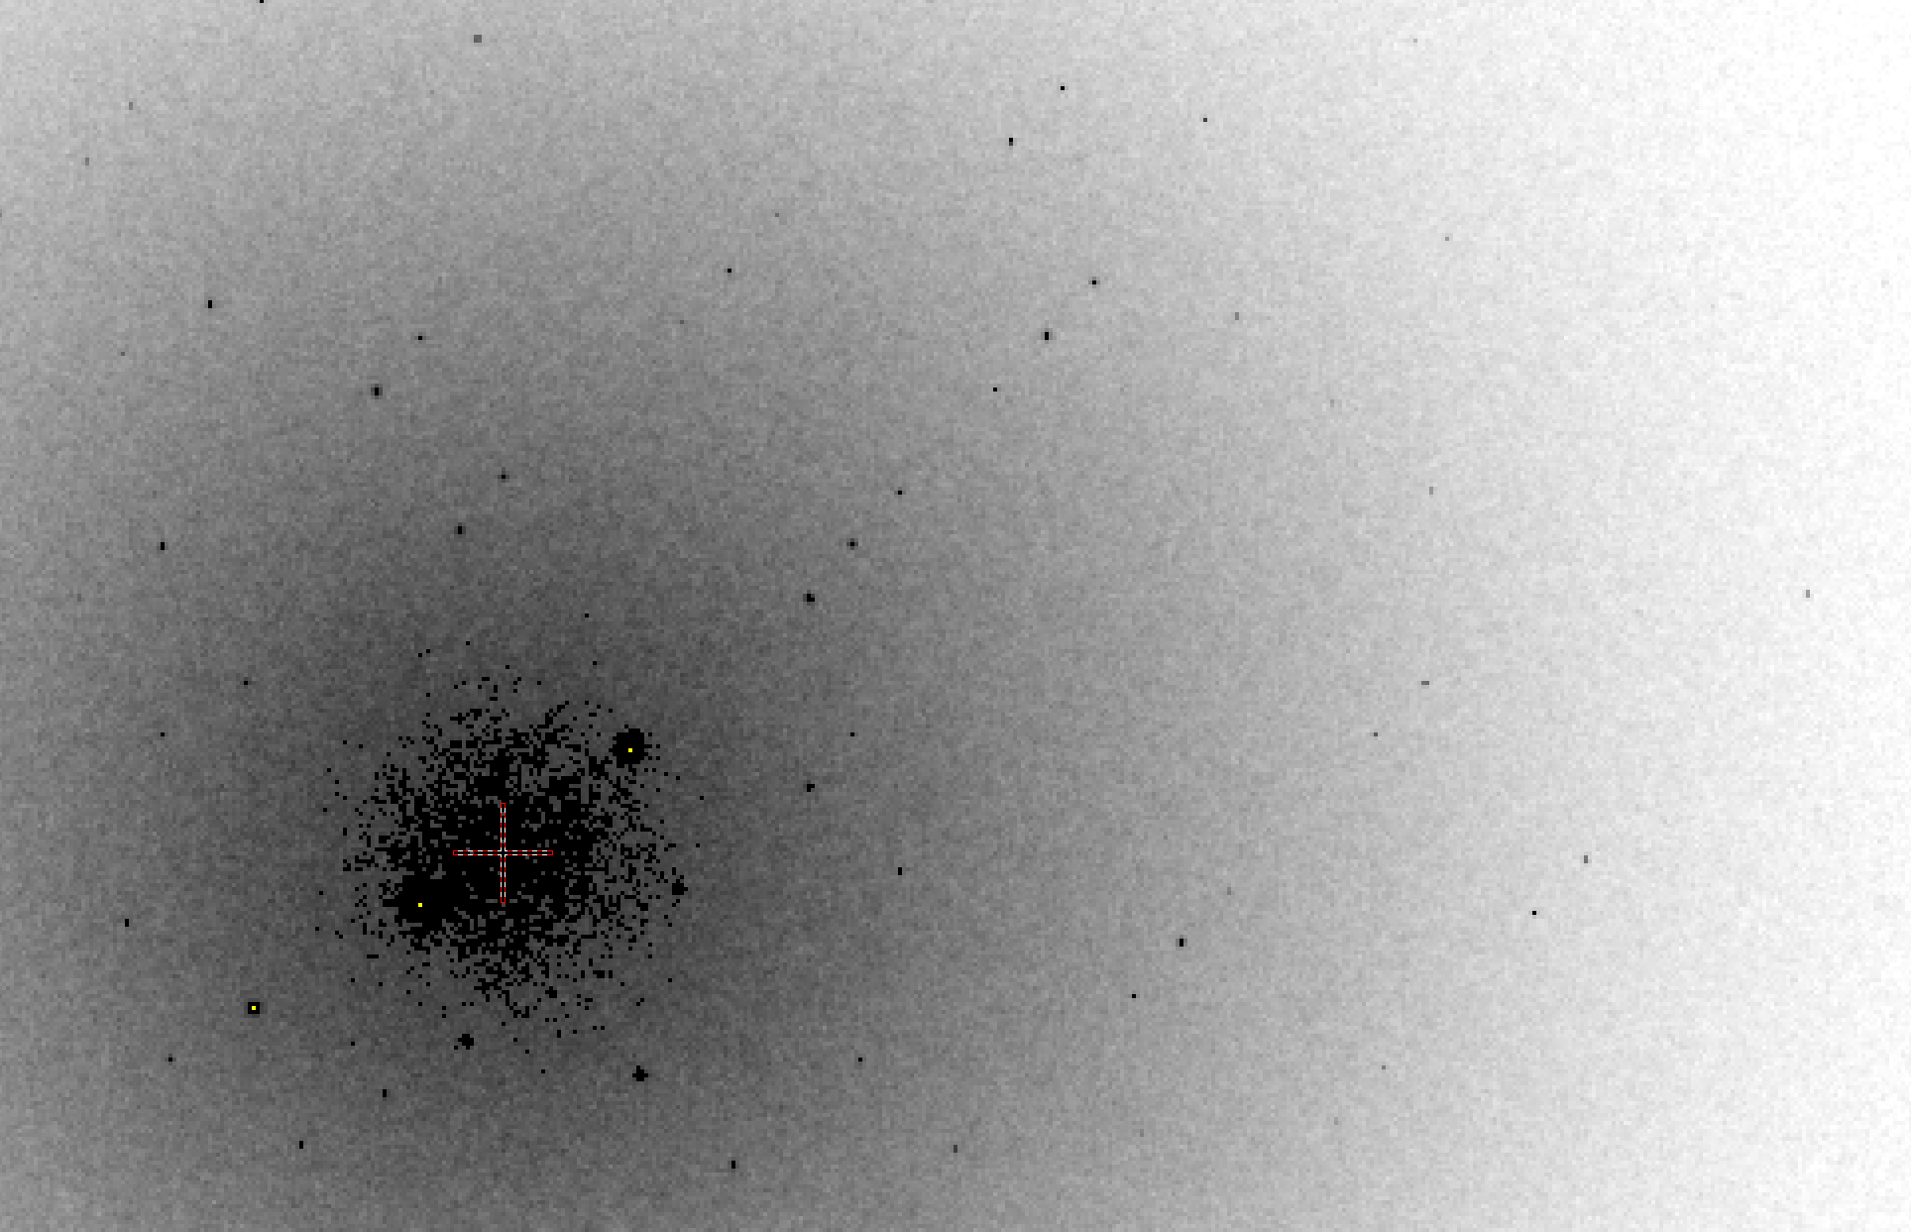
B factor from image analysis
B = 20

Slide 56
Bigger is better, but not by much
B = 20
B = 60
B = 0
B = 170
B = 330
B = 560
Resolution (Å)
B = 850
Crystal diameter (micron)

Slide 57
Diffraction Take-Home Lesson:
disorder
+ averaging
= poor resolution

Slide 58
What Causes Disorder?
Function
Radiation damage
Mosaicity
Strain
Xtal abuse
Dehydration

Slide 59
What Causes Disorder?
Function
Radiation damage
Mosaicity
Strain
Xtal abuse
Dehydration

Slide 60

Muybridge’s galloping horse (1878)

Slide 61
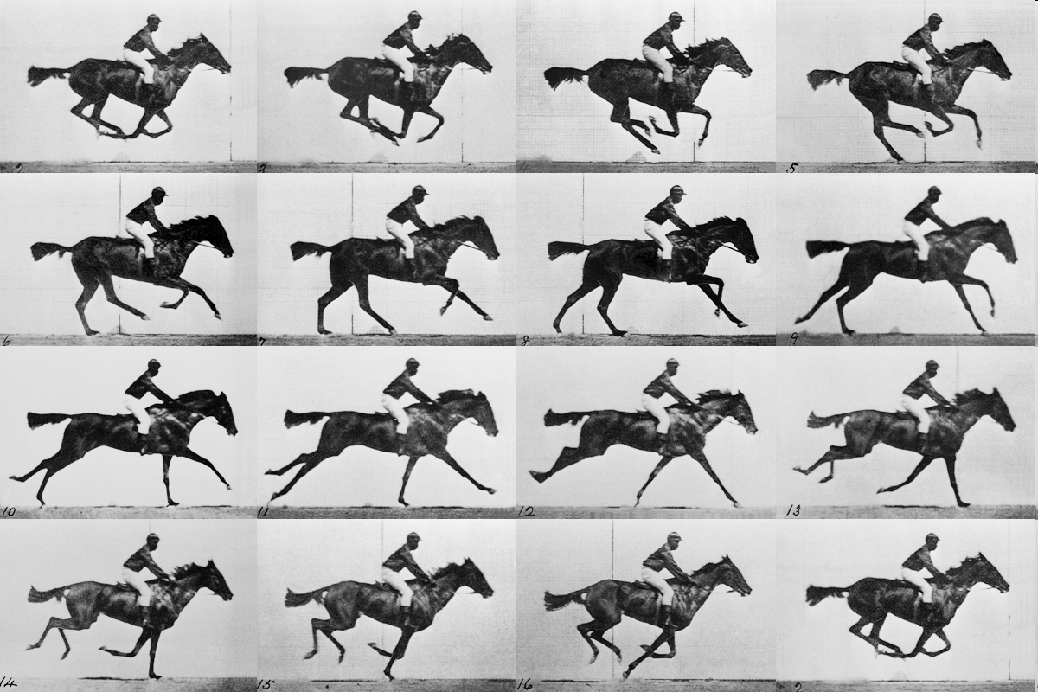
realistic “crystal” of horses

Slide 62
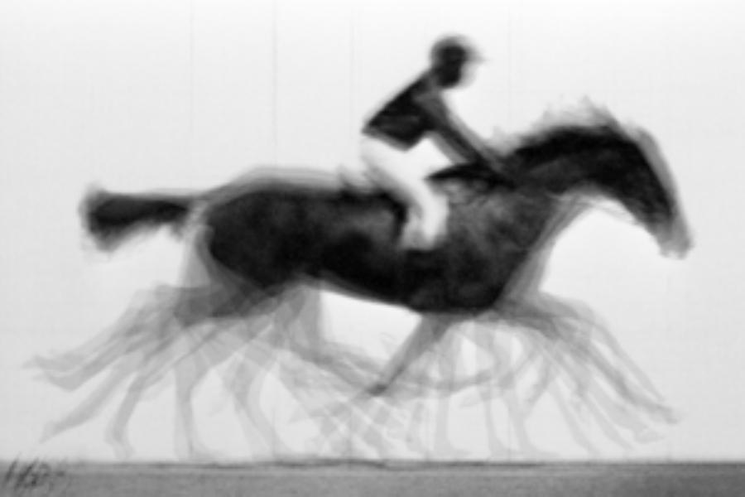
average structure: galloping horse

Slide 63

Ways to improve order
New crystal form
Purify
  - add a column
  - heat shock
Bind something
  - Known ligand
  - Silver bullets
Change the clone
  - chop off floppy bits
  - homolog
  - Ala -> Lys mutants
Make Protein Sit Still!!!
8000 cases in PDB of resolution improvement
80% of these are different crystal forms
> 1 Å improvement → 94% different forms
Newman J. (2006) Acta Cryst. D62 27-31.

Slide 64
What Causes Disorder?
Function
Radiation damage
Mosaicity
Strain
Xtal abuse
Dehydration

Slide 65
Types of radiation damage
Global
Specific

Slide 66
Types of radiation damage
Global
  scale factor
  B factor
  non-isomorphism
Specific
  depends on chemistry
  destroys phasing signal

Slide 67
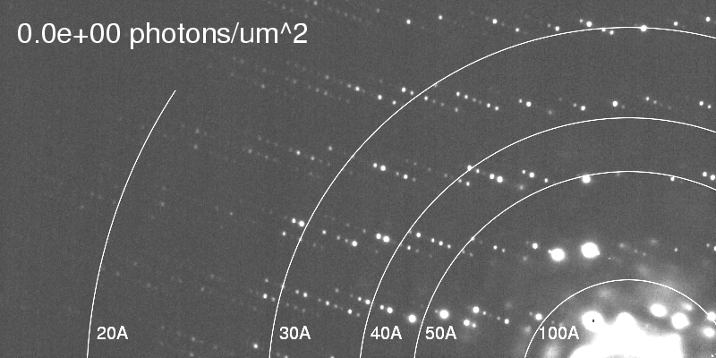
Global damage
Howells, et al. (2009) J. Electron Spectrosc. Relat. Phenom. 170, 4-12.

Slide 68
resolution dependence of global damage
10³
100
maximum tolerable dose (MGy)
10
1
1 2 3 5 7 10 20 40 70 100
resolution (Å)
Howells et al. (2009) J. Electron. Spectrosc. Relat. Phenom. 170 4-12

Slide 69
resolution dependence of global damage
10³
10 MGy/Å
100
maximum tolerable dose (MGy)
10
1
1 2 3 5 7 10 20 40 70 100
resolution (Å)
Howells et al. (2009) J. Electron. Spectrosc. Relat. Phenom. 170 4-12

Slide 70
what the is a MGy?
1 MGy = 10⁶ J/kg
http://bl831.als.lbl.gov/
damage_rates.pdf
Holton J. M. (2009) J. Synchrotron Rad. 16 133-42

Slide 71
How long will my crystal last?
synch line type flux beamsize flux density dose max xtal min site
ph/s μm ph/μm2/s rate lifetime lifetime
BESSY 14.1 MAD 1.6e11 340x800 5.9e+05 298 Gy/s 28 h 1.9 h
BESSY 14.2 MAD 1.9e11 190x90 1.1e+07 5.63 kGy/s 89 m 5.9 m
BESSY 14.3 mono 0.9e11 255x40 8.8e+06 3.18 kGy/s 2.6 h 10 m
BSRF 3W1A MAD 5e10? 800x600 1.0e+05 53 Gy/s 6.6 d 10 h
CLSI 08ID-1 MAD 1e12 200x100 5.0e+07 28.2 kGy/s 18 m 71 s
DIAMOND I02 MAD 1e12 100 1.0e+08 50.9 kGy/s 9.8 m 39 s
DIAMOND I03 MAD 1e12 100 1.0e+08 50.9 kGy/s 9.8 m 39 s
DIAMOND I04 MAD 1e12 100 1.0e+08 50.9 kGy/s 9.8 m 39 s
DIAMOND I04.1 MAD 1e12 100 1.0e+08 50.9 kGy/s 9.8 m 39 s
ESRF BM14 MAD 1.5e10 100 1.5e+06 704 Gy/s 12 h 47 m
ESRF ID14-1 MAD ?
ESRF ID14-2 MAD ?
ESRF ID14-3 MAD ?
ESRF ID14-4 MAD ?
ESRF BM30A MAD 0.5e11 300 5.6e+05 275 Gy/s 30 h 2 h
LNLS W01B-MX2 MAD 5e11 250x500 3.8e+06 7.7 kGy/s 1.0 h 4 m
MAXLAB I711 mono 2e11 300 2.2e+06 613 Gy/s 14 h 54 m
MAXLAB I911-1 mono 3e10 300x100 1.0e+06 1.03 kGy/s 8.1 h 32 m
MAXLAB I911-2 mono 1e11 300 1.1e+06 1.15 kGy/s 7.3 h 29 m
MAXLAB I911-3 MAD 3e11 250x150 8.0e+06 4.07 kGy/s 2 h 8.2 m
MAXLAB I911-4 mono 5e11 400x200 6.2e+06 3.18 kGy/s 2.6 h 10 m
MAXLAB I911-5 mono 5e10 300x200 8.3e+05 424 Gy/s 20 h 79 m
NSRRC BL13B1 MAD 4e11 200 1.3e+07 6.05 kGy/s 83 m 5.5 m
NSRRC BL13C1 MAD 4e10 200 1.3e+06 598 Gy/s 14 h 56 m
NSRRC BL17B1 MAD 4e9 200 1.3e+05 71.8 Gy/s 4.8 d 7.7 h

Slide 72
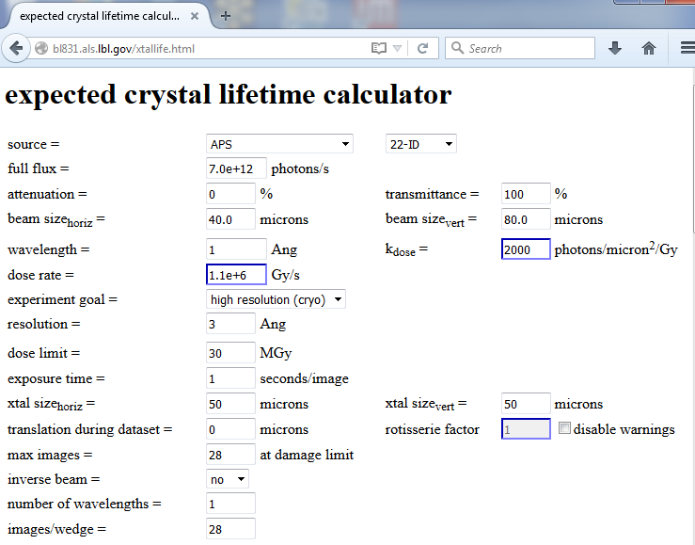

Slide 73
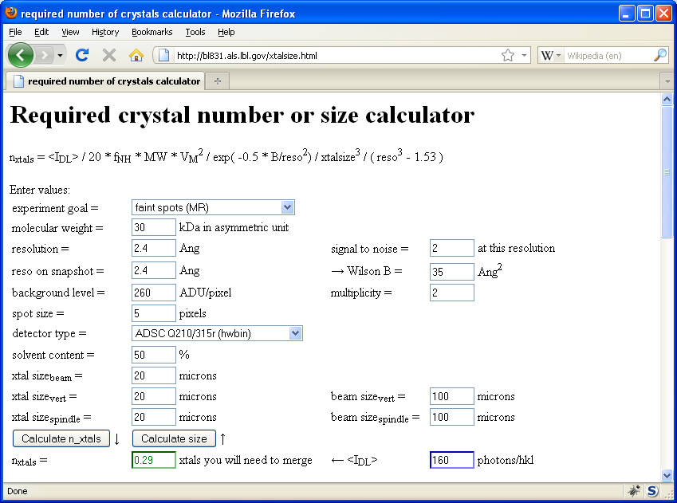
Holton & Frankel (2010) Acta D 66 393-408.

Slide 74
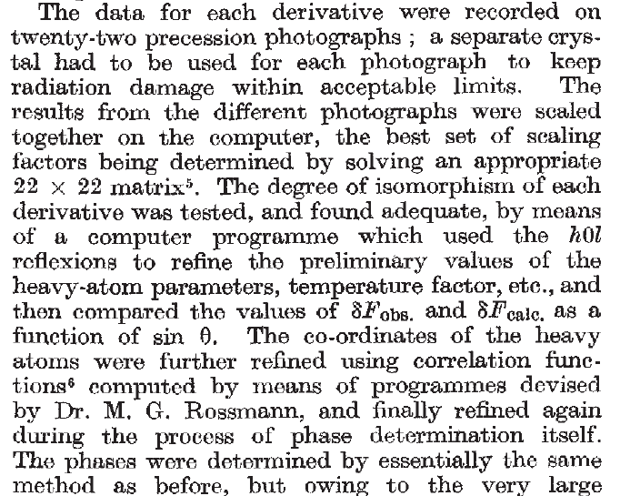
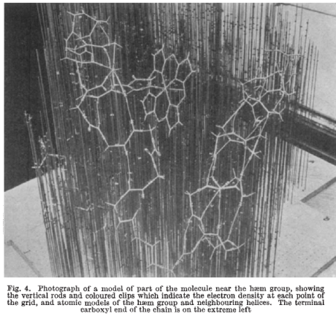
Multi-crystal strategies
Kendrew et al. (1960) "Structure of Myoglobin” Nature 185, 422-427.

Slide 75
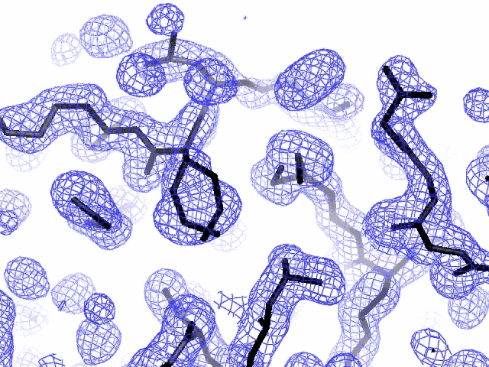
Specific damage
final, refined phases

Slide 76
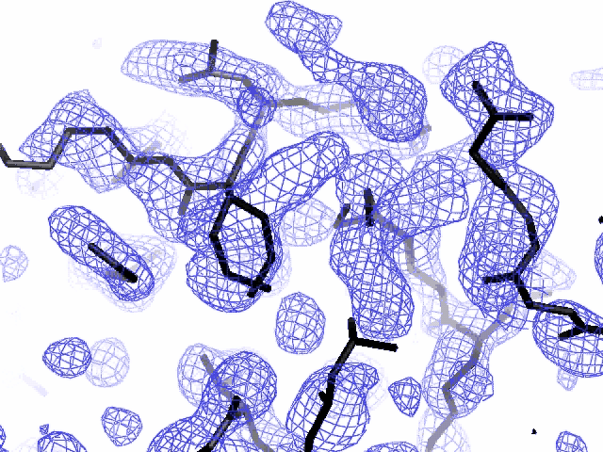
Specific damage
experimentally-obtained phases

Slide 77
Holton, J. M. (2007) J. Synch. Rad. 14, 51-72.

Slide 78
1.0
fraction
unconverted
0.0
Holton, J. M. (2007) J. Synch. Rad. 14, 51-72.

Slide 79
MGy reaction reference
~45 global damage Owen et al. (2006)
10/Å global damage Howells et al. (2009)
5 Se-Met Holton (2007)
4 Hg-S Ramagopal et al. (2004)
4 R-C-COOH Garman et al. (2015)
3 S-S Murray et al. (2002)
1 Br-RNA Olieric et al. (2007)
~1? Cl-C ???
0.5 Mn in PS II Yano et al. (2005)
0.06 putidaredoxin Corbett et al. (2007)
0.02 Fe in myoglobin Denisov et al. (2007)
Radiation Damage World Records
Holton (2009) J. Synchrotron Rad. 16 133-42

Slide 80
Life-halving concentration
molar, at the Se edge based on RADDOSE
Na | 44
Mg | 27
P | 9
S | 7
Cl | 5
K | 3.3
Ca | 2.7
Fe | 1.0
Cu | 0.67
Zn | 0.58
As | 0.44
Se | 0.42
Br | 2.9
I | 0.47
Gd | 0.21
Ta | 0.13
Pt | 0.17
Au | 0.16
Hg | 0.16
U | 0.23

Slide 81
Life-halving concentration
molar, at the Se edge based on RADDOSE
Na | 44
Mg | 27
P | 9
S | 7
Cl | 5
K | 3.3
Ca | 2.7
Fe | 1.0
Cu | 0.67
Zn | 0.58
As | 0.44
Se | 0.42
Br | 2.9
I | 0.47
Gd | 0.21
Ta | 0.13
Pt | 0.17
Au | 0.16
Hg | 0.16
U | 0.23

Slide 82
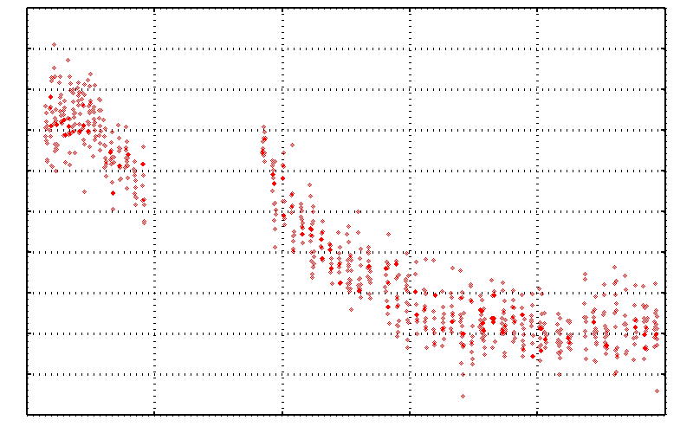
No Damage in the Dark!
4.6 5.0 5.4 5.8 6.2 6.6
Peak absorbance (electrons)
0 5 10 15 20 25
Experiment time (hours)

Slide 83
Self-calibrated damage limit
Where:
⟨I⟩_{DL} - average damage-limited intensity (photons/hkl) at a given resolution
10⁵ - converting R from μm to m, r_{e} from m to Å, ρ from g/cm³ to kg/m³ and MGy to Gy
r_{e} - classical electron radius (2.818 x 10⁻¹⁵ m/electron)
h - Planck’s constant (6.626 x 10⁻³⁴ J∙s)
c - speed of light (299792458 m/s)
f_{decayed} - fractional progress toward completely faded spots at end of data set
ρ - density of crystal (~1.2 g/cm³)
R - radius of the spherical crystal (μm)
λ - X-ray wavelength (Å)
f_{NH} - the Nave & Hill (2005) dose capture fraction (1 for large crystals)
n_{ASU} - number of proteins in the asymmetric unit
M_{r} - molecular weight of the protein (Daltons or g/mol)
V_{M} - Matthews’s coefficient (~2.4 Å³/Dalton)
H - Howells’s criterion (10 MGy/Å)
θ - Bragg angle
⟨ƒ_{a}²⟩ - number-averaged squared structure factor per protein atom (electron²)
⟨M_{a}⟩ - number-averaged atomic weight of a protein atom (~7.1 Daltons)
B - average (Wilson) temperature factor (Å²)
μ - attenuation coefficient of sphere material (m⁻¹)
μ_{en} - mass energy-absorption coefficient of sphere material (m⁻¹)
No flux
No symmetry
No exposure time
Holton & Frankel (2010) Acta D 66 393-408.

Slide 84
The number of photons scattered
before crystal is dead
is independent
of flux & time
1 um³ = 10⁵ photons (roomT)
1 um³ = 10⁶ photons (synch)
1 um³ = 10⁸ photons (XFEL)
(synch)
Henderson, 1990; Gonzalez & Nave, 1994; Glaeser et al., 2000; Sliz et al., 2003; Leiros et al., 2006; Owen et al., 2006; Garman & McSweeney, 2006; Garman & Nave, 2009; Holton, 2009

Slide 85

Dose slicing
unacceptable
completeness
N
photons
crystal’s useful life
N
photons
unacceptable
read noise
N
photons

Slide 86
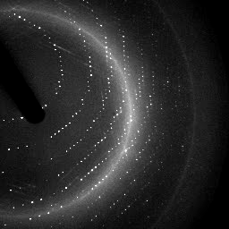

X-ray data are 3D!

Slide 87
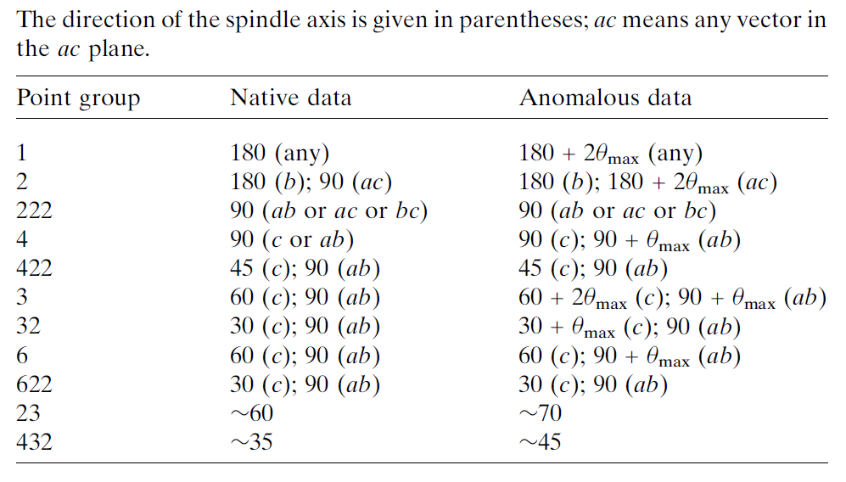
Data collection “strategy”
The “American Method”:
360° no matter what
(shoot first, questions later)
Dauter, Z. (1999). "Data-collection strategies." Acta Cryst. D 55(10): 1703-1717.

Slide 88
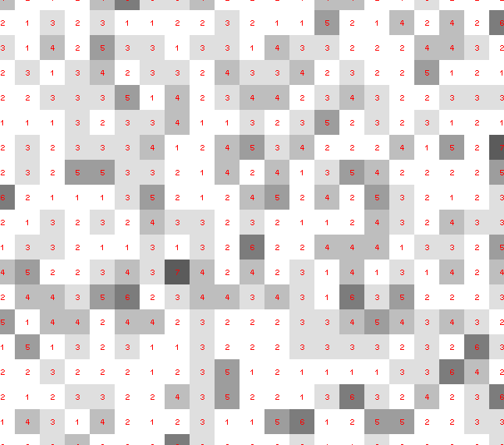
Dose slicing: is that a spot?

Slide 89
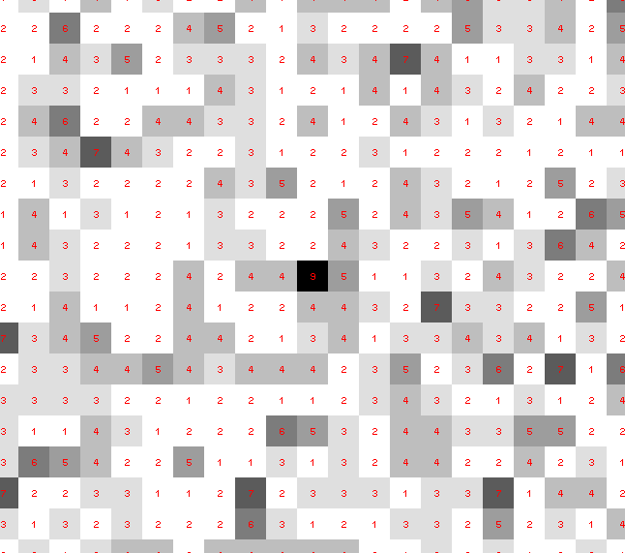
Dose slicing: is that a spot?

Slide 90
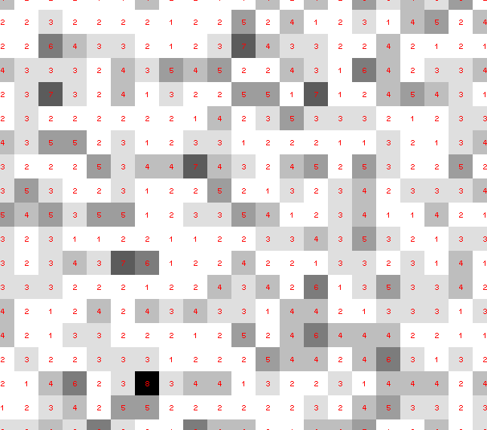
Dose slicing: is that a spot?

Slide 91
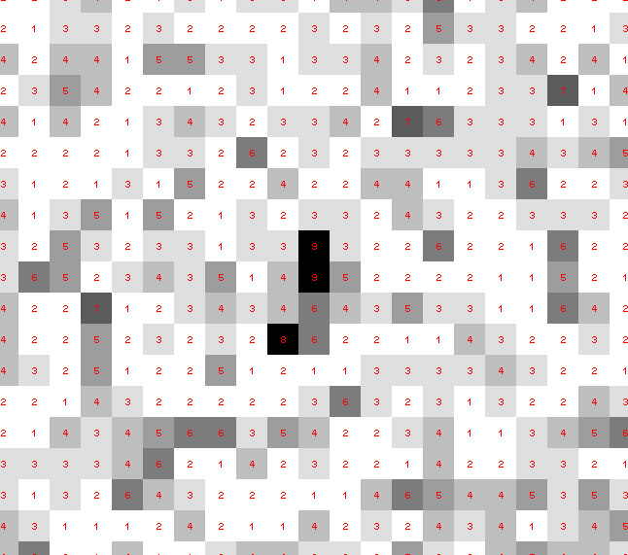
Dose slicing: is that a spot?

Slide 92
Dose slicing: is that a spot?

Slide 93
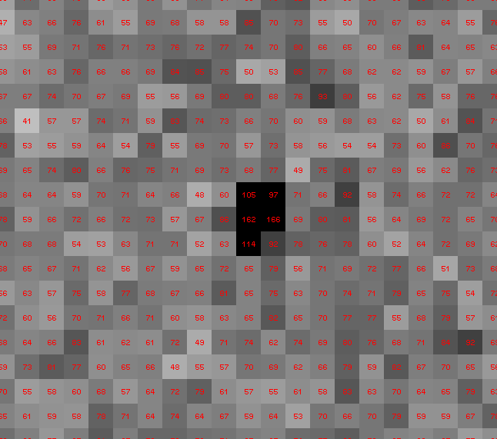
Dose slicing: is that a spot?

Slide 94
What if?
You only have a few small crystals…
Should you:
  Collect 360° from each?
  Collect 10° from each at 36x exposure?
  Glue 36 xtals together, then collect 360° ?
  Glue, and do 12960° faint exposures?

Slide 95
“true” resolution limit
CC vs right answer
Resolution (Å)

Slide 96
“true” resolution vs strategy
Dose slice collection scenario
fine | coarse | glue | Glue & fine
3.17700 | 3.14057 | 3.17604 | 3.12086
301,640,334 photons/xtal

Slide 97
processing procedure | resolution limit
 | fine | coarse | glue | glue&fine
XDS/XSCALE | 3.17700 | 3.14057 | 3.17604 | 3.12086
XDS/aimless | 3.16251 | 3.15922 | 3.16675 | 3.12162
XDS/noscale | 3.27289 | 3.15617 | 3.38929 | 3.12162
MOSFLM-defaults | x | x | x | x
MOSFLM-cheat | 3.19755 | 3.18166 | 3.20354 | 3.19755
HKL2000-defaults | x | x | x | x
HKL2000-expert | 3.21803 | 3.12646 | 3.11551 | 3.21803
HKL2000-cheat | 3.16119 | 3.10338 | 3.10338 | 3.16300
DIALS-defaults | x | x | 3.42125 | x
DIALS-expert | 3.10296 | 3.09547 | 3.07653 | 3.08465
d*Trek | ? | ? | 4.34076 | ?
EVAL15 | 3.14352 | 3.10383 | 3.09936 | 3.14105
EVAL15-sadabs | 3.13920 | 3.10797 | 3.10171 | 3.13700

Slide 98
Minimum exposure time:
~1 photon/pixel
  PAD w XDS, DIALS
~10 photon/pixel
PAD w HKL2k, MOSFLM
~30 photon/pixel
CCD detector

Slide 99

Optimal exposure time
(faint spots on CCD or IP)
t_{hr} Optimal exposure time for data set (s)
t_{ref} exposure time of reference image (s)
bg_{ref} background level near weak spots on
reference image (ADU)
bg₀ ADC offset of detector (ADU)
bg_{hr} optimal background level (via t_{hr})
σ₀ rms read-out noise (ADU)
gain ADU/photon
m multiplicity of data set (including partials)
adjust exposure
so this is ~15

Slide 100
What Causes Disorder?
Function
Radiation damage
Mosaicity
Strain
Xtal abuse
Dehydration

Slide 101
Ewald’s “mosaic” picture

Slide 102
Ewald’s “mosaic” picture

Slide 103
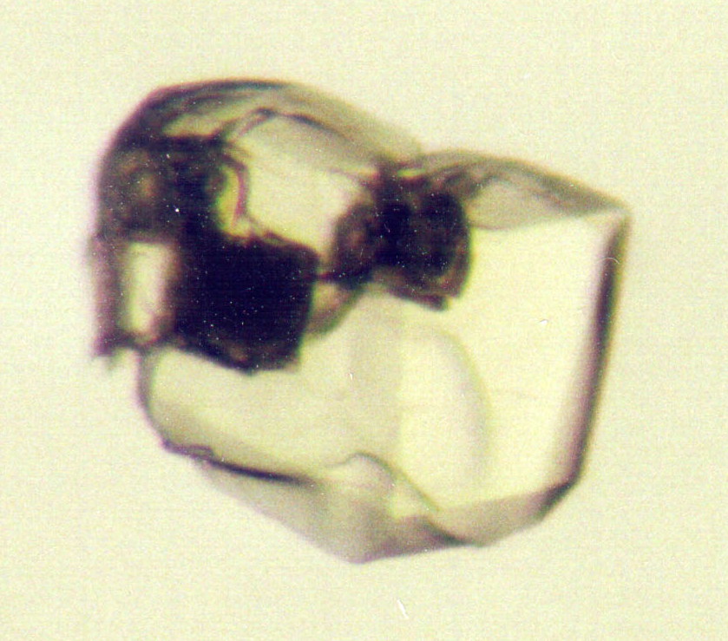
Ewald’s “mosaic” picture
What is
this stuff?

Slide 104
Darwin’s original picture

Slide 105
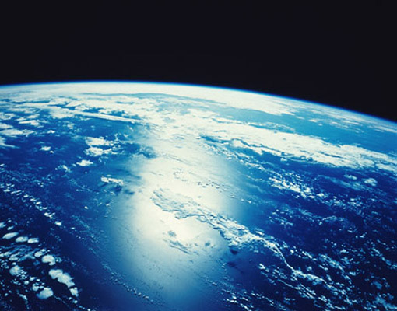
“mosaicity” with visible light

Slide 106

mosaic spread = 0 º

Slide 107

mosaic spread = 0.1º

Slide 108

mosaic spread = 0.2º

Slide 109

mosaic spread = 0.4º

Slide 110

mosaic spread = 0.6º

Slide 111

mosaic spread = 0.8º

Slide 112

mosaic spread = 1.0º

Slide 113

mosaic spread = 1.5º

Slide 114

mosaic spread = 2.0º

Slide 115

mosaic spread = 2.5º

Slide 116

mosaic spread = 3.2º

Slide 117

mosaic spread = 6.4º

Slide 118

mosaic spread = 12.8º

Slide 119
What Causes Disorder?
Function
Radiation damage
Mosaicity
Strain
Xtal abuse
Dehydration

Slide 120
stress and strain
What about
undamaged crystals?
radiation damage = defects

Slide 121
Purity is crucial!
important for
resolution
McPherson, A., Malkin, A. J., Kuznetsov, Y. G. & Plomp, M. (2001)."Atomic force microscopy applications in macromolecular crystallography", Acta Cryst. D 57, 1053-1060.
not important for
initial hits

Slide 122
What can I improve?
Purity!
is 95% good enough? 99%?
Purity!
conformational (homogeneous)
Purity!
kinetic (stable over time)

Slide 123
What Causes Disorder?
Function
Radiation damage
Mosaicity (η) > ~3 μm
Strain (B) < ~3 μm
Xtal abuse
Dehydration

Slide 124
What Causes Disorder?
Function
Radiation damage
Mosaicity > ~3 μm
Strain < ~3 μm
Xtal abuse
Dehydration

Slide 125
Xtal Abuse
physical contact
don’t touch the part you intend to shoot
osmotic shock
equilibrate, or calculate matching solution
changes in dielectric constant
Petsko (1975) J. Mol. Biol. 96, 381-388.
cooled density mismatch
Juers & Matthews (2004) Acta Cryst. D 60, 412-421.
basically: no sudden moves!

Slide 126
What Causes Disorder?
Function
Radiation damage
Mosaicity > ~3 μm
Strain < ~3 μm
Xtal abuse
Dehydration

Slide 127
opened drop: you have ~30 seconds!
equilibrated drop

Slide 128
OK! OK!
Now I am afraid!
What should I do?

Slide 129
Basic Principles
“Hell, there are NO RULES here - we're trying to accomplish something.”
Thomas A. Edison – inventor
“You’ve got to have an ASSAY.”
Arthur Kornberg – Nobel Laureate
“Control, control, you must learn CONTROL!”
Yoda – Jedi Master

Slide 130
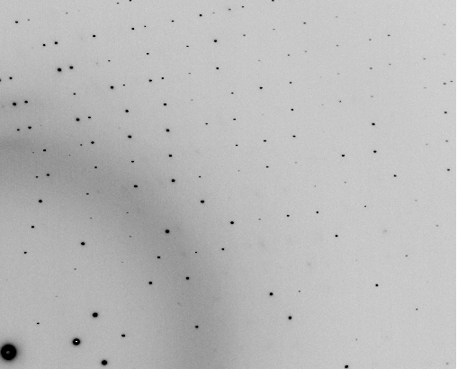
The Best Assay

Slide 131
And the dominant source of error is…
Resolution
  Disorder (including Radiation Damage)
  Background
Phases
  Non-isomorphism (including Radiation Damage)
  Vibration (beam, xtal, spindle, etc.)
  Detector calibration

Slide 132
beam size vs xtal size
  Put your crystal into the beam

Slide 133
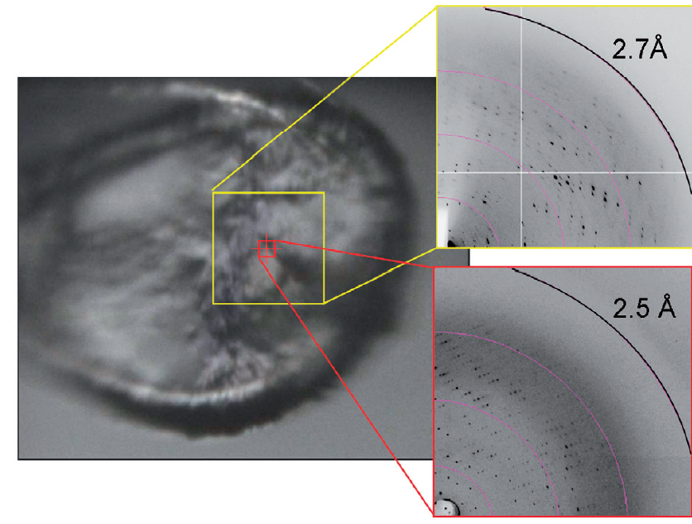
Get thee to a microbeam?
Evans et al. (2011)."Macromolecular microcrystallography", Crystallography Reviews 17, 105-142.

Slide 134
beam size vs xtal size
  Put your crystal into the beam
  Shoot the whole crystal

Slide 135
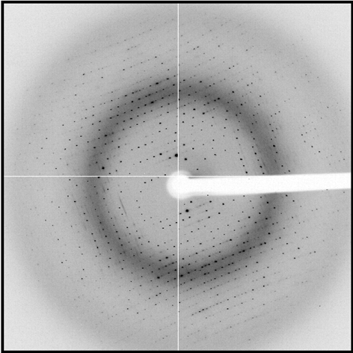
shoot the whole crystal

Slide 136
shoot the whole crystal

Slide 137
shoot the whole crystal

Slide 138
beam size vs xtal size
  Put your crystal into the beam
  Shoot the whole crystal
  Shoot nothing but the crystal

Slide 139
scattering/absorptoin “rules”:
1 μm crystal ≈ 1 μm water
≈ 1 μm plastic
≈ 0.1 μm glass
≈ 1000 μm air
Optimum: support thickness = crystal thickness

Slide 140
Resolution (Å)
too big
too small
just right
X-ray beam size (μm)

Slide 141
shoot nothing but the crystal

Slide 142
shoot nothing but the crystal

Slide 143
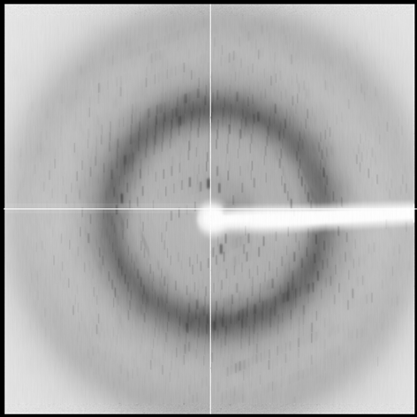
shoot nothing but the crystal

Slide 144
shoot nothing but the crystal

Slide 145
shoot nothing but the crystal

Slide 146
Tipping point for µfocus:
10 µm
~1 mrad =0.06°
~10 mm

Slide 147
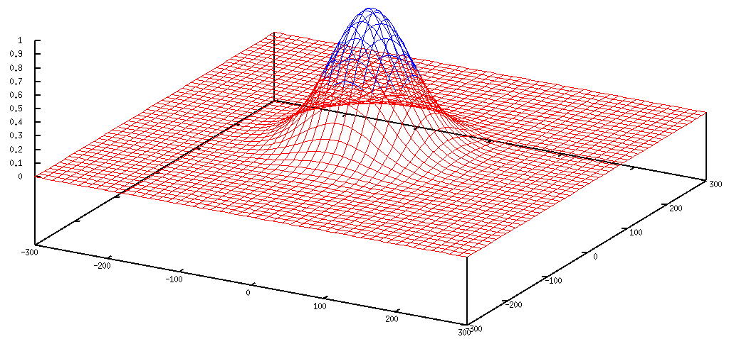
Gaussian beam
50% of flux
the other 50%

Slide 148
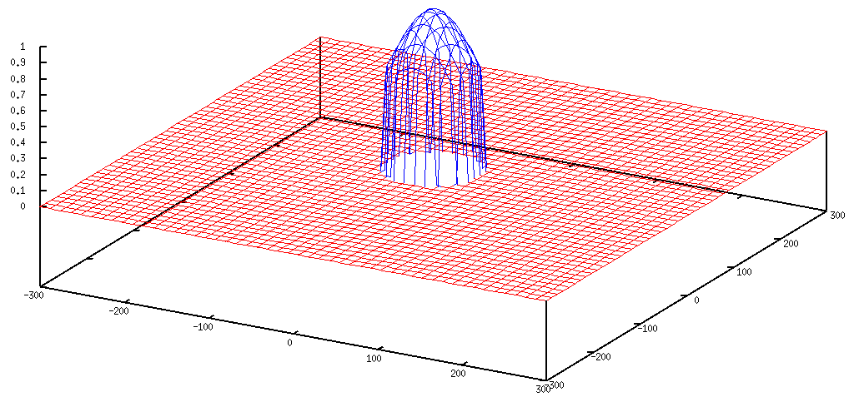
Collimated beam
100% of flux
0%

Slide 149
beam size vs xtal size
  Put your crystal into the beam
  Shoot the whole crystal
  Shoot nothing but the crystal
  Back off!

Slide 150
Background scattering

Slide 151
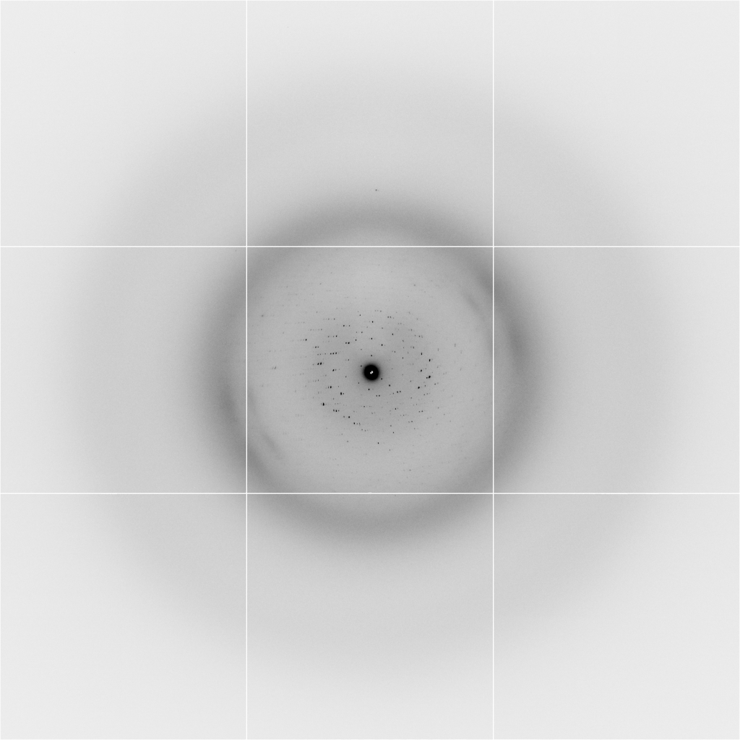
Background scattering
$100,000.00
$100,000.00
$100,000.00
real estate is
expensive
use it!
$100,000.00
$100,000.00
$100,000.00
$100,000.00
$100,000.00

Slide 152
Mosquito tips cost $0.15 each
So do Pilatus pixels!
We bought 6,224,001
Use them!
(they are reusable)

Slide 153
Fine Slicing
background
background
Pflugrath, J. W. (1999)."The finer things in X-ray diffraction data collection", Acta Cryst. D 55, 1718-1725.

Slide 154
beam size vs xtal size
  Put your crystal into the beam
  Shoot the whole crystal
  Shoot nothing but the crystal
  Back off!
  The crystal must rotate

Slide 155
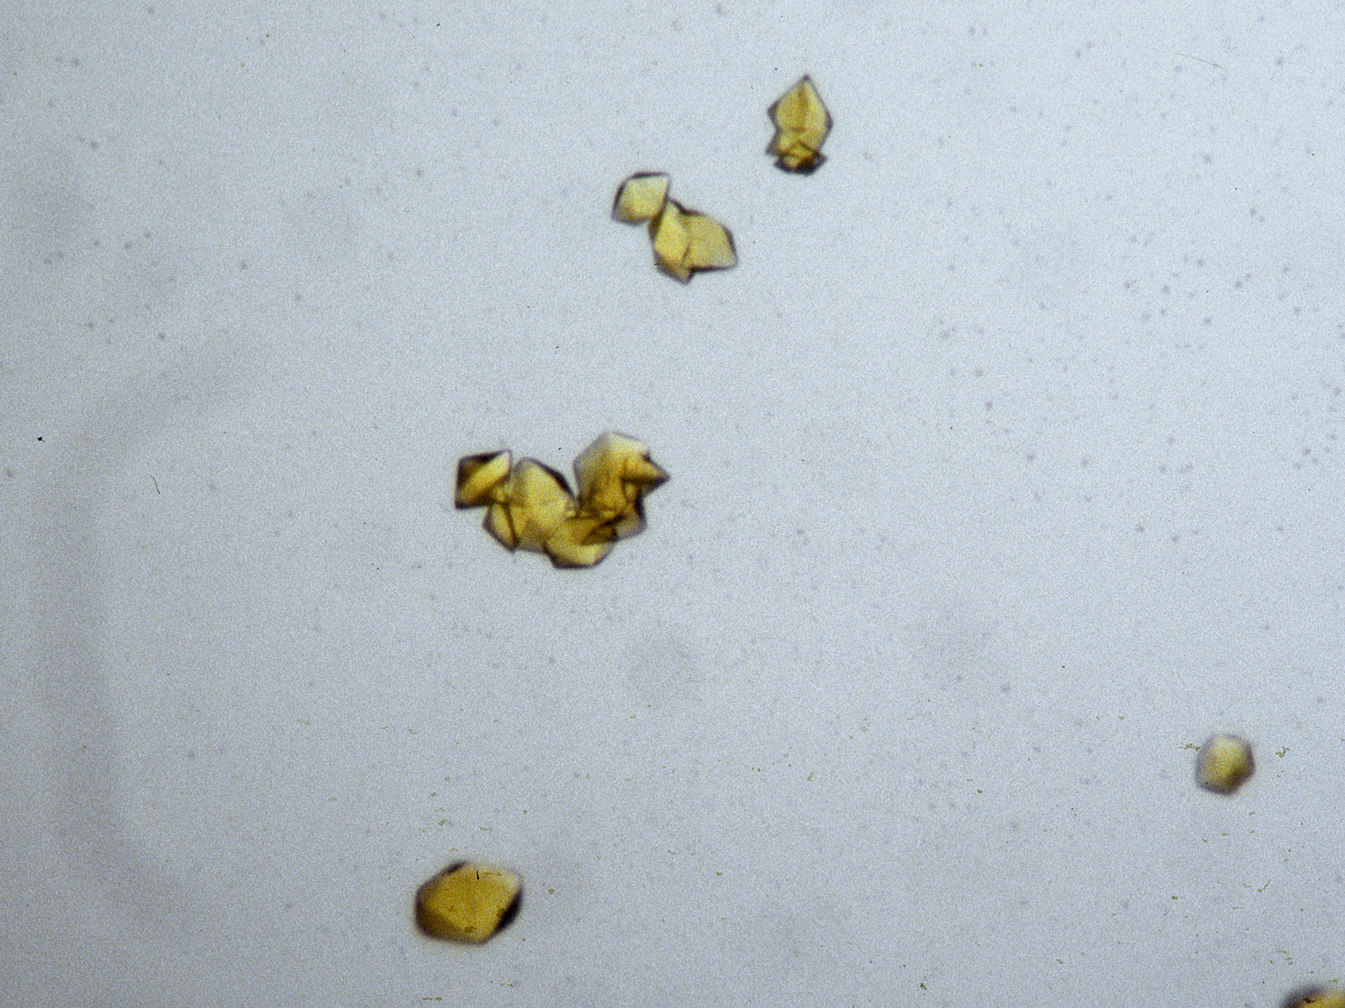
The crystal rotates!

Slide 156
The crystal rotates!
Membrane Protein Expression Center © 2012

Slide 157
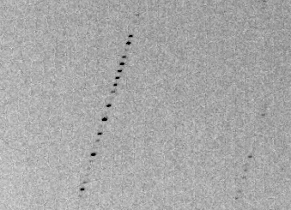
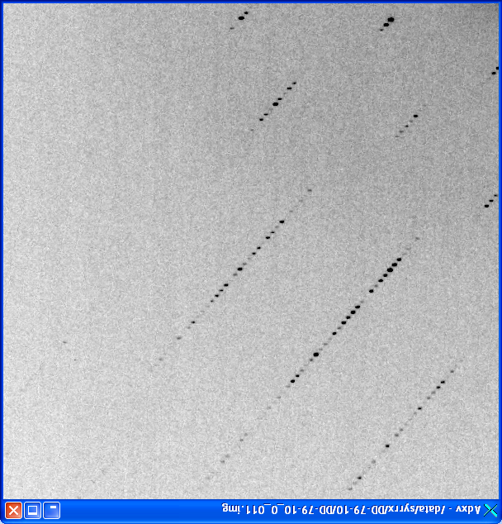
avoiding overlaps
c
c

Slide 158
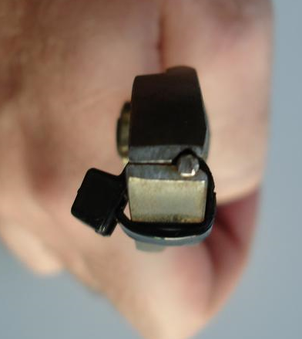
avoiding overlaps
c

Slide 159
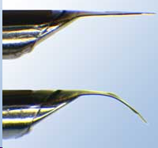
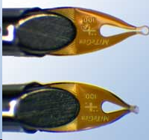
avoiding overlaps
c
http://www.mitegen.com/mic_catalog.php?c=DTMicroMounts

Slide 160
avoiding overlaps
c
http://www.mitegen.com/mic_catalog.php?c=orientedmounts

Slide 161
One xtal, no idea?
Suggested native protocol:
Do strategy
Start at specified phi
Complete fast as you can
Keep going to 360°
Move detector
Advance phi 10-30 deg
Increase photons/image 4x
goto 4

Slide 162
Adding images
% cat << EOF > MERGE2CBF.INP
NAME_TEMPLATE_OF_DATA_FRAMES= /data/you/weak_?????.cbf
DATA_RANGE= 1 10
NAME_TEMPLATE_OF_OUTPUT_FRAMES=/data/you/sum_???.cbf
NUMBER_OF_DATA_FRAMES_COVERED_BY_EACH_OUTPUT_FRAME= 10
EOF
% merge2cbf
Which is better?:
% xds_runme.com /data/you/weak_?????.cbf
% xds_runme.com /data/you/sum_?????.cbf
“lossy”
compression

Slide 163
Native Summary
http://bl831.als.lbl.gov/xtalsize.html
http://bl831.als.lbl.gov/xtallife.html
http://bl831.als.lbl.gov/~jamesh/powerpoint/Uruguay_dtacoll_2017.pptx
100 ADU/pixel
10 μm for lysozyme
Do “strategy”
Follow by “American Method”
“Attenu-wait”: dose slicing
Assay, control and open mind

Slide 164
And the dominant source of error is…
Resolution
  Disorder (including Radiation Damage)
  Background
Phases
  Non-isomorphism (including Radiation Damage)
  Vibration (beam, xtal, spindle, etc.)
  Detector calibration

Slide 165
anomalous signal
ΔF
F
√
# sites
MW (Da)
≈ 1.2 f”
World record!
ΔF/F = 0.5%
Wang, Dauter & Dauter (2006) Acta Cryst. D 62, 1475-1483.
Crick, F. H. C. & Magdoff, B. S. (1956) Acta Crystallogr. 9, 901-908.
Hendrickson, W. A. & Teeter, M. M. (1981) Nature 290, 107-113.

Slide 166
R_{iso} vs dose
R_{iso} (%)
change in dose (MGy)
data taken from Banumathi, et al. (2004) Acta Cryst. D 60, 1085-1093.

Slide 167
R_{iso} vs dose
R_{iso} ≈ 0.7 %/MGy
R_{iso} (%)
change in dose (MGy)
data taken from Banumathi, et al. (2004) Acta Cryst. D 60, 1085-1093.

Slide 168
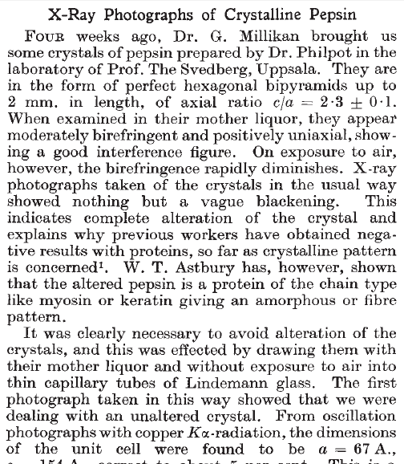
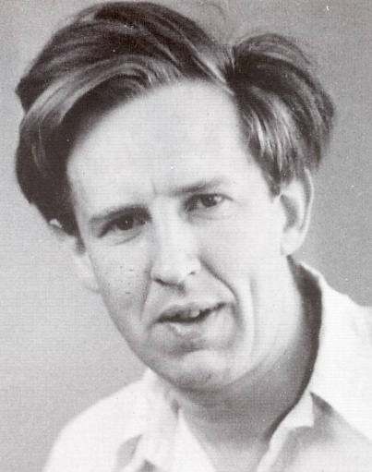
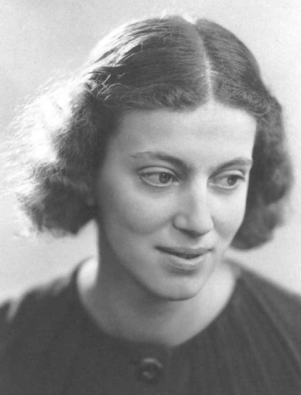
First diffraction from protein xtal
1934
Bernal, J. & Crowfoot, D. (1934). "X-ray photographs of crystalline pepsin", Nature 133, 794-795.

Slide 169
Dehydration: 1934
and 2017?
= 1.5 μL
100 μm
= 1.0 nL
2 mm
= 1.0 pL
10 μm
= 1.0 fL
1 μm

Slide 170
Non-isomorphism in lysozyme
Dear James
The story of the two forms of lysozyme crystals goes back to about 1964 when it was found that the diffraction patterns from different crystals could be placed in one of two classes depending on their intensities. This discovery was a big set back at the time and I can remember a lecture title being changed from the 'The structure of lysozyme' to 'The structure of lysozyme two steps forward and one step back'. Thereafter the crystals were screened based on intensities of the (11,11,l) rows to distinguish them (e.g. 11,11,4 > 11,11,5 in one form and vice versa in another). Data were collected only for those that fulfilled the Type II criteria. (These reflections were easy to measure on the linear diffractometer because crystals were mounted to rotate about the diagonal axis). As I recall both Type I and Type II could be found in the same crystallisation batch . Although sometimes the external morphology allowed recognition this was not infallible.
The structure was based on Type II crystals. Later a graduate student Helen Handoll examined Type I. The work, which was in the early days and before refinement programmes, seemed to suggest that the differences lay in the arrangement of water or chloride molecules (Lysozyme was crystallised from NaCl). But the work was never written up. Keith Wilson at one stage was following this up as lysozyme was being used to test data collection strategies but I do not know the outcome.
An account of this is given in International Table Volume F (Rossmann and Arnold edited 2001) p760.
Tony North was much involved in sorting this out and if you wanted more info he would be the person to contact. I hope this is helpful. Do let me know if you need more.
Best wishes
Louise

Slide 171
Non-isomorphism in lysozyme
Structure factor (e⁻)
Johnson’s ratio

Slide 172
Non-isomorphism in lysozyme
Structure factor (e⁻)
Johnson’s ratio

Slide 173
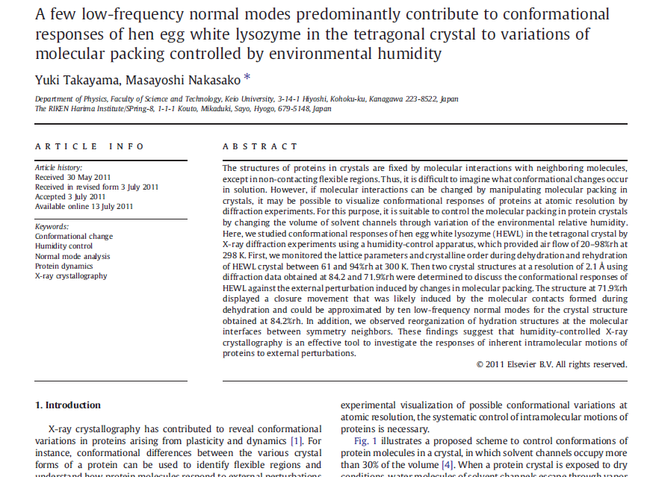

Slide 174

Non-isomorphism in lysozyme
RMSD = 1.70 Å
Δcell = 0.7 %
R_{iso} = 44.5%
RMSD = 0.18 Å
3aw6
3aw7
RH: 84.2%
vs 71.9%

Slide 175
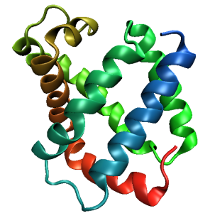
Same structure, different cell
0.5% cell change → 15%
Crick & Magdoff (1956) “theory method isomorphous replacement”, Acta Cryst. 9, 901-8.

Slide 176
Same structure, different cell
0.5% cell change → 15%
Crick & Magdoff (1956) “theory method isomorphous replacement”, Acta Cryst. 9, 901-8.

Slide 177
Same cell, rotated protein
0.5° rotation → 16%
Crick & Magdoff (1956) “theory method isomorphous replacement”, Acta Cryst. 9, 901-8.

Slide 178
Same cell, rotated protein
0.5° rotation → 16%
Crick & Magdoff (1956) “theory method isomorphous replacement”, Acta Cryst. 9, 901-8.

Slide 179
Uniform stretch
5% change → 0%

Slide 180
Uniform stretch
5% change → 0%

Slide 181
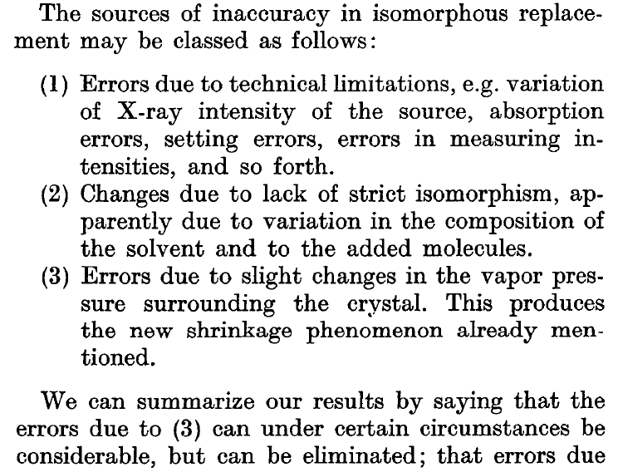
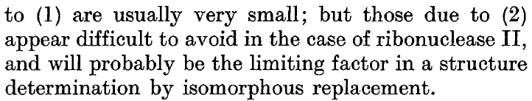
Magdoff & Crick (1955) “Ribonuclease II. Accuracy of measurement and shrinkage”, Acta Cryst. 8, 461-8.
Crick & Magdoff (1956) “The theory of the method of isomorphous replacement for protein crystals”, Acta Cryst. 9, 901-8.

Slide 182
Elastic deformation
= non-isomorphism

Slide 183
Elastic deformation
= non-isomorphism

Slide 184
Plastic deformation
= poor diffraction

Slide 185
Plastic deformation
= poor diffraction

Slide 186
… but does it work for membrane proteins?
CCP4BB:
“We used it for a large membrane protein complex and diffraction improved from ~7 to 2.7 A. The crystal is fished out and put into mother liquor solution in the button, sealed with dialysis membrane and the button is then placed into about 5 mls of mother liquor with slightly higher PEG concentration. Then you just exchange outside buffer every day or so for solutions containing higher concentrations of PEG. We went from ~9 to 30 % PEG4000 in about a week. You can easily observe crystal under microscope and if it cracks - you went too far/too quickly with PEG and need to use a bit less next time. Also, this method allows you to control all other components of the dehydrating solution - we needed to decrease salt concentration at the same time as increasing PEG. You can also introduce/increase cryo-protectant concentration at the same time. With these crystals, otherwise excellent dehydration machines already mentioned did not work, possibly because the process had to be really slow.”
Efremov, R. G. & Sazanov, L. A. (2011)."Structure of the membrane domain of respiratory complex I", Nature 476, 414-420.
“To improve diffraction properties, crystals were slowly cooled to 4 C, placed into micro-dialysis buttons, and mother liquor was exchanged by dialysis for 0.1 M sodium acetate (pH 4.8), 0.15 M sodium tartrate (pH 5.0), 30% PEG4000, 0.1% sodium cholate and 12.5% glycerol over a period of 5 days.”

Slide 187
And the dominant source of error is…
Resolution
  Disorder (including Radiation Damage)
  Background
Phases
  Non-isomorphism (including Radiation Damage)
  Vibration (beam, xtal, spindle, etc.)
  Detector calibration

Slide 188
Optimal exposure time
(anomalous on a PAD)
2.03 ms
intensity
time

Slide 189
PAD full vs partial
Summed intensity
iteration

Slide 190
Optimal exposure time
(anomalous on a PAD)
PILATUS
>0.2 s/frame
EIGER
>0.0003 s/frame
t_{mad} Optimal exposure time (s)
t_{ro} read-out time (s)
2.03 ms on Pilatus³ S
0.95 ms on Pilatus³ X
0.003 ms on Eiger
Attenuate for MAD

Slide 191
And the dominant source of error is…
Resolution
  Disorder (including Radiation Damage)
  Background
Phases
  Non-isomorphism (including Radiation Damage)
  Vibration (beam, xtal, spindle, etc.)
  Detector calibration

Slide 192
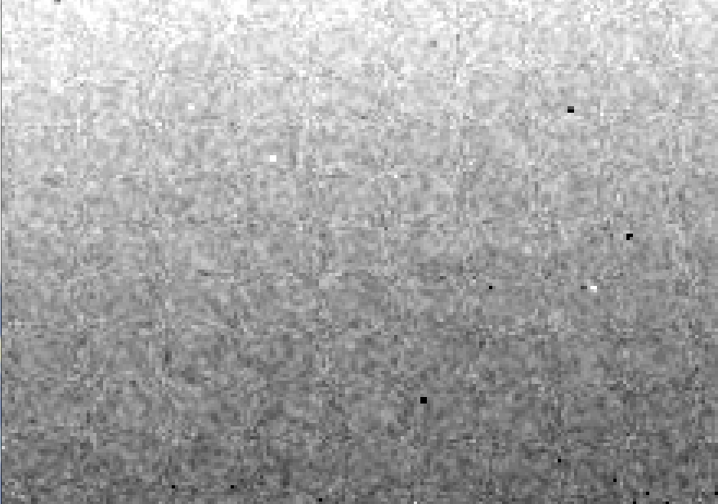
Detector calibration: 7235 eV

Slide 193

Detector calibration: 7247 eV

Slide 194
Gadox calibration vs energy
same = good!
Relative absorption depth
bad!
photon energy (keV)

Slide 195

Spatial Heterogeneity in Sharp Spot Sensitivity
~3x10⁵ photon/pixel Pilatus detector
Bragg
glitch
“tree rings”
Pick-up tool mark
oxygen
inclusions
1% high
average
1% low

Slide 196

Systematic error does not “average out”

Slide 197
Threshold of a revolution in phasing
CCD
old Pilatus
Goal
Solve-able proteins (%)
Best
Pilatus
Required signal-to-noise (I/σ)

Slide 198
Can you count to 1,000,000 ?
sqrt(1,000,000)
1,000,000
Theoretically:
= 0.1%
R_{meas} ≈ 0.1% ?
ISa = 1000
In reality:
ISa ~ 33
R_{meas =} ≈ 3%
sqrt(1,000)
1,000
= 3%
photon
spot
> 1000 is a waste!

Slide 199
Fractional error
^{mult >} (—)²
~3%
<ΔF/F>

Slide 200

Holton & Frankel (2010) Acta D 66 393-408.

Slide 201

S-SAD merging 20 xtals
Knott et al. (2017). "Guide-bound CRISPR-Cas13a." Nature S&MB online

Slide 202
Systematic vs random error
intensity
observation

Slide 203
Data collection parameters:
16 crystals
360° each, inverse beam
7235 eV photon energy
< 1 MGy per xtal
Australian Synchrotron MX1
  35 kGy/s into 100 μm x 100 μm

Slide 204
140-fold multiplicity: 16 crystals, 360° each, inverse beam, 7235 eV
RESOLUTION COMPLETENESS R-FACTOR I/SIGMA R-meas CC(1/2) Anomal SigAno Nano
LIMIT OF DATA observed Corr
9.17 99.1% 3.9% 257.47 3.9% 100.0* 91* 5.024 450
6.49 100.0% 5.2% 214.33 5.2% 100.0* 86* 3.836 882
5.30 100.0% 7.2% 165.13 7.2% 100.0* 76* 3.257 1175
4.59 100.0% 7.2% 175.42 7.3% 100.0* 67* 2.589 1403
4.10 99.9% 7.7% 174.13 7.7% 100.0* 59* 2.264 1594
3.74 99.9% 9.4% 143.09 9.4% 100.0* 49* 1.953 1783
3.47 100.0% 11.2% 120.17 11.2% 100.0* 39* 1.696 1942
3.24 100.0% 14.1% 91.14 14.1% 100.0* 30* 1.333 2103
3.06 99.9% 19.5% 65.79 19.5% 100.0* 23* 1.117 2214
2.90 99.9% 29.0% 44.85 29.1% 99.9* 17* 1.008 2369
2.77 99.9% 40.5% 32.58 40.6% 99.8* 11* 0.901 2493
2.65 99.9% 52.8% 25.16 52.9% 99.8* 10* 0.866 2605
2.54 100.0% 67.4% 19.47 67.6% 99.6* 2 0.804 2705
2.45 100.0% 88.9% 14.58 89.2% 99.2* 4 0.831 2859
2.37 100.0% 109.3% 9.97 109.7% 98.1* 5 0.829 2925
2.29 100.0% 138.2% 6.87 138.9% 96.1* 1 0.760 3037
2.22 100.0% 197.1% 4.03 198.6% 83.5* -1 0.721 3159
2.16 100.0% 227.3% 2.41 230.8% 46.9* -1 0.677 3224
2.10 61.2% 154.4% 1.28 163.6% 47.0* -2 0.660 1999
2.05 47.9% 170.1% 0.68 196.5% 25.7* 3 0.629 1578
total 93.3% 15.7% 54.30 15.8% 100.0* 12* 1.217 42499

Slide 205

140-fold multiplicity
18 σ
16 σ
Phased anomalous difference Fourier

Slide 206

140-fold multiplicity
15σ = PO₄
Phased anomalous difference Fourier

Slide 207

140-fold multiplicity
~2σ = Mg?
Phased anomalous difference Fourier

Slide 208

140-fold multiplicity
8.2σ = Mg?
DELFAN residual anomalous difference

Slide 209
Discerning Na⁺ from Mg⁺⁺
DELFAN peak height (σ)
N
O
F
Ne
Na
Mg
f’’ (electrons)

Slide 210

140-fold multiplicity
7.4σ = Na
DELFAN residual anomalous difference

Slide 211
XFEL Phasing success vs Figure of Merit
Adjusting:
Solvent content
Resolution
SDfac Sdadd
Cycles of dm
“mode”
“scheme”
NCS radius
NCS cycles
Phase blur
Correlation to final map
FOM from “dm”
http://cxidb.org/id54-SfjMJjaBny/id-54.html http://cxidb.org/id55-BWuBDSUrBy/id-55.html
Hunter et al. (2016)."Selenium anomalous phasing XFEL", Nature Comm. 7, 13388.

Slide 212
Phasing Summary
http://bl831.als.lbl.gov/xtalsize.html
http://bl831.als.lbl.gov/xtallife.html
http://bl831.als.lbl.gov/~jamesh/powerpoint/Uruguay_datacoll_2017.pptx
~3% error per spot, 1%/MGy
7235 eV for S-SAD
Multiplicity multiplicity multiplicity
“Attenu-wait”: dose slicing
>1000 photons/spot is a waste

Slide 213
But my reviewer says…
R_{merge} in high-resolution bin is >100% !
Answer: this is expected

Slide 214
Expected R_{merge} as I_{obs} → 0

Slide 215
Averaging Gaussian error
Average value
Number of samples averaged

Slide 216
Averaging Gauss/Gauss error
Average value
Number of samples averaged

Slide 217
R_{merge} at the resolution limit in PDB
Average outer-shell R_{merge}
Year

Slide 218
Take-home lesson:
R factors are
undefined
as I_{obs} → 0
Report as “ – “ in outer bin

Slide 219

Re-indexing cheat sheet
Dauter, Z. (1999). "Data-collection strategies." Acta Cryst. D 55(10): 1703-1717.

Slide 220
Adding noise
1² + 1² = 1.4²

Slide 221

100% SeMet incorporation
Trivial to solve

Slide 222

100% S -Met incorporation
Impossible to solve

Slide 223
Phase Problem: Se vs S
correlation coefficient
fraction Sulfur

Slide 224
Phase Problem: Se vs S
correlation coefficient
fraction Sulfur

Slide 225
Phase Problem: Se vs S
correlation coefficient
fraction Sulfur

Slide 226
Phase Problem: Se vs S
correlation coefficient
fraction Sulfur

Slide 227
Phase Problem: Se vs S
correlation coefficient
fraction Sulfur

Slide 228

29% Se 71% S

Slide 229

28% Se 72% S

Slide 230

21% Se 79% S

Slide 231

11% Se 89% S

Slide 232
Finding sites
Number of correct sites
fraction Sulfur

Slide 233
Finding sites
Number of correct sites
fraction Sulfur

Slide 234
Finding sites
Number of correct sites
fraction Sulfur

Slide 235
Finding sites
25
20
15
10
5
0
Number of correct sites
peak height (σ)
fraction Sulfur

Slide 236
Finding sites
Number of correct sites
fraction Sulfur

Slide 237
CCP4: aimless log
$TABLE: Analysis against resolution, XDSdataset:
$GRAPHS:I/sigma, Mean Mn(I)/sd(Mn(I)):0|0.216023x0|137.14:2,13,14:
:Rmerge, Rfull, Rmeas, Rpim v Resolution:0|0.216023x0|1.70834:2,4,5,6,7:
:Average I, RMSdeviation and Sd:0|0.216023x0|1650.8:2,10,11,12:
:Fractional bias:0|0.216023x0|0:2,15:
$$
N 1/d^2 Dmid Rmrg Rfull Rcum Rmeas Rpim Nmeas AvI RMSdev sd I/RMS Mn(I/sd) FrcBias $$ $$
1 0.0064 12.55 0.020 0.020 0.020 0.021 0.006 13115 1651 57 42 29.2 137.1 -
2 0.0191 7.24 0.027 0.027 0.024 0.028 0.008 24753 1171 47 42 25.0 105.2 -
3 0.0318 5.61 0.038 0.038 0.029 0.040 0.012 32197 857 46 43 18.4 79.6 -
4 0.0445 4.74 0.034 0.034 0.031 0.035 0.010 37743 1212 57 53 21.4 91.2 -
5 0.0572 4.18 0.036 0.036 0.032 0.038 0.011 42642 1181 59 57 19.9 83.8 -
6 0.0699 3.78 0.049 0.049 0.036 0.052 0.015 47224 883 59 57 15.1 65.1 -
7 0.0826 3.48 0.065 0.065 0.040 0.068 0.020 51052 685 59 58 11.7 50.9 -
8 0.0953 3.24 0.096 0.096 0.045 0.100 0.029 54636 448 56 56 8.0 35.0 -
9 0.1080 3.04 0.151 0.151 0.050 0.158 0.046 58072 268 53 53 5.1 22.7 -
10 0.1207 2.88 0.229 0.229 0.056 0.240 0.070 60731 171 51 51 3.3 15.4 -
11 0.1334 2.74 0.314 0.314 0.063 0.329 0.097 63807 125 51 51 2.4 11.3 -
12 0.1461 2.62 0.406 0.406 0.070 0.425 0.125 66241 98 51 52 1.9 8.7 -
13 0.1588 2.51 0.537 0.537 0.078 0.562 0.166 68272 76 53 53 1.4 6.5 -
14 0.1715 2.41 0.685 0.685 0.084 0.727 0.237 54170 61 53 54 1.1 4.4 -
15 0.1843 2.33 0.886 0.886 0.088 0.950 0.333 39781 48 55 56 0.9 3.1 -
16 0.1970 2.25 1.249 1.249 0.092 1.355 0.508 29754 35 57 59 0.6 2.1 -

Slide 238
CCP4: aimless log
$TABLE: Correlations CC(1/2) within dataset, XDSdataset:
$GRAPHS: Anom & Imean CCs v resolution:0|0.216023x0|1:2,4,7:
: RMS correlation ratio :0|0.216023x0|2.20344:2,6:
$$
N 1/d^2 Dmid CCanom Nanom RCRanom CC1/2 NImean $$ $$
1 0.0064 12.55 0.659 499 2.203 1.000 669
2 0.0191 7.24 0.550 975 1.853 1.000 1155
3 0.0318 5.61 0.527 1295 1.798 1.000 1479
16 0.1970 2.25 0.037 2123 1.038 0.711 2275
17 0.2097 2.18 0.043 1682 1.044 0.460 1877

Slide 239
XDS: CORRECT.LP or XSCALE.LP
SUBSET OF INTENSITY DATA WITH SIGNAL/NOISE >= -3.0 AS FUNCTION OF RESOLUTION
RESOLUTION NUMBER OF REFLECTIONS COMPLETENESS R-FACTOR R-FACTOR COMPARED I/SIGMA R-meas CC(1/2) Anomal SigAno Nano
LIMIT OBSERVED UNIQUE POSSIBLE OF DATA observed expected Corr
6.39 4103 2517 3135 80.3% 1.7% 1.8% 3018 33.77 2.3% 99.9* 21* 1.012 533
4.54 7339 4970 5544 89.6% 2.6% 2.6% 4585 22.56 3.6% 99.8* 9 0.914 796
3.72 9442 6724 7186 93.6% 2.8% 2.9% 5327 19.99 4.0% 99.7* 9 0.859 877
3.22 11077 7997 8486 94.2% 4.8% 4.9% 6094 12.27 6.8% 99.3* -1 0.784 913
2.88 12408 8851 9595 92.2% 10.0% 10.1% 7068 6.01 14.2% 97.8* -2 0.799 1012
2.63 13673 9561 10662 89.7% 20.8% 20.8% 8185 3.10 29.4% 88.8* -4 0.776 1274
2.44 14360 9852 11510 85.6% 34.5% 34.7% 8981 1.90 48.8% 75.9* 2 0.765 1525
2.28 9501 6495 12416 52.3% 61.8% 59.6% 5991 1.14 87.3% 53.5* -2 0.722 1031
2.15 4567 3307 13210 25.0% 120.5% 120.3% 2520 0.59 170.4% 21.9* 4 0.693 408
total 86470 60274 81744 73.7% 6.7% 6.7% 51769 8.97 9.5% 99.5* 2 0.804 8369

Slide 240
XDS: CORRECT.LP or XSCALE.LP
******************************************************************************
CORRECTION PARAMETERS FOR THE STANDARD ERROR OF REFLECTION INTENSITIES
******************************************************************************
The variance v0(I) of the intensity I obtained from counting statistics is
replaced by v(I)=a*(v0(I)+b*I^2). The model parameters a, b are chosen to
minimize the discrepancies between v(I) and the variance estimated from
sample statistics of symmetry related reflections. This model implicates
an asymptotic limit ISa=1/SQRT(a*b) for the highest I/Sigma(I) that the
experimental setup can produce (Diederichs (2010) Acta Cryst D66, 733-740).
a b ISa
3.806E+00 1.080E-04 49.32

Slide 241
Major Phasing techniques
Molecular Replacement
Multiple Isomorphous Replacement
Multiwavelength Anomalous Diffraction
Single-wavelength Anomalous Diffraction

Slide 242


Molecular Replacement
correct structure and intensities
?
http://www.ysbl.york.ac.uk/~cowtan/fourier/coeff.html

Slide 243


Molecular Replacement
use something similar as a starting model

Slide 244

Model Building
current model is missing something

Slide 245
Model Building
phases from model

Slide 246


Model Building
missing bits show up in “difference map”

Slide 247


Model Building
missing bits show up better in F_{O} + (F_{O} - F_{C}) map

