Slide 1
Acknowledgements
Robert Stroud James Fraser Dave Case
Chris Nielsen Clemens Schulze-Briese Aina Cohen Ana Gonzalez
Christine Gee Tom Peat Janet Newman
UCSF LBNL SLAC
ALS 8.3.1 creator: Tom Alber
UC Multicampus Research Programs and Initiatives (MRPI)
UCSF Program for Breakthrough Biomedical Research (PBBR)
one-time NIH-DOE Inter-agency agreement (IAA)
Integrated Diffraction Analysis Technologies (IDAT)
Plexxikon, Inc.
M D Anderson CRC
Synchrotron Radiation Structural Biology Resource (SLAC)
The Advanced Light Source is supported by the Director, Office of Science, Office of Basic Energy Sciences, Materials Sciences Division, of the US Department of Energy under contract No. DE-AC02-05CH11231 at Lawrence Berkeley National Laboratory.

Slide 2
PowerPoint File available:
http://bl831.als.lbl.gov/
~jamesh/powerpoint/
UQ_averaging_2016.pptx

Slide 3
Hot debate:
AD 1872
When a horse gallops, is there ever a moment where all four hooves leave the ground?

Slide 4
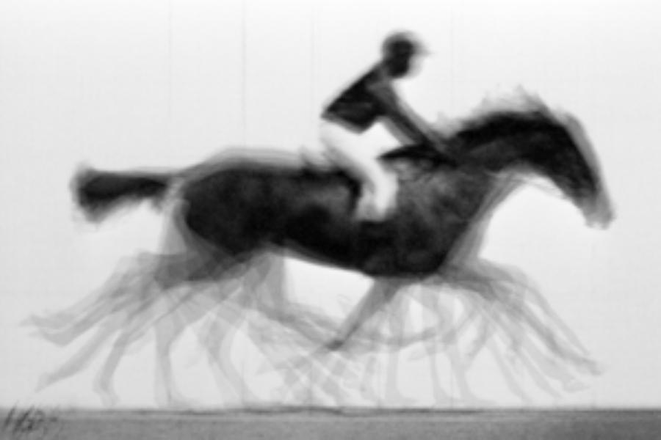
average structure: galloping horse

Slide 5
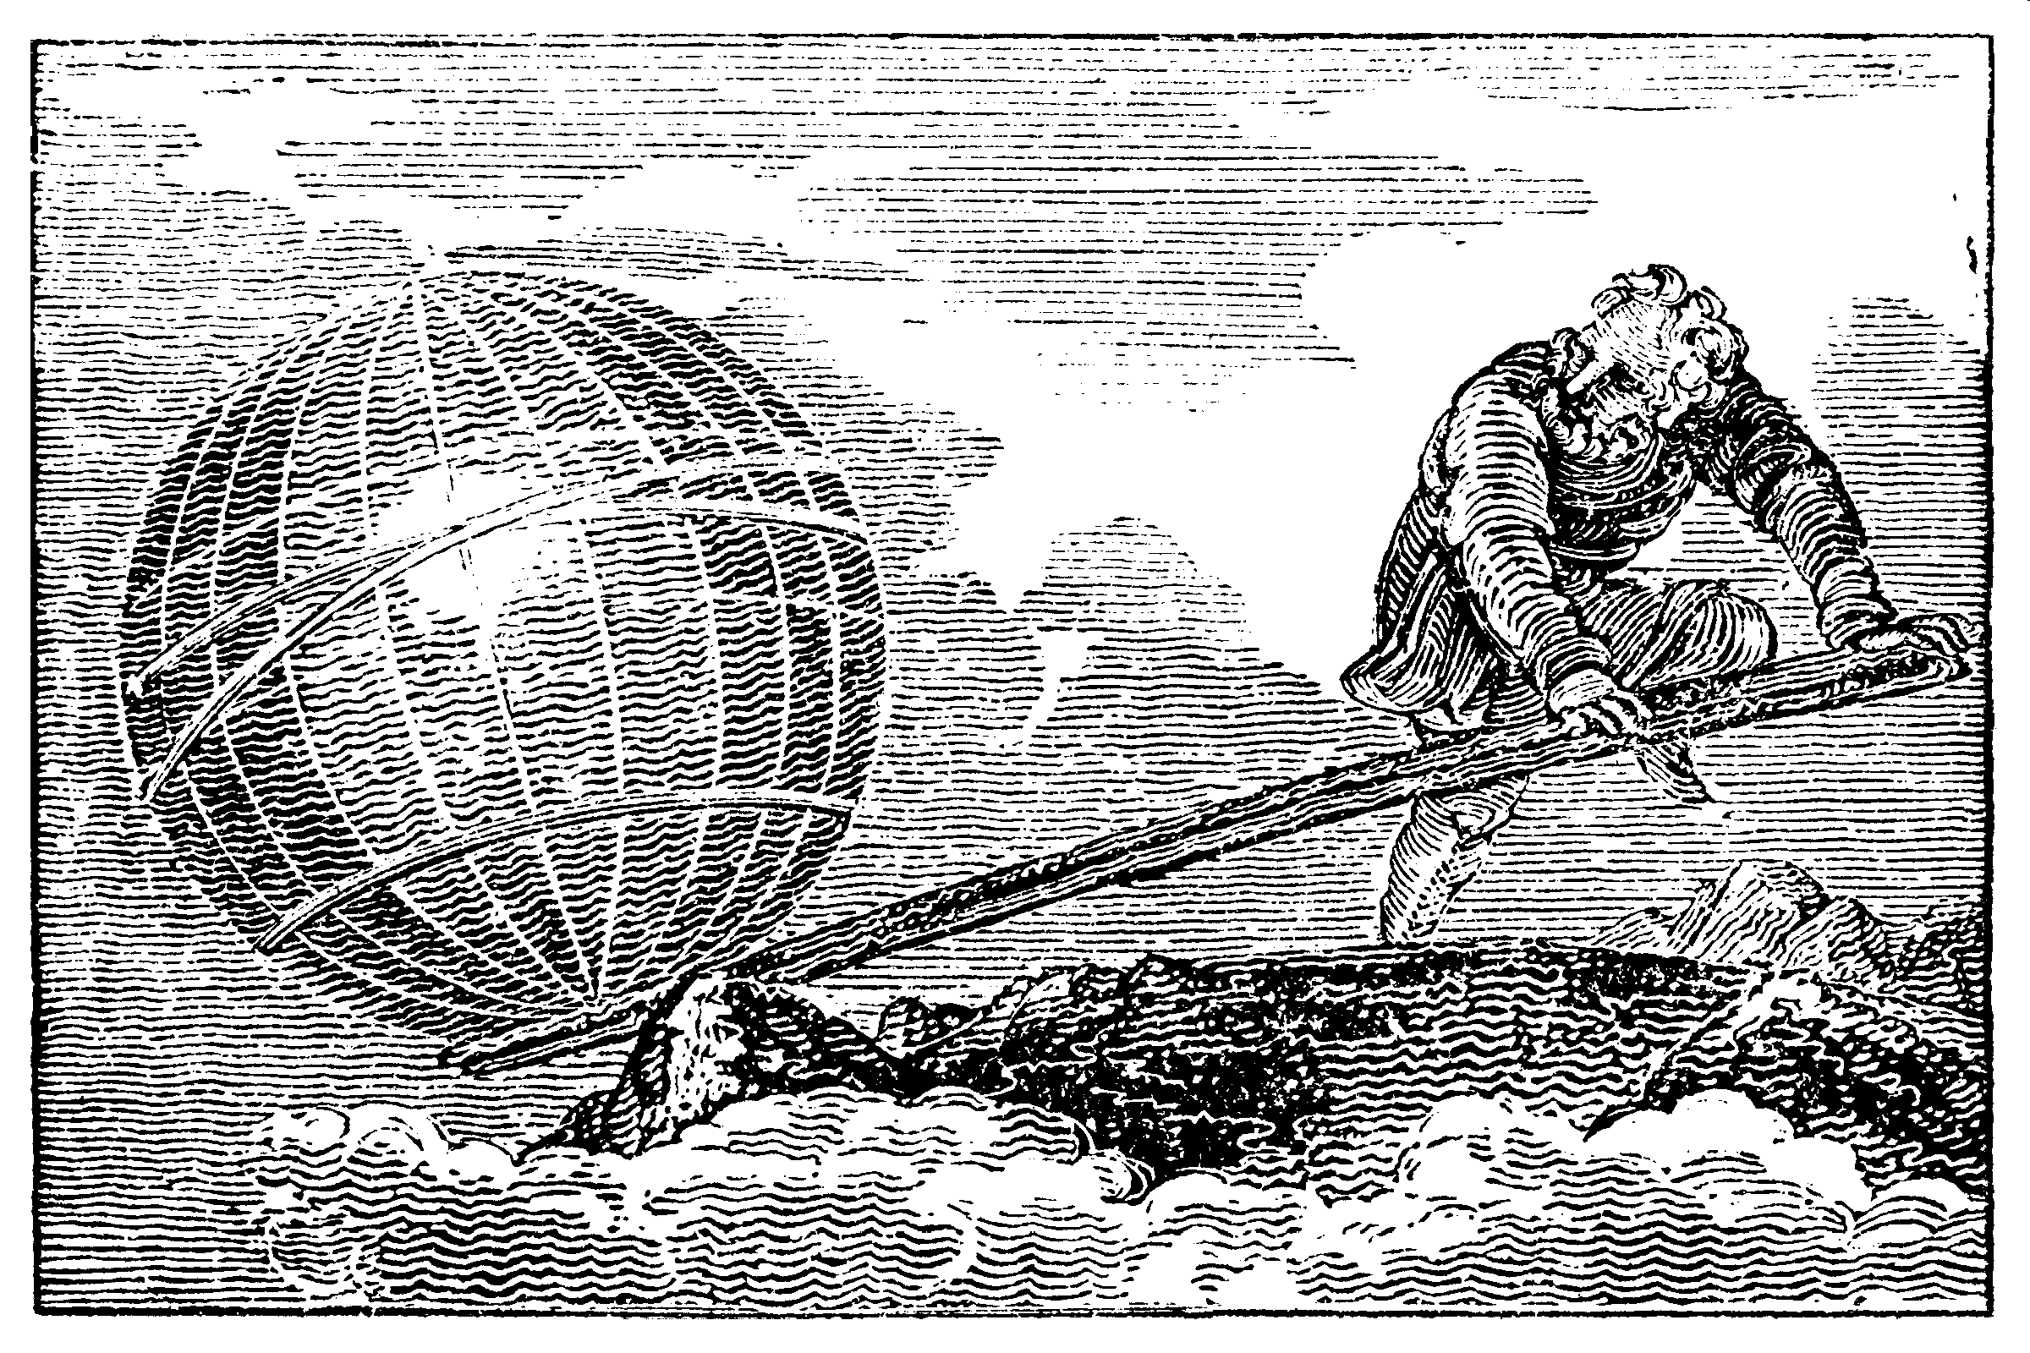
Anything is possible … with the right tools.

Slide 6
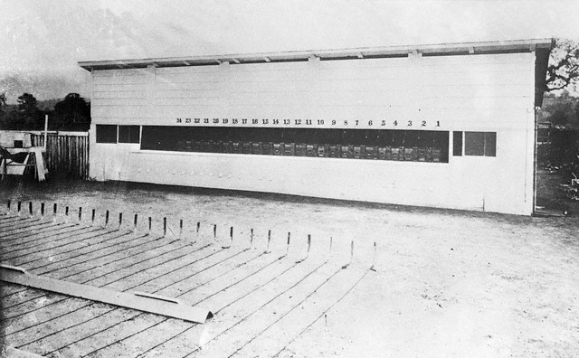
Muybridge’s multi-camera

Slide 7

Muybridge’s galloping horse (1878)

Slide 8
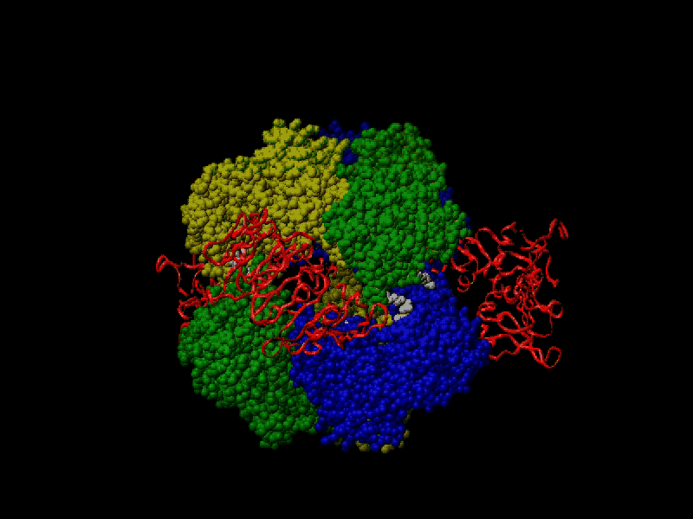
Hot questions: 21st century how do molecules work?
Beernink, Endrizzi, Alber & Schachman (1999). PNAS USA 96, 5388-5393.

Slide 9

a “crystal” of horses

Slide 10
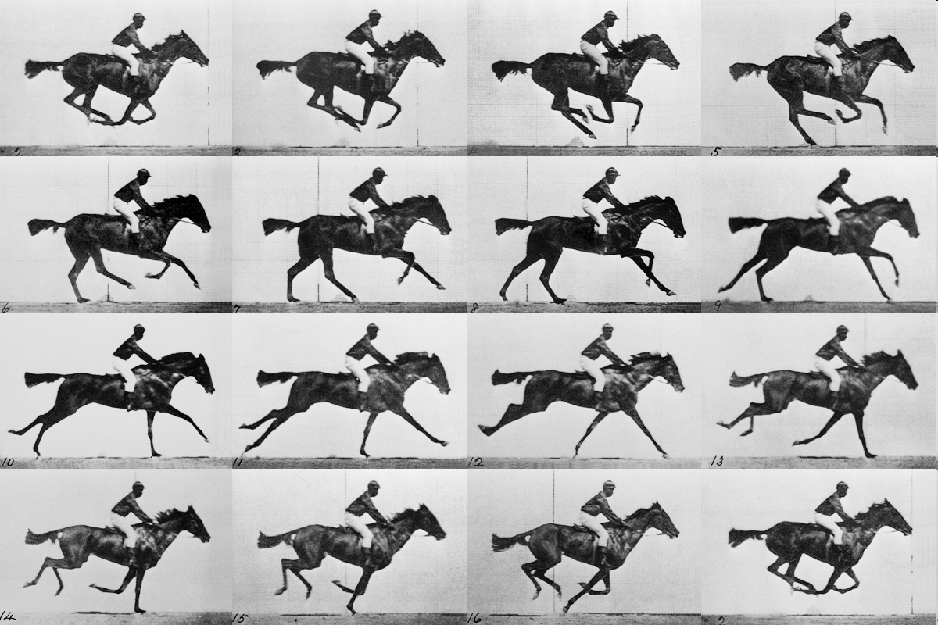
realistic “crystal” of horses

Slide 11
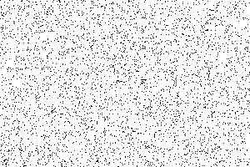
Not enough light

Slide 12
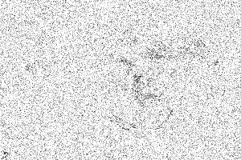
brighter light

Slide 13
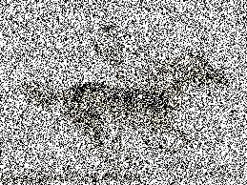
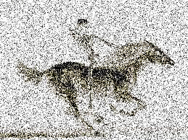
brighter light

Slide 14
even brighter

Slide 15
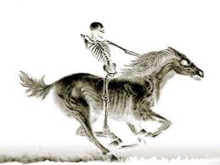
very bright light

Slide 16
average structure: galloping horse

Slide 17
Damage is done
by dose (MGy)
proportional to photons/area
not time
not heat
Sliz P, Harrison SC & Rosenbaum G (2003). Structure 11, 13-19.
Garman EF & McSweeney SM (2006). J. Sync. Rad. 14, 1-3.
Owen RL, Rudino-Pinera E & Garman EF (2006). PNAS 103, 4912-4917.
Leiros et al. (2006). Acta Cryst. D 62, 125-132.
Holton JM (2007). J. Synch Rad. 14, 51-72.

Slide 18
resolution dependence of global damage
10³
100
maximum tolerable dose (MGy)
10
1
1 2 3 5 7 10 20 40 70 100
resolution (Å)
Howells et al. (2009) J. Electron. Spectrosc. Relat. Phenom. 170 4-12

Slide 19
resolution dependence of global damage
10³
10 MGy/Å
100
maximum tolerable dose (MGy)
10
1
1 2 3 5 7 10 20 40 70 100
resolution (Å)
Howells et al. (2009) J. Electron. Spectrosc. Relat. Phenom. 170 4-12

Slide 20
Radiation Damage
World Records
MGy reaction reference
~45 global damage Owen et al. (2006)
5 Se-Met Holton (2007)
4 Hg-S Ramagopal et al. (2004)
4 R-C-COOH Garman et al. (2015)
3 S-S Murray et al. (2002)
1 Br-RNA Olieric et al. (2007)
~1? Cl-C ???
0.5 Mn in PS II Yano et al. (2005)
0.02 Fe in myoglobin Denisov et al. (2007)
Holton (2009) J. Synchrotron Rad. 16 133-42

Slide 21
what the is a MGy?
1 MGy = 10⁶ J/kg
http://bl831.als.lbl.gov/
damage_rates.pdf
Holton J. M. (2009) J. Synchrotron Rad. 16 133-42

Slide 22
How long will my crystal last?
synch line type flux beamsize flux density dose max xtal min site
ph/s μm ph/μm2/s rate lifetime lifetime
ALS 4.2.2 MAD 2.2e11 75x80 3.7e+07 27.3 kGy/s 18 m 73 s
ALS 5.0.1 mono 1.6e11 100 2.0e+07 10.4 kGy/s 48 m 3.2 m
ALS 5.0.2 MAD 8e11 100 1.0e+08 51.8 kGy/s 9.6 m 39 s
ALS 5.0.3 mono 1.7e11 100 2.2e+07 11 kGy/s 45 m 3 m
ALS 8.2.1 MAD 1.8e11 100 2.3e+07 11.7 kGy/s 43 m 2.9 m
ALS 8.2.2 MAD 2.3e11 100 2.9e+07 14.9 kGy/s 34 m 2.2 m
ALS 8.3.1 MAD 9e11 70 2.3e+08 119 kGy/s 4.2 m 17 s
ALS 8.3.1 typical 6e11 70 1.6e+08 115 kGy/s 4.3 m 17 s
ALS 12.3.1 MAD 1.8e11 100 2.3e+07 11.7 kGy/s 43 m 2.9 m
ALS 12.3.1 ML 4.0e12 100 5.1e+08 513 kGy/s 58 s 3.9 s
APS 8-BM MAD 1e11 200 2.5e+06 1.27 kGy/s 6.6 h 26 m
APS 14-BM-C mono 5.8e10 200 1.4e+06 738 Gy/s 11 h 45 m
APS 14-BM-D MAD 3.3e9 200 8.2e+04 42 Gy/s 8.3 d 13 h
APS 14-ID-B MAD 6.0e10 200 1.5e+06 763 Gy/s 11 h 44 m
APS 17-BM MAD 1.1e11 200 2.8e+06 1.4 kGy/s 6 h 24 m
APS 17-ID MAD 2.3e11 200 5.8e+06 2.93 kGy/s 2.8 h 11 m
APS 19-BM MAD 2.0e11 70x60 4.8e+07 24.2 kGy/s 21 m 83 s
APS 19-ID MAD 1.3e13 80x40 4.1e+09 2.07 MGy/s 15 s 0.97 s
APS 19-ID typical 5.5e11 100x100 5.5e+07 28 kGy/s 18 m 71 s
APS 22-BM MAD 7e12 80x40 2.2e+09 1.23 MGy/s 24 s 1.6 s
APS 22-ID MAD 7e12 80x40 2.2e+09 1.23 MGy/s 24 s 1.6 s
APS 22-ID typical 1.5e12 80 2.3e+08 119 kGy/s 4.2 m 17 s
APS 23-ID-B MAD 1e13 75x25 5.3e+09 3.01 MGy/s 10 s 0.66 s
APS 23-ID typical 1.5e12 80 2.3e+08 119 kGy/s 4.2 m 17 s
APS 24-ID-C MAD 1.3e13 20x60 1.1e+10 5.23 MGy/s 5.7 s 0.38 s
APS 24-ID-E MAD 0.5e13 20x100 2.5e+09 1.19 MGy/s 25 s 1.7 s
APS 31-ID MAD 2e12 70 4.1e+08 194 kGy/s 2.6 m 10 s

Slide 23
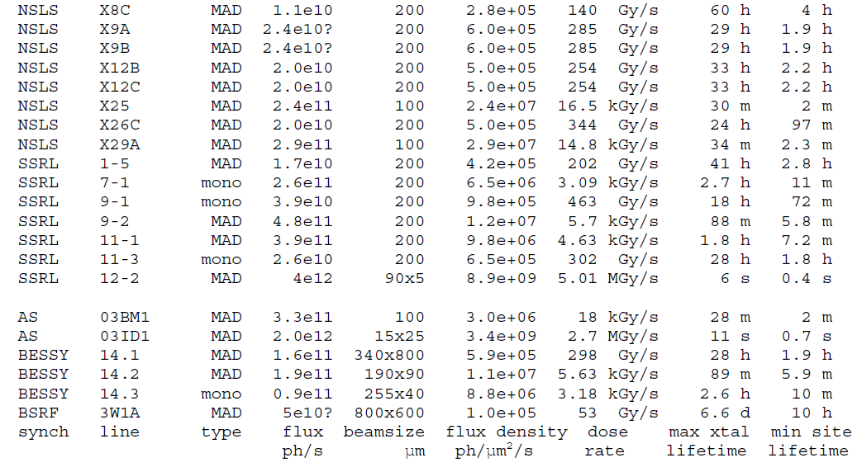
How long will my crystal last?
http://bl831.als.lbl.gov/damage_rates.pdf

Slide 24
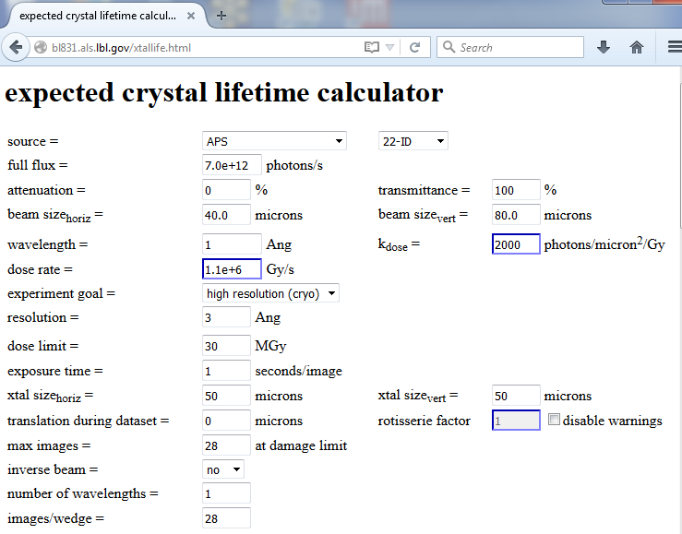

Slide 25
The number of photons scattered
before crystal is dead
is independent
of data collection time
1 um³ = 10⁶ photons (synch)
Henderson, 1990; Gonzalez & Nave, 1994; Glaeser et al., 2000; Sliz et al., 2003; Leiros et al., 2006; Owen et al., 2006; Garman & McSweeney, 2006; Garman & Nave, 2009; Holton, 2009

Slide 26

Dose slicing
unacceptable
damage
N
photons
crystal’s useful life
N
photons
unacceptable
read noise
N
photons

Slide 27
What if…
You only have a few small crystals?
Should you:
  Collect 360° from each?
  Collect 10° from each at 36x exposure?
  Glue 36 xtals together, then collect 360° ?
  Glue together and do 12960° ?
  http://bl1231.als.lbl.gov/~jamesh/dose_slice/results.html
5 μm & 1 MGy = 301,640,334 photons

Slide 28
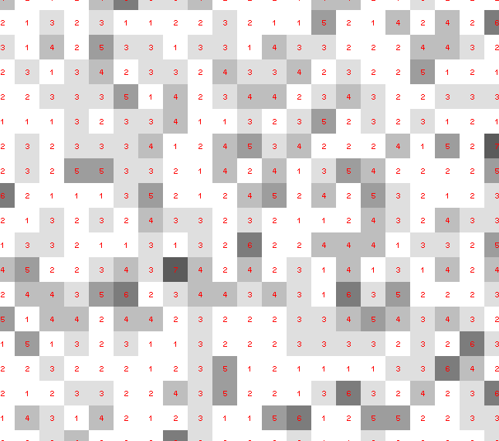
Dose slicing: is that a spot?

Slide 29
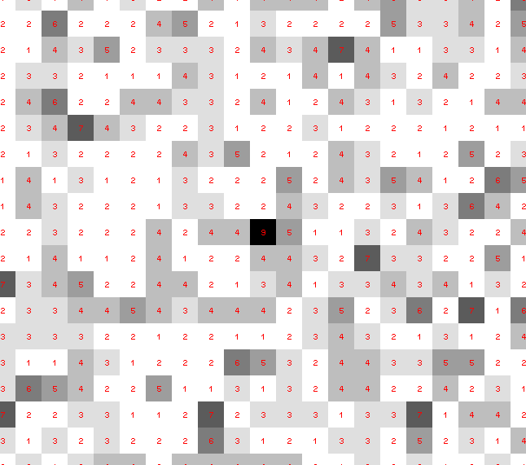
Dose slicing: is that a spot?

Slide 30
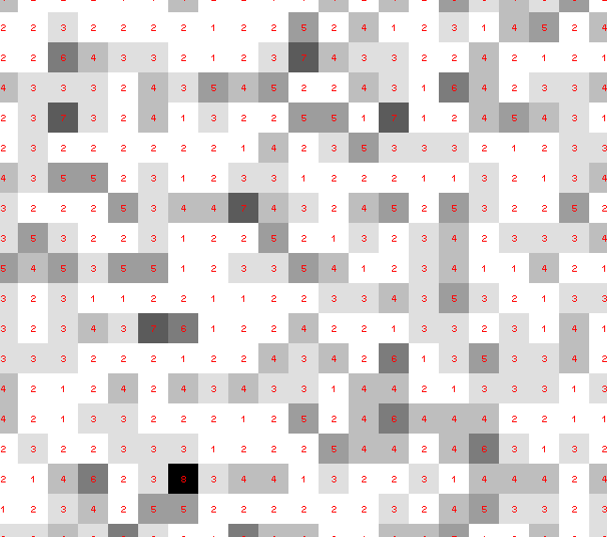
Dose slicing: is that a spot?

Slide 31
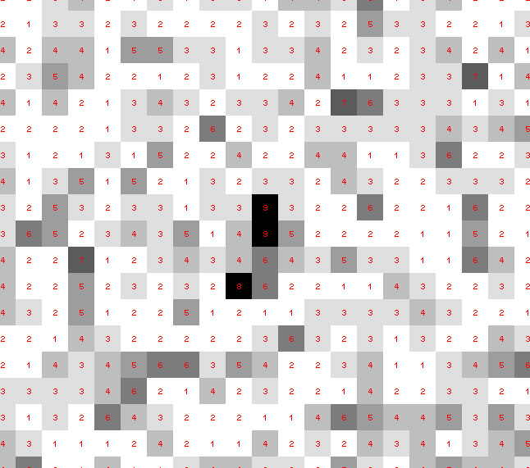
Dose slicing: is that a spot?

Slide 32
Dose slicing: is that a spot?

Slide 33
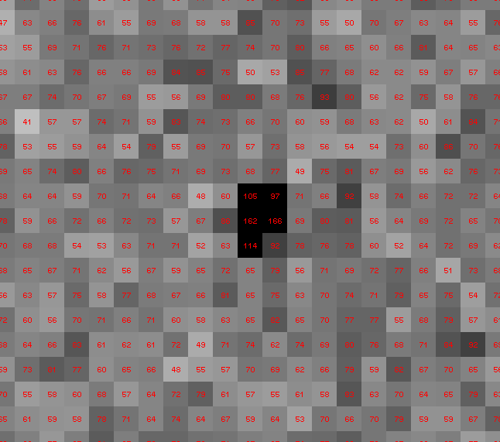
Dose slicing: is that a spot?

Slide 34
“true” resolution limit
CC vs right answer
Resolution (Å)

Slide 35
“true” resolution vs strategy
Dose slice collection scenario
fine | coarse | glue | Glue & fine
3.03874 | 3.02970 | 3.0270 | 3.02948
301,640,334 photons

Slide 36

Optimal exposure time
(faint spots on a CCD)
t_{hr} Optimal exposure time for data set (s)
t_{ref} exposure time of reference image (s)
bg_{ref} background level near weak spots on
reference image (ADU)
bg₀ ADC offset of detector (ADU)
bg_{hr} optimal background level (via t_{hr})
σ₀ rms read-out noise (ADU)
gain ADU/photon
m multiplicity of data set (including partials)
adjust exposure
so this is ~100

Slide 37
Optimal exposure time
(faint spots on a PAD)
t_{hr} Optimal exposure time for data set (s)
t_{ro} read-out time (s)
2.03 ms on PILATUS3 S
3 μs on EIGER

Slide 38
Optimal exposure time
(anomalous on a PAD)
2.03 ms
intensity
time

Slide 39
Optimal exposure time
(anomalous on EIGER)
0.003 ms
intensity
time

Slide 40
Optimal exposure time
(anomalous on a PAD)
PILATUS
>0.2 s/frame
EIGER
>0.0003 s/frame
t_{hr} Optimal exposure time (s)
t_{ro} read-out time (s)
2.03 ms on PILATUS3 S
3 μs on EIGER
= 20,000 frames
350 GB/dataset
11 seconds

Slide 41

Holton & Frankel (2010) Acta D 66 393-408.

Slide 42
Self-calibrated damage limit
Where:
⟨I⟩_{DL} - average damage-limited intensity (photons/hkl) at a given resolution
10⁵ - converting R from μm to m, r_{e} from m to Å, ρ from g/cm³ to kg/m³ and MGy to Gy
r_{e} - classical electron radius (2.818 x 10⁻¹⁵ m/electron)
h - Planck’s constant (6.626 x 10⁻³⁴ J∙s)
c - speed of light (299792458 m/s)
f_{decayed} - fractional progress toward completely faded spots at end of data set
ρ - density of crystal (~1.2 g/cm³)
R - radius of the spherical crystal (μm)
λ - X-ray wavelength (Å)
f_{NH} - the Nave & Hill (2005) dose capture fraction (1 for large crystals)
n_{ASU} - number of proteins in the asymmetric unit
M_{r} - molecular weight of the protein (Daltons or g/mol)
V_{M} - Matthews’s coefficient (~2.4 Å³/Dalton)
H - Howells’s criterion (10 MGy/Å)
θ - Bragg angle
⟨ƒ_{a}²⟩ - number-averaged squared structure factor per protein atom (electron²)
⟨M_{a}⟩ - number-averaged atomic weight of a protein atom (~7.1 Daltons)
B - average (Wilson) temperature factor (Å²)
μ - attenuation coefficient of sphere material (m⁻¹)
μ_{en} - mass energy-absorption coefficient of sphere material (m⁻¹)
No flux
No symmetry
Holton & Frankel (2010) Acta D 66 393-408.

Slide 43
Bigger is better, but not by much
B = 20
B = 60
B = 0
B = 170
B = 330
B = 560
Resolution (Å)
B = 850
Crystal diameter (micron)

Slide 44
Increased exposure won’t make the target sit still

Slide 45
Timescales of radiation damage
Garret et. al. (2005) Chem. Rev. 105, 355-389

Slide 46
Timescales of radiation damage
LCLS
synch
bunch
Garret et. al. (2005) Chem. Rev. 105, 355-389

Slide 47
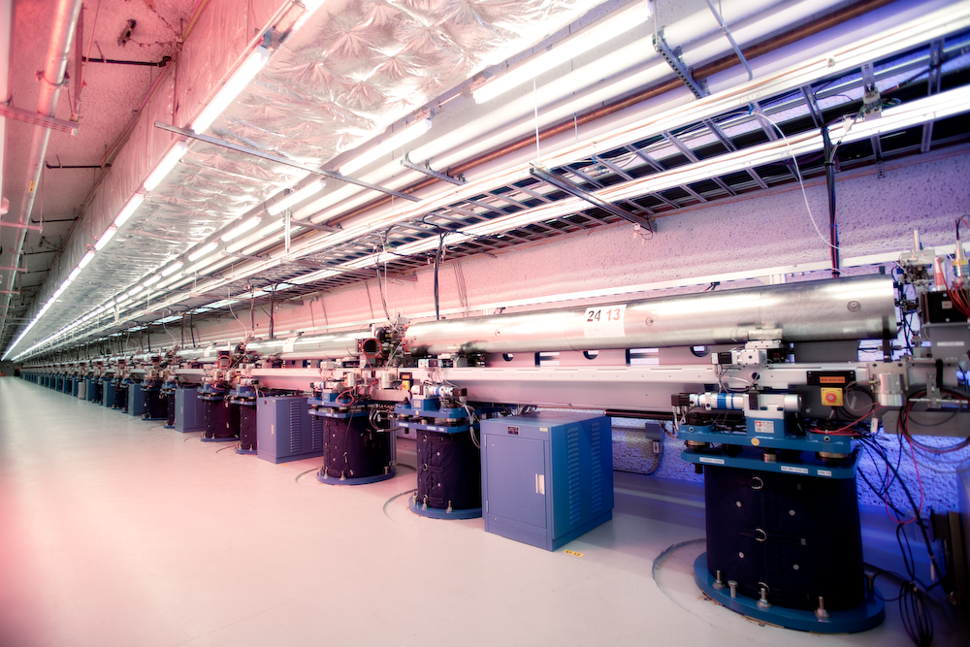
LCLS: outrunning damage

Slide 48
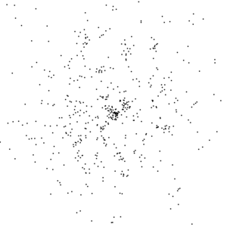
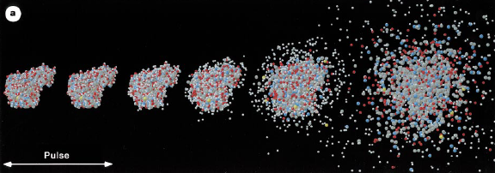
Realistic single-particle prediction
10¹² photon/pulse
100 nm focus

Slide 49
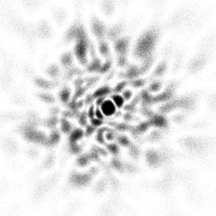
Realistic single-particle prediction
10¹² photon/pulse
3 nm focus

Slide 50

lysozyme: real and reciprocal

Slide 51
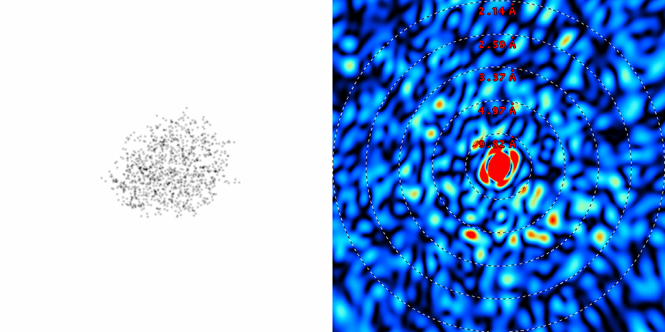
lysozyme: thermal motion

Slide 52
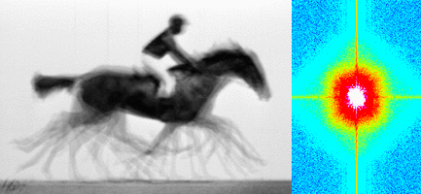
Muybridge’s galloping horse (1878)
Average electron density
Real space
reciprocal

Slide 53
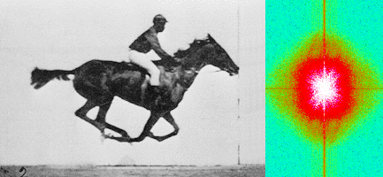
Muybridge’s galloping horse (1878)
“Time-resolved” diffraction
Real space
reciprocal

Slide 54
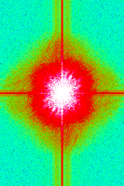
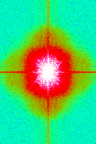
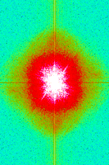
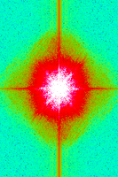
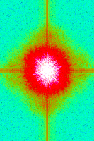
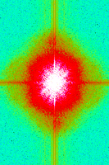
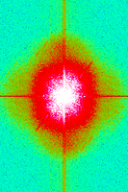
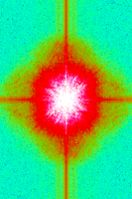
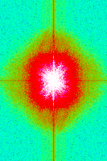
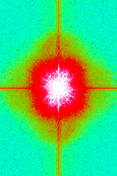
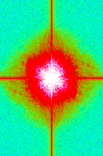
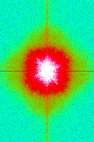
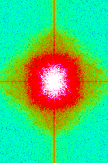
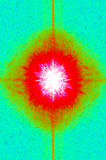
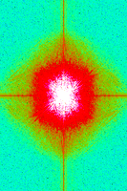
Single-image model refinement?
Supporting a 4D model with 2D data

Slide 55
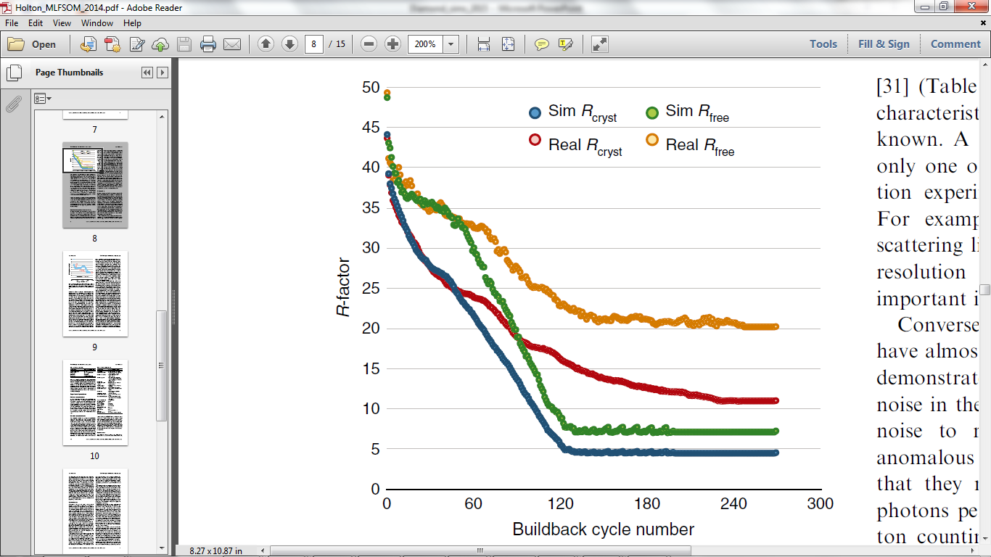
The R-factor Gap
Holton et al. (2014) "The R-factor gap", FEBS J. 281, 4046-4060.

Slide 56
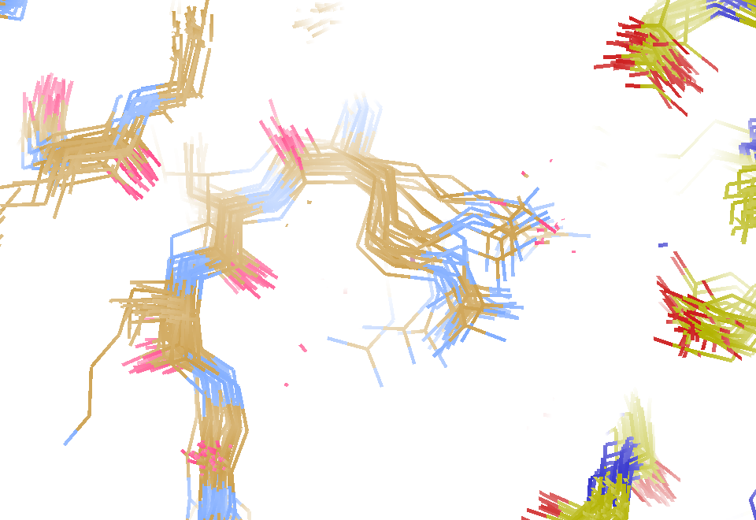
MD simulation: 30 conformers from 24,000
Cerutti et al. (2010).J. Phys. Chem. B 114, 12811-12824.

Slide 57
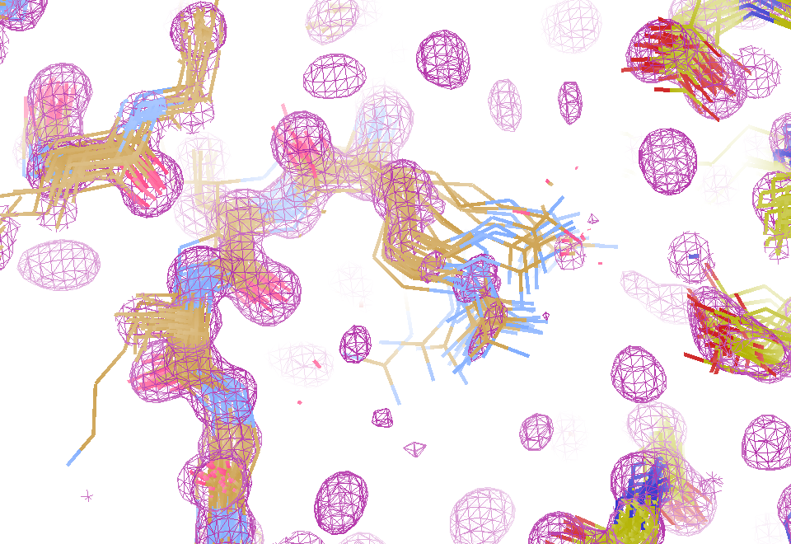
Electron density from 24,000 conformers

Slide 58
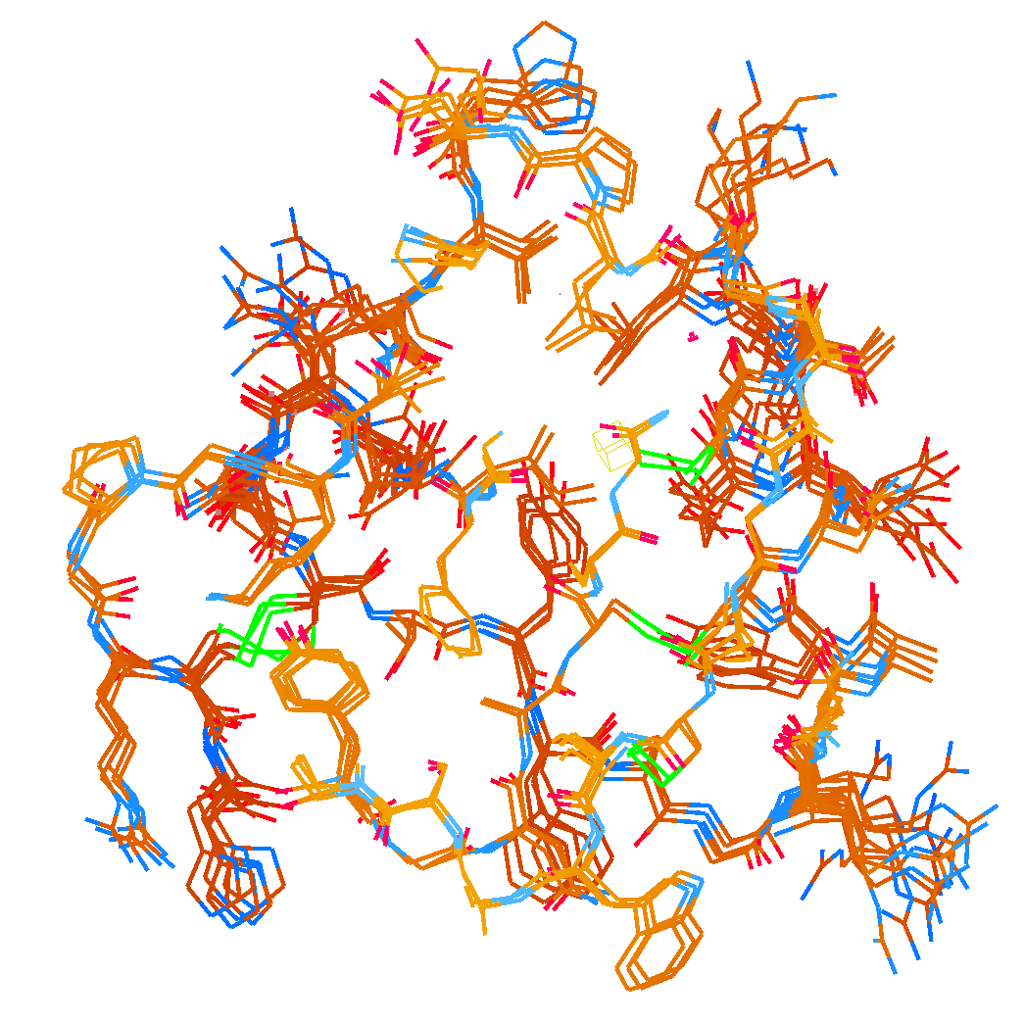
How many “conformers” are needed?
Answer: 2-14
R_{work} = 0.0441
R_{free} = 0.0516
vs F_{sim}
No solvent!

Slide 59
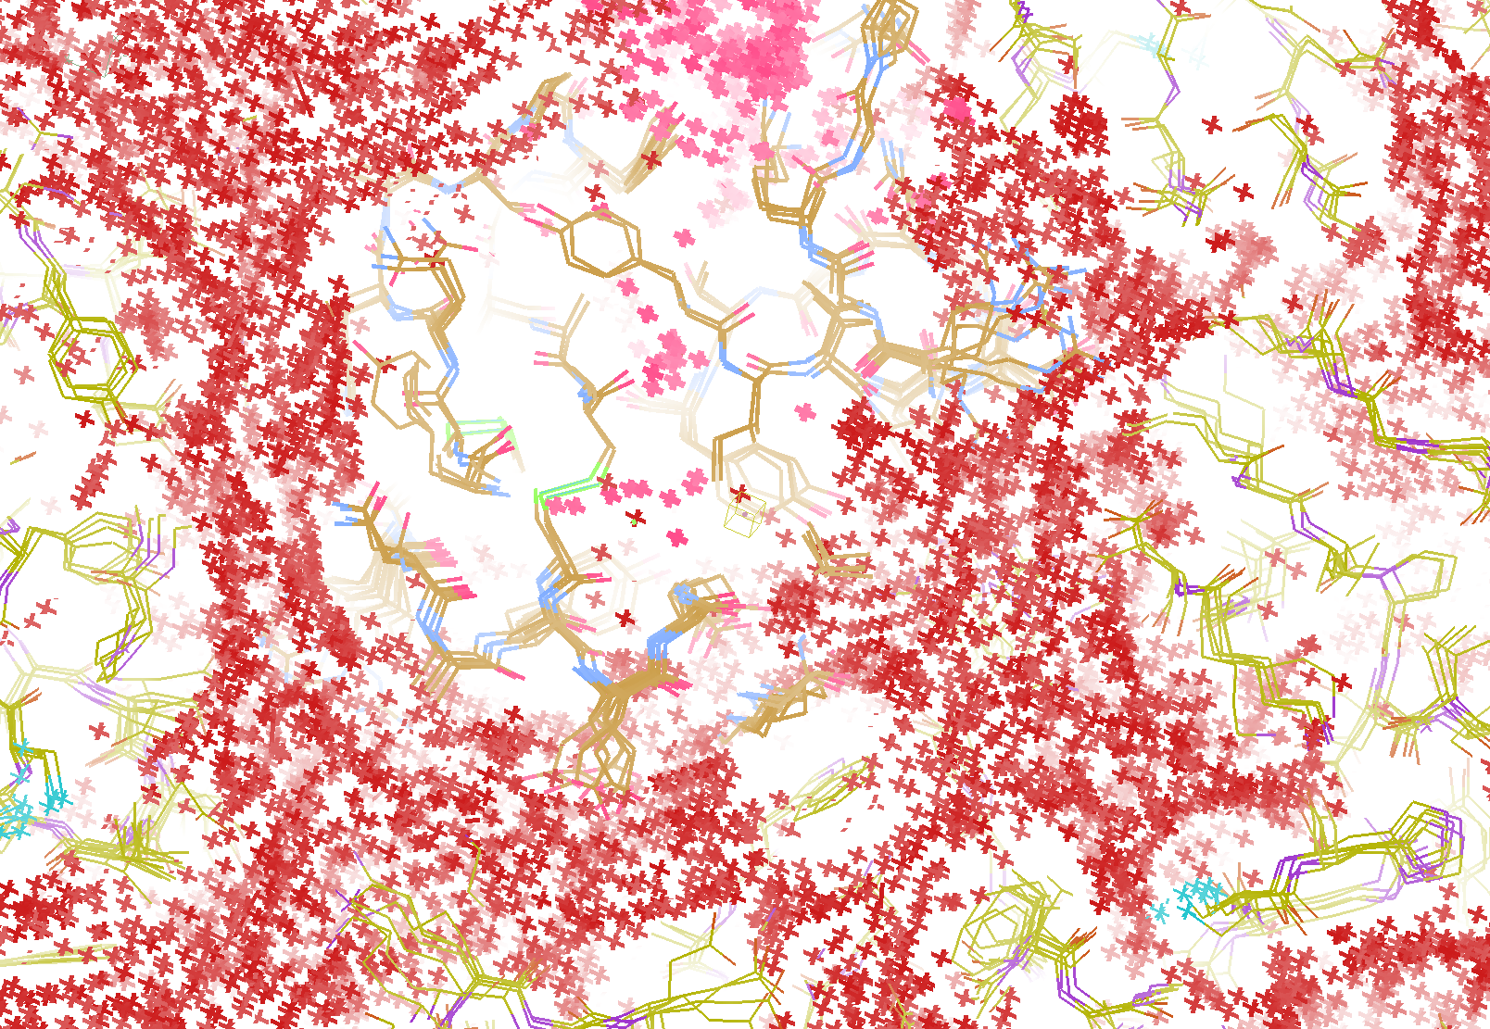
How do you model solvent?
R_{work} = 0.0309
R_{free} = 0.0678
vs F_{sim}
Problem: diverges with more cycles

Slide 60
“R-factor Gap” for macromolecules
Publication criterion for chemical crystallography:
R1 < 2*R_{sigma}
R1 = F_{o} vs F_{c} for I/σ(I) > 3
R_{sigma} = <σ(I)>/<I>
There are no PDB entries that pass this test!
Holton et al. (2014) "The R-factor gap", FEBS J. 281, 4046-4060.

Slide 61
Status of macromolecular representation:
Even if we knew the “right answer”
it would blow up.

Slide 62
Threshold of a revolution in phasing
Current
technology
Goal
Solve-able proteins (%)
Required signal-to-noise (I/σ)

Slide 63
Can you count to 1,000,000 ?
sqrt(1,000,000)
1,000,000
Theoretically:
= 0.1%
R_{meas} ≈ 0.1% ?
ISa = 1000
In reality:
ISa ~ 33
R_{meas =} ≈ 3%
sqrt(1,000)
1,000
= 3%
photon
spot
> 1000 is a waste!

Slide 64
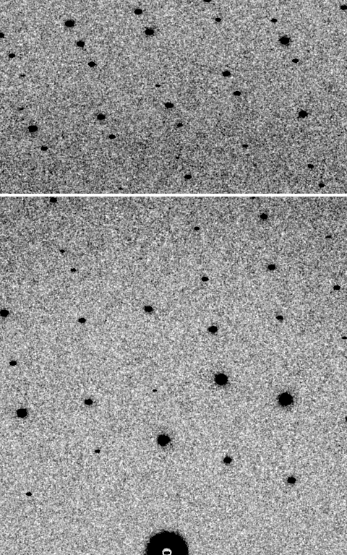
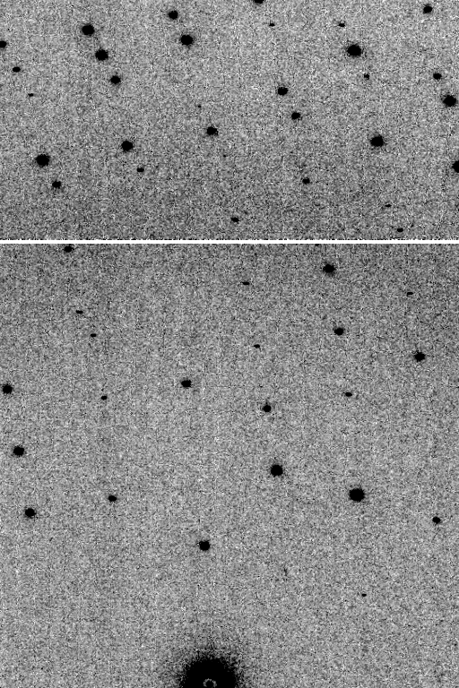
Is it Real? Or is it MLFSOM
simulated
real
Holton et al (2014) "R-factor gap", FEBS Journal 281, 4046-4060.

Slide 65
Threshold of a revolution in phasing
Source of error | realistic simulation | No SHSSS | Perfect detector
Photon counting | + | + | +
Shutter jitter | + | + | -
Beam flicker | + | + | -
Sample absorption | + | + | -
Radiation damage | + | + | -
Imperfect spindle | + | + | -
vignette | + | + | -
Corner correction | + | + | -
SHSSS | + | - | -
R_{meas} (∞-10 Å) | 2.8% | 0.7% | 0.7%
I/σ asymptotic | 26.8 | 74.2 | 81.0
Holton et al (2014) "R-factor gap", FEBS Journal 281, 4046-4060.

Slide 66
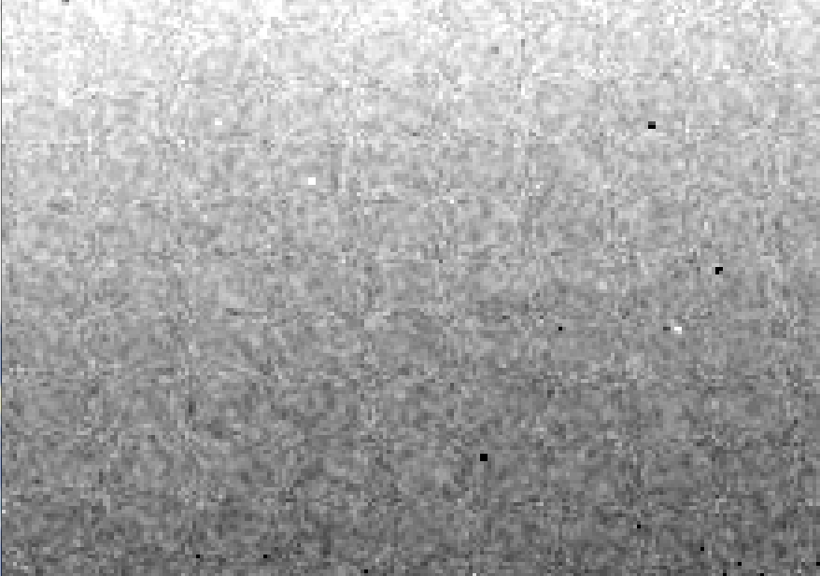
CCD calibration: 7235 eV

Slide 67
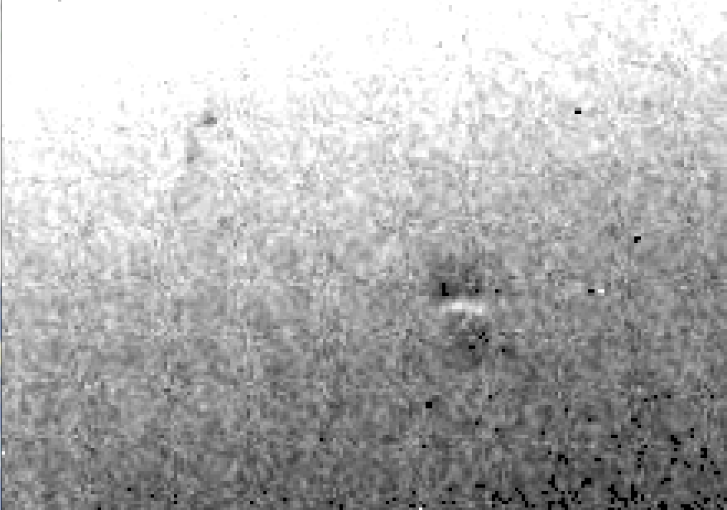
CCD calibration: 7247 eV

Slide 68
Gadox calibration vs energy
same = good!
Relative absorption depth
bad!
photon energy (keV)

Slide 69
Data collection parameters:
16 crystals
360° each, inverse beam
7235 eV photon energy
< 1 MGy per xtal
Australian Synchrotron MX1
  35 kGy/s into 100 μm x 100 μm

Slide 70
140-fold multiplicity: 16 crystals, 360° each, inverse beam, 7235 eV
RESOLUTION COMPLETENESS R-FACTOR I/SIGMA R-meas CC(1/2) Anomal SigAno Nano
LIMIT OF DATA observed Corr
9.17 99.1% 3.9% 257.47 3.9% 100.0* 91* 5.024 450
6.49 100.0% 5.2% 214.33 5.2% 100.0* 86* 3.836 882
5.30 100.0% 7.2% 165.13 7.2% 100.0* 76* 3.257 1175
4.59 100.0% 7.2% 175.42 7.3% 100.0* 67* 2.589 1403
4.10 99.9% 7.7% 174.13 7.7% 100.0* 59* 2.264 1594
3.74 99.9% 9.4% 143.09 9.4% 100.0* 49* 1.953 1783
3.47 100.0% 11.2% 120.17 11.2% 100.0* 39* 1.696 1942
3.24 100.0% 14.1% 91.14 14.1% 100.0* 30* 1.333 2103
3.06 99.9% 19.5% 65.79 19.5% 100.0* 23* 1.117 2214
2.90 99.9% 29.0% 44.85 29.1% 99.9* 17* 1.008 2369
2.77 99.9% 40.5% 32.58 40.6% 99.8* 11* 0.901 2493
2.65 99.9% 52.8% 25.16 52.9% 99.8* 10* 0.866 2605
2.54 100.0% 67.4% 19.47 67.6% 99.6* 2 0.804 2705
2.45 100.0% 88.9% 14.58 89.2% 99.2* 4 0.831 2859
2.37 100.0% 109.3% 9.97 109.7% 98.1* 5 0.829 2925
2.29 100.0% 138.2% 6.87 138.9% 96.1* 1 0.760 3037
2.22 100.0% 197.1% 4.03 198.6% 83.5* -1 0.721 3159
2.16 100.0% 227.3% 2.41 230.8% 46.9* -1 0.677 3224
2.10 61.2% 154.4% 1.28 163.6% 47.0* -2 0.660 1999
2.05 47.9% 170.1% 0.68 196.5% 25.7* 3 0.629 1578
total 93.3% 15.7% 54.30 15.8% 100.0* 12* 1.217 42499

Slide 71
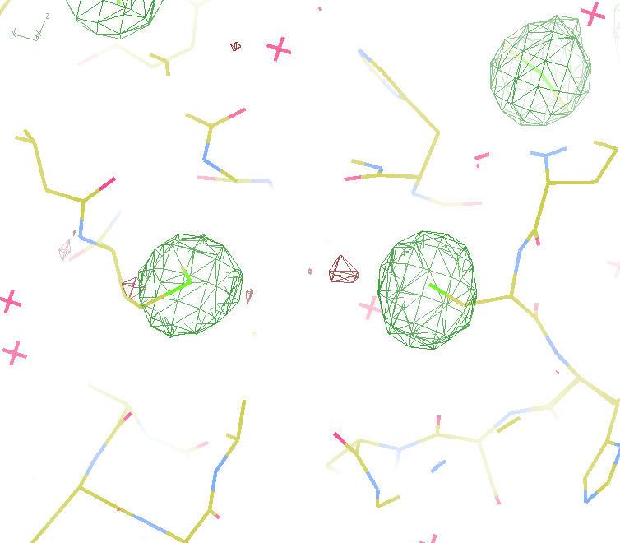
140-fold multiplicity
18 σ
16 σ
Phased anomalous difference Fourier

Slide 72
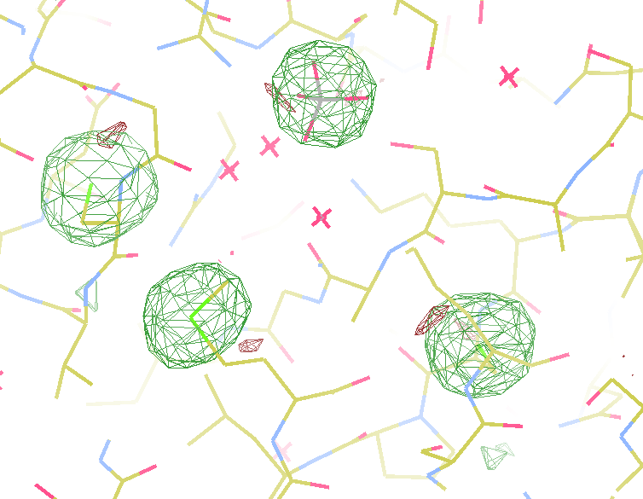
140-fold multiplicity
15σ = PO₄
Phased anomalous difference Fourier

Slide 73

140-fold multiplicity
~2σ = Mg?
Phased anomalous difference Fourier

Slide 74

140-fold multiplicity
8.2σ = Mg or Na
DELFAN residual anomalous difference

Slide 75

Pilatus: subtract smooth baseline
~3x10⁵ photon/pixel
Bragg
glitch
“tree rings”
Pick-up tool mark
oxygen
inclusions
1% high
average
1% low

Slide 76

3.5
3.0
2.5
2.0
1.5
1.0
0.5
CCD detector
different
modules
anomalous mates are always on
different modules
SHSSS
Systematic component of R_{sseparate} (%)
Pilatus
SN001
New
Pilatus
SN113
0.1 1 10 100
distance between spots (mm)
Notes:
Comparision of SHSSS measured by the detector-shift experiment on three different detectors:
The Q315R in ALS 8.3.1
The first Pilatus detector at the Swiss Light Soruce
A newer Pilatus detector at Stanford
Improvements in calibration technology have finally made
Pilatus competitive with calibration on CCDs

Slide 77
non-isomorphism
Why doesn’t everyone do
Multi-crystal averaging?

Slide 78
Non-isomorphism in lysozyme
Dear James
The story of the two forms of lysozyme crystals goes back to about 1964 when it was found that the diffraction patterns from different crystals could be placed in one of two classes depending on their intensities. This discovery was a big set back at the time and I can remember a lecture title being changed from the 'The structure of lysozyme' to 'The structure of lysozyme two steps forward and one step back'. Thereafter the crystals were screened based on intensities of the (11,11,l) rows to distinguish them (e.g. 11,11,4 > 11,11,5 in one form and vice versa in another). Data were collected only for those that fulfilled the Type II criteria. (These reflections were easy to measure on the linear diffractometer because crystals were mounted to rotate about the diagonal axis). As I recall both Type I and Type II could be found in the same crystallisation batch . Although sometimes the external morphology allowed recognition this was not infallible.
The structure was based on Type II crystals. Later a graduate student Helen Handoll examined Type I. The work, which was in the early days and before refinement programmes, seemed to suggest that the differences lay in the arrangement of water or chloride molecules (Lysozyme was crystallised from NaCl). But the work was never written up. Keith Wilson at one stage was following this up as lysozyme was being used to test data collection strategies but I do not know the outcome.
An account of this is given in International Table Volume F (Rossmann and Arnold edited 2001) p760.
Tony North was much involved in sorting this out and if you wanted more info he would be the person to contact. I hope this is helpful. Do let me know if you need more.
Best wishes
Louise

Slide 79
Non-isomorphism in lysozyme
Structure factor (e⁻)
Johnson’s ratio

Slide 80
Non-isomorphism in lysozyme
Structure factor (e⁻)
Johnson’s ratio

Slide 81


Slide 82

Non-isomorphism in lysozyme
RMSD = 0.18 Å
Δcell = 0.7 %
R_{iso} = 44.5%
3aw6
3aw7
RH: 84.2%
vs 71.9%

Slide 83
X-ray Data Sets
Singular values & vectors
data
set
h,k,l | structure factors (F)
 | #1 | #2 | #3 | #4
5,3,4 | 523.7 | 559.8 | 579.9 | 603.2
5,4,4 | 168.2 | 166.6 | 177.2 | 196.1
5,5,4 | 34.9 | 26.4 | 19.2 | 17.3
6,1,4 | 305.7 | 301.1 | 298.1 | 296.3
6,2,4 | 353.0 | 353.9 | 356.2 | 366.9
6,3,4 | 300.9 | 285.3 | 273.5 | 259.4
6,3,5 | 223.8 | 226.3 | 234.6 | 251.4
… | … | … | … | …
h,k,l | 100% | 17 % | 13 % | 9 %
 | 1st | 2nd | 3rd | 4th
5,3,4 | -1.46 | -0.02 | 1.84 | -0.72
5,4,4 | -0.88 | -0.29 | -0.34 | 0.15
5,5,4 | -0.42 | -0.65 | 1.02 | 1.47
6,1,4 | -0.90 | -0.85 | 1.44 | -0.40
6,2,4 | -1.20 | -0.37 | 0.67 | 0.01
6,3,4 | -0.75 | 0.31 | 0.48 | 0.00
6,3,5 | -0.75 | -0.85 | 0.72 | -0.82
… | … | … | … | …
value
vector
Singular value decomp.
SVD
-0.68
-0.24
0.32 …
CC1
Data sets
Positioned
in
“Correlation
Space”
Correlation
Coefficients
CC1 CC2 CC3
CC2
data set #1
data set #2
data set #3
CC3

Slide 84


Slide 85
Structure factor (electrons)
Correlation to 2nd & 3rd singular vectors

Slide 86
Structure factor (electrons)
Correlation to 2nd & 3rd singular vectors

Slide 87
Structure factor (electrons)
Correlation to 2nd & 3rd singular vectors

Slide 88

Bragg’s “minimum wavelength principle”
Perutz (1985). “Early Days of Cryst…” Methods in Enzymology, Vol. 114, 3-18.
Bragg & Perutz (1952)."external form haemoglobin I", Acta Cryst. 5, 277-283.

Slide 89

DMMULTI – fake data
4 deg rotation: 8 “xtals”: before
CC = 0.02

Slide 90

DMMULTI – fake data
4 deg rotation: 8 “xtals”: after
CC = 0.8

Slide 91
Non-isomorphism in lysozyme
Dear James
The story of the two forms of lysozyme crystals goes back to about 1964 when it was found that the diffraction patterns from different crystals could be placed in one of two classes depending on their intensities. This discovery was a big set back at the time and I can remember a lecture title being changed from the 'The structure of lysozyme' to 'The structure of lysozyme two steps forward and one step back'. Thereafter the crystals were screened based on intensities of the (11,11,l) rows to distinguish them (e.g. 11,11,4 > 11,11,5 in one form and vice versa in another). Data were collected only for those that fulfilled the Type II criteria. (These reflections were easy to measure on the linear diffractometer because crystals were mounted to rotate about the diagonal axis). As I recall both Type I and Type II could be found in the same crystallisation batch . Although sometimes the external morphology allowed recognition this was not infallible.
The structure was based on Type II crystals. Later a graduate student Helen Handoll examined Type I. The work, which was in the early days and before refinement programmes, seemed to suggest that the differences lay in the arrangement of water or chloride molecules (Lysozyme was crystallised from NaCl). But the work was never written up. Keith Wilson at one stage was following this up as lysozyme was being used to test data collection strategies but I do not know the outcome.
An account of this is given in International Table Volume F (Rossmann and Arnold edited 2001) p760.
Tony North was much involved in sorting this out and if you wanted more info he would be the person to contact. I hope this is helpful. Do let me know if you need more.
Best wishes
Louise

Slide 92
Elastic deformation
= non-isomorphism

Slide 93
Elastic deformation
= non-isomorphism

Slide 94
Plastic deformation
= poor diffraction

Slide 95
Plastic deformation
= poor diffraction

Slide 96
Dehydration: 1934
and 2016?
= 1.5 μL
100 μm
= 1.0 nL
2 mm
= 1.0 pL
10 μm
= 1.0 fL
1 μm

Slide 97
OK! OK!
Now I am afraid!
What should I do?

Slide 98
… but does it work for membrane proteins?
CCP4BB:
“We used it for a large membrane protein complex and diffraction improved from ~7 to 2.7 A. The crystal is fished out and put into mother liquor solution in the button, sealed with dialysis membrane and the button is then placed into about 5 mls of mother liquor with slightly higher PEG concentration. Then you just exchange outside buffer every day or so for solutions containing higher concentrations of PEG. We went from ~9 to 30 % PEG4000 in about a week. You can easily observe crystal under microscope and if it cracks - you went too far/too quickly with PEG and need to use a bit less next time. Also, this method allows you to control all other components of the dehydrating solution - we needed to decrease salt concentration at the same time as increasing PEG. You can also introduce/increase cryo-protectant concentration at the same time. With these crystals, otherwise excellent dehydration machines already mentioned did not work, possibly because the process had to be really slow.”
Efremov, R. G. & Sazanov, L. A. (2011)."Structure of the membrane domain of respiratory complex I", Nature 476, 414-420.
“To improve diffraction properties, crystals were slowly cooled to 4 C, placed into micro-dialysis buttons, and mother liquor was exchanged by dialysis for 0.1 M sodium acetate (pH 4.8), 0.15 M sodium tartrate (pH 5.0), 30% PEG4000, 0.1% sodium cholate and 12.5% glycerol over a period of 5 days.”

Slide 99





oil is your friend

Slide 100
opened drop: you have ~30 seconds!
oil

Slide 101
oiled drop: you have ~3 hours
oil

Slide 102
Dabbing to remove excess
clean surface

Slide 103
Dabbing to remove excess
clean surface

Slide 104
Dabbing to remove excess
clean surface

Slide 105
Dabbing to remove excess
clean surface

Slide 106
Dabbing to remove excess
clean surface

Slide 107
Dabbing to remove excess
clean surface

Slide 108
Dabbing to remove excess
clean surface

Slide 109
X-ray scattering “rules”:
1 μm crystal ≈ 1 μm water
≈ 1 μm plastic
≈ 0.1 μm glass
≈ 1000 μm air
you want:
air gap < 1000x xtal size

Slide 110
Non-crystal stuff in the beam
Too much
Just right
Too little

Slide 111
Sources of error for weak spots
Beam intensity sqrt(seconds)
Radiation damage (10 MGy/Å)
Illuminated volume (size³)
Background sqrt(I_{spot}+I_{bg})
Disorder (e^{-B})

Slide 112
Fine Slicing
background
background
Pflugrath, J. W. (1999)."The finer things in X-ray diffraction data collection", Acta Cryst. D 55, 1718-1725.

Slide 113
Background scattering

Slide 114
Mosquito tips cost $0.15 each
So do EIGER pixels!
You just bought 18x10⁶
Use them!
(they are reusable)

Slide 115
Always better to match beam to target size
Resolution (Å)
too big
too small
just right
X-ray beam size (μm)

Slide 116

Now What?
10 Å

Slide 117

Ways to improve diffraction
New crystal form
Purify
  - add a column
  - heat shock
Bind something
  - Known ligand
  - Silver bullets
Change the clone
  - chop off floppy bits
  - homolog
  - Ala -> Lys mutants
Make Protein Sit Still!!!
Heras B & Martin JL (2005) Acta Cryst. D61, 1173-1180.
Newman J. (2006) Acta Cryst. D62 27-31.

Slide 118
Basic Principles
“Hell, there are NO RULES here - we're trying to accomplish something.”
Thomas A. Edison – inventor
“You’ve got to have an ASSAY.”
Arthur Kornberg – Nobel Laureate
“Control, control, you must learn CONTROL!”
Yoda – Jedi Master

Slide 119
URL Summary
http://bl831.als.lbl.gov/~jamesh/powerpoint/
UQ_averaging_2016.pptx
http://bl831.als.lbl.gov/xtalsize.html
http://bl831.als.lbl.gov/xtallife.html
Averaging is good for phasing
Averaging + disorder destroys resolution
Averaging + isomorphism = good for resolution
Humidity = isomorphism
Dose-slice with EIGER
The future = better models for “disorder”

Slide 120

The Future of Structural Biology
We need
better
data
We need
better
models
grand challenge for the 21st century

Slide 121
Grand Challenges in Structural Biology
Phase Problem
Better detector calibration
non-isomorphism phasing?
Amplitude Problem
    Revolution in sample handling
    Get around averaging (better models)
R-factor Gap
    Better models for “disorder” (function)
    If we had right answer, it would blow up!

Slide 122
Suggested anomalous protocol:
360° in < 5 MGy
move detector
4X exposure
goto 2
2 wavelengths are better than 1
- (peak + inf)/2, and remote
MAD, not M-SAD!

Slide 123

Real XFEL still

Slide 124

Simulation of XFEL still

Slide 125
XFEL: “fit” simulation to reality
Dispersion
Divergence
Mosaicity
Wavelength
Unit cell parameters (3)
Crystal orientation (3)
Mosaic domain size (3)
Beam center (2)
Beam direction (2)
Detector distance

Slide 126



Simulation of XFEL still
phix
phiy
phiz
real
VS
phix
phiy
phiz

Slide 127

Systematic error does not “average out”

