Slide 1
Acknowledgements
Robert Stroud James Fraser Aina Cohen Ana Gonzalez
Axel Brunger Monarin Uervirojnangkoorn Artem Lyubimov Nick Sauter
UCSF LBNL SLAC
ALS 8.3.1 creator: Tom Alber
UC Multicampus Research Programs and Initiatives (MRPI)
UCSF Program for Breakthrough Biomedical Research (PBBR)
one-time NIH-DOE Inter-agency agreement (IAA)
Integrated Diffraction Analysis Technologies (IDAT)
Plexxikon, Inc.
M D Anderson CRC
Synchrotron Radiation Structural Biology Resource (SLAC)
The Advanced Light Source is supported by the Director, Office of Science, Office of Basic Energy Sciences, Materials Sciences Division, of the US Department of Energy under contract No. DE-AC02-05CH11231 at Lawrence Berkeley National Laboratory.

Slide 2
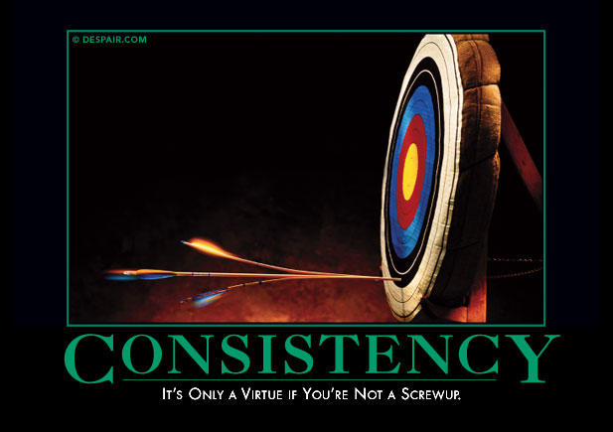
Systematic Error vs Random Noise

Slide 3
Reducing error with averaging
^{mult >} (—)²
error
<ΔF/F>

Slide 4
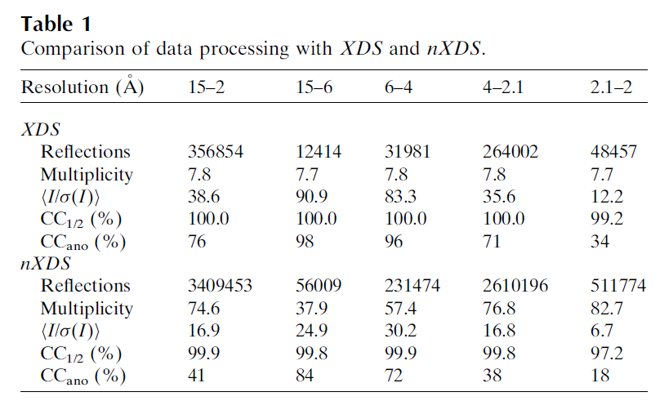
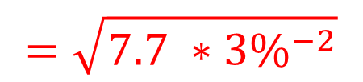
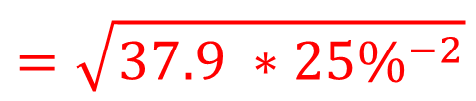
Partiality > 25% error per spot!
$$=\sqrt{7.7 ∗{3\%}^{−2}}$$
$$=\sqrt{37.9 ∗{25\%}^{−2}}$$
Kabsch W (2014)."Processing of X-ray snapshots from crystals in random orientations", Acta Cryst D 70, 2204-2216.

Slide 5
The “partiality problem”
0.006°
1 μm xtal
1 Å x-rays

Slide 6
Multiplicity required to phase
Monte Carlo
  100% /obs → 10,000 fold
nXDS
  25% /obs → 625 fold
Synchrotron
  3% /obs → 9 fold
  Assuming ΔF/F ~ 1%
Beam time:
$2/s

Slide 7
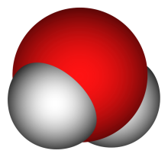
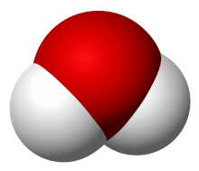
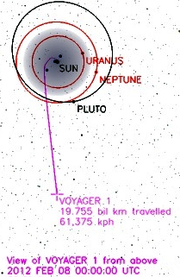
Can’t we just rotate the crystal?
9 nm
= 90 km/s
100 fs
1°
1 μm
(90 km/s)²
0.5 μm
17.26 km/s
= 1.5 x 10¹⁵ G
= 0.5 nN

Slide 8
Can’t we just rotate the crystal?
NO
Why do we want to
rotate the crystal?

Slide 9
The “nanocrystal advantage”
2
I_{spot} = k N_{cells}
caveat: 100% error!
Ewald sphere
range

Slide 10
What is “partiality”?
Ewald sphere

Slide 11
What is “partiality”?
Ewald sphere

Slide 12
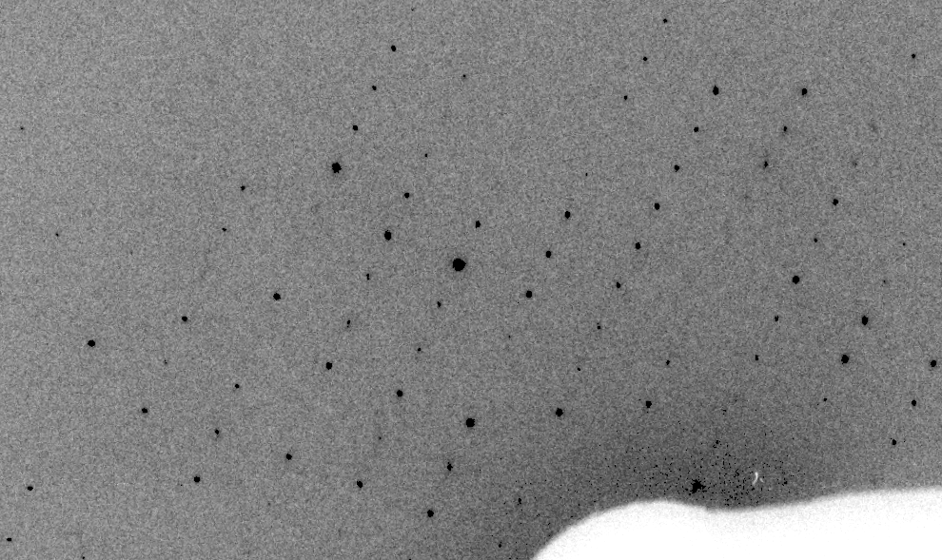
Real XFEL still

Slide 13
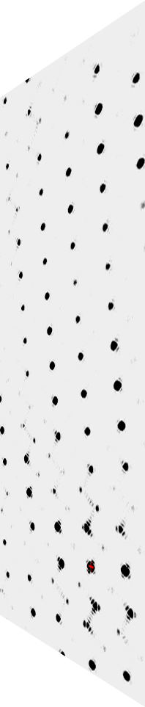
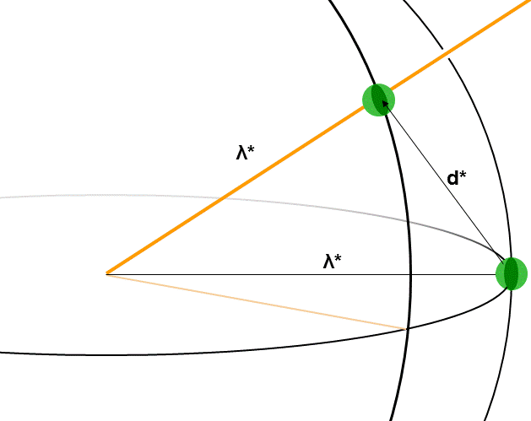
fastBragg program
http://bl831.als.lbl.gov/~jamesh/fastBragg/
Optimized for nanocrystals
Square or round
Takes h,k,l and F
Supports 1 unit cell
no “mosaicity”
arbitrary “source”
arbitrary “phi” steps

Slide 14
“fit” simulation to reality
Dispersion
Divergence
Mosaicity
Wavelength
Unit cell parameters (3)
Crystal orientation (3)
Mosaic domain size (3)
Beam center (2)
Beam direction (2)
Detector distance

Slide 15
Simulation of XFEL stills

Slide 16
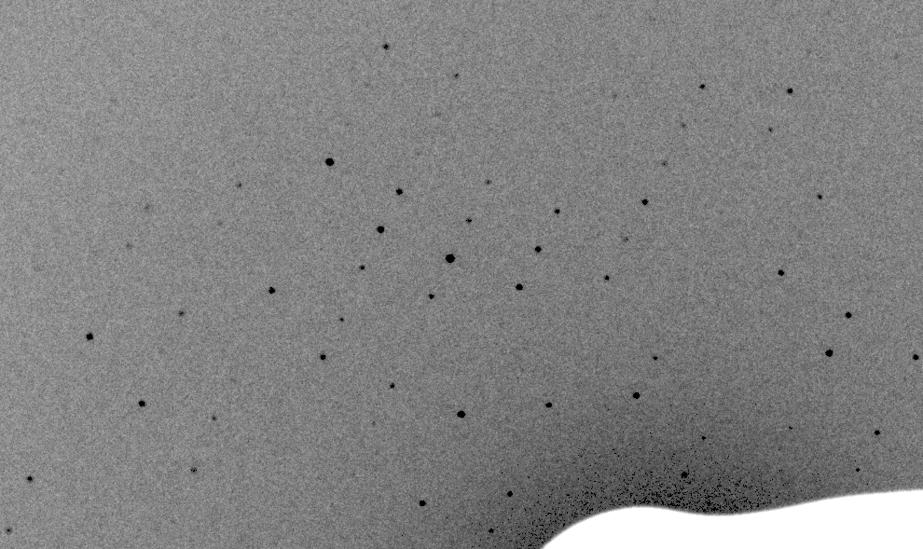
Simulation of XFEL stills

Slide 17
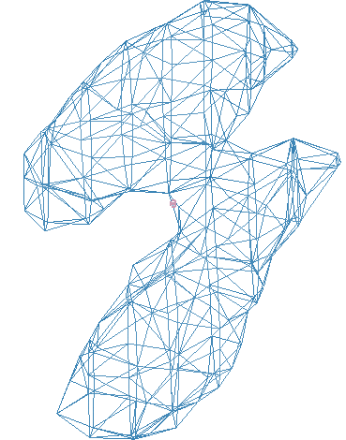
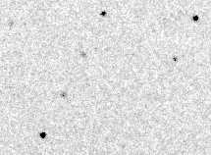
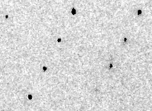
Simulation of XFEL stills
phix
phiy
phiz
real
VS
phix
phiy
phiz

Slide 18
Fitting individual “mosaic domains”
CC to observed spots
Best of
262,140 trials
Angle about y axis (°)

Slide 19
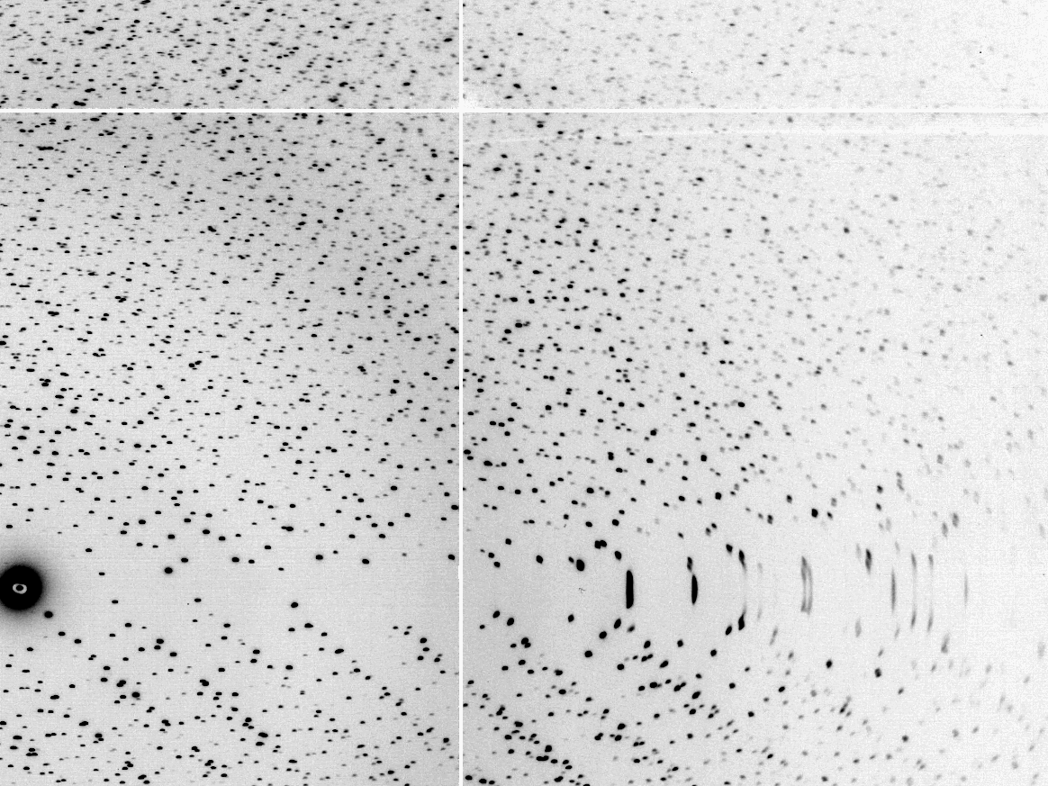
The “Lorentz zone”

Slide 20
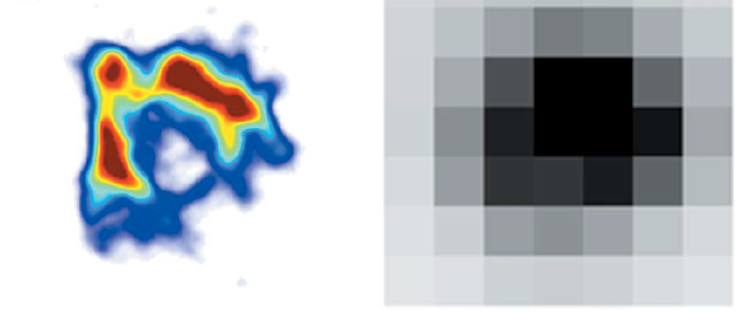
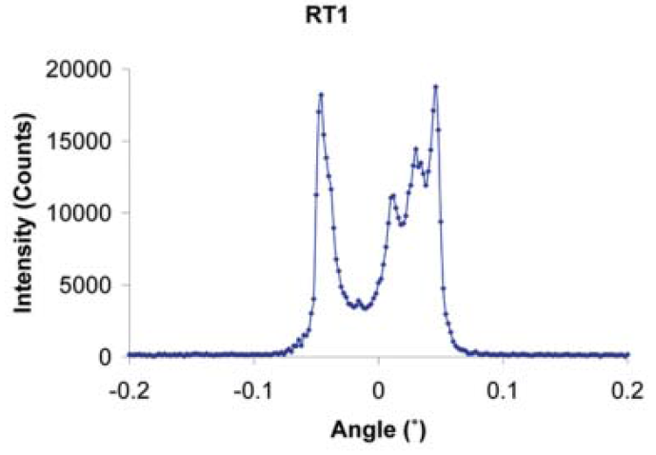
The “partiality problem”
0.006°
1 μm xtal
1 Å x-rays
Lovelace et al. (2006)."topography", J. Appl. Cryst. 39, 425-432.

Slide 21
mosaic spread
Ewald sphere
F(h,k,l)
λ*
d*
diffracted ray
λ*
F(0,0,0)

Slide 22
mosaic spread
Ewald sphere
F(h,k,l)
λ*
d*
diffracted ray
d*
λ*
F(0,0,0)

Slide 23

mosaic spread = 0 º

Slide 24

mosaic spread = 0.1º

Slide 25

mosaic spread = 0.2º

Slide 26

mosaic spread = 0.4º

Slide 27

mosaic spread = 0.6º

Slide 28

mosaic spread = 0.8º

Slide 29

mosaic spread = 1.0º

Slide 30

mosaic spread = 1.5º

Slide 31

mosaic spread = 2.0º

Slide 32

mosaic spread = 2.5º

Slide 33

mosaic spread = 3.2º

Slide 34

mosaic spread = 6.4º

Slide 35

mosaic spread = 12.8º

Slide 36
beam divergence
Ewald sphere
F(h,k,l)
λ*
d*
diffracted ray
λ*
F(0,0,0)

Slide 37
beam divergence
Ewald sphere
λ*
d*
diffracted ray
F(0,0,0)
λ*

Slide 38
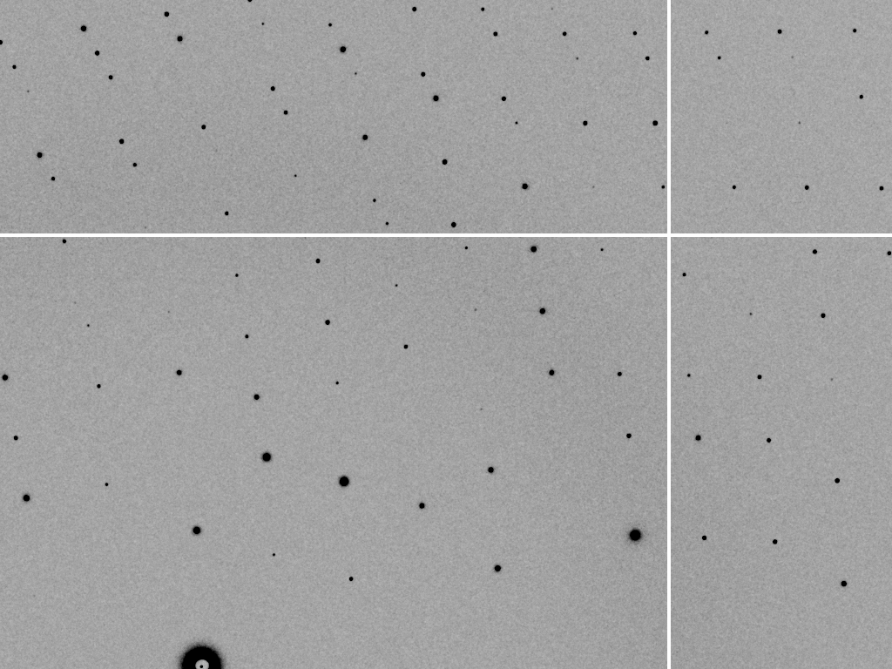
divergence = 0 º

Slide 39
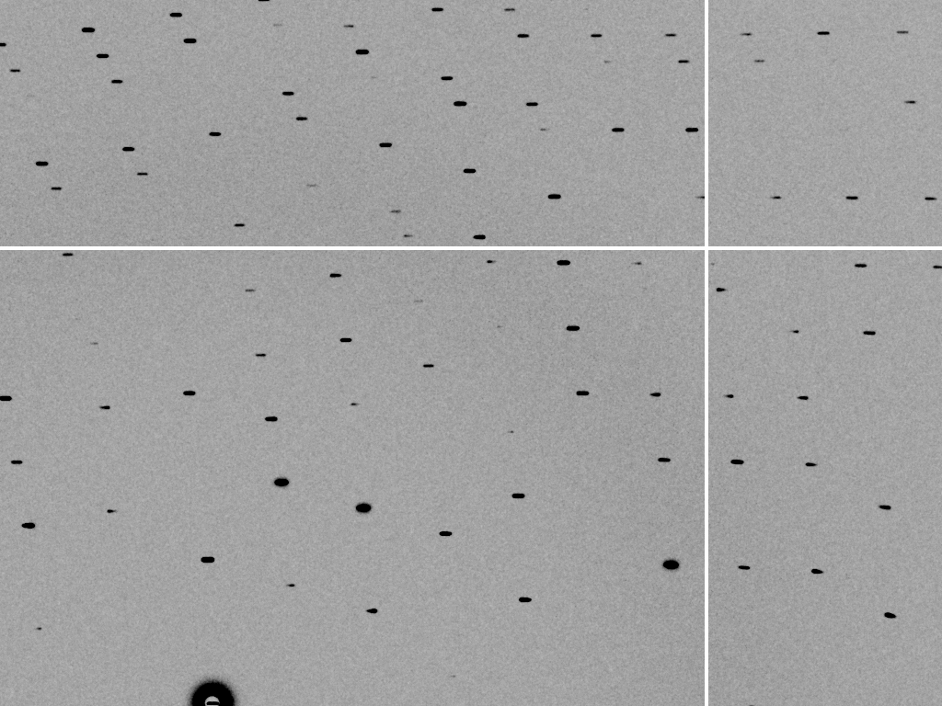
divergence = 0.3 º

Slide 40
spectral dispersion
Ewald sphere
F(h,k,l)
λ*
d*
diffracted ray
λ*
F(0,0,0)

Slide 41
spectral dispersion
Ewald sphere
F(h,k,l)
λ’*
d*
diffracted ray
λ’*
F(0,0,0)

Slide 42
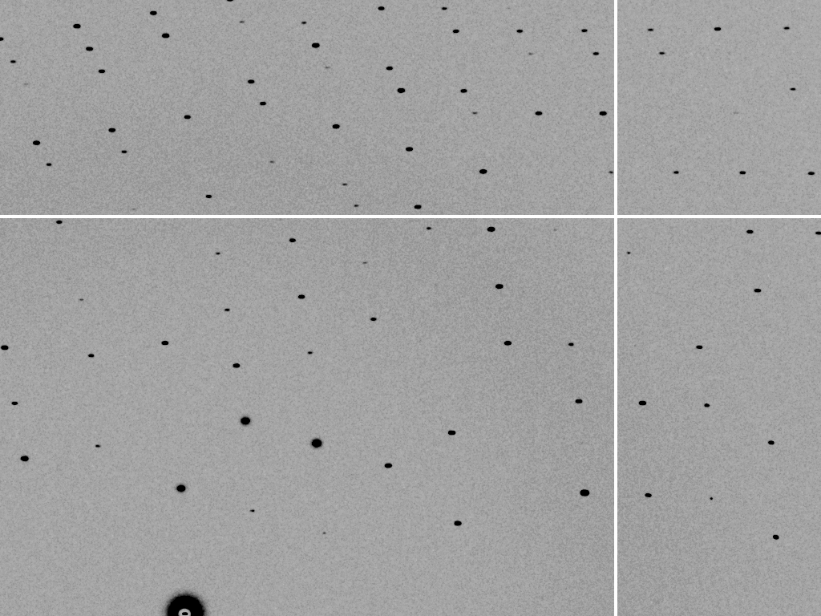
dispersion = 0

Slide 43

dispersion = 0.014% (Si 111)

Slide 44
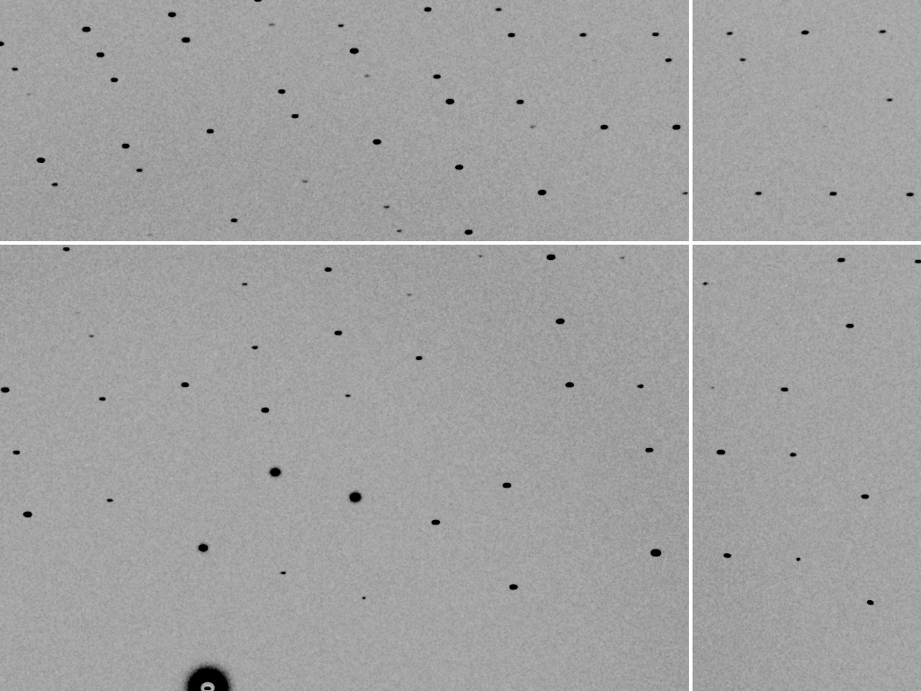
dispersion = 0.25% (CuK_{α})

Slide 45
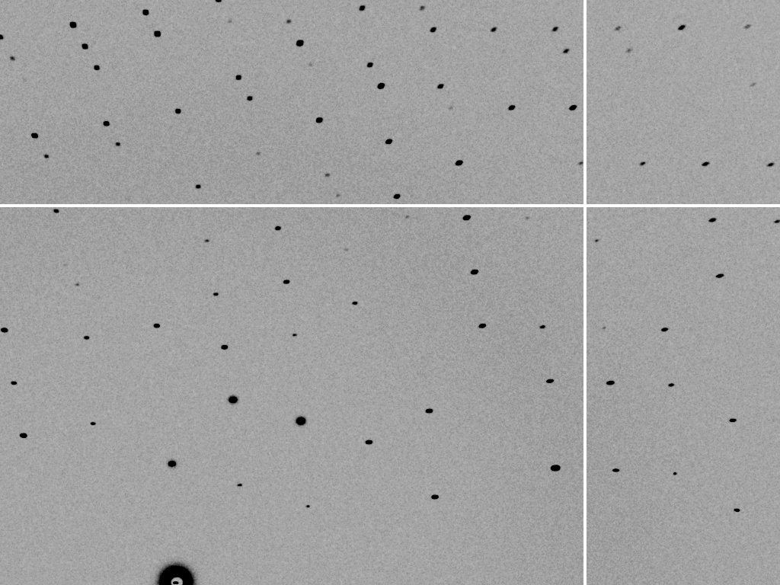
dispersion = 0.6%

Slide 46

dispersion = 1.3%

Slide 47

dispersion = 2.6%

Slide 48

dispersion = 5.1%

Slide 49
spot shape
Ewald sphere
Ewald sphere
Ewald sphere
Ewald sphere
λ’*
λ*
d*
d*
d*
λ*
diffracted rays
d*
d*
diffracted ray
diffracted ray
diffracted ray
λ’*
λ*
λ*

Slide 50
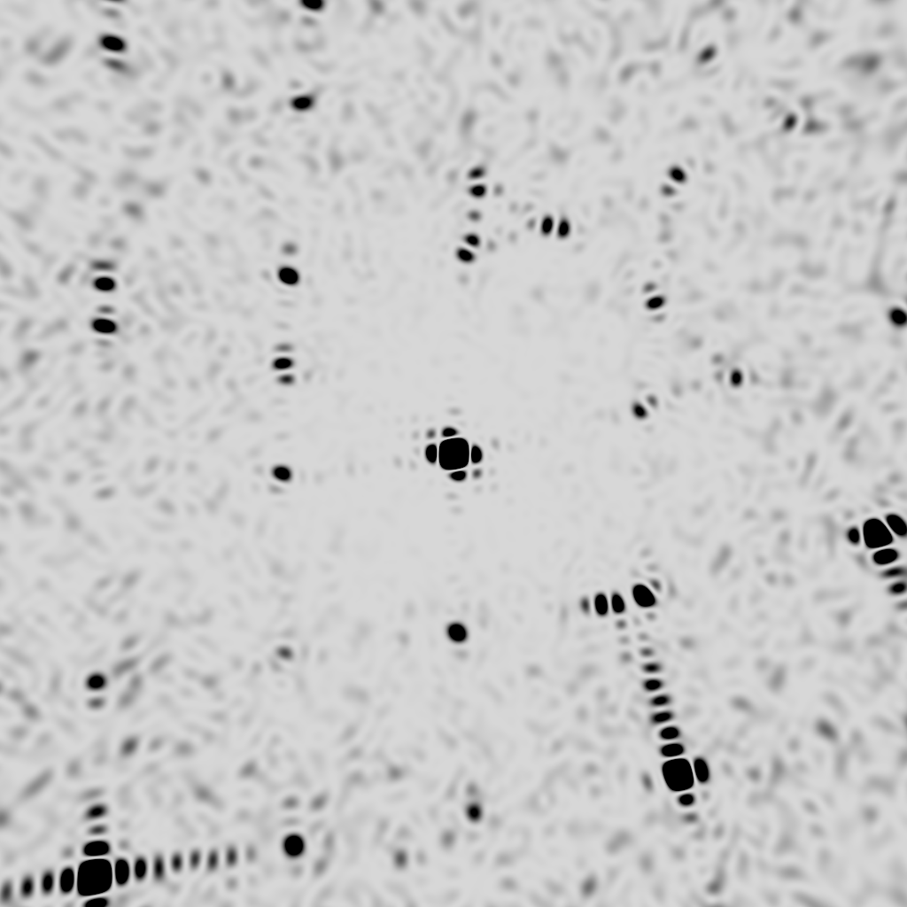
0 mrad, 0.0% bw

Slide 51
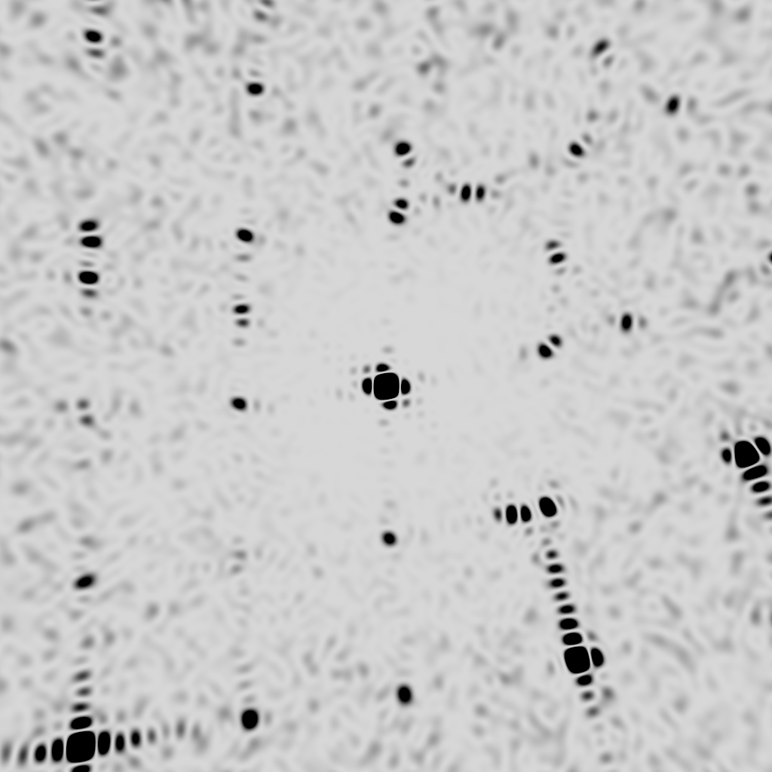
1 mrad, 0.1% bw

Slide 52
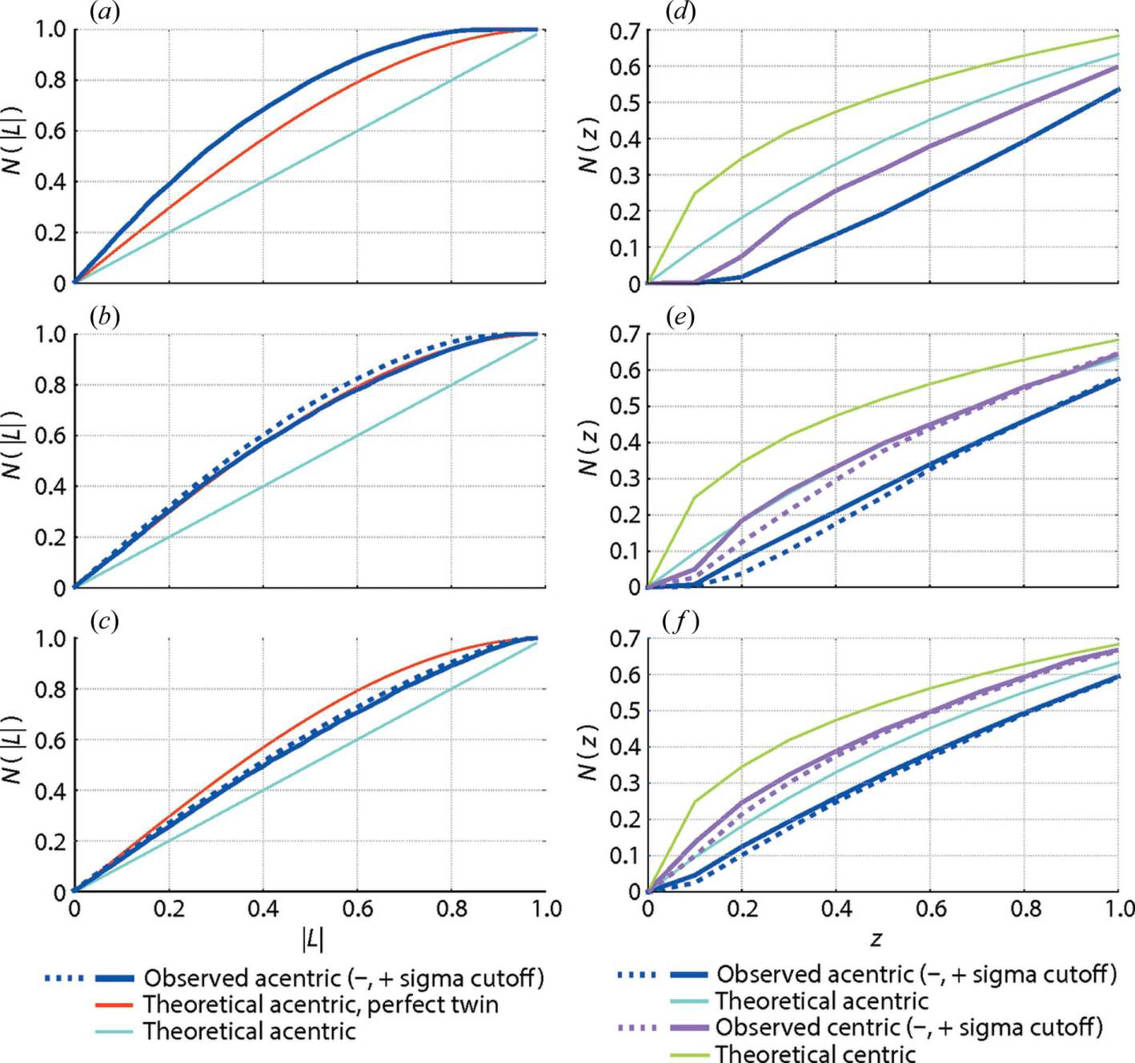
Simulation of XFEL stills
Sauter (2015). JSR 22, 239.
Beam center from autoindexing

Slide 53
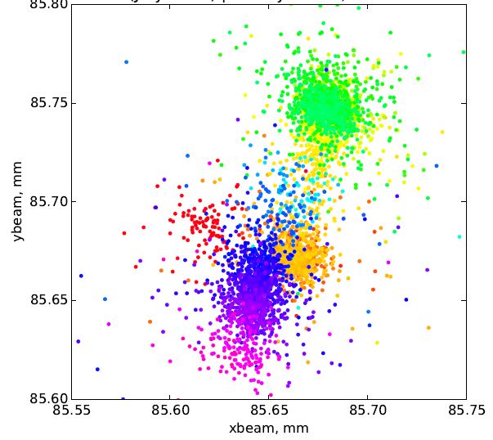
Simulation of XFEL stills
Color is
time
Sauter (2015). JSR 22, 239.
Beam center from autoindexing

Slide 54
Sanity check on beam position?
pinhole
~1 m
100 μm
~1000 m
0.3 m

Slide 55
Can’t we just widen the bandpass?

Slide 56
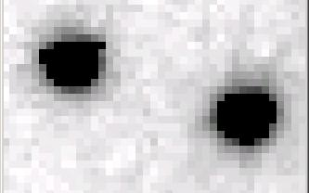
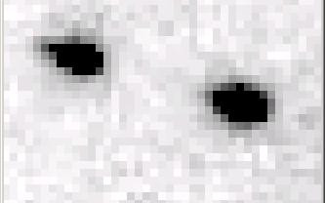
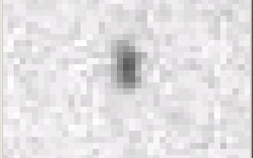
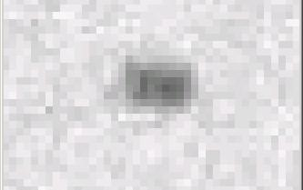
Si(111) vs multilayers
0.014%
Si(111)
spectral
dispersion
1%
multilayer
4 Å
resolution
1.9 Å

Slide 57
Wide-bandpass MX?
Mono | Si(111) | multilayer | Difference (%) | good
Energy (eV) | 11111 | 12027.5 | +8.2 | Same
Scale | 1.0000 | 1.0964 | +9.6 | Yes
R_{merge} (%) | 7.5 | 8.4 | +12 | No
R_{anom} (%) | 5.6 | 5.5 | -1.8 | Same
I/sd | 13.2 | 12.3 | -6.8 | Same
I/sd (1.5Å) | 2.3 | 1.8 | -21.7 | No
Ano Patt | 5.96 | 4.75 | -20.3 | Same
Ano Phased | 41 | 39.33 | -4.1 | Same
FOM | 0.238 | 0.192 | -19.3 | Same
CC | 0.555 | 0.647 | -6.1 | Yes
R_{cryst} (%) | 26.70 | 26.48 | -0.2 | Same
Ligand peak | 8.213 | 8.250 | +0.4 | Same

Slide 58
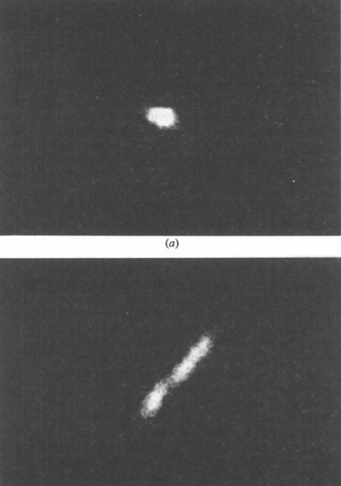

Wide bandpass reveals mosaicity from a still
low mosaic
high mosaic
Δ_{radial} = 2ηD/cos²2θ
Snell EH, Weisgerber S, Helliwell JR, Holzer K & Schroer K (1995)."Improvements in lysozyme protein crystal perfection through microgravity growth", Acta crystallographica. Section D, Biological crystallography 51, 1099-1102.

Slide 59
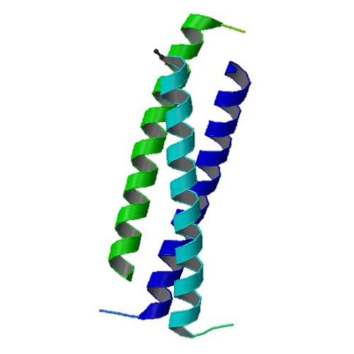
Narrow bandpass does not improve anomalous signal
h,k,l = 5,5,0
Si(333)
Si(333)
vertical
divergence
(240 μRad)
Al
absorber
100 μm
pinhole
1rb5

Slide 60
2472.7 2473.5
Anomalous f” (electrons)
Photon Energy (eV)
Bohic et al. Anal. Chem. 2008; 80(24):9557. doi: 10.1021/ac801817k

Slide 61
S-MAD Sample size Dilemma

Slide 62
(h,k,l)
Ewald sphere 2
λ*
diffracted ray
d*
θ
λ*
λ*
θ
d*
diffracted ray
λ*
Ewald sphere
1
(-h,-k,-l)

Slide 63
Si(111)
52.87deg
Si(111)
2 Multilayer mirrors
d=2nm, W/B4C
KB Horiz focus
KB vertical focus
Si(111)
Detector
Detector
λ = 5 Å
h,k,l
sample
injector
-h,-k,-l
Si(111)
Detector
Detector
~ 1m
Si(111)
Si(111)
Notes:
Proposed 5-crystal monochromator for colliding-beam crystallography. The generation of two opposing Ewald spheres means that for every h,k,l index reflected from the protein crystal, the Friedel mate is reflected in the opposite direction, allowing for very accurate anomalous difference measurements. The wavelength need not be set precisely at the sulfur or phosphorous edge, but merely at a wavelength where the f” of those elements are strong. For fs-class pulses, the distances above will have to be precise to withing ~3 microns, and for accurate reproduction of the partiality of the Friedel mates, the angular precision of the colliding beams must be within ~1% of the sample crystal’s rocking width, or ~100 microrads.

Slide 64
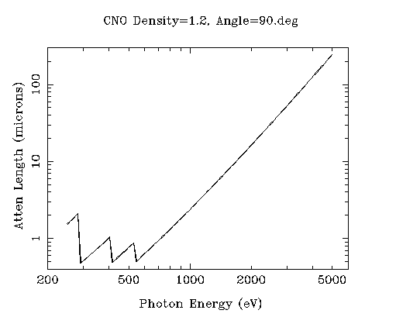
“sweet spot” for sample size ?
Ca
Ar
Cl
K
S
P
2 Å
2sin(90°)
Mg
C
Na
Se
Ne
3 Å
2sin(90°)
N
O
F
4 Å
2sin(90°)

Slide 65
ALS-U: Small, soft beams

Slide 66
ALS-U: Small, soft beams
Diamond
($100, reusable)

Slide 67
ALS-U: Small, soft beams
oil ?
Diamond
($100, reusable)

Slide 68
ALS-U: Small, soft beams
oil ?
Diamond
($100, reusable)

Slide 69
ALS-U: Small, soft beams
oil ?
λ=2d sinθ
2.5 Å data
with 5 Å X-rays
Only analytic absorption correction:
International Tables for Crystallography, Vol. C, 2nd ed., chapter 6.3

Slide 70
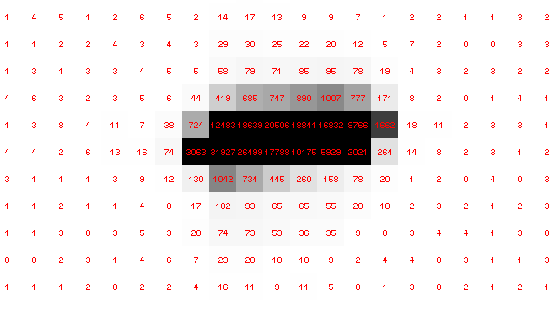
Pilatus pile-up for RT MX: same photons, different speeds
Collaboroators:
Aina Cohen
Ana Gonzalez

Slide 71
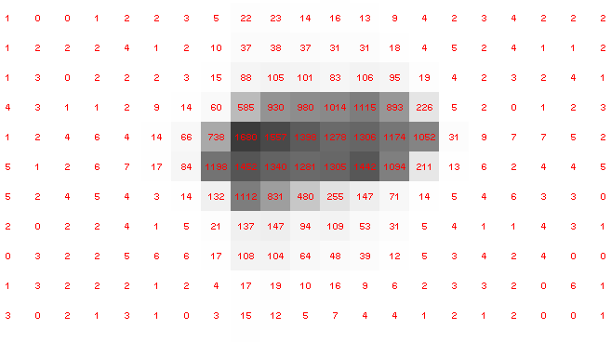
Pilatus pile-up for RT MX: same photons, different speeds
Collaboroators:
Aina Cohen
Ana Gonzalez

Slide 72
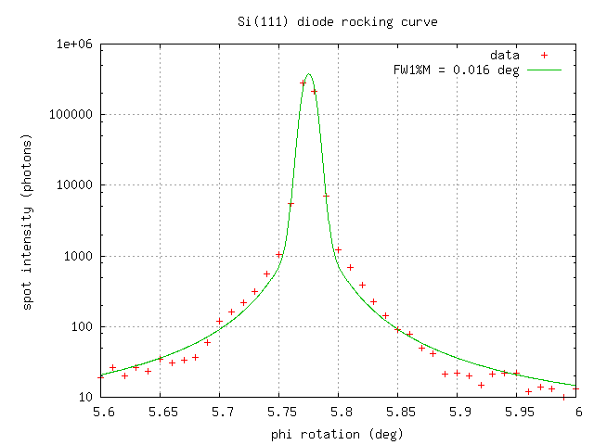

Pilatus pile-up for RT MX: same photons, different speeds
Collaboroators:
Aina Cohen
Ana Gonzalez

Slide 73
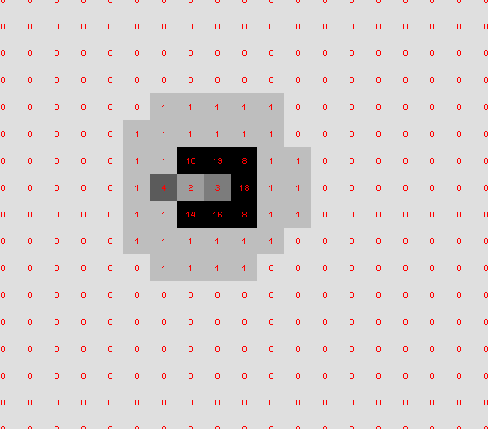
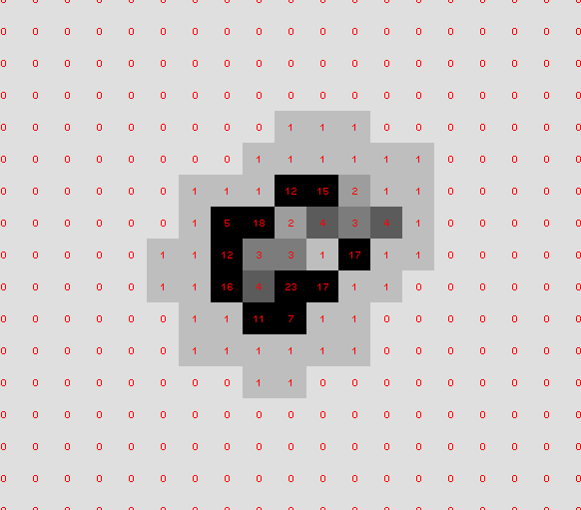
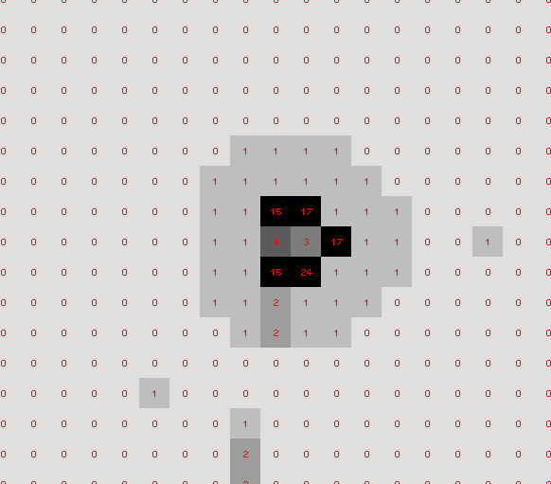
What are these?

Slide 74
X-ray scattering “rules”:
Optimum: support thickness = crystal thickness
1 μm crystal ≈ 1 μm water
≈ 1 μm plastic
≈ 0.1 μm glass
≈ 1000 μm air
~ 50 mm He
≈ 370 mm sat water vapor @ 4C

Slide 75
The number of photons scattered
before crystal is dead
is independent
of data collection time
1 um³ = 10⁵ photons (roomT)
1 um³ = 10⁶ photons (synch)
1 um³ = 10⁸ photons (XFEL)
(synch)
Henderson, 1990; Gonzalez & Nave, 1994; Glaeser et al., 2000; Sliz et al., 2003; Leiros et al., 2006; Owen et al., 2006; Garman & McSweeney, 2006; Garman & Nave, 2009; Holton, 2009

Slide 76
Self-calibrated damage limit
Where:
⟨I⟩_{DL} - average damage-limited intensity (photons/hkl) at a given resolution
10⁵ - converting R from μm to m, r_{e} from m to Å, ρ from g/cm³ to kg/m³ and MGy to Gy
r_{e} - classical electron radius (2.818 x 10⁻¹⁵ m/electron)
h - Planck’s constant (6.626 x 10⁻³⁴ J∙s)
c - speed of light (299792458 m/s)
f_{decayed} - fractional progress toward completely faded spots at end of data set
ρ - density of crystal (~1.2 g/cm³)
R - radius of the spherical crystal (μm)
λ - X-ray wavelength (Å)
f_{NH} - the Nave & Hill (2005) dose capture fraction (1 for large crystals)
n_{ASU} - number of proteins in the asymmetric unit
M_{r} - molecular weight of the protein (Daltons or g/mol)
V_{M} - Matthews’s coefficient (~2.4 Å³/Dalton)
H - Howells’s criterion (10 MGy/Å)
θ - Bragg angle
⟨ƒ_{a}²⟩ - number-averaged squared structure factor per protein atom (electron²)
⟨M_{a}⟩ - number-averaged atomic weight of a protein atom (~7.1 Daltons)
B - average (Wilson) temperature factor (Å²)
μ - attenuation coefficient of sphere material (m⁻¹)
μ_{en} - mass energy-absorption coefficient of sphere material (m⁻¹)
No flux
No symmetry
Holton & Frankel (2010) Acta D 66 393-408.

Slide 77
Bigger is better, but not by much
B = 20
B = 60
B = 0
B = 170
B = 330
B = 560
Resolution (Å)
B = 850
Crystal diameter (micron)

Slide 78
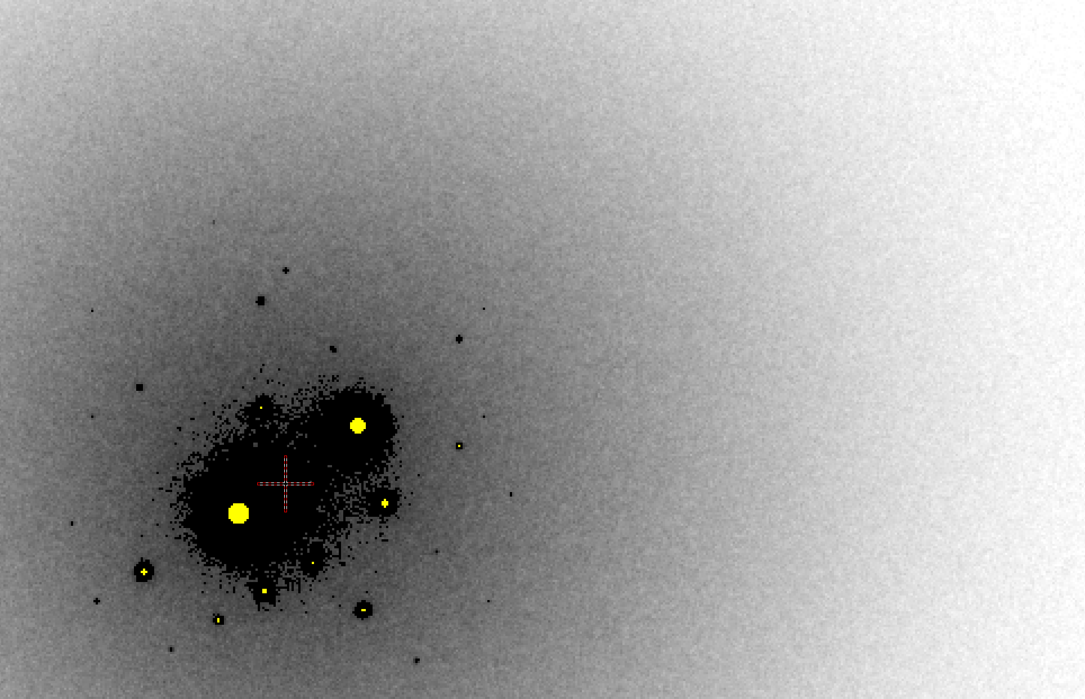
B factor from image analysis
B = 500

Slide 79
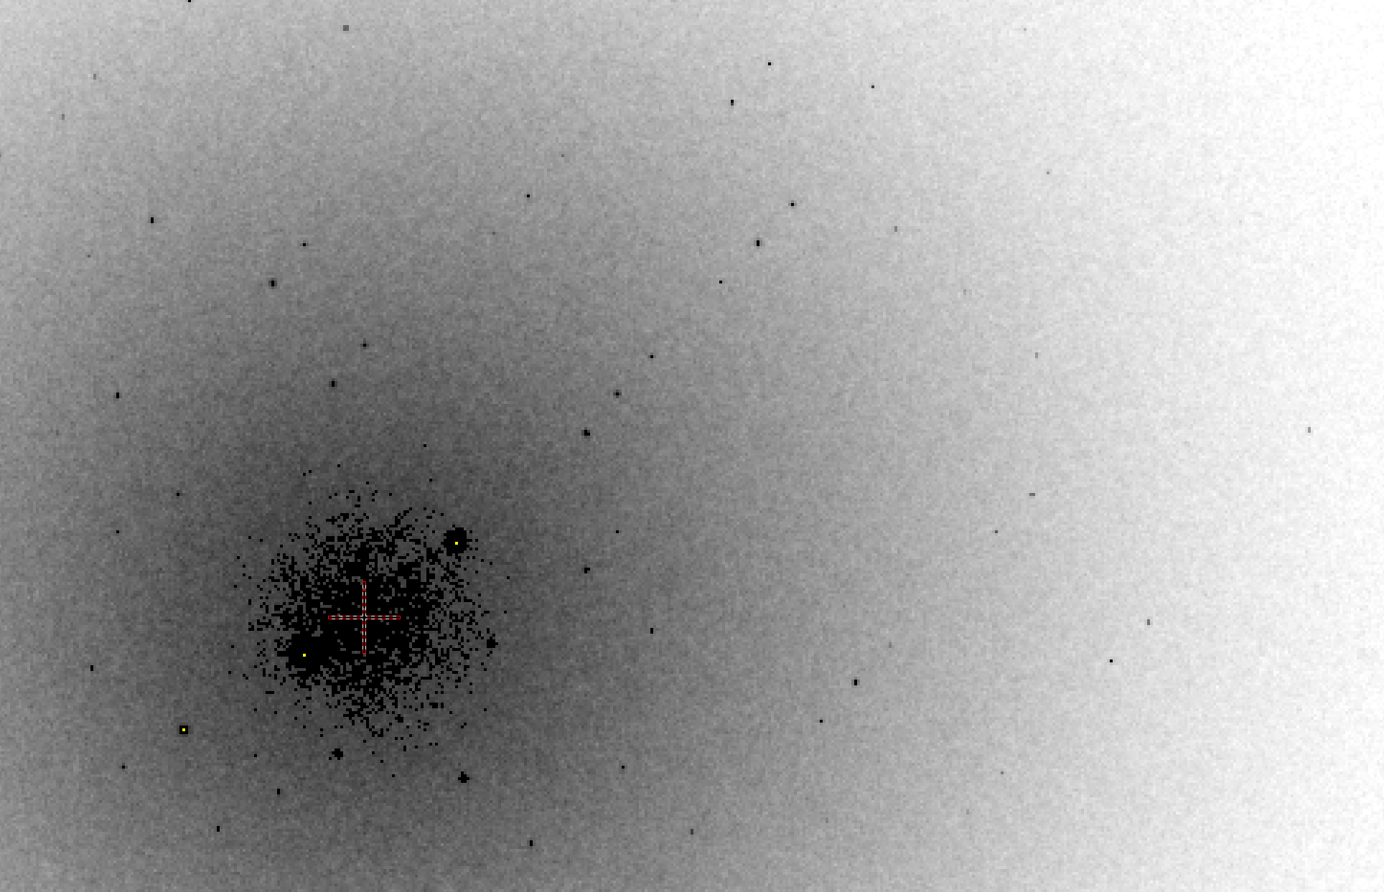
B factor from image analysis
B = 20

Slide 80
Predicting resolution limits
Synchrotron Resolution (Å)
Home Lab Resolution (Å)

Slide 81
Predicting resolution limits
XFEL Resolution (Å)
Synchrotron Resolution (Å)

Slide 82
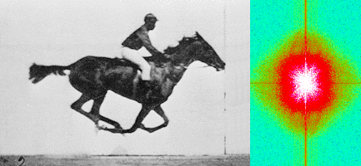
Muybridge’s galloping horse (1878)
“Time-resolved” diffraction
Real space
reciprocal

Slide 83
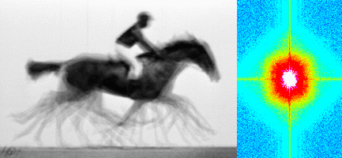
Muybridge’s galloping horse (1878)
Average electron density
Real space
reciprocal

Slide 84
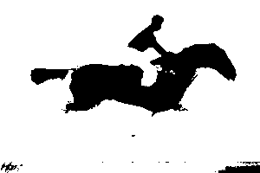
Muybridge’s galloping horse (1878)
Average electron density: 1 sigma contour
Real space
reciprocal

Slide 85

lysozyme: real and reciprocal

Slide 86
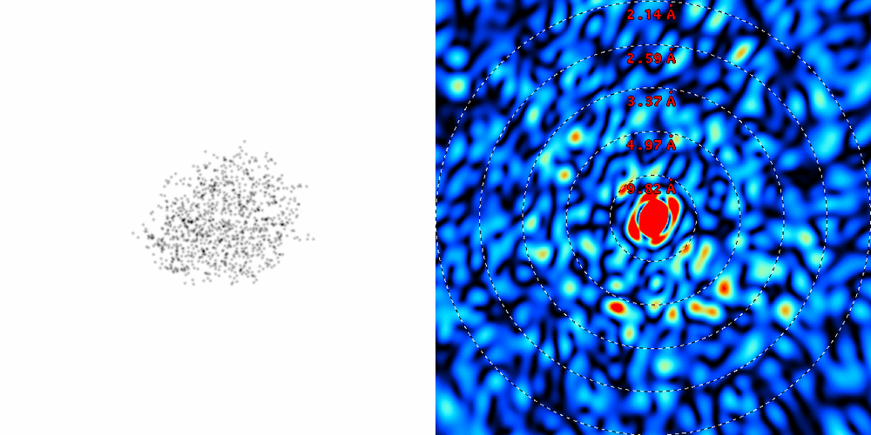
lysozyme: thermal motion

Slide 87
URL Summary
http://bl831.als.lbl.gov/~jamesh/powerpoint/
UCSF_partiality_2016.pptx
http://bl831.als.lbl.gov/~jamesh/bin_stuff/
http://bl831.als.lbl.gov/~jamesh/mlfsom/
25% error from partiality
Phasing limited by relative error
Resolution limited by disorder
“wet vacuum” for bio samples?
Conventional PAD at XFEL?
How do we make our molecules sit still?

Slide 88
How much H₂ are we making?
Meents et al. (2010) claimed:
"400 molecules of H2 for every 12.5 keV photon“
= 3.3x10⁻⁷ mol/J
200 kGy to 100 um³ = 0.24 J
= 1.2x10⁻⁸ mol H₂
100 um³ of water = 6.7x10⁻⁸ mol
→ 18% of water has reacted!

Slide 89
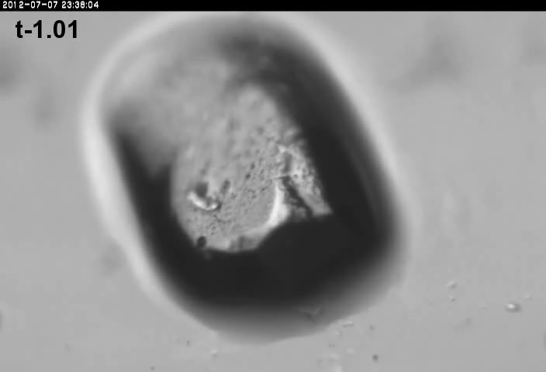
xtal5_t1
Crystal “shrinks?” at 764 kGy/s

Slide 90
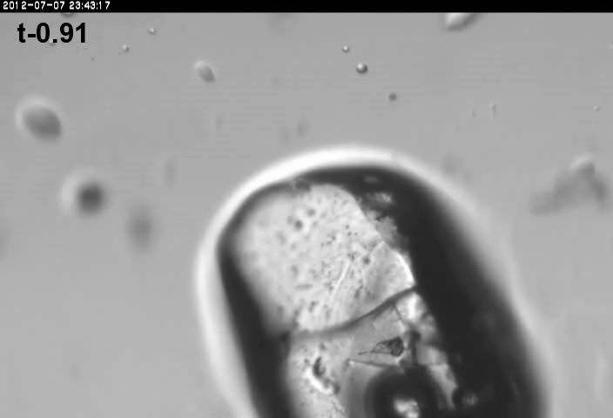
xtal5_t2
Crystal “shrinks?” at 764 kGy/s

Slide 91
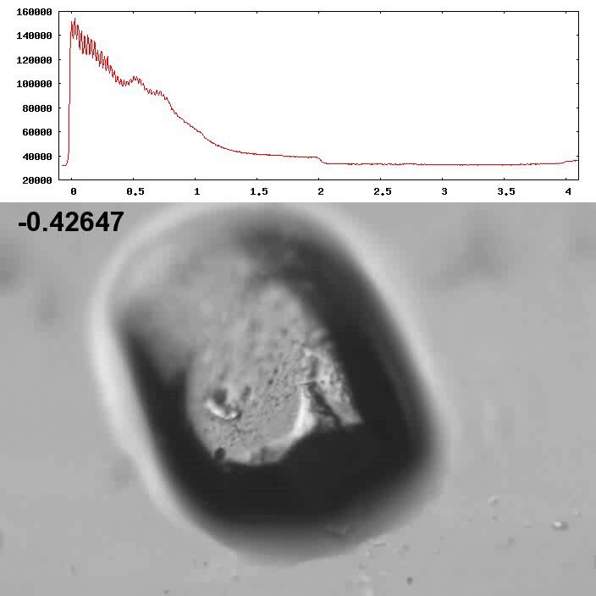
Xtal5_t1 graph
Spot intensity
seconds

Slide 92
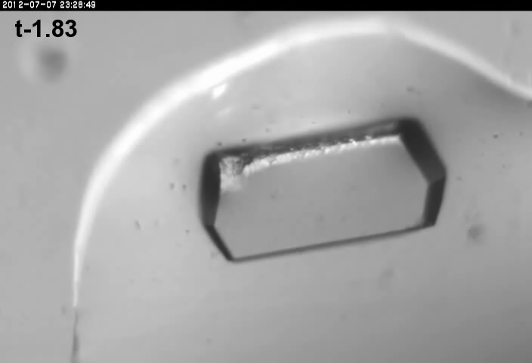
Xtal4_t1
No bubbles? 764 kGy/s

Slide 93
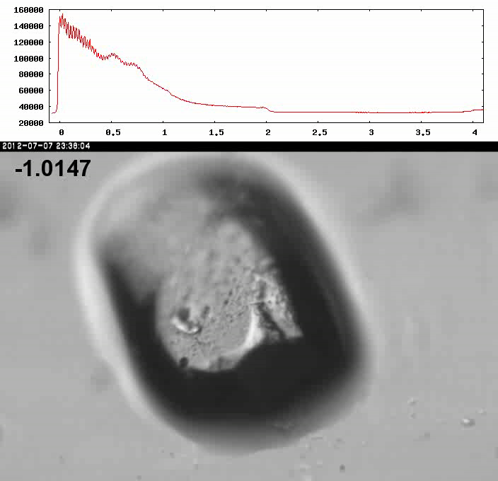
Xtal5_t1 graph

