Slide 1
What if we knew everything?
How would we store it?
How would we look at it?
How would we compare to data?
How would we know we know?
…
How would we begin?

Slide 2
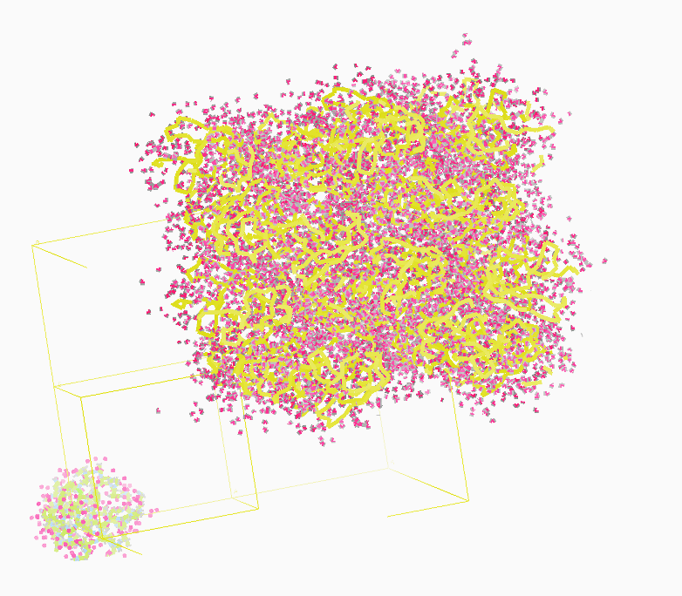
Molecular Dynamics Simulation
using real
crystal’s lattice
1aho
Scorpion toxin
0.96 Å resolution
64 residues
Solvent: H₂0 + acetate
Cerutti et al. (2010).J. Phys. Chem. B 114, 12811-12824.

Slide 3
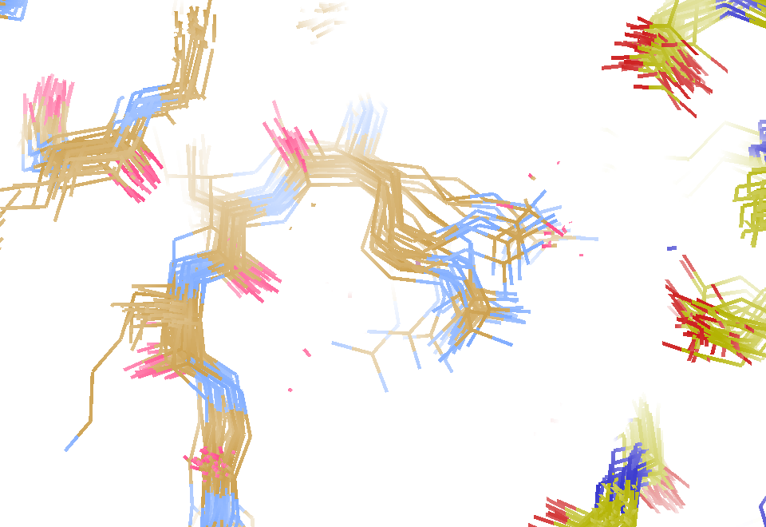
MD simulation: 30 conformers from 24,000
Cerutti et al. (2010).J. Phys. Chem. B 114, 12811-12824.

Slide 4
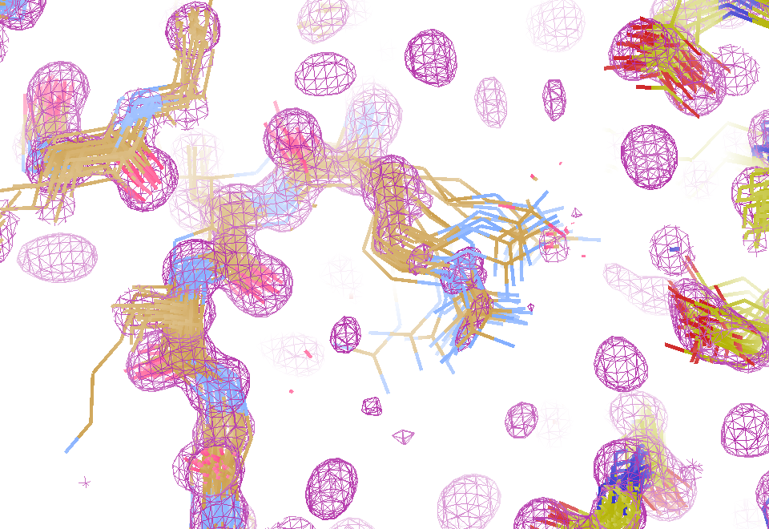
Electron density from 24,000 conformers

Slide 5
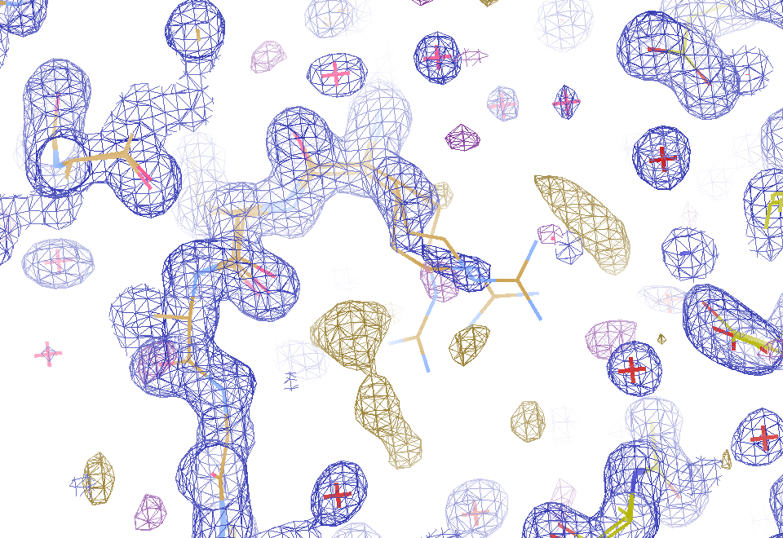
2F_{sim}-F_{calc} and F_{sim}-F_{calc} maps
1.0 Å data
R_{cryst}= 0.137
R_{free} = 0.159
1 “sigma” 2F_{sim}-F_{c}
2.5 “sigma” F_{sim}-F_{c}

Slide 6
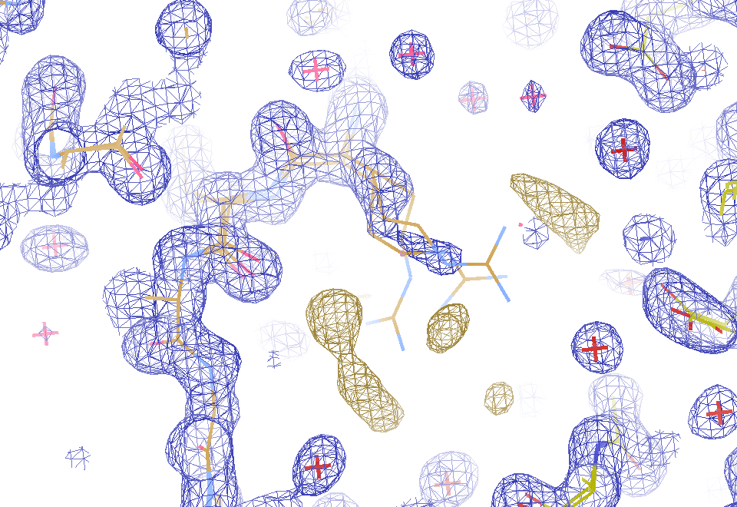
2F_{sim}-F_{calc} and (F_{sim} Φ_{sim}) - (F_{calc} Φ_{calc}) maps
1.0 Å data
R_{cryst}= 0.137
R_{free} = 0.159
1 “sigma” 2F_{sim}-F_{c}
F_{right} – (2F_{sim}-F_{c})

Slide 7
30 conformers from 24,000

Slide 8
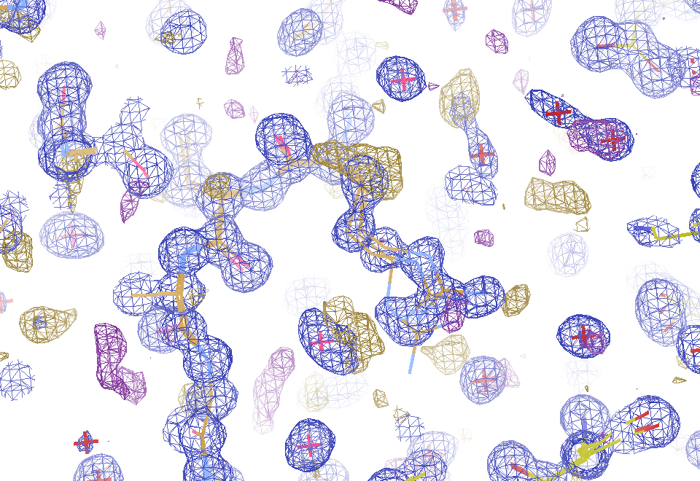
Regular model with real data!
1.0 Å data
R_{cryst}= 0.116
R_{free} = 0.135
1 “sigma” 2F_{sim}-F_{c}
2.5 “sigma” F_{sim}-F_{c}

Slide 9
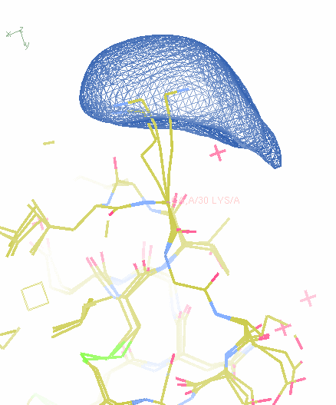
MD: predicted density for one atom

Slide 10
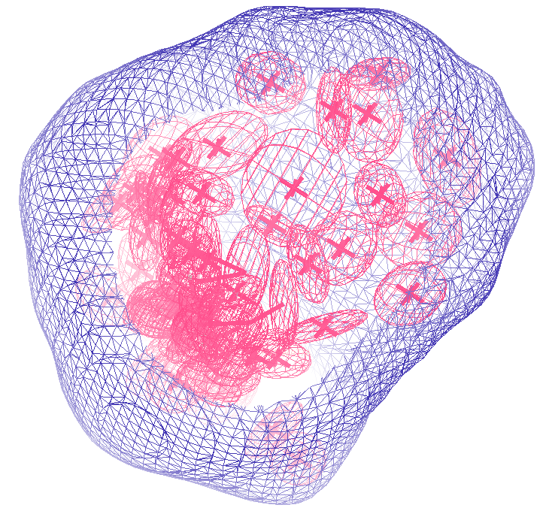
How many conformers are there?
Answer: 40
R_{cryst} = 0.0506
R_{free} = 0.0556
vs F_{sim}

Slide 11
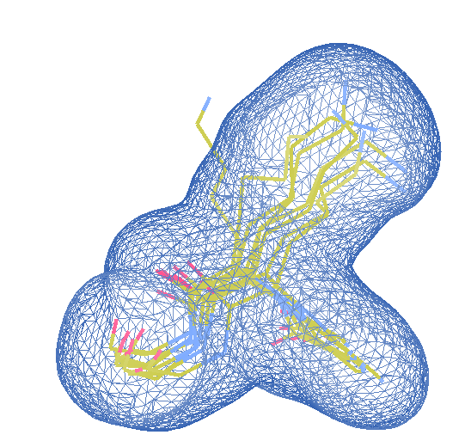
How many conformers are there?
Answer: 8
R_{cryst} = 0.0297
R_{free} = 0.0293
vs F_{sim}

Slide 12
Extract dihedrals from MD run
phi psi omega chi1 chi2 chi3 chi4
1 VAL 2 - 143.29 179.88 169.10
1 ASN 3 -135.76 155.12 166.82 -97.96 -106.16
1 PRO 4 -63.33 147.75 -160.78
1 THR 5 -144.48 142.12 -156.19 -175.99
1 VAL 6 -145.54 156.12 179.20 161.99
1 PHE 7 -138.16 153.89 161.23 68.20 178.28
1 PHE 8 -123.42 133.50 157.48 -63.54 -22.62
1 ASP 9 -100.56 142.02 -161.91 -82.27 -30.26
1 ILE 10 -110.11 144.78 161.43 179.25 -61.33
1 ALA 11 -124.89 153.28 170.06
1 VAL 12 -117.88 103.10 178.28 60.00
1 ASP 13 52.67 33.29 -177.17 -156.24 -13.48
1 GLY 14 88.50 0.85 162.69
1 GLU 15 -90.39 142.19 171.32 -55.56 -36.87 -133.12
1 PRO 16 -68.85 150.14 168.40
1 LEU 17 -118.52 -9.73 -175.24 -52.63 163.93
1 GLY 18 102.79 179.85 178.57
1 ARG 19 -72.34 142.26 159.44 -174.27 148.16 -59.37 -164.09
1 VAL 20 -121.74 142.40 -175.51 -177.82
1 SER 21 -138.43 153.35 -154.50 -178.51
1 PHE 22 -144.88 118.97 164.03 -45.98 -162.78

Slide 13
Extract dihedrals from MD run
phi psi omega chi1 chi2 chi3 chi4
2 VAL 2 - 120.06 -178.91 177.11
2 ASN 3 -62.79 167.20 166.33 -74.03 -36.22
2 PRO 4 -71.10 148.90 174.80
2 THR 5 -136.30 139.18 -175.56 -173.74
2 VAL 6 -112.49 155.07 162.85 161.01
2 PHE 7 -121.81 153.35 167.79 74.02 -177.54
2 PHE 8 -131.69 141.64 164.88 -61.98 -32.74
2 ASP 9 -95.78 103.80 179.18 -75.05 -67.62
2 ILE 10 -76.05 151.02 -174.50 -177.12 -54.37
2 ALA 11 -152.12 166.48 -169.90
2 VAL 12 -150.54 121.59 -164.84 79.08
2 ASP 13 42.91 34.28 178.03 -169.99 40.22
2 GLY 14 97.48 -20.91 -176.08
2 GLU 15 -87.49 143.97 -174.23 -44.86 -63.40 -158.92
2 PRO 16 -70.67 132.96 -172.74
2 LEU 17 -110.55 -52.36 163.86 -167.73 76.11
2 GLY 18 165.94 -179.42 -179.11
2 ARG 19 -84.76 128.73 167.66 -170.38 151.22 -73.25 178.95
2 VAL 20 -111.57 136.90 177.12 -177.74
2 SER 21 -125.08 147.60 -165.66 -179.77
2 PHE 22 -137.73 134.80 162.31 -64.66 -160.6

Slide 14
Extract dihedrals from MD run
phi psi omega chi1 chi2 chi3 chi4
3 VAL 2 - 133.10 -175.96 64.27
3 ASN 3 -68.36 132.53 -171.72 -69.43 -10.46
3 PRO 4 -91.33 173.06 173.97
3 THR 5 -115.43 132.20 172.06 -178.59
3 VAL 6 -121.47 137.70 170.56 169.35
3 PHE 7 -111.58 136.50 155.37 86.89 173.14
3 PHE 8 -107.53 128.54 155.26 -70.42 -7.44
3 ASP 9 -82.48 137.05 -168.44 -83.58 -35.26
3 ILE 10 -122.72 144.47 170.18 173.24 -57.80
3 ALA 11 -124.40 146.28 172.75
3 VAL 12 -115.88 98.33 -170.33 51.04
3 ASP 13 59.01 32.44 179.37 -155.68 61.5
3 GLY 14 103.11 -31.56 -165.42
3 GLU 15 -80.47 144.34 176.31 -82.71 -61.23 -142.8
3 PRO 16 -57.64 113.96 175.25
3 LEU 17 -80.23 -48.33 169.62 -174.99 60.92
3 GLY 18 161.83 -150.19 -171.28
3 ARG 19 -126.54 140.74 163.51 179.41 177.93 -76.95 -177.04
3 VAL 20 -117.28 140.53 176.19 -172.28
3 SER 21 -132.05 137.02 -173.77 176.24
3 PHE 22 -113.43 146.42 158.42 -44.35 -138.68

Slide 15
Clustering angles: cypA Phe88 psi
Frequency
dihedral angle (°)

Slide 16
Clustering angles: cypA Phe88 psi
Frequency
dihedral angle (°)

Slide 17
Clustering angles: cypA Phe88 chi1
Frequency
dihedral angle (°)

Slide 18
Clustering angles: cypA Phe88 chi2
Frequency
dihedral angle (°)

Slide 19
Clustering angles: cypA Glu86 psi
Frequency
dihedral angle (°)

Slide 20
Combine angles into rotamers
Take centroid angles (rotamers)
1-14 centroids per angle (avg: 2.2)
606 angles in cypA
2.2⁶⁰⁶ possibilities

Slide 21
Too many combinations!
combo# 2psi 2chi1 3phi 3psi 3chi1 3chi2 4phi 4psi 5phi
00001 131.4 177.7 -67.5 122.8 -74.2 -29.1 -73.2 154.4 -131.0
00002 131.4 177.7 -67.5 122.8 -74.2 -29.1 -73.2 154.4 -112.5
00003 131.4 177.7 -67.5 122.8 -74.2 -29.1 -73.2 163.6 -131.0
00004 131.4 177.7 -67.5 122.8 -74.2 -29.1 -73.2 163.6 -112.5
00005 131.4 177.7 -67.5 122.8 -74.2 -29.1 -58.1 154.4 -131.0
00006 131.4 177.7 -67.5 122.8 -74.2 -29.1 -58.1 154.4 -112.5
00007 131.4 177.7 -67.5 122.8 -74.2 -29.1 -58.1 163.6 -131.0
00008 131.4 177.7 -67.5 122.8 -74.2 -29.1 -58.1 163.6 -112.5
00009 131.4 177.7 -67.5 122.8 -92.6 -29.1 -73.2 154.4 -131.0
00010 131.4 177.7 -67.5 122.8 -92.6 -29.1 -73.2 154.4 -112.5
00011 131.4 177.7 -67.5 122.8 -92.6 -29.1 -73.2 163.6 -131.0
00012 131.4 177.7 -67.5 122.8 -92.6 -29.1 -73.2 163.6 -112.5
00013 131.4 177.7 -67.5 122.8 -92.6 -29.1 -58.1 154.4 -131.0
00014 131.4 177.7 -67.5 122.8 -92.6 -29.1 -58.1 154.4 -112.5
00015 131.4 177.7 -67.5 122.8 -92.6 -29.1 -58.1 163.6 -131.0
00016 131.4 177.7 -67.5 122.8 -92.6 -29.1 -58.1 163.6 -112.5
00017 131.4 177.7 -67.5 144.5 -74.2 -29.1 -73.2 154.4 -131.0
00018 131.4 177.7 -67.5 144.5 -74.2 -29.1 -73.2 154.4 -112.5
00019 131.4 177.7 -67.5 144.5 -74.2 -29.1 -73.2 163.6 -131.0
00020 131.4 177.7 -67.5 144.5 -74.2 -29.1 -73.2 163.6 -112.5
00021 131.4 177.7 -67.5 144.5 -74.2 -29.1 -58.1 154.4 -131.0

Slide 22
How to combine the angles?
Take centroid angles (rotamers)
assign “rotamer” to each of 4000 MD pdbs
Discard combinations of rotamers not represented in MD
Add one more angle to possible combos
Repeat -> 2
Gather coordinates from nearest MD pdb to each rotamer

Slide 23
Progressive clustering of angles
combinations
number of angles included

Slide 24
Assign MD models to combos
combo# population representative
00097 86 monomer_00969_02472.pdb
00033 77 monomer_00986_02472.pdb
00001 66 monomer_00665_02472.pdb
00081 63 monomer_00997_04944.pdb
00083 63 monomer_00811_02472.pdb
00049 62 monomer_00810_07416.pdb
00002 60 monomer_00637_02472.pdb
00029 58 monomer_00837_09888.pdb
00096 54 monomer_00758_02472.pdb
00082 53 monomer_00994_04944.pdb
00005 52 monomer_00469_07416.pdb
00098 51 monomer_00292_07416.pdb
00007 49 monomer_00591_02472.pdb
00095 49 monomer_00812_02472.pdb
00004 48 monomer_00411_04944.pdb
00073 48 monomer_00165_09888.pdb
00021 47 monomer_00581_04944.pdb
00067 47 monomer_00392_09888.pdb
00003 44 monomer_00236_04944.pdb
00009 44 monomer_00917_07416.pdb
00015 44 monomer_00756_04944.pdb

Slide 25
Occupancy refinement!
e⁻ density from all 4000 copies
only atoms in side chain
Perfect phases
SA refine
Occ ref
Discard zero occ
R < 2%

Slide 26
“deconform” to parsimonious model
R factor (%)
Number of conformers

Slide 27
“deconform” to parsimonious model
R factor (%)
Number of conformers

Slide 28
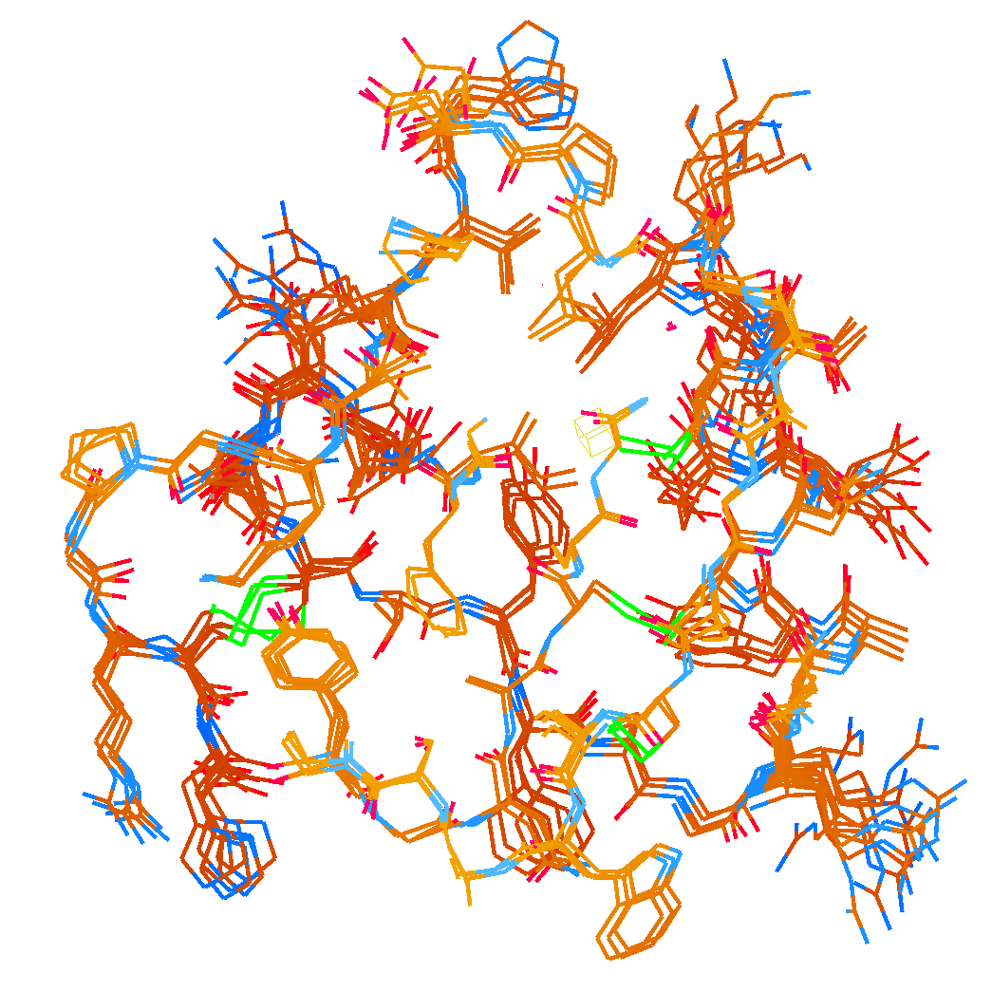
How many conformers are there?
Answer: 2-14
R_{cryst} = 0.0441
R_{free} = 0.0516
vs F_{sim}

Slide 29
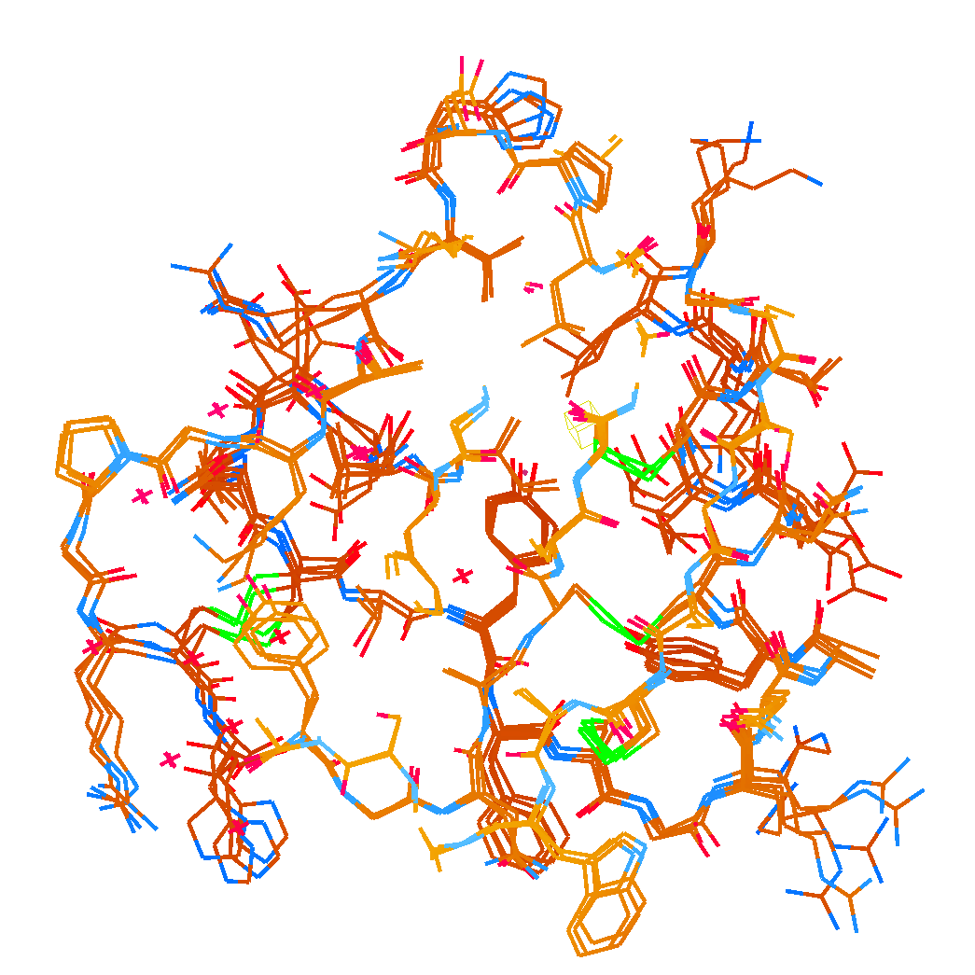
How many conformers are there?
Answer: 1-7
R_{cryst} = 0.1546
R_{free} = 0.1749
vs F_{obs}
1aho:
R_{cryst} = 0.1630
R_{free} = n/d

Slide 30
Adding noise
14%² + 14%² = 20%²
R_{protein} + R_{solvent} ≈ R_{cryst}

Slide 31
Adding noise
0%² + 14%² = 14%²
R_{protein} + R_{solvent} ≈ R_{cryst}

Slide 32
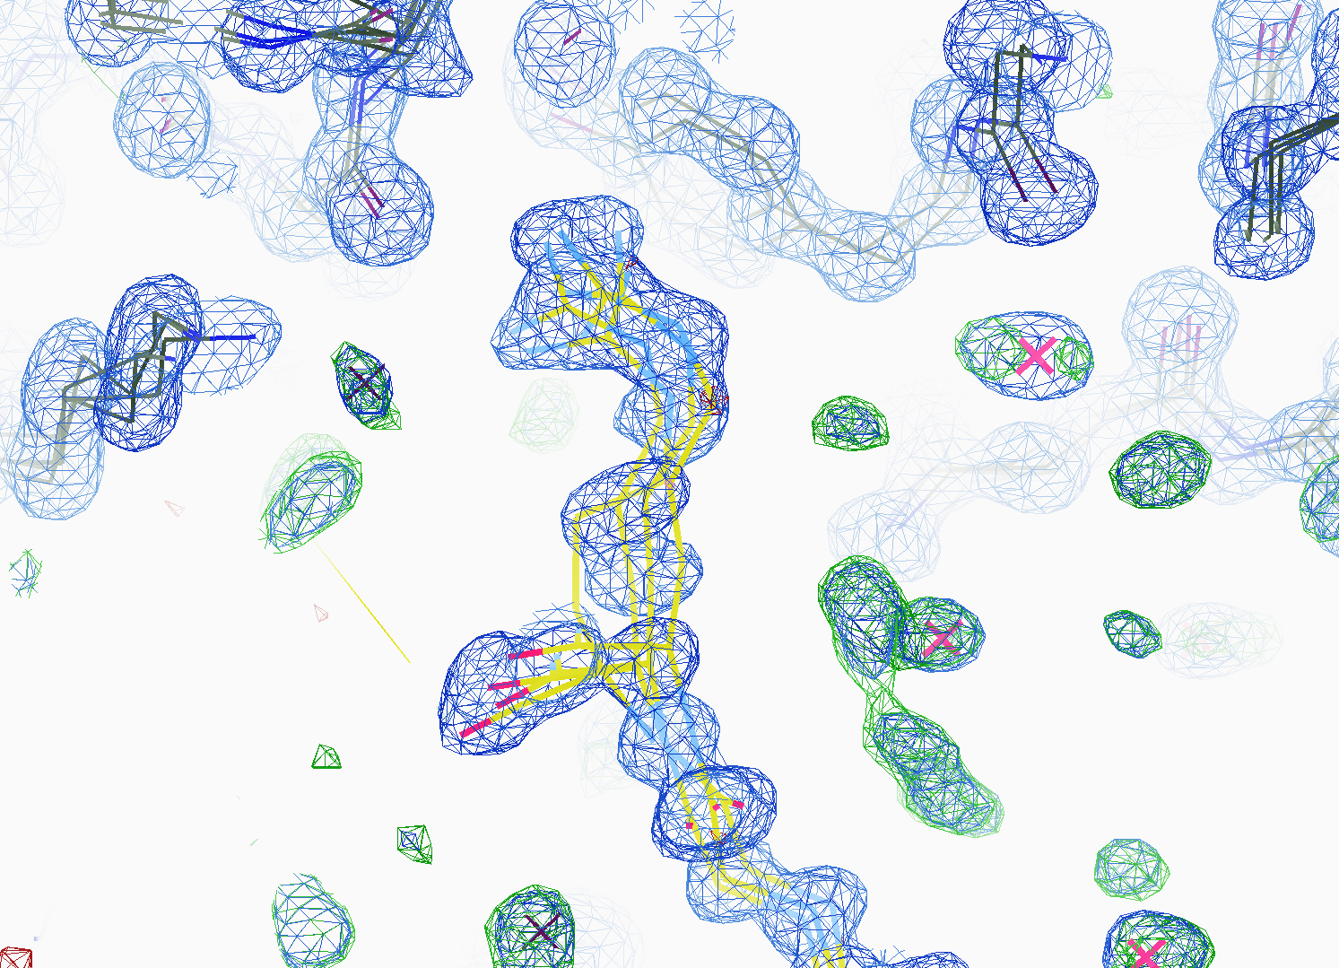
How many conformers are there?
All difference
features
are in
the solvent!
real data

Slide 33
RISM model for “bulk” solvent
Method | R_{work} | R_{free}
Default refmac5: flat bulk solvent | .1784 | .1898
RISM – self-consistent density field based on electrostatics | .1640 | .1808
Explicit MD solvent, protein fixed | .1523 | .1690
RISM – protein fixed multi-conformer weighted | .1578 | .1739
Explicit – protein fixed multi-conformer weighted | .1440 | .1666

Slide 34
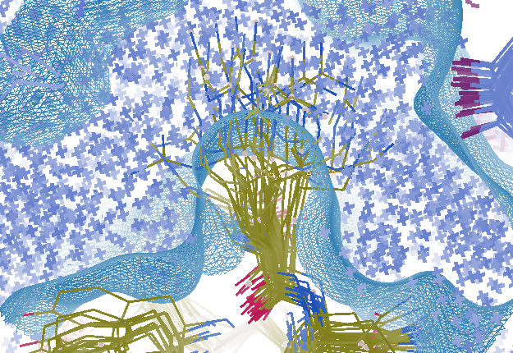
Combined multi-conformer & explicit solvent
R_{work} = 0.0309
R_{free} = 0.0678
vs F_{sim}
Problem: diverges with more cycles

Slide 35
Explicit solvent: refinement is unstable
R factor (%)
Phenix macro-cycle

Slide 36
Crowded-atom refinement

Slide 37
Crowded-atom refinement

Slide 38
How to stabilize refinement?
Do just 1 macro cycle
Apply overall scale factor to occupancies
Scale all changes back so that:
max XYZ shift <= 0.01 Å
Max occ shift <= 0.01
Max B shift <= 1
Repeat 1

Slide 39
Small steps = stable refinement
R factor (%)
Phenix macro-cycle

Slide 40
Status of macromolecular representation:
Even if we start with the “right answer”
it will blow up.
Might work better with smaller step size
Half the error is in the solvent,
and 20%² - 14%² = 14%²

Slide 41
Interpolation of structure factors: 2 1 2
Structure factor (e⁻)
Temperature (K)

Slide 42
Interpolation of structure factors: 2 1 2
Structure factor (e⁻)
Temperature (K)

Slide 43
Interpolation of structure factors: 10 11 3
Structure factor (e⁻)
Temperature (K)

Slide 44
Interpolation of atomic parameters
occupancy
Temperature (K)

Slide 45
Interpolation of atomic parameters
X coordinate
Temperature (K)

Slide 46
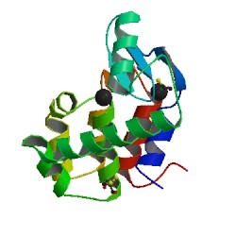
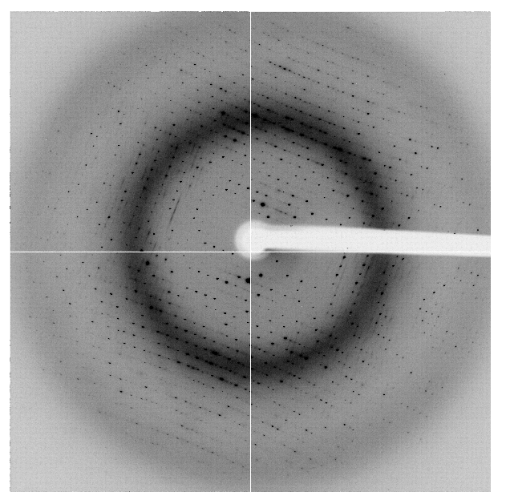
The R-factor Gap
multi-conformer PDB file
R_{merge} = 6%
R_{cryst} = 17%
R_{free} = 20%
MLFSOM
Elves
1H87
Holton, Classen, Frankel & Tainer (2014)."The R-factor gap in macromolecular crystallography: an untapped potential for insights on accurate structures", FEBS J. 281, 4046-4060.

Slide 47
The R-factor Gap
multi-conformer PDB file
R_{merge} = 6%
R_{cryst} = 7%
R_{free} = 8%
MLFSOM
Elves
1H87
Holton, Classen, Frankel & Tainer (2014)."The R-factor gap in macromolecular crystallography: an untapped potential for insights on accurate structures", FEBS J. 281, 4046-4060.

Slide 48
The R-factor Gap
single-conformer PDB file
R_{merge} = 6%
R_{cryst} = 7%
R_{free} = 8%
MLFSOM
Elves
1H87; conf “A”
Holton, Classen, Frankel & Tainer (2014)."The R-factor gap in macromolecular crystallography: an untapped potential for insights on accurate structures", FEBS J. 281, 4046-4060.

Slide 49
The R-factor Gap
Holton et al. (2014) "The R-factor gap", FEBS J. 281, 4046-4060.

Slide 50
“R-factor Gap” for macromolecules
Publication criterion for chemical crystallography:
R1 < 2*R_{sigma}
R1 = F_{o} vs F_{c} for I/σ(I) > 3
R_{sigma} = <σ(I)>/<I>
There are no PDB entries that pass this test!
Holton et al. (2014) "The R-factor gap", FEBS J. 281, 4046-4060.

Slide 51
Is this good enough?
d_{max} = 4.5 Å
R_{cryst} = 27%
R_{free} = 38%

Slide 52
Is this good enough?
3a8n 4.5 Å R_{merge} = 0.15 R/R_{free} = 0.306/0.396
1qzv 4.44 Å R_{merge} = 0.099 R/R_{free} = 0.41/0.42
1grz 5 Å R_{merge} = 0.052 R/R_{free} = 0.369/0.428

Slide 53
Is this good enough?
1hvu 4.75 Å R_{merge} = 0.064 R/R_{free} = 0.34/0.413
1n8e 4.5 Å R_{merge} = 0.138 R/R_{free} = 0.415/0.416
2r6e 5.02 Å R_{merge} = 0.058 R/R_{free} = 0.394/0.397

Slide 54
The R-factor Gap
R_{merge} = 6%
R_{cryst} = 17%
R_{free} = 20%
real
data
Elves
R_{merge} = 6%
R_{cryst} = 7%
R_{free} = 8%
MLFSOM
Elves
single-conformer PDB file
Notes:
Typically, when atomic models are refined against macromolecular crystallographic data, the model-data agreement statistics (Rcryst and Rfree) are many times higher than the internal self-consistency of the observations (exemplified by Rmerge here). The diffraction image simulation program MLFSOM includes all known sources of experimental error (including the systematic errors of sample absorption and detector calibration), and when the simulated images are processed with common data reduction packages such as Elves, the data quality statistics (such as Rmerge, I/sigma, and phasing power) obtained are essentially identical to those obtained from real data. The only exceptions are Rcryst and Rfree, which rapidly refine down to where the calculated and “observed” structure factors agree to within experimental error. Essentially, this result implies that experimental noise is not the cause of the large disagreements that persist between observed spot intensities and our molecular models. Indeed, if this were the case, then averaging over many crystals should result in significantly lower Rcryst/Rfree.

Slide 55
20%² + 5%² = 20.6%²
R_{merge} = 6%
R_{cryst} = 17%
R_{free} = 20%
MLFSOM
Elves
1H87
molecular model
structure factors
R_{cryst} = 7%
R_{free} = 8%
REFMAC
Notes:
When the PDB file 1H87 is used to create simulated diffraction images with MLFSOM and the Elves suite is used to reduce those images to structure factors, the final Rmerge, Rcryst, and Rfree statistics are remarkably similar to those obtained with real data. However, this is largely because the ARP/wARP program will not build multiple-confomer side chains, leading to an incomplete model.

Slide 56
The R-factor Gap
multi-conformer PDB file
R_{merge} = 6%
R_{cryst} = 17%
R_{free} = 20%
MLFSOM
Elves
1H87

Slide 57
The R-factor Gap
multi-conformer PDB file
R_{merge} = 6%
R_{cryst} = 7%
R_{free} = 8%
MLFSOM
Elves
1H87

Slide 58
The R-factor Gap
single-conformer PDB file
R_{merge} = 6%
R_{cryst} = 7%
R_{free} = 8%
MLFSOM
Elves
1H87; conf “A”

Slide 59
How do you model solvent?
Electron number density (e⁻/Å³)
x along line y=z=0 (Å)

Slide 60
How do you model solvent?
Electron number density (e⁻/Å³)
x along line y=z=0 (Å)

Slide 61
How do you model solvent?
Electron number density (e⁻/Å³)
x along line y=z=0 (Å)

Slide 62
How do you model solvent?
Electron number density (e⁻/Å³)
x along line y=z=0 (Å)

Slide 63
How do you model solvent?
Electron number density (e⁻/Å³)
x along line y=z=0 (Å)

Slide 64
RISM model for “bulk” solvent
Method | R_{work} | R_{free}
Default refmac5: flat bulk solvent | .1784 | .1898
RISM – self-consistent density field based on electrostatics | .1640 | .1808
Explicit MD solvent, protein fixed | .1523 | .1690

Slide 65
Solvent boundary problem

Slide 66
Solvent boundary problem

Slide 67
Solvent boundary problem

Slide 68
Solvent boundary problem

Slide 69
Current implementation

Slide 70
Better implementation?

Slide 71
0.00
0.20
0.39
0.57
0.72
0.86
1.00
Glu 24
A
B
C
D
E
F
0.24
0.41
0.55
0.68
0.79
0.90
Arg 18
A
B
C
D
E
F
G
0.28
0.55
0.80
Tyr 21
A
B
C
D
0.28
0.48
0.65
0.77
0.89
Asp 9
A
B
C
D
E
F
0.3
0.60
0.83
His 54
A
B
C
D
0.3
0.59
0.81
Pro 60
A
B
C
D

Slide 72
20%
0.00
0.20
0.39
0.57
0.72
0.86
1.00
Glu 24
A
B
C
D
E
F
0.24
0.41
0.55
0.68
0.79
0.90
Arg 18
A
B
C
D
E
F
G
0.28
0.55
0.80
Tyr 21
A
B
C
D
0.28
0.48
0.65
0.77
0.89
Asp 9
A
B
C
D
E
F
0.3
0.60
0.83
His 54
A
B
C
D
0.3
0.59
0.81
Pro 60
A
B
C
D

Slide 73
4%
0.00
0.20
0.39
0.57
0.72
0.86
1.00
Glu 24
A
B
C
D
E
F
0.24
0.41
0.55
0.68
0.79
0.90
Arg 18
A
B
C
D
E
F
G
0.28
0.55
0.80
Tyr 21
A
B
C
D
0.28
0.48
0.65
0.77
0.89
Asp 9
A
B
C
D
E
F
0.3
0.60
0.83
His 54
A
B
C
D
0.3
0.59
0.81
Pro 60
A
B
C
D

Slide 74
4%
0.00
0.20
0.39
0.57
0.72
0.86
1.00
Glu 24
A
B
C
D
E
F
0.24
0.41
0.55
0.68
0.79
0.90
Arg 18
A
B
C
D
E
F
G
0.28
0.55
0.80
Tyr 21
A
B
C
D
0.28
0.48
0.65
0.77
0.89
Asp 9
A
B
C
D
E
F
0.3
0.60
0.83
His 54
A
B
C
D
0.3
0.59
0.81
Pro 60
A
B
C
D

Slide 75
2%
0.00
0.20
0.39
0.57
0.72
0.86
1.00
Glu 24
A
B
C
D
E
F
0.24
0.41
0.55
0.68
0.79
0.90
Arg 18
A
B
C
D
E
F
G
0.28
0.55
0.80
Tyr 21
A
B
C
D
0.28
0.48
0.65
0.77
0.89
Asp 9
A
B
C
D
E
F
0.3
0.60
0.83
His 54
A
B
C
D
0.3
0.59
0.81
Pro 60
A
B
C
D

Slide 76
9%
0.00
0.20
0.39
0.57
0.72
0.86
1.00
Glu 24
A
B
C
D
E
F
0.24
0.41
0.55
0.68
0.79
0.90
Arg 18
A
B
C
D
E
F
G
0.28
0.55
0.80
Tyr 21
A
B
C
D
0.28
0.48
0.65
0.77
0.89
Asp 9
A
B
C
D
E
F
0.3
0.60
0.83
His 54
A
B
C
D
0.3
0.59
0.81
Pro 60
A
B
C
D

Slide 77
2%
0.00
0.20
0.39
0.57
0.72
0.86
1.00
Glu 24
A
B
C
D
E
F
0.24
0.41
0.55
0.68
0.79
0.90
Arg 18
A
B
C
D
E
F
G
0.28
0.55
0.80
Tyr 21
A
B
C
D
0.28
0.48
0.65
0.77
0.89
Asp 9
A
B
C
D
E
F
0.3
0.60
0.83
His 54
A
B
C
D
0.3
0.59
0.81
Pro 60
A
B
C
D

Slide 78
7%
0.00
0.20
0.39
0.57
0.72
0.86
1.00
Glu 24
A
B
C
D
E
F
0.24
0.41
0.55
0.68
0.79
0.90
Arg 18
A
B
C
D
E
F
G
0.28
0.55
0.80
Tyr 21
A
B
C
D
0.28
0.48
0.65
0.77
0.89
Asp 9
A
B
C
D
E
F
0.3
0.60
0.83
His 54
A
B
C
D
0.3
0.59
0.81
Pro 60
A
B
C
D

Slide 79
7%
0.00
0.20
0.39
0.57
0.72
0.86
1.00
Glu 24
A
B
C
D
E
F
0.24
0.41
0.55
0.68
0.79
0.90
Arg 18
A
B
C
D
E
F
G
0.28
0.55
0.80
Tyr 21
A
B
C
D
0.28
0.48
0.65
0.77
0.89
Asp 9
A
B
C
D
E
F
0.3
0.60
0.83
His 54
A
B
C
D
0.3
0.59
0.81
Pro 60
A
B
C
D

Slide 80
2%
0.00
0.20
0.39
0.57
0.72
0.86
1.00
Glu 24
A
B
C
D
E
F
0.24
0.41
0.55
0.68
0.79
0.90
Arg 18
A
B
C
D
E
F
G
0.28
0.55
0.80
Tyr 21
A
B
C
D
0.28
0.48
0.65
0.77
0.89
Asp 9
A
B
C
D
E
F
0.3
0.60
0.83
His 54
A
B
C
D
0.3
0.59
0.81
Pro 60
A
B
C
D

Slide 81
2%
0.00
0.20
0.39
0.57
0.72
0.86
1.00
Glu 24
A
B
C
D
E
F
0.24
0.41
0.55
0.68
0.79
0.90
Arg 18
A
B
C
D
E
F
G
0.28
0.55
0.80
Tyr 21
A
B
C
D
0.28
0.48
0.65
0.77
0.89
Asp 9
A
B
C
D
E
F
0.3
0.60
0.83
His 54
A
B
C
D
0.3
0.59
0.81
Pro 60
A
B
C
D

Slide 82
1%
0.00
0.20
0.39
0.57
0.72
0.86
1.00
Glu 24
A
B
C
D
E
F
0.24
0.41
0.55
0.68
0.79
0.90
Arg 18
A
B
C
D
E
F
G
0.28
0.55
0.80
Tyr 21
A
B
C
D
0.28
0.48
0.65
0.77
0.89
Asp 9
A
B
C
D
E
F
0.3
0.60
0.83
His 54
A
B
C
D
0.3
0.59
0.81
Pro 60
A
B
C
D

Slide 83
5%
0.00
0.20
0.39
0.57
0.72
0.86
1.00
Glu 24
A
B
C
D
E
F
0.24
0.41
0.55
0.68
0.79
0.90
Arg 18
A
B
C
D
E
F
G
0.28
0.55
0.80
Tyr 21
A
B
C
D
0.28
0.48
0.65
0.77
0.89
Asp 9
A
B
C
D
E
F
0.3
0.60
0.83
His 54
A
B
C
D
0.3
0.59
0.81
Pro 60
A
B
C
D

Slide 84
3%
0.00
0.20
0.39
0.57
0.72
0.86
1.00
Glu 24
A
B
C
D
E
F
0.24
0.41
0.55
0.68
0.79
0.90
Arg 18
A
B
C
D
E
F
G
0.28
0.55
0.80
Tyr 21
A
B
C
D
0.28
0.48
0.65
0.77
0.89
Asp 9
A
B
C
D
E
F
0.3
0.60
0.83
His 54
A
B
C
D
0.3
0.59
0.81
Pro 60
A
B
C
D

Slide 85
4%
0.00
0.20
0.39
0.57
0.72
0.86
1.00
Glu 24
A
B
C
D
E
F
0.24
0.41
0.55
0.68
0.79
0.90
Arg 18
A
B
C
D
E
F
G
0.28
0.55
0.80
Tyr 21
A
B
C
D
0.28
0.48
0.65
0.77
0.89
Asp 9
A
B
C
D
E
F
0.3
0.60
0.83
His 54
A
B
C
D
0.3
0.59
0.81
Pro 60
A
B
C
D

Slide 86
5%
0.00
0.20
0.39
0.57
0.72
0.86
1.00
Glu 24
A
B
C
D
E
F
0.24
0.41
0.55
0.68
0.79
0.90
Arg 18
A
B
C
D
E
F
G
0.28
0.55
0.80
Tyr 21
A
B
C
D
0.28
0.48
0.65
0.77
0.89
Asp 9
A
B
C
D
E
F
0.3
0.60
0.83
His 54
A
B
C
D
0.3
0.59
0.81
Pro 60
A
B
C
D

Slide 87
2%
0.00
0.20
0.39
0.57
0.72
0.86
1.00
Glu 24
A
B
C
D
E
F
0.24
0.41
0.55
0.68
0.79
0.90
Arg 18
A
B
C
D
E
F
G
0.28
0.55
0.80
Tyr 21
A
B
C
D
0.28
0.48
0.65
0.77
0.89
Asp 9
A
B
C
D
E
F
0.3
0.60
0.83
His 54
A
B
C
D
0.3
0.59
0.81
Pro 60
A
B
C
D

Slide 88
1%
0.00
0.20
0.39
0.57
0.72
0.86
1.00
Glu 24
A
B
C
D
E
F
0.24
0.41
0.55
0.68
0.79
0.90
Arg 18
A
B
C
D
E
F
G
0.28
0.55
0.80
Tyr 21
A
B
C
D
0.28
0.48
0.65
0.77
0.89
Asp 9
A
B
C
D
E
F
0.3
0.60
0.83
His 54
A
B
C
D
0.3
0.59
0.81
Pro 60
A
B
C
D

Slide 89
1%
0.00
0.20
0.39
0.57
0.72
0.86
1.00
Glu 24
A
B
C
D
E
F
0.24
0.41
0.55
0.68
0.79
0.90
Arg 18
A
B
C
D
E
F
G
0.28
0.55
0.80
Tyr 21
A
B
C
D
0.28
0.48
0.65
0.77
0.89
Asp 9
A
B
C
D
E
F
0.3
0.60
0.83
His 54
A
B
C
D
0.3
0.59
0.81
Pro 60
A
B
C
D

Slide 90
2%
0.00
0.20
0.39
0.57
0.72
0.86
1.00
Glu 24
A
B
C
D
E
F
0.24
0.41
0.55
0.68
0.79
0.90
Arg 18
A
B
C
D
E
F
G
0.28
0.55
0.80
Tyr 21
A
B
C
D
0.28
0.48
0.65
0.77
0.89
Asp 9
A
B
C
D
E
F
0.3
0.60
0.83
His 54
A
B
C
D
0.3
0.59
0.81
Pro 60
A
B
C
D

Slide 91
3%
0.00
0.20
0.39
0.57
0.72
0.86
1.00
Glu 24
A
B
C
D
E
F
0.24
0.41
0.55
0.68
0.79
0.90
Arg 18
A
B
C
D
E
F
G
0.28
0.55
0.80
Tyr 21
A
B
C
D
0.28
0.48
0.65
0.77
0.89
Asp 9
A
B
C
D
E
F
0.3
0.60
0.83
His 54
A
B
C
D
0.3
0.59
0.81
Pro 60
A
B
C
D

Slide 92
3%
0.00
0.20
0.39
0.57
0.72
0.86
1.00
Glu 24
A
B
C
D
E
F
0.24
0.41
0.55
0.68
0.79
0.90
Arg 18
A
B
C
D
E
F
G
0.28
0.55
0.80
Tyr 21
A
B
C
D
0.28
0.48
0.65
0.77
0.89
Asp 9
A
B
C
D
E
F
0.3
0.60
0.83
His 54
A
B
C
D
0.3
0.59
0.81
Pro 60
A
B
C
D

Slide 93
1%
0.00
0.20
0.39
0.57
0.72
0.86
1.00
Glu 24
A
B
C
D
E
F
0.24
0.41
0.55
0.68
0.79
0.90
Arg 18
A
B
C
D
E
F
G
0.28
0.55
0.80
Tyr 21
A
B
C
D
0.28
0.48
0.65
0.77
0.89
Asp 9
A
B
C
D
E
F
0.3
0.60
0.83
His 54
A
B
C
D
0.3
0.59
0.81
Pro 60
A
B
C
D

Slide 94
3%
20%
2%
1%
4%
3%
3%
4%
9%
2%
7%
7%
2%
3%
5%
2%
1%
10%
4%
2%
5%
2%
3%
0.00
0.20
0.39
0.57
0.72
0.86
1.00
Glu 24
A
B
C
D
E
F
0.24
0.41
0.55
0.68
0.79
0.90
Arg 18
A
B
C
D
E
F
G
0.28
0.55
0.80
Tyr 21
A
B
C
D
0.28
0.48
0.65
0.77
0.89
Asp 9
A
B
C
D
E
F
0.3
0.60
0.83
His 54
A
B
C
D
0.3
0.59
0.81
Pro 60
A
B
C
D

Slide 95
RISM model for “bulk” solvent
Method | R_{work} | R_{free}
Default refmac5: flat bulk solvent | .1784 | .1898
RISM – self-consistent density field based on electrostatics | .1640 | .1808
Explicit MD solvent, protein fixed | .1523 | .1690
RISM – protein fixed multi-conformer weighted | .1578 | .1739
Explicit – protein fixed multi-conformer weighted | .1440 | .1666

Slide 96
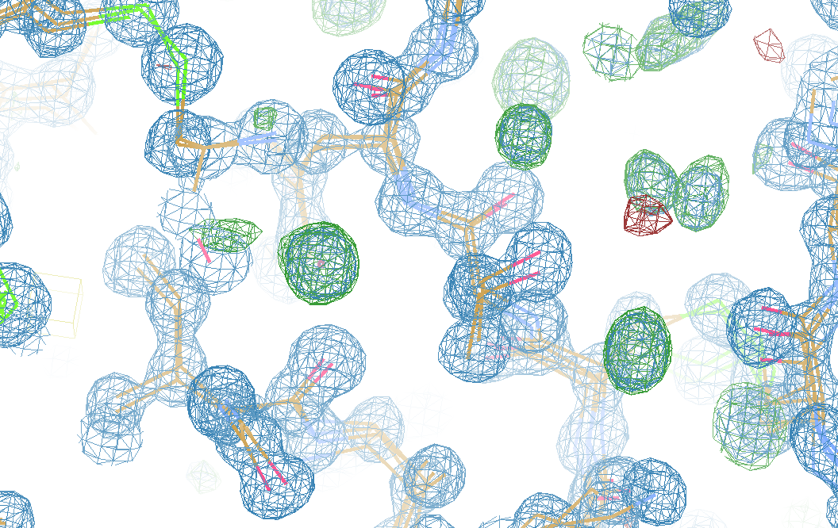
What is “missing”?

Slide 97
Optimum resolution cutoff is:
Too optimistic: add nothing but noise
Too pessimistic: series-termination error
Happy medium?
Simulate:
Random atoms, compute F²
Add Gaussian noise, RMS = 1
Truncate
Subtract “right” map, RMS difference

Slide 98
Optimal resolution cutoff
Error in map (rms e⁻)
Resolution cutoff (Å)

Slide 99
Optimal resolution cutoff
Correlation Coefficient
Resolution cutoff (Å)

Slide 100
Optimal resolution cutoff
Correlation Coefficient
Resolution cutoff (Å)

Slide 101
Optimal resolution cutoff
Error in map (rms e⁻)
Resolution cutoff (Å)

Slide 102
Wilson Plot
2
log( intensity )
8
2.2 1.6 1.3 1.1 1.0 0.9 0.85 0.8 0.75 0.7
resolution (Å)

Slide 103
Optimum resolution cutoff is:
0.0 Å

