Slide 1
non-isomorphism

Slide 2
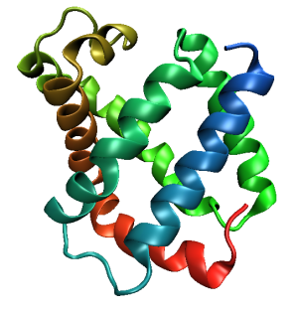
Same structure, different cell
0.5% cell change → 15%
Crick & Magdoff (1956) “theory method isomorphous replacement”, Acta Cryst. 9, 901-8.

Slide 3
Same structure, different cell
0.5% cell change → 15%
Crick & Magdoff (1956) “theory method isomorphous replacement”, Acta Cryst. 9, 901-8.

Slide 4
Same cell, rotated protein
0.5° rotation → 16%
Crick & Magdoff (1956) “theory method isomorphous replacement”, Acta Cryst. 9, 901-8.

Slide 5
Same cell, rotated protein
0.5° rotation → 16%
Crick & Magdoff (1956) “theory method isomorphous replacement”, Acta Cryst. 9, 901-8.

Slide 6
Uniform stretch
5% change → 0%

Slide 7
Uniform stretch
5% change → 0%

Slide 8
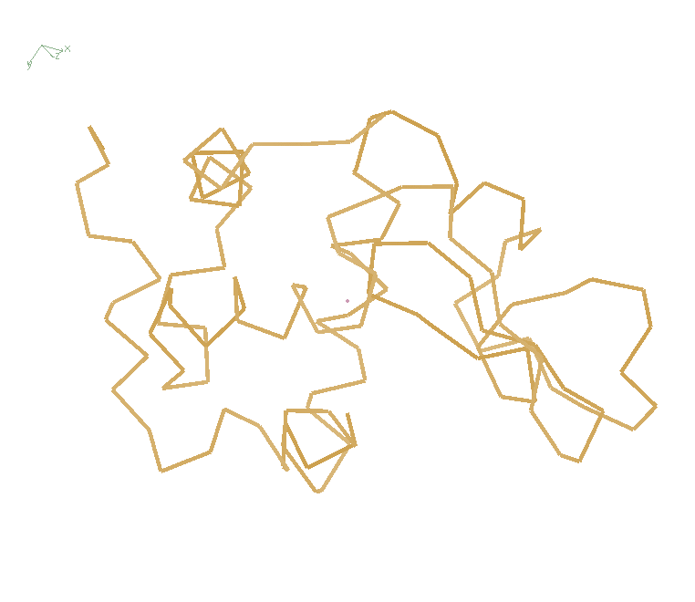
Non-isomorphism in lysozyme
RMSD = 1.70 Å
Δcell = 0.7 %
R_{iso} = 44.5%
RMSD = 0.18 Å
3aw6
3aw7
RH: 84.2%
vs 71.9%

Slide 9
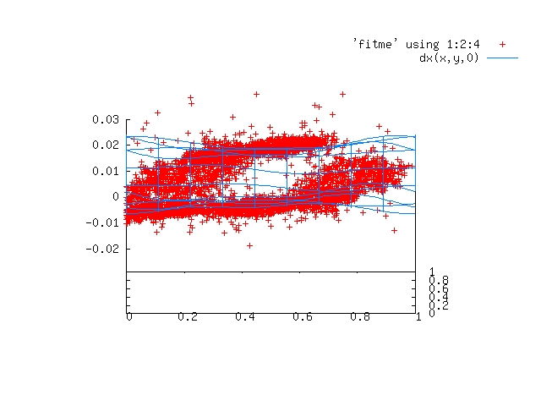

Slide 10
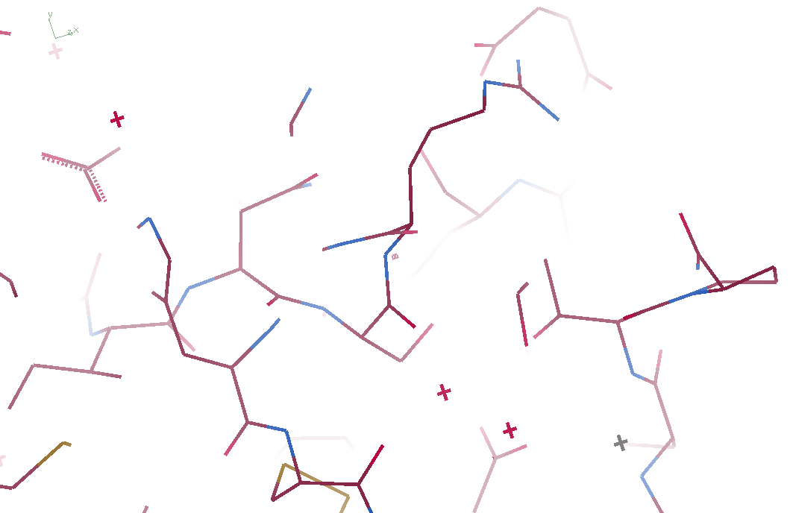
3aw6

Slide 11
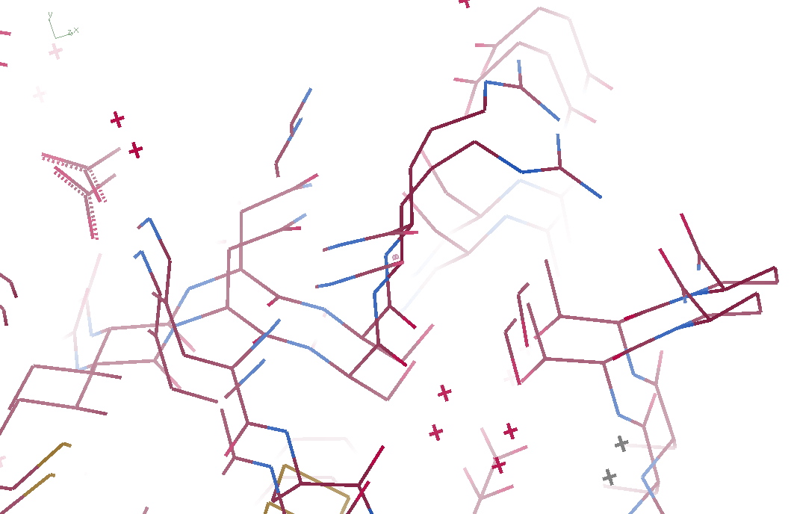
3aw6 3aw7

Slide 12
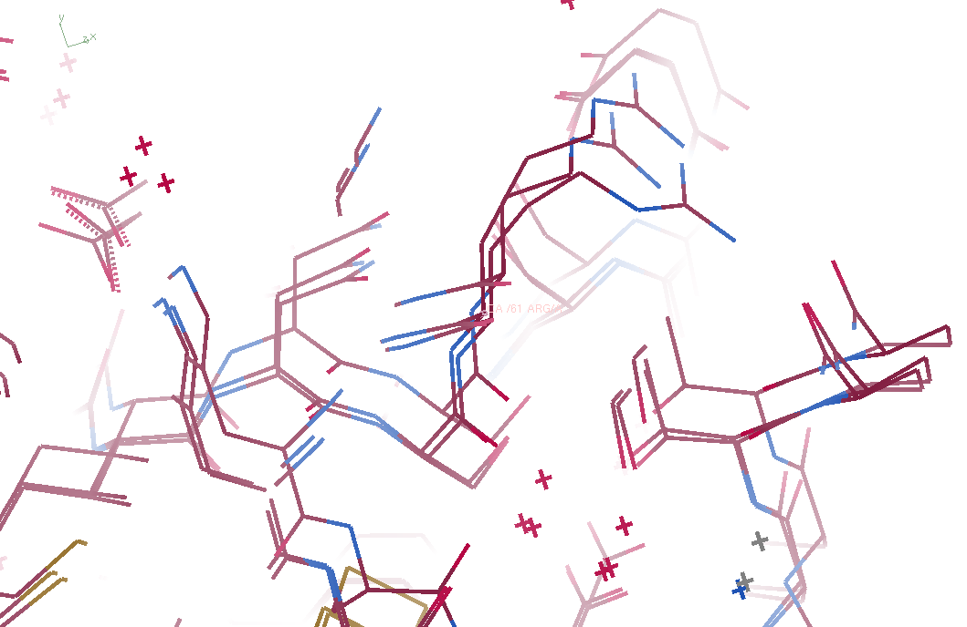
3aw6, 3aw7, “bent” 3aw6

Slide 13
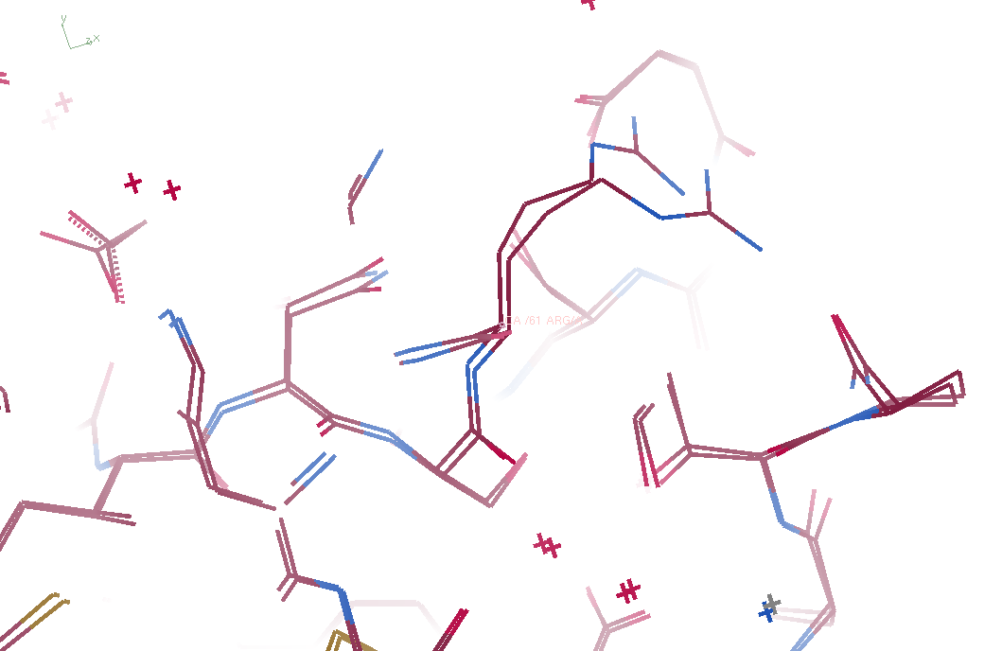
3aw7, “bent” 3aw6

Slide 14
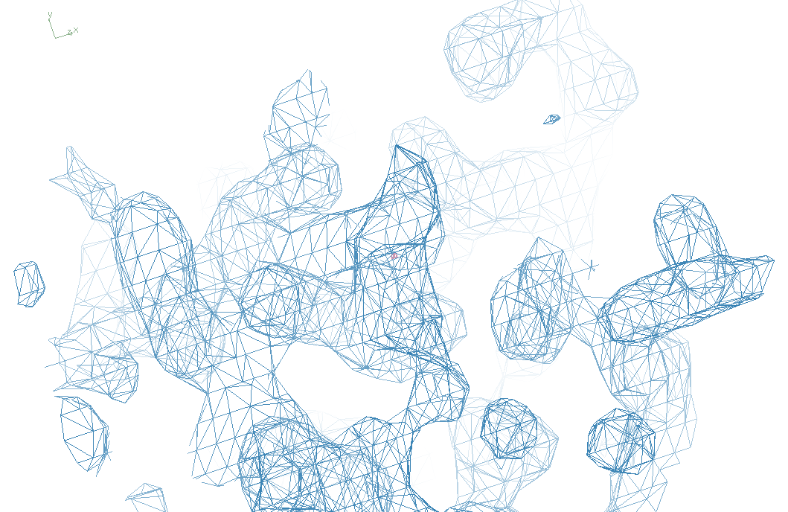
3aw6

Slide 15
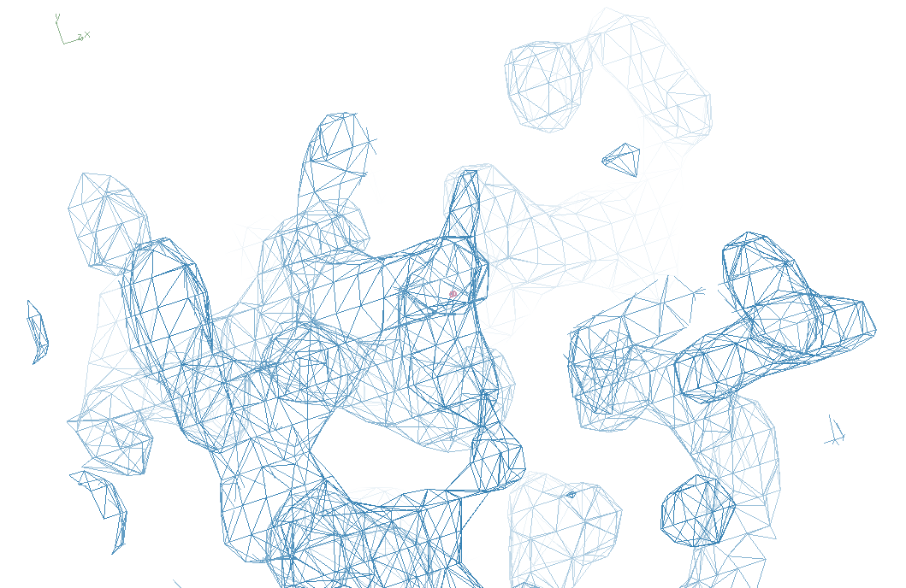
“bent” 3aw7

Slide 16
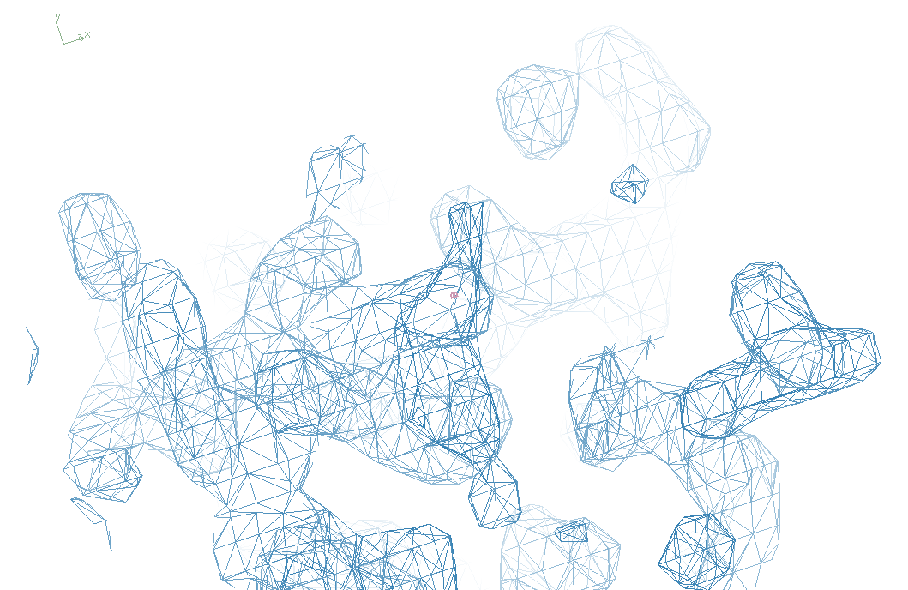
3aw7

Slide 17
Structure Factor Equation
F_{hkl} = f_{atom} exp(-2π i (hx + ky + lz))
Σ
dF_{hkl}
dx
= f_{atom} (-2π i hx) exp(-2π i (hx + ky + lz))
Σ

Slide 18
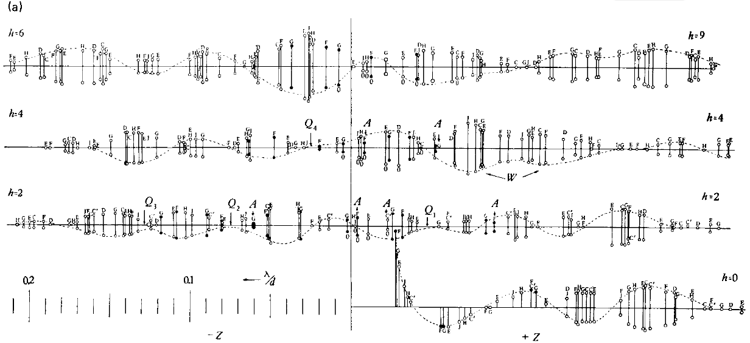
Bragg’s “minimum wavelength principle”
Perutz (1985). “Early Days of Cryst…” Methods in Enzymology, Vol. 114, 3-18.
Bragg & Perutz (1952)."external form haemoglobin I", Acta Cryst. 5, 277-283.

Slide 19
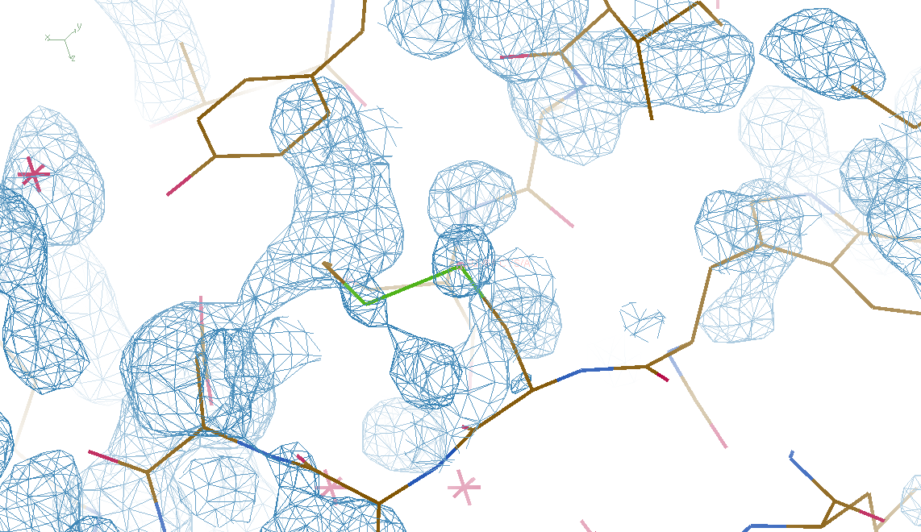
DMMULTI – fake data
4 deg rotation: 8 “xtals”: before
CC = 0.02

Slide 20
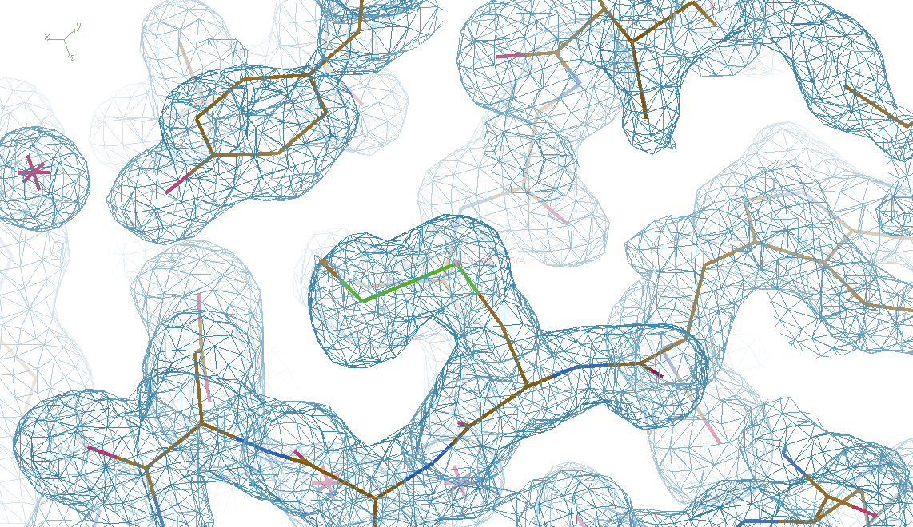
DMMULTI – fake data
4 deg rotation: 8 “xtals”: after
CC = 0.8

Slide 21
X-ray Data Sets
Singular values & vectors
data
set
h,k,l | structure factors (F)
 | #1 | #2 | #3 | #4
5,3,4 | 523.7 | 559.8 | 579.9 | 603.2
5,4,4 | 168.2 | 166.6 | 177.2 | 196.1
5,5,4 | 34.9 | 26.4 | 19.2 | 17.3
6,1,4 | 305.7 | 301.1 | 298.1 | 296.3
6,2,4 | 353.0 | 353.9 | 356.2 | 366.9
6,3,4 | 300.9 | 285.3 | 273.5 | 259.4
6,3,5 | 223.8 | 226.3 | 234.6 | 251.4
… | … | … | … | …
h,k,l | 100% | 17 % | 13 % | 9 %
 | 1st | 2nd | 3rd | 4th
5,3,4 | -1.46 | -0.02 | 1.84 | -0.72
5,4,4 | -0.88 | -0.29 | -0.34 | 0.15
5,5,4 | -0.42 | -0.65 | 1.02 | 1.47
6,1,4 | -0.90 | -0.85 | 1.44 | -0.40
6,2,4 | -1.20 | -0.37 | 0.67 | 0.01
6,3,4 | -0.75 | 0.31 | 0.48 | 0.00
6,3,5 | -0.75 | -0.85 | 0.72 | -0.82
… | … | … | … | …
value
vector
Singular value decomp.
SVD
-0.68
-0.24
0.32 …
CC1
Data sets
Positioned
in
“Correlation
Space”
Correlation
Coefficients
CC1 CC2 CC3
CC2
data set #1
data set #2
data set #3
CC3

Slide 22
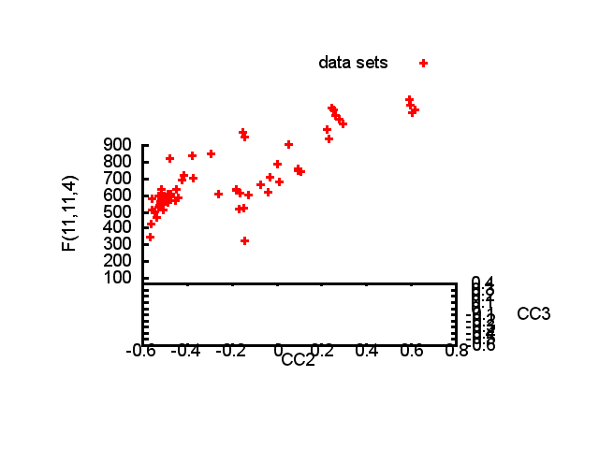

Slide 23
Structure factor (electrons)
Correlation to 2nd & 3rd singular vectors

Slide 24
Structure factor (electrons)
Correlation to 2nd & 3rd singular vectors

Slide 25
Structure factor (electrons)
Correlation to 2nd & 3rd singular vectors

Slide 26
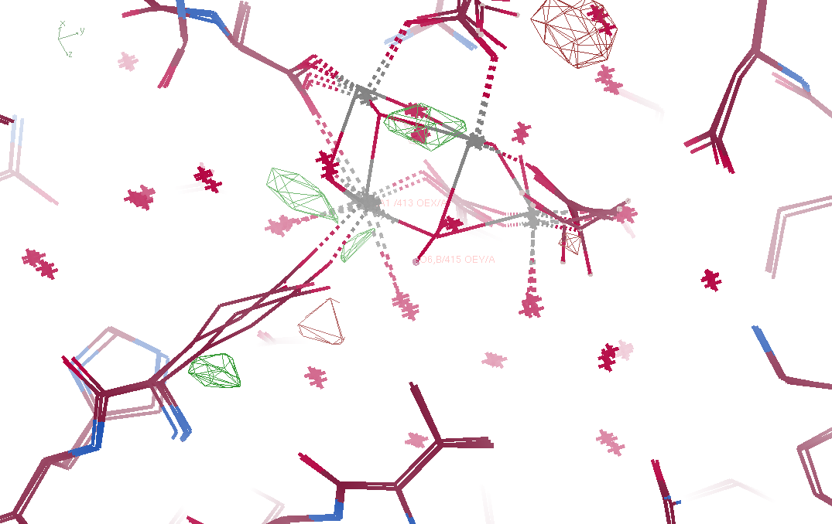
Fo – Fc maps

Slide 27
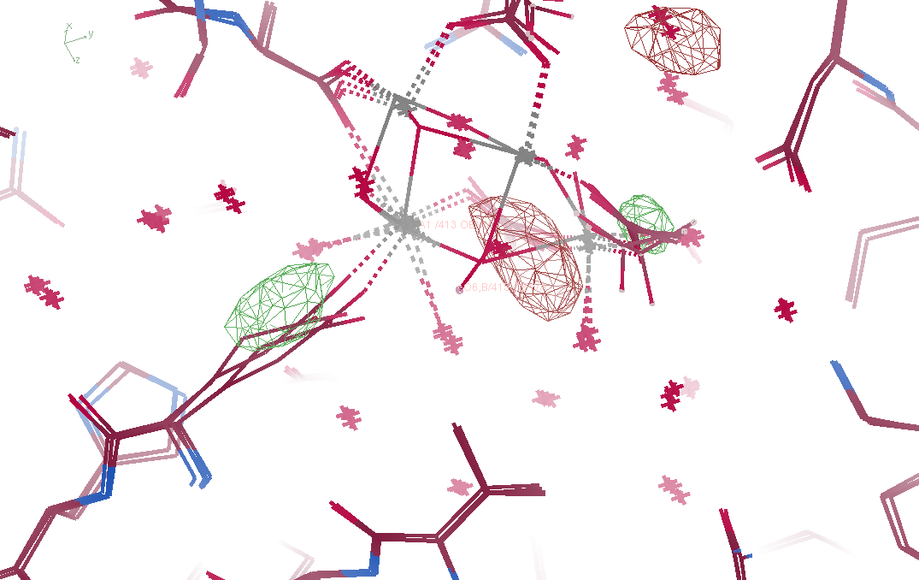
Fo – Fo maps

Slide 28
Non-isomorphism in lysozyme
Dear James
The story of the two forms of lysozyme crystals goes back to about 1964 when it was found that the diffraction patterns from different crystals could be placed in one of two classes depending on their intensities. This discovery was a big set back at the time and I can remember a lecture title being changed from the 'The structure of lysozyme' to 'The structure of lysozyme two steps forward and one step back'. Thereafter the crystals were screened based on intensities of the (11,11,l) rows to distinguish them (e.g. 11,11,4 > 11,11,5 in one form and vice versa in another). Data were collected only for those that fulfilled the Type II criteria. (These reflections were easy to measure on the linear diffractometer because crystals were mounted to rotate about the diagonal axis). As I recall both Type I and Type II could be found in the same crystallisation batch . Although sometimes the external morphology allowed recognition this was not infallible.
The structure was based on Type II crystals. Later a graduate student Helen Handoll examined Type I. The work, which was in the early days and before refinement programmes, seemed to suggest that the differences lay in the arrangement of water or chloride molecules (Lysozyme was crystallised from NaCl). But the work was never written up. Keith Wilson at one stage was following this up as lysozyme was being used to test data collection strategies but I do not know the outcome.
An account of this is given in International Table Volume F (Rossmann and Arnold edited 2001) p760.
Tony North was much involved in sorting this out and if you wanted more info he would be the person to contact. I hope this is helpful. Do let me know if you need more.
Best wishes
Louise

Slide 29
Dehydration: 1934
and 2017?
= 1.5 μL
100 μm
= 1.0 nL
2 mm
= 1.0 pL
10 μm
= 1.0 fL
1 μm

Slide 30
“deconform” cypA 100K
R factor (%)
Number of conformers

Slide 31
“deconform” cypA 300K
R factor (%)
Number of conformers

