Slide 1
Acknowledgements
Robert Stroud James Fraser John Spence
Chris Nielsen Clemens Schulze-Briese Aina Cohen Ana Gonzalez
UCSF LBNL SLAC
ALS 8.3.1 creator: Tom Alber
Center for Structure of Membrane Proteins (CSMP)
Membrane Protein Expression Center II (MPEC)
Center for HIV Accessory and Regulatory Complexes (HARC)
UC Multicampus Research Programs and Initiatives (MRPI)
UCSF Program for Breakthrough Biomedical Research (PBBR) Integrated Diffraction Analysis Technologies (IDAT)
Plexxikon, Inc.
M D Anderson CRC
Synchrotron Radiation Strucural Biology Resource (SLAC)
The Advanced Light Source is supported by the Director, Office of Science, Office of Basic Energy Sciences, Materials Sciences Division, of the US Department of Energy under contract No. DE-AC02-05CH11231 at Lawrence Berkeley National Laboratory.

Slide 2
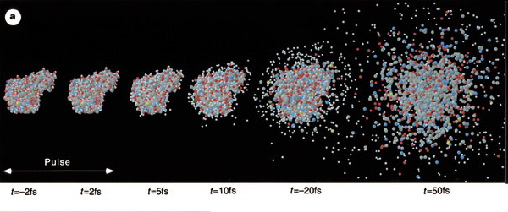
Promise of Single-molecule imaging
R. Neutze et al., Nature 406, pp. 752-757 (2000)

Slide 3
Single-molecule diffraction: problems
Focusing
Hit rate
Bragg’s law
Radiation damage
Motion blur
Data processing

Slide 4
Single-molecule diffraction: problems
Focusing
Hit rate
Bragg’s law
Radiation damage
Motion blur
Data processing

Slide 5
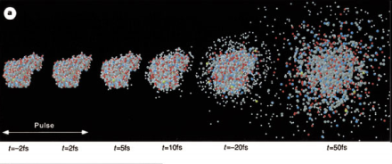
X-ray laser
7 μm beam
10¹²/10 ² /2000*(12.4/9.5)²
8 MGy
3 μm beam
10¹²/3 ² /2000*(12.4/2)²
2 GGy
2 TGy
100 nm beam
10¹²/10 ² /2000*(12.4/2)²
200 MGy

Slide 6
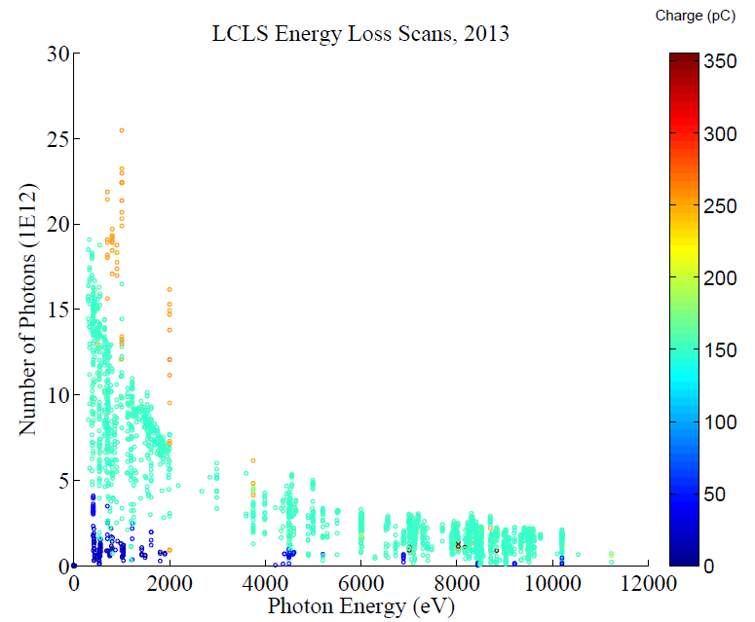

Slide 7
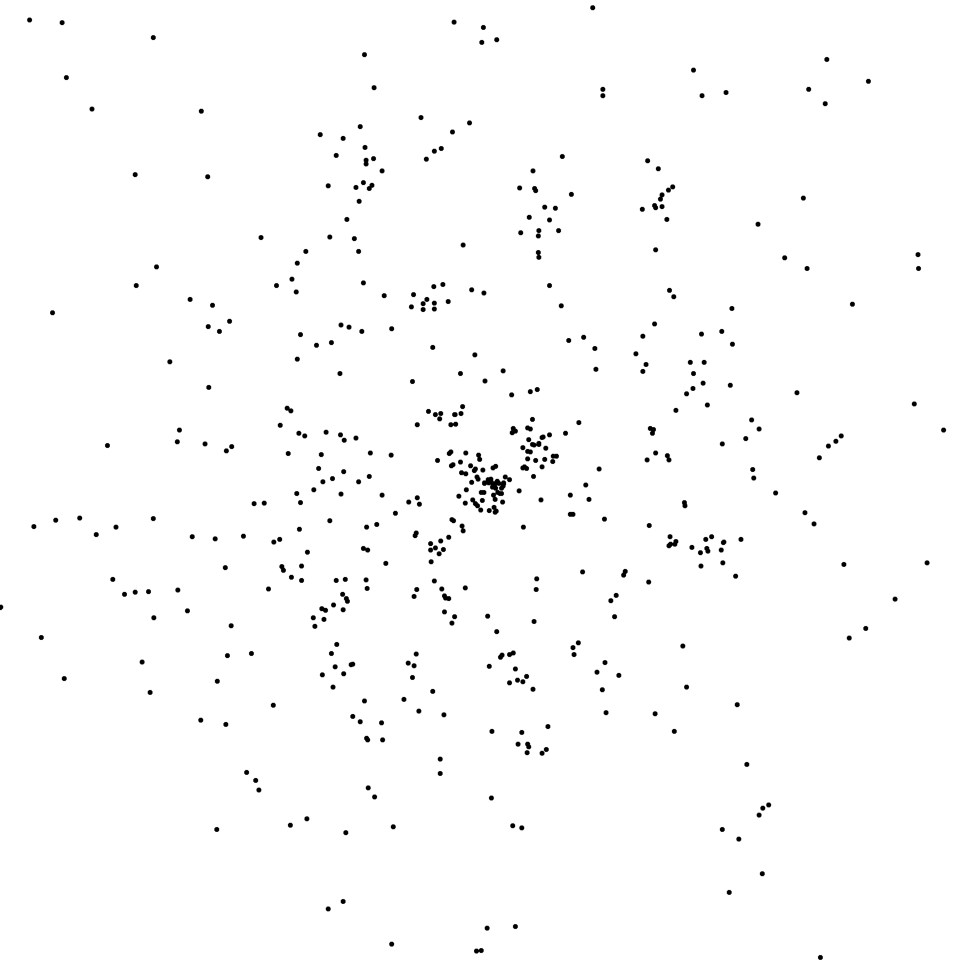
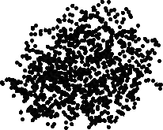
5x10¹² photons
100 nm focus
one lysozyme
Babinet water
flat detector
200 mm detector
50 mm distance
4 keV photons
2.7 Å at corner
2.4 TGy

Slide 8
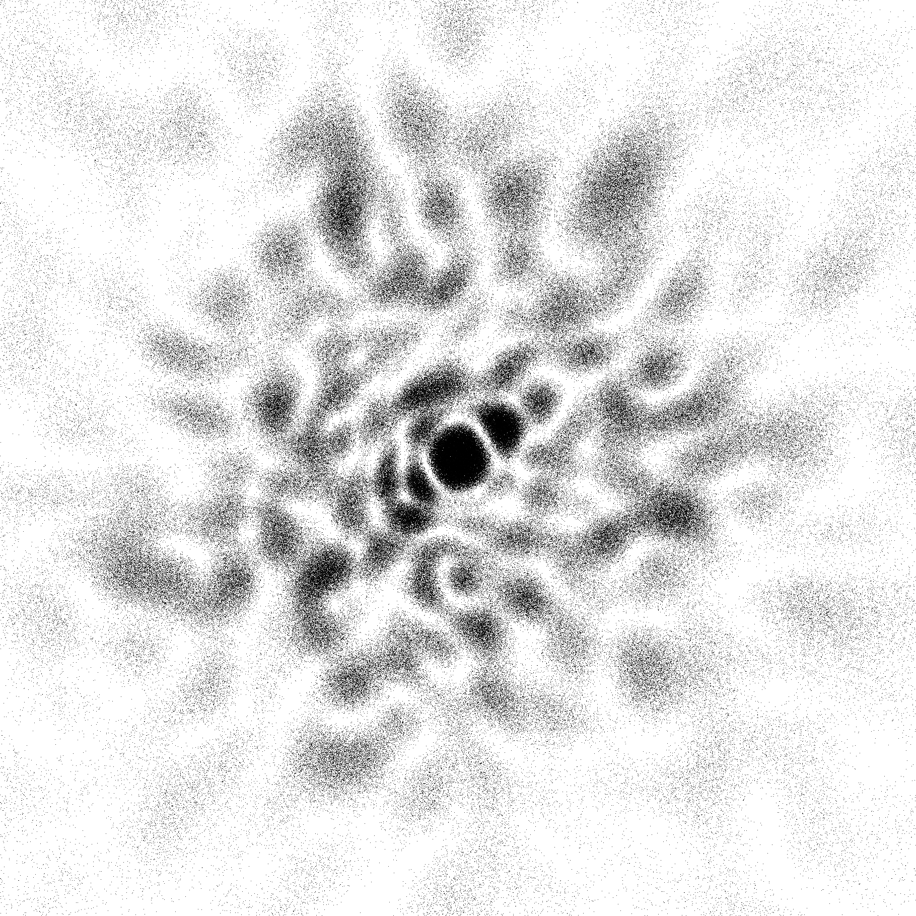
5x10¹⁵ photons
100 nm focus
one lysozyme
Babinet water
flat detector
200 mm detector
50 mm distance
4 keV photons
2.7 Å at corner
2400 TGy

Slide 9
5x10¹² photons
30 Å focus
one lysozyme
Babinet water
flat detector
200 mm detector
50 mm distance
4 keV photons
2.7 Å at corner
2400 TGy

Slide 10
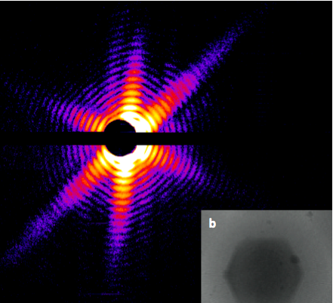
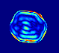
Snapshot from single virus particles
2KV LCLS 200fs Mimi virus single-shot.
_{200 nm}
_{Resolution: ~100 Å}
_{1 GGy}
_{TEM}
T. Ekeberg et al.. PRL 114, 098102 (2015).
Notes:
what limits single-particle resolution ?
get 100 times more photons/shot if correctly focussed beam
get 100 times more with submicron beam focus on CXI chamber
Problem – scattering goes from N^2 to N (Wilson statistics).
So use a-priori information – modelling Axel Brummer
Make beam smaller than jet to elliminate streak
₁₀

Slide 11
Single-molecule diffraction: problems
Focusing
Hit rate
Bragg’s law
Radiation damage
Motion blur
Data processing

Slide 12
Single-molecule diffraction: problems
Focusing
Hit rate
Bragg’s law
Radiation damage
Motion blur
Data processing

Slide 13
10 m/s

Slide 14
Fixed target data collection “plan”

Slide 16
Diamond
($100, reusable)

Slide 17
oil ?
Diamond
($100, reusable)

Slide 18
oil ?
Diamond
($100, reusable)

Slide 19
oil ?
International Tables for Crystallography, Vol. C, 2nd ed., chapter 6.3

Slide 20
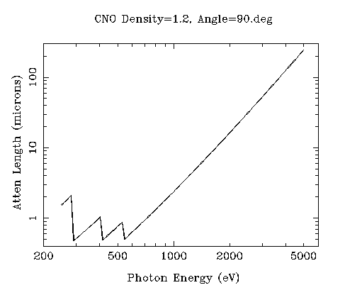
“sweet spot” for sample size ?
2 Å
2sin(90°)
C
3 Å
2sin(90°)
N
O
4 Å
2sin(90°)

Slide 21
Single-molecule diffraction: problems
Focusing
Hit rate
Bragg’s law
Radiation damage
Motion blur
Data processing

Slide 22
Single-molecule diffraction: problems
Focusing
Hit rate
Bragg’s law
Radiation damage
Motion blur
Data processing

Slide 23
λ = 2d sin(θ)
F = e⁻

Slide 24
λ = 2d sin(θ)
F = e⁻

Slide 25
λ = 2d sin(θ)
F = e⁻

Slide 26
“sweet spot” for resolution and phasing
Ca
Ar
Cl
K
S
P
2 Å
2sin(90°)
Mg
C
Na
Se
Ne
3 Å
2sin(90°)
N
O
F
4 Å
2sin(90°)

Slide 27
Almkvist, et al. J. Synch. Rad. 17, 683 (2010).
Anomalous f” (electrons)
Photon Energy (eV)

Slide 28
(h,k,l)
Ewald sphere 2
λ*
diffracted ray
d*
θ
λ*
λ*
θ
d*
diffracted ray
λ*
Ewald sphere
1
(-h,-k,-l)

Slide 29
Si(111)
52.87deg
Si(111)
2 Multilayer mirrors
d=2nm, W/B4C
KB Horiz focus
KB vertical focus
Si(111)
Detector
Detector
λ = 5 Å
h,k,l
sample
injector
-h,-k,-l
Si(111)
Detector
Detector
~ 1m
Si(111)
Si(111)
Notes:
Proposed 5-crystal monochromator for colliding-beam crystallography. The generation of two opposing Ewald spheres means that for every h,k,l index reflected from the protein crystal, the Friedel mate is reflected in the opposite direction, allowing for very accurate anomalous difference measurements. The wavelength need not be set precisely at the sulfur or phosphorous edge, but merely at a wavelength where the f” of those elements are strong. For fs-class pulses, the distances above will have to be precise to withing ~3 microns, and for accurate reproduction of the partiality of the Friedel mates, the angular precision of the colliding beams must be within ~1% of the sample crystal’s rocking width, or ~100 microrads.

Slide 30
S-SAD threshold of solvability
Single-spot limit
latest PAD
(uncalibrated)
Single-spot limit
Goal
Aim 1 & 2
Solve-able proteins (%)
Single-spot limit
CCD
& early PAD
Required signal-to-noise (I/σ)

Slide 31
Single-molecule diffraction: problems
Focusing
Hit rate
Bragg’s law
Radiation damage
Motion blur
Data processing

Slide 32
Single-molecule diffraction: problems
Focusing
Hit rate
Bragg’s law
Radiation damage
Motion blur
Data processing

Slide 33
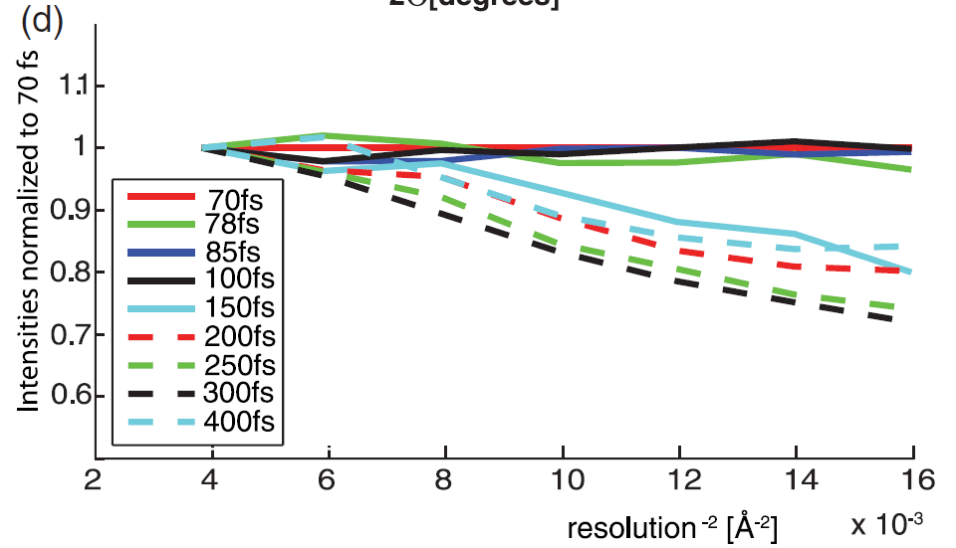
100 fs damage “threshold”
Lomb et al. (2011) Phys Rev B 84, 214111

Slide 34
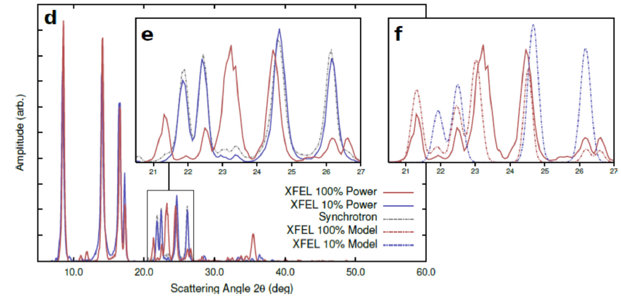
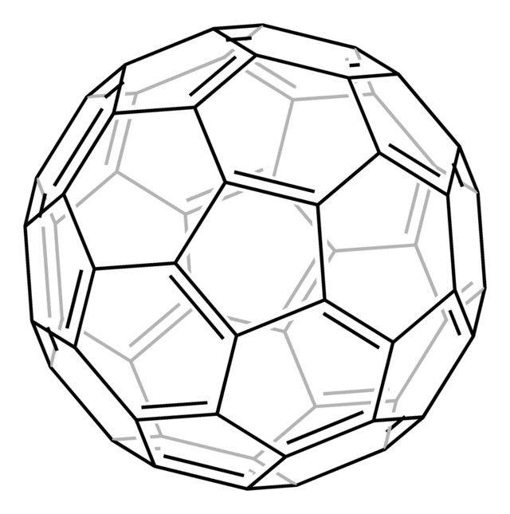
New damage at high fluence?
Abbey et al. (2012)."Femtosecond X-ray Laser induced transient electronic phase change observed in fullerene C60", arXiv:1209.5168.

Slide 35
Elastic scattering

Slide 36
Inelastic scattering

Slide 37
Photoelectric absorption

Slide 38
Photoelectric absorption
e⁻
+

Slide 39
Field Ionization?
+

Slide 40
Single-molecule diffraction: problems
Focusing
Hit rate
Bragg’s law
Radiation damage
Motion blur
Data processing

Slide 41
Single-molecule diffraction: problems
Focusing
Hit rate
Bragg’s law
Radiation damage
Motion blur
Data processing

Slide 42

lysozyme: real and reciprocal

Slide 43
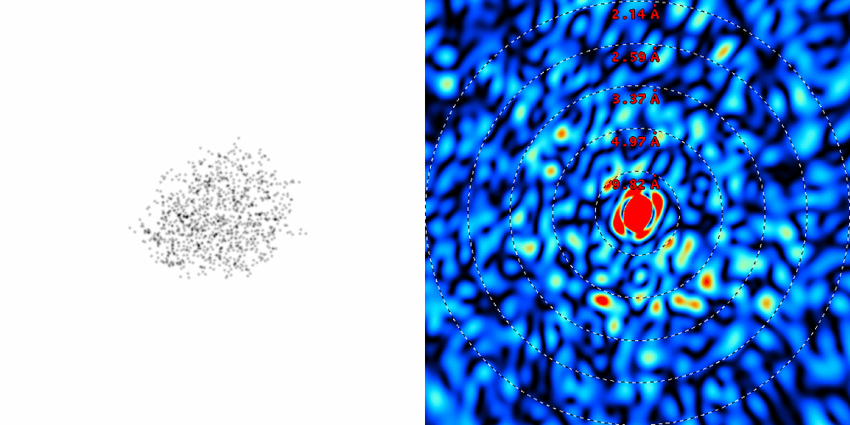
lysozyme: thermal motion

Slide 44
Protein crystal reality
McPherson, A., Malkin, A. J., Kuznetsov, Y. G. & Plomp, M. (2001)."Atomic force microscopy applications in macromolecular crystallography", Acta Cryst. D 57, 1053-1060.

Slide 45

Muybridge’s galloping horse (1878)

Slide 46
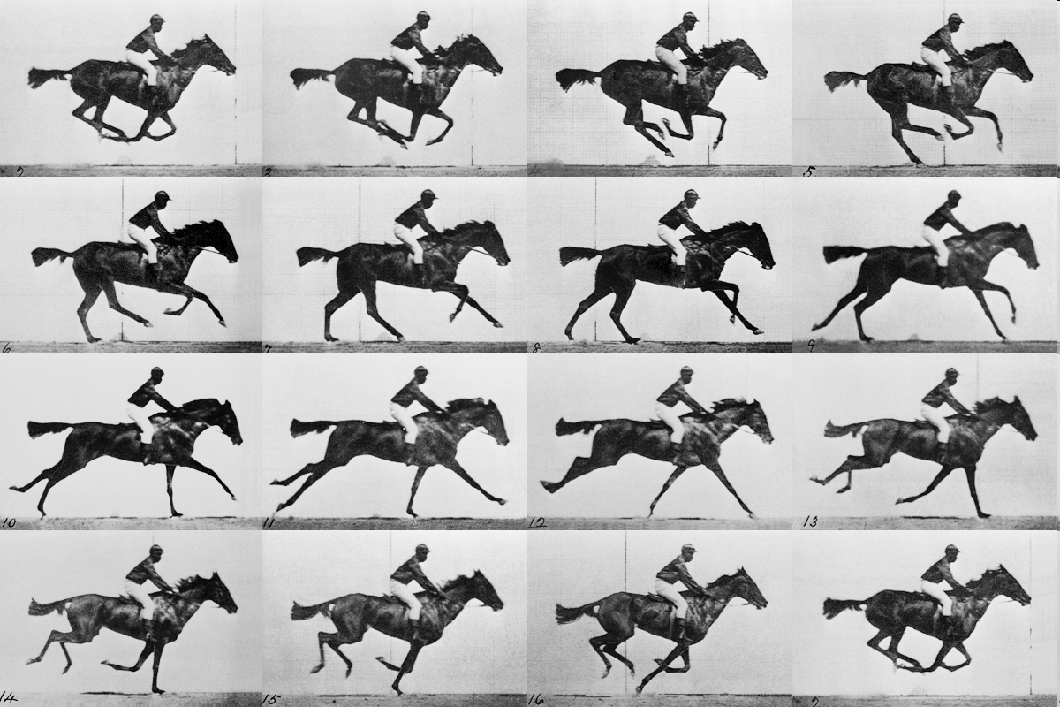
realistic “crystal” of horses

Slide 47
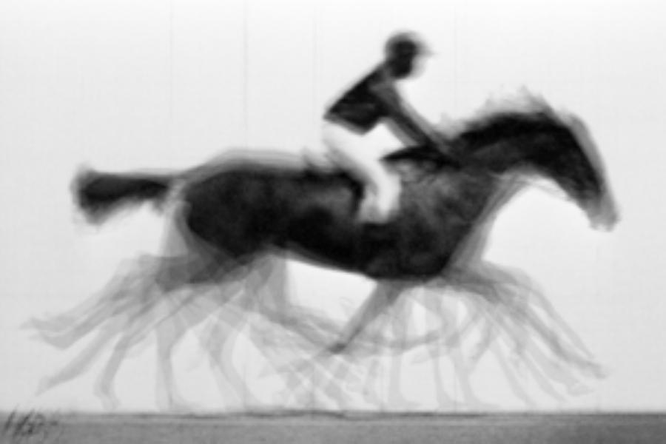
average structure: galloping horse

Slide 48
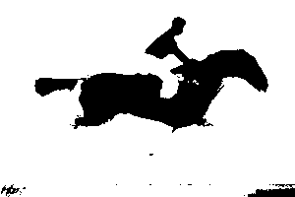
average structure: 1-sigma contour

Slide 49
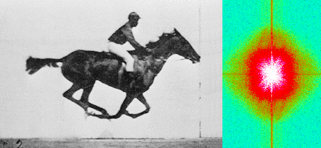
Muybridge’s galloping horse (1878)
“Time-resolved” diffraction
Real space
reciprocal

Slide 50
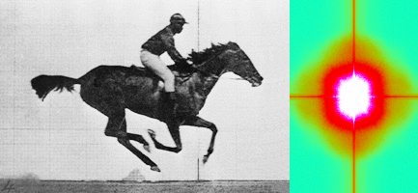
Muybridge’s galloping horse (1878)
Average intensity
Real space
reciprocal

Slide 51
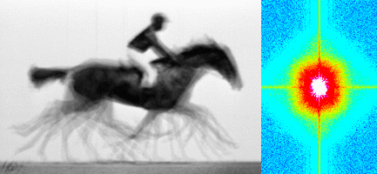
Muybridge’s galloping horse (1878)
Average electron density
Real space
reciprocal

Slide 52
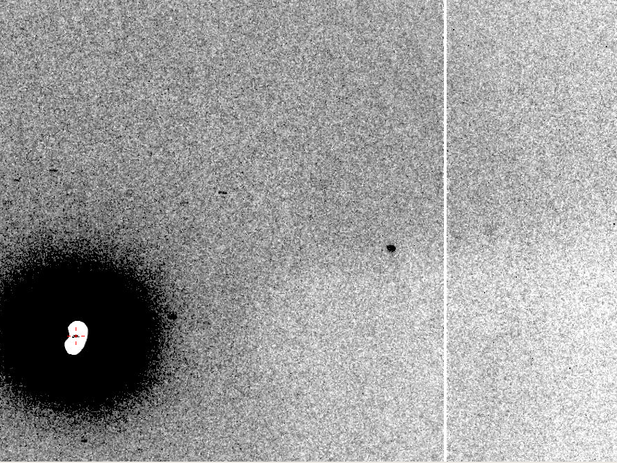
Now What?
10 Å
The “Amplitude Problem” in MX

Slide 53
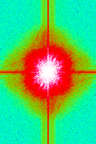
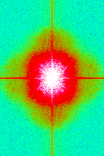
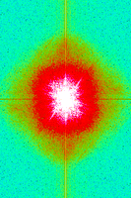
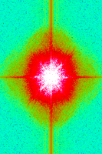
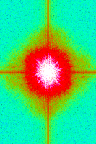
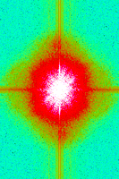
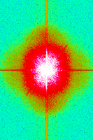
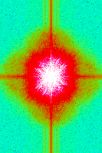
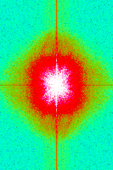
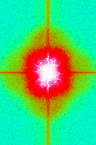
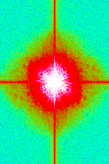
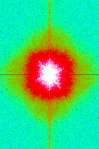
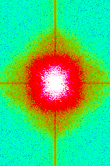
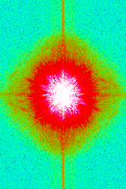
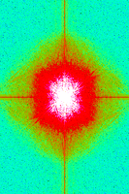
Supporting a model with data

Slide 54
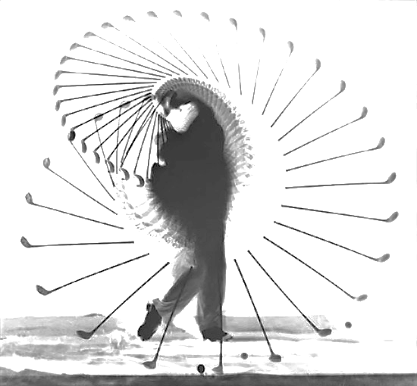
What is the structure of “disorder” ?
a grand challenge for structural biology in the 21st century

Slide 55
Single-molecule diffraction: problems
Focusing
Hit rate
Bragg’s law
Radiation damage
Motion blur
Data processing

Slide 56
Single-molecule diffraction: problems
Focusing
Hit rate
Bragg’s law
Radiation damage
Motion blur
Data processing

Slide 57
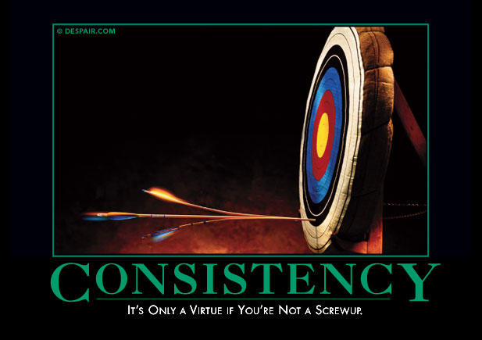
Averaging doesn’t always reduce error

Slide 58

May learn more about detectors than planned
~3x10⁵ photon/pixel Pilatus detector Black to white is a 2% range

Slide 59
What is “partiality”?
Ewald sphere

Slide 60
What is “partiality”?
Ewald sphere

Slide 61
The “nanocrystal advantage”
2
I_{spot} = k N_{cells}
Ewald sphere
range

Slide 62
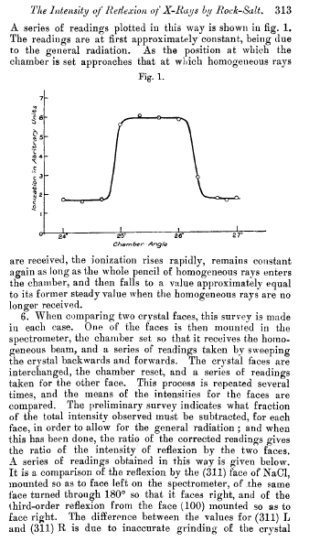
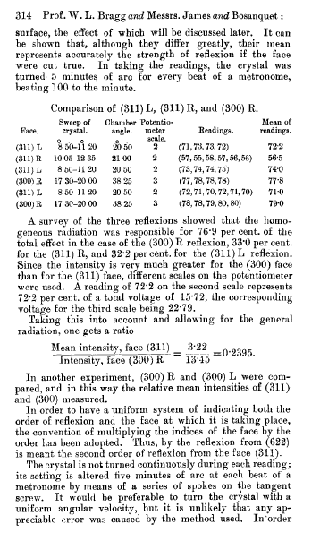
Bragg, James & Bosanquet (1921). Philos. Mag. Ser. 6, 41, 309–337.

Slide 63

Non-isomorphism in lysozyme
RH 84.2% vs 71.9%
RMSD = 0.18 Å
R_{iso} = 44.5%

Slide 64
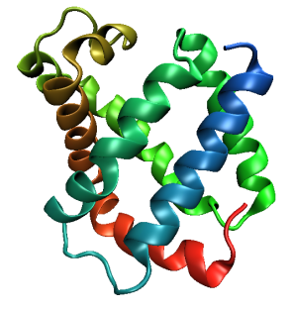
A
B
0.5% cell change → 15%
0.5° rotation → 16%
C
D
0.1 Å shift → 17%
0.5° cell angle → 16%

Slide 65
X-ray Data Sets
Singular values & vectors
data
set
h,k,l | structure factors (F)
 | #1 | #2 | #3 | #4
5,3,4 | 523.7 | 559.8 | 579.9 | 603.2
5,4,4 | 168.2 | 166.6 | 177.2 | 196.1
5,5,4 | 34.9 | 26.4 | 19.2 | 17.3
6,1,4 | 305.7 | 301.1 | 298.1 | 296.3
6,2,4 | 353.0 | 353.9 | 356.2 | 366.9
6,3,4 | 300.9 | 285.3 | 273.5 | 259.4
6,3,5 | 223.8 | 226.3 | 234.6 | 251.4
… | … | … | … | …
h,k,l | 100% | 17 % | 13 % | 9 %
 | 1st | 2nd | 3rd | 4th
5,3,4 | -1.46 | -0.02 | 1.84 | -0.72
5,4,4 | -0.88 | -0.29 | -0.34 | 0.15
5,5,4 | -0.42 | -0.65 | 1.02 | 1.47
6,1,4 | -0.90 | -0.85 | 1.44 | -0.40
6,2,4 | -1.20 | -0.37 | 0.67 | 0.01
6,3,4 | -0.75 | 0.31 | 0.48 | 0.00
6,3,5 | -0.75 | -0.85 | 0.72 | -0.82
… | … | … | … | …
value
vector
Singular value decomp.
SVD
-0.68 -0.24 0.32 …
CC1
Data sets
Positioned
in
“Correlation
Space”
Correlation
Coefficients
CC1 CC2 CC3
CC2
data set #1
data set #2
data set #3
CC3

Slide 66
Structure factor (electrons)
Correlation to 2nd & 3rd singular vectors

Slide 67
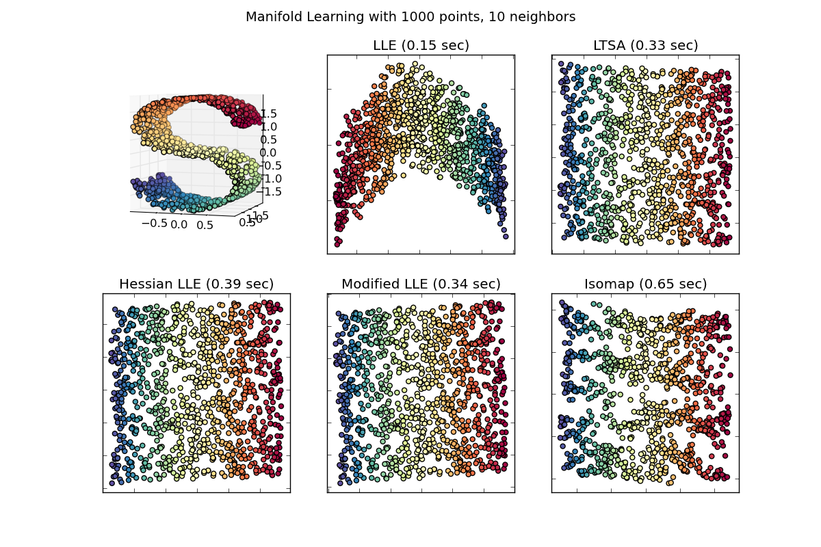
Manifold Embedding: solution for systematics?

Slide 68
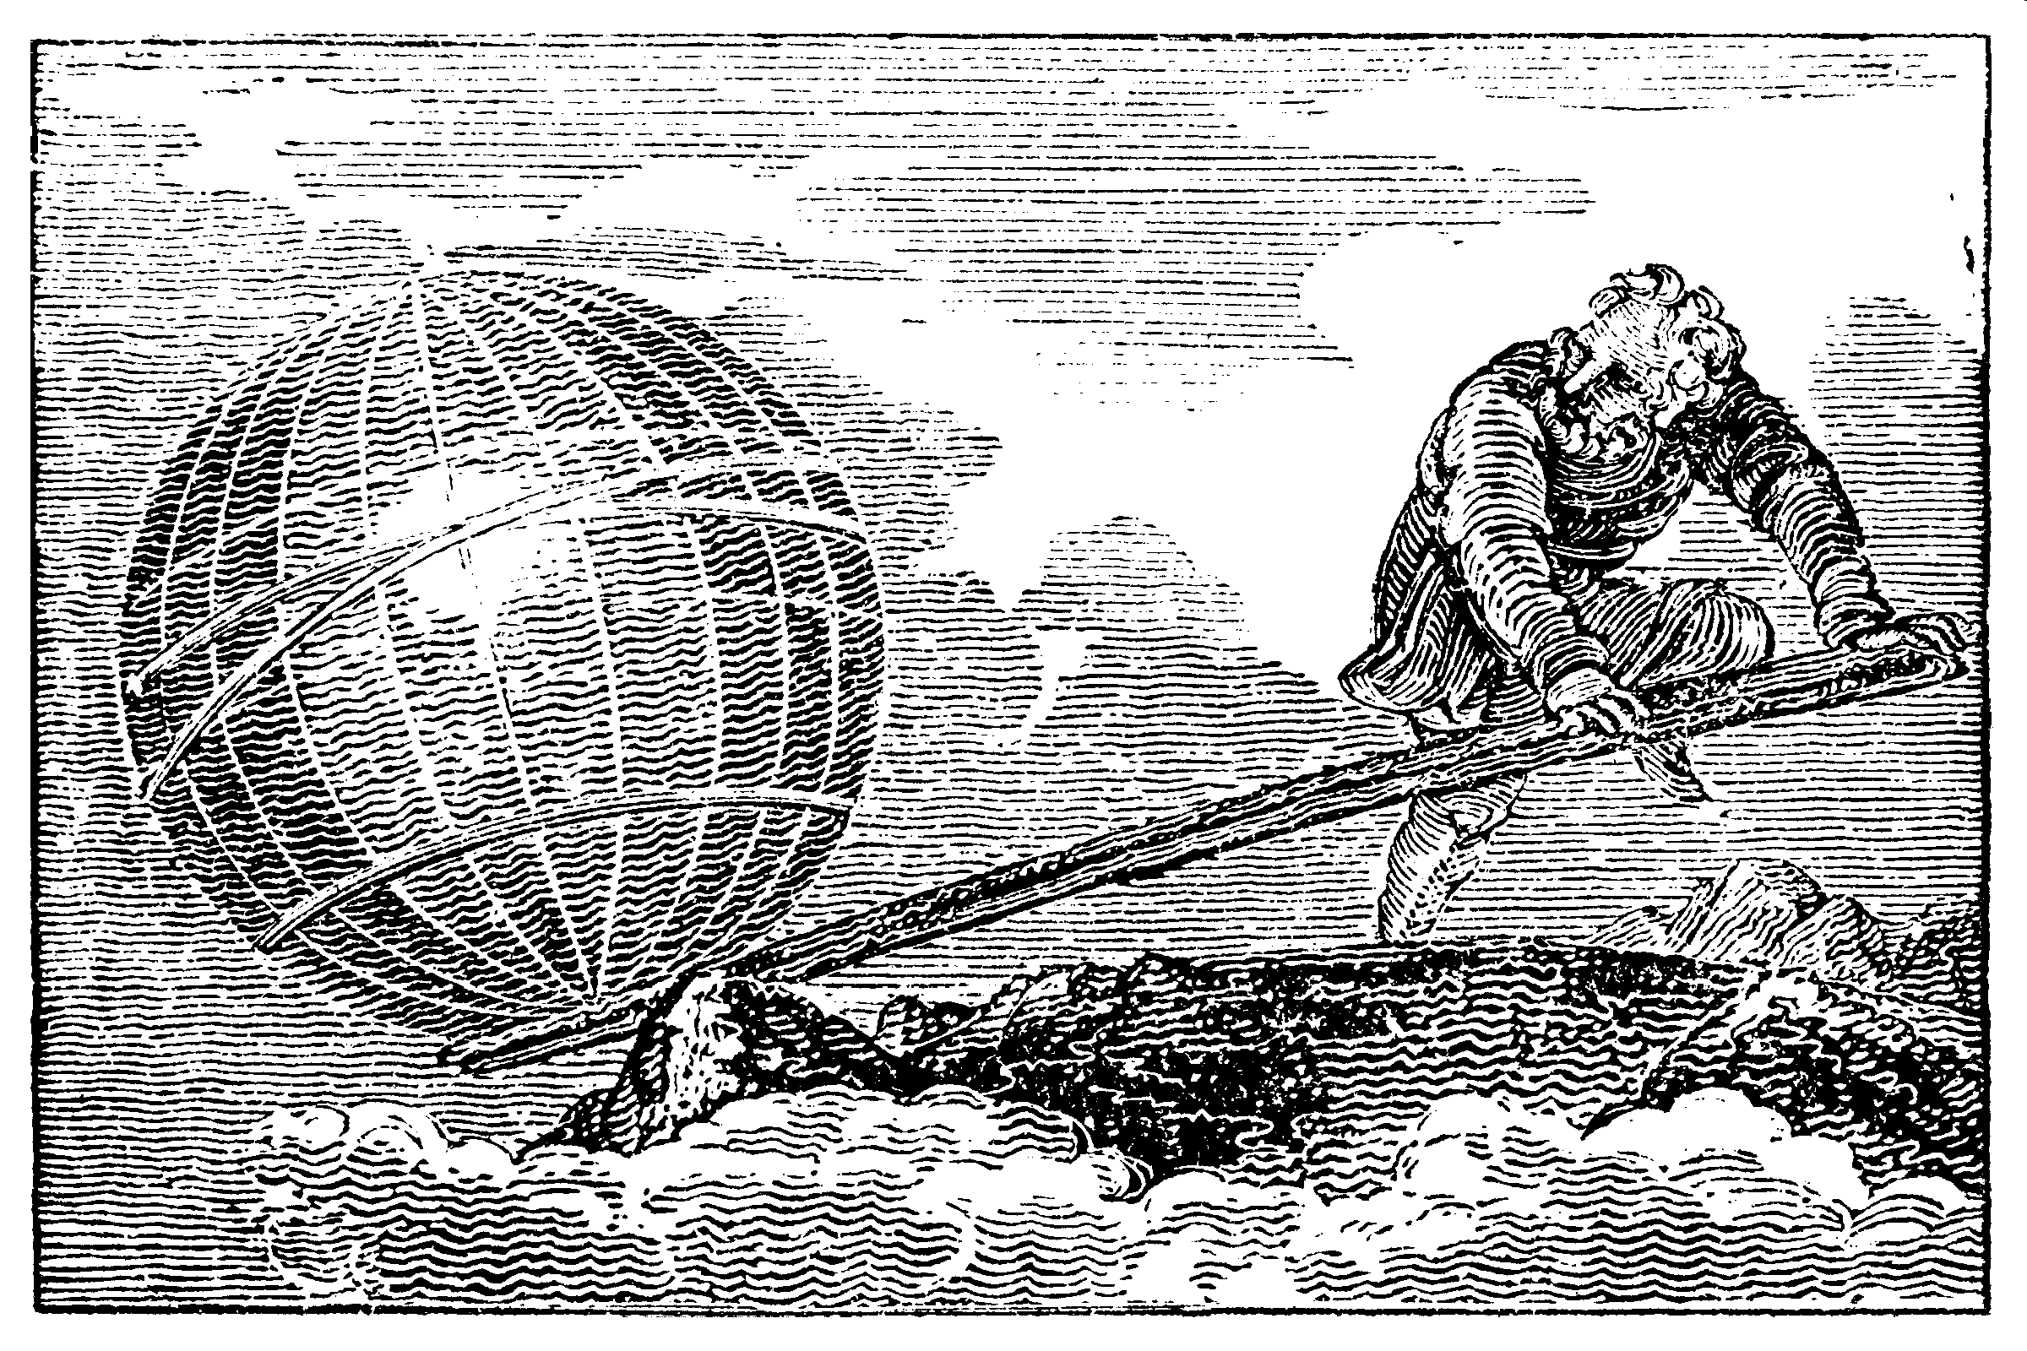
Anything is possible … with the right tools.

Slide 69
Single-molecule diffraction: solutions to problems
http://bl831.als.lbl.gov/~jamesh/powerpoint/
UCSF_exploding_lysozyme_2015.pptx
Focusing
Hit rate
Bragg’s law
Radiation damage
Motion blur
Data processing
More power!
Plan targets
4π detector
Raddam studies
Software

Slide 70
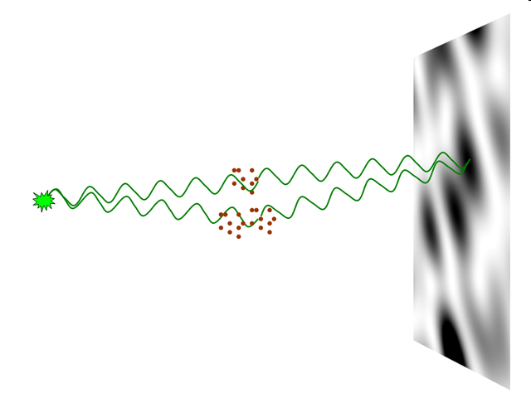
nearBragg program
http://bl831.als.lbl.gov/~jamesh/nearBragg/
“assumption-free” total scattering
no Fourier Transform
no unit cells
no “mosaicity”
arbitrary “atoms”
arbitrary “source”
coherent or not

Slide 71
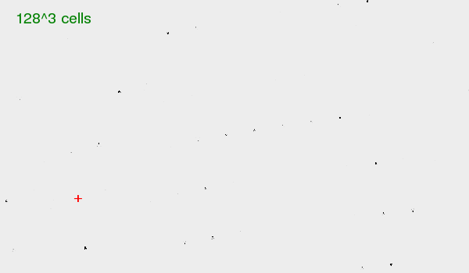
fastBragg
http://bl831.als.lbl.gov/~jamesh/fastBragg/
sin(πN·hkl)
I_{pixel} = I_{beam} r_{e}² Ω
P A | F(hkl) |²
sin(π·hkl)

Slide 72
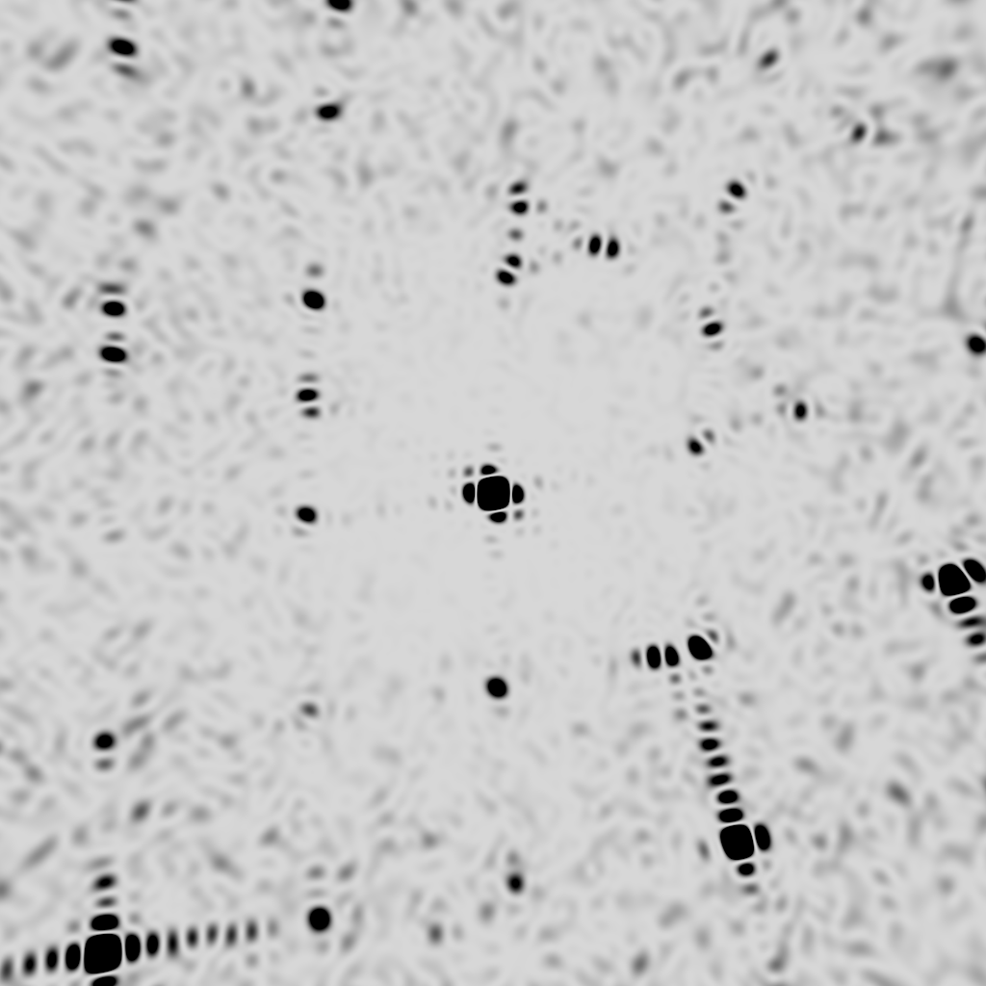
square

Slide 73
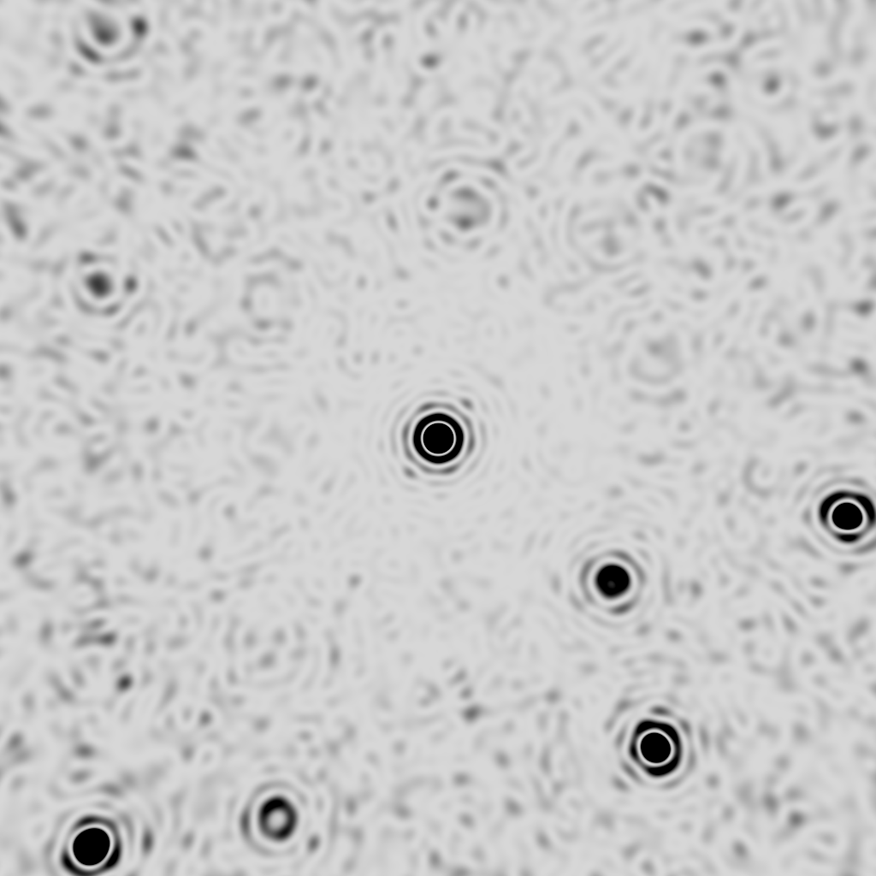
round

Slide 74
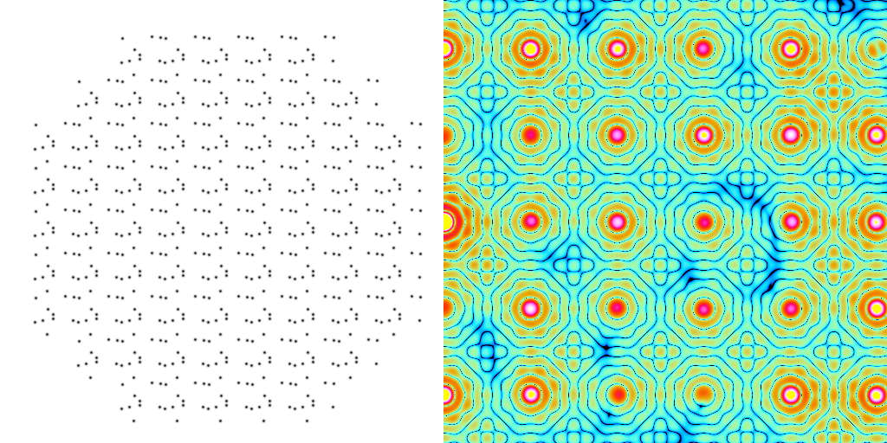
scattering from a crystal structure
False color intensity
sample
detector

Slide 75
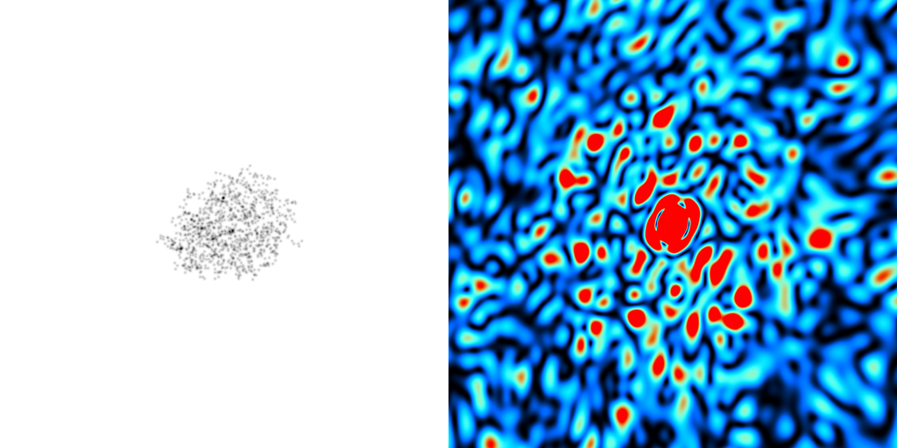
scattering from a crystal structure
False color intensity
sample
detector

Slide 76
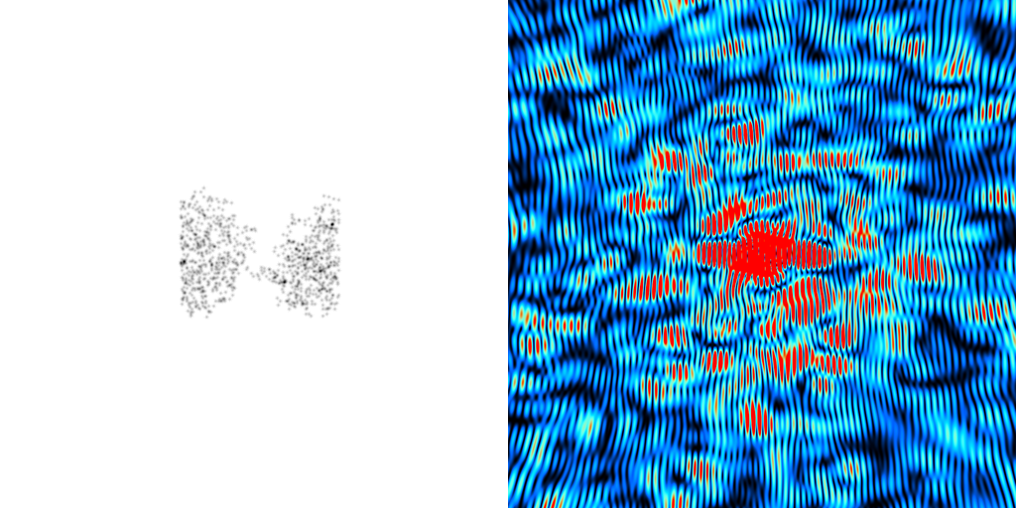
scattering from a crystal structure
False color intensity
sample
detector

