Slide 1
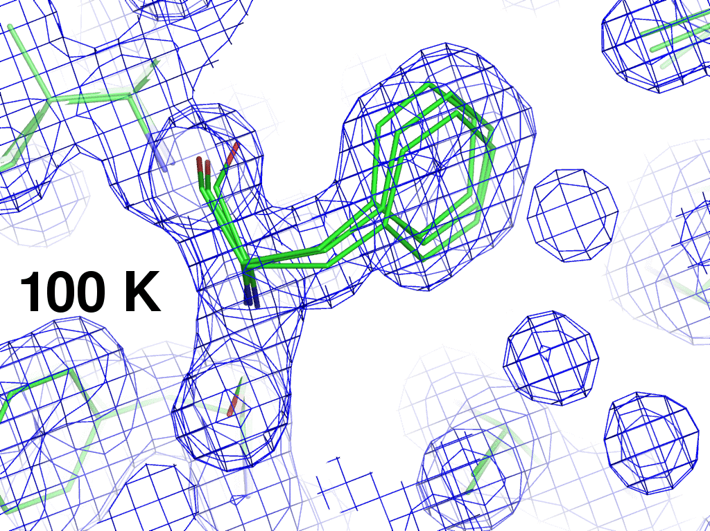

Slide 2
Interpolation of structure factors: 2 1 2
Structure factor (e⁻)
Temperature (K)

Slide 3
Interpolation of structure factors: 2 1 2
Structure factor (e⁻)
Temperature (K)

Slide 4
Interpolation of structure factors: 10 11 3
Structure factor (e⁻)
Temperature (K)

Slide 5
Phe 113 conformer B
occupancy
Temperature (K)
Notes:
supercell density gives clue to diffuse scatter, but Bragg peaks are still relative to zero

Slide 6
Phe 113 conformer B
X position
Temperature (K)
Notes:
supercell density gives clue to diffuse scatter, but Bragg peaks are still relative to zero

Slide 7
Interpolation of atomic parameters
occupancy
Temperature (K)

Slide 8
How to do it? You will need:
CCP4 Suite
gnuplot installed
smooth_pdbs_multi.com
usage: smooth_pdbs_multi.com refined_00?.pdb CPUs=12 weight=1 in_states=100,200,250,300,310 out_states=100-300:10
ref= single PDB file containing all possible atoms
weight data weight in smoothing function
in_states specify "x" axis for smoothing as comma-separated list or start-end:step range.
out_states specify "x" axis for output files. default: same as inputs

Slide 9
Interpolation of atomic parameters
X coordinate
Temperature (K)

Slide 10
Solvent boundary problem

Slide 11
Solvent boundary problem

Slide 12
Solvent boundary problem

Slide 13
Solvent boundary problem

Slide 14
Current implementation

Slide 15
Better implementation?

Slide 16
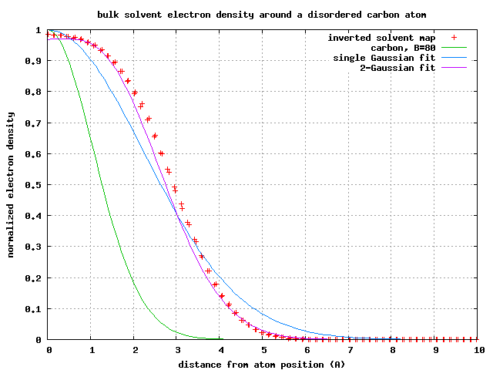
Average hard-shell bulk solvent
1-density (relative to bulk)
Distance from atom position (A)

Slide 17
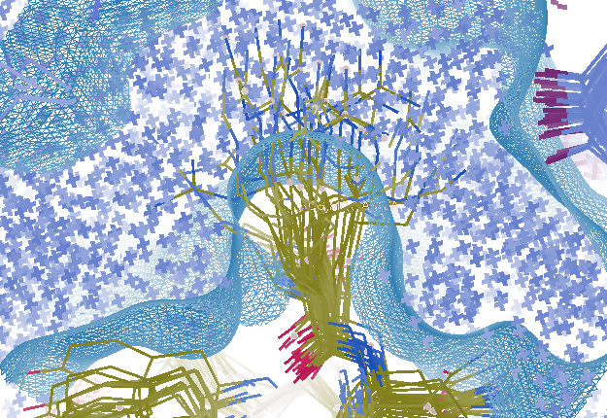
Combined multi-conformer & explicit solvent
R_{work} = 0.0309
R_{free} = 0.0678
vs F_{sim}
Problem: diverges with more cycles

Slide 18
Fuzzy solvent protocol:
1) For each residue
select one conformer
occupancy weighted
2) For each water
occupancy = probability of appearing
3) Shift all atoms
Gaussian-random
RMS = sqrt(B/8)/π
4) Calculate bulk solvent mask
5) Average over lots of trials
optimize: vdwprobe ionprobe rshrink

Slide 19
Multi-conformer model

Slide 20
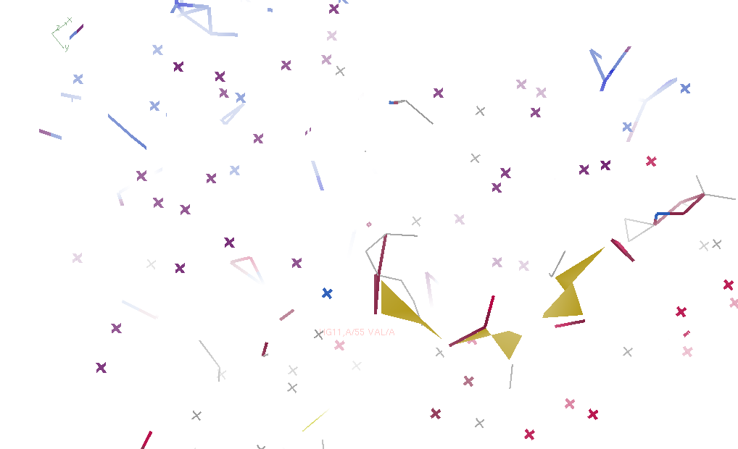
Jiggled pdb (one conformer)

Slide 21
Geometry minimized

Slide 22
Bulk solvent for 1 conformer

Slide 23
Trial 2

Slide 24
Trial 3

Slide 25
Trial 4

Slide 26
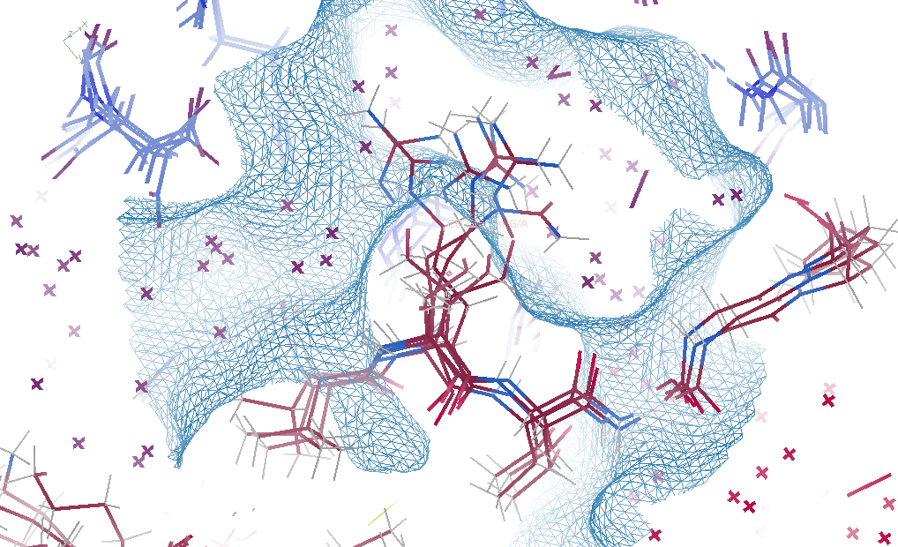
Average over 500 trials

Slide 27
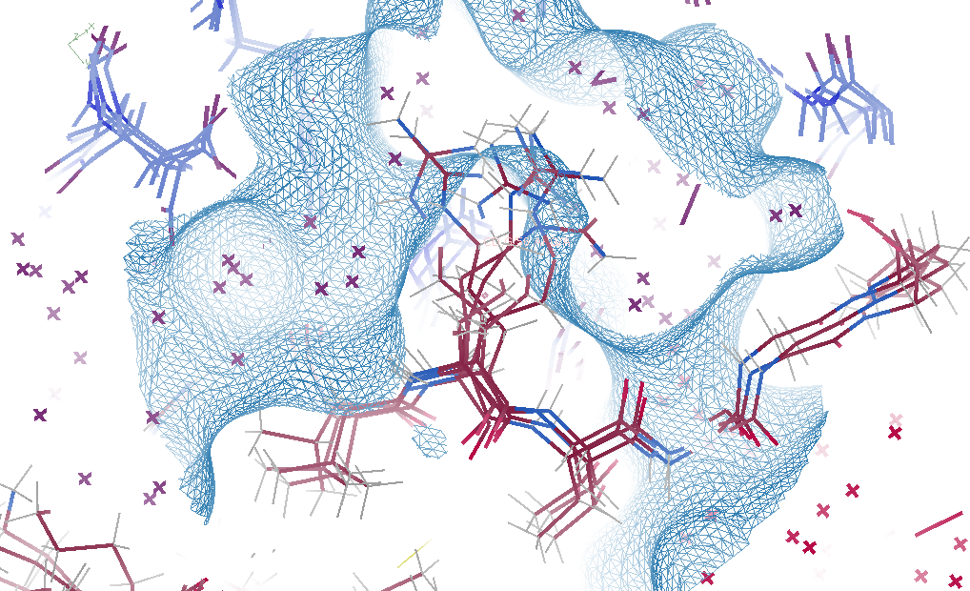
“right” solvent (cheating)

Slide 28
Fuzzy bulk solvent
Method | R_{work} | R_{free}
Default refmac5: flat bulk solvent 257 ordered waters | .0928 | .1188
Fuzzy solvent: mask averaged over 500 random fluctuations 569 ordered waters | .0628 | .0975
Cheat: perfect solvent density 0 ordered waters | .0390 | .0498

Slide 29
Fuzzy bulk solvent
Method | R_{work} | R_{free}
Default refmac5: flat bulk solvent 257 ordered waters | .0928 | .1188
Fuzzy solvent: mask averaged over 500 random fluctuations 569 ordered waters | .0628 | .0975
Cheat: perfect solvent density 0 ordered waters | .0390 | .0498
phenix.refine ordered_solvent optimize_mask | .1082 | .1470

Slide 30
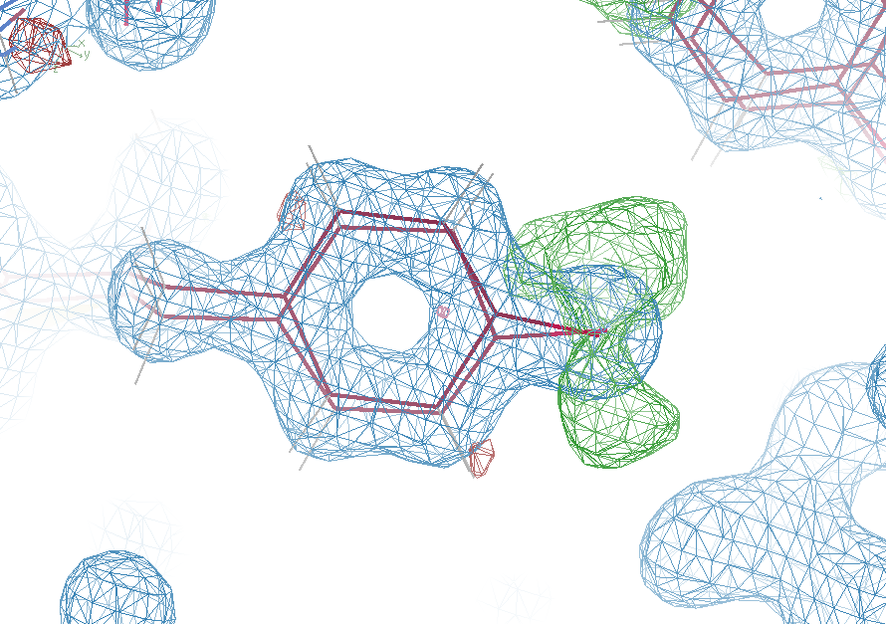
Why low R factors matter

Slide 31
How to run it? You will need
pdb file
mtz file
CCP4 Suite
Refmac inputs: refmac_opts.txt
LABIN FP=FP SIGFP=SIGFP FPART1=Fpart –
PHIP1=PHIpart FREE=FreeR_flag
scpart 1
solvent no
scale type simple
vdwrestrains 0
#make hout Y
#make hydr Y

Slide 32
How to run it? You will need
% wget http://bl831.als.lbl.gov/~jamesh/ \
solvent_model/fuzzymask.com
% chmod a+x fuzzymask.com
% ./fuzzymask.com
usage: ./fuzzymask.com refme.pdb refme.mtz [ligand.cif] \
[ksol=0.35824] \
[vdwprobe=1.1] [ionprobe=0.5] [rshrink=0.5] \
[ncyc_ideal=5] [ncyc_data=0]\
[seeds=500] [CPUs=auto] \
[fuzzysolvent.map] [output=Fparted.mtz]
% gedit refmac_opts.txt &
% ./fuzzymask.com model.pdb data.mtz

Slide 33
Other useful scripts:
% converge_refmac.com model.pdb data.mtz
Auto-detects Fpart, etc. in MTZ
Uses refmac_opts.txt
Keeps running until convergence
% refmac_occupancy_setup.com model.pdb
Auto set up occupancy refinement (like phenix)
https://www2.mrc-lmb.cam.ac.uk/
groups/murshudov/content/refmac/refmac_keywords.html

Slide 34
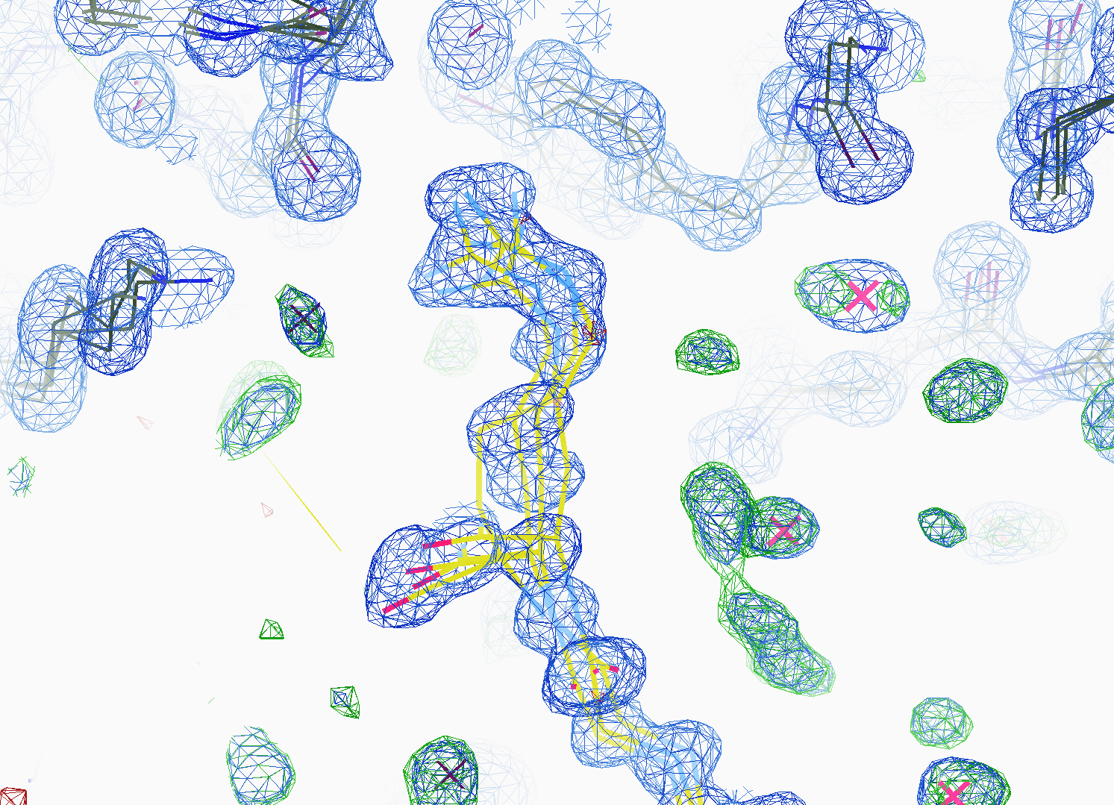
How many conformers are there?
All difference
features
are in
the solvent!
real data

