Slide 1
PowerPoint File available:
http://bl831.als.lbl.gov/
~jamesh/powerpoint/
UCSF_DQvMI_2017.pptx

Slide 2
Acknowledgements
Robert Stroud James Fraser John Spence
Chris Nielsen Clemens Schulze-Briese Aina Cohen Ana Gonzalez
UCSF LBNL SLAC
ALS 8.3.1: TomAlberTron
UC Multicampus Research Programs and Initiatives (MRPI)
NIH NIGMS R01 GM124149
NIH NIGMS P30 GM124169
Integrated Diffraction Analysis Technologies (IDAT)
Plexxikon, Inc.
Synchrotron Radiation Structural Biology Resource (SLAC)
The Advanced Light Source is supported by the Director, Office of Science, Office of Basic Energy Sciences, Materials Sciences Division, of the US Department of Energy under contract No. DE-AC02-05CH11231 at Lawrence Berkeley National Laboratory.

Slide 3
signal vs noise
“If you don’t have good data, then you have no data at all.”
-Sung-Hou Kim

Slide 4
signal vs noise
easy
hard
impossible

Slide 5
signal vs noise
easy
hard
impossible
threshold of “solvability”

Slide 6
signal vs noise
“If you don’t have good data, then you must learn statistics.”
-James Holton

Slide 7
Adding noise

Slide 8
Adding noise
1² + 1² = 1.4²

Slide 9
Adding noise
1² + 1² = 1.4²
3² + 1² = 3.2²
σ_{total}² = σ₁² + σ₂²

Slide 10
Adding noise
1² + 1² = 1.4²
3² + 1² = 3.2²
σ_{total}² = σ₁² + σ₂²

Slide 11
Adding noise
1² + 1² = 1.4²
3² + 1² = 3.2²
σ_{total}² = σ₁² + σ₂²

Slide 12
Adding noise
1² + 1² = 1.4²
3² + 1² = 3.2²
10² + 1² = 10.05²

Slide 13
What do we want?
Resolution
Low R factor
Mosaicity
Nice, round spots
No overlaps
No twinning
Lots of crystals
…

Slide 15
What do we want?
Resolution
Low R-factor
Mosaicity
Nice, round spots
No overlaps
No twinning
Lots of crystals
…
2. Phases

Slide 16
Phases
http://bl831.als.lbl.gov/~jamesh/movies/dephase.mpeg

Slide 17
scattering from a structure
sample
detector
beam center
+

Slide 18
forward Fourier Transform
inverse Fourier Transform
no phase
+

Slide 19
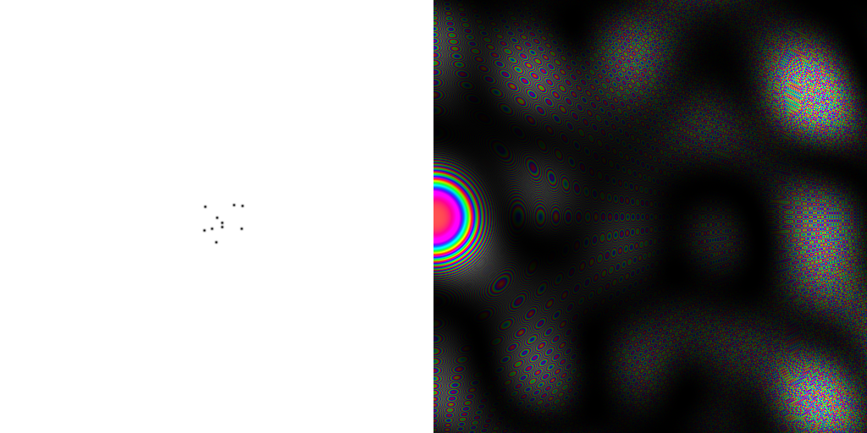
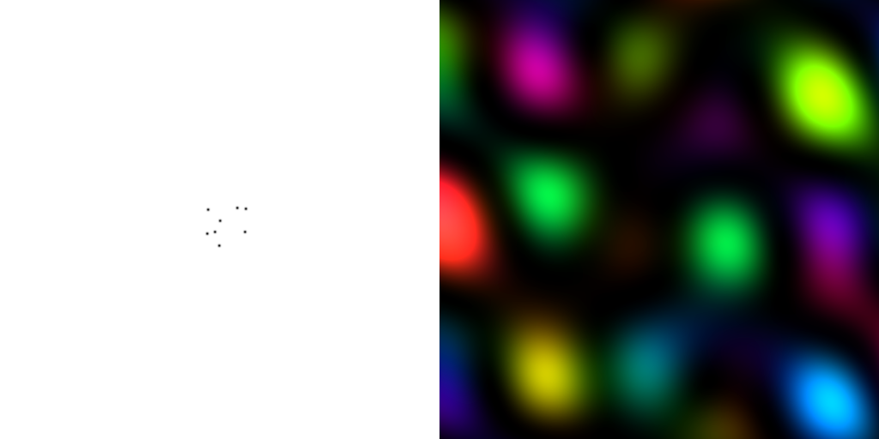
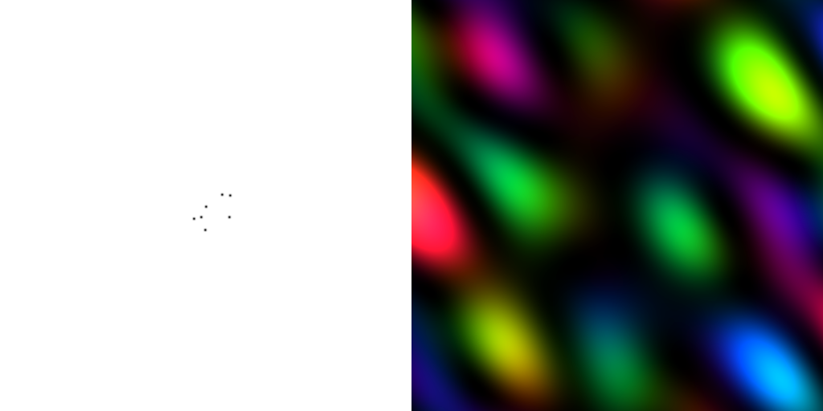
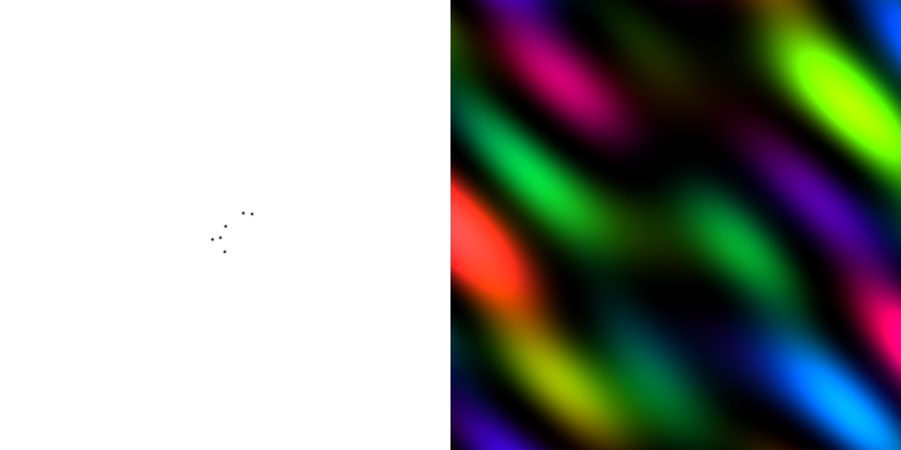
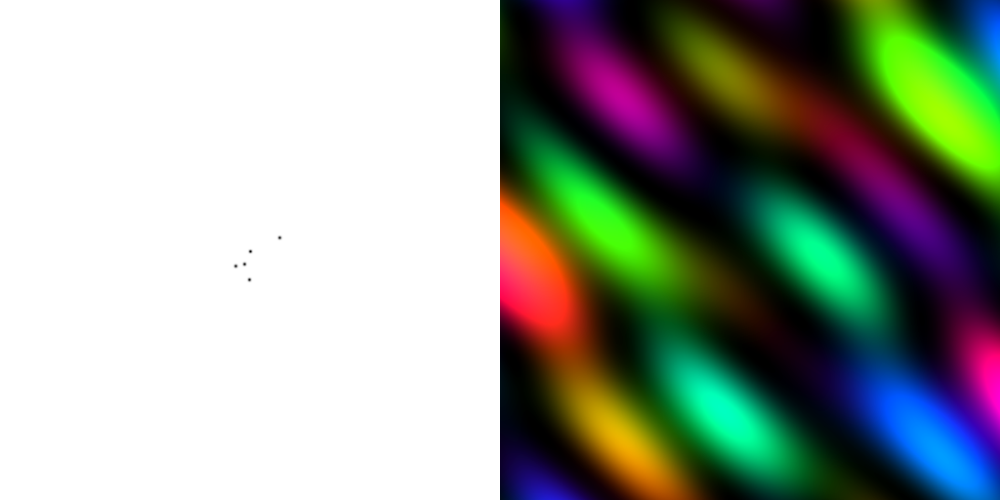
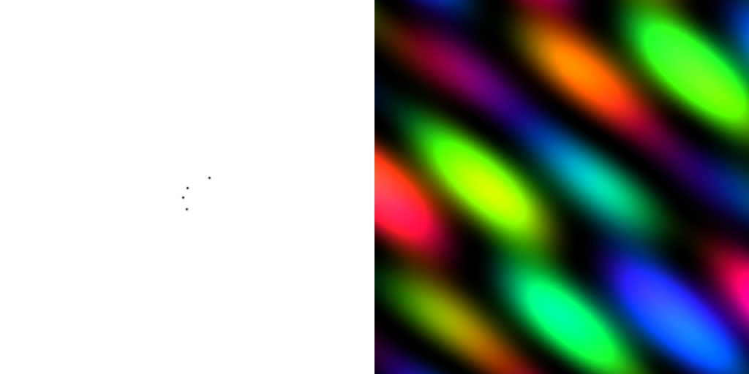
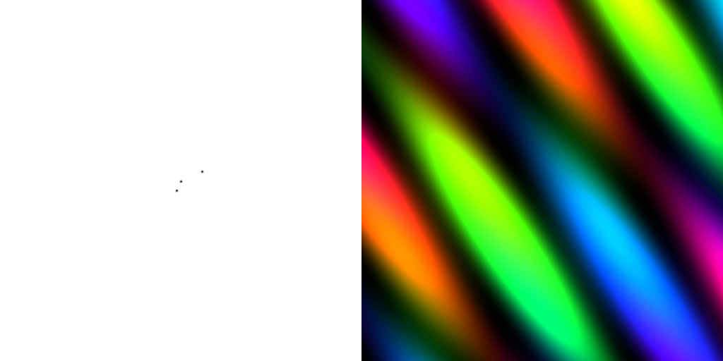
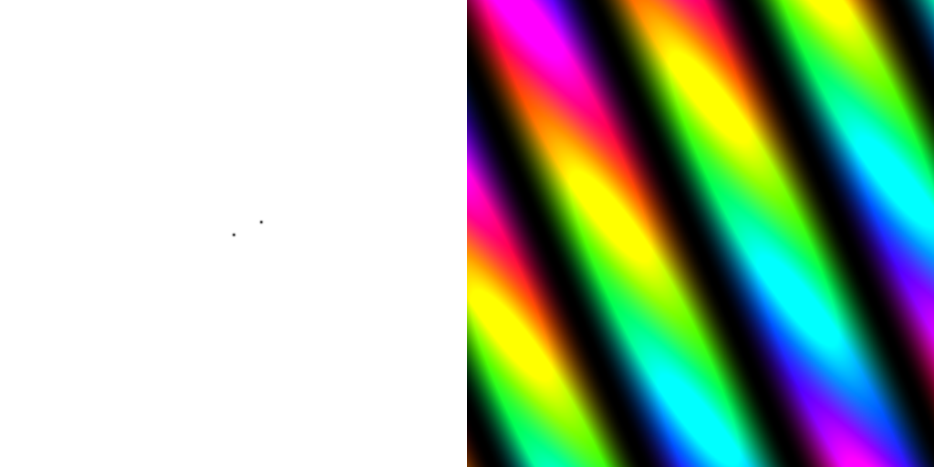
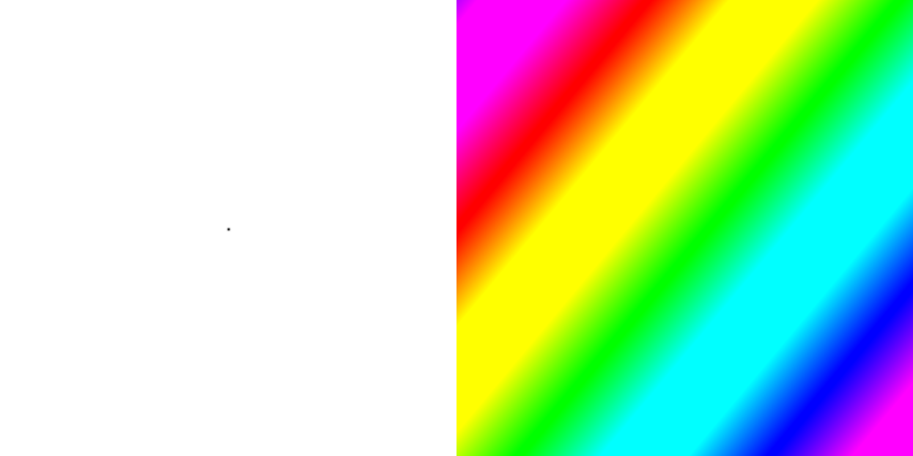
inverse Fourier Transform
scattering from a structure
colored by phase
sample
detector
+

Slide 20
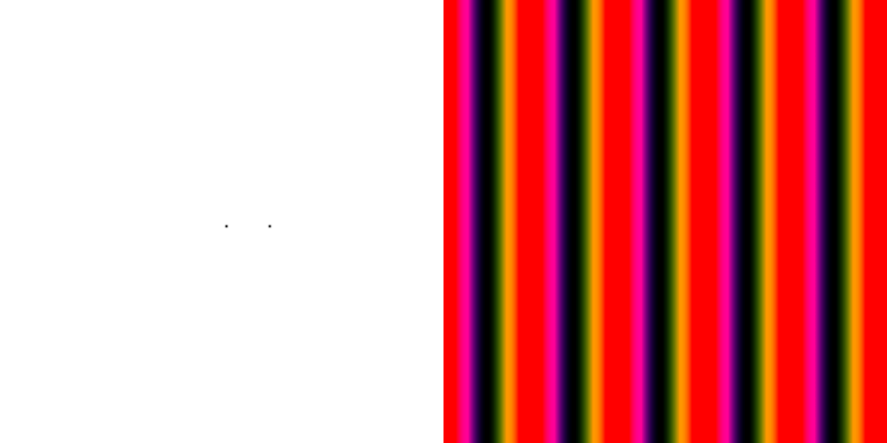
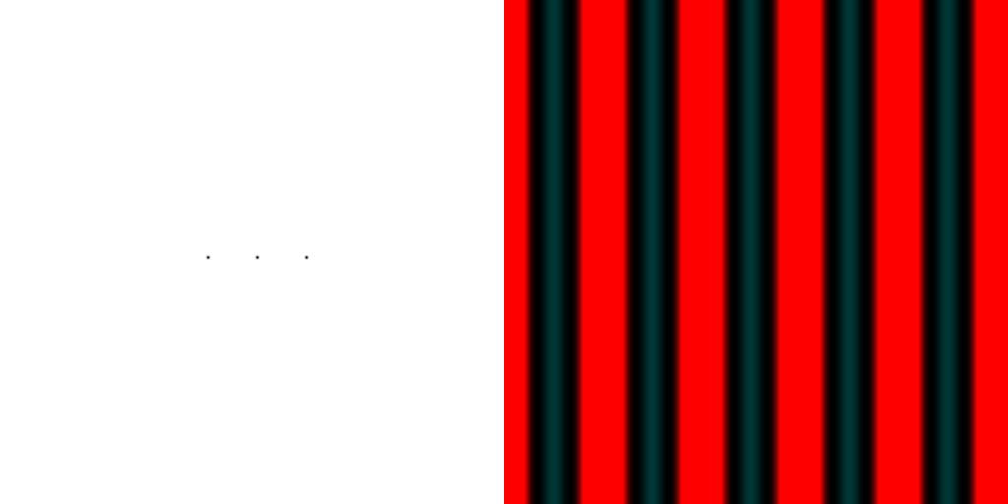
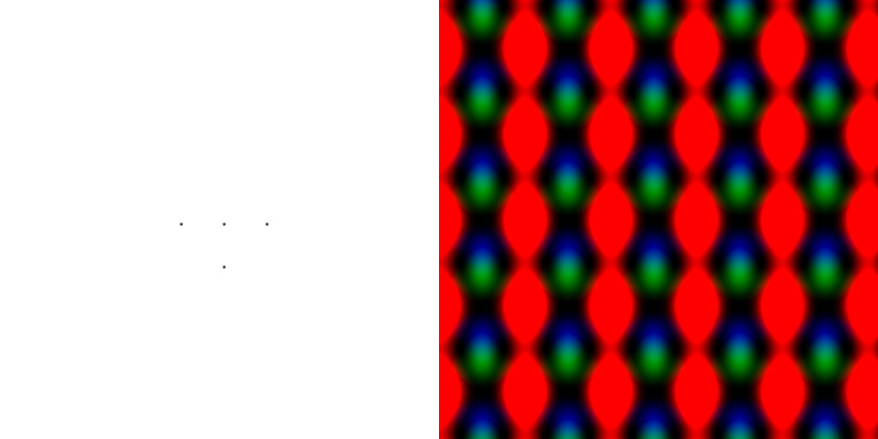
scattering from a lattice
colored by phase
sample
detector
beam center
+

Slide 21
scattering from a lattice
colored by phase
sample
detector
beam center
+

Slide 22
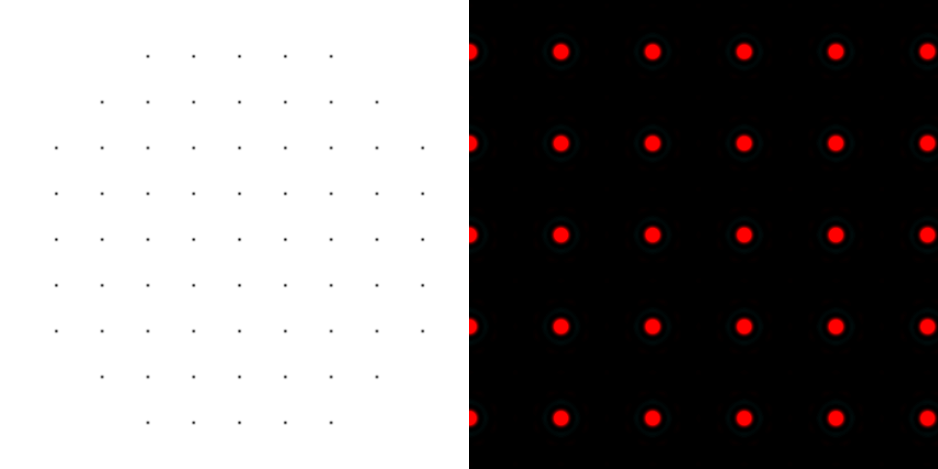
scattering from a lattice
colored by phase
sample
detector
beam center
+

Slide 23
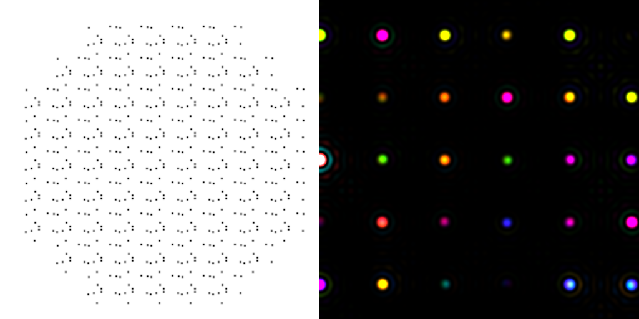
scattering from a crystal structure
colored by phase
sample
detector
beam center
+

Slide 24
Major Phasing techniques
Molecular Replacement
Multiple Isomorphous Replacement
Multiwavelength Anomalous Diffraction
Single-wavelength Anomalous Diffraction

Slide 25
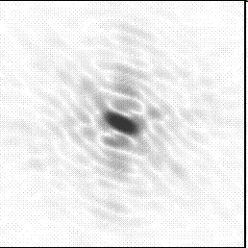
Molecular Replacement
correct structure and intensities
?
http://www.ysbl.york.ac.uk/~cowtan/fourier/coeff.html

Slide 26
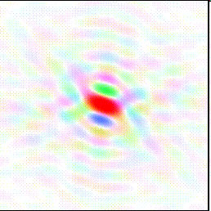
Molecular Replacement
Available model and intensities

Slide 27
Molecular Replacement
correct structure and intensities
?

Slide 28
Molecular Replacement
use something similar as a starting model

Slide 29
Model Building
current model is missing something

Slide 30
Model Building
phases from available model

Slide 31
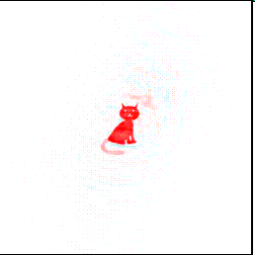
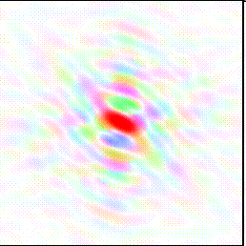
Model Building
missing bits show up, even if not in available model!

Slide 32
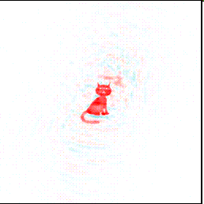
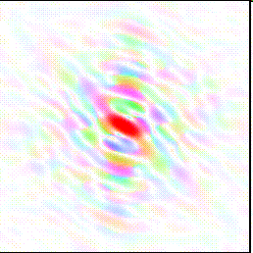
Model Building
missing bits show up better in F_{obs} + (F_{obs} - F_{calc}) map

Slide 33
Phase errors: simplest possible case
electron density (e⁻/Å³)
fractional coordinate

Slide 34
Phase errors: simplest possible case
electron density (e⁻/Å³)
fractional coordinate

Slide 35
Phase errors: simplest possible case
electron density (e⁻/Å³)
fractional coordinate

Slide 36
Phase errors: simplest possible case
electron density (e⁻/Å³)
fractional coordinate

Slide 37
Phase errors: simplest possible case
electron density (e⁻/Å³)
fractional coordinate

Slide 38
Phase errors: simplest possible case
electron density (e⁻/Å³)
fractional coordinate

Slide 39
Phase errors: simplest possible case
electron density (e⁻/Å³)
fractional coordinate

Slide 40
Phase errors: simplest possible case
electron density (e⁻/Å³)
fractional coordinate

Slide 41
Phase errors: 3-atom case
electron density (e⁻/Å³)
fractional coordinate

Slide 42
Phase errors: 3-atom case
electron density (e⁻/Å³)
fractional coordinate

Slide 43
Phase errors: 3-atom case
electron density (e⁻/Å³)
fractional coordinate

Slide 44
Phase errors: 3-atom case
electron density (e⁻/Å³)
fractional coordinate

Slide 45
Phase errors: 3-atom case
electron density (e⁻/Å³)
fractional coordinate

Slide 46
Phase errors: 3-atom case
electron density (e⁻/Å³)
fractional coordinate

Slide 47
Phase errors: 3-atom case
electron density (e⁻/Å³)
fractional coordinate

Slide 48
Phase errors: 3-atom case
electron density (e⁻/Å³)
fractional coordinate

Slide 49
Phase errors: 3-atom case
electron density (e⁻/Å³)
fractional coordinate

Slide 50
Phase errors: 3-atom case
electron density (e⁻/Å³)
fractional coordinate

Slide 51
Phase errors: 3-atom case
electron density (e⁻/Å³)
fractional coordinate

Slide 52
Phase errors: asymmetric case
electron density (e⁻/Å³)
fractional coordinate

Slide 53
Phase errors: asymmetric case
electron density (e⁻/Å³)
fractional coordinate

Slide 54
Phase errors: asymmetric case
electron density (e⁻/Å³)
fractional coordinate

Slide 55
Phase errors: asymmetric case
electron density (e⁻/Å³)
fractional coordinate

Slide 56
Phase errors: asymmetric case
electron density (e⁻/Å³)
fractional coordinate

Slide 57
Phase errors: asymmetric case
electron density (e⁻/Å³)
fractional coordinate

Slide 58
Phase errors: asymmetric case
electron density (e⁻/Å³)
fractional coordinate

Slide 59
Phase errors: asymmetric case
electron density (e⁻/Å³)
fractional coordinate

Slide 60
Phase errors: asymmetric case
electron density (e⁻/Å³)
fractional coordinate

Slide 61
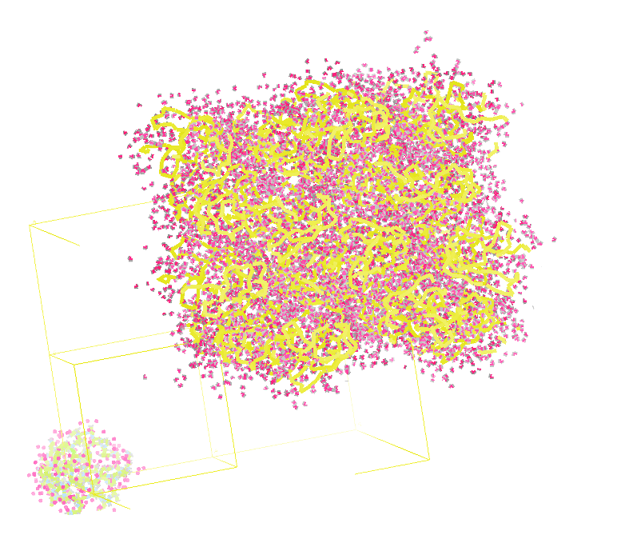
Molecular Dynamics Simulation
using real
crystal’s lattice
1aho
Scorpion toxin
0.96 Å resolution
64 residues
Solvent: H₂0 + acetate
Cerutti et al. (2010).J. Phys. Chem. B 114, 12811-12824.

Slide 62
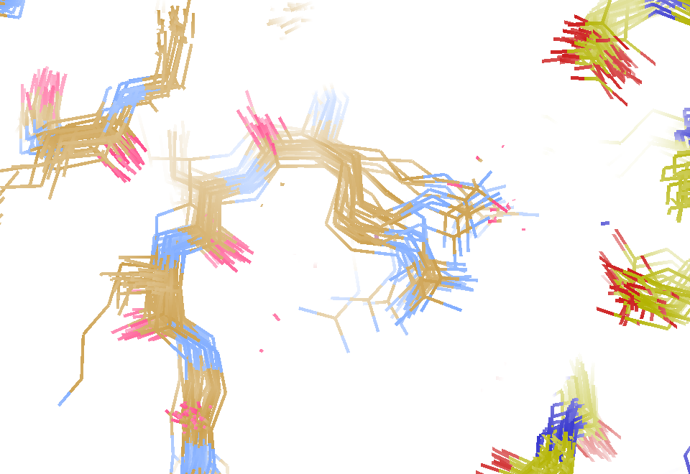
MD simulation: 30 conformers from 24,000
Cerutti et al. (2010).J. Phys. Chem. B 114, 12811-12824.

Slide 63
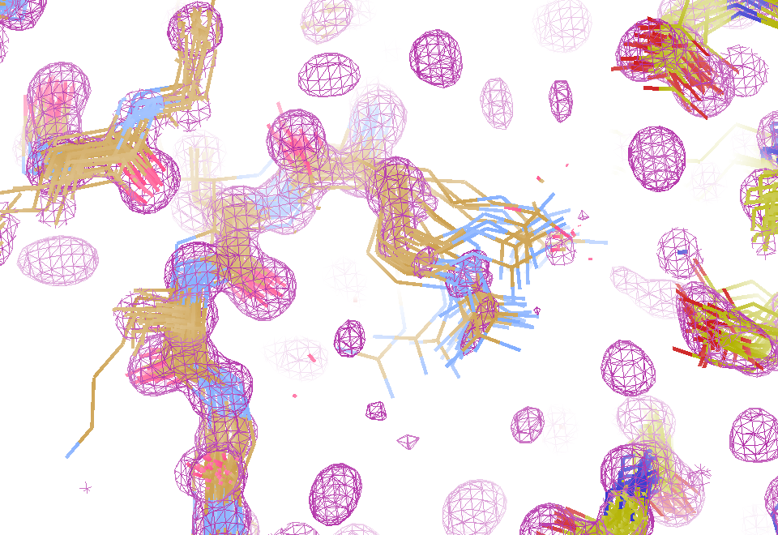
Electron density from 24,000 conformers

Slide 64
MLFSOM simulation
Holton, Classen, Frankel & Tainer (2014) "R-factor gap" FEBS 281 4046-60

Slide 65
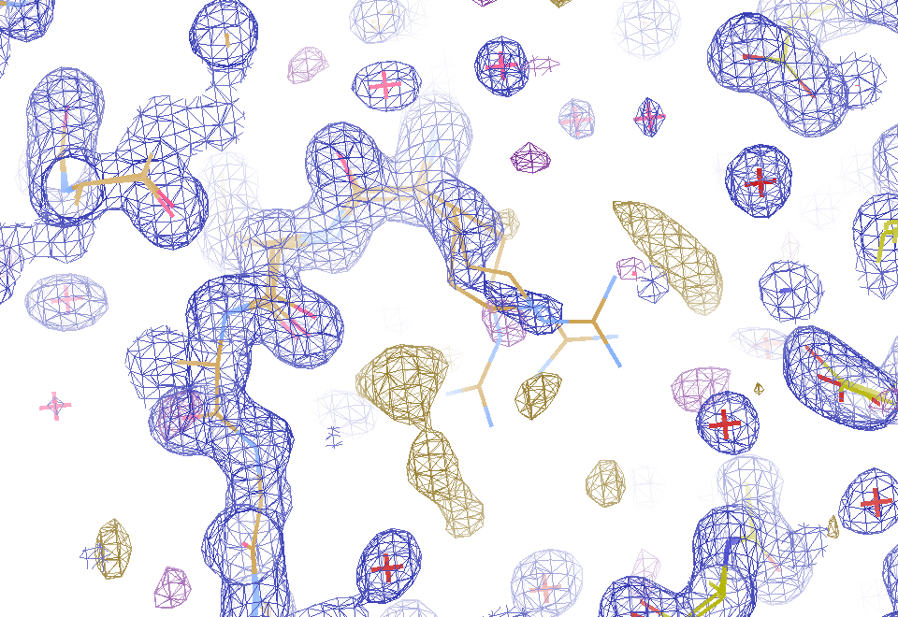
2F_{sim}-F_{calc} and F_{sim}-F_{calc} maps
1.0 Å data
R_{work}= 0.137
R_{free} = 0.159
1 “sigma” 2F_{sim}-F_{c}
2.5 “sigma” F_{sim}-F_{c}

Slide 66
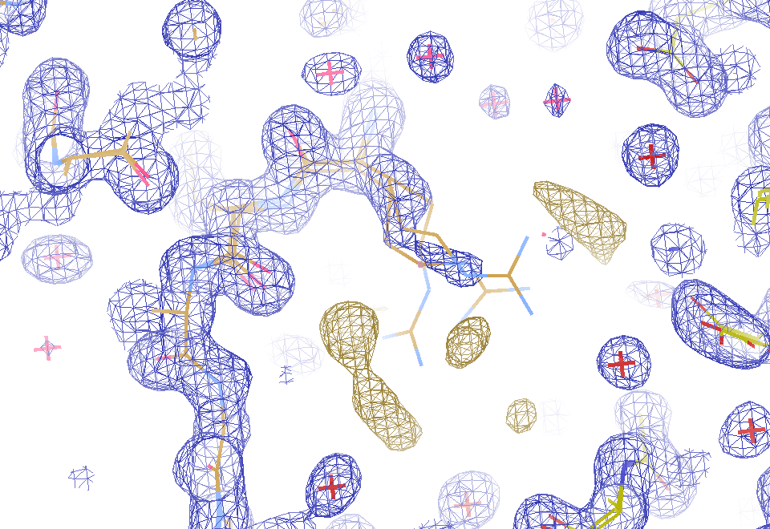
2F_{sim}-F_{calc} and “true difference” maps
1.0 Å data
R_{work}= 0.137
R_{free} = 0.159
1 “sigma” 2F_{sim}-F_{c}
F_{right} – (2F_{sim}-F_{c})

Slide 67
30 conformers from 24,000

Slide 68
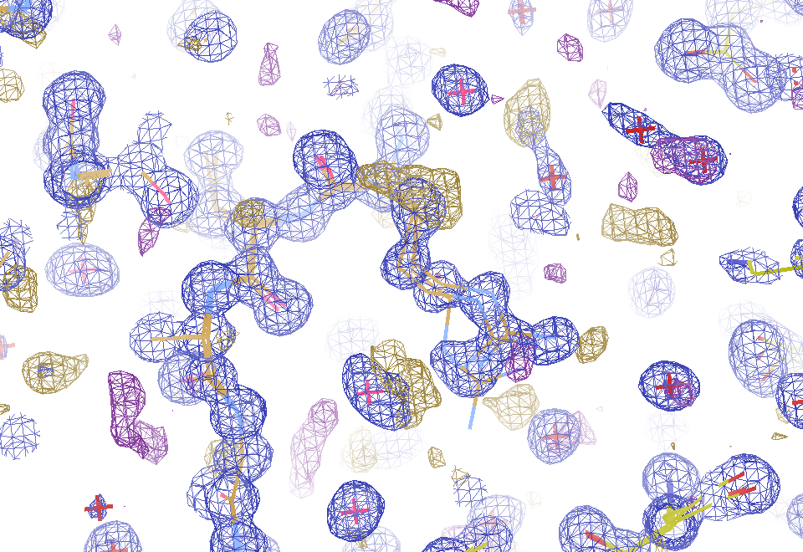
Conventional model vs X-ray data
1.0 Å data
R_{work} = 0.116
R_{free} = 0.135
1 “sigma” 2F_{obs}-F_{c}
2.5 “sigma” F_{obs}-F_{c}

Slide 69
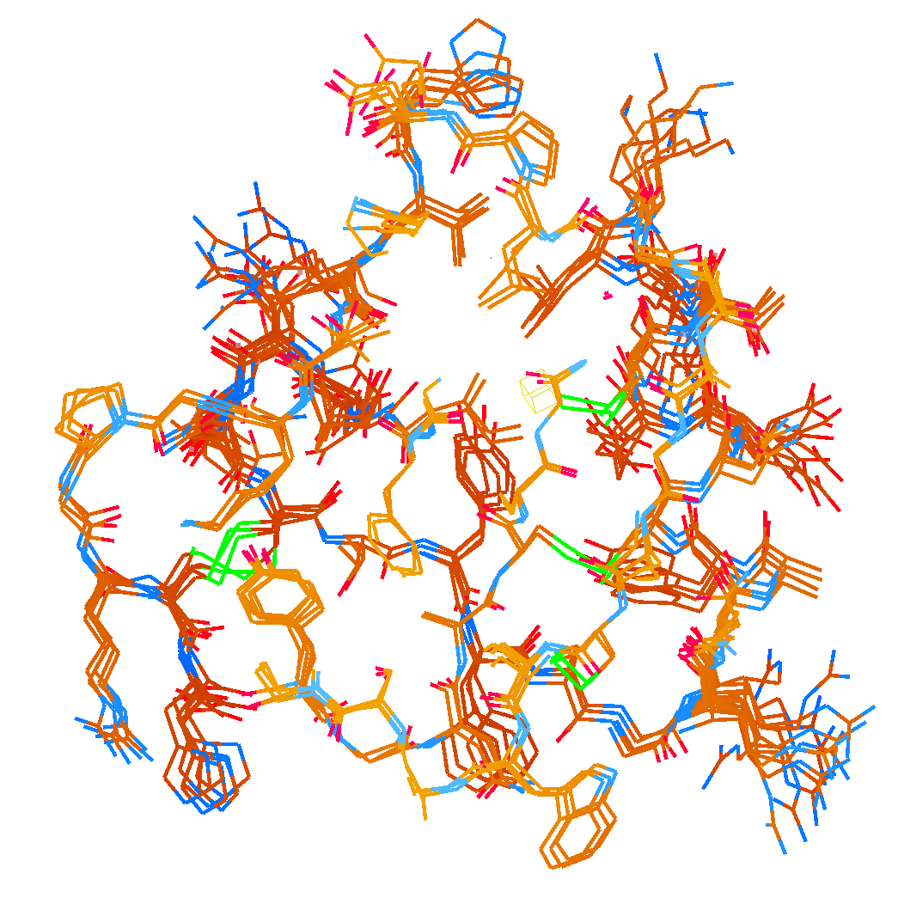
How many conformers are needed?
MD-derived fake data
Answer: 2-14
R_{work} = 0.0441
R_{free} = 0.0516
vs F_{sim}

Slide 70
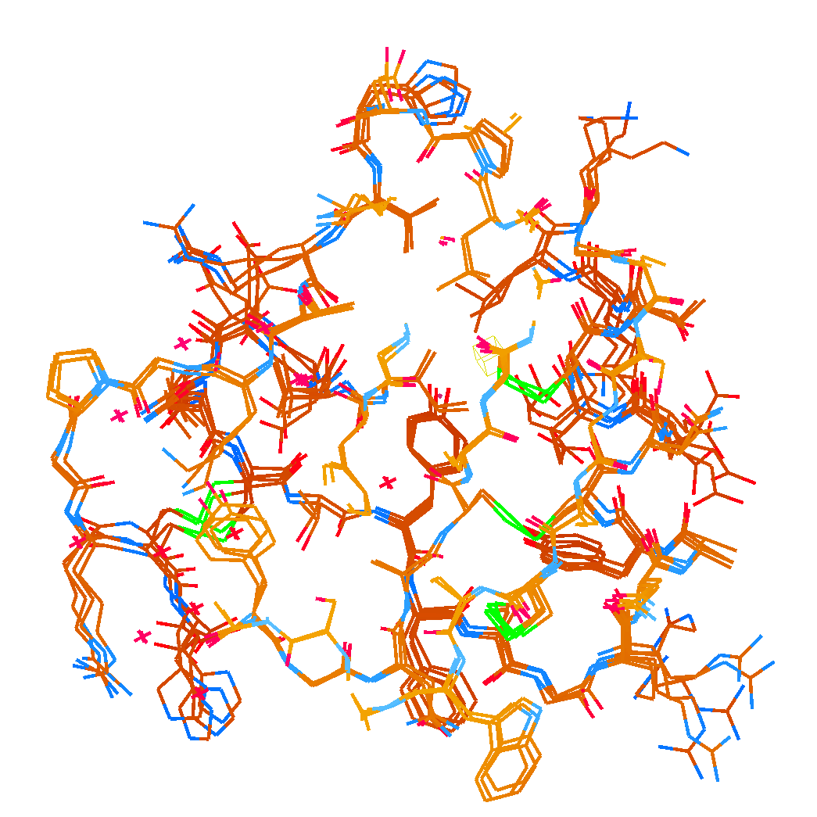
How many conformers are needed?
Observed x-ray data
Answer: 1-7
R_{work} = 0.135
R_{free} = 0.158
vs F_{obs}
1aho:
R_{work} = 0.1475
R_{free} = 0.1685

Slide 71
Adding noise
12%² + 12%² = 17%²
R_{protein} + R_{solvent} ≈ R_{work}

Slide 72
Adding noise
4%² + 12%² = 12.6%²
R_{protein} + R_{solvent} ≈ R_{work}

Slide 73
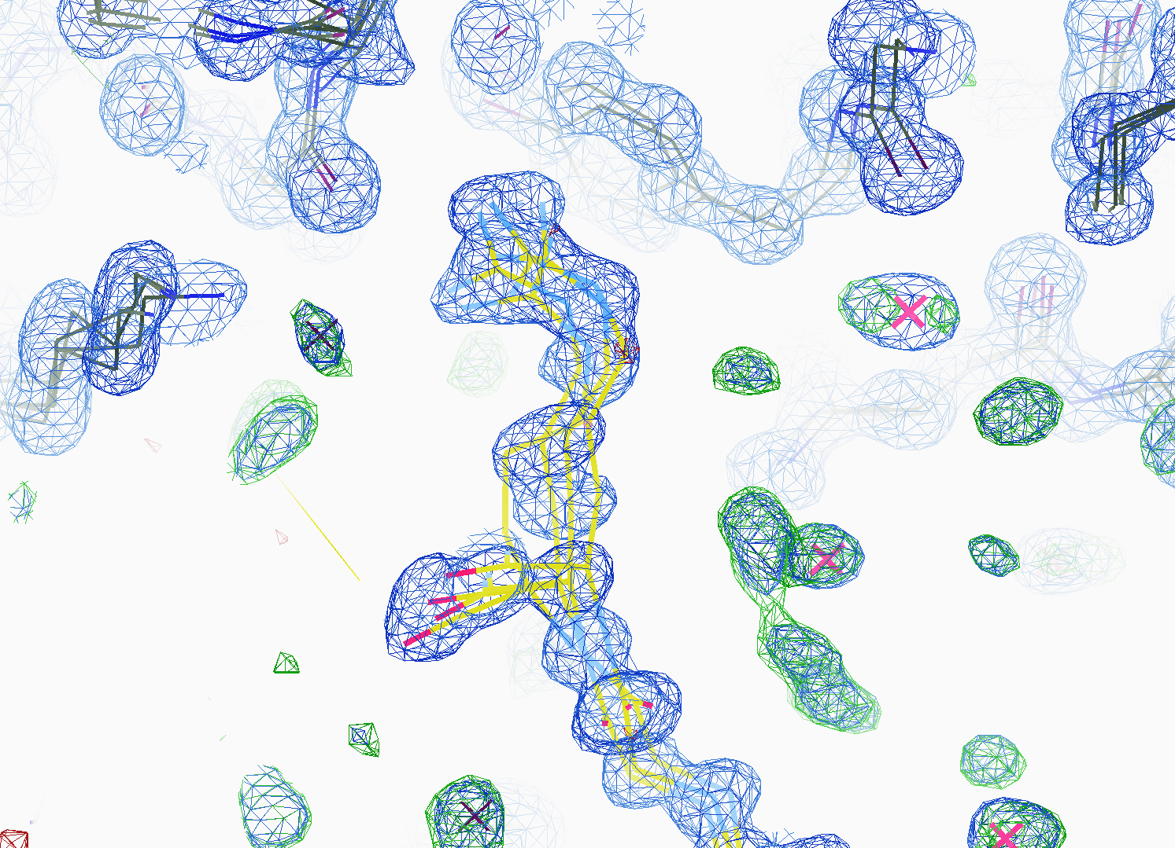
How many conformers are there?
All difference
features
are in
the solvent!
real data

Slide 74
Solvent boundary problem

Slide 75
Solvent boundary problem

Slide 76
Solvent boundary problem

Slide 77
Solvent boundary problem

Slide 78
Current implementation

Slide 79
Better implementation? (not available yet)

Slide 80
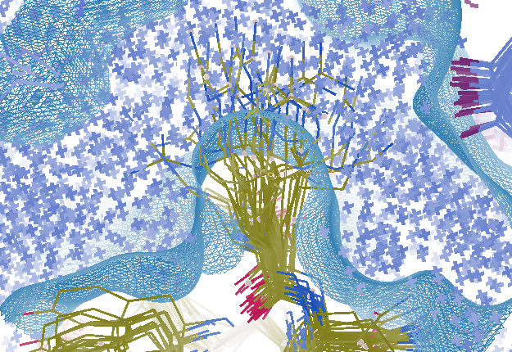
Combined multi-conformer & cloud solvent
R_{work} = 0.0309
R_{free} = 0.0678
vs F_{sim}
Problem: diverges with more cycles

Slide 81
Getting rid of “bias”
Throw out everything not 100% sure about
Alt confs? Side chains? Loops?
Can often cut down to 50% or more
Build biggest F_{obs}-F_{calc} feature
Refine to convergence
Atoms stop moving, not just R settling
Goto 2.
Note: Repeating MR = rigid-body shift
Solvent-flattened SAD phases not better

Slide 82
Building back from mainchain
Holton et al. (2014) "The R-factor gap", FEBS J. 281, 4046-4060.

Slide 83
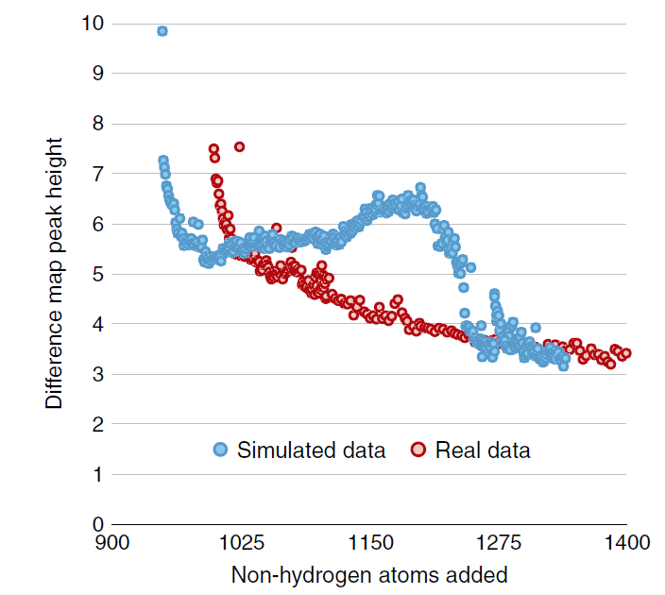
Building back from mainchain
Fo-Fc difference map peak height
Holton et al. (2014) "The R-factor gap", FEBS J. 281, 4046-4060.

Slide 84
Take-home lesson:
Always build into the
biggest
F_{obs}-F_{calc} difference feature
(least likely to be noise)
If biggest feature is negative:
adjust bulk solvent parameters

Slide 85
“R” factors
R = % error

Slide 86
“R” factors
completely random: 0.59
starting MR solution: 0.4-0.55
something still wrong?: > 0.3
correct chain trace: < 0.2
small molecule: ~ 0.05

Slide 87
“R” factors
R_{cryst} (or just “R”)
observed vs calculated data (Fs)
R_{free}
cross-check with “random” subset of data
should be < 0.3 and < R_{cryst} + 0.1

Slide 88
Fitting data
structure factor (F)
spot index (h)

Slide 89
Fitting data
structure factor (F)
spot index (h)

Slide 90
Fitting data
structure factor (F)
spot index (h)

Slide 91
Fitting data
structure factor (F)
spot index (h)

Slide 92
“R” factors
R_{cryst} (or just “R”)
observed vs calculated data (Fs)
R_{free}
cross-check with “random” subset of data
should be < 0.3 and < R_{cryst} + 0.1
R_{sym} = R_{merge} (self-consistency of data: Is)

Slide 93
R_{merge}
blows up
as I_{obs} → 0
completely random: 0.59
weak data (high angle): 0.7- ∞
wrong symmetry choice?: ~0.2-0.55
small or disordered crystal: ~0.1-0.2
typical: ~ 0.05

Slide 94
R-factor Gap
Publication criterion for chemical crystallography:
R1 < 2*R_{sigma}
R1 = F_{o} vs F_{c} for I/σ(I) > 3
R_{sigma} = <σ(I)>/<I>
There are no PDB entries that pass this test!
Holton et al. (2014). FEBS J. 281, 4046-60.

Slide 95
Why should you care?
d_{max} = 4.5 Å
R_{cryst} = 27%
R_{free} = 38%

Slide 96
Why should you care?
3a8n 4.5 Å R_{merge} = 0.15 R/R_{free} = 0.306/0.396
1qzv 4.44 Å R_{merge} = 0.099 R/R_{free} = 0.41/0.42
1grz 5 Å R_{merge} = 0.052 R/R_{free} = 0.369/0.428

Slide 97
Why should you care?
1hvu 4.75 Å R_{merge} = 0.064 R/R_{free} = 0.34/0.413
1n8e 4.5 Å R_{merge} = 0.138 R/R_{free} = 0.415/0.416
2r6e 5.02 Å R_{merge} = 0.058 R/R_{free} = 0.394/0.397

Slide 98
“R” factors
R_{cryst} (or just “R”)
observed vs calculated data (Fs)
R_{free}
cross-check with “random” subset of data
should be < 0.3 and < R_{cryst} + 0.1
R_{sym} = R_{merge} (self-consistency of data: Is)
R_{rim} R_{pim} R_{meas}
R_{iso} R_{anom}
R_{diff}
R_{sym} is “unfair” to high multiplicity

Slide 99
R-factor
http://bl831.als.lbl.gov/~jamesh/movies/rfactor.mpeg

Slide 100
Overloads
http://bl831.als.lbl.gov/~jamesh/movies/overloads.mpeg

Slide 101
Resolution: low-angle cutoff
http://bl831.als.lbl.gov/~jamesh/movies/lo_cut.mpeg

Slide 102
Completeness: missing wedge
http://bl831.als.lbl.gov/~jamesh/movies/osc.mpeg

Slide 103
Completeness: random deletion
http://bl831.als.lbl.gov/~jamesh/movies/completeness.mpeg

Slide 104
And the dominant source of error is…
Resolution
Disorder (including Radiation Damage)
Background
Phases
Non-isomorphism (including Radiation Damage)
Vibration (beam, xtal, spindle, etc.)
Detector calibration

Slide 105
What is “disorder”?

Slide 106
What is “disorder”?

Slide 107
What is “disorder”?

Slide 108
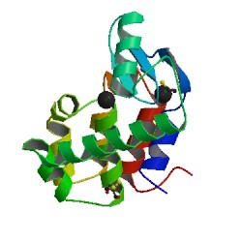
What is “disorder”?
order
order
B-factor
disorder

Slide 109
“B” factors
ATOM 122 N LEU A 13 -3.244 25.808 19.998 1.00 16.96 N
ATOM 123 CA LEU A 13 -2.877 25.448 21.355 1.00 15.29 C
ATOM 124 C LEU A 13 -2.792 23.966 21.561 1.00 17.54 C
ATOM 125 O LEU A 13 -1.814 23.493 22.143 1.00 16.35 O
ATOM 126 CB LEU A 13 -3.907 26.164 22.268 1.00 18.72 C
ATOM 127 CG LEU A 13 -3.577 25.982 23.738 1.00 21.19 C
ATOM 128 CD1 LEU A 13 -2.283 26.820 24.019 1.00 19.43 C
ATOM 129 CD2 LEU A 13 -4.702 26.474 24.639 1.00 24.65 C
ATOM 130 N SER A 14 -3.677 23.149 20.979 1.00 15.96 N
ATOM 131 CA SER A 14 -3.646 21.711 21.061 1.00 18.26 C
ATOM 132 C SER A 14 -2.373 21.203 20.360 1.00 18.71 C
ATOM 133 O SER A 14 -1.747 20.315 20.930 1.00 17.47 O
ATOM 134 CB SER A 14 -4.875 21.077 20.419 1.00 17.62 C
ATOM 135 OG ASER A 14 -4.825 19.665 20.388 0.50 20.89 O
ATOM 136 OG BSER A 14 -6.027 21.408 21.164 0.50 18.67 O
ATOM 137 N LYS A 15 -2.045 21.772 19.215 1.00 18.03 N
ATOM 138 CA LYS A 15 -0.799 21.361 18.555 1.00 18.12 C
ATOM 139 C LYS A 15 0.446 21.707 19.351 1.00 18.81 C
ATOM 140 O LYS A 15 1.400 20.948 19.411 1.00 17.77 O
ATOM 141 CB LYS A 15 -0.700 22.034 17.177 1.00 14.49 C
ATOM 142 CG LYS A 15 -1.727 21.368 16.256 1.00 16.12 C
ATOM 143 CD LYS A 15 -1.663 22.147 14.936 1.00 19.40 C
ATOM 144 CE ALYS A 15 -2.725 21.614 13.986 0.50 17.42 C
ATOM 145 CE BLYS A 15 -1.750 21.211 13.750 0.50 17.01 C
ATOM 146 NZ ALYS A 15 -2.346 21.674 12.559 0.50 18.61 N
ATOM 147 NZ BLYS A 15 -3.052 20.513 13.741 0.50 18.76 N

Slide 110
“B” factors
B ≈ 4d² + 12
d = resolution in Å
essentially, the “resolution” of an atom

Slide 111
“B” factors
electron density (e⁻/Å³)
position (Å)

Slide 112
“B” factors
electron density (e⁻/Å³)
position (Å)

Slide 113
“B” factors
electron density (e⁻/Å³)
position (Å)

Slide 114
“B” factors
electron density (e⁻/Å³)
position (Å)

Slide 115
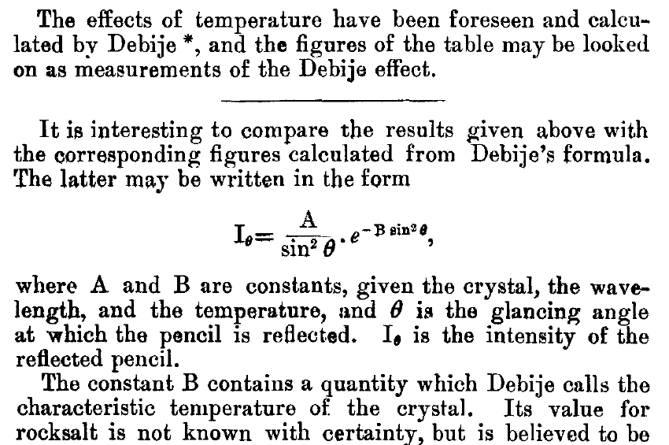
The B factor
Bragg, W. H. (1914)."XCVII. The intensity of reflexion of X rays by crystals", Philosophical Magazine Series 6 27, 881-899. Published May 1 1914

Slide 116
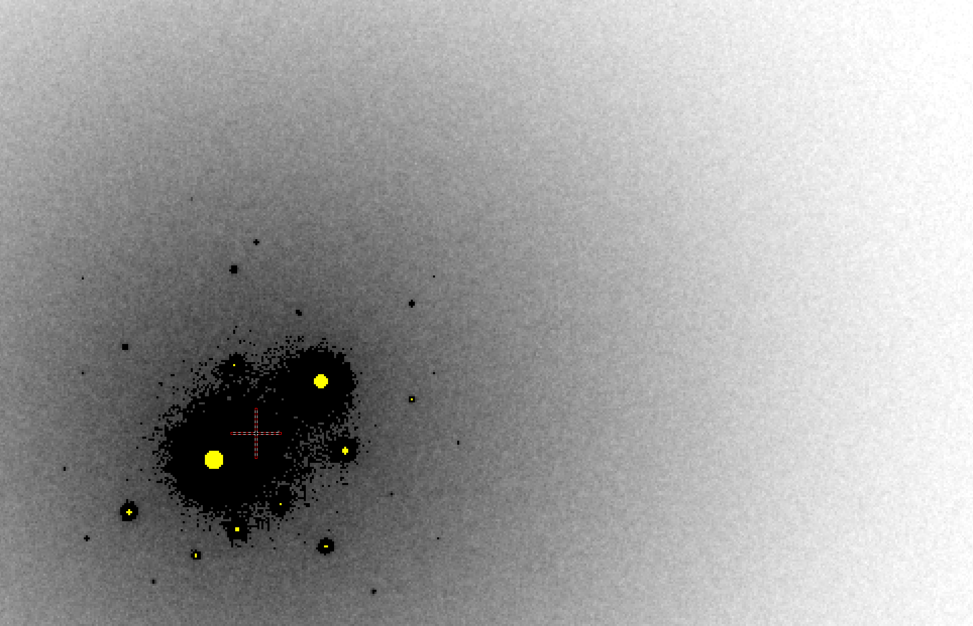
B factor from image analysis
B = 500

Slide 117
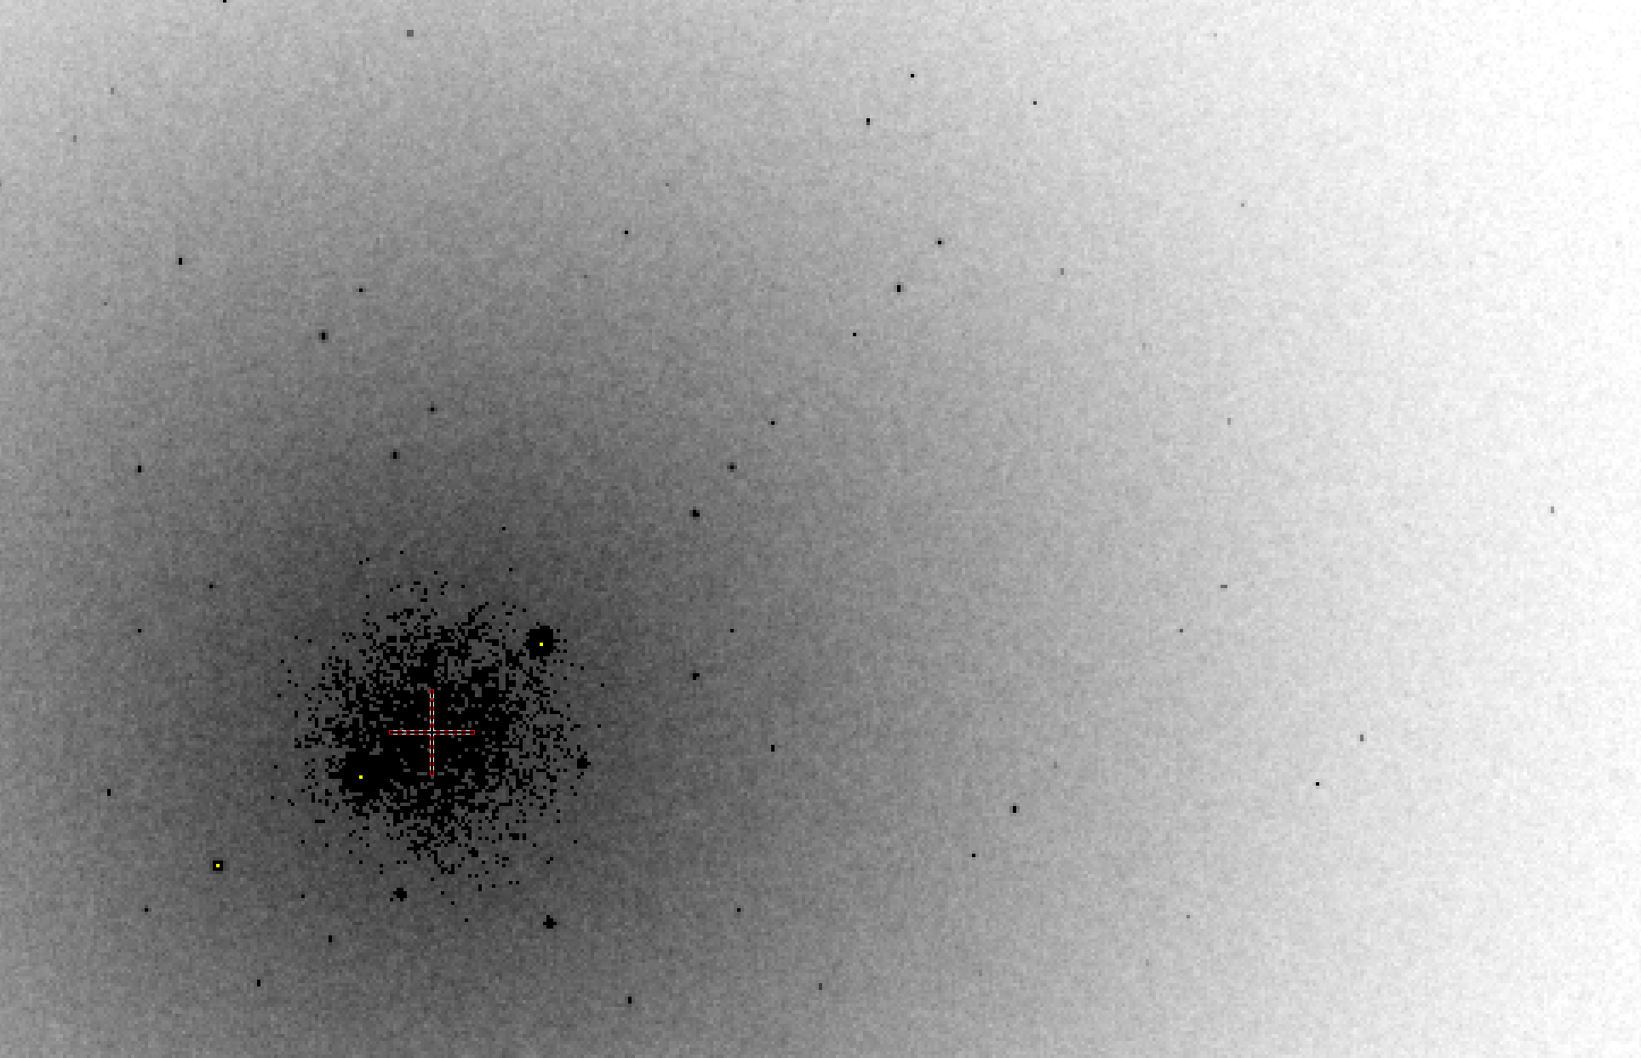
B factor from image analysis
B = 20

Slide 118
Bigger is better, but not by much
B = 20
B = 60
B = 0
B = 170
B = 330
B = 560
Resolution (Å)
B = 850
Crystal diameter (micron)

Slide 119
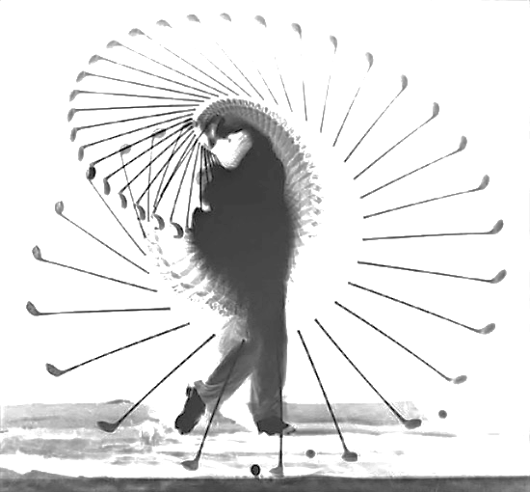
The real problem is:
Averaging
+
Dynamics
=
Poor
resolution
a grand challenge for structural biology in the 21st century

Slide 120
What Causes Disorder?
Function
Radiation damage
Mosaicity
Strain
Xtal abuse
Dehydration

Slide 121
What Causes Disorder?
Function
Radiation damage
Mosaicity
Strain
Xtal abuse
Dehydration

Slide 122
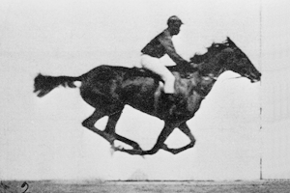
Muybridge’s galloping horse (1878)

Slide 123
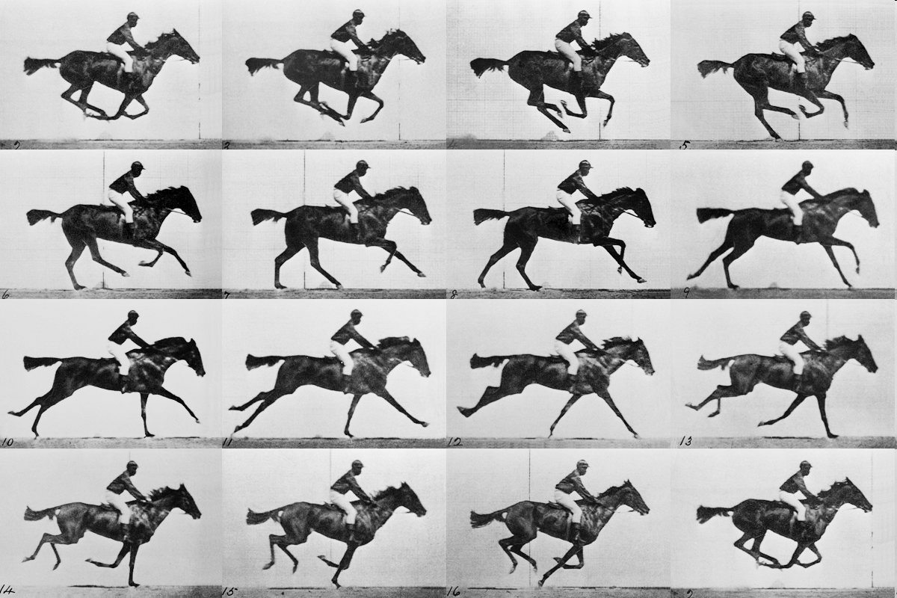
realistic “crystal” of horses

Slide 124
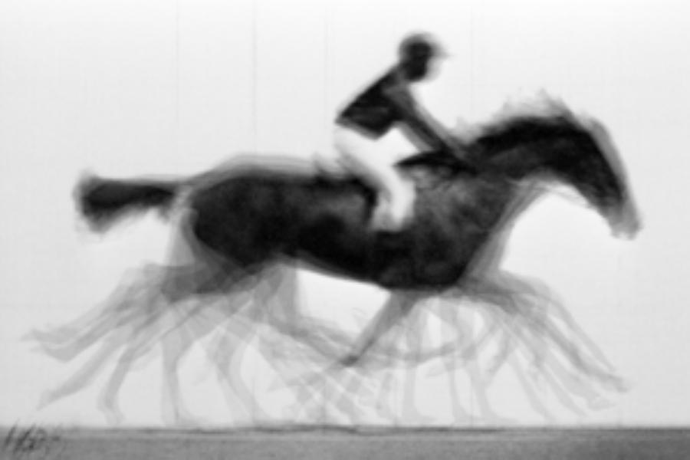
average structure: galloping horse

Slide 125
Ways to improve order
New crystal form
Purify
- add a column
- heat shock
Bind something
- Known ligand
- Silver bullets
Change the clone
- chop off floppy bits
- homolog
- Ala -> Lys mutants
Make Protein Sit Still!!!
8000 cases in PDB of resolution improvement
80% of these are different crystal forms
> 1 Å improvement → 94% different forms
Newman J. (2006) Acta Cryst. D62 27-31.

Slide 126
What Causes Disorder?
Function
Radiation damage
Mosaicity
Strain
Xtal abuse
Dehydration

Slide 127
Types of radiation damage
Global
Specific

Slide 128
Types of radiation damage
Global
scale factor
B factor
non-isomorphism
Specific
depends on chemistry
destroys phasing signal

Slide 129
Global damage
Howells, et al. (2009) J. Electron Spectrosc. Relat. Phenom. 170, 4-12.

Slide 130
resolution dependence of global damage
10³
100
maximum tolerable dose (MGy)
10
1
1 2 3 5 7 10 20 40 70 100
resolution (Å)
Howells et al. (2009) J. Electron. Spectrosc. Relat. Phenom. 170 4-12

Slide 131
resolution dependence of global damage
10³
10 MGy/Å
100
maximum tolerable dose (MGy)
10
1
1 2 3 5 7 10 20 40 70 100
resolution (Å)
Howells et al. (2009) J. Electron. Spectrosc. Relat. Phenom. 170 4-12

Slide 132
what the is a MGy?
1 MGy = 10⁶ J/kg
http://bl831.als.lbl.gov/
damage_rates.pdf
Holton J. M. (2009) J. Synchrotron Rad. 16 133-42

Slide 133
How long will my crystal last?
synch line type flux beamsize flux density dose max xtal min site
ph/s μm ph/μm2/s rate lifetime lifetime
ALS 4.2.2 MAD 2.2e11 75x80 3.7e+07 27.3 kGy/s 18 m 73 s
ALS 5.0.1 mono 1.6e11 100 2.0e+07 10.4 kGy/s 48 m 3.2 m
ALS 5.0.2 MAD 8e11 100 1.0e+08 51.8 kGy/s 9.6 m 39 s
ALS 5.0.3 mono 1.7e11 100 2.2e+07 11 kGy/s 45 m 3 m
ALS 8.2.1 MAD 1.8e11 100 2.3e+07 11.7 kGy/s 43 m 2.9 m
ALS 8.2.2 MAD 2.3e11 100 2.9e+07 14.9 kGy/s 34 m 2.2 m
ALS 8.3.1 MAD 9e11 70 2.3e+08 119 kGy/s 4.2 m 17 s
ALS 8.3.1 typical 6e11 70 1.6e+08 115 kGy/s 4.3 m 17 s
ALS 12.3.1 MAD 1.8e11 100 2.3e+07 11.7 kGy/s 43 m 2.9 m
ALS 12.3.1 ML 4.0e12 100 5.1e+08 513 kGy/s 58 s 3.9 s
APS 8-BM MAD 1e11 200 2.5e+06 1.27 kGy/s 6.6 h 26 m
APS 14-BM-C mono 5.8e10 200 1.4e+06 738 Gy/s 11 h 45 m
APS 14-BM-D MAD 3.3e9 200 8.2e+04 42 Gy/s 8.3 d 13 h
APS 14-ID-B MAD 6.0e10 200 1.5e+06 763 Gy/s 11 h 44 m
APS 17-BM MAD 1.1e11 200 2.8e+06 1.4 kGy/s 6 h 24 m
APS 17-ID MAD 2.3e11 200 5.8e+06 2.93 kGy/s 2.8 h 11 m
APS 19-BM MAD 2.0e11 70x60 4.8e+07 24.2 kGy/s 21 m 83 s
APS 19-ID MAD 1.3e13 80x40 4.1e+09 2.07 MGy/s 15 s 0.97 s
APS 19-ID typical 5.5e11 100x100 5.5e+07 28 kGy/s 18 m 71 s
APS 22-BM MAD 7e12 80x40 2.2e+09 1.23 MGy/s 24 s 1.6 s
APS 22-ID MAD 7e12 80x40 2.2e+09 1.23 MGy/s 24 s 1.6 s
APS 22-ID typical 1.5e12 80 2.3e+08 119 kGy/s 4.2 m 17 s
APS 23-ID-B MAD 1e13 75x25 5.3e+09 3.01 MGy/s 10 s 0.66 s
APS 23-ID typical 1.5e12 80 2.3e+08 119 kGy/s 4.2 m 17 s
APS 24-ID-C MAD 1.3e13 20x60 1.1e+10 5.23 MGy/s 5.7 s 0.38 s
APS 24-ID-E MAD 0.5e13 20x100 2.5e+09 1.19 MGy/s 25 s 1.7 s
APS 31-ID MAD 2e12 70 4.1e+08 194 kGy/s 2.6 m 10 s

Slide 135
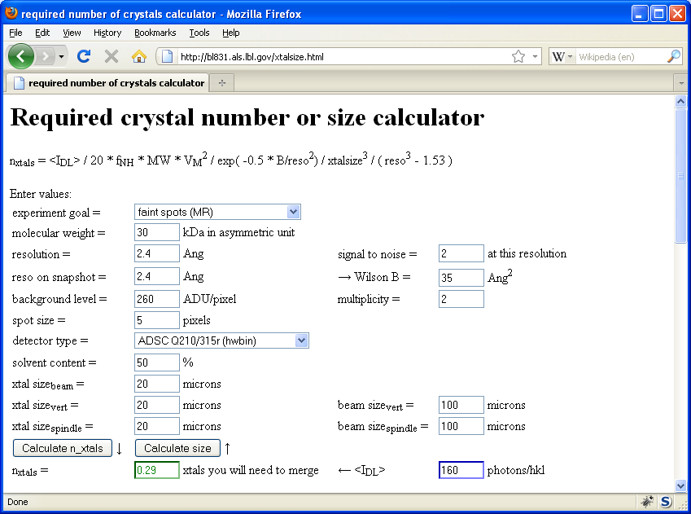
Holton & Frankel (2010) Acta D 66 393-408.

Slide 136
Specific damage
final, refined phases

Slide 137
Specific damage
experimentally-obtained phases

Slide 138
Holton, J. M. (2007) J. Synch. Rad. 14, 51-72.

Slide 139
1.0
fraction
unconverted
0.0
Holton, J. M. (2007) J. Synch. Rad. 14, 51-72.

Slide 140
MGy reaction reference
~45 global damage Owen et al. (2006)
10/Å global damage Howells et al. (2009)
5 Se-Met Holton (2007)
4 Hg-S Ramagopal et al. (2004)
4 R-C-COOH Garman et al. (2015)
3 S-S Murray et al. (2002)
1 Br-RNA Olieric et al. (2007)
~1? Cl-C ???
0.5 Mn in PS II Yano et al. (2005)
0.06 putidaredoxin Corbett et al. (2007)
0.02 Fe in myoglobin Denisov et al. (2007)
Radiation Damage World Records
Holton (2009) J. Synchrotron Rad. 16 133-42

Slide 141
Life-halving concentration
molar, at the Se edge based on RADDOSE
Na | 44
Mg | 27
P | 9
S | 7
Cl | 5
K | 3.3
Ca | 2.7
Fe | 1.0
Cu | 0.67
Zn | 0.58
As | 0.44
Se | 0.42
Br | 2.9
I | 0.47
Gd | 0.21
Ta | 0.13
Pt | 0.17
Au | 0.16
Hg | 0.16
U | 0.23

Slide 142
Life-halving concentration
molar, at the Se edge based on RADDOSE
Na | 44
Mg | 27
P | 9
S | 7
Cl | 5
K | 3.3
Ca | 2.7
Fe | 1.0
Cu | 0.67
Zn | 0.58
As | 0.44
Se | 0.42
Br | 2.9
I | 0.47
Gd | 0.21
Ta | 0.13
Pt | 0.17
Au | 0.16
Hg | 0.16
U | 0.23

Slide 143
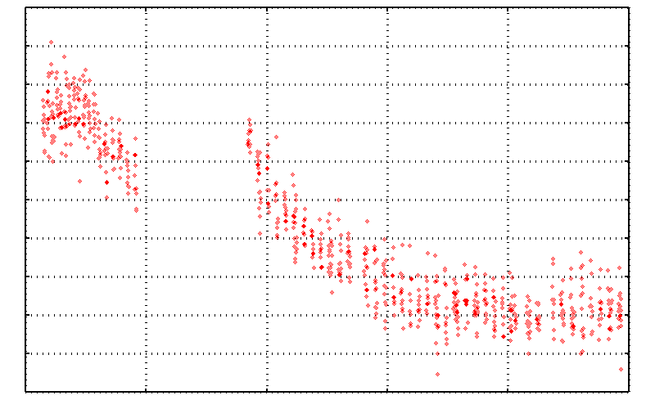
No Damage in the Dark!
4.6 5.0 5.4 5.8 6.2 6.6
Peak absorbance (electrons)
0 5 10 15 20 25
Experiment time (hours)

Slide 144
Rad dam take-home lesson:
The number of photons scattered
before crystal is dead
is independent
of flux & time
1 um³ = 10⁵ photons (roomT)
1 um³ = 10⁶ photons (synch)
1 um³ = 10⁸ photons (XFEL)
(synch)
Henderson, 1990; Gonzalez & Nave, 1994; Glaeser et al., 2000; Sliz et al., 2003; Leiros et al., 2006; Owen et al., 2006; Garman & McSweeney, 2006; Garman & Nave, 2009; Holton, 2009

Slide 145
Dose slicing
unacceptable
completeness
N
photons
crystal’s useful life
N
photons
unacceptable
read noise
N
photons

Slide 146
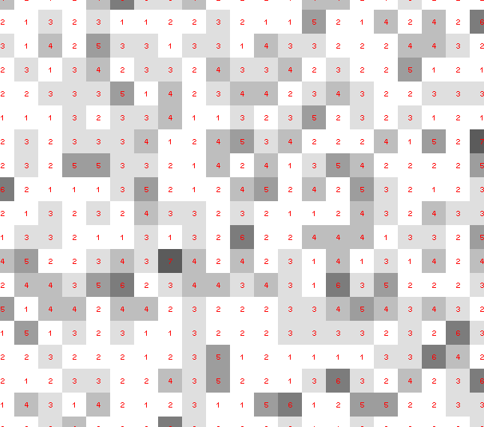
Dose slicing: is that a spot?

Slide 147
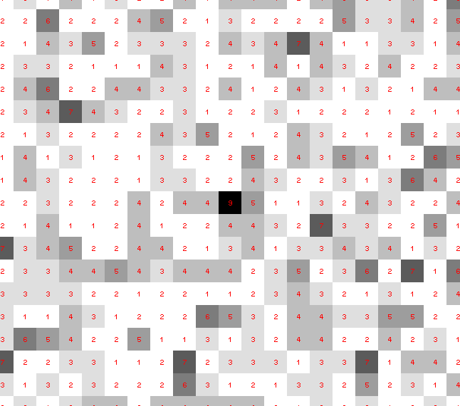
Dose slicing: is that a spot?

Slide 148
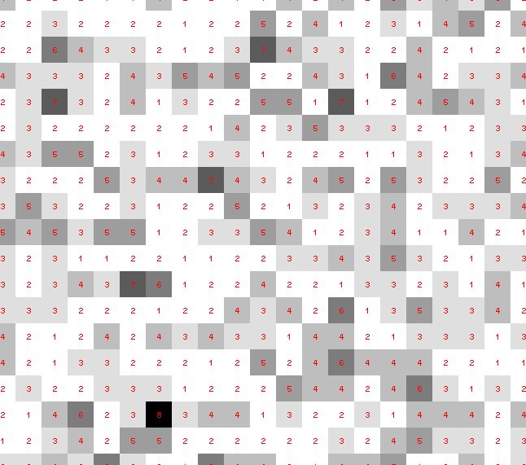
Dose slicing: is that a spot?

Slide 149
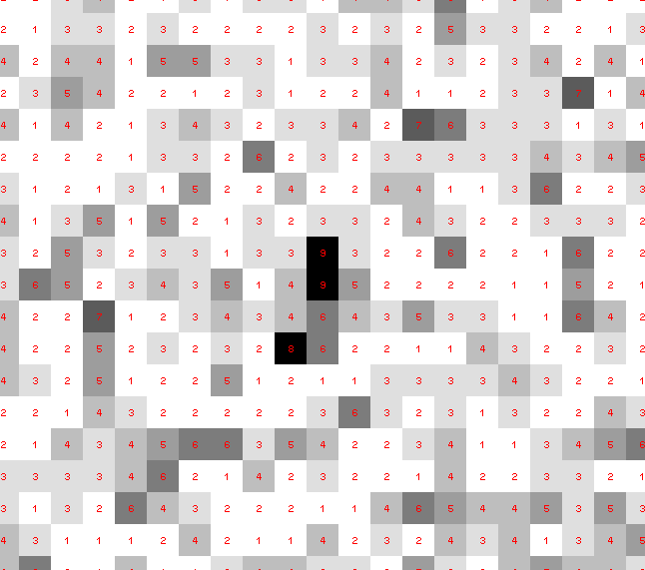
Dose slicing: is that a spot?

Slide 150
Dose slicing: is that a spot?

Slide 151
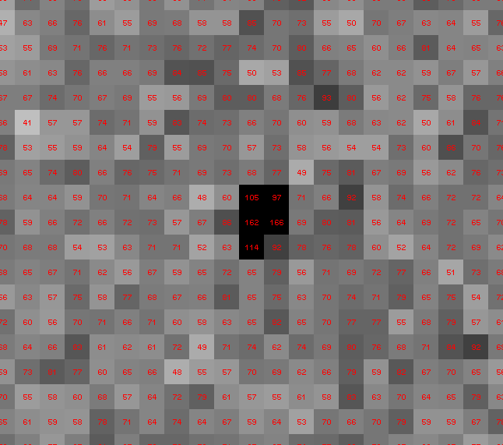
Dose slicing: is that a spot?

Slide 152
What if?
You only have a few small crystals…
Should you:
Collect 360° from each?
Collect 10° from each at 36x exposure?
Glue 36 xtals together, then collect 360° ?
Glue, and do 12960° faint exposures?

Slide 153
“true” resolution limit
CC vs right answer
Resolution (Å)

Slide 154
“true” resolution vs strategy
Dose slice collection scenario
fine | coarse | glue | Glue & fine
3.17700 | 3.14057 | 3.17604 | 3.12086
301,640,334 photons/xtal

Slide 155
processing procedure | resolution limit
 | fine | coarse | glue | glue&fine
XDS/XSCALE | 3.17700 | 3.14057 | 3.17604 | 3.12086
XDS/aimless | 3.16251 | 3.15922 | 3.16675 | 3.12162
XDS/noscale | 3.27289 | 3.15617 | 3.38929 | 3.12162
MOSFLM-defaults | x | x | x | x
MOSFLM-cheat | 3.19755 | 3.18166 | 3.20354 | 3.19755
HKL2000-defaults | x | x | x | x
HKL2000-expert | 3.21803 | 3.12646 | 3.11551 | 3.21803
HKL2000-cheat | 3.16119 | 3.10338 | 3.10338 | 3.16300
DIALS-defaults | x | x | 3.42125 | x
DIALS-expert | 3.10296 | 3.09547 | 3.07653 | 3.08465
d*Trek | ? | ? | 4.34076 | ?
EVAL15 | 3.14352 | 3.10383 | 3.09936 | 3.14105
EVAL15-sadabs | 3.13920 | 3.10797 | 3.10171 | 3.13700

Slide 156
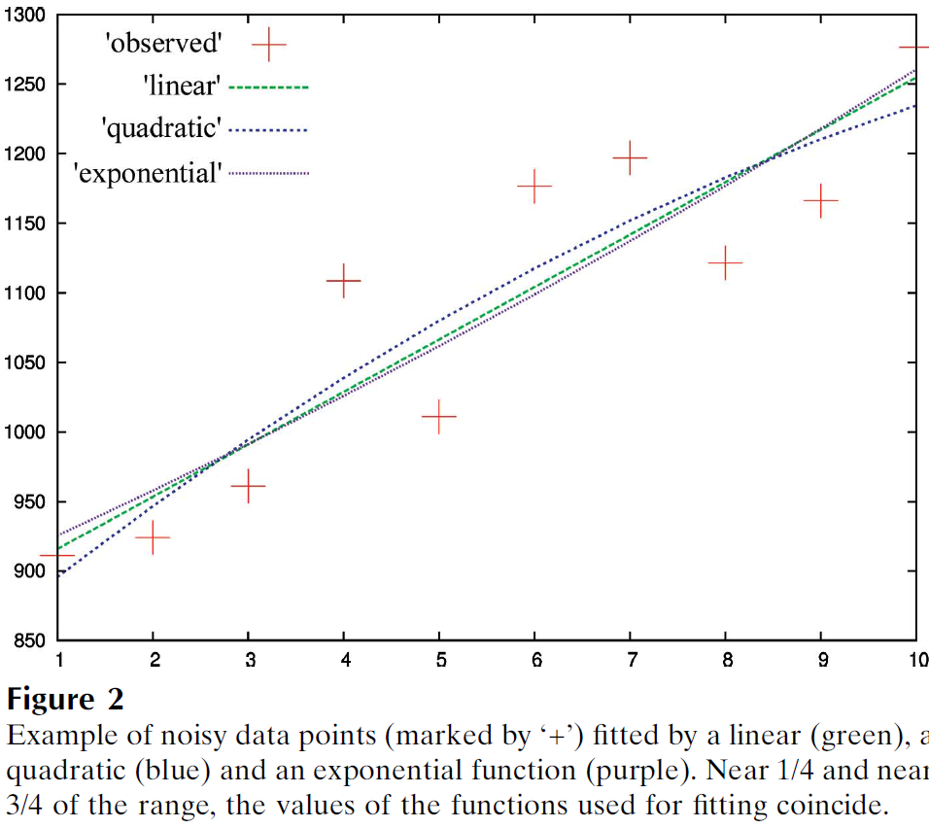
Zero-dose extrapolation (ZDE)
Diederichs, K. (2006). "Some aspects of quantitative analysis and correction of radiation damage." Acta Cryst. D 62(1): 96-101.

Slide 157
"error bar" for electron density
structure factor (e⁻/cell)
spot index

Slide 158
"error bar" for electron density
structure factor (e⁻/cell)
electron density (e⁻/Å³)
spot index
fractional coordinate

Slide 159
"error bar" for electron density
structure factor (e⁻/cell)
electron density (e⁻/Å³)
spot index
fractional coordinate

Slide 160
"error bar" for electron density
structure factor (e⁻/cell)
electron density (e⁻/Å³)
spot index
fractional coordinate

Slide 161
"error bar" for electron density
structure factor (e⁻/cell)
electron density (e⁻/Å³)
spot index
fractional coordinate

Slide 162
"error bar" for electron density
structure factor (e⁻/cell)
electron density (e⁻/Å³)
spot index
fractional coordinate

Slide 163
"error bar" for electron density
structure factor (e⁻/cell)
electron density (e⁻/Å³)
spot index
fractional coordinate

Slide 164
"error bar" for electron density
structure factor (e⁻/cell)
electron density (e⁻/Å³)
spot index
fractional coordinate

Slide 165
"error bar" for electron density
structure factor (e⁻/cell)
electron density (e⁻/Å³)
spot index
fractional coordinate

Slide 166
"error bar" for electron density
structure factor (e⁻/cell)
electron density (e⁻/Å³)
spot index
fractional coordinate

Slide 167
"error bar" for electron density
structure factor (e⁻/cell)
electron density (e⁻/Å³)
spot index
fractional coordinate

Slide 168
"error bar" for electron density
structure factor (e⁻/cell)
electron density (e⁻/Å³)
spot index
fractional coordinate

Slide 169
"error bar" for electron density
Refinement
Against
Perturbed
Input
Data
electron density (e⁻/Å³)
fractional coordinate

Slide 170
How does the “error” compare to “sigma”?
normalized counts
Electron Number Density (e⁻/Å³)

Slide 171
How does the “error” compare to “sigma”?
normalized counts
Electron Number Density (e⁻/Å³)

Slide 172
How does the “error” compare to “sigma”?
normalized counts
Electron Number Density (e⁻/Å³)

Slide 173
What is the “error” in 2Fo-Fc “sigma” units?
normalized counts
traditional “sigma” units (multples of rms(ρ-⟨ρ⟩) relative to ⟨ρ⟩)

Slide 174
What is the “error” in Fo-Fc “sigma” units?
normalized counts
traditional “sigma” units (multples of rms(ρ-⟨ρ⟩) relative to ⟨ρ⟩)

Slide 175
Tradition
electron density (e⁻/Å³)
fractional coordinate

Slide 176
Better contour: derived from noise
electron density (e⁻/Å³)
fractional coordinate

Slide 177
Basic Principles
“Hell, there are NO RULES here - we're trying to accomplish something.”
Thomas A. Edison – inventor
“You’ve got to have an ASSAY.”
Arthur Kornberg – Nobel Laureate
“Control, control, you must learn CONTROL!”
Yoda – Jedi Master

Slide 178
Data quality vs Model Interpretation
Big difference features first
Don’t build anything you don’t have to
Ligand bound or not?
Omit maps, “polder” maps, chemistry
R factor good enough?
Rules of thumb
Nothing beats a “control”
Radiation damage?
Only control: early vs late data

Slide 179
PowerPoint File available:
http://bl831.als.lbl.gov/
~jamesh/powerpoint/
UCSF_DQvMI_2017.pptx

Slide 180
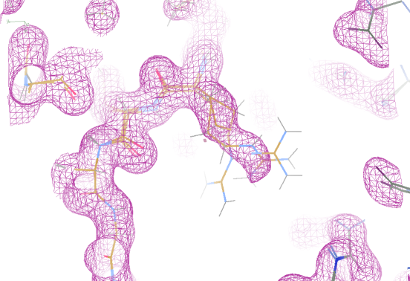
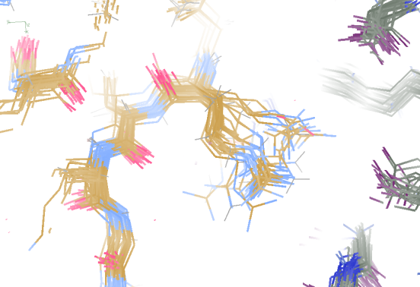
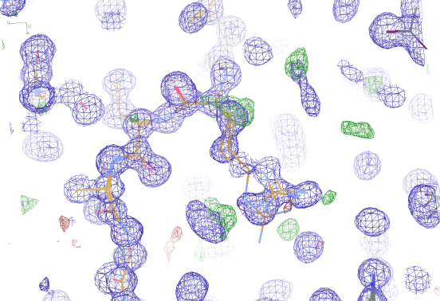
Molecular Dynamics vs Observation
1aho 64-residue scorpion toxin in water to 1.0 Å resolution
refined_vs_Fsim.pdb
1aho.cif
1aho.pdb
F_{calc}
F_{sim}
F_{obs}
F_{calc}
R_{vault} = 0.69
R_{work}= 0.137
R_{iso} =
R_{work}= 0.116
R_{vault} = 0.48 to 4 Å
rmsd = 1.05 Å
LSQ rmsd = 0.43Å

Slide 181
Molecular Dynamics vs Observation
“fav8” 8-residue aromatic peptide with 4 waters to 1.0 Å resolution
refined_vs_Fsim.pdb
fav8.fcf
fav8.cif
F_{calc}
F_{sim}
F_{obs}
F_{calc}
R_{work}= 0.13
R_{vault}= 0.23
R_{work}= 0.16
R_{vault} = 0.20 to 2Å
R1 = 0.041
With 4σ cutoff!
rmsd = 0.20 Å
LSQ rmsd = 0.091Å & 0.15 Å

Slide 182
Is the structure any good?
“do the data presented justify the conclusions drawn?”

