Slide 1
Acknowledgements
http://bl831.als.lbl.gov/~jamesh/powerpoint/UCLA_summit_2023.pptx
Robert Stroud James Fraser Nevan Krogan
Paul Adams John Tainer Greg Hura Nick Sauter
Aina Cohen Art Lyubimov Jeney Wierman
UCSF LBNL SLAC
ALS 8.3.1: TomAlberTron
NIH NIGMS R01 GM124149
NIH NIAID P50 AI150476
NIH NIGMS P30 GM124169
DOE-BER Integrated Diffraction Analysis Technologies (IDAT)
NIH NIGMS P30 GM133894
The Advanced Light Source is supported by the Director, Office of Science, Office of Basic Energy Sciences, Materials Sciences Division, of the US Department of Energy under contract No. DE-AC02-05CH11231 at Lawrence Berkeley National Laboratory.

Slide 2
Systematic Errors! … and how to eliminate them
Resolution
Non-isomorphism
Radiation Damage
R_{work} vs R_{sigma}

Slide 3
R-factor Gap small vs macro molecules
Publication criterion for chemical crystallography:
R1 < 2*R_{sigma}
R1 = F_{o} vs F_{c} for I/σ(I) > 3
R_{sigma} = <σ(I)>/<I>

Slide 4
R-factor Gap
Publication criterion ? :
R_{work} < 2*R_{merge}
There are no PDB entries
that pass this test!
Holton et al. (2014) "The R-factor gap", FEBS J. 281, 4046-4060.

Slide 5
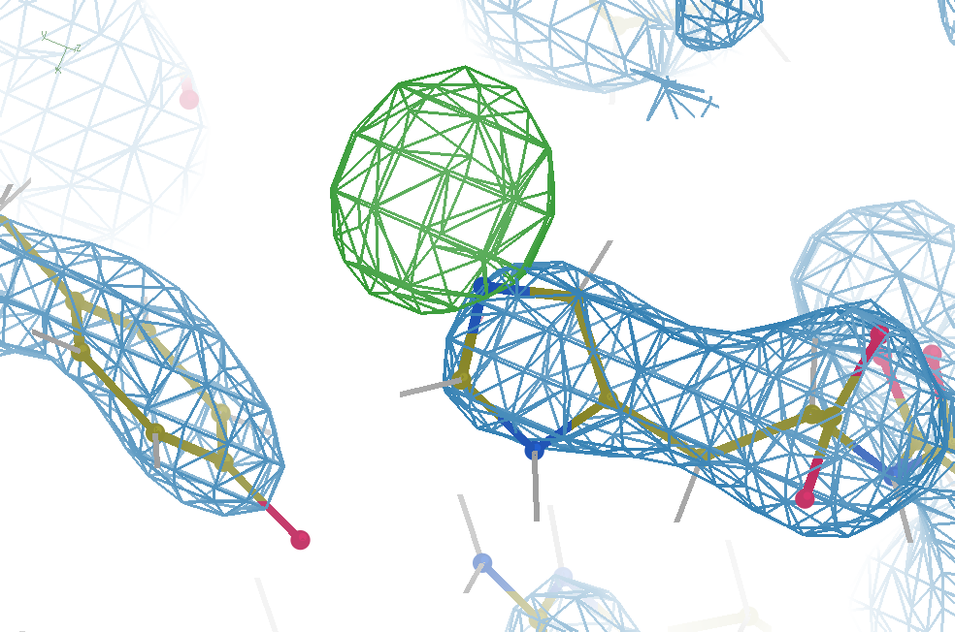
Hydrogen: visible at 3.5 Å resolution!
R_{work} = 0.04
R_{free} = 0.05
d_{min} = 3.5 Å
6σ = 1 e⁻
Simulation:
Realistic noise
“perfect” model

Slide 6
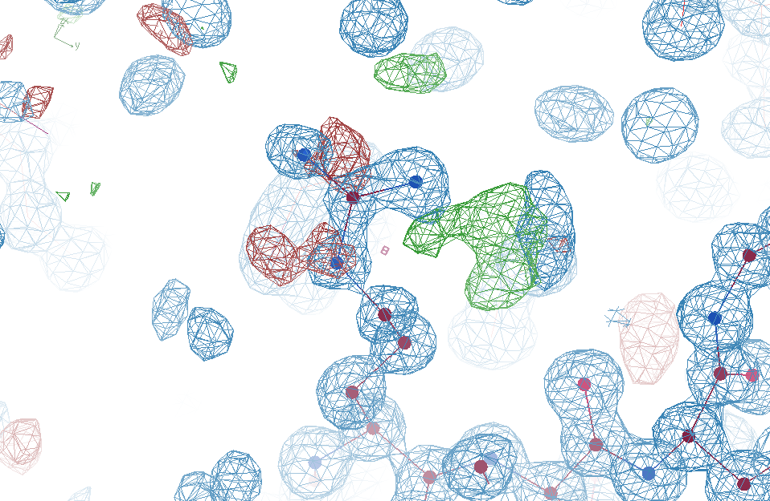
R_{work}: 0.0823
R_{free}: 0.1106
reso: 1.0 Å
Real Data
6σ

Slide 7
R_{work}: 0.0823
R_{free}: 0.1106
bond: 0.014 Å
angle: 1.92°
MoPro: 1.15
Clash: 0.49
Cβdev: 20
Rota: 1.7%
Rama: 0.03%
reso: 1.0 Å
6σ
1.2 σ

Slide 8
R_{work}: 0.0823
R_{free}: 0.1106
0.2 σ
reso: 1.0 Å

Slide 9
Why does ensemble refinement suck? (3 parameters/observation and R_{work} still high!)

Slide 10
Fitting data
structure factor (F)
spot index (h)

Slide 11
Fitting data
structure factor (F)
spot index (h)

Slide 12
Fitting data
structure factor (F)
spot index (h)

Slide 13
Fitting data
structure factor (F)
spot index (h)

Slide 14
R_{work}: 0.0823
R_{free}: 0.1106
bond: 0.014 Å
angle: 1.92°
3 parameters
per observation!
MoPro: 1.15
Clash: 0.49
Cβdev: 20
Rota: 1.7%
Rama: 0.03%
reso: 1.0 Å
6σ

Slide 15
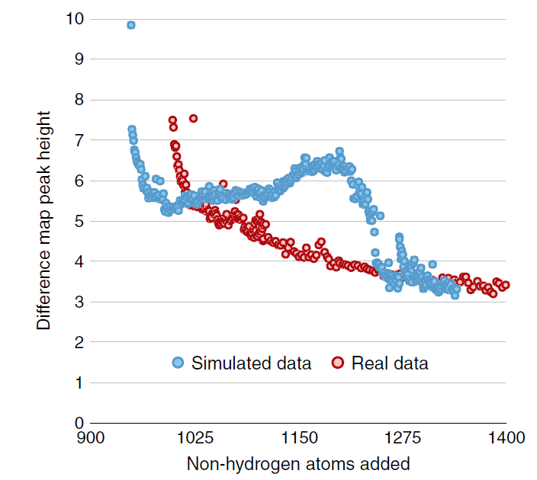
Model building: real vs sim data
Fo-Fc difference map peak height
Holton et al. (2014) "The R-factor gap", FEBS J. 281, 4046-4060.

Slide 16
Model building: real vs sim data
Holton et al. (2014) "The R-factor gap", FEBS J. 281, 4046-4060.

Slide 17
Why does ensemble refinement suck? (3 parameters/observation and R_{work} still high!) The chains are “tangled”

Slide 18
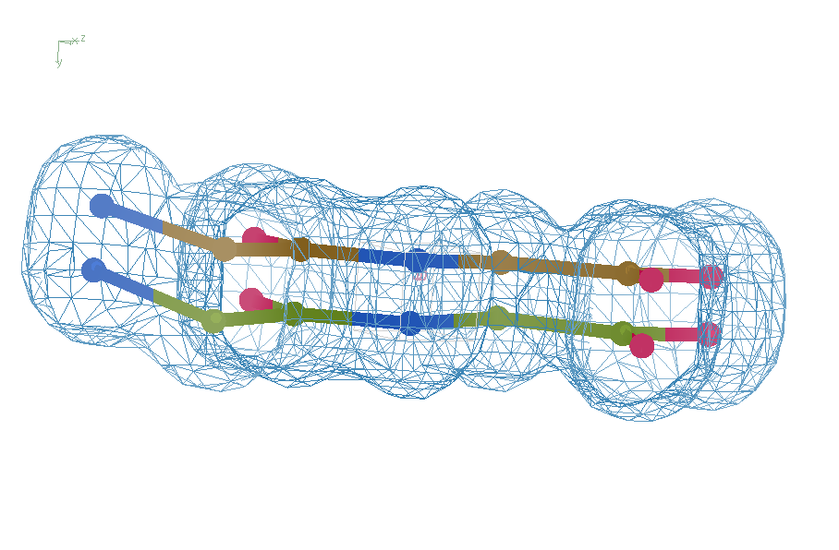
Right answer
R = 0.8%
rms bond = 0.0002
simplest possible chain tangle

Slide 19
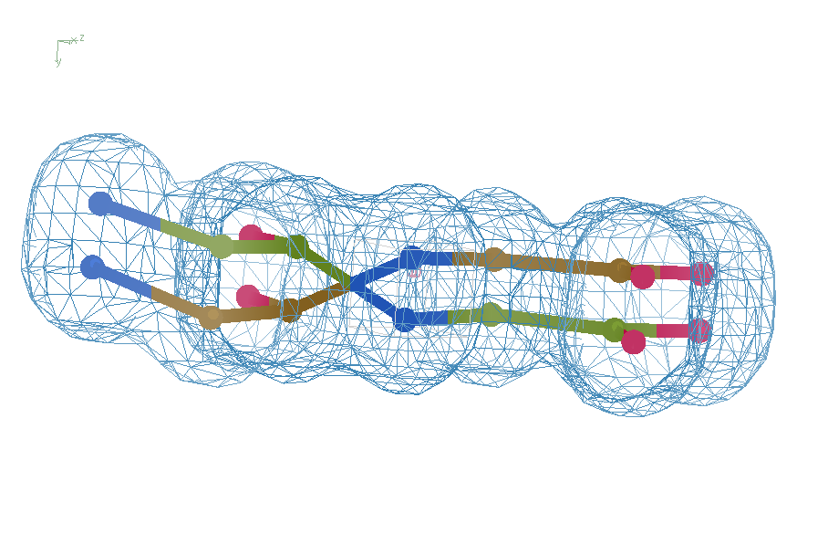
swap assignments
R = 0.8%
rms bond = 0.04

Slide 20
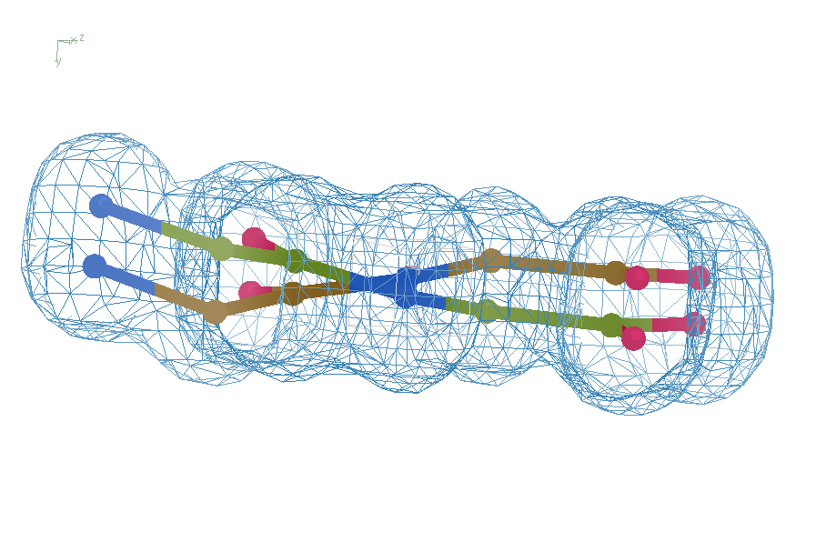
Refine – low x-ray weight
R = 14.3%
rms bond = 0.0002

Slide 21
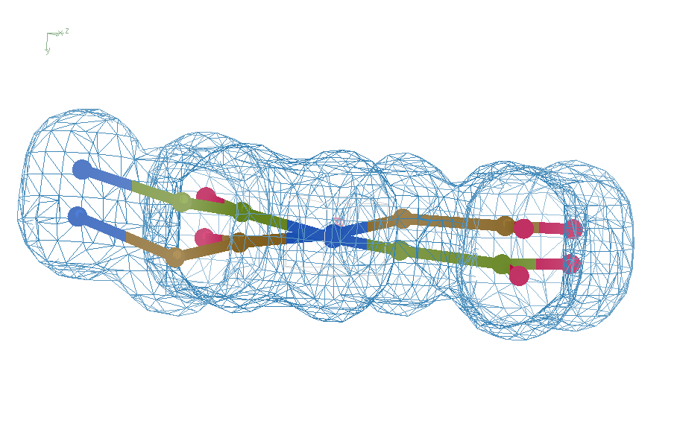
Refine – step 61
R = 6.8%
rms bond = 0.001

Slide 22
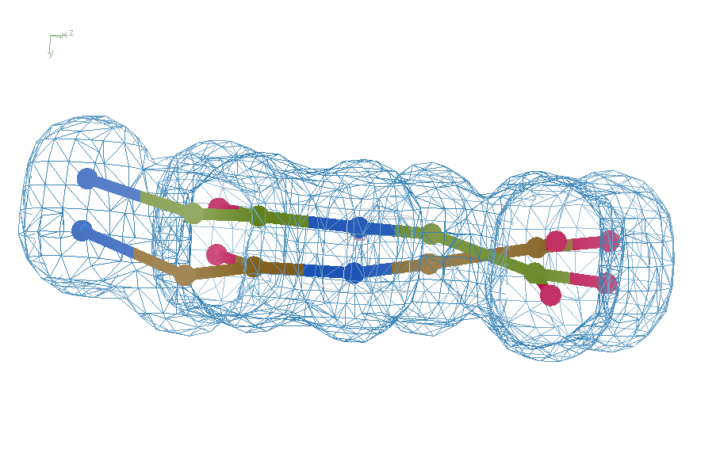
Refine – step 62
R = 5.7%
rms bond = 0.003

Slide 23
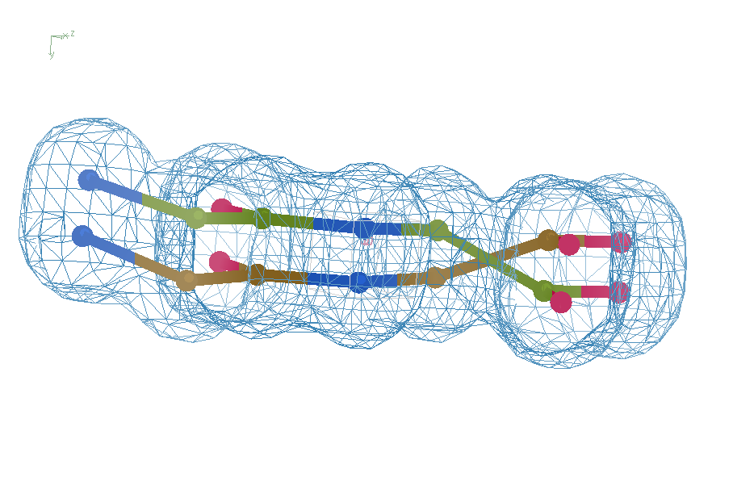
swap assignments
R = 1.2%
rms bond = 0.06
simplest possible chain tangle

Slide 24
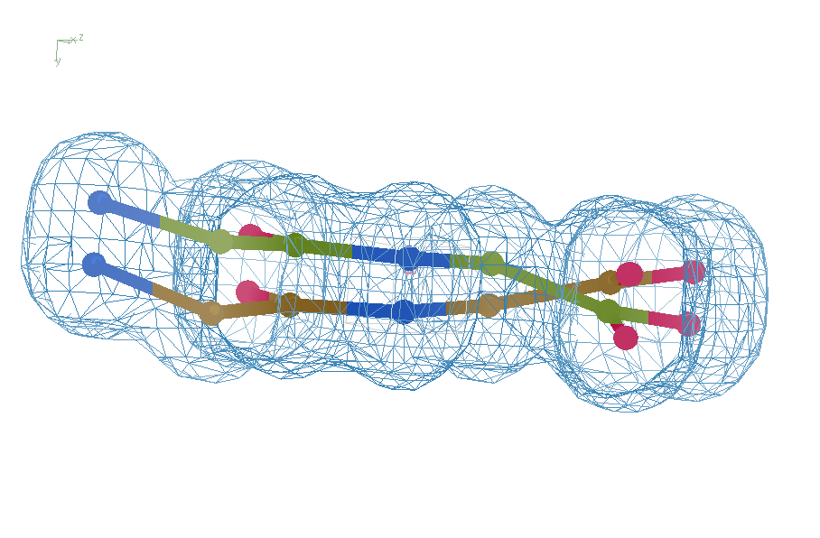
default refinement
R = 7.07%
rms bond = 0.001
simplest possible chain tangle

Slide 25
Right answer
R = 0.8%
rms bond = 0.0002
simplest possible chain tangle

Slide 26
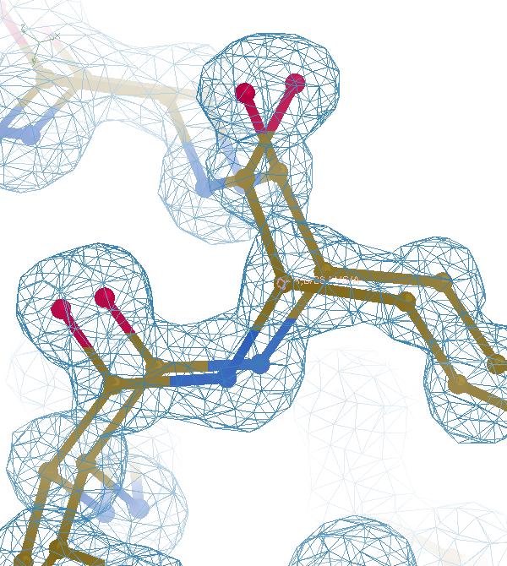

Slide 28
What if … ?
Exactly two conformations
50:50
Geometry/energy excellent
Solvent model-able
Can correct assignments be found?
If so, what would R_{free} be?
~4%

Slide 29
flipme.pdb
Refine
Score & Sort
control
Multiply together:
R_{work} Clashscore
VdW_Energy Cβ_{dev}
Worst & average Z-scores:
rama rotamer
sin(ω)
bonds angles planes
Chirals dihedrals
Flip_1
Flip_2
Flip_3 …
Flip_4 …

Slide 30
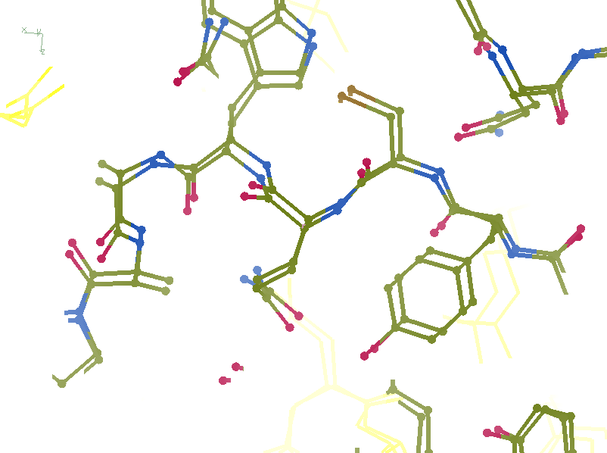
R_{work}: 0.1226
R_{free}: 0.1385
bond: 0.0319
Angle: 3.57
MoPro: 2.12
Clash: 6.52
Cβdev: 11
Rota: 2.78
Rama: 1.61

Slide 31
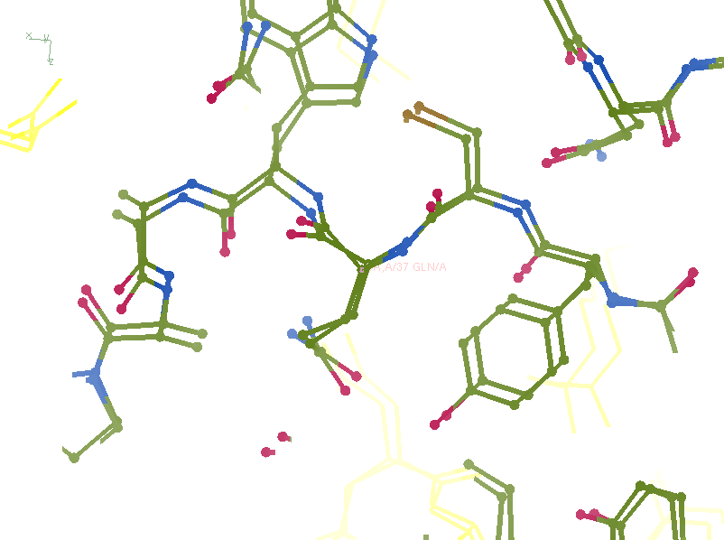
R_{work}: 0.1107
R_{free}: 0.1250
bond: 0.024
Angle: 4.11
MoPro: 0.89
Clash: 0.54
Cβdev: 1
Rota: 0.93
Rama: 0

Slide 32
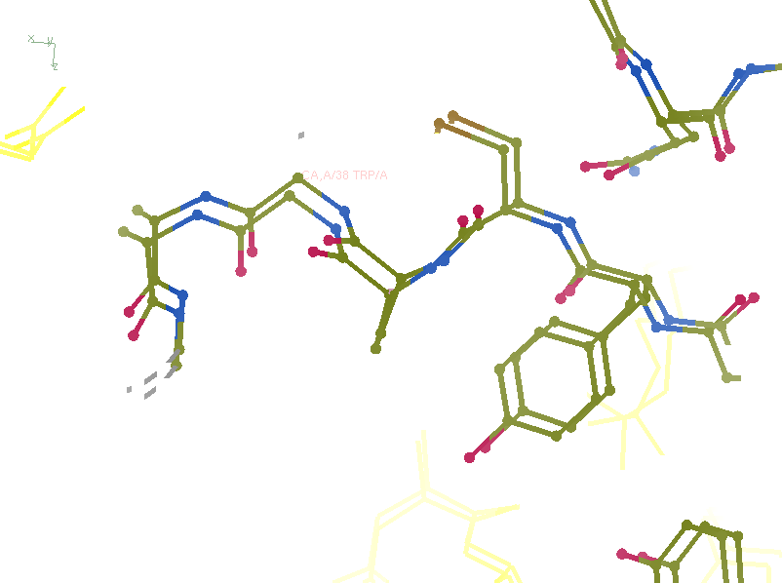
R_{work}: 0.0815
R_{free}: 0.0805
bond: 0.0101
Angle: 1.83
MoPro: 0.72
Clash: 0
Cβdev: 0
Rota: 0
Rama: 0

Slide 33
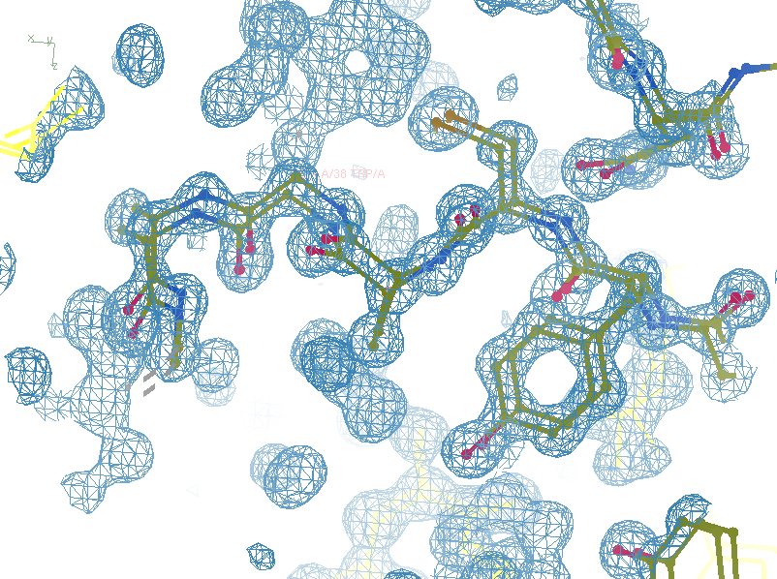
R_{work}: 0.0815
R_{free}: 0.0805
bond: 0.0101
Angle: 1.83
MoPro: 0.72
Clash: 0
Cβdev: 0
Rota: 0
Rama: 0

Slide 34
Take home:
Single-electron changes
are visible at 3.5 Å
(but only if R_{free} ~ 5%)

Slide 35
Systematic Errors! … and how to eliminate them
Resolution
Non-isomorphism
Radiation Damage
R_{work} vs R_{sigma}

Slide 36
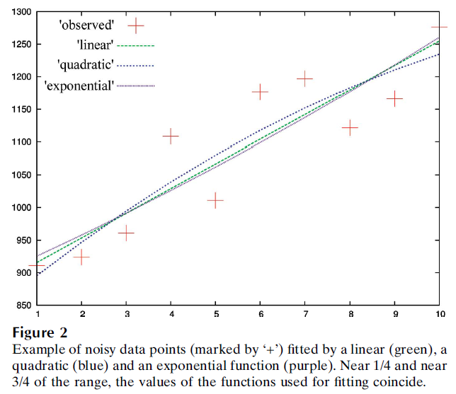
Zero-dose extrapolation
Diederichs Acta Cryst (2003, 2006, 2009 )

Slide 37
e⁻/Å²
300keV
25
5
2.7
2.2
2.2
1.7
0.6
0.6
0.3
0.03
0.01
e⁻/Å²
200keV
18
4
2
1.6
1.6
1.2
0.4
0.4
0.2
0.024
0.008
MGy reaction reference
~45 global damage Owen et al. (2006)
10/Å global damage Howells et al. (2009)
5 Se-Met Holton (2007)
4 Hg-S Ramagopal et al. (2004)
4 R-C-COOH Garman et al. (2015)
3 S-S Murray et al. (2002)
1 Br-RNA Olieric et al. (2007)
~1? Cl-C ???
0.5 Mn in PS II Yano et al. (2005)
0.06 putidaredoxin Corbett et al. (2007)
0.02 Fe in myoglobin Denisov et al. (2007)
Radiation Damage World Records
Holton (2009) J. Synchrotron Rad. 16 133-42

Slide 38
Beam Shape Dichotomy
Flat-top beam
Uniform dose in illuminated region
High background (poor resolution)
Gaussian beam
Softer edges
High dose contrast (distortion)
Best of both?
“dose flattening”

Slide 39
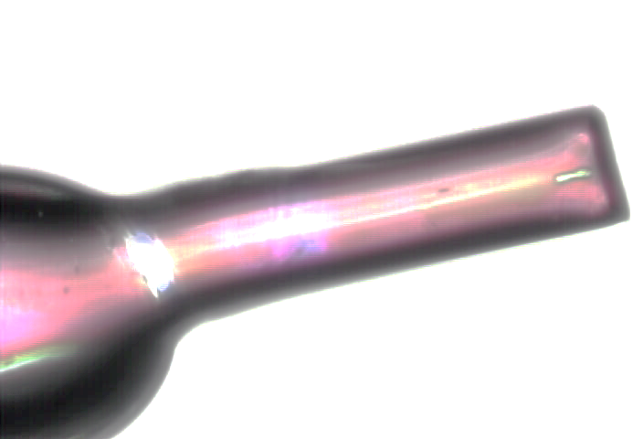

Slide 40
0 Gy

Slide 41
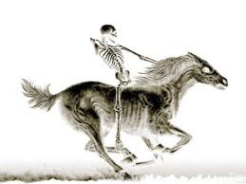
100 MGy

Slide 42
What is the dose?
50 MGy ?

Slide 43
Take home:
“dose contrast”
makes rad dam
Hard to correct

Slide 44
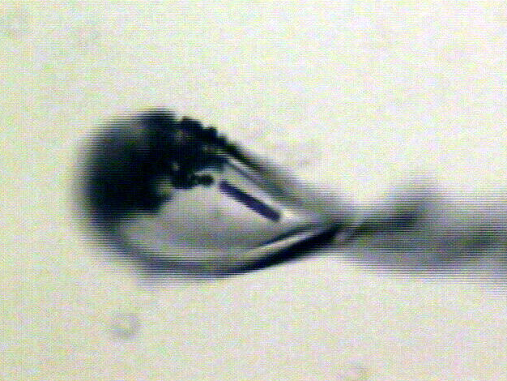
“rastering” to find the crystal
X-ray beam
ice
Membrane
protein crystal

Slide 45
“rastering” for flat dose

Slide 46
“rastering” for virtual beam

Slide 47
Old way: shoot and scoot
phi
0°
360°
position along crystal

Slide 48
Old way: shoot and scoot
phi
0°
360°
position along crystal

Slide 49
Old way: shoot and scoot
phi
0°
360°
position along crystal

Slide 50
Painting mode: raster as collection
phi
phi
0°
1080°
0°
360°
position along crystal

Slide 51
Painting mode: raster as collection
phi
phi
0°
1080°
0°
360°
position along crystal

Slide 52
Painting mode: raster as collection
phi
phi
0°
1080°
0°
360°
position along crystal

Slide 53
Painting mode: raster as collection
phi
phi
0°
1080°
0°
360°
position along crystal

Slide 54
How many images?
360° / 0.1° * ( 100 µm / 1 µm )²
⁼ 36x10⁶
28,000 photons/image

Slide 55
Lossless data rate
bits
s
= log₂(pixels) * flux * thick * 1.2x10⁻⁵
where: bits/s = entropy-limited compressed data rate
pixels = number of pixels in the detector
flux = photons/s onto the sample thick = sample thickness in microns
EG: 1e12 ph/s * 100um thick = 3.4 GBytes/s
The 1.2e-5 scattered photons per incident photon can be derived form the cross section of oxygen (0.2 cm^2/g) and the rough density of protein crystals (1.2 g/cm^3), and the fact that about half of all scattered photons hit a flat detector: 0.2*1.2*1e-4/2 = 1.155e-5 That is, flux*thickness*1.2e-5 is the rate of photon arrivals and log2(pixels) is the number of bits required to store the location of one photon in the entropy-limited regime. Lossless compression cannot be better than this because individual photon arrivals are genuinely random.

Slide 56
How to lose information
long exposures
>1 photon/image = order of arrivals
Wide phi slice
sum over angle
Large beams
sum over profile area
Pink/divergent beam
sum over lambda/angle
Background
non-crystal stuff
Systematics
Dose contrast, drift, read-out gap

Slide 57
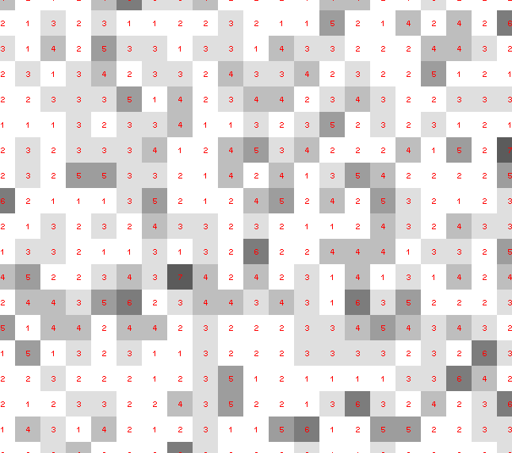
Dose slicing: is that a spot?

Slide 58
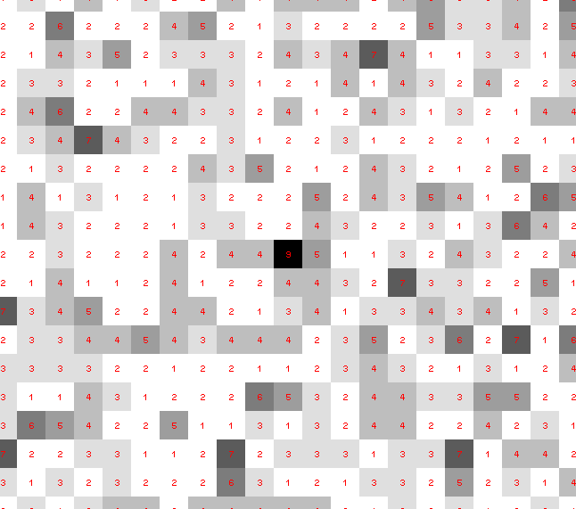
Dose slicing: is that a spot?

Slide 59
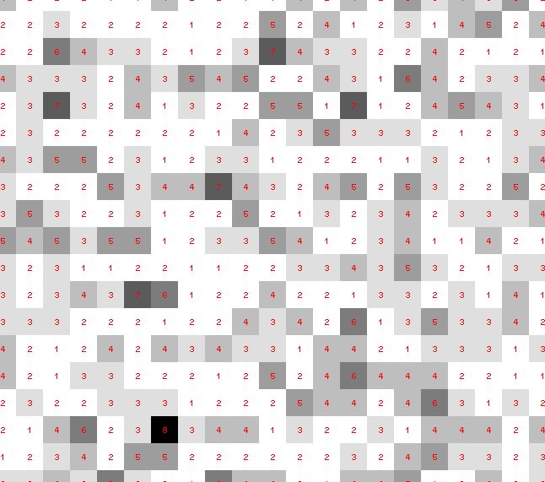
Dose slicing: is that a spot?

Slide 60
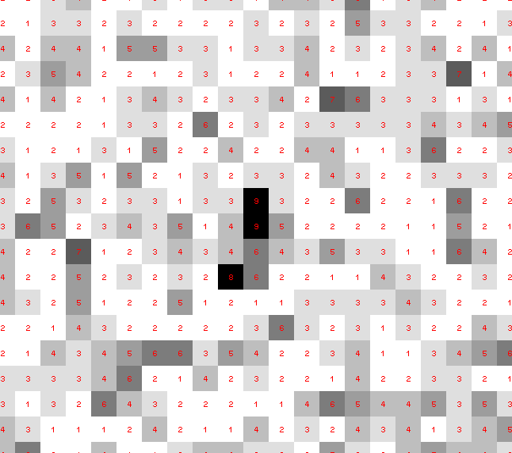
Dose slicing: is that a spot?

Slide 61
Dose slicing: is that a spot?

Slide 62
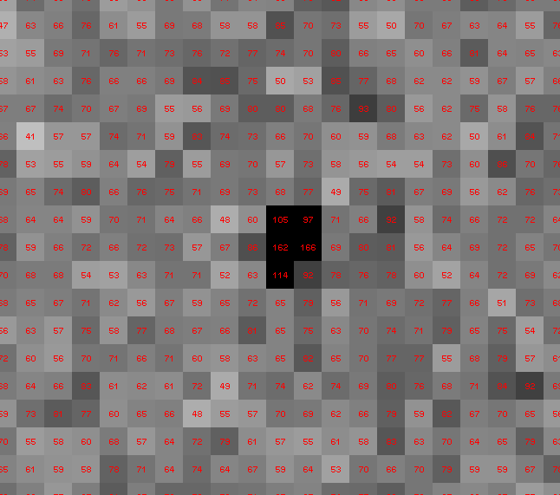
Dose slicing: is that a spot?

Slide 63
Single Photons Carry Information
About Radiation Damage
4
4
photons
photons
0
0
4
4
photons
photons
0
0
time
time

Slide 64
Take home:
rad dam is
correctable
(if we can use weak images)

Slide 65
Systematic Errors! … and how to eliminate them
Resolution
Non-isomorphism
Radiation Damage
R_{work} vs R_{sigma}

Slide 66
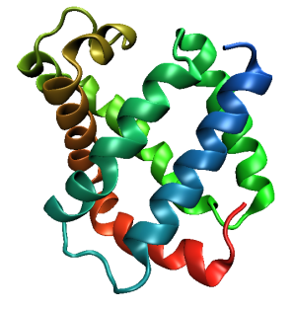
Same structure, different cell
0.5% cell change → 15%
Crick & Magdoff (1956) “theory method isomorphous replacement”, Acta Cryst. 9, 901-8.

Slide 67
Same structure, different cell
0.5% cell change → 15%
Crick & Magdoff (1956) “theory method isomorphous replacement”, Acta Cryst. 9, 901-8.

Slide 68
Non-isomorphism
is annoying
means you:
can’t merge
can’t
add
can’t
subtract
Caused by:
rad dam
humidity
temperature
Growth conditions
Cryo-cooling
Everything

Slide 69
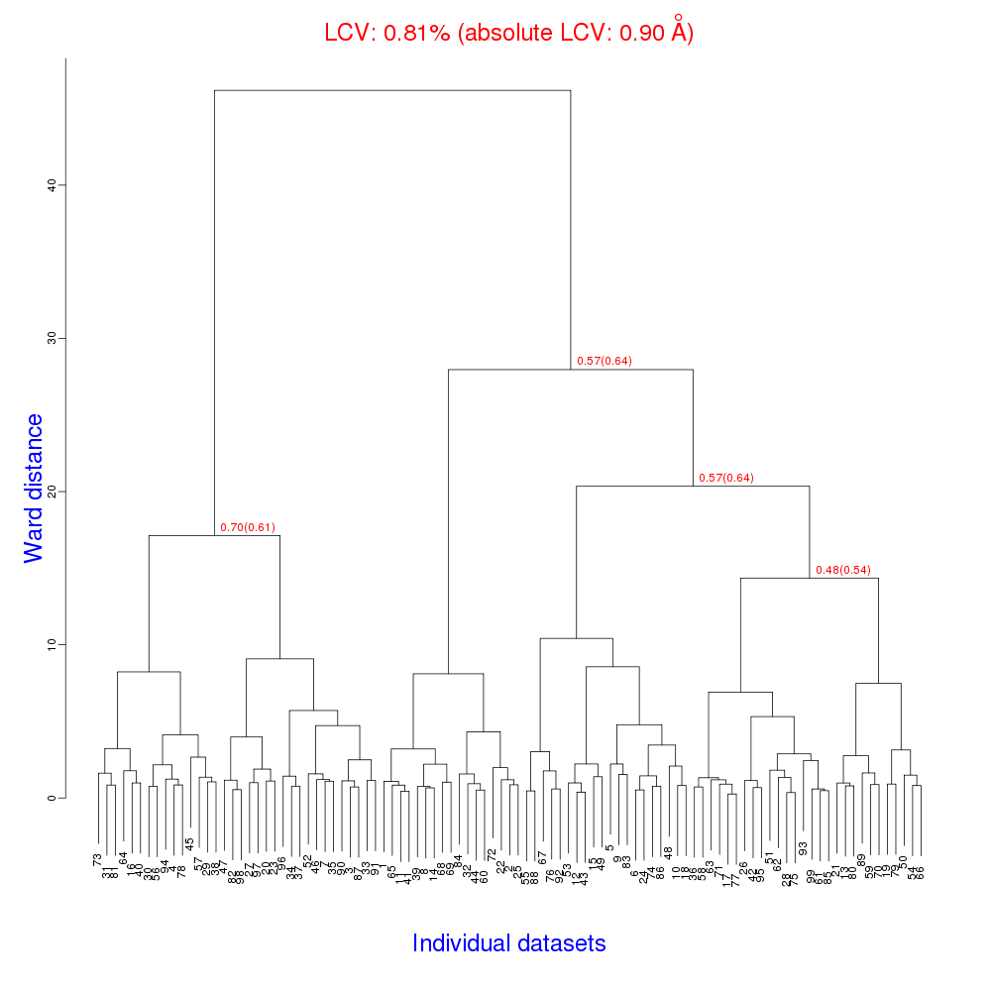
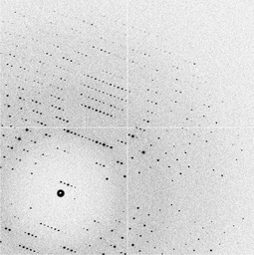
Cell clustering: 100 datasets
Reality:
Perfect isomorphism
(simulated data)
Holton, J. (2019). Acta Cryst. D 75, 113-122.

Slide 70
Uniform stretch
5% change → 0%

Slide 71
Uniform stretch
5% change → 0%

Slide 72
Hygrostatic gradients
high
water activity
low
jet
loop

Slide 73
Non-isomorphism in lysozyme
RMSD = 1.70 Å
Δcell = 0.7 %
R_{iso} = 44.5%
RMSD = 0.18 Å LSQ
RH: 84.2%
vs 71.9%
3aw6
3aw7

Slide 74
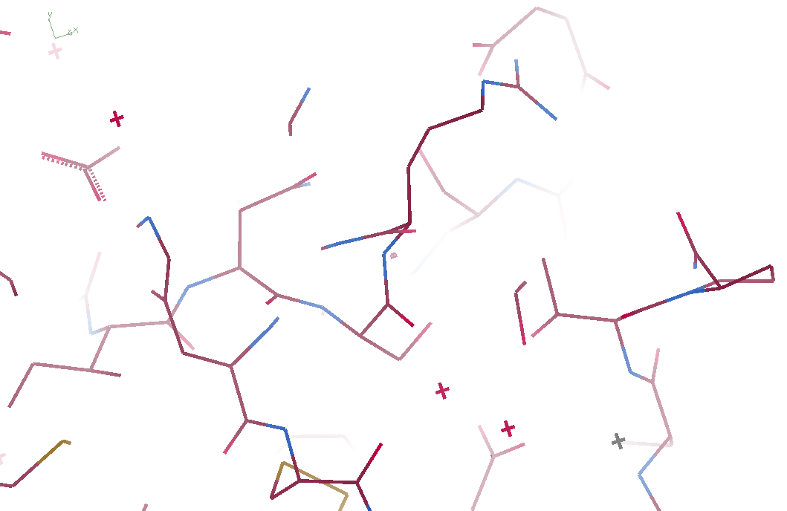
3aw6

Slide 75
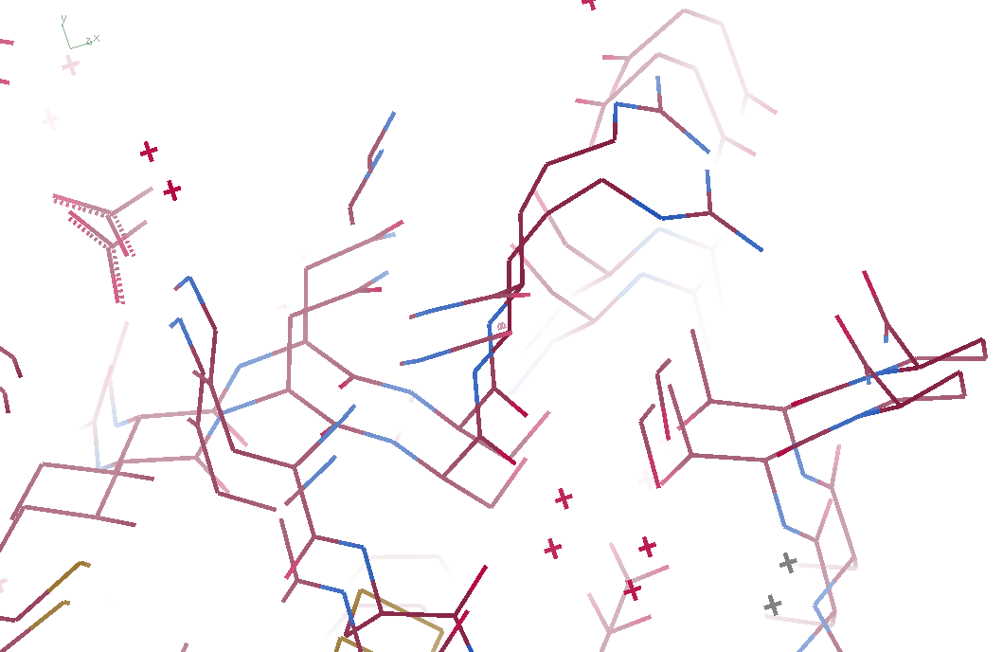
3aw6 3aw7

Slide 76
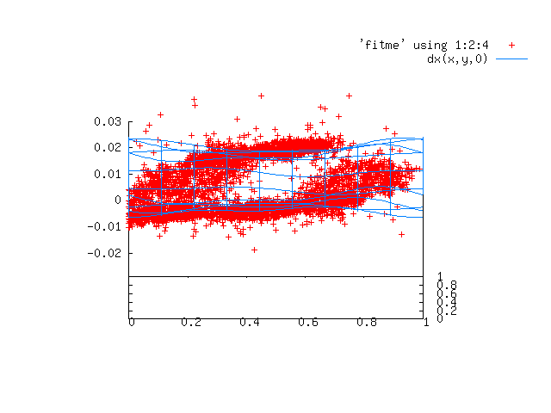
Periodic Spatial Distortion Vector Field

Slide 77
3aw6 3aw7

Slide 78
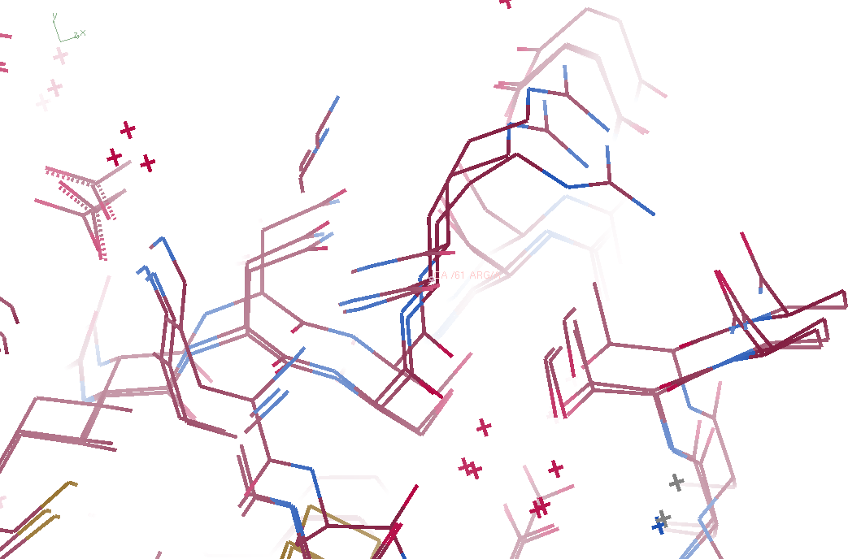
3aw6, 3aw7, “bent” 3aw6

Slide 79
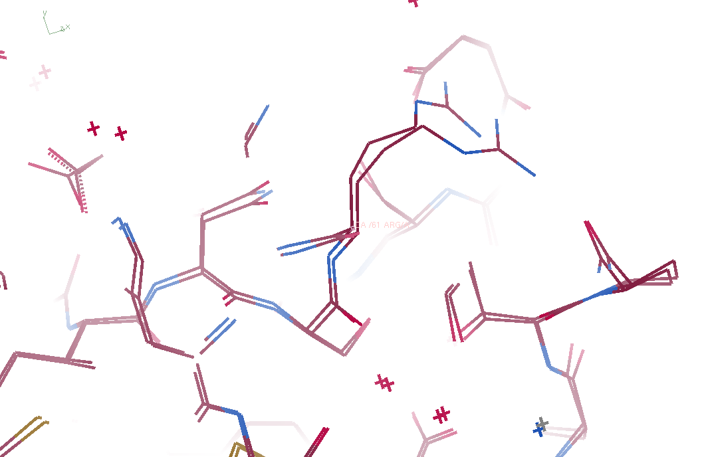
3aw7, “bent” 3aw6

Slide 80
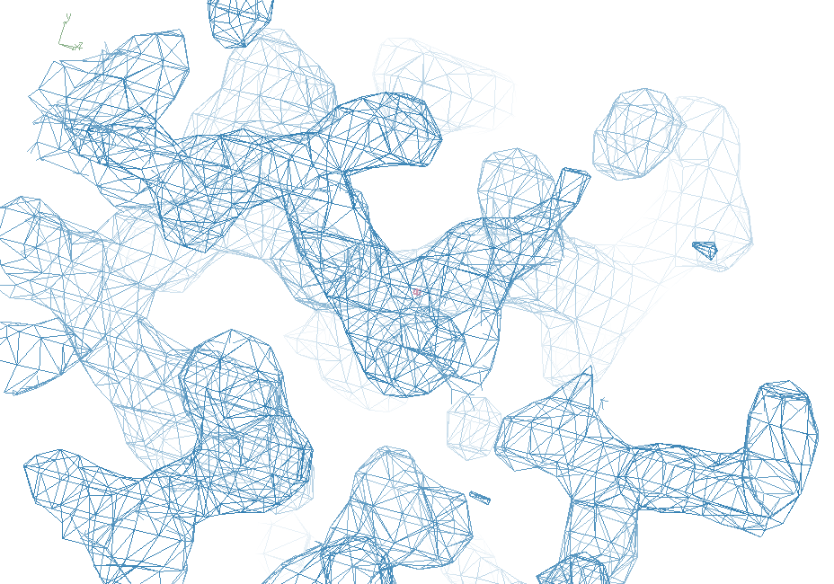
3aw7

Slide 81
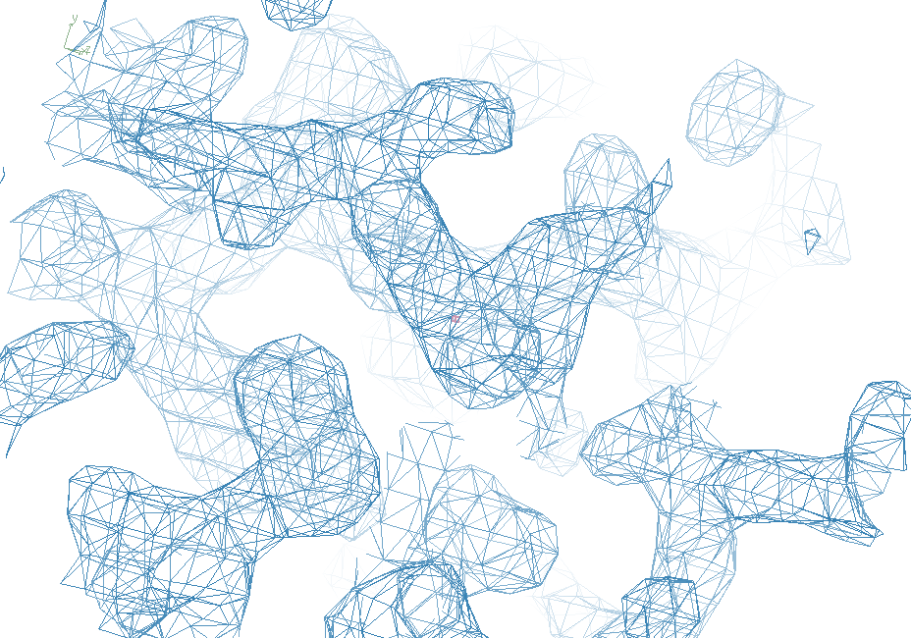
“bent” 3aw7

Slide 82
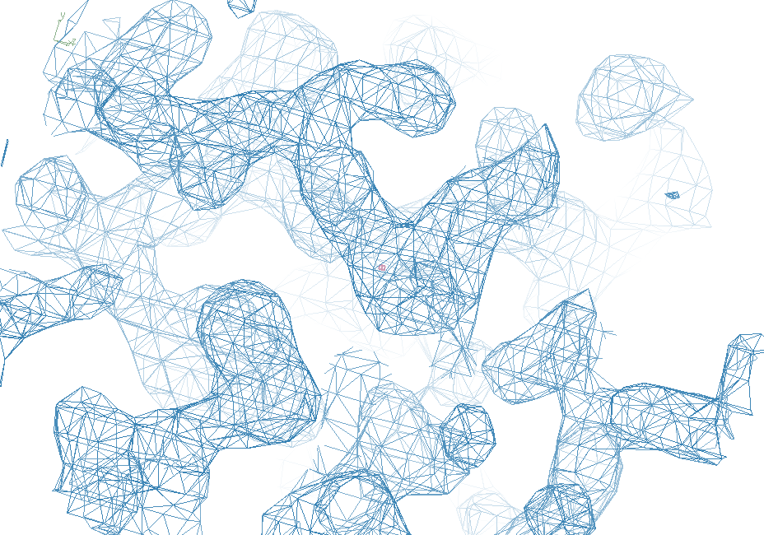
3aw6

Slide 83
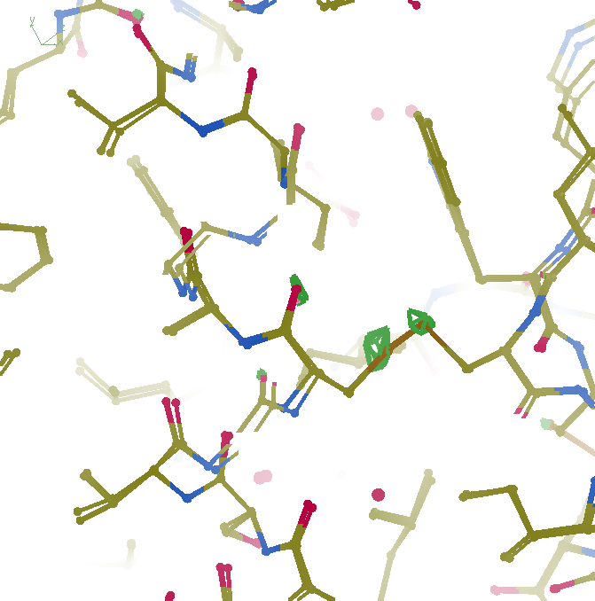
F_{obs}-F_{obs} difference
3σ 1.8 Å
“unbent”

Slide 84
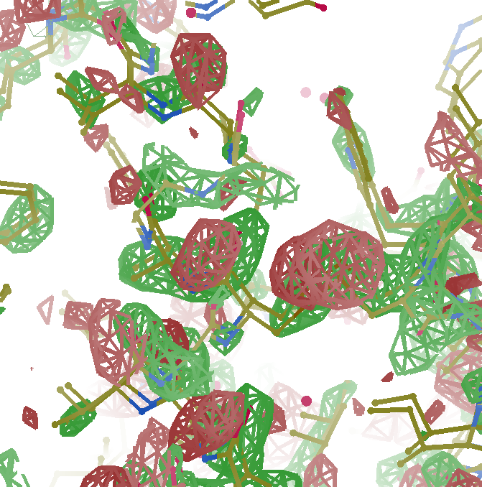
F_{obs}-F_{obs} difference
3σ 1.8 Å
old way

Slide 85
Take home:
Non-isomorphism
is correctable
(in real space)

Slide 86
Systematic Errors! … and how to eliminate them
Resolution
Non-isomorphism
Radiation Damage
R_{work} vs R_{sigma}

Slide 87
Optimum resolution cutoff is:
Too optimistic: add nothing but noise
Too pessimistic: series-termination error
Happy medium?
Simulate:
Random atoms, compute F²
Add Gaussian noise, RMS = 1
Convert back to F (French-Wilson Truncate)
Subtract “right” map, RMS difference

Slide 88
Optimal resolution cutoff
Error in map (rms e⁻)
Resolution cutoff (Å)

Slide 89
Optimal resolution cutoff
Correlation Coefficient
Resolution cutoff (Å)

Slide 90
Optimal resolution cutoff
Correlation Coefficient
Resolution cutoff (Å)

Slide 91
Wilson Plot
2
log( intensity )
8
2.2 1.6 1.3 1.1 1.0 0.9 0.85 0.8 0.75 0.7
resolution (Å)

Slide 92
Optimum resolution cutoff is:
0.0 Å

Slide 93
But my reviewer says…
R_{merge} in high-resolution bin is >100% !
Answer: this is expected

Slide 94
Expected R_{merge} as I_{obs} → 0

Slide 95
Averaging Gaussian error
Average value
Number of samples averaged

Slide 96
Averaging Gauss/Gauss error
Average value
Number of samples averaged

Slide 97
R_{merge} at the resolution limit in PDB
Average outer-shell R_{merge}
Year

Slide 98
Summary
http://bl831.als.lbl.gov/~jamesh/
powerpoint/UCLA_summit_2023.pptx
Low counts/image is the future
Non-isomorphism is correctable
Untangling improves models
Hydrogens at 3.5 Å

