Slide 1
Acknowledgements
http://bl831.als.lbl.gov/~jamesh/powerpoint/UCLA_summit_2023.pptx
Robert Stroud James Fraser Nevan Krogan
Paul Adams John Tainer Greg Hura Nick Sauter
Aina Cohen Art Lyubimov Jeney Wierman
UCSF LBNL SLAC
ALS 8.3.1: TomAlberTron
NIH NIGMS R01 GM124149 (Holton)
NIH NIAID P50 AI150476 (Krogan)
NIH NIGMS P30 GM124169 (Adams)
DOE-BER IDAT (Hura)
NIH NIGMS P30 GM133894 (Hodgson)
The Advanced Light Source is supported by the Director, Office of Science, Office of Basic Energy Sciences, Materials Sciences Division, of the US Department of Energy under contract No. DE-AC02-05CH11231 at Lawrence Berkeley National Laboratory.

Slide 2
Systematic Errors! … and how to eliminate them
Resolution
Non-isomorphism
Radiation Damage
R_{work} vs R_{sigma}

Slide 3
R-factor Gap small vs macro molecules
Publication criterion for chemical crystallography:
R1 < 2*R_{sigma}
R1 = F_{o} vs F_{c} for I/σ(I) > 3
R_{sigma} = <σ(I)>/<I>

Slide 4
R-factor Gap
Publication criterion ? :
R_{work} < 2*R_{merge}
There are no PDB entries
that pass this test!

Slide 5
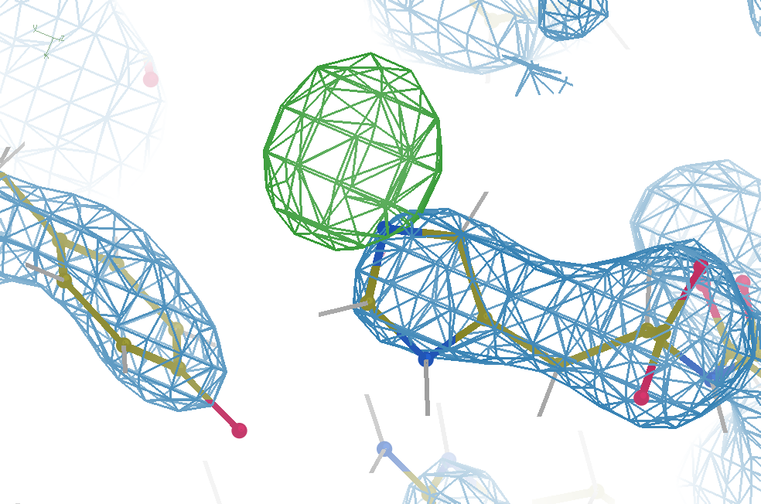
Hydrogen: visible at 3.5 Å resolution!
R_{work} = 0.04
R_{free} = 0.05
6σ = 1 e⁻
Simulation:
Realistic noise
“perfect” model

Slide 6
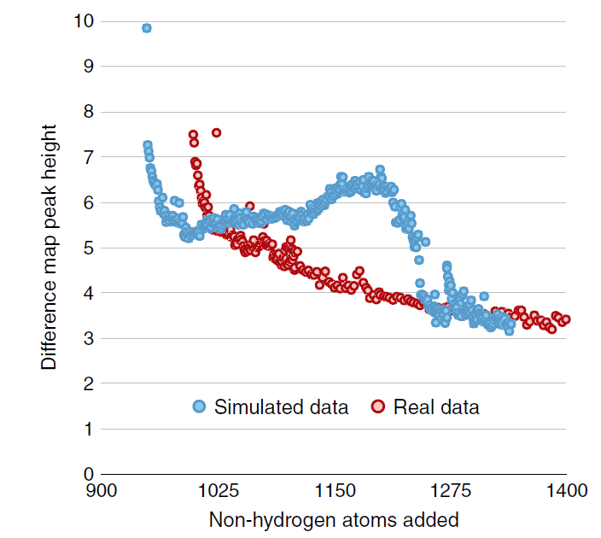
Model building: real vs sim data
Fo-Fc difference map peak height
Holton et al. (2014) "The R-factor gap", FEBS J. 281, 4046-4060.

Slide 7
Model building: real vs sim data
Holton et al. (2014) "The R-factor gap", FEBS J. 281, 4046-4060.

Slide 8
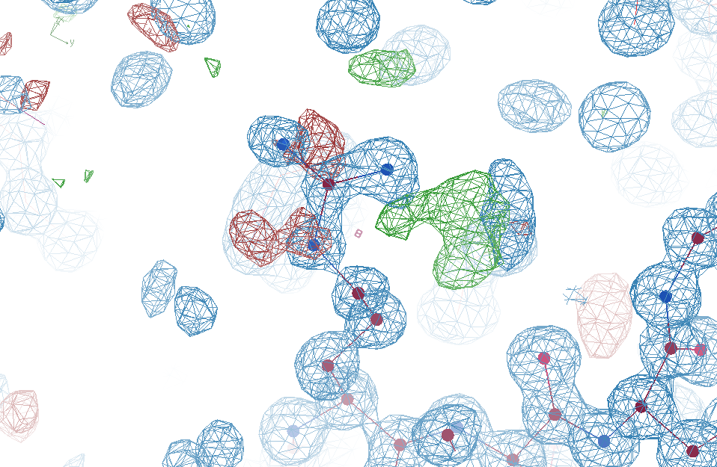
R_{work}: 0.0823
R_{free}: 0.1106
reso: 1.0 Å
Real Data
6σ
1.2 σ

Slide 9
R_{work}: 0.0823
R_{free}: 0.1106
0.2 σ
reso: 1.0 Å

Slide 10
R_{work}: 0.0823
R_{free}: 0.1106
reso: 1.0 Å
6σ
1.2 σ

Slide 11
R_{work}: 0.0823
R_{free}: 0.1106
bond: 0.014 Å
angle: 1.92°
MoPro: 1.15
Clash: 0.49
Cβdev: 20
Rota: 1.7%
Rama: 0.03%
reso: 1.0 Å
6σ

Slide 12
Why does ensemble refinement suck? (3 parameters/observation and R_{work} still high!)

Slide 13
Fitting data
structure factor (F)
spot index (h)

Slide 14
Fitting data
structure factor (F)
spot index (h)

Slide 15
Fitting data
structure factor (F)
spot index (h)

Slide 16
Over-Fitting data
structure factor (F)
spot index (h)

Slide 17
R_{work}: 0.0823
R_{free}: 0.1106
bond: 0.014 Å
angle: 1.92°
3 parameters
per observation!
MoPro: 1.15
Clash: 0.49
Cβdev: 20
Rota: 1.7%
Rama: 0.03%
reso: 1.0 Å
6σ

Slide 18
Why does ensemble refinement suck? (3 parameters/observation and R_{work} still high!)
The chains are “tangled”

Slide 19
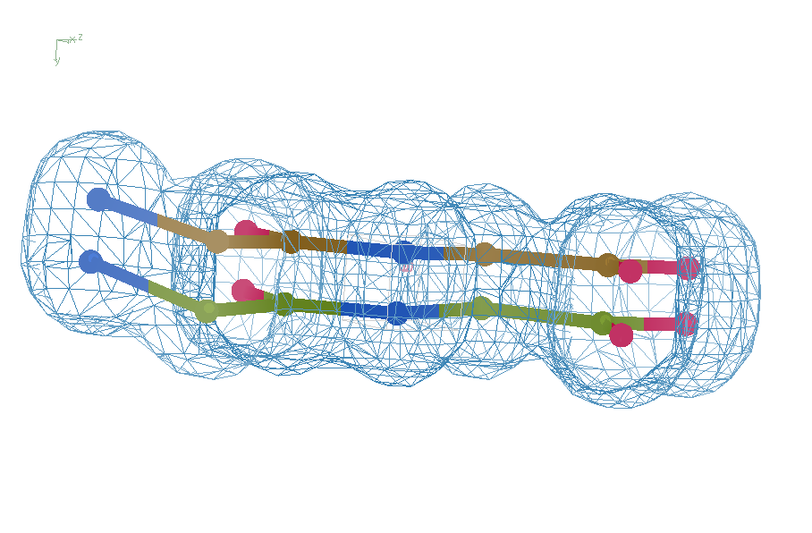
Right answer
R = 0.8%
rms bond = 0.0002
simplest possible chain tangle

Slide 20
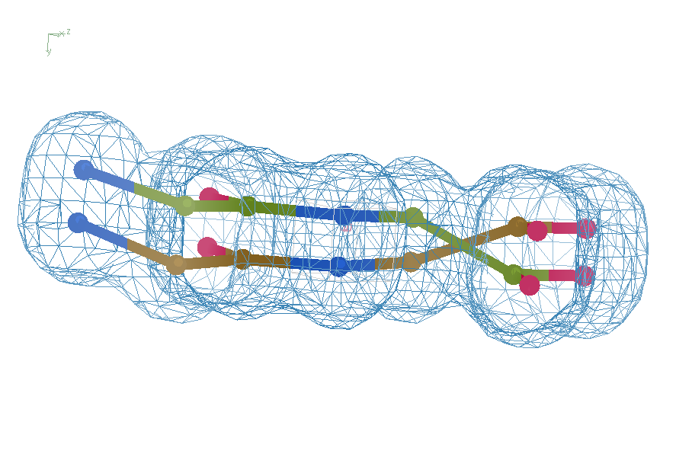
swap assignments
R = 1.2%
rms bond = 0.06
simplest possible chain tangle

Slide 21
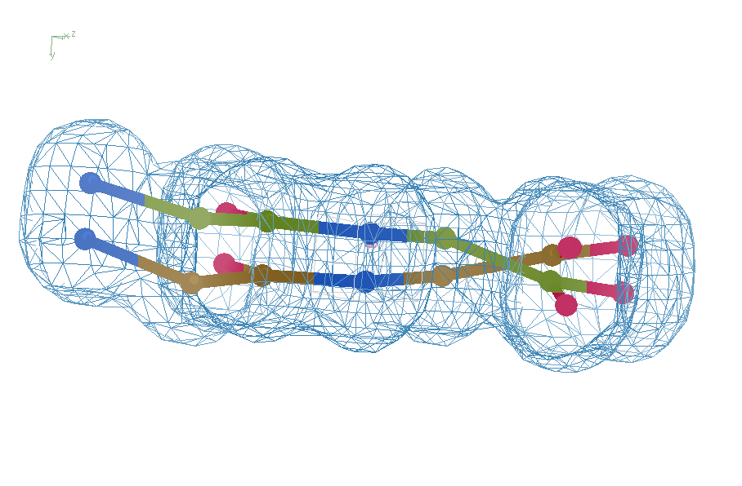
default refinement
R = 7.07%
rms bond = 0.001
simplest possible chain tangle

Slide 22
Right answer
R = 0.8%
rms bond = 0.0002
simplest possible chain tangle

Slide 23
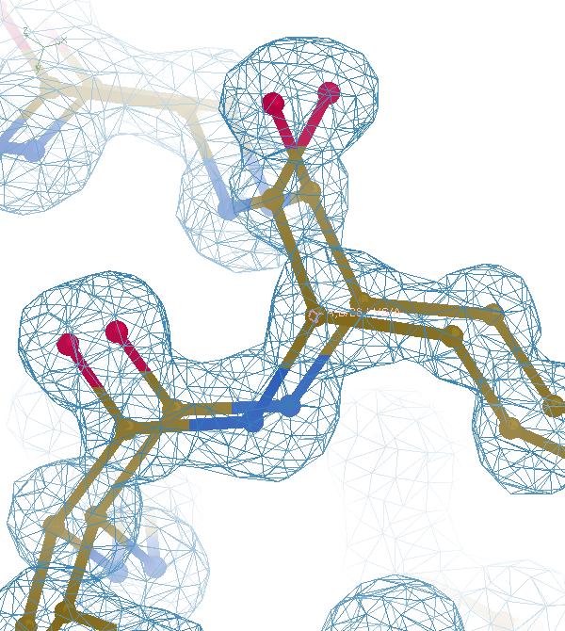

Slide 25
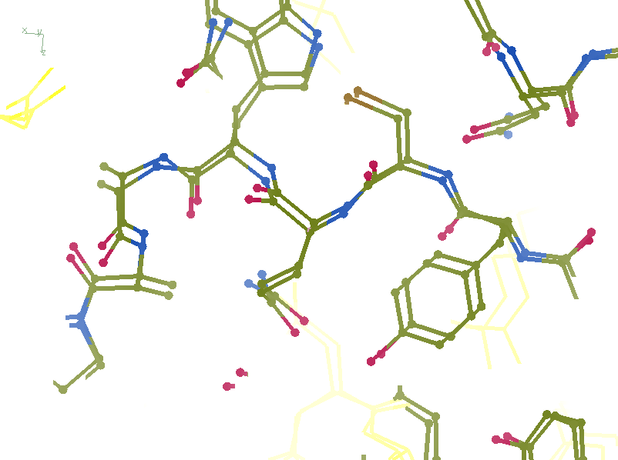
R_{work}: 0.1226
R_{free}: 0.1385
bond: 0.0319
Angle: 3.57
MoPro: 2.12
Clash: 6.52
Cβdev: 11
Rota: 2.78
Rama: 1.61

Slide 26
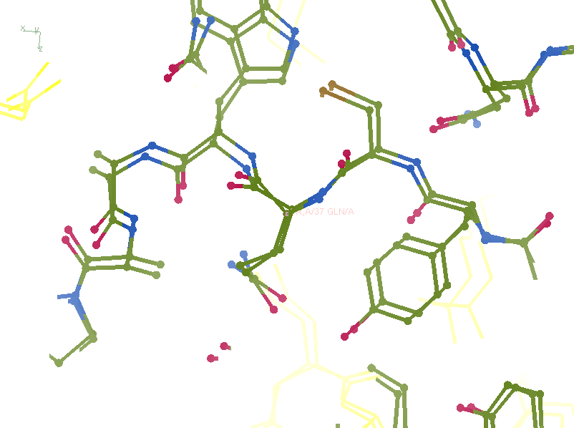
R_{work}: 0.1107
R_{free}: 0.1250
bond: 0.024
Angle: 4.11
MoPro: 0.89
Clash: 0.54
Cβdev: 1
Rota: 0.93
Rama: 0

Slide 27
One crossover
is detectable
R = 7.07%
rms bond = 0.001

Slide 28
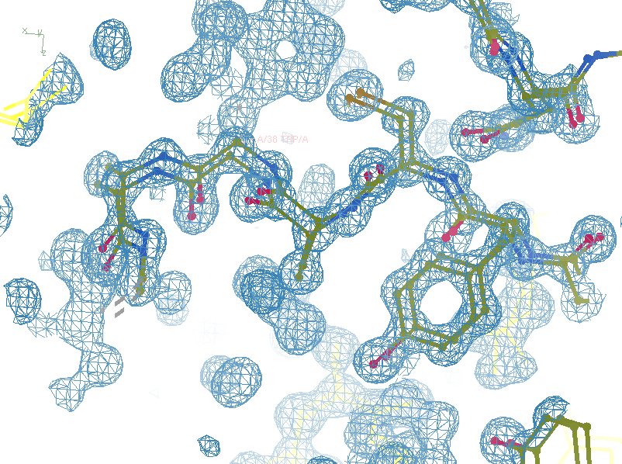
R_{work}: 0.0815
R_{free}: 0.0805
bond: 0.0101
Angle: 1.83
MoPro: 0.72
Clash: 0
Cβdev: 0
Rota: 0
Rama: 0

Slide 29
Take home:
Single-electron changes
are visible at 3.5 Å
(but only if R_{free} ~ 5%)
Only possible with “true” ensemble?

Slide 30
Systematic Errors! … and how to eliminate them
Resolution
Non-isomorphism
Radiation Damage
R_{work} vs R_{sigma}

Slide 31
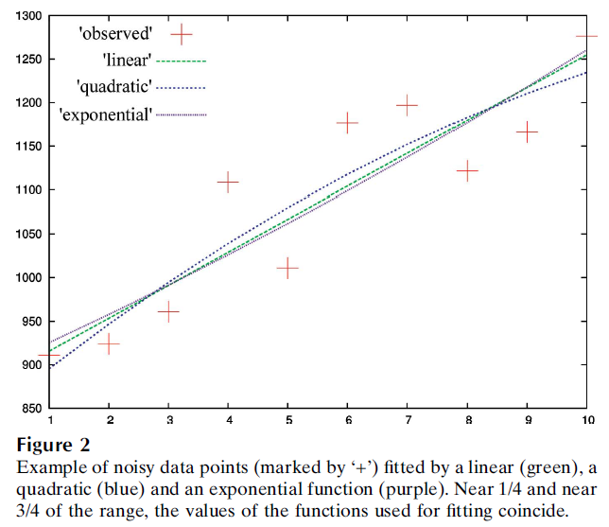
Zero-dose extrapolation
Diederichs Acta Cryst (2003, 2006, 2009 )

Slide 32
e⁻/Å²
300keV
25
5
2.7
2.2
2.2
1.7
0.6
0.6
0.3
0.03
0.01
e⁻/Å²
200keV
18
4
2
1.6
1.6
1.2
0.4
0.4
0.2
0.024
0.008
MGy reaction reference
~45 global damage Owen et al. (2006)
10/Å global damage Howells et al. (2009)
5 Se-Met Holton (2007)
4 Hg-S Ramagopal et al. (2004)
4 R-C-COOH Garman et al. (2015)
3 S-S Murray et al. (2002)
1 Br-RNA Olieric et al. (2007)
~1? Cl-C ???
0.5 Mn in PS II Yano et al. (2005)
0.06 putidaredoxin Corbett et al. (2007)
0.02 Fe in myoglobin Denisov et al. (2007)
Radiation Damage World Records
https://bl831.als.lbl.gov/~jamesh/dose2dose.html

Slide 33
Beam Shape Dichotomy
Flat-top beam
Uniform dose in illuminated region
High background (poor resolution)
Gaussian beam
Softer edges
High dose contrast (distortion)
Best of both?
“dose flattening”

Slide 34
How to lose information
long exposures
>1 photon/image = order of arrivals
Wide phi slice
sum over angle
Large beams
sum over profile area
Pink/divergent beam
sum over lambda/angle
Background
non-crystal stuff
Systematics
Dose contrast, drift, read-out gap

Slide 35
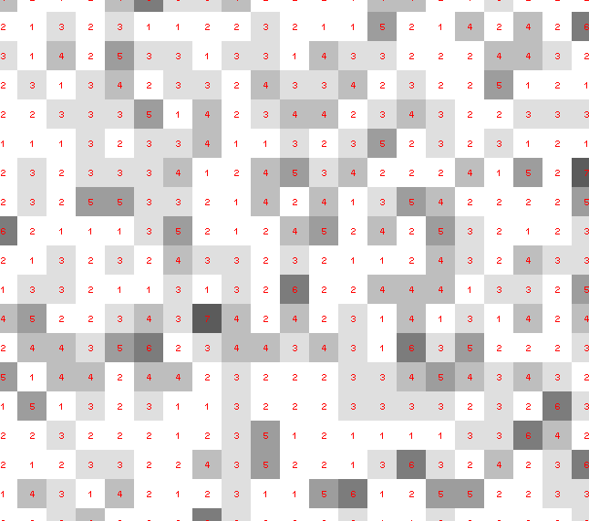
Dose slicing: is that a spot?

Slide 36
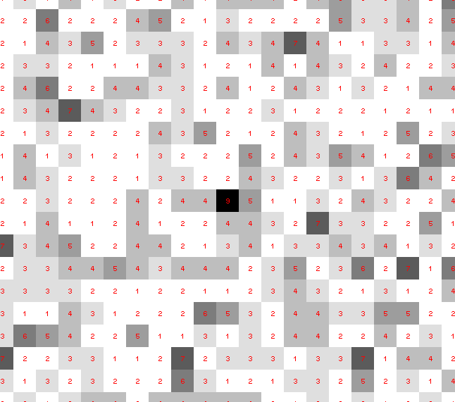
Dose slicing: is that a spot?

Slide 37
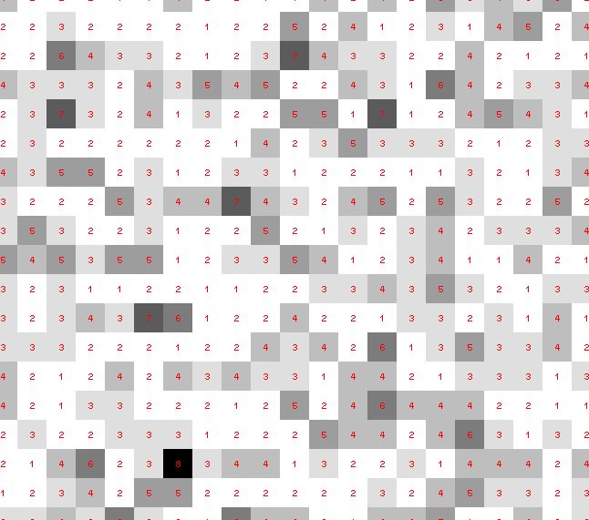
Dose slicing: is that a spot?

Slide 38
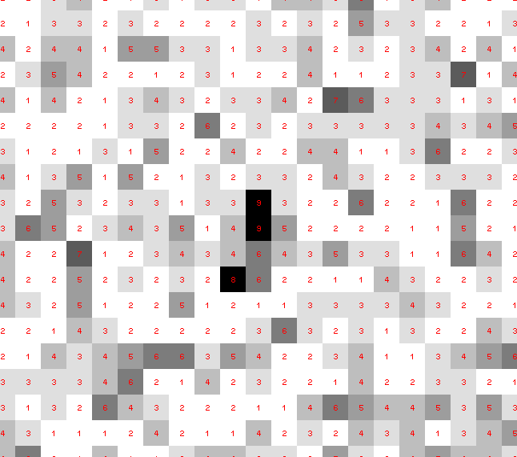
Dose slicing: is that a spot?

Slide 39
Dose slicing: is that a spot?

Slide 40
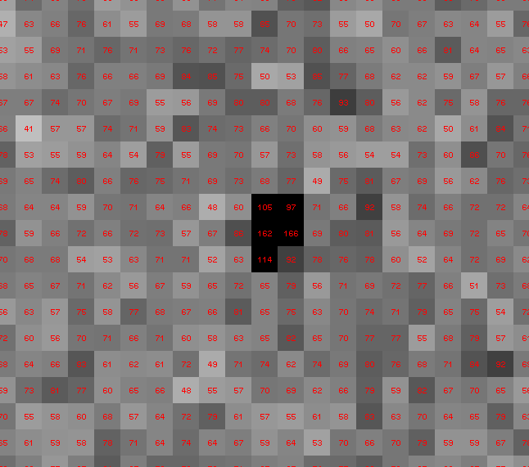
Dose slicing: is that a spot?
Order-of-arrival information has been lost!

Slide 41
Single Counts Carry Information
About Radiation Damage
4
4
counts
counts
0
0
4
4
counts
counts
0
0
time
time

Slide 42
Take home:
rad dam is
correctable
(if we can use weak images)

Slide 43
Systematic Errors! … and how to eliminate them
Resolution
Non-isomorphism
Radiation Damage
R_{work} vs R_{sigma}

Slide 44
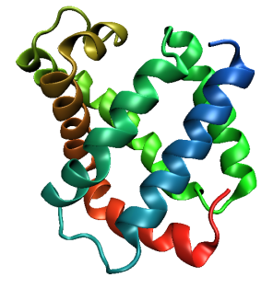
Same structure, different cell
0.5% cell change → 15%
Crick & Magdoff (1956) “theory method isomorphous replacement”, Acta Cryst. 9, 901-8.

Slide 45
Same structure, different cell
0.5% cell change → 15%
Crick & Magdoff (1956) “theory method isomorphous replacement”, Acta Cryst. 9, 901-8.

Slide 46
Non-isomorphism
is annoying
means you:
can’t merge
can’t
add
can’t
subtract
Caused by:
rad dam
humidity
temperature
Growth conditions
Cryo-cooling
Everything

Slide 47
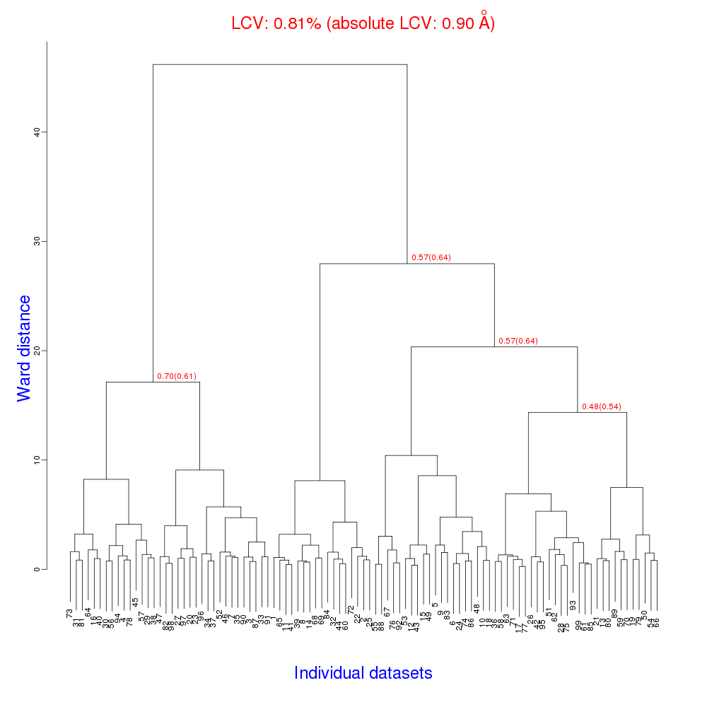
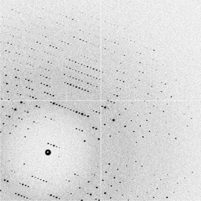
Cell clustering: 100 datasets
Reality:
Perfect isomorphism
(simulated data)
Holton, J. (2019). Acta Cryst. D 75, 113-122.

Slide 48
Uniform stretch
5% change → 0%

Slide 49
Uniform stretch
5% change → 0%

Slide 50
Hygrostatic gradients
high
water activity
low
jet
loop

Slide 51
Non-isomorphism in lysozyme
RMSD = 1.70 Å
Δcell = 0.7 %
R_{iso} = 44.5%
RMSD = 0.18 Å LSQ
RH: 84.2%
vs 71.9%
3aw6
3aw7

Slide 52
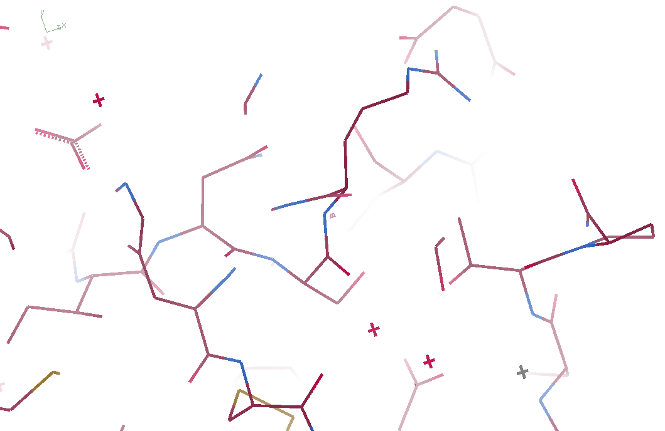
3aw6

Slide 53
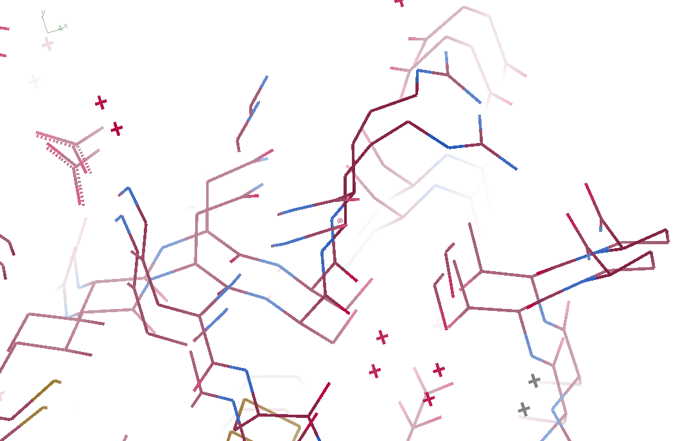
3aw6 3aw7

Slide 54
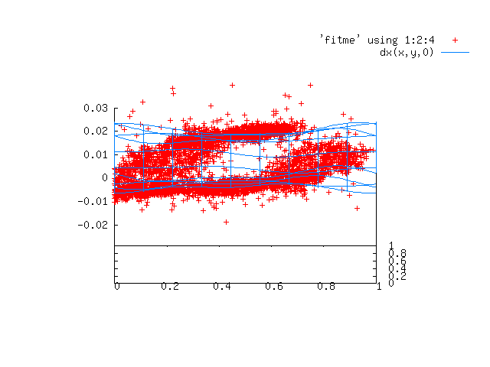
Periodic Spatial Distortion Vector Field

Slide 55
3aw6 3aw7

Slide 56
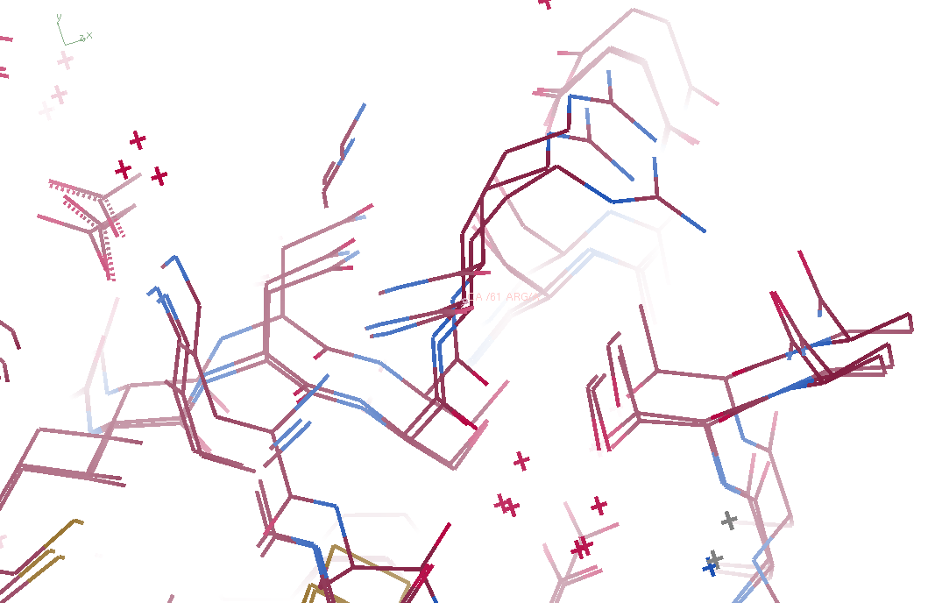
3aw6, 3aw7, “bent” 3aw6

Slide 57
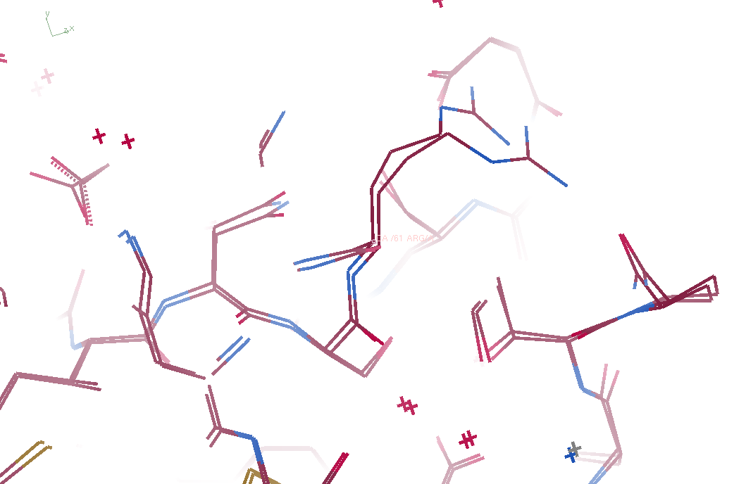
3aw7, “bent” 3aw6

Slide 58
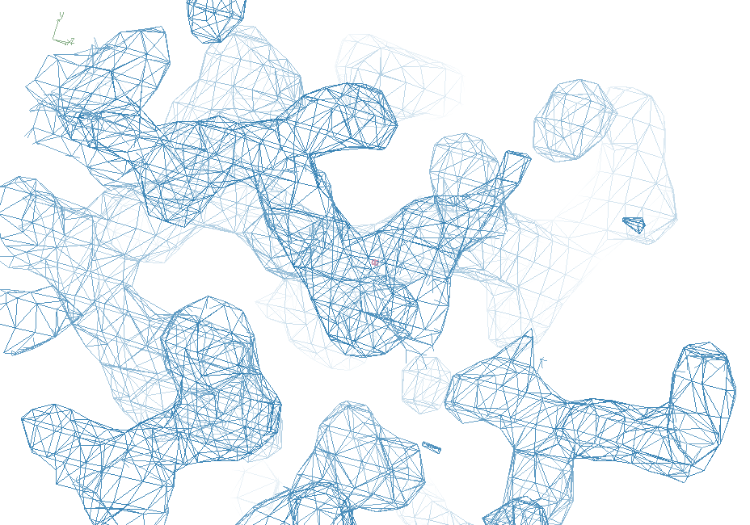
3aw7

Slide 59
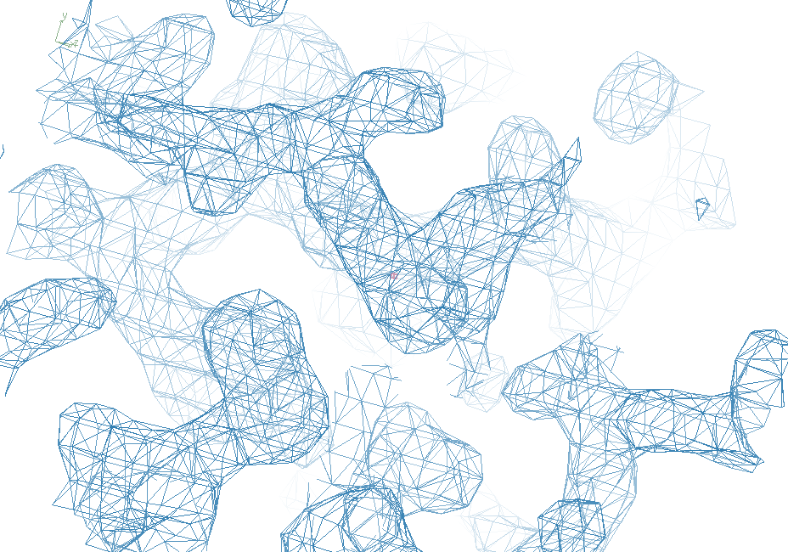
“bent” 3aw7

Slide 60
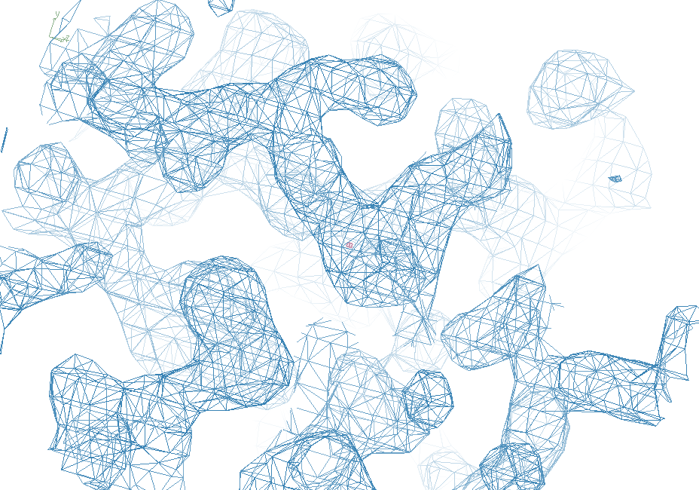
3aw6

Slide 61
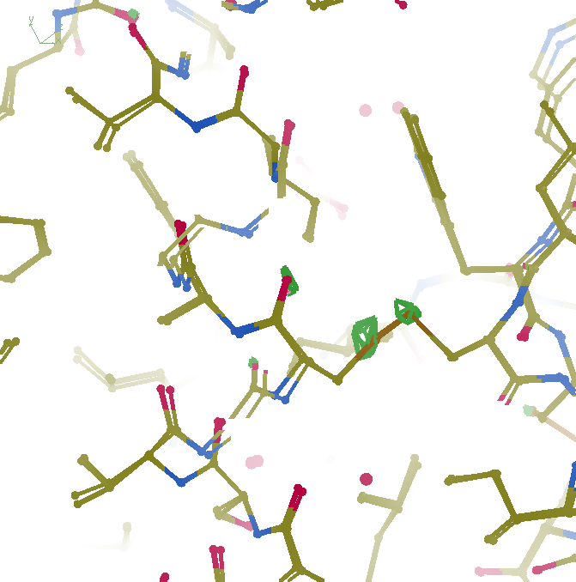
F_{obs}-F_{obs} difference
3σ 1.8 Å
“unbent”

Slide 62
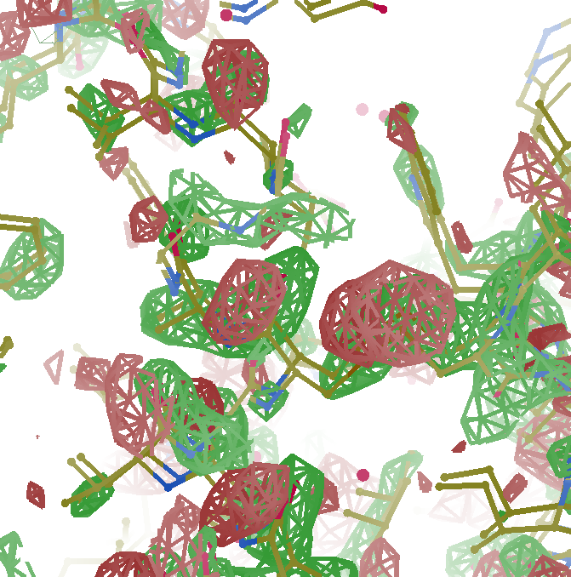
F_{obs}-F_{obs} difference
3σ 1.8 Å
old way

Slide 63
Take home:
Non-isomorphism
is correctable
(in real space)

Slide 64
Systematic Errors! … and how to eliminate them
Resolution
Non-isomorphism
Radiation Damage
R_{work} vs R_{sigma}

Slide 65
Optimum resolution cutoff is:
Too optimistic: add nothing but noise
Too pessimistic: series-termination error
Happy medium?
Simulate:
Random atoms, compute F²
Add Gaussian noise, RMS = 1
Convert back to F (French-Wilson Truncate)
Subtract “right” map, RMS difference

Slide 66
Optimal resolution cutoff
Error in map (rms e⁻)
Resolution cutoff (Å)

Slide 67
Optimal resolution cutoff
Correlation Coefficient
Resolution cutoff (Å)

Slide 68
Optimal resolution cutoff
Correlation Coefficient
Resolution cutoff (Å)

Slide 69
Wilson Plot
2
log( intensity )
8
2.2 1.6 1.3 1.1 1.0 0.9 0.85 0.8 0.75 0.7
resolution (Å)

Slide 70
Optimum resolution cutoff is:
0.0 Å

Slide 71
But my reviewer says…
R_{merge} in high-resolution bin is >100% !
Answer: this is expected

Slide 72
Expected R_{merge} as I_{obs} → 0

Slide 73
Averaging Gaussian error
Average value
Number of samples averaged

Slide 74
Averaging Gauss/Gauss error
Average value
Number of samples averaged

Slide 75
R_{merge} at the resolution limit in PDB
Average outer-shell R_{merge}
Year

Slide 76
Summary
http://bl831.als.lbl.gov/~jamesh/
powerpoint/UCLA_summit_2023.pptx
Low counts/image is the future
Non-isomorphism is correctable
Untangling improves models
Hydrogens at 3.5 Å
0.0 Å resolution

