Slide 1
PowerPoint File available:
http://bl831.als.lbl.gov/
~jamesh/powerpoint/
Supergroup_AXTP_2017.pptx

Slide 2
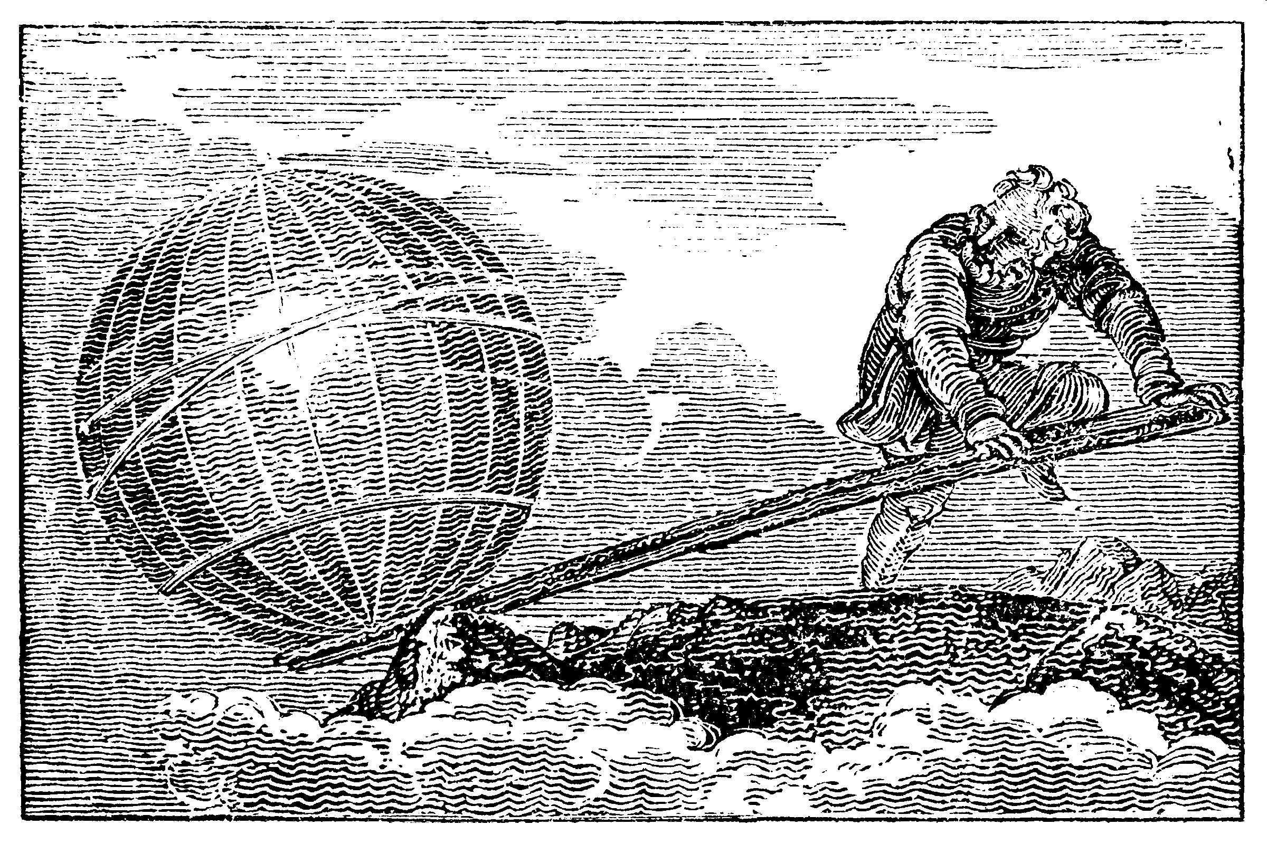
Anything is possible … with the right tools.

Slide 3
Big Question:
AD 1872
When a horse gallops, is there ever a moment where all four hooves leave the ground?

Slide 4
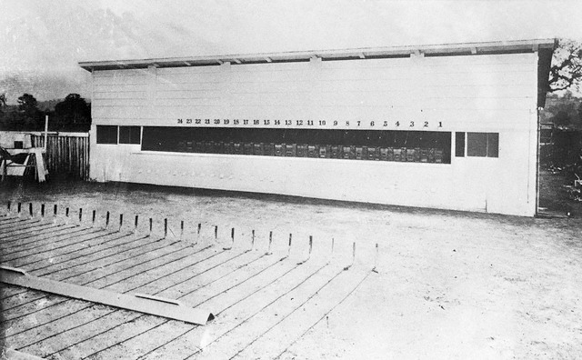
Muybridge’s multi-camera

Slide 5
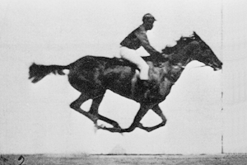
Muybridge’s galloping horse (1878)

Slide 6
not enough signal

Slide 7
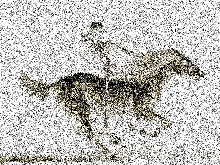
brighter light

Slide 8
even brighter

Slide 9
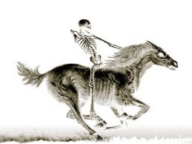
very bright light

Slide 10
a “crystal” of horses

Slide 11
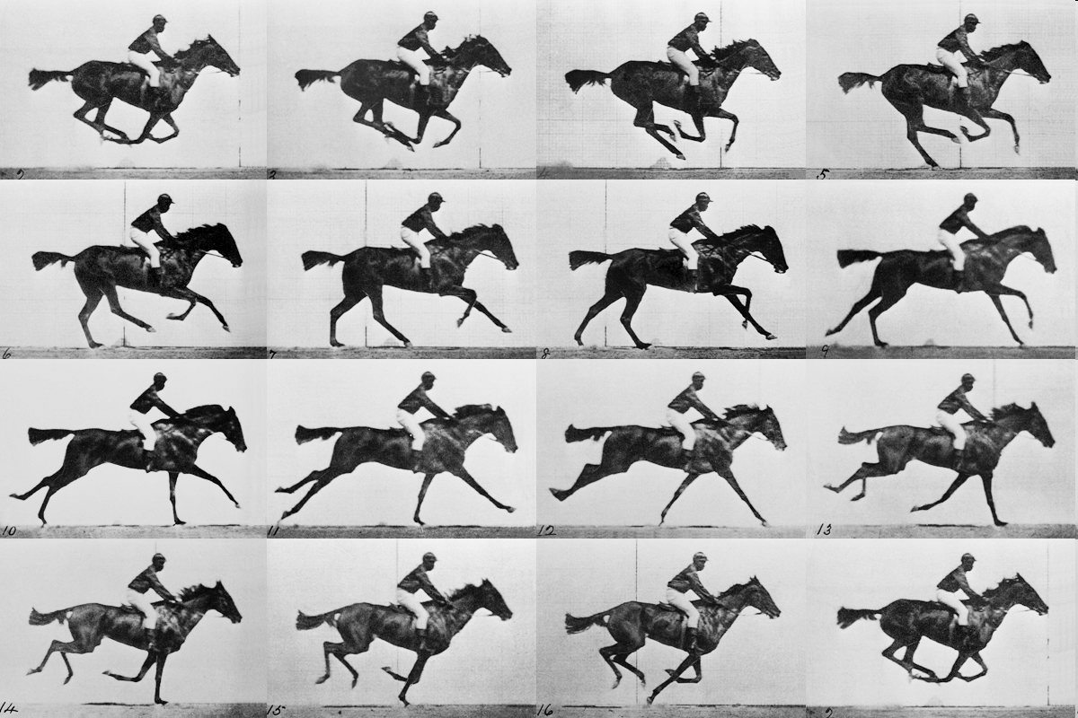
realistic “crystal” of horses

Slide 12
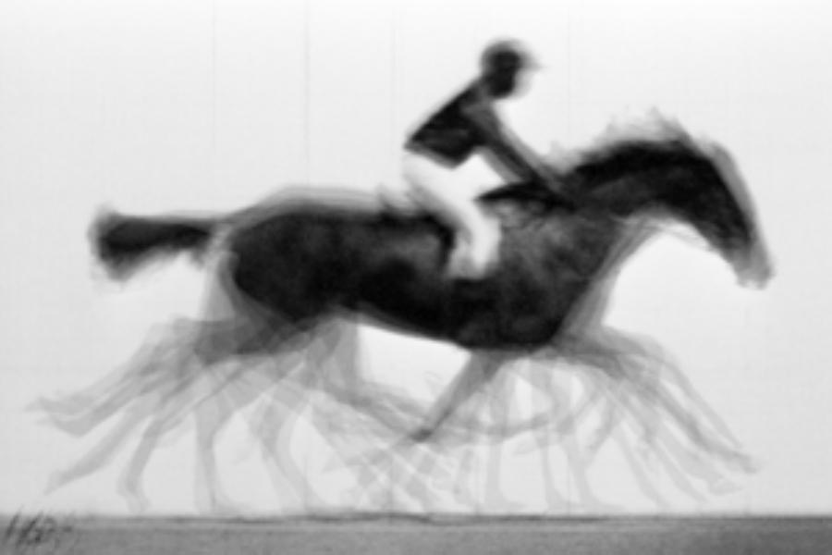
average structure: galloping horse

Slide 13
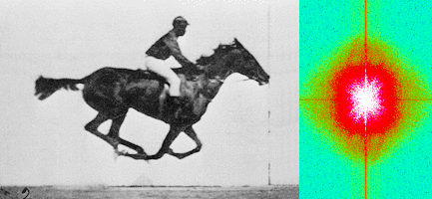
Muybridge’s galloping horse (1878)
“Time-resolved” diffraction
Real space
reciprocal

Slide 14
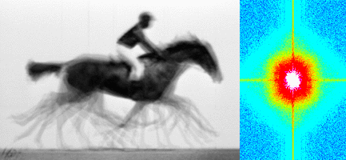
Muybridge’s galloping horse (1878)
Average electron density
Real space
reciprocal

Slide 15
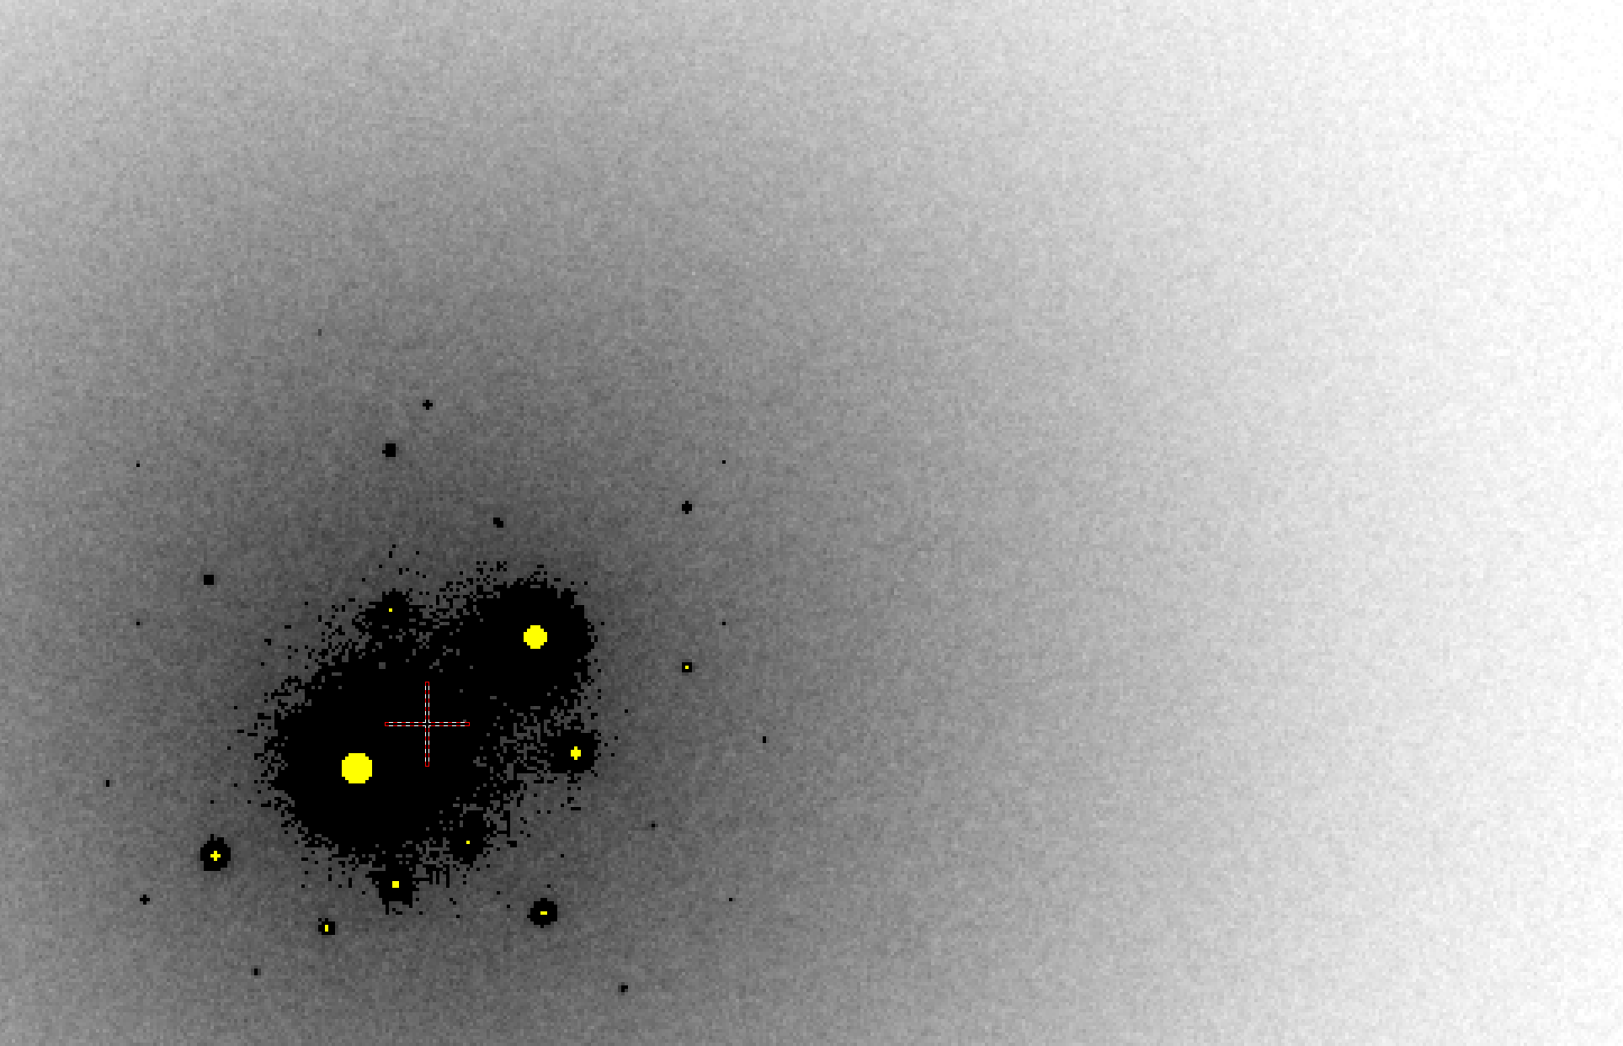
The “6 Å slump”
B = 500

Slide 16
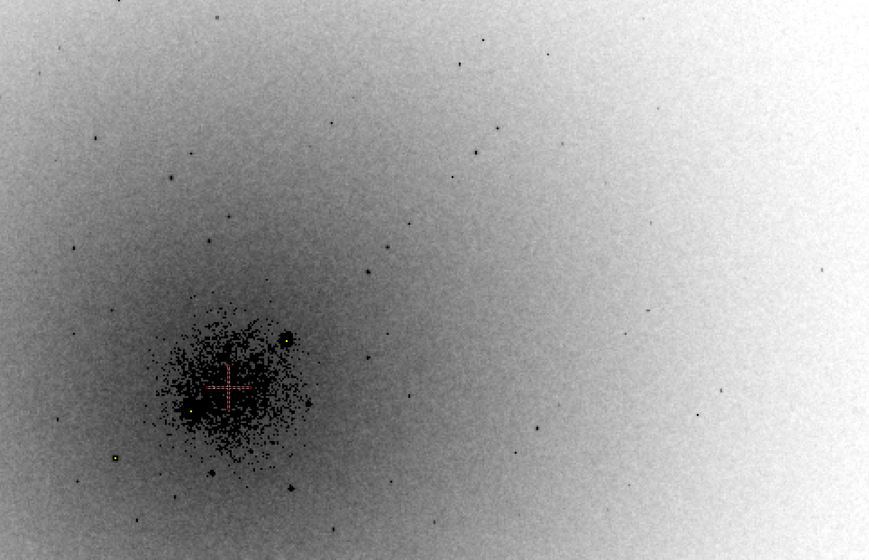
The faint hope
B = 20

Slide 17
Bigger is better, but not by much
B = 20
B = 60
B = 0
B = 170
B = 330
B = 560
Resolution (Å)
B = 850
Crystal diameter (micron)

Slide 18
Ways to improve resolution
New crystal form
Purify
- add a column
- heat shock
Bind something
- Known ligand
- Silver bullets
Change the clone
- chop off floppy bits
- homolog
- Ala -> Lys mutants
Make Protein Sit Still!!!
ALS 8.3.1 MRPI
Max Data Qual. W.S.
Oct 5-6 at LBL
Sign up with:
JTanamachi@lbl.gov
Newman J. (2006) Acta Cryst. D62 27-31.

Slide 19
plunge cooling
warm, moist air
ice
cold N₂
liquid N₂
foam insulation

Slide 20
plunge cooling
warm, moist air
ice
cold N₂
liquid N₂
foam insulation

Slide 21
Warkentin method
liquid N₂
foam insulation
Warkentin (2006) J. Appl. Crystallogr. 39, 805-811.

Slide 22
21st Century Big Question: how do biomolecules work?
Beernink, Endrizzi, Alber & Schachman (1999). PNAS USA 96, 5388-5393.

Slide 23
lysozyme: real and reciprocal

Slide 24
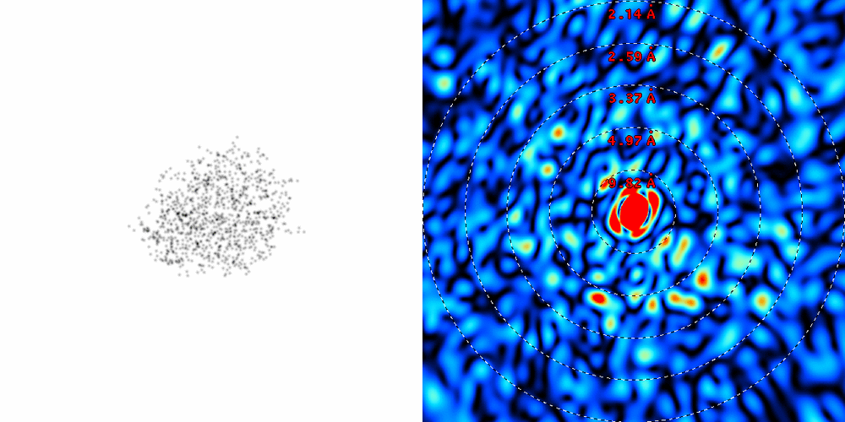
lysozyme: thermal motion

Slide 25
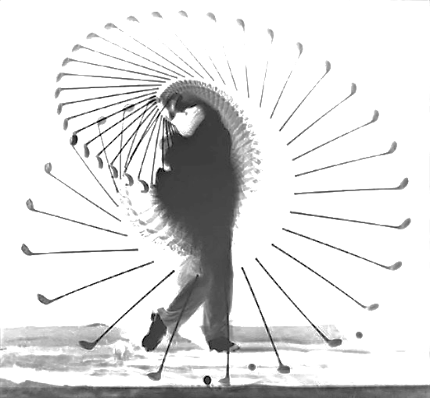
The real problem is:
Averaging
+
Dynamics
=
Poor
resolution
a grand challenge for structural biology in the 21st century

Slide 26
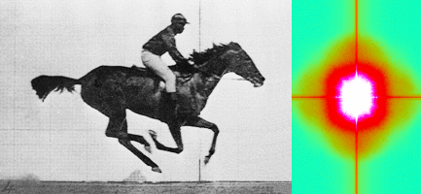
Muybridge’s galloping horse (1878)
Average intensity
Real space
reciprocal

Slide 27
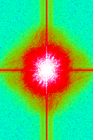
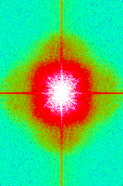
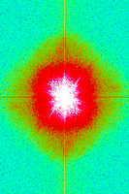
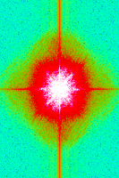
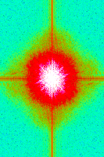
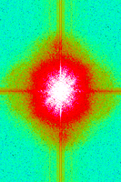
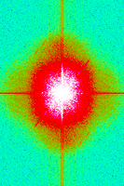
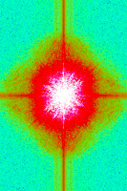
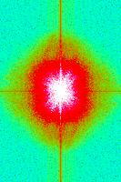
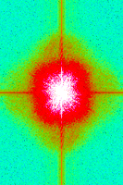
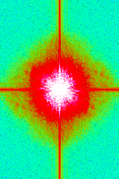
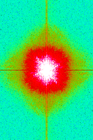
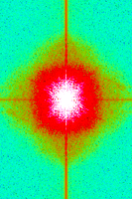
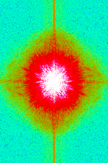
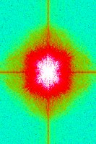
Getting around averaging?

Slide 28
What if we knew everything?
How would we store it?
How would we look at it?
How would we compare to data?
How would we know we know?
…
How would we begin?

Slide 29
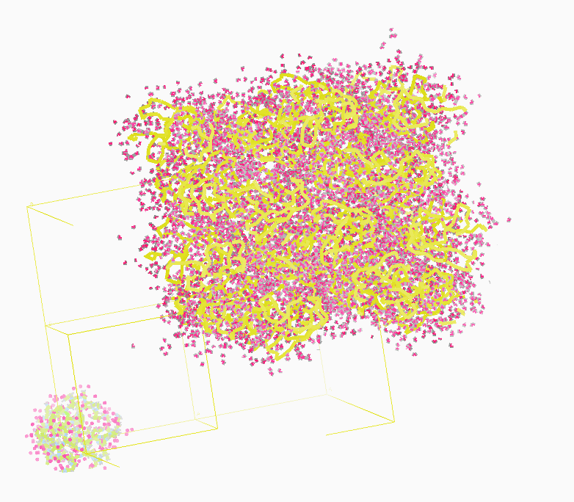
Molecular Dynamics Simulation
using real
crystal’s lattice
1aho
Scorpion toxin
0.96 Å resolution
64 residues
Solvent: H₂0 + acetate
Cerutti et al. (2010).J. Phys. Chem. B 114, 12811-12824.

Slide 30
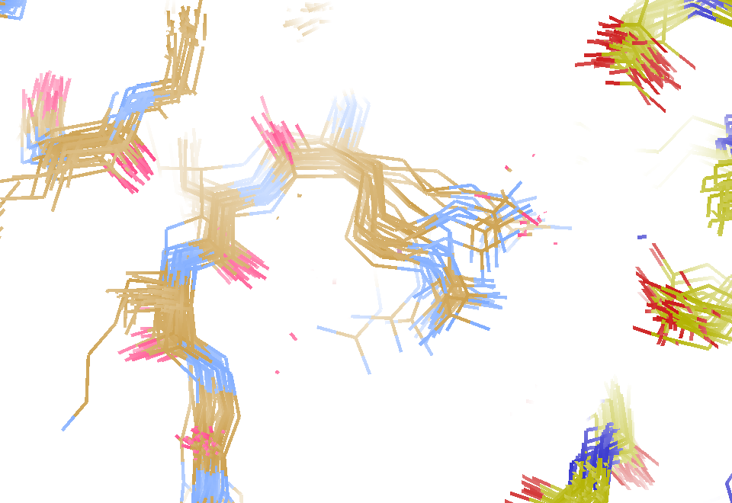
MD simulation: 30 conformers from 24,000
Cerutti et al. (2010).J. Phys. Chem. B 114, 12811-12824.

Slide 31
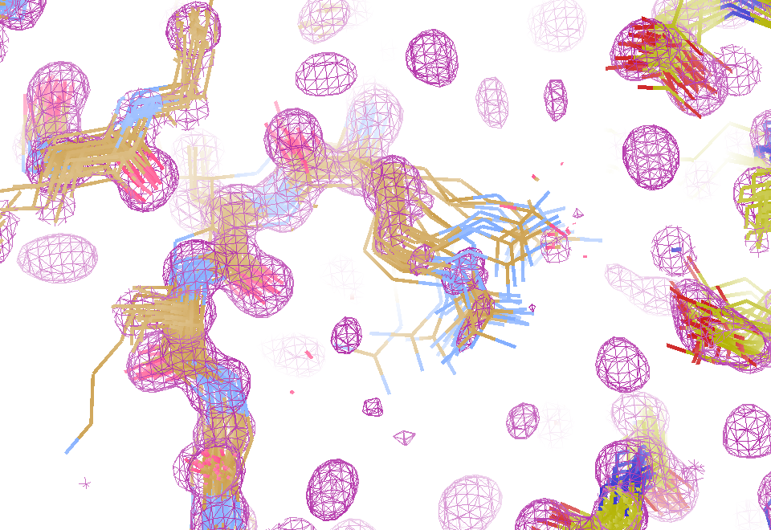
Electron density from 24,000 conformers

Slide 32
MLFSOM simulation
Holton, Classen, Frankel & Tainer (2014) "R-factor gap" FEBS 281 4046-60

Slide 33
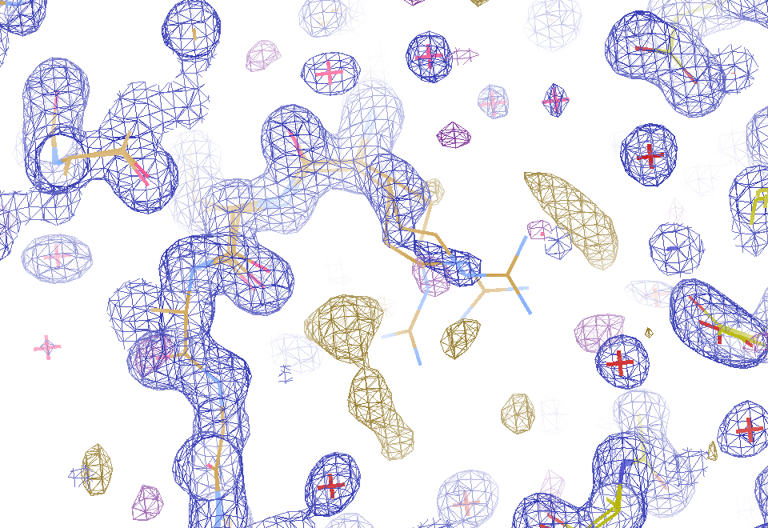
2F_{sim}-F_{calc} and F_{sim}-F_{calc} maps
1.0 Å data
R_{work}= 0.137
R_{free} = 0.159
1 “sigma” 2F_{sim}-F_{c}
2.5 “sigma” F_{sim}-F_{c}

Slide 34
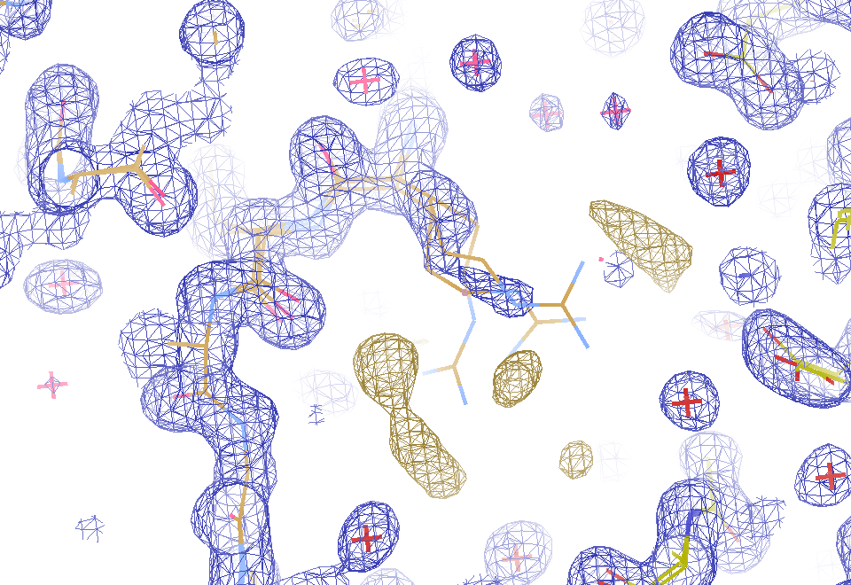
2F_{sim}-F_{calc} and “true difference” maps
1.0 Å data
R_{work}= 0.137
R_{free} = 0.159
1 “sigma” 2F_{sim}-F_{c}
F_{right} – (2F_{sim}-F_{c})

Slide 35
30 conformers from 24,000

Slide 36
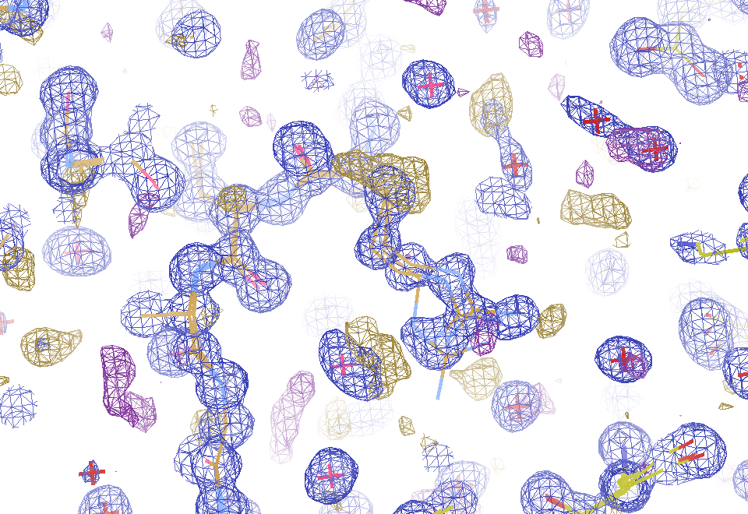
Conventional model vs X-ray data
1.0 Å data
R_{work} = 0.116
R_{free} = 0.135
1 “sigma” 2F_{obs}-F_{c}
2.5 “sigma” F_{obs}-F_{c}

Slide 37
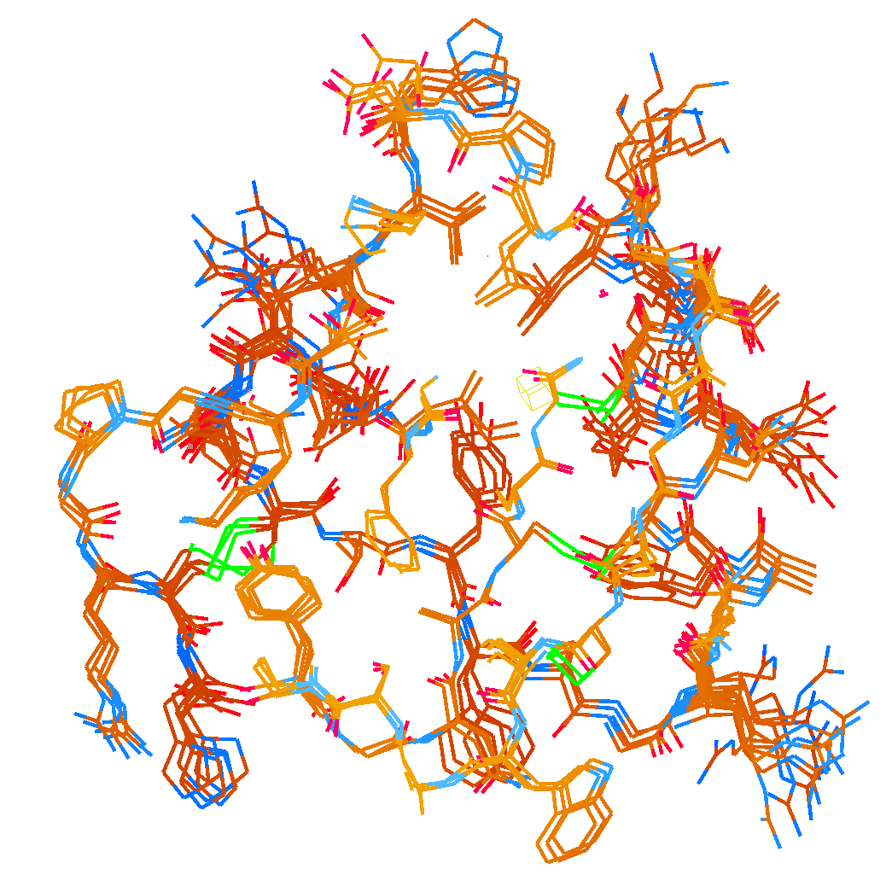
How many conformers are needed?
MD-derived fake data
Answer: 2-14
R_{work} = 0.0441
R_{free} = 0.0516
vs F_{sim}

Slide 38
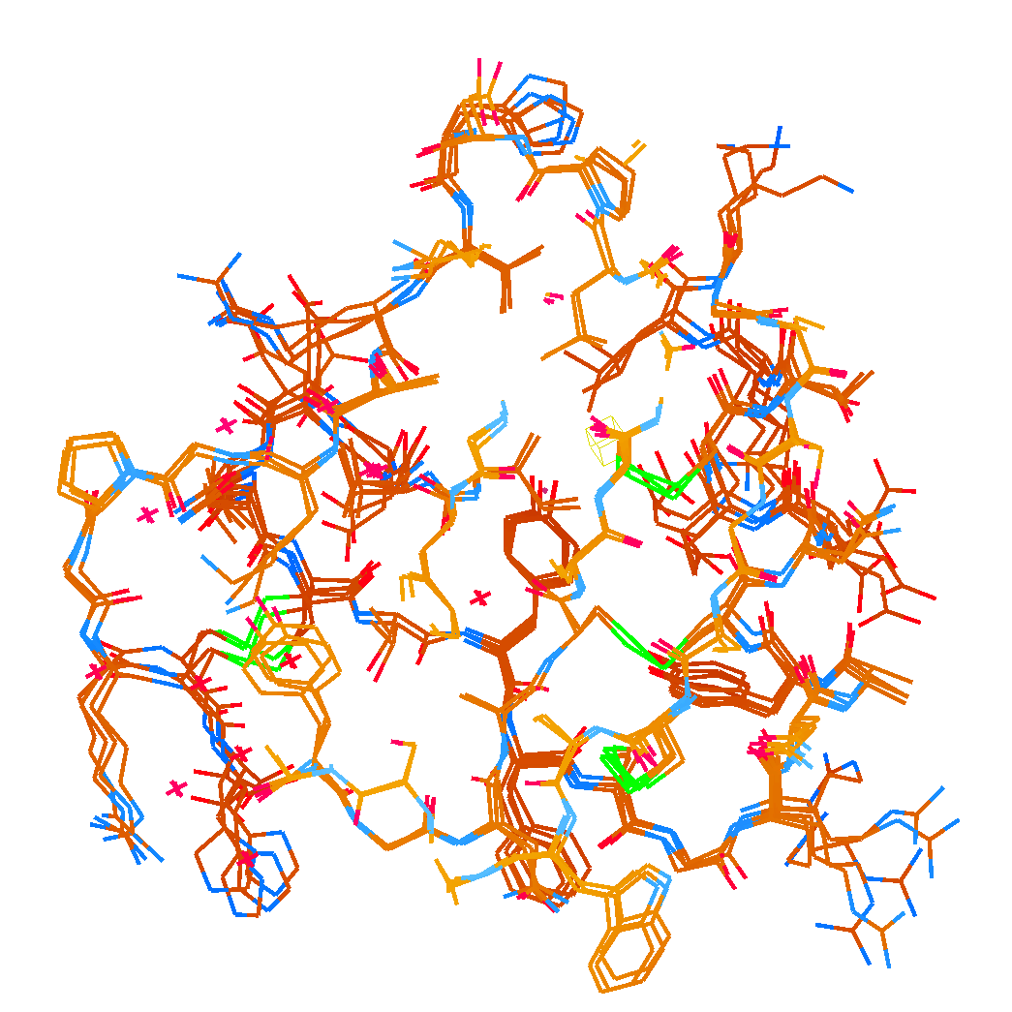
How many conformers are needed?
Observed x-ray data
Answer: 1-7
R_{work} = 0.135
R_{free} = 0.158
vs F_{obs}
1aho:
R_{work} = 0.1475
R_{free} = 0.1685

Slide 39
Adding noise
1² + 1² = 1.4²

Slide 40
Adding noise
1² + 1² = 1.4²
3² + 1² = 3.2²
σ_{total}² = σ₁² + σ₂²

Slide 41
Adding noise
1² + 1² = 1.4²
3² + 1² = 3.2²
σ_{total}² = σ₁² + σ₂²

Slide 42
Adding noise
1² + 1² = 1.4²
3² + 1² = 3.2²
10² + 1² = 10.05²

Slide 43
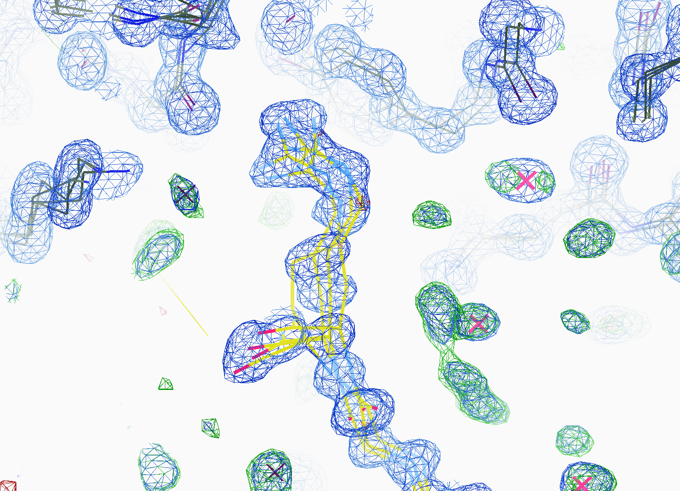
How many conformers are there?
All difference
features
are in
the solvent!
real data

Slide 44
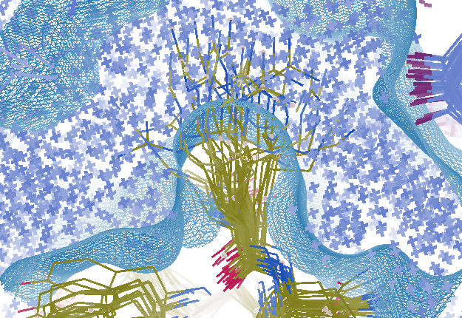
Combined multi-conformer & cloud solvent
R_{work} = 0.0309
R_{free} = 0.0678
vs F_{sim}
Problem: diverges with more cycles

Slide 45
“hydrogen cloud” solvent: unstable
R factor (%)
Phenix macro-cycle

Slide 46
Crowded-atom problem

Slide 47
Crowded-atom problem

Slide 48
How to stabilize refinement?
Do just 1 macro cycle
Apply overall scale factor to occupancies
Scale all changes back so that:
max XYZ shift <= 0.01 Å
Max occ shift <= 0.01
Max B shift <= 1
Repeat 1

Slide 49
“Small moves, Ellie. Small moves.”
R factor (%)
Phenix macro-cycle

Slide 50
Closing the R-factor Gap
Method | R_{work} | R_{free}
Deposited 1aho model flat bulk solvent | .1475 | .1685

Slide 51
Closing the R-factor Gap
Method | R_{work} | R_{free}
Deposited 1aho model flat bulk solvent | .1475 | .1685
MD-derived protein flat bulk solvent | .1350 | .1580

Slide 52
Closing the R-factor Gap
Method | R_{work} | R_{free}
Deposited 1aho model flat bulk solvent | .1475 | .1685
MD-derived protein flat bulk solvent | .1350 | .1580
MD-derived protein MD-derived “hard” solvent | .1308 | .1476

Slide 53
Closing the R-factor Gap
Method | R_{work} | R_{free}
Deposited 1aho model flat bulk solvent | .1475 | .1685
MD-derived protein flat bulk solvent | .1350 | .1580
MD-derived protein MD-derived “hard” solvent | .1308 | .1476
MD-derived protein “hydrogen cloud” solvent | .0963 | .1426

Slide 54
Why should you care?
d_{max} = 4.5 Å
R_{cryst} = 27%
R_{free} = 38%

Slide 55
Why should you care?
3a8n 4.5 Å R_{merge} = 0.15 R/R_{free} = 0.306/0.396
1qzv 4.44 Å R_{merge} = 0.099 R/R_{free} = 0.41/0.42
1grz 5 Å R_{merge} = 0.052 R/R_{free} = 0.369/0.428

Slide 56
Why should you care?
1hvu 4.75 Å R_{merge} = 0.064 R/R_{free} = 0.34/0.413
1n8e 4.5 Å R_{merge} = 0.138 R/R_{free} = 0.415/0.416
2r6e 5.02 Å R_{merge} = 0.058 R/R_{free} = 0.394/0.397

Slide 57
R-factor Gap?
Publication criterion for chemical crystallography:
R1 < 2*R_{sigma}
R1 = F_{o} vs F_{c} for I/σ(I) > 3
R_{sigma} = <σ(I)>/<I>
There are no PDB entries that pass this test!
Holton et al. (2014). FEBS J. 281, 4046-60.

Slide 58
Closing the R-factor Gap
Explain data to within error bars
extract & validate dynamics
Ligand bound or not?
error bar → p value
Single-electron changes
20% * 6 e⁻ = 1.2
Make reviewers shut up
statistics = end of story

Slide 59
PowerPoint File available:
http://bl831.als.lbl.gov/
~jamesh/powerpoint/
Supergroup_AXTP_2017.pptx

Slide 60
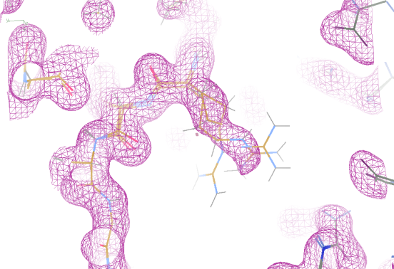
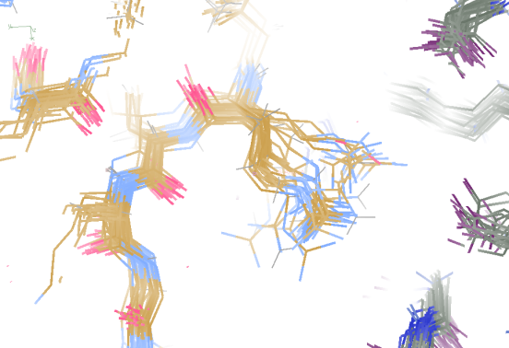
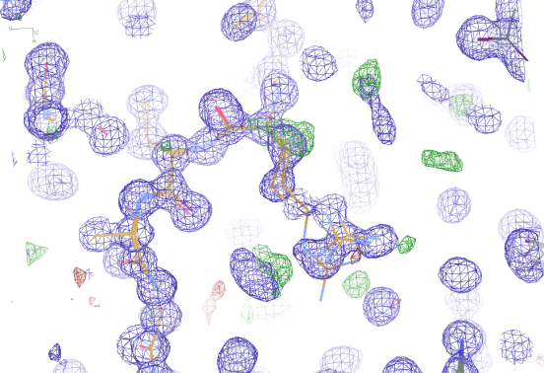
Molecular Dynamics vs Observation
1aho 64-residue scorpion toxin in water to 1.0 Å resolution
refined_vs_Fsim.pdb
1aho.cif
1aho.pdb
F_{calc}
F_{sim}
F_{obs}
F_{calc}
R_{vault} = 0.69
R_{work}= 0.137
R_{iso} =
R_{work}= 0.116
R_{vault} = 0.48 to 4 Å
rmsd = 1.05 Å
LSQ rmsd = 0.43Å

Slide 61
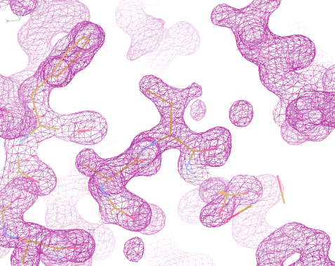
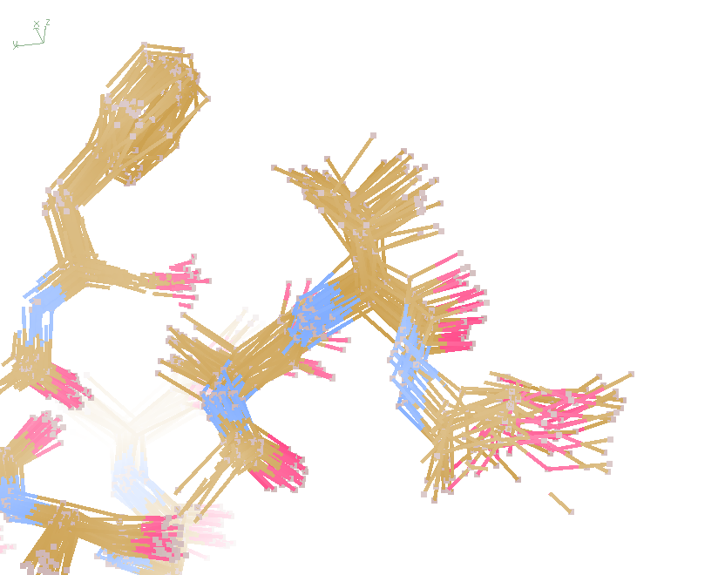
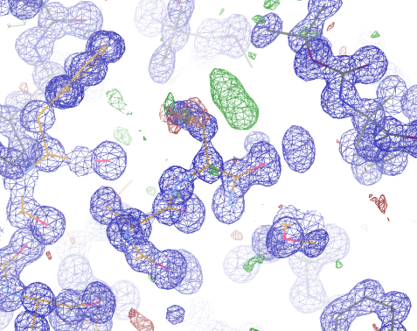
Molecular Dynamics vs Observation
“fav8” 8-residue aromatic peptide with 4 waters to 1.0 Å resolution
refined_vs_Fsim.pdb
fav8.fcf
fav8.cif
F_{calc}
F_{sim}
F_{obs}
F_{calc}
R_{work}= 0.13
R_{vault}= 0.23
R_{work}= 0.16
R_{vault} = 0.20 to 2Å
R1 = 0.041
With 4σ cutoff!
rmsd = 0.20 Å
LSQ rmsd = 0.091Å & 0.15 Å

Slide 62
What is a B-factor?

Slide 63
What is a B-factor?

Slide 64
What is a B-factor?

Slide 65
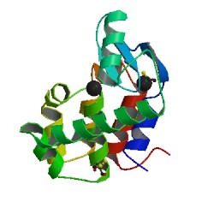
What is a B-factor?
order
order
B-factor
disorder

Slide 66
The R-factor Gap
Holton et al. (2014) "The R-factor gap", FEBS J. 281, 4046-4060.

Slide 67
Adding noise
12%² + 12%² = 17%²
R_{protein} + R_{solvent} ≈ R_{work}

Slide 68
Adding noise
4%² + 12%² = 12.6%²
R_{protein} + R_{solvent} ≈ R_{work}

