Slide 1
Global virus surveillance: billion tests
Problem
$1000/test is infeasible
PPE
Centralization -> logistics
Specialized equipment
Specialized skills
Antibodies unreliable?
Solution
$1 test
Self-test
decentralize
Pre-distributed hw
YouTube training
Robust reagents

Slide 2
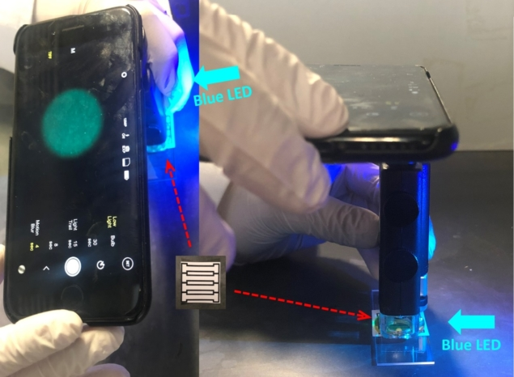
https://physicsworld.com/a/smartphone-based-device-detects-norovirus/

Slide 3
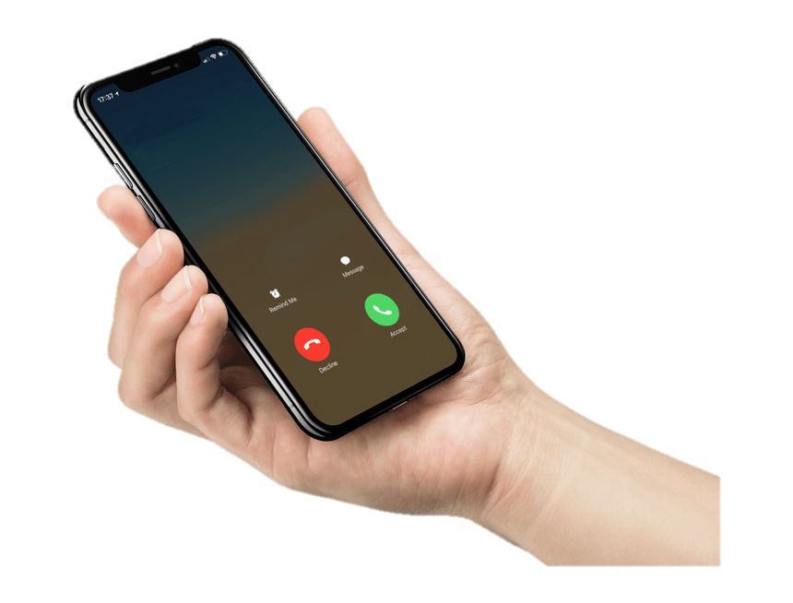
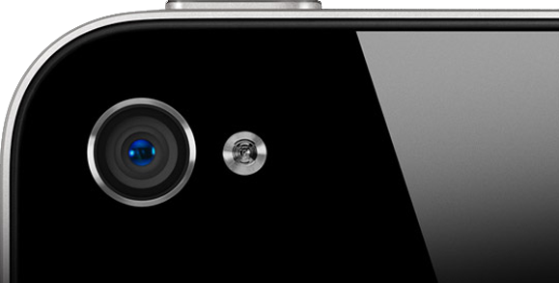
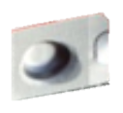
SARS-CoV-2 test with smartphone and $1 reagents
End user
= patient
-
cattggtcttacctc
saliva
sample
gtctaagttgaccgt
+
no virus
COVID-19
detected
donor
acceptor
+
gtctaagttgaccgtcattggtcttacctc cagattcaactggcagtaaccagaatggag
virus genome
heat
kill
blue
filter
absorb
RNA
on
coated
plastic
dry chemical
blister pack
(reflective &
light tight)
Place directly
over camera
blister pack
becomes reflector

Slide 4
reflecting dome
silica beads
sample
pressure
pressure
stiff, dark sheet
light
tight
seal
blue filter
red filter
Al foil
Al foil
lens
flash
LED
CMOS
sensor
smartphone

Slide 5
anchor
oligo
(multiple sequences)
nano
xtal
labeled
oligo
(FRET acceptor)
Viral
genome
blue filter
red filter
window
smart
phone
flash
LED
CMOS
sensor

Slide 6
The billion-test scale
Smartphones can detect 10⁶ particles/mL
https://www.nature.com/articles/srep40203.pdf
Virus titer in sputum is 10⁶-10⁸ particles/mL
https://www.ncbi.nlm.nih.gov/pmc/articles/PMC4187748/
Multi-tag signal enhancement (30 kb)
Plan A: FRET
ATTO465 and ATTOThio12 dyes
Plan B: TR-FRET
Tb or Gd donor, “afterglow”
(maybe ATTO465 in solid)

Slide 7
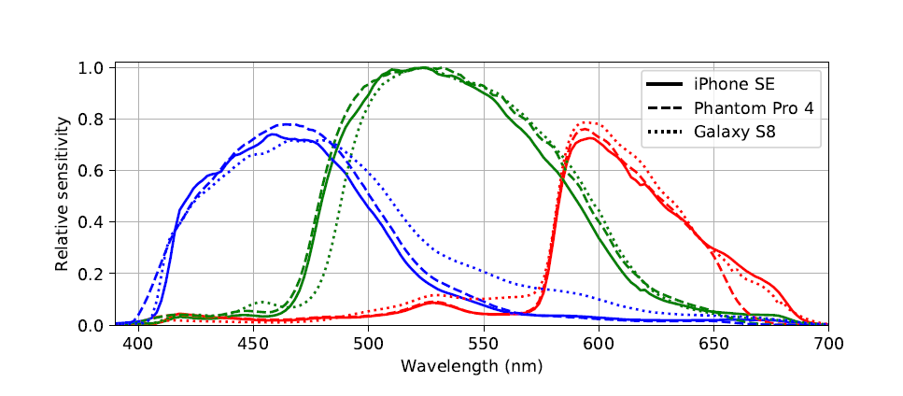
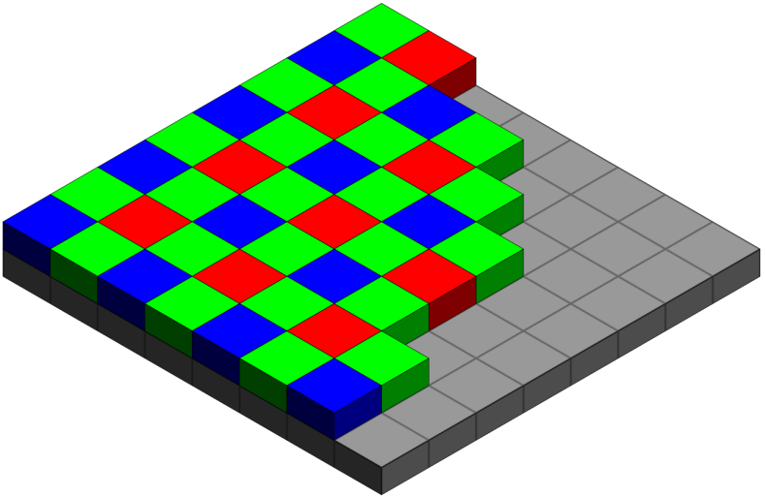
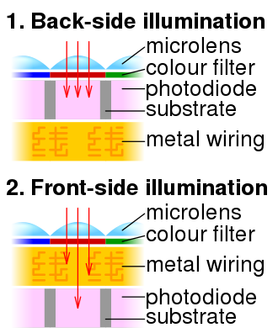
The (pixel array) Detector
RAW
mode
https://arxiv.org/abs/1906.04155

Slide 8
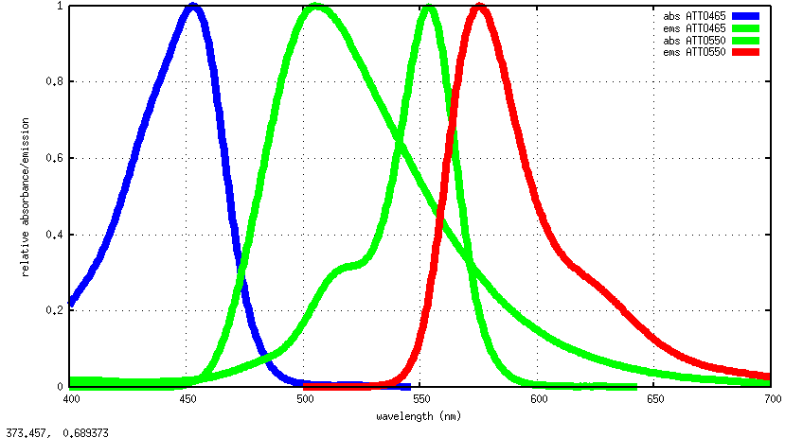
The (pixel array) Detector
https://arxiv.org/abs/1906.04155

Slide 9
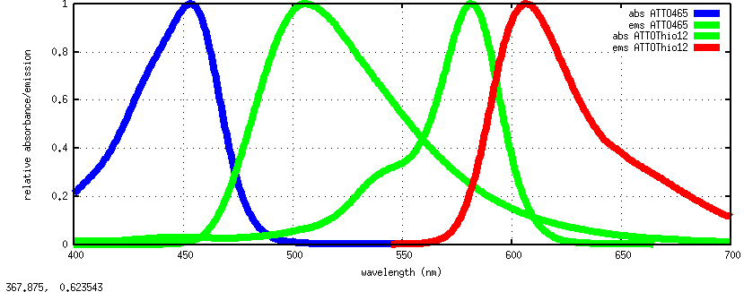
The (pixel array) Detector
https://arxiv.org/abs/1906.04155

Slide 10
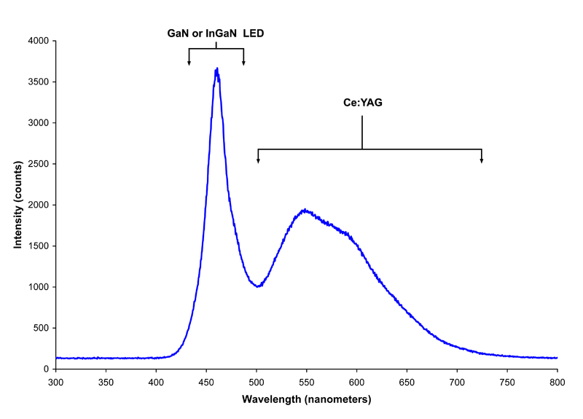
The (pixel array) Detector
https://arxiv.org/abs/1906.04155

Slide 11
The (advanced) Light Source
~100 lumens
= ~4x10¹⁷ ph/s
Singh, Subhash. (2009). Basics of Light Emitting diodes, Characterizations and Applications.

Slide 12
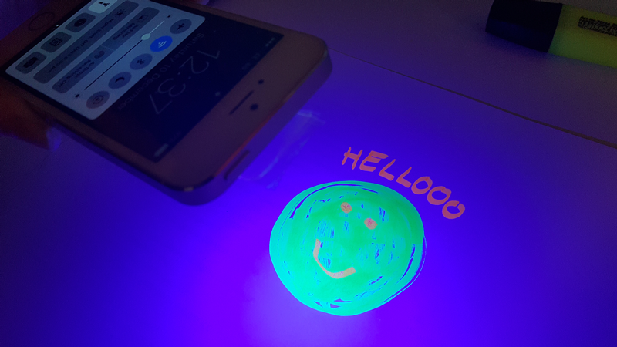
Sharpie and Scotch tape as filters
https://www.techadvisor.co.uk/how-to/mobile-phone/
how-turn-your-phone-into-black-light-3651570/

Slide 13
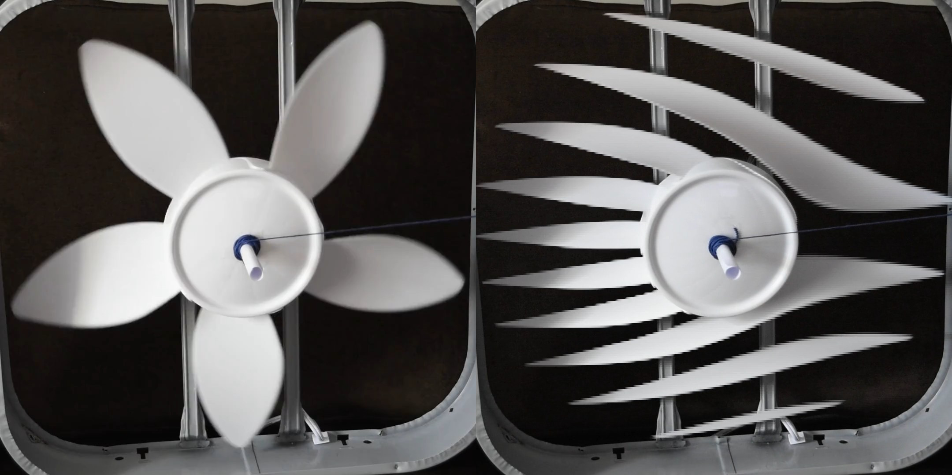
“rolling shutter”

Slide 14
LED flash turn-on time

Slide 15
LED flash turn-off time

Slide 17
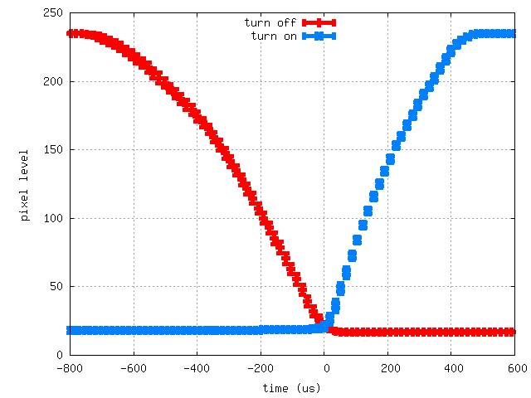

Slide 18
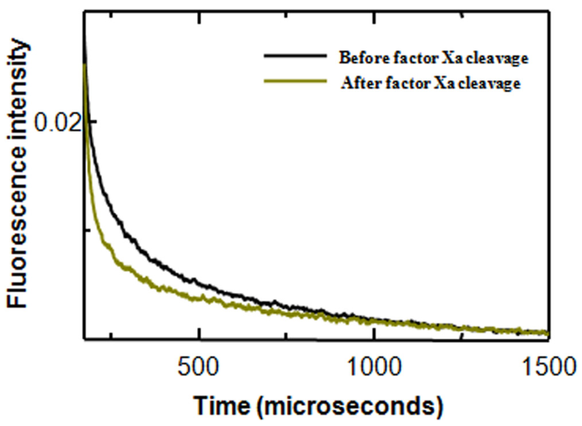
PMC4596616

Slide 19
Quantum Dots?
Pro
10x brighter
Tunable
Versatile
La-based possible
upconverting
Con
Large radius
< 10% FRET
Cd toxic
fragile
No acceptors

Slide 20
Things I could use help with
Design ~1000 oligos
FRET filter selection & tests!
RAW mode phone app
Establish FRET detection limit
Time-resolved phone app
Establish TR-FRET detection limit

