Slide 1
User-Focused: Transitioning to serial and time-resolved modes
Why don’t (your friends) always use serial mode to collect data?
What question(s) would you answer with time-resolved data?
What forum would be best for communicating “gripes”? Email? Social? Anonymous?
What forum would be best for communicating results?

Slide 2
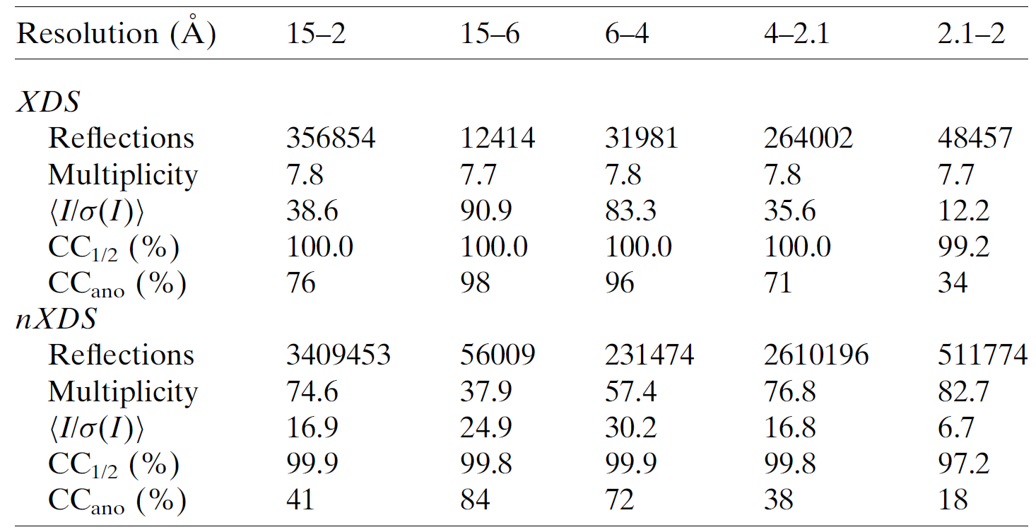
Why not use serial?
Rotation mode
Serial stills mode
same images
Kabsch nXDS Acta Cryst. (2014). D70, 2204–2216

Slide 3
Talking points
Why don’t (your friends) always use serial mode to collect data?
What question(s) would you answer with time-resolved data?
What forum would be best for communicating “gripes”? Email? Social? Anonymous?
What forum would be best for communicating results?

Slide 4
Limiting factors in
Serial Crystallography
Texture
Non-isomorphism
Tangling

Slide 5
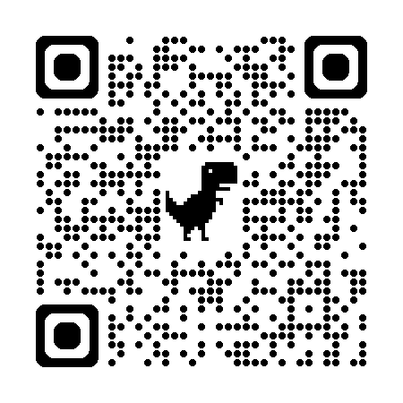
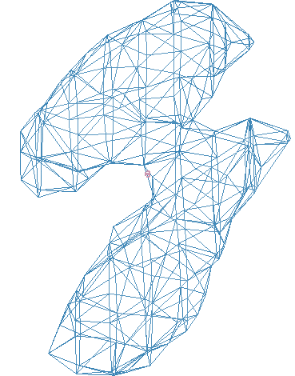
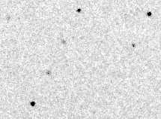
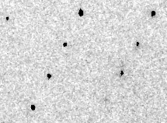
Simulation fit to XFEL still
phix
https://pmc.ncbi.nlm.nih.gov/articles/PMC11801403/
phiy
phiz
real
VS
“texture”
phix
phiy
phiz

Slide 6
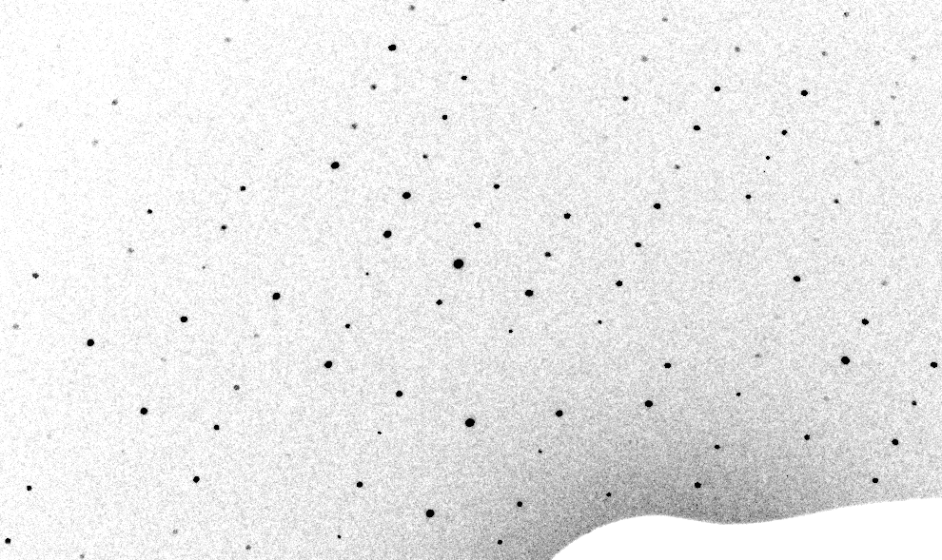
3-cluster texture simulation

Slide 7
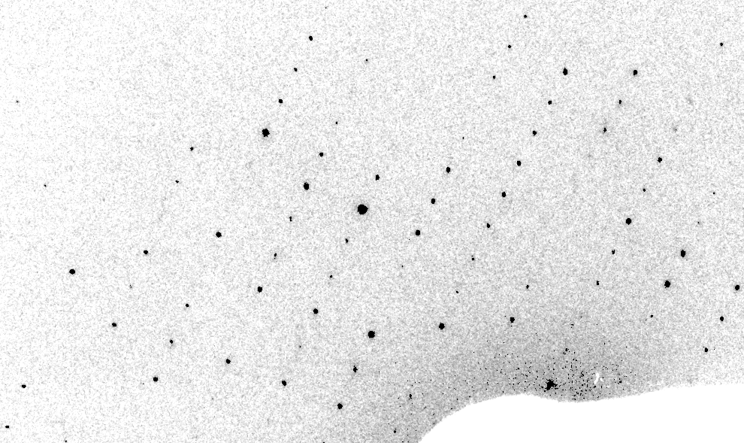
Real XFEL still
Lyubimov et al. (2016).
eLife 5, e18740.

Slide 8
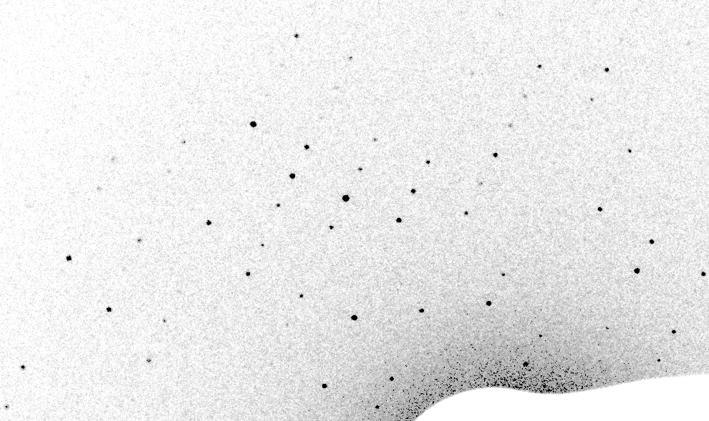
Mosaic (1-cluster texture) simulation

Slide 9
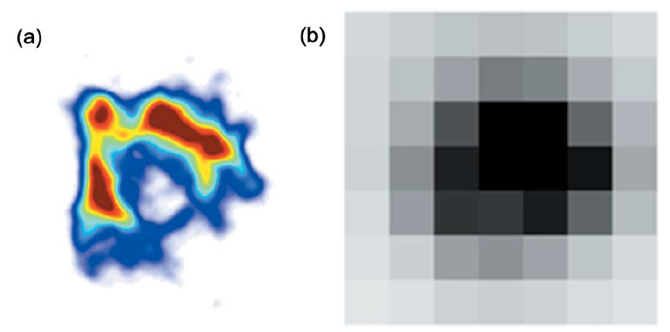
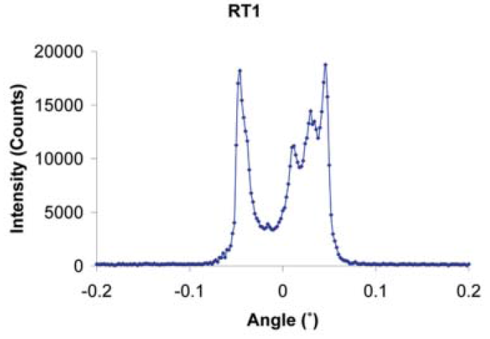
The true nature of “mosaic spread”
Any function can be approximated by a family of Gaussians
Lovelace JJ, Murphy CR, Pahl R, Brister K & Borgstahl GEO (2006)."Tracking reflections through cryogenic cooling with topography", J. Appl. Cryst. 39, 425-432.

Slide 10
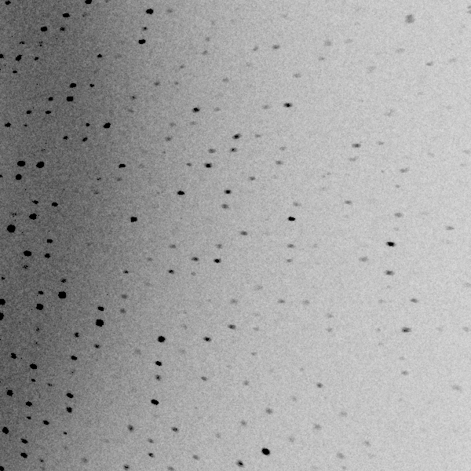
3 domains within 1°

Slide 11
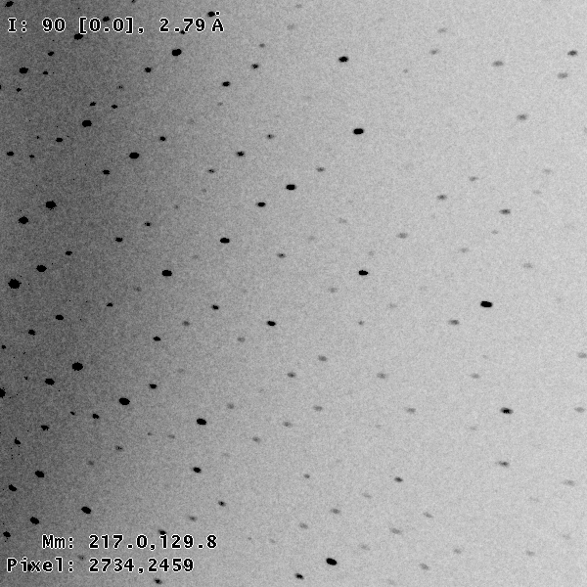
3 domains within 0.2°

Slide 12
Texture sufficient for poor stats
500 images Results from iota: cctbx & prime
texture | 1 cluster | 3 clusters
R_{true}* | 4% | 16%
*Agreement with F value fed into simulation

Slide 13
Texture sufficient for poor stats
500 images Results from iota: cctbx & prime
texture | 1 cluster | 3 clusters
R_{true}* | 4% | 16%
R_{merge} | 23% | 66%
*Agreement with F value fed into simulation

Slide 14
Texture sufficient for poor stats
500 images Results from iota: cctbx & prime
texture | 1 cluster | 3 clusters
R_{true}* | 4% | 16%
R_{merge} | 23% | 66%
I/σ | 32 (1.1) | 19 (1.2)
*Agreement with F value fed into simulation

Slide 15
Texture sufficient for poor stats
500 images Results from iota: cctbx & prime
texture | 1 cluster | 3 clusters
R_{true}* | 4% | 16%
R_{merge} | 23% | 66%
I/σ | 32 (1.1) | 19 (1.2)
CC_{1/2} | 99 (69) | 99 (58)
*Agreement with F value fed into simulation

Slide 16
Texture sufficient for poor stats
500 images Results from iota: cctbx & prime
texture | 1 cluster | 3 clusters
R_{true}* | 4% | 16%
R_{merge} | 23% | 66%
I/σ | 32 (1.1) | 19 (1.2)
CC_{1/2} | 99 (69) | 99 (58)
resolution | 1.55 | 1.94
*Agreement with F value fed into simulation

Slide 17
Fitting multiple clusters is stable!
Fraction pixels predicted
Best of
262,140 trials
Angle about y axis (°)

Slide 18
Prediction:
Incorporating texture
in serial data processing will
reduce image count requirement
from ~1e4 to ~100
Why? Because rotation data lack texture error

Slide 19
Limiting factors in
Serial Crystallography
Texture
Non-isomorphism
Tangling

Slide 20
non-isomorphism

Slide 21
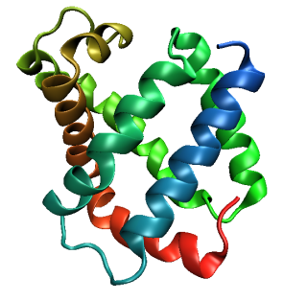
Same structure, different cell
0.5% cell change → 15%
Crick & Magdoff (1956) “theory method isomorphous replacement”, Acta Cryst. 9, 901-8.

Slide 22
Same structure, different cell
0.5% cell change → 15%
Crick & Magdoff (1956) “theory method isomorphous replacement”, Acta Cryst. 9, 901-8.

Slide 23
Same cell, rotated protein
0.5° rotation → 16%
Crick & Magdoff (1956) “theory method isomorphous replacement”, Acta Cryst. 9, 901-8.

Slide 24
Same cell, rotated protein
0.5° rotation → 16%
Crick & Magdoff (1956) “theory method isomorphous replacement”, Acta Cryst. 9, 901-8.

Slide 25
Uniform stretch
5% change → 0% R

Slide 26
Uniform stretch
5% change → 0% R

Slide 27
non-isomorphism correction must:
be periodic
be continuous
preserve scale & zoom
preserve bonds, angles

Slide 28
“map bender” procedure
Convert to fractional coordinates
Basis functions: spatial sin waves

Slide 29
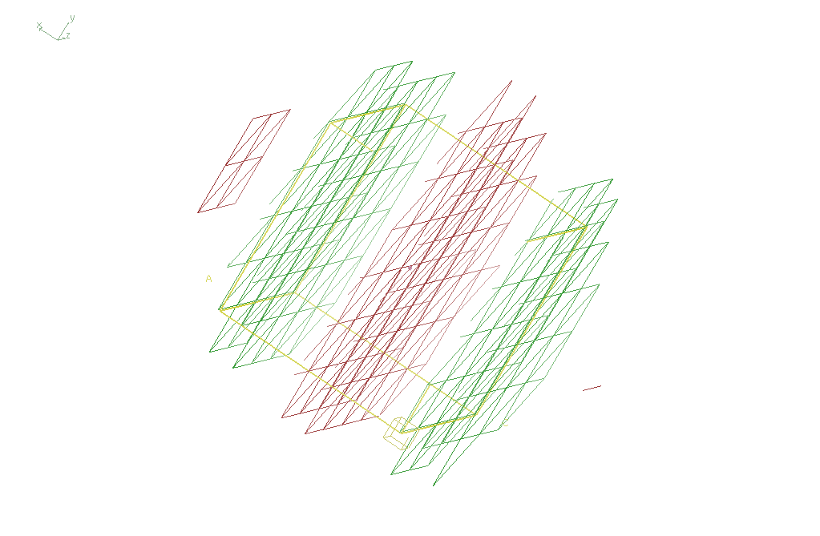
Basis function 1 0 0

Slide 30
“map bender” procedure
Convert to fractional coordinates
Basis functions: spatial sin waves
  Repeats with unit cell
  Low-order h,k,l indices first
Fit function to Δx vs x,y,z across P1 cell
Repeat with Δy, Δz
Apply to PDB file and interpolate map grid
Usually 3-5 orders comparable to LSQ

Slide 31
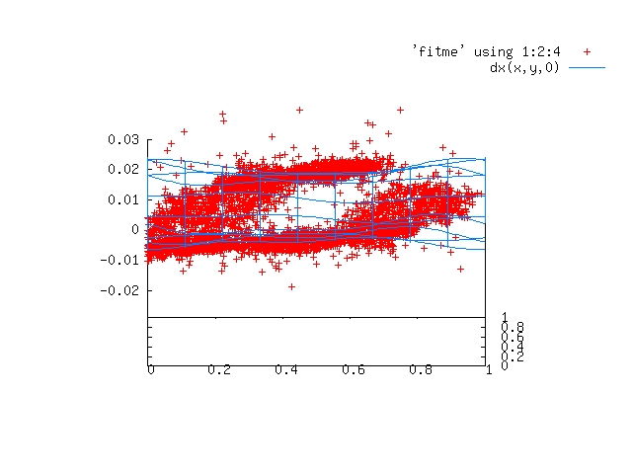

Slide 32
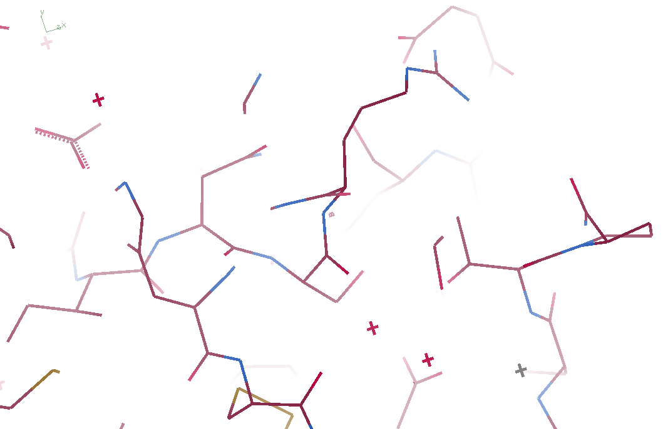
3aw6

Slide 33
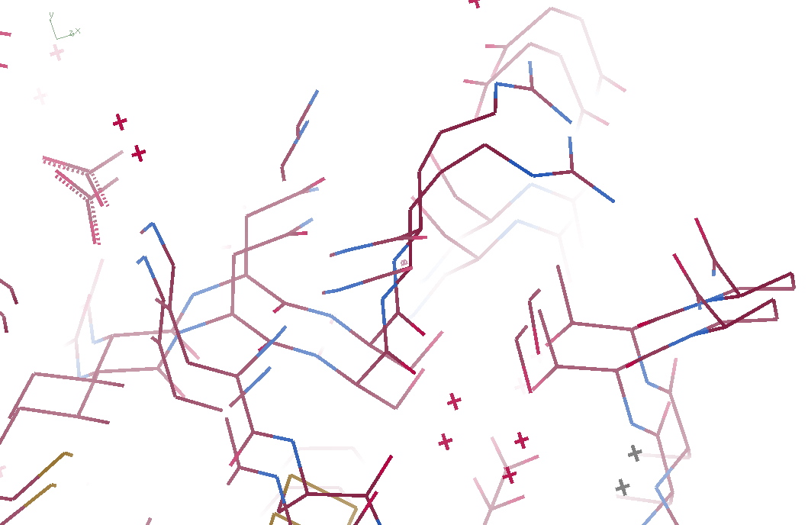
3aw6 3aw7

Slide 34
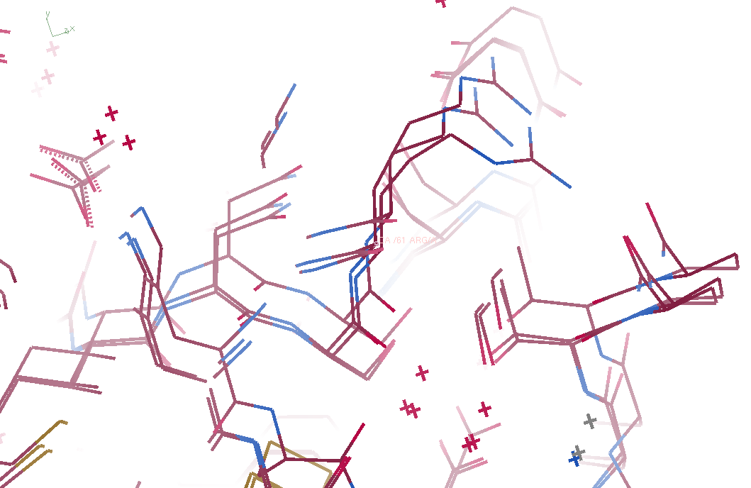
3aw6, 3aw7, “bent” 3aw6

Slide 35
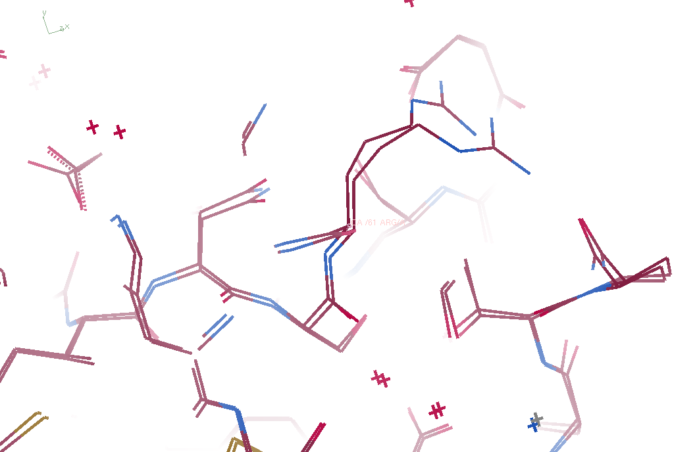
3aw7, “bent” 3aw6

Slide 36
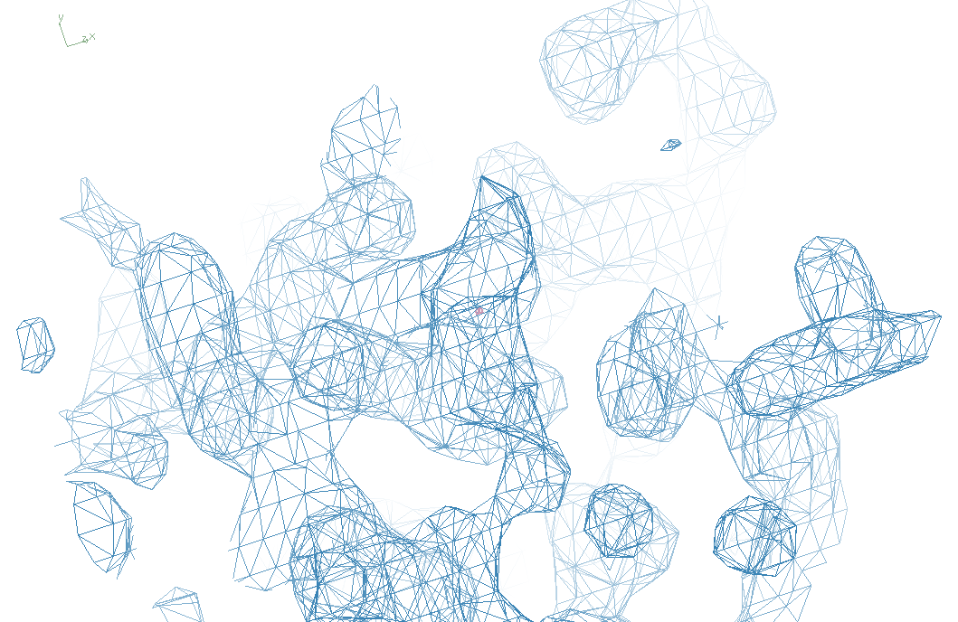
3aw6

Slide 37
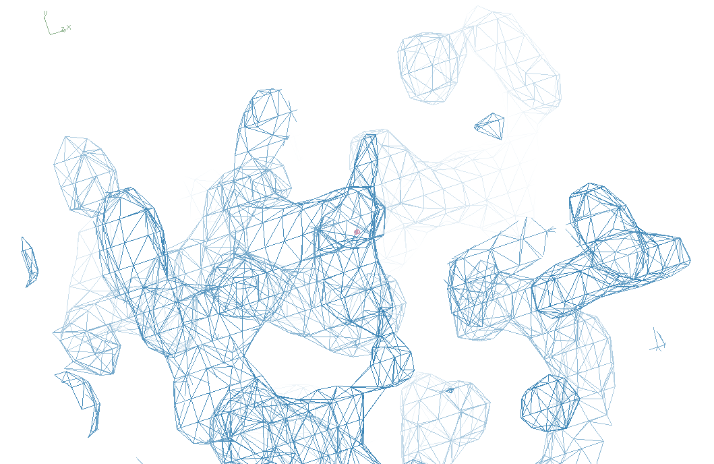
“bent” 3aw7

Slide 38
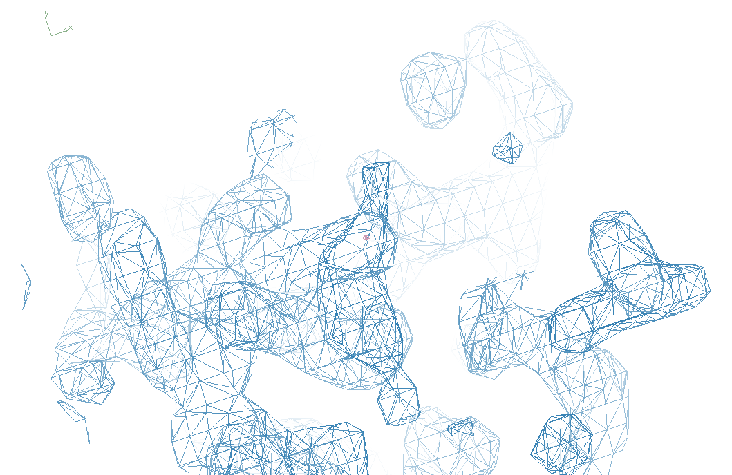
3aw7

Slide 39
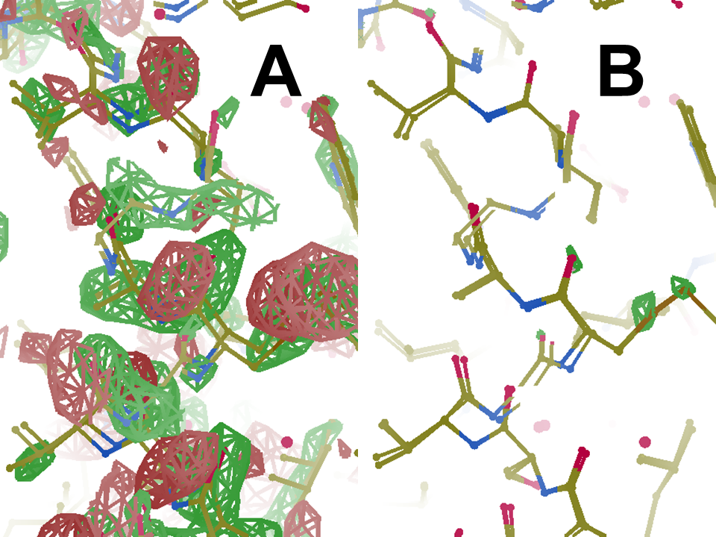
Simple
diff
map
unbent
diff
map

Slide 40
Prediction:
Correcting non-isomorphism
will allow
infinite averaging
allowing arbitrary signal/noise
Why? Because it works for cryoEM

Slide 41
Limiting factors in
Serial Crystallography
Texture
Non-isomorphism
Tangling

Slide 42
What do you mean, “tangled”?
Ground Truth
Local Minimum

Slide 43
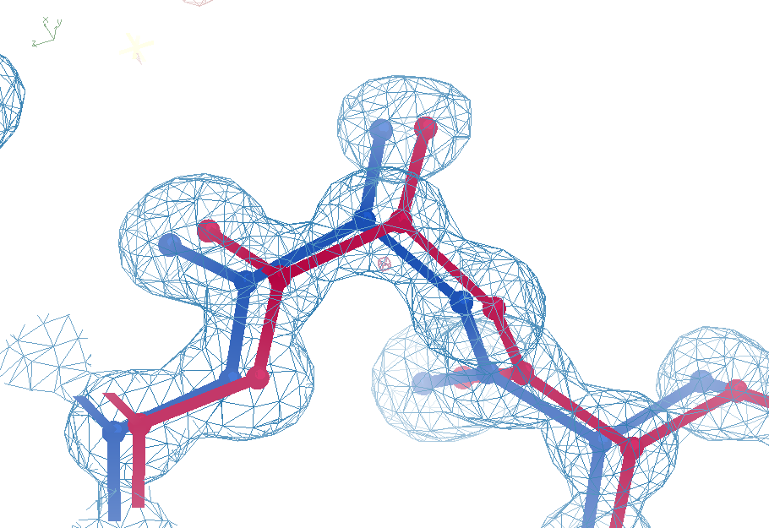
Sim challenge data
Ala39
-0.2σ
wE=18.2
N-C_{α}
bond
-0.3σ
0.8σ
angle
A B conformers

Slide 44
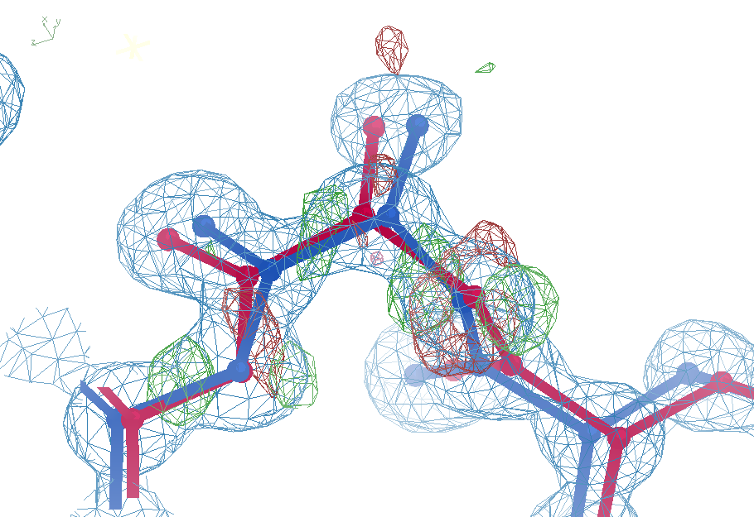

Sim challenge data: “otw39”
Ala39
+11σ
wE=63.5
N-C_{α}
bond
-9σ
It’s a TRAP!
5σ
angle
A B conformers

Slide 45
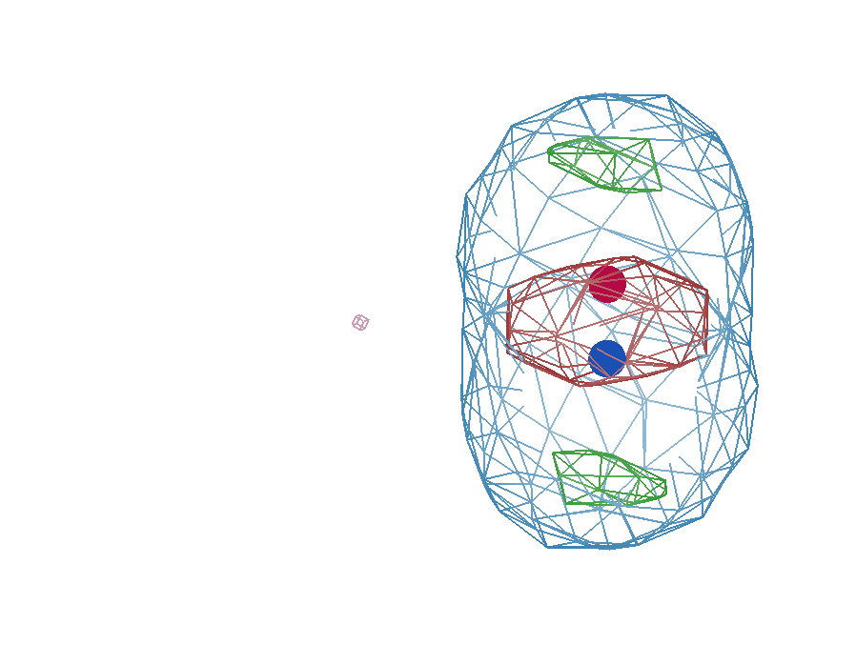
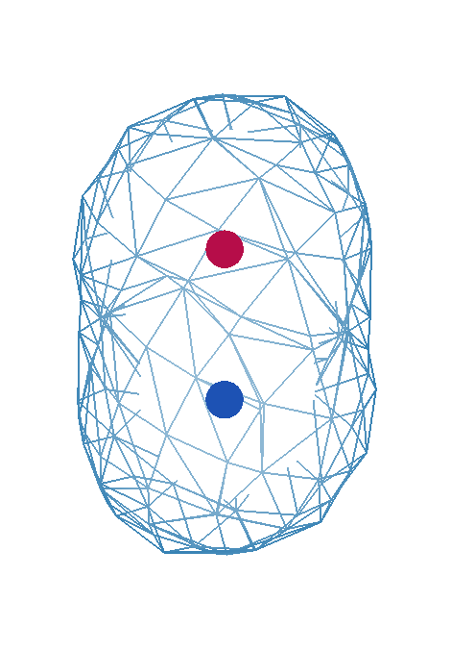
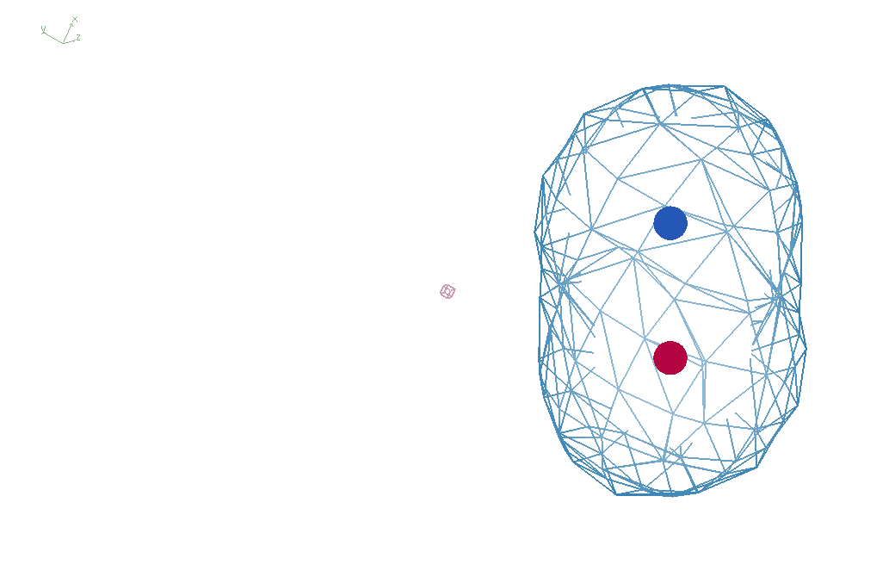
It takes two to tangle
density
fit
Chemical
strain
energy
A
A
B
B
B
A
tangled
barrier
untangled

Slide 46
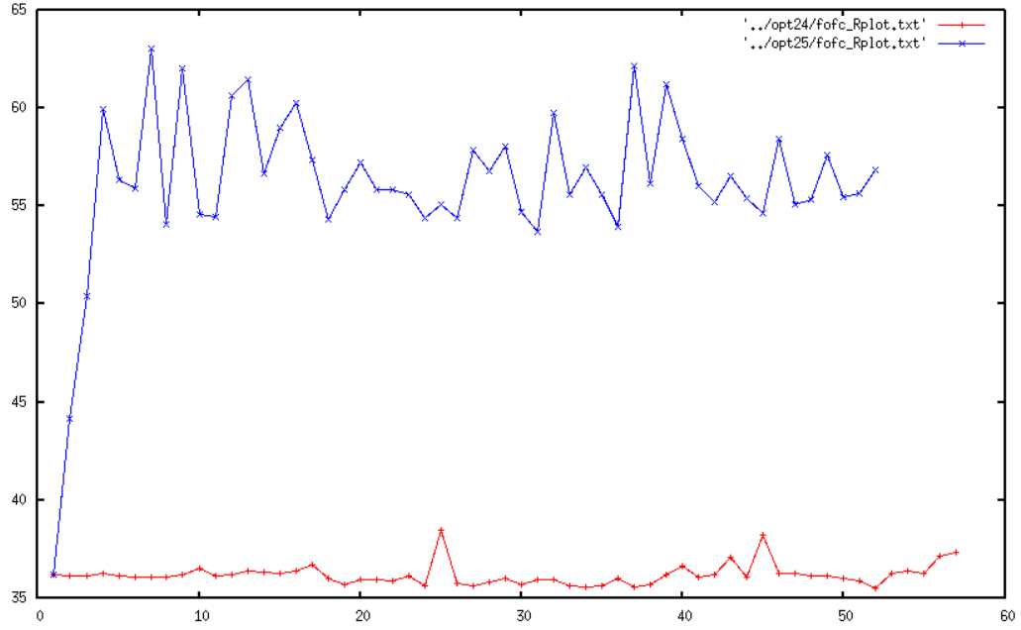
Molecular Dynamics of crystals
65
60
55
50
45
40
35
unrestrained
R_{free} (%)
restrained
Time (ns)

Slide 47
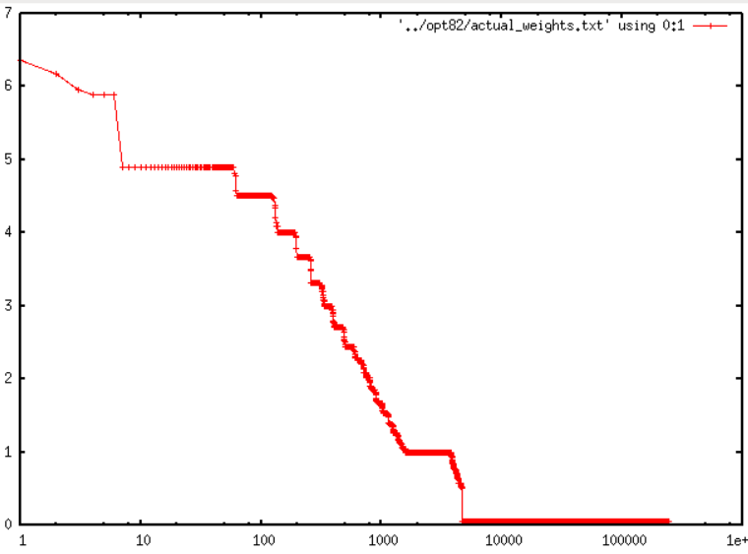
Less than 2% of atoms need restraints
7
6
5
4
3
2
1
0
R_{free} = 27%
no X-ray term!
?
Restraint weight (kcal/Å²)
1.8%
1 10 100 1000 10000 1e5 1e6
Sorted atom count

Slide 48
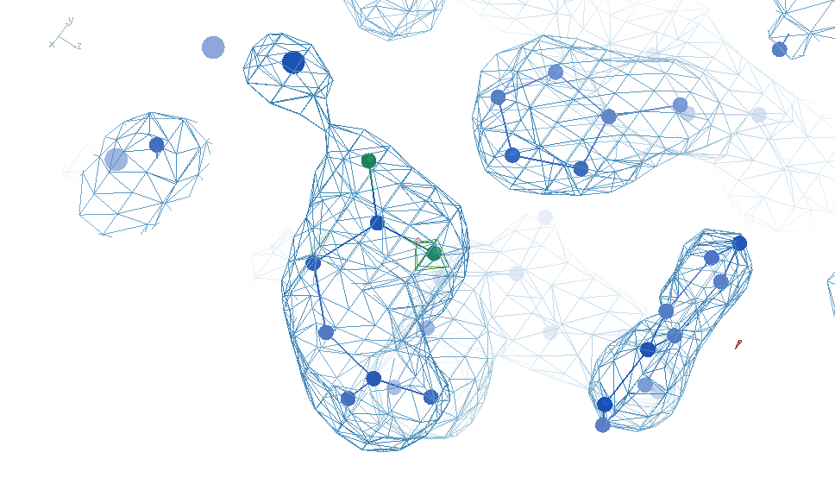
Most-challenged restraint

Slide 49
Talking points
Why is Python so slow?

