Slide 1
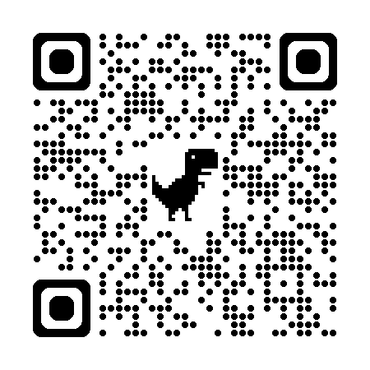
Acknowledgements
https://bl831.als.lbl.gov/~jamesh/powerpoint/SSRL_untangle_2025.pptx
James Fraser Nevan Krogan
Paul Adams John Tainer Greg Hura Nick Sauter
Pavel Afonine Tom Terwilliger Nigel Moriarty, Dorothee Liebschner
Dale Tronrud Helen Ginn Spencer Passmore Aina Cohen
UCSF LBNL SLAC
ALS 8.3.1: TomAlberTron
Astera.org diff-USE (Fraser)
NIH NIGMS R35 GM158447 (Holton)
NIH NIAID P50 AI150476 (Krogan)
NIH NIGMS P30 GM124169 (Adams)
DOE-BER IDAT (Hura)
NIH NIGMS P30 GM133894 (Hodgson)
The Advanced Light Source is supported by the Director, Office of Science, Office of Basic Energy Sciences, Materials Sciences Division, of the US Department of Energy under contract No. DE-AC02-05CH11231 at Lawrence Berkeley National Laboratory.

Slide 2
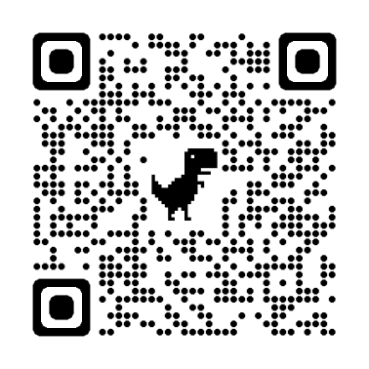
The UNTANGLE Challenge
best.pdb
refme.mtz
(simulated)
11) Build better than the best:
as-good or better score, R_{free} as best.pdb
alternate mechanism ensemble
$1000
https://github.com/jmholton/UnTangle

Slide 3
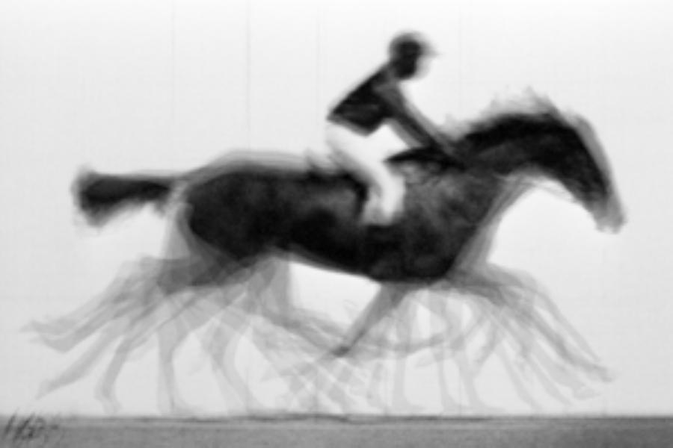
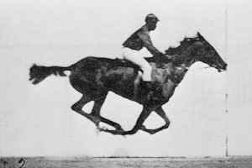
The UNTANGLE Challenge
best.pdb
refme.mtz
(simulated)
11) Build better than the best:
as-good or better score, R_{free} as best.pdb
alternate mechanism ensemble
10) Recover best.pdb from refme.mtz
true phases, auto-building allowed
no cheating (don’t use best.pdb as guide)
Prove: true ensemble is unique and recoverable
$1000
$500
https://github.com/jmholton/UnTangle

Slide 4
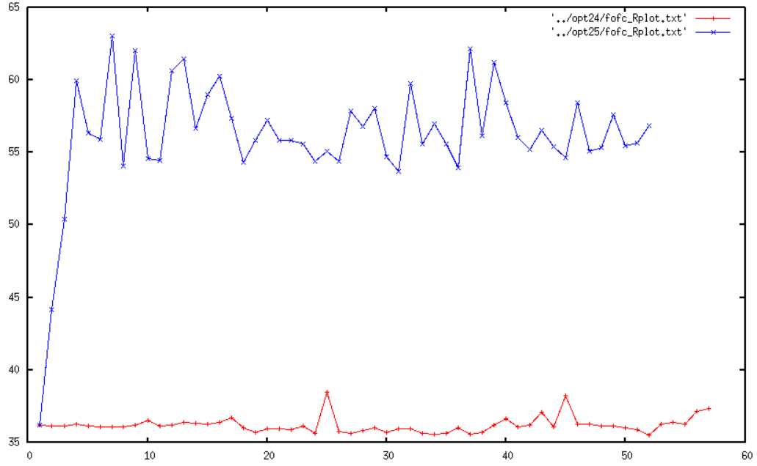
Molecular Dynamics of crystals
65
60
55
50
45
40
35
unrestrained
R_{free} (%)
restrained
Time (ns)

Slide 5
ensemble refine ???

Slide 6
Why doesn’t ensemble refinement:
Find the underlying ensemble?
Converge to good geometry?
yield R_{work}=0?
The chains are “tangled”

Slide 7
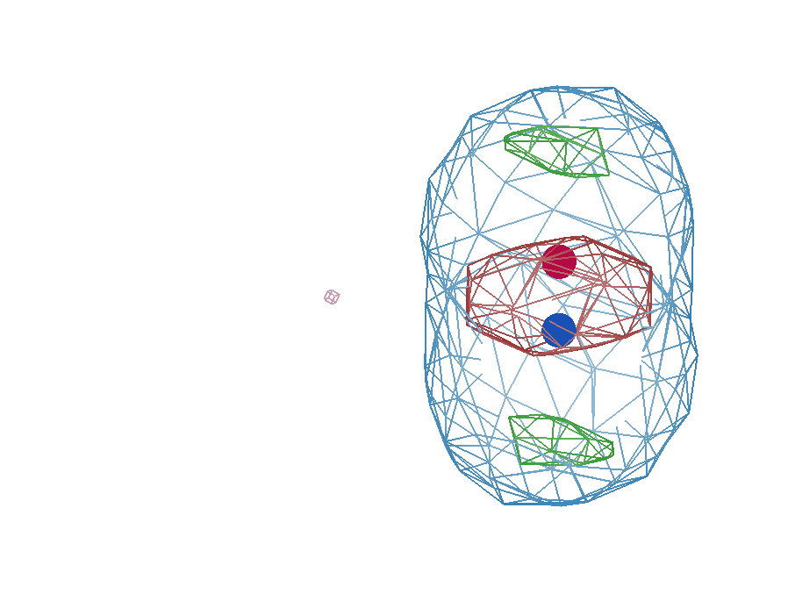
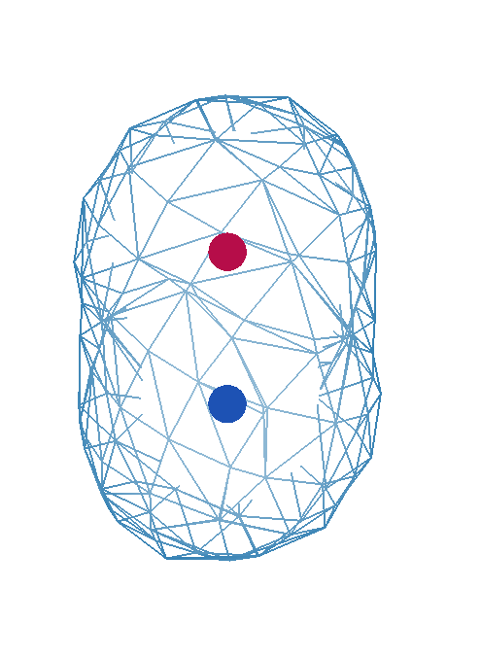
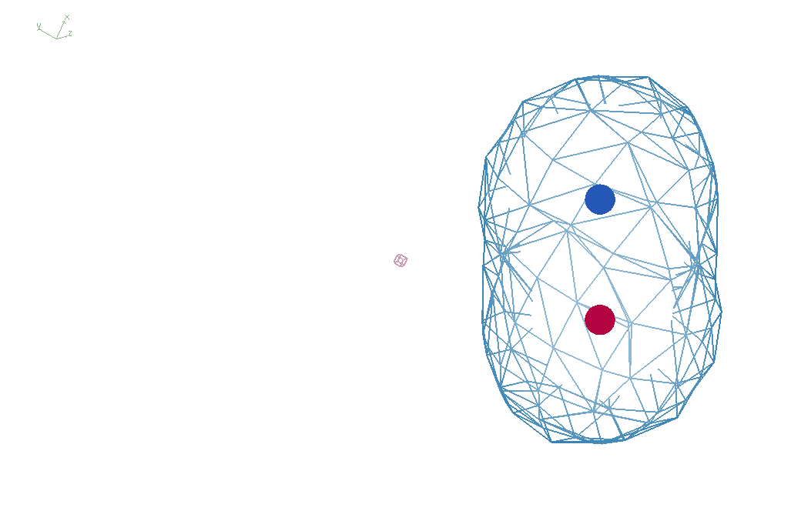
It takes two to tangle
density
fit
Chemical
strain
energy
A
A
B
B
B
A
tangled
barrier
untangled

Slide 8
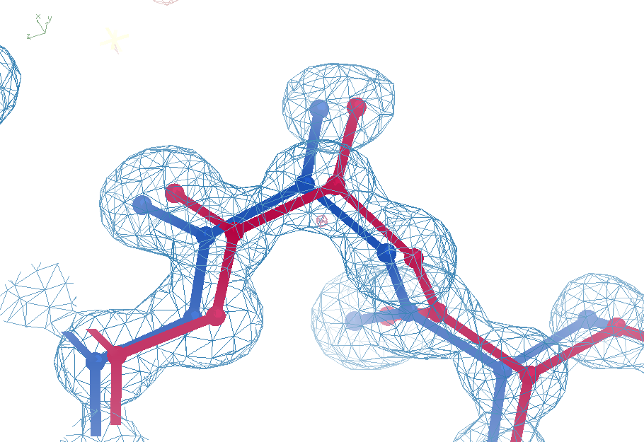
Sim challenge data
Ala39
-0.2σ
wE=18.2
N-C_{α}
bond
R_{free}=3.14
-0.3σ
0.8σ
angle
A B conformers

Slide 9
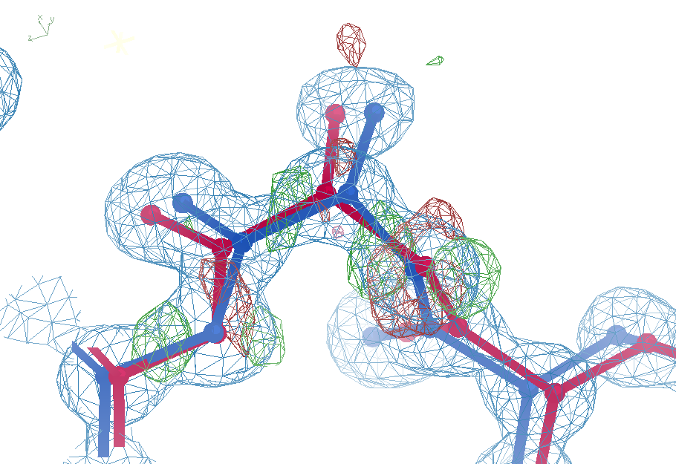

Sim data + “one thing wrong”
Ala39
+11σ
wE=33.9
N-C_{α}
bond
R_{free}=3.32
-9σ
It’s a TRAP!
5σ
angle
A B conformers

Slide 10
What do you mean, “tangled”?
Ground Truth
Local Minimum

Slide 11
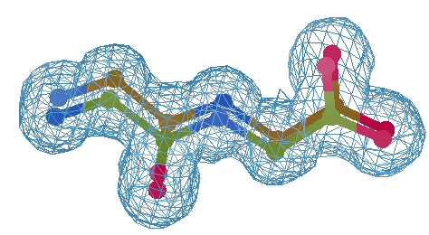
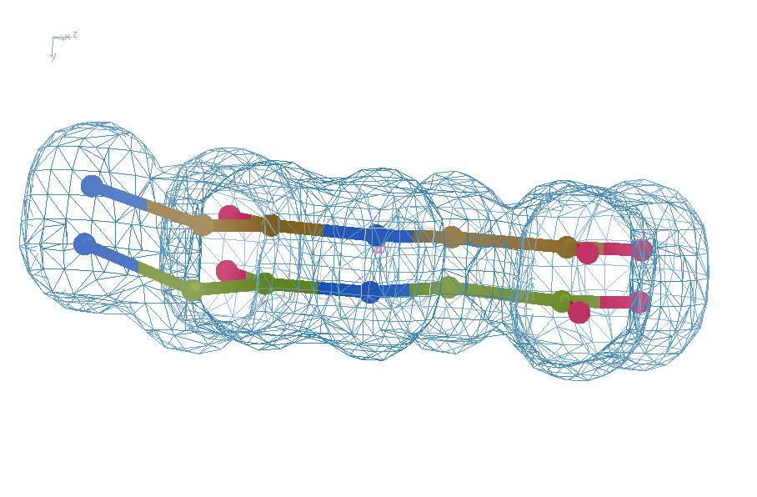
Refine from right answer
R = 0.8%
rms bond = 0.0002

Slide 12
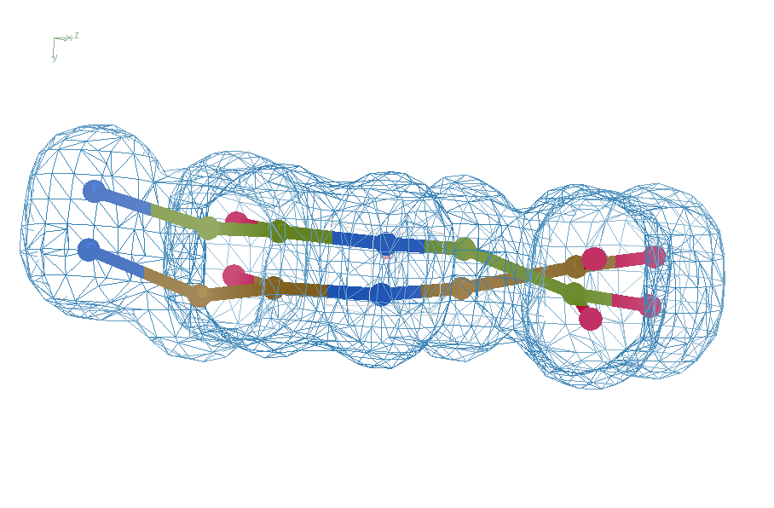
Refine from wrong starting point
R = 7.07%
rms bond = 0.001

Slide 13
UNTANGLE: sim-data Ground Truth
As simple as possible:
2 conformers
50:50 occupancy
Accessible
64 residues
78 waters
Every chance of success
1.0 Å reso
“one thing wrong”
flat bulk solvent
no false outliers
phenix, refmac, shelxl
clear score
Experimental error only
perfect phases

Slide 14
Untangle score: key concepts
sqrt()
erf()
Energy ↔ dev/sigma ↔ Probability
Probability outlier is not noise
“clip” energy to tolerate real outliers
Not so sharp transition to outlier
Tighter Non-bond (Lennard-Jones)

Slide 15
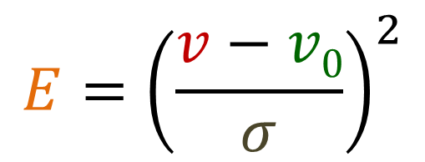
Untangle Score: wE
$$E={\left(\frac{v−v0}{σ}\right)}^{2}$$
E “energy”
v model value
v₀ ideal value
σ rms deviation expected
1 x 6σ ← 40x 1σ
1 x 6σ ≈ 36x 1σ
Outlier problem:
solution: weight by w = “probability its not noise”
→ wE

Slide 16
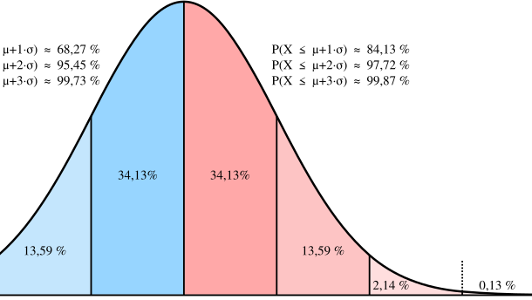
Probability that it’s not noise
erf()
←68%→
← 95% →
-1σ 0 1σ 2σ 3σ

Slide 17
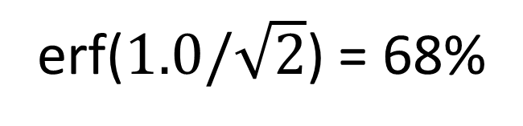
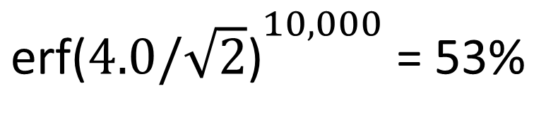
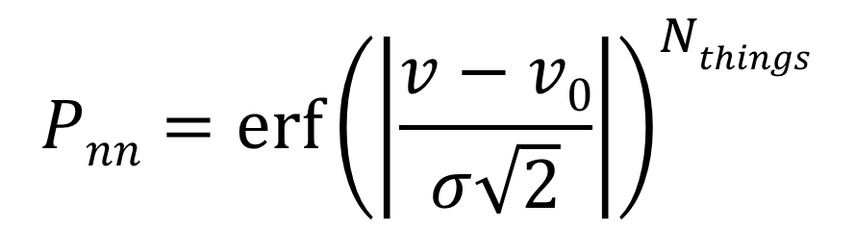
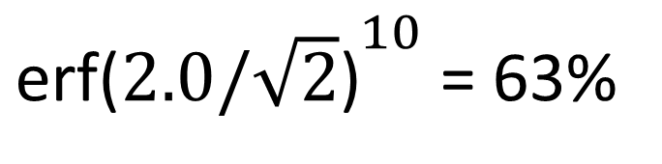
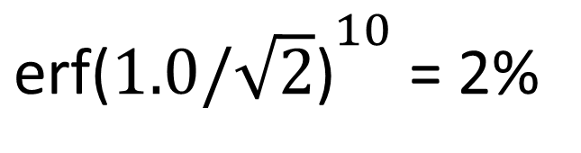
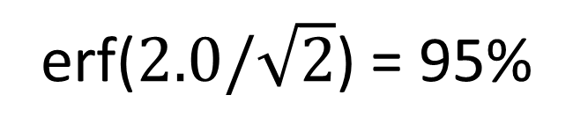
Probability that it’s not noise
$$Pnn={\operatorname{erf}\left(\left|\frac{v−v0}{σ\sqrt{2}}\right|\right)}^{Nthings}$$
P_{nn} probability
v-v₀ deviation from ideal
σ rms deviation expected
erf() integral of a Gaussian
N_{things} number of trials
erf($1.0/\sqrt{2}$) = 68%
${\text{erf}\text{(}1.0/\sqrt{2}\text{)}}^{10}$ = 2%
erf($2.0/\sqrt{2}$) = 95%
${\text{erf}\text{(}2.0/\sqrt{2}\text{)}}^{10}$ = 63%
${\text{erf}\text{(}4.0/\sqrt{2}\text{)}}^{10,000}$ = 53%

Slide 18
verified Score sheet
wE | R_{work} | R_{free} | method
185 | 20.6 | 21.4 | Alphafold2
109.6 | 8.87 | 9.44 | Phenix.ensemble_refine
97.3 | 8.84 | 9.27 | qFit default
80.5 | 4.31 | 4.75 | lotswrong
54.8 | 9.47 | 10.4 | Amber24
54.6 | 5.87 | 6.57 | single conf w aniso B
33.5 | 2.94 | 3.32 | One thing wrong: Ala39
21.4 | 3.12 | 3.48 | Rectified Simulated Annealing
19.4 | 3.72 | 4.64 | Helen Ginn (by hand)
18.1 | 17.9 | 18.4 | Phenix autobuild
18.2 | 2.79 | 3.14 | best (ground truth)
17.6 | 3.18 | 3.71 | Terwilliger create_alt_conf

Slide 19
verified Score sheet
wE | R_{work} | R_{free} | method
185 | 20.6 | 21.4 | Alphafold2
109.6 | 8.87 | 9.44 | Phenix.ensemble_refine
97.3 | 8.84 | 9.27 | qFit default
80.5 | 4.31 | 4.75 | lotswrong
54.8 | 9.47 | 10.4 | Amber24
54.6 | 5.87 | 6.57 | single conf w aniso B
33.5 | 2.94 | 3.32 | One thing wrong: Ala39
21.4 | 3.12 | 3.48 | Rectified Simulated Annealing
19.4 | 3.72 | 4.64 | Helen Ginn (by hand)
18.1 | 17.9 | 18.4 | Phenix autobuild
18.2 | 2.79 | 3.14 | best (ground truth)
17.6 | 3.18 | 3.71 | Terwilliger create_alt_conf

Slide 20
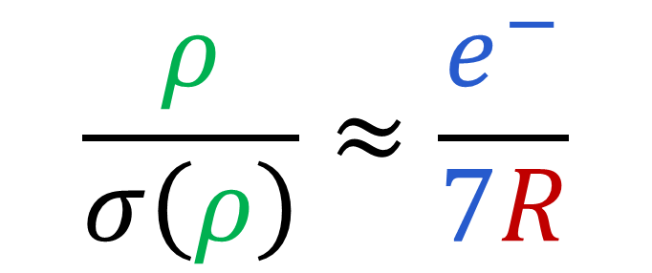
Map Noise: R factors matter via Parseval’s Theorem
$$\frac{ρ}{σ\left(ρ\right)}≈\frac{e^{−}}{7R}$$
e⁻ number of electrons in peak
7 number of electrons in typical atom
R R_{iso} or R_{free}
ρ electron density peak
σ rms deviation expected

Slide 21
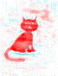
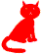
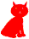
Dominant source of error in MX maps: Cowtan’s Cat
+
=
Amplitudes
Phases
2F_{o}-F_{c}
http://www.ysbl.york.ac.uk/~cowtan/fourier/coeff.html

Slide 22
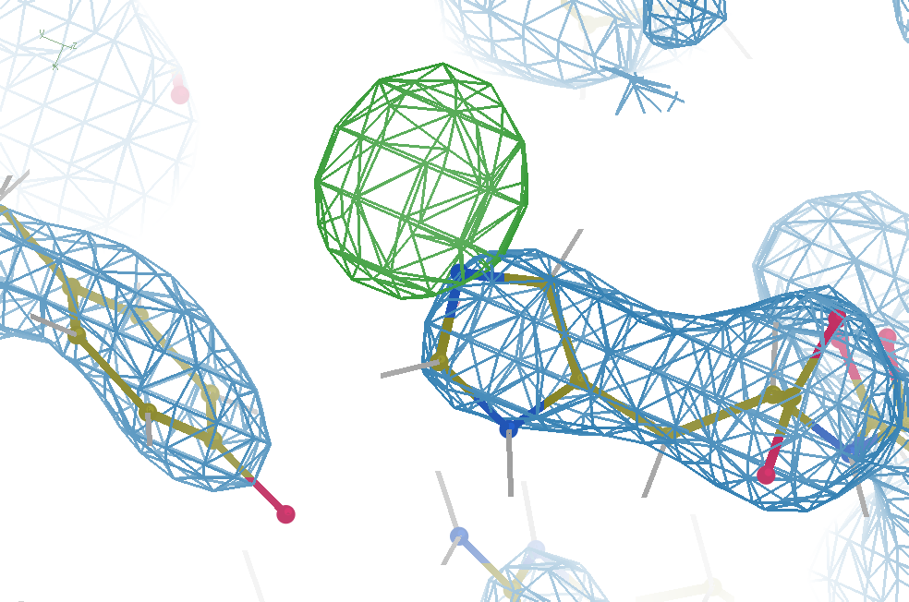
Hydrogen: visible at 3.5 Å resolution!
R_{work} = 0.04
R_{free} = 0.05
6σ = 1 e⁻
cut at 5 Å :
R_{free} = 0.01
Simulation:
Realistic noise
“perfect” model

Slide 23
New Untangling Ideas!
Variable Labels - Tronrud
ROPE - Ginn
phenix.create_alt_conf - Terwilliger
Rectified Simulated Annealing
Bespoke harmonic restraints in MD
Traveling Salesman - Passmore

Slide 24
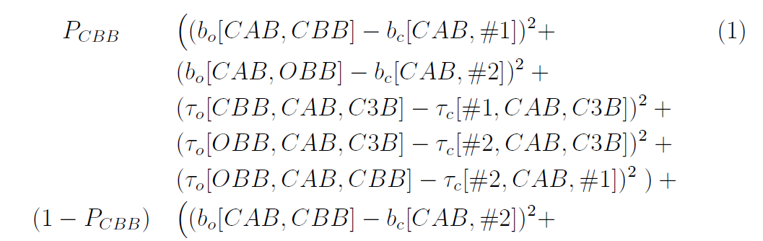
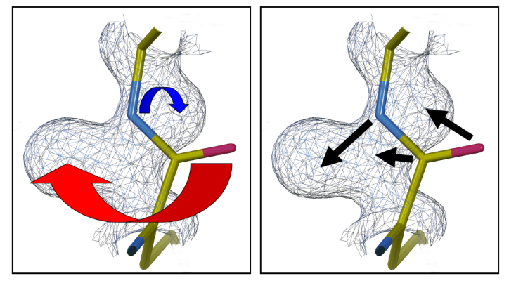
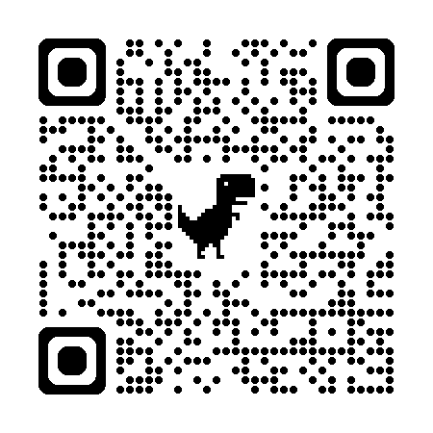
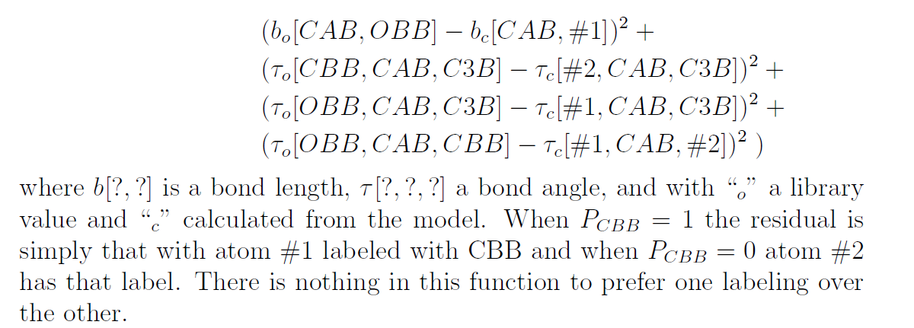
Tronrud’s “Variable Labels” proposal
New ideas!
unimplemented

Slide 25
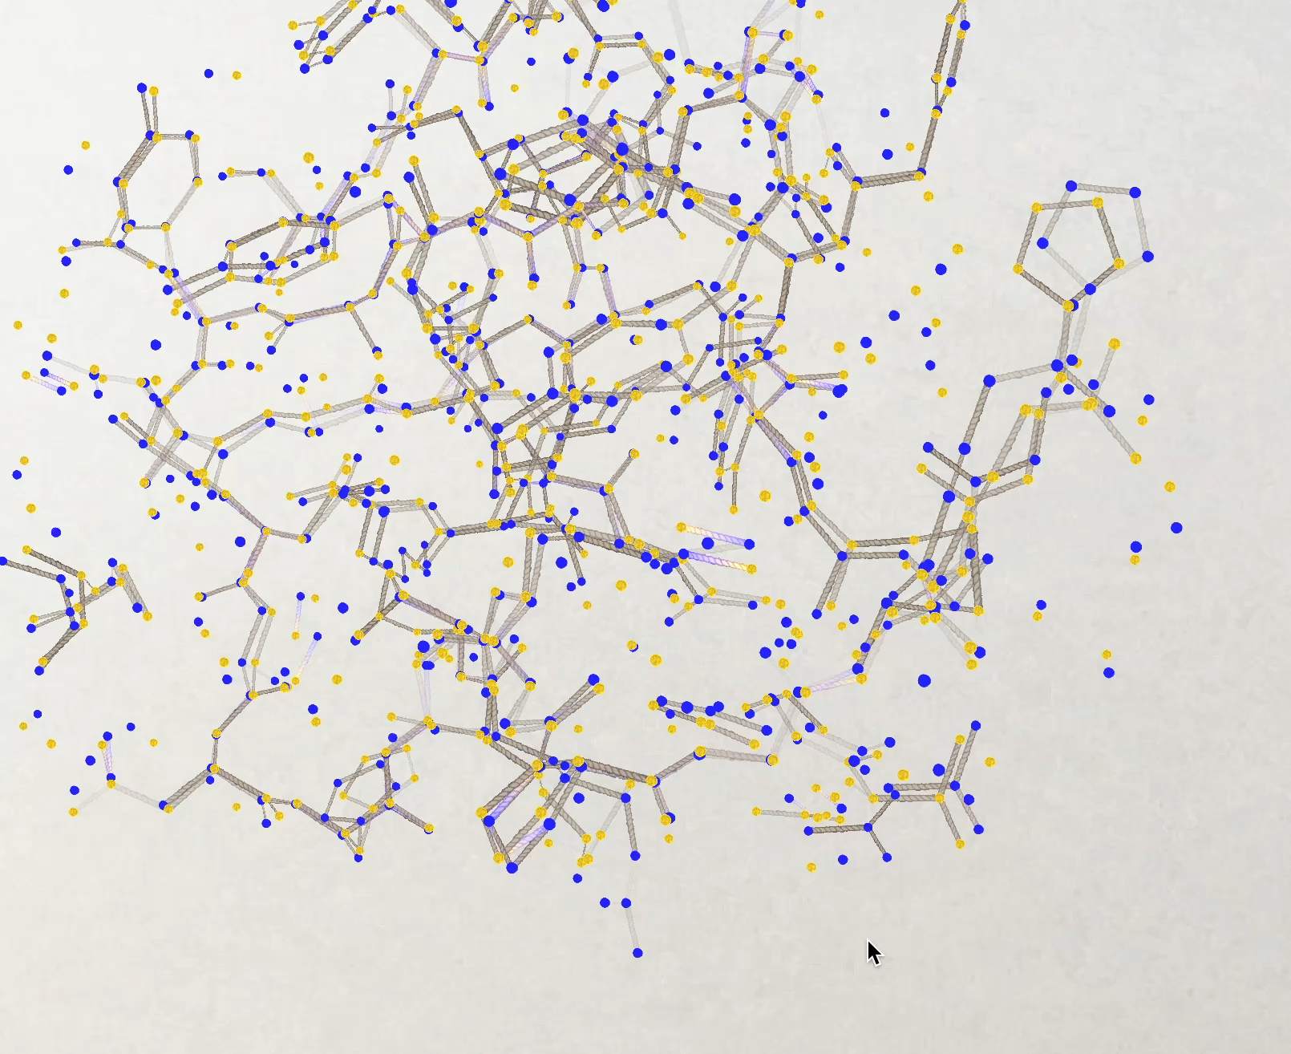
New tools!
Helen Ginn ROPE-based program
GUI showing both conformers A and B and bonds drawn between them according to the following rules:
good geometry, for
or
bad geometry, for
or
good geometry, for
or
bad geometry, for
or
Conformer A
Helen wE = 19.4
Conformer B
“best”: wE = 18.2
This indicates the bottom atom conformers need untangling. Clicking on the atoms flips the conformers over right to the end of the chain.

Slide 26
verified Score sheet
wE | R_{work} | R_{free} | method
185 | 20.6 | 21.4 | Alphafold2
109.6 | 8.87 | 9.44 | Phenix.ensemble_refine
97.3 | 8.84 | 9.27 | qFit default
80.5 | 4.31 | 4.75 | lotswrong
54.8 | 9.47 | 10.4 | Amber24
54.6 | 5.87 | 6.57 | single conf w aniso B
33.5 | 2.94 | 3.32 | One thing wrong: Ala39
21.4 | 3.12 | 3.48 | Rectified Simulated Annealing
19.4 | 3.72 | 4.64 | Helen Ginn (by hand)
18.1 | 17.9 | 18.4 | Phenix autobuild
18.2 | 2.79 | 3.14 | best (ground truth)
17.6 | 3.18 | 3.71 | Terwilliger create_alt_conf

Slide 27
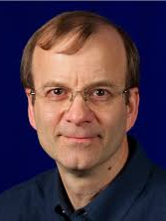
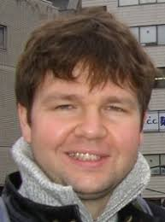
New Tools!
Tom
Terwilliger
phenix.holton_geometry_validation test.pdb
phenix.create_alt_conf phenix_autobuild.pdb refme.mtz \
nproc=48
phenix.refine \
model.pdb refme.mtz \
main.number_of_mac=10 \
fit_altlocs_method=masking \
ordered_solvent=true \
include_altlocs=true \
ordered_solvent.mode=every_macro_cycle_after_first \
refine_oat=true
Pavel Afonine

Slide 28
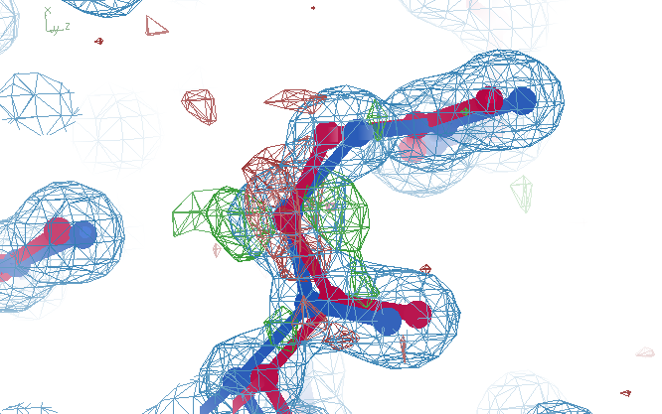
Better than the best?
Ala39
wE=17.2
R_{free}=3.71
A B conformers

Slide 29
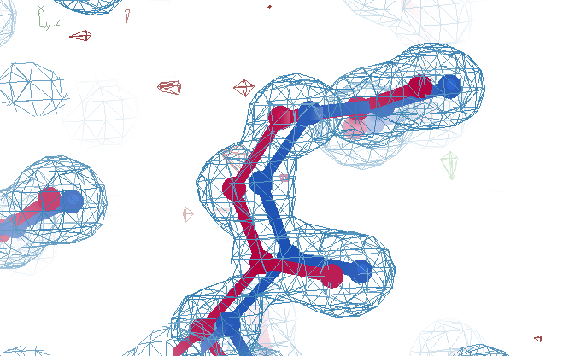
best?
Ala39
wE=18.2
R_{free}=3.14
A B conformers

Slide 30
verified Score sheet
wE | R_{work} | R_{free} | method
185 | 20.6 | 21.4 | Alphafold2
109.6 | 8.87 | 9.44 | Phenix.ensemble_refine
97.3 | 8.84 | 9.27 | qFit default
80.5 | 4.31 | 4.75 | lotswrong
54.8 | 9.47 | 10.4 | Amber24
54.6 | 5.87 | 6.57 | single conf w aniso B
33.5 | 2.94 | 3.32 | One thing wrong: Ala39
21.4 | 3.12 | 3.48 | Rectified Simulated Annealing
19.4 | 3.72 | 4.64 | Helen Ginn (by hand)
18.1 | 17.9 | 18.4 | Phenix autobuild
18.2 | 2.79 | 3.14 | best (ground truth)
17.6 | 3.18 | 3.71 | Terwilliger create_alt_conf

Slide 31
verified Score sheet
wE | R_{work} | R_{free} | method
185 | 20.6 | 21.4 | Alphafold2
109.6 | 8.87 | 9.44 | Phenix.ensemble_refine
97.3 | 8.84 | 9.27 | qFit default
80.5 | 4.31 | 4.75 | lotswrong
54.8 | 9.47 | 10.4 | Amber24
54.6 | 5.87 | 6.57 | single conf w aniso B
33.5 | 2.94 | 3.32 | One thing wrong: Ala39
21.4 | 3.12 | 3.48 | Rectified Simulated Annealing
19.4 | 3.72 | 4.64 | Helen Ginn (by hand)
18.1 | 17.9 | 18.4 | Phenix autobuild
18.2 | 2.79 | 3.14 | best (ground truth)
17.6 | 3.18 | 3.71 | Terwilliger create_alt_conf

Slide 32
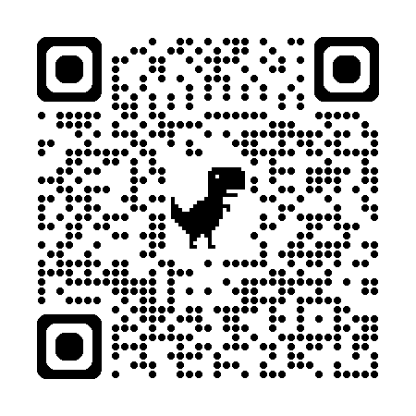
“rectified” Simulated Annealing
Default simulated annealing in phenix
Run score on result
Run score on starting model
Probe difference map
Atom by atom: is worse? Move it back
Iterate
Parallel seeds and temperatures
https://github.com/jmholton/rectified_simulated_annealing

Slide 33
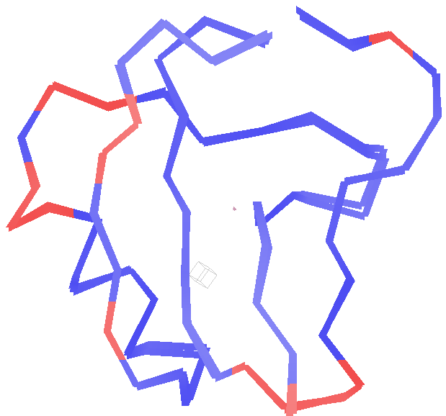
Long-range traps from rectified SA
wE=21.4
R_{free}=3.48
Match ground-truth
swapped relative
To ground truth

Slide 34
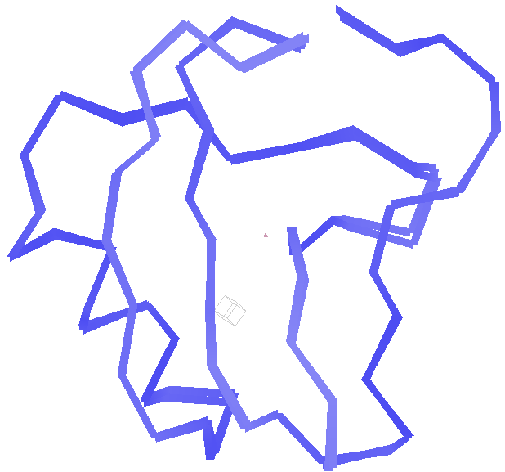
best.pdb
wE=18.2
R_{free}=3.14
Match ground-truth
Nothing
swapped relative
To ground truth

Slide 35
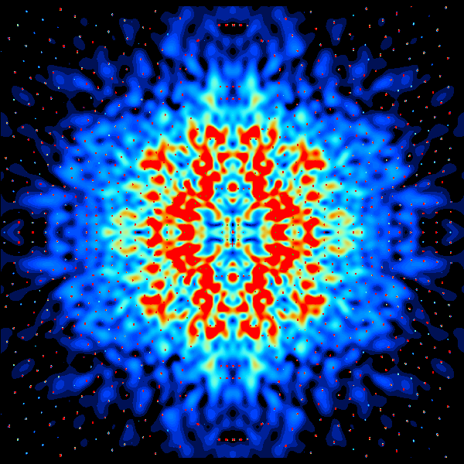
Diffuse Scatter
Ground
Truth

Slide 36
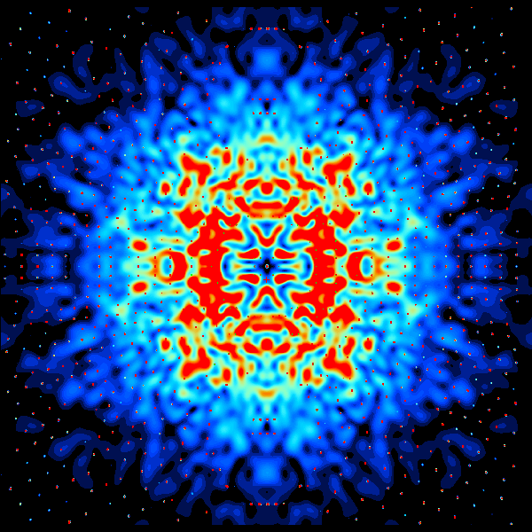
Diffuse Scatter
Long
Range
Traps

Slide 37
Correct
ensemble
Diffuse Scatter
Wrong
ensemble

Slide 38
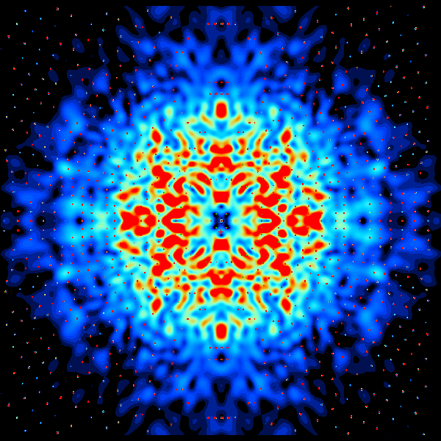
Diffuse Scatter
Lots
Wrong

Slide 39
Correct
ensemble
Diffuse Scatter
Lots
Wrong

Slide 40
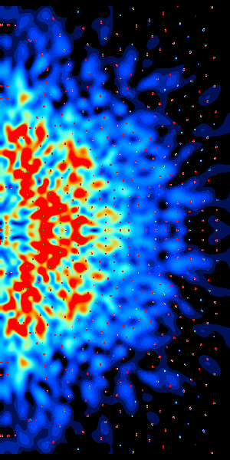
Correct
ensemble
Diffuse Scatter
Val1

Slide 41
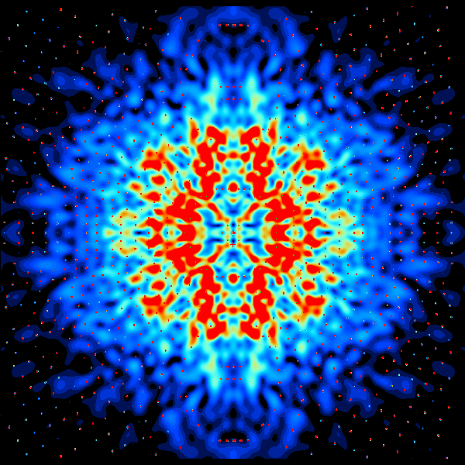
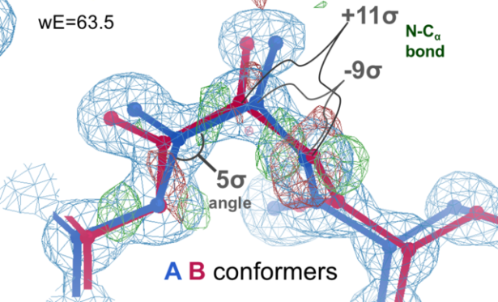
Diffuse Scatter
Ala39
swapped

Slide 42
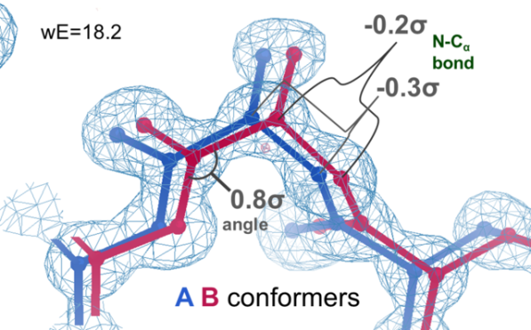
Correct
ensemble
Diffuse Scatter
Ala39
swapped

Slide 43
New Untangling Ideas!
Variable Labels - Tronrud
ROPE - Ginn
phenix.create_alt_conf - Terwilliger
Rectified Simulated Annealing
Bespoke harmonic restraints in MD
Traveling Salesman - Passmore

Slide 44
verified Score sheet
wE | R_{work} | R_{free} | method
185 | 20.6 | 21.4 | Alphafold2
109.6 | 8.87 | 9.44 | Phenix.ensemble_refine
97.3 | 8.84 | 9.27 | qFit default
80.5 | 4.31 | 4.75 | lotswrong
54.8 | 9.47 | 10.4 | Amber24
54.6 | 5.87 | 6.57 | single conf w aniso B
33.5 | 2.94 | 3.32 | One thing wrong: Ala39
21.4 | 3.12 | 3.48 | Rectified Simulated Annealing
19.4 | 3.72 | 4.64 | Helen Ginn (by hand)
18.1 | 17.9 | 18.4 | Phenix autobuild
18.2 | 2.79 | 3.14 | best (ground truth)
17.6 | 3.18 | 3.71 | Terwilliger create_alt_conf

Slide 45
“bespoke” harmonic restraints in MD
A
A
or
B
B
Stays tangled
agnostic

Slide 46
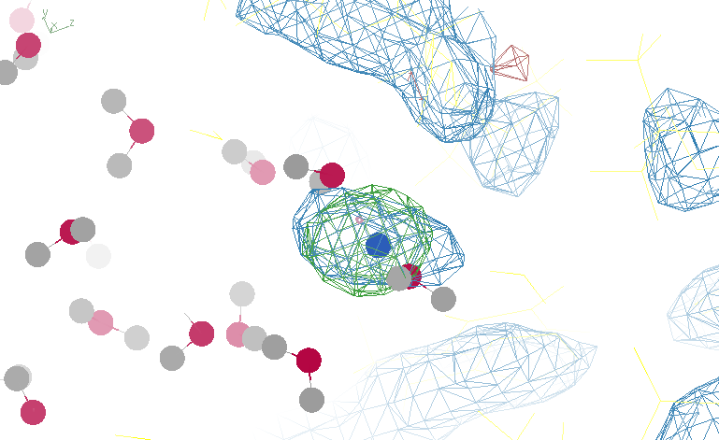
Reference point with too-low weight
Restrained atom
Reference point

Slide 47
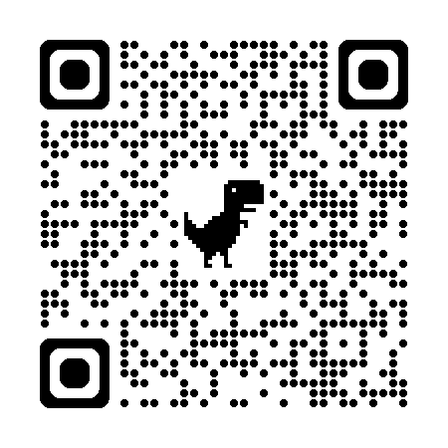
“bespoke” harmonic restraints in MD
Reference points at density centroids
0.5 ns run – average ASU density
F_{obs}-F_{calc} difference map
update weights (green=more ; red=less)
Reduce all weights by ~1%
iterate
https://github.com/jmholton/bespoke_amber_restraints

Slide 48
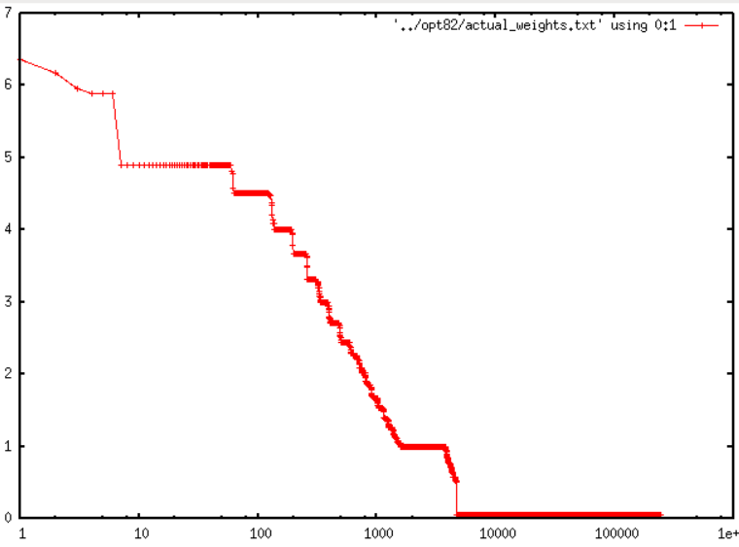
Less than 2% of atoms need restraints
7
6
5
4
3
2
1
0
R_{free} = 27%
no X-ray term!
?
Restraint weight (kcal/Å²)
1.8%
1 10 100 1000 10000 1e5 1e6
Sorted atom count

Slide 49
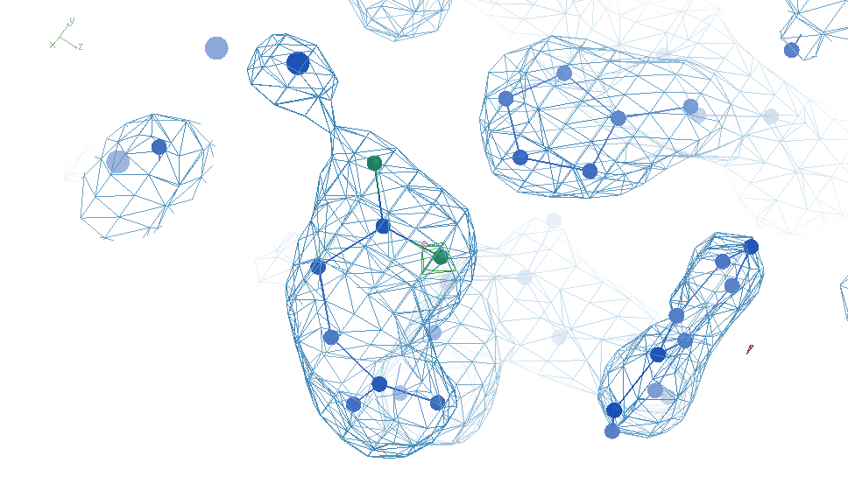
Most-challenged restraint

Slide 50
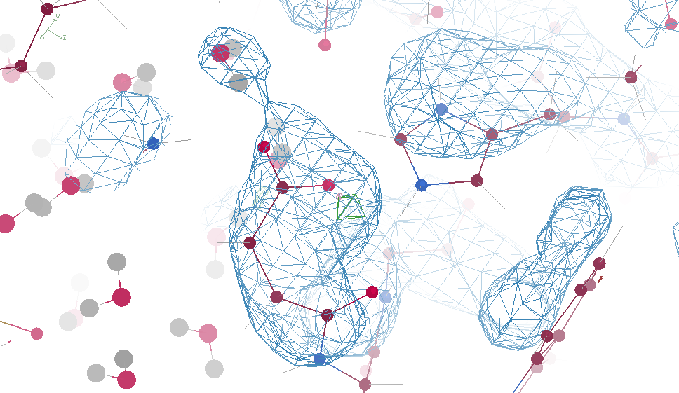
“flying” MD snapshot

Slide 51


Slide 52

Solved, but weird, problem! Vacuum bubbles at 10k atm
Solution:
Netfrc=0
Bespoke restraints
No restraints

Slide 53

Restraints lead to “sloshing”
sparse restraints without alignment
No restraints

Slide 54
New Untangling Ideas!
Variable Labels - Tronrud
ROPE - Ginn
phenix.create_alt_conf - Terwilliger
Rectified Simulated Annealing
Bespoke harmonic restraints in MD
Traveling Salesman - Passmore

Slide 55








Travelling Salesman Problem Analogy
Spencer Passmore - Swinburne University, Melbourne, Australia
2 possible costs per bond
(AA-BB, AB-BA)
4 possible costs per angle
(AAA-BBB, BAA-ABB, ABA-BAB, AAB-BBA)
Minimum:
Minimize
we find 20 or so structures with the lowest values for C, then perform restrained refinement

Slide 56

Travelling Salesman Problem
Spencer Passmore - Swinburne University, Melbourne, Australia
Long_range_traps.pdb → wE = 18.05
Conformer A
Ground Truth
Conformer B

Slide 57
Next Steps
https://bl831.als.lbl.gov/~jamesh/powerpoint/SSRL_untangle_2025.pptx
improved score
not just worst-outlier
density over R_{free}
More realistic ground truth
Fix Sigma(I) bug
Bulk/littoral solvent
Untangling pipeline software!

Slide 58
Summary
https://bl831.als.lbl.gov/~jamesh/powerpoint/SSRL_untangle_2025.pptx
Recover underlying ensemble
A solution exists!
Next: more realism
Now with Diffuse Scatter
Rfree < 3% → single e⁻
Main barrier: tangled ensemble
Weighted “wE” score
Cooperative motions
$1000
$500

Slide 59
Over-Fitting data
Map density
position

Slide 60
Over-Fitting data
Map density
position

Slide 61
Over-Fitting data
Map density
position

Slide 62
Over-Fitting data
R_{work} ≈ 0
N_{params}= N_{obs}
Map density
position

Slide 63

Under-Fitting data
R_{work} > 0
N_{params}> N_{obs}
Map density
position

Slide 64

R_{work}: 0.0823
R_{free}: 0.1106
bond: 0.014 Å
angle: 1.92°
under-fitting:
R_{work} > 0
MoPro: 1.15
Clash: 0.49
Cβdev: 20
Rota: 1.7%
Rama: 0.03%
reso: 1.0 Å
6σ

Slide 65

What is holding this back?
1 member of 48-copy
ensemble
R_{work}: 0.0823
R_{free}: 0.1106
bond: 0.014 Å
angle: 1.92°
MoPro: 1.15
Clash: 0.49
Cβdev: 20
Rota: 1.7%
Rama: 0.03%
reso: 1.0 Å
30°
peptide
bond twist

Slide 66
wE score: key concepts
sqrt()
erf()
Energy ↔ dev/sigma ↔ Probability
Probability outlier is not noise
“clip” energy to tolerate real outliers
Not so sharp transition to outlier
Tighter Non-bond (Lennard-Jones)

Slide 67


“clip” for tolerating true outliers
clip(E) $=\left\{\begin{matrix}E, if E<10 \\ 10+\log\left(E\right)−log⁡(10)\end{matrix}\right.$
Statistical Energy
$$E={\left(\frac{v−v0}{σ}\right)}^{2}$$
10
wE
Colloquially:
OK! OK! Its an outlier! Let’s not agonize about it
N=10
5
N=10,000
10σ vs 10.1σ not more important
than 3.3σ vs 3.0σ
0
3
6
8
max sigma deviate

Slide 68

Glu32
Genuine outlier
in ground truth
real data
-80°
Torsion outlier

Slide 69

Cys12
Genuine outlier
in ground truth
real data
-107°
torsion outlier
A B conformers

Slide 70
wE score: key concepts
sqrt()
erf()
Energy ↔ dev/sigma ↔ Probability
Probability outlier is not noise
“clip” energy to tolerate real outliers
Not so sharp transition to outlier
Tighter Non-bond (Lennard-Jones)

Slide 71


Probability that it’s not noise softer
$${Pnn}^{soft}=1−2^{\left({\left(\frac{\left|v−v0\right|}{σ_{P50}}\right)}^{5}\right)}$$
1
P_{nn} probability
v-v₀ deviation from ideal
σ rms deviation expected
inverf() inverse erf()
N_{things} number of trials
P
N=1
0.5
N=1 soft
$$σ_{P50}=$$
$$\sqrt{2} \text{inverf}\left({0.5}^{1/{N_{things}}}\right)$$
N=10,000
soft
N=10,000
0
1
2
3
4
5
6
max sigma deviate

Slide 72

Probability that it’s not noise average/sum of N_{things}
χ² test
N_{things}
Probability
That its
Gaussian
tie breaker

Slide 73
wE score: key concepts
sqrt()
erf()
Energy ↔ dev/sigma ↔ Probability
Probability outlier is not noise
“clip” energy to tolerate real outliers
Not so sharp transition to outlier
Tighter Non-bond (Lennard-Jones)

Slide 74
wE scoring function
Statistical potential
bonds, angles, planes, torsions, chiral
Lennard-Jones vdW
non-bond and clashes
Probability -> σ dev
- Rota, rama
Peptide bond
σ → 4°
C_{β}dev
σ = 0.05 Å
4
2
van der Waals
Phenix/refmac
0
Energy
-1
1
2
3
4
5
Atomic separation (Å)

Slide 75





weighted Energy scoring function
$$=\sum{w_{avg}\left\langle E\right\rangle +}w_{max}max\left(clip\left(E\right)\right)$$
wE
validation types
phenix.holton_geometry_validation
$$w_{max}=\text{P}\text{nn}max\left(clip\left(E\right)\right)$$
10
$$w_{avg}=χ^{2}\left(\sum{E}\right)$$
wE
N=10
5
N=10,000
N_{bonds}
$$E={\left(\frac{v−v0}{σ}\right)}^{2}$$
max() = worst outlier
0
clip(E) $=\left\{\begin{matrix}E, if E<10 \\ 10+\log\left(E\right)−log⁡(10)\end{matrix}\right.$
3
6
8
max sigma deviate

Slide 76


UNTANGLE scoring function
$$score=wE+{\left(\frac{Rfree−σ_{R}}{σ_{R}}\right)}^{2}$$
score UNTANGLE Challenge score
wE weighted energy avg + worst
σ_{R} experimental error (2%)
https://github.com/jmholton/UnTangle

Slide 77

One-atom trap
Ser40
wE=18.8
A B conformers

Slide 78

One-atom trap
Ser40
wE=18.2
A B conformers

Slide 79
Muybridge’s galloping horse (1872)

Slide 80
average structure: galloping horse

Slide 81

Horses have bones
+/- 0.01

Slide 82
Differences & Similarities
horse
molecule
~2 m
Stiff backbone
Bone sigma ~ 1 mm
4 joints/leg
Continuous angle
No torision
Concerted motion
no steric clashes
~100 Å
Stiff backbone
Bond sigma = 0.01 Å
0-4 chi angles
Angle sigma ~ 1°
Rotamers
Concerted motion
no steric clashes

Slide 83
Horses have bones

Slide 84

Muybridge’s galloping horse 0

Slide 85

Muybridge’s galloping horse 1

Slide 86

Muybridge’s galloping horse 2

Slide 87

Muybridge’s galloping horse 3

Slide 88

Muybridge’s galloping horse 4

Slide 89

Muybridge’s galloping horse 5

Slide 90

Muybridge’s galloping horse 6

Slide 91

Muybridge’s galloping horse 7

Slide 92

Muybridge’s galloping horse 8

Slide 93

Muybridge’s galloping horse 9

Slide 94

Muybridge’s galloping horse 10

Slide 95

Muybridge’s galloping horse 11

Slide 96

Muybridge’s galloping horse 12

Slide 97

Muybridge’s galloping horse 13

Slide 98

Muybridge’s galloping horse 14

Slide 99
Older Score sheet
wE | R_{work} | R_{free} | method
185 | 20.6 | 21.4 | Alphafold2
109.6 | 8.87 | 9.44 | Phenix.ensemble_refine
97.3 | 8.84 | 9.27 | qFit best
91.7 | 3.64 | 4.27 | manual
80.5 | 4.31 | 4.75 | lotswrong
65.2 | 6.35 | 6.93 | Amber24
54.6 | 5.87 | 6.57 | single conf w aniso B
33.5 | 2.94 | 3.32 | One thing wrong: Ala39
19.4 | 3.72 | 4.64 | Helen Ginn (by hand)
21.4 | 3.12 | 3.48 | Long Range Traps
18.1 | 17.9 | 18.4 | Phenix autobuild
18.2 | 2.79 | 3.14 | best (ground truth)

Slide 100

sim data
Arg62
wE=63.5
2.8 Å
4σ
C_{γ}-C_{δ}
bond
2.7σ torsion
A B conformers

Slide 101

sim data
Arg62
wE=50.7
2.8 Å
2σ
angle
A B conformers

Slide 102

sim data
Arg62
wE=18.2
3.0 Å
0.3σ
C_{γ}-C_{δ}
bond
1σ
angle
1.6σ torsion
A B conformers

Slide 103

Tyr14
sim data
wE=33.1
3.0 Å
A B conformers

Slide 104

Tyr14
sim data
wE=18.2
3.2 Å
A B conformers

Slide 105

Cys16
sim data
wE=21.4
2.7σ
angle
A B conformers

Slide 106

Cys16
sim data
wE=18.2
1.5σ
angle
A B conformers

