Slide 1
Acknowledgements
James Fraser Terry Lang Ken Frankel John Tainer
ALS 8.3.1 creator: Tom Alber
Center for Structure of Membrane Proteins (CSMP)
Membrane Protein Expression Center II (MPEC)
Center for HIV Accessory and Regulatory Complexes (HARC)
Integrated Diffraction Analysis Technologies (IDAT)
W. M. Keck Foundation
Plexxikon, Inc.
M D Anderson CRC
University of California Berkeley
University of California San Francisco
University of California Campus-Laboratory Collaboration Grant
Henry Wheeler
The Advanced Light Source is supported by the Director, Office of Science, Office of Basic Energy Sciences, Materials Sciences Division, of the US Department of Energy under contract No. DE-AC02-05CH11231 at Lawrence Berkeley National Laboratory.

Slide 2
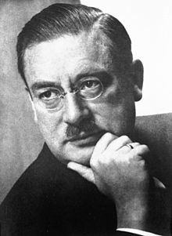
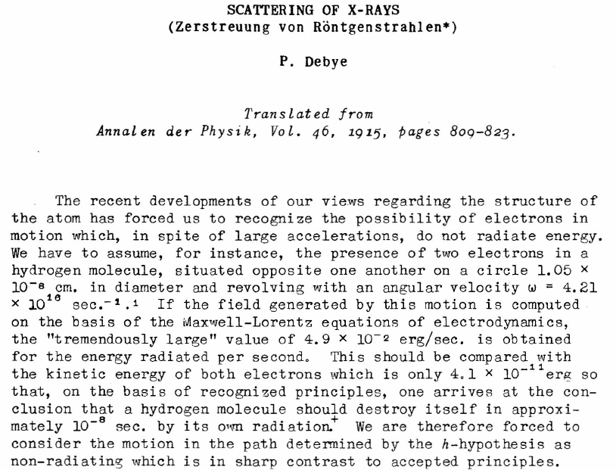
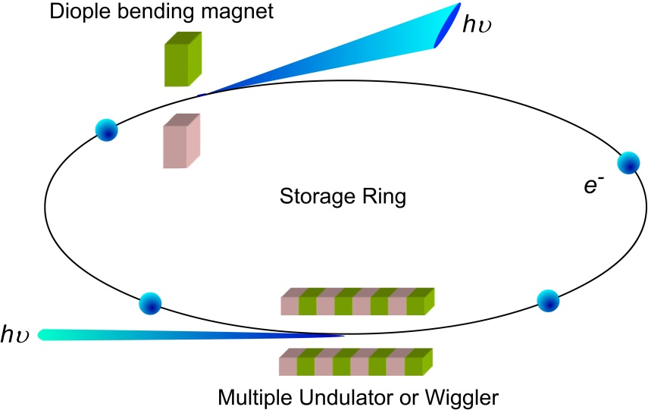
Dawn of the Age of Uncertainty

Slide 3
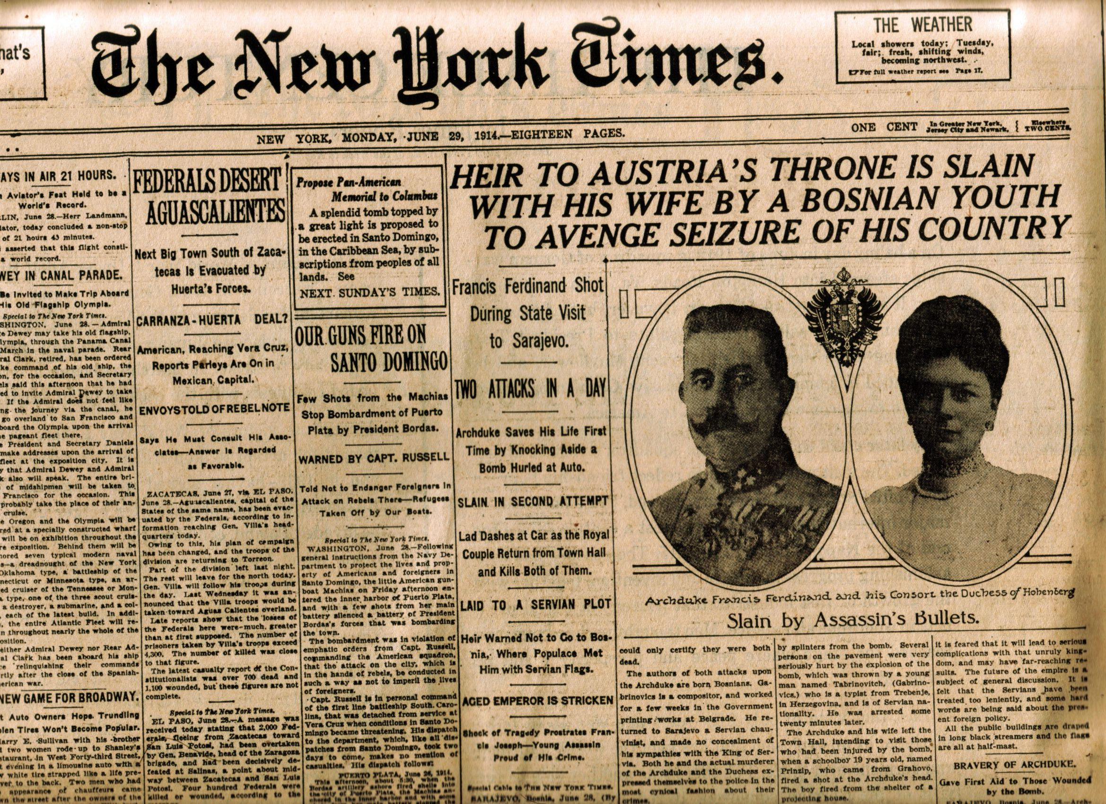
June 28 1914

Slide 4
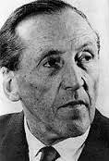
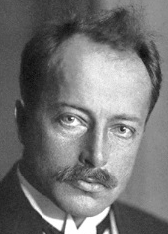
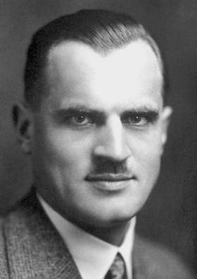
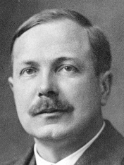
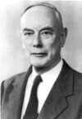
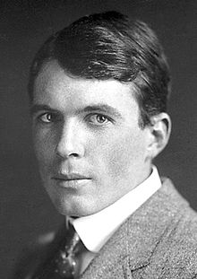
1914: who was there?
Curie
47
Crowfoot
3
Scherrer
25
Debye
31
Lorentz
61
Einstein
36
Laue
35
Edison
68
Tesla
58
Compton
22
Röntgen
70
CG Darwin
27
Moseley
27
PP Ewald
27
JC Maxwell
48 for 36
Rayleigh
72
JJ Thomson
56
Rutherford
43
WL Bragg
24
WH Bragg
52

Slide 5
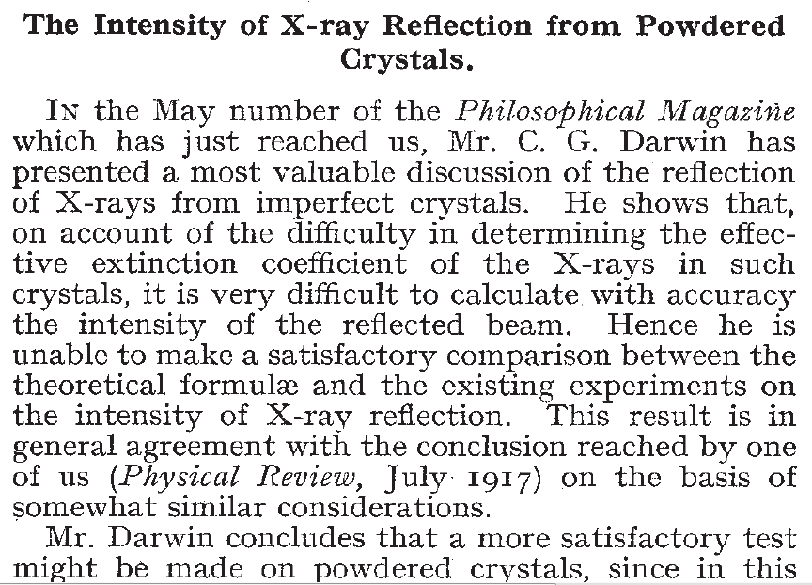
Flow of information
written:
30 May
other paper:
1 May
Compton, A. H. & Freeman, N. L. (1922), Nature 110, 38.

Slide 6
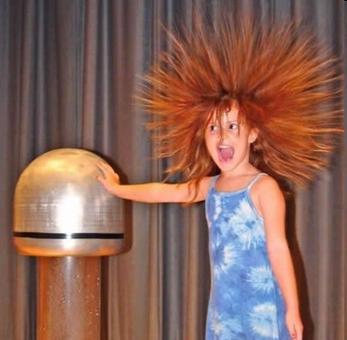
Electric fields: voltage vs current

Slide 7
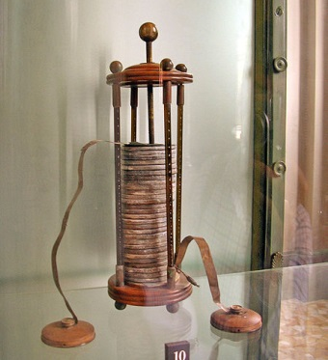
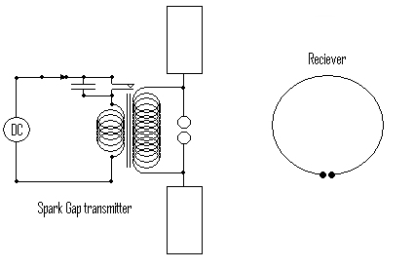
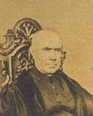
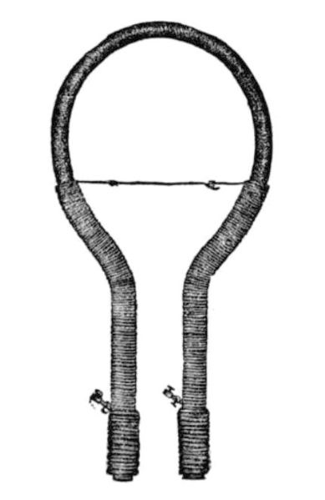
A Brief History of Electricity
~1-60 Volts
Alessandro Volta
voltaic pile
1837 >60 kV
Nicholas Callan
induction coil
1865
J. C. Maxwell
electromagnetic waves
1886-1896 34 miles
Hertz / Marconi / Tesla
wireless spark gap transmitter

Slide 8
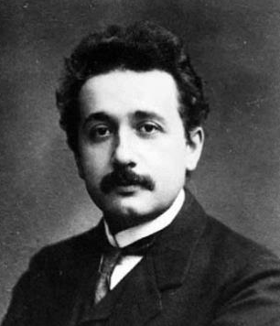
The speed of light
299792458.000 m/s
JC Maxwell
Einstein

Slide 9
Electric field of a moving charge
JC Maxwell
Einstein

Slide 10
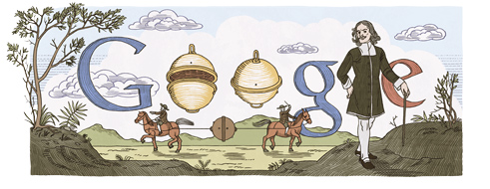
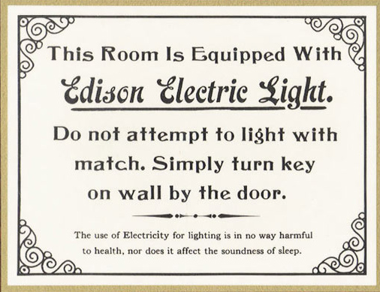
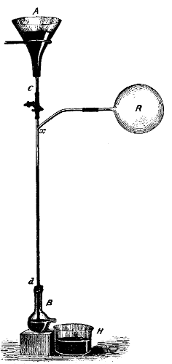
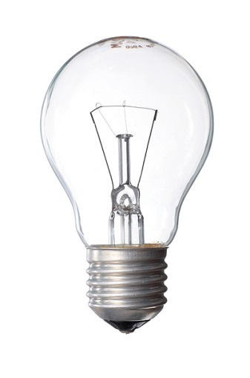
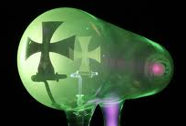
Electricity + vacuum = X-rays
1654 ~10 Torr
Otto von Guericke’s
“Magdeburg hemispheres”
1865 < 10⁻² Torr
Hg “fall tube” pump
Sprengel, H. (1865). "Researches on the vacuum", J. Chem. Soc. 18, 9b-21.
1870s < 10⁻³ Torr
1894 < 10⁻⁵ Torr
Sprengel pump
Redhead, Paul A., ed. Vacuum Science and Technology: Pioneers of the 20th Century. Vol. 2. Springer, 1994.
Benvenuti, C. & Chiggiato, P. (1993). "Obtention of pressures in the 10⁻¹⁴ torr range by means of a Zr-V-Fe non evaporable getter", Vacuum 44, 511-513.
1993 ~10⁻¹⁴ Torr

Slide 11
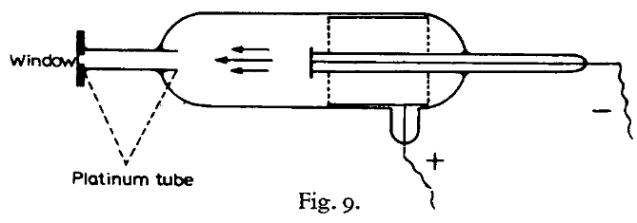
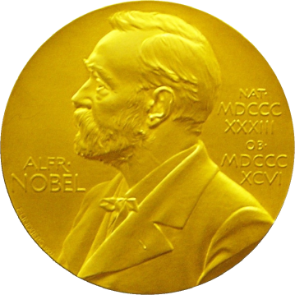
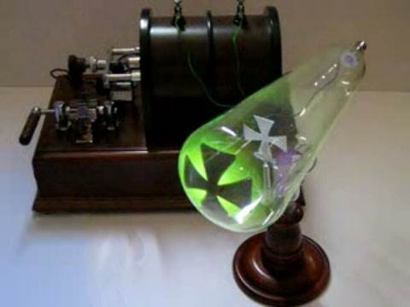
X-rays (aka “Röntgenstrahlung”)
The discovery soon after this of X-rays by Röntgen (22), the first investigator to use the type of tube described above, is generally considered to be a good example of a lucky discovery.
P.E.A. von Lenard
1906 Nobel Lecture
Röntgen, W. C. (1898)."Ueber eine neue Art von Strahlen", Annalen der Physik 300, 1-11.

Slide 12
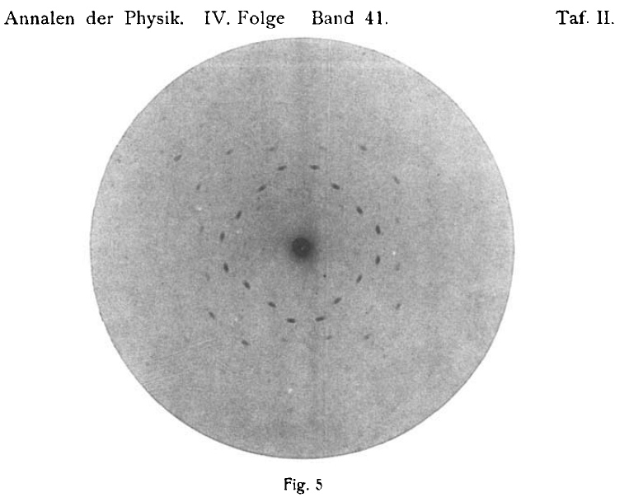
Laue’s diffraction photograph (not to be confused with Laue diffraction)
“In 1910, when I began work on my thesis, there was no quantitative proof for the internal periodicity of crystals. My teacher Sommerfeld had the idea that … a lattice, would produce observable double refraction”
Submitted
June 8 1912
Friedrich, W., Knipping, P. &
Laue, M. (1913). "Interferenzerscheinungen bei Röntgenstrahlen", Annalen der Physik
346, 971-988.
Ewald, P. (1979).
"A review of my papers on crystal optics 1912 to 1968", Acta Cryst. A 35, 1-9.
ZnS

Slide 13
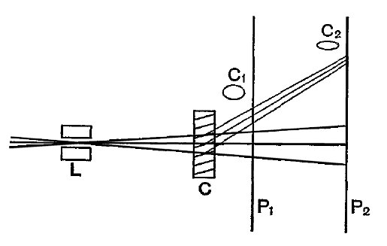
W. L. Bragg on spot shape
nλ = 2d sin θ
Bragg, W. L. (1912). “On the diffraction of short electromagnetic waves by a crystal” Proc. Cambridge Philos. Soc. 17, 43-57
23 years old

Slide 14
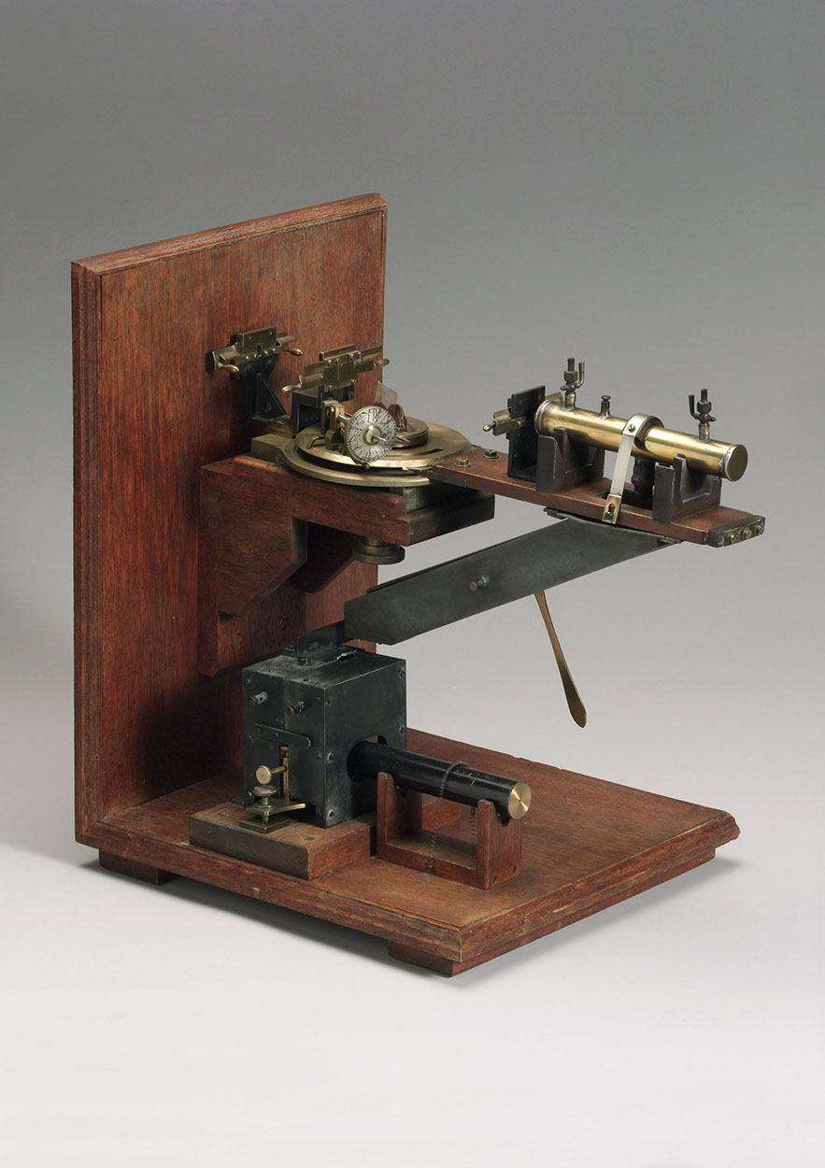
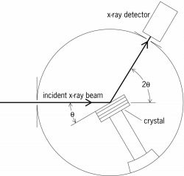
W.H. Bragg’s “spectrometer”

Slide 15
1914: who was there?
Curie
47
Crowfoot
3
Scherrer
25
Debye
31
Lorentz
61
Einstein
36
Laue
35
Edison
68
Tesla
58
Compton
22
Röntgen
70
CG Darwin
27
Moseley
27
PP Ewald
27
JC Maxwell
48 for 36
Rayleigh
72
JJ Thomson
56
Rutherford
43
WL Bragg
24
WH Bragg
52

Slide 16
Darwin’s Formula
V_{xtal}
λ³ L
I(hkl) = I_{beam} r_{e}²
P A | F(hkl) |²
V_{cell}
ωV_{cell}
I(hkl) - photons/spot (fully-recorded)
I_{beam} - incident (photons/s/m² )
r_{e} - classical electron radius (2.818x10⁻¹⁵ m)
V_{xtal} - volume of crystal (in m³)
V_{cell} - volume of unit cell (in m³)
λ - x-ray wavelength (in meters!)
ω - rotation speed (radians/s)
L - Lorentz factor (speed/speed)
P - polarization factor
(1+cos²(2θ) -Pfac∙cos(2Φ)sin²(2θ))/2
A - attenuation factor
exp(-μ_{xtal}∙l_{path})
F(hkl) - structure amplitude (electrons)
C. G. Darwin (1914)

Slide 17
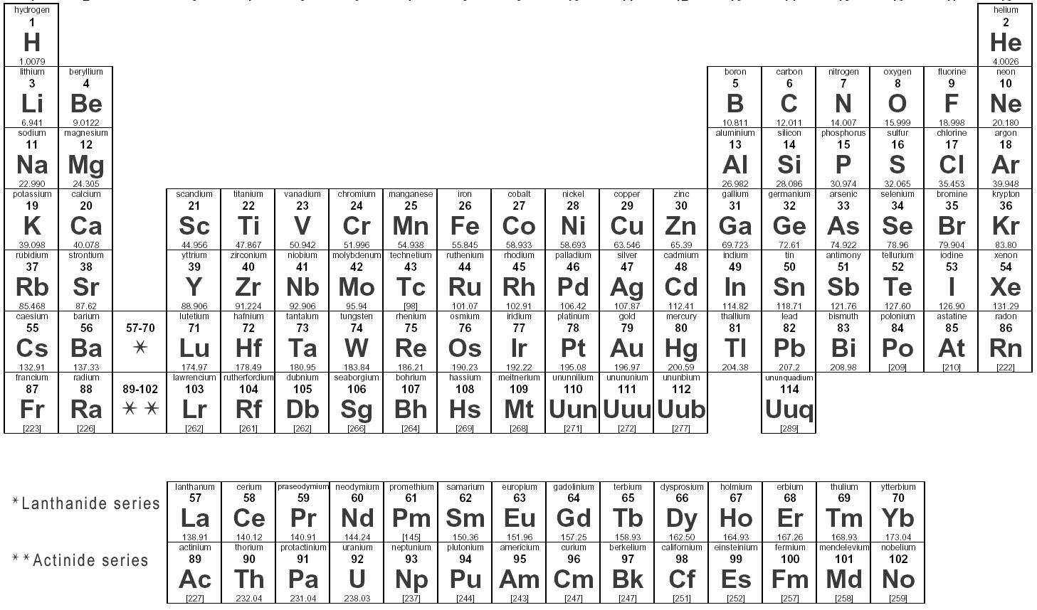
Periodic Table ca 1914
argon
18
Ar
39.948
potassium
19
K
39.098
Chadwick, J. (1932)."Possible existence of a neutron", Nature 129, 312.
nλ = 2d sin θ

Slide 18
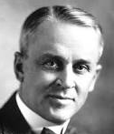
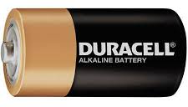
How do you weigh an atom?
O₂
John Dalton 1808
Hydrogen = 1
H₂
Michael Faraday 1820s
1 mol e⁻ = 96485 Coulomb
Robert Millikan 1910
1 e⁻ = 1.9x10⁻¹⁹ Coulomb
e⁻
e⁻
e⁻
e⁻
e⁻
e⁻
e⁻
N_{A} = 1 mol = 6.022x10²³ e⁻
1914 Nobel in Chemistry: T.W. Richards

Slide 19
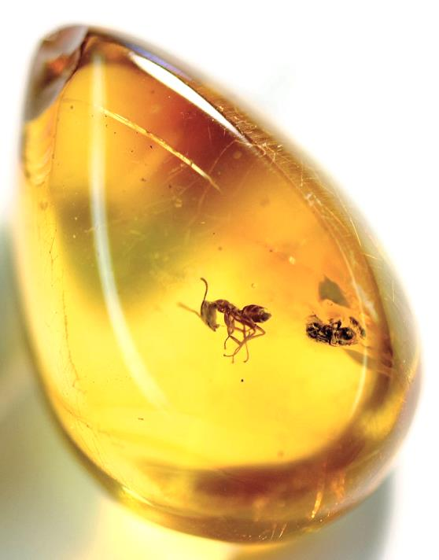
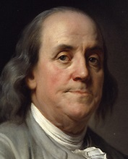
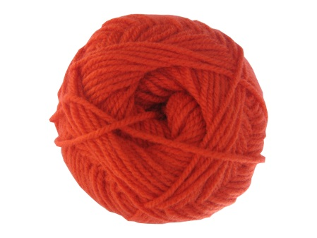
A Brief History of Electricity
amber = ήλεκτρο
elektro
1737
-
-
“electrical fluids”
resinous
vitreous
-
+
+
+
negative
positive
-
~1750
-
-
+
+
+
glass

Slide 20
Thomson’s Atom
+
-
-
-
+
-
+
+
+
-
+
1870 The atom as a
“vortex” in the æther
+
-
-
+
+
-
-
1906 J. J. Thomson’s
the “plum pudding” model
W. Thomson
(Lord Kelvin)
J.J. Thomson
(Cavendish)

Slide 21
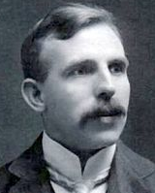
Rutherford’s Atom
α
α
-
+
α
+
-
+
+6
α
+
Curie
-
α
-
+
+
-
-
Geiger, H. & Marsden, E. (1909).
"On a diffuse reflection of the α-particles", Proc. Roy. Soc. London. A, 82, 495-500.
W. Thomson
(Lord Kelvin)
J.J. Thomson
(Cavendish)
E. Rutherford
(Cavendish)

Slide 22
A Fourier view of scattering
density (ρ)
intensity
distance (Å)
angle (°)

Slide 23
A Fourier view of scattering
density (ρ)
intensity
distance (Å)
angle (°)

Slide 24
A Fourier view of scattering
density (ρ)
intensity
distance (Å)
angle (°)

Slide 25
A Fourier view of scattering
density (ρ)
intensity
distance (Å)
angle (°)

Slide 26
“B” factors
electron density (e⁻/Å³)
position (Å)

Slide 27
“B” factors
electron density (e⁻/Å³)
position (Å)

Slide 28
“B” factors
electron density (e⁻/Å³)
position (Å)

Slide 29
“B” factors
electron density (e⁻/Å³)
position (Å)

Slide 30
“B” factors
electron density (e⁻/Å³)
position (Å)

Slide 31
Temperature is not enough
Debye, P. J. W. (1914)."Interferenz von Röntgenstrahlen und Wärmebewegung", Annalen der Physik 348, 49-92.

Slide 32
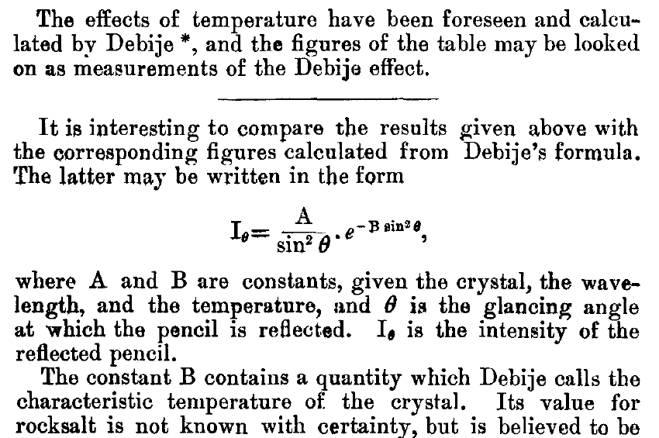
The B factor
Bragg, W. H. (1914)."XCVII. The intensity of reflexion of X rays by crystals", Philosophical Magazine Series 6 27, 881-899. Published May 1 1914

Slide 33
Lorentz factor: note added in proof
Debye, P. J. W. (1914)."Interferenz von Röntgenstrahlen und Wärmebewegung", Annalen der Physik 348, 49-92.
Lorentz

Slide 34
Dawn of the Age of Uncertainty

Slide 35
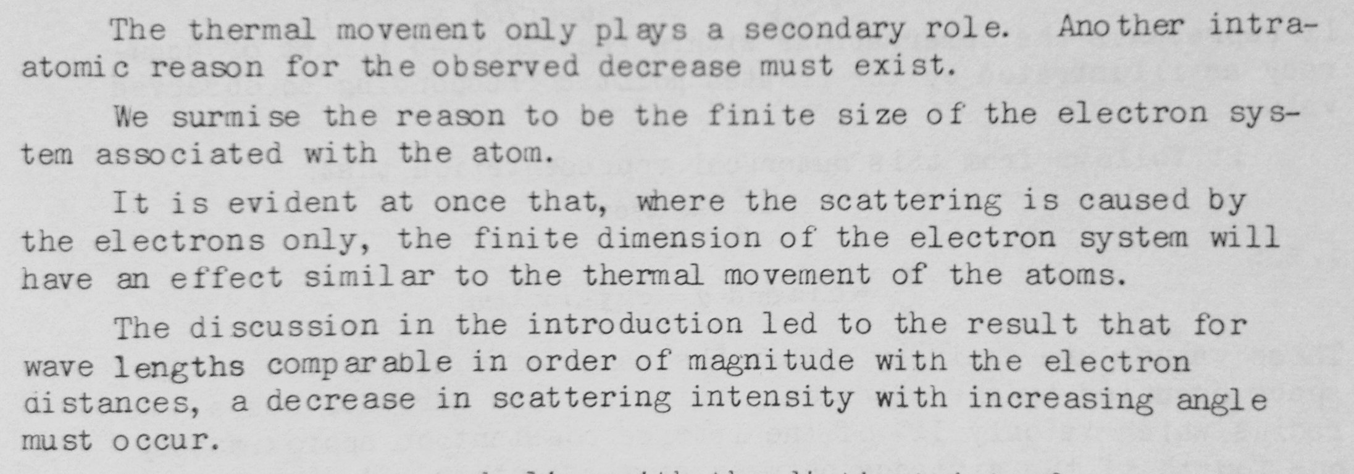
Temperature is not enough
Debye
35
Scherrer
30
Debye, P. J. W. & Scherrer, P. (1918)."Atomic structure", Physikalische Zeitschrift 19, 474-483.

Slide 36
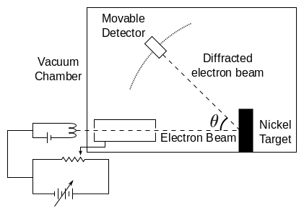
1928: the last straw for determinism
Davisson-Germer Experiment
Single electron interferes with itself.
Otherwise, diffraction cannot work!
Davisson, C. J. (1928). "The diffraction of electrons by a crystal of nickel", Bell System Technical Journal, The 7, 90-105.

Slide 37
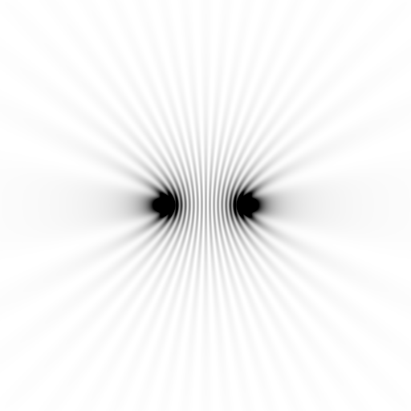
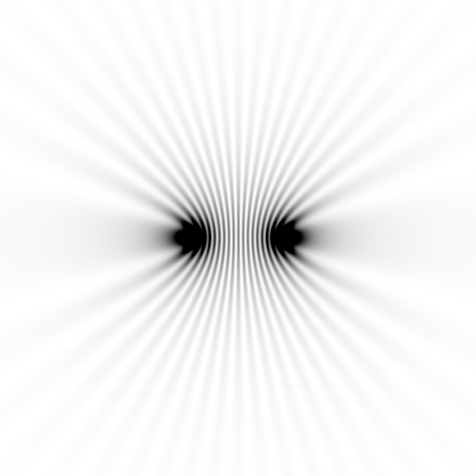
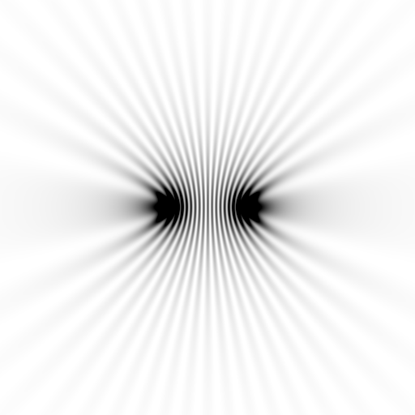
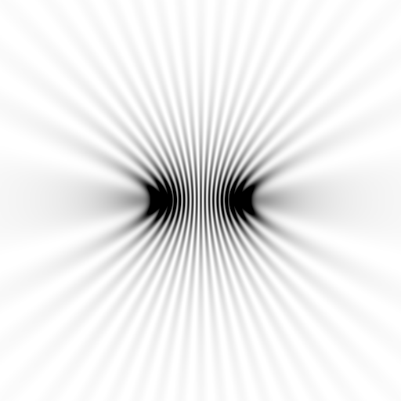
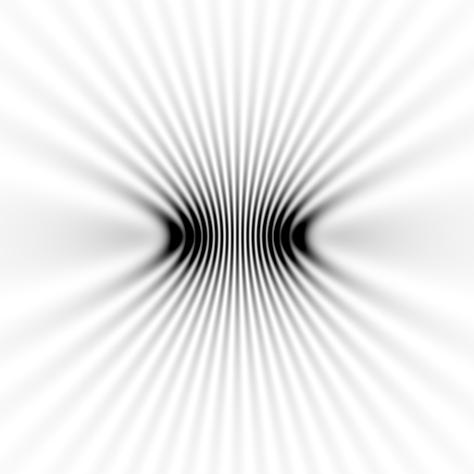
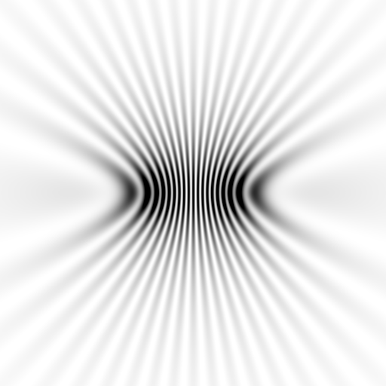
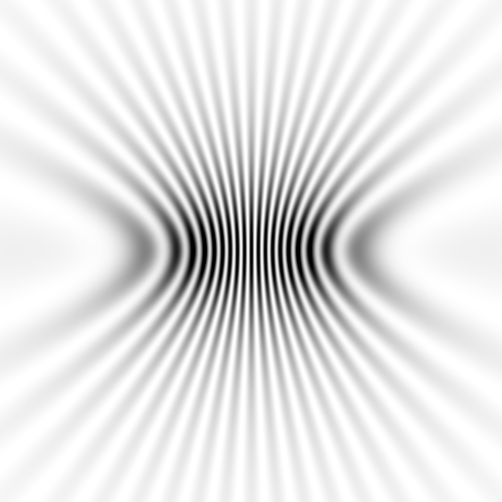
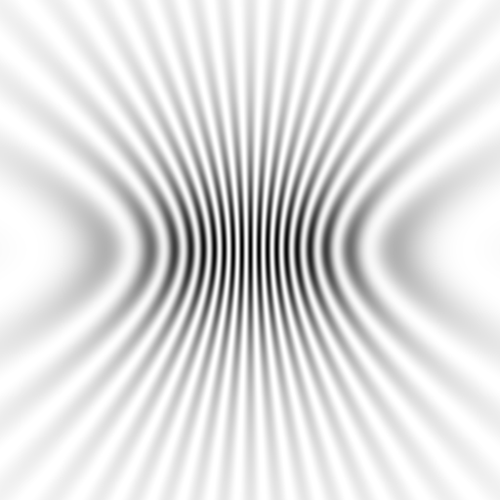
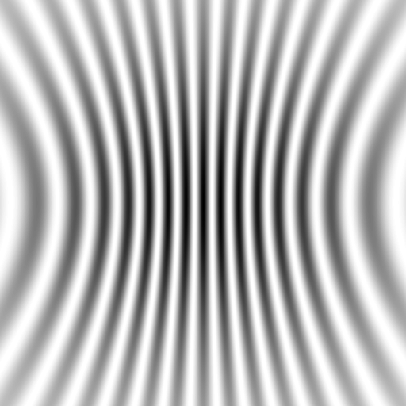

Slide 38
1914: who was there?
Curie
47
Crowfoot
3
Scherrer
25
Debye
31
Lorentz
61
Einstein
36
Laue
35
Edison
68
Tesla
58
Compton
22
Röntgen
70
CG Darwin
27
Moseley
27
PP Ewald
27
JC Maxwell
48 for 36
Rayleigh
72
JJ Thomson
56
Rutherford
43
WL Bragg
24
WH Bragg
52

Slide 39
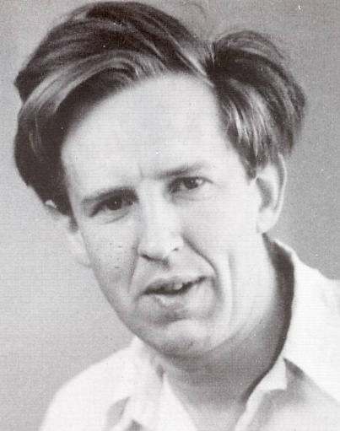
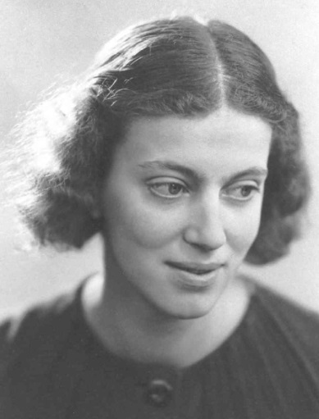
First diffraction from protein xtal
1934
Bernal, J. & Crowfoot, D. (1934). "X-ray photographs of crystalline pepsin", Nature 133, 794-795.

Slide 40
Dehydration: 1936
and 2014?
= 1.5 μL
100 μm
= 1.0 nL
2 mm
= 1.0 pL
10 μm
= 1.0 fL
1 μm

Slide 41
2014: are atoms finally collapsing?

Slide 42
MD simulation: 30 conformers from 24,000
Cerutti et al. (2010).J. Phys. Chem. B 114, 12811-12824.

Slide 43
2F_{sim}-F_{calc} and (F_{sim} Φ_{sim}) - (F_{calc} Φ_{calc}) maps
1.0 Å data
R_{cryst}= 0.137
R_{free} = 0.159
1 “sigma” 2F_{sim}-F_{c}
F_{right} – (2F_{sim}-F_{c})

Slide 44
2014: Electron density for one atom

Slide 45
How many conformers are there?
Answer: 40
R_{cryst} = 0.0506
R_{free} = 0.0556
vs F_{sim}

Slide 46
How many conformers are there?
Answer: 8
R_{cryst} = 0.0297
R_{free} = 0.0293
vs F_{sim}

Slide 47
How many conformers are there?
Answer: 2-14
R_{cryst} = 0.0441
R_{free} = 0.0516
vs F_{sim}

Slide 48
How many conformers are there?
Answer: 1-7
R_{cryst} = 0.1546
R_{free} = 0.1749
vs F_{obs}
1aho:
R_{cryst} = 0.1630
R_{free} = n/d

Slide 49
How many conformers are there?
All difference
features
are in
the solvent!
real data

Slide 50
How “rough” is the solvent?
R_{cryst} = 0.0309
R_{free} = 0.0678
vs F_{sim}

Slide 51
Structural Biology 2114
will be noisy
Averaging destroys resolution

Slide 52
lysozyme: real and reciprocal

Slide 53
lysozyme: thermal motion

Slide 54
Structural Biology 2114
will be noisy
Averaging destroys resolution
structures of the future must be 4D
There is “life” below 1 σ

Slide 55
How rough is the solvent?
Electron number density (e⁻/Å³)
x along line y=z=0 (Å)

Slide 56
How rough is the solvent?
Electron number density (e⁻/Å³)
x along line y=z=0 (Å)

Slide 57
How rough is the solvent?
Electron number density (e⁻/Å³)
x along line y=z=0 (Å)

Slide 58
How rough is the solvent?
Electron number density (e⁻/Å³)
x along line y=z=0 (Å)

Slide 59
How rough is the solvent?
Electron number density (e⁻/Å³)
x along line y=z=0 (Å)

Slide 60
Molecular Dynamics Simulation
using real
crystal’s lattice
1aho
Scorpion toxin
0.96 Å resolution
64 residues
Solvent: H₂0 + acetate
Cerutti et al. (2010).J. Phys. Chem. B 114, 12811-12824.

Slide 61
30 conformers from 24,000

Slide 62
Electron density from 24,000 conformers

Slide 63
Electron density from 24,000 conformers

Slide 64
Molecular Dynamics vs Observation
1aho 64-residue scorpion toxin in water to 1.0 Å resolution
refined_vs_Fsim.pdb
F_{calc}
F_{sim}
R_{cryst}= 0.137

Slide 65
Molecular Dynamics vs Observation
1aho 64-residue scorpion toxin in water to 1.0 Å resolution
refined_vs_Fsim.pdb
1aho.cif
1aho.pdb
F_{calc}
F_{sim}
F_{obs}
F_{calc}
R_{free} = 0.69
R_{cryst}= 0.137
R_{free} =
R_{cryst}= 0.116
R_{free} = 0.48 to 4 Å
rmsd = 1.05 Å
LSQ rmsd = 0.43Å

Slide 66
Molecular Dynamics vs Observation
RMSD
1.05 Å

Slide 67
Molecular Dynamics vs Observation
RMSD
0.45 Å
aligned

Slide 68
Molecular Dynamics vs Observation
Sodium acetate trihydrate
5 atoms
3 waters
0.9 Å resolution
C2/c
R_{vault} = 0.03

Slide 69
Molecular Dynamics vs Observation
fav8
8 residues
4 waters
1.0 Å resolution
P1

Slide 70
Molecular Dynamics vs Observation
“fav8” 8-residue aromatic peptide with 4 waters to 1.0 Å resolution
refined_vs_Fsim.pdb
fav8.fcf
fav8.cif
F_{calc}
F_{sim}
F_{obs}
F_{calc}
R_{cryst}= 0.13
R_{free}= 0.23
R_{cryst}= 0.16
R_{free} = 0.20 to 2Å
R1 = 0.041
With 4σ cutoff!
rmsd = 0.20 Å
LSQ rmsd = 0.091Å & 0.15 Å

Slide 71
MD-predicted water structure
Simulated
density
Janowski et al (2013) JACS 135, 7938-7948

Slide 72
MD-predicted water structure
Simulated
density
2mF_{o}-DF_{c}
Janowski et al (2013) JACS 135, 7938-7948

Slide 73
MD-predicted Val rotamer
Janowski et al (2013) JACS 135, 7938-7948

Slide 74
MD-predicted Val rotamer
confs | R_{work} | R_{free}
one | 4.11% | 5.84%
A & B | 3.89% | 5.53%
Janowski et al (2013) JACS 135, 7938-7948

