Slide 1
Acknowledgements
In order of response:
David von Stetten
Meitian Wang
Manfred Weiss
Judith Juanhuix Gibert
Bill Shepard
Ilme Schlichting
Kunio Hirata
Armin Wanger
Tom Caradoc-Davies
UCSF LBNL SLAC
ALS 8.3.1: TomAlberTron
Astera.org diff-USE (Fraser)
NIH NIGMS R35 GM158447 (Holton)
NIH NIAID P50 AI150476 (Krogan)
NIH NIGMS P30 GM124169 (Adams)
DOE-BER IDAT (Hura)
NIH NIGMS P30 GM133894 (Hodgson)
The Advanced Light Source is supported by the Director, Office of Science, Office of Basic Energy Sciences, Materials Sciences Division, of the US Department of Energy under contract No. DE-AC02-05CH11231 at Lawrence Berkeley National Laboratory.

Slide 2
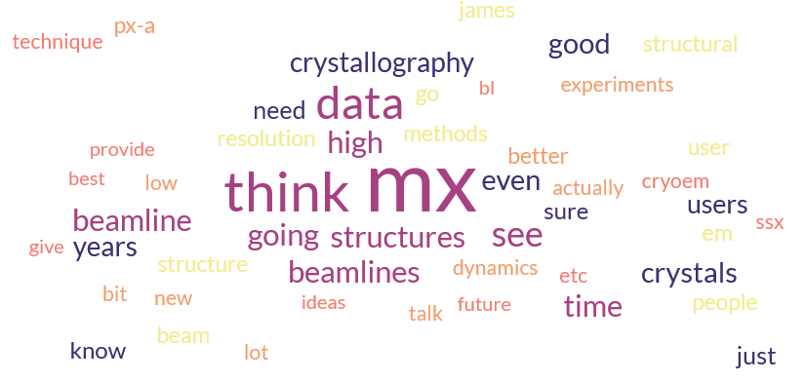
From round the world

Slide 3
From round the world
Study function and dynamics
  Fixed target, “serial”, capture intermediates
Multi-crystal multi-data
  Fragment screening
  Time-resolved (laser?, mixer?, tape?)
“room” (core) temperature
Element identification
Very high resolution

Slide 4
From round the world
“Fewer Beamlines” or industrialized?
cryoEM
  “interesting” things don’t crystallize
Alphafold is the new “low resolution”
Data curation, training students
Multilayers?, high energy? In-vacuum?
Source upgrades!
China?

Slide 5
Main Challenges in Structural Biology
$$$
Predicting crystallization outcomes
Getting crystals to diffract better
Is the ligand there or not?
Anisotropic diffraction
Radiation damage
Phase problem
Metals (anaerobic)
What is “resolution”
Serial crystallography (processing)
Non-isomorphism & multi-crystal methods

Slide 6
Magic Microscope
Visualize a single molecule
spatial resolution 1 Å
temporal resolution: ~100 fs
Watch same molecule indefinitely
No damage to molecule/patient
Ability to tap / tug
Handheld & common
Q: what would you look at first?
Q2: how long before end of disease?
second

Slide 7
Goals of Methods Development
Impossible → Expensive
Expensive → Cheaper
  Difficult → Easier

Slide 8
The last Å
between prediction and reality
Because: the future of crystallography has alternate conformations
Single-conf models
poor resolution
Low signal/noise
Phase Problem
Dynamics?
Mechanism?
Small signal?
Overlapping states?

Slide 9
The last Å: near, but far
ATOM 122 N LEU A 13 -3.244 25.808 19.998 1.00 16.96 N
ATOM 123 CA LEU A 13 -2.877 25.448 21.355 1.00 15.29 C
ATOM 124 C LEU A 13 -2.792 23.966 21.561 1.00 17.54 C
ATOM 125 O LEU A 13 -1.814 23.493 22.143 1.00 16.35 O
ATOM 126 CB LEU A 13 -3.907 26.164 22.268 1.00 18.72 C
ATOM 127 CG LEU A 13 -3.577 25.982 23.738 1.00 21.19 C
ATOM 128 CD1 LEU A 13 -2.283 26.820 24.019 1.00 19.43 C
ATOM 129 CD2 LEU A 13 -4.702 26.474 24.639 1.00 24.65 C
ATOM 130 N SER A 14 -3.677 23.149 20.979 1.00 15.96 N
ATOM 131 CA SER A 14 -3.646 21.711 21.061 1.00 18.26 C
ATOM 132 C SER A 14 -2.373 21.203 20.360 1.00 18.71 C
ATOM 133 O SER A 14 -1.747 20.315 20.930 1.00 17.47 O
ATOM 134 CB SER A 14 -4.875 21.077 20.419 1.00 17.62 C
ATOM 135 OG ASER A 14 -4.825 19.665 20.388 0.50 20.89 O
ATOM 136 OG BSER A 14 -6.027 21.408 21.164 0.50 18.67 O
ATOM 137 N LYS A 15 -2.045 21.772 19.215 1.00 18.03 N
ATOM 138 CA LYS A 15 -0.799 21.361 18.555 1.00 18.12 C
ATOM 139 C LYS A 15 0.446 21.707 19.351 1.00 18.81 C
ATOM 140 O LYS A 15 1.400 20.948 19.411 1.00 17.77 O
ATOM 141 CB LYS A 15 -0.700 22.034 17.177 1.00 14.49 C
ATOM 142 CG LYS A 15 -1.727 21.368 16.256 1.00 16.12 C
ATOM 143 CD LYS A 15 -1.663 22.147 14.936 1.00 19.40 C
ATOM 144 CE ALYS A 15 -2.725 21.614 13.986 0.50 17.42 C
ATOM 145 CE BLYS A 15 -1.750 21.211 13.750 0.50 17.01 C
ATOM 146 NZ ALYS A 15 -2.346 21.674 12.559 0.50 18.61 N
ATOM 147 NZ BLYS A 15 -3.052 20.513 13.741 0.50 18.76 N

Slide 10
The last Å: near, but far
ATOM 122 N LEU A 13 -3.000 26.000 20.000 1.00 16.96 N
ATOM 123 CA LEU A 13 -3.000 25.000 21.000 1.00 15.29 C
ATOM 124 C LEU A 13 -3.000 24.000 22.000 1.00 17.54 C
ATOM 125 O LEU A 13 -2.000 23.000 22.000 1.00 16.35 O
ATOM 126 CB LEU A 13 -4.000 26.000 22.000 1.00 18.72 C
ATOM 127 CG LEU A 13 -4.000 26.000 24.000 1.00 21.19 C
ATOM 128 CD1 LEU A 13 -2.000 27.000 24.000 1.00 19.43 C
ATOM 129 CD2 LEU A 13 -5.000 26.000 25.000 1.00 24.65 C
ATOM 130 N SER A 14 -4.000 23.000 21.000 1.00 15.96 N
ATOM 131 CA SER A 14 -4.000 22.000 21.000 1.00 18.26 C
ATOM 132 C SER A 14 -2.000 21.000 20.000 1.00 18.71 C
ATOM 133 O SER A 14 -2.000 20.000 21.000 1.00 17.47 O
ATOM 134 CB SER A 14 -5.000 21.000 20.000 1.00 17.62 C
ATOM 135 OG ASER A 14 -5.000 20.000 20.000 0.50 20.89 O
ATOM 136 OG BSER A 14 -6.000 21.000 21.000 0.50 18.67 O
ATOM 137 N LYS A 15 -2.000 22.000 19.000 1.00 18.03 N
ATOM 138 CA LYS A 15 -1.000 21.000 19.000 1.00 18.12 C
ATOM 139 C LYS A 15 0.000 22.000 19.000 1.00 18.81 C
ATOM 140 O LYS A 15 1.000 21.000 19.000 1.00 17.77 O
ATOM 141 CB LYS A 15 -1.000 22.000 17.000 1.00 14.49 C
ATOM 142 CG LYS A 15 -2.000 21.000 16.000 1.00 16.12 C
ATOM 143 CD LYS A 15 -2.000 22.000 15.000 1.00 19.40 C
ATOM 144 CE ALYS A 15 -3.000 22.000 14.000 0.50 17.42 C
ATOM 145 CE BLYS A 15 -2.000 21.000 14.000 0.50 17.01 C
ATOM 146 NZ ALYS A 15 -2.000 22.000 13.000 0.50 18.61 N
ATOM 147 NZ BLYS A 15 -3.000 21.000 14.000 0.50 18.76 N

Slide 11
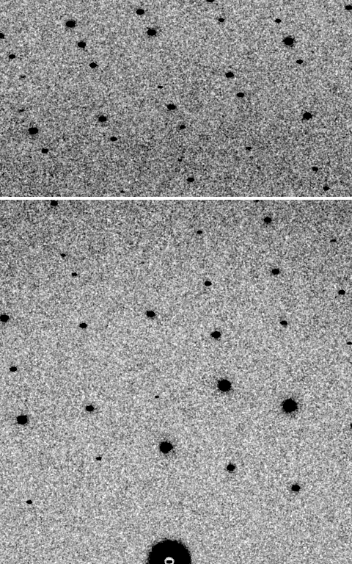
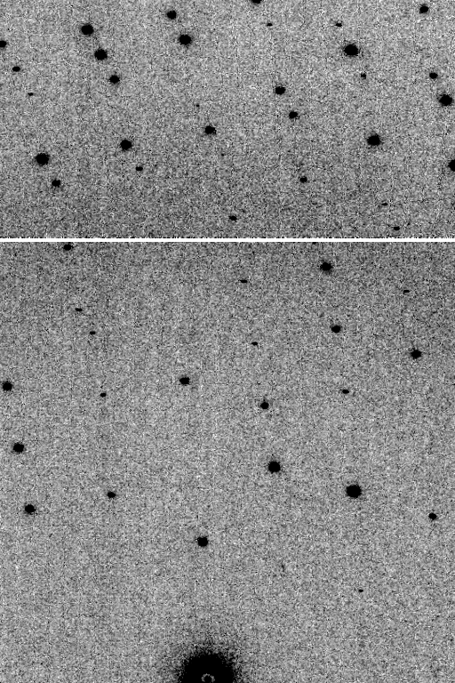
Is it Real? Or is it MLFSOM
simulated
real
Holton et al (2014) "R-factor gap", FEBS Journal 281, 4046-4060.

Slide 12
Stills should be better

Slide 13
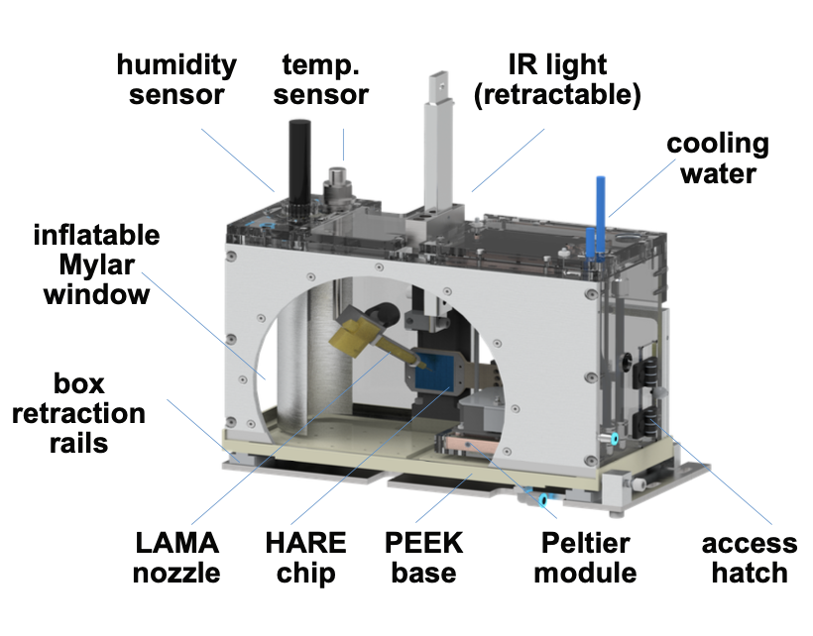
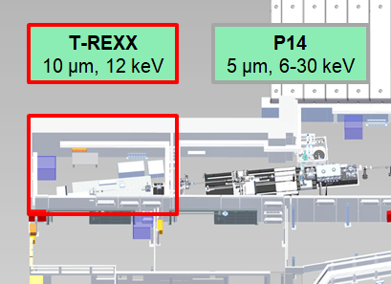
T-REXX beamline - Sample environment chamber
relative humidity: up to 98%
temperature: 8 – 70 °C
still a prototype, but in constant use
[Schulz et al., Nature Commun. 16, 6553 (2025)]

Slide 14
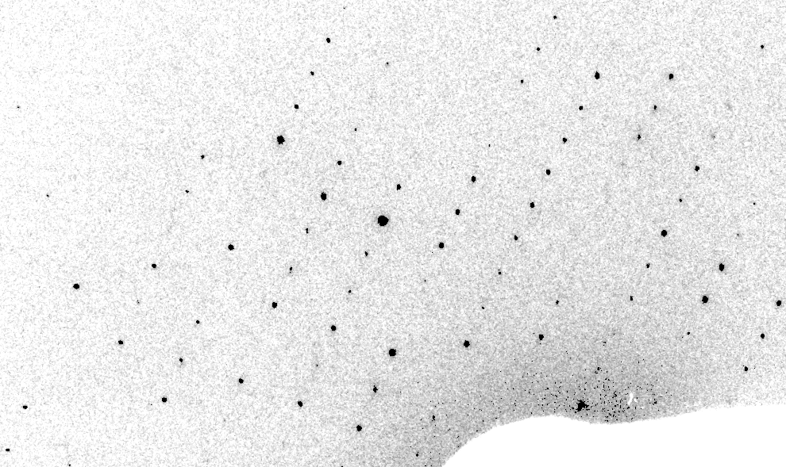
Real XFEL still
Lyubimov et al. (2016).
eLife 5, e18740.

Slide 15
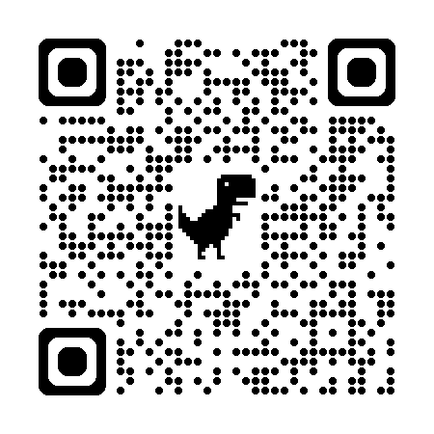
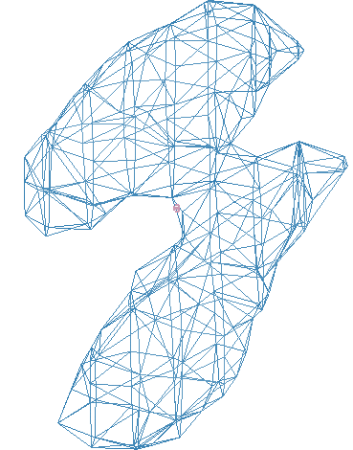
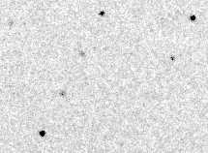
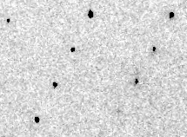
Simulation fit to XFEL still
phix
https://pmc.ncbi.nlm.nih.gov/articles/PMC11801403/
phiy
phiz
real
VS
“texture”
phix
phiy
phiz

Slide 16
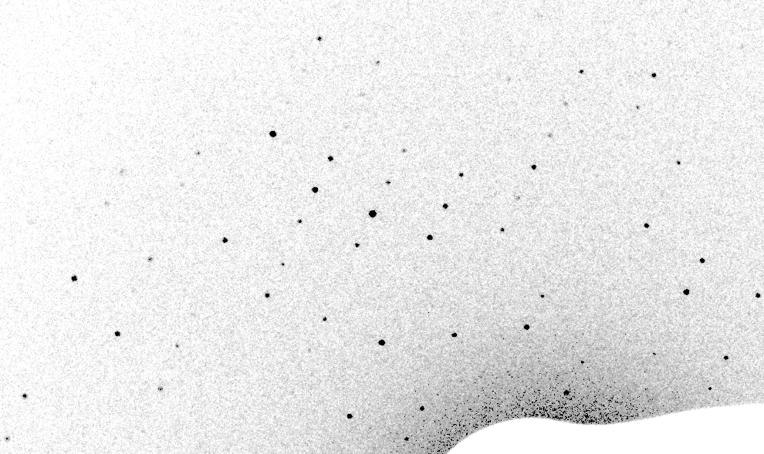
Best “round relp” simulation

Slide 17
Real XFEL still
Lyubimov et al. (2016).
eLife 5, e18740.

Slide 18
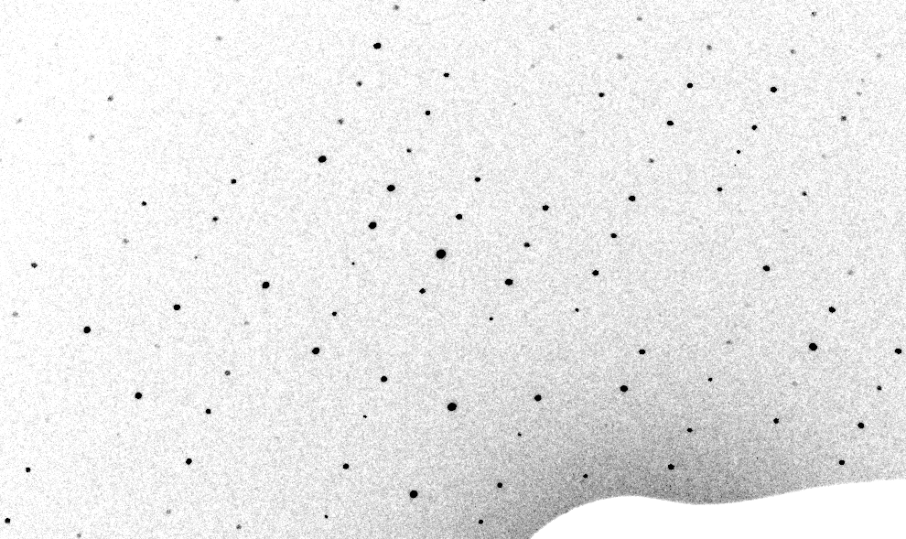
3-cluster texture simulation

Slide 19
Texture sufficient for poor stats
500 images Results from iota: cctbx & prime
texture | 1 cluster | 3 clusters
R_{true}* | 4% | 16%
R_{merge} | 23% | 66%
I/σ | 32 (1.1) | 19 (1.2)
CC_{1/2} | 99 (69) | 99 (58)
resolution | 1.55 | 1.94
*Agreement with F value fed into simulation

Slide 20
Prediction:
Incorporating texture
in serial data processing will
reduce image count requirement
from ~1e4 to ~100
Why? Because rotation data lack texture error

Slide 21
Non-isomorphism
is annoying
means you:
can’t merge
can’t
add
can’t
subtract
Caused by:
rad dam
humidity
temperature
Growth conditions
Cryo-cooling
Everything

Slide 22
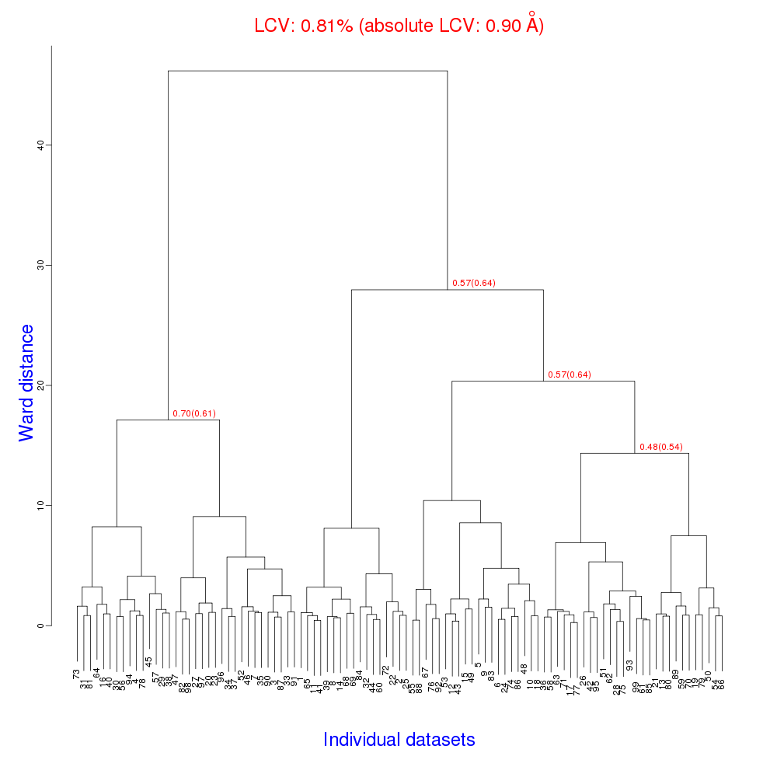
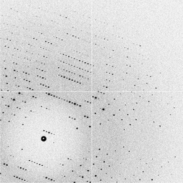
Cell clustering: 100 datasets
Reality:
Perfect isomorphism
(simulated data)
Holton, J. (2019). Acta Cryst. D 75, 113-122.

Slide 23
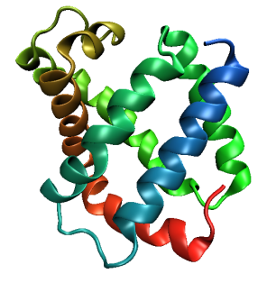
Same structure, different cell
0.5% cell change → 15%
Crick & Magdoff (1956) “theory method isomorphous replacement”, Acta Cryst. 9, 901-8.

Slide 24
Same structure, different cell
0.5% cell change → 15%
Crick & Magdoff (1956) “theory method isomorphous replacement”, Acta Cryst. 9, 901-8.

Slide 25
Uniform stretch
5% change → 0%

Slide 26
Uniform stretch
5% change → 0%

Slide 27
Hygrostatic gradients
high
water activity
low
jet
loop

Slide 28
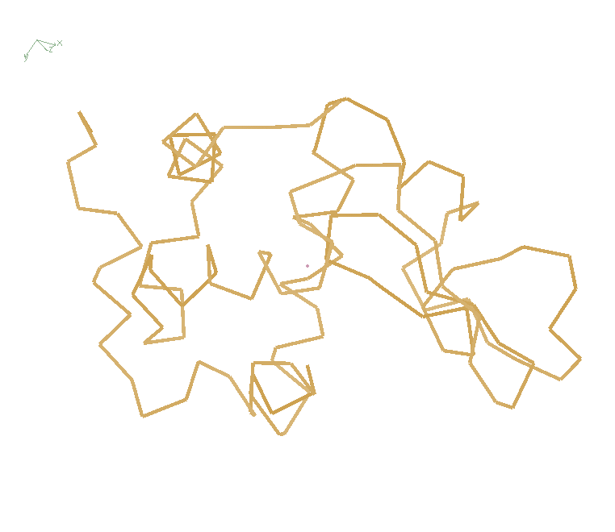
Non-isomorphism in lysozyme
RMSD = 1.70 Å
Δcell = 0.7 %
R_{iso} = 44.5%
RMSD = 0.18 Å LSQ
RH: 84.2%
vs 71.9%
3aw6
3aw7

Slide 29
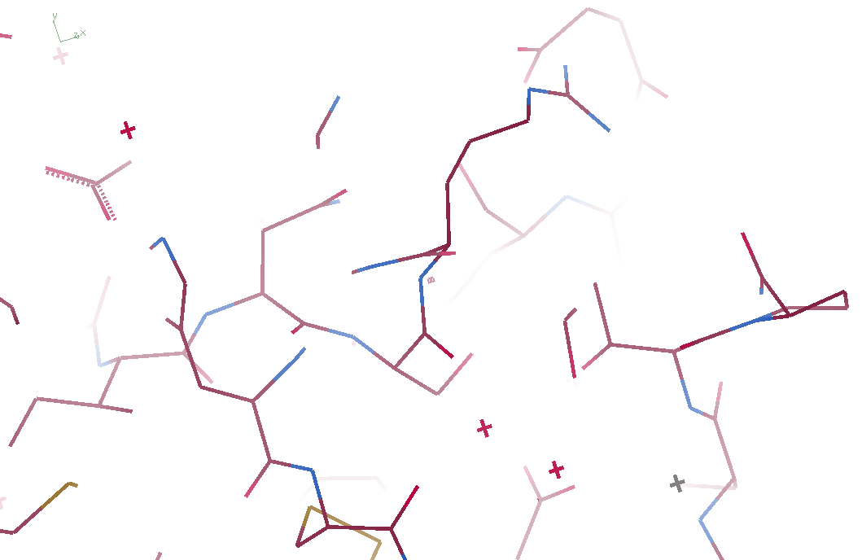
3aw6

Slide 30
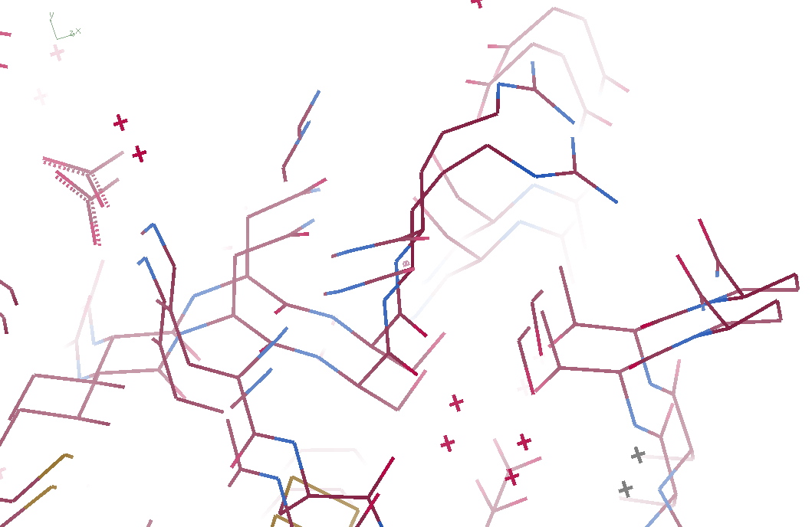
3aw6 3aw7

Slide 31
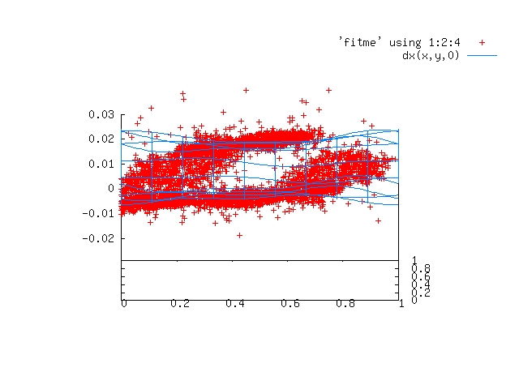
Periodic Spatial Distortion Vector Field

Slide 32
3aw6 3aw7

Slide 33
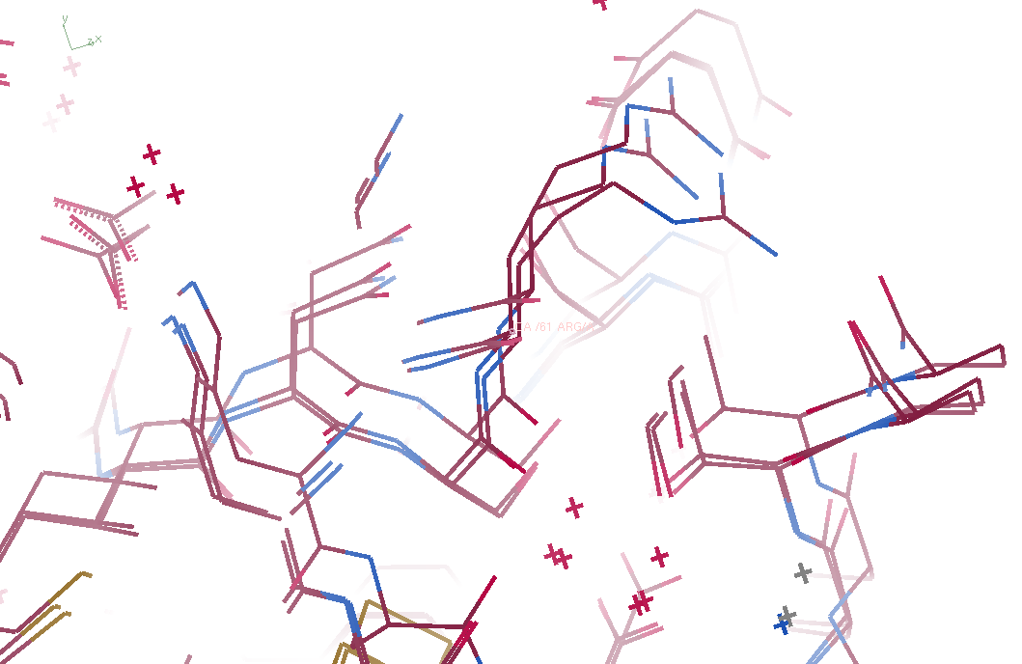
3aw6, 3aw7, “bent” 3aw6

Slide 34
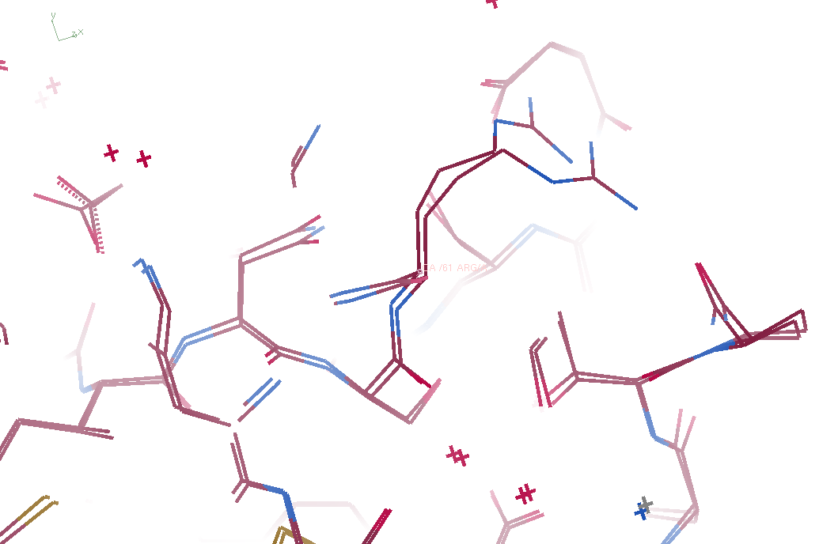
3aw7, “bent” 3aw6

Slide 35
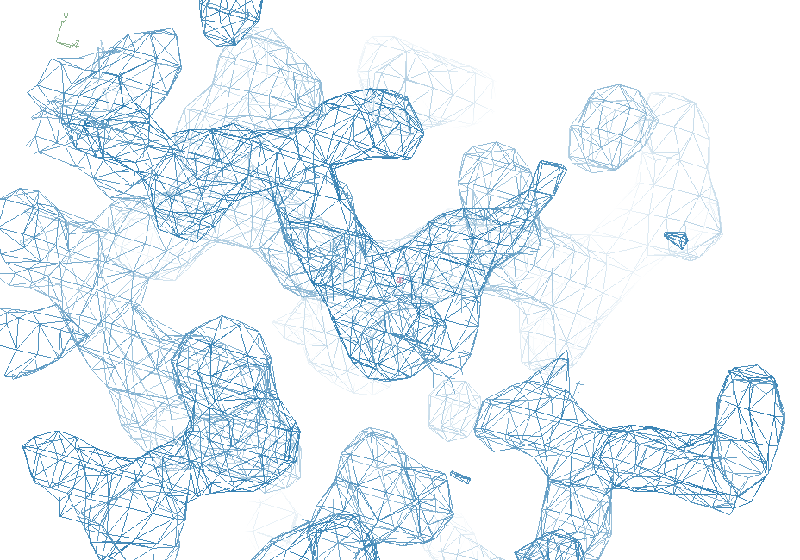
3aw7

Slide 36
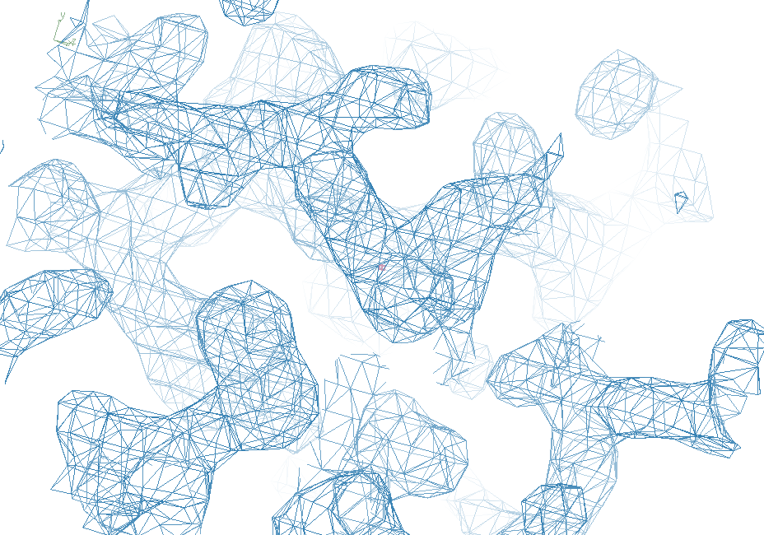
“bent” 3aw7

Slide 37
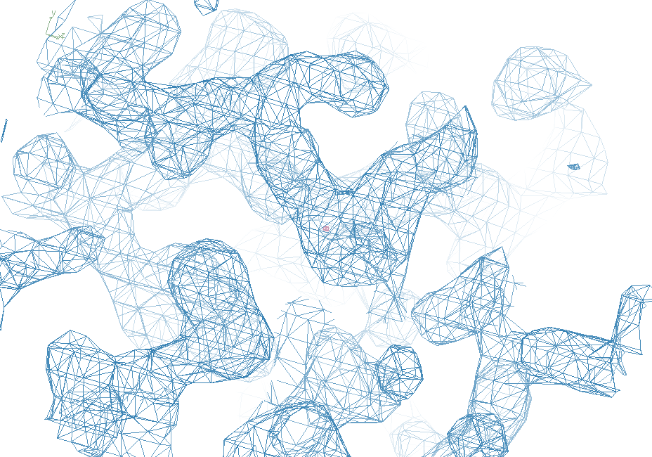
3aw6

Slide 38
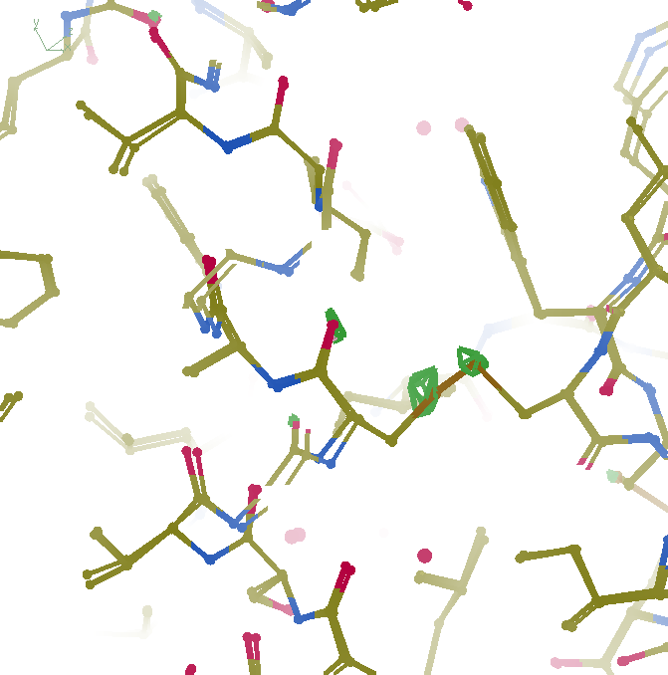
F_{obs}-F_{obs} difference
3σ 1.8 Å
“unbent”

Slide 39
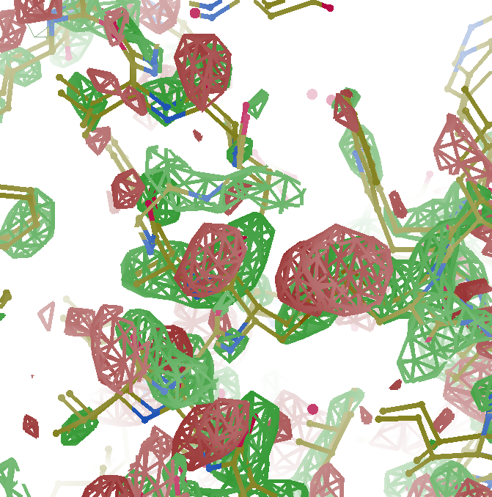
F_{obs}-F_{obs} difference
3σ 1.8 Å
old way

Slide 40
Prediction:
Correcting non-isomorphism
will allow
infinite averaging
allowing arbitrary signal/noise
Why? Because it works for cryoEM

Slide 41
Radiation Damage

Slide 42
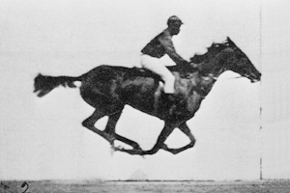
0 Gy

Slide 43
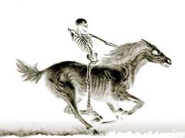
100 MGy

Slide 44
What is the dose?
50 MGy ?

Slide 45
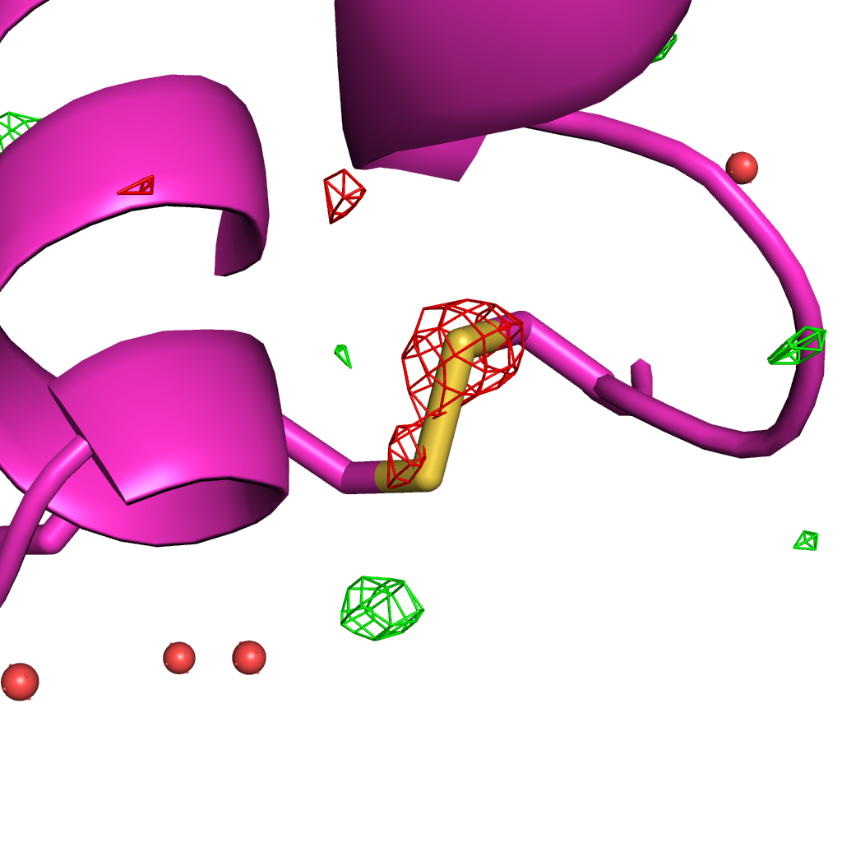
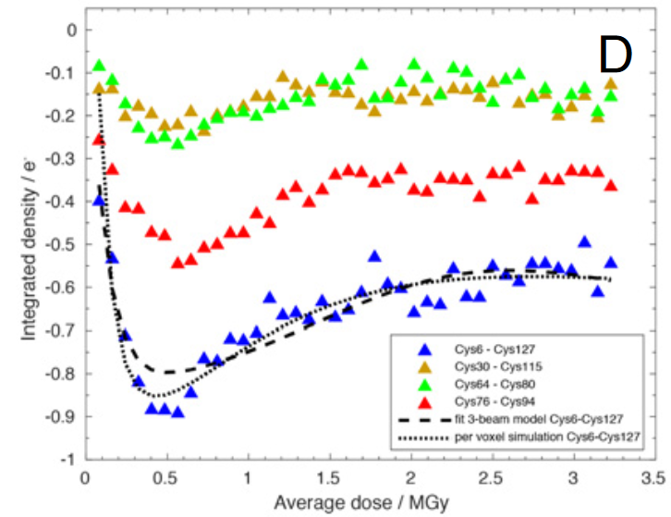
Systematic error: Illumination contrast appears to “reverse” damage
Room temperature high-dose rate series
0.35 MGy
Cys127
Cys6
de la Mora, et al. (2020) PNAS USA 117, 4142-4151

Slide 46
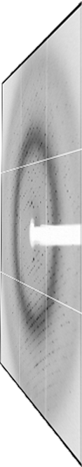
False Damage reversal: from “hole burning”
X-ray beam
crystal

Slide 47
False “Damage reversal”: from beam profile
Cold beam
Hot beam
crystal

Slide 48
False “Damage reversal”: from beam profile
Cold beam
Hot beam
crystal

Slide 49
False “Damage reversal”: from beam profile
Cold beam
Hot beam
crystal

Slide 50
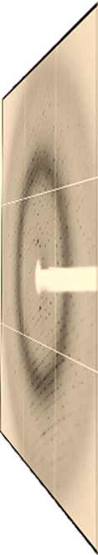
False “Damage reversal”: from beam profile
Cold beam
Hot beam
crystal

Slide 51
False “Damage reversal”: from beam profile
Cold beam
Hot beam
crystal

Slide 52
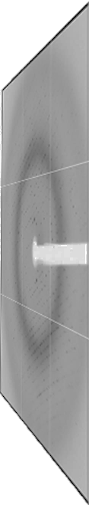
False “Damage reversal”: from drift
X-ray beam
crystal

Slide 53
Systematic error: Illumination contrast appears to “reverse” damage
Room temperature high-dose rate series
1
cold
occupancy
hot
observed
0
time
de la Mora, et al. (2020) PNAS USA 117, 4142-4151

Slide 54
MGy reaction reference
~45 global damage Owen et al. (2006)
10/Å global damage Howells et al. (2009)
5 Se-Met Holton (2007)
4 Hg-S Ramagopal et al. (2004)
4 R-C-COOH Garman et al. (2015)
3 S-S Murray et al. (2002)
1 Br-RNA Olieric et al. (2007)
~1? Cl-C ???
0.5 Mn in PS II Yano et al. (2005)
0.06 putidaredoxin Corbett et al. (2007)
0.02 Fe in myoglobin Denisov et al. (2007)
Radiation Damage World Records
Holton (2009) J. Synchrotron Rad. 16 133-42

Slide 55
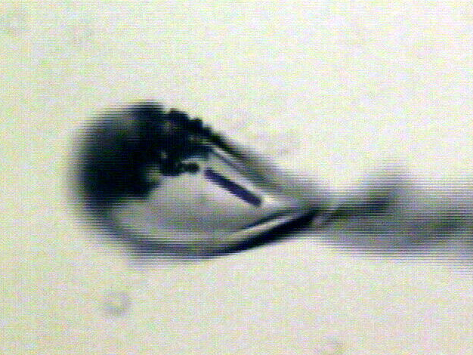
“rastering” to find the crystal
X-ray beam
ice
Membrane
protein crystal

Slide 56
“painting” for flat dose

Slide 57
“painting” for virtual beam

Slide 58
Painting with X-rays
0°
img_000045

Slide 59
Painting with X-rays
0.2°
img_000100

Slide 60
Painting with X-rays
30°
img_015000

Slide 61
Painting with X-rays
90°
img_045000

Slide 62
Painting with X-rays
360°
img_180000

Slide 63
Painting with X-rays
1080°
img_540000

Slide 64
Beam Shape Dichotomy
Flat-top beam
  Uniform dose in illuminated region
  Sharp edges: sensitive to drift
Gaussian beam
  Softer edges
  High dose contrast
Best of both?
  “dose flattening”

Slide 65
How many images?
360° / 0.1° * ( 100 µm / 1 µm )²
⁼ 36x10⁶
28,000 photons/image

Slide 66
Lossless data rate
bits
s
= log₂(pixels) * flux * thick * 1.2x10⁻⁵
where:
bits/s = entropy-limited compressed data rate
pixels = number of pixels in the detector
flux = photons/s onto the sample
thick = sample thickness in microns
EG: 1e12 ph/s * 100um thick = 3.4 GBytes/s
The 1.2e-5 scattered photons per incident photon can be derived form the cross section of oxygen (0.2 cm^2/g) and the rough density of protein crystals (1.2 g/cm^3), and the fact that about half of all scattered photons hit a flat detector: 0.2*1.2*1e-4/2 = 1.155e-5
That is, flux*thickness*1.2e-5 is the rate of photon arrivals and log2(pixels) is the number of bits required to store the location of one photon in the entropy-limited regime. Lossless compression cannot be better than this because individual photon arrivals are genuinely random.

Slide 67
How to lose information
long exposures
  >1 photon/image = order of arrivals
Wide phi slice
  sum over angle
Large beams
  sum over profile area
Pink/divergent beam
  sum over lambda/angle
Background
  non-crystal stuff
Systematics
  Dose contrast, drift, read-out gap

Slide 68
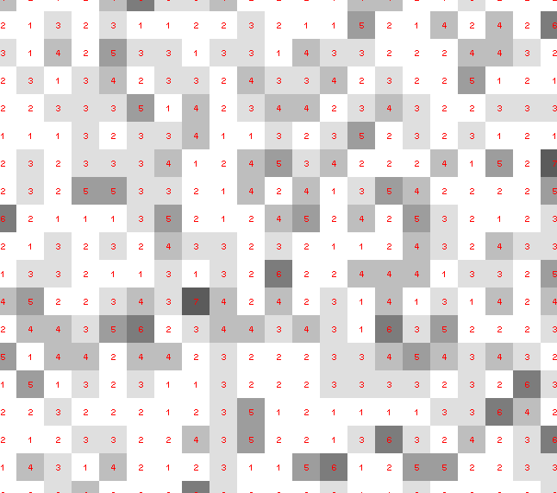
Dose slicing: is that a spot?

Slide 69
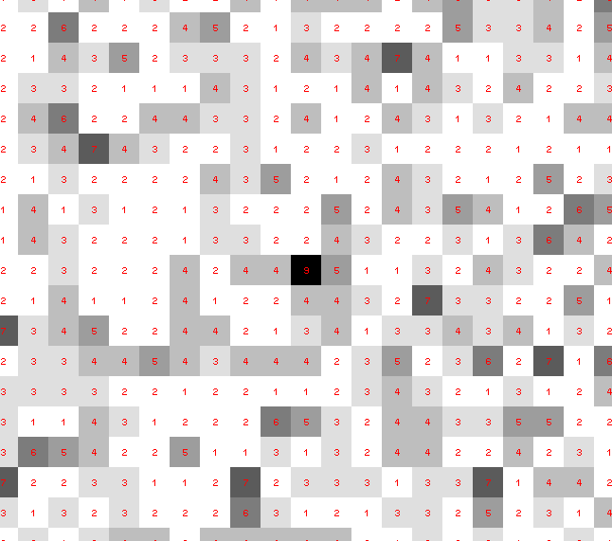
Dose slicing: is that a spot?

Slide 70
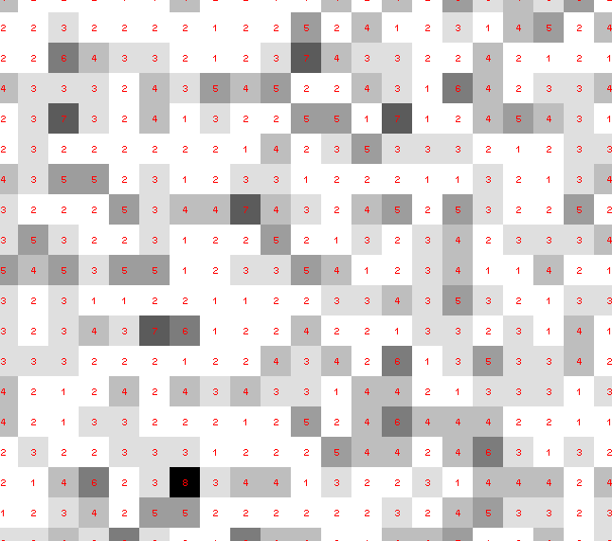
Dose slicing: is that a spot?

Slide 71
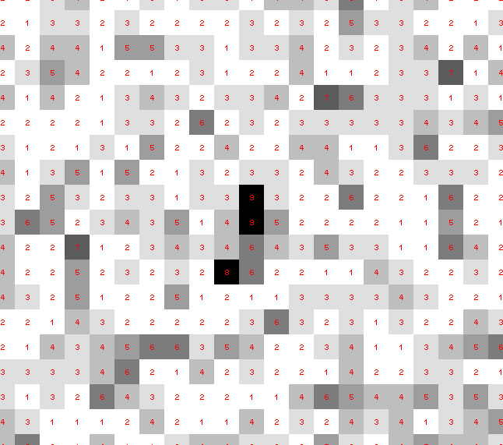
Dose slicing: is that a spot?

Slide 72
Dose slicing: is that a spot?

Slide 73
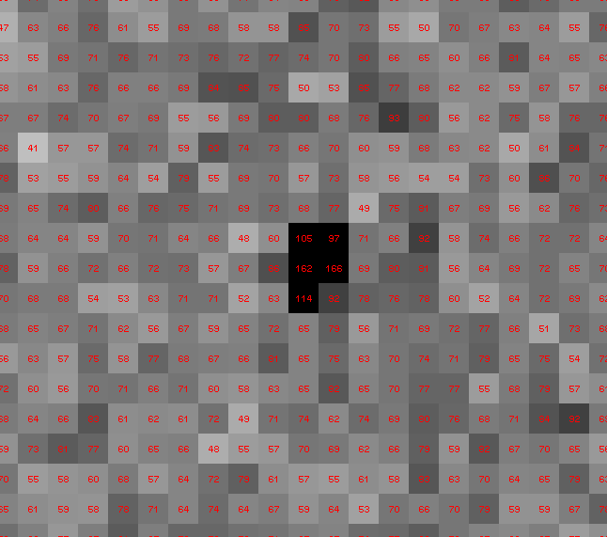
Dose slicing: is that a spot?

Slide 74
Single Photons Carry Information
About Radiation Damage
4
4
photons
photons
0
0
4
4
photons
photons
0
0
time
time

Slide 75
Prediction:
“painting mode” data collection =
damage-free data from synchrotron
zero-dose extrapolation that works
Why? Because everything is linear (to first order)

Slide 76
Detector Calibration

Slide 77
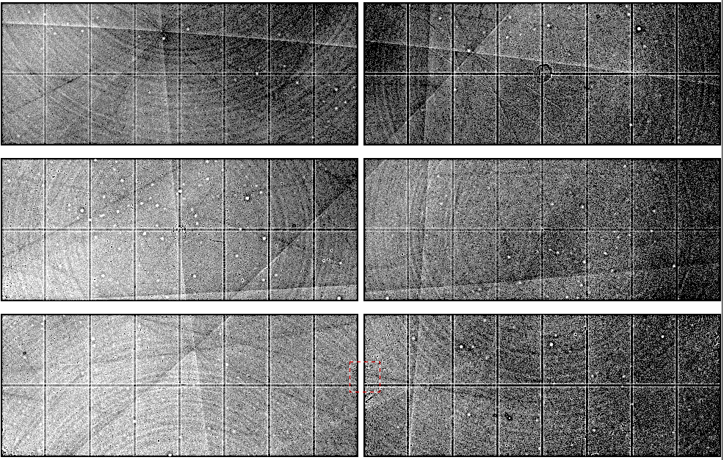
Spatial Heterogeneity in Sharp Spot Sensitivity
~3x10⁵ photon/pixel Pilatus detector
Bragg
glitch
“tree rings”
Pick-up tool mark
oxygen
inclusions
1% high
average
1% low

Slide 78
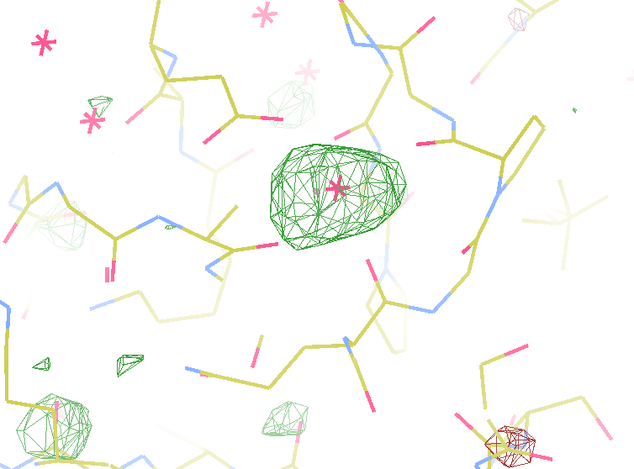
140-fold multiplicity
I/Sa = 260
7.4σ = Na
DELFAN residual anomalous difference
data Courtesy of Tom & Janet

Slide 79
Prediction:
Detector ultra-calibration will
Reveal identify of light metals
down to Na
(perhaps F?)
Why? Because ultra-high multiplicity can

Slide 80
The R-factor Gap

Slide 81
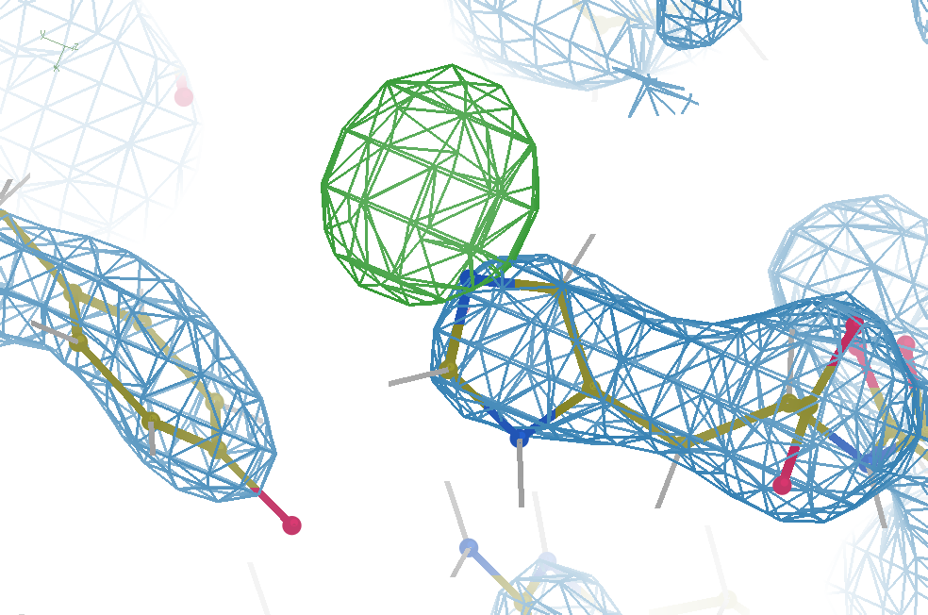
Hydrogen: visible at 3.5 Å resolution!
R_{work} = 0.04
R_{free} = 0.05
d_{min} = 3.5 Å
6σ = 1 e⁻
Simulation:
Realistic noise
“perfect” model

Slide 82
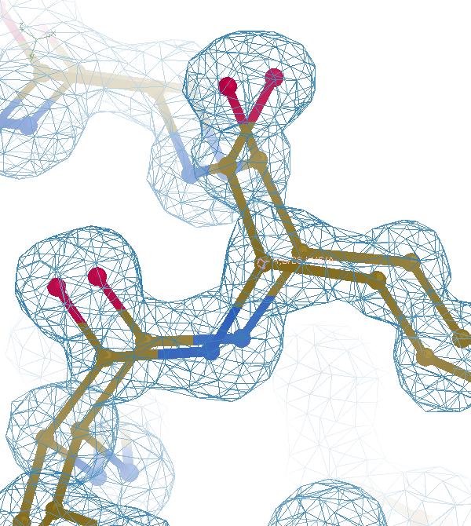

Slide 83


Slide 84
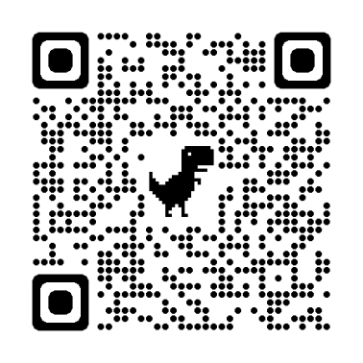
The UNTANGLE Challenge
https://github.com/jmholton/UnTangle

Slide 85
Prediction:
Untangling Ensemble Models will
Simultaneously reveal correlated motions and low-lying map features
down to 1 e⁻
Why? Because small molecules can

Slide 86
Summary
Re-tool or die
Stills should be better
Ultra-calibration to see Na
Correct Rad Dam by “painting”
Correct non-isomorphism by “bending”
Correct ensemble for low-noise maps
The Last Å: where we live now

Slide 87
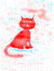
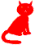
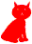
Dominant source of error in MX:
Cowtan’s Cat
+
=
Amplitudes
Phases
2F_{o}-F_{c}
http://www.ysbl.york.ac.uk/~cowtan/fourier/coeff.html

Slide 88
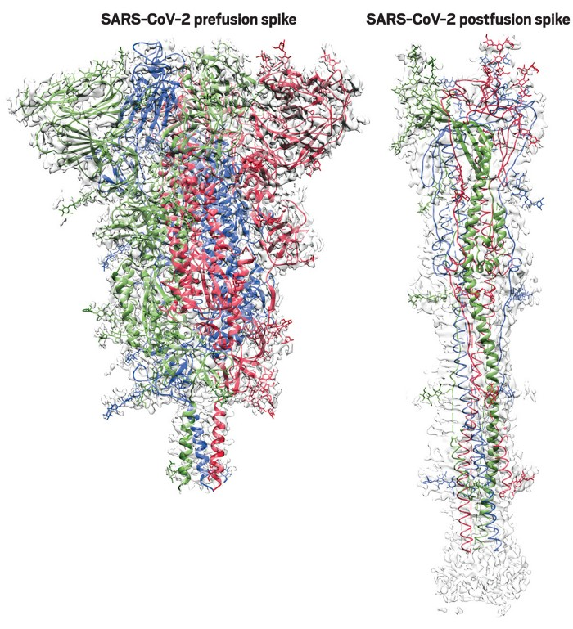
key structural dynamical insight
https://cen.acs.org/pharmaceuticals/vaccines/tiny-tweak-behind-COVID-19/98/i38

Slide 89
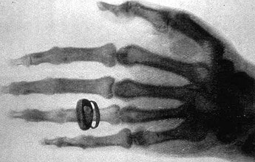


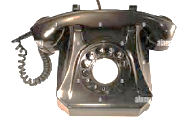






















X-rays
hormones
Pavlov
electron
DNA
bakelite
tunguska
1901 1902 1903 1904 1905 1906 1907 1908 1909 1910
conv.
plasma
relativity
victrola
Genes on
Chromasomes
novocaine
X-ray
diffraction
Russia
vs
Ukra
Curie
Bohr
polymer
1911 1912 1913 1914 1915 1916 1917 1918 1919 1920
Titanic
Word War I
Pandemic
Vitamin A
“Nature
of chem
Bond”
Neutron
mass
spec
Svedberg
kleenex
Lucy
1921 1922 1923 1924 1925 1926 1927 1928 1929 1930
“how-to”
“giant
hereditary
molecule”
penicillin
(1941)
e-
scope
insulin
Vitamin K
USSR

Slide 90























firefox
wikipedia
iPhone
iPod
ribosome
iPad
2001 2002 2003 2004 2005 2006 2007 2008 2009 2010
9/11
16k PDBs: Protein Structure Initiative ->
LHC
Pandemic
grav wave
Quasi
Xtals
100k
PDBs
Rosetta
cryoEM
H₂O
150k
PDBs
Pandemic
2011 2012 2013 2014 2015 2016 2017 2018 2019 2020
PSI ends
pluto
zika
AlphaFold
AlphaFold2
CRISPR
Pandemic
ALS-U
2021 2022 2023 2024 2025 2026 2027 2028 2029 2030
CASP15
APS-U
Diamond & Soleil

