Slide 1
PowerPoint File available:
http://bl831.als.lbl.gov/
~jamesh/powerpoint/
SLS_insitu_2017.pptx

Slide 2
Acknowledgements
http://bl831.als.lbl.gov/~jamesh/powerpoint/SLS_insitu_2017.pptx
Robert Stroud James Fraser
Nick Sauter John Tainer Aina Cohen Mike Soltis
UCSF LBNL SLAC
ALS 8.3.1 creator: Tom Alber
UC Multicampus Research Programs and Initiatives (MRPI)
UCSF Program for Breakthrough Biomedical Research (PBBR)
one-time NIH-DOE Inter-agency agreement (IAA)
R01 GM124149 to Holton
GM117126 to Sauter (DIALS)
Integrated Diffraction Analysis Technologies (IDAT)
Plexxikon, Inc.
Synchrotron Radiation Structural Biology Resource (SLAC)
The Advanced Light Source is supported by the Director, Office of Science, Office of Basic Energy Sciences, Materials Sciences Division, of the US Department of Energy under contract No. DE-AC02-05CH11231 at Lawrence Berkeley National Laboratory.

Slide 3
Acknowledgments
Fluidigm
Andy May
Brian Fowler
Hany Nassef
Geoff Facer
LBNL
James Holton
Ken Frankel
George Meigs
John Tainer
Funded by STTR Phase II grant (NIGMS) 2R42GM071326-02A1

Slide 4
Three Laws of in-situ MX
Trays must be Thin
plastic = water = protein != glass
Normalize for absorption!
walls <= xtal size
Trays must be Tight
evaporation = nonisomorphism
Plastic = pile of worms
Trays must be Cheap
$1-20/tray
New tray = new experiment

Slide 5
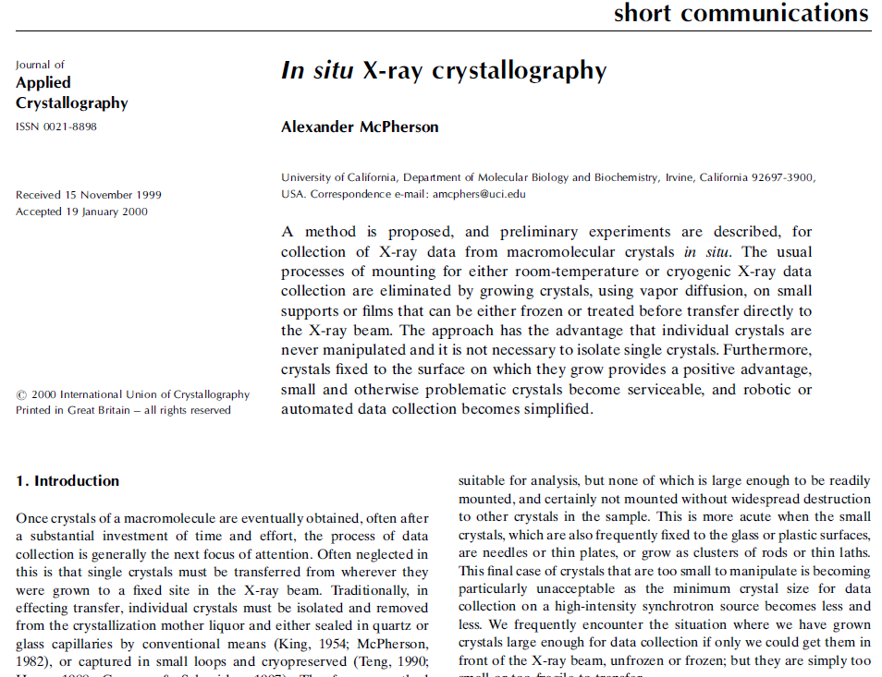

Slide 6
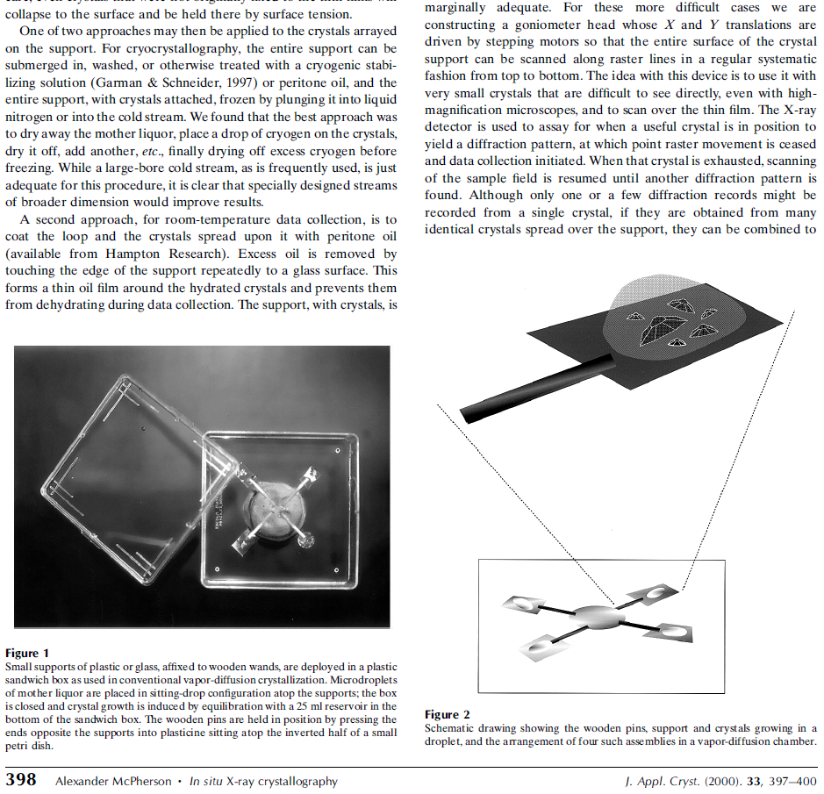

Slide 7
Advantages of in-situ diffraction
No evaporation
- dehydration
- pH change (acetate, NH₃)
- oxidation in air
No mechanical disturbance
- mounting, fishing, cryo-cooling
Low thermal artifacts
- protein expansion, pH of tris

Slide 8
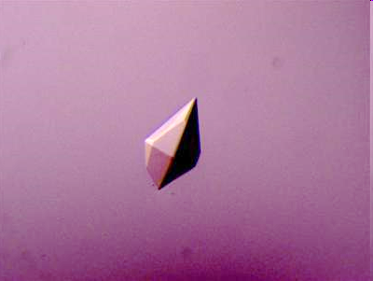

Slide 9
opened drop: you have ~30 seconds!
equilibrated drop

Slide 10
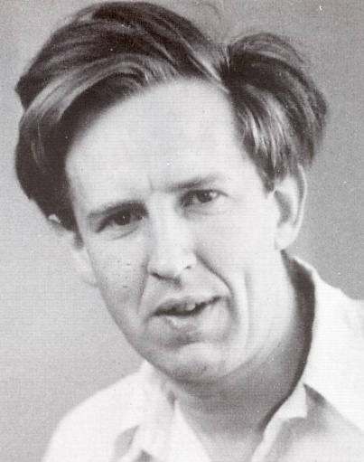
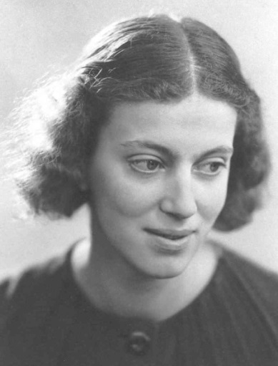
First diffraction from protein xtal
1934
Bernal, J. & Crowfoot, D. (1934). "X-ray photographs of crystalline pepsin", Nature 133, 794-795.

Slide 11
Dehydration: 1934
and 2017?
= 1.5 μL
100 μm
= 1.0 nL
2 mm
= 1.0 pL
10 μm
= 1.0 fL
1 μm

Slide 12
Non-isomorphism in lysozyme
Dear James
The story of the two forms of lysozyme crystals goes back to about 1964 when it was found that the diffraction patterns from different crystals could be placed in one of two classes depending on their intensities. This discovery was a big set back at the time and I can remember a lecture title being changed from the 'The structure of lysozyme' to 'The structure of lysozyme two steps forward and one step back'. Thereafter the crystals were screened based on intensities of the (11,11,l) rows to distinguish them (e.g. 11,11,4 > 11,11,5 in one form and vice versa in another). Data were collected only for those that fulfilled the Type II criteria. (These reflections were easy to measure on the linear diffractometer because crystals were mounted to rotate about the diagonal axis). As I recall both Type I and Type II could be found in the same crystallisation batch . Although sometimes the external morphology allowed recognition this was not infallible.
The structure was based on Type II crystals. Later a graduate student Helen Handoll examined Type I. The work, which was in the early days and before refinement programmes, seemed to suggest that the differences lay in the arrangement of water or chloride molecules (Lysozyme was crystallised from NaCl). But the work was never written up. Keith Wilson at one stage was following this up as lysozyme was being used to test data collection strategies but I do not know the outcome.
An account of this is given in International Table Volume F (Rossmann and Arnold edited 2001) p760.
Tony North was much involved in sorting this out and if you wanted more info he would be the person to contact. I hope this is helpful. Do let me know if you need more.
Best wishes
Louise

Slide 13
Non-isomorphism in lysozyme
Structure factor (e⁻)
Johnson’s ratio

Slide 14
Non-isomorphism in lysozyme
Structure factor (e⁻)
Johnson’s ratio

Slide 15
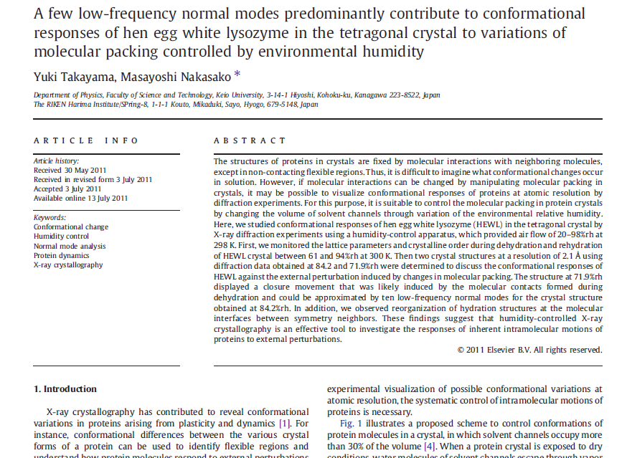

Slide 16
Non-isomorphism in lysozyme
RMSD = 1.70 Å
Δcell = 0.7 %
R_{iso} = 44.5%
RMSD = 0.18 Å
RH: 84.2%
vs 71.9%
3aw6
3aw7

Slide 17
Magdoff & Crick (1955) “Ribonuclease II. Accuracy of measurement and shrinkage”, Acta Cryst. 8, 461-8.
Crick & Magdoff (1956) “The theory of the method of isomorphous replacement for protein crystals”, Acta Cryst. 9, 901-8.

Slide 18
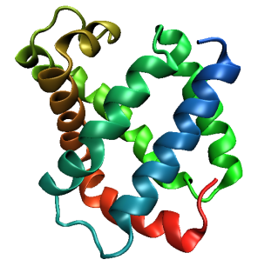
Same structure, different cell
0.5% cell change → 15%
Crick & Magdoff (1956) “theory method isomorphous replacement”, Acta Cryst. 9, 901-8.

Slide 19
Same structure, different cell
0.5% cell change → 15%
Crick & Magdoff (1956) “theory method isomorphous replacement”, Acta Cryst. 9, 901-8.

Slide 20
Same cell, rotated protein
0.5° rotation → 16%
Crick & Magdoff (1956) “theory method isomorphous replacement”, Acta Cryst. 9, 901-8.

Slide 21
Same cell, rotated protein
0.5° rotation → 16%
Crick & Magdoff (1956) “theory method isomorphous replacement”, Acta Cryst. 9, 901-8.

Slide 22
Uniform stretch
5% change → 0%

Slide 23
Uniform stretch
5% change → 0%

Slide 24
Elastic deformation = non-isomorphism

Slide 25
Elastic deformation = non-isomorphism

Slide 26
Plastic deformation = poor diffraction

Slide 27
Plastic deformation = poor diffraction

Slide 28
Xtal5_t1 graph
Spot intensity

Slide 29
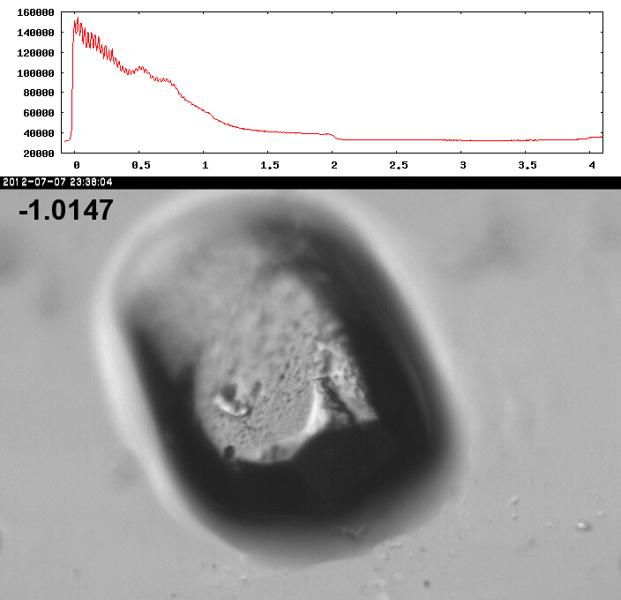
Spot intensity

Slide 30
How much H₂ are we making?
Meents et al. (2010) claimed:
"400 molecules of H2 for every 12.5 keV photon“
= 3.3x10⁻⁷ mol/J
200 kGy to 100 um³ = 0.24 J
= 1.2x10⁻⁸ mol H₂
100 um³ of water = 6.7x10⁻⁸ mol
→ 18% of water has reacted!

Slide 31
Dose-rate dependence of damage
maximum useful dose (MGy)
dose rate (kGy/s)

Slide 32
Self-calibrated damage limit
Where:
⟨I⟩_{DL} - average damage-limited intensity (photons/hkl) at a given resolution
10⁵ - converting R from μm to m, r_{e} from m to Å, ρ from g/cm³ to kg/m³ and MGy to Gy
r_{e} - classical electron radius (2.818 x 10⁻¹⁵ m/electron)
h - Planck’s constant (6.626 x 10⁻³⁴ J∙s)
c - speed of light (299792458 m/s)
f_{decayed} - fractional progress toward completely faded spots at end of data set
ρ - density of crystal (~1.2 g/cm³)
R - radius of the spherical crystal (μm)
λ - X-ray wavelength (Å)
f_{NH} - the Nave & Hill (2005) dose capture fraction (1 for large crystals)
n_{ASU} - number of proteins in the asymmetric unit
M_{r} - molecular weight of the protein (Daltons or g/mol)
V_{M} - Matthews’s coefficient (~2.4 Å³/Dalton)
H - Howells’s criterion (10 MGy/Å)
θ - Bragg angle
⟨ƒ_{a}²⟩ - number-averaged squared structure factor per protein atom (electron²)
⟨M_{a}⟩ - number-averaged atomic weight of a protein atom (~7.1 Daltons)
B - average (Wilson) temperature factor (Å²)
μ - attenuation coefficient of sphere material (m⁻¹)
μ_{en} - mass energy-absorption coefficient of sphere material (m⁻¹)
No flux
No symmetry
No exposure time
Holton & Frankel (2010) Acta D 66 393-408.

Slide 33
The number of photons scattered
before crystal is dead
is independent
of flux & time
1 um³ = 10⁵ photons (roomT)
1 um³ = 10⁶ photons (synch)
1 um³ = 10⁸ photons (XFEL)
(synch)
Henderson, 1990; Gonzalez & Nave, 1994; Glaeser et al., 2000; Sliz et al., 2003; Leiros et al., 2006; Owen et al., 2006; Garman & McSweeney, 2006; Garman & Nave, 2009; Holton, 2009

Slide 35
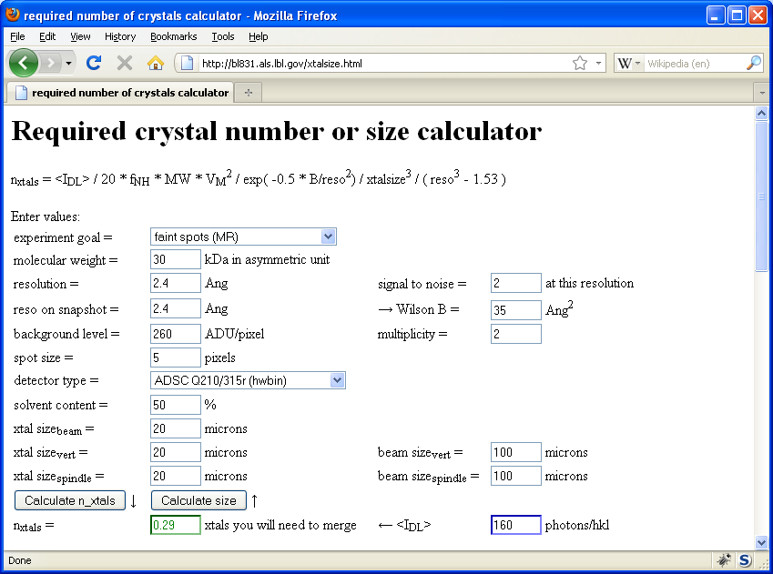
Holton & Frankel (2010) Acta D 66 393-408.

Slide 36
Multi-crystal strategies
Kendrew et al. (1960) "Structure of Myoglobin” Nature 185, 422-427.

Slide 37
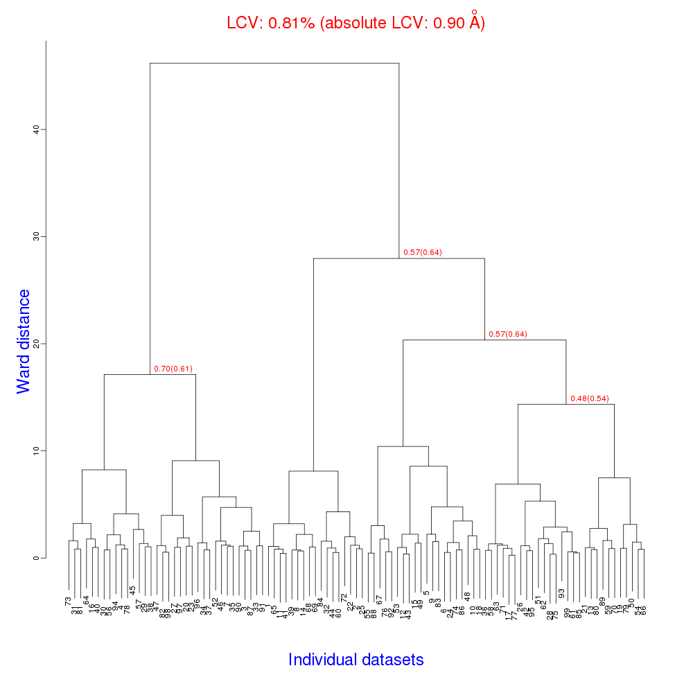
Cell clustering: 100 datasets
Reality:
Perfect isomorphism
(simulated data)

Slide 38
Micro-focus challenge
http://bl831.als.lbl.gov/~jamesh/challenge/microfocus/

Slide 39
Dose slicing
unacceptable
completeness
N
photons
crystal’s useful life
N
photons
unacceptable
read noise
N
photons

Slide 40
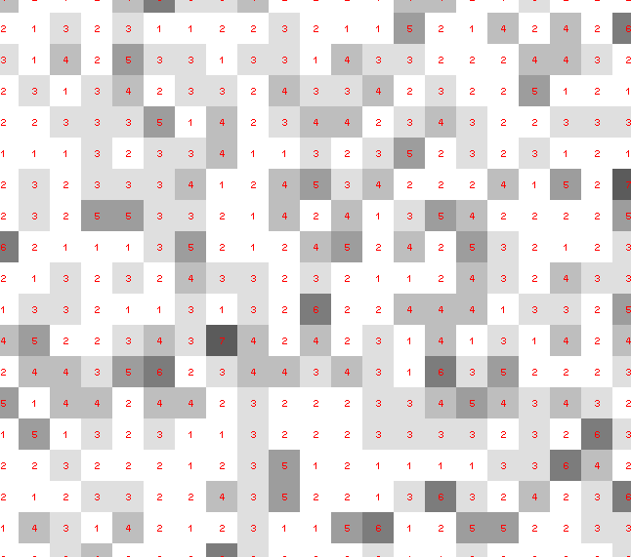
Dose slicing: is that a spot?

Slide 41
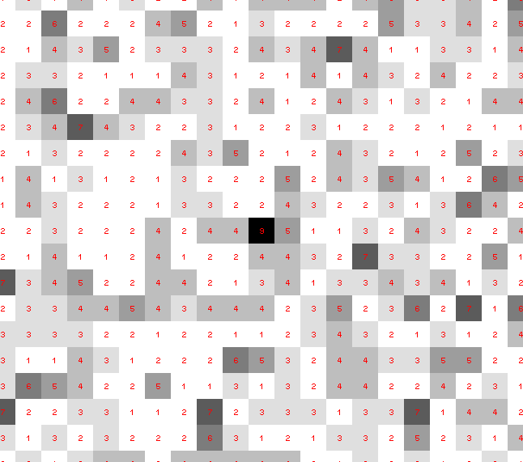
Dose slicing: is that a spot?

Slide 42
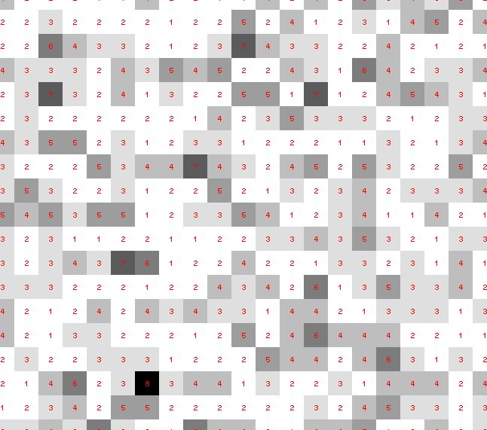
Dose slicing: is that a spot?

Slide 43
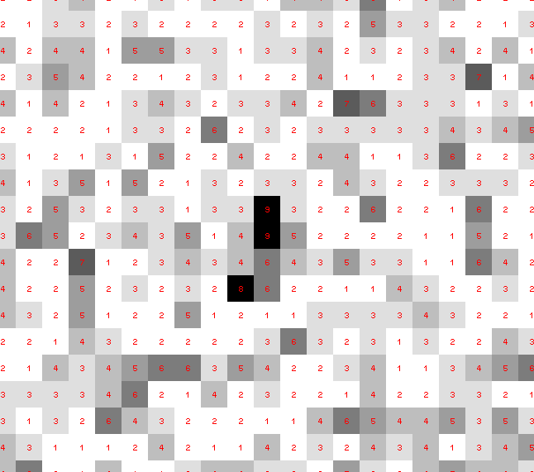
Dose slicing: is that a spot?

Slide 44
Dose slicing: is that a spot?

Slide 45
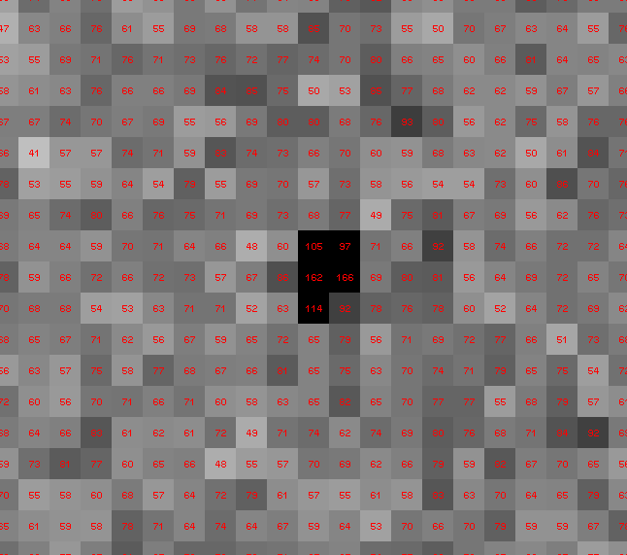
Dose slicing: is that a spot?

Slide 46
What if?
You only have a few small crystals…
Should you:
Collect 360° from each?
Collect 10° from each at 36x exposure?
Glue 36 xtals together, then collect 360° ?
Glue, and do 12960° faint exposures?

Slide 47
“true” resolution limit
CC vs right answer
Resolution (Å)

Slide 48
“true” resolution vs strategy
Dose slice collection scenario
fine | coarse | glue | Glue & fine
3.17700 | 3.14057 | 3.17604 | 3.12086
301,640,334 photons/xtal

Slide 49
Trick Question: What is the space group?
a = 63 b = 63 c = 63
α = 90 β = 90 γ = 90

Slide 50
Pitfalls: sub-space groups
P622
What else?
P6₁22 P6₅22 P6₂22 P6₄22 P6₃22
P6 P6₁ P6₅ P6₂ P6₄ P6₃
P3₁2 P321 P3₁12 P3₁21 P3₂12 P3₂21
P3 P3₁ P3₂
P2 P2₁ C2 C222 C222₁
P1

Slide 51
Multi-crystal merge preparation
Take each pair of datasets
“othercell” to find all possible re-indexings
Apply all re-indexing operators in turn
Evaluate best agreement (R, CC)
Cluster by acceptable distance (20% ?)
Re-index clusters to common lattice
Apply xscale_isocluster

Slide 52
And the dominant source of error is…
Resolution
Disorder (including Radiation Damage)
Background
Phases
Non-isomorphism (including Radiation Damage)
Vibration (beam, xtal, spindle, etc.)
Detector calibration

Slide 53
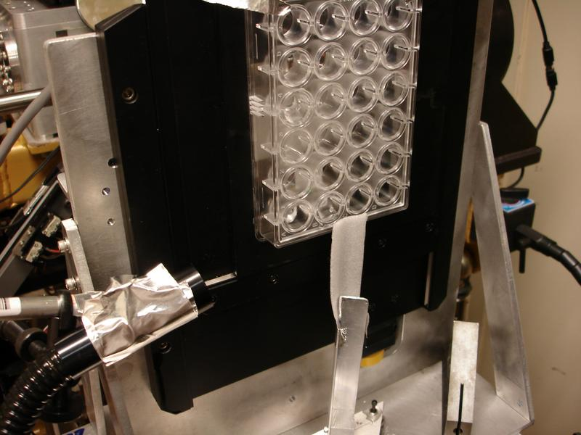

Slide 54
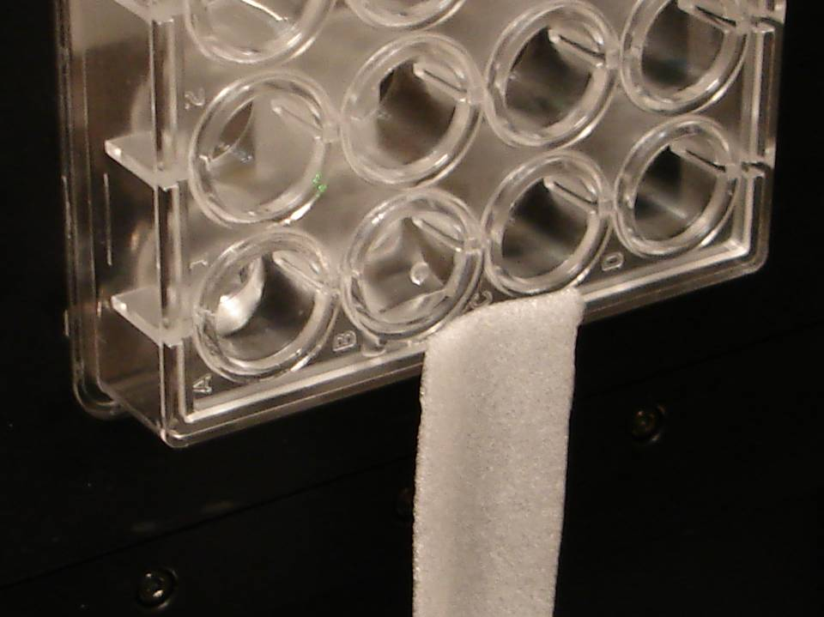

Slide 59
from Lysozyme?
~4Ǻ

Slide 61
X-ray vs tray

Slide 63
attenuation factor
μ_{solvent}
t_{so}
t_{xo}
t_{si}
t_{xi}
μ_{xtal}
t_{so}
t_{xo}
t_{si}
t_{xi}
t_{so}
t_{xo}
I_{T}
I_{beam}
t_{si}
t_{xi}
A = = exp[-μ_{xtal}(t_{xi}+ t_{xo})
-μ_{solvent}(t_{si} + t_{so})]
Bouguer, P. (1729). Essai d'optique sur la gradation de la lumière.
Lambert, J. H. (1760). Photometria: sive De mensura et gradibus luminis, colorum et umbrae. E. Klett.
Beer, A. (1852)."Bestimmung der Absorption des rothen Lichts in farbigen Flüssigkeiten", Ann. Phys. Chem 86, 78-90.

Slide 64
X-ray transmission of tray materials
at the selenium edge
transmission
Depth into material (mm)

Slide 65
X-ray transmission of tray materials
at the selenium edge
transmission
protein
crystal
Depth into material (mm)

Slide 66
X-ray transmission of tray materials
at the selenium edge
transmission
water
protein
crystal
Depth into material (mm)

Slide 67
X-ray transmission of tray materials
at the selenium edge
transmission
water
protein
crystal
PDMS
Depth into material (mm)

Slide 68
X-ray transmission of tray materials
at the selenium edge
transmission
water
protein
crystal
glass
PDMS
Depth into material (mm)

Slide 69
X-ray transmission of tray materials
at the selenium edge
air
transmission
water
protein
crystal
glass
PDMS
Depth into material (mm)

Slide 70
X-ray transmission of tray materials
air
transmission
water
protein
crystal
PDMS
glass
Depth into material (μm)

Slide 71
X-ray transmission of tray materials
air
transmission
nylon
water
protein
crystal
PDMS
glass
Depth into material (μm)

Slide 72
X-ray transmission of tray materials
air
plastic
transmission
nylon
water
protein
crystal
PDMS
glass
Depth into material (μm)

Slide 73
X-ray transmission of tray materials
air
beryllium
plastic
transmission
nylon
water
protein
crystal
PDMS
glass
Depth into material (μm)

Slide 74
X-ray transmission of tray materials
air
beryllium
plastic
transmission
nylon
diamond
water
protein
crystal
PDMS
glass
Depth into material (μm)

Slide 75
X-ray transmission of tray materials
air
water
protein
crystal
transmission
glass
Depth into material (μm)

Slide 76
X-ray scattering of tray materials
water
Differential cross section
(scattered photons/solid angle/incident photon/meter thickness)
∞ 7.5 3.8 2.5 1.9 1.5
d-spacing (Ǻ)

Slide 77
X-ray scattering of tray materials
water
Differential cross section
(scattered photons/solid angle/incident photon/meter thickness)
25% glycerol
∞ 7.5 3.8 2.5 1.9 1.5
d-spacing (Ǻ)

Slide 78
X-ray scattering of tray materials
water
Paratone-N oil
Differential cross section
(scattered photons/solid angle/incident photon/meter thickness)
25% glycerol
∞ 7.5 3.8 2.5 1.9 1.5
d-spacing (Ǻ)

Slide 79
X-ray scattering of tray materials
water
Differential cross section
(scattered photons/solid angle/incident photon/meter thickness)
Paratone-N oil
25% glycerol
∞ 7.5 3.8 2.5 1.9 1.5
d-spacing (Ǻ)

Slide 80
X-ray scattering of tray materials
Differential cross section
(scattered photons/solid angle/incident photon/meter thickness)
paratone-N oil
25% glycerol
water
∞ 7.5 3.8 2.5 1.9 1.5
d-spacing (Ǻ)

Slide 81
X-ray scattering of tray materials
PDMS
Differential cross section
(scattered photons/solid angle/incident photon/meter thickness)
paratone-N oil
25% glycerol
water
∞ 7.5 3.8 2.5 1.9 1.5
d-spacing (Ǻ)

Slide 82
X-ray scattering of tray materials
PDMS
plastic1
Differential cross section
(scattered photons/solid angle/incident photon/meter thickness)
paratone-N oil
25% glycerol
water
∞ 7.5 3.8 2.5 1.9 1.5
d-spacing (Ǻ)

Slide 83
X-ray scattering of tray materials
PDMS
plastic1
plastic2
Differential cross section
(scattered photons/solid angle/incident photon/meter thickness)
paratone-N oil
25% glycerol
water
∞ 7.5 3.8 2.5 1.9 1.5
d-spacing (Ǻ)

Slide 84
X-ray scattering of tray materials
PDMS
plastic1
plastic2
Differential cross section
(scattered photons/solid angle/incident photon/meter thickness)
plastic3
paratone-N oil
25% glycerol
water
∞ 7.5 3.8 2.5 1.9 1.5
d-spacing (Ǻ)

Slide 85
X-ray scattering of tray materials
PDMS
plastic1
plastic2
Differential cross section
(scattered photons/solid angle/incident photon/meter thickness)
plastic3
paper
paratone-N oil
25% glycerol
water
∞ 7.5 3.8 2.5 1.9 1.5
d-spacing (Ǻ)

Slide 86
X-ray scattering of tray materials
glass
PDMS
plastic1
Differential cross section
(scattered photons/solid angle/incident photon/meter thickness)
plastic2
plastic3
paper
paratone-N oil
25% glycerol
water
∞ 7.5 3.8 2.5 1.9 1.5
d-spacing (Ǻ)

Slide 87
X-ray scattering of tray materials
PDMS
plastic1
plastic2
Differential cross section
(scattered photons/solid angle/incident photon/meter thickness)
plastic3
paper
paratone-N oil
25% glycerol
water
∞ 7.5 3.8 2.5 1.9 1.5
d-spacing (Ǻ)

Slide 88
X-ray scattering of tray materials
PDMS
plastic1
plastic2
Plastic … n
Differential cross section
(scattered photons/solid angle/incident photon/meter thickness)
plastic3
paper
paratone-N oil
25% glycerol
water
∞ 7.5 3.8 2.5 1.9 1.5
d-spacing (Ǻ)

Slide 89
X-ray scattering of tray materials
PDMS
Plastic … n
Differential cross section
(scattered photons/solid angle/incident photon/meter thickness)
paratone-N oil
water
∞ 7.5 3.8 2.5 1.9 1.5
d-spacing (Ǻ)

Slide 90
Background scattering
R. W. James (1947)
N_{A} ρV
I_{bg} = I_{beam} t r_{e}²
P A | f(s) |²
Mr
I_{bg} - scattered photons/steradian
I_{beam} - incident (photons/s/m² )
t - exposure time (s)
r_{e} - classical electron radius (2.818x10⁻¹⁵ m)
N_{A} - Avogadro number (6.02x10²³)
ρ - density of material (g/m³)
Mr - molecular weight (g/mol)
V - volume of material (in m3)
P - polarization factor
(1+cos²(2θ) -Pfac∙cos(2Φ)sin²(2θ))/2
A - absorption factor
exp(-μ_{xtal}∙l_{path})
f(s) - molecular structure amplitude (electrons)
s - scattering length (sin(θ)/λ)

Slide 91
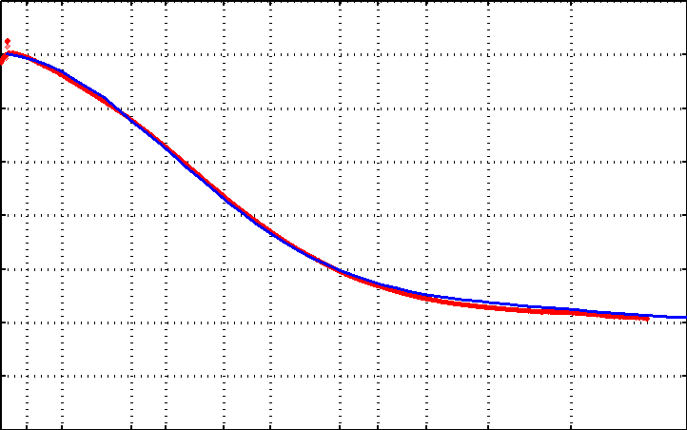
Background scattering
The form-factor of the cryostream
measured
theoretical
0 2 4 6 8 10 12 14 16
Electron equivalents
20 10 5 4 3 2.5 2 1.8 1.6 1.4 1.2 1
Resolution (Ǻ)

Slide 92
Background scattering
R. W. James (1947)
N_{A} ρV
I_{bg} = I_{beam} t r_{e}²
P A | f(s) |²
Mr
I_{bg} - scattered photons/steradian
I_{beam} - incident (photons/s/m² )
t - exposure time (s)
r_{e} - classical electron radius (2.818x10⁻¹⁵ m)
N_{A} - Avogadro number (6.02x10²³)
ρ - density of material (g/m³)
Mr - molecular weight (g/mol)
V - volume of material (in m3)
P - polarization factor
(1+cos²(2θ) -Pfac∙cos(2Φ)sin²(2θ))/2
A - absorption factor
exp(-μ_{xtal}∙l_{path})
f(s) - molecular structure amplitude (electrons)
s - scattering length (sin(θ)/λ)

Slide 93
Diffuse scattering
R. W. James (1947)
V_{xtal}
Σ
I_{ds} = I_{beam} t r_{e}²
P A
|f_{a}(s)|² (1-exp(-2B_{a}∙s²))
V_{ASU}
a
I_{ds} - scattered photons/steradian
I_{beam} - incident (photons/s/m² )
t - exposure time (s)
r_{e} - classical electron radius (2.818x10⁻¹⁵ m)
V_{xtal} - volume of crystal (in m³)
V_{ASU} - asymmetric unit (in m³)
P - polarization factor
A - absorption factor
a - particular atom in the ASU
f_{a}(s) - atomic structure amplitude (electrons)
s - scattering length (sin(θ)/λ)
B_{a} - atomic B factor

Slide 94
Diffuse scattering
R. W. James (1947)
V_{xtal}
Σ
I_{ds} = I_{beam} t r_{e}²
P A
|f_{a}(s)|² (1-exp(-2B_{a}∙s²))
V_{ASU}
a
I_{ds} - scattered photons/steradian
I_{beam} - incident (photons/s/m² )
t - exposure time (s)
r_{e} - classical electron radius (2.818x10⁻¹⁵ m)
V_{xtal} - volume of crystal (in m³)
V_{ASU} - asymmetric unit (in m³)
P - polarization factor
A - absorption factor
a - particular atom in the ASU
f_{a}(s) - atomic structure amplitude (electrons)
s - scattering length (sin(θ)/λ)
B_{a} - atomic B factor

Slide 95
scattering/absorptoin “rules”:
1 μm crystal ≈ 1 μm water
≈ 1 μm plastic
≈ 0.1 μm glass
≈ 1000 μm air
Optimum: support thickness = crystal thickness

Slide 96
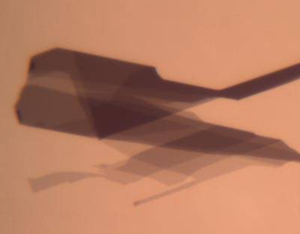
What we really need
Thin
Tight
Cheap
GRAPHENE

Slide 97
Crowfoot Cell
Bernal & Crowfoot, Nature (London) 133, 794 (1934).

Slide 98
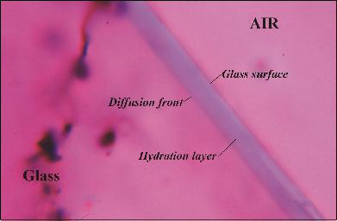
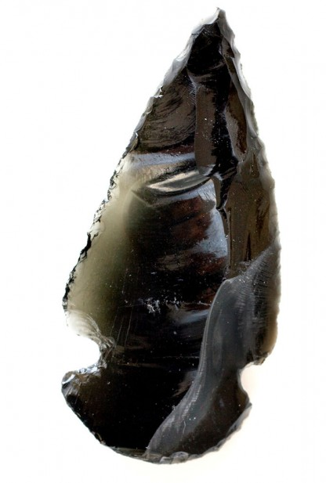
Water permeability of glass
x² = kt
x = thickness t = time
k = um/1000 year
Friedman & Smith (1960), American Antiquity, 476-493.

Slide 99
Water permeability of glass
Liritzis (2006), Archaeometry. 48, 533-547.

Slide 100
Water permeability of glass
Thin
~ Tight
? Cheap ?

Slide 101
in-situ diffraction systems
25 μm wall
~50 μm tape
~50 μm tape
PDMS
PDMS
250 μm
100 μm
200 μm
1000 μm
25 μm wall
MiTeGen
MicroRT™
Fluidigm
Topaz® DC
Microlytic
Crystal Former™
NatX-ray
CrystalQuick™ X
MiTeGen
in-situ-1
http://www.mitegen.com/products/micrort/micrort.shtml
http://www.fluidigm.com/home/fluidigm/docs/Datasheet_1.96DC.pdf
Ng, J. et al. (2008). Acta Cryst. D 64, 189-197.
Soliman, A. et al. (2011). Acta Cryst. D 67, 646-656.
http://www.mitegen.com/mic_catalog.php?c=insituplates
Notes:
Next slide please

Slide 102
in-situ diffraction systems
25 μm wall
~50 μm tape
~50 μm tape
~50 μm tape
PDMS
PDMS
250 μm
100 μm
25 μm
200 μm
25 μm wall
MiTeGen
MicroRT™
Fluidigm
Topaz® DC
NatX-ray
CrystalQuick™ X
MiTeGen
in-situ-1
Crystal DirectTM
http://www.mitegen.com/products/micrort/micrort.shtml
http://www.fluidigm.com/home/fluidigm/docs/Datasheet_1.96DC.pdf
Soliman, A. et al. (2011). Acta Cryst. D 67, 646-656.
http://www.mitegen.com/mic_catalog.php?c=insituplates
Márquez, J. & Cipriani, F. (2014) Structural Genomics (Chen, Y. W., ed) pp. 197-203.
Notes:
Next slide please

Slide 103
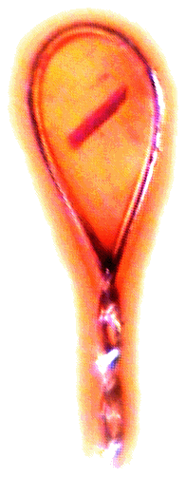
Zero-parallax microscope
Styrofoam™ backlight
backstop
mirror
pinhole
microscope
Notes:
Next slide please

Slide 104
Zero-parallax microscope
Styrofoam™ backlight
backstop
mirror
pinhole
microscope
Notes:
Inspired by the ESRF microcrystal camera, the superbend endstations are all equipped with zero-paralax optics. The user sees their sample from the point of view of the x-ray beam. Sample alignment is not only more stable but more intuitive than an off-axis camera. Placing the crystal into the microscope crosshairs gaurantees that it will be hit by the beam.

Slide 105
Zero-parallax microscope
mirror
pinhole
microscope
Notes:
Inspired by the ESRF microcrystal camera, the superbend endstations are all equipped with zero-paralax optics. The user sees their sample from the point of view of the x-ray beam. Sample alignment is not only more stable but more intuitive than an off-axis camera. Placing the crystal into the microscope crosshairs gaurantees that it will be hit by the beam.

Slide 106
Zero-parallax microscope
mirror
pinhole
microscope
Notes:
Inspired by the ESRF microcrystal camera, the superbend endstations are all equipped with zero-paralax optics. The user sees their sample from the point of view of the x-ray beam. Sample alignment is not only more stable but more intuitive than an off-axis camera. Placing the crystal into the microscope crosshairs gaurantees that it will be hit by the beam.

Slide 107
Zero-parallax microscope
mirror
pinhole
microscope
Notes:
Inspired by the ESRF microcrystal camera, the superbend endstations are all equipped with zero-paralax optics. The user sees their sample from the point of view of the x-ray beam. Sample alignment is not only more stable but more intuitive than an off-axis camera. Placing the crystal into the microscope crosshairs gaurantees that it will be hit by the beam.

Slide 108
Sample parallax
Image plane
x-rays
mirror
Microscope
light cone
Notes:
Inspired by the ESRF microcrystal camera, the superbend endstations are all equipped with zero-paralax optics. The user sees their sample from the point of view of the x-ray beam. Sample alignment is not only more stable but more intuitive than an off-axis camera. Placing the crystal into the microscope crosshairs gaurantees that it will be hit by the beam.

Slide 109
Sample parallax
Notes:
Inspired by the ESRF microcrystal camera, the superbend endstations are all equipped with zero-paralax optics. The user sees their sample from the point of view of the x-ray beam. Sample alignment is not only more stable but more intuitive than an off-axis camera. Placing the crystal into the microscope crosshairs gaurantees that it will be hit by the beam.

Slide 110
Sample parallax
n>1
Notes:
Inspired by the ESRF microcrystal camera, the superbend endstations are all equipped with zero-paralax optics. The user sees their sample from the point of view of the x-ray beam. Sample alignment is not only more stable but more intuitive than an off-axis camera. Placing the crystal into the microscope crosshairs gaurantees that it will be hit by the beam.

Slide 111
Sample parallax
n>1
Notes:
Inspired by the ESRF microcrystal camera, the superbend endstations are all equipped with zero-paralax optics. The user sees their sample from the point of view of the x-ray beam. Sample alignment is not only more stable but more intuitive than an off-axis camera. Placing the crystal into the microscope crosshairs gaurantees that it will be hit by the beam.

Slide 112
Sample parallax
n>1
Notes:
Inspired by the ESRF microcrystal camera, the superbend endstations are all equipped with zero-paralax optics. The user sees their sample from the point of view of the x-ray beam. Sample alignment is not only more stable but more intuitive than an off-axis camera. Placing the crystal into the microscope crosshairs gaurantees that it will be hit by the beam.

Slide 113
Sample parallax
n>1
Notes:
Inspired by the ESRF microcrystal camera, the superbend endstations are all equipped with zero-paralax optics. The user sees their sample from the point of view of the x-ray beam. Sample alignment is not only more stable but more intuitive than an off-axis camera. Placing the crystal into the microscope crosshairs gaurantees that it will be hit by the beam.

Slide 114
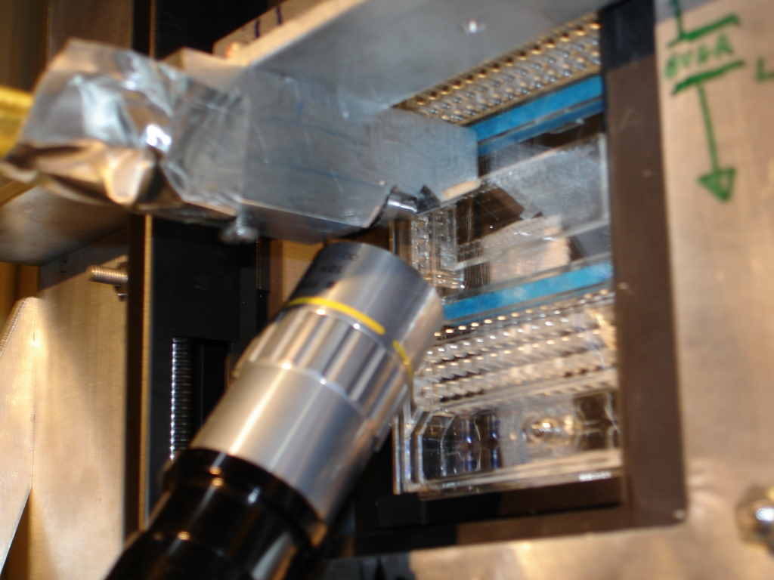

Slide 117
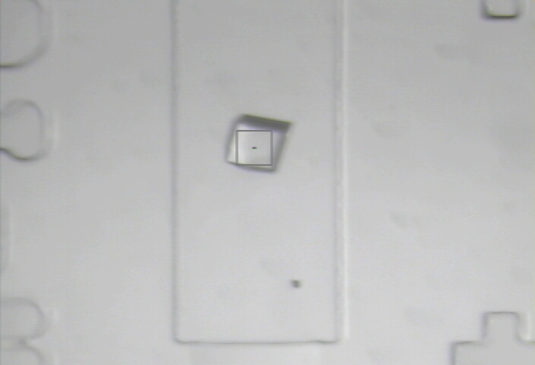

Slide 118
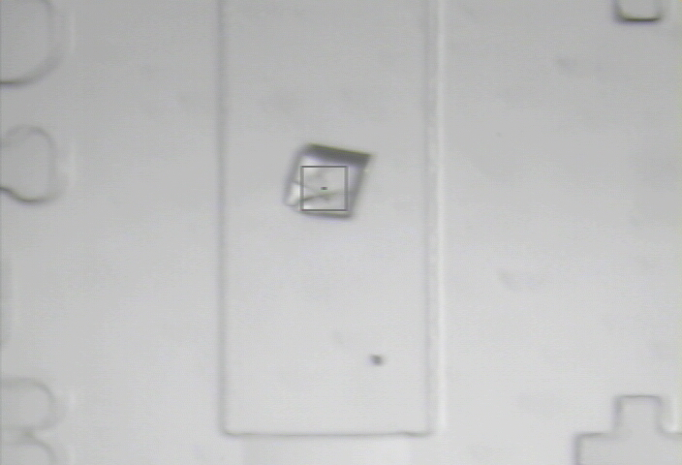
8000 Gy/s

Slide 119
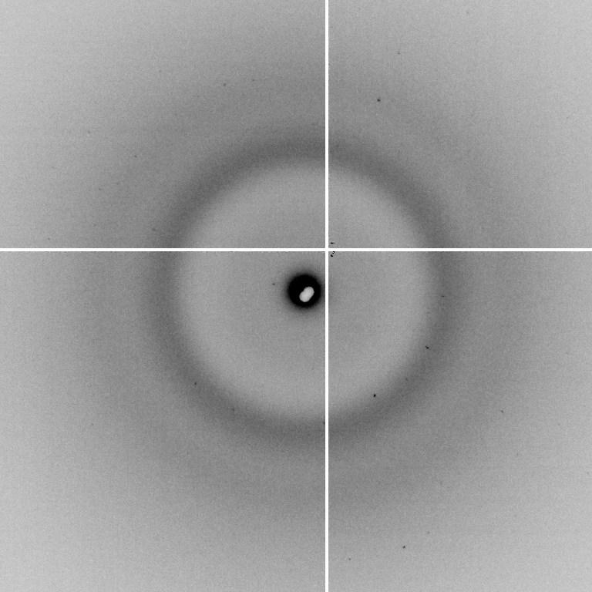
pseudo-Laue from Lysozyme

Slide 120
Laue spot from lysozyme
10s exposure
after 30s
as in: Snell, et al. (1995), Acta Cryst D. 51, 1099-102.

Slide 121
Rastering math
Damage & diffraction = flux / area
Gy/s = ph/s /2000 / um²
Example: flux= 10¹² ph/s, 1 mm² beam = 500 Gy/s
1 mm² beam = 500 Gy/s → 30 MGy = 17 hours
100 µm beam = 50 kGy/s * 10x10 shots = 17 hours
10 µm beam = 5 MGy/s * 100x100 shots = 17 hours
1% sample life → 300 kGy / 500 Gy/s = 10 min
room temp → 200 kGy / 500 Gy/s = 7 min
Holton (2009)."beginner's guide rad dam", J. Synch. Rad. 16, 133-142.

Slide 122
Multilayers: better for rastering
0.014 % (1x10¹² ph/s
= 400 s/mm²)
Existing mono
Si(111)
ML
Si(111)
ML

Slide 123
Multilayers: better for rastering
1 % (7x10¹³ ph/s
= 2 s/mm²)
Existing mono
Si(111)
ML
ML
Si(111)

Slide 124
Wide bandpass reveals mosaicity from a still
low mosaic
high mosaic
Δ_{radial} = 2ηD/cos²2θ
Snell EH, Weisgerber S, Helliwell JR, Holzer K & Schroer K (1995)."Improvements in lysozyme protein crystal perfection through microgravity growth", Acta crystallographica. Section D, Biological crystallography 51, 1099-1102.

Slide 125
Si(111) vs multilayers
0.014%
Si(111)
spectral
dispersion
1%
multilayer
4 Å
resolution
1.9 Å

Slide 126
Wide-bandpass MX?
Mono | Si(111) | multilayer | Difference (%) | good
Energy (eV) | 11111 | 12027.5 | +8.2 | Same
Scale | 1.0000 | 1.0964 | +9.6 | Yes
R_{merge} (%) | 7.5 | 8.4 | +12 | No
R_{anom} (%) | 5.6 | 5.5 | -1.8 | Same
I/sd | 13.2 | 12.3 | -6.8 | Same
I/sd (1.5Å) | 2.3 | 1.8 | -21.7 | No
Ano Patt | 5.96 | 4.75 | -20.3 | Same
Ano Phased | 41 | 39.33 | -4.1 | Same
FOM | 0.238 | 0.192 | -19.3 | Same
CC | 0.555 | 0.647 | -6.1 | Yes
R_{cryst} (%) | 26.70 | 26.48 | -0.2 | Same
Ligand peak | 8.213 | 8.250 | +0.4 | Same

Slide 127
ML good for raster
What about collection?

Slide 128
High energy compresses pattern
2 Å data
2 Å data
Notes:
Next slide please

Slide 129
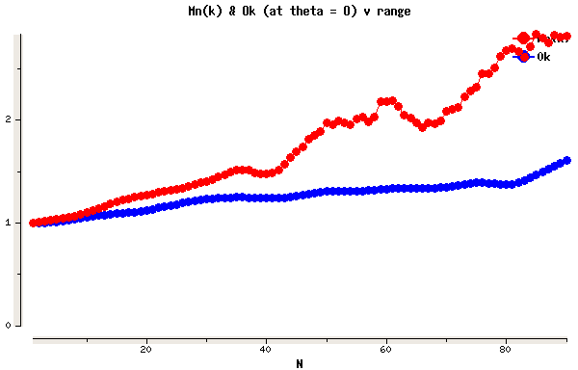
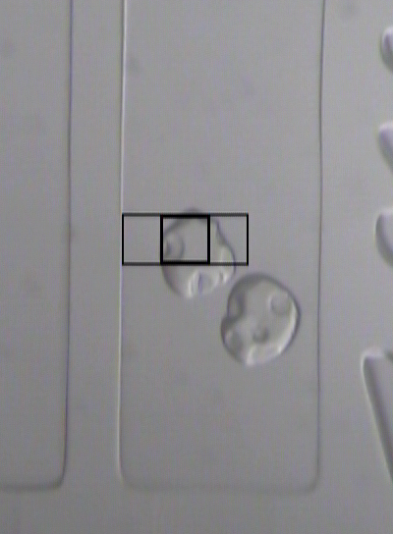
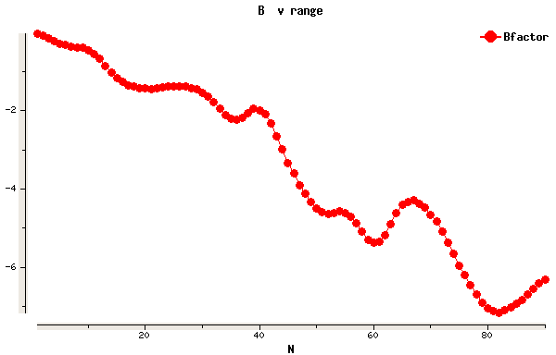
Example Data
70 μm lysozyme xtal
50 μm beam
37 Gy/s (0.775 Å)
30s exposures at 20C
90° of data, 97% complete
I/σ = 1.5 at 1.9 Å
R_{merge} 18% (overall) 5% (low)
ΔB same as 20 min at 100K
2
1
0
scale vs batch
B factor
-2
-4
-6

Slide 130
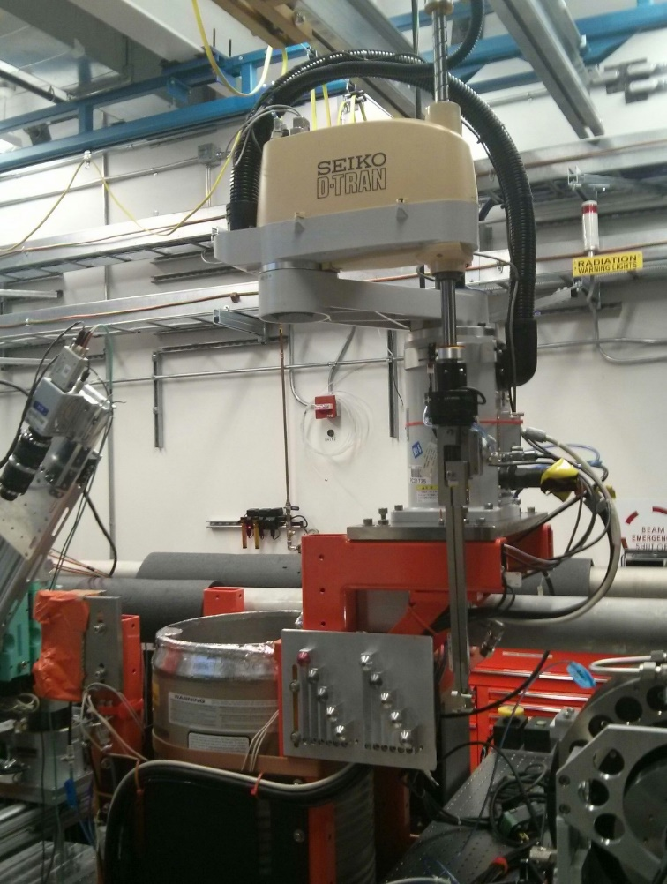
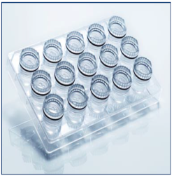
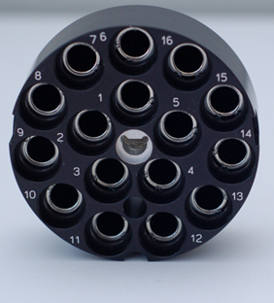
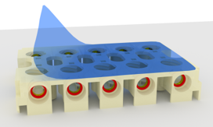
Room Temperature Sample Mounting
at LCLS-MFX
SSRL
Crystallization Plate
Uni-Puck
solution vial
10 Room Temperature
Sample Holder Locations
=
LCLS-MFX June 2016
(Problem - samples could dry out)
SAM Compatible
Crystallization Plate
sample base holder

Slide 131
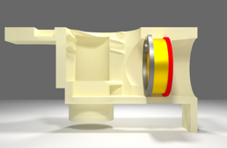
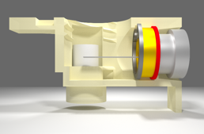
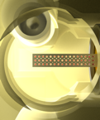
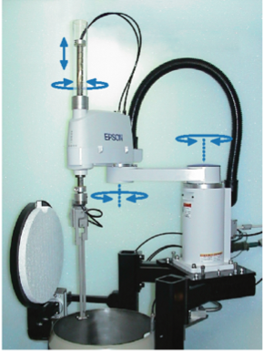
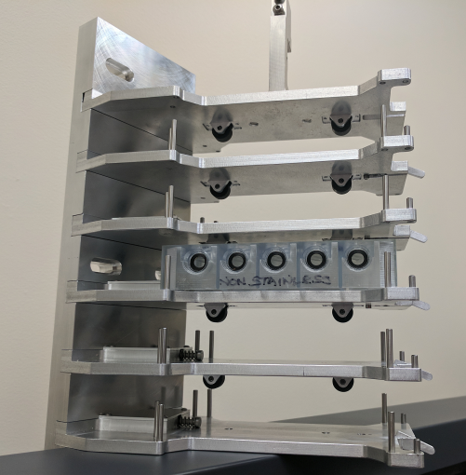
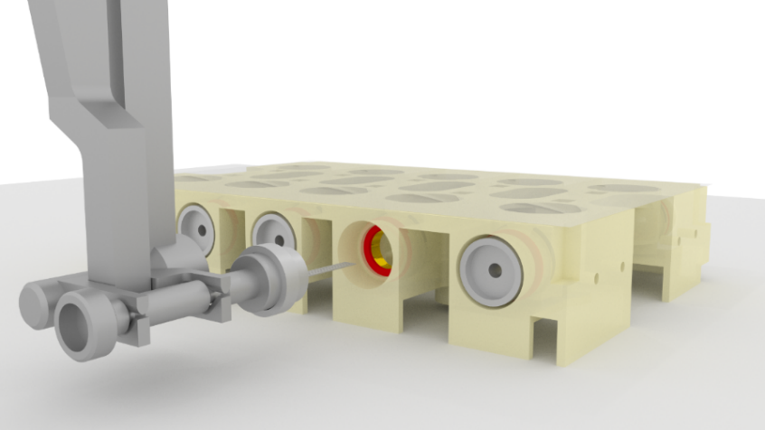
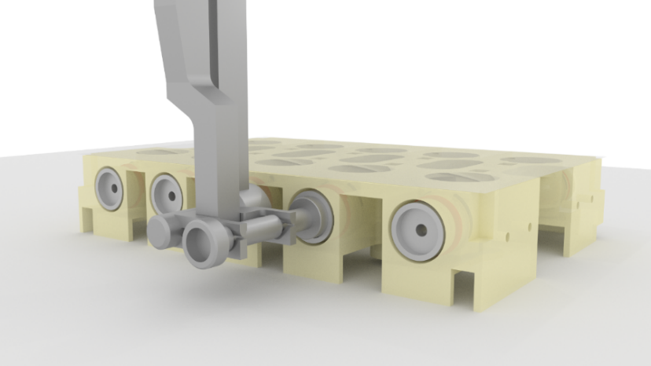
SSRL
Humidity Controlled Crystallization,
Storage and Delivery Plate
Compatible with Qiagen screw-caps
Ring magnet holds sample base inside
Sample delivery device in hydrated environment
Automated sample exchange with SAM
Capacity for 5 trays/50 sample bases
(Humidity controlled enclosure for shelf in progress)

Slide 132
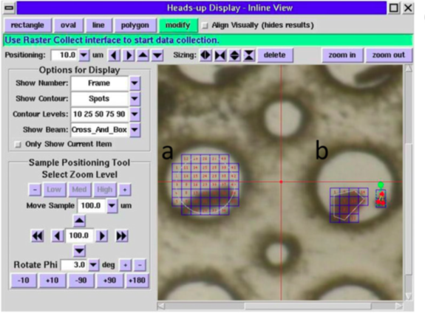
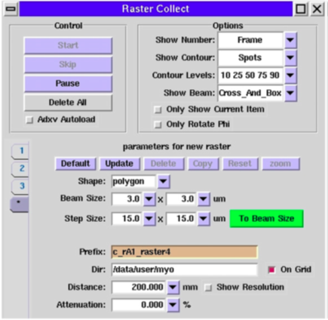
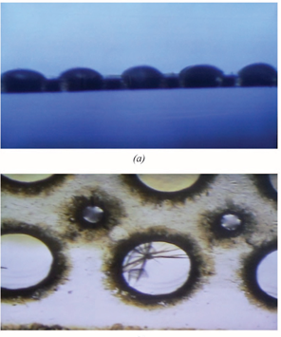
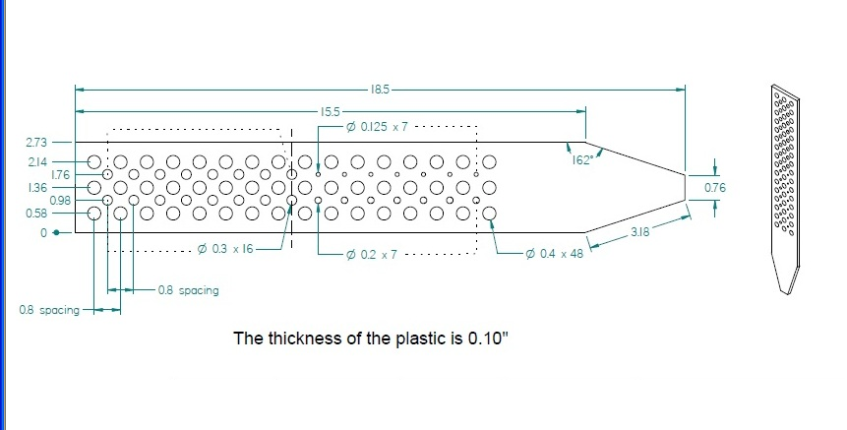
Multi-Crystal Mounting Grid
SSRL
Comparison of grid to copper-magnetic pin
Raster Data Collection in Grids
Crystallization Drops on Window
Single thin window
After X-ray Exposure at LCLS
Cohen, A. E. et al. (2014). Proc. Natl Acad. Sci. USA, 111, 17122–17127
Baxter E. L. et al. Acta Cryst. (2016). D72, 2–11.

Slide 133
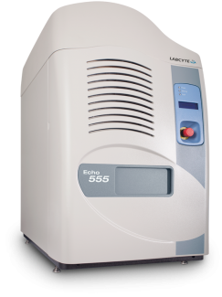
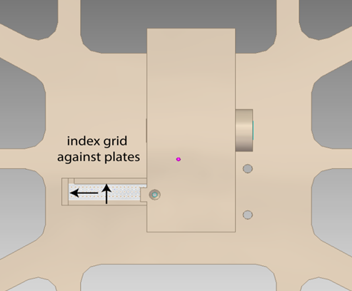
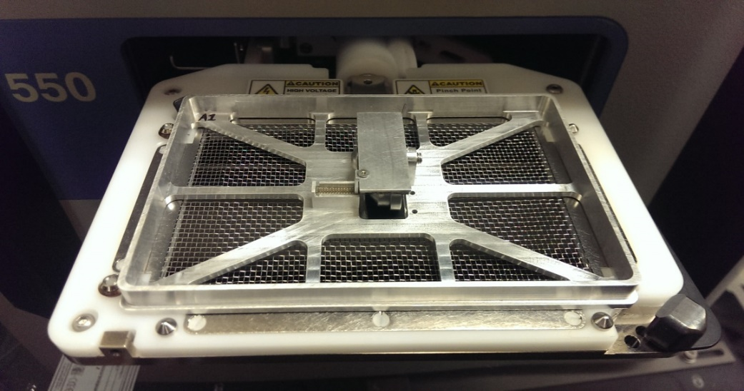
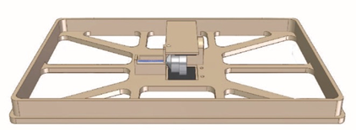
Automation for Filling Grids
Adaptor in standard microplate form factor
Compatible with a variety of fluid handing robots
Labcyte Echo (hanging drop)
Art Robbins Gryphon and TTP Labtech Mosquito (LCP)
SSRL
Mosquito
Gryphon
Baxter E. L. et al. Acta Cryst. (2016). D72, 2–11.

Slide 134
Three Laws of in-situ MX
Must be Thin
plastic = water = protein != glass
Normalize for absorption!
walls <= xtal size
Must be Tight
evaporation = nonisomorphism
Plastic = pile of worms
Must be Cheap
$1-20/tray
New tray = new experiment

Slide 135
In-situ diffraction
promises
pitfalls
Better resolution
Isomorphism
Control: “no hands!”
Dose rate advantage?
Mosaicity from still
Datasets possible
Radiation damage
Trays dry out
thick = background
Thin = evaporation
Graphene = $$$$
2D array = bulky
Microscope parallax
http://bl831.als.lbl.gov/~jamesh/powerpoint/SLS_insitu_2017.pptx

Slide 136
In-situ diffraction
promises
pitfalls
Better resolution
Isomorphism
Control: “no hands!”
Dose rate advantage?
Mosaicity from still
Datasets possible
Radiation damage
Trays dry out
thick = background
Thin = evaporation
Graphene = $$$$
2D array = bulky
Microscope parallax
http://bl831.als.lbl.gov/~jamesh/powerpoint/SLS_insitu_2017.pptx

Slide 137
… but does it work for membrane proteins?
CCP4BB:
“We used it for a large membrane protein complex and diffraction improved from ~7 to 2.7 A. The crystal is fished out and put into mother liquor solution in the button, sealed with dialysis membrane and the button is then placed into about 5 mls of mother liquor with slightly higher PEG concentration. Then you just exchange outside buffer every day or so for solutions containing higher concentrations of PEG. We went from ~9 to 30 % PEG4000 in about a week. You can easily observe crystal under microscope and if it cracks - you went too far/too quickly with PEG and need to use a bit less next time. Also, this method allows you to control all other components of the dehydrating solution - we needed to decrease salt concentration at the same time as increasing PEG. You can also introduce/increase cryo-protectant concentration at the same time. With these crystals, otherwise excellent dehydration machines already mentioned did not work, possibly because the process had to be really slow.”
Efremov, R. G. & Sazanov, L. A. (2011)."Structure of the membrane domain of respiratory complex I", Nature 476, 414-420.
“To improve diffraction properties, crystals were slowly cooled to 4 C, placed into micro-dialysis buttons, and mother liquor was exchanged by dialysis for 0.1 M sodium acetate (pH 4.8), 0.15 M sodium tartrate (pH 5.0), 30% PEG4000, 0.1% sodium cholate and 12.5% glycerol over a period of 5 days.”

Slide 138
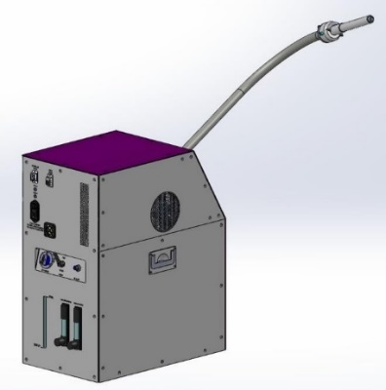
Experiments at Controlled Humidity
SSRL
Arinax Humidity Control Device acquired for MFX and SSRL
Data collection at room temperature
Controlled dehydration to improve diffraction resolution
Test Case: Bovine Liver Catalase Crystals
Dehydration Protocol
starting RH=96%, final RH=90%, 1 % RH steps,
300 seconds equilibration time between steps
2.7 Å
1.7 Å
96 % RH
90 % RH
a=87.8 Å, b=140.8 Å, c=233.1 Å, P212121
a=84.6 Å, b=142.0 Å, c=233.8 Å, P212121

Slide 139
What you know when:
Autoindexing: Lattice (14)
Scaling: Point Group (43)
Refinement: Space Group (84)

Slide 140
plunge cooling
warm, moist air
ice
cold N₂
liquid N₂
foam insulation

Slide 141
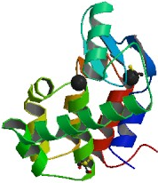
ice = bad

Slide 142
plunge cooling
warm, moist air
ice
cold N₂
liquid N₂
foam insulation

Slide 143
Warkentin method
liquid N₂
foam insulation
Warkentin (2006) J. Appl. Crystallogr. 39, 805-811.

Slide 144
Tris buffer vs temperature
pH
Temperature (C)

Slide 145
Tris buffer under cryo
pH*
Temperature (K)
Douzou (1977) Cryobiochemistry. Academic Press.

Slide 146
Dielectric matching
Travers & Douzou (1970) J. of Phys. Chem. 74, 2243-2244.
Petsko (1975) J. Mol. Biol. 96, 381-388.
Douzou (1977) Cryobiochemistry. Academic Press.

Slide 147
processing procedure | resolution limit
 | fine | coarse | glue | glue&fine
XDS/XSCALE | 3.17700 | 3.14057 | 3.17604 | 3.12086
XDS/aimless | 3.16251 | 3.15922 | 3.16675 | 3.12162
XDS/noscale | 3.27289 | 3.15617 | 3.38929 | 3.12162
MOSFLM-defaults | x | x | x | x
MOSFLM-cheat | 3.19755 | 3.18166 | 3.20354 | 3.19755
HKL2000-defaults | x | x | x | x
HKL2000-expert | 3.21803 | 3.12646 | 3.11551 | 3.21803
HKL2000-cheat | 3.16119 | 3.10338 | 3.10338 | 3.16300
DIALS-defaults | x | x | 3.42125 | x
DIALS-expert | 3.10296 | 3.09547 | 3.07653 | 3.08465
d*Trek | ? | ? | 4.34076 | ?
EVAL15 | 3.14352 | 3.10383 | 3.09936 | 3.14105
EVAL15-sadabs | 3.13920 | 3.10797 | 3.10171 | 3.13700

Slide 148
Minimum exposure time:
~1 photon/pixel
PAD w XDS, DIALS
~10 photon/pixel
PAD w HKL2k, MOSFLM
~30 photon/pixel
CCD detector

Slide 149
Plate goniometers
Notes:
The non-rotating “plate goniometer” (left) was developed last year. A new incarnation for taking rotation-camera data is now being developed (right). Either of these devices will accept most any crystallization tray that can be rotated 90 degrees to gravity and probe arbitrary points in each crystallization drop with a 50 um x-ray beam. Installing a plate goniometer takes ~30 minutes and the location ~300 mm downbeam from the “normal” protein crystallography sample mounting point makes this technology transferable to most any beamline.
Current status is that a 95% complete data set has been collected from a 50 um lysozyme crystal at room temperature, and trials are now underway to collect data sets from “real” crystals.

