Slide 1
Acknowledgements
Robert Stroud James Fraser Aina Cohen Ana Gonzalez
Axel Brunger Monarin Uervirojnangkoorn Artem Lyubimov Nick Sauter
UCSF LBNL SLAC
ALS 8.3.1 creator: Tom Alber
UC Multicampus Research Programs and Initiatives (MRPI)
UCSF Program for Breakthrough Biomedical Research (PBBR)
one-time NIH-DOE Inter-agency agreement (IAA)
Integrated Diffraction Analysis Technologies (IDAT)
Plexxikon, Inc.
M D Anderson CRC
Synchrotron Radiation Structural Biology Resource (SLAC)
The Advanced Light Source is supported by the Director, Office of Science, Office of Basic Energy Sciences, Materials Sciences Division, of the US Department of Energy under contract No. DE-AC02-05CH11231 at Lawrence Berkeley National Laboratory.

Slide 2
Structural Biologists Want:
Resolution
Phases

Slide 3
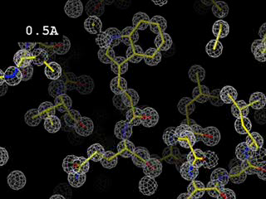
Resolution
http://bl831.als.lbl.gov/~jamesh/movies/resolution.mpeg

Slide 4
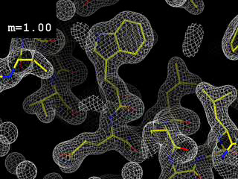
Phases
http://bl831.als.lbl.gov/~jamesh/movies/dephase.mpeg

Slide 5
Structural Biologists Want:
Resolution
  problem: background
  solution: use as few pixels as possible
Phases
  problem: fractional errors
  solution: use as many pixels as possible
Problem for both: radiation damage

Slide 6
Can radiation damage be “outrun”?

Slide 7
Dose-rate dependence of damage
maximum useful dose (MGy)
dose rate (kGy/s)

Slide 8
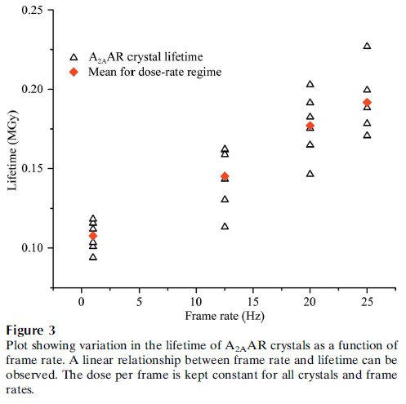
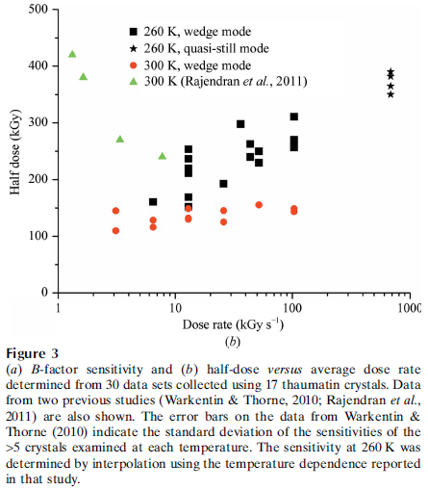
Dose-rate effect at Room Temp?
Owen RL, Axford D, Nettleship JE, Owens RJ, Robinson JI, Morgan AW, Dore AS, Lebon G, Tate CG, Fry EE, Ren J, Stuart DI & Evans G (2012)."Outrunning free radicals in room-temperature macromolecular crystallography", Acta Cryst. D 68, 810-818.
Warkentin M, Badeau R, Hopkins JB, Mulichak AM, Keefe LJ & Thorne RE (2012)."Global radiation damage at 300 and 260 K with dose rates approaching 1 MGy s-1", Acta Cryst. D 68, 124-133.

Slide 9

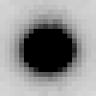

Attenu-wait: same photons, different time
Incident beam transmittance (%)
100 20 10 6.7 5
Integrated photons in spot
Exposure time (seconds) for 1° osc

Slide 10
Attenu-wait: same photons, different time
Incident beam transmittance (%)
100 20 10 6.7 5
Integrated photons in spot
Exposure time (seconds) for 1° osc

Slide 11
What could be better than photon-counting?
Count rate (photons/s)
phi position (degrees)

Slide 12
What could be better than photon-counting?
Dead times:
1000 ns Oxford
200 ns Pilatus
Count rate (photons/s)
phi position (degrees)

Slide 13
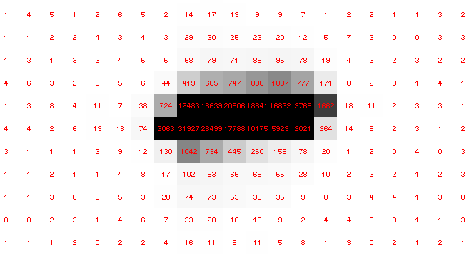
Pilatus pile-up for RT MX? same photons, different speeds
SLOW
Sum of 193 shots with
193-fold attenuation

Slide 14
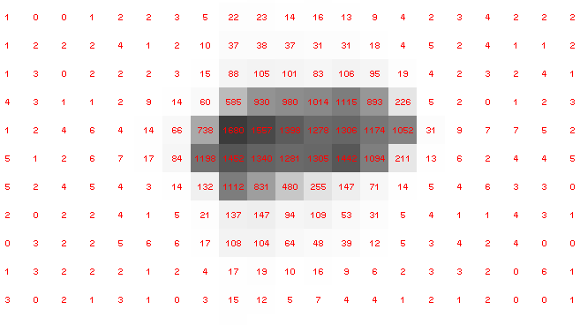
Pilatus pile-up for RT MX? same photons, different speeds
FAST
1 shot with
no attenuation

Slide 15
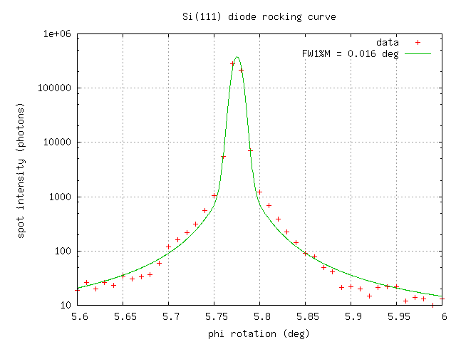
Pilatus pile-up for RT MX? same photons, different speeds

Slide 16
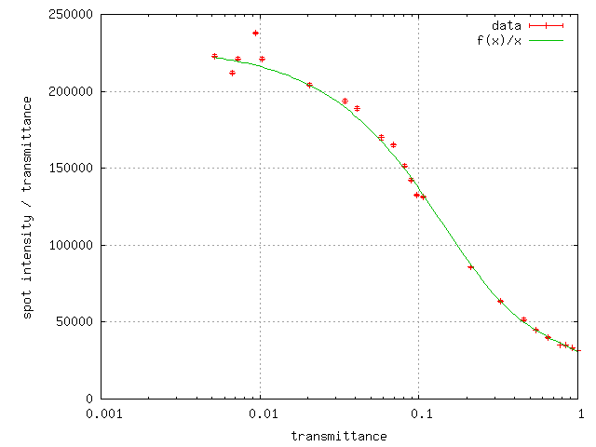
Pilatus pile-up for RT MX? same photons, different speeds
20 deg/s
0.016 deg
mosaic

Slide 17
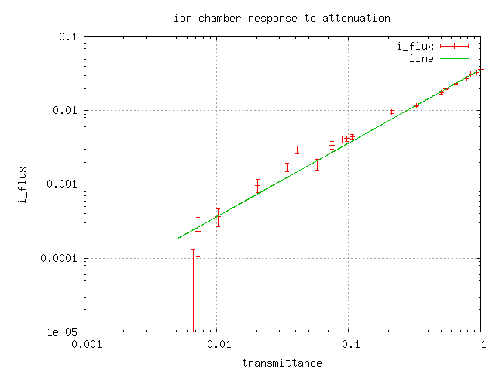
Pilatus pile-up for RT MX? same photons, different speeds

Slide 18
Do we expect this with protein?
Mosaic spread (η) < 0.02°
20°/s rotation
50x50x50 μm lysozyme crystal
I_{still} = 0.07*(F/mosaic)²
F=130 → 3e6 photons/s/spot
Max Eiger count rate = 3e6 photons/s/spot
35% of Fs > 130 (lysozyme @ 2.0 Å)
45% under-counting expected

Slide 19
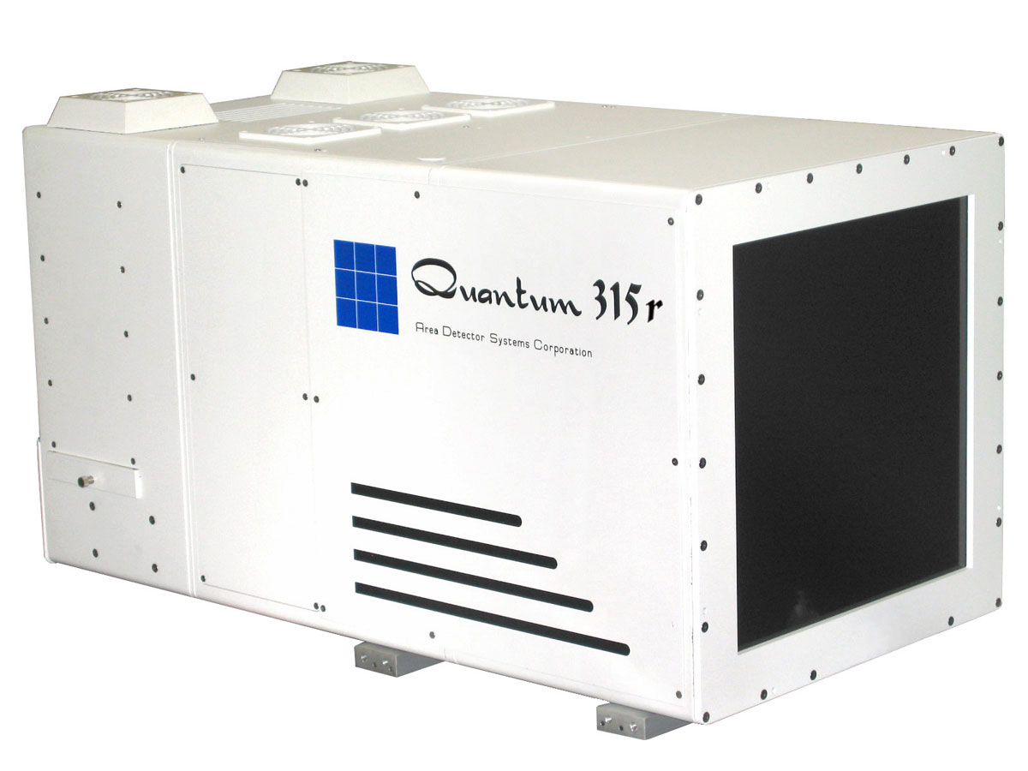
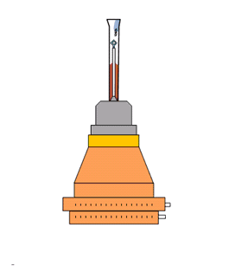
What is a “streak camera”?

Slide 20
What is a “streak camera”?
0.1 mm/pixel
= 4 ms/pixel
25 mm/s

Slide 21
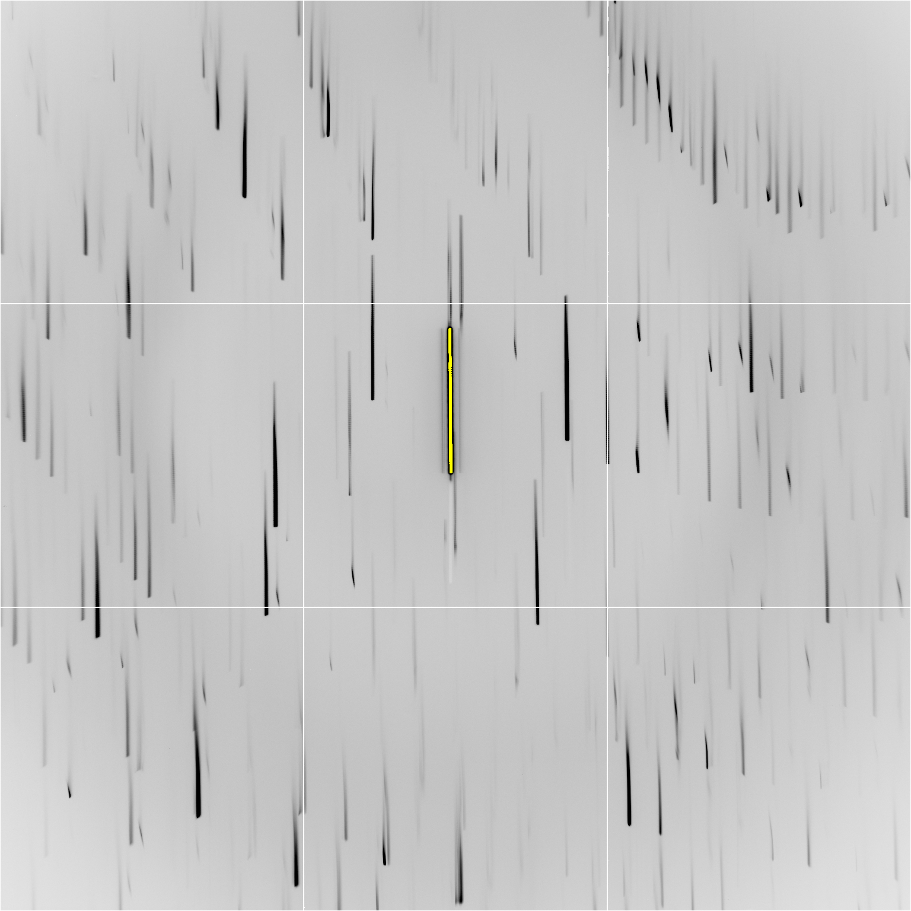

Slide 23
Individual spots at 768 kGy/s
Intensity (photons)
0
Dose (kGy)
Same xtal, different spots

Slide 24
Individual spots at 768 kGy/s
Intensity (photons)
0
Dose (kGy)
Same xtal, different spots

Slide 25
Individual spots at 768 kGy/s
Intensity (photons)
0
Dose (kGy)
Same xtal, different spots

Slide 26
Individual spots at 768 kGy/s
Intensity (photons)
0
Dose (kGy)
Same xtal, different spots

Slide 27
Individual spots at 768 kGy/s
Intensity (photons)
0
Dose (kGy)
Same xtal, different spots

Slide 28
Individual spots at 768 kGy/s
Intensity (photons)
0
Dose (kGy)
Same xtal, different spots

Slide 29
Individual spots at 768 kGy/s
Intensity (photons)
0
Dose (kGy)
Same xtal, different spots

Slide 30
Wiggle to get fulls
Ewald sphere

Slide 31
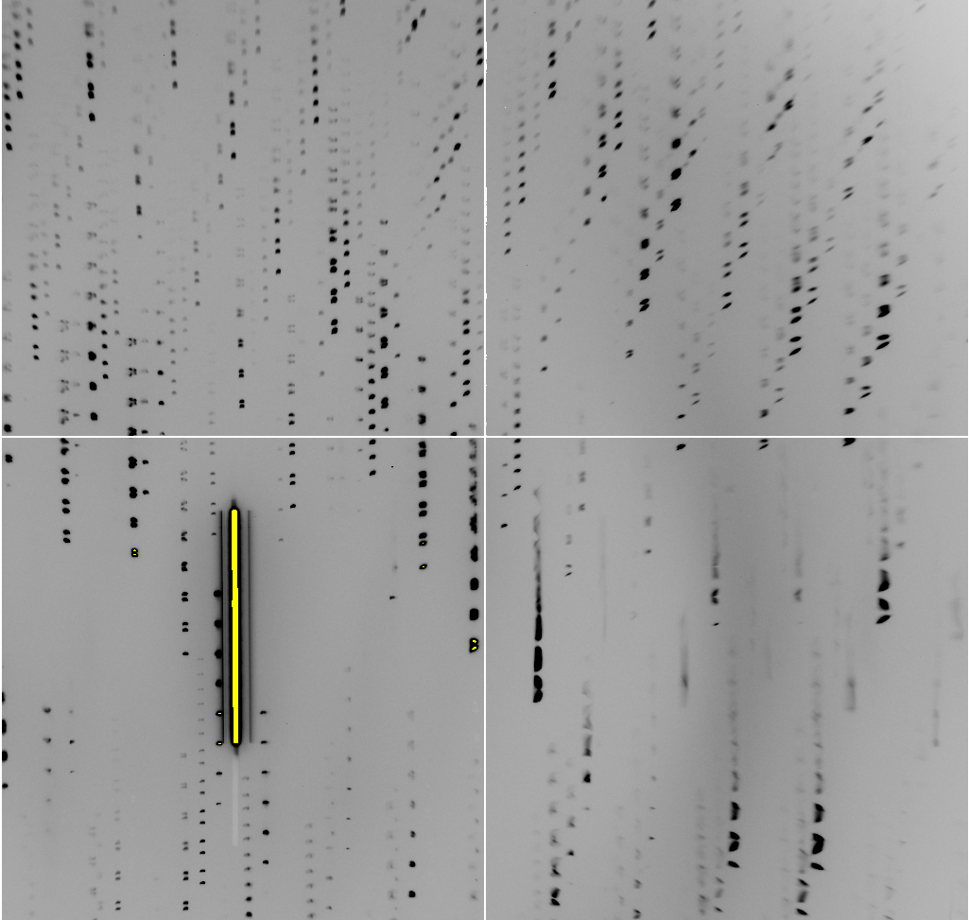
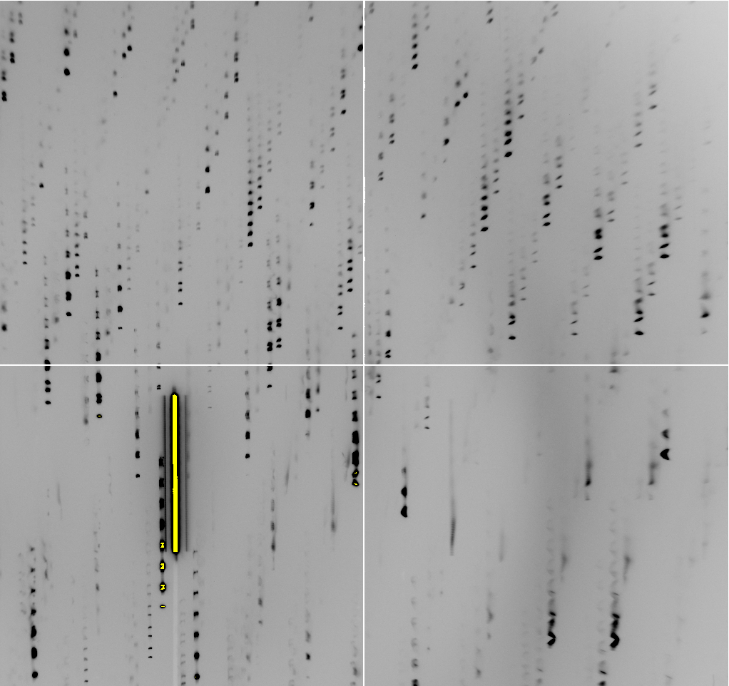
Slow wiggle

Slide 32
Dose rate: same hkl, same xtal
Intensity (photons)
Dose (kGy)

Slide 33
Dose rate: same hkl, same xtal
Intensity (photons)
Dose (kGy)

Slide 34
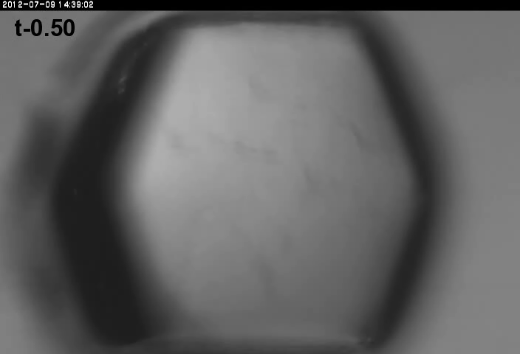
xtal24big
Real time at 674 kGy/s

Slide 35
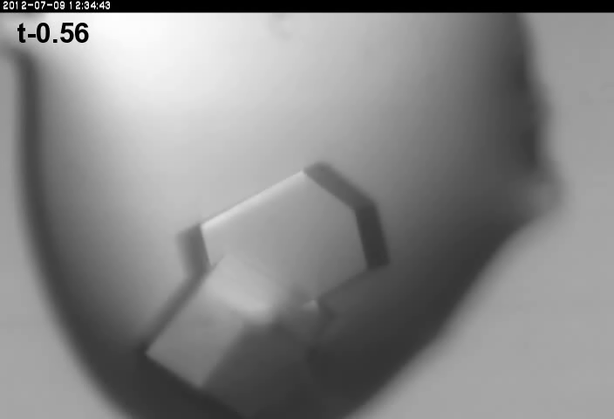
xtal12
Double tap: 0.4 s on + 1 s off + on again

Slide 36
Double-tap: no dark progression at 675 kGy/s
Intensity (photons)
Dose (kGy)

Slide 37
Double-tap: no dark progression at 675 kGy/s
Intensity (photons)
Dose (kGy)

Slide 38
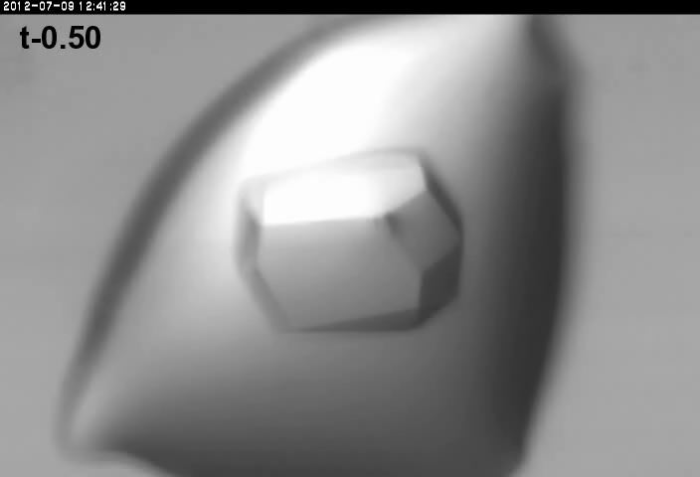
xtal14
Double tap: 0.4 s on + 1 s off + on again

Slide 39
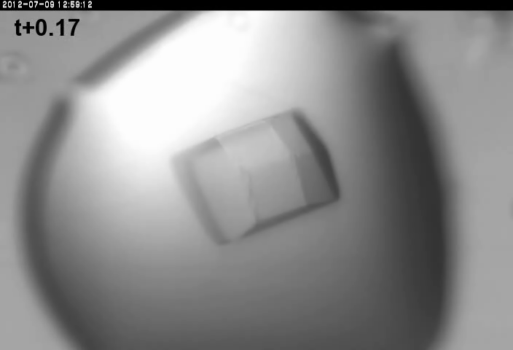
Xtal15 slow
Double tap lite: 5 s on + 12.6 s off + on again

Slide 40

Xtal15 fast
Double tap lite: 5 s on + 12.6 s off + on again

Slide 41
Individual spots at 44.3 kGy/s
Intensity (photons)
Time (seconds)

Slide 42
Individual spots at 44.3 kGy/s
Intensity (photons)
Time (seconds)

Slide 43
Individual spots at 44.3 kGy/s
Intensity (photons)
Time (seconds)

Slide 44
Dose rate: same hkl, same xtal
Intensity (photons)
Dose (kGy)

Slide 45
Dose rate: same hkl, same xtal
Intensity (photons)
Dose (kGy)

Slide 46
Dose rate: same hkl, same xtal
Intensity (photons)
Dose (kGy)

Slide 47
Dose rate: same hkl, same xtal
Intensity (photons)
Dose (kGy)

Slide 48
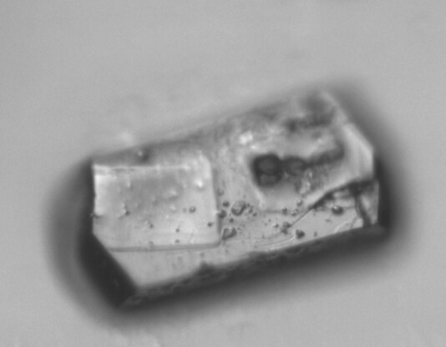
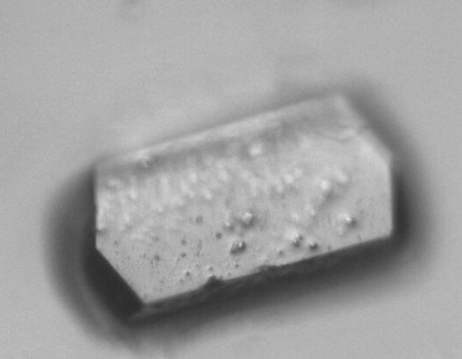
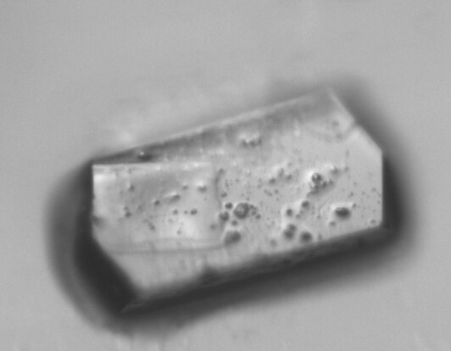
Xtal12 before & after
morphological dose-rate effect?
110 kGy/s
720 kGy/s

Slide 49
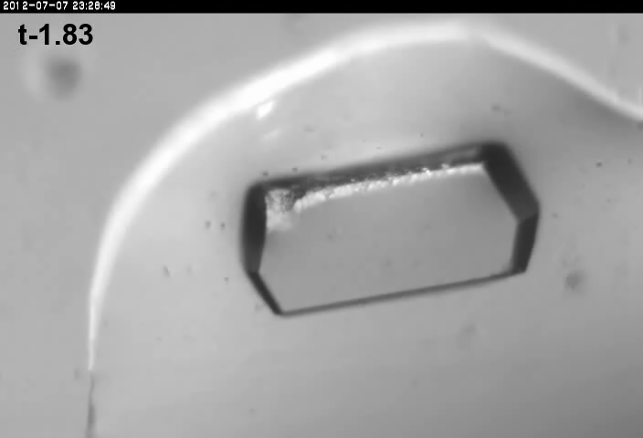
Xtal4_t1
Solvent “reaction” at 764 kGy/s

Slide 50
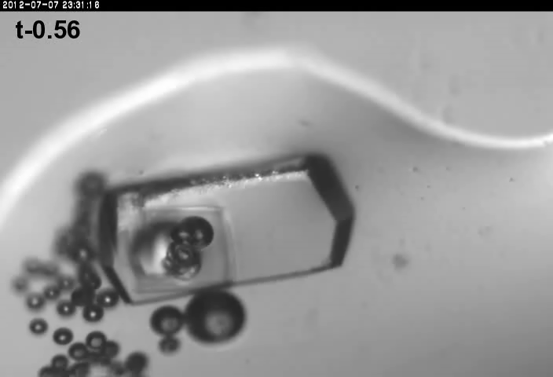
xtal4_t2
Solvent “reaction” at 764 kGy/s

Slide 51
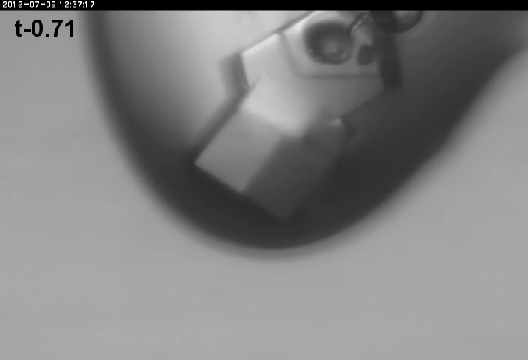
xtal13
Double tap: 0.4 s on + 1 s off + on again

Slide 52


xtal13
Double tap: 0.4 s on + 1 s off + on again

Slide 53
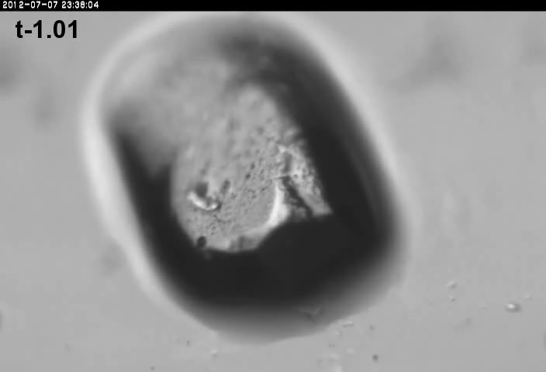
xtal5_t1
Crystal “shrinks?” at 764 kGy/s

Slide 54
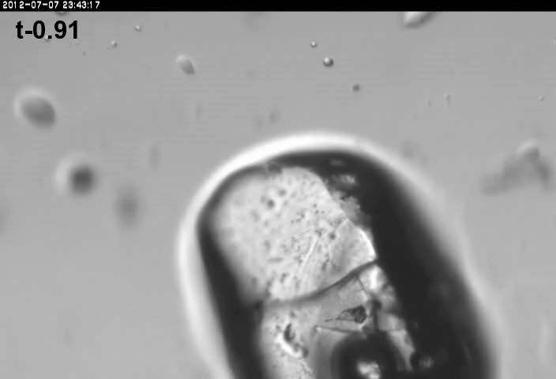
xtal5_t2
Crystal “shrinks?” at 764 kGy/s

Slide 55
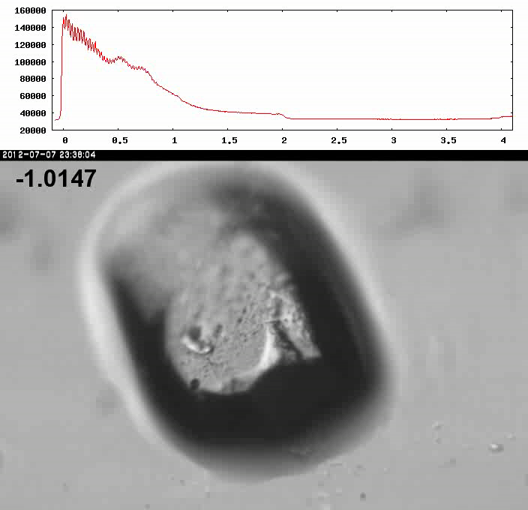
Xtal5_t1 graph

Slide 56
How much H₂ are we making?
Meents et al. (2010) claimed:
"400 molecules of H2 for every 12.5 keV photon“
= 3.3x10⁻⁷ mol/J
200 kGy to 100 um³ = 0.24 J
= 1.2x10⁻⁸ mol H₂
100 um³ of water = 6.7x10⁻⁸ mol
→ 18% of water has reacted!

Slide 57
Damage at 100K is done
by dose (MGy)
proportional to photons/area
not time
not heat
Sliz P, Harrison SC & Rosenbaum G (2003). Structure 11, 13-19.
Garman EF & McSweeney SM (2006). J. Sync. Rad. 14, 1-3.
Owen RL, Rudino-Pinera E & Garman EF (2006). PNAS 103, 4912-4917.
Leiros et al. (2006). Acta Cryst. D 62, 125-132.
Holton JM (2007). J. Synch Rad. 14, 51-72.

Slide 58
what the is a MGy?
energy
mass
http://bl831.als.lbl.gov/
damage_rates.pdf
Holton J. M. (2009) J. Synchrotron Rad. 16 133-42

Slide 59
How long will my crystal last?
synch line type flux beamsize flux density dose max xtal min site
ph/s μm ph/μm2/s rate lifetime lifetime
ALS 4.2.2 MAD 2.2e11 75x80 3.7e+07 27.3 kGy/s 18 m 73 s
ALS 5.0.1 mono 1.6e11 100 2.0e+07 10.4 kGy/s 48 m 3.2 m
ALS 5.0.2 MAD 8e11 100 1.0e+08 51.8 kGy/s 9.6 m 39 s
ALS 5.0.3 mono 1.7e11 100 2.2e+07 11 kGy/s 45 m 3 m
ALS 8.2.1 MAD 1.8e11 100 2.3e+07 11.7 kGy/s 43 m 2.9 m
ALS 8.2.2 MAD 2.3e11 100 2.9e+07 14.9 kGy/s 34 m 2.2 m
ALS 8.3.1 MAD 9e11 70 2.3e+08 119 kGy/s 4.2 m 17 s
ALS 8.3.1 typical 6e11 70 1.6e+08 115 kGy/s 4.3 m 17 s
ALS 12.3.1 MAD 1.8e11 100 2.3e+07 11.7 kGy/s 43 m 2.9 m
ALS 12.3.1 ML 4.0e12 100 5.1e+08 513 kGy/s 58 s 3.9 s
APS 8-BM MAD 1e11 200 2.5e+06 1.27 kGy/s 6.6 h 26 m
APS 14-BM-C mono 5.8e10 200 1.4e+06 738 Gy/s 11 h 45 m
APS 14-BM-D MAD 3.3e9 200 8.2e+04 42 Gy/s 8.3 d 13 h
APS 14-ID-B MAD 6.0e10 200 1.5e+06 763 Gy/s 11 h 44 m
APS 17-BM MAD 1.1e11 200 2.8e+06 1.4 kGy/s 6 h 24 m
APS 17-ID MAD 2.3e11 200 5.8e+06 2.93 kGy/s 2.8 h 11 m
APS 19-BM MAD 2.0e11 70x60 4.8e+07 24.2 kGy/s 21 m 83 s
APS 19-ID MAD 1.3e13 80x40 4.1e+09 2.07 MGy/s 15 s 0.97 s
APS 19-ID typical 5.5e11 100x100 5.5e+07 28 kGy/s 18 m 71 s
APS 22-BM MAD 7e12 80x40 2.2e+09 1.23 MGy/s 24 s 1.6 s
APS 22-ID MAD 7e12 80x40 2.2e+09 1.23 MGy/s 24 s 1.6 s
APS 22-ID typical 1.5e12 80 2.3e+08 119 kGy/s 4.2 m 17 s
APS 23-ID-B MAD 1e13 75x25 5.3e+09 3.01 MGy/s 10 s 0.66 s
APS 23-ID typical 1.5e12 80 2.3e+08 119 kGy/s 4.2 m 17 s
APS 24-ID-C MAD 1.3e13 20x60 1.1e+10 5.23 MGy/s 5.7 s 0.38 s
APS 24-ID-E MAD 0.5e13 20x100 2.5e+09 1.19 MGy/s 25 s 1.7 s
APS 31-ID MAD 2e12 70 4.1e+08 194 kGy/s 2.6 m 10 s

Slide 60
resolution dependence of global damage
10³
100
maximum tolerable dose (MGy)
10
1
1 2 3 5 7 10 20 40 70 100
resolution (Å)
Howells et al. (2009) J. Electron. Spectrosc. Relat. Phenom. 170 4-12

Slide 61
resolution dependence of global damage
10³
10 MGy/Å
100
maximum tolerable dose (MGy)
10
1
1 2 3 5 7 10 20 40 70 100
resolution (Å)
Howells et al. (2009) J. Electron. Spectrosc. Relat. Phenom. 170 4-12

Slide 62
R_{iso} vs dose
R_{iso} (%)
change in dose (MGy)
data taken from Banumathi, et al. (2004) Acta Cryst. D 60, 1085-1093.

Slide 63
R_{iso} vs dose
R_{iso} ≈ 0.7 %/MGy
R_{iso} (%)
change in dose (MGy)
data taken from Banumathi, et al. (2004) Acta Cryst. D 60, 1085-1093.

Slide 64
Dose-doubling concentration
molar, at the Se edge based on RADDOSE
Na | 44
Mg | 27
P | 9
S | 7
Cl | 5
K | 3.3
Ca | 2.7
Fe | 1.0
Cu | 0.67
Zn | 0.58
As | 0.44
Se | 0.42
Br | 2.9
I | 0.47
Gd | 0.21
Ta | 0.13
Pt | 0.17
Au | 0.16
Hg | 0.16
U | 0.23

Slide 65
Dose-doubling concentration
molar, at the Se edge based on RADDOSE
Na | 44
Mg | 27
P | 9
S | 7
Cl | 5
K | 3.3
Ca | 2.7
Fe | 1.0
Cu | 0.67
Zn | 0.58
As | 0.44
Se | 0.42
Br | 2.9
I | 0.47
Gd | 0.21
Ta | 0.13
Pt | 0.17
Au | 0.16
Hg | 0.16
U | 0.23

Slide 66
Specific Damage
World Records
MGy reaction reference
~45 global damage Owen et al. (2006)
5 Se-Met Holton (2007)
4 Hg-S Ramagopal et al. (2004)
3 S-S Murray et al. (2002)
1 Br-RNA Olieric et al. (2007)
? Cl-C ???
0.5 Mn in PS II Yano et al. (2005)
0.02 Fe in myoglobin Denisov et al. (2007)
Holton (2009) J. Synchrotron Rad. 16 133-42

Slide 67
Elastic scattering

Slide 68
Elastic scattering

Slide 69

Where do photons go?
Protein
1A x-rays
elastic scattering (6%)
Transmitted (98%)
beamstop

Slide 70
Elastic scattering

Slide 71
Inelastic scattering

Slide 72
Where do photons go?
Protein
1A x-rays
elastic scattering (6%)
Transmitted (98%)
beamstop

Slide 73
Where do photons go?
Protein
1A x-rays
elastic scattering (6%)
Transmitted (98%)
beamstop
inelastic scattering (7%)

Slide 74
Where do photons go?
Protein
1A x-rays
elastic scattering (6%)
Transmitted (98%)
beamstop
inelastic scattering (7%)
Re-emitted (99%)
Absorbed (~0%)

Slide 75
Photoelectric absorption

Slide 76
Photoelectric absorption
e⁻
+

Slide 77
Fluorescence
+

Slide 78
Fluorescence
e⁻
+

Slide 79
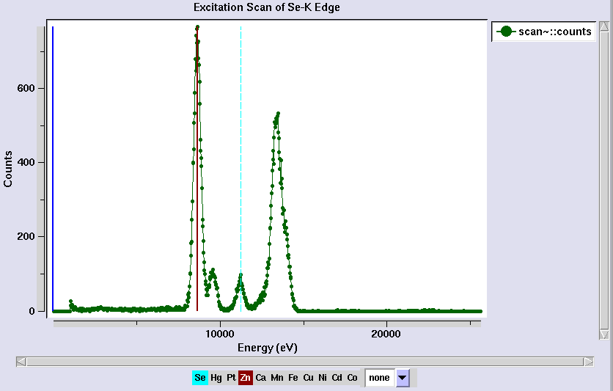
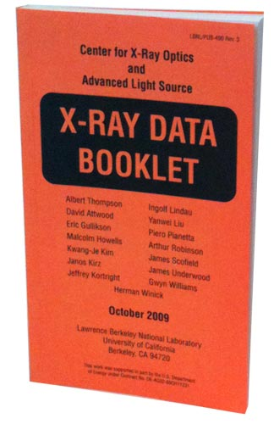
Metal identification

Slide 80
Auger emission
+

Slide 81
Auger emission
e⁻
++

Slide 82
Where do photons go?
Protein
1A x-rays
elastic scattering (6%)
Transmitted (98%)
beamstop
inelastic scattering (7%)
Re-emitted (99%)
Absorbed (~0%)

Slide 83
Where do photons go?
Protein
1A x-rays
elastic scattering (6%)
Transmitted (98%)
beamstop
inelastic scattering (7%)
Photoelectric (87%)
Re-emitted (99%)
Absorbed (~0%)

Slide 84
Where do photons go?
Protein
1A x-rays
elastic scattering (6%)
Transmitted (98%)
beamstop
inelastic scattering (7%)
Photoelectric (87%)
Re-emitted (99%)
Absorbed (~0%)
Re-emitted (~0%)
Absorbed (99%)

Slide 85
Where do photons go?
Protein
1A x-rays
elastic scattering (6%)
Transmitted (98%)
beamstop
inelastic scattering (7%)
Photoelectric (87%)
Re-emitted (99%)
Absorbed (~0%)
Re-emitted (~0%)
Absorbed (99%)
useful/absorbed energy: 7.3%

Slide 86
Photoelectric absorption

Slide 87
Photoelectric absorption
e⁻
+

Slide 88
Secondary ionization
e⁻

Slide 89
Secondary ionization
+
e⁻
e⁻

Slide 90
Excitation
e⁻

Slide 91
Excitation
e⁻

Slide 92
Excitation
e⁻

Slide 93
Excitation

Slide 94
Electron attachment
e⁻

Slide 95
Electron attachment
-

Slide 96
Sample atoms

Slide 97
Sample atoms

Slide 98
Primary ionization
e⁻
+

Slide 99
Secondary ionizations
e⁻
e⁻
+
e⁻
e⁻
+
+
+
+
+
e⁻
e⁻

Slide 100
Ionization track
e⁻
e⁻
e⁻
e⁻
+
e⁻
+
+
+
e⁻
e⁻
+
+
+
+
+
e⁻
+
e⁻
e⁻

Slide 101
Ionization track
e⁻
e⁻
e⁻
e⁻
+
e⁻
+
+
+
e⁻
e⁻
+
+
+
+
+
e⁻
+
e⁻
e⁻

Slide 102
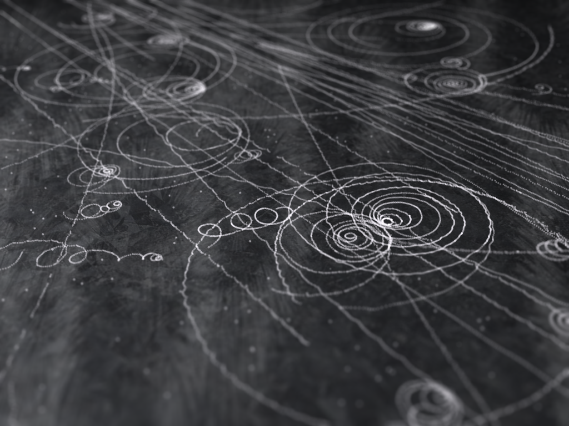
Ionization track

Slide 103
Ionization track

Slide 104
Ionization track
3 μm

Slide 105
Ionization track
Linear Energy Transfer

Slide 106
Ionization track
initial effects

Slide 107
Ionization track
initial effects
Homogeneous reactions

Slide 108
initial effects
e⁻
e⁻
e⁻
e⁻
+
e⁻
+
+
+
e⁻
e⁻
+
+
+
+
+
e⁻
+
e⁻
e⁻

Slide 109
initial effects
e⁻
e⁻
e⁻
e⁻
+
e⁻
+
+
+
e⁻
neutralization
e⁻
+
+
+
+
+
e⁻
+
e⁻
e⁻

Slide 110
initial effects
e⁻
e⁻
e⁻
e⁻
+
e⁻
+
+
neutralization
e⁻
+
+
+
+
+
e⁻
+
e⁻
e⁻

Slide 111
initial effects
e⁻
e⁻
e⁻
e⁻
+
neutralization
+
e⁻
+
+
+
+
+
neutralization
e⁻
e⁻

Slide 112
initial effects
e⁻
e⁻
e⁻
e⁻
+
+
e⁻
+
+
+
+
+
e⁻
attachment
e⁻

Slide 113
initial effects
e⁻
e⁻
e⁻
e⁻
+
+
e⁻
+
+
+
+
+
-
attachment
e⁻

Slide 114
initial effects
e⁻
e⁻
e⁻
attachment
e⁻
+
+
e⁻
+
+
+
+
+
-
e⁻
attachment

Slide 115
initial effects
e⁻
-
e⁻
e⁻
+
+
e⁻
+
+
+
+
+
-
-

Slide 116
initial effects
-
-
-
e⁻
+
+
+
+
+
+
-
-

Slide 117
initial effects
-
-
-
e⁻
solvation
+
+
+
+
+
+
-
-

Slide 118
initial effects
-
-
-
solvation
+
e⁻
+
+
+
+
+
-
-

Slide 119
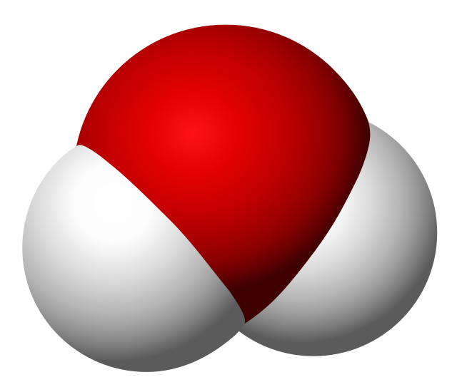
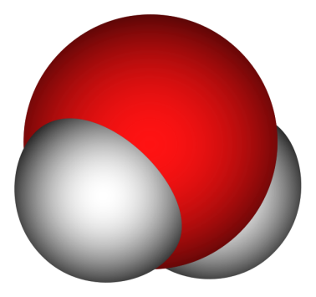
Solvated electron
e⁻

Slide 120
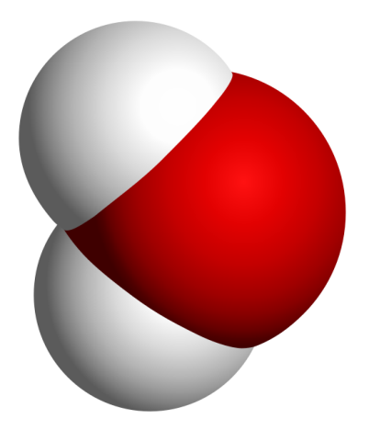
Solvated electron
e⁻

Slide 121
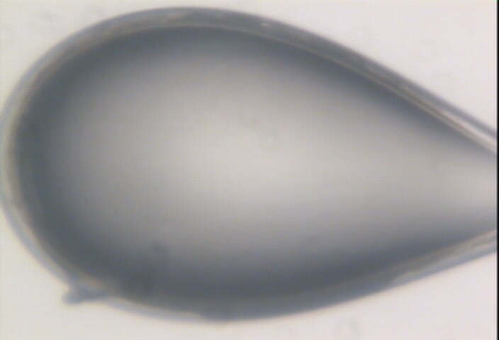

Slide 122
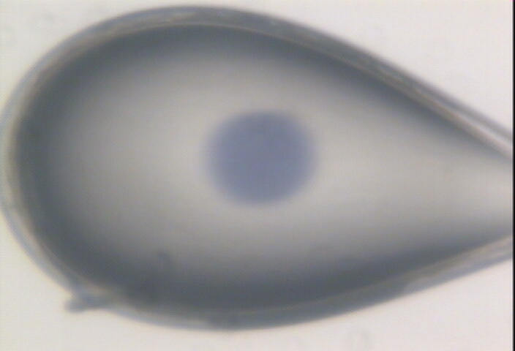

Slide 123
initial effects
-
-
-
+
e⁻
+
+
+
+
+
-
-

Slide 124
initial effects
-
-
-
+
e⁻
+
+
+
+
+
-
-

Slide 125
initial effects
-
-
+
e⁻
+
+
+
+
-
-

Slide 126
initial effects
e⁻
+
+
+
-
-

Slide 127
initial effects
e⁻
+
+
-

Slide 128
Excitation transfer

Slide 129
Excitation transfer
UV photon

Slide 130
Excitation transfer

Slide 131
Excitation transfer
r⁻⁶
Förster transfer

Slide 132
Excitation transfer

Slide 133
t = 0 s

Slide 134
t ≈ 10⁻¹⁵ s
e⁻
+
+
-

Slide 135
Timescales of radiation damage
Garret et. al. (2005) Chem. Rev. 105, 355-389

Slide 136
Timescales of radiation damage
LCLS
ALS
bunch
Garret et. al. (2005) Chem. Rev. 105, 355-389

Slide 137
Ionization track
Heterogeneous reactions
Homogeneous reactions

Slide 138
Rough values of energy quanta
1 MeV 100 GJ/mol Medical radiation therapy
100 keV 10 GJ/mol Medical imaging
10 keV 1 GJ/mol X-ray crystallography
1 keV 100 MJ/mol S and P K-edges
100 eV 10 MJ/mol “water window”
10 eV 1 MJ/mol C≡C bond
1 eV 100 kJ/mol C-C bond, visible light
100 meV 10 kJ/mol hydrogen bond
10 meV 1 kJ/mol heat (~300 K)

Slide 139

Energy Transfer Analogy
37 C

Slide 140

Systematic Error vs Random Noise

Slide 141
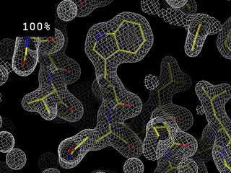
Completeness: random deletion
http://bl831.als.lbl.gov/~jamesh/movies/completeness.mpeg

Slide 142
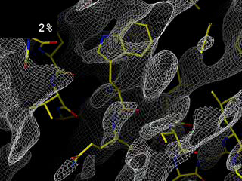
Completeness: missing wedge
http://bl831.als.lbl.gov/~jamesh/movies/osc.mpeg

Slide 143
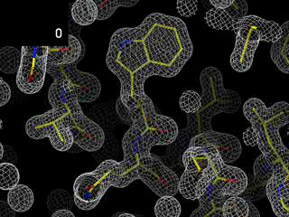
Overloads
http://bl831.als.lbl.gov/~jamesh/movies/overloads.mpeg

Slide 144
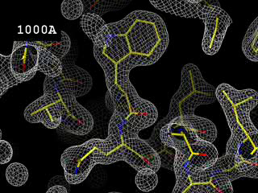
Resolution: low-angle cutoff
http://bl831.als.lbl.gov/~jamesh/movies/lo_cut.mpeg

Slide 145
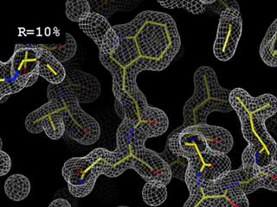
R-factor
http://bl831.als.lbl.gov/~jamesh/movies/rfactor.mpeg

Slide 146
The R-factor Gap
R_{merge} = 3%
R_{work} = 20%
R_{free} = 24%
Experimental
error
“systematic”
error
20% of carbon atom = 1.2 e⁻
5% of carbon atom = 0.3 e⁻
Closing the R-factor gap will enable study of 1-electron changes

Slide 147
The R-factor Gap
Publication criterion for chemical crystallography:
R1 < 2*R_{sigma}
R1 = F_{o} vs F_{c} for I/σ(I) > 3
R_{sigma} = <σ(I)>/<I>
There are no PDB entries that pass this test!
Holton et al. (2014). FEBS J. 281, 4046-60.

Slide 148

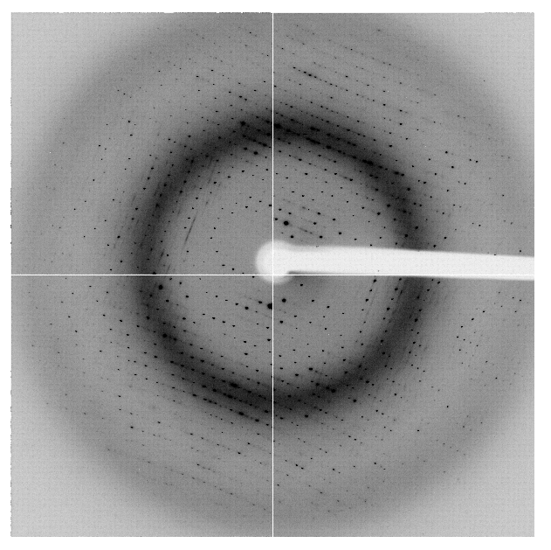
The R-factor Gap
multi-conformer PDB file
R_{merge} = 6%
R_{cryst} = 17%
R_{free} = 20%
MLFSOM
Elves
1H87
Holton, Classen, Frankel & Tainer (2014)."The R-factor gap in macromolecular crystallography: an untapped potential for insights on accurate structures", FEBS J. 281, 4046-4060.

Slide 149
The R-factor Gap
multi-conformer PDB file
R_{merge} = 6%
R_{cryst} = 7%
R_{free} = 8%
MLFSOM
Elves
1H87
Holton, Classen, Frankel & Tainer (2014)."The R-factor gap in macromolecular crystallography: an untapped potential for insights on accurate structures", FEBS J. 281, 4046-4060.

Slide 150
The R-factor Gap
single-conformer PDB file
R_{merge} = 6%
R_{cryst} = 7%
R_{free} = 8%
MLFSOM
Elves
ARP/wARP
1H87; conf “A”
Holton, Classen, Frankel & Tainer (2014)."The R-factor gap in macromolecular crystallography: an untapped potential for insights on accurate structures", FEBS J. 281, 4046-4060.

Slide 151
Is this good enough?
d_{max} = 4.5 Å
R_{cryst} = 27%
R_{free} = 38%

Slide 152
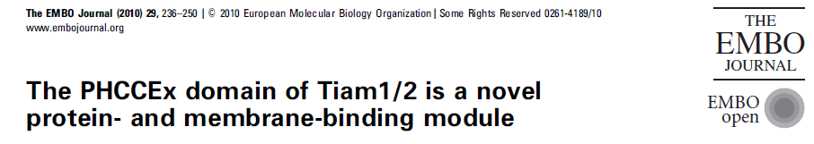
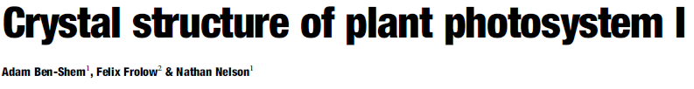
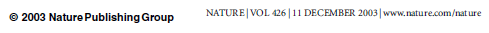
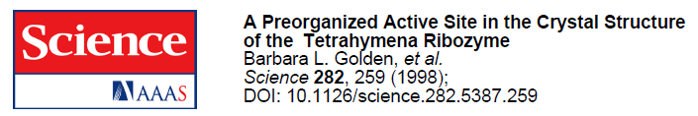
Is this good enough?
3a8n 4.5 Å R_{merge} = 0.15 R/R_{free} = 0.306/0.396
1qzv 4.44 Å R_{merge} = 0.099 R/R_{free} = 0.41/0.42
1grz 5 Å R_{merge} = 0.052 R/R_{free} = 0.369/0.428

Slide 153
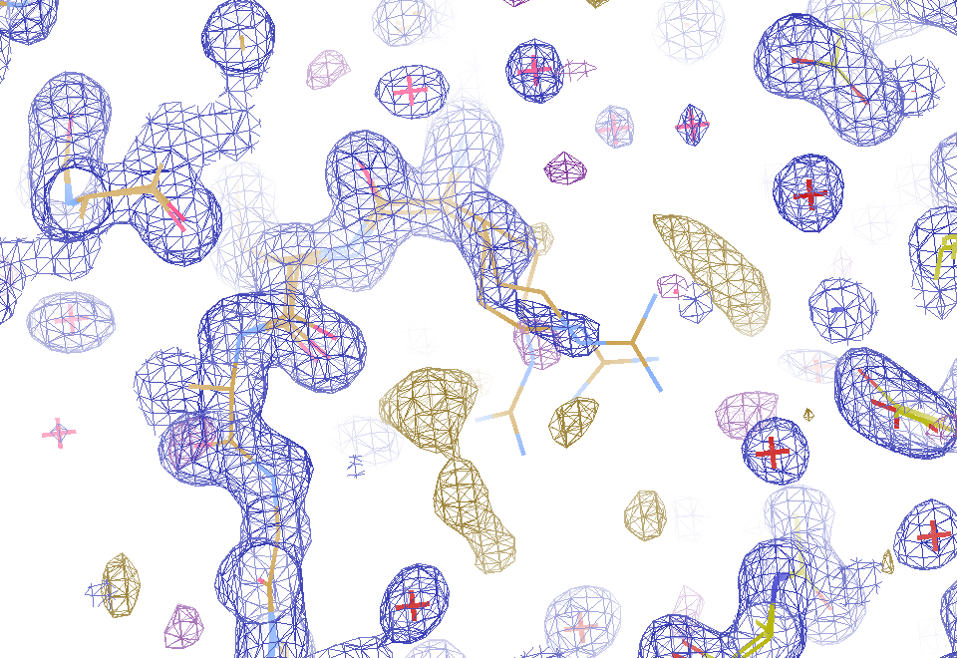
2F_{sim}-F_{calc} and F_{sim}-F_{calc} maps
1.0 Å data
R_{cryst}= 0.137
R_{free} = 0.159
1 “sigma” 2F_{sim}-F_{c}
2.5 “sigma” F_{sim}-F_{c}

Slide 154
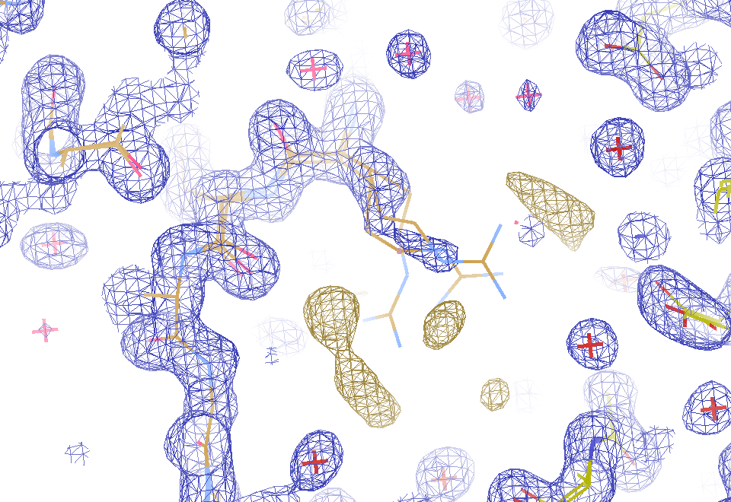
2F_{sim}-F_{calc} and (F_{sim} Φ_{sim}) - (F_{calc} Φ_{calc}) maps
1.0 Å data
R_{cryst}= 0.137
R_{free} = 0.159
1 “sigma” 2F_{sim}-F_{c}
F_{right} – (2F_{sim}-F_{c})

Slide 155
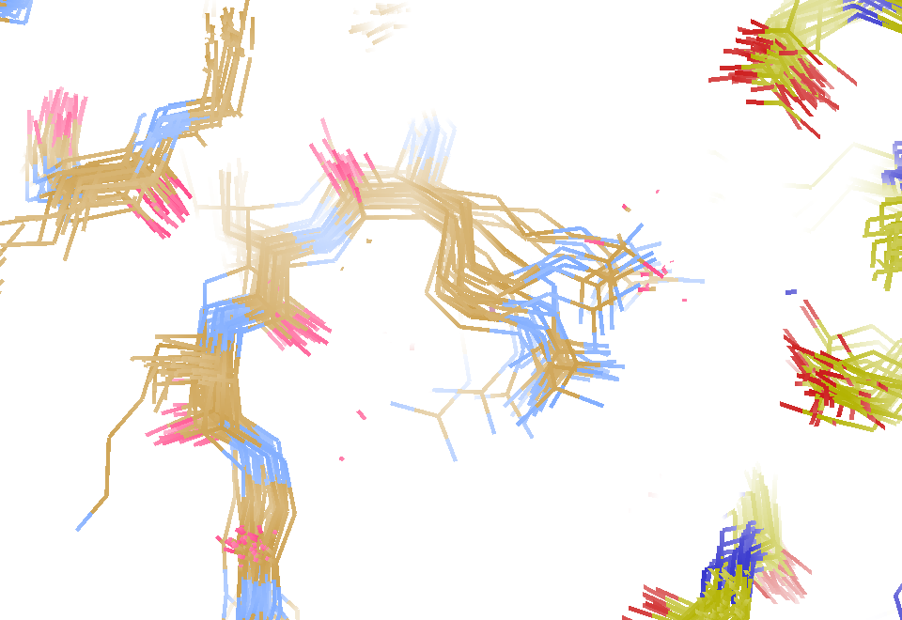
30 conformers from 24,000

Slide 156
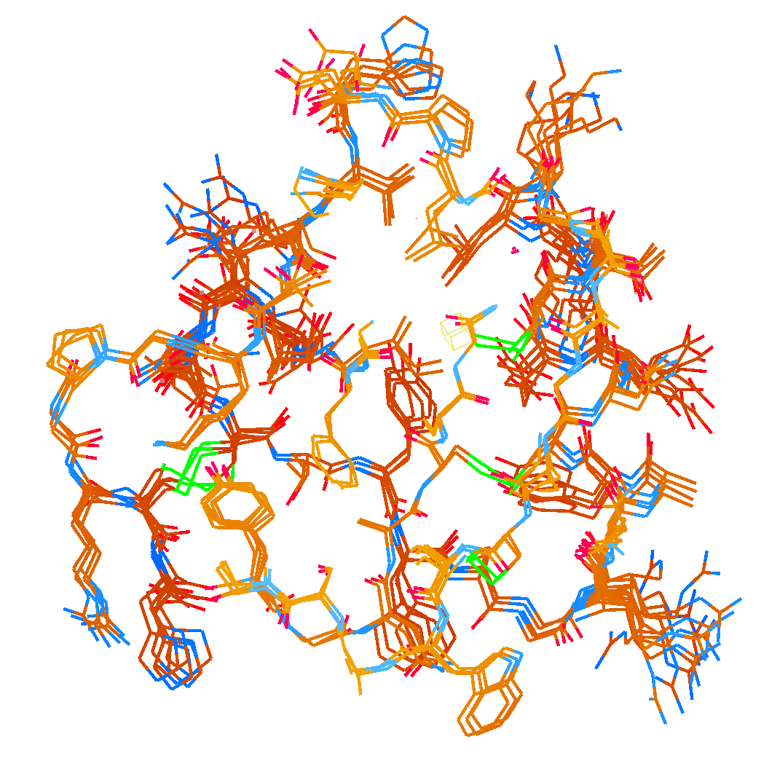
How many conformers are there?
Answer: 2-14
R_{cryst} = 0.0441
R_{free} = 0.0516
vs F_{sim}

Slide 157

How many conformers are there?
Answer: 1-7
R_{cryst} = 0.1546
R_{free} = 0.1749
vs F_{obs}
1aho:
R_{cryst} = 0.1630
R_{free} = n/d

Slide 158

How many conformers are there?
All difference
features
are in
the solvent!
real data

Slide 159
The R-factor Gap
MX data quality is not limiting
Hypotheses:
  Hidden systematic error?
  Model-building problem?
  Representation problem?

Slide 160
RISM model for “bulk” solvent
Method | R_{work} | R_{free}
Default refmac5: flat bulk solvent | .1784 | .1898
RISM – self-consistent density field based on electrostatics | .1640 | .1808
Explicit MD solvent, protein fixed | .1523 | .1690
RISM – protein fixed multi-conformer weighted | .1578 | .1739
Explicit – protein fixed multi-conformer weighted | .1440 | .1666

Slide 161
Phases
http://bl831.als.lbl.gov/~jamesh/movies/dephase.mpeg

Slide 162

100% SeMet incorporation
Trivial to solve

Slide 163

100% S -Met incorporation
Impossible to solve

Slide 164
Can you count to 1,000,000 ?
sqrt(1,000,000)
1,000,000
Theoretically:
= 0.1%
R_{meas} ≈ 0.1% ?
ISa = 1000
In reality:
ISa ~ 33
R_{meas =} ≈ 3%
sqrt(1,000)
1,000
= 3%
photon
spot
> 1000 is a waste!

Slide 165
Threshold of a revolution in phasing
Current
technology
Goal
Solve-able proteins (%)
Required signal-to-noise (I/σ)

Slide 166
Threshold of a revolution in phasing
Source of error | realistic simulation | No SHSSS | Perfect detector
Photon counting | + | + | +
Shutter jitter | + | + | -
Beam flicker | + | + | -
Sample absorption | + | + | -
Radiation damage | + | + | -
Imperfect spindle | + | + | -
vignette | + | + | -
Corner correction | + | + | -
SHSSS | + | - | -
R_{meas} (∞-10 Å) | 2.8% | 0.7% | 0.7%
I/σ asymptotic | 26.8 | 74.2 | 81.0
Holton et al (2014) "R-factor gap", FEBS Journal 281, 4046-4060.

Slide 167
Spatial Heterogeneity in Sharp Spot Sensitivity

Slide 168
Spatial Heterogeneity in Sharp Spot Sensitivity

Slide 169
Spatial Heterogeneity in Sharp Spot Sensitivity
Relative spot intensity
Spot centroid position (pixels)

Slide 170
Spatial Heterogeneity in Sharp Spot Sensitivity
Relative spot intensity
Spot centroid position (pixels)

Slide 171
SHSSS!
The dominant source of error for anomalous difference measurements
Spatial
Heterogeneity in
Sharp
Spot
Sensitivity
Flat
Field

Slide 172
SHSSS!
The dominant source of error for anomalous difference measurements
Spatial
Heterogeneity in
Sharp
Spot
Sensitivity
Flat
Field
90%
110%
x 1.11 =
100%
x 0.91 =
100%

Slide 173
SHSSS!
The dominant source of error for anomalous difference measurements
Spatial
Heterogeneity in
Sharp
Spot
Sensitivity
Sharp
Spot
20%
110%
x 1.11 =
22%
x 0.91 =
100%

Slide 174
SHSSS!
The dominant source of error for anomalous difference measurements
Spatial
Heterogeneity in
Sharp
Spot
Sensitivity
Sharp
Spot
90%
30%
Integral: 127.3
x 1.11 =
100%
x 0.91 =
27.3%

Slide 175
SHSSS!
The dominant source of error for anomalous difference measurements
Spatial
Heterogeneity in
Sharp
Spot
Sensitivity
Sharp
Spot
20%
110%
Integral: 122.2
x 1.11 =
22.2%
x 0.91 =
100%

Slide 176
SHSSS!
The dominant source of error for anomalous difference measurements
Spatial
Heterogeneity in
Sharp
Spot
Sensitivity
Sharp
Spot
90%
30%
Integral: 127.3
x 1.11 =
100%
x 0.91 =
27.3%

Slide 177

Spatial Heterogeneity in Sharp Spot Sensitivity

Slide 178
Spatial Heterogeneity in Sharp Spot Sensitivity
down

Slide 179
Spatial Heterogeneity in Sharp Spot Sensitivity
down
up

Slide 180
Spatial Heterogeneity in Sharp Spot Sensitivity
down
up
R_{separate}

Slide 181
Spatial Heterogeneity in Sharp Spot Sensitivity
odd
even
R_{mixed}

Slide 182
Spatial Heterogeneity in Sharp Spot Sensitivity
separate:
2.5%

Slide 183
Spatial Heterogeneity in Sharp Spot Sensitivity
separate:
mixed:
2.5%
0.9%

Slide 184


Slide 185


Slide 186


Slide 187
Spatial Heterogeneity in Sharp Spot Sensitivity
separate:
mixed:
2.5%
0.9%
2.5%²-0.9%² = 2.3%²

Slide 188

Spatial Heterogeneity in Sharp Spot Sensitivity
3.5
3.0
2.5
2.0
1.5
1.0
0.5
CCD detector
different
modules
anomalous mates are always on
different modules
SHSSS
Systematic component of R_{sseparate} (%)
Pilatus
SN001
0.1 1 10 100
distance between spots (mm)
Notes:
Comparision of SHSSS measured by the detector-shift experiment on three different detectors:
The Q315R in ALS 8.3.1
The first Pilatus detector at the Swiss Light Soruce
A newer Pilatus detector at Stanford
Improvements in calibration technology have finally made
Pilatus competitive with calibration on CCDs

Slide 189

Pilatus: 1-module shift
Notes:
Insulin diffraction recorded at Swiss light source detector centered on beam

Slide 190

Pilatus: 1-module shift
Notes:
Same insulin pattern, but with detector raised by one module width. This image can then be “digitally shifted” to overlay the same spots on top of one another, but recorded by different pixels.

Slide 191

Pilatus: 1-module shift
Notes:
Subtraction of equivalent pixels after shifting the detector
Note that some modules are mis-aligned relative to a perfect grid. These sub-pixel shifts can be resolved with “triangle binning”

Slide 192

Pilatus: 1-module shift - aligned
Notes:
Subtracted image after correcting for sub-pixel shifts

Slide 193

Pilatus: 1-module shift - ratio
3% high
average
3% low
Notes:
Ratio image: difference divided by average, again after correcting for sub-pixel shifts
Note: range of calibration error from module to module is RMS 3%

Slide 194
3.5
3.0
2.5
2.0
1.5
1.0
0.5
CCD detector
different
modules
anomalous mates are always on
different modules
SHSSS
Systematic component of R_{sseparate} (%)
Pilatus
SN001
Pilatus
SN113
0.1 1 10 100
distance between spots (mm)
Notes:
Comparision of SHSSS measured by the detector-shift experiment on three different detectors:
The Q315R in ALS 8.3.1
The first Pilatus detector at the Swiss Light Soruce
A newer Pilatus detector at Stanford
Improvements in calibration technology have finally made
Pilatus competitive with calibration on CCDs

Slide 195

Pilatus: subtract smooth baseline
~3x10⁵ photon/pixel
Bragg
glitch
“tree rings”
Pick-up tool mark
oxygen
inclusions
1% high
average
1% low

Slide 196
PAD: need more than flood-field
θ
incoming
photon
λ
detection
event
N
N
N

Slide 197
PAD: need more than flood-field
θ
Bragg
glitch
width
incoming
photon
λ
oxygen
inclusion
thickness
detection
event
N
N
N

Slide 198

CCD calibration: 7235 eV

Slide 199

CCD calibration: 7247 eV

Slide 200
Gadox calibration vs energy
same = good!
Relative absorption depth
bad!
photon energy (keV)

Slide 201
Systematic Error vs Random Noise

Slide 202
Data collection parameters:
16 crystals
360° each, inverse beam
7235 eV photon energy
< 1 MGy per xtal
Australian Synchrotron MX1
  35 kGy/s into 100 μm x 100 μm

Slide 203
140-fold multiplicity: 16 crystals, 360° each, inverse beam, 7235 eV
RESOLUTION COMPLETENESS R-FACTOR I/SIGMA R-meas CC(1/2) Anomal SigAno Nano
LIMIT OF DATA observed Corr
9.17 99.1% 3.9% 257.47 3.9% 100.0* 91* 5.024 450
6.49 100.0% 5.2% 214.33 5.2% 100.0* 86* 3.836 882
5.30 100.0% 7.2% 165.13 7.2% 100.0* 76* 3.257 1175
4.59 100.0% 7.2% 175.42 7.3% 100.0* 67* 2.589 1403
4.10 99.9% 7.7% 174.13 7.7% 100.0* 59* 2.264 1594
3.74 99.9% 9.4% 143.09 9.4% 100.0* 49* 1.953 1783
3.47 100.0% 11.2% 120.17 11.2% 100.0* 39* 1.696 1942
3.24 100.0% 14.1% 91.14 14.1% 100.0* 30* 1.333 2103
3.06 99.9% 19.5% 65.79 19.5% 100.0* 23* 1.117 2214
2.90 99.9% 29.0% 44.85 29.1% 99.9* 17* 1.008 2369
2.77 99.9% 40.5% 32.58 40.6% 99.8* 11* 0.901 2493
2.65 99.9% 52.8% 25.16 52.9% 99.8* 10* 0.866 2605
2.54 100.0% 67.4% 19.47 67.6% 99.6* 2 0.804 2705
2.45 100.0% 88.9% 14.58 89.2% 99.2* 4 0.831 2859
2.37 100.0% 109.3% 9.97 109.7% 98.1* 5 0.829 2925
2.29 100.0% 138.2% 6.87 138.9% 96.1* 1 0.760 3037
2.22 100.0% 197.1% 4.03 198.6% 83.5* -1 0.721 3159
2.16 100.0% 227.3% 2.41 230.8% 46.9* -1 0.677 3224
2.10 61.2% 154.4% 1.28 163.6% 47.0* -2 0.660 1999
2.05 47.9% 170.1% 0.68 196.5% 25.7* 3 0.629 1578
total 93.3% 15.7% 54.30 15.8% 100.0* 12* 1.217 42499

Slide 204

140-fold multiplicity
18 σ
16 σ
Phased anomalous difference Fourier

Slide 205

140-fold multiplicity
15σ = PO₄
Phased anomalous difference Fourier

Slide 206

140-fold multiplicity
~2σ = Mg?
Phased anomalous difference Fourier

Slide 207

140-fold multiplicity
8.2σ = Mg or Na
DELFAN residual anomalous difference

Slide 208
non-isomorphism
Why doesn’t everyone do this?

Slide 209

Non-isomorphism in lysozyme
RMSD = 0.18 Å
Δcell = 0.7 %
R_{iso} = 44.5%
3aw6
3aw7
RH: 84.2%
vs 71.9%

Slide 210
X-ray Data Sets
Singular values & vectors
data
set
h,k,l | structure factors (F)
 | #1 | #2 | #3 | #4
5,3,4 | 523.7 | 559.8 | 579.9 | 603.2
5,4,4 | 168.2 | 166.6 | 177.2 | 196.1
5,5,4 | 34.9 | 26.4 | 19.2 | 17.3
6,1,4 | 305.7 | 301.1 | 298.1 | 296.3
6,2,4 | 353.0 | 353.9 | 356.2 | 366.9
6,3,4 | 300.9 | 285.3 | 273.5 | 259.4
6,3,5 | 223.8 | 226.3 | 234.6 | 251.4
… | … | … | … | …
h,k,l | 100% | 17 % | 13 % | 9 %
 | 1st | 2nd | 3rd | 4th
5,3,4 | -1.46 | -0.02 | 1.84 | -0.72
5,4,4 | -0.88 | -0.29 | -0.34 | 0.15
5,5,4 | -0.42 | -0.65 | 1.02 | 1.47
6,1,4 | -0.90 | -0.85 | 1.44 | -0.40
6,2,4 | -1.20 | -0.37 | 0.67 | 0.01
6,3,4 | -0.75 | 0.31 | 0.48 | 0.00
6,3,5 | -0.75 | -0.85 | 0.72 | -0.82
… | … | … | … | …
value
vector
Singular value decomp.
SVD
-0.68
-0.24
0.32 …
CC1
Data sets
Positioned
in
“Correlation
Space”
Correlation
Coefficients
CC1 CC2 CC3
CC2
data set #1
data set #2
data set #3
CC3

Slide 211


Slide 212
Structure factor (electrons)
Correlation to 2nd & 3rd singular vectors

Slide 213
Structure factor (electrons)
Correlation to 2nd & 3rd singular vectors

Slide 214
Structure factor (electrons)
Correlation to 2nd & 3rd singular vectors

Slide 215

Bragg’s “minimum wavelength principle”
Perutz (1985). “Early Days of Cryst…” Methods in Enzymology, Vol. 114, 3-18.
Bragg & Perutz (1952)."external form haemoglobin I", Acta Cryst. 5, 277-283.

Slide 216

DMMULTI – fake data
4 deg rotation: 8 “xtals”: before
CC = 0.02

Slide 217

DMMULTI – fake data
4 deg rotation: 8 “xtals”: after
CC = 0.8

Slide 218



Partiality > 25% error per spot!
$$=\sqrt{7.7 ∗{3\%}^{−2}}$$
$$=\sqrt{37.9 ∗{25\%}^{−2}}$$
Kabsch W (2014)."Processing of X-ray snapshots from crystals in random orientations", Acta Cryst D 70, 2204-2216.

Slide 219
What is “partiality”?
Ewald sphere

Slide 220
What is “partiality”?
Ewald sphere

Slide 221
The “partiality problem”
0.006°
1 μm xtal
1 Å x-rays

Slide 222
Multiplicity required to phase
Monte Carlo
  100% /obs → 10,000 fold
nXDS
  25% /obs → 625 fold
Synchrotron
  3% /obs → 9 fold
  Assuming ΔF/F ~ 1%
Beam time:
$2/s

Slide 223



Can’t we just rotate the crystal?
9 nm
= 90 km/s
100 fs
1°
1 μm
(90 km/s)²
0.5 μm
17.26 km/s
= 1.5 x 10¹⁵ G
= 0.5 nN

Slide 224
Can’t we just rotate the crystal?
NO
Why do we want to
rotate the crystal?

Slide 225
The “nanocrystal advantage”
2
I_{spot} = k N_{cells}
caveat: 100% error!
Ewald sphere
range

Slide 226

Real XFEL still

Slide 227


fastBragg program
http://bl831.als.lbl.gov/~jamesh/fastBragg/
Optimized for nanocrystals
Square or round
Takes h,k,l and F
Supports 1 unit cell
no “mosaicity”
arbitrary “source”
arbitrary “phi” steps

Slide 228



nonBragg for background

Slide 229
“fit” simulation to reality
Dispersion
Divergence
Mosaicity
Wavelength
Unit cell parameters (3)
Crystal orientation (3)
Mosaic domain size (3)
Beam center (2)
Beam direction (2)
Detector distance

Slide 230
Simulation of XFEL stills

Slide 231

Simulation of XFEL stills

Slide 232



Simulation of XFEL stills
phix
phiy
phiz
real
VS
phix
phiy
phiz

Slide 233
Fitting individual “mosaic domains”
Fraction pixels predicted
Best of
262,140 trials
Angle about y axis (°)

Slide 234

The “Lorentz zone”

Slide 235


The “partiality problem”
0.006°
1 μm xtal
1 Å x-rays
Lovelace et al. (2006)."topography", J. Appl. Cryst. 39, 425-432.

Slide 236
mosaic spread
Ewald sphere
F(h,k,l)
λ*
d*
diffracted ray
λ*
F(0,0,0)

Slide 237
mosaic spread
Ewald sphere
F(h,k,l)
λ*
d*
diffracted ray
d*
λ*
F(0,0,0)

Slide 238

mosaic spread = 0 º

Slide 239

mosaic spread = 0.1º

Slide 240

mosaic spread = 0.2º

Slide 241

mosaic spread = 0.4º

Slide 242

mosaic spread = 0.6º

Slide 243

mosaic spread = 0.8º

Slide 244

mosaic spread = 1.0º

Slide 245

mosaic spread = 1.5º

Slide 246

mosaic spread = 2.0º

Slide 247

mosaic spread = 2.5º

Slide 248

mosaic spread = 3.2º

Slide 249

mosaic spread = 6.4º

Slide 250

mosaic spread = 12.8º

Slide 251
beam divergence
Ewald sphere
F(h,k,l)
λ*
d*
diffracted ray
λ*
F(0,0,0)

Slide 252
beam divergence
Ewald sphere
λ*
d*
diffracted ray
F(0,0,0)
λ*

Slide 253

divergence = 0 º

Slide 254

divergence = 0.3 º

Slide 255
spectral dispersion
Ewald sphere
F(h,k,l)
λ*
d*
diffracted ray
λ*
F(0,0,0)

Slide 256
spectral dispersion
Ewald sphere
F(h,k,l)
λ’*
d*
diffracted ray
λ’*
F(0,0,0)

Slide 257

dispersion = 0

Slide 258

dispersion = 0.014% (Si 111)

Slide 259

dispersion = 0.25% (CuK_{α})

Slide 260

dispersion = 0.6%

Slide 261

dispersion = 1.3%

Slide 262

dispersion = 2.6%

Slide 263

dispersion = 5.1%

Slide 264
spot shape
Ewald sphere
Ewald sphere
Ewald sphere
Ewald sphere
λ’*
λ*
d*
d*
d*
λ*
diffracted rays
d*
d*
diffracted ray
diffracted ray
diffracted ray
λ’*
λ*
λ*

Slide 265

0 mrad, 0.0% bw

Slide 266

1 mrad, 0.1% bw

Slide 267

Simulation of XFEL stills
Sauter (2015). JSR 22, 239.
Beam center from autoindexing

Slide 268

Simulation of XFEL stills
Color is
time
Sauter (2015). JSR 22, 239.
Beam center from autoindexing

Slide 269
Sanity check on beam position?
pinhole
~1 m
100 μm
~1000 m
0.3 m

Slide 270
Can’t we just widen the bandpass?

Slide 271




Si(111) vs multilayers
0.014%
Si(111)
spectral
dispersion
1%
multilayer
4 Å
resolution
1.9 Å

Slide 272
Wide-bandpass MX?
Mono | Si(111) | multilayer | Difference (%) | good
Energy (eV) | 11111 | 12027.5 | +8.2 | Same
Scale | 1.0000 | 1.0964 | +9.6 | Yes
R_{merge} (%) | 7.5 | 8.4 | +12 | No
R_{anom} (%) | 5.6 | 5.5 | -1.8 | Same
I/sd | 13.2 | 12.3 | -6.8 | Same
I/sd (1.5Å) | 2.3 | 1.8 | -21.7 | No
Ano Patt | 5.96 | 4.75 | -20.3 | Same
Ano Phased | 41 | 39.33 | -4.1 | Same
FOM | 0.238 | 0.192 | -19.3 | Same
CC | 0.555 | 0.647 | -6.1 | Yes
R_{cryst} (%) | 26.70 | 26.48 | -0.2 | Same
Ligand peak | 8.213 | 8.250 | +0.4 | Same

Slide 273


Wide bandpass reveals mosaicity from a still
low mosaic
high mosaic
Δ_{radial} = 2ηD/cos²2θ
Snell EH, Weisgerber S, Helliwell JR, Holzer K & Schroer K (1995)."Improvements in lysozyme protein crystal perfection through microgravity growth", Acta crystallographica. Section D, Biological crystallography 51, 1099-1102.

Slide 274

Narrow bandpass does not improve anomalous signal
h,k,l = 5,5,0
Si(333)
Si(333)
vertical
divergence
(240 μRad)
Al
absorber
100 μm
pinhole
1rb5

Slide 275
2472.7 2473.5
Anomalous f” (electrons)
Photon Energy (eV)
Bohic et al. Anal. Chem. 2008; 80(24):9557. doi: 10.1021/ac801817k

Slide 276
S-MAD Sample size Dilemma

Slide 277
(h,k,l)
Ewald sphere 2
λ*
diffracted ray
d*
θ
λ*
λ*
θ
d*
diffracted ray
λ*
Ewald sphere
1
(-h,-k,-l)

Slide 278
Si(111)
52.87deg
Si(111)
2 Multilayer mirrors
d=2nm, W/B4C
KB Horiz focus
KB vertical focus
Si(111)
Detector
Detector
λ = 5 Å
h,k,l
sample
injector
-h,-k,-l
Si(111)
Detector
Detector
~ 1m
Si(111)
Si(111)
Notes:
Proposed 5-crystal monochromator for colliding-beam crystallography. The generation of two opposing Ewald spheres means that for every h,k,l index reflected from the protein crystal, the Friedel mate is reflected in the opposite direction, allowing for very accurate anomalous difference measurements. The wavelength need not be set precisely at the sulfur or phosphorous edge, but merely at a wavelength where the f” of those elements are strong. For fs-class pulses, the distances above will have to be precise to withing ~3 microns, and for accurate reproduction of the partiality of the Friedel mates, the angular precision of the colliding beams must be within ~1% of the sample crystal’s rocking width, or ~100 microrads.

Slide 279

“sweet spot” for sample size ?
Ca
Ar
Cl
K
S
P
2 Å
2sin(90°)
Mg
C
Na
Se
Ne
3 Å
2sin(90°)
N
O
F
4 Å
2sin(90°)

Slide 280
Small, soft beams

Slide 281
Small, soft beams
Diamond
($100, reusable)

Slide 282
Small, soft beams
oil ?
Diamond
($100, reusable)

Slide 283
Small, soft beams
oil ?
Diamond
($100, reusable)

Slide 284
Small, soft beams
oil ?
λ=2d sinθ
2.5 Å data
with 5 Å X-rays
Only analytic absorption correction:
International Tables for Crystallography, Vol. C, 2nd ed., chapter 6.3

Slide 285
X-ray scattering “rules”:
Optimum: support thickness = crystal thickness
1 μm crystal ≈ 1 μm water
≈ 1 μm plastic
≈ 0.1 μm glass
≈ 1000 μm air
~ 50 mm He
≈ 370 mm sat water vapor @ 4C

Slide 286
The number of photons scattered
before crystal is dead
is independent
of data collection time
1 um³ = 10⁵ photons (roomT)
1 um³ = 10⁶ photons (synch)
1 um³ = 10⁸ photons (XFEL)
(synch)
Henderson, 1990; Gonzalez & Nave, 1994; Glaeser et al., 2000; Sliz et al., 2003; Leiros et al., 2006; Owen et al., 2006; Garman & McSweeney, 2006; Garman & Nave, 2009; Holton, 2009

Slide 287
Self-calibrated damage limit
Where:
⟨I⟩_{DL} - average damage-limited intensity (photons/hkl) at a given resolution
10⁵ - converting R from μm to m, r_{e} from m to Å, ρ from g/cm³ to kg/m³ and MGy to Gy
r_{e} - classical electron radius (2.818 x 10⁻¹⁵ m/electron)
h - Planck’s constant (6.626 x 10⁻³⁴ J∙s)
c - speed of light (299792458 m/s)
f_{decayed} - fractional progress toward completely faded spots at end of data set
ρ - density of crystal (~1.2 g/cm³)
R - radius of the spherical crystal (μm)
λ - X-ray wavelength (Å)
f_{NH} - the Nave & Hill (2005) dose capture fraction (1 for large crystals)
n_{ASU} - number of proteins in the asymmetric unit
M_{r} - molecular weight of the protein (Daltons or g/mol)
V_{M} - Matthews’s coefficient (~2.4 Å³/Dalton)
H - Howells’s criterion (10 MGy/Å)
θ - Bragg angle
⟨ƒ_{a}²⟩ - number-averaged squared structure factor per protein atom (electron²)
⟨M_{a}⟩ - number-averaged atomic weight of a protein atom (~7.1 Daltons)
B - average (Wilson) temperature factor (Å²)
μ - attenuation coefficient of sphere material (m⁻¹)
μ_{en} - mass energy-absorption coefficient of sphere material (m⁻¹)
No flux
No symmetry
Holton & Frankel (2010) Acta D 66 393-408.

Slide 288
Bigger is better, but not by much
B = 20
B = 60
B = 0
B = 170
B = 330
B = 560
Resolution (Å)
B = 850
Crystal diameter (micron)

Slide 289

B factor from image analysis
B = 500

Slide 290

B factor from image analysis
B = 20

Slide 291
Predicting resolution limits
Synchrotron Resolution (Å)
Home Lab Resolution (Å)

Slide 292
Predicting resolution limits
XFEL Resolution (Å)
Synchrotron Resolution (Å)

Slide 293

Muybridge’s galloping horse (1878)
“Time-resolved” diffraction
Real space
reciprocal

Slide 294

Muybridge’s galloping horse (1878)
Average electron density
Real space
reciprocal

Slide 295

Muybridge’s galloping horse (1878)
Average electron density: 1 sigma contour
Real space
reciprocal

Slide 296

lysozyme: real and reciprocal

Slide 297

lysozyme: thermal motion

Slide 298















Sparse validation supporting a 4D model with 2D data

Slide 299
URLs & Summary
http://bl831.als.lbl.gov/~jamesh/powerpoint/
SLAC_uxss_2016.pptx
http://bl831.als.lbl.gov/~jamesh/bin_stuff/
http://bl831.als.lbl.gov/~jamesh/mlfsom/
Outrun radiation damage
25% error from partiality
Phasing limited by relative error
Resolution limited by disorder
“wet vacuum” for bio samples?
How do we make our molecules sit still?

