Slide 1

Acknowledgements
http://bl831.als.lbl.gov/~jamesh/powerpoint/SLAC_lossy_2023.pptx
Robert Stroud James Fraser Nevan Krogan
Paul Adams John Tainer Greg Hura Nick Sauter
Aina Cohen Art Lyubimov Jeney Wierman
UCSF LBNL SLAC
ALS 8.3.1: TomAlberTron
NIH NIGMS R01 GM124149 (Holton)
NIH NIAID P50 AI150476 (Krogan)
NIH NIGMS P30 GM124169 (Adams)
DOE-BER IDAT (Hura)
NIH NIGMS P30 GM133894 (Hodgson)
The Advanced Light Source is supported by the Director, Office of Science, Office of Basic Energy Sciences, Materials Sciences Division, of the US Department of Energy under contract No. DE-AC02-05CH11231 at Lawrence Berkeley National Laboratory.

Slide 2
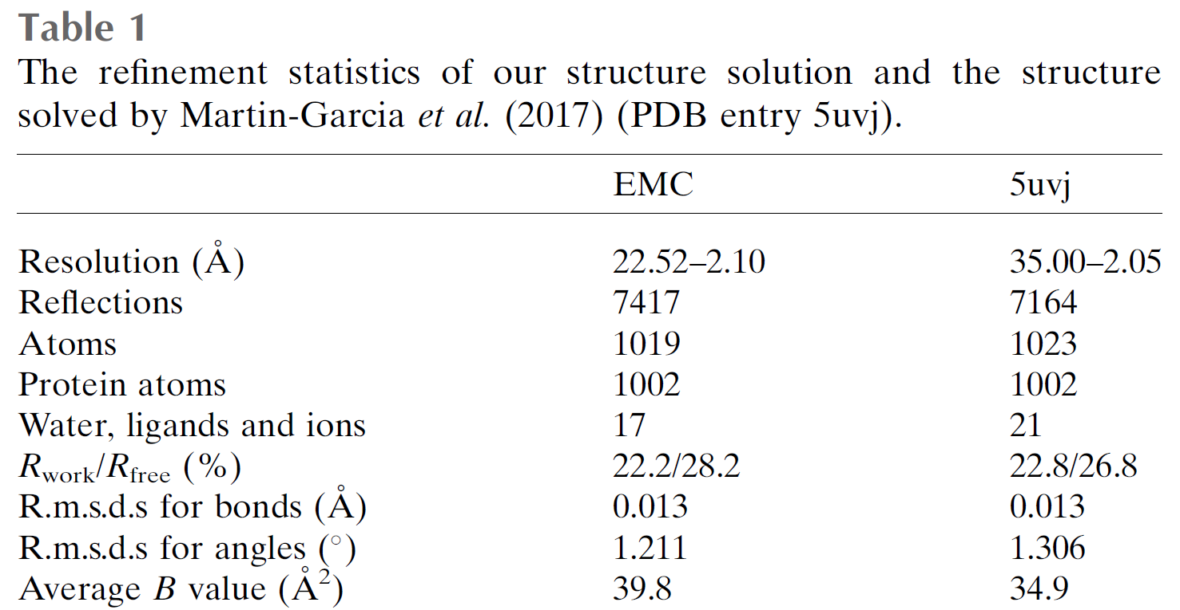
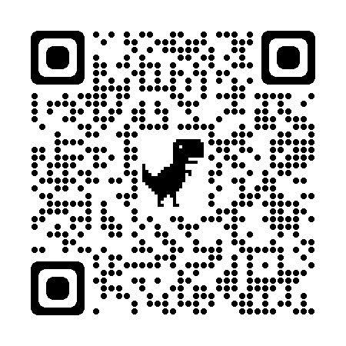
Why keep “blanks”?
“blank” images
Lan et al. “EMC” IUCrJ (2018)

Slide 3
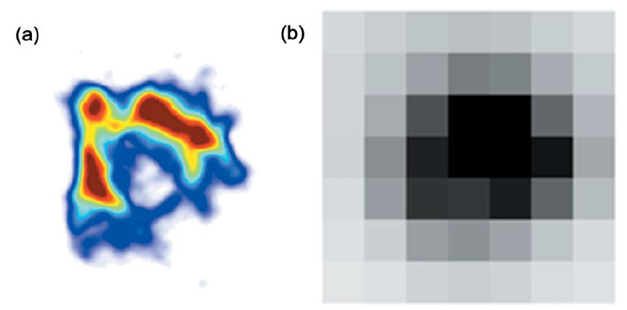
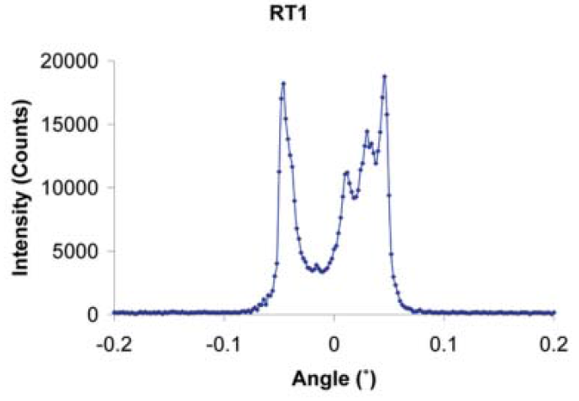
Why keep pixels?
Because we can’t model mosaicity (yet)
Any function can be approximated by a family of Gaussians
Lovelace JJ, Murphy CR, Pahl R, Brister K & Borgstahl GEO (2006)."Tracking reflections through cryogenic cooling with topography", J. Appl. Cryst. 39, 425-432.

Slide 4
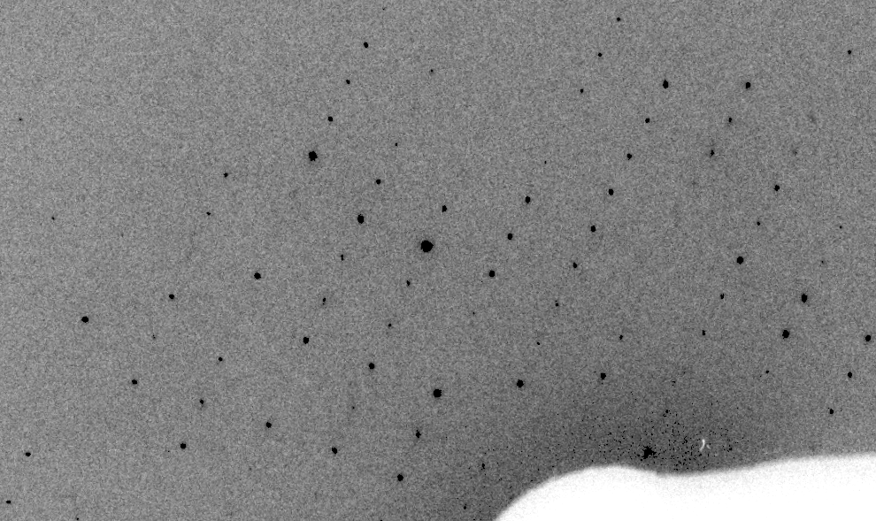
Real XFEL still
Lyubimov et al. (2016).
eLife 5, e18740.

Slide 5
“fit” simulation to real image
Why keep pixels ?
Dispersion
Divergence
Mosaicity
Wavelength
Unit cell parameters (3)
Crystal orientation (3)
Mosaic domain size (3)
Beam center (2)
Beam direction (2)
Detector distance

Slide 6
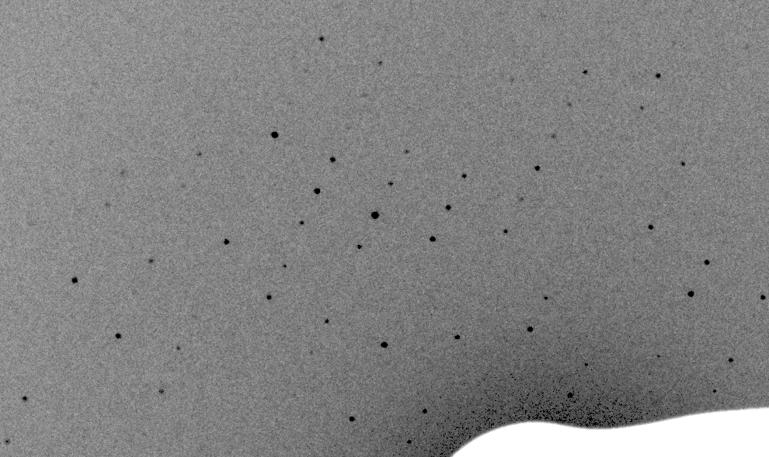
Simulation of XFEL still

Slide 7
Real XFEL still
Lyubimov et al. (2016).
eLife 5, e18740.

Slide 8
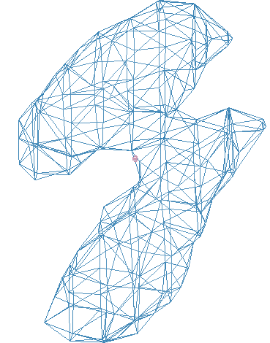
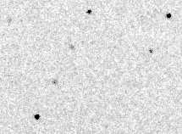
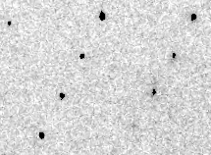
Simulation of XFEL still
phix
phiy
phiz
real
VS
phix
phiy
phiz

Slide 9
Fitting individual “mosaic domains”
Fraction pixels predicted
Best of
262,140 trials
Angle about y axis (°)

Slide 10
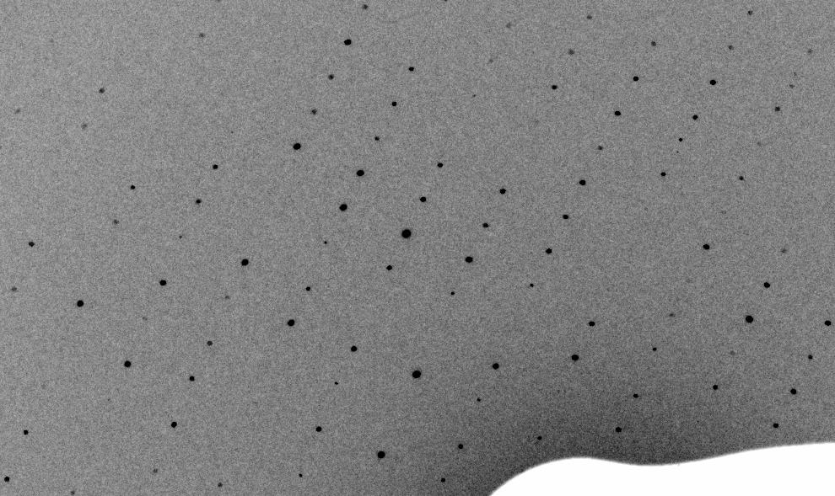
3-domain Simulation of XFEL still

Slide 11
Real XFEL still

Slide 12
1-domain Simulation of XFEL still

Slide 13
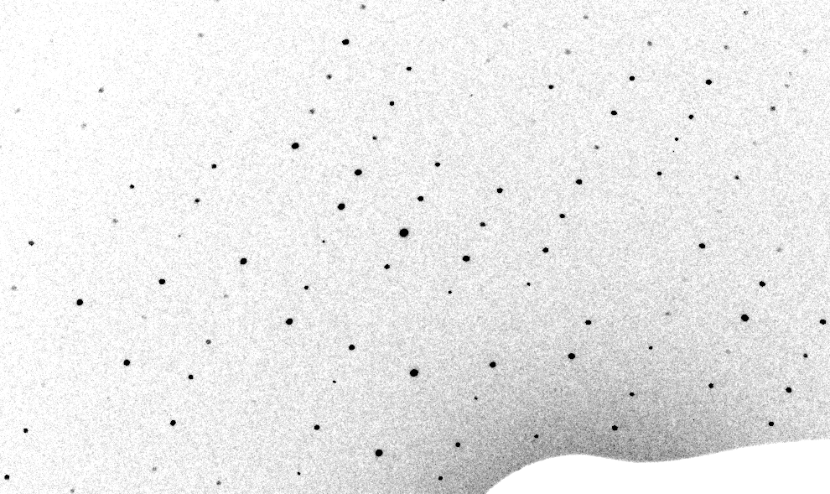
3-cluster mosaic simulation

Slide 14
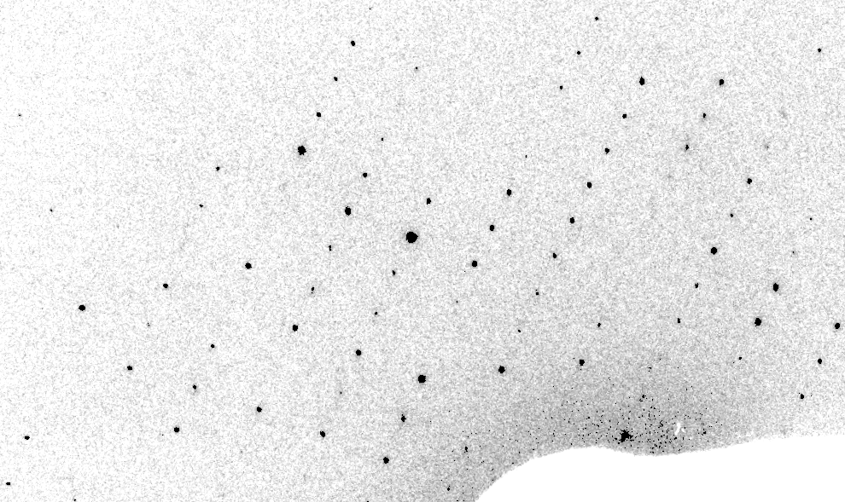
Real XFEL still
Lyubimov et al. (2016).
eLife 5, e18740.

Slide 15
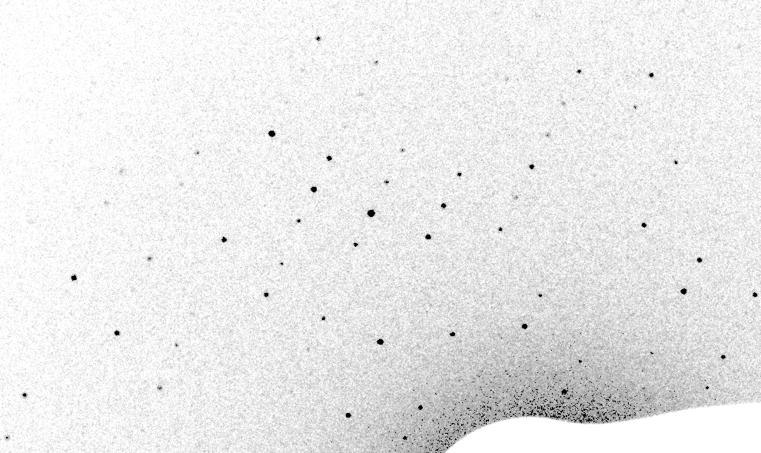
1-cluster Simulation of XFEL still

Slide 16
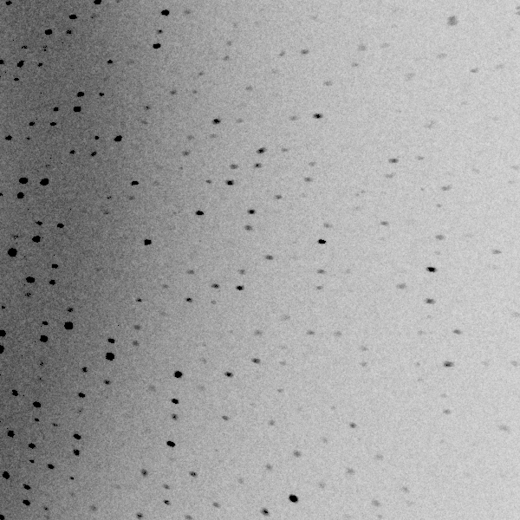
3 domains within 1°

Slide 17
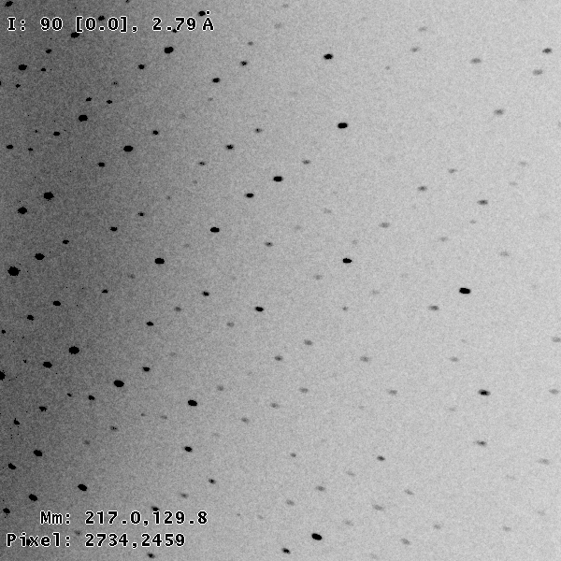
3 domains within 0.2°

Slide 18
Texture sufficient for poor stats
500 images Results from iota: cctbx & prime
texture | 1 cluster | 3 clusters
R_{true}* | 4% | 16%
*Agreement with F value fed into simulation

Slide 19
Texture sufficient for poor stats
500 images Results from iota: cctbx & prime
texture | 1 cluster | 3 clusters
R_{true}* | 4% | 16%
R_{merge} | 23% | 66%
*Agreement with F value fed into simulation

Slide 20
Texture sufficient for poor stats
500 images Results from iota: cctbx & prime
texture | 1 cluster | 3 clusters
R_{true}* | 4% | 16%
R_{merge} | 23% | 66%
I/σ | 32 (1.1) | 19 (1.2)
*Agreement with F value fed into simulation

Slide 21
Texture sufficient for poor stats
500 images Results from iota: cctbx & prime
texture | 1 cluster | 3 clusters
R_{true}* | 4% | 16%
R_{merge} | 23% | 66%
I/σ | 32 (1.1) | 19 (1.2)
CC_{1/2} | 99 (69) | 99 (58)
*Agreement with F value fed into simulation

Slide 22
Texture sufficient for poor stats
500 images Results from iota: cctbx & prime
texture | 1 cluster | 3 clusters
R_{true}* | 4% | 16%
R_{merge} | 23% | 66%
I/σ | 32 (1.1) | 19 (1.2)
CC_{1/2} | 99 (69) | 99 (58)
resolution | 1.55 | 1.94
*Agreement with F value fed into simulation

Slide 23
How to lose information
long exposures
  >1 photon/image = order of arrivals
Wide phi slice
  sum over angle
Large beams
  sum over area
Pink/divergent beam
  sum over lambda/angle
Background
  non-crystal stuff
Systematics
  Dose contrast

Slide 24
Lossless compression: data rate
bits
s
= log₂(N_{pixels}) * flux * t_{sample} * 1.2x10⁻⁵
minimum data rate with no information loss
N_{pixels} = 4150*4371 for Eiger
flux = photons/s onto the sample
t_{sample} = sample thickness in µm
1.2x10⁻⁵ = 10⁻⁴ cm/µm * cross section of oxygen (0.2 cm²/g)
* density of protein crystal (1.2 g/cm³ )
* ~1/2 of total scattering intersects detector
E.G. 34 GByte/s for 10¹³ photons/s and 100 µm thick

Slide 25
Lossless compression: data rate
bits
s
= pixels/s * (2 + log₂(RMSD))
calibrated using modern lossless algorithms
bits/s = compressed data rate
pixels = number of pixels in the detector
RMSD = RMS deviation of pixels from mean
E.G. ~4 GByte/s for ~1 photon/pixel at 18M 100 Hz

Slide 26
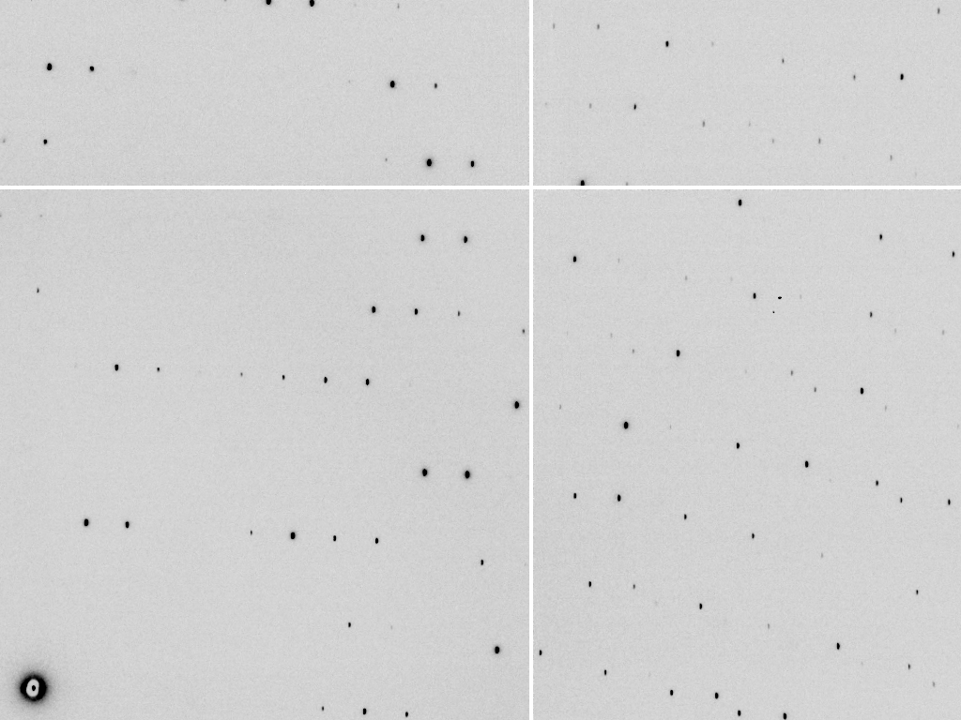

compresses 4.2x
Notes:
Test data set: ADSC Q315r ccd. No loss, compresses 4.2x with gzip, etc.

Slide 27
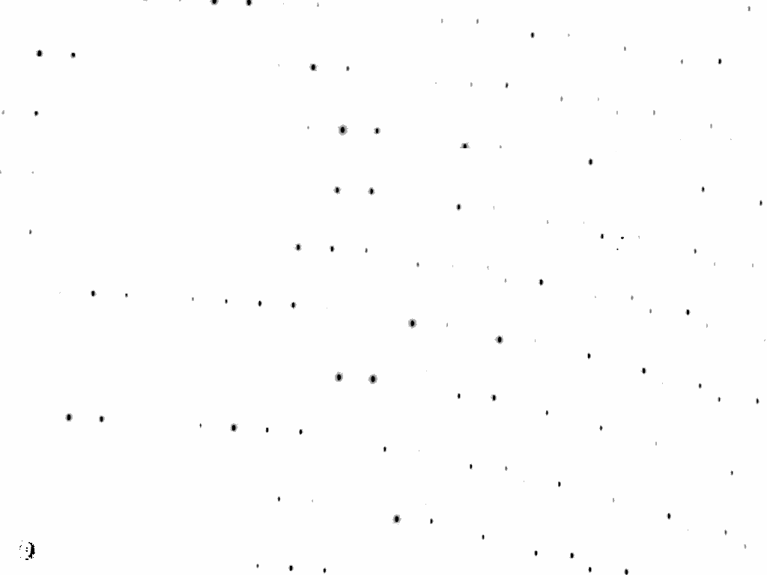

compresses 337x
Notes:
Isolate spots by looking for peaks. Set everything else to zero, compresses almost 100x better!

Slide 28
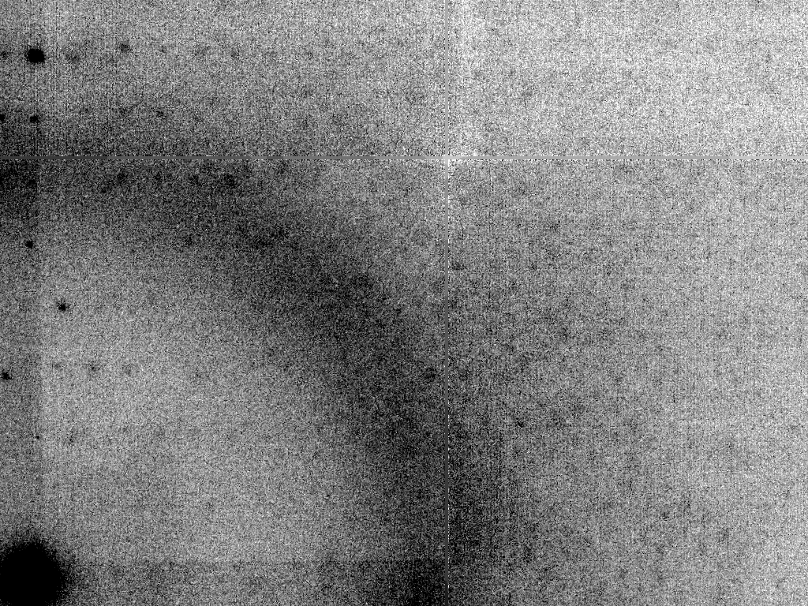
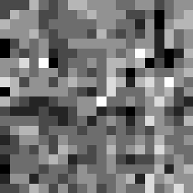
compresses 5x, but only one per dataset!
Notes:
Median background and median absolute deviation from that background, store this separately as two images, compression is > 100x if you consider that there were 100 images in this data set.

Slide 29
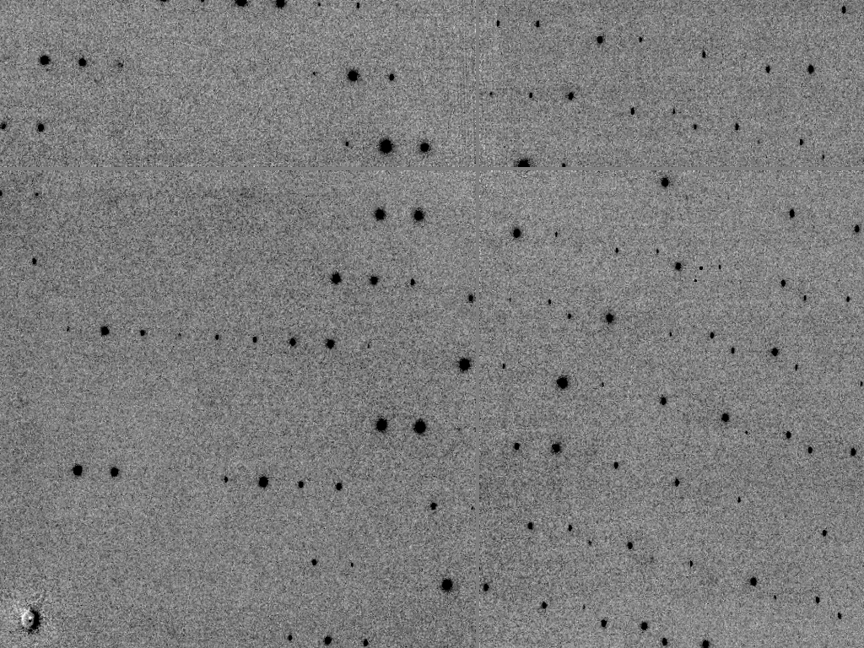
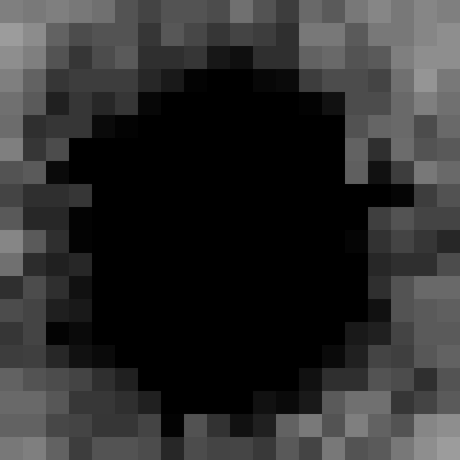
compresses 3.5x
Notes:
Subtract meidan background and spots, left with difference between original image and everything we have compressed so far (spots, median background and median background noize level). This compresses less well than original image because all the “information” in the background is in here.

Slide 30


compressed ~50x
Notes:
After doing lossy compression on background, the image can be re-assembled by adding the spots to the median background and then finally adding the lossy-compressed difference image. So, we have only modified background pixels, but achieved 10x more compression!

Slide 31
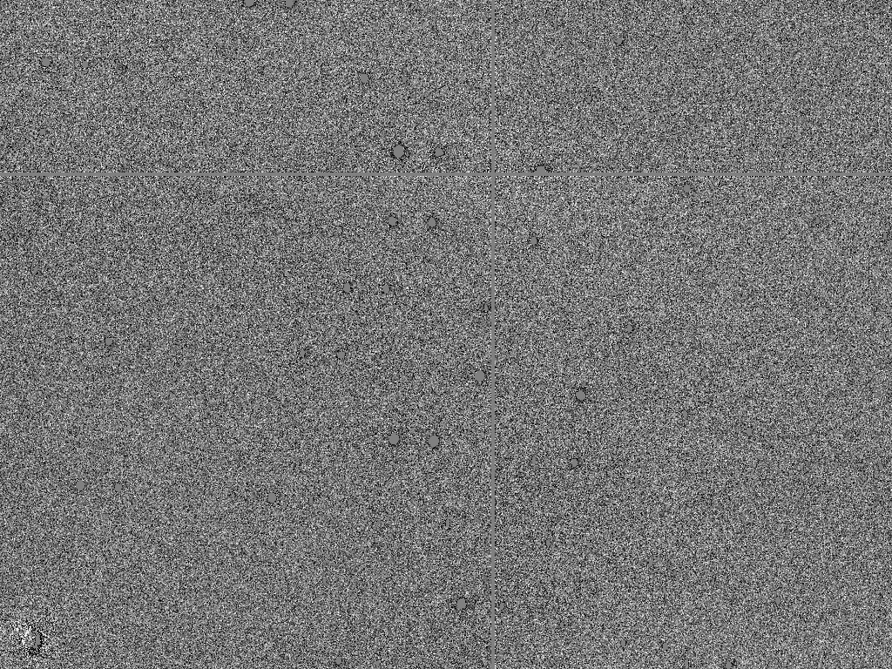
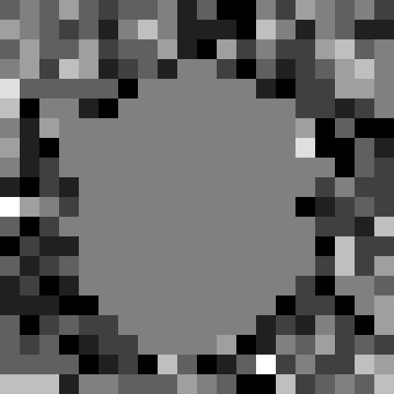
compresses 5.2x
Notes:
Difference between the 50x lossy-compressed image and the original image. Note that the spots are “blank” because they were not modified by the lossy compression. This difference image contains most of the entropy of the original data set, as evidence by how it doesn’t compress very well. Theoretically, the difference data set could be stored separately from the 50x lossy-compressed data. Perhaps on tape or other slow long-term media. That way if anyone wants the original data back they can still get it. But for quick online storage the 50x compressed data can be used.

Slide 32
Lossy compression vs R/R_{free}
R factor
Background
“too smooth”
compression ratio
Notes:
By adjusting the h264 lossy compression ratio of the background pixels the impact of the compression on crystallographic statistics can be evaluated. Note that some of these points are actually better than the uncompessed data! This is due to random noise, but could be a misguided argument for lossy compression: it can improve your Rfree

Slide 33
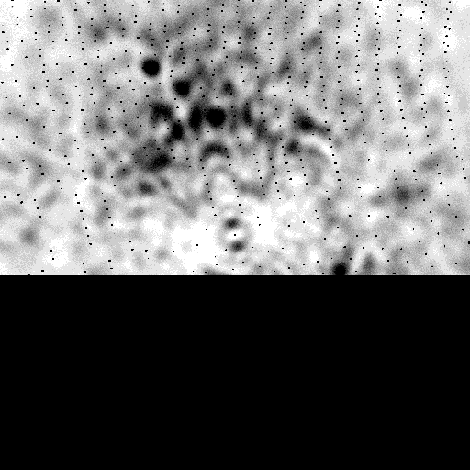
Why keep “background”?
http://bl831.als.lbl.gov/example_data_sets/Illuin/lyso_DS

Slide 34
Noise “compression”
Find best-fit pseudo-random sequence to real noise
intensity
pixel
Notes:
By adjusting the h264 lossy compression ratio of the background pixels the impact of the compression on crystallographic statistics can be evaluated. Note that some of these points are actually better than the uncompessed data! This is due to random noise, but could be a misguided argument for lossy compression: it can improve your Rfree

Slide 35
Noise “compression”
Find best-fit pseudo-random sequence to real noise
intensity
pixel

Slide 36

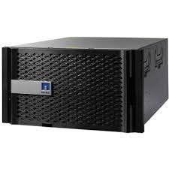
3-year service contract
$180k / 400 TB
$450 / TB / 3 years
$150,000 / PB / year

Slide 37

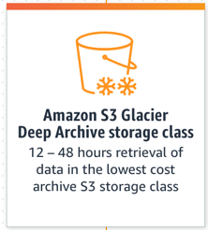
“At just $0.00099 per GB-month”
$12,000 / PB / year

Slide 38
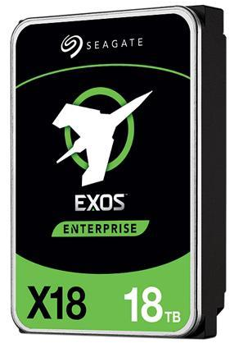
Bare
drives
$300 / 18 TB
$17 / TB / 5 years
$3400 / PB / year

Slide 39
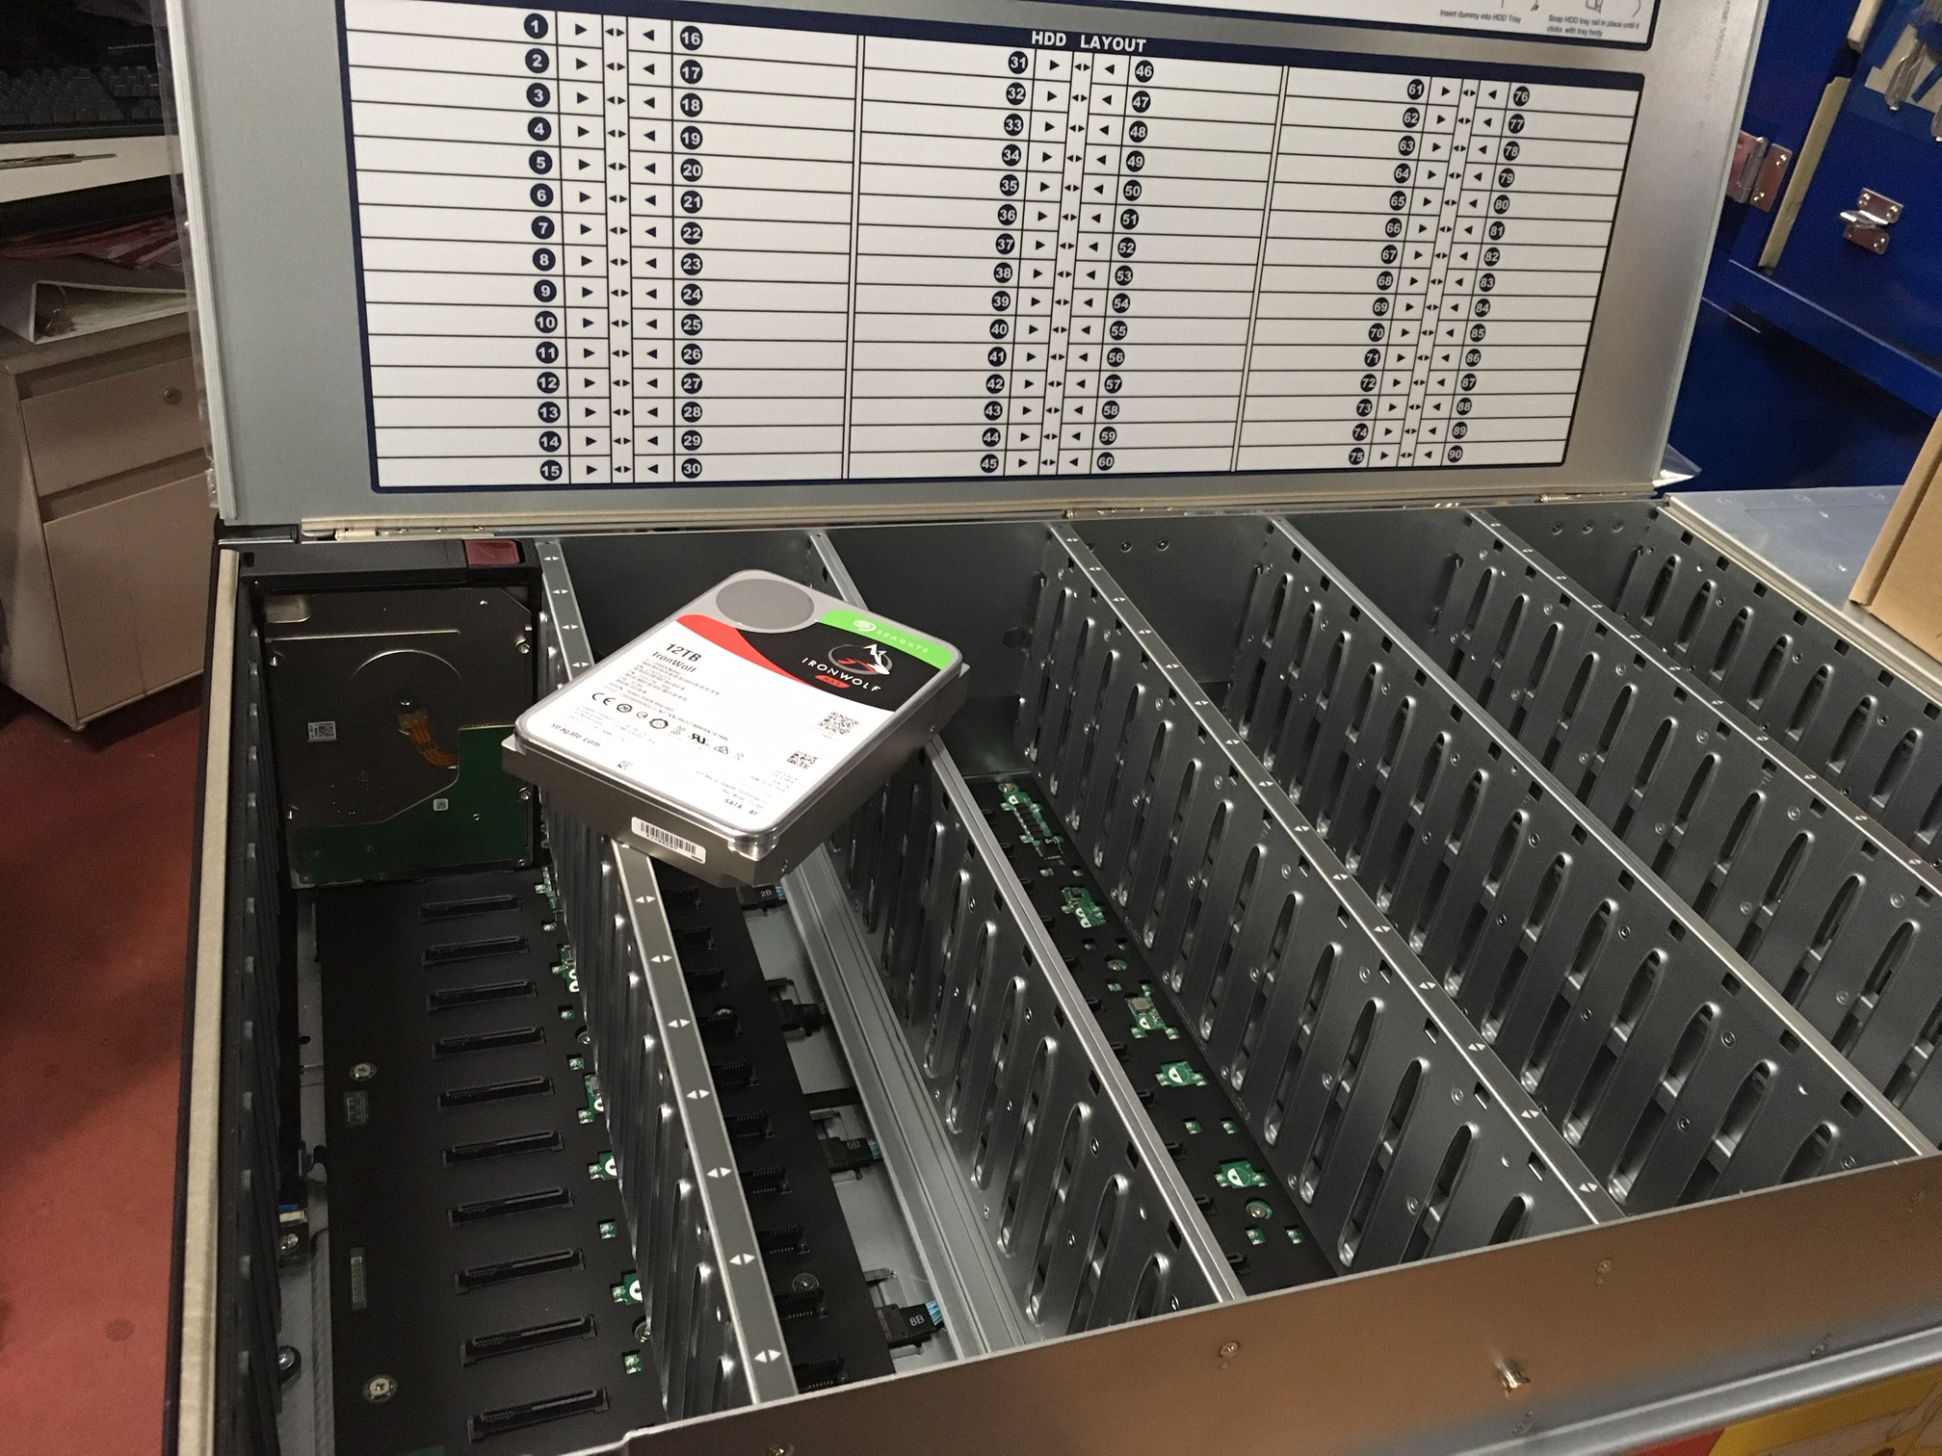
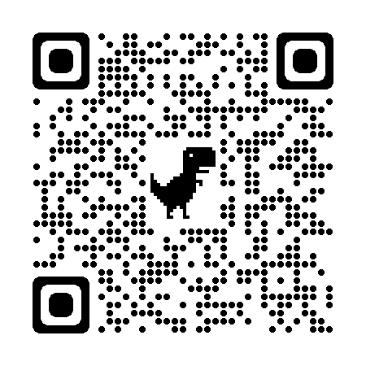
“petabyte”
90 drive bays
HDD life:
4-7 years
600 W
= $1k/y
SSG-640SP-E1CR90
$57k / 1.8 PB
$32 / TB / 5 years
$7400 / PB / year

Slide 40

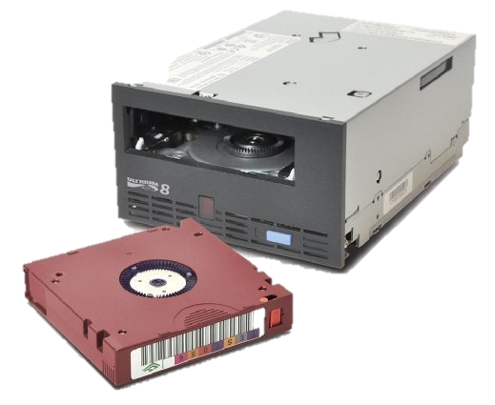
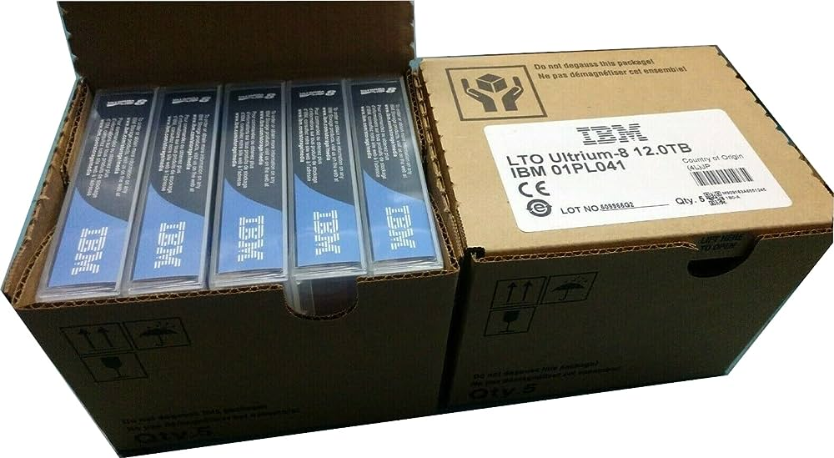
8
$4k
Shelf life:
15-30 years
Write speed:
360 MB/s
$54 / 12 TB
$4.5 / TB / 15 years
$300 / PB / year

Slide 41
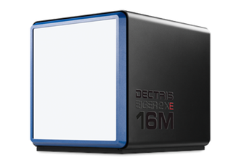
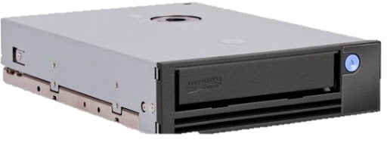
1 GB/s – direct to tape?
LTO-10

Slide 42
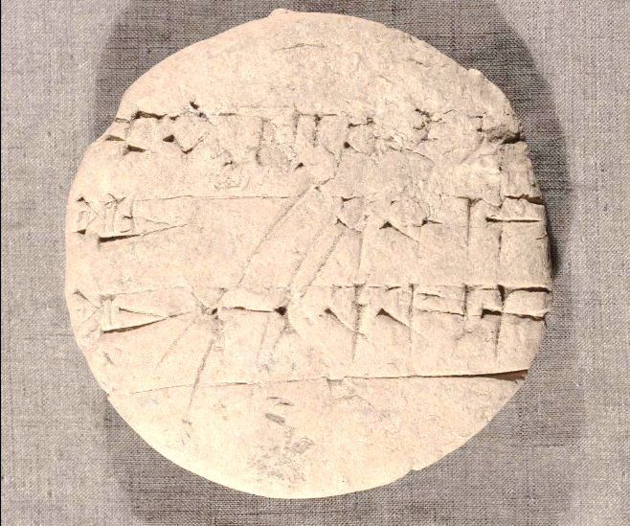
clay tablet ca. 2000 BC
$0.3/lb ; 1 bit = 1 mm³
$2.7 / TB / 4000 years
$0.3 / PB / year

Slide 43

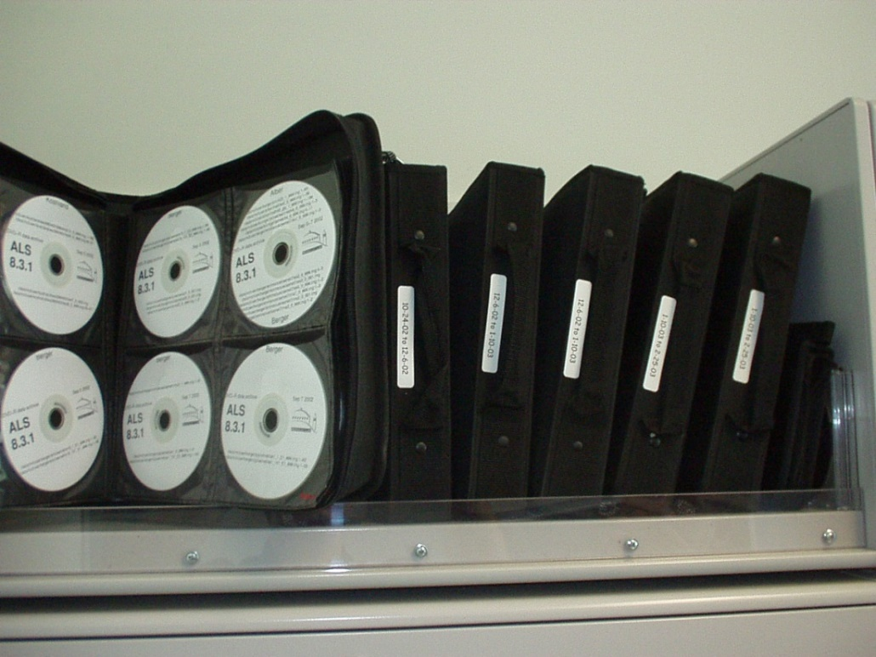
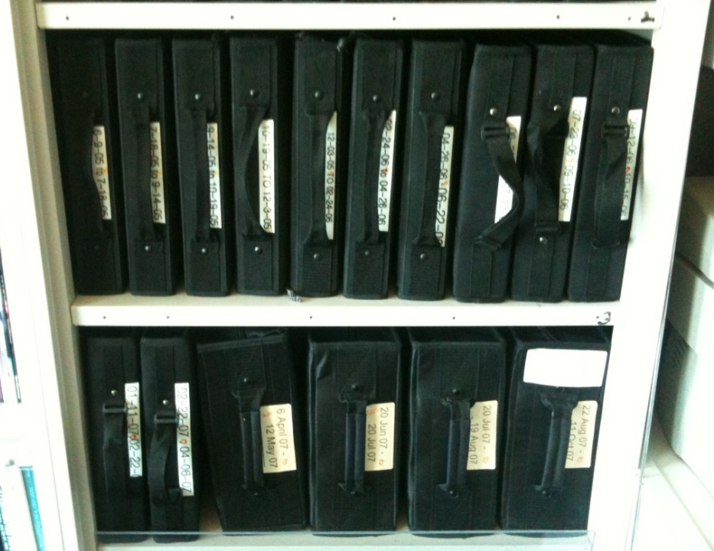
DVD data archive: ~100 TB
Shelf life:
> 20 years
$0.2 / 4.7 GB
$42 / TB / 20 years
$2000 / PB / year

Slide 44
Which data go with which PDB?
260,000 images are called “test”
cell: 48 62 84 90 101 104
  is within 5 Å and 5° of 16,000 PDBs
focusing on 2001-2006
490 PDBs credit ALS 8.3.1 with data
44 of these didn’t actually collect data
64 collected data, but no credit

Slide 45
Which data go with which PDB?
images from 2001-2006
collected “near” edges
find “runs” of >10 images
unify multi-wedge sets
run labelit & XDS
>70% complete?
I/σ > 10
reduced cell vs PDB
1,604,031
682,712
3602
3331
2524
1479
1054
1 to 200+

Slide 46
Responses to inquiries
“I have to find my old note book as I have no idea what that is.”
“I have changed jobs a few times since and am really far away from crystallography now.”
“Will see what I can find.”
“We solved it but never published it. Sorry!”

Slide 47

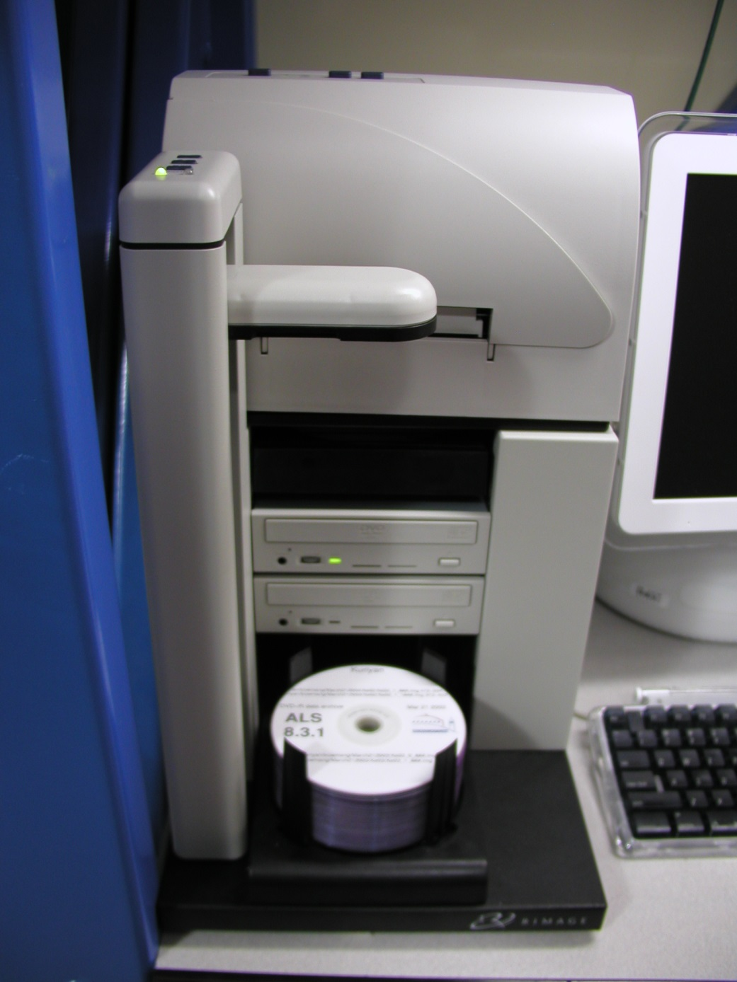
DVD data archive

Slide 48
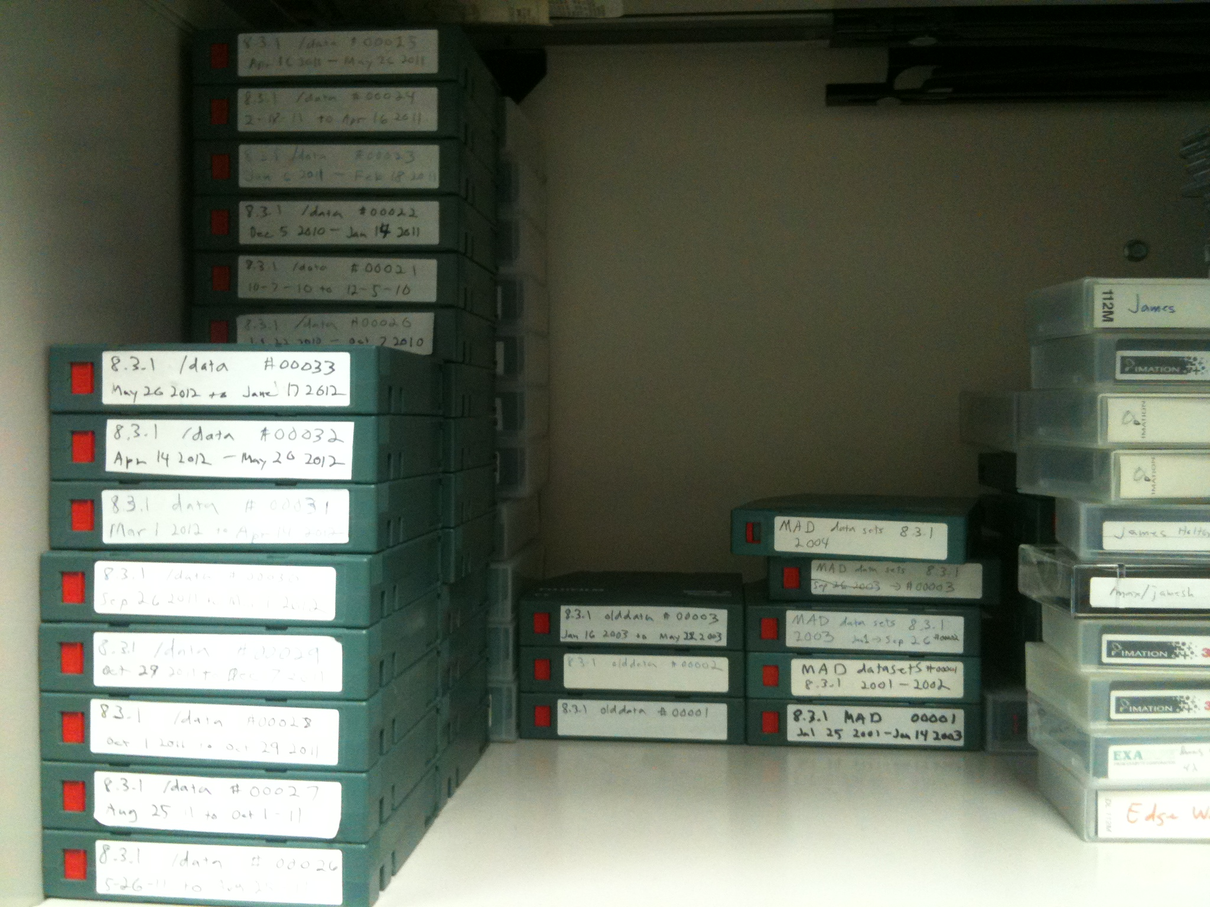

Slide 49
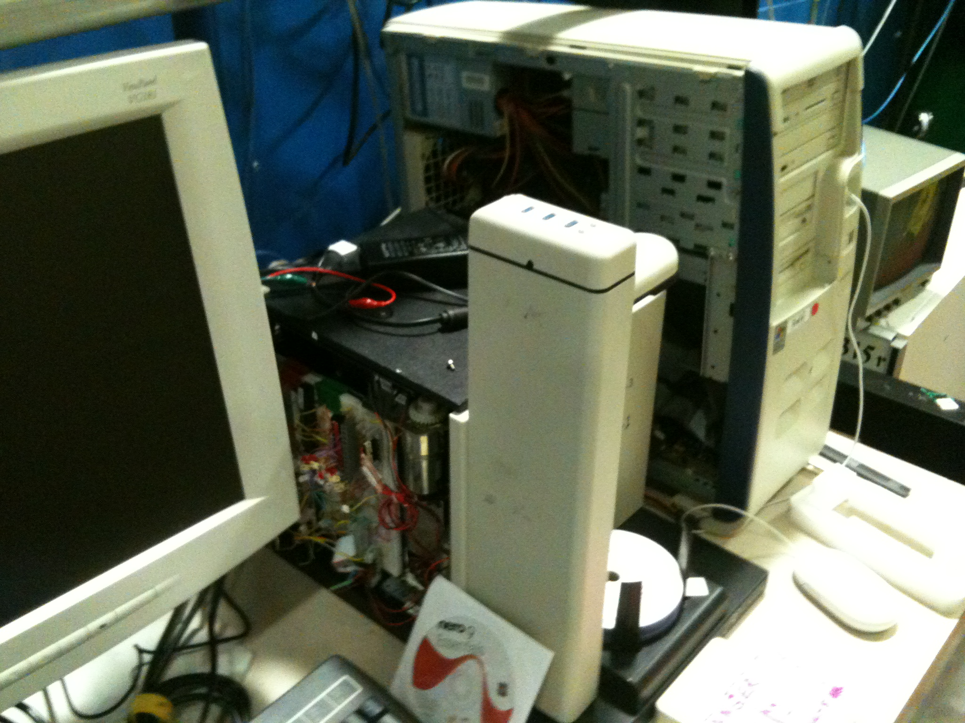

Slide 50

Primary failure mode of DVDs

Slide 51
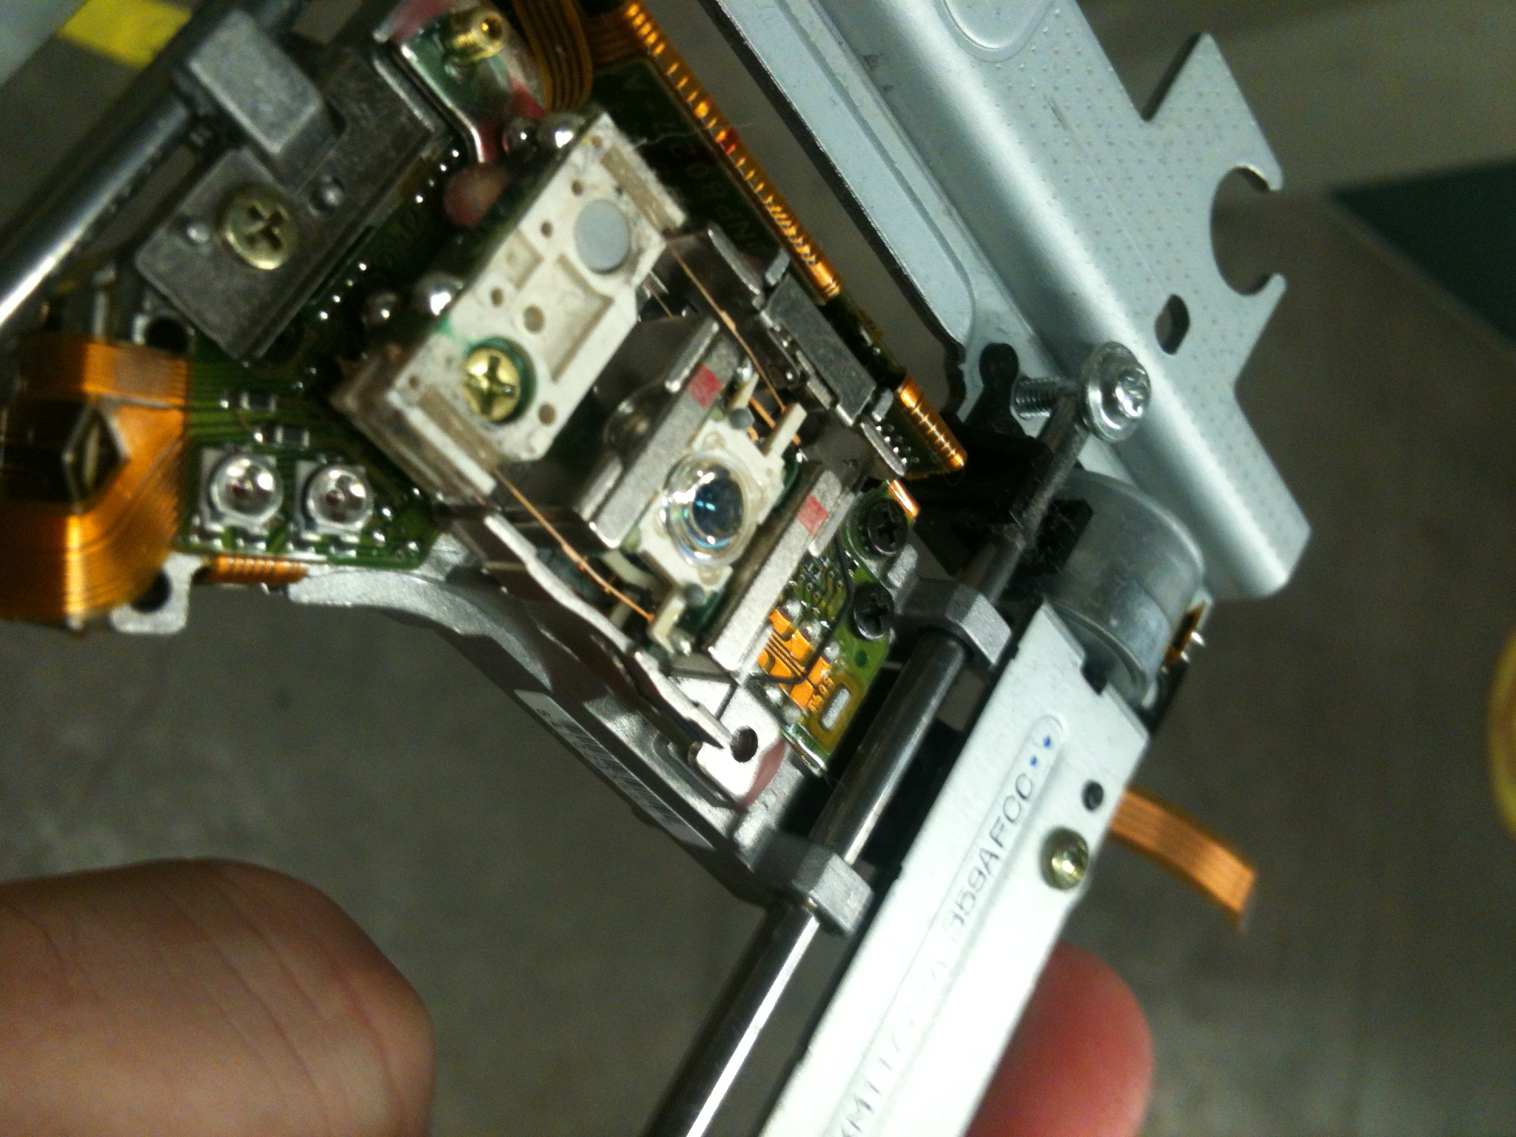

Slide 52
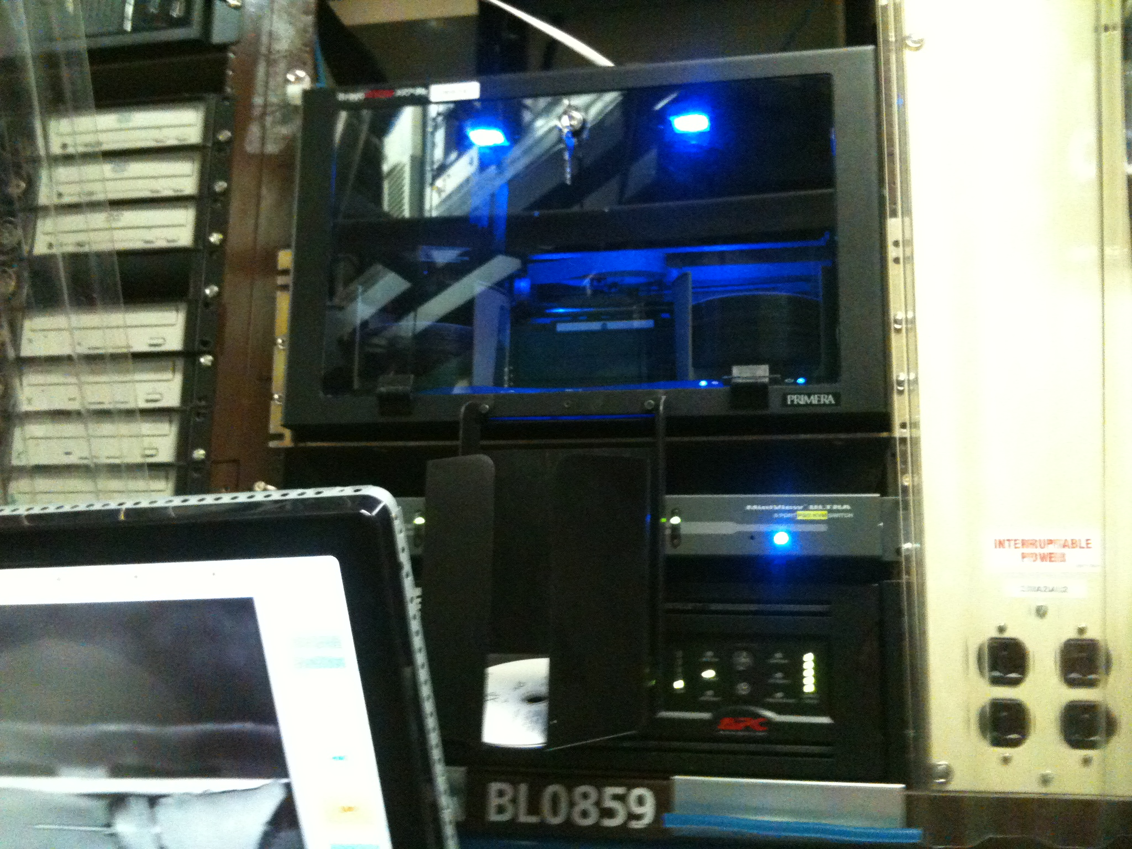

Slide 53
dataset identification protocol
images from 2001-2006
collected “near” edges
find “runs” of >10 images
sort out multi-wedge sets
run XDS
>70% complete?
I/σ > 10
reduced cell vs PDB
1,604,031
682,712
3602
3331
2524
1479
1054
1 to 200+

Slide 54
Unit Cell: 90.9 90.9 46.8 90 90 120
1hh7 M. TB CSOR
myoglobin
best R_{cryst} after rigid-body refinement
1rb5
RMS unit cell length deviation (Å)

Slide 55
MAD/SAD datasets
non-isomorphous
Unsolved?
R_{iso} vs PDB deposit
Published
best R_{cryst} after rigid-body refinement

Slide 56
EGDA
Dec 01 19:45:12 2001 egda46_*1_E#_###.img (1112 images, Se MAD)
Dec 02 15:10:06 2001 egda27_*1_###.img (180, 1A, native?)
Dec 02 19:21:55 2001 egdau1_*1_###.img (427, 8000eV (U?) SAD)
Dec 02 20:58:26 2001 egdau1_*2_###.img (360, 8000eV (U?) SAD)
Jun 01 14:07:43 2002 egda60_*1_###.img (360, Lutetium SAD)
“I think that these EGDA data sets are very likely some of xxx’s data sets, he was working on E.coli guanine deaminase, something he brought from yyy. No structure was ever published James, xxx was unable to solve the structure from these data.”

Slide 57
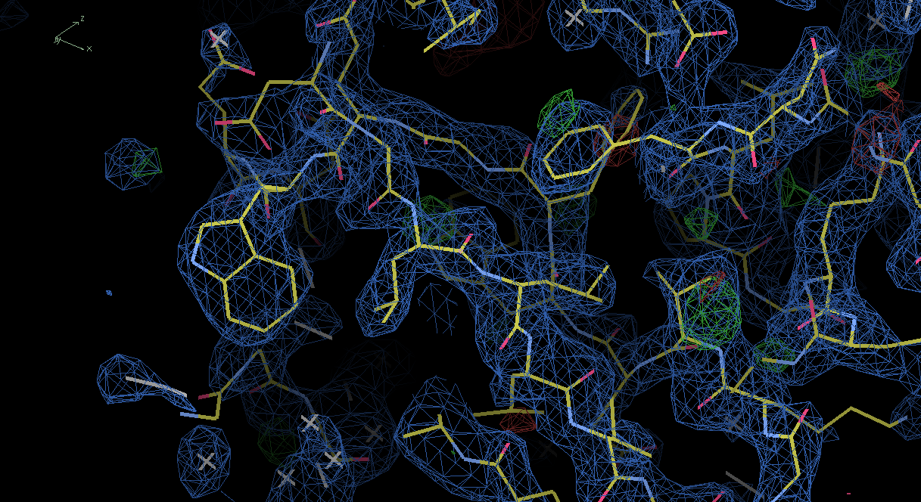
~2.9 Å
P2₁2₁2
E. coli
guanine
deaminase
R = 0.32
R_{free} = 0.39
Identical
sequence:
6ohc (2019)
PDB ID: ????

Slide 58
Summary
Old data can age well
Smooth the background?
Bare LTO tape = $300/PB/year
metadata: trust, but verify?

