Slide 1
Acknowledgements
Chris Neilson Aina Cohen Ana Gonzalez Mike Soltis
ALS 8.3.1 creator: Tom Alber
Integrated Diffraction Analysis Technologies (IDAT)
Center for Structure of Membrane Proteins (CSMP)
Membrane Protein Expression Center II (MPEC)
Center for HIV Accessory and Regulatory Complexes (HARC)
W. M. Keck Foundation
Plexxikon, Inc.
M D Anderson CRC
University of California Berkeley
University of California San Francisco
University of California Campus-Laboratory Collaboration Grant
Henry Wheeler
The Advanced Light Source is supported by the Director, Office of Science, Office of Basic Energy Sciences, Materials Sciences Division, of the US Department of Energy under contract No. DE-AC02-05CH11231 at Lawrence Berkeley National Laboratory.

Slide 2
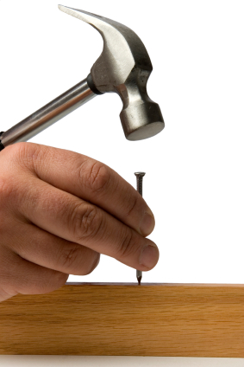
The Tool: LSLS II vs LCLS
High rep rate
  GDVN jet no longer “wasting” sample
  Containerless = low bg = resolution
  Splash-over limit?
Lower J/pulse
  Avoid high field damage?
More stable
  Lower jitter & flicker
  Sharper spots
Long λ performance
  Native element phasing
  Match to sample size

Slide 3

Grand Challenges in Structural Biology
Phase Problem
spots, but no maps
Amplitude Problem
    Crystals, but no spots
R-factor Gap
    Can’t/shouldn’t publish

Slide 4

Averaging doesn’t always reduce error

Slide 5

May learn more about detectors than planned
~3x10⁵ photon/pixel Pilatus detector Black to white is a 2% range

Slide 6
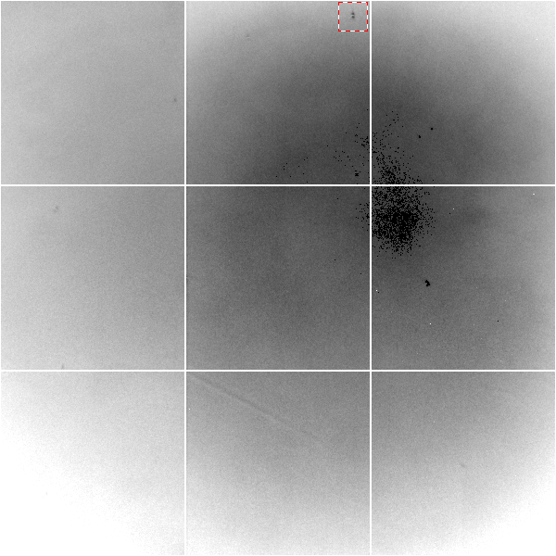
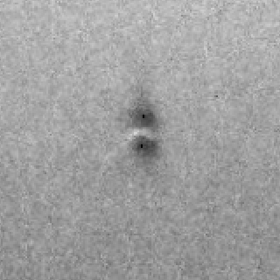
May learn more about detectors than planned
Gadolinium edge contrast map of fiber-coupled CCD detector. Black to white is a 20% range.

Slide 7
The Tool: LSLS II vs LCLS
High rep rate
  GDVN jet no longer “wasting” sample
  Containerless = low bg = resolution
  Splash-over limit?
Lower J/pulse
  Avoid high field damage?
More stable
  Lower jitter & flicker
  Sharper spots
Long λ performance
  Native element phasing
  Match to sample size

Slide 8
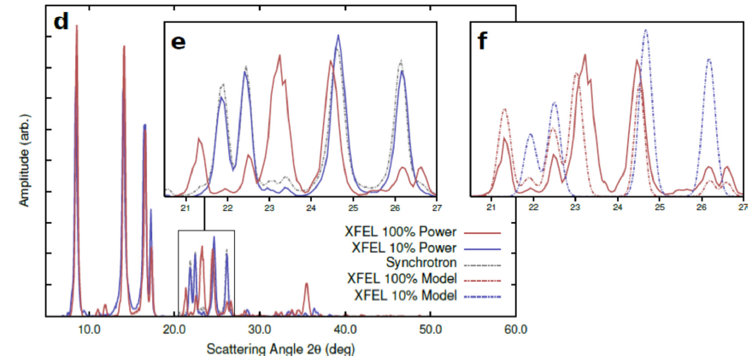
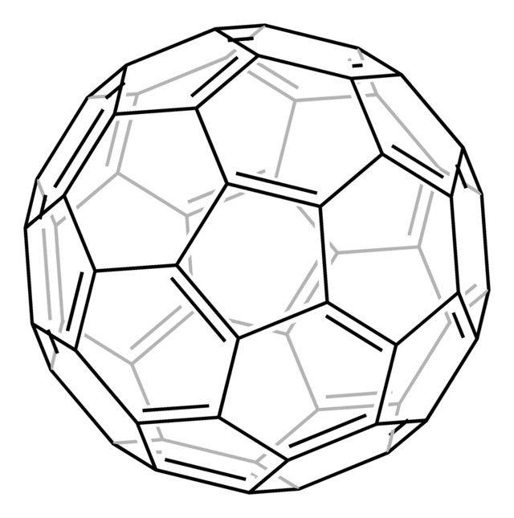
New damage at high fluence?
Abbey et al. (2012)."Femtosecond X-ray Laser induced transient electronic phase change observed in fullerene C60", arXiv:1209.5168.

Slide 9
Dose-rate dependence of damage
maximum useful dose (MGy)
dose rate (kGy/s)

Slide 10
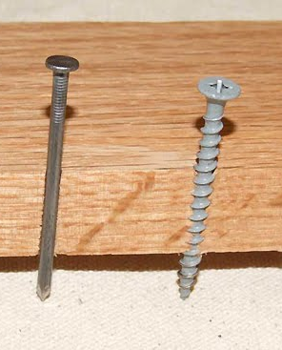
Alternative tools?
Assume:
50% absorption: 1 mJ/xtal
Zero-dose extrapolation
Linear to half-reaction point (5% error)
XFEL worthy?
Size (μm) | D_{1/2} (MGy) | example
30 | 30 | Cryo MX
118 | 0.5 | PS II
160 | 0.2 | RT MX
350 | 0.02 | Myoglobin

Slide 11
Grand Challenges in Structural Biology
Phase Problem
spots, but no maps
Amplitude Problem
    Crystals, but no spots
R-factor Gap
    Can’t/shouldn’t publish

Slide 12
Fractional error
^{mult >} (—)²
~3%
<ΔF/F>

Slide 13
Fractional error at XFEL
^{mult >} (—)²
~100%
<ΔF/F>
Gd lyso: ΔF/F = 8.7% → mult = 132

Slide 14
The “partiality problem”
0.006°
1 μm xtal
1 Å x-rays

Slide 15
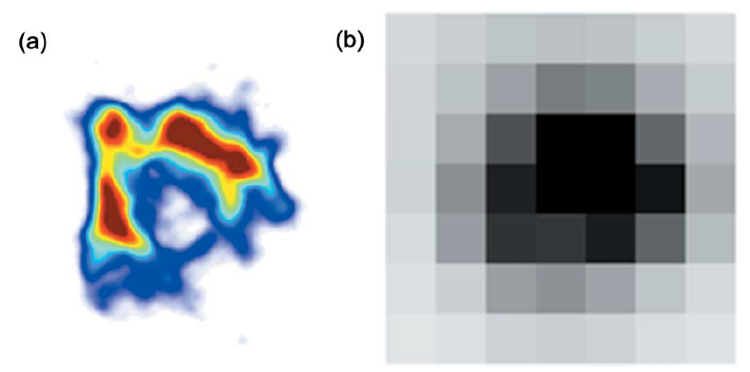
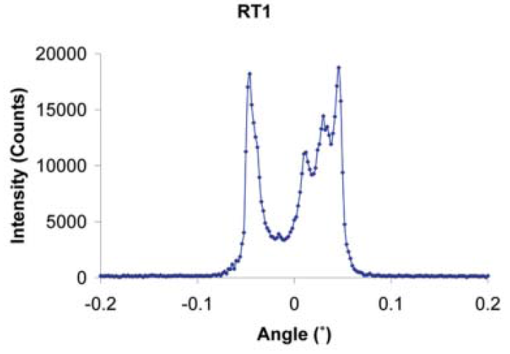
The true nature of “mosaic spread”
Any function can be approximated by a family of Gaussians
Lovelace JJ, Murphy CR, Pahl R, Brister K & Borgstahl GEO (2006)."Tracking reflections through cryogenic cooling with topography", J. Appl. Cryst. 39, 425-432.

Slide 16
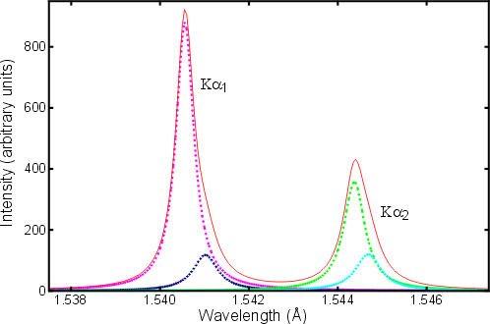
Two-color experiment (ca 1914)
20 eV

Slide 17

Non-isomorphism in lysozyme
PDB:
3aw6
3aw7
Δa = 0.8%
RH 84.2% vs 71.9%
RMSD = 0.18 Å
R_{iso} = 44.5%

Slide 18
Si(111)
52.87deg
Si(111)
2 Multilayer mirrors
d=2nm, W/B4C
KB Horiz focus
KB vertical focus
Si(111)
Detector
Detector
λ = 5 Å
h,k,l
sample
injector
-h,-k,-l
Si(111)
Detector
Detector
~ 1m
Si(111)
Si(111)
Notes:
Proposed 5-crystal monochromator for colliding-beam crystallography. The generation of two opposing Ewald spheres means that for every h,k,l index reflected from the protein crystal, the Friedel mate is reflected in the opposite direction, allowing for very accurate anomalous difference measurements. The wavelength need not be set precisely at the sulfur or phosphorous edge, but merely at a wavelength where the f” of those elements are strong. For fs-class pulses, the distances above will have to be precise to withing ~3 microns, and for accurate reproduction of the partiality of the Friedel mates, the angular precision of the colliding beams must be within ~1% of the sample crystal’s rocking width, or ~100 microrads.

Slide 19
The Tool: LSLS II vs LCLS
High rep rate
  GDVN jet no longer “wasting” sample
  Containerless = low bg = resolution
  Splash-over limit?
Lower J/pulse
  Avoid high field damage?
More stable
  Lower jitter & flicker
  Sharper spots
Long λ performance
  Native element phasing
  Match to sample size

Slide 20
Darwin’s Formula
V_{xtal}
λ³ L
I_{spot} = I_{beam} r_{e}²
P A | F₀e^{-Bs2} |²
V_{cell}
ωV_{cell}
I_{spot} - photons/spot (fully-recorded)
I_{beam} - incident (photons/s/m² )
r_{e} - classical electron radius (2.818x10⁻¹⁵ m)
V_{xtal} - volume of crystal (in m³)
V_{cell} - volume of unit cell (in m³)
λ - x-ray wavelength (in meters!)
ω - rotation speed (radians/s)
L - Lorentz factor (speed/speed)
P - polarization factor
A - attenuation correction
F₀ - structure factor at T = 0
B - Debye-Waller-Ott factor
s - 0.5/d-spacing
C. G. Darwin (1914)

Slide 21
Damage limited crystal size (synchrotron)
wavelength dependence
Å
Å
crystal diameter (μm)

Slide 22
attenuation correction
μ
I_{T}
I_{beam}
A = = exp(-μt)
t
Bouguer, P. (1729). Essai d'optique sur la gradation de la lumière.
Lambert, J. H. (1760). Photometria: sive De mensura et gradibus luminis, colorum et umbrae. E. Klett.
Beer, A. (1852)."Bestimmung der Absorption des rothen Lichts in farbigen Flüssigkeiten", Ann. Phys. Chem 86, 78-90.

Slide 23
attenuation correction
μ
t_{out}
t_{in}
I_{T}
I_{beam}
I_{T}
I_{beam}
A = = exp(-μ(t_{in}+ t_{out}))
A = = exp(-μt)
t
Bouguer, P. (1729). Essai d'optique sur la gradation de la lumière.
Lambert, J. H. (1760). Photometria: sive De mensura et gradibus luminis, colorum et umbrae. E. Klett.
Beer, A. (1852)."Bestimmung der Absorption des rothen Lichts in farbigen Flüssigkeiten", Ann. Phys. Chem 86, 78-90.

Slide 24
attenuation correction
t_{out}
t_{in}
μ
t_{out}
t_{in}
t_{out}
I_{T}
I_{beam}
t_{in}
A = = exp(-μ(t_{in}+ t_{out}))
Bouguer, P. (1729). Essai d'optique sur la gradation de la lumière.
Lambert, J. H. (1760). Photometria: sive De mensura et gradibus luminis, colorum et umbrae. E. Klett.
Beer, A. (1852)."Bestimmung der Absorption des rothen Lichts in farbigen Flüssigkeiten", Ann. Phys. Chem 86, 78-90.

Slide 25
attenuation correction
μ_{solvent}
t_{so}
t_{xo}
t_{si}
t_{xi}
μ_{xtal}
t_{so}
t_{xo}
t_{si}
t_{xi}
t_{so}
t_{xo}
I_{T}
I_{beam}
t_{si}
t_{xi}
A = = exp[-μ_{xtal}(t_{xi}+ t_{xo})
-μ_{solvent}(t_{si} + t_{so})]
Bouguer, P. (1729). Essai d'optique sur la gradation de la lumière.
Lambert, J. H. (1760). Photometria: sive De mensura et gradibus luminis, colorum et umbrae. E. Klett.
Beer, A. (1852)."Bestimmung der Absorption des rothen Lichts in farbigen Flüssigkeiten", Ann. Phys. Chem 86, 78-90.

Slide 26
Where do photons go?
100 μm
thick
protein
97%
transmitted
1 Å x-rays
beamstop
attenuation correction
error cannot be > ~3%

Slide 27
Where do photons go?
100 μm
thick
protein
2%
transmitted
5 Å x-rays
beamstop
attenuation correction
error can be ~98%

Slide 28
Where do photons go?
1 μm
thick
protein
96%
transmitted
5 Å x-rays
beamstop
attenuation correction
error cannot be > ~4%

Slide 29
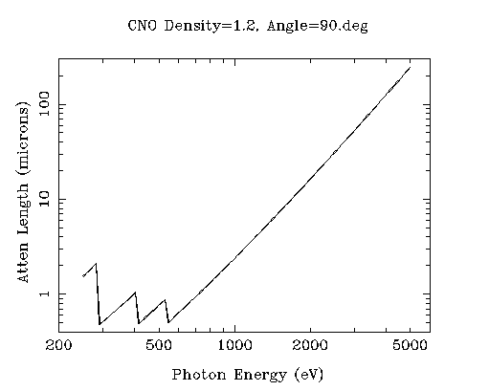
“sweet spot” for sample size ?
Ca
Ar
Cl
K
S
P
2 Å
2sin(90°)
Mg
C
Na
Se
Ne
3 Å
2sin(90°)
N
O
F
4 Å
2sin(90°)

Slide 30
Grand Challenges in Structural Biology
Phase Problem
spots, but no maps
Amplitude Problem
    Crystals, but no spots
R-factor Gap
    Can’t/shouldn’t publish

Slide 31
Darwin’s Formula
V_{xtal}
λ³ L
I_{spot} = I_{beam} r_{e}²
P A | F₀e^{-Bs2} |²
V_{cell}
ωV_{cell}
I_{spot} - photons/spot (fully-recorded)
I_{beam} - incident (photons/s/m² )
r_{e} - classical electron radius (2.818x10⁻¹⁵ m)
V_{xtal} - volume of crystal (in m³)
V_{cell} - volume of unit cell (in m³)
λ - x-ray wavelength (in meters!)
ω - rotation speed (radians/s)
L - Lorentz factor (speed/speed)
P - polarization factor
A - attenuation correction
F₀ - structure factor at T = 0
B - Debye-Waller-Ott factor
s - 0.5/d-spacing
C. G. Darwin (1914)

Slide 32
Diffraction Take-Home Lesson:
Disorder
Trumps
Everything!

Slide 33

lysozyme: real and reciprocal

Slide 34
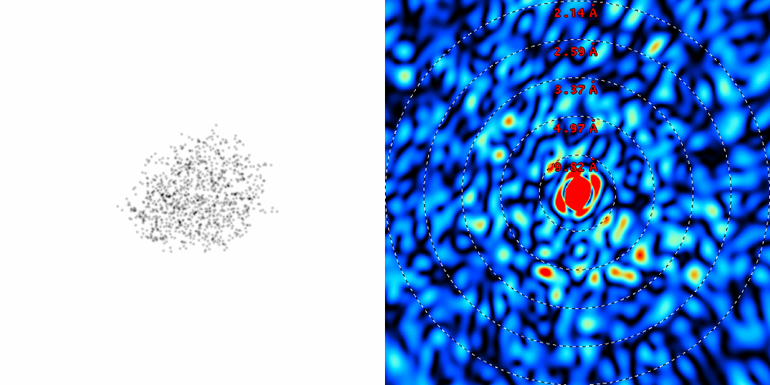
lysozyme: thermal motion

Slide 35
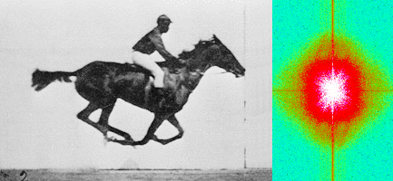
Muybridge’s galloping horse (1878)
“Time-resolved” diffraction
Real space
reciprocal

Slide 36
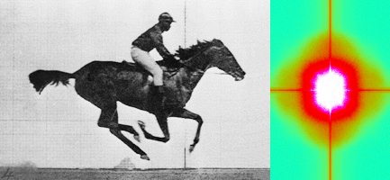
Muybridge’s galloping horse (1878)
Average intensity
Real space
reciprocal

Slide 37
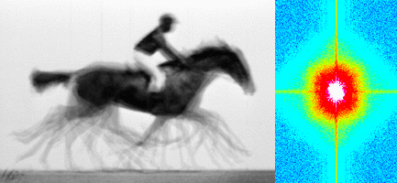
Muybridge’s galloping horse (1878)
Average electron density
Real space
reciprocal

Slide 38
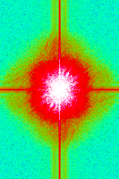
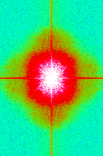
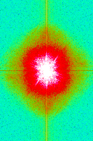
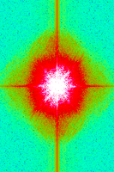
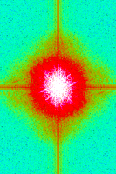
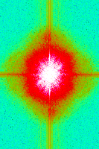
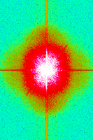
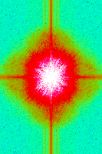
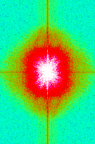
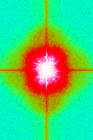
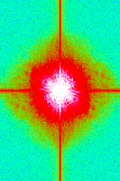
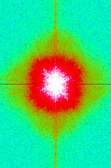
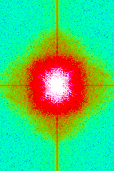
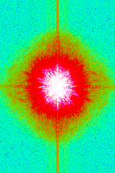
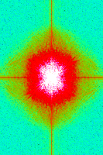
Supporting a model with data

Slide 39
Grand Challenges in Structural Biology
Phase Problem
spots, but no maps
Amplitude Problem
    Crystals, but no spots
R-factor Gap
    Can’t/shouldn’t publish

Slide 40
Is this good enough?
d_{max} = 4.5 Å
R_{cryst} = 27%
R_{free} = 38%

Slide 41
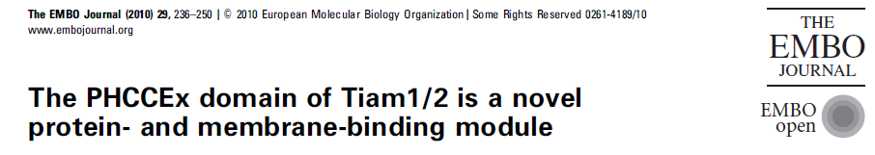
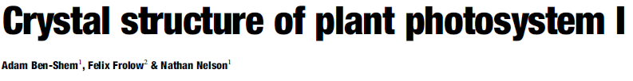
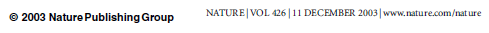
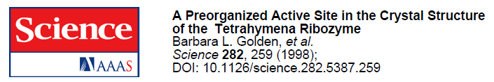
Is this good enough?
3a8n 4.5 Å R_{merge} = 0.15 R/R_{free} = 0.306/0.396
1qzv 4.44 Å R_{merge} = 0.099 R/R_{free} = 0.41/0.42
1grz 5 Å R_{merge} = 0.052 R/R_{free} = 0.369/0.428

Slide 42
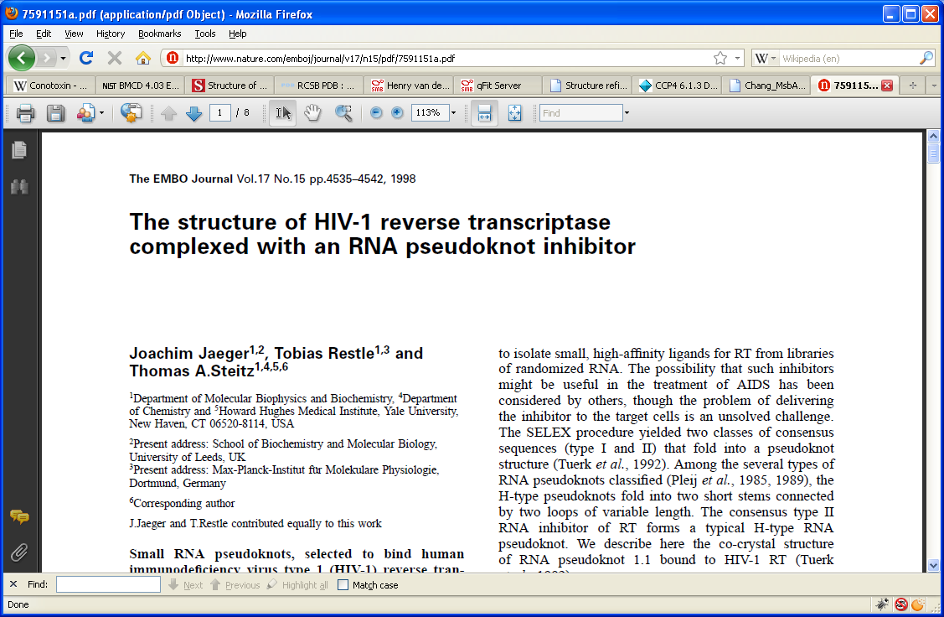
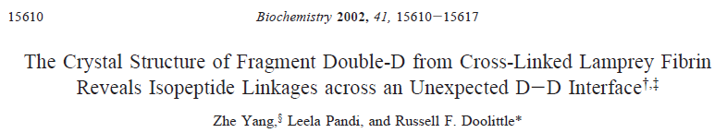
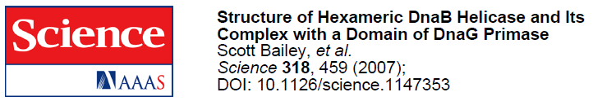
Is this good enough?
1hvu 4.75 Å R_{merge} = 0.064 R/R_{free} = 0.34/0.413
1n8e 4.5 Å R_{merge} = 0.138 R/R_{free} = 0.415/0.416
2r6e 5.02 Å R_{merge} = 0.058 R/R_{free} = 0.394/0.397

Slide 43
R-factor Gap?
Publication criterion for chemical crystallography:
R1 < 2*R_{sigma}
R1 = F_{o} vs F_{c} for I/σ(I) > 3
R_{sigma} = <σ(I)>/<I>
There are no PDB entries that pass this test!
Holton et al. (2014). FEBS J. 281, 4046-60.

Slide 44

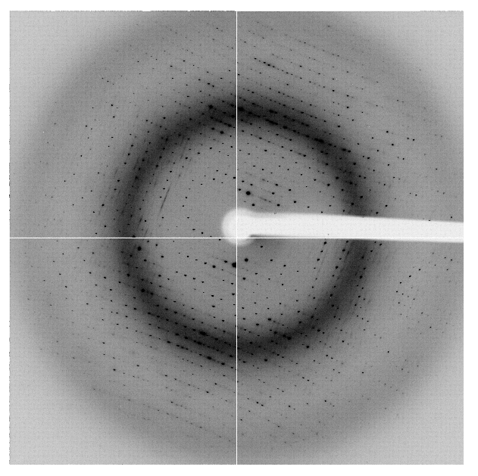
The R-factor Gap
multi-conformer PDB file
R_{merge} = 6%
R_{cryst} = 17%
R_{free} = 20%
MLFSOM
Elves
1H87
Holton, Classen, Frankel & Tainer (2014)."The R-factor gap in macromolecular crystallography: an untapped potential for insights on accurate structures", FEBS J. 281, 4046-4060.

Slide 45
The R-factor Gap
multi-conformer PDB file
R_{merge} = 6%
R_{cryst} = 7%
R_{free} = 8%
MLFSOM
Elves
1H87
Holton, Classen, Frankel & Tainer (2014)."The R-factor gap in macromolecular crystallography: an untapped potential for insights on accurate structures", FEBS J. 281, 4046-4060.

Slide 46
The R-factor Gap
single-conformer PDB file
R_{merge} = 6%
R_{cryst} = 7%
R_{free} = 8%
MLFSOM
Elves
1H87; conf “A”
Holton, Classen, Frankel & Tainer (2014)."The R-factor gap in macromolecular crystallography: an untapped potential for insights on accurate structures", FEBS J. 281, 4046-4060.

Slide 47
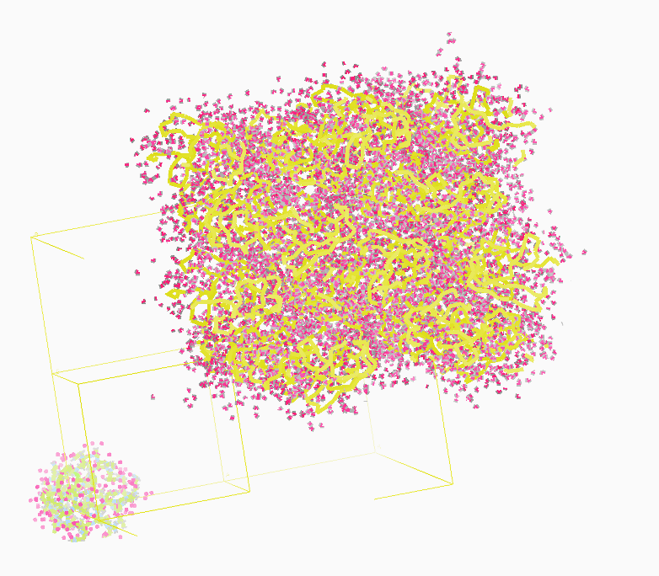
Molecular Dynamics Simulation
using real
crystal’s lattice
1aho
Scorpion toxin
0.96 Å resolution
64 residues
Solvent: H₂0 + acetate
Cerutti et al. (2010).J. Phys. Chem. B 114, 12811-12824.

Slide 48
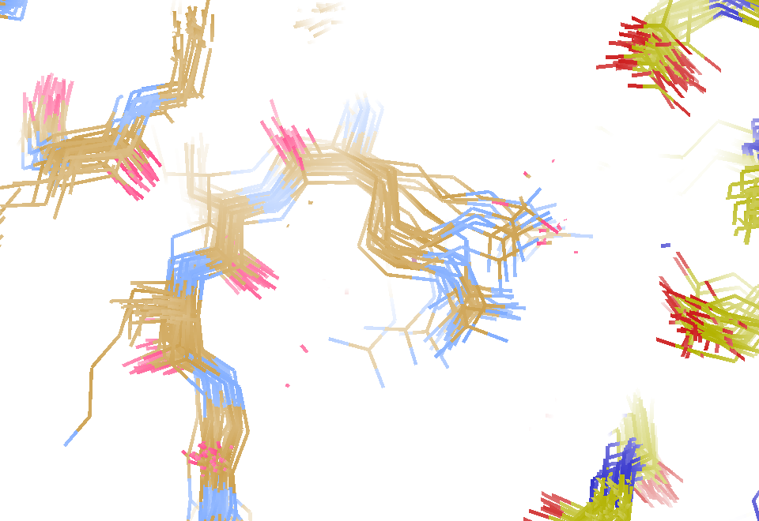
30 conformers from 24,000

Slide 49
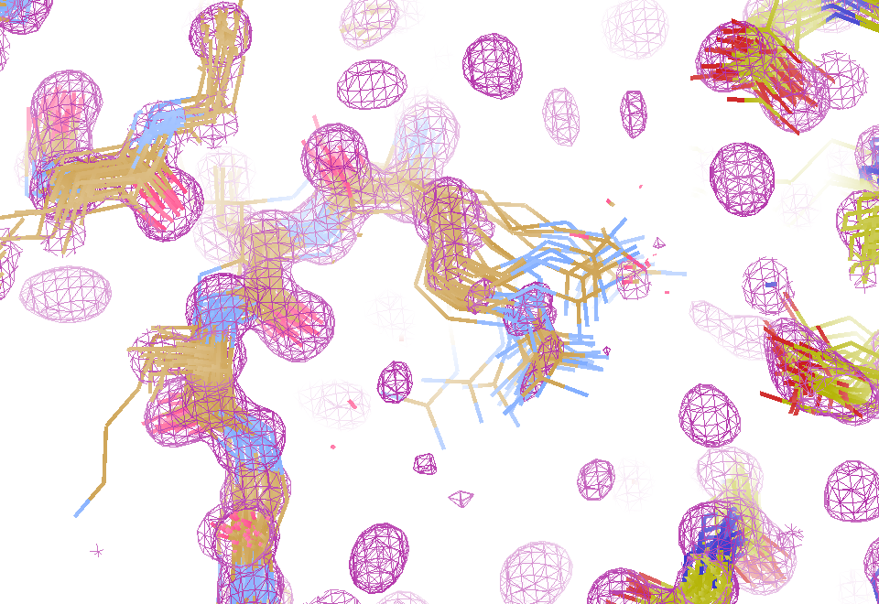
Electron density from 24,000 conformers

Slide 50
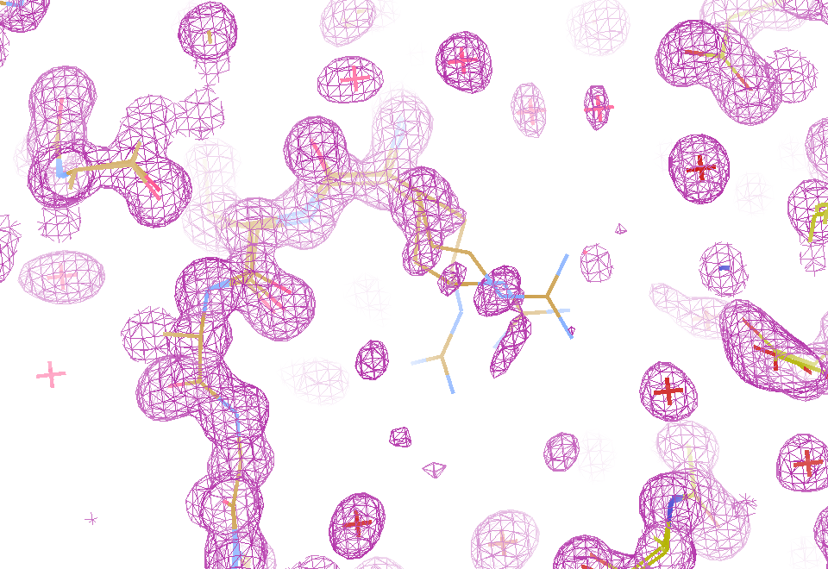
Electron density from 24,000 conformers

Slide 51
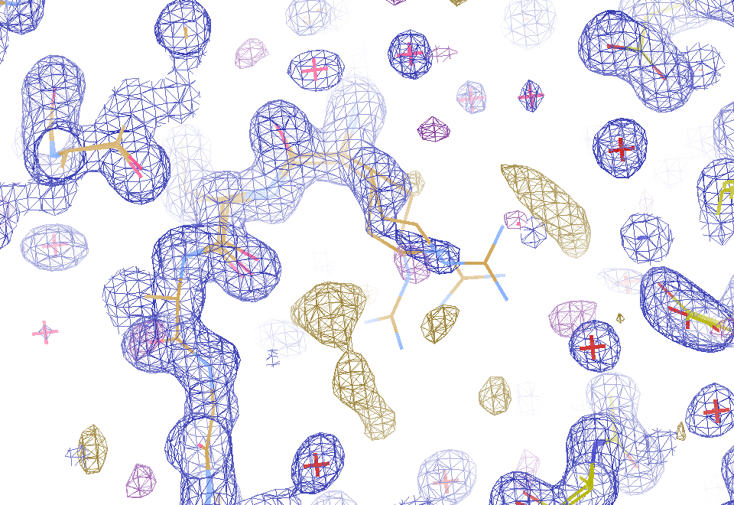
2F_{sim}-F_{calc} and F_{sim}-F_{calc} maps
1.0 Å data
R_{cryst}= 0.137
R_{free} = 0.159
1 “sigma” 2F_{sim}-F_{c}
2.5 “sigma” F_{sim}-F_{c}

Slide 52
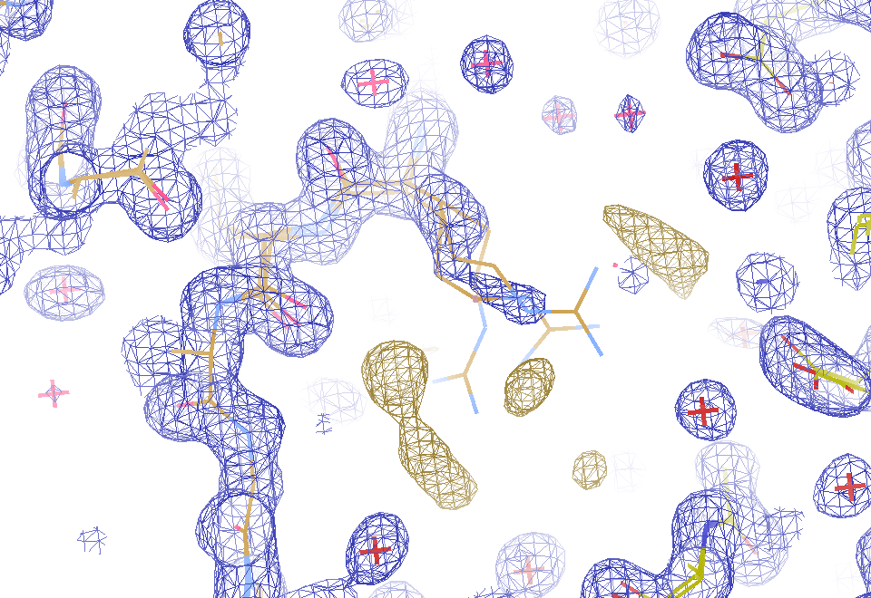
2F_{sim}-F_{calc} and (F_{sim} Φ_{sim}) - (F_{calc} Φ_{calc}) maps
1.0 Å data
R_{cryst}= 0.137
R_{free} = 0.159
1 “sigma” 2F_{sim}-F_{c}
F_{right} – (2F_{sim}-F_{c})

Slide 53
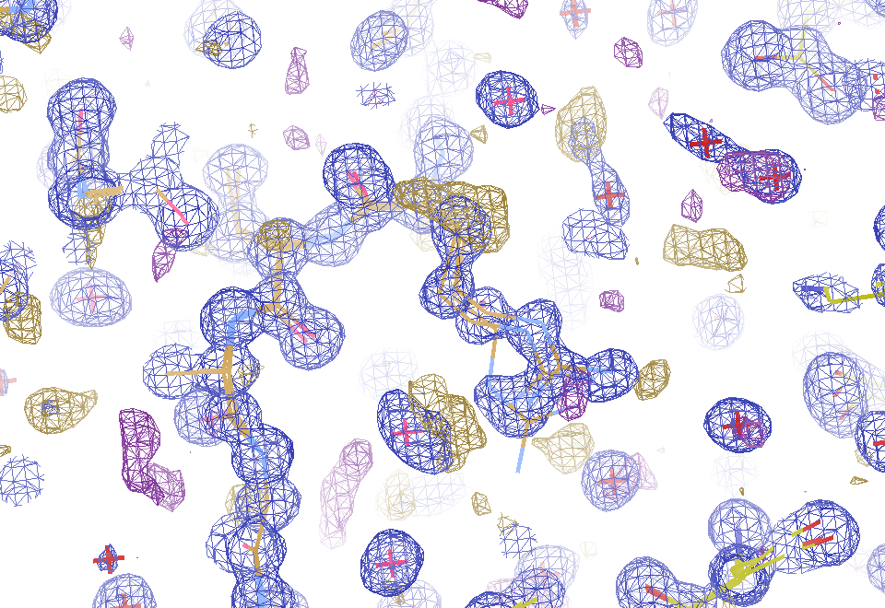
Regular model with real data!
1.0 Å data
R_{cryst}= 0.116
R_{free} = 0.135
1 “sigma” 2F_{sim}-F_{c}
2.5 “sigma” F_{sim}-F_{c}

Slide 54
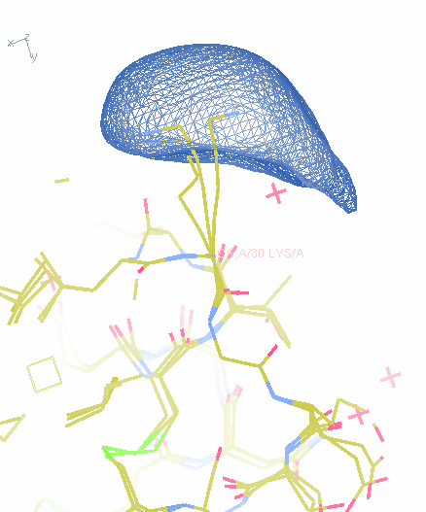
MD: predicted density for one atom

Slide 55
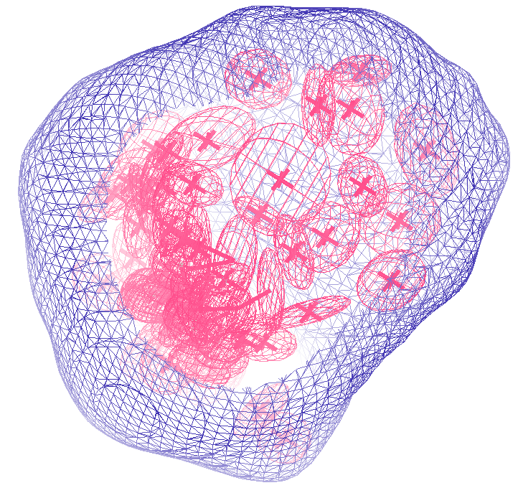
How many conformers are there?
Answer: 40
R_{cryst} = 0.0506
R_{free} = 0.0556
vs F_{sim}

Slide 56
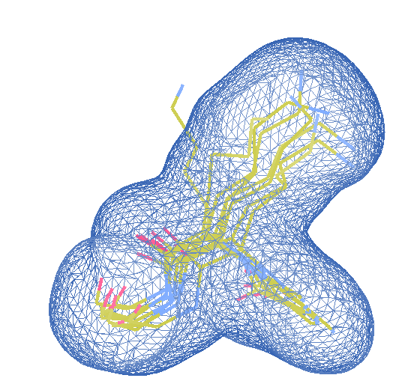
How many conformers are there?
Answer: 8
R_{cryst} = 0.0297
R_{free} = 0.0293
vs F_{sim}

Slide 57
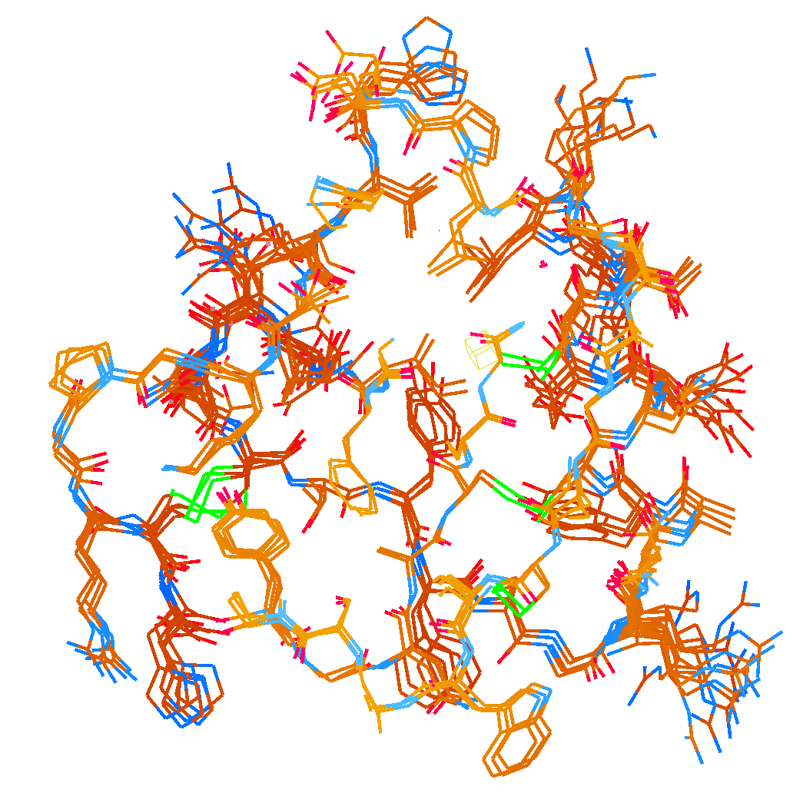
How many conformers are there?
Answer: 2-14
R_{cryst} = 0.0441
R_{free} = 0.0516
vs F_{sim}

Slide 58
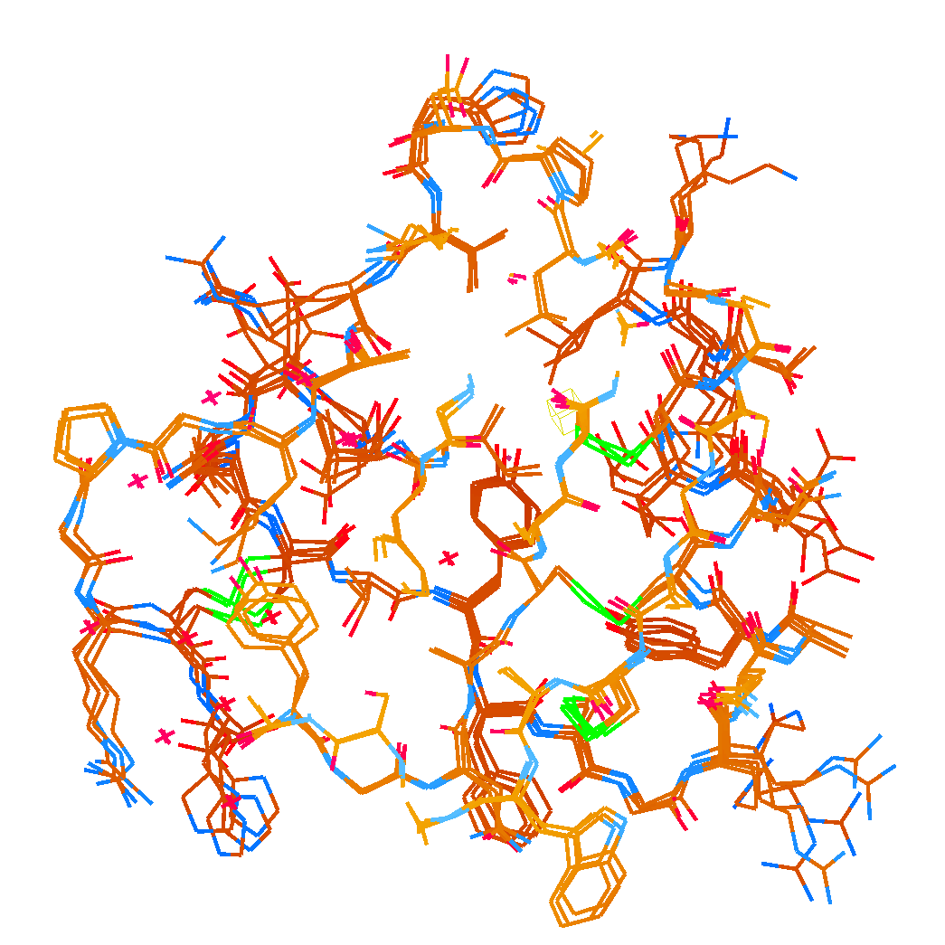
How many conformers are there?
Answer: 1-7
R_{cryst} = 0.1546
R_{free} = 0.1749
vs F_{obs}
1aho:
R_{cryst} = 0.1630
R_{free} = n/d

Slide 59
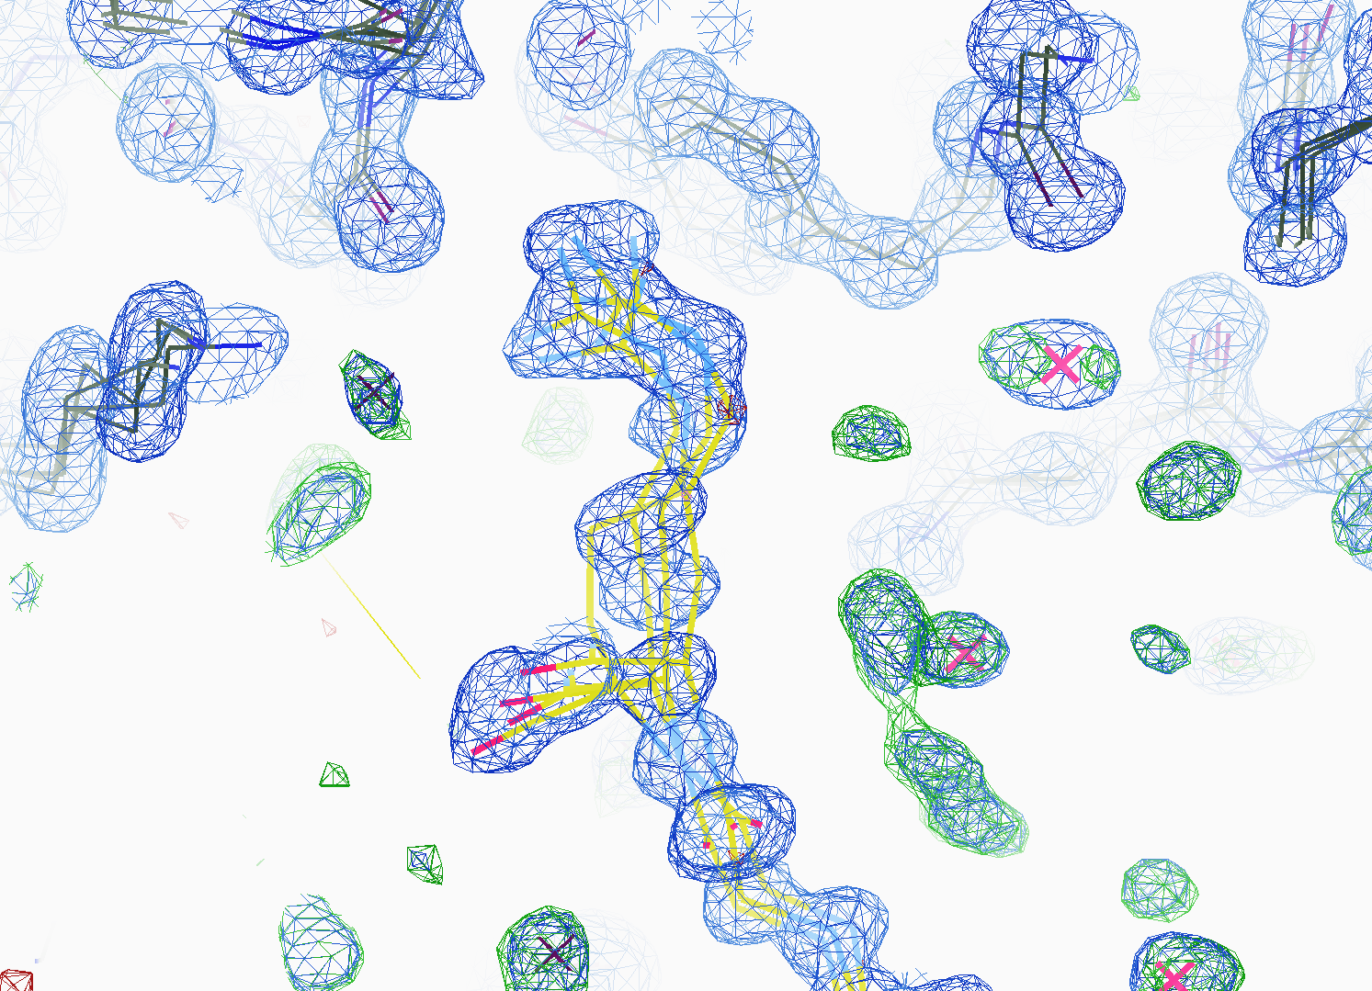
How many conformers are there?
All difference
features
are in
the solvent!
real data

Slide 60

How “rough” is the solvent?
R_{cryst} = 0.0309
R_{free} = 0.0678
vs F_{sim}

Slide 61
Grand Challenges in Structural Biology
Phase Problem
“true” multiplicity
optimum size
SINBAD for non-isomorphism?
Amplitude Problem
Disorder trumps everything
Revolution in sample handling?
R-factor Gap
2D data vs 4D models?
http://bl831.als.lbl.gov/~jamesh/powerpoint/SLAC_LCLS2_2015.pptx

Slide 62
What good are low energies?
Carbon 284
Nitrogen 402
Oxygen 537
Fluorine 685
Neon 866
Sodium 1072
Magnesium 1304
Aluminum 1559
Silicon 1838
Phosphorous 2148
Sulfur 2475
Chlorine 2825
Argon 3205
Potassium 3610
Calcium 4041
Scandium 4495

Slide 63
140-fold multiplicity
16 crystals, 360° each, inverse beam, 7235 eV AS MX1
SUBSET OF INTENSITY DATA WITH SIGNAL/NOISE >= -3.0 AS FUNCTION OF RESOLUTION
RESOLUTION NUMBER OF REFLECTIONS COMPLETENESS R-FACTOR R-FACTOR COMPARED I/SIGMA R-meas CC(1/2) Anomal SigAno Nano
LIMIT OBSERVED UNIQUE POSSIBLE OF DATA observed expected Corr
9.17 188919 1061 1071 99.1% 3.9% 4.8% 188919 257.47 3.9% 100.0* 91* 5.024 450
6.49 356827 1933 1933 100.0% 5.2% 5.5% 356827 214.33 5.2% 100.0* 86* 3.836 882
5.30 466503 2515 2515 100.0% 7.2% 7.0% 466503 165.13 7.2% 100.0* 76* 3.257 1175
4.59 548405 2974 2974 100.0% 7.2% 6.6% 548405 175.42 7.3% 100.0* 67* 2.589 1403
4.10 615117 3353 3355 99.9% 7.7% 6.7% 615117 174.13 7.7% 100.0* 59* 2.264 1594
3.74 684947 3734 3737 99.9% 9.4% 8.3% 684947 143.09 9.4% 100.0* 49* 1.953 1783
3.47 743557 4051 4051 100.0% 11.2% 10.1% 743557 120.17 11.2% 100.0* 39* 1.696 1942
3.24 799722 4366 4366 100.0% 14.1% 13.9% 799722 91.14 14.1% 100.0* 30* 1.333 2103
3.06 839252 4598 4603 99.9% 19.5% 20.2% 839252 65.79 19.5% 100.0* 23* 1.117 2214
2.90 891398 4904 4908 99.9% 29.0% 31.7% 891398 44.85 29.1% 99.9* 17* 1.008 2369
2.77 931622 5148 5151 99.9% 40.5% 44.8% 931622 32.58 40.6% 99.8* 11* 0.901 2493
2.65 969629 5384 5387 99.9% 52.8% 58.8% 969629 25.16 52.9% 99.8* 10* 0.866 2605
2.54 997213 5574 5574 100.0% 67.4% 76.0% 997213 19.47 67.6% 99.6* 2 0.804 2705
2.45 1031222 5889 5889 100.0% 88.9% 101.2% 1031222 14.58 89.2% 99.2* 4 0.831 2859
2.37 788617 6008 6008 100.0% 109.3% 125.5% 788617 9.97 109.7% 98.1* 5 0.829 2925
2.29 614145 6252 6252 100.0% 138.2% 161.4% 614145 6.87 138.9% 96.1* 1 0.760 3037
2.22 470283 6481 6481 100.0% 197.1% 231.7% 470283 4.03 198.6% 83.5* -1 0.721 3159
2.16 259836 6629 6631 100.0% 227.3% 268.7% 259831 2.41 230.8% 46.9* -1 0.677 3224
2.10 36259 4169 6807 61.2% 154.4% 169.4% 36229 1.28 163.6% 47.0* -2 0.660 1999
2.05 13567 3372 7037 47.9% 170.1% 187.0% 13503 0.68 196.5% 25.7* 3 0.629 1578
total 12247040 88395 94730 93.3% 15.7% 16.4% 12246941 54.30 15.8% 100.0* 12* 1.217 42499

Slide 64
140-fold multiplicity: 16 crystals, 360° each, inverse beam, 7235 eV
RESOLUTION COMPLETENESS R-FACTOR I/SIGMA R-meas CC(1/2) Anomal SigAno Nano
LIMIT OF DATA observed Corr
9.17 99.1% 3.9% 257.47 3.9% 100.0* 91* 5.024 450
6.49 100.0% 5.2% 214.33 5.2% 100.0* 86* 3.836 882
5.30 100.0% 7.2% 165.13 7.2% 100.0* 76* 3.257 1175
4.59 100.0% 7.2% 175.42 7.3% 100.0* 67* 2.589 1403
4.10 99.9% 7.7% 174.13 7.7% 100.0* 59* 2.264 1594
3.74 99.9% 9.4% 143.09 9.4% 100.0* 49* 1.953 1783
3.47 100.0% 11.2% 120.17 11.2% 100.0* 39* 1.696 1942
3.24 100.0% 14.1% 91.14 14.1% 100.0* 30* 1.333 2103
3.06 99.9% 19.5% 65.79 19.5% 100.0* 23* 1.117 2214
2.90 99.9% 29.0% 44.85 29.1% 99.9* 17* 1.008 2369
2.77 99.9% 40.5% 32.58 40.6% 99.8* 11* 0.901 2493
2.65 99.9% 52.8% 25.16 52.9% 99.8* 10* 0.866 2605
2.54 100.0% 67.4% 19.47 67.6% 99.6* 2 0.804 2705
2.45 100.0% 88.9% 14.58 89.2% 99.2* 4 0.831 2859
2.37 100.0% 109.3% 9.97 109.7% 98.1* 5 0.829 2925
2.29 100.0% 138.2% 6.87 138.9% 96.1* 1 0.760 3037
2.22 100.0% 197.1% 4.03 198.6% 83.5* -1 0.721 3159
2.16 100.0% 227.3% 2.41 230.8% 46.9* -1 0.677 3224
2.10 61.2% 154.4% 1.28 163.6% 47.0* -2 0.660 1999
2.05 47.9% 170.1% 0.68 196.5% 25.7* 3 0.629 1578
total 93.3% 15.7% 54.30 15.8% 100.0* 12* 1.217 42499

Slide 65

140-fold multiplicity
18 σ
16 σ
Phased anomalous difference Fourier
data Courtesy of Tom & Janet

Slide 66

140-fold multiplicity
15σ = PO₄
Phased anomalous difference Fourier
data Courtesy of Tom & Janet

Slide 67

140-fold multiplicity
~2σ = Mg?
Phased anomalous difference Fourier
data Courtesy of Tom & Janet

Slide 68

140-fold multiplicity
8.2σ = Mg?
DELFAN residual anomalous difference
data Courtesy of Tom & Janet

Slide 69
Discerning Na⁺ from Mg⁺⁺
DELFAN peak height (σ)
N
O
F
Ne
Na
Mg
f’’ (electrons)

Slide 70
The Tool: LSLS II vs LCLS
Higher rep rate: 5 kHz vs 120 Hz
Coherent power:
200 W X-rays max
1 MHz with lower power
Self-seeding at lower energy -
Lower energy < 200eV - 5 keV vs 9.5 keV
Lower enerfy/pulse
Higher energy up to 25 keV
More stable beam 10x

Slide 71
Molecular Dynamics Simulation
using real
crystal’s lattice
1aho
Scorpion toxin
0.96 Å resolution
64 residues
Solvent: H₂0 + acetate
Cerutti et al. (2010).J. Phys. Chem. B 114, 12811-12824.

Slide 72
30 conformers from 24,000

Slide 73
Electron density from 24,000 conformers

Slide 74
Electron density from 24,000 conformers

Slide 75
2F_{sim}-F_{calc} and F_{sim}-F_{calc} maps
1.0 Å data
R_{cryst}= 0.137
R_{free} = 0.159
1 “sigma” 2F_{sim}-F_{c}
2.5 “sigma” F_{sim}-F_{c}

Slide 76
2F_{sim}-F_{calc} and (F_{sim} Φ_{sim}) - (F_{calc} Φ_{calc}) maps
1.0 Å data
R_{cryst}= 0.137
R_{free} = 0.159
1 “sigma” 2F_{sim}-F_{c}
F_{right} – (2F_{sim}-F_{c})

Slide 77
Regular model with real data!
1.0 Å data
R_{cryst}= 0.116
R_{free} = 0.135
1 “sigma” 2F_{sim}-F_{c}
2.5 “sigma” F_{sim}-F_{c}

Slide 78
Darwin’s Formula
V_{xtal}
λ³ L
I(hkl) = I_{beam} r_{e}²
P A | F(hkl) |²
V_{cell}
ωV_{cell}
I(hkl) - photons/spot (fully-recorded)
I_{beam} - incident (photons/s/m² )
r_{e} - classical electron radius (2.818x10⁻¹⁵ m)
V_{xtal} - volume of crystal (in m³)
V_{cell} - volume of unit cell (in m³)
λ - x-ray wavelength (in meters!)
ω - rotation speed (radians/s)
L - Lorentz factor (speed/speed)
P - polarization factor
(1+cos²(2θ) -Pfac∙cos(2Φ)sin²(2θ))/2
A - attenuation correction
exp(-μ_{xtal}∙l_{path})
F(hkl) - structure amplitude (electrons)
C. G. Darwin (1914)

Slide 79
Darwin’s Formula
V_{xtal}
λ³ L
I(hkl) = I_{beam} r_{e}²
P A | F(hkl) |²
V_{cell}
ωV_{cell}
I(hkl) - photons/spot (fully-recorded)
I_{beam} - incident (photons/s/m² )
r_{e} - classical electron radius (2.818x10⁻¹⁵ m)
V_{xtal} - volume of crystal (in m³)
V_{cell} - volume of unit cell (in m³)
λ - x-ray wavelength (in meters!)
ω - rotation speed (radians/s)
L - Lorentz factor (speed/speed)
P - polarization factor
(1+cos²(2θ) -Pfac∙cos(2Φ)sin²(2θ))/2
A - attenuation correction
exp(-μ_{xtal}∙l_{path})
F(hkl) - structure amplitude (electrons)
C. G. Darwin (1914)

Slide 80
Greenhough-Helliwell Formula
ΔΦ = L sin2θ (2η + Δλ/λ tanθ)
+ ((L²sin²2θ - 1)γ_{H}² + γ_{V}²)^{1/2}
ΔΦ - reflecting range (radians)
2η - mosaic spread (radians)
L - Lorentz factor (speed/speed)
θ - Bragg angle
λ - x-ray wavelength
Δλ - wavelength spread
γ_{HV} - horizontal and vertical
beam divergence (radians)
Greenhough & Helliwell (1983)

Slide 81
Greenhough-Helliwell Formula
ΔΦ = L sin2θ (2η + Δλ/λ tanθ)
+ ((L²sin²2θ - 1)γ_{H}² + γ_{V}²)^{1/2}
ΔΦ - reflecting range (radians)
2η - mosaic spread (radians)
L - Lorentz factor (speed/speed)
θ - Bragg angle
λ - x-ray wavelength
Δλ - wavelength spread
γ_{HV} - horizontal and vertical
beam divergence (radians)
Greenhough & Helliwell (1983)

Slide 82
Darwin’s Formula
V_{xtal}
λ³ L
I(hkl) = I_{beam} r_{e}²
P A | F(hkl) |²
V_{cell}
ωV_{cell}
I(hkl) - photons/spot (fully-recorded)
I_{beam} - incident (photons/s/m² )
r_{e} - classical electron radius (2.818x10⁻¹⁵ m)
V_{xtal} - volume of crystal (in m³)
V_{cell} - volume of unit cell (in m³)
λ - x-ray wavelength (in meters!)
ω - rotation speed (radians/s)
L - Lorentz factor (speed/speed)
P - polarization factor
(1+cos²(2θ) -Pfac∙cos(2Φ)sin²(2θ))/2
A - attenuation correction
exp(-μ_{xtal}∙l_{path})
F(hkl) - structure amplitude (electrons)
C. G. Darwin (1914)

Slide 83
The “nanocrystal advantage”
2
I_{spot} = k N_{cells}
Ewald sphere
range

Slide 84
Fraunhofer’s Formula
sin(πN·hkl)
2
I_{pixel} = I_{beam} r_{e}² Ω
P A | F(hkl) |²
sin(π·hkl)
I_{pixel} - photons/pixel/s
I_{beam} - incident (photons/s/m² )
r_{e} - classical electron radius (2.818x10⁻¹⁵ m)
hkl - index of pixel (a·(u_{p}+u_{s})/λ)
a - orientation (recip. cell vectors)
u_{p},u_{s} - unit vector pointing at pixel,source
λ - x-ray wavelength (in meters!)
N - number of cells (each direction)
Ω - solid angle of pixel (steradian)
P - polarization factor
(1+cos²(2θ) -Pfac∙cos(2Φ)sin²(2θ))/2
A - attenuation correction
exp(-μ_{xtal}∙l_{path})
F(hkl) - structure amplitude (electrons)
see: Kirian et al. (2010)

Slide 85

fastBragg
http://bl831.als.lbl.gov/~jamesh/fastBragg/
sin(πN·hkl)
I_{pixel} = I_{beam} r_{e}² Ω
P A | F(hkl) |²
sin(π·hkl)

Slide 86


Bragg, James & Bosanquet (1921). Philos. Mag. Ser. 6, 41, 309–337.

Slide 87
What is “partiality”?
Ewald sphere

Slide 88
What is “partiality”?
Ewald sphere

Slide 89

nearBragg program
http://bl831.als.lbl.gov/~jamesh/nearBragg/
“assumption-free” total scattering
no Fourier Transform
no unit cells
no “mosaicity”
arbitrary “atoms”
arbitrary “source”
coherent or not

Slide 90

square

Slide 91

round

Slide 92
Classes of error in MX
Dependence on signal
none sqrt proportional
CCD
Read-out
Photon
counting
Detector calibration
attenuation
partiality
Non-isomorphism
Radiation damage
none
1/sqrt
1/prop.
Time
Beam flicker
Shutter jitter
Sample vibration

Slide 93

scattering from a crystal structure
False color intensity
sample
detector

Slide 94

scattering from a crystal structure
False color intensity
sample
detector

Slide 95

scattering from a crystal structure
False color intensity
sample
detector

Slide 96
Classes of error in MX
Dependence on signal
none sqrt proportional
CCD
Read-out
Photon
counting
Detector calibration
attenuation
partiality
Non-isomorphism
Radiation damage
none
1/sqrt
1/prop.
Time
Beam flicker
Shutter jitter
Sample vibration

