Slide 1
Untangling models
for less noisy maps

Slide 2
Why is a beamline scientist working on refinement things?
Because: the future of crystallography has alternate conformations
Single-conf models
poor resolution
Low signal/noise
Phase Problem
Dynamics?
Mechanism?
Small signal?
Overlapping states?

Slide 3
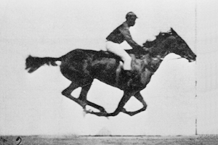
Muybridge’s galloping horse (1872)

Slide 4
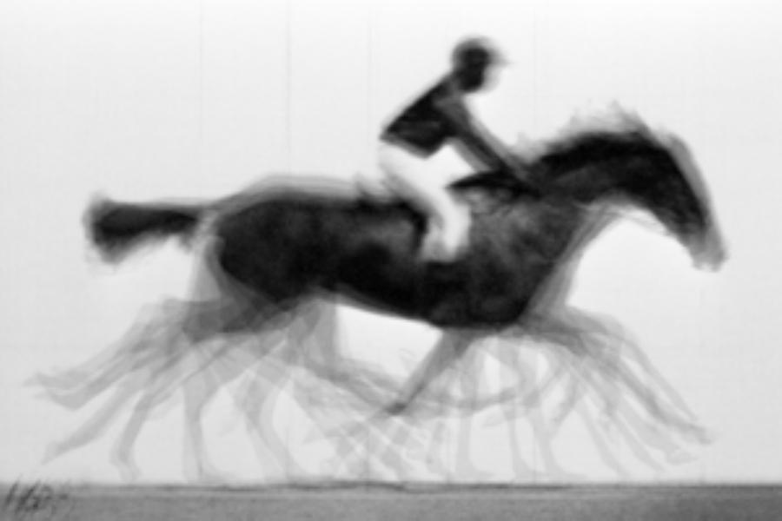
average structure: galloping horse

Slide 5
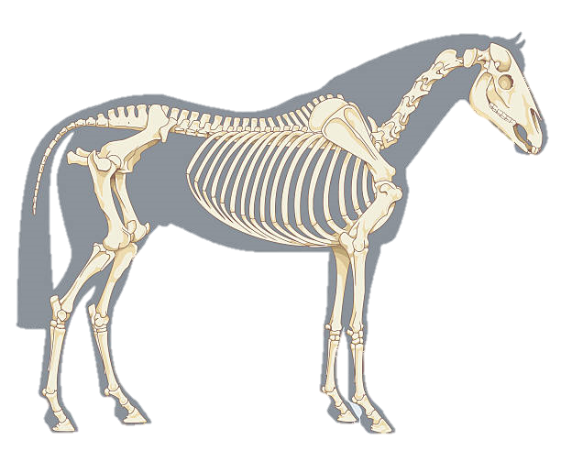
Horses have bones
+/- 0.01

Slide 6
Horses have bones

Slide 7
Muybridge’s galloping horse 0

Slide 8
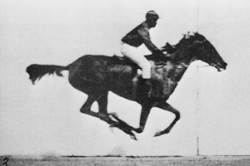
Muybridge’s galloping horse 1

Slide 9
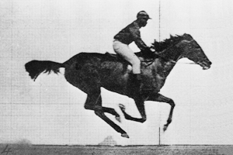
Muybridge’s galloping horse 2

Slide 10
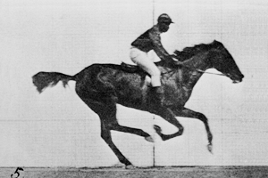
Muybridge’s galloping horse 3

Slide 11
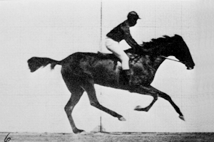
Muybridge’s galloping horse 4

Slide 12
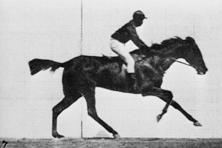
Muybridge’s galloping horse 5

Slide 13
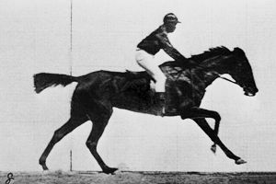
Muybridge’s galloping horse 6

Slide 14
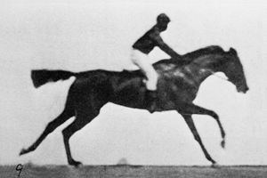
Muybridge’s galloping horse 7

Slide 15
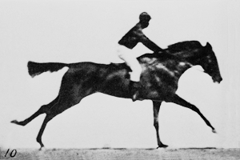
Muybridge’s galloping horse 8

Slide 16
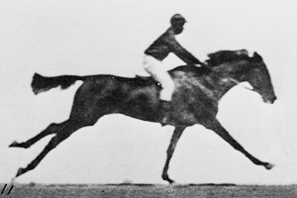
Muybridge’s galloping horse 9

Slide 17
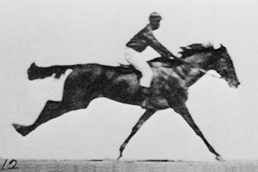
Muybridge’s galloping horse 10

Slide 18
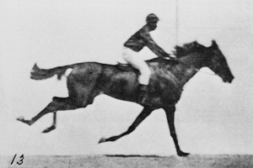
Muybridge’s galloping horse 11

Slide 19
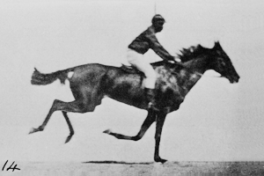
Muybridge’s galloping horse 12

Slide 20
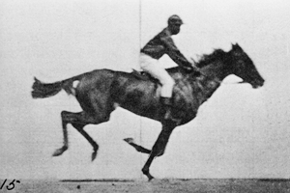
Muybridge’s galloping horse 13

Slide 21
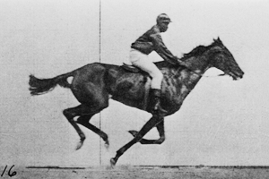
Muybridge’s galloping horse 14

Slide 22
ensemble refine ???

Slide 23
R_{work}: 0.0823
R_{free}: 0.1106
bond: 0.014 Å
angle: 1.92°
Real Data
1.2 σ
MoPro: 1.15
Clash: 0.49
Cβdev: 20
Rota: 1.7%
Rama: 0.03%
reso: 1.0 Å
6σ

Slide 24
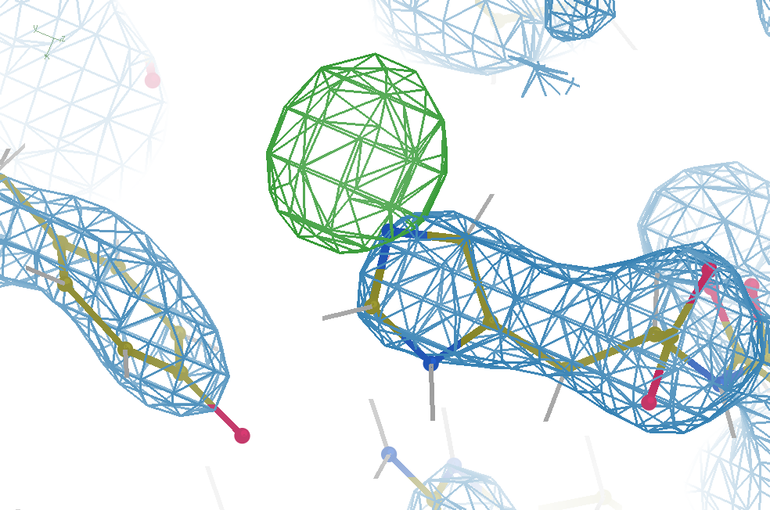
Hydrogen: visible at 3.5 Å resolution!
R_{work} = 0.04
R_{free} = 0.05
6σ = 1 e⁻
Simulation:
Realistic noise
“perfect” model

Slide 25
Model building: real vs sim data
multi
single
single
single
multi
multi
multi
single
Holton et al. (2014) "The R-factor gap", FEBS J. 281, 4046-4060.

Slide 26
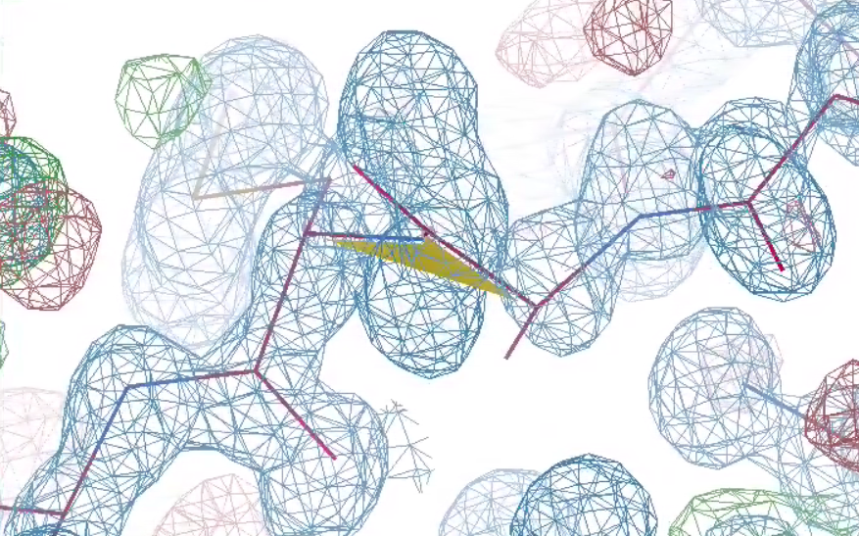
Why does ensemble refinement suck?
48-copy ensemble
3 parameters
per observation!
30°
peptide
bond twist

Slide 27
Fitting data
structure factor (F)
spot index (h)

Slide 28
Fitting data
structure factor (F)
spot index (h)

Slide 29
Fitting data
structure factor (F)
spot index (h)

Slide 30
Over-Fitting data
structure factor (F)
spot index (h)

Slide 31
Under-Fitting data
structure factor (F)
spot index (h)

Slide 32
R_{work}: 0.0823
R_{free}: 0.1106
bond: 0.014 Å
angle: 1.92°
under-fitting:
R_{work} > 0
MoPro: 1.15
Clash: 0.49
Cβdev: 20
Rota: 1.7%
Rama: 0.03%
reso: 1.0 Å
6σ

Slide 33
Why does ensemble refinement suck? (3 parameters/observation and R_{work} still high!)
The chains are “tangled”

Slide 34
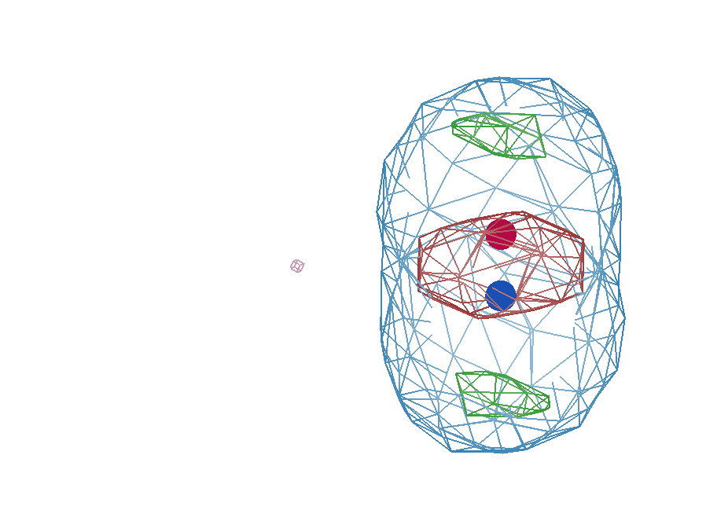
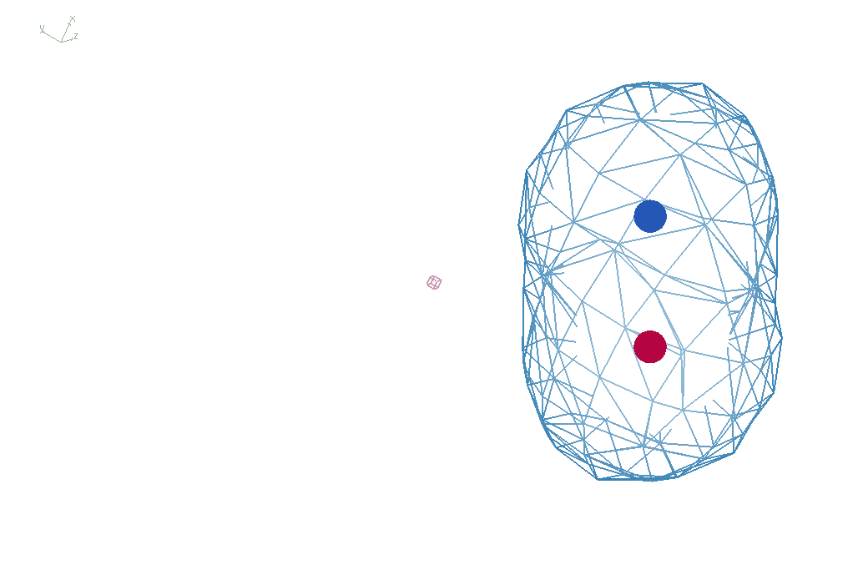
E_{xray}
A
A
B
B
B
A

Slide 35
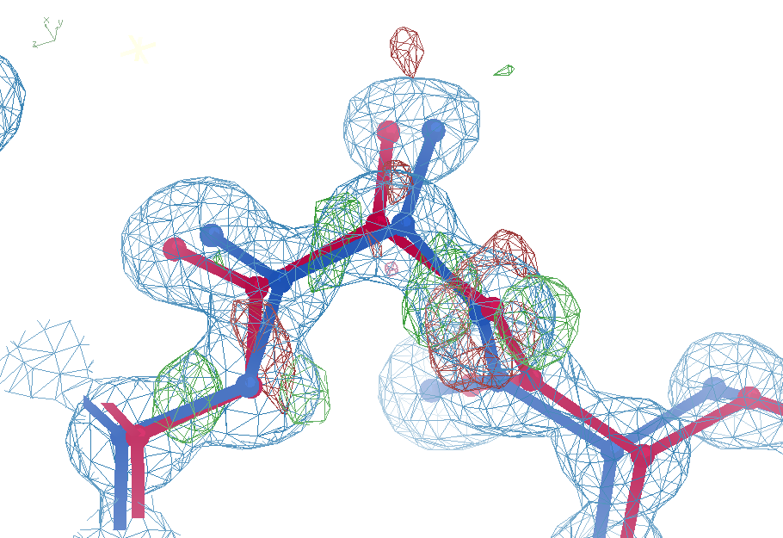
Ala39
+11σ
wE=63.5
N-C_{α}
bond
-9σ
5σ
angle
A B conformers

Slide 36
Ala39
-0.2σ
wE=18.2
N-C_{α}
bond
-0.3σ
0.8σ
angle
A B conformers

Slide 37
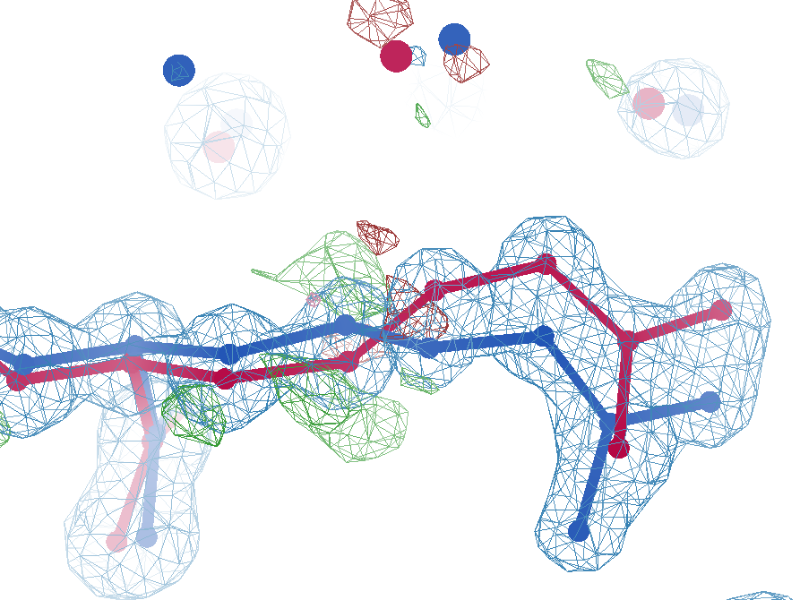
Arg62
wE=63.5
2.8 Å
4σ
C_{γ}-C_{δ}
bond
2.7σ torsion
A B conformers

Slide 38
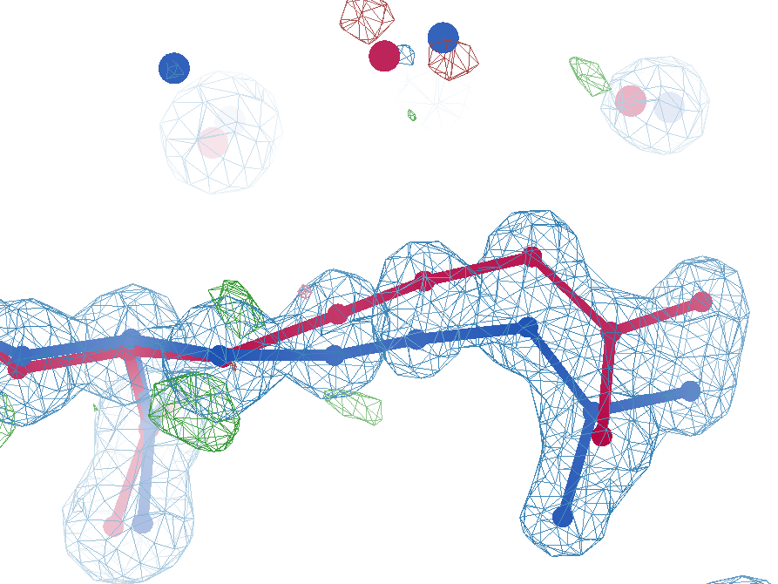
Arg62
wE=50.7
2.8 Å
2σ
angle
A B conformers

Slide 39
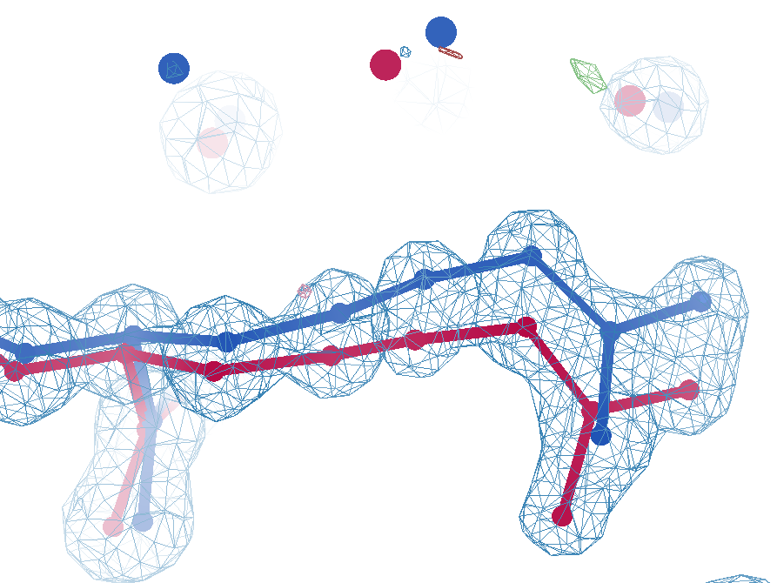
Arg62
wE=18.2
3.0 Å
0.3σ
C_{γ}-C_{δ}
bond
1σ
angle
1.6σ torsion
A B conformers

Slide 40
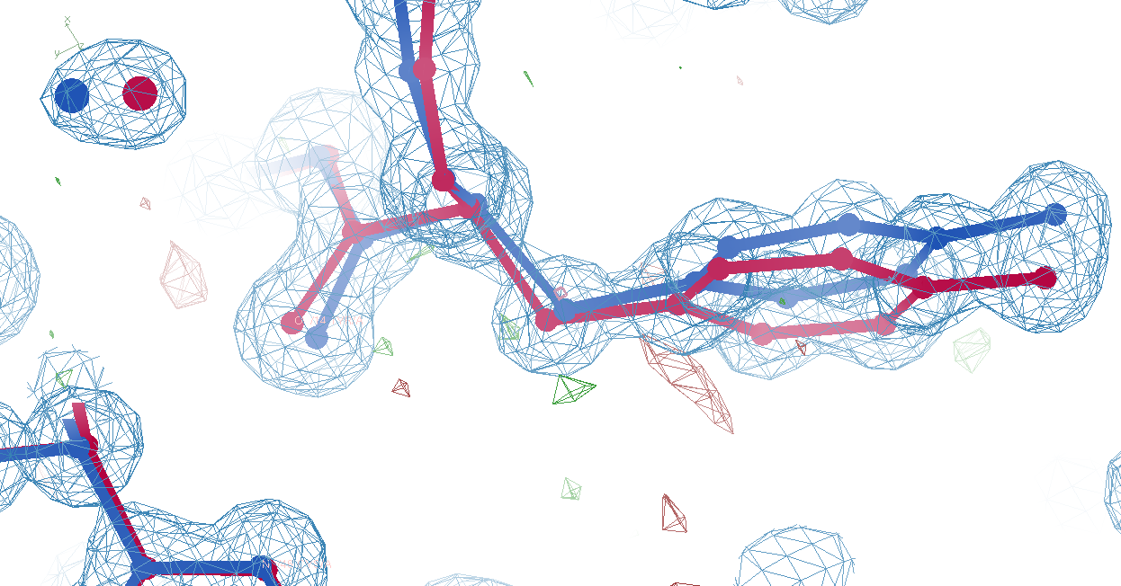
Tyr14
wE=33.1
3.0 Å
A B conformers

Slide 41
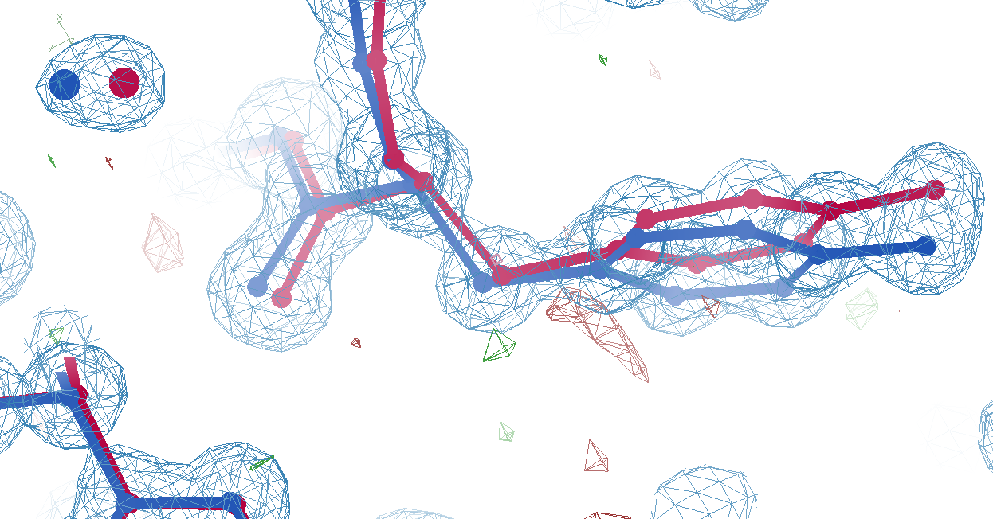
Tyr14
wE=18.2
3.2 Å
A B conformers

Slide 42
The Challenge
best.pdb
refme.mtz
1) Build better than the best:
as-good or better wE, R_{free} as best.pdb
non-equivalent ensemble
2) Recover best.pdb from refme.mtz
true phases, auto-building allowed
no cheating (don’t use best.pdb as guide)
Prove: true ensemble is unique, and can be recovered
$1000
$500

Slide 43
Fake-data Ground Truth
As simple as possible:
2 conformers
50:50 occupancy
Accessible
64 residues
78 waters
Every chance of success
1.0 Å reso
one thing wrong
flat bulk solvent
no false outliers
phenix, refmac, shelxl
clear score
Experimental error only
perfect phases

Slide 44
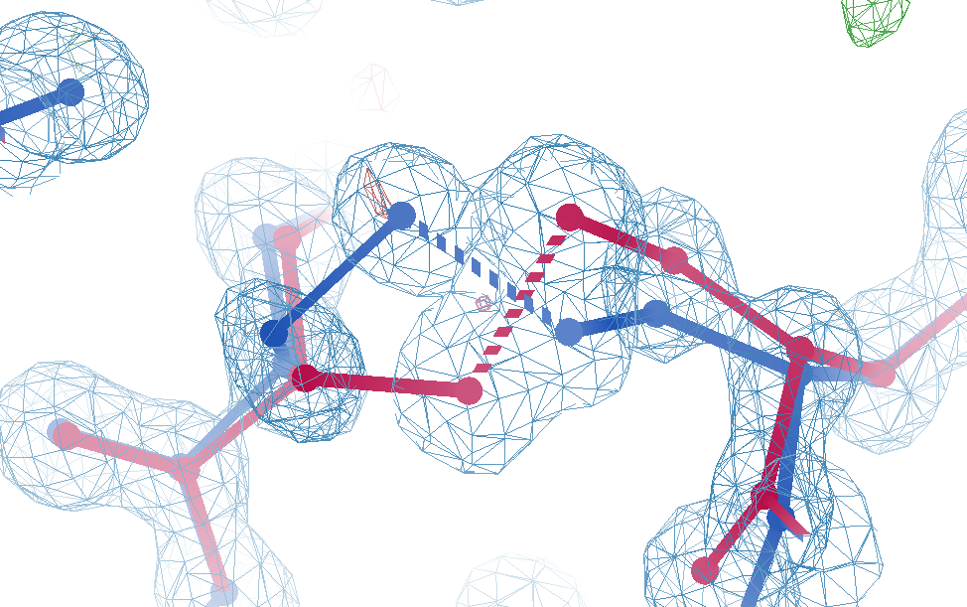
Cys12
real data
-107°
torsion outlier
A B conformers

Slide 45
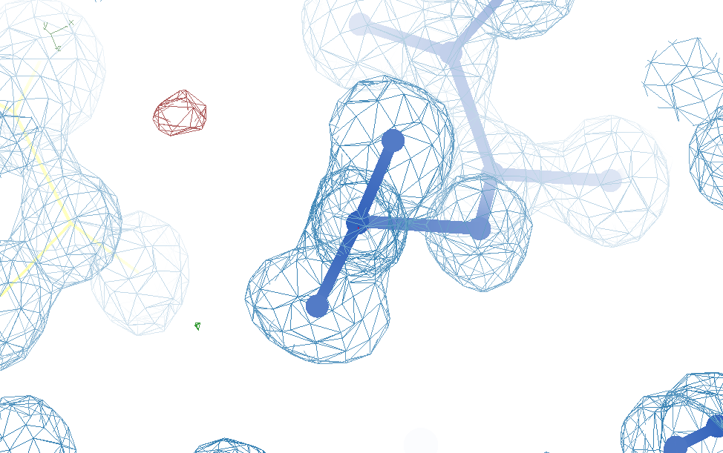
Glu32
real data
-80°
Torsion outlier

Slide 46
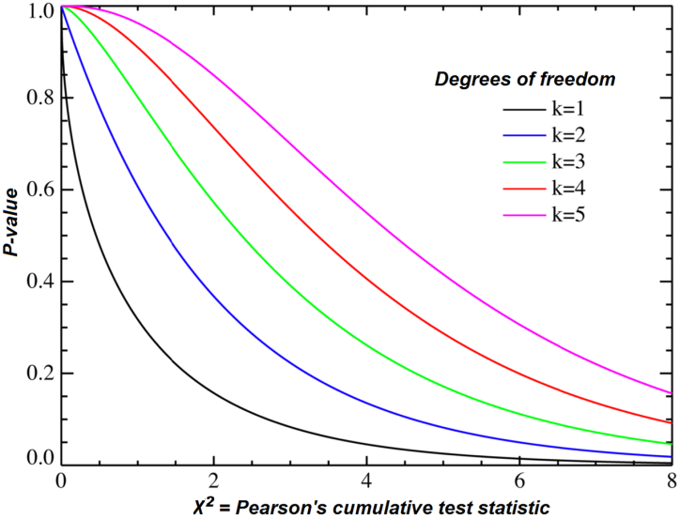
Statistical Potential
$$E={\left(\frac{v−v0}{σ}\right)}^{2}$$
E “energy”
v model value
v₀ ideal value
σ rms deviation expected
1 x 6σ ≈ 36x 1σ
Outlier problem:
solution: weight by
“probability its not noise”
χ² test for average

Slide 47
Sensible scoring function
Statistical potential
bonds, angles, planes, torsions, chiral
Leonard-Jones vdW
non-bond and clashes
Probability -> σ dev
- Rota, rama
Peptide bond
σ → 5°
C_{β}dev
σ = 0.05 Å
4
2
van der Waals
Phenix/refmac
0
Energy
-1
1
2
3
4
5
Atomic separation (Å)

Slide 48
Probability that it’s not noise
$$Pnn={\operatorname{erf}\left(\left|\frac{v−v0}{σ\sqrt{2}}\right|\right)}^{Nthings}$$
P_{nn} probability
v-v₀ deviation from ideal
σ rms deviation expected
erf() integral of a Gaussian
N_{things} number of trials
erf($1.0/\sqrt{2}$) = 68%
${\text{erf}\text{(}1.0/\sqrt{2}\text{)}}^{10}$ = 2%
erf($2.0/\sqrt{2}$) = 95%
${\text{erf}\text{(}2.0/\sqrt{2}\text{)}}^{10}$ = 63%
${\text{erf}\text{(}4.0/\sqrt{2}\text{)}}^{10,000}$ = 53%

Slide 49
weighted Energy scoring function
$$wE=χ^{2}\sum{E}+\text{P}\text{nn}max\left(clip\left(E\right)\right)$$
$$E={\left(\frac{v−v0}{σ}\right)}^{2}$$
10
wE
N=10
max() = worst outlier
5
N=10,000
Sum over all validation types
0
clip(E) $=\left\{\begin{matrix}E, if E<10 \\ 10+\log\left(E\right)−log⁡(10)\end{matrix}\right.$
3
6
8
max sigma deviate

Slide 50
Score sheet
wE | R_{work} | R_{free} | method
109.6 | 8.87 | 9.44 | Phenix.ensemble_refine
97.3 | 8.84 | 9.27 | qFit best
91.7 | 3.64 | 4.27 | manual
80.5 | 4.31 | 4.75 | lotswrong
54.6 | 5.87 | 6.57 | single conf w aniso B
33.5 | 2.94 | 3.32 | One thing wrong: 39
23.5 | 2.95 | 3.31 | One thing wrong: 1
21.4 | 3.12 | 3.48 | Simulated annealing w reversion
18.1 | 17.9 | 18.4 | Phenix autobuild
18.3 | 2.79 | 3.14 | best (ground truth)

Slide 51
wE=18.2

Slide 52
wE=21.4

Slide 53
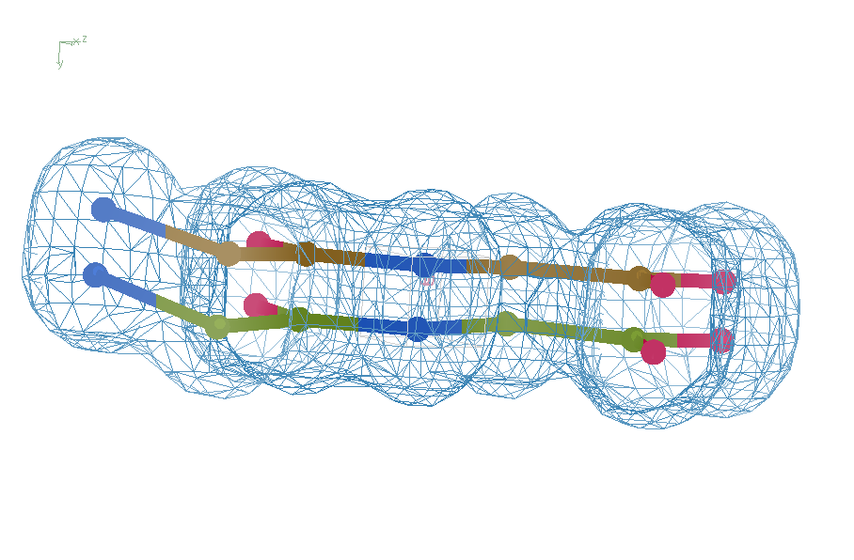
Right answer
R = 0.8%
rms bond = 0.0002

Slide 54
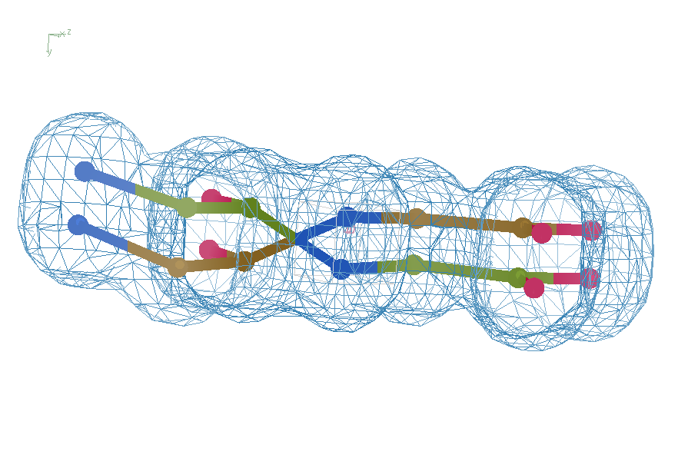
swap assignments
R = 0.8%
rms bond = 0.04

Slide 55
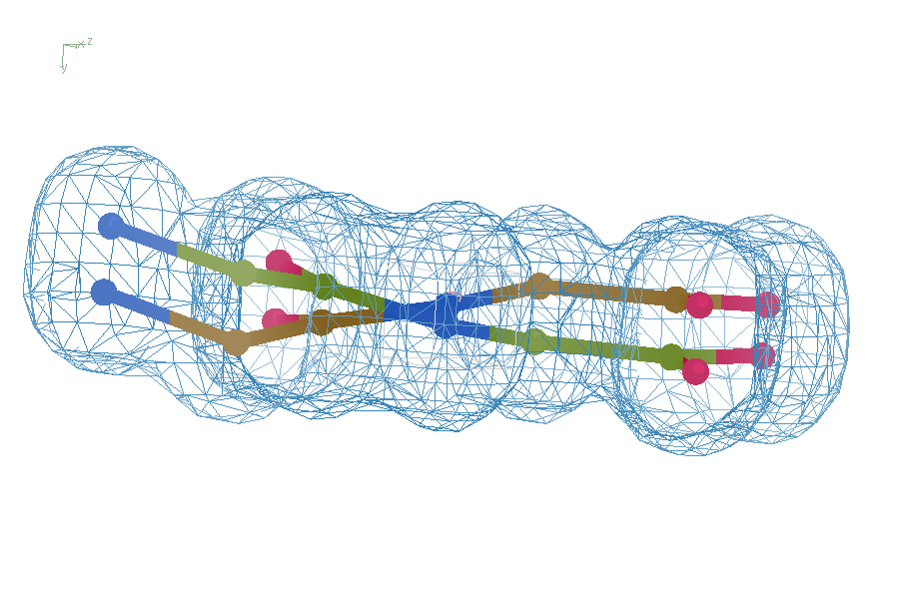
Refine – low x-ray weight
R = 14.3%
rms bond = 0.0002

Slide 56
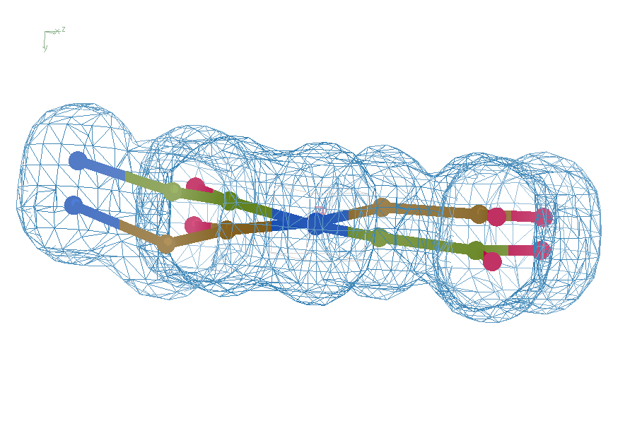
Refine – step 61
R = 6.8%
rms bond = 0.001

Slide 57
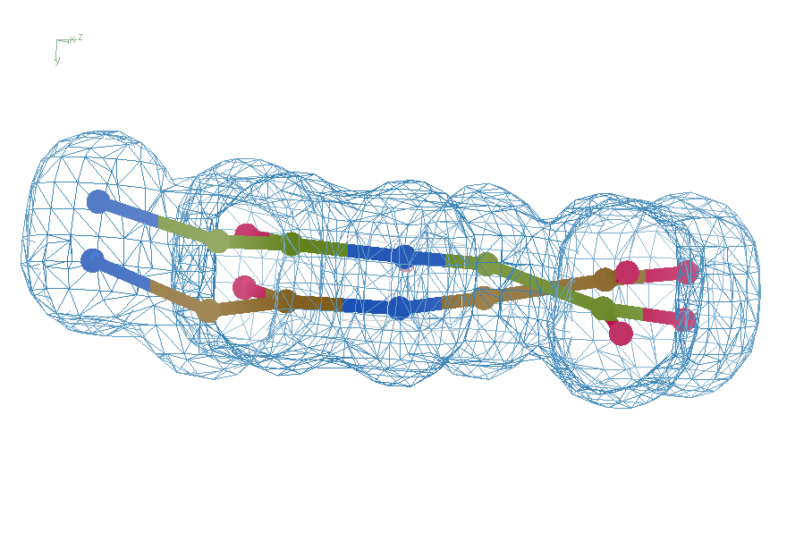
Refine – step 62
R = 5.7%
rms bond = 0.003

Slide 58
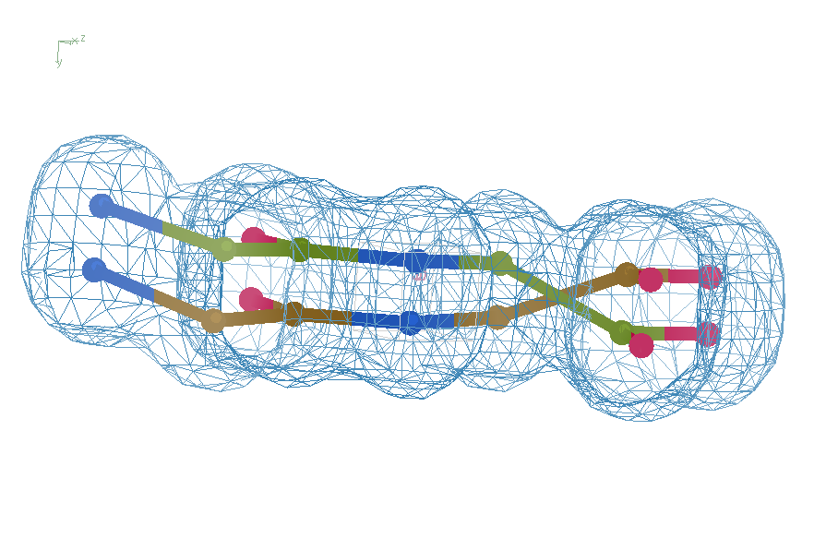
Refine – high x-ray weight
R = 1.2%
rms bond = 0.06

Slide 59
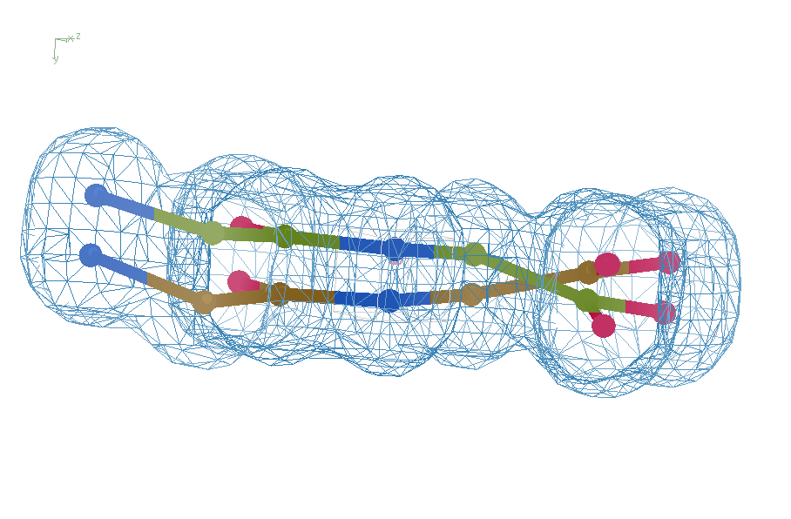
Final compromise
R = 7.07%
rms bond = 0.001

Slide 60
Right answer
R = 0.8%
rms bond = 0.0002

