Slide 1
Acknowledgements
James Fraser Terry Lang Ken Frankel John Tainer
ALS 8.3.1 creator: Tom Alber
8.3.1 PRT head: Jamie Cate
Integrated Diffraction Analysis Technologies (IDAT)
Center for Structure of Membrane Proteins (CSMP)
Membrane Protein Expression Center II (MPEC)
Center for HIV Accessory and Regulatory Complexes (HARC)
W. M. Keck Foundation
Plexxikon, Inc.
M D Anderson CRC
University of California Berkeley
University of California San Francisco
University of California Campus-Laboratory Collaboration Grant
Henry Wheeler
The Advanced Light Source is supported by the Director, Office of Science, Office of Basic Energy Sciences, Materials Sciences Division, of the US Department of Energy under contract No. DE-AC02-05CH11231 at Lawrence Berkeley National Laboratory.

Slide 2
The Future of Structural Biology
10 Å
Disorder? or Dynamics?

Slide 3
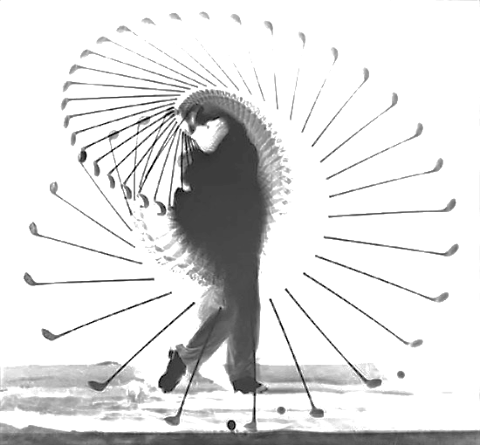
What is the structure of “disorder” ?
a grand challenge for structural biology in the 21st century

Slide 4
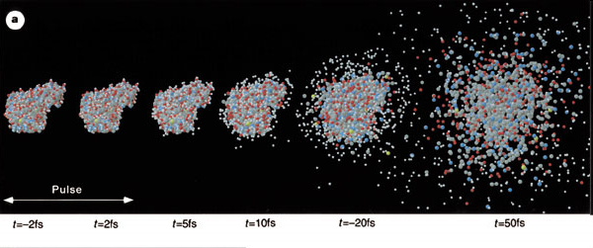
Promise of Single-molecule Imaging
R. Neutze et al., Nature 406, pp. 752-757 (2000)

Slide 5
lysozyme: real and reciprocal

Slide 6
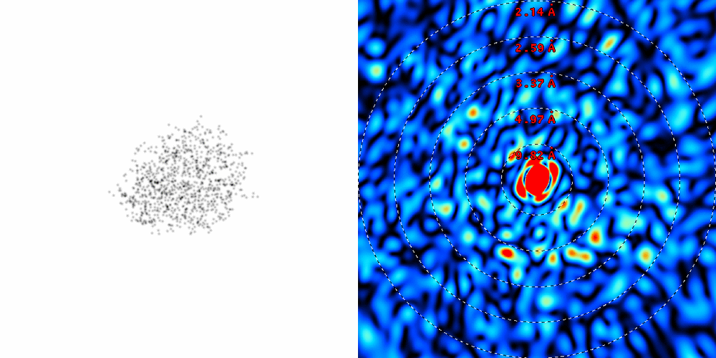
lysozyme: thermal motion
RMS displacement from B factors

Slide 7
The Future of Structural Biology
Problem:
XFELs
cannot solve the
“resolution problem”

Slide 8
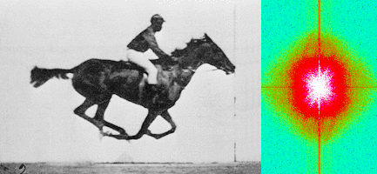
Muybridge’s galloping horse (1878)
“Time-resolved” diffraction
Real space
reciprocal

Slide 9
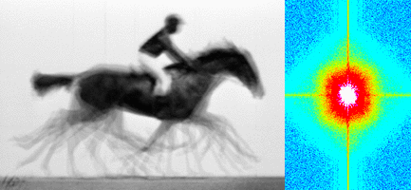
Muybridge’s galloping horse (1878)
Average electron density
Real space
reciprocal

Slide 10
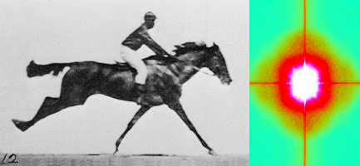
Muybridge’s galloping horse (1878)
Diffract and Destroy
Real space
reciprocal

Slide 11
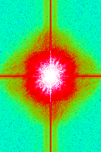
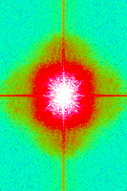
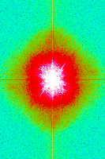
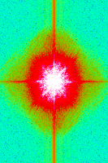
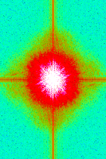
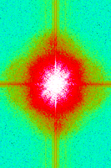
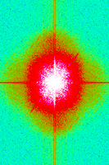
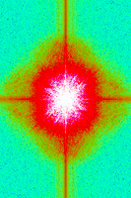
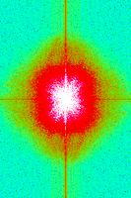
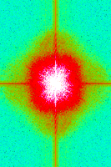
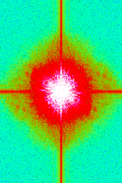
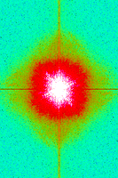
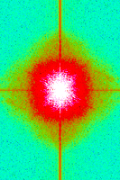
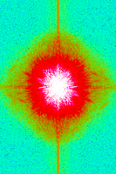
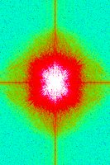
Supporting a model with data

Slide 12
What can we do now?
Make the molecule sit still

Slide 13
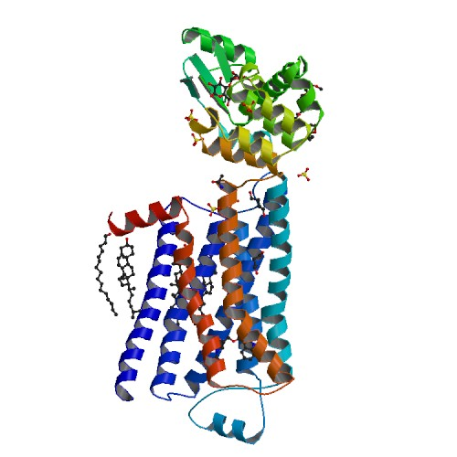
Make the molecule sit still
20 years of biochemistry
How long to find this in a random search?
Biophysical assays for rigidity?
What about function?
What if function and “disorder” are the same thing?

Slide 14
Disorder? or Dynamics?
Beernink, Endrizzi, Alber & Schachman (1999). PNAS USA 96, 5388-5393.

Slide 15
What can we do now?
Make the molecule sit still
Preserve sample integrity

Slide 16
Non-isomorphism in lysozyme
RMSD = 0.18 Å
R_{iso} = 44.5%

Slide 17
Non-isomorphism in lysozyme
Dear James
The story of the two forms of lysozyme crystals goes back to about 1964 when it was found that the diffraction patterns from different crystals could be placed in one of two classes depending on their intensities. This discovery was a big set back at the time and I can remember a lecture title being changed from the 'The structure of lysozyme' to 'The structure of lysozyme two steps forward and one step back'. Thereafter the crystals were screened based on intensities of the (11,11,l) rows to distinguish them (e.g. 11,11,4 > 11,11,5 in one form and vice versa in another). Data were collected only for those that fulfilled the Type II criteria. (These reflections were easy to measure on the linear diffractometer because crystals were mounted to rotate about the diagonal axis). As I recall both Type I and Type II could be found in the same crystallisation batch . Although sometimes the external morphology allowed recognition this was not infallible.
The structure was based on Type II crystals. Later a graduate student Helen Handoll examined Type I. The work, which was in the early days and before refinement programmes, seemed to suggest that the differences lay in the arrangement of water or chloride molecules (Lysozyme was crystallised from NaCl). But the work was never written up. Keith Wilson at one stage was following this up as lysozyme was being used to test data collection strategies but I do not know the outcome.
An account of this is given in International Table Volume F (Rossmann and Arnold edited 2001) p760.
Tony North was much involved in sorting this out and if you wanted more info he would be the person to contact. I hope this is helpful. Do let me know if you need more.
Best wishes
Louise

Slide 18
Non-isomorphism in lysozyme
Dear James
The story of the two forms of lysozyme crystals goes back to about 1964 when it was found that the diffraction patterns from different crystals could be placed in one of two classes depending on their intensities. This discovery was a big set back at the time and I can remember a lecture title being changed from the 'The structure of lysozyme' to 'The structure of lysozyme two steps forward and one step back'. Thereafter the crystals were screened based on intensities of the (11,11,l) rows to distinguish them (e.g. 11,11,4 > 11,11,5 in one form and vice versa in another). Data were collected only for those that fulfilled the Type II criteria. (These reflections were easy to measure on the linear diffractometer because crystals were mounted to rotate about the diagonal axis). As I recall both Type I and Type II could be found in the same crystallisation batch . Although sometimes the external morphology allowed recognition this was not infallible.
The structure was based on Type II crystals. Later a graduate student Helen Handoll examined Type I. The work, which was in the early days and before refinement programmes, seemed to suggest that the differences lay in the arrangement of water or chloride molecules (Lysozyme was crystallised from NaCl). But the work was never written up. Keith Wilson at one stage was following this up as lysozyme was being used to test data collection strategies but I do not know the outcome.
An account of this is given in International Table Volume F (Rossmann and Arnold edited 2001) p760.
Tony North was much involved in sorting this out and if you wanted more info he would be the person to contact. I hope this is helpful. Do let me know if you need more.
Best wishes
Louise

Slide 19
Non-isomorphism in lysozyme
Structure factor (e⁻)
Johnson’s ratio

Slide 20
Non-isomorphism in lysozyme
Structure factor (e⁻)
Johnson’s ratio

Slide 21
Non-isomorphism in lysozyme
RH 84.2% vs 71.9%
RMSD = 0.18 Å
R_{iso} = 44.5%

Slide 22
Elastic deformation = non-isomorphism

Slide 23
Elastic deformation = non-isomorphism

Slide 24
Plastic deformation = poor diffraction

Slide 25
Plastic deformation = poor diffraction

Slide 26
Plastic deformation is irreversible
10 Å

Slide 27
What can we do now?
Make the molecule sit still
Preserve sample integrity
Model the average structure

Slide 28
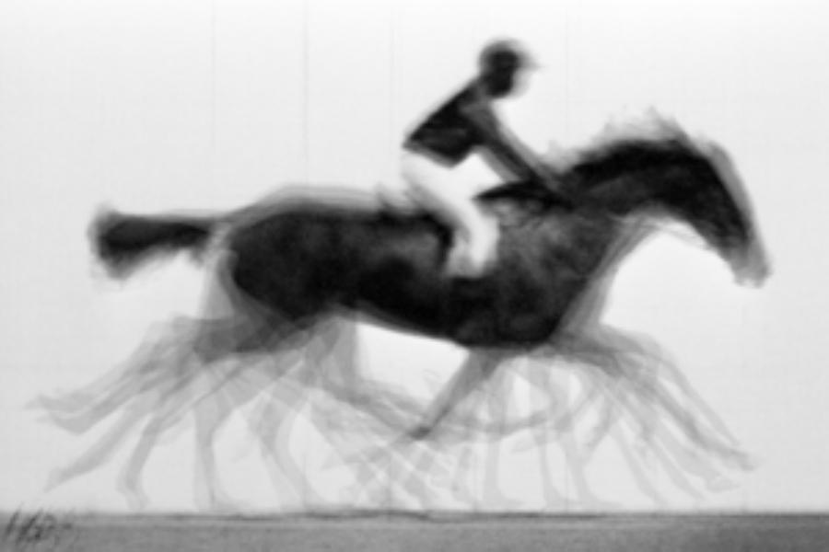
average structure

Slide 29
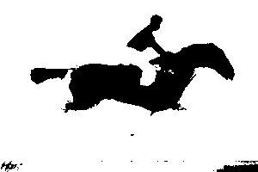
average structure: 1-sigma contour

Slide 30
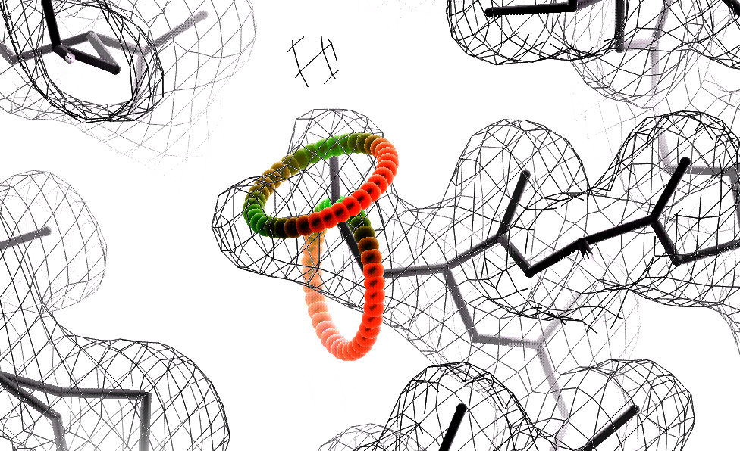
Ringer: systematic map sampling
Lang et al. (2010) Protein Sci. 19, 1420-31.
Fraser, et al. (2009) Nature 462, 669-73.

Slide 31
Ringer: systematic map sampling
electron density (e⁻/Å³)
χ₁ angle (degrees)

Slide 32
Ringer: systematic map sampling
electron density (e⁻/Å³)
χ₁ angle (degrees)

Slide 33
Ringer: systematic map sampling
electron density (e⁻/Å³)
χ₁ angle (degrees)

Slide 34
Ringer: systematic map sampling
electron density (e⁻/Å³)
χ₁ angle (degrees)

Slide 35
Independent estimates of F₀₀₀
PDB | Method | F₀₀₀ | diff
3DKE | Matthews et. al. (2008) | 121700 | +6.7%
 | END map estimate | 130500
2NVH | Matthews et. al. (2006) | 92800 | +3.0%
 | END map estimate | 95656
1AHO | Cerutti et. al. (2010) | 23177 | -5.0%
 | END map estimate | 22020
Lang et al. (2014) PNAS USA 111, 237-242.
--

Slide 36
Ringer: systematic map sampling
electron density (e⁻/Å³)
χ₁ angle (degrees)

Slide 37
Ringer: systematic map sampling
electron density (e⁻/Å³)
χ₁ angle (degrees)

Slide 38
"error bar" for electron density
error bars for electron density
structure factor (e⁻/cell)
electron density (e⁻/Å³)
spot index
fractional coordinate
Lang et al. (2014) PNAS USA 111, 237-242.

Slide 39
"error bar" for electron density
error bars for electron density
structure factor (e⁻/cell)
electron density (e⁻/Å³)
spot index
fractional coordinate
Lang et al. (2014) PNAS USA 111, 237-242.

Slide 40
"error bar" for electron density
error bars for electron density
structure factor (e⁻/cell)
electron density (e⁻/Å³)
spot index
fractional coordinate
Lang et al. (2014) PNAS USA 111, 237-242.

Slide 41
"error bar" for electron density
error bars for electron density
structure factor (e⁻/cell)
electron density (e⁻/Å³)
spot index
fractional coordinate
Lang et al. (2014) PNAS USA 111, 237-242.

Slide 42
"error bar" for electron density
error bars for electron density
structure factor (e⁻/cell)
electron density (e⁻/Å³)
spot index
fractional coordinate
Lang et al. (2014) PNAS USA 111, 237-242.

Slide 43
"error bar" for electron density
error bars for electron density
structure factor (e⁻/cell)
electron density (e⁻/Å³)
spot index
fractional coordinate
Lang et al. (2014) PNAS USA 111, 237-242.

Slide 44
"error bar" for electron density
error bars for electron density
structure factor (e⁻/cell)
electron density (e⁻/Å³)
spot index
fractional coordinate
Lang et al. (2014) PNAS USA 111, 237-242.

Slide 45
"error bar" for electron density
error bars for electron density
structure factor (e⁻/cell)
electron density (e⁻/Å³)
spot index
fractional coordinate
Lang et al. (2014) PNAS USA 111, 237-242.

Slide 46
"error bar" for electron density
error bars for electron density
Refinement
Against
Perturbed
Input
Data
electron density (e⁻/Å³)
fractional coordinate
Lang et al. (2014) PNAS USA 111, 237-242.

Slide 47
How does the “error” compare to “sigma”?
error bars for electron density
normalized counts
Electron Number Density (e⁻/Å³)
Lang et al. (2014) PNAS USA 111, 237-242.

Slide 48
How does the “error” compare to “sigma”?
error bars for electron density
normalized counts
Electron Number Density (e⁻/Å³)
Lang et al. (2014) PNAS USA 111, 237-242.

Slide 49
1 “sigma” is not a good criterion
normalized counts
Electron Number Density (e⁻/Å³)
Lang et al. (2014) PNAS USA 111, 237-242.

Slide 50
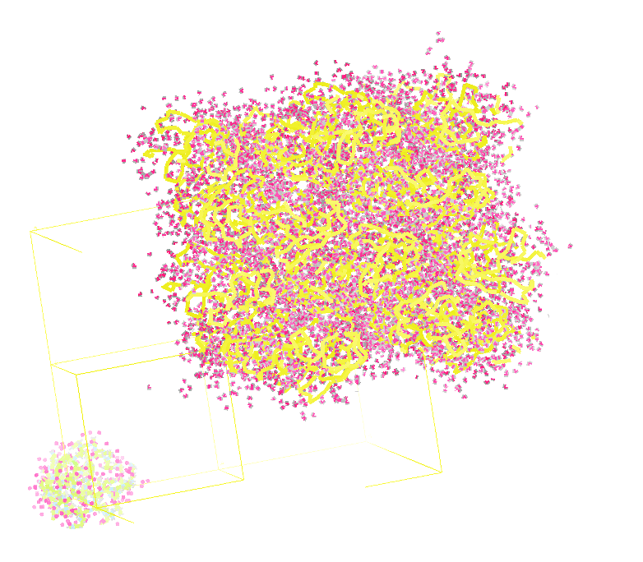
Molecular Dynamics Simulation
using real
crystal’s lattice
1aho
Scorpion toxin
0.96 Å resolution
64 residues
Solvent: H₂0 + acetate
Cerutti et al. (2010).J. Phys. Chem. B 114, 12811-12824.

Slide 51
30 conformers from 24,000

Slide 52
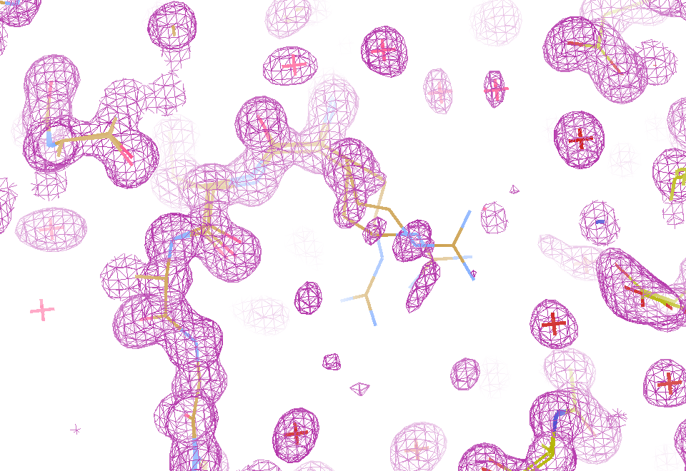
Electron density from 24,000 conformers

Slide 53
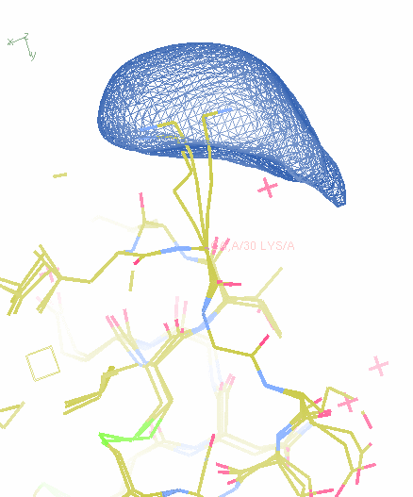
How many conformers are there?

Slide 54
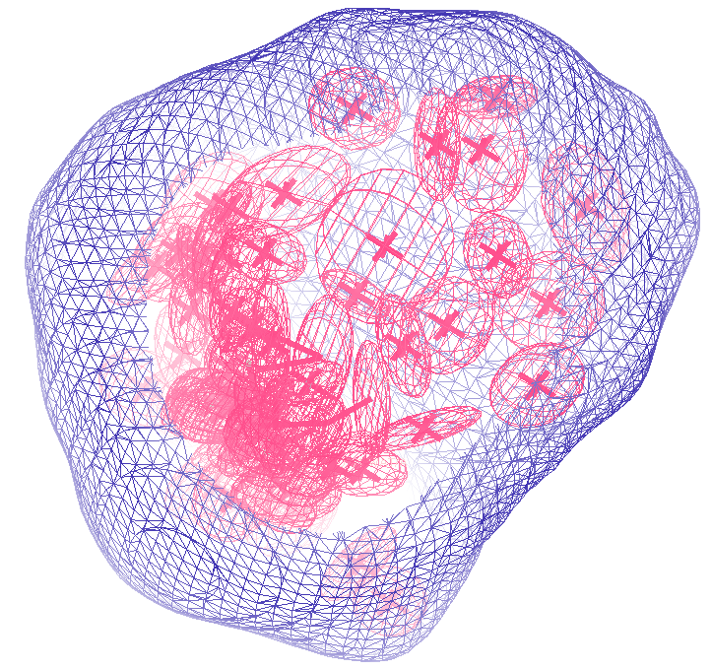
How many conformers are there?
Answer: 40
R_{cryst} = 0.0506
R_{free} = 0.0556
vs F_{sim}

Slide 55
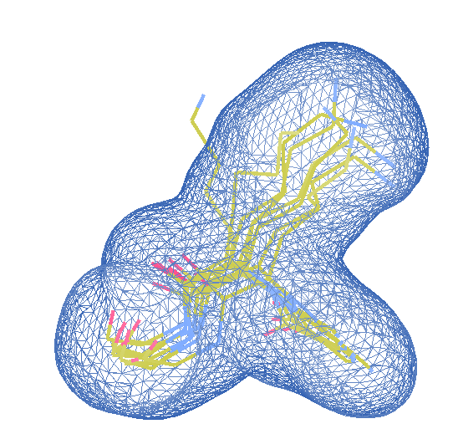
How many conformers are there?
Answer: 8
R_{cryst} = 0.0297
R_{free} = 0.0293
vs F_{sim}

Slide 56
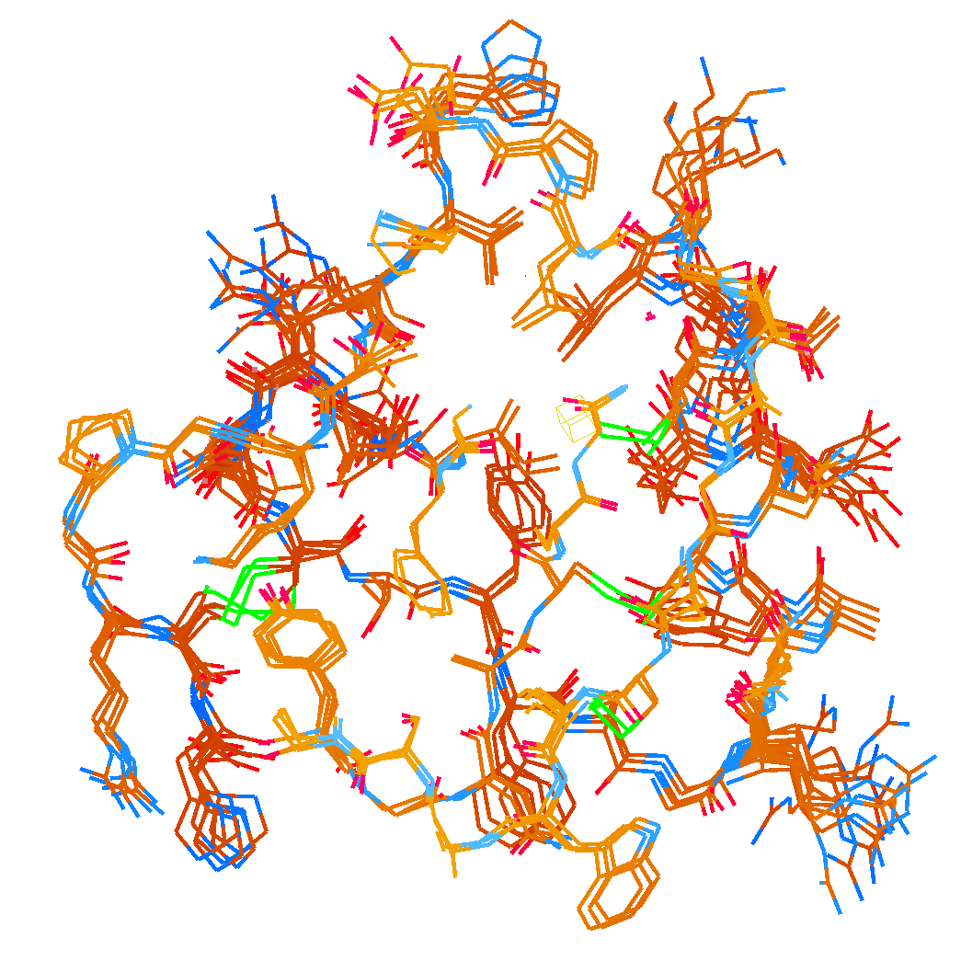
How many conformers are there?
Answer: 2-14
R_{cryst} = 0.0441
R_{free} = 0.0516
vs F_{sim}

Slide 57
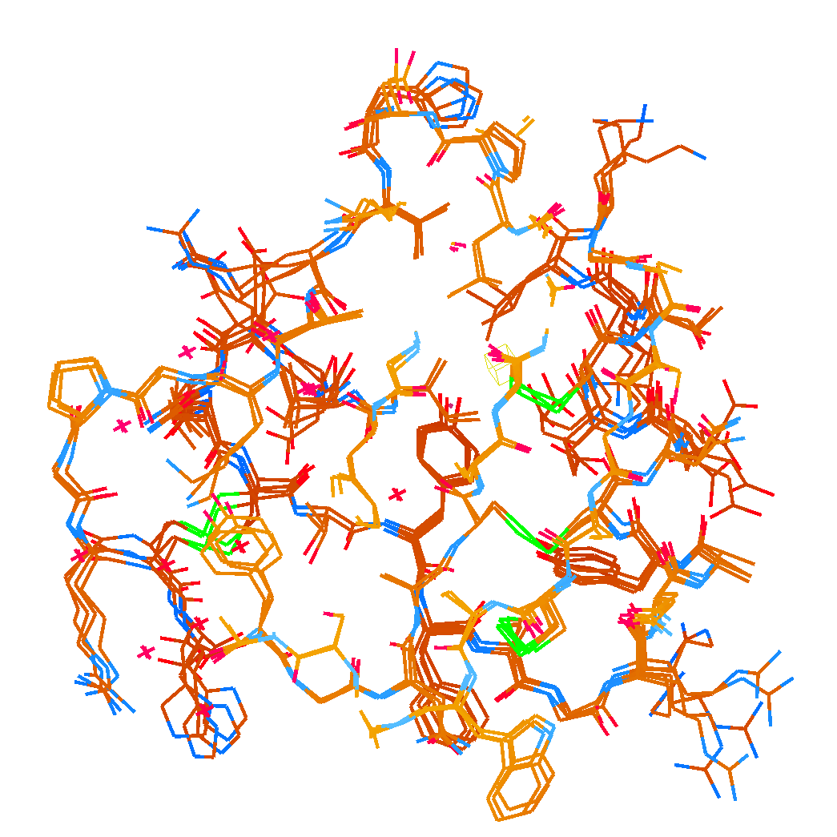
How many conformers are there?
Answer: 1-7
R_{cryst} = 0.1546
R_{free} = 0.1749
vs F_{obs}
1aho:
R_{cryst} = 0.1630
R_{free} = n/d

Slide 58
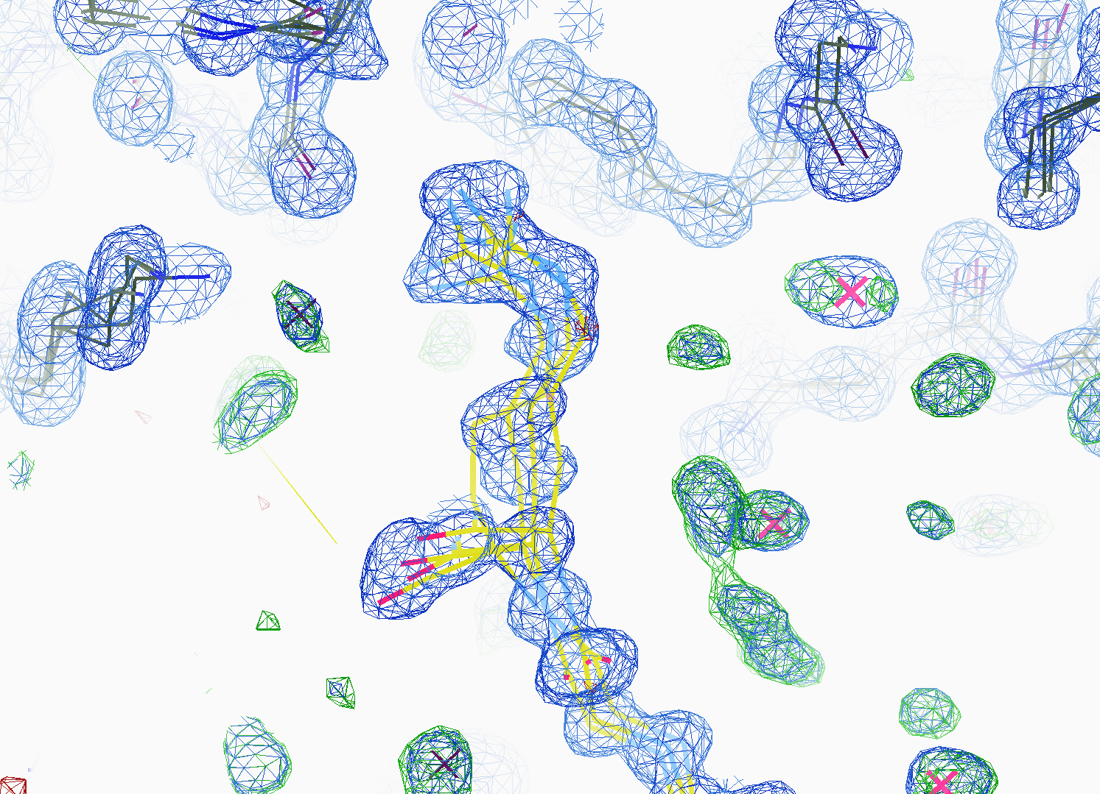
How many conformers are there?
All difference
features
are in
the solvent!
real data

Slide 59
How rough is the solvent?
Electron number density (e⁻/Å³)
x along line y=z=0 (Å)

Slide 60
How rough is the solvent?
Electron number density (e⁻/Å³)
x along line y=z=0 (Å)

Slide 61
How rough is the solvent?
Electron number density (e⁻/Å³)
x along line y=z=0 (Å)

Slide 62
How rough is the solvent?
Electron number density (e⁻/Å³)
x along line y=z=0 (Å)

Slide 63
How rough is the solvent?
Electron number density (e⁻/Å³)
x along line y=z=0 (Å)

Slide 64
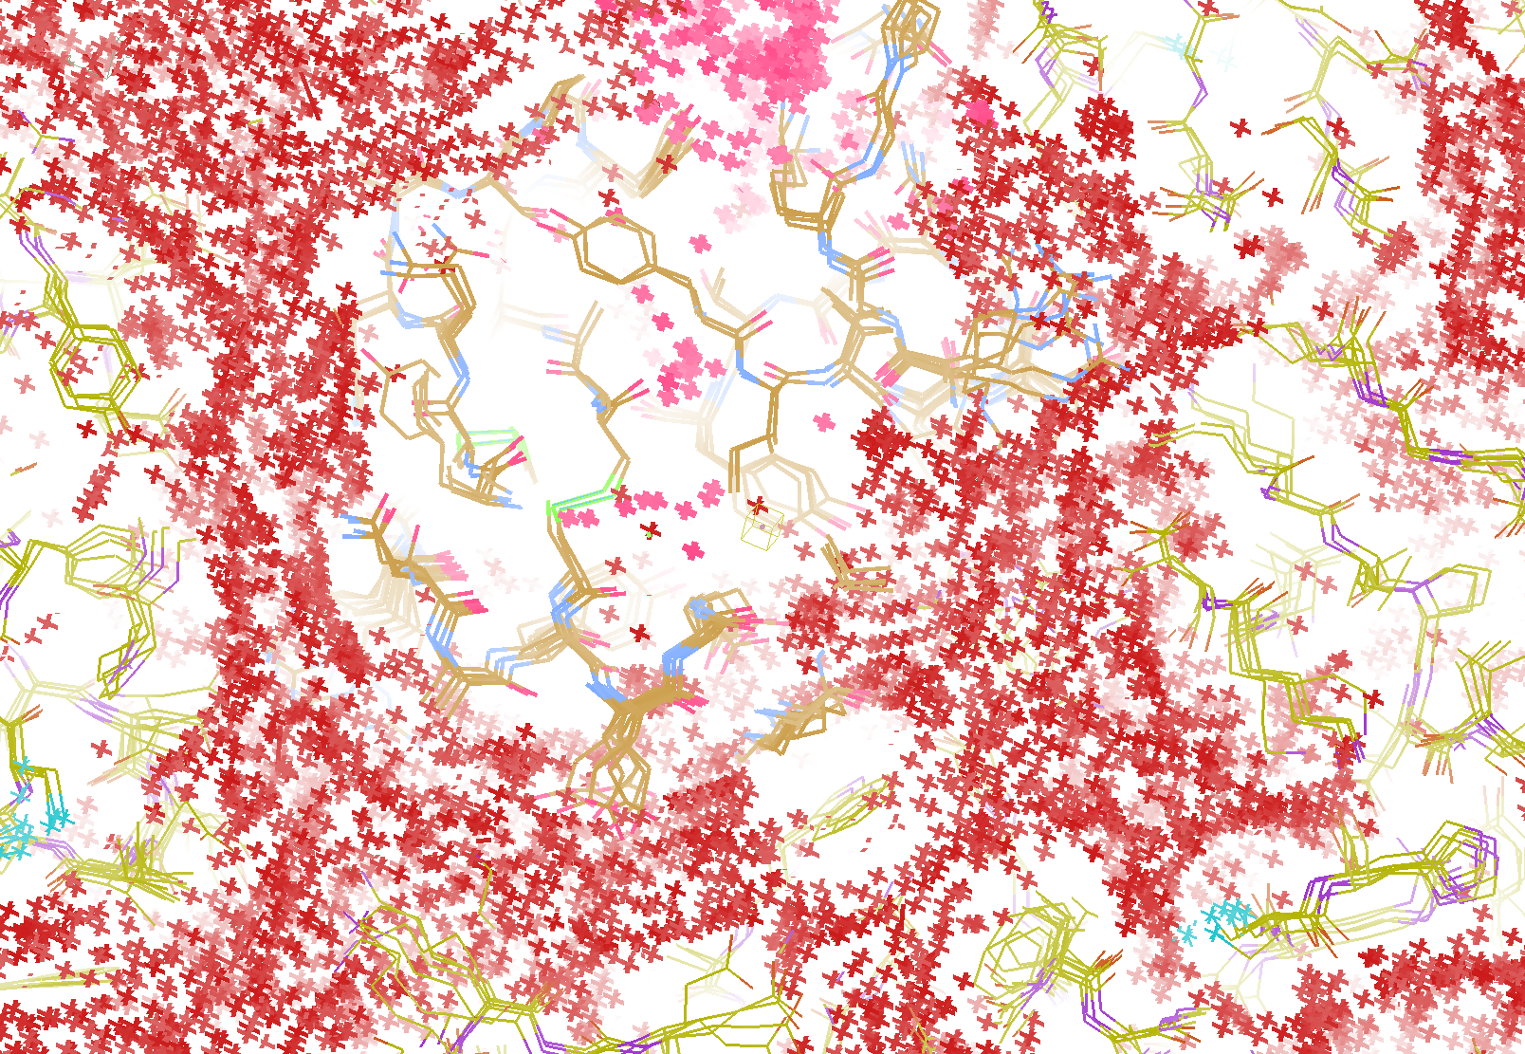
How “rough” is the solvent?
R_{cryst} = 0.0309
R_{free} = 0.0678
vs F_{sim}

Slide 65
The Future of Structural Biology
will be noisy
Averaging destroys resolution
Multi-crystal data – isomorphism
structures of the future must be 4D
There is “life” below 1 σ

