Slide 1
Acknowledgements
David Case David Cerruti
Robert Stroud James Fraser Scott Classen John Tainer
Chris Nielsen Clemens Schulze-Briese Aina Cohen Ana Gonzalez
UCSF LBNL SLAC
ALS 8.3.1: TomAlberTron
UC Multicampus Research Programs and Initiatives (MRPI)
NIH NIGMS R01 GM124149
NIH NIGMS P30 GM124169
Integrated Diffraction Analysis Technologies (IDAT)
Plexxikon, Inc.
Synchrotron Radiation Structural Biology Resource (SLAC)
The Advanced Light Source is supported by the Director, Office of Science, Office of Basic Energy Sciences, Materials Sciences Division, of the US Department of Energy under contract No. DE-AC02-05CH11231 at Lawrence Berkeley National Laboratory.

Slide 2
“R-factor Gap” small vs macro molecules
Publication criterion for chemical crystallography:
R1 < 2*R_{sigma}
R1 = F_{o} vs F_{c} for I/σ(I) > 3
R_{sigma} = <σ(I)>/<I>
There are no PDB entries that pass this test!
Holton et al. (2014) "The R-factor gap", FEBS J. 281, 4046-4060.

Slide 3
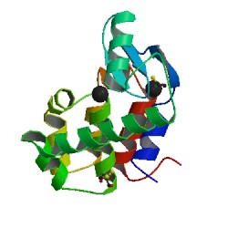
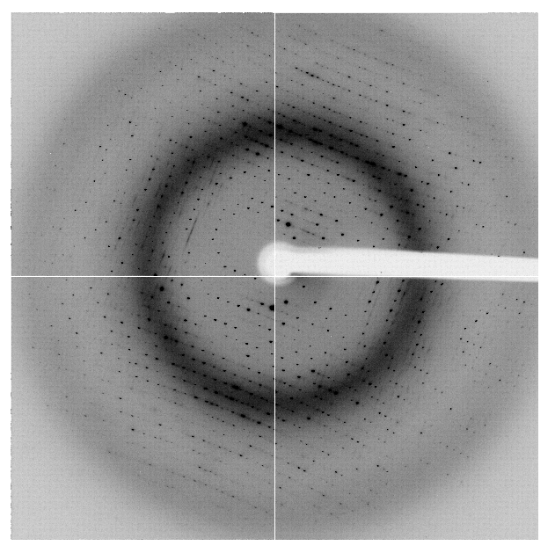
“R-factor Gap” for macromolecules
single-conformer PDB file
R_{merge} = 6%
R_{work} = 7%
R_{free} = 8%
MLFSOM
Elves
1H87; conf “A”
Holton et al. (2014) "The R-factor gap", FEBS J. 281, 4046-4060.

Slide 4
“R-factor Gap” for macromolecules
multi-conformer PDB file
R_{merge} = 6%
R_{work} = 17%
R_{free} = 20%
MLFSOM
Elves
1H87
Holton et al. (2014) "The R-factor gap", FEBS J. 281, 4046-4060.

Slide 5
“R-factor Gap” for macromolecules
multi-conformer PDB file
R_{merge} = 6%
R_{work} = 7%
R_{free} = 8%
MLFSOM
Elves
1H87
Holton et al. (2014) "The R-factor gap", FEBS J. 281, 4046-4060.

Slide 6
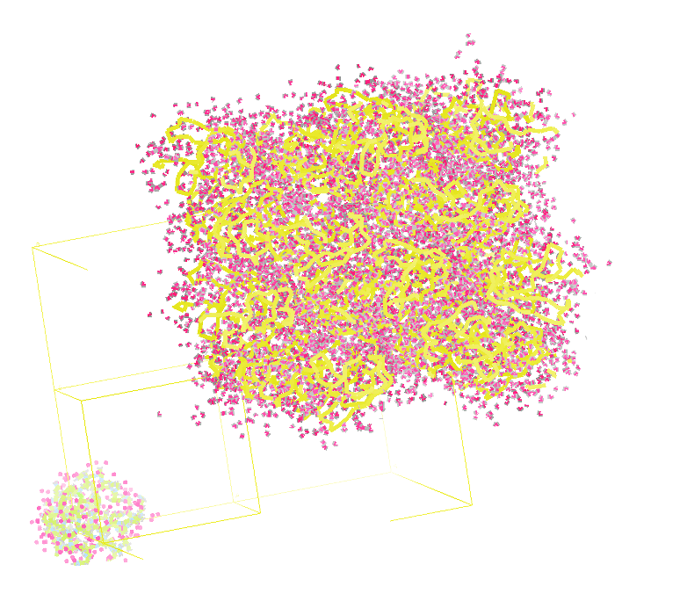
Molecular Dynamics Simulation
using real
crystal’s lattice
1aho
Scorpion toxin
0.96 Å resolution
64 residues
Solvent: H₂0 + acetate
Cerutti et al. (2010).J. Phys. Chem. B 114, 12811-12824.

Slide 7
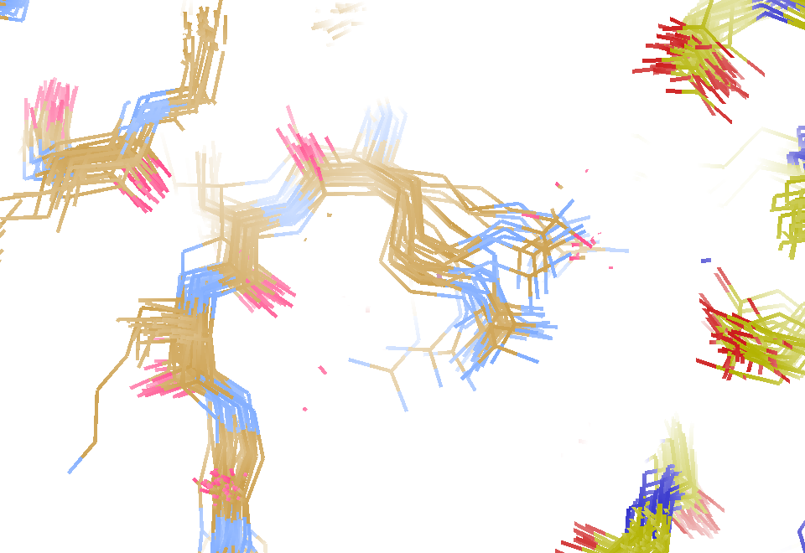
MD simulation: 30 conformers from 24,000
Cerutti et al. (2010).J. Phys. Chem. B 114, 12811-12824.

Slide 8
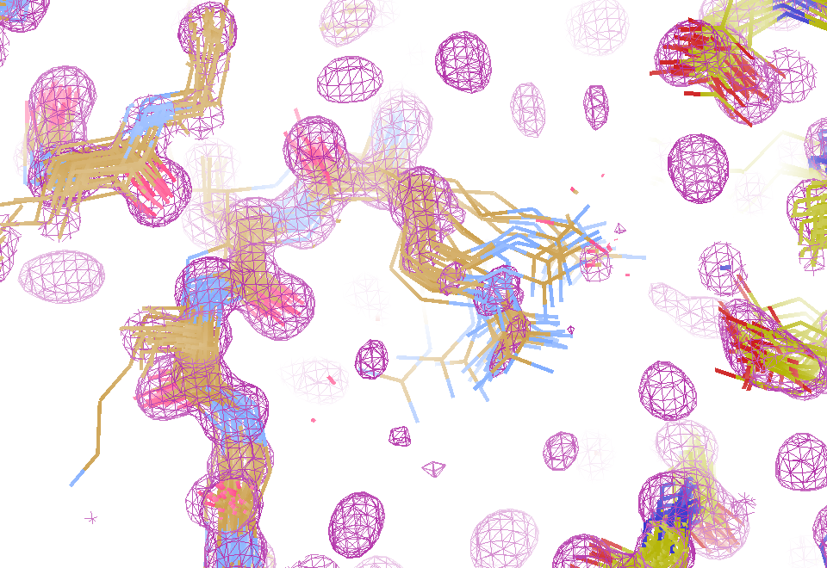
Electron density from 24,000 conformers

Slide 9
MLFSOM simulation
Holton, Classen, Frankel & Tainer (2014) "R-factor gap" FEBS 281 4046-60

Slide 10
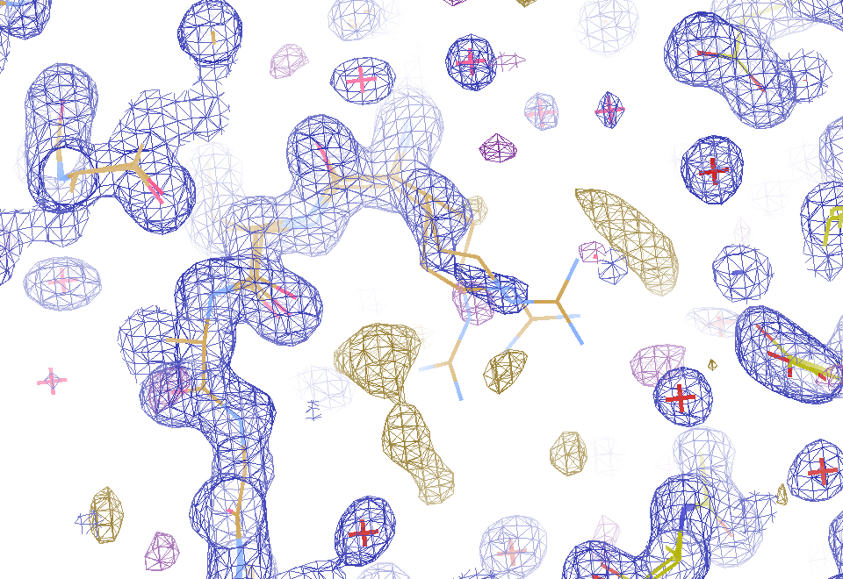
2F_{sim}-F_{calc} and F_{sim}-F_{calc} maps
1.0 Å data
R_{work}= 0.137
R_{free} = 0.159
1 “sigma” 2F_{sim}-F_{c}
2.5 “sigma” F_{sim}-F_{c}

Slide 11
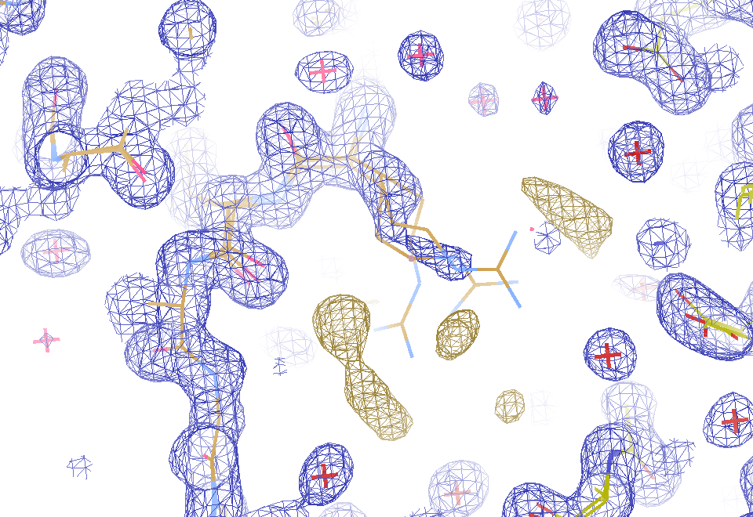
2F_{sim}-F_{calc} and “true difference” maps
1.0 Å data
R_{work}= 0.137
R_{free} = 0.159
1 “sigma” 2F_{sim}-F_{c}
F_{right} – (2F_{sim}-F_{c})

Slide 12
30 conformers from 24,000

Slide 13
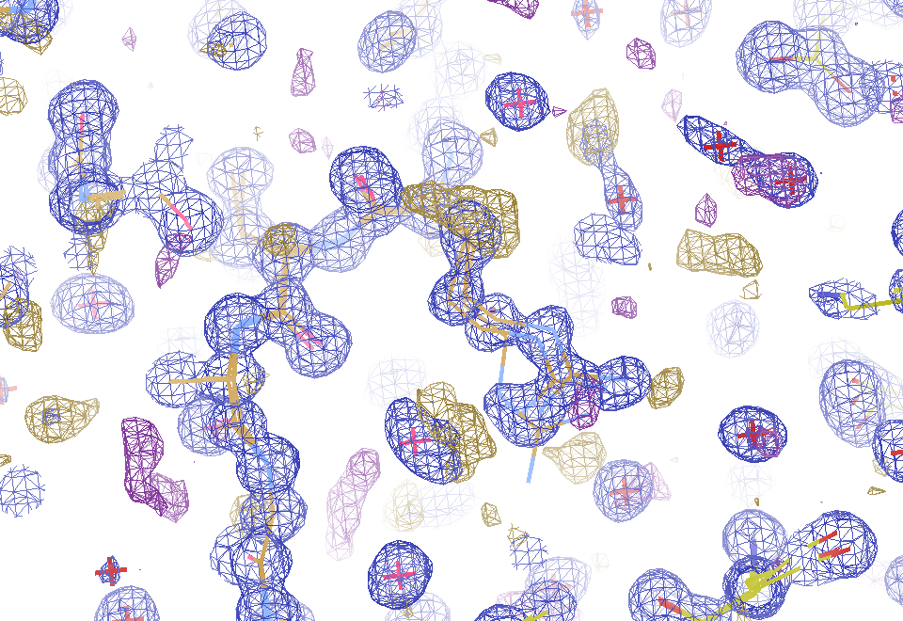
Conventional model vs X-ray data
1.0 Å data
R_{work} = 0.116
R_{free} = 0.135
1 “sigma” 2F_{obs}-F_{c}
2.5 “sigma” F_{obs}-F_{c}

Slide 14
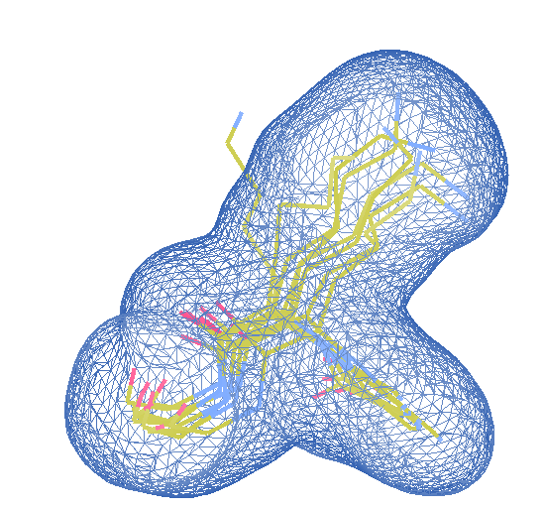
Cheating! Use MD as a guide
e⁻ density from all 24000 copies
only side chain in cell
Rotamers from MD
Perfect phases
SA refine
Occ ref
Discard zero occ
R < 2%

Slide 15
“de-conform” protocol
Discard one conformer
SA refine
Repeat for all confs
Pick least important
Remove it
goto 1
Stop when R > 3%

Slide 16
“deconform” to parsimonious model
R factor (%)
Number of conformers

Slide 17
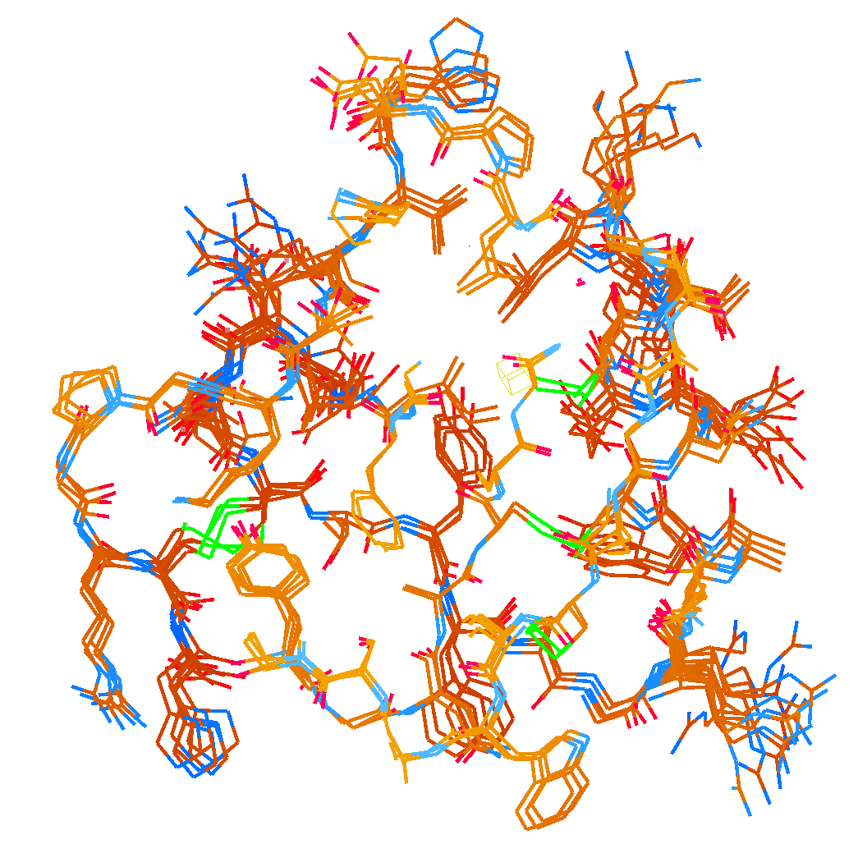
How many conformers are needed?
Answer: 2-14
R_{work} = 0.0441
R_{free} = 0.0516
vs F_{sim}
MD-derived fake data
protein only

Slide 18
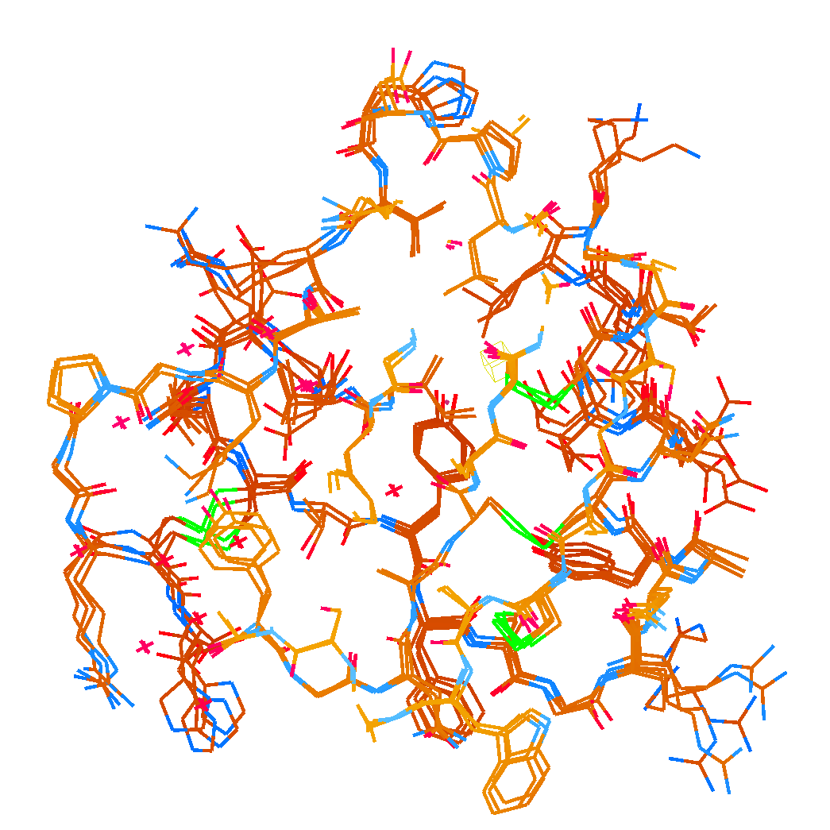
How many conformers are needed?
Answer: 1-7
R_{work} = 0.135
R_{free} = 0.158
vs F_{obs}
Observed x-ray data
1aho:
R_{work} = 0.1475
R_{free} = 0.1685

Slide 19
Adding noise

Slide 20
Adding noise
1² + 1² = 1.4²

Slide 21
Adding noise
1² + 1² = 1.4²
3² + 1² = 3.2²
σ_{total}² = σ₁² + σ₂²

Slide 22
Adding noise
12%² + 12%² = 17%²
R_{protein} + R_{solvent} ≈ R_{work}

Slide 23
Adding noise
4%² + 12%² = 12.6%²
R_{protein} + R_{solvent} ≈ R_{work}

Slide 24
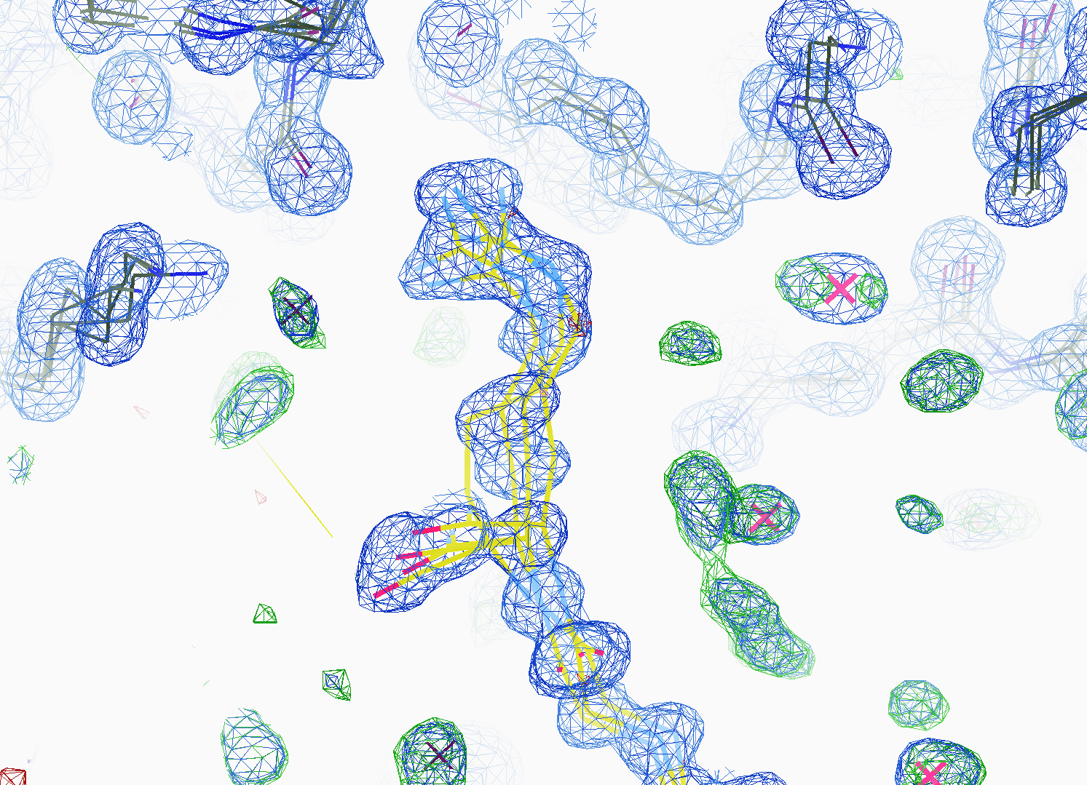
How many conformers are there?
All difference
features
are in
the solvent!
real data

Slide 25
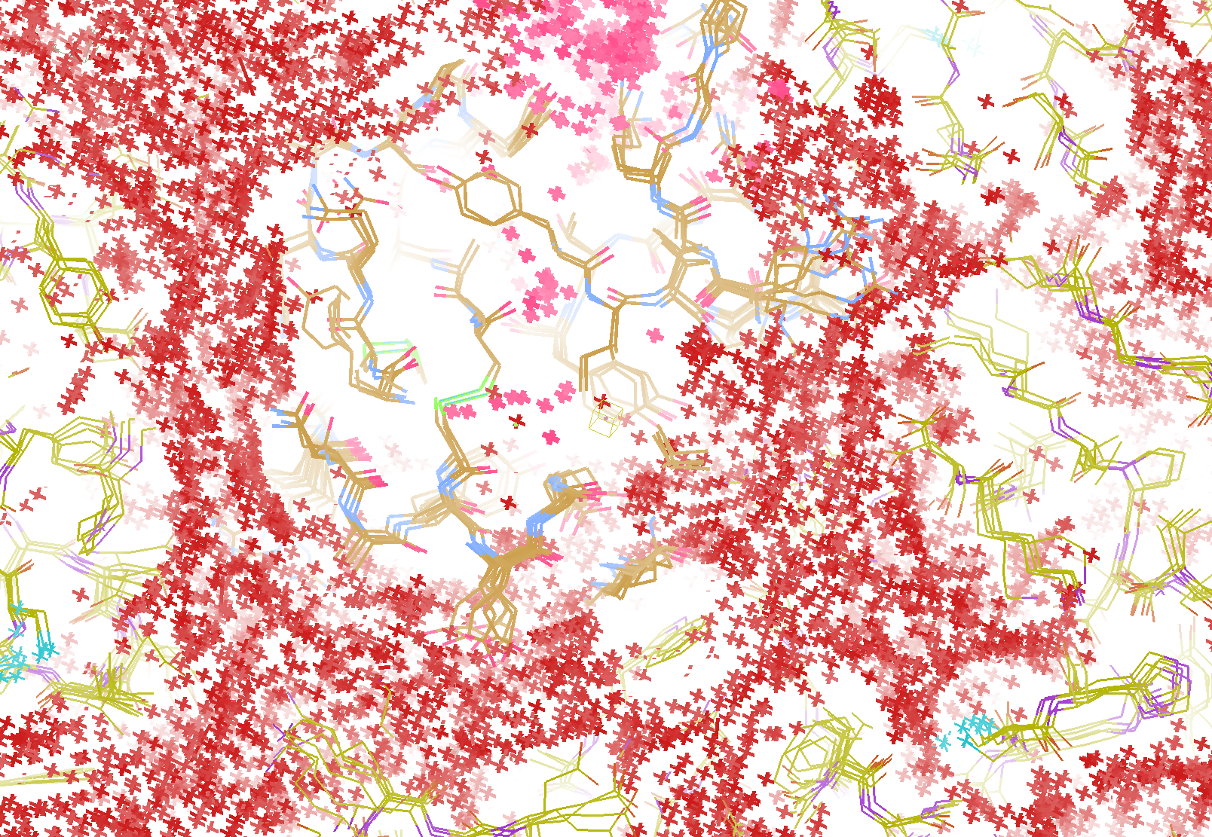
How do you model solvent?
R_{work} = 0.0309
R_{free} = 0.0678
vs F_{sim}
Problem: diverges with more cycles

Slide 26
“hydrogen cloud” solvent: unstable
R factor (%)
Phenix macro-cycle

Slide 27
Summary
If we got model “right”, it would blow up
Maps are telling us what to do
“de-conform” → parsimonious
Solvent is half the battle!
http://bl831.als.lbl.gov/~jamesh/powerpoint/SIBYLS_GM_2018.pptx

Slide 28
“water shed” procedure
Occupancy refine waters – to convergence
For each water:
Eliminate water from model
Re-refine to convergence (with occ)
Each water = different CPU (use a cluster)
Control: keep all – same refi protocol
Sort results on R_{work}
Worst R better than control?
Yes: New reference – goto 1.
No: done
For speed: worst waters > 5 Å apart

Slide 29
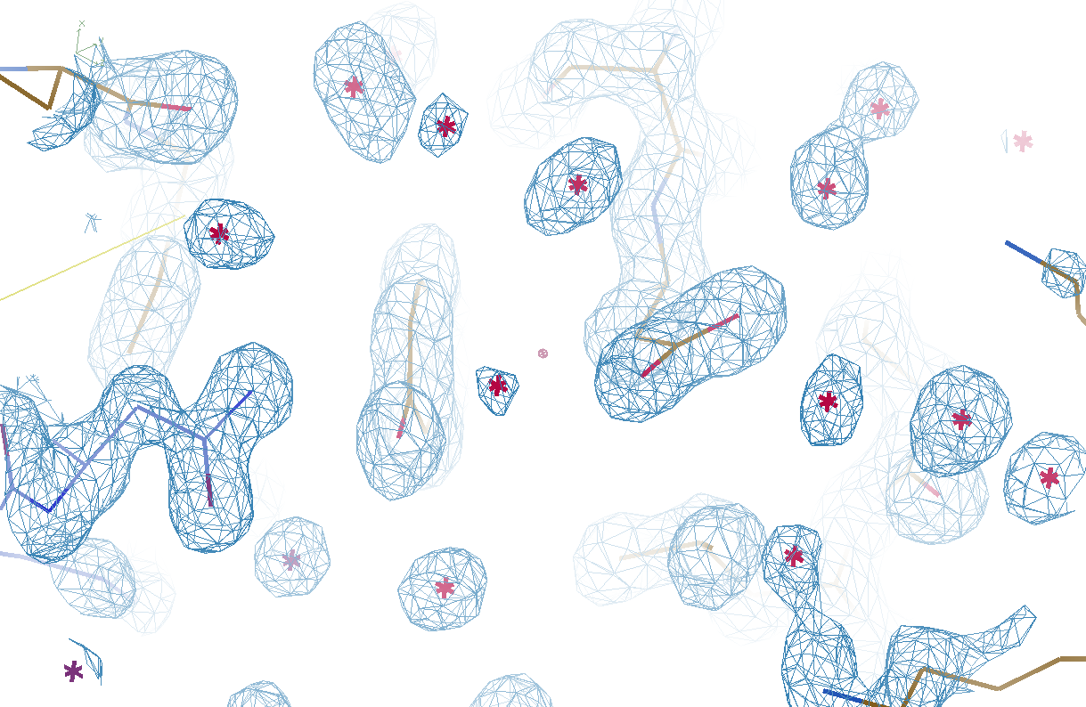
Original
3si4
R_{work} = 0.17023
R_{free} = 0.19309

Slide 30
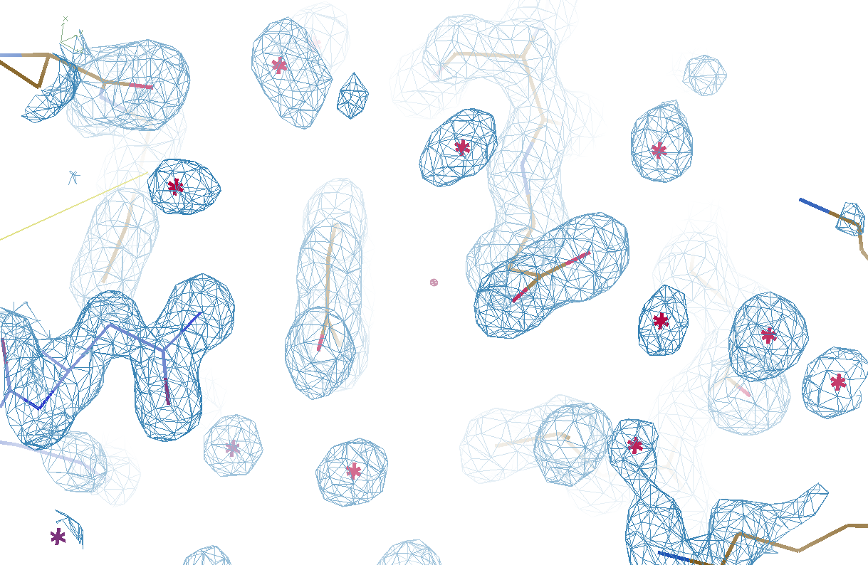
Watershed-ed
3si4
R_{work} = 0.17727
R_{free} = 0.19281

Slide 31
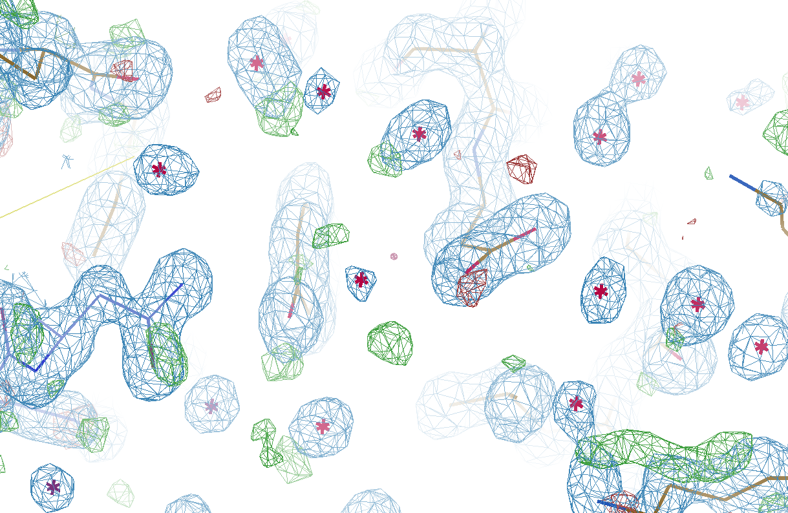
Refined
3si4
R_{work} = 0.17023
R_{free} = 0.19309

Slide 32
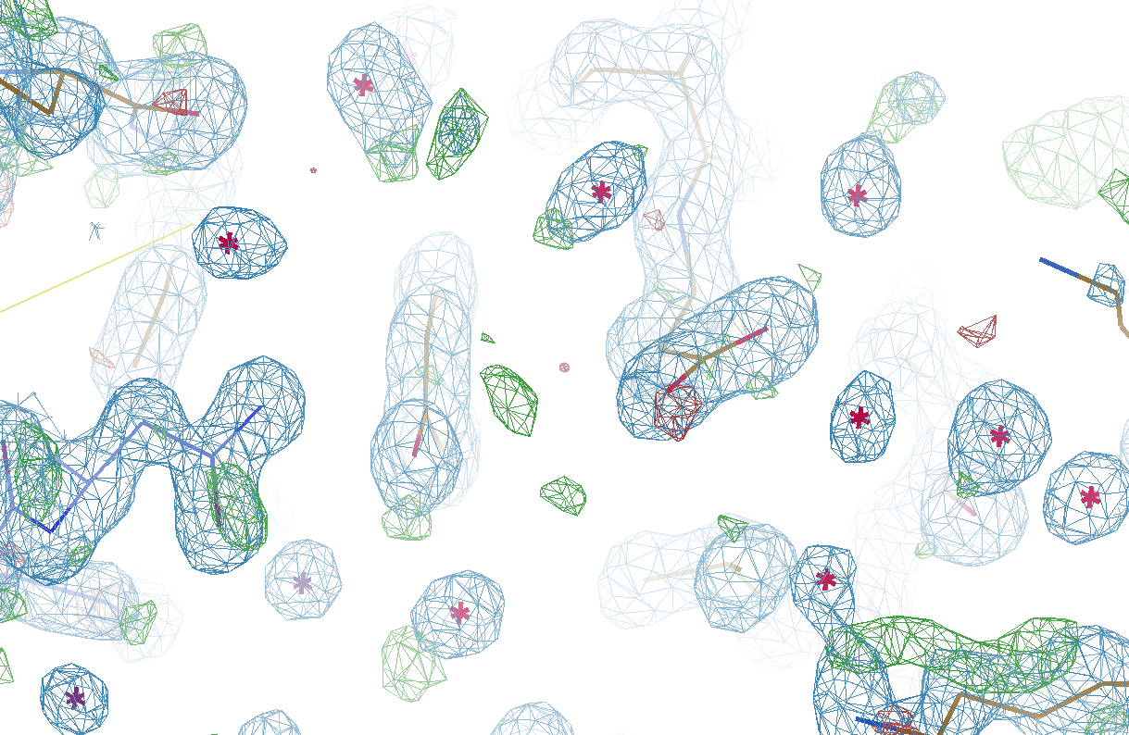
Watershed-ed
3si4
R_{work} = 0.17727
R_{free} = 0.19281

Slide 33
Phase errors: simplest possible case
electron density (e⁻/Å³)
fractional coordinate

Slide 34
Phase errors: simplest possible case
electron density (e⁻/Å³)
fractional coordinate

Slide 35
Phase errors: simplest possible case
electron density (e⁻/Å³)
fractional coordinate

Slide 36
Phase errors: simplest possible case
electron density (e⁻/Å³)
fractional coordinate

Slide 37
Phase errors: simplest possible case
electron density (e⁻/Å³)
fractional coordinate

Slide 38
Phase errors: simplest possible case
electron density (e⁻/Å³)
fractional coordinate

Slide 39
Phase errors: simplest possible case
electron density (e⁻/Å³)
fractional coordinate

Slide 40
Phase errors: simplest possible case
electron density (e⁻/Å³)
fractional coordinate

Slide 41
Phase errors: 3-atom case
electron density (e⁻/Å³)
fractional coordinate

Slide 42
Phase errors: 3-atom case
electron density (e⁻/Å³)
fractional coordinate

Slide 43
Phase errors: 3-atom case
electron density (e⁻/Å³)
fractional coordinate

Slide 44
Phase errors: 3-atom case
electron density (e⁻/Å³)
fractional coordinate

Slide 45
Phase errors: 3-atom case
electron density (e⁻/Å³)
fractional coordinate

Slide 46
Phase errors: 3-atom case
electron density (e⁻/Å³)
fractional coordinate

Slide 47
Phase errors: 3-atom case
electron density (e⁻/Å³)
fractional coordinate

Slide 48
Phase errors: 3-atom case
electron density (e⁻/Å³)
fractional coordinate

Slide 49
Phase errors: 3-atom case
electron density (e⁻/Å³)
fractional coordinate

Slide 50
Phase errors: 3-atom case
electron density (e⁻/Å³)
fractional coordinate

Slide 51
Phase errors: 3-atom case
electron density (e⁻/Å³)
fractional coordinate

Slide 52
Phase errors: asymmetric case
electron density (e⁻/Å³)
fractional coordinate

Slide 53
Phase errors: asymmetric case
electron density (e⁻/Å³)
fractional coordinate

Slide 54
Phase errors: asymmetric case
electron density (e⁻/Å³)
fractional coordinate

Slide 55
Phase errors: asymmetric case
electron density (e⁻/Å³)
fractional coordinate

Slide 56
Phase errors: asymmetric case
electron density (e⁻/Å³)
fractional coordinate

Slide 57
Phase errors: asymmetric case
electron density (e⁻/Å³)
fractional coordinate

Slide 58
Phase errors: asymmetric case
electron density (e⁻/Å³)
fractional coordinate

Slide 59
Phase errors: asymmetric case
electron density (e⁻/Å³)
fractional coordinate

Slide 60
Phase errors: asymmetric case
electron density (e⁻/Å³)
fractional coordinate

Slide 61
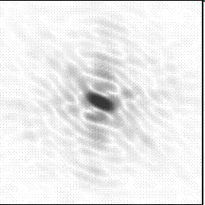
Molecular Replacement
correct structure and intensities
?
http://www.ysbl.york.ac.uk/~cowtan/fourier/coeff.html

Slide 62
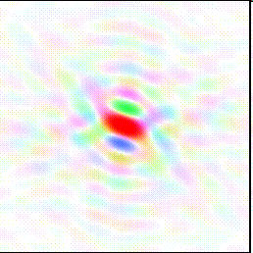
Molecular Replacement
Available model and intensities

Slide 63
Molecular Replacement
correct structure and intensities
?

Slide 64
Molecular Replacement
use something similar as a starting model

Slide 65
Model Building
current model is missing something

Slide 66
Model Building
phases from available model

Slide 67
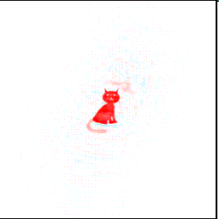
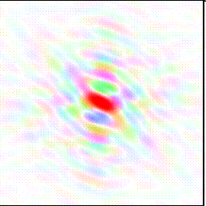
Model Building
missing bits show up, even if not in available model!

Slide 68
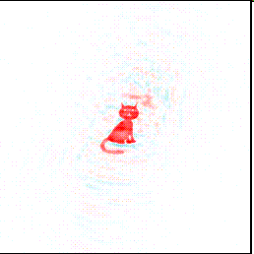
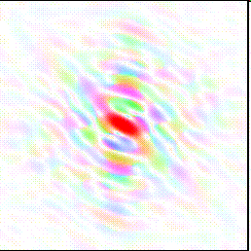
Model Building
missing bits show up better in F_{obs} + (F_{obs} - F_{calc}) map

Slide 69
non-isomorphism

Slide 70
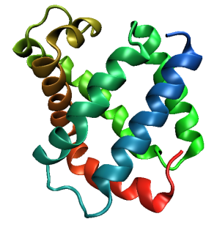
Same structure, different cell
0.5% cell change → 15%
Crick & Magdoff (1956) “theory method isomorphous replacement”, Acta Cryst. 9, 901-8.

Slide 71
Same structure, different cell
0.5% cell change → 15%
Crick & Magdoff (1956) “theory method isomorphous replacement”, Acta Cryst. 9, 901-8.

Slide 72
Same cell, rotated protein
0.5° rotation → 16%
Crick & Magdoff (1956) “theory method isomorphous replacement”, Acta Cryst. 9, 901-8.

Slide 73
Same cell, rotated protein
0.5° rotation → 16%
Crick & Magdoff (1956) “theory method isomorphous replacement”, Acta Cryst. 9, 901-8.

Slide 74
Uniform stretch
5% change → 0%

Slide 75
Uniform stretch
5% change → 0%

Slide 76
Non-isomorphism in lysozyme
RMSD = 1.70 Å
Δcell = 0.7 %
R_{iso} = 44.5%
RMSD = 0.18 Å
3aw6
3aw7
RH: 84.2%
vs 71.9%

Slide 77
Hygrostatic gradients
high
water activity
low
jet
loop

Slide 78
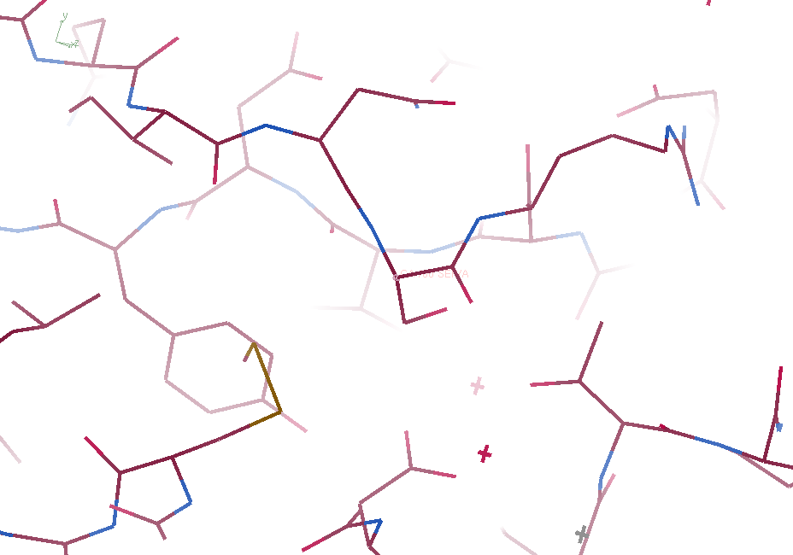
3aw6

Slide 79
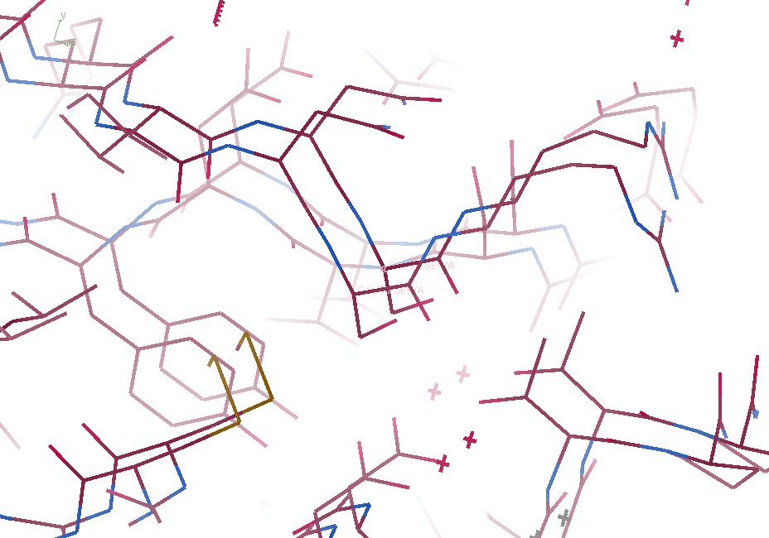
3aw6 3aw7

Slide 80
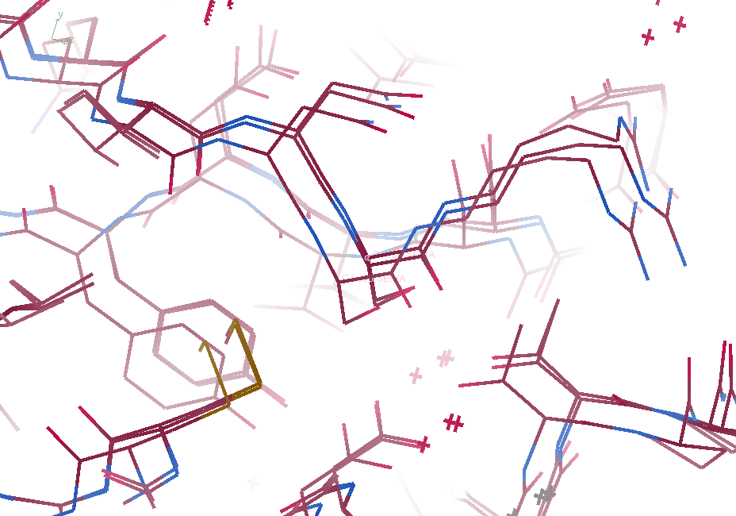
3aw6, 3aw7, “bent” 3aw7

Slide 81
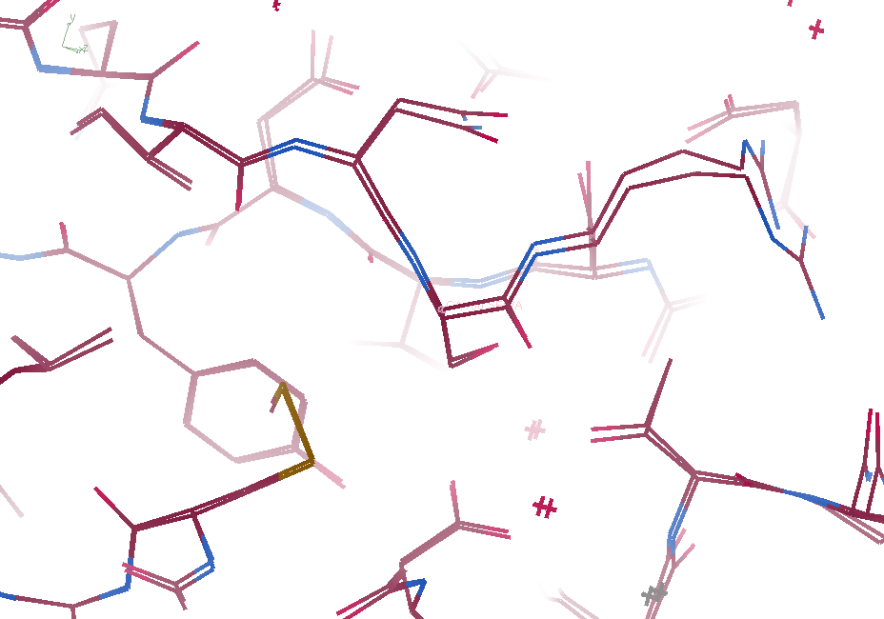
3aw6, “bent” 3aw7

Slide 82
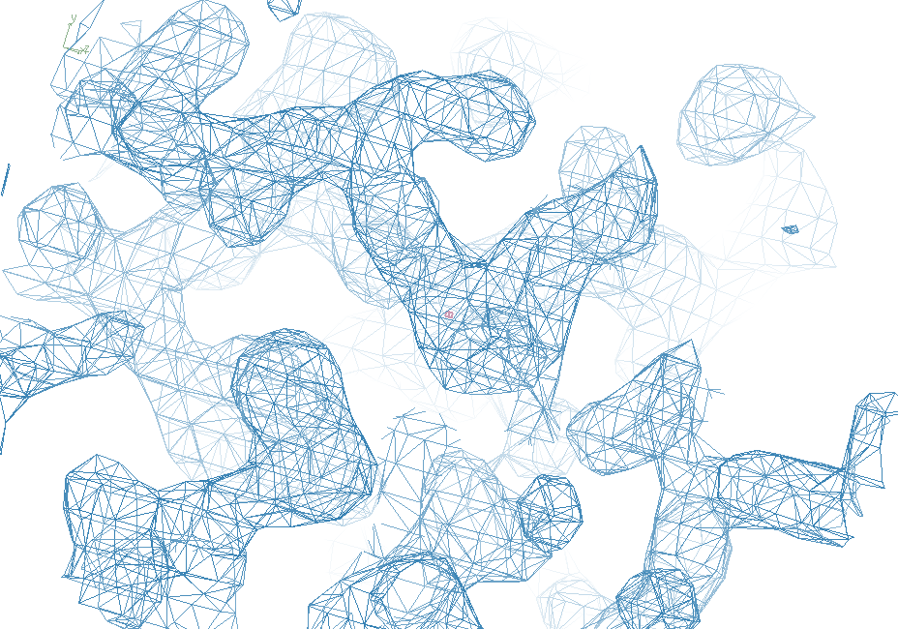
3aw6

Slide 83
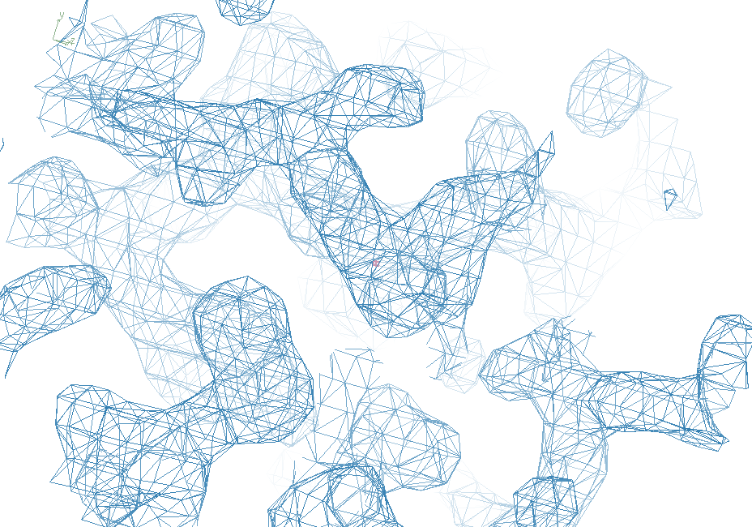
“bent” 3aw7

Slide 84
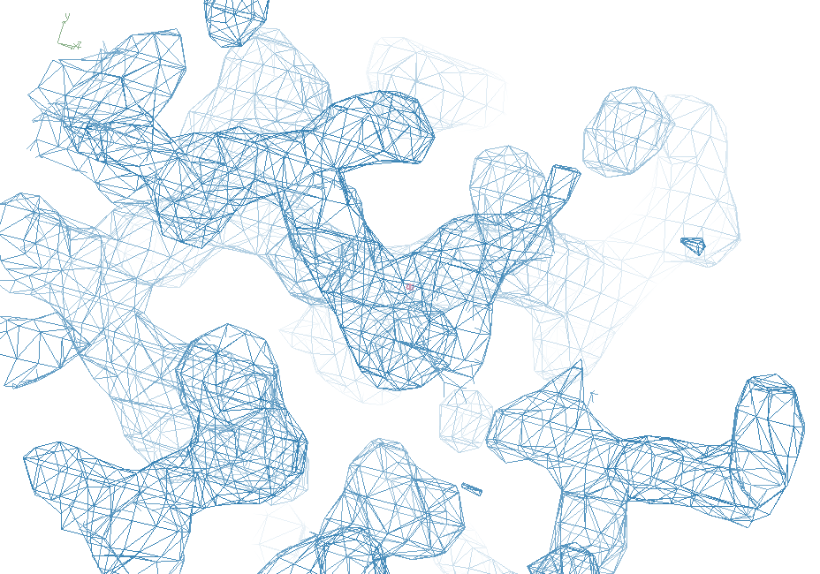
3aw7

Slide 85
“map bender” procedure
Convert to fractional coordinate shifts

Slide 86
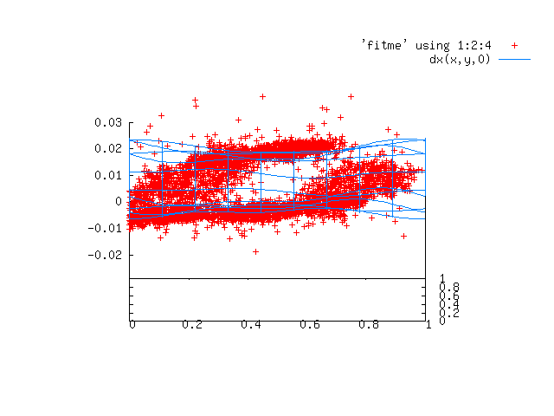

Slide 87
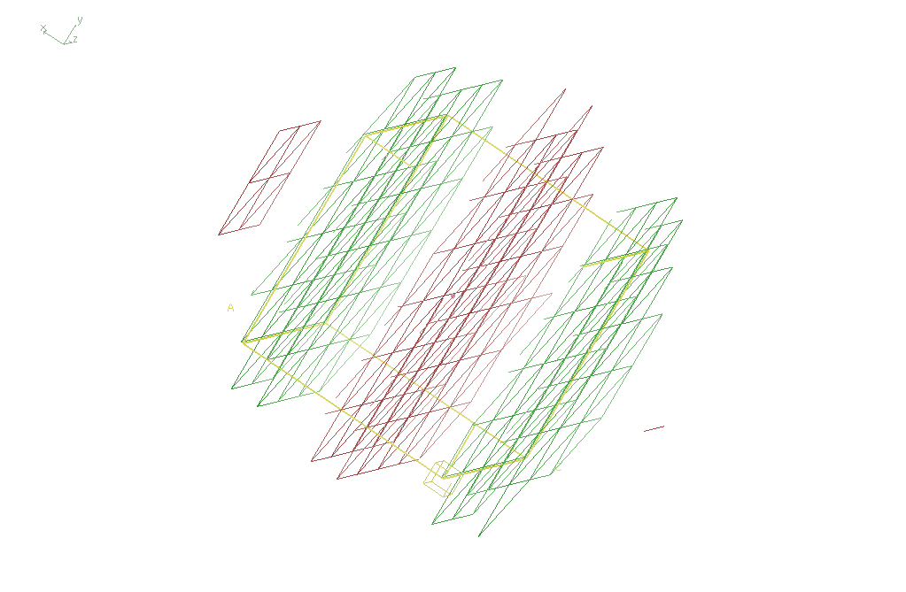
Basis function 1 0 0

Slide 88
“map bender” procedure
Convert to fractional coordinate shifts
Basis functions: spatial sin waves
Repeats with unit cell
Low-order h,k,l indices first
Fit function to Δx vs x,y,z across P1 cell
Repeat with Δy, Δz
Apply to PDB file and interpolate map grid
Usually 3-5 orders comparable to LSQ

Slide 89
Photosystem O=O bond?
Suga, M., et al., site of O=O bond formation in PSII
caught by XFEL. Nature, 2017. 543: p. 131.

Slide 90
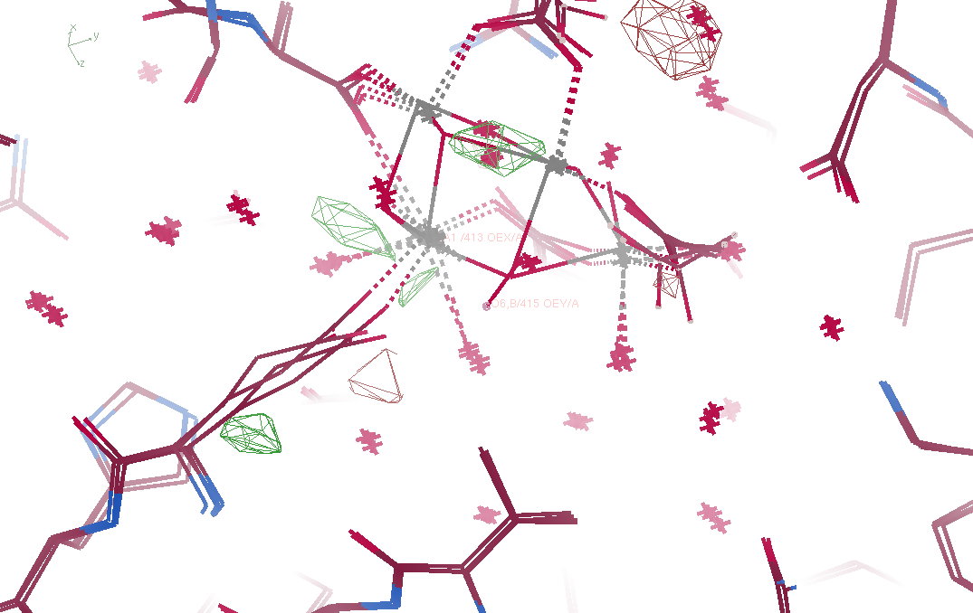
Fo – Fc maps
5ws5 vs 5ws6

Slide 91
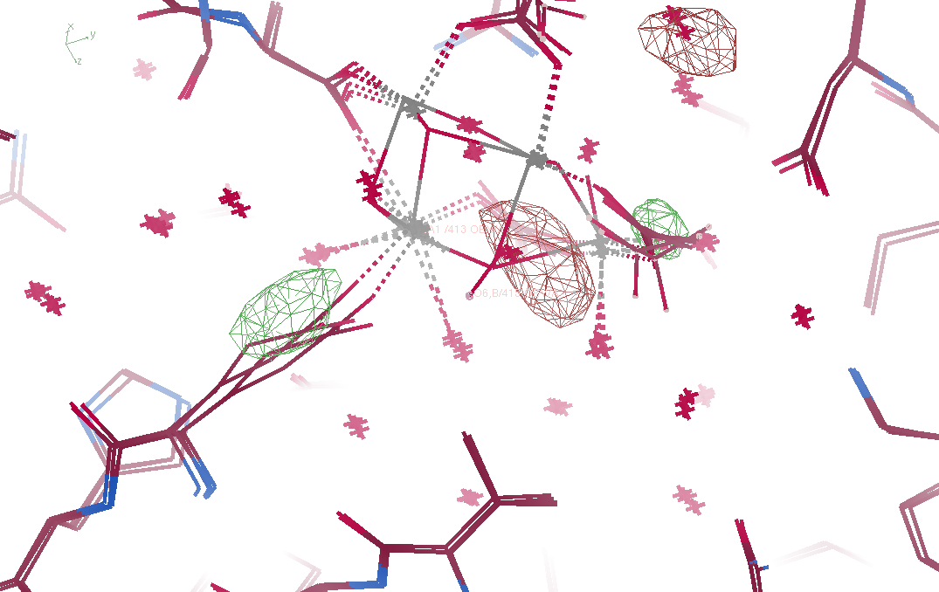
Fo – Fo maps
5ws5 vs 5ws6

Slide 92
Summary
If we got model “right”, it would blow up
Maps are telling us what to do
Solvent is half the battle!
“Water shedder” = remove bad water
“map bender” = compare maps
http://bl831.als.lbl.gov/~jamesh/powerpoint/SIBYLS_GM_2018.pptx

Slide 94
Structure Factor Equation
F_{hkl} = f_{atom} exp(-2π i (hx + ky + lz))
Σ
dF_{hkl}
dx
= f_{atom} (-2π i hx) exp(-2π i (hx + ky + lz))
Σ

Slide 95
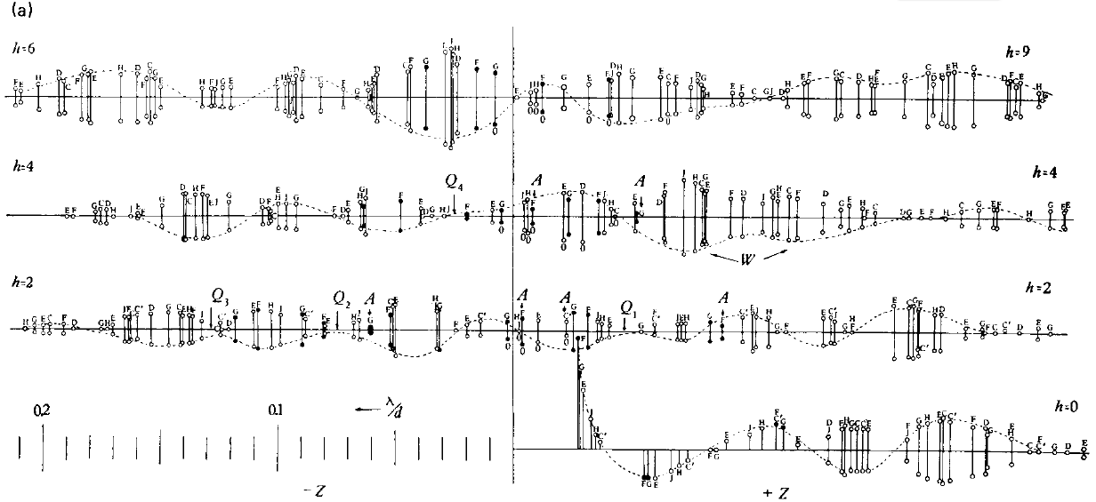
Bragg’s “minimum wavelength principle”
Perutz (1985). “Early Days of Cryst…” Methods in Enzymology, Vol. 114, 3-18.
Bragg & Perutz (1952)."external form haemoglobin I", Acta Cryst. 5, 277-283.

Slide 96
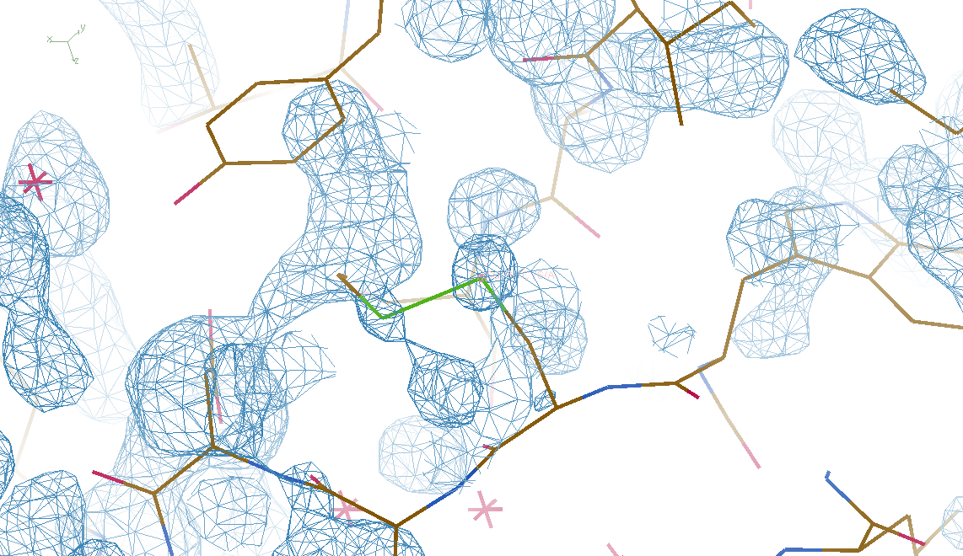
DMMULTI – fake data 4 deg rotation: 8 “xtals”: before
CC = 0.02

Slide 97
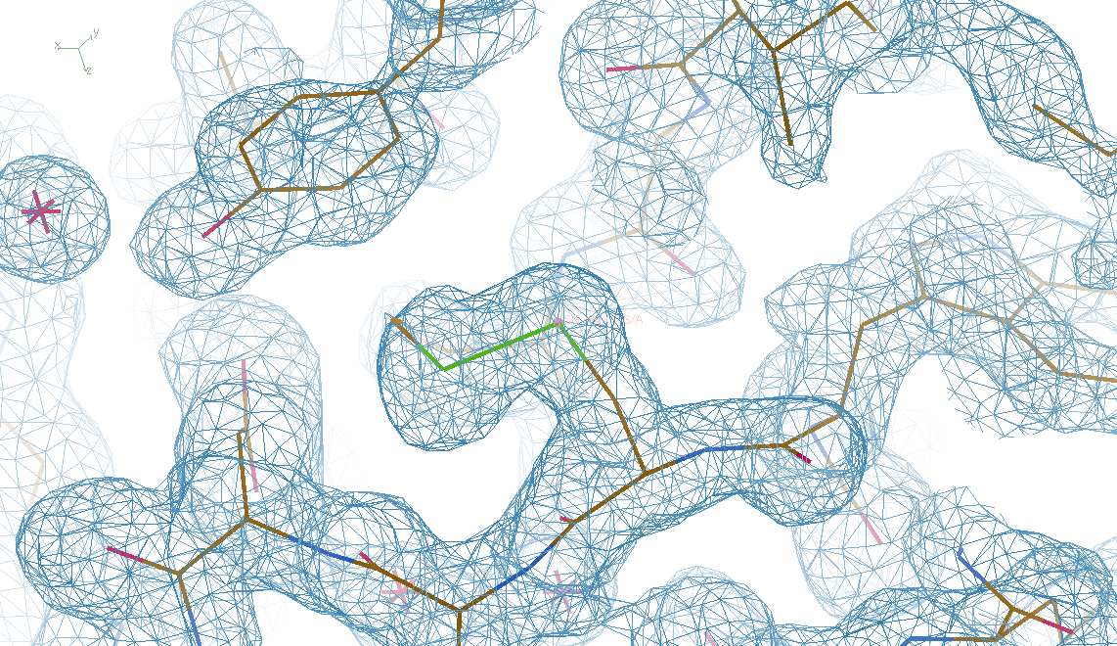
DMMULTI – fake data 4 deg rotation: 8 “xtals”: after
CC = 0.8

Slide 98
X-ray Data Sets
Singular values & vectors
data
set
h,k,l | structure factors (F)
 | #1 | #2 | #3 | #4
5,3,4 | 523.7 | 559.8 | 579.9 | 603.2
5,4,4 | 168.2 | 166.6 | 177.2 | 196.1
5,5,4 | 34.9 | 26.4 | 19.2 | 17.3
6,1,4 | 305.7 | 301.1 | 298.1 | 296.3
6,2,4 | 353.0 | 353.9 | 356.2 | 366.9
6,3,4 | 300.9 | 285.3 | 273.5 | 259.4
6,3,5 | 223.8 | 226.3 | 234.6 | 251.4
… | … | … | … | …
h,k,l | 100% | 17 % | 13 % | 9 %
 | 1st | 2nd | 3rd | 4th
5,3,4 | -1.46 | -0.02 | 1.84 | -0.72
5,4,4 | -0.88 | -0.29 | -0.34 | 0.15
5,5,4 | -0.42 | -0.65 | 1.02 | 1.47
6,1,4 | -0.90 | -0.85 | 1.44 | -0.40
6,2,4 | -1.20 | -0.37 | 0.67 | 0.01
6,3,4 | -0.75 | 0.31 | 0.48 | 0.00
6,3,5 | -0.75 | -0.85 | 0.72 | -0.82
… | … | … | … | …
value
vector
Singular value decomp.
SVD
-0.68
-0.24
0.32 …
CC1
Data sets
Positioned
in
“Correlation
Space”
Correlation
Coefficients
CC1 CC2 CC3
CC2
data set #1
data set #2
data set #3
CC3

Slide 99
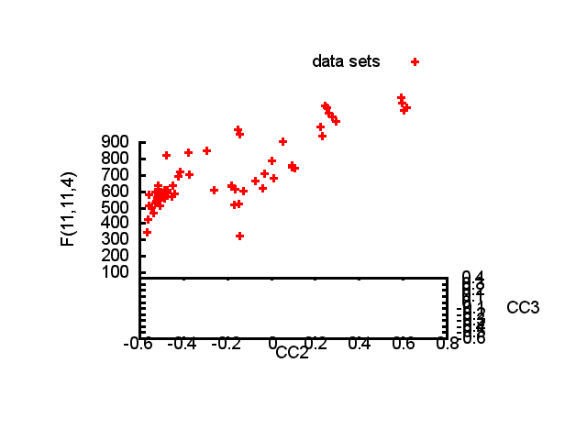

Slide 100
Structure factor (electrons)
Correlation to 2nd & 3rd singular vectors

Slide 101
Structure factor (electrons)
Correlation to 2nd & 3rd singular vectors

Slide 102
Structure factor (electrons)
Correlation to 2nd & 3rd singular vectors

Slide 103
Non-isomorphism in lysozyme
Dear James
The story of the two forms of lysozyme crystals goes back to about 1964 when it was found that the diffraction patterns from different crystals could be placed in one of two classes depending on their intensities. This discovery was a big set back at the time and I can remember a lecture title being changed from the 'The structure of lysozyme' to 'The structure of lysozyme two steps forward and one step back'. Thereafter the crystals were screened based on intensities of the (11,11,l) rows to distinguish them (e.g. 11,11,4 > 11,11,5 in one form and vice versa in another). Data were collected only for those that fulfilled the Type II criteria. (These reflections were easy to measure on the linear diffractometer because crystals were mounted to rotate about the diagonal axis). As I recall both Type I and Type II could be found in the same crystallisation batch . Although sometimes the external morphology allowed recognition this was not infallible.
The structure was based on Type II crystals. Later a graduate student Helen Handoll examined Type I. The work, which was in the early days and before refinement programmes, seemed to suggest that the differences lay in the arrangement of water or chloride molecules (Lysozyme was crystallised from NaCl). But the work was never written up. Keith Wilson at one stage was following this up as lysozyme was being used to test data collection strategies but I do not know the outcome.
An account of this is given in International Table Volume F (Rossmann and Arnold edited 2001) p760.
Tony North was much involved in sorting this out and if you wanted more info he would be the person to contact. I hope this is helpful. Do let me know if you need more.
Best wishes
Louise

Slide 104
Dehydration: 1934
and 2017?
= 1.5 μL
100 μm
= 1.0 nL
2 mm
= 1.0 pL
10 μm
= 1.0 fL
1 μm

Slide 105
… but does it work for membrane proteins?
CCP4BB:
“We used it for a large membrane protein complex and diffraction improved from ~7 to 2.7 A. The crystal is fished out and put into mother liquor solution in the button, sealed with dialysis membrane and the button is then placed into about 5 mls of mother liquor with slightly higher PEG concentration. Then you just exchange outside buffer every day or so for solutions containing higher concentrations of PEG. We went from ~9 to 30 % PEG4000 in about a week. You can easily observe crystal under microscope and if it cracks - you went too far/too quickly with PEG and need to use a bit less next time. Also, this method allows you to control all other components of the dehydrating solution - we needed to decrease salt concentration at the same time as increasing PEG. You can also introduce/increase cryo-protectant concentration at the same time. With these crystals, otherwise excellent dehydration machines already mentioned did not work, possibly because the process had to be really slow.”
Efremov, R. G. & Sazanov, L. A. (2011)."Structure of the membrane domain of respiratory complex I", Nature 476, 414-420.
“To improve diffraction properties, crystals were slowly cooled to 4 C, placed into micro-dialysis buttons, and mother liquor was exchanged by dialysis for 0.1 M sodium acetate (pH 4.8), 0.15 M sodium tartrate (pH 5.0), 30% PEG4000, 0.1% sodium cholate and 12.5% glycerol over a period of 5 days.”

