Slide 1
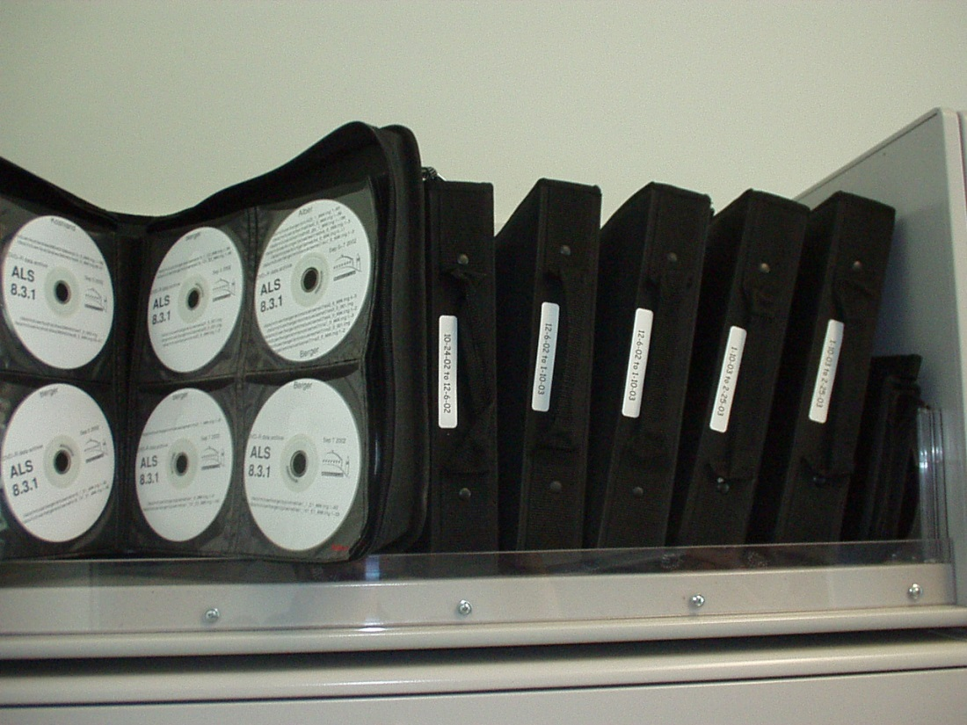
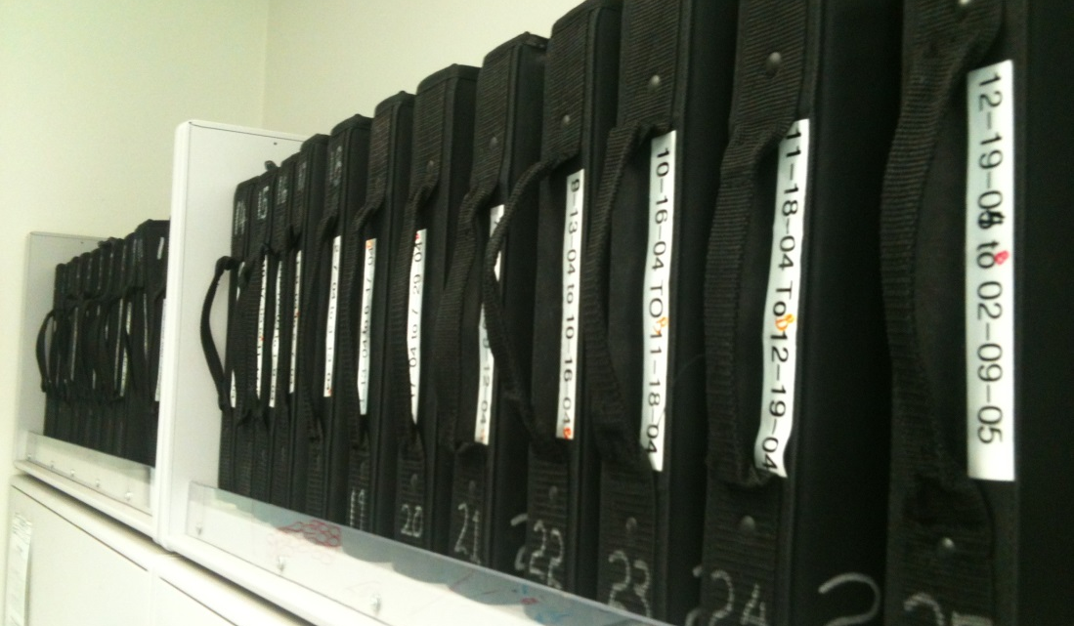
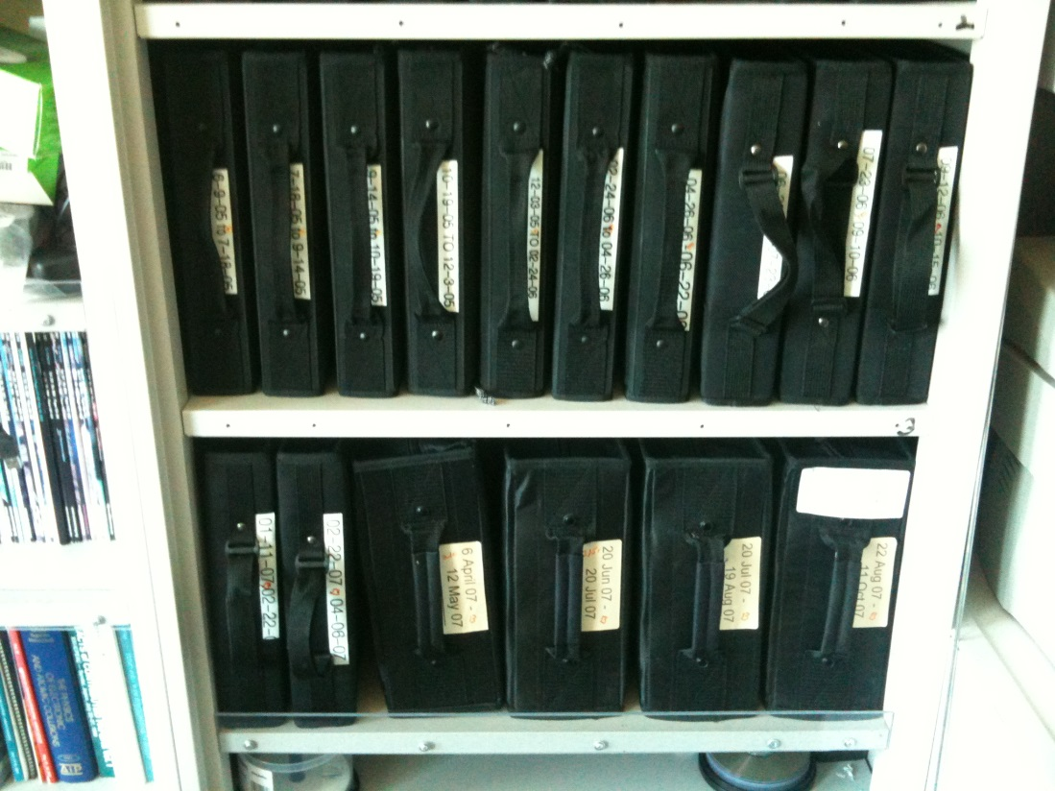
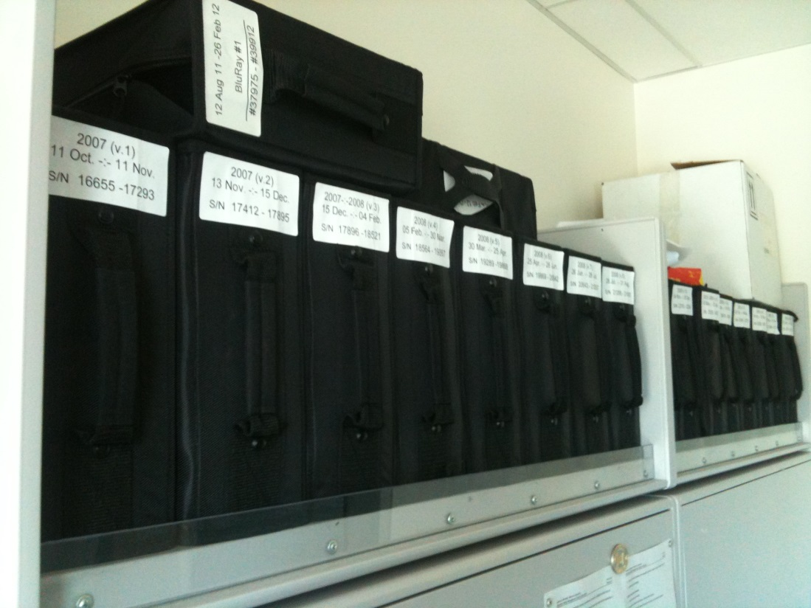
“Success rate” of structures
~2500 datasets/year
~100 PDBs/year

Slide 2
Why do structures fail?
Overlaps
Radiation Damage
Signal to noise

Slide 3
Why do structures fail?
Overlaps
Radiation Damage
Signal to noise

Slide 4
Types of radiation damage
Global
Specific

Slide 5
Global Damage: scale
normalized total intensity
accumulated dose (MGy)

Slide 6
Global Damage: scale
normalized total intensity
accumulated dose (MGy)

Slide 7
Types of radiation damage
Global
  scale factor
  B factor
Specific

Slide 8
Global Damage: B factor
data taken from Kmetko et. al. 2006
~ 1.0 B/MGy
relative B factor
accumulated dose (MGy)

Slide 9
Global Damage: scale
normalized total intensity
accumulated dose (MGy)

Slide 10
Radiation Damage Model
1.0 B/MGy
normalized total intensity
accumulated dose (MGy)

Slide 11
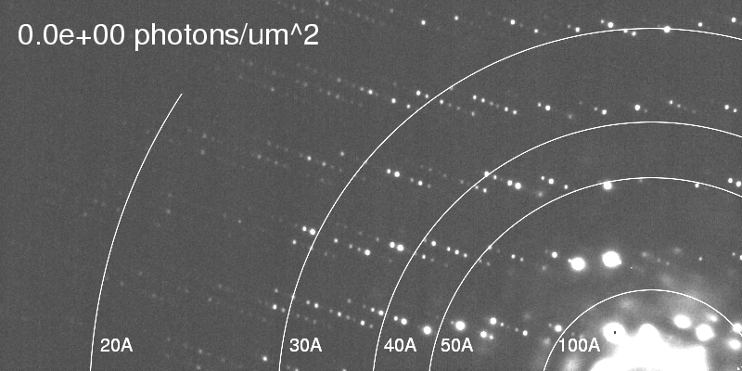
resolution dependence of global damage
http://bl831.als.lbl.gov/~jamesh/ribo_blast/
Howells et al. (2009) J. Electron. Spectrosc. Relat. Phenom. 170 4-12

Slide 12
resolution dependence of global damage
10³
100
maximum tolerable dose (MGy)
10
1
1 2 3 5 7 10 20 40 70 100
resolution (Å)
Howells et al. (2009) J. Electron. Spectrosc. Relat. Phenom. 170 4-12

Slide 13
resolution dependence of global damage
10³
10 MGy/Å
100
maximum tolerable dose (MGy)
10
1
1 2 3 5 7 10 20 40 70 100
resolution (Å)
Howells et al. (2009) J. Electron. Spectrosc. Relat. Phenom. 170 4-12

Slide 14
Radiation Damage Model
global (lattice) damage
dose
I = I₀ exp(-ln(2) )
d∙H
I - average observed spot intensity
I₀ - intensity of “undamaged” spot
dose - absorbed dose (MGy)
H - 10 MGy/Å
d - resolution of spot (Å)

Slide 15
Radiation Damage Model
global (lattice) damage
dose
I = I₀ exp(-ln(2) )
d∙H
I - average observed spot intensity
I₀ - intensity of “undamaged” spot
dose - absorbed dose (MGy)
H - 10 MGy/Å
d - resolution of spot (Å)
10 MGy/Å

Slide 16
Radiation Damage Model
normalized total intensity
accumulated dose (MGy)

Slide 17
Radiation Damage Model
normalized total intensity
accumulated dose (MGy)

Slide 18
Radiation Damage Model
data taken from Kmetko et. al. 2006
relative B factor
accumulated dose (MGy)

Slide 19
Radiation Damage Model
data taken from Kmetko et. al. 2006
relative B factor
accumulated dose (MGy)

Slide 20
Radiation Damage Model
data taken from Kmetko et. al. 2006
relative B factor
accumulated dose (MGy)

Slide 21
10 MGy/Å
what the is a MGy?
http://bl831.als.lbl.gov/
damage_rates.pdf
Holton J. M. (2009) J. Synchrotron Rad. 16 133-42

Slide 22
Theoretical limit:
Where:
⟨I⟩_{DL} - average damage-limited intensity (photons/hkl) at a given resolution
10⁵ - converting R from μm to m, r_{e} from m to Å, ρ from g/cm³ to kg/m³ and MGy to Gy
r_{e} - classical electron radius (2.818 x 10⁻¹⁵ m/electron)
h - Planck’s constant (6.626 x 10⁻³⁴ J∙s)
c - speed of light (299792458 m/s)
f_{decayed} - fractional progress toward completely faded spots at end of data set
ρ - density of crystal (~1.2 g/cm³)
R - radius of the spherical crystal (μm)
λ - X-ray wavelength (Å)
f_{NH} - the Nave & Hill (2005) dose capture fraction (1 for large crystals)
n_{ASU} - number of proteins in the asymmetric unit
M_{r} - molecular weight of the protein (Daltons or g/mol)
V_{M} - Matthews’s coefficient (~2.4 Å³/Dalton)
H - Howells’s criterion (10 MGy/Å)
θ - Bragg angle
⟨ƒ_{a}²⟩ - number-averaged squared structure factor per protein atom (electron²)
⟨M_{a}⟩ - number-averaged atomic weight of a protein atom (~7.1 Daltons)
B - average (Wilson) temperature factor (Å²)
μ - attenuation coefficient of sphere material (m⁻¹)
μ_{en} - mass energy-absorption coefficient of sphere material (m⁻¹)
Holton J. M. and Frankel K. A. (2010) Acta D in press

Slide 23
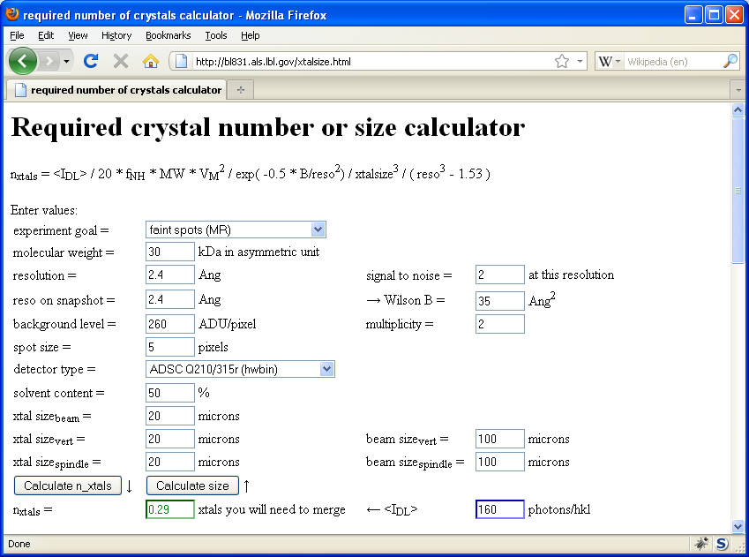
Holton & Frankel (2010) Acta D 66 393-408.

Slide 24
Types of radiation damage
Global
  scale factor
  B factor
  non-isomorphism
Specific

Slide 25
R_{iso} vs dose
R_{iso} (%)
change in dose (MGy)
data taken from Banumathi, et al. (2004) Acta Cryst. D 60, 1085-1093.

Slide 26
R_{iso} vs dose
R_{iso} ≈ 0.7 %/MGy
R_{iso} (%)
change in dose (MGy)
data taken from Banumathi, et al. (2004) Acta Cryst. D 60, 1085-1093.

Slide 27
Types of radiation damage
Global
  scale factor
  B factor
  non-isomorphism
Specific
  depends on chemistry

Slide 28
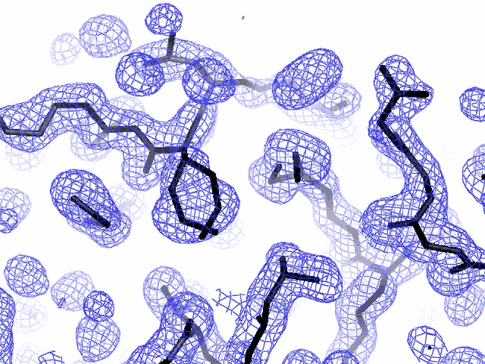
Specific damage
final, refined phases

Slide 29
Types of radiation damage
Global
  scale factor
  B factor
  non-isomorphism
Specific
  depends on chemistry
  destroys phasing signal

Slide 30
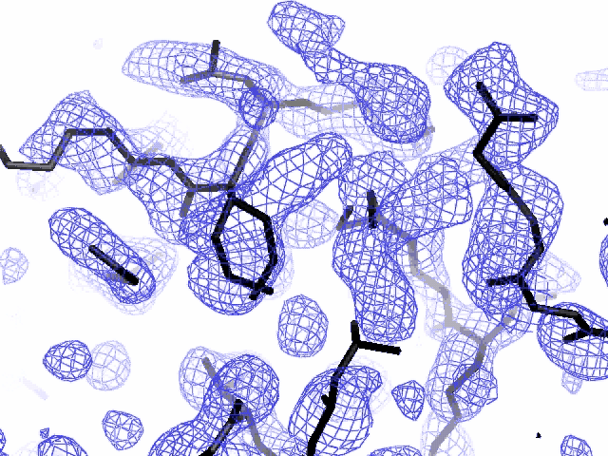
Specific damage
experimentally-obtained phases

Slide 31
Holton, J. M. (2007) J. Synch. Rad. 14, 51-72.

Slide 32
1
0
-CH₂-Se-CH₃
-CH₂ Se-CH₃
must be same phi value!
Holton, J. M. (2007) J. Synch. Rad. 14, 51-72.

Slide 33
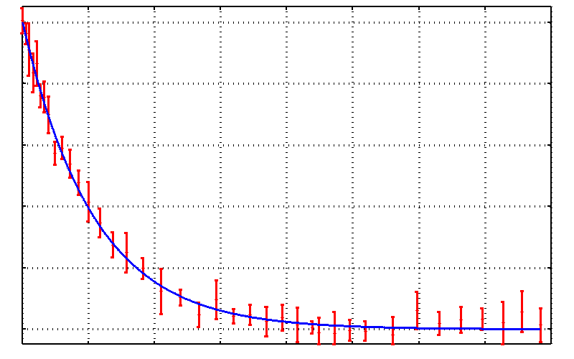
Damage faster than photon hits!
25mM SeMet in 25% glycerol
-CH₂-Se-CH₃
0.0 0.2 0.4 0.6 0.8 1.0
Fraction unconverted
-CH₂ Se-CH₃
0 50 100 150 200 250 300 350 400
fluence (10¹⁵ photons/mm²)
Holton, J. M. (2007) J. Synch. Rad. 14, 51-72.

Slide 34
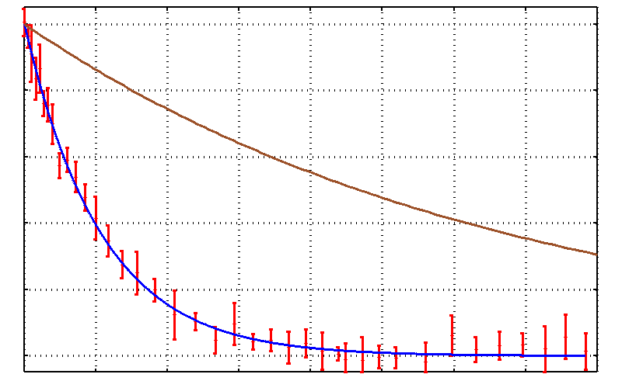
Damage faster than photon hits!
25mM SeMet in 25% glycerol
-CH₂-Se-CH₃
fraction of Se atoms hit
0.0 0.2 0.4 0.6 0.8 1.0
Fraction unconverted
50% Se atoms hit
100% Se-C bonds broken
-CH₂ Se-CH₃
0 50 100 150 200 250 300 350 400
fluence (10¹⁵ photons/mm²)
Holton, J. M. (2007) J. Synch. Rad. 14, 51-72.

Slide 36
Specific damage rates
world records:
MGy reaction reference
~45 global damage Owen et al. (2006)
5 Se-Met Holton (2007)
4 Hg-S Ramagopal et al. (2004)
3 S-S Murray et al. (2002)
1 Br-RNA Olieric et al. (2007)
? Cl-C ???
0.5 Mn in PS II Yano et al. (2005)
0.02 Fe in myoglobin Denisov et al. (2007)
Holton (2009) J. Synchrotron Rad. 16 133-42

Slide 37
Fraction SeMet remaining
Fraction SeMet remaining
Dose (MGy)
+drift
Dose (MGy)
+ drift
Fraction SeMet remaining
burn
&
probe
pinhole
Dose (MGy)

Slide 38
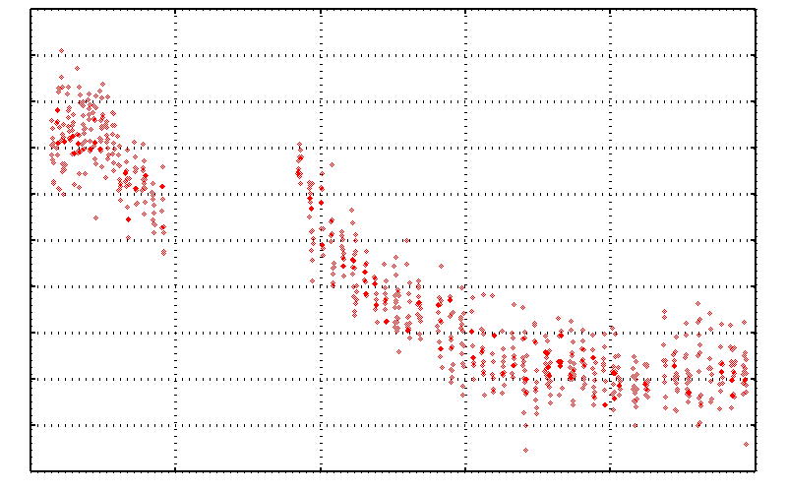
No Damage in the Dark!
4.6 5.0 5.4 5.8 6.2 6.6
Peak absorbance (electrons)
0 5 10 15 20 25
Experiment time (hours)

Slide 39
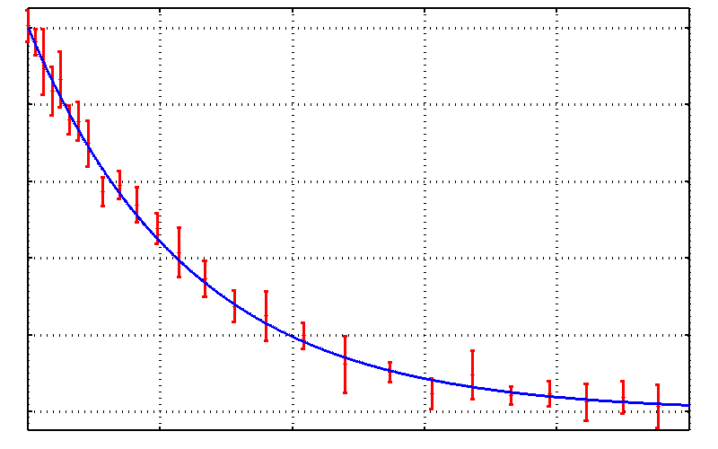
Same experiment vs dose
radiation damage is
FAST!
0.0 0.2 0.4 0.6 0.8 1.0
Fraction unconverted
0 20 40 60 80 100
Absorbed Dose (MGy)

Slide 40
How can solid-state reactions be so fast?
example: electric current
e⁻
e⁻

Slide 41
Where do photons go?
Protein
1A x-rays
Transmitted (98%)
beamstop

Slide 42
Photonuclear absorption

Slide 43
Photonuclear absorption

Slide 44
Elastic scattering

Slide 45
Elastic scattering

Slide 46

Where do photons go?
Protein
1A x-rays
elastic scattering (6%)
Transmitted (98%)
beamstop

Slide 47
Elastic scattering

Slide 48
Inelastic scattering

Slide 49
Where do photons go?
Protein
1A x-rays
elastic scattering (6%)
Transmitted (98%)
beamstop

Slide 50
Where do photons go?
Protein
1A x-rays
elastic scattering (6%)
Transmitted (98%)
beamstop
inelastic scattering (7%)

Slide 51
Where do photons go?
Protein
1A x-rays
elastic scattering (6%)
Transmitted (98%)
beamstop
inelastic scattering (7%)
Re-emitted (99%)
Absorbed (~0%)

Slide 52
Photoelectric absorption

Slide 53
Photoelectric absorption
e⁻
+

Slide 54
Fluorescence
+

Slide 55
Fluorescence
e⁻
+

Slide 56
Auger emission
+

Slide 57
Auger emission
e⁻
++

Slide 58
Where do photons go?
Protein
1A x-rays
elastic scattering (6%)
Transmitted (98%)
beamstop
inelastic scattering (7%)
Re-emitted (99%)
Absorbed (~0%)

Slide 59
Where do photons go?
Protein
1A x-rays
elastic scattering (6%)
Transmitted (98%)
beamstop
inelastic scattering (7%)
Photoelectric (87%)
Re-emitted (99%)
Absorbed (~0%)

Slide 60
Where do photons go?
Protein
1A x-rays
elastic scattering (6%)
Transmitted (98%)
beamstop
inelastic scattering (7%)
Photoelectric (87%)
Re-emitted (99%)
Absorbed (~0%)
Re-emitted (~0%)
Absorbed (99%)

Slide 61
Where do photons go?
Protein
1A x-rays
elastic scattering (6%)
Transmitted (98%)
beamstop
inelastic scattering (7%)
Photoelectric (87%)
Re-emitted (99%)
Absorbed (~0%)
Re-emitted (~0%)
Absorbed (99%)
useful/absorbed energy: 7.3%

Slide 62
Where do photons go?
SelenoProtein
1A x-rays
elastic scattering (6%)
Transmitted (97%)
beamstop
inelastic scattering (5%)
Photoelectric (88%)
Re-emitted (99%)
Absorbed (~0%)
Re-emitted (~0%)
Absorbed (99%)
useful/absorbed energy: 7.6%

Slide 63
Where do photons go?
SelenoProtein
0.92A x-rays
just above the edge
elastic scattering (2%)
Transmitted (91%)
beamstop
inelastic scattering (2%)
Photoelectric (96%)
Re-emitted (99%)
Absorbed (~0%)
Re-emitted (57%)
Absorbed (44%)
useful/absorbed energy: 5.1%

Slide 64
Where do photons go?
SelenoProtein
0.97A x-rays
far above the edge
elastic scattering (2%)
Transmitted (90%)
beamstop
inelastic scattering (2%)
Photoelectric (96%)
Re-emitted (99%)
Absorbed (~0%)
Re-emitted (60%)
Absorbed (40%)
useful/absorbed energy: 5.1%

Slide 65
Photoelectric absorption

Slide 66
Photoelectric absorption
e⁻
+

Slide 67
Secondary ionization
e⁻

Slide 68
Secondary ionization
+
e⁻
e⁻

Slide 69
Excitation
e⁻

Slide 70
Excitation
e⁻

Slide 71
Excitation
e⁻

Slide 72
Excitation

Slide 73
Electron attachment
e⁻

Slide 74
Electron attachment
-

Slide 75
Sample atoms

Slide 76
Sample atoms

Slide 77
Primary ionization
e⁻
+

Slide 78
Secondary ionizations
e⁻
e⁻
+
e⁻
e⁻
+
+
+
+
+
e⁻
e⁻

Slide 79
Ionization track
e⁻
e⁻
e⁻
e⁻
+
e⁻
+
+
+
e⁻
e⁻
+
+
+
+
+
e⁻
+
e⁻
e⁻

Slide 80
Ionization track
e⁻
e⁻
e⁻
e⁻
+
e⁻
+
+
+
e⁻
e⁻
+
+
+
+
+
e⁻
+
e⁻
e⁻

Slide 81
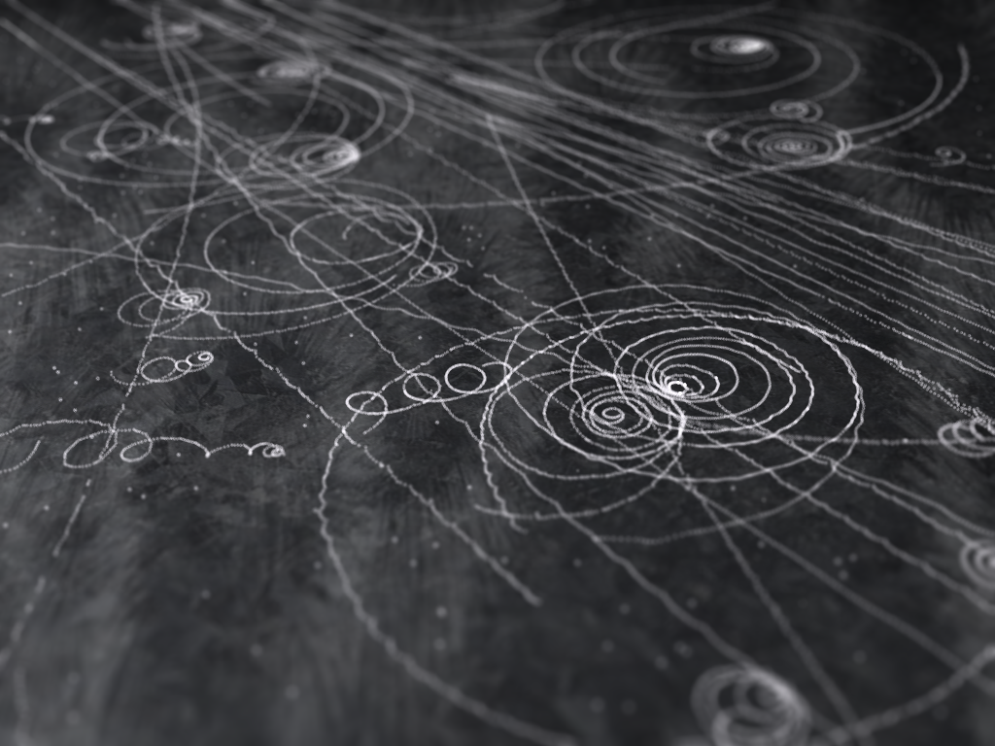
Ionization track

Slide 82
Ionization track

Slide 83
Ionization track
3 μm

Slide 84
Ionization track
Linear Energy Transfer

Slide 85
Ionization track
initial effects

Slide 86
Ionization track
initial effects
Homogeneous reactions

Slide 87
initial effects
e⁻
e⁻
e⁻
e⁻
+
e⁻
+
+
+
e⁻
e⁻
+
+
+
+
+
e⁻
+
e⁻
e⁻

Slide 88
initial effects
e⁻
e⁻
e⁻
e⁻
+
e⁻
+
+
+
e⁻
neutralization
e⁻
+
+
+
+
+
e⁻
+
e⁻
e⁻

Slide 89
initial effects
e⁻
e⁻
e⁻
e⁻
+
e⁻
+
+
neutralization
e⁻
+
+
+
+
+
e⁻
+
e⁻
e⁻

Slide 90
initial effects
e⁻
e⁻
e⁻
e⁻
+
neutralization
+
e⁻
+
+
+
+
+
neutralization
e⁻
e⁻

Slide 91
initial effects
e⁻
e⁻
e⁻
e⁻
+
+
e⁻
+
+
+
+
+
e⁻
attachment
e⁻

Slide 92
initial effects
e⁻
e⁻
e⁻
e⁻
+
+
e⁻
+
+
+
+
+
-
attachment
e⁻

Slide 93
initial effects
e⁻
e⁻
e⁻
attachment
e⁻
+
+
e⁻
+
+
+
+
+
-
e⁻
attachment

Slide 94
initial effects
e⁻
-
e⁻
e⁻
+
+
e⁻
+
+
+
+
+
-
-

Slide 95
initial effects
-
-
-
e⁻
+
+
+
+
+
+
-
-

Slide 96
initial effects
-
-
-
e⁻
solvation
+
+
+
+
+
+
-
-

Slide 97
initial effects
-
-
-
solvation
+
e⁻
+
+
+
+
+
-
-

Slide 98
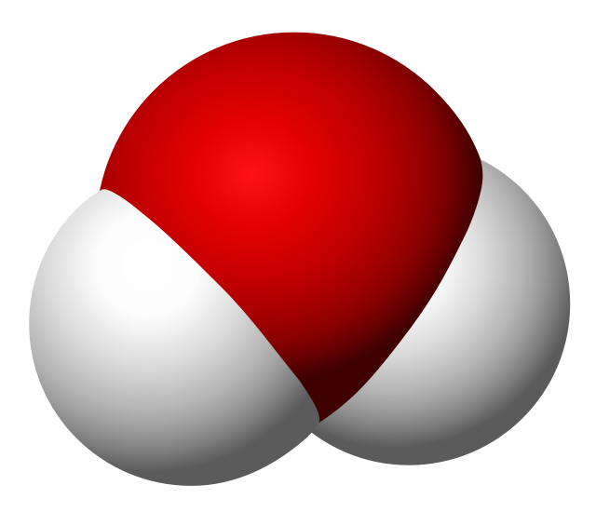
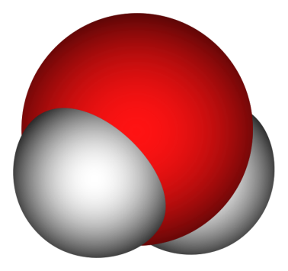
Solvated electron
e⁻

Slide 99
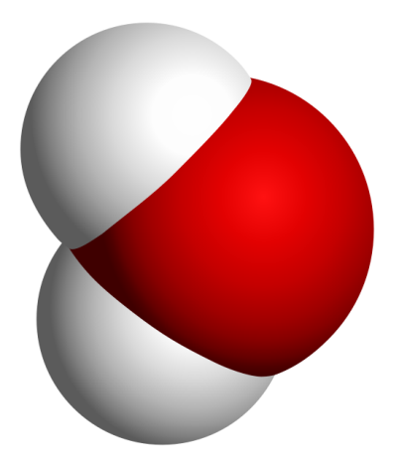
Solvated electron
e⁻

Slide 100
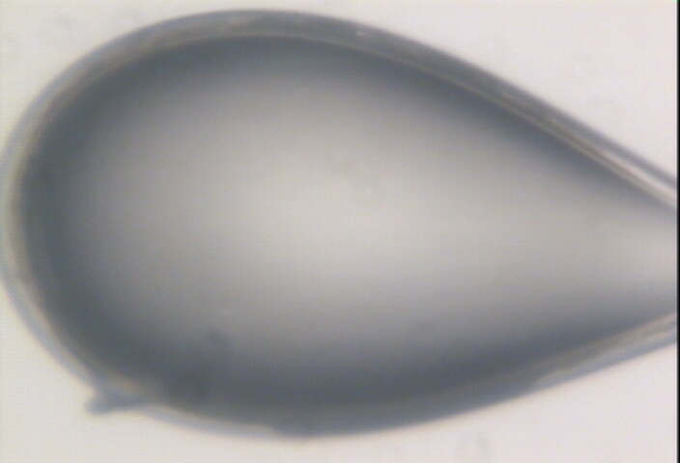

Slide 101
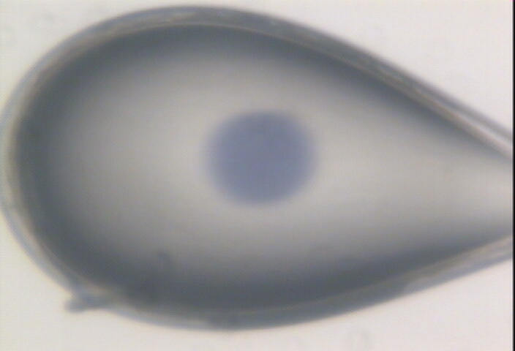

Slide 102
initial effects
-
-
-
+
e⁻
+
+
+
+
+
-
-

Slide 103
initial effects
-
-
-
+
e⁻
+
+
+
+
+
-
-

Slide 104
initial effects
-
-
+
e⁻
+
+
+
+
-
-

Slide 105
initial effects
e⁻
+
+
+
-
-

Slide 106
initial effects
e⁻
+
+
-

Slide 107
Excitation transfer

Slide 108
Excitation transfer
UV photon

Slide 109
Excitation transfer

Slide 110
Excitation transfer
r⁻⁶
Förster transfer

Slide 111
Excitation transfer

Slide 112
t = 0 s

Slide 113
t ≈ 10⁻¹⁵ s
e⁻
+
+
-

Slide 114
Timescales of radiation damage
Garret et. al. (2005) Chem. Rev. 105, 355-389

Slide 115
Ionization track
Heterogeneous reactions
Homogeneous reactions

Slide 116
Timescales of radiation damage
Garret et. al. (2005) Chem. Rev. 105, 355-389

Slide 117
Timescales of radiation damage
LCLS
ALS
bunch
Garret et. al. (2005) Chem. Rev. 105, 355-389

Slide 118
Where do photons go?
Protein
1A x-rays
elastic scattering (6%)
Transmitted (98%)
beamstop
inelastic scattering (7%)
Photoelectric (87%)
Re-emitted (99%)
Absorbed (~0%)
Re-emitted (~0%)
Absorbed (99%)
useful/absorbed energy: 7.3%

Slide 119
Where do photons go?
SelenoProtein
1A x-rays
elastic scattering (6%)
Transmitted (97%)
beamstop
inelastic scattering (5%)
Photoelectric (88%)
Re-emitted (99%)
Absorbed (~0%)
Re-emitted (~0%)
Absorbed (99%)
useful/absorbed energy: 7.6%

Slide 120
Where do photons go?
SelenoProtein
0.92A x-rays
just above the edge
elastic scattering (2%)
Transmitted (91%)
beamstop
inelastic scattering (2%)
Photoelectric (96%)
Re-emitted (99%)
Absorbed (~0%)
Re-emitted (57%)
Absorbed (44%)
useful/absorbed energy: 5.1%

Slide 121
Where do photons go?
SelenoProtein
0.97A x-rays
far above the edge
elastic scattering (2%)
Transmitted (90%)
beamstop
inelastic scattering (2%)
Photoelectric (96%)
Re-emitted (99%)
Absorbed (~0%)
Re-emitted (60%)
Absorbed (40%)
useful/absorbed energy: 5.1%

Slide 122
Rough values of energy quanta
1 MeV 100 GJ/mol Medical radiation therapy
100 keV 10 GJ/mol Medical imaging
10 keV 1 GJ/mol X-ray crystallography
1 keV 100 MJ/mol S and P K-edges
100 eV 10 MJ/mol “water window”
10 eV 1 MJ/mol C≡C bond
1 eV 100 kJ/mol C-C bond, visible light
100 meV 10 kJ/mol hydrogen bond
10 meV 1 kJ/mol heat (~300 K)

Slide 123

Energy Transfer Analogy
37 C

Slide 124
Damage is done
by dose
energy/mass
not time
not heat

Slide 125
what the is a MGy?
http://bl831.als.lbl.gov/
damage_rates.pdf
Holton J. M. (2009) J. Synchrotron Rad. 16 133-42

Slide 126
Things that affect dose
if all others are equal!
flux
beam size
  photons/area matters
heavy atoms
  ~2x for 100 mM

Slide 127
Dose-doubling concentration
molar, at the Se edge based on RADDOSE
Na | 44
Mg | 27
P | 9
S | 7
Cl | 5
K | 3.3
Ca | 2.7
Fe | 1.0
Cu | 0.67
Zn | 0.58
As | 0.44
Se | 0.42
Br | 2.9
I | 0.47
Gd | 0.21
Ta | 0.13
Pt | 0.17
Au | 0.16
Hg | 0.16
U | 0.23

Slide 128
Dose-doubling concentration
molar, at the Se edge based on RADDOSE
Na | 44
Mg | 27
P | 9
S | 7
Cl | 5
K | 3.3
Ca | 2.7
Fe | 1.0
Cu | 0.67
Zn | 0.58
As | 0.44
Se | 0.42
Br | 2.9
I | 0.47
Gd | 0.21
Ta | 0.13
Pt | 0.17
Au | 0.16
Hg | 0.16
U | 0.23

Slide 129
How does “dose” connect to damage?
A simple case…

Slide 130
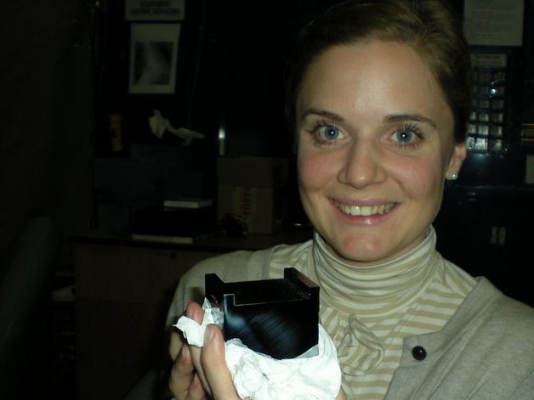
D_{1/2} ~ 10 Gy
D_{1/2} >> 10¹² Gy

Slide 131
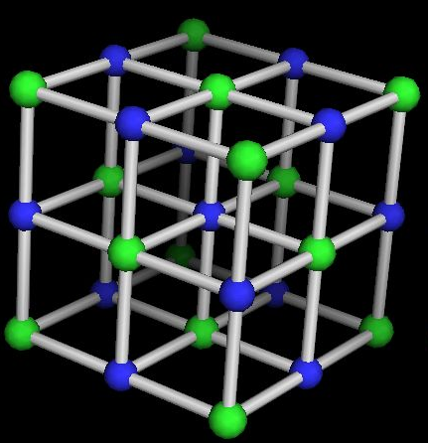
Sodium Chloride is Immortal!
D_{1/2} > 1 GGy

Slide 132
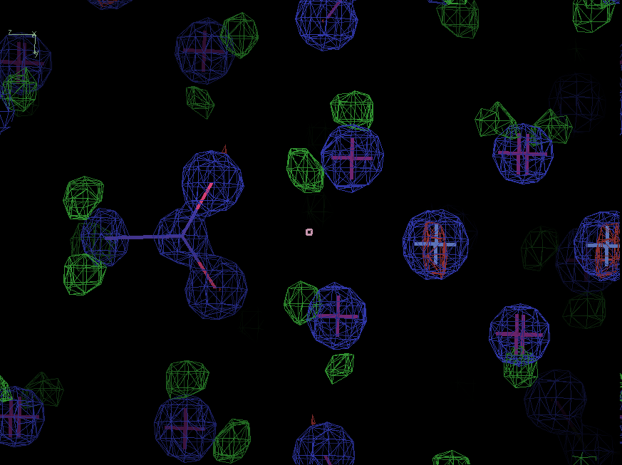
Sodium acetate trihydrate
D_{1/2} = 15 MGy
resolution: 0.92 Å
C2/c
R/Rfree: ~4%
avg B: ~ 0

Slide 133
Interesting spots: (1,1,4) 2.1 Å
integrated spot intensity
phase reversal!
dose (MGy)

Slide 134
lowest-angle spot: (1,1,4) 2.1 Å
integrated spot intensity
dose (MGy)

Slide 135
Brightest spot: (0,0,4) 2.4 Å
integrated spot intensity
dose (MGy)

Slide 136
Brightest spot: (0,0,4) 2.4 Å
integrated spot intensity
dose (MGy)

Slide 137
BEWARE: XDS will re-scale data!
******************************************************************************
CORRECTION PARAMETERS FOR THE STANDARD ERROR OF REFLECTION INTENSITIES
******************************************************************************
The variance v0(I) of the intensity I obtained from counting statistics is
replaced by v(I)=a*(v0(I)+b*I^2). The model parameters a, b are chosen to
minimize the discrepancies between v(I) and the variance estimated from
sample statistics of symmetry related reflections. This model implicates
an asymptotic limit ISa=1/SQRT(a*b) for the highest I/Sigma(I) that the
experimental setup can produce (Diederichs (2010) Acta Cryst D66, 733-740).
Often the value of ISa is reduced from the initial value ISa0 due to systematic
errors showing up by comparison with other data sets in the scaling procedure.
(ISa=ISa0=-1 if v0 is unknown for a data set.)
a b ISa ISa0 INPUT DATA SET
7.021E+00 2.058E-04 26.31 28.49 wedge1/XDS_ASCII.HKL
1.338E+01 5.984E-05 35.34 32.63 wedge2/XDS_ASCII.HKL
1.996E+01 6.606E-05 27.54 23.96 wedge3/XDS_ASCII.HKL
FACTOR TO PLACE ALL DATA SETS TO AN APPROXIMATE ABSOLUTE SCALE 0.3470E+00
(ASSUMING A PROTEIN WITH 50% SOLVENT)

Slide 138
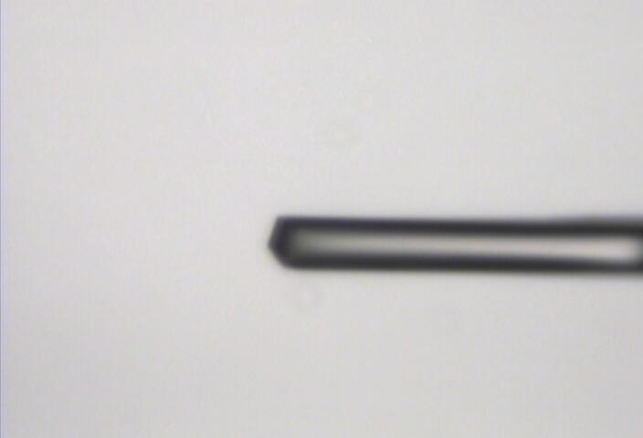
“Cleanup beam” method for flat dose profile
normalized photons/area
position relative to beam center (μm)

Slide 139
“Cleanup beam” method for flat dose profile
normalized photons/area
position relative to beam center (μm)

Slide 140
“Cleanup beam” method for flat dose profile
normalized photons/area
position relative to beam center (μm)

Slide 141
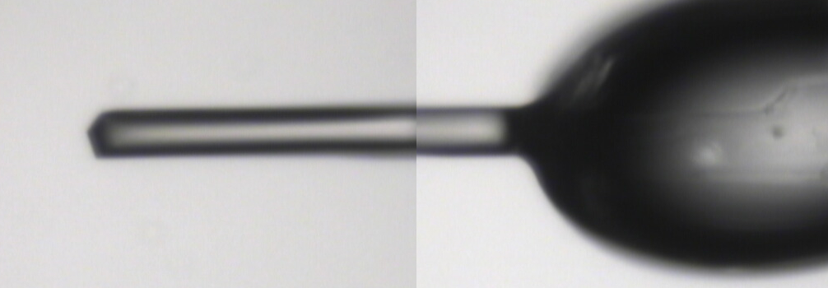
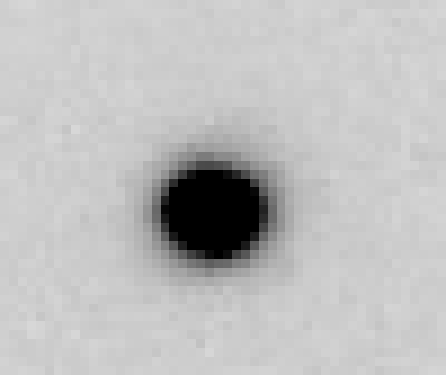
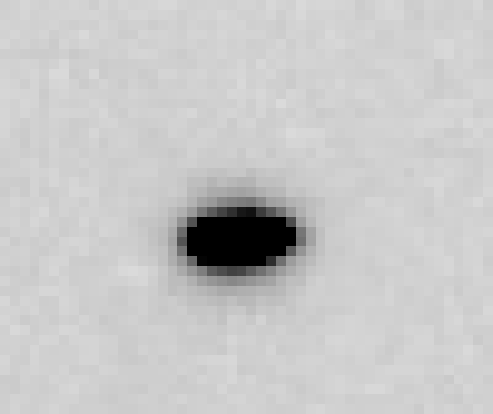
~0 MGy

Slide 142
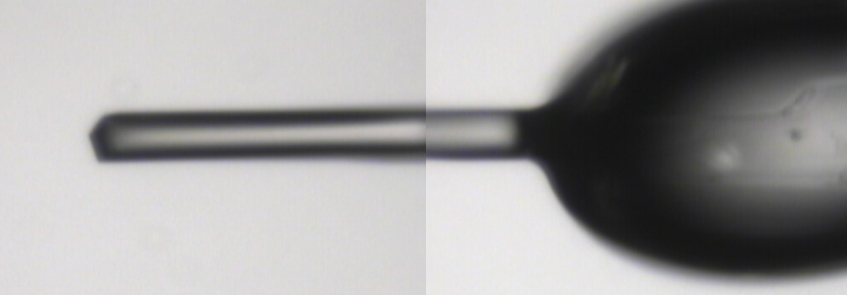
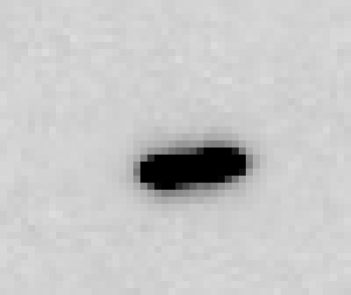
5 MGy

Slide 143
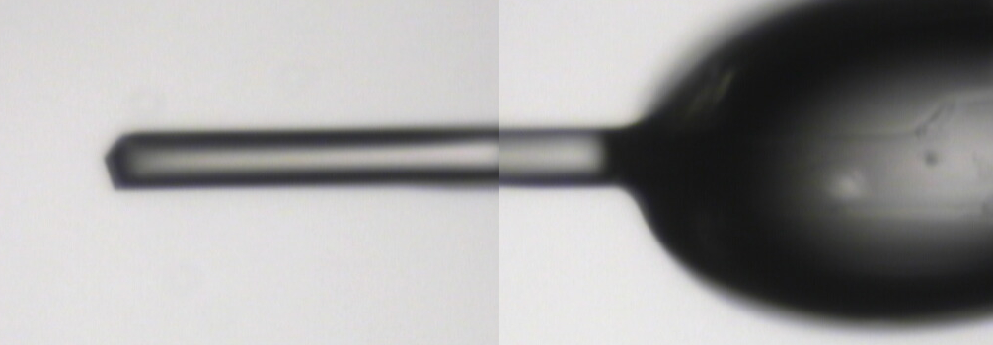
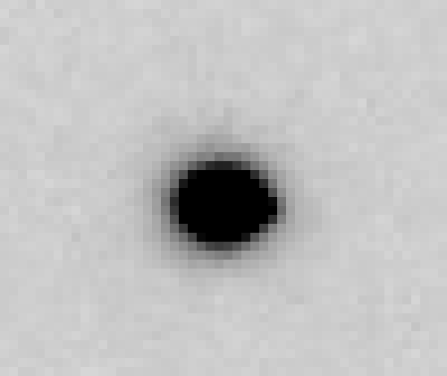
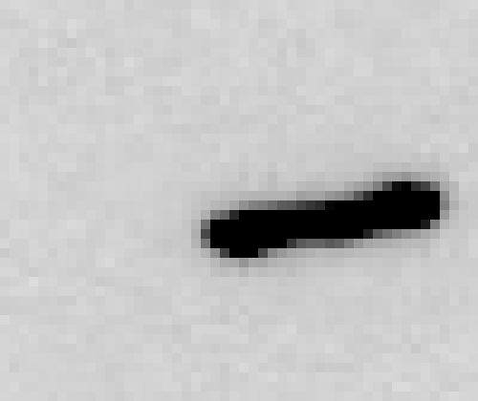
11 MGy

Slide 144
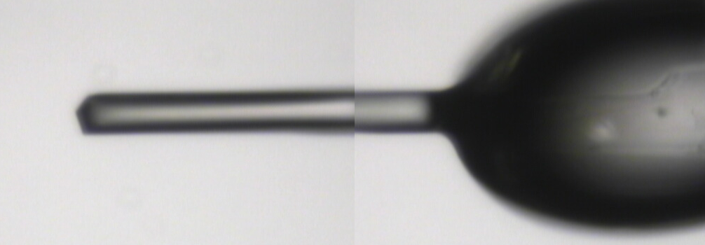
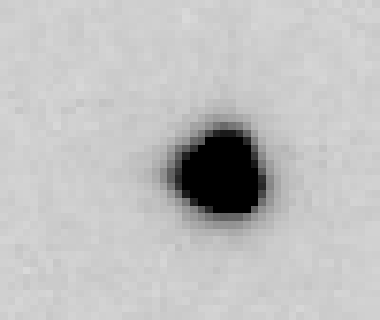

16 MGy

Slide 145
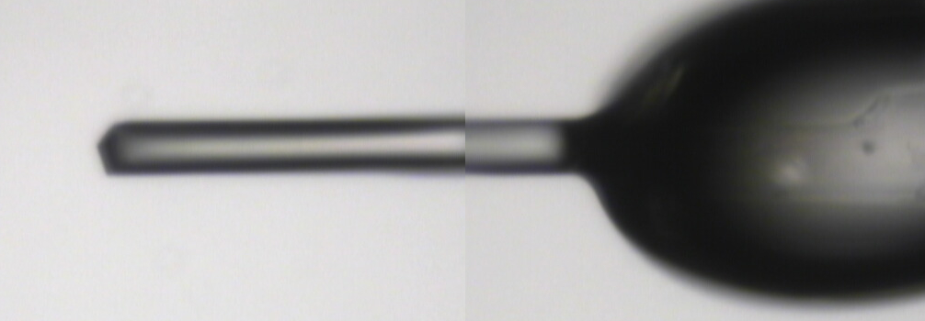
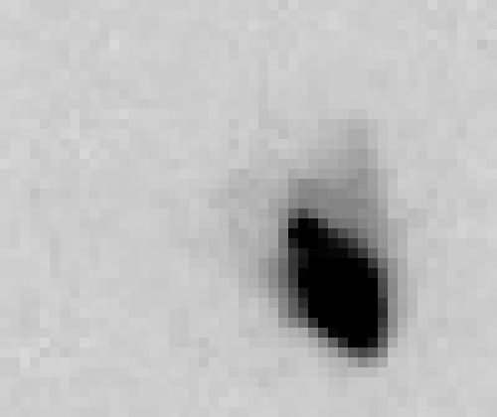
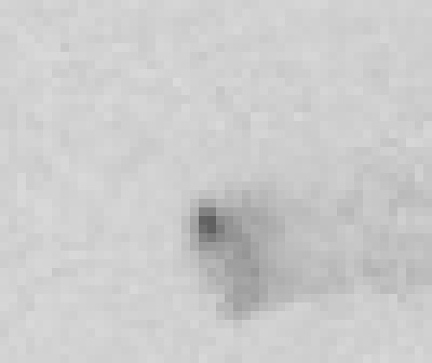
22 MGy

Slide 146
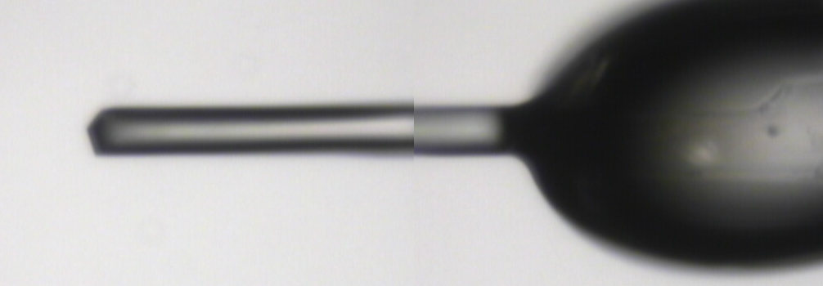
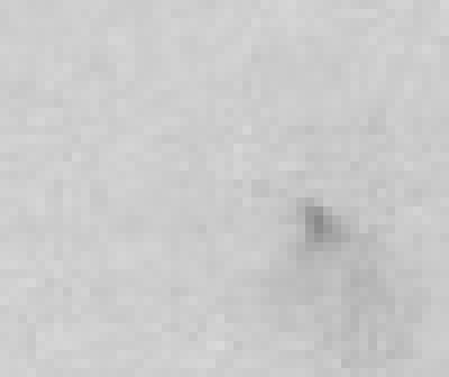
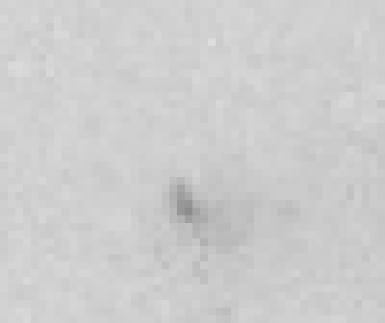
26 MGy

Slide 147
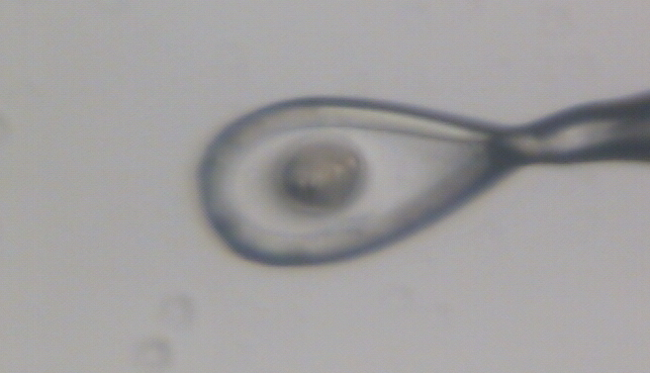
crystal expansion
Protein crystal in sucrose, NaWO4 and oil

Slide 148
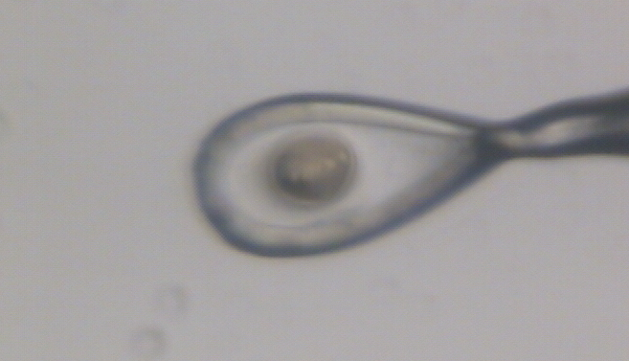
crystal expansion
Protein crystal in sucrose, NaWO4 and oil

Slide 149
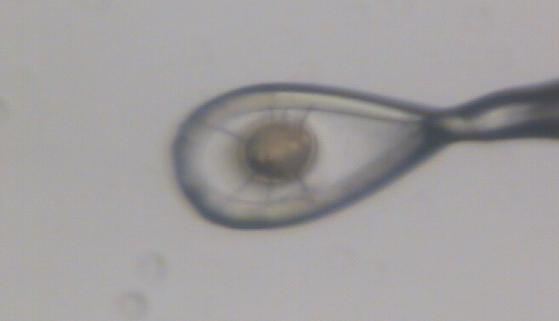
crystal expansion
Protein crystal in sucrose, NaWO4 and oil

Slide 150
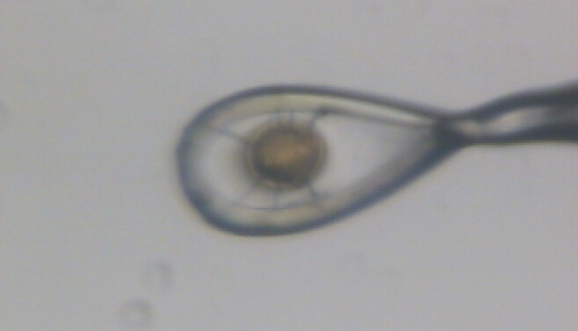
crystal expansion
Protein crystal in sucrose, NaWO4 and oil

Slide 151
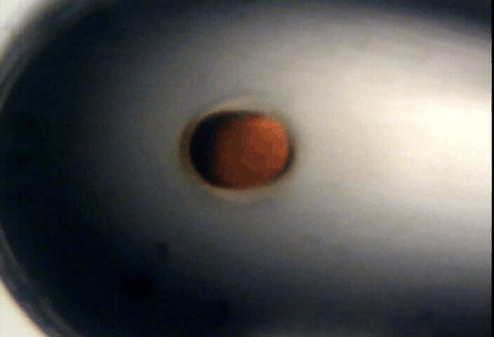
Distention of cryo with dose

Slide 152
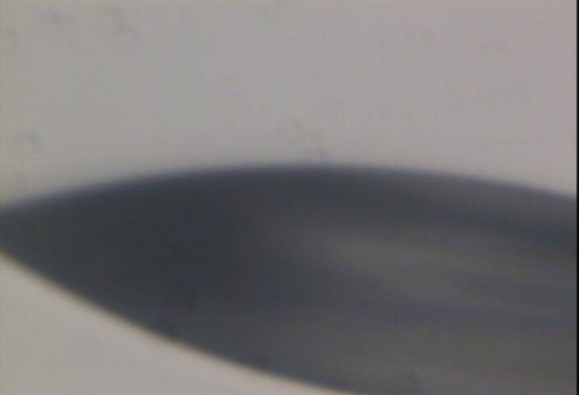
Distention of cryo with dose
before

Slide 153
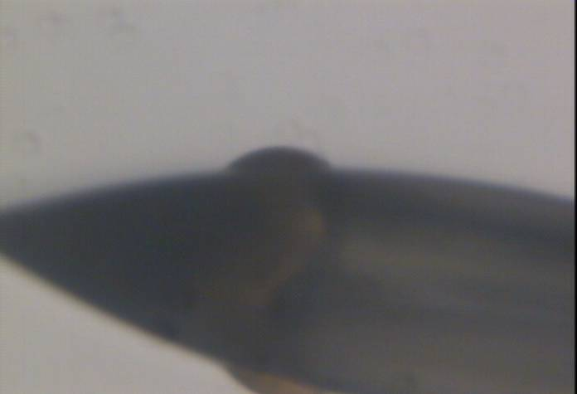
Distention of cryo with dose
after

Slide 154
Distention of cryo with dose

Slide 155
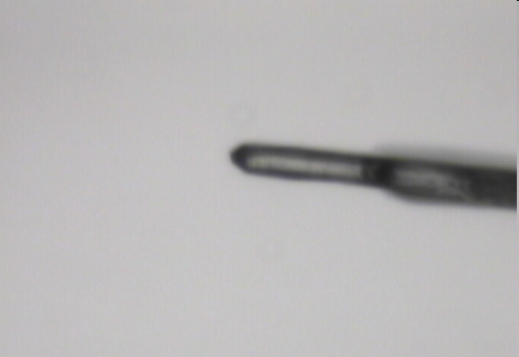
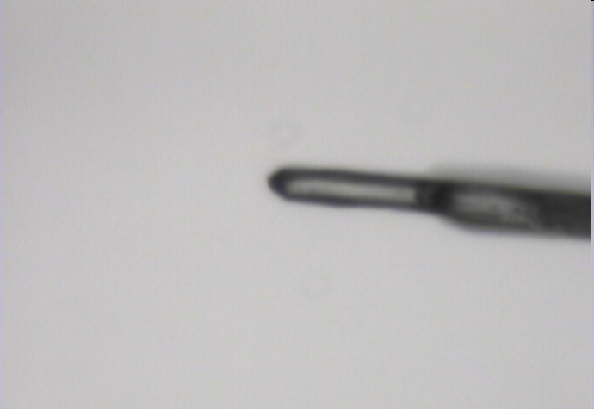
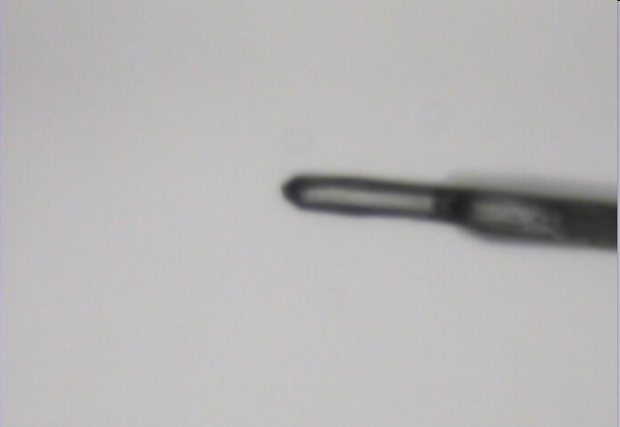
crystal expansion
48 MGy
20 MGy
2 MGy

Slide 156
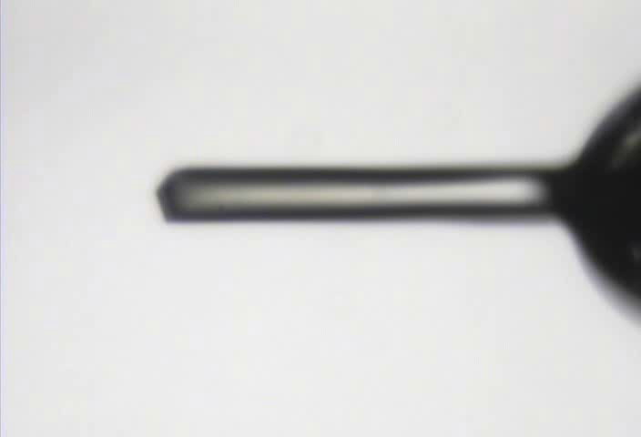
NaAc·3H₂O crystal thaw

Slide 157
Sum of all spot intensities
sum of all integrated spot intensities
dose (MGy)

Slide 158
Sum of all spot intensities
sum of all integrated spot intensities
dose (MGy)

Slide 159
lowest-angle spot: (1,1,0) 7.7 Å
integrated spot intensity
dose (MGy)

Slide 160
Interesting spots: (2,6,1) 1.6 Å
integrated spot intensity
dose (MGy)

Slide 161
Interesting spots: (3,3,-3) 2.3 Å
integrated spot intensity
dose (MGy)

Slide 162
Interesting spots: (6,2,-5) 1.6 Å
integrated spot intensity
dose (MGy)

Slide 163
Interesting spots: (3,3,-5) 1.76 Å
integrated spot intensity
dose (MGy)

Slide 164
Interesting spots: (2,0,0) 5.7 Å
integrated spot intensity
dose (MGy)

Slide 165
refinement R factors
refinement R factor (%)
dose (MGy)

Slide 166
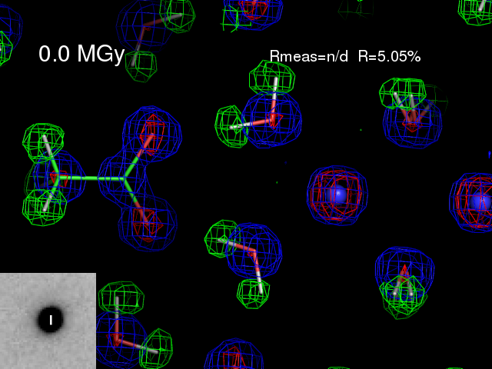

Slide 167


Slide 168


Slide 169


Slide 170


Slide 171


Slide 172


Slide 173


Slide 174


Slide 175


Slide 176


Slide 177


Slide 178


Slide 179


Slide 180


Slide 181


Slide 183


Slide 184


Slide 185


Slide 186


Slide 187


Slide 188


Slide 189
difference map peaks
worst peak height (sigma)
dose (MGy)

Slide 190
Reaction #1
water “rotation”

Slide 191

~0 MGy

Slide 192

2.3 MGy

Slide 193

4.5 MGy

Slide 194

6.8 MGy

Slide 195

9.0 MGy

Slide 196

11 MGy

Slide 197

14 MGy

Slide 198

16 MGy

Slide 199

18 MGy

Slide 200

21 MGy

Slide 201

23 MGy

Slide 202

25 MGy

Slide 203

27 MGy

Slide 204

29 MGy

Slide 205

32 MGy

Slide 206

34 MGy

Slide 207

36 MGy

Slide 208

38 MGy

Slide 209

41 MGy

Slide 210

43 MGy

Slide 211

45 MGy

Slide 212

48 MGy

Slide 213
Occupancy refinement
error bars by σ_{F}
refined occupancy
dose (MGy)

Slide 214
Occupancy refinement
error bars by σ_{F}
refined occupancy
dose (MGy)

Slide 215

hydroxide ion electron density
Mair, S. (1978)."The electron distribution of the hydroxide ion in lithium hydroxide", Acta Cryst. A 34, 542-547.

Slide 216
Reaction #2
acetate “bump”

Slide 217


Slide 218


Slide 219


Slide 220


Slide 221


Slide 222


Slide 223


Slide 224


Slide 225


Slide 226


Slide 227


Slide 228


Slide 229


Slide 230


Slide 231


Slide 232


Slide 233


Slide 234


Slide 236


Slide 237


Slide 238


Slide 239


Slide 240


Slide 241


Slide 242
Occupancy refinement
error bars by σ_{F}
refined occupancy
dose (MGy)

Slide 243
Occupancy refinement
error bars by σ_{F}
electrons
dose (MGy)

Slide 244
Reaction #3 ?
hydrogen loss ?

Slide 245
Occupancy refinement
error bars by σ_{F}
electrons
dose (MGy)

Slide 246
Occupancy refinement
error bars by σ_{F}
electrons
dose (MGy)

Slide 247


Slide 248


Slide 249


Slide 250


Slide 251


Slide 252


Slide 253


Slide 254


Slide 255


Slide 256


Slide 257


Slide 258


Slide 259


Slide 260


Slide 261


Slide 262


Slide 263


Slide 264


Slide 265


Slide 266


Slide 267


Slide 268


Slide 269
Occupancy refinement
error bars by σ_{F}
electrons
dose (MGy)

Slide 270
Overall Scale Factor
scale from phenix.refine
dose (MGy)

Slide 271
Occupancy refinement
error bars by σ_{F}
electrons
dose (MGy)

Slide 272
"error bar" for electron density
structure factor (e⁻/cell)
spot index

Slide 273
"error bar" for electron density
structure factor (e⁻/cell)
electron density (e⁻/Å³)
spot index
fractional coordinate

Slide 274
"error bar" for electron density
structure factor (e⁻/cell)
electron density (e⁻/Å³)
spot index
fractional coordinate

Slide 275
"error bar" for electron density
structure factor (e⁻/cell)
electron density (e⁻/Å³)
spot index
fractional coordinate

Slide 276
"error bar" for electron density
structure factor (e⁻/cell)
electron density (e⁻/Å³)
spot index
fractional coordinate

Slide 277
"error bar" for electron density
structure factor (e⁻/cell)
electron density (e⁻/Å³)
spot index
fractional coordinate

Slide 278
"error bar" for electron density
structure factor (e⁻/cell)
electron density (e⁻/Å³)
spot index
fractional coordinate

Slide 279
"error bar" for electron density
structure factor (e⁻/cell)
electron density (e⁻/Å³)
spot index
fractional coordinate

Slide 280
"error bar" for electron density
structure factor (e⁻/cell)
electron density (e⁻/Å³)
spot index
fractional coordinate

Slide 281
"error bar" for electron density
structure factor (e⁻/cell)
electron density (e⁻/Å³)
spot index
fractional coordinate

Slide 282
"error bar" for electron density
structure factor (e⁻/cell)
electron density (e⁻/Å³)
spot index
fractional coordinate

Slide 283
"error bar" for electron density
structure factor (e⁻/cell)
electron density (e⁻/Å³)
spot index
fractional coordinate

Slide 284
"error bar" for electron density
Refinement
Against
Perturbed
Input
Data
electron density (e⁻/Å³)
fractional coordinate

Slide 285
Occupancy refinement
error bars by σ_{F}
electrons
dose (MGy)

Slide 286
Occupancy refinement
error bars by σ ~ |F_{obs}-F_{calc}|
electrons
dose (MGy)

Slide 287
Can radiation damage be “outrun”?

Slide 288
Dose-rate dependence of damage
maximum useful dose (MGy)
dose rate (kGy/s)

Slide 289


Dose-rate effect at Room Temp?
Owen RL, Axford D, Nettleship JE, Owens RJ, Robinson JI, Morgan AW, Dore AS, Lebon G, Tate CG, Fry EE, Ren J, Stuart DI & Evans G (2012)."Outrunning free radicals in room-temperature macromolecular crystallography", Acta Cryst. D 68, 810-818.
Warkentin M, Badeau R, Hopkins JB, Mulichak AM, Keefe LJ & Thorne RE (2012)."Global radiation damage at 300 and 260 K with dose rates approaching 1 MGy s-1", Acta Cryst. D 68, 124-133.

Slide 290

Pilatus pile-up for RT MX? same photons, different speeds
Sum of 193 shots with
193-fold attenuation

Slide 291

Pilatus pile-up for RT MX? same photons, different speeds
1 shot with
no attenuation

Slide 292

Pilatus pile-up for RT MX? same photons, different speeds

Slide 293

Pilatus pile-up for RT MX? same photons, different speeds
20 deg/s
0.016 deg
mosaic

Slide 294

Pilatus pile-up for RT MX? same photons, different speeds

Slide 295



Attenu-wait: same photons, different time
Incident beam transmittance (%)
100 20 10 6.7 5
Integrated photons in spot
Exposure time (seconds) for 1° osc

Slide 296
Attenu-wait: same photons, different time
Incident beam transmittance (%)
100 20 10 6.7 5
Integrated photons in spot
Exposure time (seconds) for 1° osc

Slide 297
What could be better than photon-counting?
Count rate (photons/s)
phi position (degrees)

Slide 298
What could be better than photon-counting?
Dead times:
1000 ns Oxford
200 ns Pilatus
Count rate (photons/s)
phi position (degrees)

Slide 299


What is a “streak camera”?

Slide 300
What is a “streak camera”?
0.1 mm/pixel
= 4 ms/pixel
25 mm/s

Slide 301


Slide 303
Individual spots at 768 kGy/s
Intensity (photons)
0
Dose (kGy)
Same xtal, different spots

Slide 304
Individual spots at 768 kGy/s
Intensity (photons)
0
Dose (kGy)
Same xtal, different spots

Slide 305
Individual spots at 768 kGy/s
Intensity (photons)
0
Dose (kGy)
Same xtal, different spots

Slide 306
Individual spots at 768 kGy/s
Intensity (photons)
0
Dose (kGy)
Same xtal, different spots

Slide 307
Individual spots at 768 kGy/s
Intensity (photons)
0
Dose (kGy)
Same xtal, different spots

Slide 308
Individual spots at 768 kGy/s
Intensity (photons)
0
Dose (kGy)
Same xtal, different spots

Slide 309
Individual spots at 768 kGy/s
Intensity (photons)
0
Dose (kGy)
Same xtal, different spots

Slide 310

xtal24big
Real time at 674 kGy/s

Slide 311

xtal12
Double tap: 0.4 s on + 1 s off + on again

Slide 312
Double-tap: no dark progression at 675 kGy/s
Intensity (photons)
Dose (kGy)

Slide 313
Double-tap: no dark progression at 675 kGy/s
Intensity (photons)
Dose (kGy)

Slide 314

xtal14
Double tap: 0.4 s on + 1 s off + on again

Slide 315

Xtal15 slow
Double tap lite: 5 s on + 12.6 s off + on again

Slide 316

Xtal15 fast
Double tap lite: 5 s on + 12.6 s off + on again

Slide 317
Individual spots at 44.3 kGy/s
Intensity (photons)
Time (seconds)

Slide 318
Individual spots at 44.3 kGy/s
Intensity (photons)
Time (seconds)

Slide 319
Individual spots at 44.3 kGy/s
Intensity (photons)
Time (seconds)

Slide 320
Wiggle to get fulls
Ewald sphere

Slide 321


Slow wiggle

Slide 322
Dose rate: same hkl, same xtal
Intensity (photons)
Dose (kGy)

Slide 323
Dose rate: same hkl, same xtal
Intensity (photons)
Dose (kGy)

Slide 324
Dose rate: same hkl, same xtal
Intensity (photons)
Dose (kGy)

Slide 325
Dose rate: same hkl, same xtal
Intensity (photons)
Dose (kGy)

Slide 326
Dose rate: same hkl, same xtal
Intensity (photons)
Dose (kGy)

Slide 327
Dose rate: same hkl, same xtal
Intensity (photons)
Dose (kGy)

Slide 328



Xtal12 before & after
morphological dose-rate effect?
110 kGy/s
720 kGy/s

Slide 329

Xtal4_t1
Solvent “reaction” at 764 kGy/s

Slide 330

xtal4_t2
Solvent “reaction” at 764 kGy/s

Slide 331

xtal13
Double tap: 0.4 s on + 1 s off + on again

Slide 332


xtal13
Double tap: 0.4 s on + 1 s off + on again

Slide 333
How much H₂ are we making?
Meents et al. (2010) claimed:
"400 molecules of H2 for every 12.5 keV photon“
= 3.3x10⁻⁷ mol/J
200 kGy to 100 um³ = 0.24 J
= 1.2x10⁻⁸ mol H₂
100 um³ of water = 6.7x10⁻⁸ mol
→ 18% of water has reacted!

Slide 334

xtal5_t1
Crystal “shrinks?” at 764 kGy/s

Slide 335

xtal5_t2
Crystal “shrinks?” at 764 kGy/s

Slide 336

Xtal5_t1 graph
Spot intensity
seconds

Slide 337
Xtal4_t1
No bubbles? 764 kGy/s

Slide 338

Xtal5_t1 graph

Slide 339
Summary
Same D_{1/2} at ~700 and ~70 kGy/s
No dark progression
Delay in beam = delay in bubbles
Shrinkage suggests “radio-dessication”

Slide 340

Room Temperature Damage (powder)
fraction of starting intensity
sin(θ)/λ
dose (kGy)

Slide 341

Cryo Temperature Damage (powder)
fraction of starting intensity
sin(θ)/λ
dose (MGy)

Slide 342
Room temperature damage rate
dose at half intensity (MGy)
dose rate (kGy/s)

Slide 343
Room temperature damage rate
dose at half intensity (MGy)
dose rate (kGy/s)

Slide 344
Room temperature damage rate
dose at half intensity (MGy)
dose rate (kGy/s)

Slide 345
Room temperature damage rate
dose at half intensity (MGy)
dose rate (kGy/s)

Slide 346
Room temperature damage rates
dose at half intensity (MGy)
dose rate (kGy/s)

Slide 347
Dose-rate dependence of damage
maximum useful dose (MGy)
dose rate (kGy/s)

Slide 348
Dose-rate dependence of damage
maximum useful dose (MGy)
dose rate (kGy/s)

Slide 349
Dose-rate dependence of damage
maximum useful dose (MGy)
dose rate (kGy/s)

Slide 350

xtal16

Slide 351

xtal17

Slide 352

xtal18

Slide 353

Xtal24big_t2

Slide 354
Summary
Same D_{1/2} at ~700 and ~70 kGy/s
No dark progression
Delay in beam = delay in bubbles
Shrinkage suggests “radio-dessication”

