Slide 1
Acknowledgements
Chris Neilson Aina Cohen Ana Gonzalez Mike Soltis
Meitian Wang Clemens Schulze-Briese Joe Ferarra
UCSF LBNL SLAC
ALS 8.3.1 creator: Tom Alber
Integrated Diffraction Analysis Technologies (IDAT)
Center for Structure of Membrane Proteins (CSMP)
Membrane Protein Expression Center II (MPEC)
Center for HIV Accessory and Regulatory Complexes (HARC)
UC Multicampus Research Programs and Initiatives (MRPI)
UCSF Program for Breakthrough Biomedical Research (PBBR) Plexxikon, Inc.
M D Anderson CRC
The Advanced Light Source is supported by the Director, Office of Science, Office of Basic Energy Sciences, Materials Sciences Division, of the US Department of Energy under contract No. DE-AC02-05CH11231 at Lawrence Berkeley National Laboratory.

Slide 2
SHSSS!
The dominant source of error for anomalous difference measurements
Spatial
Heterogeneity in
Sharp
Spot
Sensitivity
Flat
Field

Slide 3
SHSSS!
The dominant source of error for anomalous difference measurements
Spatial
Heterogeneity in
Sharp
Spot
Sensitivity
Flat
Field
90%
110%
x 1.11 =
100%
x 0.91 =
100%

Slide 4
SHSSS!
The dominant source of error for anomalous difference measurements
Spatial
Heterogeneity in
Sharp
Spot
Sensitivity
Sharp
Spot
20%
110%
x 1.11 =
22%
x 0.91 =
100%

Slide 5
SHSSS!
The dominant source of error for anomalous difference measurements
Spatial
Heterogeneity in
Sharp
Spot
Sensitivity
Sharp
Spot
90%
30%
Integral: 127.3
x 1.11 =
100%
x 0.91 =
27.3%

Slide 6
SHSSS!
The dominant source of error for anomalous difference measurements
Spatial
Heterogeneity in
Sharp
Spot
Sensitivity
Sharp
Spot
20%
110%
Integral: 122.2
x 1.11 =
22.2%
x 0.91 =
100%

Slide 7
Can you count to 1,000,000?
sqrt(1,000,000)
1,000,000
= 0.1%
= R_{meas}?
I/σ = 1000
Source of error | realistic | No SHSSS | Perfect detector
Photon counting | + | + | +
Shutter jitter | + | + | -
Beam flicker | + | + | -
Sample absorption | + | + | -
Radiation damage | + | + | -
Imperfect spindle | + | + | -
Corner correction | + | + | -
SHSSS | + | - | -
R-meas (∞-10 Å) | 2.8% | 0.7% | 0.7%
I/sigma asymptotic | 26.8 | 74.2 | 81.0
Holton et al. (2014)."R-factor gap", FEBS J. 281, 4046-4060.

Slide 8
S-SAD distribution of difficulty
I/σ = 33
I/σ = 100
Number of proteins
I/σ = 200
I/σ = 50
Bijvoet ratio (%)

Slide 9
How do you measure SHSSS?

Slide 10
Spatial Heterogeneity in Sharp Spot Sensitivity
How do you measure SHSSS?
Shuffle evaluation order:
Convert systematic → random

Slide 11
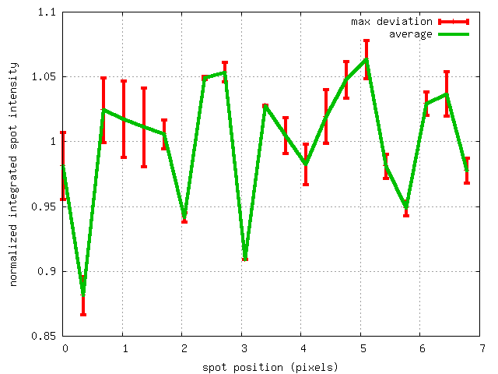
How do you measure SHSSS?
1.10
1.05
1.00
Relative integrated spot intensity
0.95
0.90
0.85
0 1 2 3 4 5 6 7
Spot position (pixels)

Slide 12

SHSSS for MX spots

Slide 13
SHSSS for MX spots
down

Slide 14
SHSSS for MX spots
down
up

Slide 15
SHSSS for MX spots
down
up
R_{separate}

Slide 16
SHSSS for MX spots
odd
even
R_{mixed}

Slide 17
SHSSS for MX spots
separate:
2.5%

Slide 18
SHSSS for MX spots
separate:
mixed:
2.5%
0.9%

Slide 19
SHSSS for MX spots
separate:
mixed:
2.5%
0.9%
2.5%²-0.9%² = 2.3%²

Slide 20
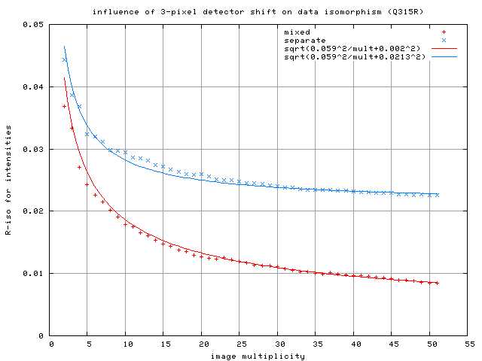
5
sqrt(5.9²/mult + 2.1²)
sqrt(5.9²/mult + 0.2²)
4
Q315r
10-pixel shift
3
R_{diff} (%) between half-sets
2
1
0
Image multiplicity

Slide 21
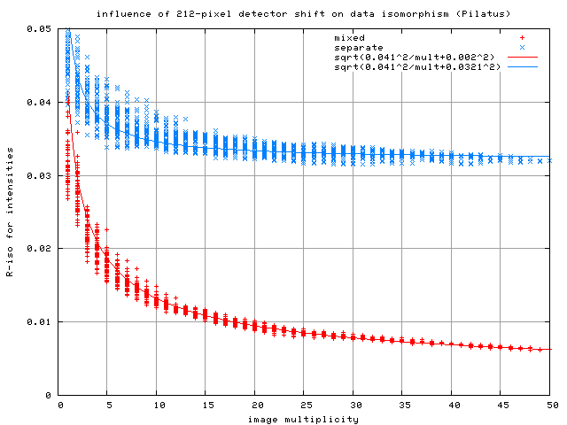
5
sqrt(4.1²/mult + 3.2²)
sqrt(4.1²/mult + 0.2²)
4
3
Pilatus
1-module shift
R_{diff} (%) between half-sets
2
1
0
Image multiplicity

Slide 22
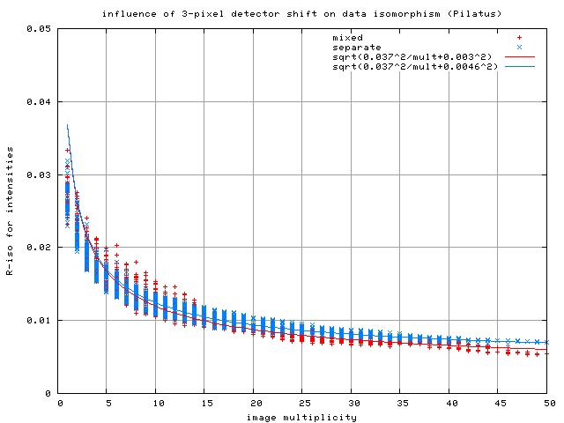
5
sqrt(3.7²/mult + 0.5²)
sqrt(3.7²/mult + 0.3²)
4
3
Pilatus
1-pixel shift
R_{diff} (%) between half-sets
2
1
0
Image multiplicity

Slide 23
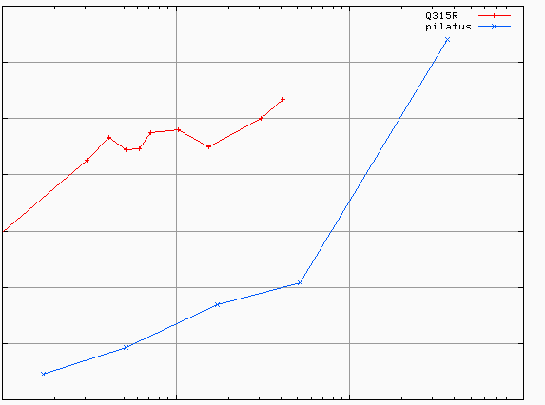
SHSSS: CCD vs PAD
3.5
3.0
2.5
2.0
1.5
1.0
0.5
different
modules
Q315r
anomalous mates are
> 100 mm apart
Systematic component of R_{shift} (%)
Pilatus
0.1 1 10 100
distance between spots (mm)

Slide 24
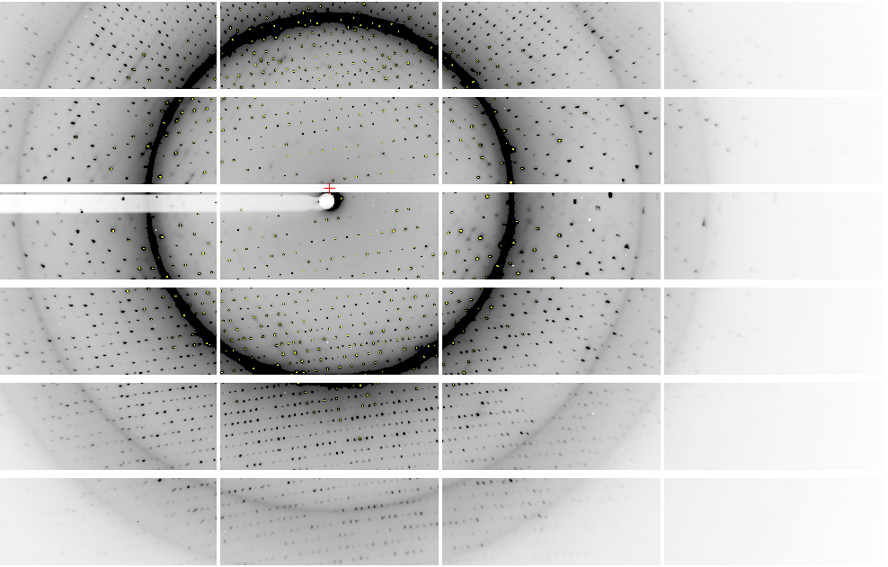
Pilatus: 1-module shift

Slide 25
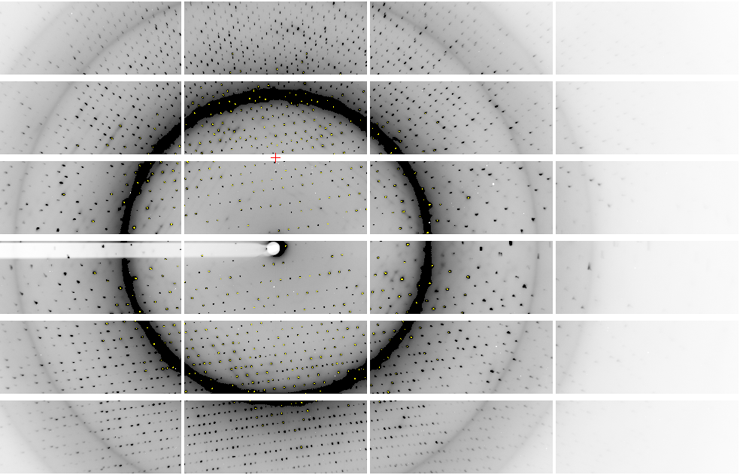
Pilatus: 1-module shift

Slide 26
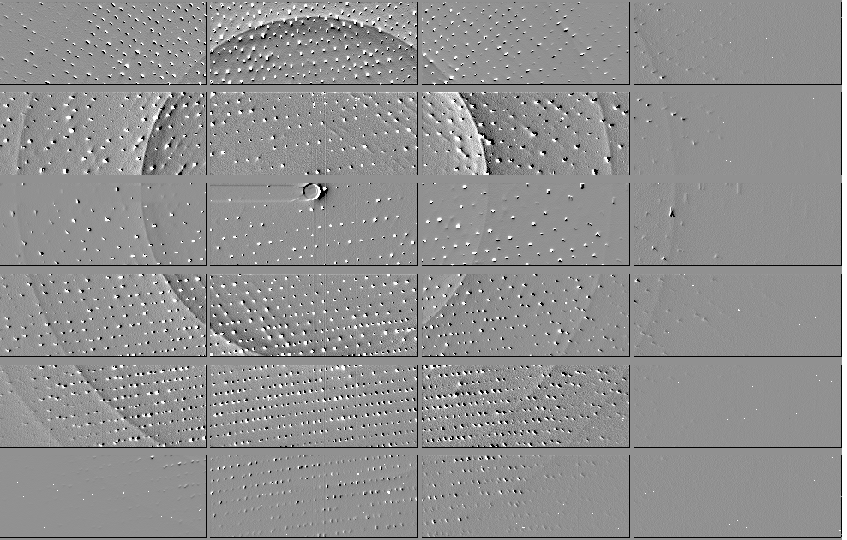
Pilatus: 1-module shift

Slide 27
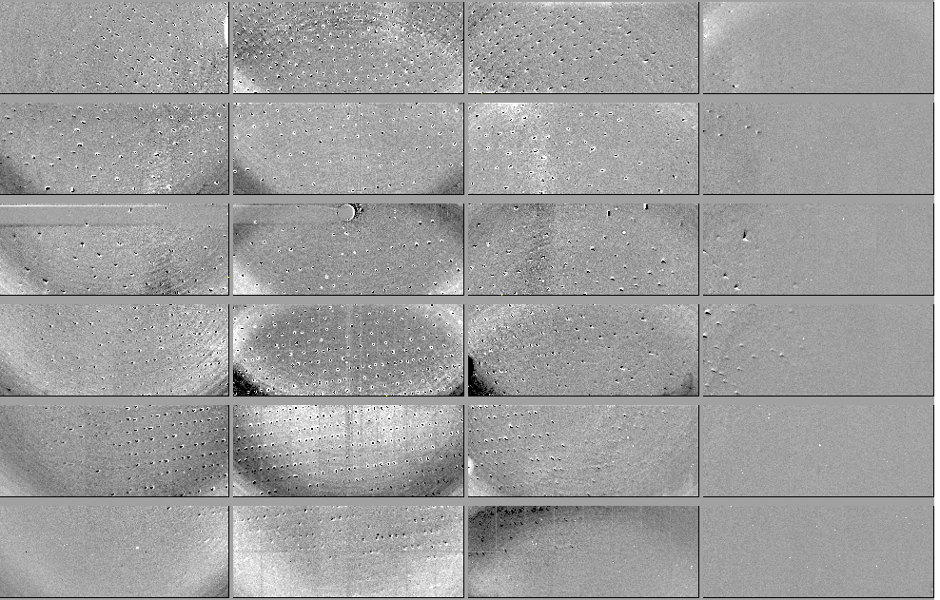
Pilatus: 1-module shift - aligned

Slide 28
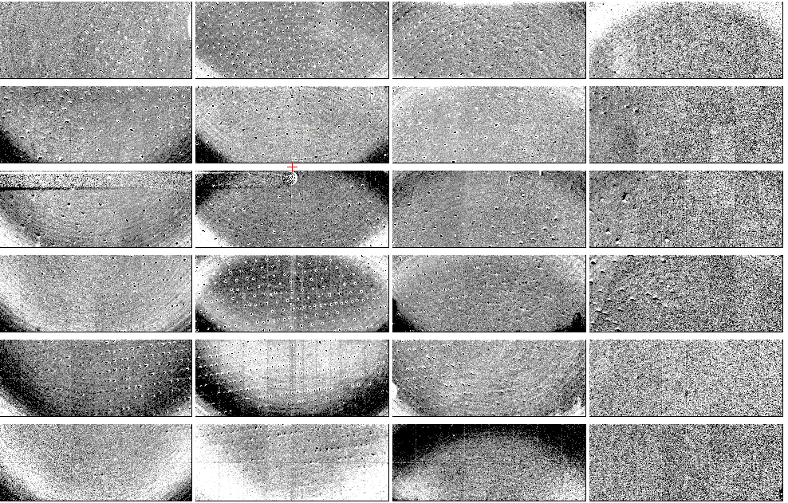
Pilatus: 1-module shift - ratio
+3%
- 3%

Slide 29

Pilatus: flood field
~3x10⁵ photon/pixel ratio vs smooth
+1%
- 1%

Slide 30
SHSSS: CCD vs PAD
3.5
3.0
2.5
2.0
1.5
1.0
0.5
different
modules
Q315r
anomalous mates are
> 100 mm apart
Systematic component of R_{shift} (%)
Pilatus
recent
model
0.1 1 10 100
distance between spots (mm)

Slide 31
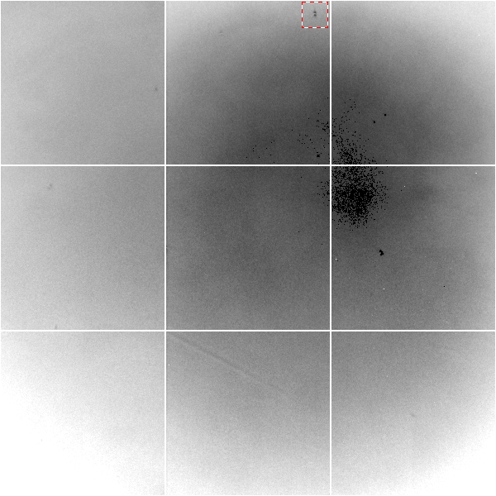
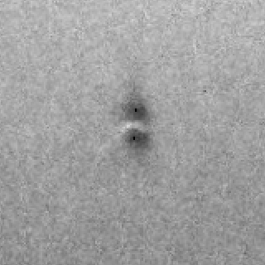
CCD: Gd edge contrast
Gadolinium edge contrast map of fiber-coupled CCD detector. Black to white is a 20% range.

Slide 32
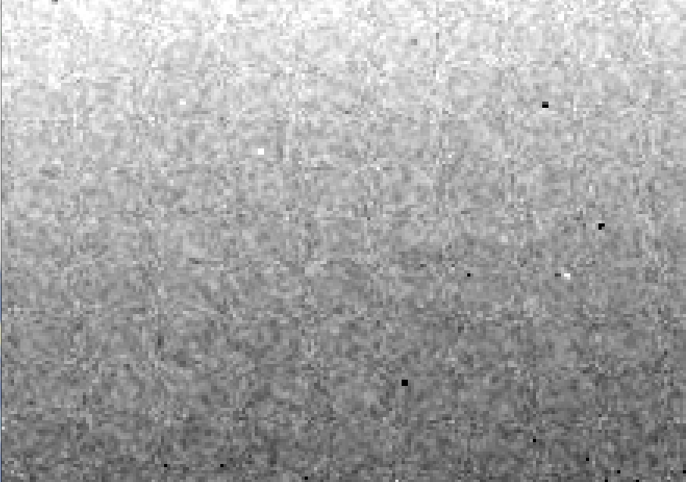
CCD calibration: 7235 eV

Slide 33
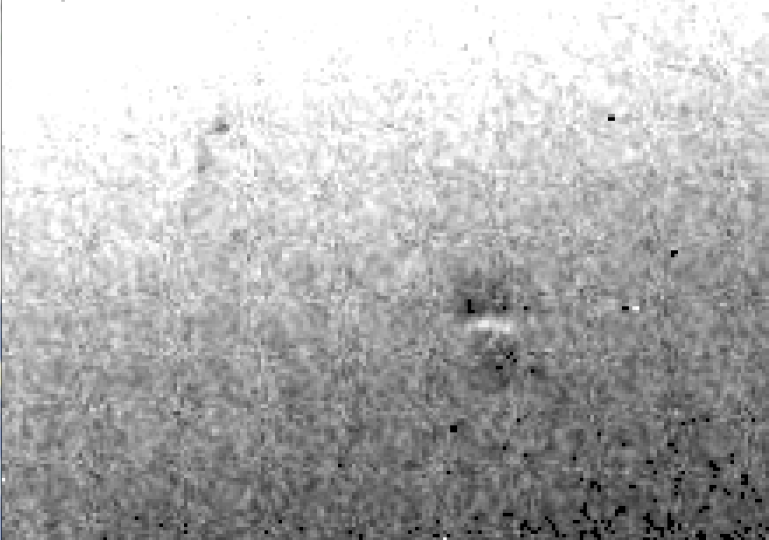
CCD calibration: 7247 eV

Slide 34
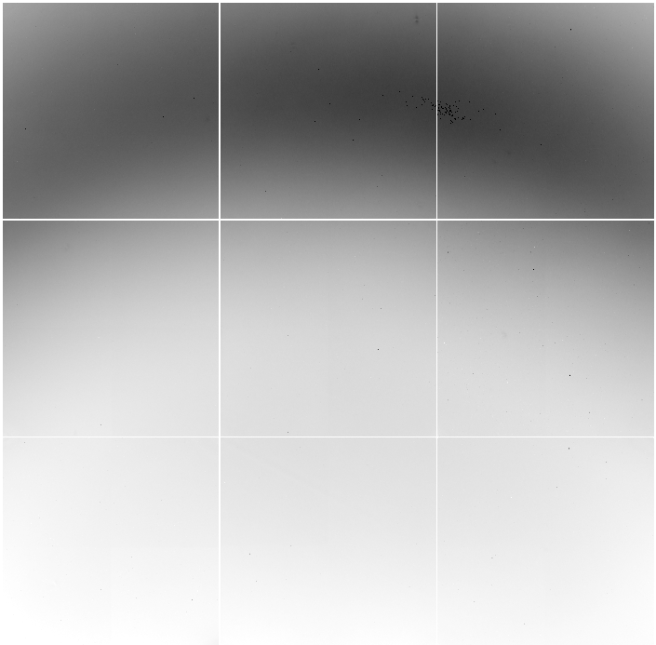
Detector calibration: 7247 eV
target:
oil
distance:
900 mm
2θ: 12°

Slide 35
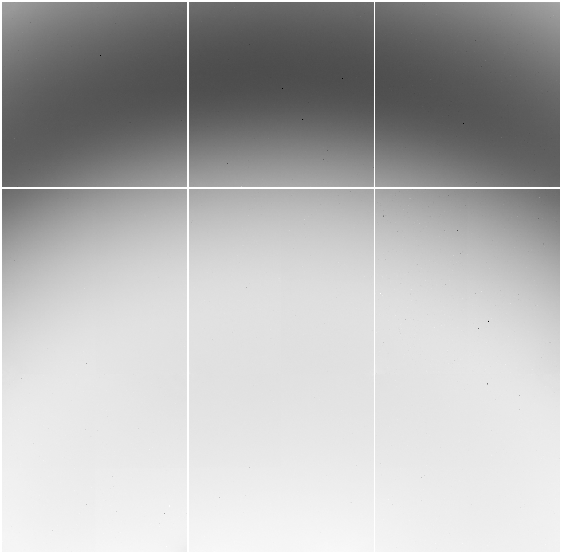
Detector calibration: 7235 eV
target:
oil
distance:
900 mm
2θ: 12°

Slide 36
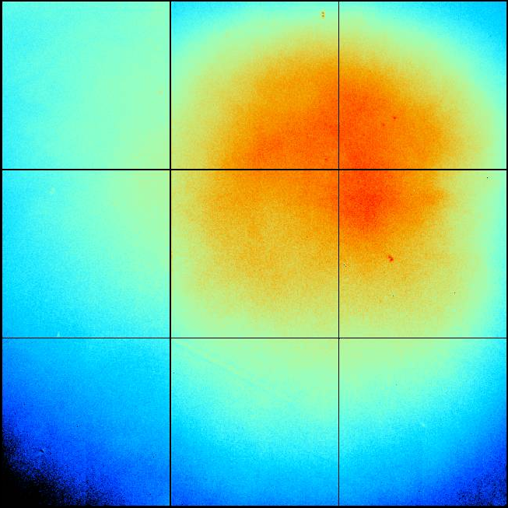
ADSC Q315r SN 926 (ALS 8.3.1)
+10%
-10%

Slide 37
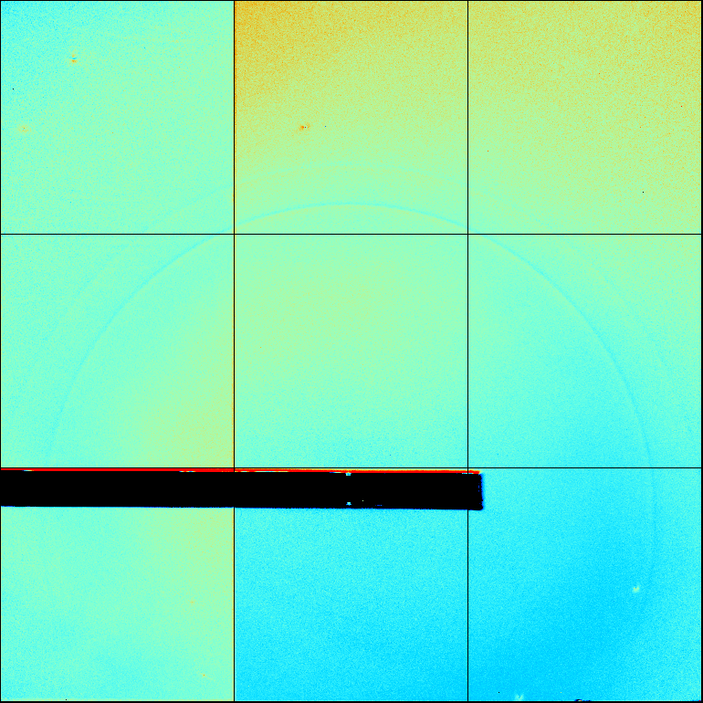
ADSC Q315r SN )

Slide 38
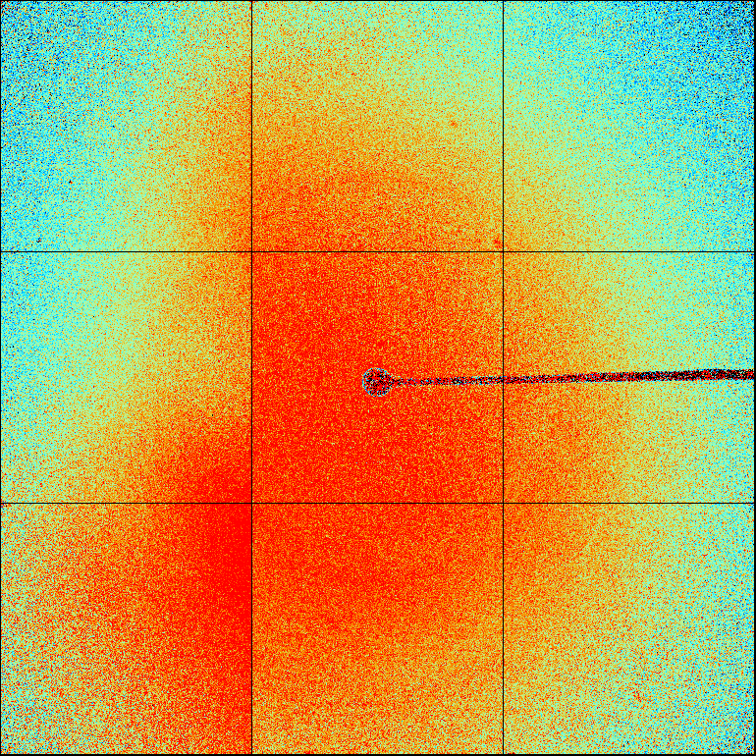
ADSC Q315r SN )

Slide 39
Detector calibration
megapixels
calibration error (%)

Slide 40
Gadox calibration vs energy
same = good!
Relative absorption depth
bad!
Mar
photon energy (keV)

Slide 41
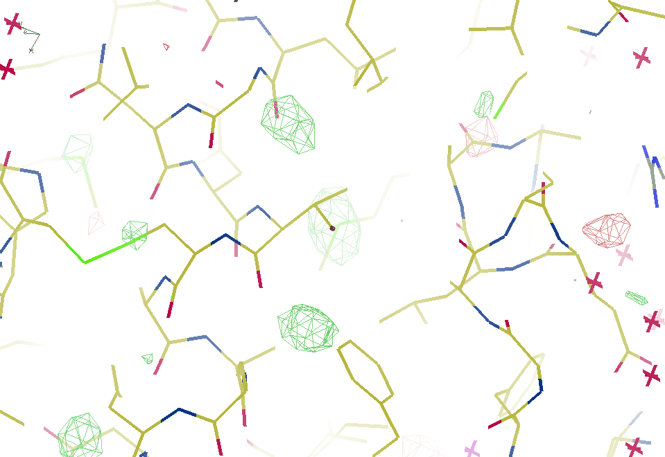
7247 eV

Slide 42
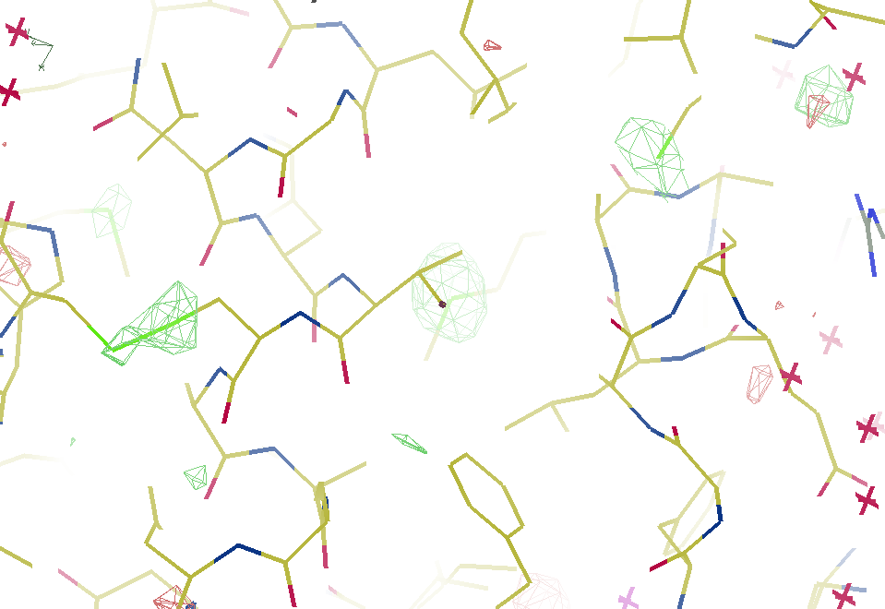
7235 eV

Slide 43
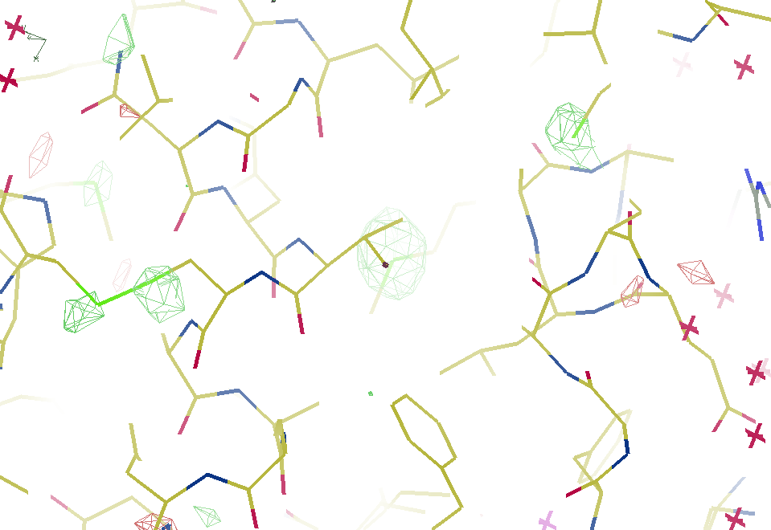
Detector calibration
7223 eV

Slide 44
Oh! SHSSS! how do we get rid of it?
Average over it
Model it out
go MAD

Slide 45
Oh! SHSSS! how do we get rid of it?
Average over it
Model it out
go MAD

Slide 46

Averaging doesn’t always reduce error

Slide 47
Averaging over SHSSS
“true” multiplicity = never use same pixel twice
^{mult >} (—)²
~3%
<ΔF/F>
sqrt(1,000)
1,000
photon
spot
= 3%
> 1000 is a waste!

Slide 48
Dose slicing
100 um³ xtal = 10¹² photons
N
photons
unacceptable
damage
N
photons
unacceptable
read noise
N
photons

Slide 49
R_{iso} vs dose
R_{iso} ≈ 0.7 %/MGy
R_{iso} (%)
change in dose (MGy)
data taken from Banumathi, et al. (2004) Acta Cryst. D 60, 1085-1093.

Slide 50
140-fold multiplicity
16 crystals, 360° each, inverse beam, 7235 eV AS MX1
SUBSET OF INTENSITY DATA WITH SIGNAL/NOISE >= -3.0 AS FUNCTION OF RESOLUTION
RESOLUTION NUMBER OF REFLECTIONS COMPLETENESS R-FACTOR R-FACTOR COMPARED I/SIGMA R-meas CC(1/2) Anomal SigAno Nano
LIMIT OBSERVED UNIQUE POSSIBLE OF DATA observed expected Corr
9.17 188919 1061 1071 99.1% 3.9% 4.8% 188919 257.47 3.9% 100.0* 91* 5.024 450
6.49 356827 1933 1933 100.0% 5.2% 5.5% 356827 214.33 5.2% 100.0* 86* 3.836 882
5.30 466503 2515 2515 100.0% 7.2% 7.0% 466503 165.13 7.2% 100.0* 76* 3.257 1175
4.59 548405 2974 2974 100.0% 7.2% 6.6% 548405 175.42 7.3% 100.0* 67* 2.589 1403
4.10 615117 3353 3355 99.9% 7.7% 6.7% 615117 174.13 7.7% 100.0* 59* 2.264 1594
3.74 684947 3734 3737 99.9% 9.4% 8.3% 684947 143.09 9.4% 100.0* 49* 1.953 1783
3.47 743557 4051 4051 100.0% 11.2% 10.1% 743557 120.17 11.2% 100.0* 39* 1.696 1942
3.24 799722 4366 4366 100.0% 14.1% 13.9% 799722 91.14 14.1% 100.0* 30* 1.333 2103
3.06 839252 4598 4603 99.9% 19.5% 20.2% 839252 65.79 19.5% 100.0* 23* 1.117 2214
2.90 891398 4904 4908 99.9% 29.0% 31.7% 891398 44.85 29.1% 99.9* 17* 1.008 2369
2.77 931622 5148 5151 99.9% 40.5% 44.8% 931622 32.58 40.6% 99.8* 11* 0.901 2493
2.65 969629 5384 5387 99.9% 52.8% 58.8% 969629 25.16 52.9% 99.8* 10* 0.866 2605
2.54 997213 5574 5574 100.0% 67.4% 76.0% 997213 19.47 67.6% 99.6* 2 0.804 2705
2.45 1031222 5889 5889 100.0% 88.9% 101.2% 1031222 14.58 89.2% 99.2* 4 0.831 2859
2.37 788617 6008 6008 100.0% 109.3% 125.5% 788617 9.97 109.7% 98.1* 5 0.829 2925
2.29 614145 6252 6252 100.0% 138.2% 161.4% 614145 6.87 138.9% 96.1* 1 0.760 3037
2.22 470283 6481 6481 100.0% 197.1% 231.7% 470283 4.03 198.6% 83.5* -1 0.721 3159
2.16 259836 6629 6631 100.0% 227.3% 268.7% 259831 2.41 230.8% 46.9* -1 0.677 3224
2.10 36259 4169 6807 61.2% 154.4% 169.4% 36229 1.28 163.6% 47.0* -2 0.660 1999
2.05 13567 3372 7037 47.9% 170.1% 187.0% 13503 0.68 196.5% 25.7* 3 0.629 1578
total 12247040 88395 94730 93.3% 15.7% 16.4% 12246941 54.30 15.8% 100.0* 12* 1.217 42499

Slide 51
140-fold multiplicity: 16 crystals, 360° each, inverse beam, 7235 eV
RESOLUTION COMPLETENESS R-FACTOR I/SIGMA R-meas CC(1/2) Anomal SigAno Nano
LIMIT OF DATA observed Corr
9.17 99.1% 3.9% 257.47 3.9% 100.0* 91* 5.024 450
6.49 100.0% 5.2% 214.33 5.2% 100.0* 86* 3.836 882
5.30 100.0% 7.2% 165.13 7.2% 100.0* 76* 3.257 1175
4.59 100.0% 7.2% 175.42 7.3% 100.0* 67* 2.589 1403
4.10 99.9% 7.7% 174.13 7.7% 100.0* 59* 2.264 1594
3.74 99.9% 9.4% 143.09 9.4% 100.0* 49* 1.953 1783
3.47 100.0% 11.2% 120.17 11.2% 100.0* 39* 1.696 1942
3.24 100.0% 14.1% 91.14 14.1% 100.0* 30* 1.333 2103
3.06 99.9% 19.5% 65.79 19.5% 100.0* 23* 1.117 2214
2.90 99.9% 29.0% 44.85 29.1% 99.9* 17* 1.008 2369
2.77 99.9% 40.5% 32.58 40.6% 99.8* 11* 0.901 2493
2.65 99.9% 52.8% 25.16 52.9% 99.8* 10* 0.866 2605
2.54 100.0% 67.4% 19.47 67.6% 99.6* 2 0.804 2705
2.45 100.0% 88.9% 14.58 89.2% 99.2* 4 0.831 2859
2.37 100.0% 109.3% 9.97 109.7% 98.1* 5 0.829 2925
2.29 100.0% 138.2% 6.87 138.9% 96.1* 1 0.760 3037
2.22 100.0% 197.1% 4.03 198.6% 83.5* -1 0.721 3159
2.16 100.0% 227.3% 2.41 230.8% 46.9* -1 0.677 3224
2.10 61.2% 154.4% 1.28 163.6% 47.0* -2 0.660 1999
2.05 47.9% 170.1% 0.68 196.5% 25.7* 3 0.629 1578
total 93.3% 15.7% 54.30 15.8% 100.0* 12* 1.217 42499

Slide 52
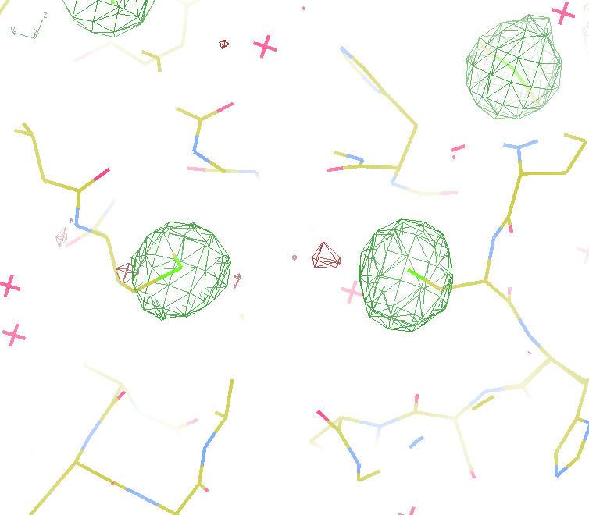
140-fold multiplicity
18 σ
16 σ
Phased anomalous difference Fourier
data Courtesy of Tom Peat & Janet Newman

Slide 53
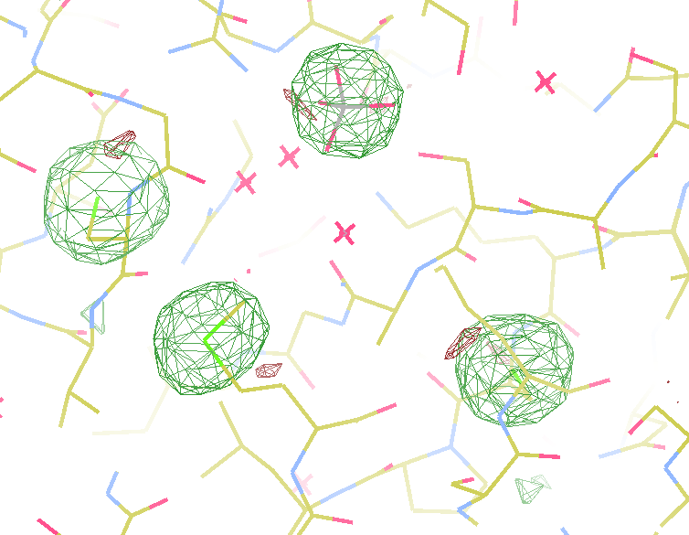
140-fold multiplicity
15σ = PO₄
Phased anomalous difference Fourier
data Courtesy of Tom Peat & Janet Newman

Slide 54
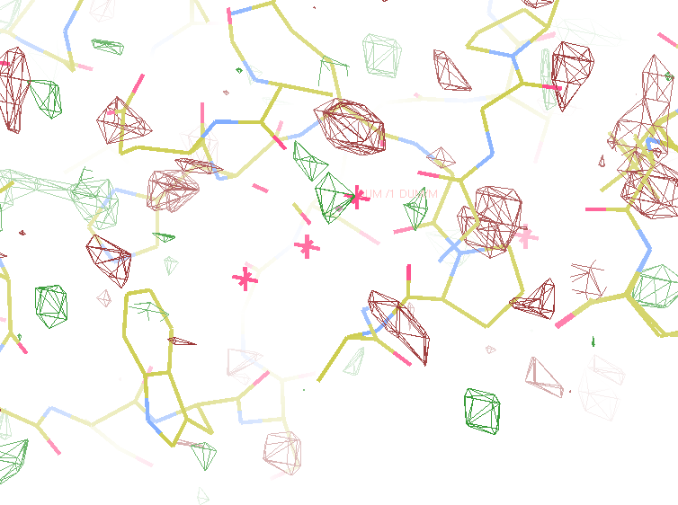
140-fold multiplicity
~2σ = Mg?
Phased anomalous difference Fourier
data Courtesy of Tom Peat & Janet Newman

Slide 55
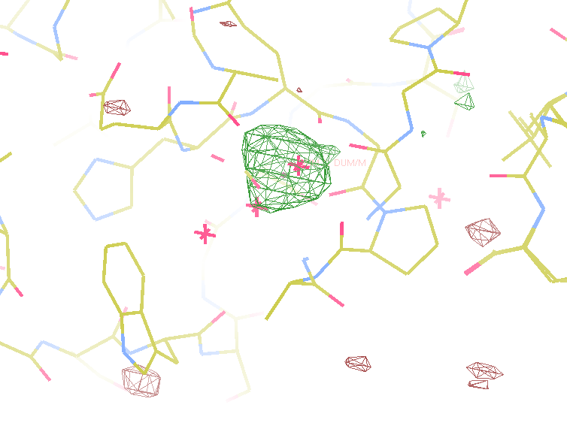
140-fold multiplicity
10 σ is enough for phasing!
Bunkoczi et al. (2015)."weak, single-wavelength anomalous", Nat. Meth. 12, 127-130.
8.2σ = Mg?
DELFAN residual anomalous difference
data Courtesy of Tom Peat & Janet Newman

Slide 56
Discerning Na⁺ from Mg⁺⁺
DELFAN peak height (σ)
N
O
F
Ne
Na
Mg
f’’ (electrons)

Slide 57

Non-isomorphism in lysozyme
PDB:
3aw6
3aw7
Δa = 0.8%
RH 84.2% vs 71.9%
RMSD = 0.18 Å
R_{iso} = 44.5%

Slide 58
plunge cooling
warm, moist air
ice
cold N₂
liquid N₂
foam insulation

Slide 59
plunge cooling
warm, moist air
ice
cold N₂
liquid N₂
foam insulation

Slide 60
Warkentin method
liquid N₂
foam insulation
Warkentin (2006) J. Appl. Crystallogr. 39, 805-811.

Slide 61
Oh! SHSSS! how do we get rid of it?
Average over it
Model it out
go MAD

Slide 62
Pilatus: flood field
~3x10⁵ photon/pixel ratio vs smooth
+1%
- 1%

Slide 63
Detector pixels are 3D
51 μm
172 μm
75 μm
150 μm
8%
side
loss
53%
side
loss
76%
side
loss
57%
side
loss
photon
17%
loss
photon
photon
31 μm thick
Pilatus
320 μm thick
Eiger
ADSC CCD
ADSC HF
26% loss
450 μm thick
Arrival angle of 2 Å spot: 29°
Mean Penetration depth 12 keV:
237 μm Si 17.5 μm Gd₂O₂S
500 μm thick
15%
loss
12% loss

Slide 64
Detector pixels are 3D
θ
λ

Slide 65
Detector pixels are 3D
θ
λ

Slide 66
Detector pixels are 3D
θ
λ
5% thickness variation

Slide 67
HPAD calibration
width
θ
λ
λ
θ
thick
trim
trim
trim
trim
trim
trim
trim
N
N
N
N
N
N
N

Slide 68
HPAD vs mmPAD
width
θ
λ
λ
θ
thick
trim
trim
trim
trim
gain
trim
gain
trim
gain
N
N
N
N
= k
Q
N
= k
Q
N
= k
Q

Slide 69
Oh! SHSSS! how do we get rid of it?
Average over it
Model it out
go MAD

Slide 70
Two wavelengths are better than one

Slide 71
S-MAD Sample size Dilemma

Slide 72
Damage limited crystal size (synchrotron)
wavelength dependence
Å
Å
crystal diameter (μm)
Holton & Frankel, “minimum crystal size” Acta Cryst. D 66, 393 (2010).

Slide 73
Darwin’s Formula
V_{xtal}
λ³ L
I_{spot} = I_{beam} r_{e}²
P A | F₀e^{-Bs2} |²
V_{cell}
ωV_{cell}
I_{spot} - photons/spot (fully-recorded)
I_{beam} - incident (photons/s/m² )
r_{e} - classical electron radius (2.818x10⁻¹⁵ m)
V_{xtal} - volume of crystal (in m³)
V_{cell} - volume of unit cell (in m³)
λ - x-ray wavelength (in meters!)
ω - rotation speed (radians/s)
L - Lorentz factor (speed/speed)
P - polarization factor
A - attenuation correction
F₀ - structure factor at T = 0
B - Debye-Waller-Ott factor
s - 0.5/d-spacing
C. G. Darwin (1914)

Slide 74
The “partiality problem” at XFEL
0.006°
1 μm xtal
1 Å x-rays

Slide 75
The “partiality problem” at XFEL
^{mult >} (—)²
~100%
<ΔF/F>
Gd lyso: ΔF/F = 8.7% → mult = 132
Barends et al. (2014) Nature 505, 244-247.

Slide 76
Osculating Ewald Spheres
(h,k,l)
Ewald sphere 2
λ*
diffracted ray
d*
θ
λ*
λ*
θ
d*
diffracted ray
λ*
Ewald sphere
1
(-h,-k,-l)

Slide 77
Si(111)
52.87deg
Si(111)
2 Multilayer mirrors
d=2nm, W/B4C
KB Horiz focus
KB vertical focus
Si(111)
Detector
Detector
λ = 5 Å
h,k,l
sample
injector
-h,-k,-l
Si(111)
Detector
Detector
~ 1m
Si(111)
Si(111)
Notes:
Proposed 5-crystal monochromator for colliding-beam crystallography. The generation of two opposing Ewald spheres means that for every h,k,l index reflected from the protein crystal, the Friedel mate is reflected in the opposite direction, allowing for very accurate anomalous difference measurements. The wavelength need not be set precisely at the sulfur or phosphorous edge, but merely at a wavelength where the f” of those elements are strong. For fs-class pulses, the distances above will have to be precise to withing ~3 microns, and for accurate reproduction of the partiality of the Friedel mates, the angular precision of the colliding beams must be within ~1% of the sample crystal’s rocking width, or ~100 microrads.

Slide 78
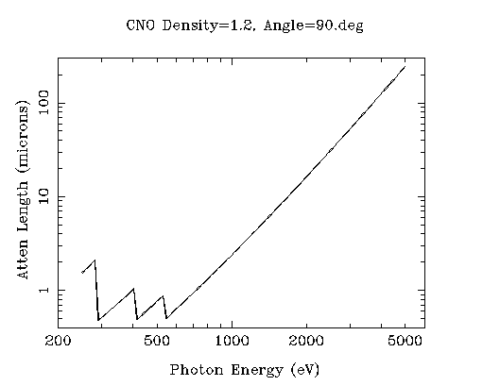
Optimum sample size w/o rad dam
Ca
Ar
Cl
K
S
P
2 Å
2sin(90°)
Mg
C
Na
Se
Ne
3 Å
2sin(90°)
N
O
F
4 Å
2sin(90°)

Slide 79
The Way Forward:
http://bl831.als.lbl.gov/xtallife.html
Average over SHSSS
  - non-isomorphism problem
Model it out
  - Impossible for CCDs
  - Need to constrain pixel model on PADs
go MAD
  - XFEL cures sample size dilemma
  - SINBAD cancels new errors
http://bl831.als.lbl.gov/~jamesh/powerpoint/SHSSS_UGA_2015.pptx

Slide 80
Where do photons go?
100 μm
thick
protein
97%
transmitted
1 Å x-rays
beamstop
attenuation correction
error cannot be > ~3%

Slide 81
Where do photons go?
100 μm
thick
protein
2%
transmitted
5 Å x-rays
beamstop
attenuation correction
error can be ~98%

Slide 82
Where do photons go?
1 μm
thick
protein
96%
transmitted
5 Å x-rays
beamstop
attenuation correction
error cannot be > ~4%

Slide 83
Scattering/absorption “rules”:
1 μm crystal ≈ 1 μm water
≈ 1 μm plastic
≈ 0.1 μm glass
≈ 1000 μm air
~ 50 mm He
≈ 370 mm water vapor @ 4C

Slide 85
Diamond
($100, reusable)

Slide 86
oil ?
Diamond
($100, reusable)

Slide 87
oil ?
Diamond
($100, reusable)

Slide 88
oil ?
λ=2d sinθ
2.5 Å data
with 5 Å X-rays
Only analytic absorption correction:
International Tables for Crystallography, Vol. C, 2nd ed., chapter 6.3

Slide 89
attenuation correction
μ
I_{T}
I_{beam}
A = = exp(-μt)
t
Bouguer, P. (1729). Essai d'optique sur la gradation de la lumière.
Lambert, J. H. (1760). Photometria: sive De mensura et gradibus luminis, colorum et umbrae. E. Klett.
Beer, A. (1852)."Bestimmung der Absorption des rothen Lichts in farbigen Flüssigkeiten", Ann. Phys. Chem 86, 78-90.

Slide 90
attenuation correction
μ
t_{out}
t_{in}
I_{T}
I_{beam}
I_{T}
I_{beam}
A = = exp(-μ(t_{in}+ t_{out}))
A = = exp(-μt)
t
Bouguer, P. (1729). Essai d'optique sur la gradation de la lumière.
Lambert, J. H. (1760). Photometria: sive De mensura et gradibus luminis, colorum et umbrae. E. Klett.
Beer, A. (1852)."Bestimmung der Absorption des rothen Lichts in farbigen Flüssigkeiten", Ann. Phys. Chem 86, 78-90.

Slide 91
attenuation correction
t_{out}
t_{in}
μ
t_{out}
t_{in}
t_{out}
I_{T}
I_{beam}
t_{in}
A = = exp(-μ(t_{in}+ t_{out}))
Bouguer, P. (1729). Essai d'optique sur la gradation de la lumière.
Lambert, J. H. (1760). Photometria: sive De mensura et gradibus luminis, colorum et umbrae. E. Klett.
Beer, A. (1852)."Bestimmung der Absorption des rothen Lichts in farbigen Flüssigkeiten", Ann. Phys. Chem 86, 78-90.

Slide 92
attenuation correction
μ_{solvent}
t_{so}
t_{xo}
t_{si}
t_{xi}
μ_{xtal}
t_{so}
t_{xo}
t_{si}
t_{xi}
t_{so}
t_{xo}
I_{T}
I_{beam}
t_{si}
t_{xi}
A = = exp[-μ_{xtal}(t_{xi}+ t_{xo})
-μ_{solvent}(t_{si} + t_{so})]
Bouguer, P. (1729). Essai d'optique sur la gradation de la lumière.
Lambert, J. H. (1760). Photometria: sive De mensura et gradibus luminis, colorum et umbrae. E. Klett.
Beer, A. (1852)."Bestimmung der Absorption des rothen Lichts in farbigen Flüssigkeiten", Ann. Phys. Chem 86, 78-90.

Slide 93

100% SeMet incorporation
Trivial to solve

Slide 94

100% S -Met incorporation
Impossible to solve

Slide 95
Solved Structure Accuracy
Perfect sites
correlation coefficient
fraction Sulfur

Slide 96
Solved Structure Accuracy
Perfect sites
correlation coefficient
fraction Sulfur

Slide 97
Solved Structure Accuracy
Perfect sites
correlation coefficient
fraction Sulfur

Slide 98
Solved Structure Accuracy
Perfect sites
correlation coefficient
fraction Sulfur

Slide 99
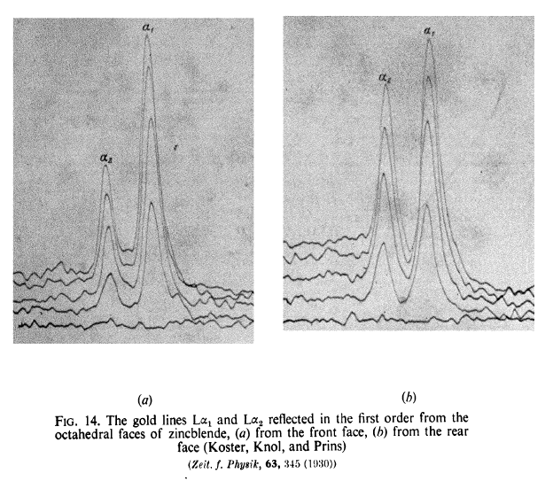
Two-color experiment (1930)

