Slide 1
PowerPoint File available:
http://bl831.als.lbl.gov/
~jamesh/powerpoint/
SHSSS_Berlin_2015.pptx

Slide 2
Acknowledgements
Robert Stroud James Fraser Christine Gee Tom Peat Janet Newman
Chris Nielsen Clemens Schulze-Briese Meitian Wang Aina Cohen Ana Gonzalez
UCSF LBNL SLAC
ALS 8.3.1 creator: Tom Alber
Center for Structure of Membrane Proteins (CSMP)
Membrane Protein Expression Center II (MPEC)
Center for HIV Accessory and Regulatory Complexes (HARC)
UC Multicampus Research Programs and Initiatives (MRPI)
UCSF Program for Breakthrough Biomedical Research (PBBR) Integrated Diffraction Analysis Technologies (IDAT)
Plexxikon, Inc.
M D Anderson CRC
Synchrotron Radiation Structural Biology Resource (SLAC)
The Advanced Light Source is supported by the Director, Office of Science, Office of Basic Energy Sciences, Materials Sciences Division, of the US Department of Energy under contract No. DE-AC02-05CH11231 at Lawrence Berkeley National Laboratory.

Slide 3
Can you count to 1,000,000 ?
sqrt(1,000,000)
1,000,000
Theoretically:
= 0.1%
R_{meas} ≈ 0.1% ?
ISa = 1000
In reality:
ISa ~ 33
R_{meas =} ≈ 3%
sqrt(1,000)
1,000
= 3%
photon
spot
> 1000 is a waste!

Slide 4
Threshold of a revolution in phasing
Current
technology
Goal
Solve-able proteins (%)
Required signal-to-noise (I/σ)
S-SAD
7 keV

Slide 5
SHSSS!
The dominant source of error for anomalous difference measurements
Spatial
Heterogeneity in
Sharp
Spot
Sensitivity
Flat
Field

Slide 6
SHSSS!
The dominant source of error for anomalous difference measurements
Spatial
Heterogeneity in
Sharp
Spot
Sensitivity
Flat
Field
90%
110%
x 1.11 =
100%
x 0.91 =
100%

Slide 7
SHSSS!
The dominant source of error for anomalous difference measurements
Spatial
Heterogeneity in
Sharp
Spot
Sensitivity
Sharp
Spot
20%
110%
x 1.11 =
22%
x 0.91 =
100%

Slide 8
SHSSS!
The dominant source of error for anomalous difference measurements
Spatial
Heterogeneity in
Sharp
Spot
Sensitivity
Sharp
Spot
90%
30%
Integral: 127.3
x 1.11 =
100%
x 0.91 =
27.3%

Slide 9
SHSSS!
The dominant source of error for anomalous difference measurements
Spatial
Heterogeneity in
Sharp
Spot
Sensitivity
Sharp
Spot
20%
110%
Integral: 122.2
x 1.11 =
22.2%
x 0.91 =
100%

Slide 10
Spatial Heterogeneity in Sharp Spot Sensitivity

Slide 11
Spatial Heterogeneity in Sharp Spot Sensitivity

Slide 12
Spatial Heterogeneity in Sharp Spot Sensitivity
Relative spot intensity
Spot centroid position (pixels)

Slide 13
Spatial Heterogeneity in Sharp Spot Sensitivity
Relative spot intensity
Spot centroid position (pixels)

Slide 14

SHSSS for MX spots

Slide 15
SHSSS for MX spots
down

Slide 16
SHSSS for MX spots
down
up

Slide 17
SHSSS for MX spots
down
up
R_{separate}

Slide 18
SHSSS for MX spots
odd
even
R_{mixed}

Slide 19
SHSSS for MX spots
separate:
2.5%

Slide 20
SHSSS for MX spots
separate:
mixed:
2.5%
0.9%

Slide 21
SHSSS for MX spots
separate:
mixed:
2.5%
0.9%
2.5%²-0.9%² = 2.3%²

Slide 22
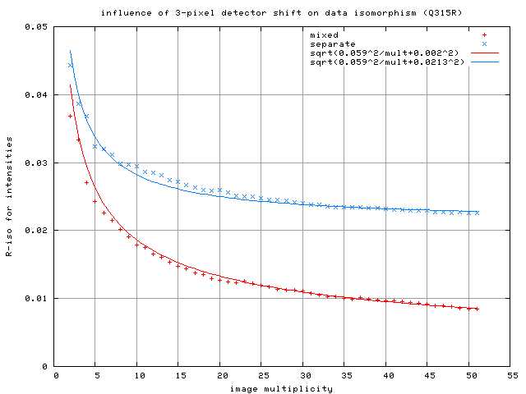
5
R_{separ} = sqrt(5.9²/mult + 2.1²)
R_{mixed} = sqrt(5.9²/mult + 0.2²)
4
3
R_{diff} (%) between half-sets
2
ADSC Q315r
3-pixel shift
1
0
Image multiplicity

Slide 23
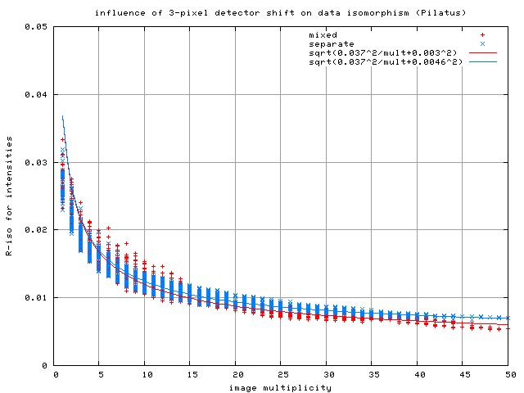
5
R_{separ} = sqrt(3.7²/mult + 0.5²)
R_{mixed} = sqrt(3.7²/mult + 0.3²)
4
3
R_{diff} (%) between half-sets
2
Pilatus
3-pixel shift
1
0
Image multiplicity

Slide 24
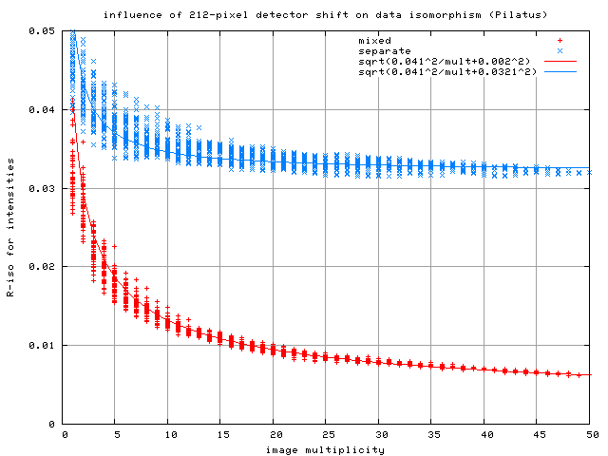
5
R_{separ} = sqrt(4.1²/mult + 3.2²)
R_{mixed} = sqrt(4.1²/mult + 0.2²)
4
3
R_{diff} (%) between half-sets
2
Pilatus
1-module shift
1
0
Image multiplicity

Slide 25
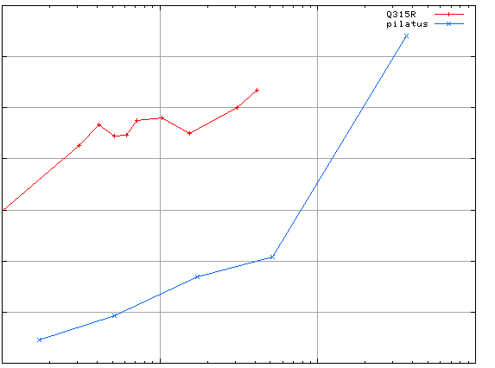
Spatial Heterogeneity in Sharp Spot Sensitivity
3.5
3.0
2.5
2.0
1.5
1.0
0.5
CCD detector
different
modules
anomalous mates are always on
different modules
SHSSS
Systematic component of R_{sseparate} (%)
Pilatus
SN001
0.1 1 10 100
distance between spots (mm)
Notes:
Comparision of SHSSS measured by the detector-shift experiment on three different detectors:
The Q315R in ALS 8.3.1
The first Pilatus detector at the Swiss Light Soruce
A newer Pilatus detector at Stanford
Improvements in calibration technology have finally made
Pilatus competitive with calibration on CCDs

Slide 26
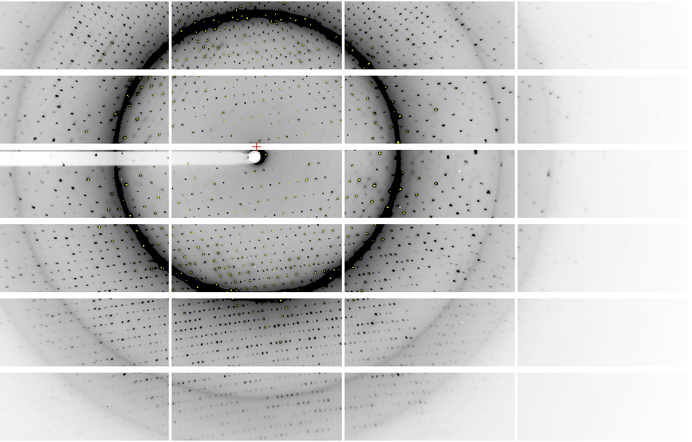
Pilatus: 1-module shift

Slide 27
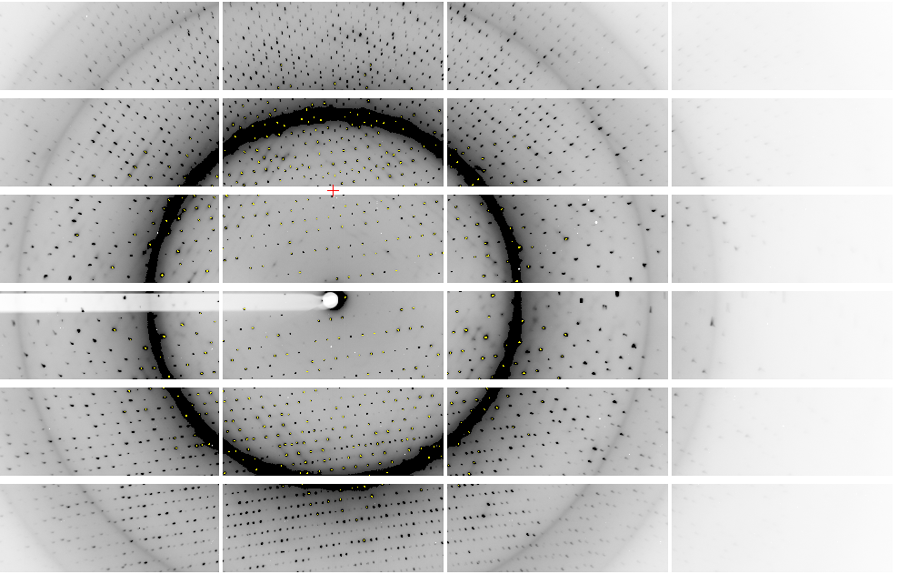
Pilatus: 1-module shift

Slide 28
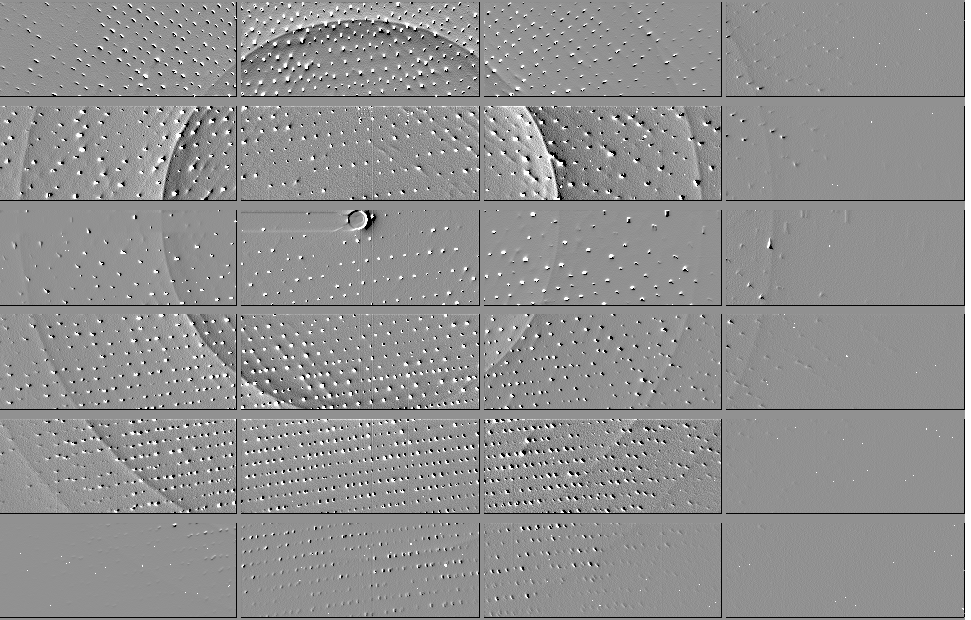
Pilatus: 1-module shift

Slide 29
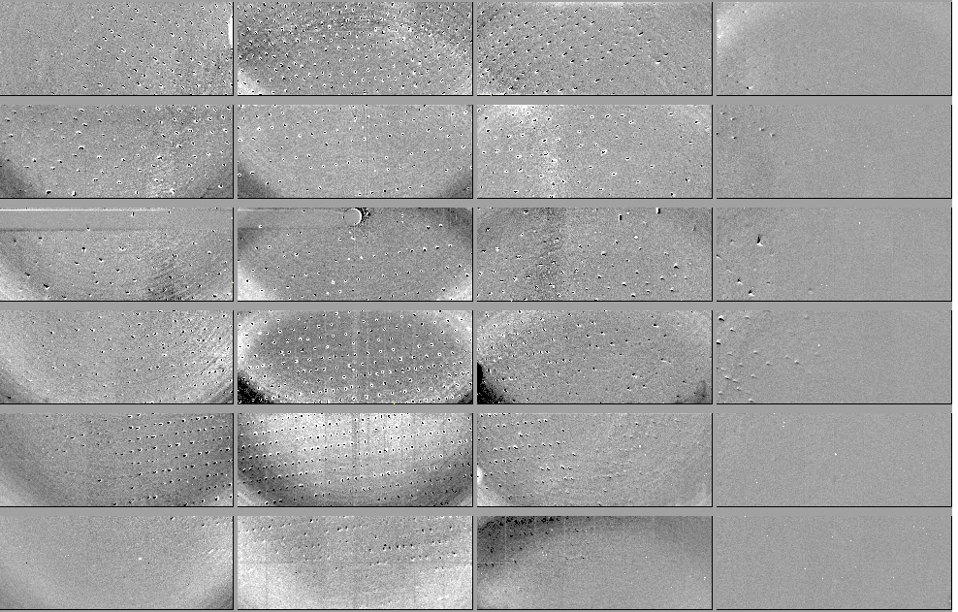
Pilatus: 1-module shift - aligned

Slide 30
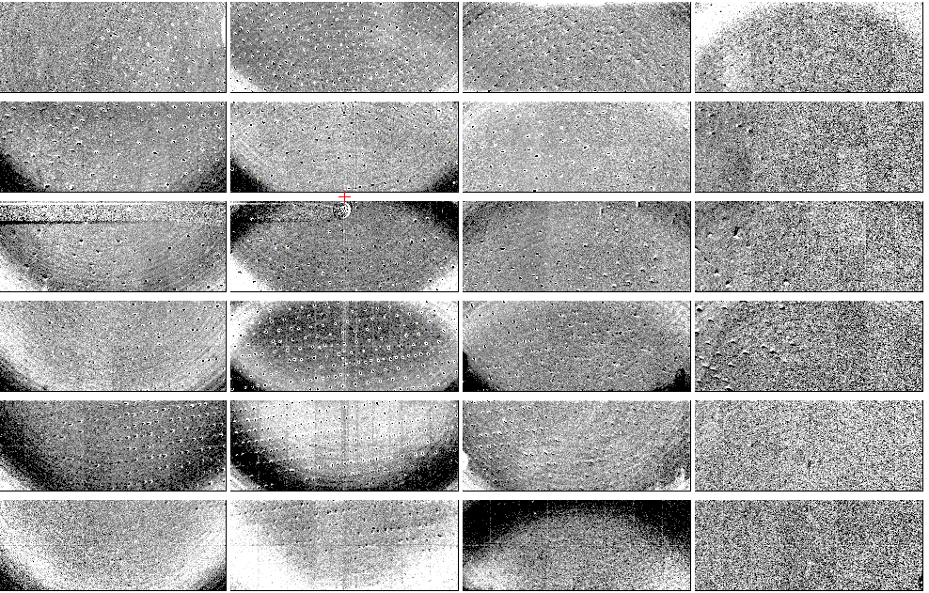
Pilatus: 1-module shift - ratio
+3%
- 3%

Slide 31
3.5
3.0
2.5
2.0
1.5
1.0
0.5
CCD detector
different
modules
anomalous mates are always on
different modules
SHSSS
Systematic component of R_{sseparate} (%)
Pilatus
SN001
Pilatus
SN113
0.1 1 10 100
distance between spots (mm)
Notes:
Comparision of SHSSS measured by the detector-shift experiment on three different detectors:
The Q315R in ALS 8.3.1
The first Pilatus detector at the Swiss Light Soruce
A newer Pilatus detector at Stanford
Improvements in calibration technology have finally made
Pilatus competitive with calibration on CCDs

Slide 32

Pilatus: subtract smooth baseline
~3x10⁵ photon/pixel → 0.3% error
Bragg
glitch
“tree rings”
Pick-up tool mark
Gollwitzer & Krumrey (2014)
J. Appl. Cryst. 47, 378
oxygen
inclusions
1% high
average
1% low

Slide 33
Beam Flicker
pinhole
removed
normalized flux through pinhole
0.15%/√Hz
time (seconds)

Slide 34
Threshold of a revolution in phasing
Source of error | realistic simulation | No SHSSS | Perfect detector
Photon counting | + | + | +
Shutter jitter | + | + | -
Beam flicker | + | + | -
Sample absorption | + | + | -
Radiation damage | + | + | -
Imperfect spindle | + | + | -
vignette | + | + | -
Corner correction | + | + | -
SHSSS | + | - | -
R_{meas} (∞-10 Å) | 2.8% | 0.7% | 0.7%
I/σ asymptotic | 26.8 | 74.2 | 81.0
Holton et al (2014) "R-factor gap", FEBS Journal 281, 4046-4060.

Slide 35
Oh! SHSSS! how do we get rid of it?
Calibrate it out
Average over it
go MAD

Slide 36
Oh! SHSSS! how do we get rid of it?
Calibrate it out
Average over it
go MAD

Slide 37
Detector pixels are 3D
51 μm
172 μm
75 μm
8%
side
loss
53%
side
loss
76%
side
loss
photon
17%
loss
photon
31 μm thick
Pilatus
320 μm thick
Eiger
Typical CCD
26% loss
450 μm thick
Arrival angle of 2 Å spot: 29°
Mean Penetration depth 12 keV:
17.5 μm Gd₂O₂S 237 μm Si
15%
loss

Slide 38
Detector pixels are 3D
θ
incoming
photon
λ
detection
event
N
N
N

Slide 39
Detector pixels are 3D
θ
Bragg
glitch
width
incoming
photon
λ
oxygen
inclusion
thickness
detection
event
N
N
N

Slide 40
Oh! SHSSS! how do we get rid of it?
Calibrate it out
Average over it
go MAD

Slide 41
Averaging over SHSSS
^{mult >} (—)²
~3%
<ΔF/F>
“true” multiplicity = different pixels

Slide 42

Averaging with systematic error

Slide 43
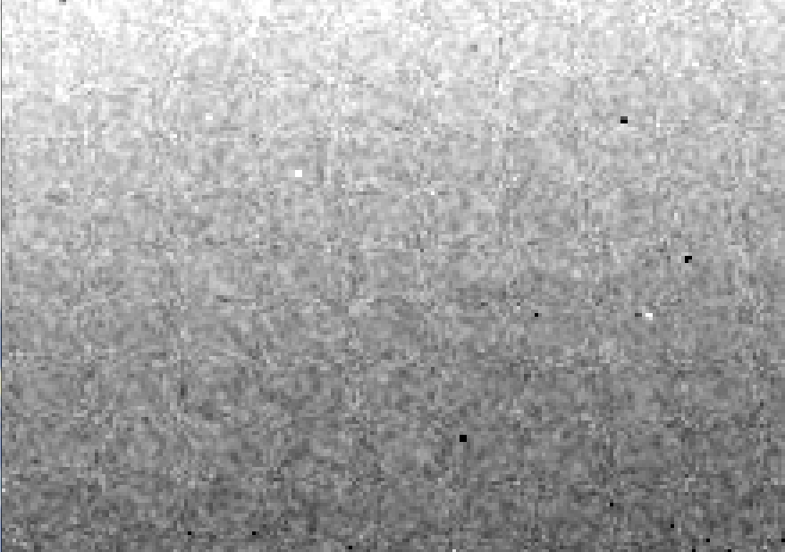
CCD calibration: 7235 eV

Slide 44
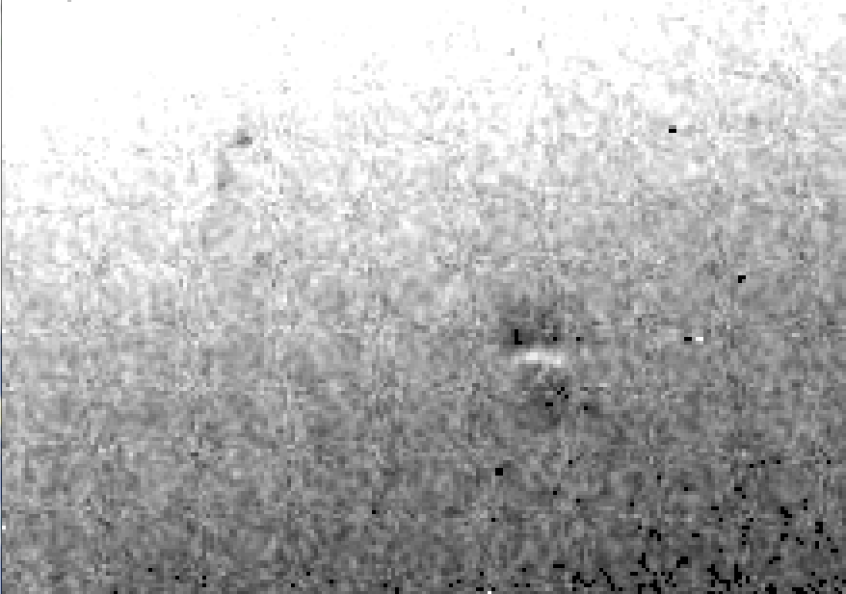
CCD calibration: 7247 eV

Slide 45
Gadox calibration vs energy
same = good!
Relative absorption depth
bad!
Mar?
photon energy (keV)

Slide 46
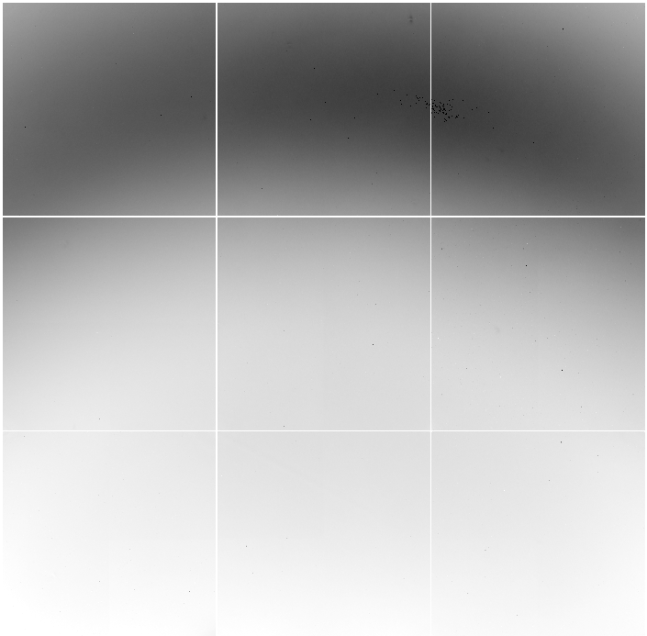
Detector calibration: 7247 eV
target:
oil
distance:
900 mm
2θ: 12°

Slide 47
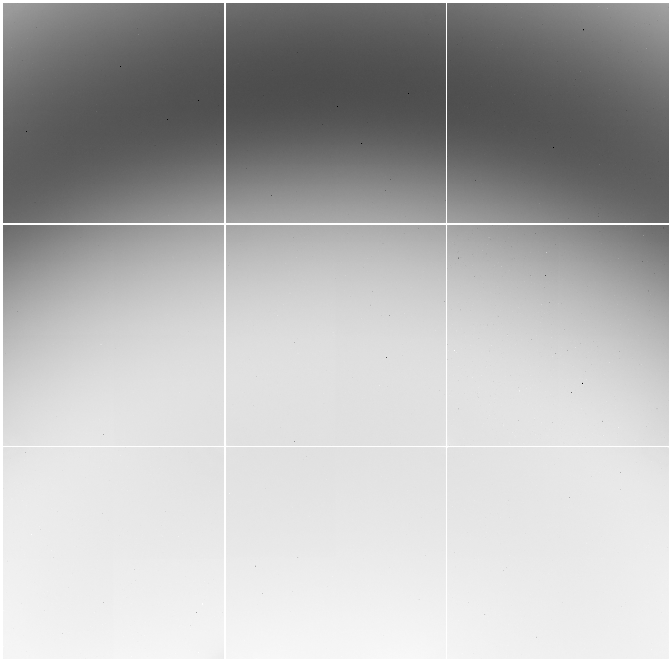
Detector calibration: 7235 eV
target:
oil
distance:
900 mm
2θ: 12°

Slide 48
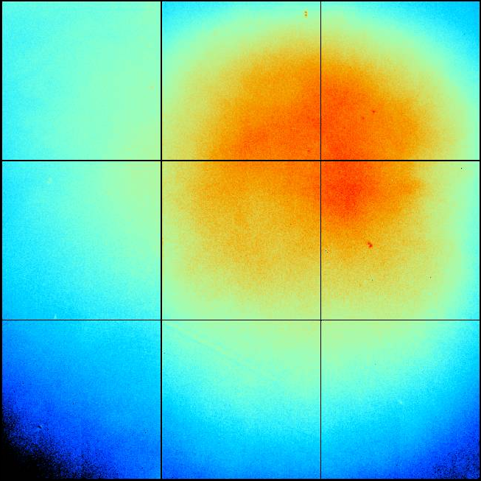
ADSC Q315r SN 926 (ALS 8.3.1)
+10%
-10%

Slide 49
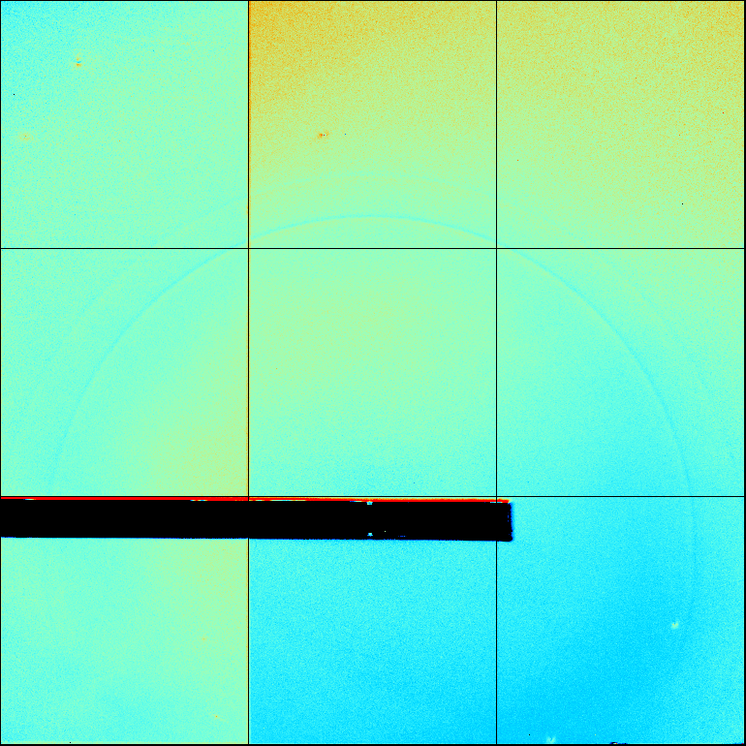
ADSC Q315r SN )

Slide 50
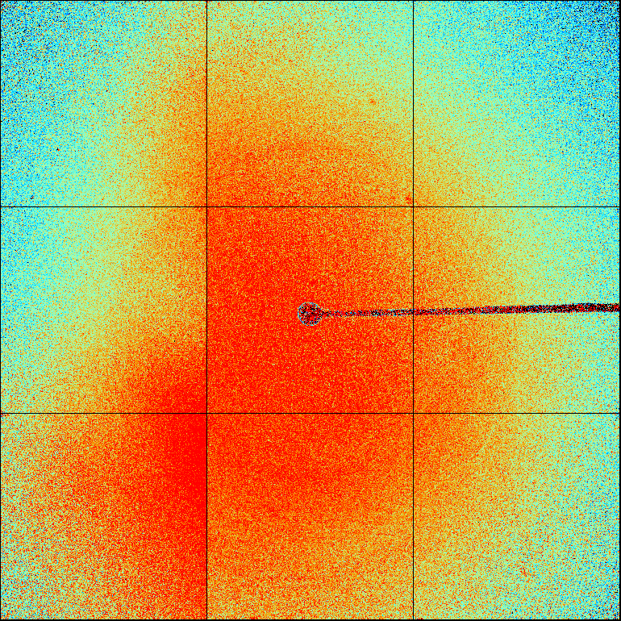
ADSC Q315r SN )

Slide 51
Detector calibration
megapixels
calibration error (%)

Slide 52
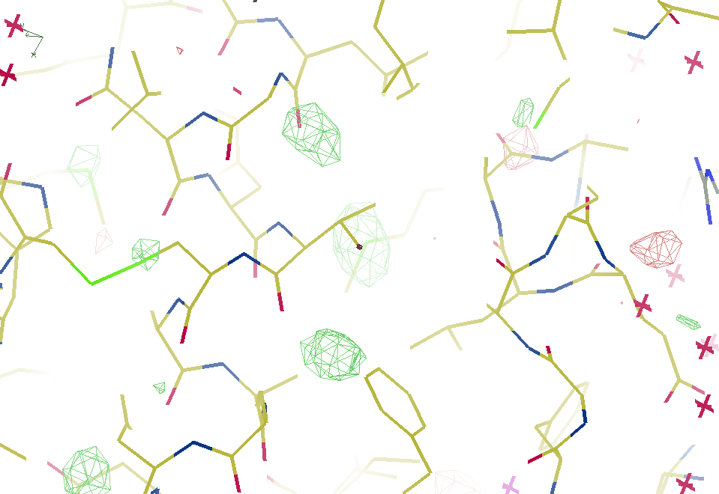
7247 eV

Slide 53
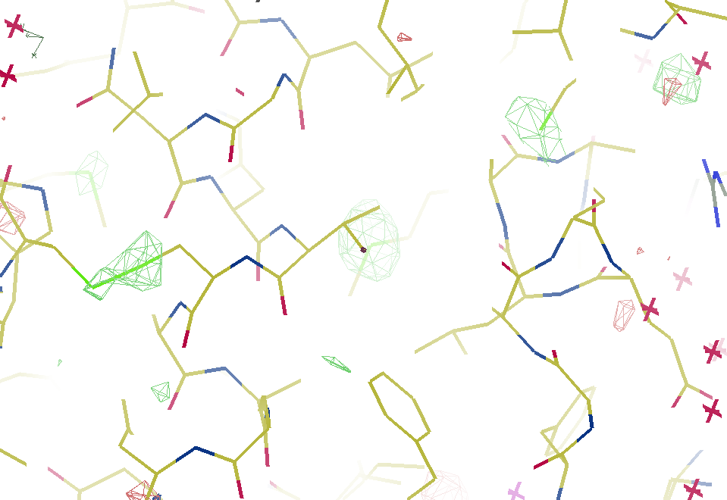
7235 eV

Slide 54
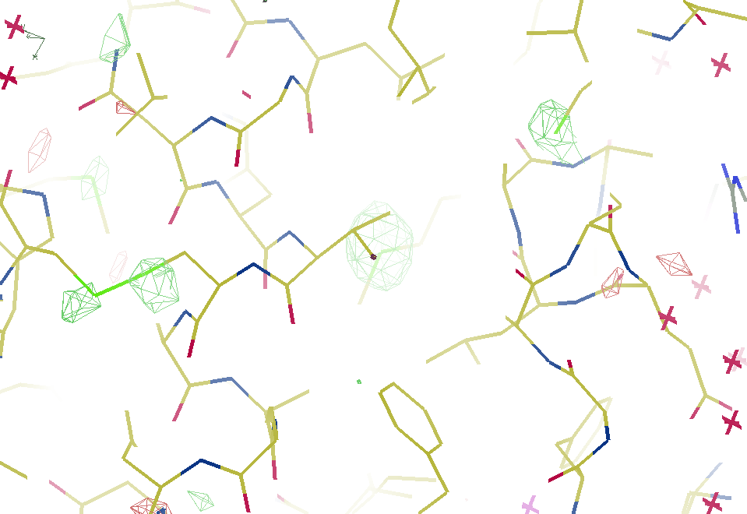
Detector calibration
7223 eV

Slide 55
Averaging over SHSSS
Never use same pixel twice
Detector calibration
- 7235 eV
Radiation Damage
- 1% error per MGy
Isomorphous crystals
- Humidity!
- Friend or foe?

Slide 56
Averaging over SHSSS
Never use same pixel twice
Detector calibration
- 7235 eV
Radiation Damage
- 1% error per MGy
Isomorphous crystals
- Humidity!
- Friend or foe?

Slide 57
Averaging over SHSSS
Never use same pixel twice
Detector calibration
- 7235 eV
Radiation Damage
- 1% error per MGy
Isomorphous crystals
- Humidity!
- Friend or foe?

Slide 58
R_{iso} vs dose
R_{iso} ≈ 0.7 %/MGy
R_{iso} (%)
change in dose (MGy)
data taken from Banumathi, et al. (2004) Acta Cryst. D 60, 1085-1093.

Slide 59
Damage Limit → Dose slicing
1 um³ xtal = 10⁶ photons
N
photons
unacceptable
damage
N
photons
unacceptable
read noise
N
photons

Slide 60
140-fold multiplicity
16 crystals, 360° each, < 1 MGy, inverse beam
7235 eV ADSC Q210r Australian Synchrotron MX1
SUBSET OF INTENSITY DATA WITH SIGNAL/NOISE >= -3.0 AS FUNCTION OF RESOLUTION
RESOLUTION NUMBER OF REFLECTIONS COMPLETENESS R-FACTOR R-FACTOR COMPARED I/SIGMA R-meas CC(1/2) Anomal SigAno Nano
LIMIT OBSERVED UNIQUE POSSIBLE OF DATA observed expected Corr
9.17 188919 1061 1071 99.1% 3.9% 4.8% 188919 257.47 3.9% 100.0* 91* 5.024 450
6.49 356827 1933 1933 100.0% 5.2% 5.5% 356827 214.33 5.2% 100.0* 86* 3.836 882
5.30 466503 2515 2515 100.0% 7.2% 7.0% 466503 165.13 7.2% 100.0* 76* 3.257 1175
4.59 548405 2974 2974 100.0% 7.2% 6.6% 548405 175.42 7.3% 100.0* 67* 2.589 1403
4.10 615117 3353 3355 99.9% 7.7% 6.7% 615117 174.13 7.7% 100.0* 59* 2.264 1594
3.74 684947 3734 3737 99.9% 9.4% 8.3% 684947 143.09 9.4% 100.0* 49* 1.953 1783
3.47 743557 4051 4051 100.0% 11.2% 10.1% 743557 120.17 11.2% 100.0* 39* 1.696 1942
3.24 799722 4366 4366 100.0% 14.1% 13.9% 799722 91.14 14.1% 100.0* 30* 1.333 2103
3.06 839252 4598 4603 99.9% 19.5% 20.2% 839252 65.79 19.5% 100.0* 23* 1.117 2214
2.90 891398 4904 4908 99.9% 29.0% 31.7% 891398 44.85 29.1% 99.9* 17* 1.008 2369
2.77 931622 5148 5151 99.9% 40.5% 44.8% 931622 32.58 40.6% 99.8* 11* 0.901 2493
2.65 969629 5384 5387 99.9% 52.8% 58.8% 969629 25.16 52.9% 99.8* 10* 0.866 2605
2.54 997213 5574 5574 100.0% 67.4% 76.0% 997213 19.47 67.6% 99.6* 2 0.804 2705
2.45 1031222 5889 5889 100.0% 88.9% 101.2% 1031222 14.58 89.2% 99.2* 4 0.831 2859
2.37 788617 6008 6008 100.0% 109.3% 125.5% 788617 9.97 109.7% 98.1* 5 0.829 2925
2.29 614145 6252 6252 100.0% 138.2% 161.4% 614145 6.87 138.9% 96.1* 1 0.760 3037
2.22 470283 6481 6481 100.0% 197.1% 231.7% 470283 4.03 198.6% 83.5* -1 0.721 3159
2.16 259836 6629 6631 100.0% 227.3% 268.7% 259831 2.41 230.8% 46.9* -1 0.677 3224
2.10 36259 4169 6807 61.2% 154.4% 169.4% 36229 1.28 163.6% 47.0* -2 0.660 1999
2.05 13567 3372 7037 47.9% 170.1% 187.0% 13503 0.68 196.5% 25.7* 3 0.629 1578
total 12247040 88395 94730 93.3% 15.7% 16.4% 12246941 54.30 15.8% 100.0* 12* 1.217 42499
I/SIGMA
257.47

Slide 61
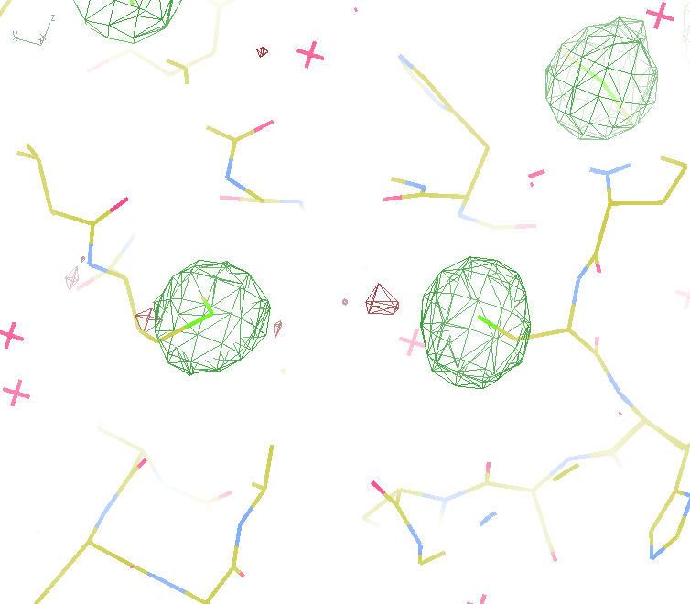
140-fold multiplicity
Not
Lysozyme!
18 σ
16 σ
Phased anomalous difference Fourier
data Courtesy of Tom Peat & Janet Newman

Slide 62
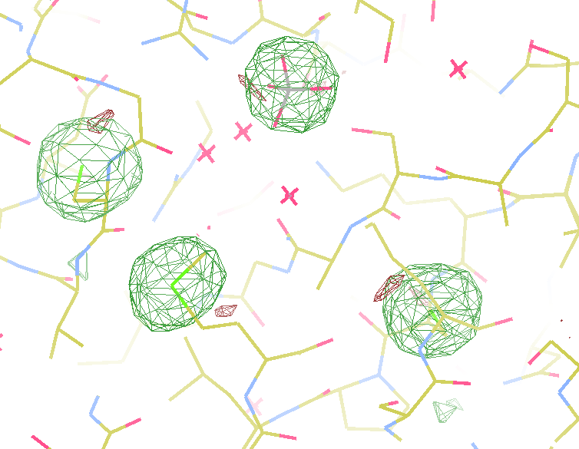
140-fold multiplicity
Not
Lysozyme!
15σ = PO₄
Phased anomalous difference Fourier
data Courtesy of Tom Peat & Janet Newman

Slide 63
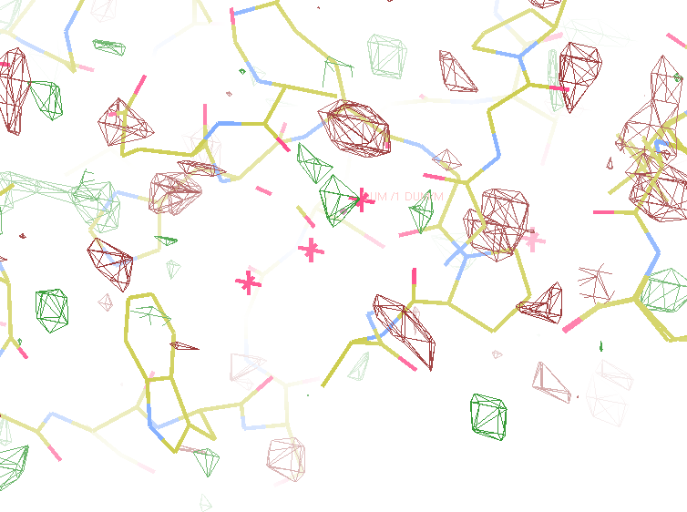
140-fold multiplicity
Not
Lysozyme!
~2σ = Mg?
Phased anomalous difference Fourier
data Courtesy of Tom Peat & Janet Newman

Slide 64
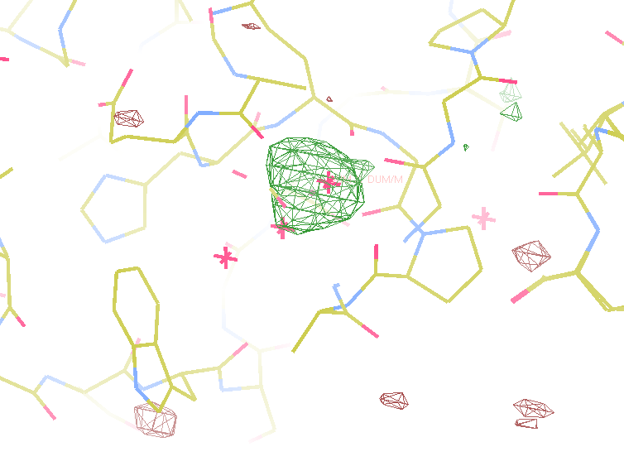
140-fold multiplicity
Not
Lysozyme!
10 σ is enough for phasing!
Bunkoczi et al. (2015)."weak, single-wavelength anomalous", Nat. Meth. 12, 127-130.
8.2σ = Na
f” = 0.15
DELFAN residual anomalous difference
data Courtesy of Tom Peat & Janet Newman

Slide 65
Discerning Na⁺ from Mg⁺⁺
DELFAN peak height (σ)
N
O
F
Ne
Na
Mg
f’’ (electrons)

Slide 66
Averaging over SHSSS
Never use same pixel twice
Detector calibration
- 7235 eV
Radiation Damage
- 1% error per MGy
Isomorphous crystals
- Humidity!
- Friend or foe?

Slide 67

Non-isomorphism in lysozyme
RMSD = 0.18 Å
Δcell = 0.7 %
R_{iso} = 44.5%
3aw6
3aw7
RH: 84.2%
vs 71.9%

Slide 68
Averaging over SHSSS
Never use same pixel twice
Detector calibration
- 7235 eV
Radiation Damage
- 1% error per MGy
Isomorphous crystals
- Humidity!
- Friend or foe?

Slide 69
X-ray Data Sets
Singular values & vectors
data
set
h,k,l | structure factors (F)
 | #1 | #2 | #3 | #4
5,3,4 | 523.7 | 559.8 | 579.9 | 603.2
5,4,4 | 168.2 | 166.6 | 177.2 | 196.1
5,5,4 | 34.9 | 26.4 | 19.2 | 17.3
6,1,4 | 305.7 | 301.1 | 298.1 | 296.3
6,2,4 | 353.0 | 353.9 | 356.2 | 366.9
6,3,4 | 300.9 | 285.3 | 273.5 | 259.4
6,3,5 | 223.8 | 226.3 | 234.6 | 251.4
… | … | … | … | …
h,k,l | 100% | 17 % | 13 % | 9 %
 | 1st | 2nd | 3rd | 4th
5,3,4 | -1.46 | -0.02 | 1.84 | -0.72
5,4,4 | -0.88 | -0.29 | -0.34 | 0.15
5,5,4 | -0.42 | -0.65 | 1.02 | 1.47
6,1,4 | -0.90 | -0.85 | 1.44 | -0.40
6,2,4 | -1.20 | -0.37 | 0.67 | 0.01
6,3,4 | -0.75 | 0.31 | 0.48 | 0.00
6,3,5 | -0.75 | -0.85 | 0.72 | -0.82
… | … | … | … | …
value
vector
Singular value decomp.
SVD
-0.68
-0.24
0.32 …
CC1
Data sets
Positioned
in
“Correlation
Space”
Correlation
Coefficients
CC1 CC2 CC3
CC2
data set #1
data set #2
data set #3
CC3

Slide 70
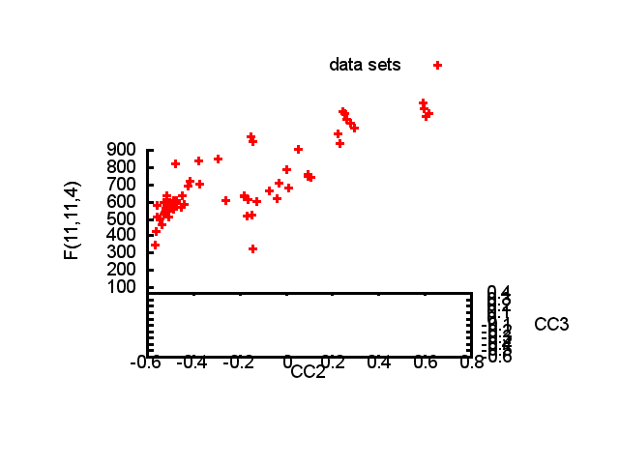

Slide 71
Structure factor (electrons)
Correlation to 2nd & 3rd singular vectors

Slide 72
Structure factor (electrons)
Correlation to 2nd & 3rd singular vectors

Slide 73
Structure factor (electrons)
Correlation to 2nd & 3rd singular vectors

Slide 74
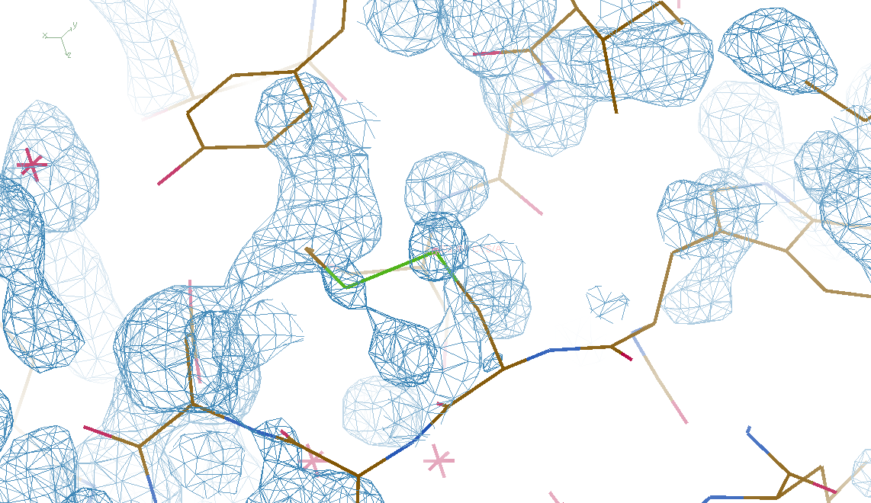
Phases from non-isomorphism?
DMMULTI – fake data - 4 deg rotation: 8 “xtals”
CC = 0.02

Slide 75
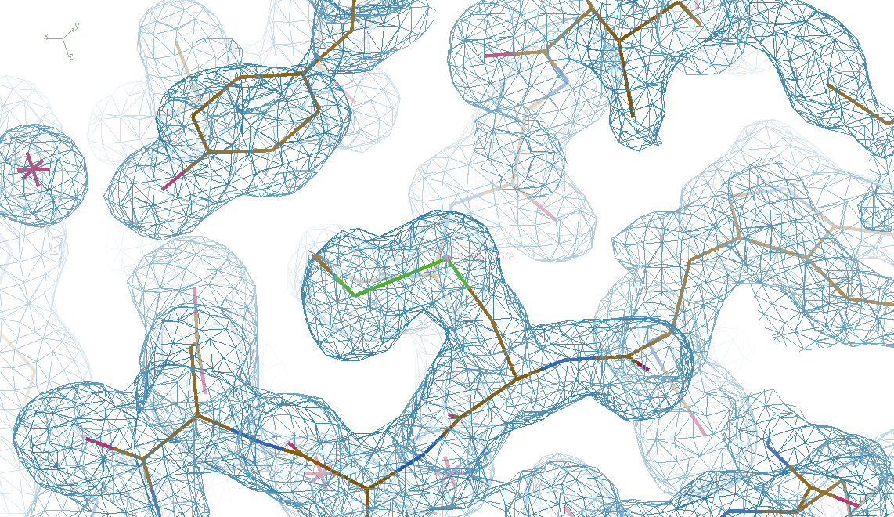
Phases from non-isomorphism!
DMMULTI – fake data - 4 deg rotation: 8 “xtals”
CC = 0.8

Slide 76
Oh! SHSSS! how do we get rid of it?
Calibrate it out
Average over it
go MAD

Slide 77
2472.7 2473.5
Anomalous f” (electrons)
Photon Energy (eV)
Bohic et al. Anal. Chem. 2008; 80(24):9557. doi: 10.1021/ac801817k

Slide 78
Two wavelengths are better than one

Slide 79
Current
detectors
Solve-able proteins (%)
Required signal-to-noise (I/σ)

Slide 80
Pro & Con of S-MAD
Excellent signal at S edge
- 2472.7 eV
x Radiation Damage
x Self absorption

Slide 81
S-MAD Sample size Dilemma

Slide 82
Darwin’s Formula
V_{xtal}
λ³ L
I_{spot} = I_{beam} r_{e}²
P A | F₀e^{-Bs2} |²
V_{cell}
ωV_{cell}
I_{spot} - photons/spot (fully-recorded)
I_{beam} - incident (photons/s/m² )
r_{e} - classical electron radius (2.818x10⁻¹⁵ m)
V_{xtal} - volume of crystal (in m³)
V_{cell} - volume of unit cell (in m³)
λ - x-ray wavelength (in meters!)
ω - rotation speed (radians/s)
L - Lorentz factor (speed/speed)
P - polarization factor
A - attenuation correction
F₀ - structure factor at T = 0
B - Debye-Waller-Ott factor
s - 0.5/d-spacing
C. G. Darwin (1914)

Slide 83
Self-calibrated damage limit
Where:
⟨I⟩_{DL} - average damage-limited intensity (photons/hkl) at a given resolution
10⁵ - converting R from μm to m, r_{e} from m to Å, ρ from g/cm³ to kg/m³ and MGy to Gy
r_{e} - classical electron radius (2.818 x 10⁻¹⁵ m/electron)
h - Planck’s constant (6.626 x 10⁻³⁴ J∙s)
c - speed of light (299792458 m/s)
f_{decayed} - fractional progress toward completely faded spots at end of data set
ρ - density of crystal (~1.2 g/cm³)
R - radius of the spherical crystal (μm)
λ - X-ray wavelength (Å)
f_{NH} - the Nave & Hill (2005) dose capture fraction (1 for large crystals)
n_{ASU} - number of proteins in the asymmetric unit
M_{r} - molecular weight of the protein (Daltons or g/mol)
V_{M} - Matthews’s coefficient (~2.4 Å³/Dalton)
H - Howells’s criterion (10 MGy/Å)
θ - Bragg angle
⟨ƒ_{a}²⟩ - number-averaged squared structure factor per protein atom (electron²)
⟨M_{a}⟩ - number-averaged atomic weight of a protein atom (~7.1 Daltons)
B - average (Wilson) temperature factor (Å²)
μ - attenuation coefficient of sphere material (m⁻¹)
μ_{en} - mass energy-absorption coefficient of sphere material (m⁻¹)
Holton & Frankel (2010) Acta D 66 393-408.

Slide 84
Damage-limited minimum crystal size
wavelength dependence
crystal diameter (μm)
Holton & Frankel (2010) Acta D 66 393-408.

Slide 85

Holton & Frankel (2010) Acta D 66 393-408.

Slide 86
Where do photons go?
100 μm
thick
protein
97%
transmitted
1 Å x-rays
beamstop
attenuation correction
error cannot be > ~3%

Slide 87
attenuation correction
μ
I_{T}
I_{beam}
A = = exp(-μt)
t
Bouguer, P. (1729). Essai d'optique sur la gradation de la lumière.
Lambert, J. H. (1760). Photometria: sive De mensura et gradibus luminis, colorum et umbrae. E. Klett.
Beer, A. (1852)."Bestimmung der Absorption des rothen Lichts in farbigen Flüssigkeiten", Ann. Phys. Chem 86, 78-90.

Slide 88
attenuation correction
μ
t_{out}
t_{in}
I_{T}
I_{beam}
I_{T}
I_{beam}
A = = exp(-μ(t_{in}+ t_{out}))
A = = exp(-μt)
t
Bouguer, P. (1729). Essai d'optique sur la gradation de la lumière.
Lambert, J. H. (1760). Photometria: sive De mensura et gradibus luminis, colorum et umbrae. E. Klett.
Beer, A. (1852)."Bestimmung der Absorption des rothen Lichts in farbigen Flüssigkeiten", Ann. Phys. Chem 86, 78-90.

Slide 89
attenuation correction
t_{out}
t_{in}
μ
t_{out}
t_{in}
t_{out}
I_{T}
I_{beam}
t_{in}
A = = exp(-μ(t_{in}+ t_{out}))
Bouguer, P. (1729). Essai d'optique sur la gradation de la lumière.
Lambert, J. H. (1760). Photometria: sive De mensura et gradibus luminis, colorum et umbrae. E. Klett.
Beer, A. (1852)."Bestimmung der Absorption des rothen Lichts in farbigen Flüssigkeiten", Ann. Phys. Chem 86, 78-90.

Slide 90
attenuation correction
μ_{solvent}
t_{so}
t_{xo}
t_{si}
t_{xi}
μ_{xtal}
t_{so}
t_{xo}
t_{si}
t_{xi}
t_{so}
t_{xo}
I_{T}
I_{beam}
t_{si}
t_{xi}
A = = exp[-μ_{xtal}(t_{xi}+ t_{xo})
-μ_{solvent}(t_{si} + t_{so})]
Bouguer, P. (1729). Essai d'optique sur la gradation de la lumière.
Lambert, J. H. (1760). Photometria: sive De mensura et gradibus luminis, colorum et umbrae. E. Klett.
Beer, A. (1852)."Bestimmung der Absorption des rothen Lichts in farbigen Flüssigkeiten", Ann. Phys. Chem 86, 78-90.

Slide 91
Scattering/absorption “rules”
1 μm crystal ≈ 1 μm water
≈ 1 μm plastic
≈ 0.1 μm glass
≈ 1000 μm air
~ 50 mm He
≈ 370 mm water vapor @ 4C

Slide 92
Where do photons go?
100 μm
thick
protein
97%
transmitted
1 Å x-rays
beamstop
attenuation correction
error cannot be > ~3%

Slide 93
Where do photons go?
100 μm
thick
protein
2%
transmitted
5 Å x-rays
beamstop
attenuation correction
error can be ~98%

Slide 94
Where do photons go?
1 μm
thick
protein
96%
transmitted
5 Å x-rays
beamstop
attenuation correction
error cannot be > ~4%

Slide 95
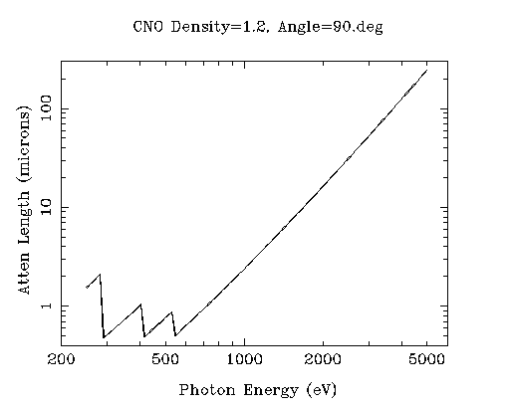
“sweet spot” for sample size ?
Ca
Ar
Cl
K
S
P
Mg
C
Na
Se
Ne
N
O
F

Slide 96
Pro & Con of S-MAD
Excellent signal at S edge
- 2472.7 eV
x Radiation Damage
- min size ~ 100 μm
x Self absorption
- 20 μm error = 50% error

Slide 97
Dose-rate dependence of damage
1 um³ xtal =
10⁸ photons
1 um³ xtal =
10⁶ photons
maximum useful dose (MGy)
dose rate (kGy/s)

Slide 98
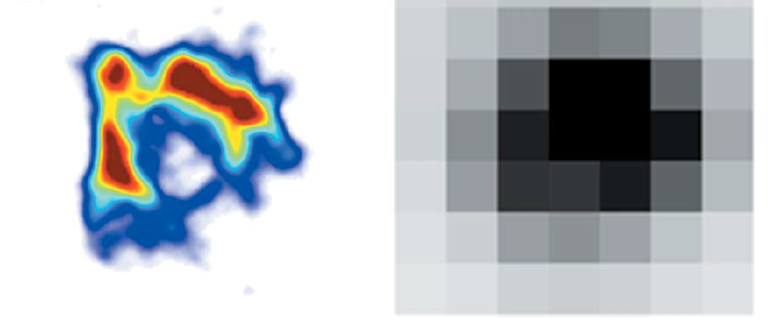
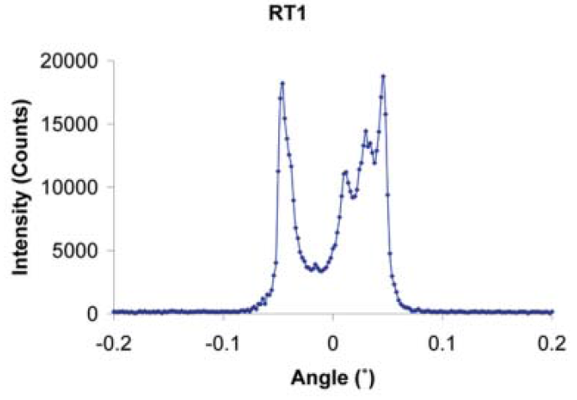
The “partiality problem” at XFEL
0.006°
1 μm xtal
1 Å x-rays
Lovelace et al. (2006)."topography", J. Appl. Cryst. 39, 425-432.

Slide 99
The “partiality problem” at XFEL
^{mult >} (—)²
~100%
<ΔF/F>
Gd lyso: ΔF/F = 8.7% → mult = 132
Barends et al. (2014) Nature 505, 244-247.

Slide 100
Osculating Ewald Spheres: SINBAD
(h,k,l)
Ewald sphere 2
λ*
diffracted ray
d*
θ
λ*
λ*
θ
d*
diffracted ray
λ*
Ewald sphere
1
(-h,-k,-l)

Slide 101
Si(111)
52.87deg
Si(111)
2 Multilayer mirrors
d=2nm, W/B4C
KB Horiz focus
KB vertical focus
Si(111)
Detector
Detector
λ = 5 Å
h,k,l
sample
injector
-h,-k,-l
Si(111)
Detector
Detector
~ 1m
Si(111)
Si(111)
Notes:
Proposed 5-crystal monochromator for colliding-beam crystallography. The generation of two opposing Ewald spheres means that for every h,k,l index reflected from the protein crystal, the Friedel mate is reflected in the opposite direction, allowing for very accurate anomalous difference measurements. The wavelength need not be set precisely at the sulfur or phosphorous edge, but merely at a wavelength where the f” of those elements are strong. For fs-class pulses, the distances above will have to be precise to withing ~3 microns, and for accurate reproduction of the partiality of the Friedel mates, the angular precision of the colliding beams must be within ~1% of the sample crystal’s rocking width, or ~100 microrads.

Slide 102
“sweet spot” for sample size ?
Ca
Ar
Cl
K
S
P
2 Å
2sin(90°)
Mg
C
Na
Se
Ne
3 Å
2sin(90°)
N
O
F
4 Å
2sin(90°)

Slide 103
Pro & Con of S-MAD
Excellent signal at S edge
- 2472.7 eV
x Radiation Damage
- min size ~ 100 μm
x Self absorption
- 20 μm error = 50% error
Solutions
- outrun damage at XFEL
- Bragg geometry?

Slide 105
Diamond
($100, reusable)

Slide 106
oil ?
Diamond
($100, reusable)

Slide 107
oil ?
Diamond
($100, reusable)

Slide 108
oil ?
λ=2d sinθ
2.5 Å data
with 5 Å X-rays
Only analytic absorption correction:
International Tables for Crystallography, Vol. C, 2nd ed., chapter 6.3

Slide 109
Pro & Con of S-MAD
Excellent signal at S edge
- 2472.7 eV
x Radiation Damage
- min size ~ 100 μm
x Self absorption
- 20 μm error = 50% error
Solutions
- outrun damage at XFEL
- Bragg geometry?

Slide 110
The Way Forward:
Calibrate it out
  - Impossible for CCDs
  - 3D pixel model on PADs
Average over SHSSS
  - non-isomorphism: foe or friend?
go MAD
  XFEL/SINBAD cancels errors
  Return to Bragg geometry (analytic absorption)
http://bl831.als.lbl.gov/~jamesh/powerpoint/
SHSSS_Berlin_2015.pptx

Slide 111
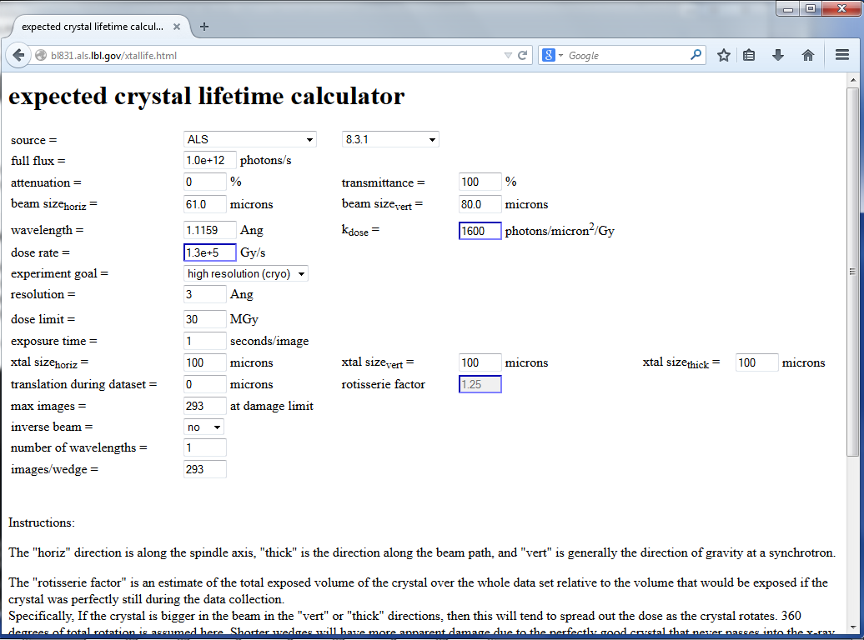

Slide 112
