Slide 1
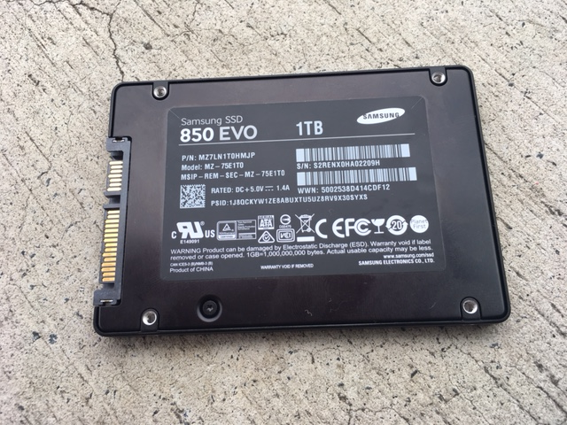
“Non Volatile” media

Slide 2
Pattersons
The “third space”
of crystallography
https://bl831.als.lbl.gov/~jamesh/powerpoint/
SCANZ_Pattersons_2019.pptx

Slide 3
The “spaces” of crystallography
Direct/real space
Distances are in Å, Angles are in degrees
Reciprocal space
Distances in 1/Å, Angles are different
Patterson space
Distances are in Å , Angles are in degrees
Relative distances only, origin lost
“direction” is preserved

Slide 4
How to make a Patterson map:
Set all phases to zero
Square all structure factors
Calculate Fourier transform

Slide 5
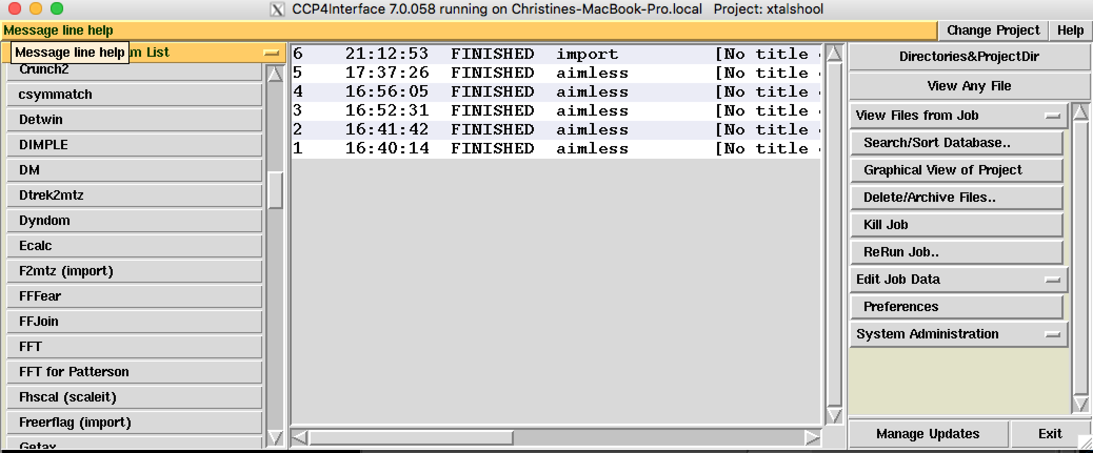
How do you make a Patterson?

Slide 6
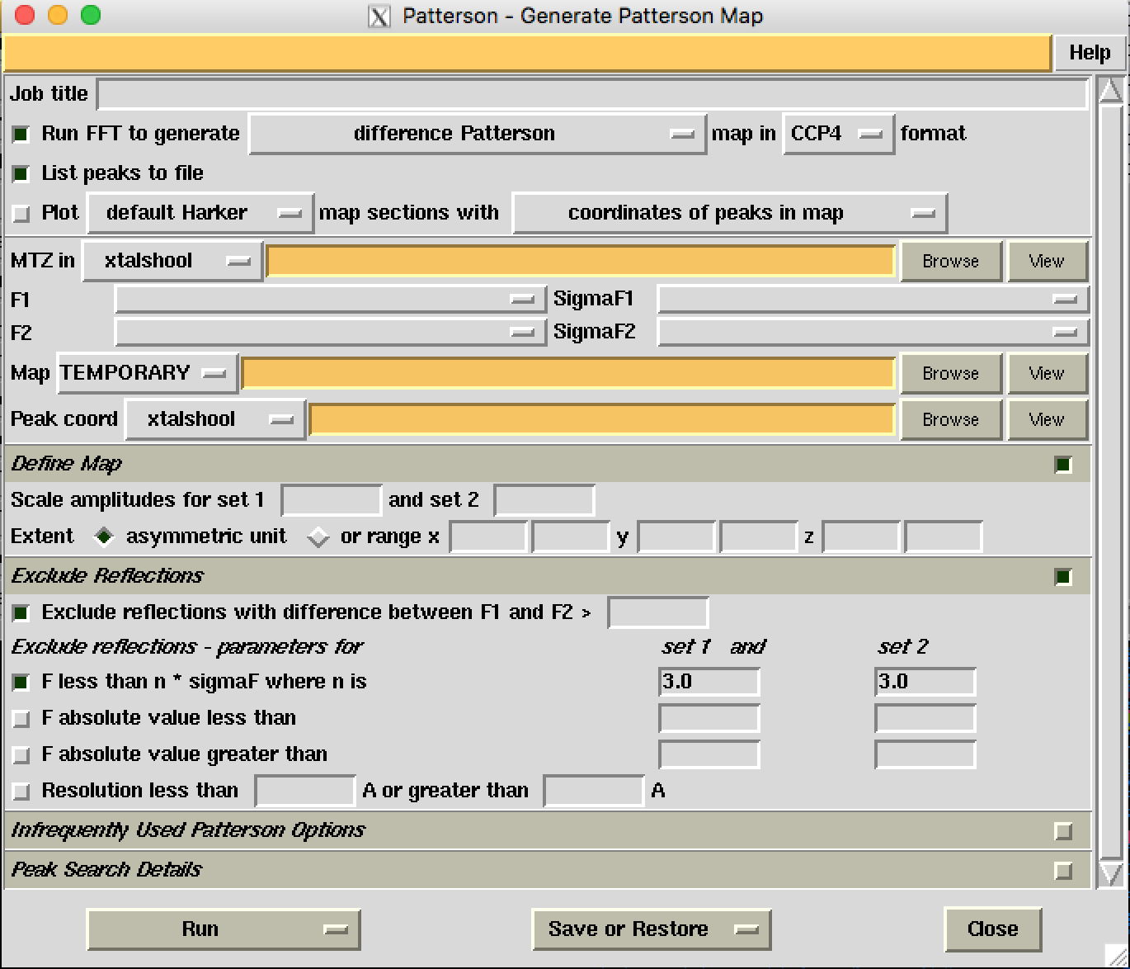
How do you make a Patterson?

Slide 7
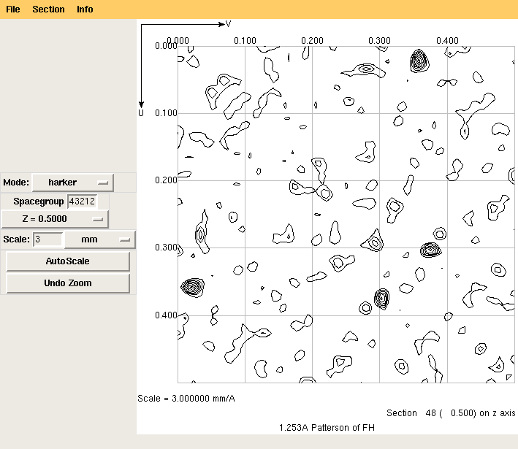
Harker Section of a Patterson

Slide 8
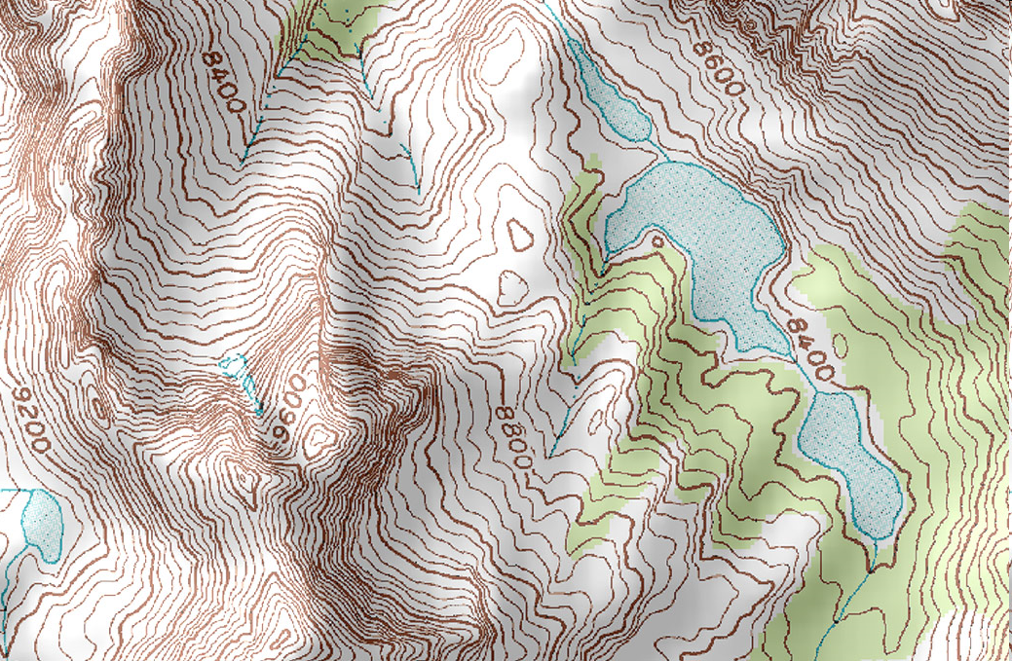
Geography

Slide 9
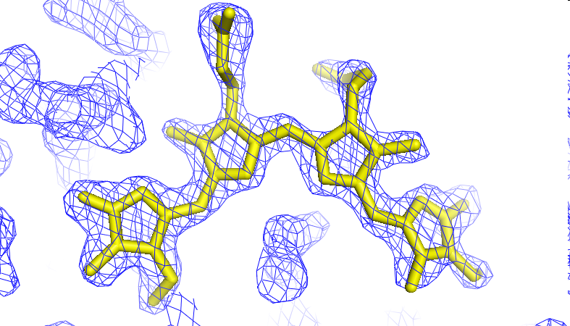
Crystallography

Slide 10
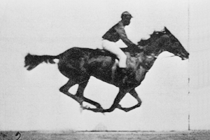
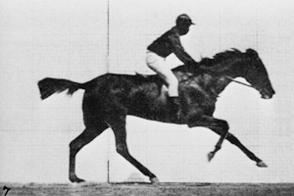
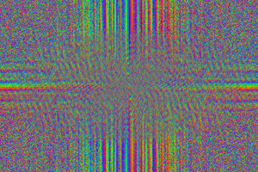
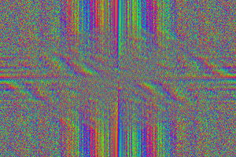
The “phase problem”

Slide 11
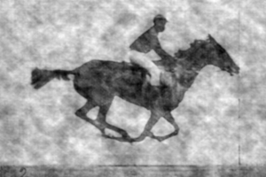
The “phase problem”
Phases
Amplitudes

Slide 12
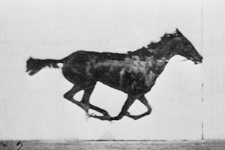
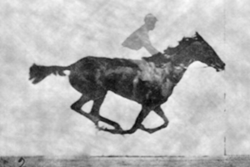
The “phase problem”
Amplitudes
Phases

Slide 13
scattering
x-ray beam
sample
detector
detector

Slide 14
scattering
x-ray beam
sample
detector

Slide 15
scattering
x-ray beam
sample
detector

Slide 16
scattering
x-ray beam
sample
detector

Slide 17
Bragg’s Law
to detector
nλ = 2d sin(θ)
atom #1
θ
d
to source
atom #2
d∙sin(θ)

Slide 18
Bragg’s Law
to detector
nλ = 2d sin(θ)
atom #1
θ
to source
d
atom #2
d∙sin(θ)

Slide 19
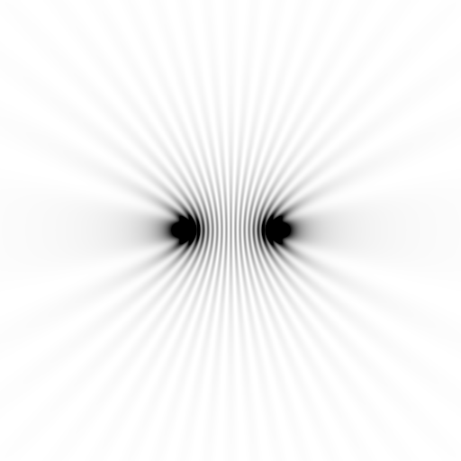
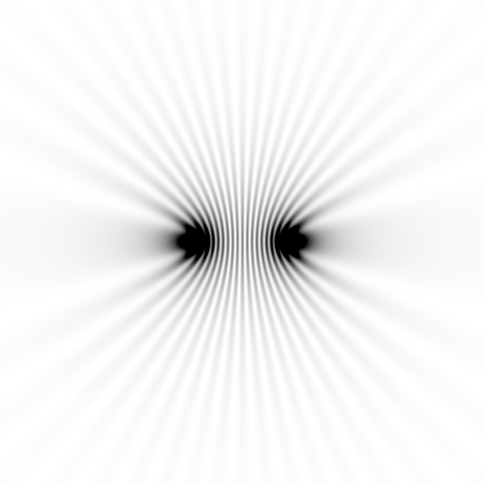
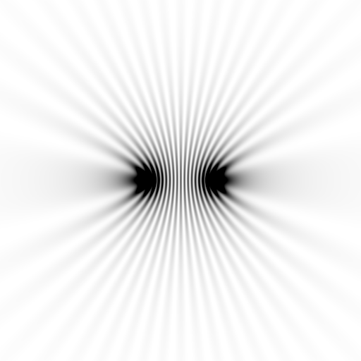
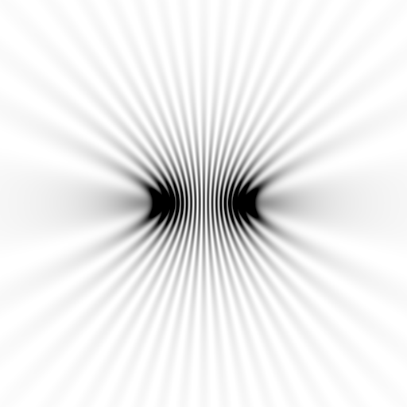
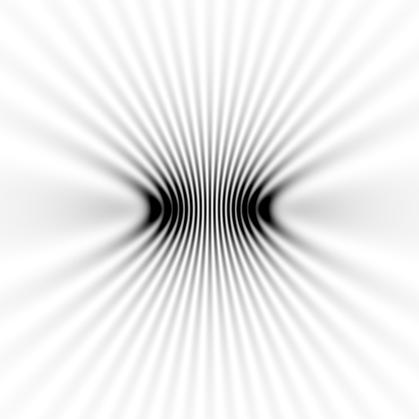
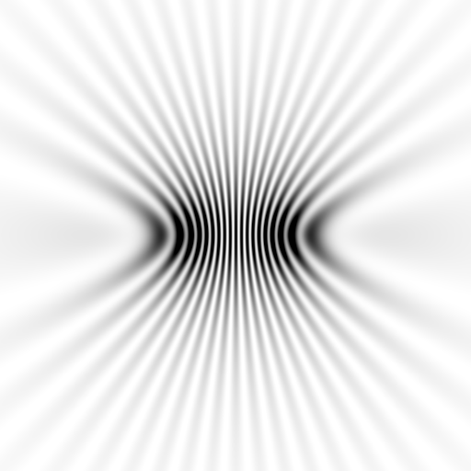
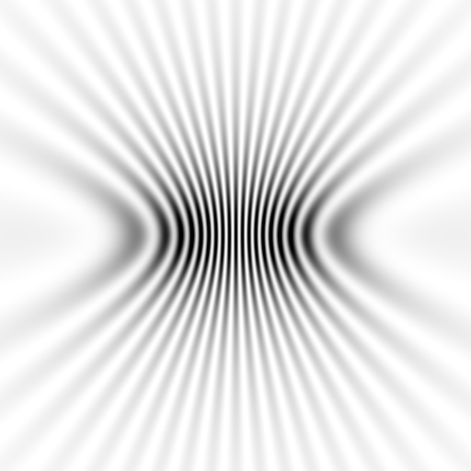
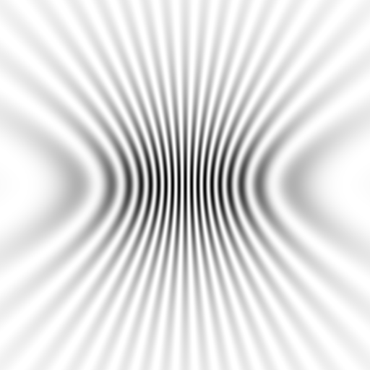
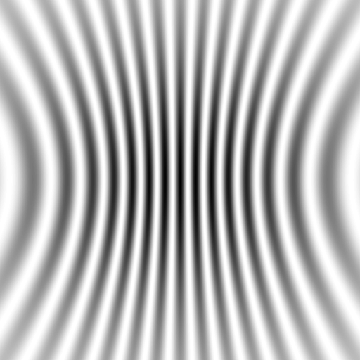

Slide 20
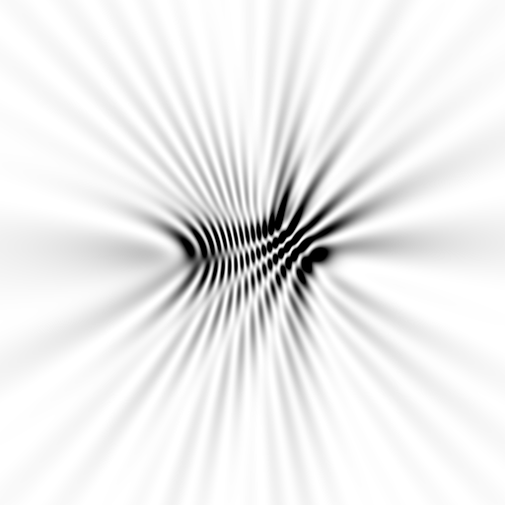
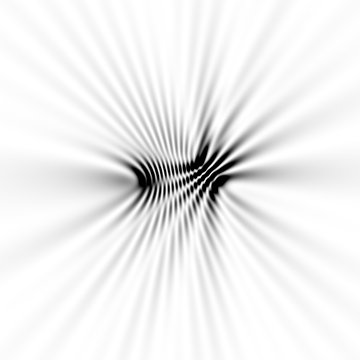

Slide 21
scattering from a structure
sample
detector
+

Slide 22
forward Fourier Transform
inverse Fourier Transform
no phase
+
Patterson map!

Slide 23
The three spaces
real-space
detector
Patterson
+

Slide 24
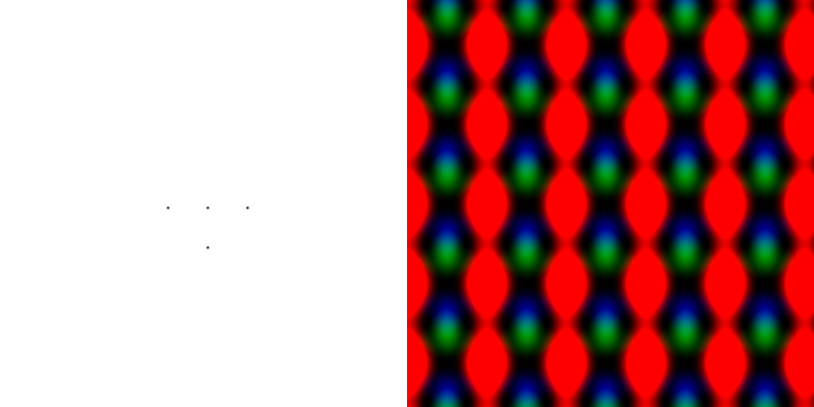
scattering from a lattice
colored by phase
sample
detector
+

Slide 25
scattering from a lattice
colored by phase
sample
detector
+

Slide 26
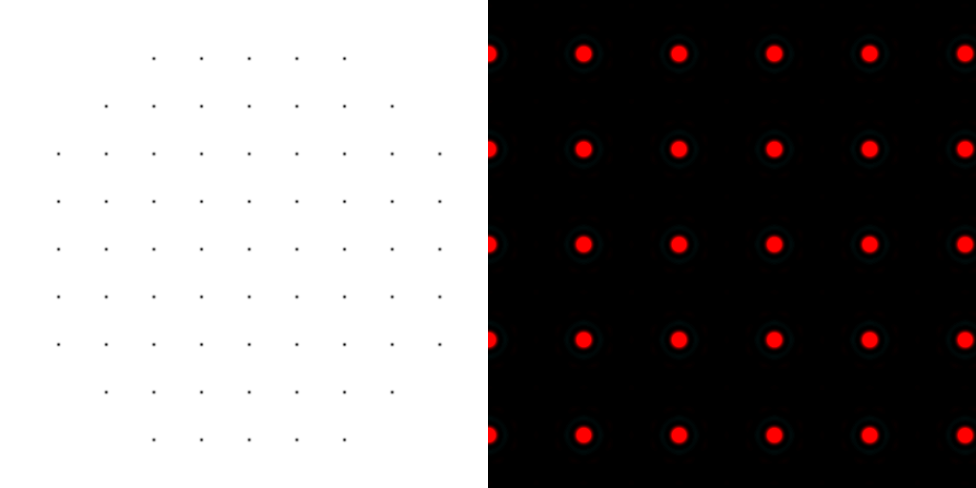
scattering from a lattice
colored by phase
sample
detector
+

Slide 27
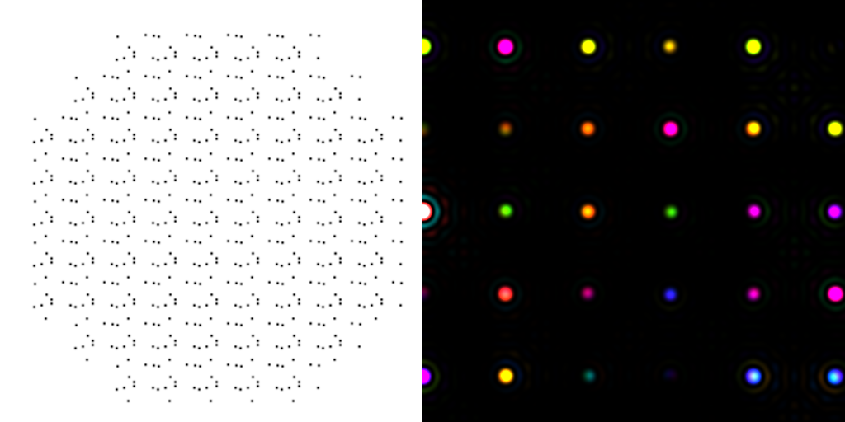
scattering from a crystal structure
colored by phase
sample
detector
+

Slide 28
scattering from a structure
colored by phase
sample
detector
+

Slide 29
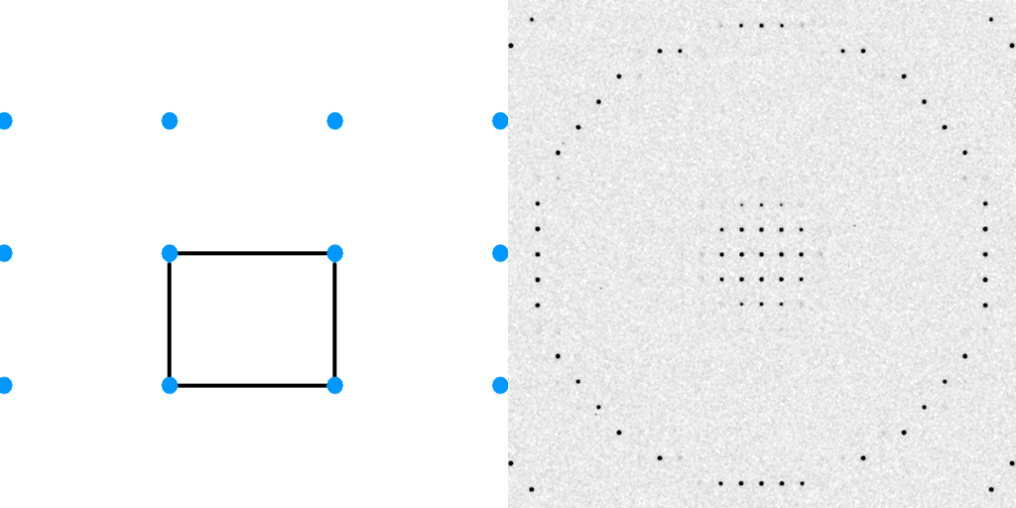
Diffraction from a 3D lattice
+
real space
reciprocal space

Slide 30
Diffraction from a 3D lattice
+
real space
reciprocal space

Slide 31
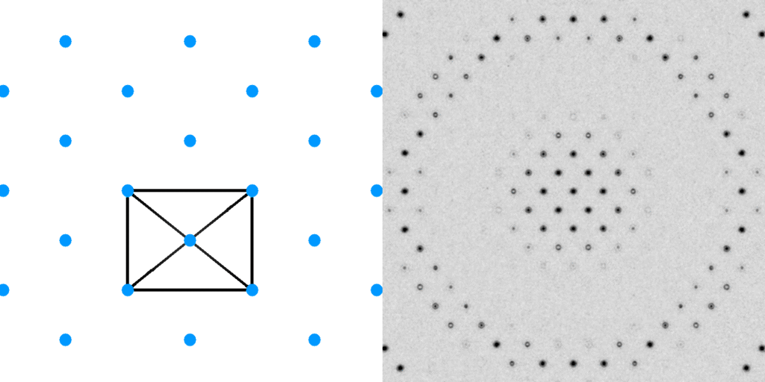
Diffraction from a 3D lattice
+
+
real space
reciprocal space

Slide 32
Diffraction from a 3D lattice
+
+
real space
reciprocal space

Slide 33
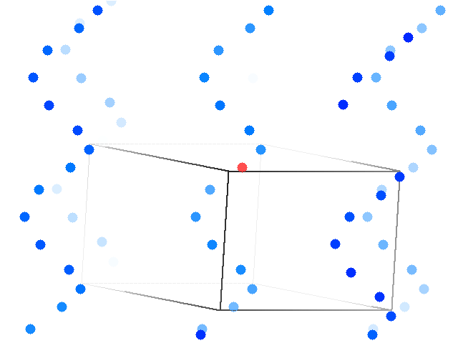
6-fold screw operator (hexagonal)

Slide 34
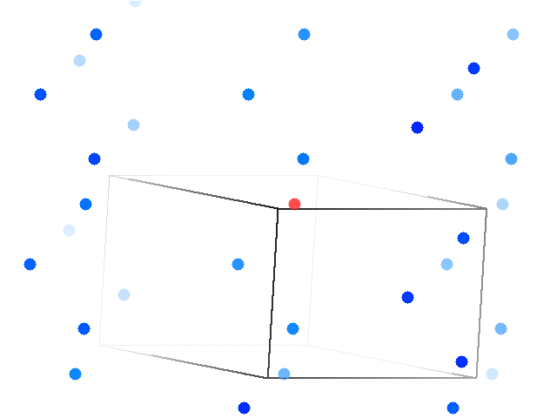
3-fold screw operator (trigonal)

Slide 35
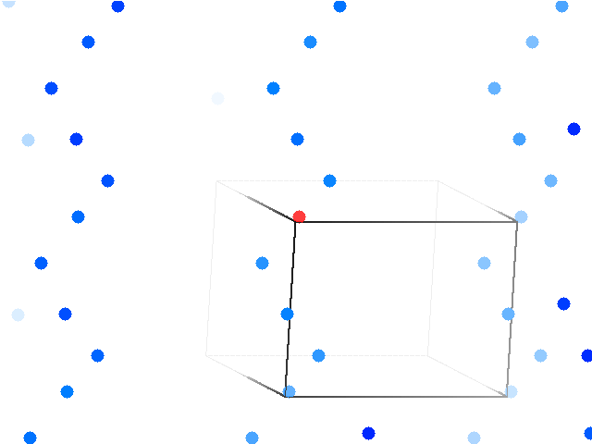
4-fold screw operator (tetragonal)

Slide 36
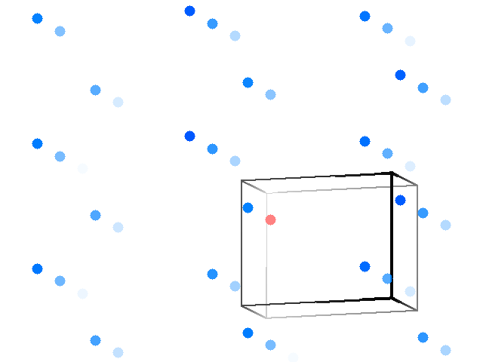
2-fold screw operator

Slide 37
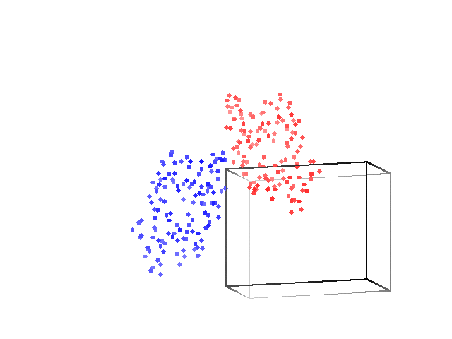
2-fold screw operator: monoclinic lysozyme

Slide 38
Harker Section of a Patterson

Slide 39
One atom in unit cell
Electron density
Fraction across unit cell

Slide 40
Patterson: one atom
Electron density
Fraction across unit cell

Slide 41
Patterson: one atom
Electron density
Fraction across unit cell

Slide 42
Patterson: one atom
Electron density
Fraction across unit cell

Slide 43
Patterson: two atoms
Electron density
Fraction across unit cell

Slide 44
Patterson: two atoms
Electron density
Fraction across unit cell

Slide 45
Patterson: three atoms
Electron density
Fraction across unit cell

Slide 46
Patterson: three atoms
Better resolution!
Electron density
Fraction across unit cell

Slide 47
Patterson: five atoms
Electron density
Fraction across unit cell

Slide 48
Patterson: five atoms
Electron density
Fraction across unit cell

Slide 49
Patterson: five atoms + 3-fold symmetry
Electron density
Fraction across unit cell

Slide 50
Patterson: five atoms + 3-fold symmetry
Electron density
Fraction across unit cell

Slide 51
forward Fourier Transform
9 atoms
+

Slide 52
forward Fourier Transform
10 atoms
+

Slide 53
Patterson map
10 atoms
+

Slide 54
Patterson map
9 atoms
+

Slide 55
Difference Patterson
Still no phases!
+

Slide 56
forward Fourier Transform
9 atoms
+

Slide 57
Native Patterson
Very useful for identifying pseudo-symmetry

Slide 58
Which ones are supposed to be there?
Pick a PDB entry with similar cell
Randomize the coordinates
Assign desired space group
Calculate Patterson

Slide 59
Which ones are supposed to be there?
P1

Slide 60
Which ones are supposed to be there?
P2

Slide 61
Which ones are supposed to be there?
P2₁

Slide 62
Which ones are supposed to be there?
P2₁2₁2₁

Slide 63
Which ones are supposed to be there?
P222

Slide 64
Major Phasing techniques
Molecular Replacement
Multiple Isomorphous Replacement
Anomalous Diffraction
Direct methods

Slide 65
anomalous scattering
x-ray beam
sample
detector

Slide 66
anomalous scattering
x-ray beam
sample
detector

Slide 67
anomalous scattering
x-ray beam
sample
detector

Slide 68
anomalous scattering
x-ray beam
sample
detector

Slide 69
anomalous scattering
x-ray beam
sample
detector

Slide 70
Major Phasing techniques
Molecular Replacement
Multiple Isomorphous Replacement
Anomalous Diffraction
Direct methods

Slide 71
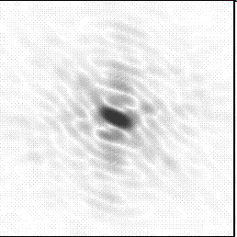
Molecular Replacement
correct structure and intensities
?
+
http://www.ysbl.york.ac.uk/~cowtan/fourier/coeff.html

Slide 72
Molecular Replacement
use something similar as a starting model
+

Slide 73
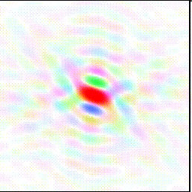
Model Building
current model is missing something
+

Slide 74
Model Building
phases from model
+

Slide 75
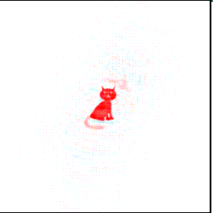
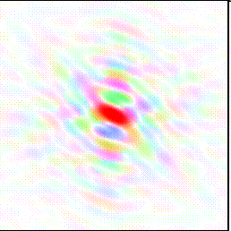
Model Building
missing bits show up in “difference map”
+

Slide 76
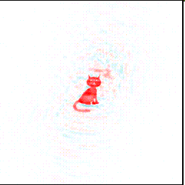
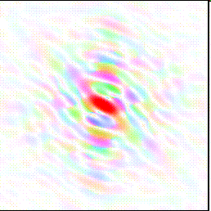
Model Building
missing bits show up better in F_{O} + (F_{O} - F_{C}) map
+

Slide 77
Phase errors: simplest possible case

Slide 78
Phase errors: simplest possible case

Slide 79
Phase errors: simplest possible case

Slide 80
Phase errors: simplest possible case

Slide 81
Phase errors: simplest possible case

Slide 82
Phase errors: simplest possible case

Slide 83
Phase errors: simplest possible case

Slide 84
Phase errors: simplest possible case

Slide 85
Phase errors: 3-atom case

Slide 86
Phase errors: 3-atom case

Slide 87
Phase errors: 3-atom case

Slide 88
Phase errors: 3-atom case

Slide 89
Phase errors: 3-atom case

Slide 90
Phase errors: 3-atom case

Slide 91
Phase errors: 3-atom case

Slide 92
Phase errors: 3-atom case

Slide 93
Phase errors: 3-atom case

Slide 94
Phase errors: 3-atom case

Slide 95
Phase errors: 3-atom case

Slide 96
Phase errors: asymmetric case

Slide 97
Phase errors: asymmetric case

Slide 98
Phase errors: asymmetric case

Slide 99
Phase errors: asymmetric case

Slide 100
Phase errors: asymmetric case

Slide 101
Phase errors: asymmetric case

Slide 102
Phase errors: asymmetric case

Slide 103
Phase errors: asymmetric case

Slide 104
Phase errors: asymmetric case

Slide 105
Summary
Patterson = real-space representation of all information in diffraction pattern
“small”, high-resolution structures solved with no phases!
Difference Pattersons for finding heavy atom sites
Native Patterson for symmetry
Used “under the hood” for all phasing!

Slide 106
Pattersons
The “third space”
of crystallography
https://bl831.als.lbl.gov/~jamesh/powerpoint/
SCANZ_Pattersons_2019.pptx

Slide 107
The “phase problem”
Phases
Amplitudes
F_{obs}

Slide 108
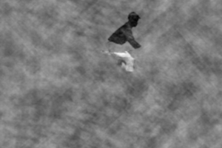
The “phase problem”
Phases & Amplitudes
Amplitudes
F_{obs}-F_{calc}

Slide 109
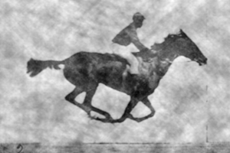
The “phase problem”
Phases & Amplitudes
Amplitudes
2F_{obs}-F_{calc}

Slide 110
The “phase problem”
Phases
Amplitudes

Slide 111
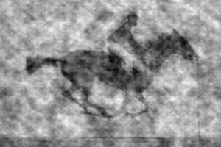
The “phase problem”
Phases & Amplitudes
Amplitudes
2F_{obs}-F_{calc}

Slide 112
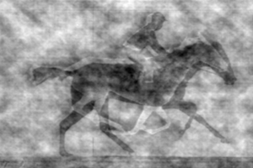
The “phase problem”
Phases & Amplitudes
Amplitudes
2mF_{obs}-F_{calc} (σ_{A} weighting)

Slide 113
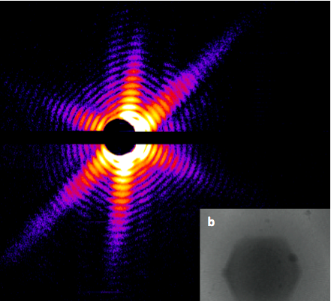
Snapshot from single virus particle
2 keV LCLS 200 fs Mimi virus single-shot.
_{200 nm}
_{Reconstructed image}
_{Resolution 20nm}
_{TEM}
Seibert, et al. (2011). Nature 470, 78-81.
Notes:
what limits single-particle resolution ?
get 100 times more photons/shot if correctly focussed beam
get 100 times more with submicron beam focus on CXI chamber
Problem – scattering goes from N^2 to N (Wilson statistics).
So use a-priori information – modelling Axel Brummer
Make beam smaller than jet to elliminate streak
₁₁₃

Slide 114
lysozyme: real and reciprocal

Slide 115
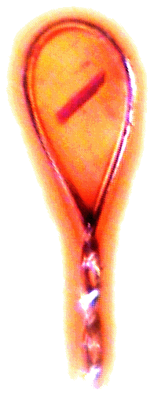
X-ray data are 3D!

