Slide 1
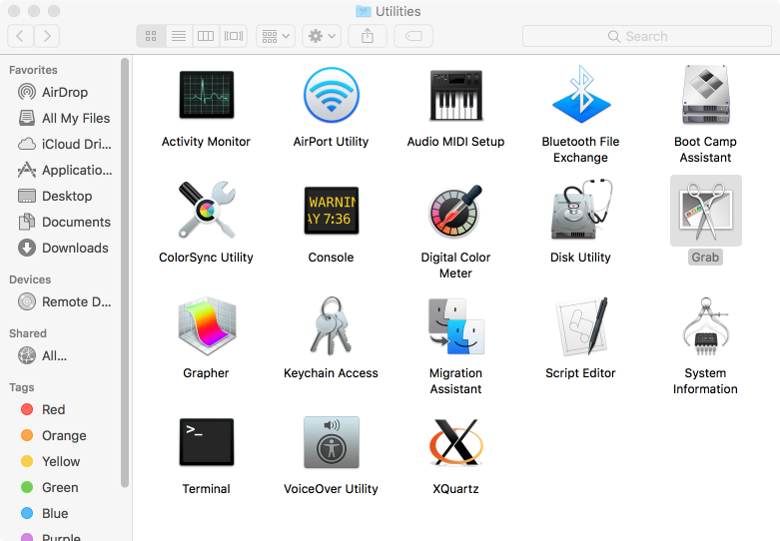

Slide 2
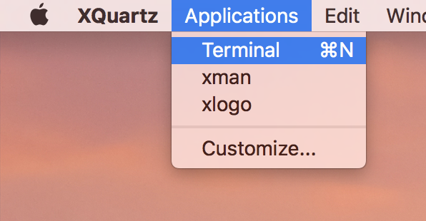

Slide 3
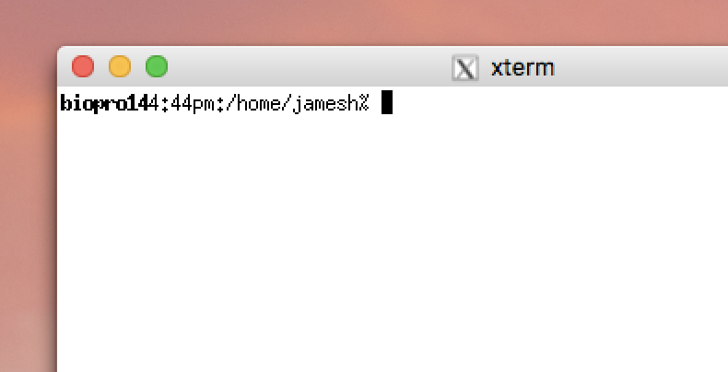
Cursor
does not move
with mouse
The “prompt”
Mouse
can be used
To select and paste
But all pasted text
Goes to the cursor

Slide 4
DIALS demo
prompt
Do not type!
underscore
~]$ cd
~]$ mkdir dials_tutorial
~]$ cd dials_tutorial
~]$ ln –sf /home/data/course_2019 .
~]$ dui
Space!
Enter
Space!

Slide 5
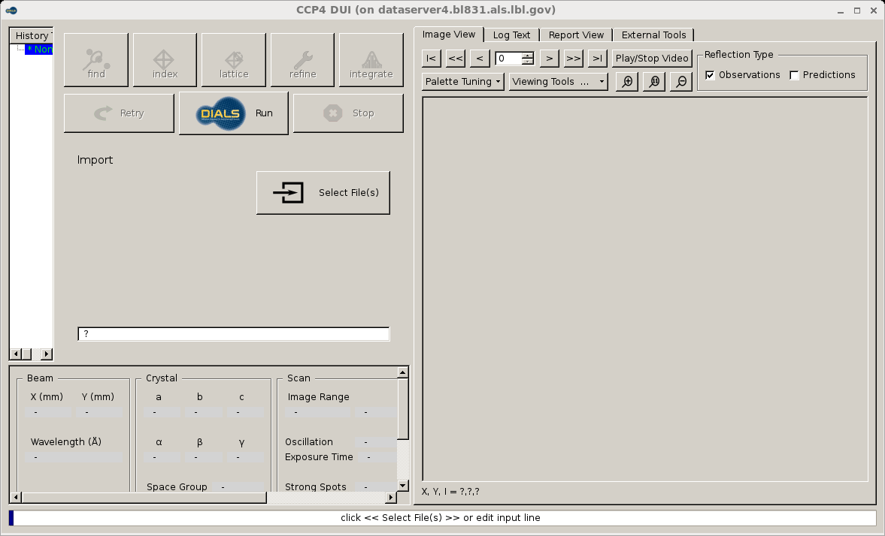

Slide 6
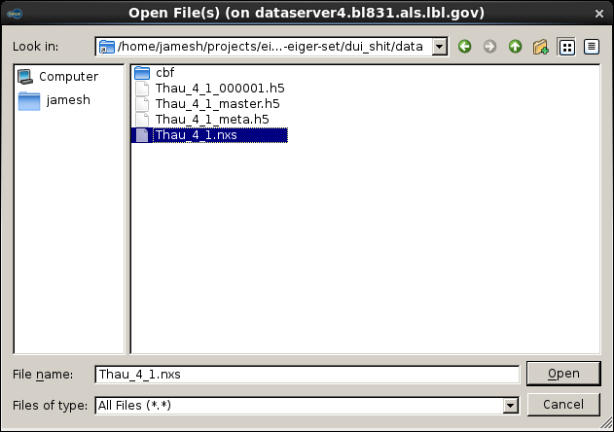

Slide 7
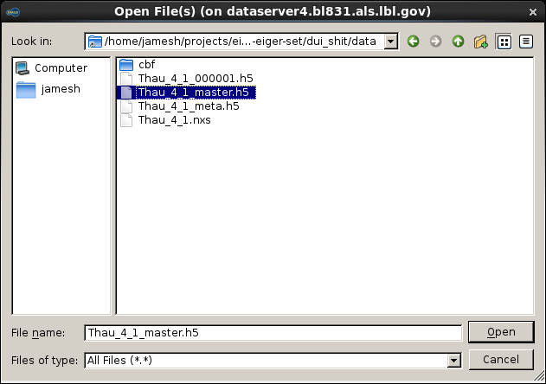

Slide 8
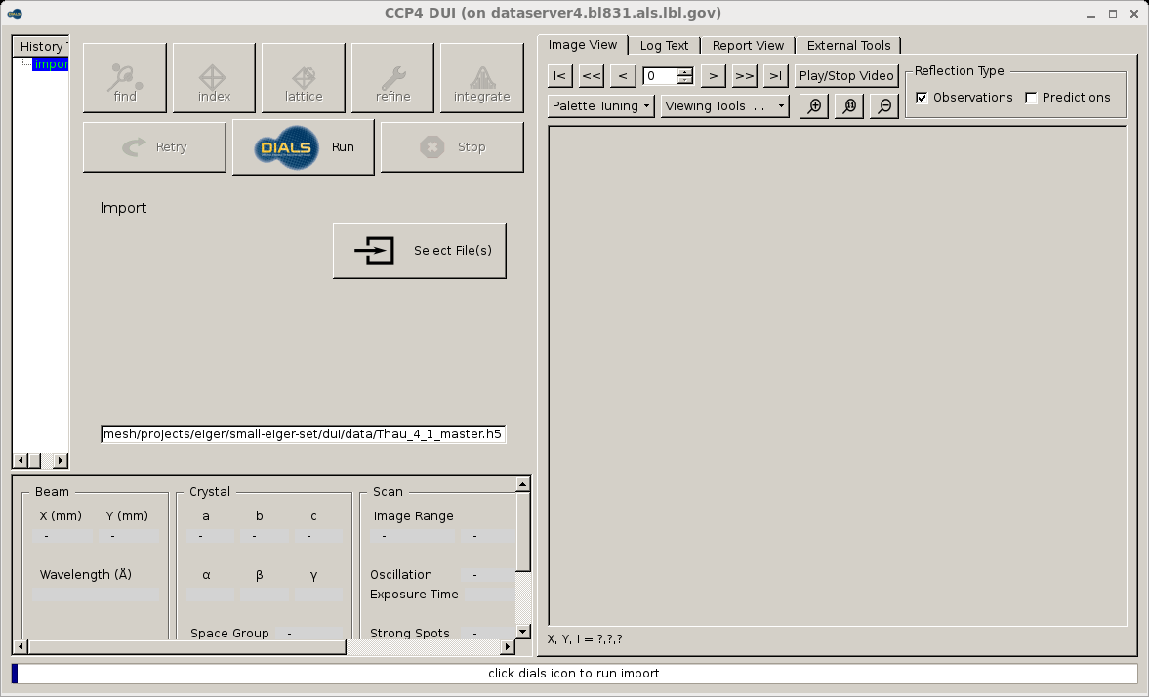

Slide 9
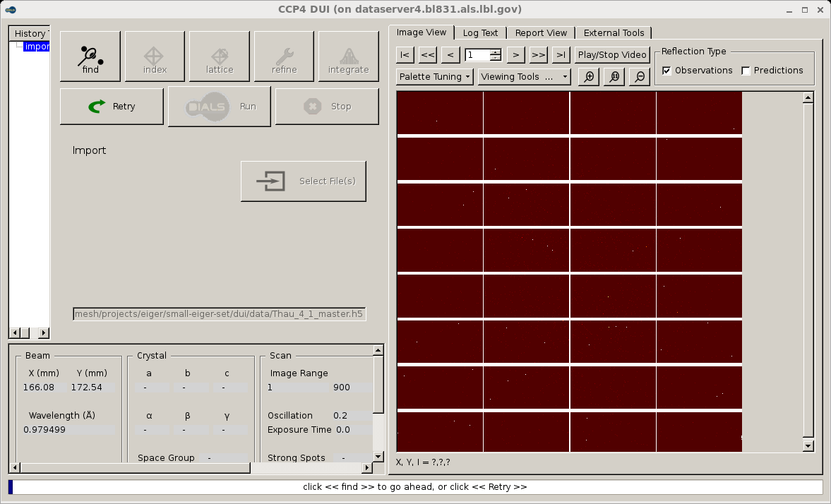

Slide 11
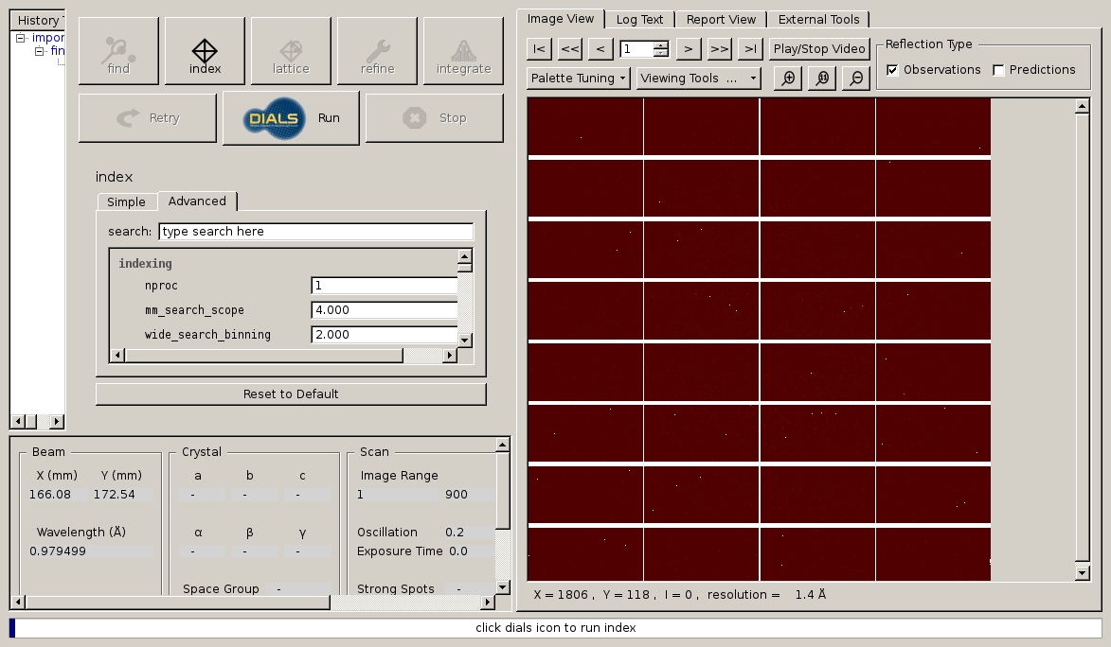

Slide 13
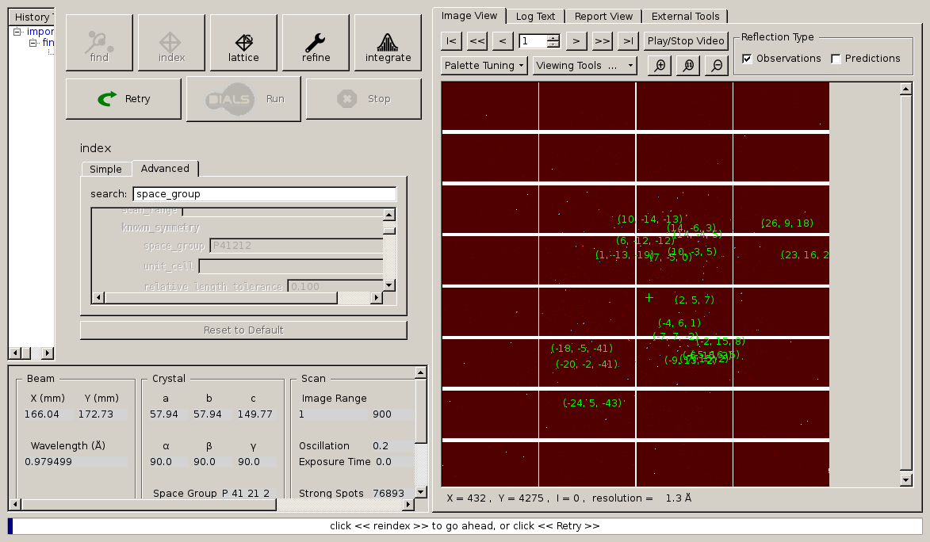

Slide 14
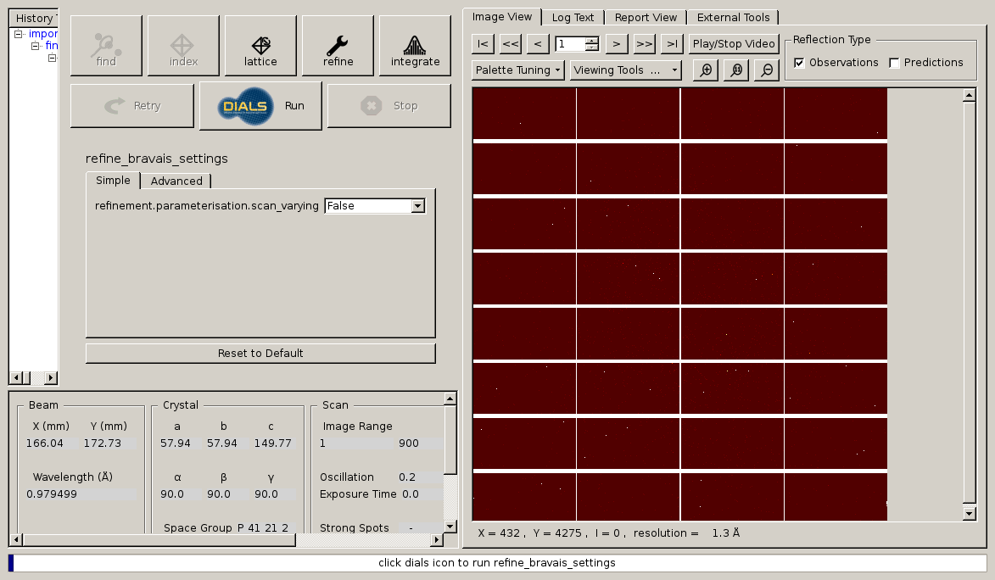

Slide 15
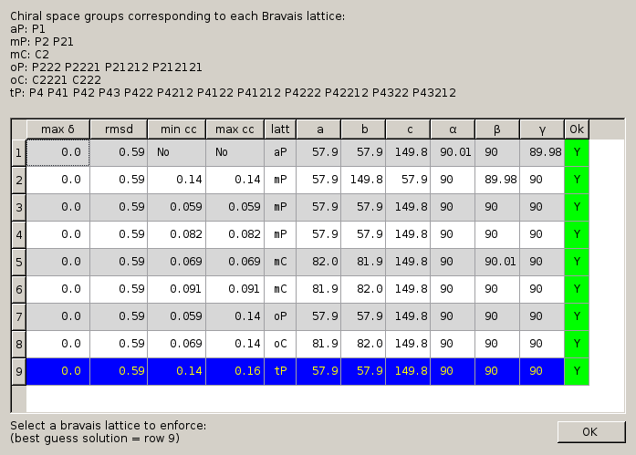

Slide 16
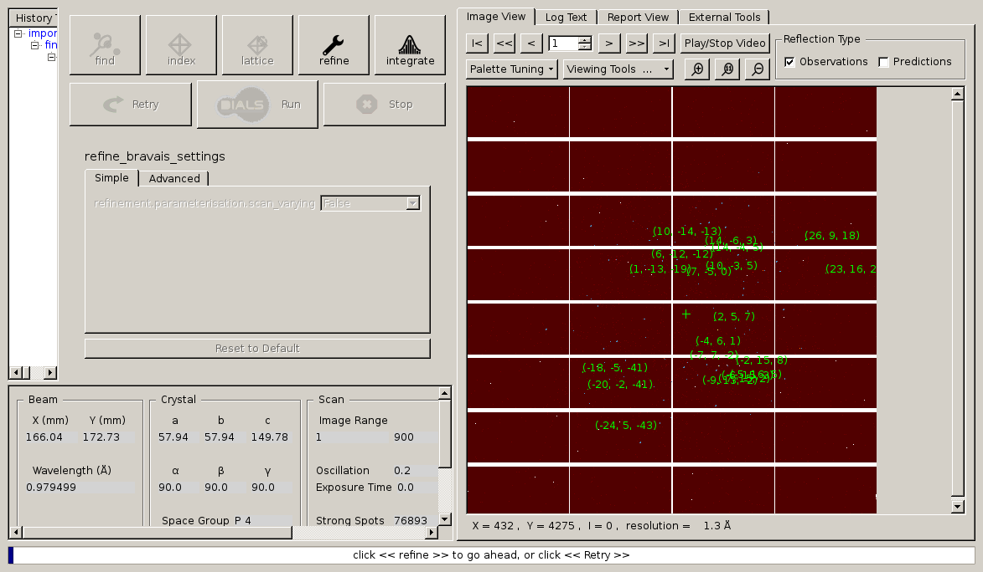

Slide 17
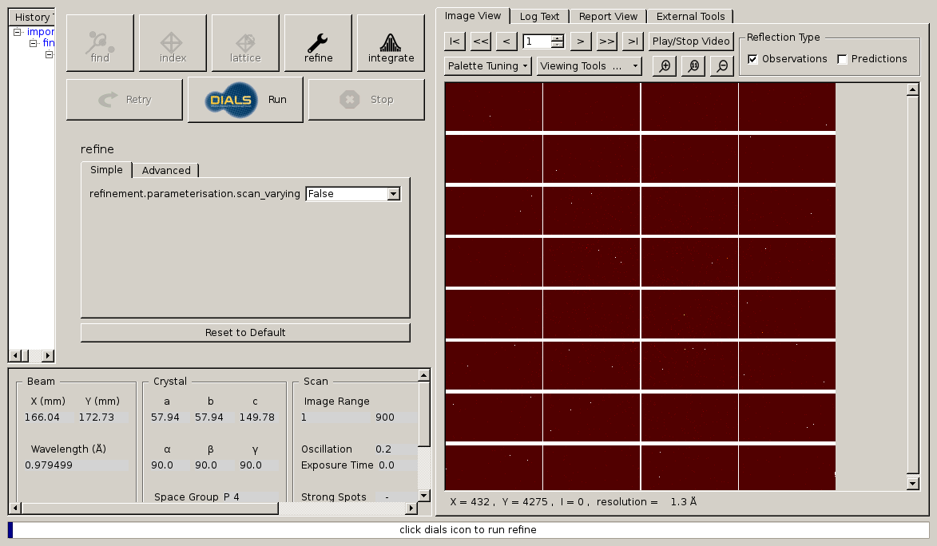

Slide 18
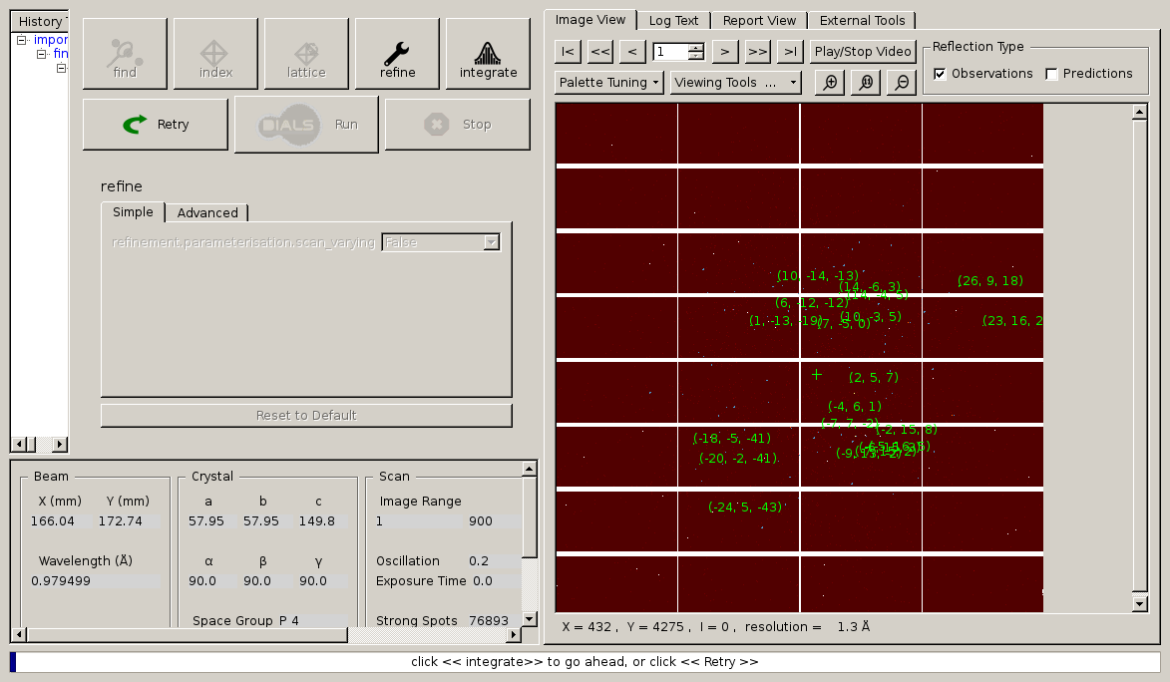

Slide 19
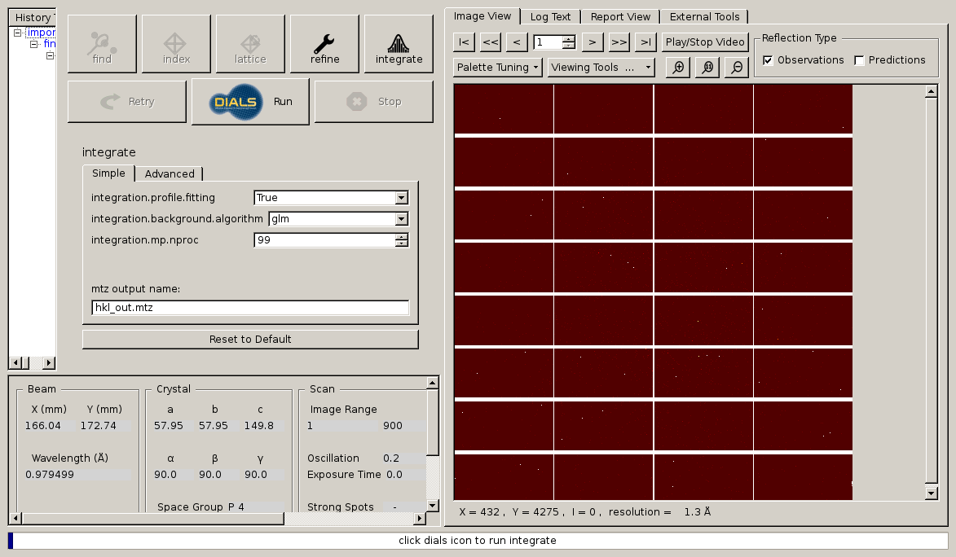

Slide 20
After DUI: scale merge refine!
$ echo | pointless hklin hkl_out.mtz hklout pointless.mtz |\
tee pointless.log
$ echo refine parallel | aimless hklin pointless.mtz \
hklout aimless.mtz | tee aimless.log
$ echo | truncate hklin aimless.mtz hklout truncated.mtz |\
tee truncate.log
$ wget http://www.rcsb.org/pdb/files/5x9L.pdb.gz
$ gunzip 5x9L.pdb.gz
$ echo | pointless xyzin 5x9L.pdb hklin truncated.mtz \
hklout reindexed.mtz | tee reindex.log
$ uniqueify reindexed.mtz
$ echo | refmac5 hklin reindexed-unique.mtz xyzin 5x9L.pdb \
hklout refmacout.mtz xyzout refmacout.pdb |\
tee refmac.log

Slide 21
How to run DIALS the easy way:
source /Applications/dials-v1-10-2/dials_env.csh
xia2 mosflm_beam_centre=151.4,144.8
/data/blah/yourname/xtal/dataset/
dials.reciprocal_space_viewer

Slide 22
How to run DIALS the hard way:
% dials.import /home/ …. /MLYS/
% dials.find_spots datablock.json nproc=8
% dials.reciprocal_space_viewer datablock.json strong.pickle &
% dials.image_viewer datablock.json &
% dials.generate_mask untrusted.polygon=1958,2024,0,2005,0,2151,1956,2125 untrusted.circle=1964,2073,200
% open –t datablock.json

Slide 23
How to run DIALS the hard way:
% open -t datablock.json
Change origin to -144.8,151.4,-200
edit mask = mask.pickle
% dials.find_spots datablock.json nproc=8
% dials.index datablock.json strong.pickle \ space_group=P21 \ unit_cell=27.28,62.44,59.82,90,90.615,90
% dials.integrate experiments.json indexed.pickle
% dials.image_viewer integrated.pickle \ integrated_experiments.json

Slide 24
How to run DIALS the hard way:
% dials.export integrated_experiments.json integrated.pickle
% pointless hklin integrated.mtz hklout ptls.mtz | tee pointless.log
% egrep “Best|twin” pointless.log
% echo “refine parallel” |\
aimless hklin ptls.mtz hklout amls.mtz |\
tee aimless.log
% truncate hklin amls.mtz hklout truncated.mtz
% phenix.autosol truncated.mtz

Slide 25
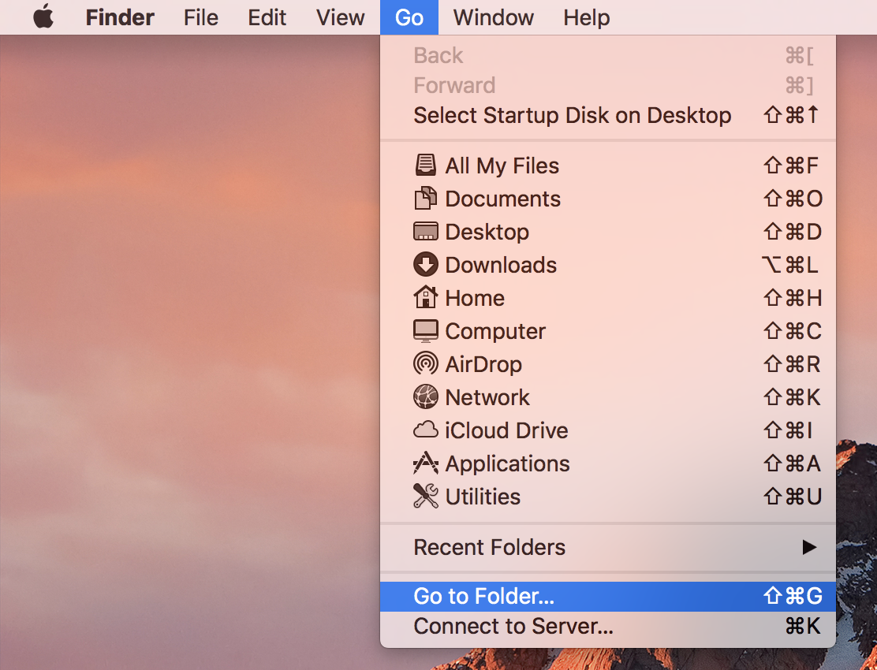
Left click
Left click

Slide 26
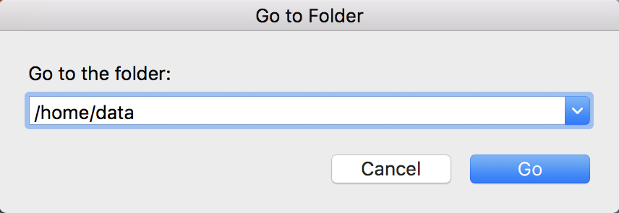
type
(with keyboard)

Slide 27
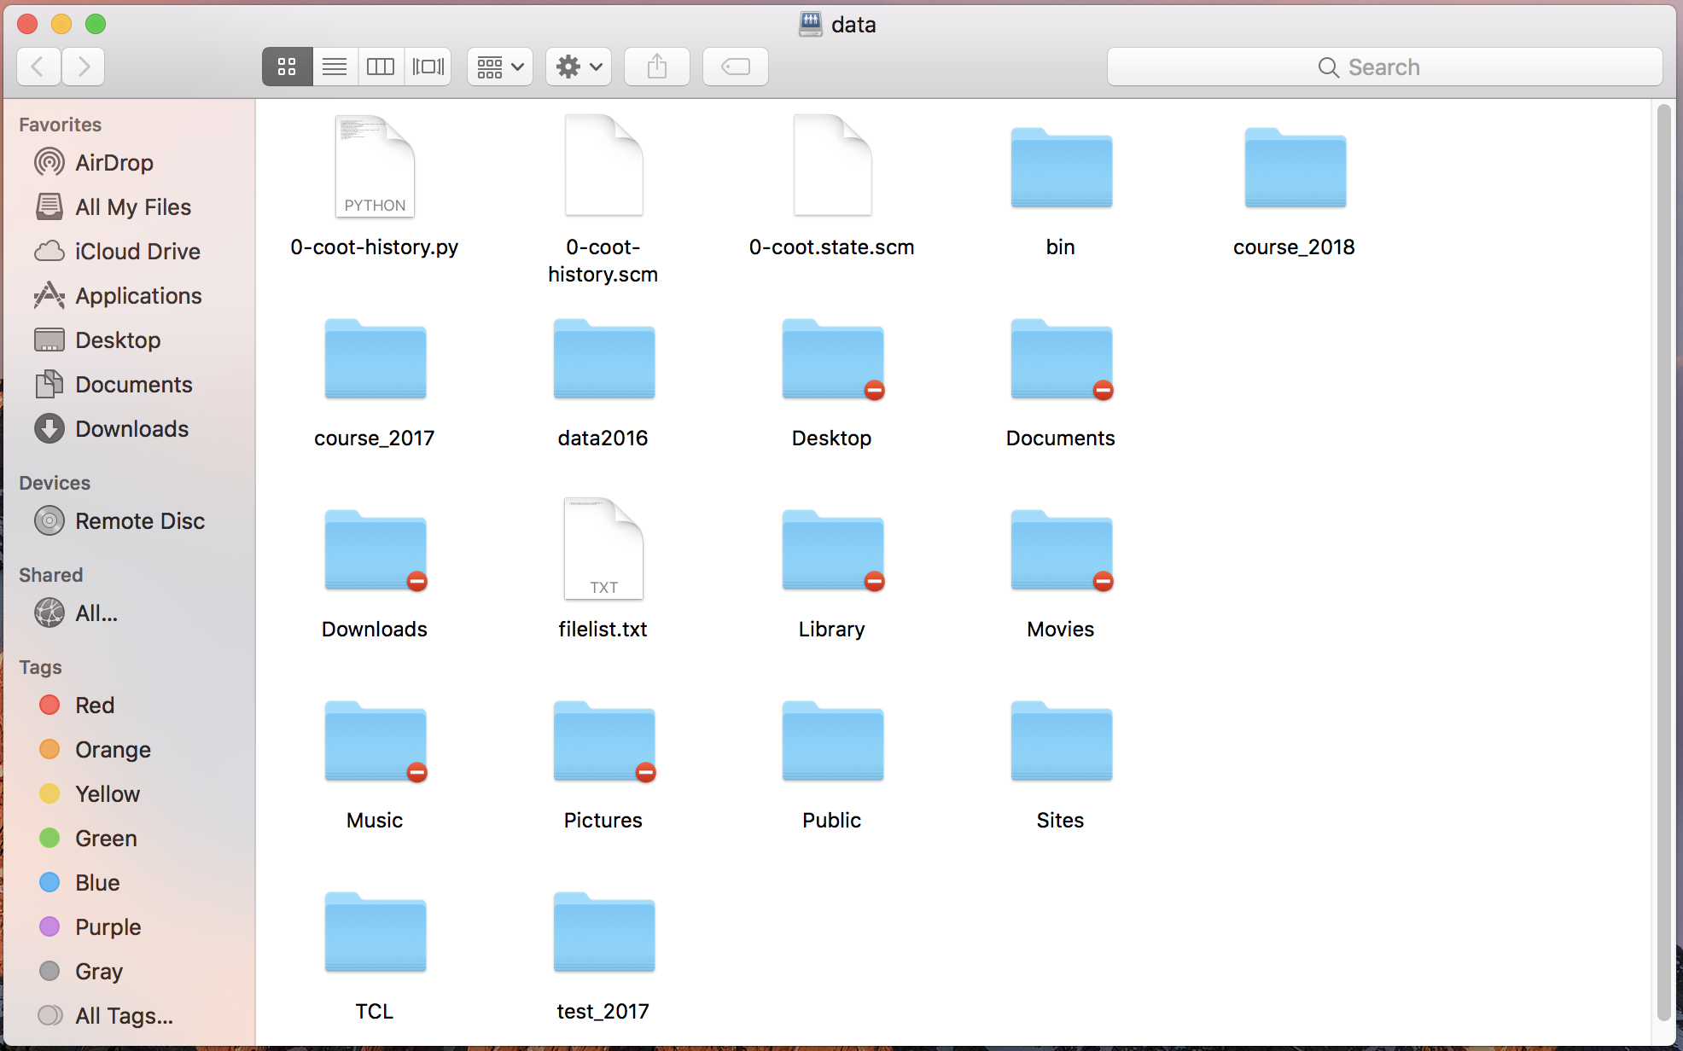
drag

Slide 28
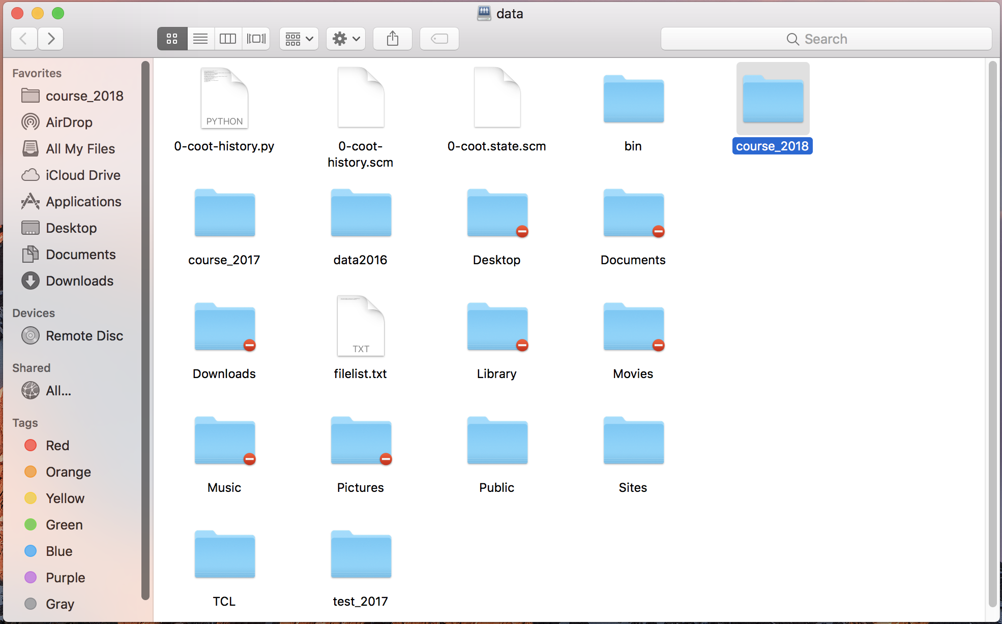

Slide 29
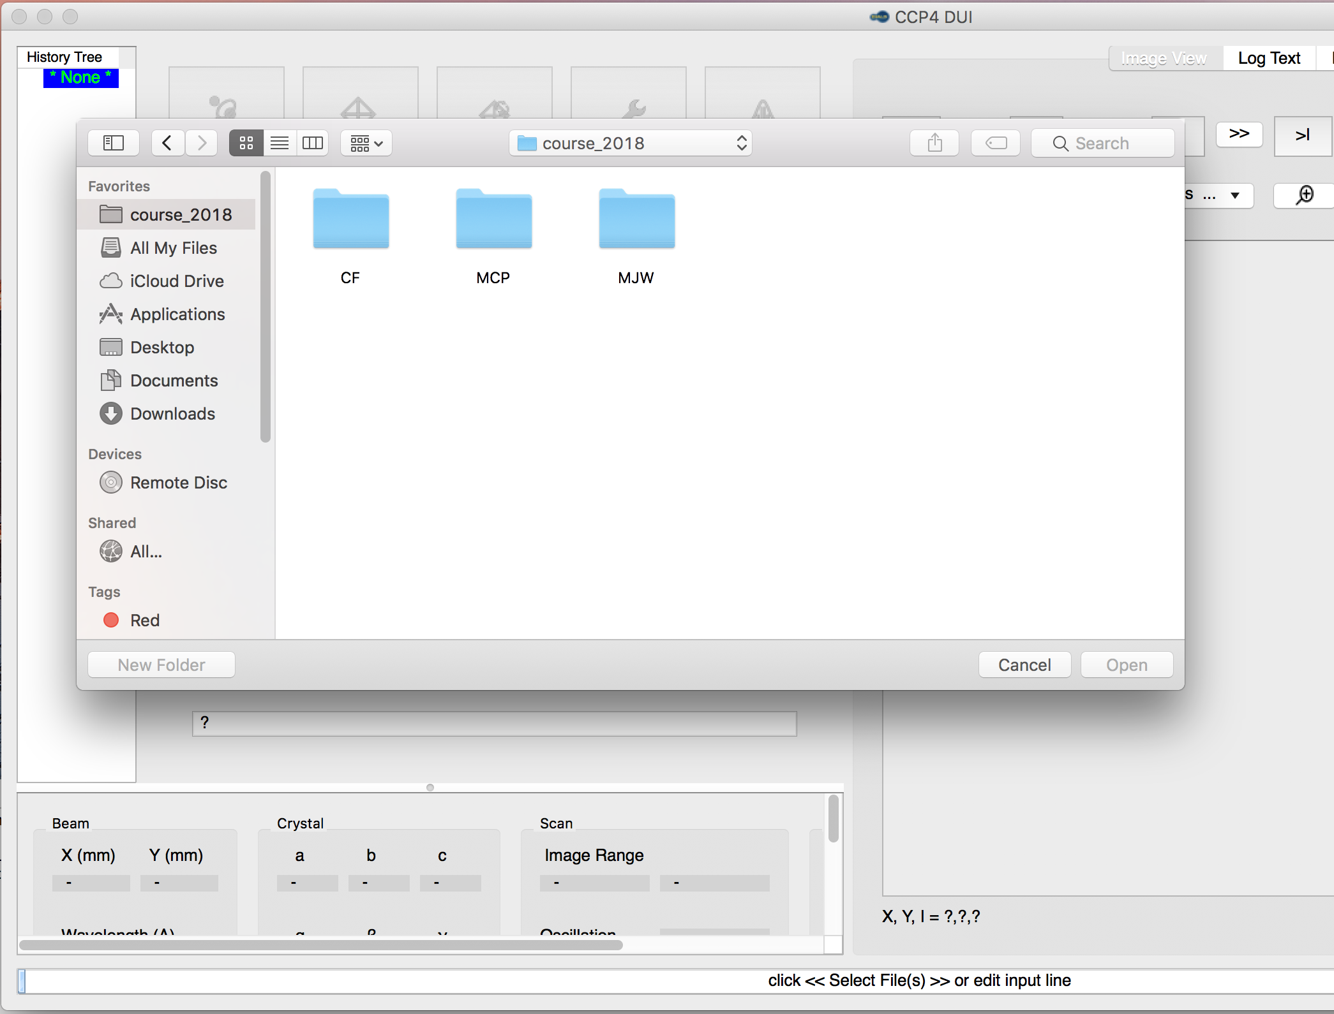

Slide 30
JMHolton@lbl.gov

