Slide 1
PowerPoint File available:
http://bl831.als.lbl.gov/
~jamesh/powerpoint/
Sbgrid_strategy_2016.pptx

Slide 2
Acknowledgements
Robert Stroud James Fraser John Spence
Chris Nielsen Clemens Schulze-Briese Aina Cohen Ana Gonzalez
UCSF LBNL SLAC
ALS 8.3.1 creator: Tom Alber
UC Multicampus Research Programs and Initiatives (MRPI)
UCSF Program for Breakthrough Biomedical Research (PBBR)
one-time NIH-DOE Inter-agency agreement (IAA)
Integrated Diffraction Analysis Technologies (IDAT)
Plexxikon, Inc.
M D Anderson CRC
Synchrotron Radiation Structural Biology Resource (SLAC)
The Advanced Light Source is supported by the Director, Office of Science, Office of Basic Energy Sciences, Materials Sciences Division, of the US Department of Energy under contract No. DE-AC02-05CH11231 at Lawrence Berkeley National Laboratory.

Slide 3
Data Collection Strategy
Exposure time
Number of images
Wavelengths
Beam: size, flux, divergence, bandpass
Inverse beam?
Kappa? - overlaps
Multiple crystals? - non-isomorphism
Run Strategy

Slide 4
The “success rate” of structure determination
100 s/dataset
200 days/year
~150 beamlines
~26,000,000 datasets/year
9333 PDBs in 2015

Slide 5
signal vs noise
“If you don’t have
good data,
then you have
no data at all.”
-Sung-Hou Kim

Slide 6
signal vs noise
easy
hard
impossible

Slide 7
signal vs noise
easy
hard
impossible
threshold of “solvability”

Slide 8
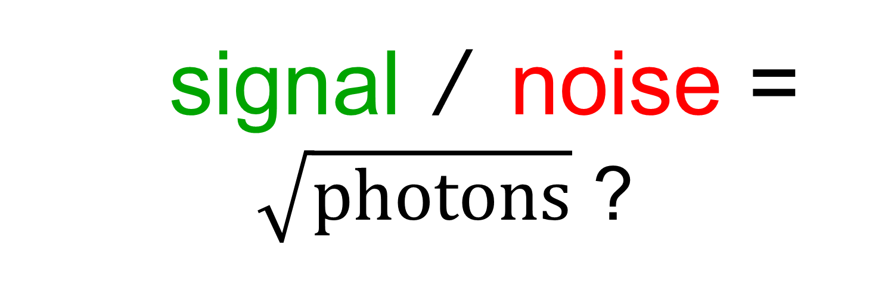
signal / noise = $\sqrt{photons}$ ?
none sqrt proportional
CCD
Read-out
Photon
counting
Detector calibration
attenuation
partiality
Non-isomorphism
Radiation damage
none
1/sqrt
1/prop.
Time
Beam flicker
Shutter jitter
Sample vibration
Pile-up

Slide 9
signal vs noise
“If you don’t have
good data,
then you must
learn statistics.”
-James Holton

Slide 10
Adding noise

Slide 11
Adding noise
1² + 1² = 1.4²

Slide 12
Adding noise
1² + 1² = 1.4²
3² + 1² = 3.2²
σ_{total}² = σ₁² + σ₂²

Slide 13
Adding noise
1² + 1² = 1.4²
3² + 1² = 3.2²
σ_{total}² = σ₁² + σ₂²

Slide 14
Adding noise
1² + 1² = 1.4²
3² + 1² = 3.2²
σ_{total}² = σ₁² + σ₂²

Slide 15
Adding noise
1² + 1² = 1.4²
3² + 1² = 3.2²
10² + 1² = 10.05²

Slide 16

100% SeMet incorporation
Trivial to solve

Slide 17

100% S -Met incorporation
Impossible to solve

Slide 18
Phase Problem: Se vs S
correlation coefficient
1.0 - fraction Se

Slide 19
Phase Problem: Se vs S
correlation coefficient
1.0 - fraction Se

Slide 20
Phase Problem: Se vs S
correlation coefficient
1.0 - fraction Se

Slide 21
Phase Problem: Se vs S
correlation coefficient
1.0 - fraction Se

Slide 22
Phase Problem: Se vs S
correlation coefficient
1.0 - fraction Se

Slide 23
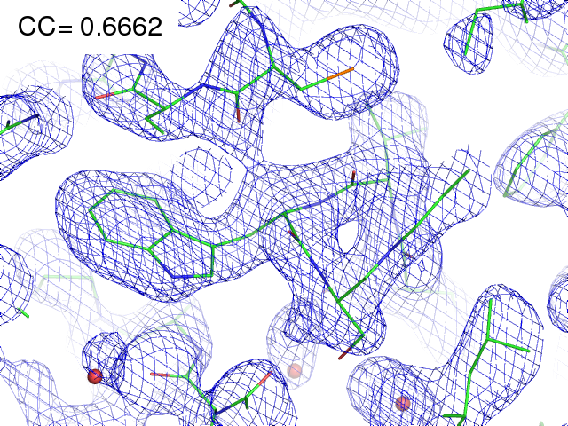
29% Se 71% S

Slide 24
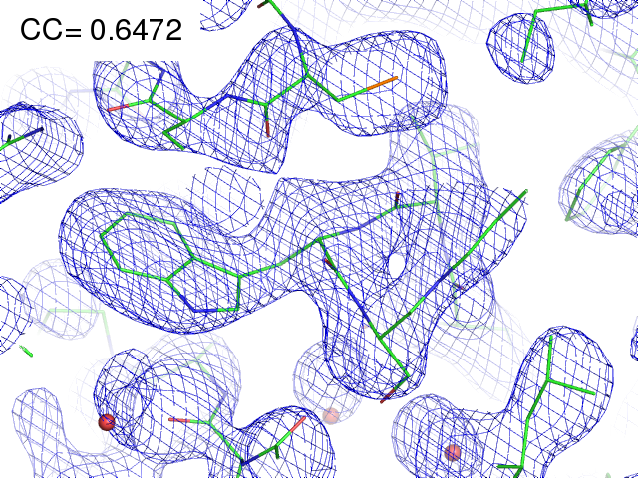
28% Se 72% S

Slide 25
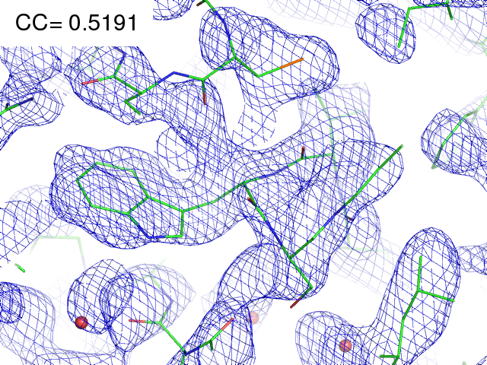
21% Se 79% S

Slide 26
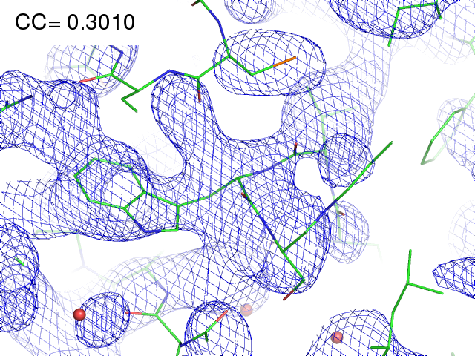
11% Se 89% S

Slide 27
MR simulation
corrupted model
Correlation coefficient to correct density
Rmsd from perfect search model (Å)

Slide 28
The transitions are sharp!
How can we predict success/failure?
Know Thy Experiment

Slide 29
Where do photons go?
Protein
1A x-rays
Transmitted (98%)
beamstop

Slide 30
Where do photons go?
Protein
1A x-rays
Transmitted (98%)
beamstop
2% total → error < 2%

Slide 31
attenuation factor
μ
I_{T}
I_{beam}
A = = exp(-μt)
t
Bouguer, P. (1729). Essai d'optique sur la gradation de la lumière.
Lambert, J. H. (1760). Photometria: sive De mensura et gradibus luminis, colorum et umbrae. E. Klett.
Beer, A. (1852)."Bestimmung der Absorption des rothen Lichts in farbigen Flüssigkeiten", Ann. Phys. Chem 86, 78-90.

Slide 32
attenuation factor
μ
t_{out}
t_{in}
I_{T}
I_{beam}
I_{T}
I_{beam}
A = = exp(-μ(t_{in}+ t_{out}))
A = = exp(-μt)
t
Bouguer, P. (1729). Essai d'optique sur la gradation de la lumière.
Lambert, J. H. (1760). Photometria: sive De mensura et gradibus luminis, colorum et umbrae. E. Klett.
Beer, A. (1852)."Bestimmung der Absorption des rothen Lichts in farbigen Flüssigkeiten", Ann. Phys. Chem 86, 78-90.

Slide 33
attenuation factor
t_{out}
t_{in}
μ
t_{out}
t_{in}
t_{out}
I_{T}
I_{beam}
t_{in}
A = = exp(-μ(t_{in}+ t_{out}))
Bouguer, P. (1729). Essai d'optique sur la gradation de la lumière.
Lambert, J. H. (1760). Photometria: sive De mensura et gradibus luminis, colorum et umbrae. E. Klett.
Beer, A. (1852)."Bestimmung der Absorption des rothen Lichts in farbigen Flüssigkeiten", Ann. Phys. Chem 86, 78-90.

Slide 34
attenuation factor
μ_{solvent}
t_{so}
t_{xo}
t_{si}
t_{xi}
μ_{xtal}
t_{so}
t_{xo}
t_{si}
t_{xi}
t_{so}
t_{xo}
I_{T}
I_{beam}
t_{si}
t_{xi}
A = = exp[-μ_{xtal}(t_{xi}+ t_{xo})
-μ_{solvent}(t_{si} + t_{so})]
Bouguer, P. (1729). Essai d'optique sur la gradation de la lumière.
Lambert, J. H. (1760). Photometria: sive De mensura et gradibus luminis, colorum et umbrae. E. Klett.
Beer, A. (1852)."Bestimmung der Absorption des rothen Lichts in farbigen Flüssigkeiten", Ann. Phys. Chem 86, 78-90.

Slide 35
Data Collection Strategy
Exposure time
Number of images
Wavelengths
Beam: size, flux, divergence, bandpass
Inverse beam?
Kappa? - overlaps
Multiple crystals? - non-isomorphism
Run Strategy

Slide 36
Elastic scattering

Slide 37
Elastic scattering

Slide 38

Where do photons go?
Protein
1A x-rays
elastic scattering (6%)
Transmitted (98%)
beamstop

Slide 39
Elastic scattering

Slide 40
Inelastic scattering

Slide 41
Where do photons go?
Protein
1A x-rays
elastic scattering (6%)
Transmitted (98%)
beamstop

Slide 42
Where do photons go?
Protein
1A x-rays
elastic scattering (6%)
Transmitted (98%)
beamstop
inelastic scattering (7%)

Slide 43
Where do photons go?
Protein
1A x-rays
elastic scattering (6%)
Transmitted (98%)
beamstop
inelastic scattering (7%)
Re-emitted (99%)
Absorbed (~0%)

Slide 44
Photoelectric absorption

Slide 45
Photoelectric absorption
e⁻
+

Slide 46
Fluorescence
+

Slide 47
Fluorescence
e⁻
+

Slide 48
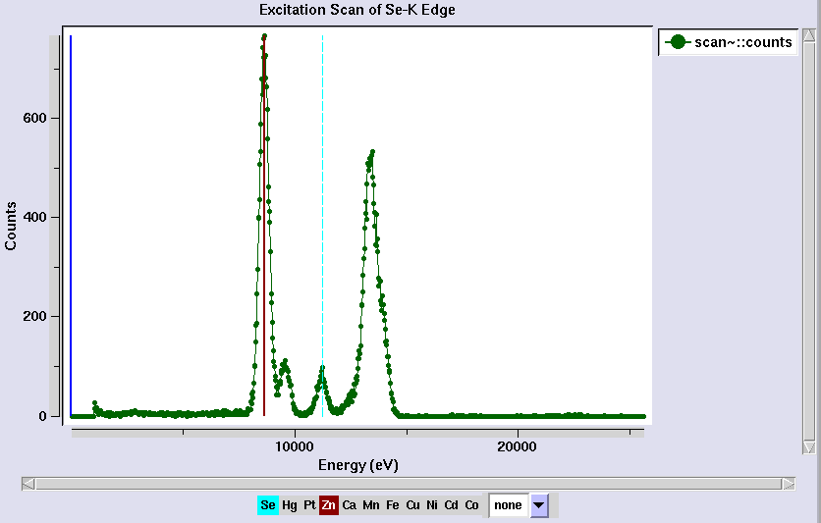
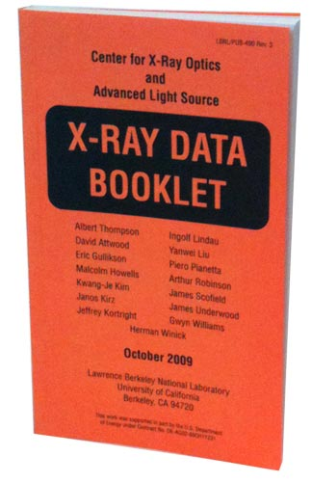
Metal identification

Slide 49
Auger emission
+

Slide 50
Auger emission
e⁻
++

Slide 51
Where do photons go?
Protein
1A x-rays
elastic scattering (6%)
Transmitted (98%)
beamstop
inelastic scattering (7%)
Re-emitted (99%)
Absorbed (~0%)

Slide 52
Where do photons go?
Protein
1A x-rays
elastic scattering (6%)
Transmitted (98%)
beamstop
inelastic scattering (7%)
Photoelectric (87%)
Re-emitted (99%)
Absorbed (~0%)

Slide 53
Where do photons go?
Protein
1A x-rays
elastic scattering (6%)
Transmitted (98%)
beamstop
inelastic scattering (7%)
Photoelectric (87%)
Re-emitted (99%)
Absorbed (~0%)
Re-emitted (~0%)
Absorbed (99%)

Slide 54
Where do photons go?
Protein
1A x-rays
elastic scattering (6%)
Transmitted (98%)
beamstop
inelastic scattering (7%)
Photoelectric (87%)
Re-emitted (99%)
Absorbed (~0%)
Re-emitted (~0%)
Absorbed (99%)
useful/absorbed energy: 7.3%

Slide 55
Photoelectric absorption

Slide 56
Photoelectric absorption
e⁻
+

Slide 57
Secondary ionization
e⁻

Slide 58
Secondary ionization
+
e⁻
e⁻

Slide 59
Excitation
e⁻

Slide 60
Excitation
e⁻

Slide 61
Excitation
e⁻

Slide 62
Excitation

Slide 63
Electron attachment
e⁻

Slide 64
Electron attachment
-

Slide 65
Sample atoms

Slide 66
Sample atoms

Slide 67
Primary ionization
e⁻
+

Slide 68
Secondary ionizations
e⁻
e⁻
+
e⁻
e⁻
+
+
+
+
+
e⁻
e⁻

Slide 69
Ionization track
e⁻
e⁻
e⁻
e⁻
+
e⁻
+
+
+
e⁻
e⁻
+
+
+
+
+
e⁻
+
e⁻
e⁻

Slide 70
Ionization track
e⁻
e⁻
e⁻
e⁻
+
e⁻
+
+
+
e⁻
e⁻
+
+
+
+
+
e⁻
+
e⁻
e⁻

Slide 71
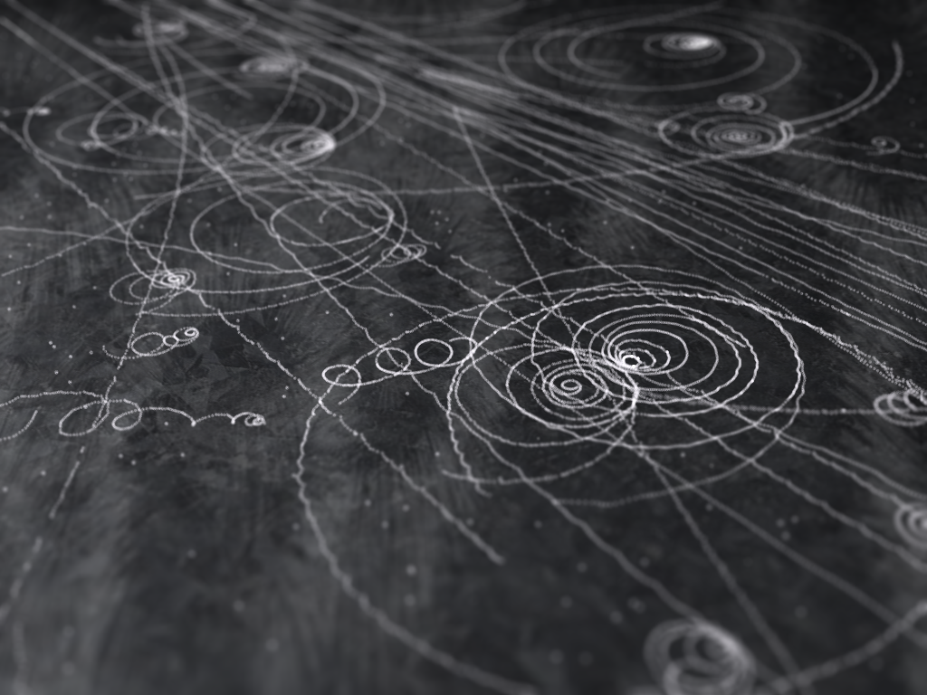
Ionization track

Slide 72
Ionization track

Slide 73
Ionization track
3 μm

Slide 74
Ionization track
Linear Energy Transfer

Slide 75
Ionization track
initial effects

Slide 76
Ionization track
initial effects
Homogeneous reactions

Slide 77
initial effects
e⁻
e⁻
e⁻
e⁻
+
e⁻
+
+
+
e⁻
e⁻
+
+
+
+
+
e⁻
+
e⁻
e⁻

Slide 78
initial effects
e⁻
e⁻
e⁻
e⁻
+
e⁻
+
+
+
e⁻
neutralization
e⁻
+
+
+
+
+
e⁻
+
e⁻
e⁻

Slide 79
initial effects
e⁻
e⁻
e⁻
e⁻
+
e⁻
+
+
neutralization
e⁻
+
+
+
+
+
e⁻
+
e⁻
e⁻

Slide 80
initial effects
e⁻
e⁻
e⁻
e⁻
+
neutralization
+
e⁻
+
+
+
+
+
neutralization
e⁻
e⁻

Slide 81
initial effects
e⁻
e⁻
e⁻
e⁻
+
+
e⁻
+
+
+
+
+
e⁻
attachment
e⁻

Slide 82
initial effects
e⁻
e⁻
e⁻
e⁻
+
+
e⁻
+
+
+
+
+
-
attachment
e⁻

Slide 83
initial effects
e⁻
e⁻
e⁻
attachment
e⁻
+
+
e⁻
+
+
+
+
+
-
e⁻
attachment

Slide 84
initial effects
e⁻
-
e⁻
e⁻
+
+
e⁻
+
+
+
+
+
-
-

Slide 85
initial effects
-
-
-
e⁻
+
+
+
+
+
+
-
-

Slide 86
initial effects
-
-
-
e⁻
solvation
+
+
+
+
+
+
-
-

Slide 87
initial effects
-
-
-
solvation
+
e⁻
+
+
+
+
+
-
-

Slide 88
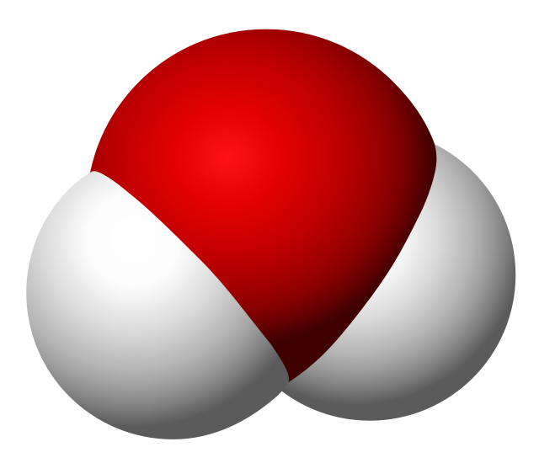
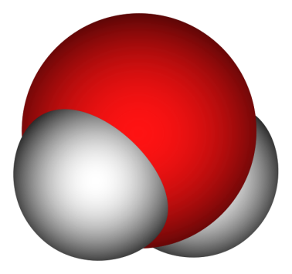
Solvated electron
e⁻

Slide 89
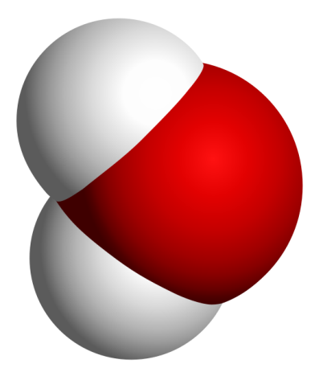
Solvated electron
e⁻

Slide 90
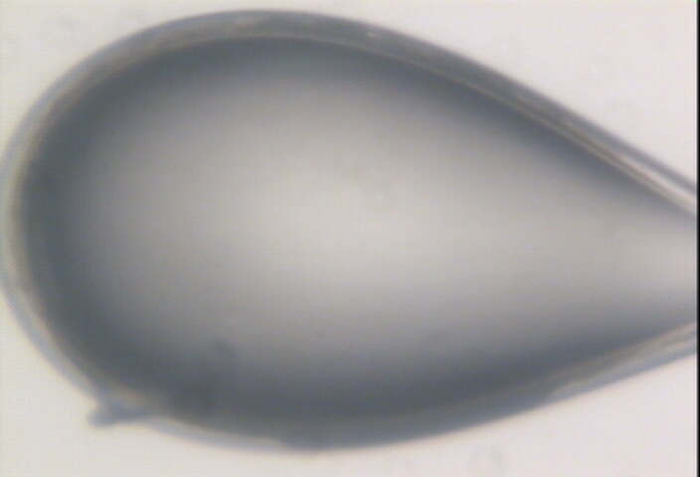

Slide 91
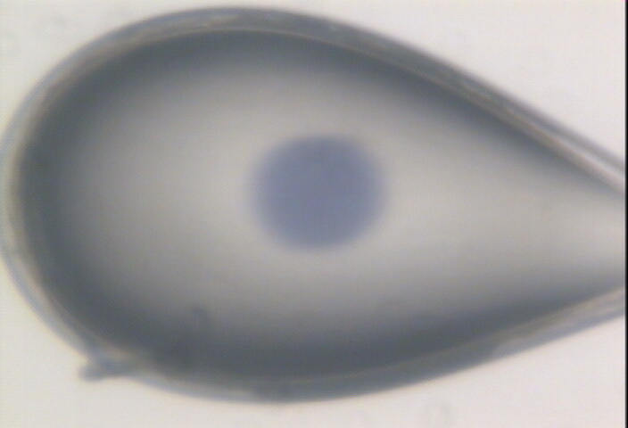

Slide 92
initial effects
-
-
-
+
e⁻
+
+
+
+
+
-
-

Slide 93
initial effects
-
-
-
+
e⁻
+
+
+
+
+
-
-

Slide 94
initial effects
-
-
+
e⁻
+
+
+
+
-
-

Slide 95
initial effects
e⁻
+
+
+
-
-

Slide 96
initial effects
e⁻
+
+
-

Slide 97
Excitation transfer

Slide 98
Excitation transfer
UV photon

Slide 99
Excitation transfer

Slide 100
Excitation transfer
r⁻⁶
Förster transfer

Slide 101
Excitation transfer

Slide 102
t = 0 s

Slide 103
t ≈ 10⁻¹⁵ s
e⁻
+
+
-

Slide 104
Timescales of radiation damage
Garret et. al. (2005) Chem. Rev. 105, 355-389

Slide 105
Timescales of radiation damage
LCLS
ALS
bunch
Garret et. al. (2005) Chem. Rev. 105, 355-389

Slide 106
Ionization track
Heterogeneous reactions
Homogeneous reactions

Slide 107
Rough values of energy quanta
1 MeV 100 GJ/mol Medical radiation therapy
100 keV 10 GJ/mol Medical imaging
10 keV 1 GJ/mol X-ray crystallography
1 keV 100 MJ/mol S and P K-edges
100 eV 10 MJ/mol “water window”
10 eV 1 MJ/mol C≡C bond
1 eV 100 kJ/mol C-C bond, visible light
100 meV 10 kJ/mol hydrogen bond
10 meV 1 kJ/mol heat (~300 K)

Slide 108

Energy Transfer Analogy
37 C

Slide 109
Damage is done
by dose (MGy)
proportional to photons/area
not time
not heat
Sliz P, Harrison SC & Rosenbaum G (2003). Structure 11, 13-19.
Garman EF & McSweeney SM (2006). J. Sync. Rad. 14, 1-3.
Owen RL, Rudino-Pinera E & Garman EF (2006). PNAS 103, 4912-4917.
Leiros et al. (2006). Acta Cryst. D 62, 125-132.
Holton JM (2007). J. Synch Rad. 14, 51-72.

Slide 110
what the is a MGy?
http://bl831.als.lbl.gov/
damage_rates.pdf
Holton J. M. (2009) J. Synchrotron Rad. 16 133-42

Slide 111
How long will my crystal last?
synch line type flux beamsize flux density dose max xtal min site
ph/s μm ph/μm2/s rate lifetime lifetime
ALS 4.2.2 MAD 2.2e11 75x80 3.7e+07 27.3 kGy/s 18 m 73 s
ALS 5.0.1 mono 1.6e11 100 2.0e+07 10.4 kGy/s 48 m 3.2 m
ALS 5.0.2 MAD 8e11 100 1.0e+08 51.8 kGy/s 9.6 m 39 s
ALS 5.0.3 mono 1.7e11 100 2.2e+07 11 kGy/s 45 m 3 m
ALS 8.2.1 MAD 1.8e11 100 2.3e+07 11.7 kGy/s 43 m 2.9 m
ALS 8.2.2 MAD 2.3e11 100 2.9e+07 14.9 kGy/s 34 m 2.2 m
ALS 8.3.1 MAD 9e11 70 2.3e+08 119 kGy/s 4.2 m 17 s
ALS 8.3.1 typical 6e11 70 1.6e+08 115 kGy/s 4.3 m 17 s
ALS 12.3.1 MAD 1.8e11 100 2.3e+07 11.7 kGy/s 43 m 2.9 m
ALS 12.3.1 ML 4.0e12 100 5.1e+08 513 kGy/s 58 s 3.9 s
APS 8-BM MAD 1e11 200 2.5e+06 1.27 kGy/s 6.6 h 26 m
APS 14-BM-C mono 5.8e10 200 1.4e+06 738 Gy/s 11 h 45 m
APS 14-BM-D MAD 3.3e9 200 8.2e+04 42 Gy/s 8.3 d 13 h
APS 14-ID-B MAD 6.0e10 200 1.5e+06 763 Gy/s 11 h 44 m
APS 17-BM MAD 1.1e11 200 2.8e+06 1.4 kGy/s 6 h 24 m
APS 17-ID MAD 2.3e11 200 5.8e+06 2.93 kGy/s 2.8 h 11 m
APS 19-BM MAD 2.0e11 70x60 4.8e+07 24.2 kGy/s 21 m 83 s
APS 19-ID MAD 1.3e13 80x40 4.1e+09 2.07 MGy/s 15 s 0.97 s
APS 19-ID typical 5.5e11 100x100 5.5e+07 28 kGy/s 18 m 71 s
APS 22-BM MAD 7e12 80x40 2.2e+09 1.23 MGy/s 24 s 1.6 s
APS 22-ID MAD 7e12 80x40 2.2e+09 1.23 MGy/s 24 s 1.6 s
APS 22-ID typical 1.5e12 80 2.3e+08 119 kGy/s 4.2 m 17 s
APS 23-ID-B MAD 1e13 75x25 5.3e+09 3.01 MGy/s 10 s 0.66 s
APS 23-ID typical 1.5e12 80 2.3e+08 119 kGy/s 4.2 m 17 s
APS 24-ID-C MAD 1.3e13 20x60 1.1e+10 5.23 MGy/s 5.7 s 0.38 s
APS 24-ID-E MAD 0.5e13 20x100 2.5e+09 1.19 MGy/s 25 s 1.7 s
APS 31-ID MAD 2e12 70 4.1e+08 194 kGy/s 2.6 m 10 s

Slide 112
resolution dependence of global damage
10³
100
maximum tolerable dose (MGy)
10
1
1 2 3 5 7 10 20 40 70 100
resolution (Å)
Howells et al. (2009) J. Electron. Spectrosc. Relat. Phenom. 170 4-12

Slide 113
resolution dependence of global damage
10³
10 MGy/Å
100
maximum tolerable dose (MGy)
10
1
1 2 3 5 7 10 20 40 70 100
resolution (Å)
Howells et al. (2009) J. Electron. Spectrosc. Relat. Phenom. 170 4-12

Slide 114
R_{iso} vs dose
R_{iso} (%)
change in dose (MGy)
data taken from Banumathi, et al. (2004) Acta Cryst. D 60, 1085-1093.

Slide 115
R_{iso} vs dose
R_{iso} ≈ 0.7 %/MGy
R_{iso} (%)
change in dose (MGy)
data taken from Banumathi, et al. (2004) Acta Cryst. D 60, 1085-1093.

Slide 116
Dose-doubling concentration
molar, at the Se edge based on RADDOSE
Na | 44
Mg | 27
P | 9
S | 7
Cl | 5
K | 3.3
Ca | 2.7
Fe | 1.0
Cu | 0.67
Zn | 0.58
As | 0.44
Se | 0.42
Br | 2.9
I | 0.47
Gd | 0.21
Ta | 0.13
Pt | 0.17
Au | 0.16
Hg | 0.16
U | 0.23

Slide 117
Dose-doubling concentration
molar, at the Se edge based on RADDOSE
Na | 44
Mg | 27
P | 9
S | 7
Cl | 5
K | 3.3
Ca | 2.7
Fe | 1.0
Cu | 0.67
Zn | 0.58
As | 0.44
Se | 0.42
Br | 2.9
I | 0.47
Gd | 0.21
Ta | 0.13
Pt | 0.17
Au | 0.16
Hg | 0.16
U | 0.23

Slide 118
Specific Damage
World Records
MGy reaction reference
~45 global damage Owen et al. (2006)
5 Se-Met Holton (2007)
4 Hg-S Ramagopal et al. (2004)
3 S-S Murray et al. (2002)
1 Br-RNA Olieric et al. (2007)
? Cl-C ???
0.5 Mn in PS II Yano et al. (2005)
0.02 Fe in myoglobin Denisov et al. (2007)
Holton (2009) J. Synchrotron Rad. 16 133-42

Slide 119
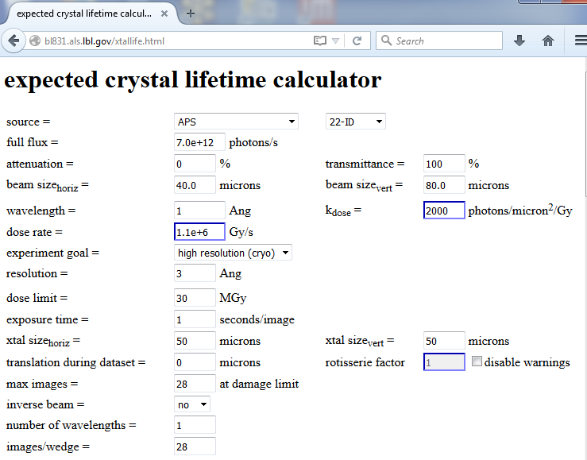

Slide 120

Holton & Frankel (2010) Acta D 66 393-408.

Slide 121
The number of photons you get
before a given crystal dies
is independent
of data collection time
1 um³ = 10⁶ photons
http://www.nist.gov/pml/data/xcom/

Slide 122
Data Collection Strategy
Exposure time
Number of images
Wavelengths
Beam: size, flux, divergence, bandpass
Inverse beam?
Kappa? - overlaps
Multiple crystals? - non-isomorphism
Run Strategy

Slide 123

Dose slicing
unacceptable
damage
N
photons
crystal’s useful life
N
photons
unacceptable
read noise
N
photons

Slide 124
Self-calibrated damage limit
Where:
⟨I⟩_{DL} - average damage-limited intensity (photons/hkl) at a given resolution
10⁵ - converting R from μm to m, r_{e} from m to Å, ρ from g/cm³ to kg/m³ and MGy to Gy
r_{e} - classical electron radius (2.818 x 10⁻¹⁵ m/electron)
h - Planck’s constant (6.626 x 10⁻³⁴ J∙s)
c - speed of light (299792458 m/s)
f_{decayed} - fractional progress toward completely faded spots at end of data set
ρ - density of crystal (~1.2 g/cm³)
R - radius of the spherical crystal (μm)
λ - X-ray wavelength (Å)
f_{NH} - the Nave & Hill (2005) dose capture fraction (1 for large crystals)
n_{ASU} - number of proteins in the asymmetric unit
M_{r} - molecular weight of the protein (Daltons or g/mol)
V_{M} - Matthews’s coefficient (~2.4 Å³/Dalton)
H - Howells’s criterion (10 MGy/Å)
θ - Bragg angle
⟨ƒ_{a}²⟩ - number-averaged squared structure factor per protein atom (electron²)
⟨M_{a}⟩ - number-averaged atomic weight of a protein atom (~7.1 Daltons)
B - average (Wilson) temperature factor (Å²)
μ - attenuation coefficient of sphere material (m⁻¹)
μ_{en} - mass energy-absorption coefficient of sphere material (m⁻¹)
No flux
No symmetry
Holton & Frankel (2010) Acta D 66 393-408.

Slide 125
Bigger is better, but not by much
B = 20
B = 60
B = 0
B = 170
B = 330
B = 560
Resolution (Å)
B = 850
Crystal diameter (micron)

Slide 126
Predicting resolution limits
Synchrotron Resolution (Å)
Home Lab Resolution (Å)

Slide 127
Predicting resolution limits
XFEL Resolution (Å)
Synchrotron Resolution (Å)

Slide 128
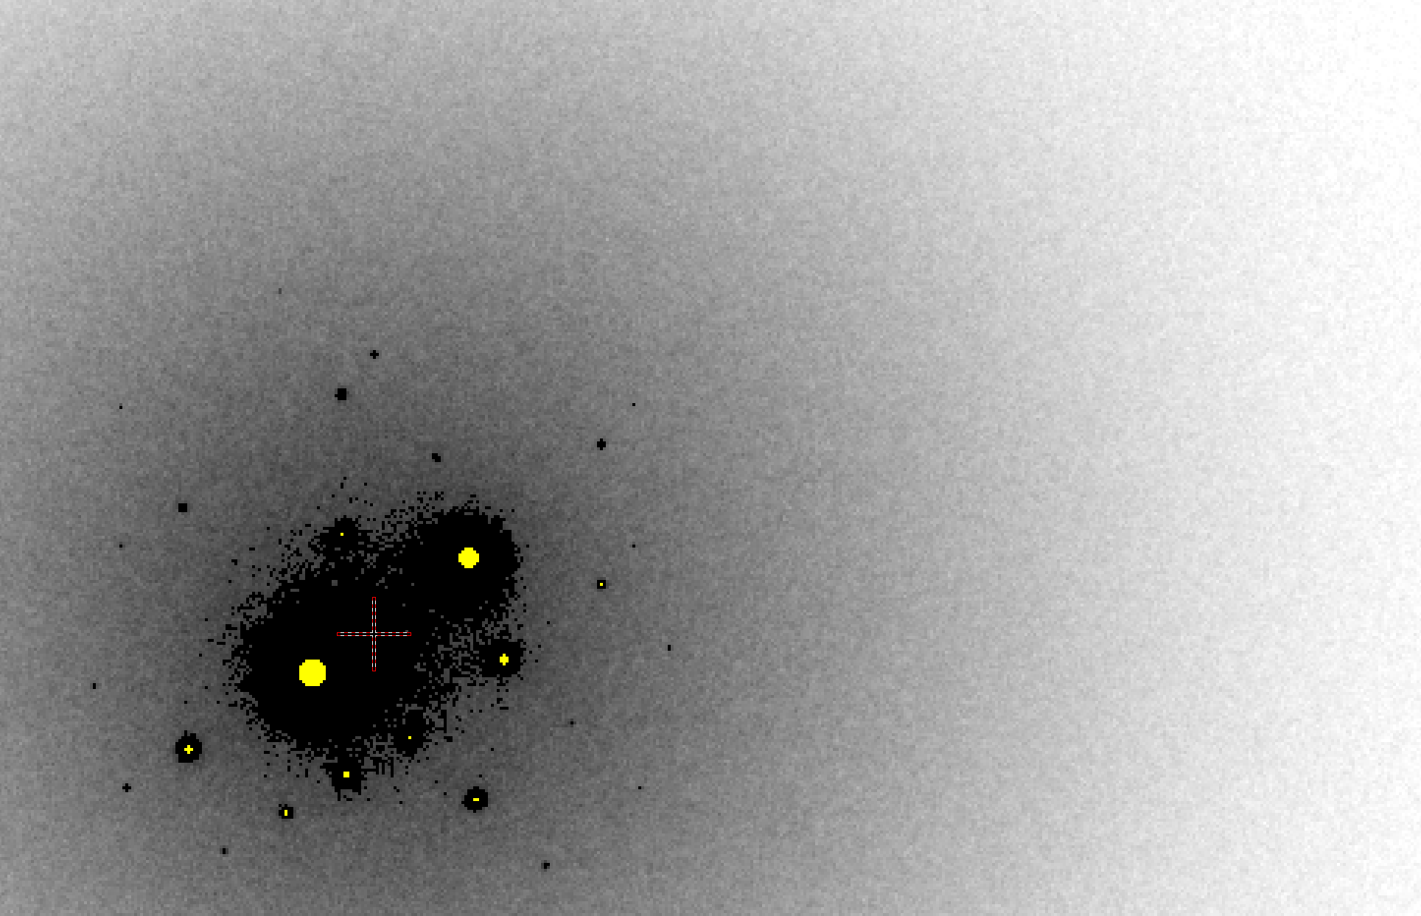
B factor from image analysis
B = 500

Slide 129
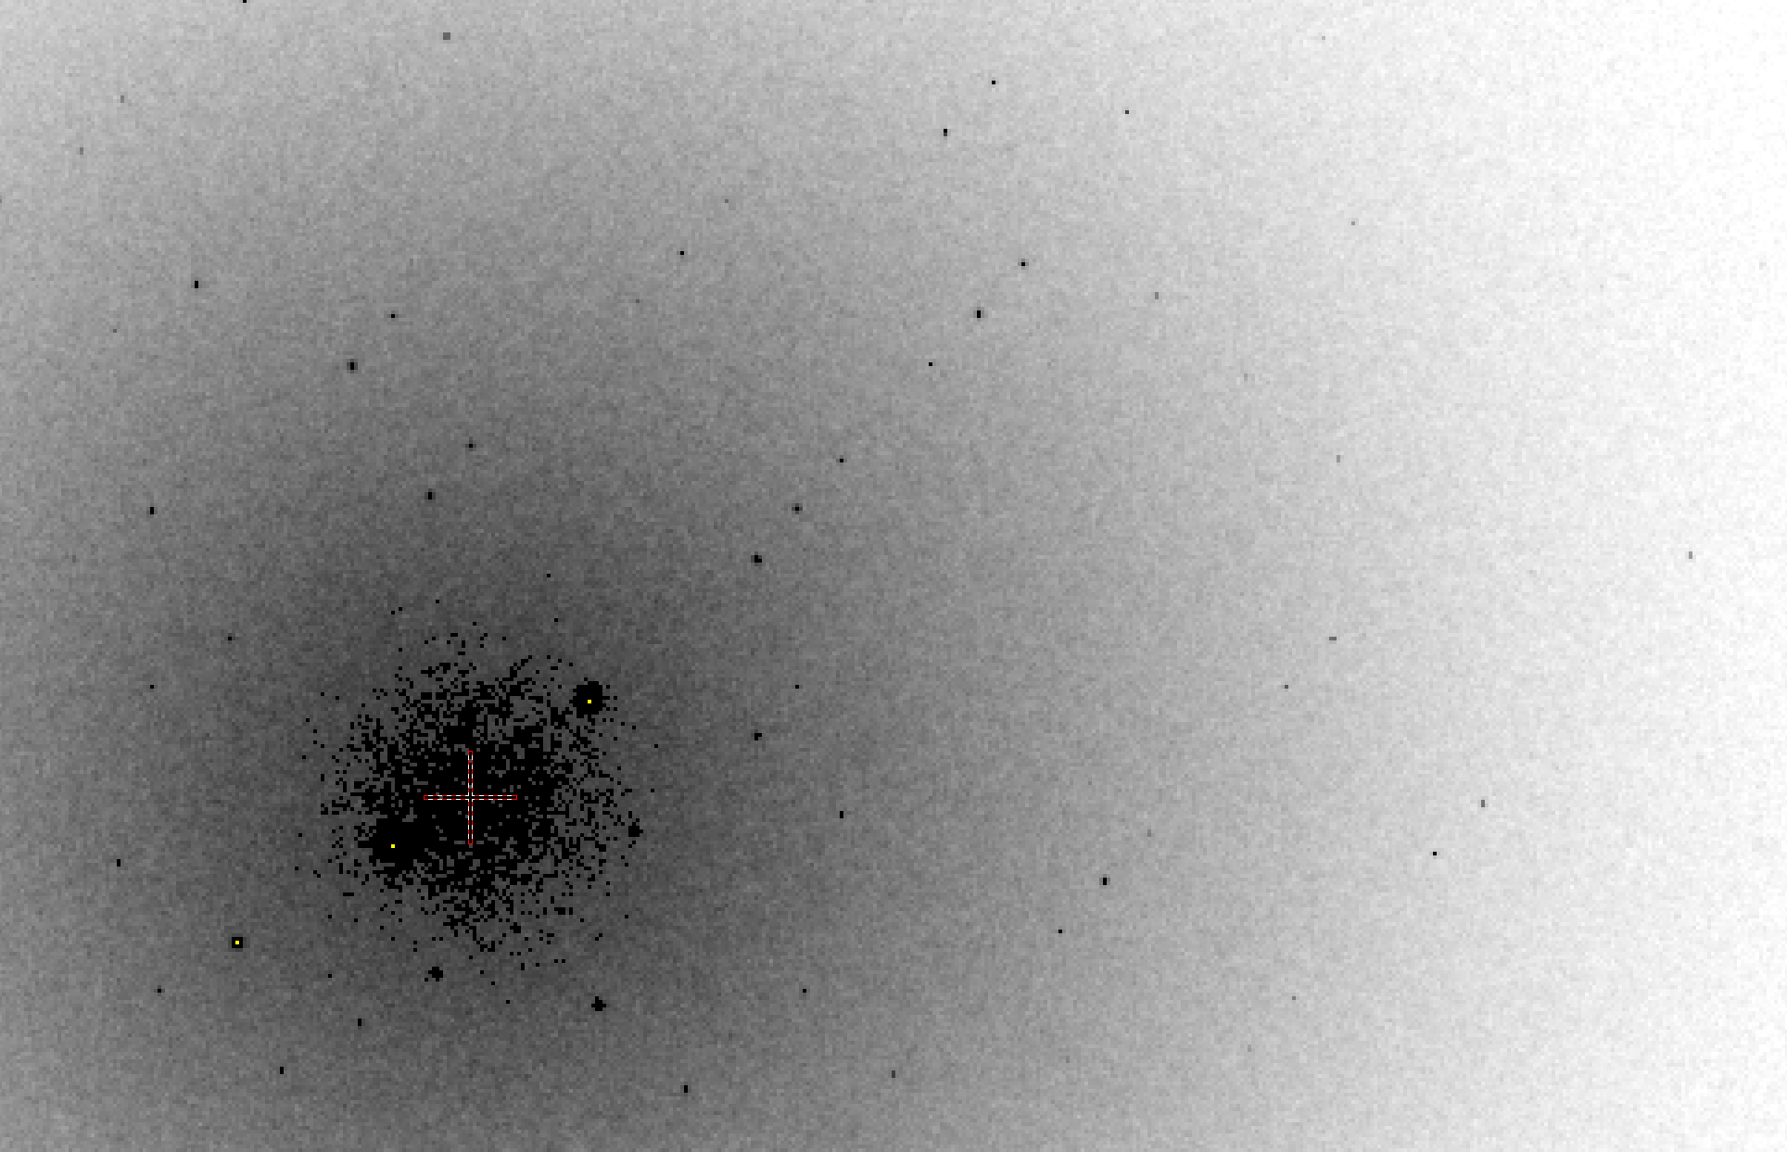
B factor from image analysis
B = 20

Slide 130
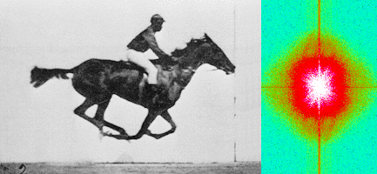
Muybridge’s galloping horse (1878)
“Time-resolved” diffraction
Real space
reciprocal

Slide 131
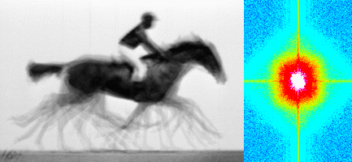
Muybridge’s galloping horse (1878)
Average electron density
Real space
reciprocal

Slide 132
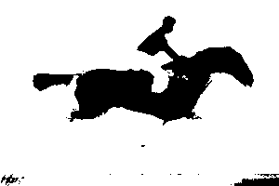
Muybridge’s galloping horse (1878)
Average electron density: 1 sigma contour
Real space
reciprocal

Slide 133

lysozyme: real and reciprocal

Slide 134
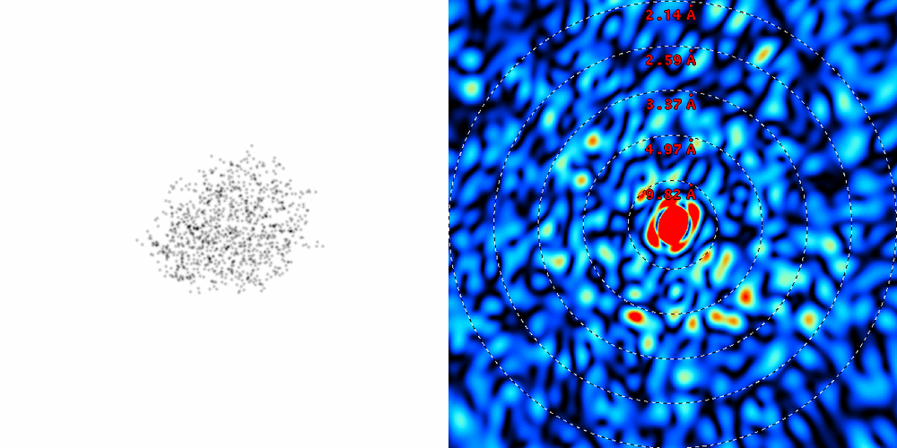
lysozyme: thermal motion

Slide 135
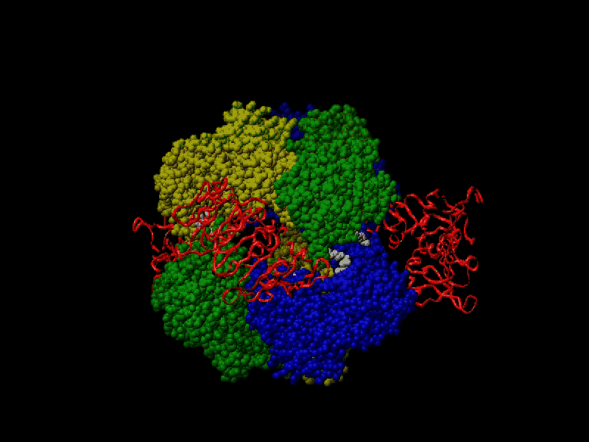
Proteins move!
Your crystal may be trying to tell you something…
Beernink, Endrizzi, Alber & Schachman (1999). PNAS USA 96, 5388-5393.

Slide 136
At the beamline…
Resolution
  problem: background
  solution: use as few pixels as possible
Phases
  problem: fractional errors
  solution: use as many pixels as possible

Slide 137
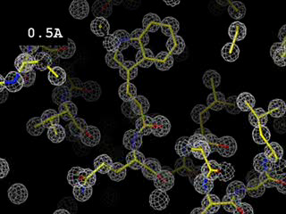
Resolution
http://bl831.als.lbl.gov/~jamesh/movies/resolution.mpeg

Slide 138
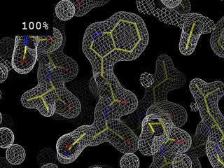
Completeness: random deletion
http://bl831.als.lbl.gov/~jamesh/movies/completeness.mpeg

Slide 139
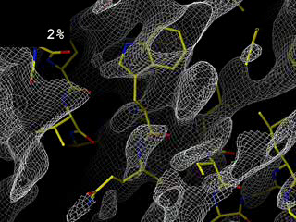
Completeness: missing wedge
http://bl831.als.lbl.gov/~jamesh/movies/osc.mpeg

Slide 140
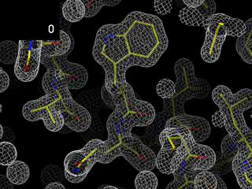
Overloads
http://bl831.als.lbl.gov/~jamesh/movies/overloads.mpeg

Slide 141
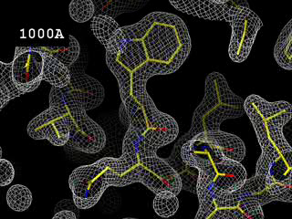
Resolution: low-angle cutoff
http://bl831.als.lbl.gov/~jamesh/movies/lo_cut.mpeg

Slide 142
The truth about x-ray beams
Term units significance
Flux photons/s duration of experiment
Beam Size μm match to crystal
Divergence mrad spot size vs distance
Wavelength Å resolution and absorption
Dispersion Δλ/λ spot size
Flux density ph/s/area scattering/damage rate
Fluence ph/area scattering/damage

Slide 143
The truth about x-ray beams
Term units significance
Flux photons/s duration of experiment
Beam Size μm match to crystal
Divergence mrad spot size vs distance
Wavelength Å resolution and absorption
Dispersion Δλ/λ spot size
Flux density ph/s/area scattering/damage rate
Fluence ph/area scattering/damage

Slide 144
The truth about x-ray beams
quantity | units | home source | MX2
flux | Photons/second | 2.5 x 10⁹ | 2 x 10¹²
exposure | seconds | 400 | 1

Slide 145
Data Collection Strategy
Exposure time
Number of images
Wavelengths
Beam: size, flux, divergence, bandpass
Inverse beam?
Kappa? - overlaps
Multiple crystals? - non-isomorphism
Run Strategy

Slide 146
The truth about x-ray beams
quantity | units | home source | MX2
flux | Photons/second | 2.5 x 10⁹ | 2 x 10¹²
exposure | seconds | 400 | 1
Dispersion | wavelength range / wavelength | 0.2% (Kα₁ - Kα₂) | 0.014% (Si111)
Divergence | milliRadian | 4.8 | 1.8 (h) 0.18 (v)
Beam size | microns | 100 | 24 (h) 12 (v)
Spectral brightness | Photons/s/mm²/ mR²/0.1%BW | 5.4 x 10⁹ | 1.5 x 10¹⁷

Slide 147
The truth about x-ray beams
quantity | units | home source | MX2
flux | Photons/second | 72 x 10⁶ | 2 x 10¹²
exposure | time | 4 hours | 1 second
Dispersion | wavelength range / wavelength | 0.2% (Kα₁ - Kα₂) | 0.014% (Si111)
Divergence | milliRadian | 4.8 | 1.8 (h) 0.18 (v)
Beam size | microns | 17 | 24 (h) 12 (v)
Spectral brightness | Photons/s/mm²/ mR²/0.1%BW | 5.4 x 10⁹ | 1.5 x 10¹⁷

Slide 148
The truth about x-ray beams
quantity | units | home source | MX2
flux | Photons/second | 1 x 10⁶ | 2 x 10¹²
exposure | time | 10 days | 1 second
Dispersion | wavelength range / wavelength | 0.2% (Kα₁ - Kα₂) | 0.014% (Si111)
Divergence | milliRadian | 0.6 | 1.8 (h) 0.18 (v)
Beam size | microns | 17 | 24 (h) 12 (v)
Spectral brightness | Photons/s/mm²/ mR²/0.1%BW | 5.4 x 10⁹ | 1.5 x 10¹⁷

Slide 149
The truth about x-ray beams
quantity | units | home source | MX2
flux | Photons/second | 8 x 10⁴ | 2 x 10¹²
exposure | time | 5 months | 1 second
Dispersion | wavelength range / wavelength | 0.014% (Si111) | 0.014% (Si111)
Divergence | milliRadian | 0.6 | 1.8 (h) 0.18 (v)
Beam size | microns | 17 | 24 (h) 12 (v)
Spectral brightness | Photons/s/mm²/ mR²/0.1%BW | 5.4 x 10⁹ | 1.5 x 10¹⁷

Slide 150
The truth about x-ray beams
Term units significance
Flux photons/s duration of experiment
Beam Size μm match to crystal
Divergence mrad spot size vs distance
Wavelength Å resolution and absorption
Dispersion Δλ/λ spot size
Flux density ph/s/area scattering/damage rate
Fluence ph/area scattering/damage

Slide 151
spectral dispersion
Ewald sphere
Φ circle
(h,k,l)
λ*
d*
spindle axis
diffracted ray
λ*

Slide 152
spectral dispersion
Ewald sphere
Φ circle
(h,k,l)
λ’*
d*
spindle axis
diffracted ray
λ’*

Slide 153
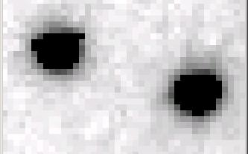
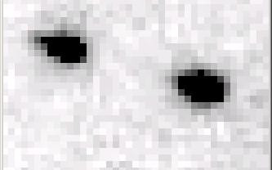
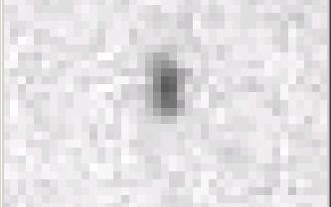
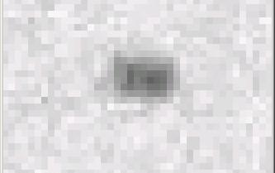
Si(111) vs multilayers
0.014%
Si(111)
spectral
dispersion
1%
multilayer
4 Å
resolution
1.9 Å

Slide 154
Wide-bandpass MX?
Mono | Si(111) | multilayer | Difference (%) | good
Energy (eV) | 11111 | 12027.5 | +8.2 | Same
Scale | 1.0000 | 1.0964 | +9.6 | Yes
R_{merge} (%) | 7.5 | 8.4 | +12 | No
R_{anom} (%) | 5.6 | 5.5 | -1.8 | Same
I/sd | 13.2 | 12.3 | -6.8 | Same
I/sd (1.5Å) | 2.3 | 1.8 | -21.7 | No
Ano Patt | 5.96 | 4.75 | -20.3 | Same
Ano Phased | 41 | 39.33 | -4.1 | Same
FOM | 0.238 | 0.192 | -19.3 | Same
CC | 0.555 | 0.647 | -6.1 | Yes
R_{cryst} (%) | 26.70 | 26.48 | -0.2 | Same
Ligand peak | 8.213 | 8.250 | +0.4 | Same

Slide 155
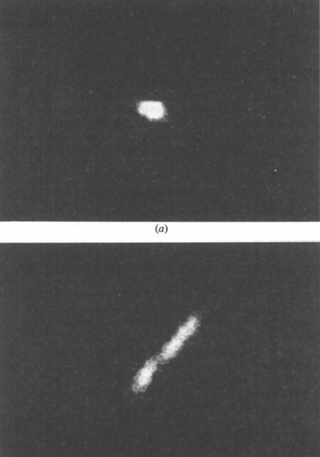

Wide bandpass reveals mosaicity from a still
low mosaic
high mosaic
Δ_{radial} = 2ηD/cos²2θ
Snell EH, Weisgerber S, Helliwell JR, Holzer K & Schroer K (1995)."Improvements in lysozyme protein crystal perfection through microgravity growth", Acta crystallographica. Section D, Biological crystallography 51, 1099-1102.

Slide 156
Data Collection Strategy
Exposure time
Number of images
Wavelengths
Beam: size, flux, divergence, bandpass
Inverse beam?
Kappa? - overlaps
Multiple crystals? - non-isomorphism
Run Strategy

Slide 157
The truth about x-ray beams
Term units significance
Flux photons/s duration of experiment
Beam Size μm match to crystal
Divergence mrad spot size vs distance
Wavelength Å resolution and absorption
Dispersion Δλ/λ spot size
Flux density ph/s/area scattering/damage rate
Fluence ph/area scattering/damage

Slide 158
beam divergence
Ewald sphere
Φ circle
(h,k,l)
λ*
d*
spindle axis
diffracted ray
λ*

Slide 159
beam divergence
Ewald sphere
Φ circle
(h,k,l)
d*
λ*
diffracted ray
spindle axis
λ*

Slide 160
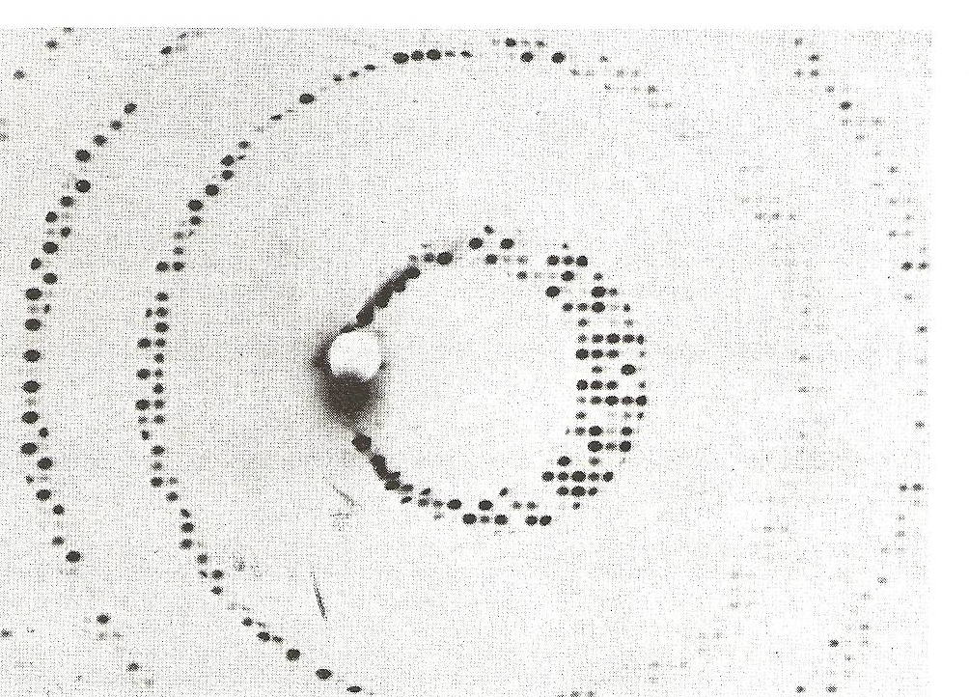
Divergence
Arndt & Wonacott (1977)

Slide 161
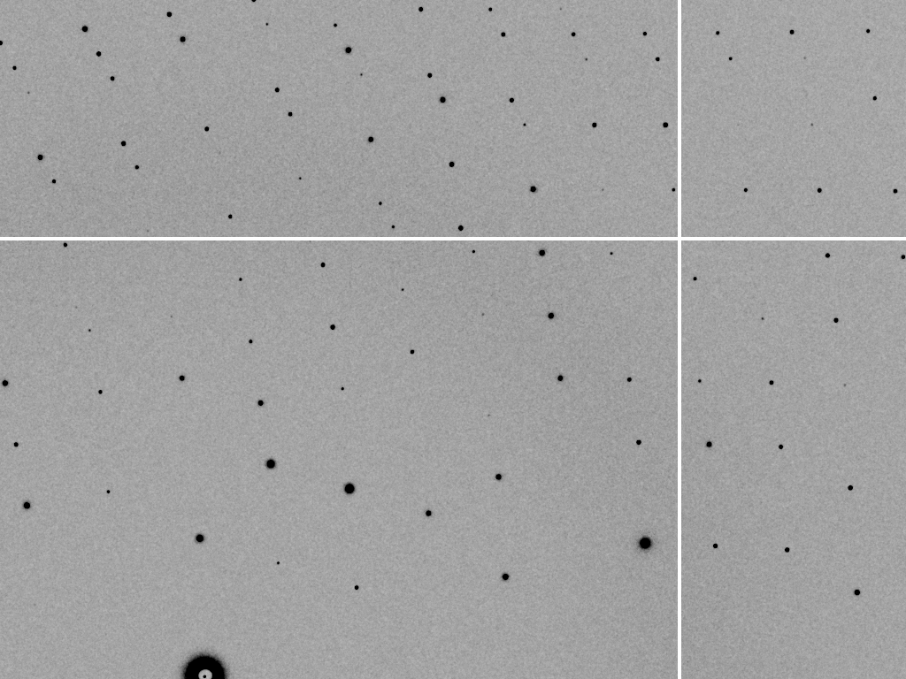
divergence = 0 º

Slide 162
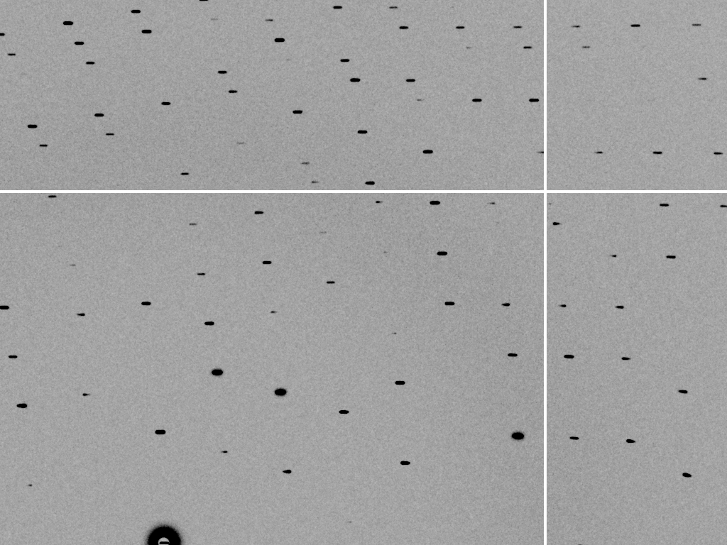
divergence = 0.3 º

Slide 163
The truth about x-ray beams
Term units significance
Flux photons/s duration of experiment
Beam Size μm match to crystal
Divergence mrad spot size vs distance
Wavelength Å resolution and absorption
Dispersion Δλ/λ spot size
Flux density ph/s/area scattering/damage rate
Fluence ph/area scattering/damage

Slide 164
Air absorption
transmittance
Distance from sample (mm)

Slide 165
The truth about x-ray beams
Term units significance
Flux photons/s duration of experiment
Beam Size μm match to crystal
Divergence mrad spot size vs distance
Wavelength Å resolution and absorption
Dispersion Δλ/λ spot size
Flux density ph/s/area scattering/damage rate
Fluence ph/area scattering/damage

Slide 166
Data Collection Strategy
Exposure time
Number of images
Wavelengths
Beam: size, flux, divergence, bandpass
Inverse beam?
Kappa? - overlaps
Multiple crystals? - non-isomorphism
Run Strategy

Slide 167
beam size vs xtal size
  Put your crystal into the beam

Slide 168
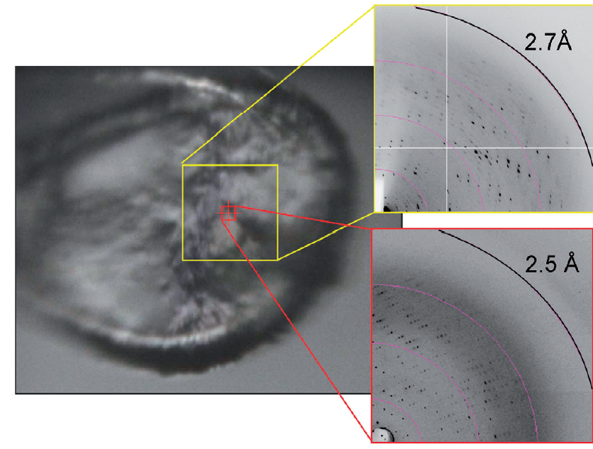
Put the “crystal” into the beam
Evans et al. (2011)."Macromolecular microcrystallography", Crystallography Reviews 17, 105-142.

Slide 169
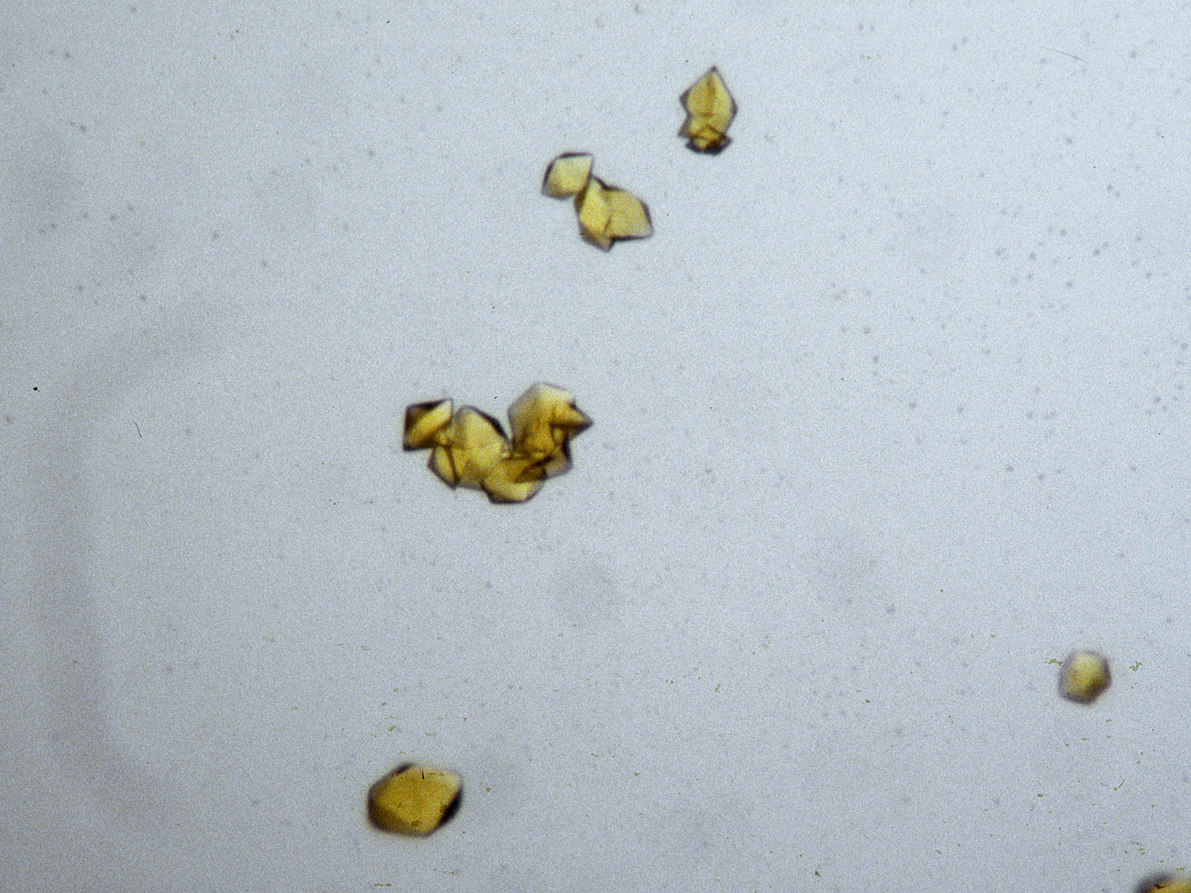
“crystal” = thing you want to shoot
Membrane Protein Expression Center © 2012

Slide 170
beam size vs xtal size
  Put your crystal into the beam
  Shoot the whole crystal

Slide 171
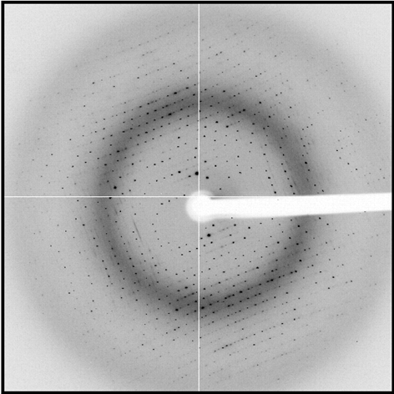
shoot the whole crystal

Slide 172
shoot the whole crystal

Slide 173
shoot the whole crystal

Slide 174
How many crystals do you see?
Shoot the “crystal” (singular)

Slide 175
mosaic spread
Ewald sphere
Φ circle
(h,k,l)
λ*
d*
diffracted ray
d*
spindle axis
λ*

Slide 176
mosaic spread
Ewald sphere
Φ circle
(h,k,l)
d*
diffracted rays
d*
spindle axis

Slide 177

mosaic spread = 0 º

Slide 178

mosaic spread = 0.1º

Slide 179

mosaic spread = 0.2º

Slide 180

mosaic spread = 0.4º

Slide 181

mosaic spread = 0.6º

Slide 182

mosaic spread = 0.8º

Slide 183

mosaic spread = 1.0º

Slide 184

mosaic spread = 1.5º

Slide 185

mosaic spread = 2.0º

Slide 186

mosaic spread = 2.5º

Slide 187

mosaic spread = 3.2º

Slide 188

mosaic spread = 6.4º

Slide 189

mosaic spread = 12.8º

Slide 190
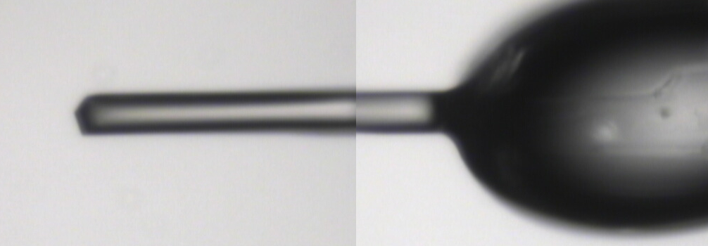
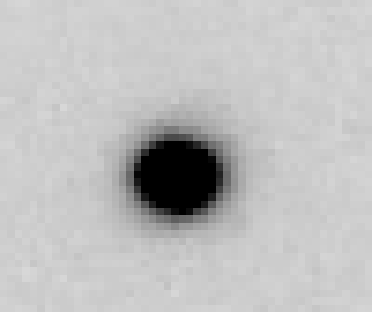
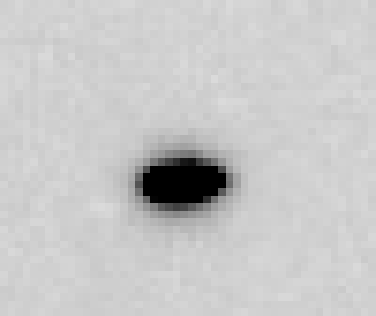
~0 MGy

Slide 191
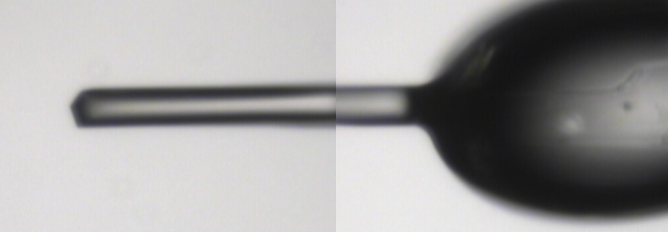
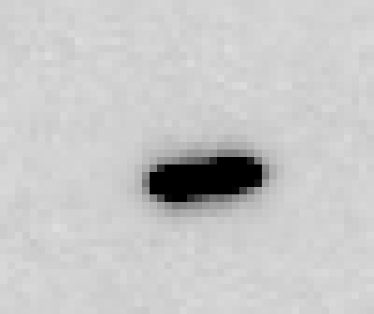
5 MGy

Slide 192
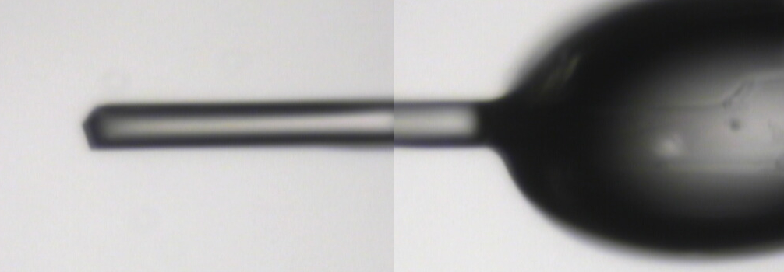
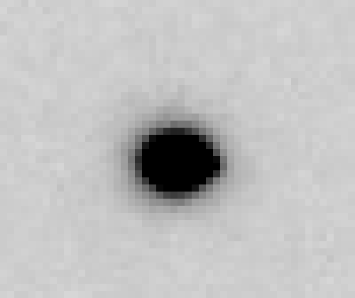
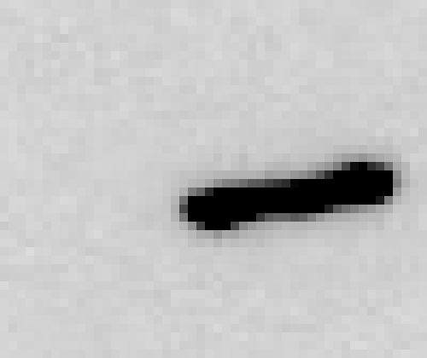
11 MGy

Slide 193
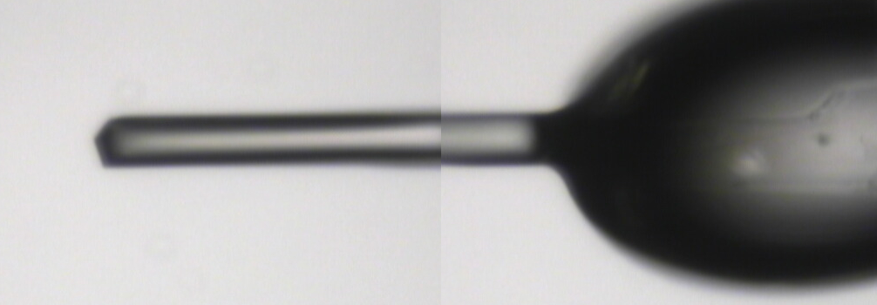
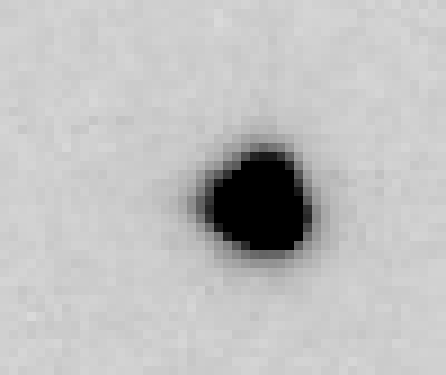
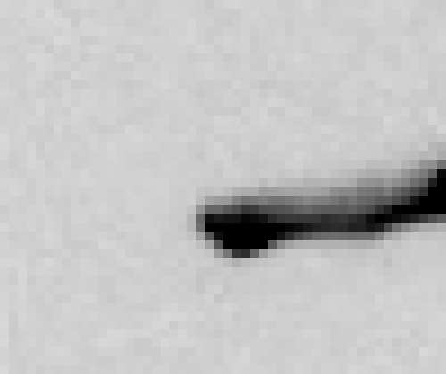
16 MGy

Slide 194
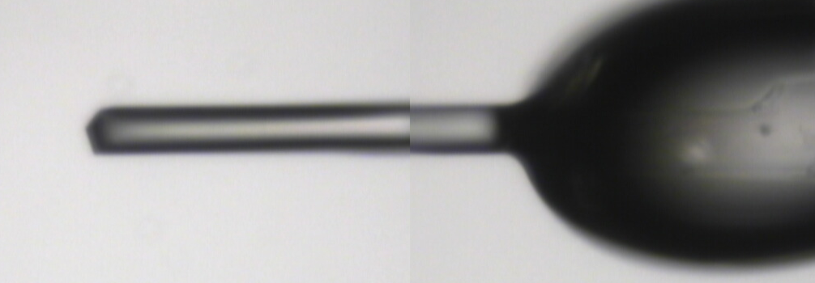
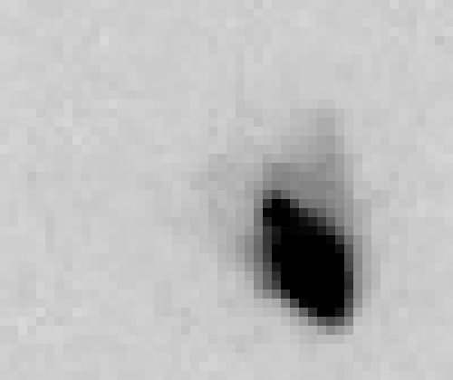

22 MGy

Slide 195



26 MGy

Slide 196
shoot the whole crystal
Do not bend!

Slide 197
platy crystals

Slide 198
platy crystals

Slide 199

MiTeGen MicroMesh grids
http://www.mitegen.com/products/micromeshes/micromeshes.shtml

Slide 200

platy crystals

Slide 201
platy crystals

Slide 202
platy crystals

Slide 203
beam size vs xtal size
  Put your crystal into the beam
  Shoot the whole crystal
  Shoot nothing but the crystal

Slide 204
shoot nothing but the crystal

Slide 205
shoot nothing but the crystal

Slide 206
Resolution (Å)
too big
too small
just right
X-ray beam size (μm)

Slide 207

Gaussian beam
50% of flux
the other 50%

Slide 208

Collimated beam
100% of flux
0%

Slide 209

shoot nothing but the crystal

Slide 210
shoot nothing but the crystal

Slide 211
shoot nothing but the crystal

Slide 212
X-ray scattering “rules”:
Optimum: support thickness = crystal thickness
1 μm crystal ≈ 1 μm water
≈ 1 μm plastic
≈ 0.1 μm glass
≈ 1000 μm air
~ 50 mm He
≈ 370 mm sat water vapor @ 4C

Slide 213
beam size vs xtal size
  Put your crystal into the beam
  Shoot the whole crystal
  Shoot nothing but the crystal
  Back off!

Slide 214
Mosquito tips cost $0.15 each
So do Pilatus pixels!
We bought 6,224,001
Use them!
(they are reusable)

Slide 215
Background scattering

Slide 216

Background scattering
$100,000.00
$100,000.00
$100,000.00
real estate is
expensive
use it!
$100,000.00
$100,000.00
$100,000.00
$100,000.00
$100,000.00

Slide 217
Fine Slicing
background
background
Pflugrath, J. W. (1999)."The finer things in X-ray diffraction data collection", Acta Cryst. D 55, 1718-1725.

Slide 218

Pilatus pile-up for RT MX? same photons, different speeds
Sum of 193 shots with
193-fold attenuation

Slide 219

Pilatus pile-up for RT MX? same photons, different speeds
1 shot with
no attenuation

Slide 220

Pilatus pile-up for RT MX? same photons, different speeds
0.016° mosaic

Slide 221

Pilatus pile-up for RT MX? same photons, different speeds
20 deg/s
0.016 deg mosaic

Slide 222

Pilatus pile-up for RT MX? same photons, different speeds

Slide 223
How to avoid pile-up? and other time-dependent noise?
Attenu-wait!
Apply 10x attenuation
Expose 10x longer
Number of photons should be the same!
Damage will also be the same!

Slide 224
Classes of error in MX
Dependence on signal
none sqrt proportional
CCD
Read-out
Photon
counting
Detector calibration
attenuation
partiality
Non-isomorphism
Radiation damage
none
1/sqrt
1/prop.
Time
Beam flicker
Shutter jitter
Sample vibration
Pile-up

Slide 225
Classes of error in MX
Dependence on signal
none sqrt proportional
CCD
Read-out
Photon
counting
Detector calibration
attenuation
partiality
Non-isomorphism
Radiation damage
none
1/sqrt
1/prop.
Time
Beam flicker
Shutter jitter
Sample vibration
Pile-up

Slide 226

Optimal exposure time
(faint spots)
t_{hr} Optimal exposure time for data set (s)
t_{ref} exposure time of reference image (s)
bg_{ref} background level near weak spots on
reference image (ADU)
bg₀ ADC offset of detector (ADU)
bg_{hr} optimal background level (via t_{hr})
σ₀ rms read-out noise (ADU)
gain ADU/photon
m multiplicity of data set (including partials)
adjust exposure
so this is ~100

Slide 227
Data Collection Strategy
Exposure time
Number of images
Wavelengths
Beam: size, flux, divergence, bandpass
Inverse beam?
Kappa? - overlaps
Multiple crystals? - non-isomorphism
Run Strategy

Slide 228
beam size vs xtal size
  Put your crystal into the beam
  Shoot the whole crystal
  Shoot nothing but the crystal
  Back off!
  The crystal must rotate

Slide 229
The crystal rotates!

Slide 230
The crystal rotates!
Membrane Protein Expression Center © 2012

Slide 231
Shoot nothing but the “crystal”
Evans et al. (2011)."Macromolecular microcrystallography", Crystallography Reviews 17, 105-142.

Slide 232
Data Collection Strategy
Exposure time
Number of images
Wavelengths
Beam: size, flux, divergence, bandpass
Inverse beam?
Kappa? - overlaps
Multiple crystals? - non-isomorphism
Run Strategy

Slide 233


avoiding overlaps
c
c

Slide 234

avoiding overlaps
c

Slide 235

SmarAct’s
“SmarGon”
Commercialized
PRIGo

Slide 236
At the beamline…
Resolution
  problem: background
  solution: use as few pixels as possible
Phases
  problem: fractional errors
  solution: use as many pixels as possible

Slide 237

R-factor
http://bl831.als.lbl.gov/~jamesh/movies/rfactor.mpeg

Slide 238

Figure of Merit
http://bl831.als.lbl.gov/~jamesh/movies/dephase.mpeg

Slide 239
anomalous signal
ΔF
F
√
# sites
MW (Da)
≈ 1.2 f”
World record!
ΔF/F = 0.5%
Wang, Dauter & Dauter (2006) Acta Cryst. D 62, 1475-1483.
Crick, F. H. C. & Magdoff, B. S. (1956) Acta Crystallogr. 9, 901-908.
Hendrickson, W. A. & Teeter, M. M. (1981) Nature 290, 107-113.

Slide 240
Fractional error
^{mult >} (—)²
~3%
<ΔF/F>

Slide 241
Holton & Frankel (2010) Acta D 66 393-408.

Slide 242

Systematic error does not “average out”

Slide 243
Can you count to 1,000,000 ?
sqrt(1,000,000)
1,000,000
Theoretically:
= 0.1%
R_{meas} ≈ 0.1% ?
ISa = 1000
In reality:
ISa ~ 33
R_{meas =} ≈ 3%
sqrt(1,000)
1,000
= 3%
photon
spot
> 1000 is a waste!

Slide 244
Threshold of a revolution in phasing
Current
technology
Goal
Solve-able proteins (%)
Required signal-to-noise (I/σ)

Slide 245
Threshold of a revolution in phasing
Source of error | realistic simulation | No SHSSS | Perfect detector
Photon counting | + | + | +
Shutter jitter | + | + | -
Beam flicker | + | + | -
Sample absorption | + | + | -
Radiation damage | + | + | -
Imperfect spindle | + | + | -
vignette | + | + | -
Corner correction | + | + | -
SHSSS | + | - | -
R_{meas} (∞-10 Å) | 2.8% | 0.7% | 0.7%
I/σ asymptotic | 26.8 | 74.2 | 81.0
Holton et al (2014) "R-factor gap", FEBS Journal 281, 4046-4060.

Slide 246
Spatial Heterogeneity in Sharp Spot Sensitivity

Slide 247
Spatial Heterogeneity in Sharp Spot Sensitivity

Slide 248
Spatial Heterogeneity in Sharp Spot Sensitivity
Relative spot intensity
Spot centroid position (pixels)

Slide 249
Spatial Heterogeneity in Sharp Spot Sensitivity
Relative spot intensity
Spot centroid position (pixels)

Slide 250
SHSSS!
The dominant source of error for anomalous difference measurements
Spatial
Heterogeneity in
Sharp
Spot
Sensitivity
Flat
Field

Slide 251
SHSSS!
The dominant source of error for anomalous difference measurements
Spatial
Heterogeneity in
Sharp
Spot
Sensitivity
Flat
Field
90%
110%
x 1.11 =
100%
x 0.91 =
100%

Slide 252
SHSSS!
The dominant source of error for anomalous difference measurements
Spatial
Heterogeneity in
Sharp
Spot
Sensitivity
Sharp
Spot
20%
110%
x 1.11 =
22%
x 0.91 =
100%

Slide 253
SHSSS!
The dominant source of error for anomalous difference measurements
Spatial
Heterogeneity in
Sharp
Spot
Sensitivity
Sharp
Spot
90%
30%
Integral: 127.3
x 1.11 =
100%
x 0.91 =
27.3%

Slide 254
SHSSS!
The dominant source of error for anomalous difference measurements
Spatial
Heterogeneity in
Sharp
Spot
Sensitivity
Sharp
Spot
20%
110%
Integral: 122.2
x 1.11 =
22.2%
x 0.91 =
100%

Slide 255
SHSSS!
The dominant source of error for anomalous difference measurements
Spatial
Heterogeneity in
Sharp
Spot
Sensitivity
Sharp
Spot
90%
30%
Integral: 127.3
x 1.11 =
100%
x 0.91 =
27.3%

Slide 256
Spatial Heterogeneity in Sharp Spot Sensitivity

Slide 257
Spatial Heterogeneity in Sharp Spot Sensitivity
down

Slide 258
Spatial Heterogeneity in Sharp Spot Sensitivity
down
up

Slide 259
Spatial Heterogeneity in Sharp Spot Sensitivity
down
up
R_{separate}

Slide 260
Spatial Heterogeneity in Sharp Spot Sensitivity
odd
even
R_{mixed}

Slide 261
Spatial Heterogeneity in Sharp Spot Sensitivity
separate:
2.5%

Slide 262
Spatial Heterogeneity in Sharp Spot Sensitivity
separate:
mixed:
2.5%
0.9%

Slide 263


Slide 264


Slide 265


Slide 266
Spatial Heterogeneity in Sharp Spot Sensitivity
separate:
mixed:
2.5%
0.9%
2.5%²-0.9%² = 2.3%²

Slide 267

Spatial Heterogeneity in Sharp Spot Sensitivity
3.5
3.0
2.5
2.0
1.5
1.0
0.5
CCD detector
different
modules
anomalous mates are always on
different modules
SHSSS
Systematic component of R_{sseparate} (%)
Pilatus
SN001
0.1 1 10 100
distance between spots (mm)
Notes:
Comparision of SHSSS measured by the detector-shift experiment on three different detectors:
The Q315R in ALS 8.3.1
The first Pilatus detector at the Swiss Light Soruce
A newer Pilatus detector at Stanford
Improvements in calibration technology have finally made
Pilatus competitive with calibration on CCDs

Slide 268

Pilatus: 1-module shift
Notes:
Insulin diffraction recorded at Swiss light source detector centered on beam

Slide 269

Pilatus: 1-module shift
Notes:
Same insulin pattern, but with detector raised by one module width. This image can then be “digitally shifted” to overlay the same spots on top of one another, but recorded by different pixels.

Slide 270

Pilatus: 1-module shift
Notes:
Subtraction of equivalent pixels after shifting the detector
Note that some modules are mis-aligned relative to a perfect grid. These sub-pixel shifts can be resolved with “triangle binning”

Slide 271

Pilatus: 1-module shift - aligned
Notes:
Subtracted image after correcting for sub-pixel shifts

Slide 272

Pilatus: 1-module shift - ratio
3% high
average
3% low
Notes:
Ratio image: difference divided by average, again after correcting for sub-pixel shifts
Note: range of calibration error from module to module is RMS 3%

Slide 273
3.5
3.0
2.5
2.0
1.5
1.0
0.5
CCD detector
different
modules
anomalous mates are always on
different modules
SHSSS
Systematic component of R_{sseparate} (%)
Pilatus
SN001
Pilatus
SN113
0.1 1 10 100
distance between spots (mm)
Notes:
Comparision of SHSSS measured by the detector-shift experiment on three different detectors:
The Q315R in ALS 8.3.1
The first Pilatus detector at the Swiss Light Soruce
A newer Pilatus detector at Stanford
Improvements in calibration technology have finally made
Pilatus competitive with calibration on CCDs

Slide 274

Pilatus: subtract smooth baseline
~3x10⁵ photon/pixel
Bragg
glitch
“tree rings”
Pick-up tool mark
oxygen
inclusions
1% high
average
1% low

Slide 275
PAD: need more than flood-field
θ
incoming
photon
λ
detection
event
N
N
N

Slide 276
PAD: need more than flood-field
θ
Bragg
glitch
width
incoming
photon
λ
oxygen
inclusion
thickness
detection
event
N
N
N

Slide 277

CCD calibration: 7235 eV

Slide 278

CCD calibration: 7247 eV

Slide 279
Gadox calibration vs energy
same = good!
Relative absorption depth
bad!
photon energy (keV)

Slide 280
Data collection parameters:
16 crystals
360° each, inverse beam
7235 eV photon energy
< 1 MGy per xtal
Australian Synchrotron MX1
  35 kGy/s into 100 μm x 100 μm

Slide 281
140-fold multiplicity: 16 crystals, 360° each, inverse beam, 7235 eV
RESOLUTION COMPLETENESS R-FACTOR I/SIGMA R-meas CC(1/2) Anomal SigAno Nano
LIMIT OF DATA observed Corr
9.17 99.1% 3.9% 257.47 3.9% 100.0* 91* 5.024 450
6.49 100.0% 5.2% 214.33 5.2% 100.0* 86* 3.836 882
5.30 100.0% 7.2% 165.13 7.2% 100.0* 76* 3.257 1175
4.59 100.0% 7.2% 175.42 7.3% 100.0* 67* 2.589 1403
4.10 99.9% 7.7% 174.13 7.7% 100.0* 59* 2.264 1594
3.74 99.9% 9.4% 143.09 9.4% 100.0* 49* 1.953 1783
3.47 100.0% 11.2% 120.17 11.2% 100.0* 39* 1.696 1942
3.24 100.0% 14.1% 91.14 14.1% 100.0* 30* 1.333 2103
3.06 99.9% 19.5% 65.79 19.5% 100.0* 23* 1.117 2214
2.90 99.9% 29.0% 44.85 29.1% 99.9* 17* 1.008 2369
2.77 99.9% 40.5% 32.58 40.6% 99.8* 11* 0.901 2493
2.65 99.9% 52.8% 25.16 52.9% 99.8* 10* 0.866 2605
2.54 100.0% 67.4% 19.47 67.6% 99.6* 2 0.804 2705
2.45 100.0% 88.9% 14.58 89.2% 99.2* 4 0.831 2859
2.37 100.0% 109.3% 9.97 109.7% 98.1* 5 0.829 2925
2.29 100.0% 138.2% 6.87 138.9% 96.1* 1 0.760 3037
2.22 100.0% 197.1% 4.03 198.6% 83.5* -1 0.721 3159
2.16 100.0% 227.3% 2.41 230.8% 46.9* -1 0.677 3224
2.10 61.2% 154.4% 1.28 163.6% 47.0* -2 0.660 1999
2.05 47.9% 170.1% 0.68 196.5% 25.7* 3 0.629 1578
total 93.3% 15.7% 54.30 15.8% 100.0* 12* 1.217 42499

Slide 282

140-fold multiplicity
18 σ
16 σ
Phased anomalous difference Fourier

Slide 283

140-fold multiplicity
15σ = PO₄
Phased anomalous difference Fourier

Slide 284

140-fold multiplicity
~2σ = Mg?
Phased anomalous difference Fourier

Slide 285

140-fold multiplicity
8.2σ = Mg or Na
DELFAN residual anomalous difference

Slide 286
non-isomorphism
Why doesn’t everyone do this?

Slide 287

Non-isomorphism in lysozyme
RMSD = 0.18 Å
Δcell = 0.7 %
R_{iso} = 44.5%
3aw6
3aw7
RH: 84.2%
vs 71.9%

Slide 288
X-ray Data Sets
Singular values & vectors
data
set
h,k,l | structure factors (F)
 | #1 | #2 | #3 | #4
5,3,4 | 523.7 | 559.8 | 579.9 | 603.2
5,4,4 | 168.2 | 166.6 | 177.2 | 196.1
5,5,4 | 34.9 | 26.4 | 19.2 | 17.3
6,1,4 | 305.7 | 301.1 | 298.1 | 296.3
6,2,4 | 353.0 | 353.9 | 356.2 | 366.9
6,3,4 | 300.9 | 285.3 | 273.5 | 259.4
6,3,5 | 223.8 | 226.3 | 234.6 | 251.4
… | … | … | … | …
h,k,l | 100% | 17 % | 13 % | 9 %
 | 1st | 2nd | 3rd | 4th
5,3,4 | -1.46 | -0.02 | 1.84 | -0.72
5,4,4 | -0.88 | -0.29 | -0.34 | 0.15
5,5,4 | -0.42 | -0.65 | 1.02 | 1.47
6,1,4 | -0.90 | -0.85 | 1.44 | -0.40
6,2,4 | -1.20 | -0.37 | 0.67 | 0.01
6,3,4 | -0.75 | 0.31 | 0.48 | 0.00
6,3,5 | -0.75 | -0.85 | 0.72 | -0.82
… | … | … | … | …
value
vector
Singular value decomp.
SVD
-0.68
-0.24
0.32 …
CC1
Data sets
Positioned
in
“Correlation
Space”
Correlation
Coefficients
CC1 CC2 CC3
CC2
data set #1
data set #2
data set #3
CC3

Slide 289


Slide 290
Structure factor (electrons)
Correlation to 2nd & 3rd singular vectors

Slide 291
Structure factor (electrons)
Correlation to 2nd & 3rd singular vectors

Slide 292
Structure factor (electrons)
Correlation to 2nd & 3rd singular vectors

Slide 293

Bragg’s “minimum wavelength principle”
Perutz (1985). “Early Days of Cryst…” Methods in Enzymology, Vol. 114, 3-18.
Bragg & Perutz (1952)."external form haemoglobin I", Acta Cryst. 5, 277-283.

Slide 294

DMMULTI – fake data
4 deg rotation: 8 “xtals”: before
CC = 0.02

Slide 295

DMMULTI – fake data
4 deg rotation: 8 “xtals”: after
CC = 0.8

Slide 296
Suggested anomalous protocol:
360° in < 5 MGy
move detector
4X exposure
goto 2
2 wavelengths are better than 1
- (peak + inf)/2, and remote
MAD, not M-SAD!

Slide 297
Data Collection Strategy
Exposure time
Number of images
Wavelengths
Beam: size, flux, divergence, bandpass
Inverse beam?
Kappa? - overlaps
Multiple crystals? - non-isomorphism
Run Strategy

Slide 298
Optimal exposure time
(faint spots)
t_{hr} Optimal exposure time for data set (s)
t_{ref} exposure time of reference image (s)
bg_{ref} background level near weak spots on
reference image (ADU)
bg₀ ADC offset of detector (ADU)
bg_{hr} optimal background level (via t_{hr})
σ₀ rms read-out noise (ADU)
gain ADU/photon
m multiplicity of data set (including partials)
adjust exposure
so this is ~100

Slide 299
Data Collection Strategy
Exposure time
Number of images
Wavelengths
Beam: size, flux, divergence, bandpass
Inverse beam?
Kappa? - overlaps
Multiple crystals? - non-isomorphism
Run Strategy

Slide 301
Data Collection Strategy
Exposure time
Number of images
Wavelengths
Beam: size, flux, divergence, bandpass
Inverse beam?
Kappa? - overlaps
Multiple crystals? - non-isomorphism
Run Strategy

Slide 302
Gadox calibration vs energy
same = good!
Relative absorption depth
bad!
photon energy (keV)

Slide 303
attenuation factor
μ_{solvent}
t_{so}
t_{xo}
t_{si}
t_{xi}
μ_{xtal}
t_{so}
t_{xo}
t_{si}
t_{xi}
t_{so}
t_{xo}
I_{T}
I_{beam}
t_{si}
t_{xi}
A = = exp[-μ_{xtal}(t_{xi}+ t_{xo})
-μ_{solvent}(t_{si} + t_{so})]
Bouguer, P. (1729). Essai d'optique sur la gradation de la lumière.
Lambert, J. H. (1760). Photometria: sive De mensura et gradibus luminis, colorum et umbrae. E. Klett.
Beer, A. (1852)."Bestimmung der Absorption des rothen Lichts in farbigen Flüssigkeiten", Ann. Phys. Chem 86, 78-90.

Slide 304
Data Collection Strategy
Exposure time
Number of images
Wavelengths
Beam: size, flux, divergence, bandpass
Inverse beam?
Kappa? - overlaps
Multiple crystals? - non-isomorphism
Run Strategy

Slide 305
Resolution (Å)
too big
too small
just right
X-ray beam size (μm)

Slide 306
Data Collection Strategy
Exposure time
Number of images
Wavelengths
Beam: size, flux, divergence, bandpass
Inverse beam?
Kappa? - overlaps
Multiple crystals? - non-isomorphism
Run Strategy

Slide 307
Systematic error does not “average out”

Slide 308
Data Collection Strategy
Exposure time
Number of images
Wavelengths
Beam: size, flux, divergence, bandpass
Inverse beam?
Kappa? - overlaps
Multiple crystals? - non-isomorphism
Run Strategy

Slide 309
SmarAct’s
“SmarGon”
Commercialized
PRIGo

Slide 310
Data Collection Strategy
Exposure time
Number of images
Wavelengths
Beam: size, flux, divergence, bandpass
Inverse beam?
Kappa? - overlaps
Multiple crystals? - non-isomorphism
Run Strategy

Slide 311
Structure factor (electrons)
Correlation to 2nd & 3rd singular vectors

Slide 312
Data Collection Strategy
Exposure time
Number of images
Wavelengths
Beam: size, flux, divergence, bandpass
Inverse beam?
Kappa? - overlaps
Multiple crystals? - non-isomorphism
Run Strategy

Slide 313
URL Summary
http://bl831.als.lbl.gov/~jamesh/powerpoint/
SBgrid_strategy_2016.pptx
http://bl831.als.lbl.gov/xtalsize.html
http://bl831.als.lbl.gov/xtallife.html
100 ADU/pixel
10 μm for lysozyme
~3% error per spot, 1%/MGy
7235 eV for S-SAD on CCDs
“Attenu-wait” & dose slicing

