Slide 1

PowerPoint File available:
http://bl831.als.lbl.gov/~jamesh/powerpoint/
Ringberg_xfel_2019.pptx

Slide 2
Acknowledgements
Robert Stroud James Fraser
Paul Adams John Tainer Greg Hura Nick Sauter
Aina Cohen Art Lyubimov Sabine Hollatz
UCSF LBNL SLAC
ALS 8.3.1: TomAlberTron
UC Multicampus Research Programs and Initiatives (MRPI)
NIH NIGMS R01 GM124149
NIH NIGMS P50 GM082250
NIH NIGMS P30 GM124169
NIH NIGMS R01 GM117126
Integrated Diffraction Analysis Technologies (IDAT)
Plexxikon, Inc.
Synchrotron Radiation Structural Biology Resource (SLAC)
The Advanced Light Source is supported by the Director, Office of Science, Office of Basic Energy Sciences, Materials Sciences Division, of the US Department of Energy under contract No. DE-AC02-05CH11231 at Lawrence Berkeley National Laboratory.

Slide 3
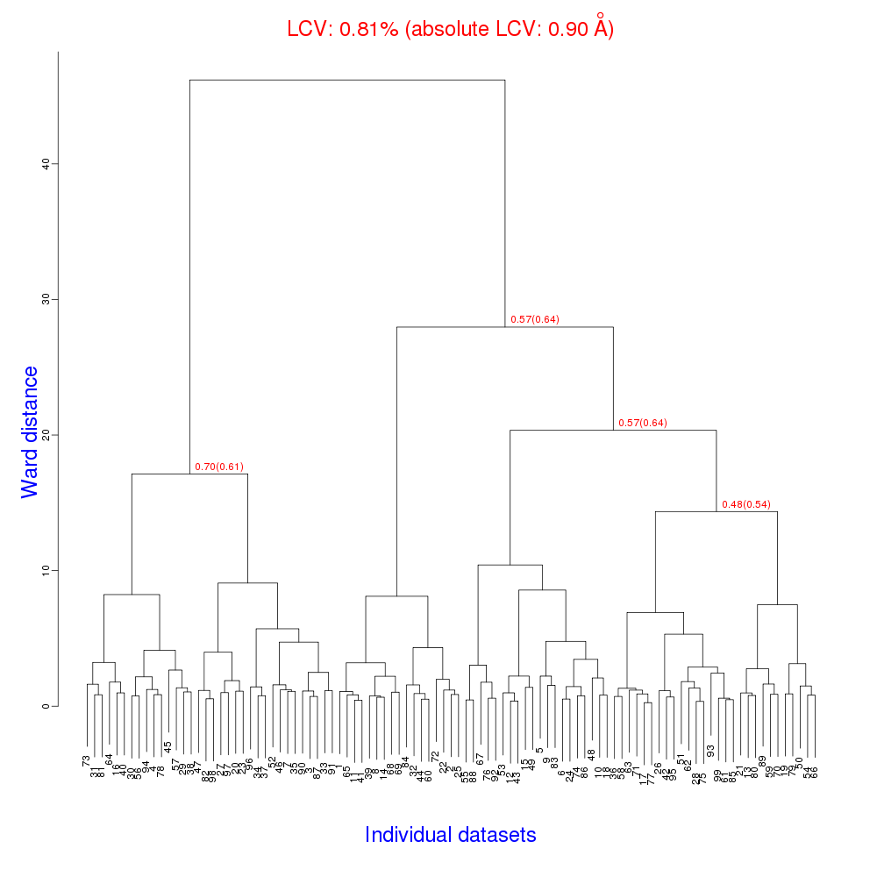
Cell clustering: 100 datasets
Reality:
Perfect isomorphism
(simulated data)

Slide 4
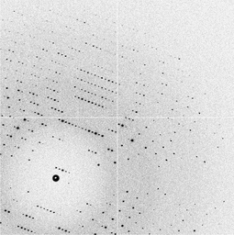
Simulation: Micro-focus challenge
5 µm xtals
5 µm beam
~ 5 img / xtal
P2₁2₁2₁
XDS thinks:
P422
https://doi.org/10.1107/S2059798319001426

Slide 5
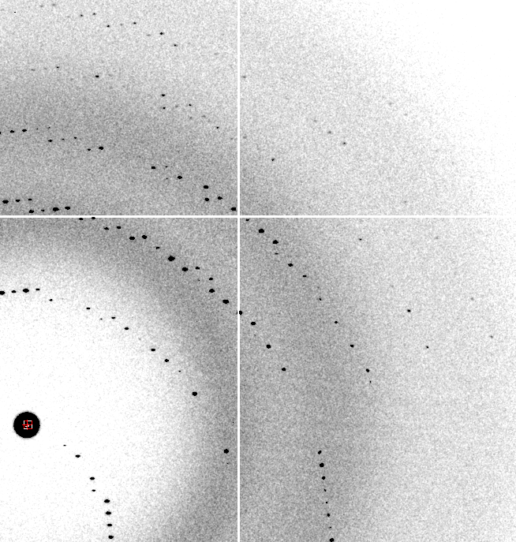
Problem images: indexing

Slide 6
Lesson 1:
Indexing algorithm is a source of:
  Cell variation
  Orientation bias
NOT a source of non-isomorphism

Slide 7
non-isomorphism
What do you mean?

Slide 8
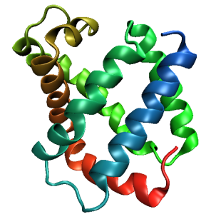
Same structure, different cell
0.5% cell change → 15%
Crick & Magdoff (1956) “theory method isomorphous replacement”, Acta Cryst. 9, 901-8.

Slide 9
Same structure, different cell
0.5% cell change → 15%
Crick & Magdoff (1956) “theory method isomorphous replacement”, Acta Cryst. 9, 901-8.

Slide 10
Same cell, rotated protein
0.5° rotation → 16%
Crick & Magdoff (1956) “theory method isomorphous replacement”, Acta Cryst. 9, 901-8.

Slide 11
Same cell, rotated protein
0.5° rotation → 16%
Crick & Magdoff (1956) “theory method isomorphous replacement”, Acta Cryst. 9, 901-8.

Slide 12
Uniform stretch
5% change → 0%

Slide 13
Uniform stretch
5% change → 0%

Slide 14
non-isomorphism

Slide 15
non-isomorphism

Slide 16

Temperature jump?
ΔT
dark
light

Slide 17
Hygrostatic gradients
high
water activity
low
jet
loop

Slide 18

Non-isomorphism in lysozyme
RMSD = 0.18 Å
Δcell = 0.7 %
R_{iso} = 44.5%
3aw6
3aw7
RH: 84.2%
vs 71.9%

Slide 19
“map bender” procedure
Convert to fractional coordinates
Plot Δx vs x,y,z across P1 cell
Fit function to Δx vs x,y,z
  Repeats with unit cell
Repeat with Δy, Δz
Basis functions: spatial sin waves
https://github.com/fraser-lab/holton_scripts/tree/master/map_bender

Slide 20
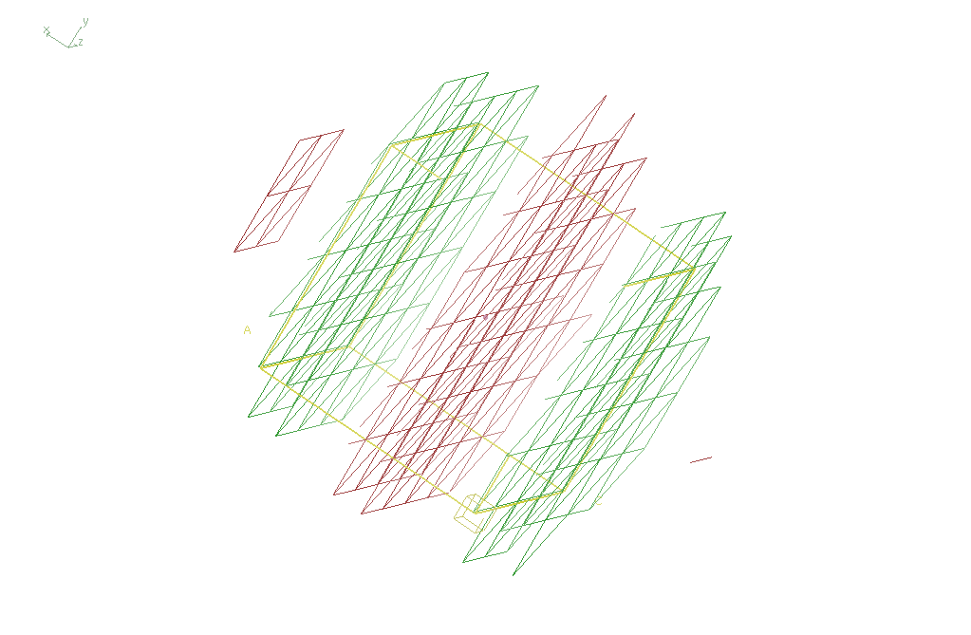
Basis function 1 0 0

Slide 21
“map bender” procedure
Convert to fractional coordinates
Plot Δx vs x,y,z across P1 cell
Fit function to Δx vs x,y,z
    Repeats with unit cell
Repeat with Δy, Δz
Basis functions: spatial sin waves
  Low-order h,k,l indices first
Apply to PDB file and interpolate map grid
Usually 3-5 orders comparable to LSQ
https://github.com/fraser-lab/holton_scripts/tree/master/map_bender

Slide 22
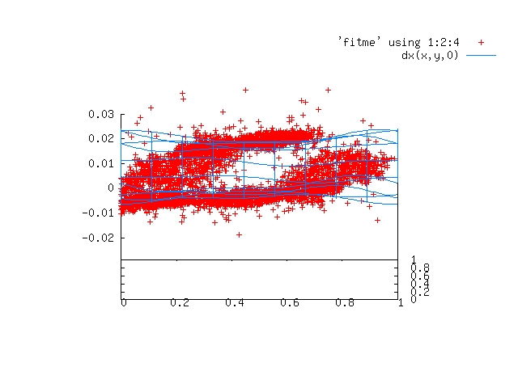

Slide 23
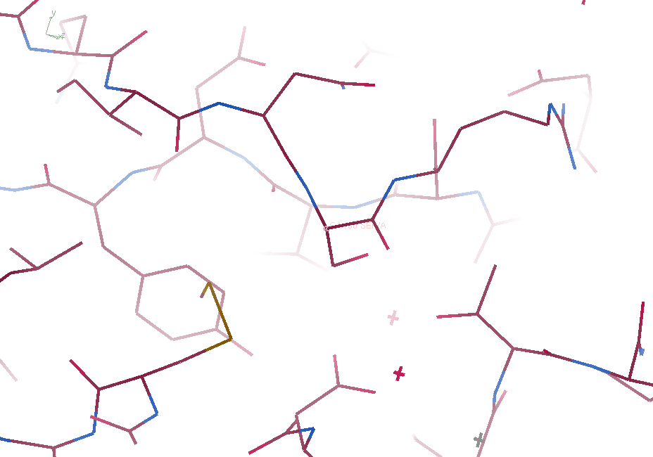
3aw6

Slide 24
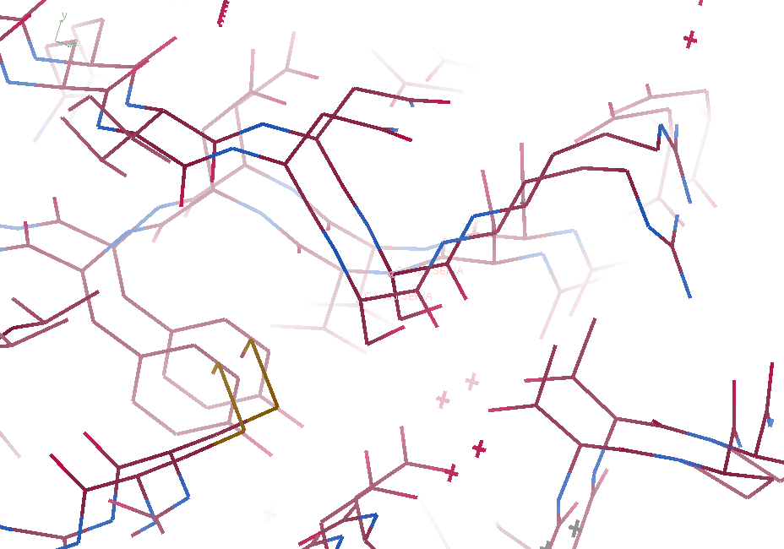
3aw6 3aw7

Slide 25
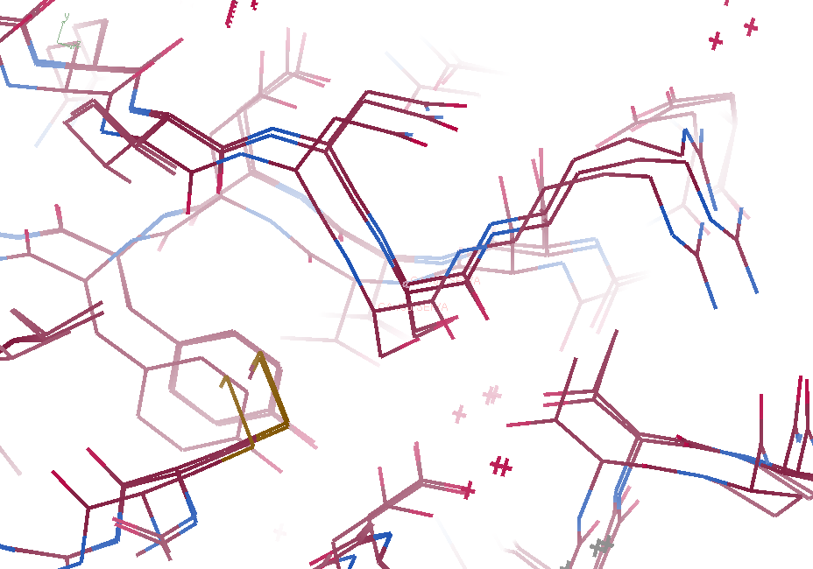
3aw6, 3aw7, “bent” 3aw7

Slide 26
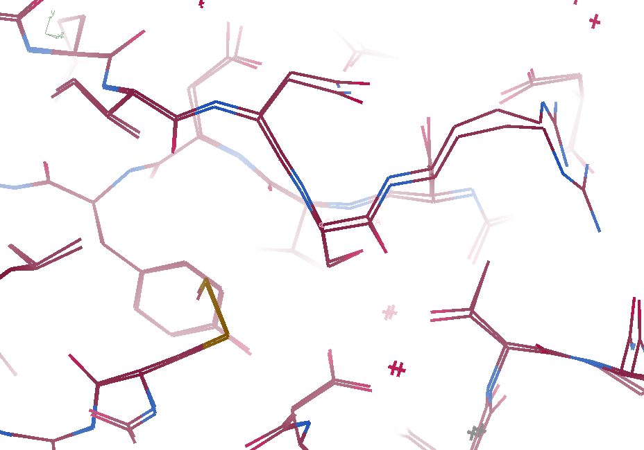
3aw6, “bent” 3aw7

Slide 27
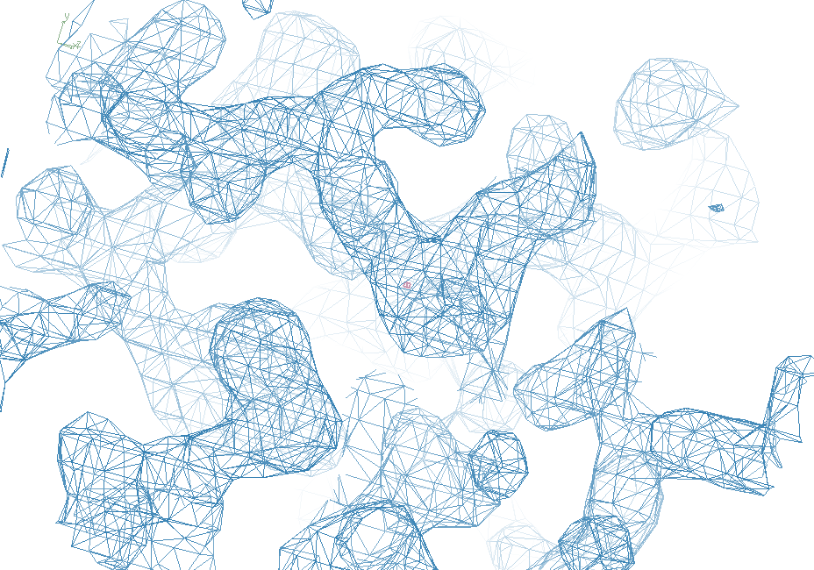
3aw6

Slide 28
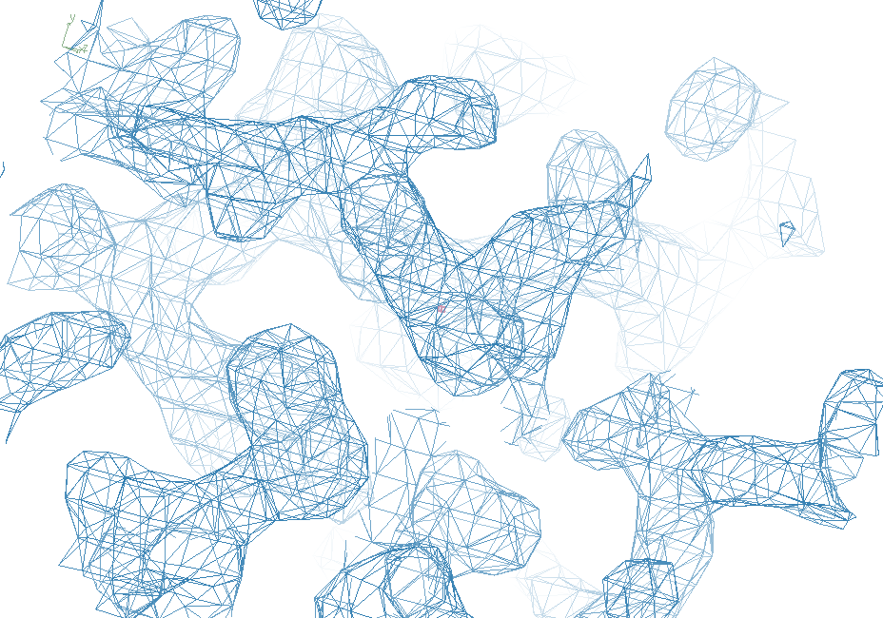
“bent” 3aw7

Slide 29
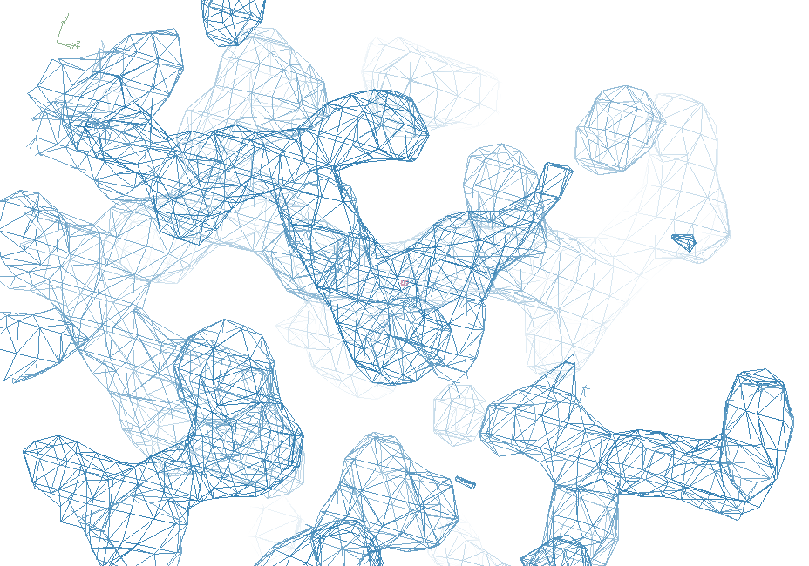
3aw7

Slide 30
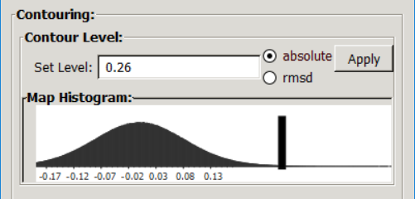
Quick and dirty way:
Coot: Extensions > Maps… >
  Transform map by LSQ model fit …
Extensions -> Maps … >
  Make Difference Map
Careful! Sigma contour is wrong!
Examine absolute contour of F_{o}-F_{c}
Apply same contour to new difference map

Slide 31
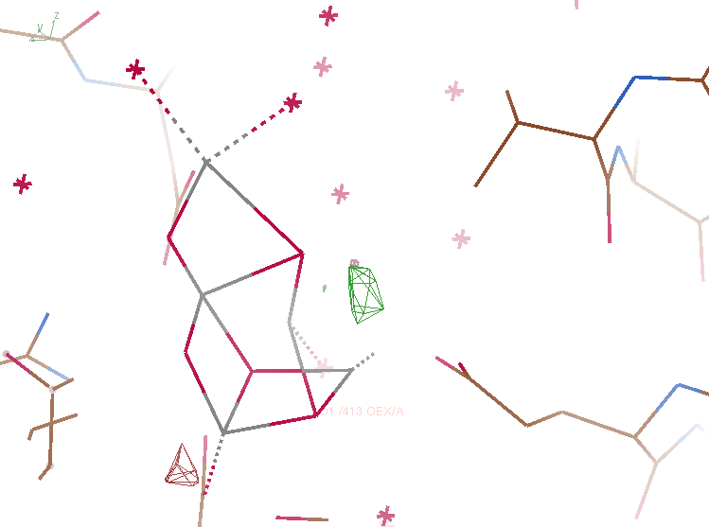
(2F_{o}-F_{c}) – (2F_{o}-F_{c})
5ws6 - 5ws5
not
aligned
0.35 e-/Å³

Slide 32
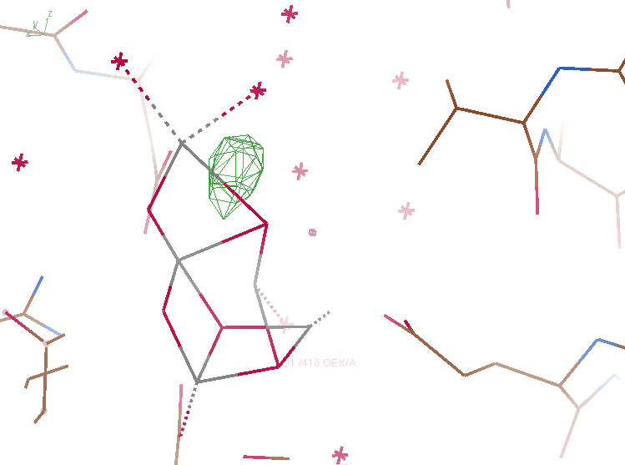
(2F_{o}-F_{c}) – (2F_{o}-F_{c})
5ws6 - 5ws5
aligned
0.35 e-/Å³

Slide 33
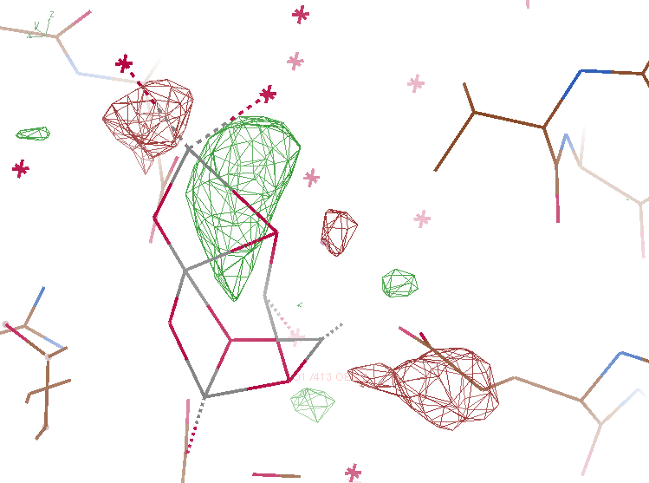
(2F_{o}-F_{c}) – (2F_{o}-F_{c})
5ws6 - 5ws5
aligned
0.20 e-/Å³

Slide 34
(2F_{o}-F_{c}) – (2F_{o}-F_{c})
5ws6 - 5ws5
not
aligned
0.35 e-/Å³

Slide 35
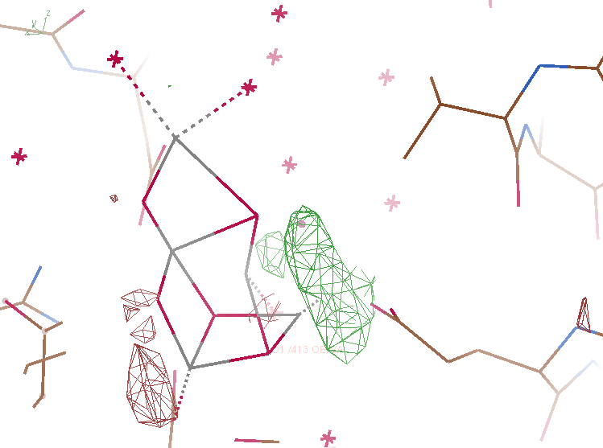
(2F_{o}-F_{c}) – (2F_{o}-F_{c})
5ws6 - 5ws5
not
aligned
0.30 e-/Å³

Slide 36
“map bender” procedure
https://github.com/fraser-lab/holton_scripts/tree/master/map_bender
Convert to fractional coordinates
Plot Δx vs x,y,z across P1 cell
Fit function to Δx vs x,y,z
    Repeats with unit cell
Repeat with Δy, Δz
Basis functions: spatial sin waves
  Low-order h,k,l indices first
Apply to PDB file and interpolate map grid
Usually 3-5 orders comparable to LSQ

Slide 37
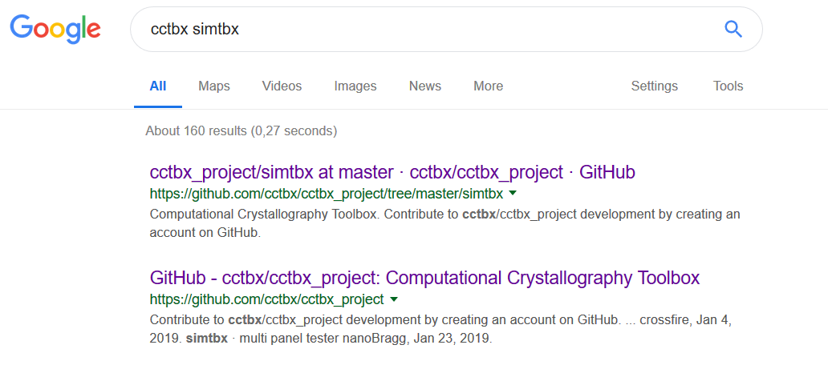
Diffraction simulation: now available in Python
https://github.com/nksauter/LS49/

Slide 38
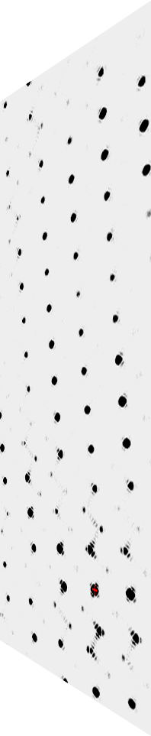
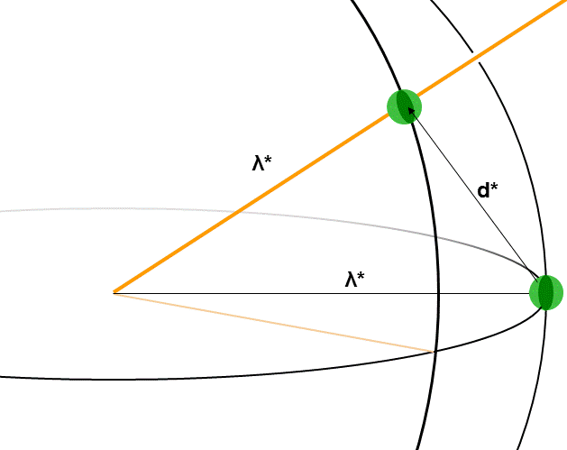
simtbx nanoBragg program
http://bl831.als.lbl.gov/~jamesh/nanoBragg/
Optimized for nanocrystals
Square, round, tophat
Takes h,k,l and F
Supports 1 unit cell
explicit “mosaicity”
arbitrary source
explicit “phi” steps

Slide 39
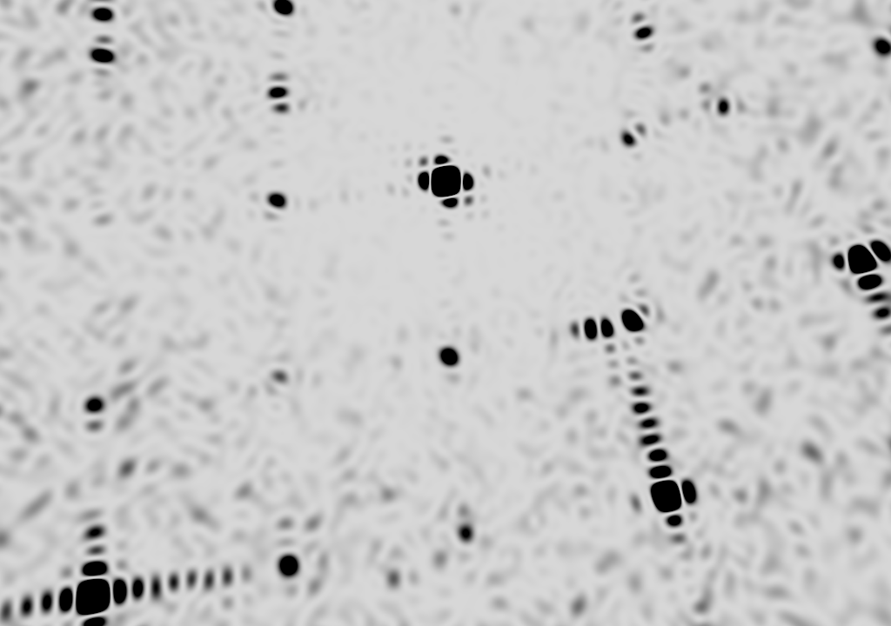
square

Slide 40
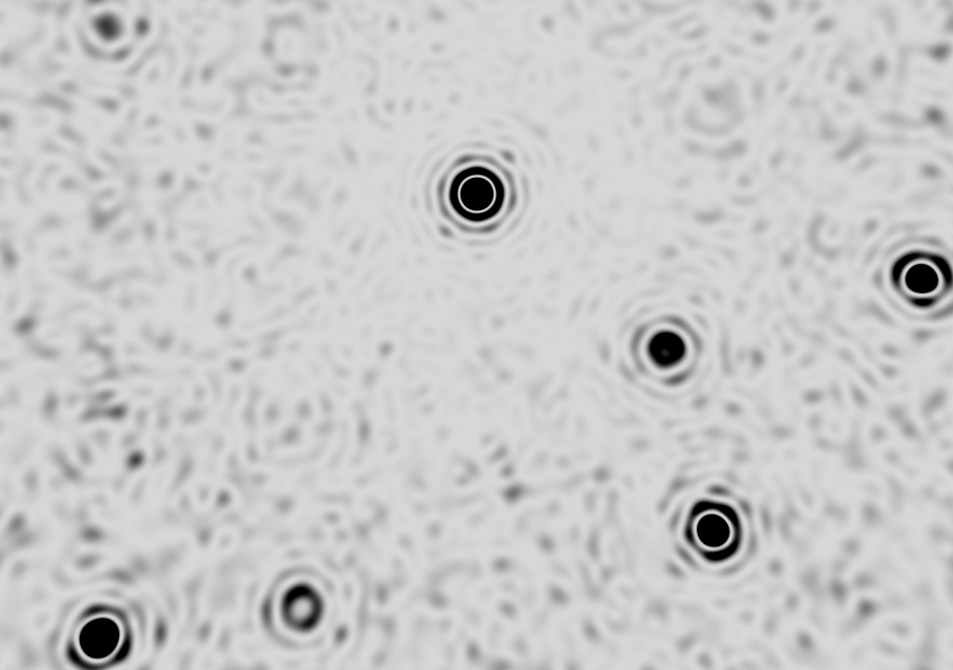
round

Slide 41
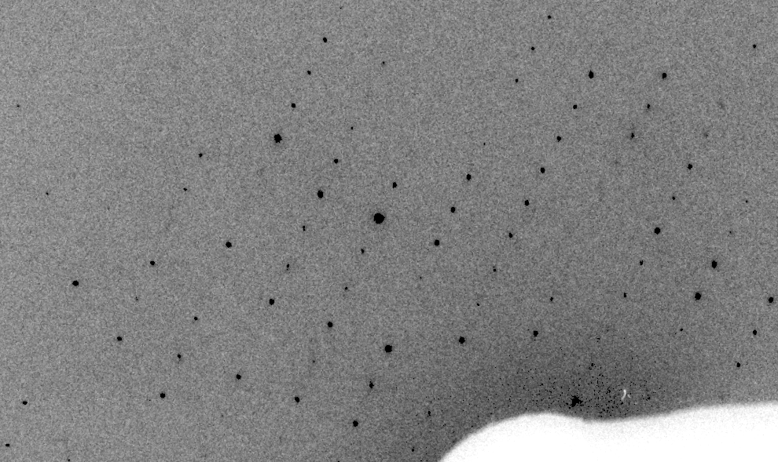
Real XFEL still
Lyubimov et al. (2016).
eLife 5, e18740.

Slide 42
XFEL: “fit” simulation to reality
Dispersion
Divergence
Mosaicity
Wavelength
Unit cell parameters (3)
Crystal orientation (3)
Mosaic domain size (3)
Beam center (2)
Beam direction (2)
Detector distance

Slide 43
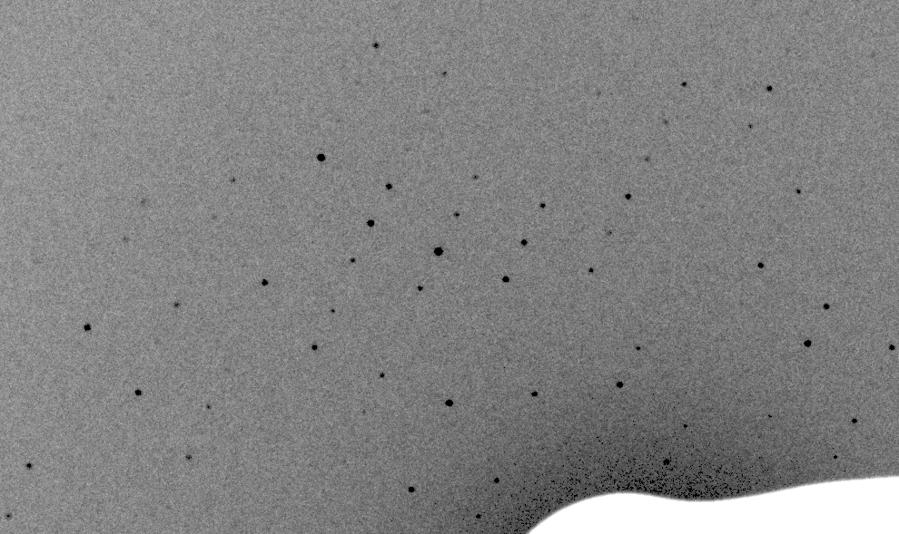
Simulation of XFEL still
Lyubimov et al. (2016).
eLife 5, e18740.

Slide 44
Real XFEL still
Lyubimov et al. (2016).
eLife 5, e18740.

Slide 45
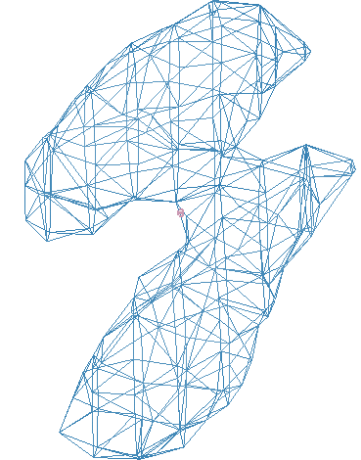
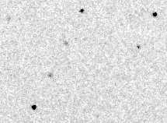
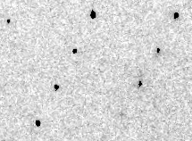
Simulation of XFEL still
phix
phiy
phiz
real
VS
phix
phiy
phiz

Slide 46
Fitting individual “mosaic domains”
Fraction pixels predicted
Best of
262,140 trials
Angle about y axis (°)

Slide 47
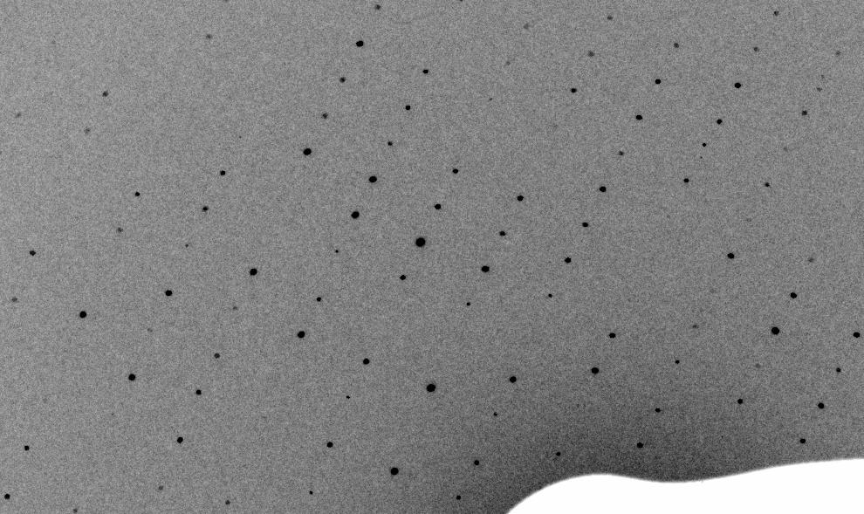
3-domain Simulation of XFEL still

Slide 48
Real XFEL still

Slide 49
1-domain Simulation of XFEL still

Slide 50
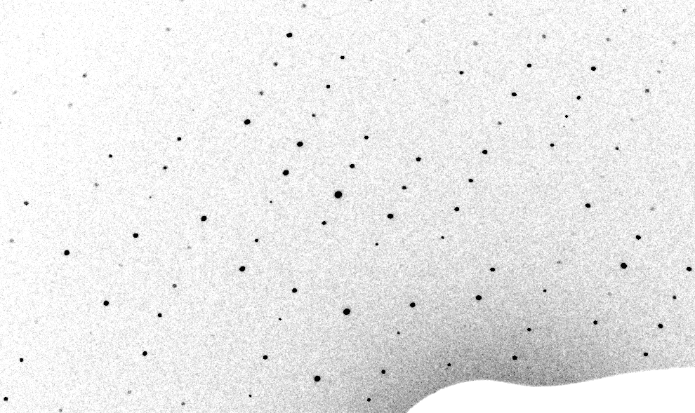
3-cluster mosaic simulation

Slide 51
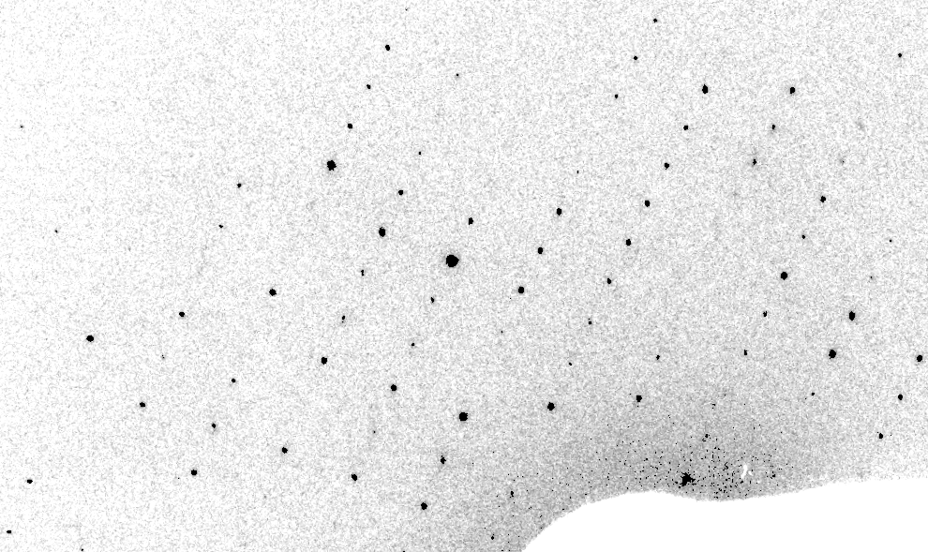
Real XFEL still
Lyubimov et al. (2016).
eLife 5, e18740.

Slide 52
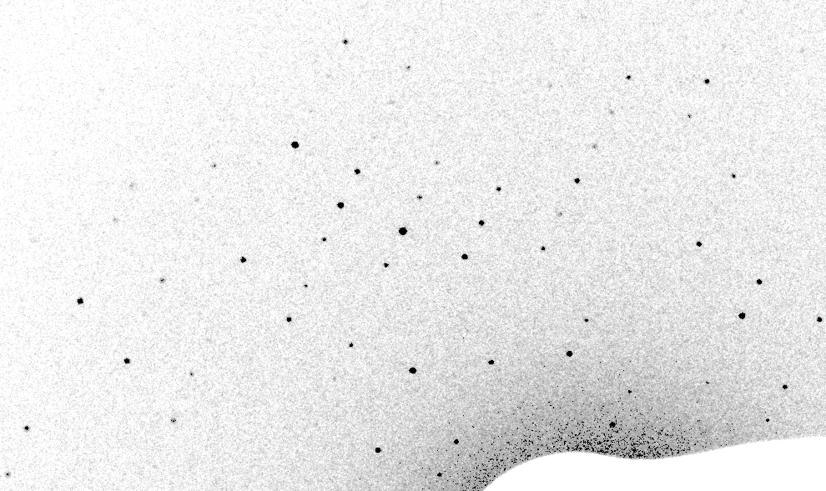
1-cluster Simulation of XFEL still

Slide 53
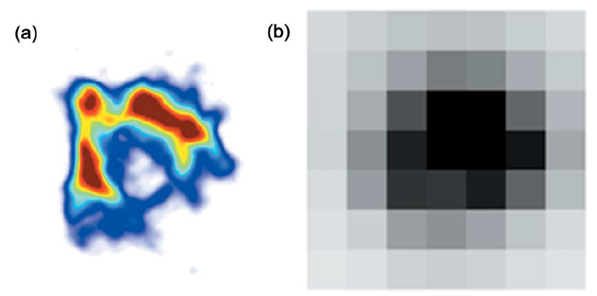
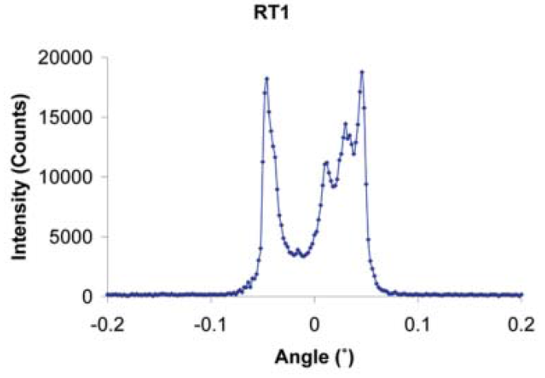
The true nature of “mosaic spread”
Any function can be approximated by a family of Gaussians
Lovelace JJ, Murphy CR, Pahl R, Brister K & Borgstahl GEO (2006)."Tracking reflections through cryogenic cooling with topography", J. Appl. Cryst. 39, 425-432.

Slide 54
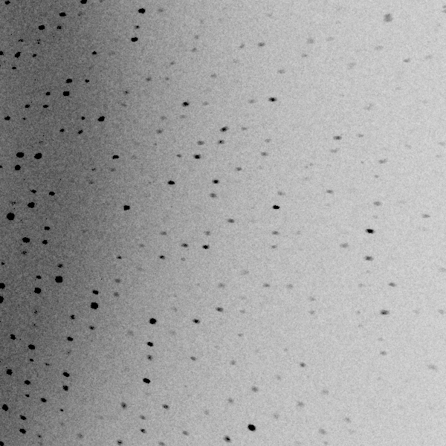
3 domains within 1°

Slide 55
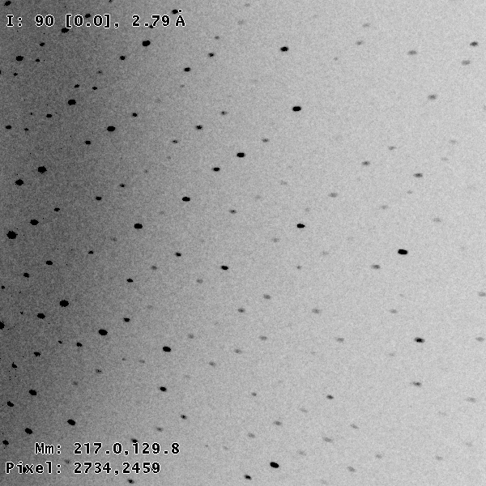
3 domains within 0.2°

Slide 56
Texture sufficient for poor stats
500 images Results from iota: cctbx & prime
texture | 1 cluster | 3 clusters
R_{true}* | 4% | 16%
*Agreement with F value fed into simulation

Slide 57
Texture sufficient for poor stats
500 images Results from iota: cctbx & prime
texture | 1 cluster | 3 clusters
R_{true}* | 4% | 16%
R_{merge} | 23% | 66%
*Agreement with F value fed into simulation

Slide 58
Texture sufficient for poor stats
500 images Results from iota: cctbx & prime
texture | 1 cluster | 3 clusters
R_{true}* | 4% | 16%
R_{merge} | 23% | 66%
I/σ | 32 (1.1) | 19 (1.2)
*Agreement with F value fed into simulation

Slide 59
Texture sufficient for poor stats
500 images Results from iota: cctbx & prime
texture | 1 cluster | 3 clusters
R_{true}* | 4% | 16%
R_{merge} | 23% | 66%
I/σ | 32 (1.1) | 19 (1.2)
CC_{1/2} | 99 (69) | 99 (58)
*Agreement with F value fed into simulation

Slide 60
Texture sufficient for poor stats
500 images Results from iota: cctbx & prime
texture | 1 cluster | 3 clusters
R_{true}* | 4% | 16%
R_{merge} | 23% | 66%
I/σ | 32 (1.1) | 19 (1.2)
CC_{1/2} | 99 (69) | 99 (58)
resolution | 1.55 | 1.94
*Agreement with F value fed into simulation

Slide 61
Diffraction Simulation run times
6016 s
238 s
316 s
22 s
6 s
16 s
Xeon W-2155 4.5 GHz
Xeon E7-8870 72 cores
Kepler GM107GL
Pascal 1080 Ti ($1k)
Volta GV100 ($3k)
Turing 2080 Ti

Slide 62
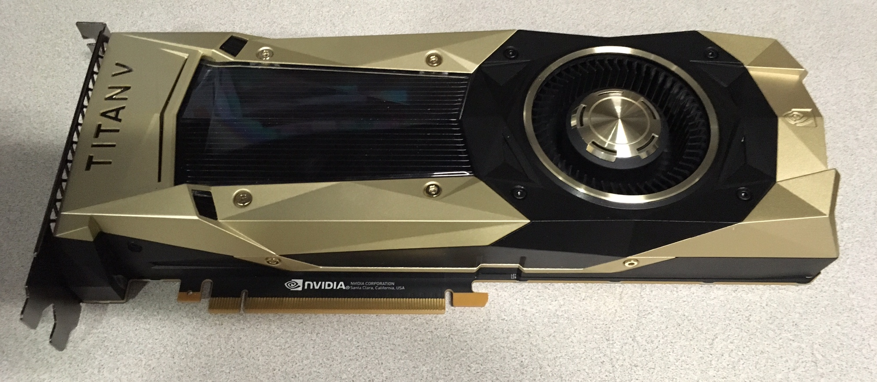
1000x faster, 5% price

Slide 63
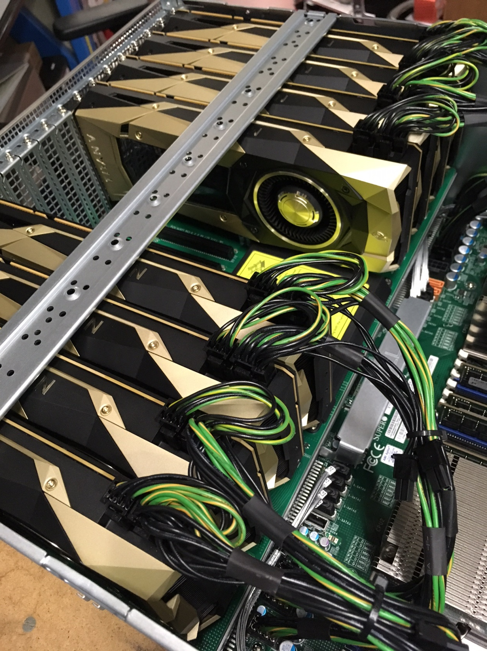
“voltron”
8 x
Titan V
~ 1 Pflop
$47k

Slide 64
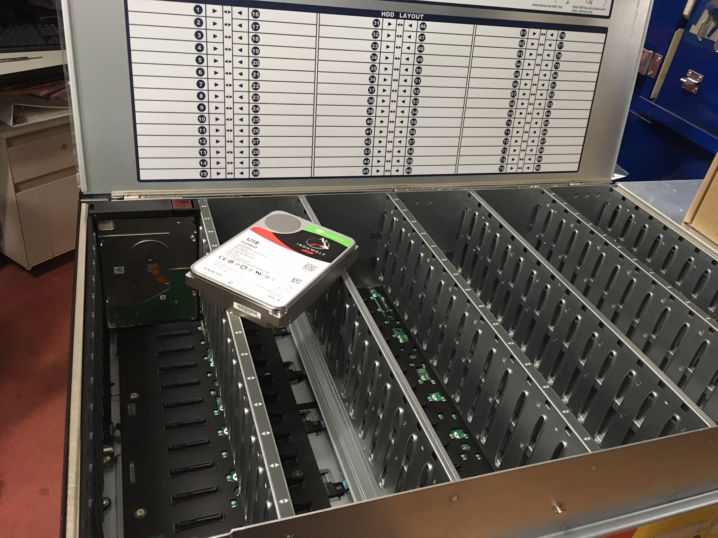
“petabyte” $11k

Slide 65
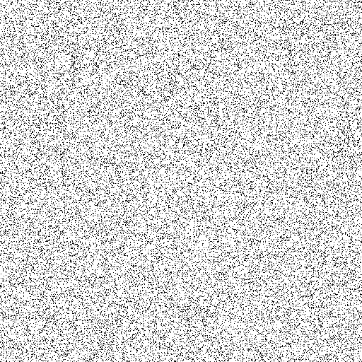
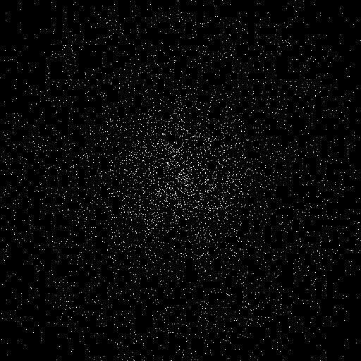
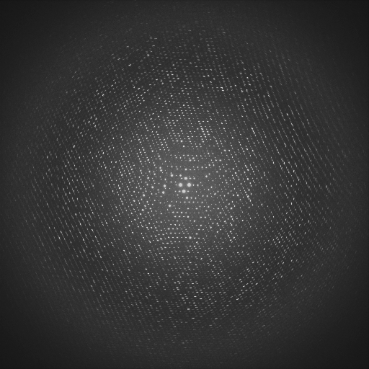
Deep Learning for hit finding
Trained on 12,400 simulated images
93.7% accurate on 458 real images
Problem: must be 512x512 x 8 bit

Slide 66
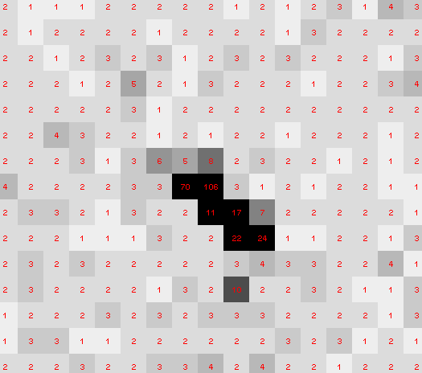
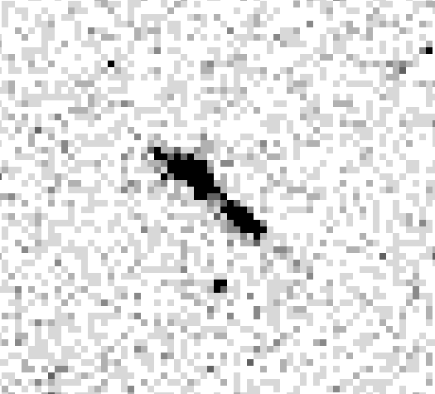
8x8 Max-pool & sqrt filter

Slide 67
Deep Learning: scoring speeds
1.2 Hz
6.5 Hz
17 Hz
17 Hz
24 Hz
Xeon W-2155 4.5 GHz
Xeon W-2155 10 cores
Kepler K40c
Pascal 1080 Ti
Volta GV100 ($3k)

Slide 68
Deep Learning setup
yum install cuda-repo-rhel7-*.rpm
yum install cuda-9-2
cd /usr/local/
tar xvzf ~/Downloads/cudnn-9.2-*.tgz
yum install gcc gcc-c++ python-pip python-devel atlas atlas-devel gcc-gfortran openssl-devel libffi-devel
pip install --upgrade numpy scipy wheel cryptography six scikit-learn protobuf scikit-image h5py tensorflow-gpu keras pillow
python
import tensorflow keras

Slide 69
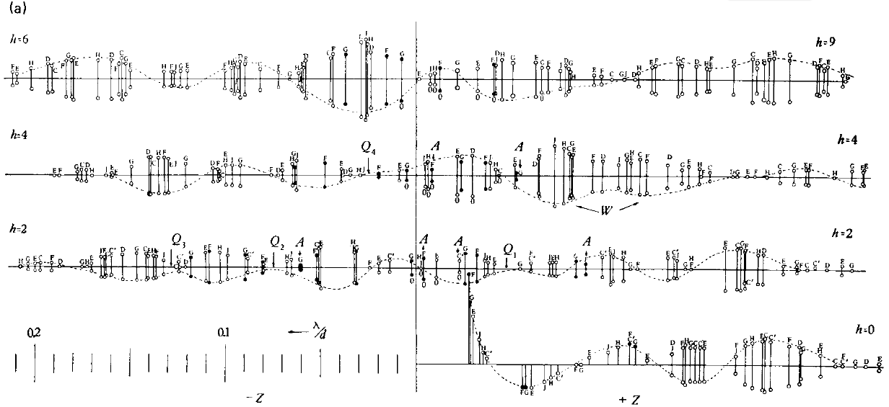
Bragg’s “minimum wavelength principle”
Perutz (1985). “Early Days of Cryst…” Methods in Enzymology, Vol. 114, 3-18.
Bragg & Perutz (1952)."external form haemoglobin I", Acta Cryst. 5, 277-283.

Slide 70
Structure Factor Equation
F_{hkl} = f_{atom} exp(-2π i (hx + ky + lz))
Σ
dF_{hkl}
dh
= f_{atom} (-2π i hx) exp(-2π i (hx + ky + lz))
Σ

Slide 71
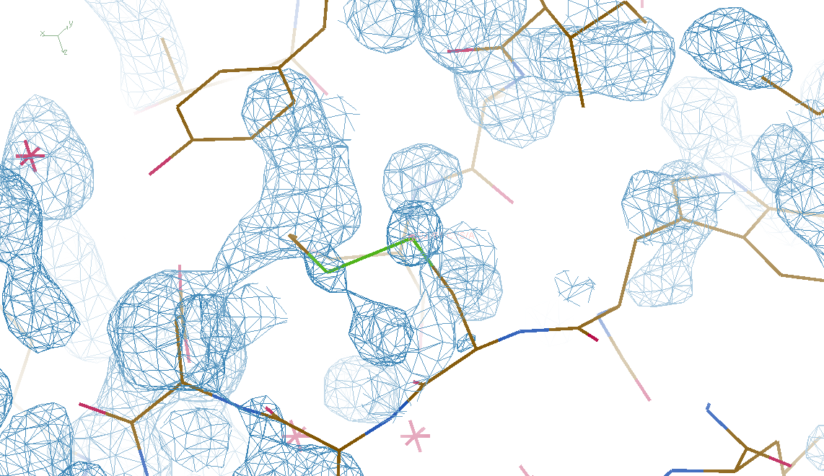
DMMULTI – fake data
4 deg rotation: 8 “xtals”: before
CC = 0.02

Slide 72
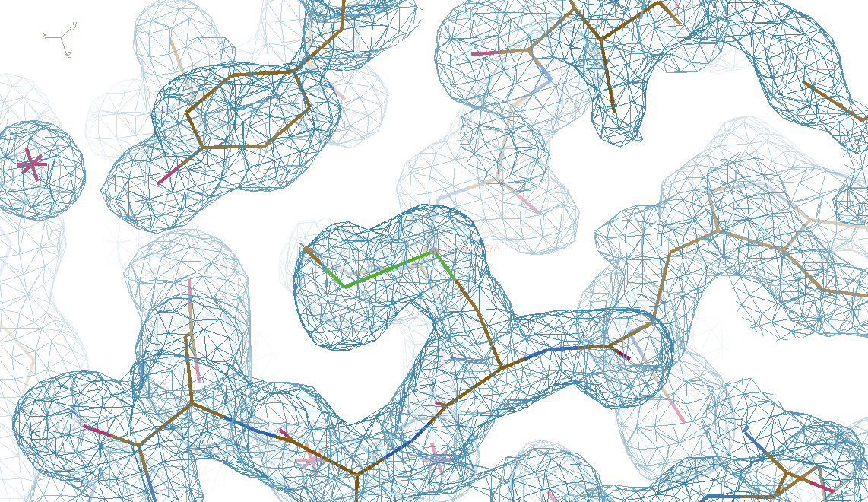
DMMULTI – fake data
4 deg rotation: 8 “xtals”: after
CC = 0.8

Slide 73
Summary
http://bl831.als.lbl.gov/~jamesh/powerpoint/Ringberg_xfel_2019.pptx
Indexing software = orientation bias?
Non-isomorphism
  Cell is not the whole story
  Real space: bend it out
  Reciprocal space: TBD
Simulation
  nanoBragg or “simtbx” in cctbx
  GPU = 1000x faster

Slide 74
Radiation Damage
World Records
MGy reaction reference
~45 global damage Owen et al. (2006)
5 Se-Met Holton (2007)
4 Hg-S Ramagopal et al. (2004)
4 R-C-COOH Garman et al. (2015)
3 S-S Murray et al. (2002)
1 Br-RNA Olieric et al. (2007)
~1? Cl-C ???
0.5 Mn in PS II Yano et al. (2005)
0.06 putidaredoxin Corbett et al. (2007)
0.02 Fe in myoglobin Denisov et al. (2007)
Holton (2009) J. Synchrotron Rad. 16 133-42

Slide 75
Plastic deformation
= poor diffraction

Slide 76
Plastic deformation
= poor diffraction

Slide 77
Elastic deformation
= non-isomorphism

Slide 78
Elastic deformation
= non-isomorphism

Slide 79
Non-isomorphism in lysozyme
Dear James
The story of the two forms of lysozyme crystals goes back to about 1964 when it was found that the diffraction patterns from different crystals could be placed in one of two classes depending on their intensities. This discovery was a big set back at the time and I can remember a lecture title being changed from the 'The structure of lysozyme' to 'The structure of lysozyme two steps forward and one step back'. Thereafter the crystals were screened based on intensities of the (11,11,l) rows to distinguish them (e.g. 11,11,4 > 11,11,5 in one form and vice versa in another). Data were collected only for those that fulfilled the Type II criteria. (These reflections were easy to measure on the linear diffractometer because crystals were mounted to rotate about the diagonal axis). As I recall both Type I and Type II could be found in the same crystallisation batch . Although sometimes the external morphology allowed recognition this was not infallible.
The structure was based on Type II crystals. Later a graduate student Helen Handoll examined Type I. The work, which was in the early days and before refinement programmes, seemed to suggest that the differences lay in the arrangement of water or chloride molecules (Lysozyme was crystallised from NaCl). But the work was never written up. Keith Wilson at one stage was following this up as lysozyme was being used to test data collection strategies but I do not know the outcome.
An account of this is given in International Table Volume F (Rossmann and Arnold edited 2001) p760.
Tony North was much involved in sorting this out and if you wanted more info he would be the person to contact. I hope this is helpful. Do let me know if you need more.
Best wishes
Louise

Slide 80
Non-isomorphism in lysozyme
Dear James
The story of the two forms of lysozyme crystals goes back to about 1964 when it was found that the diffraction patterns from different crystals could be placed in one of two classes depending on their intensities. This discovery was a big set back at the time and I can remember a lecture title being changed from the 'The structure of lysozyme' to 'The structure of lysozyme two steps forward and one step back'. Thereafter the crystals were screened based on intensities of the (11,11,l) rows to distinguish them (e.g. 11,11,4 > 11,11,5 in one form and vice versa in another). Data were collected only for those that fulfilled the Type II criteria. (These reflections were easy to measure on the linear diffractometer because crystals were mounted to rotate about the diagonal axis). As I recall both Type I and Type II could be found in the same crystallisation batch . Although sometimes the external morphology allowed recognition this was not infallible.
The structure was based on Type II crystals. Later a graduate student Helen Handoll examined Type I. The work, which was in the early days and before refinement programmes, seemed to suggest that the differences lay in the arrangement of water or chloride molecules (Lysozyme was crystallised from NaCl). But the work was never written up. Keith Wilson at one stage was following this up as lysozyme was being used to test data collection strategies but I do not know the outcome.
An account of this is given in International Table Volume F (Rossmann and Arnold edited 2001) p760.
Tony North was much involved in sorting this out and if you wanted more info he would be the person to contact. I hope this is helpful. Do let me know if you need more.
Best wishes
Louise

Slide 81
Dehydration: 1934
and 2017?
= 1.5 μL
100 μm
= 1.0 nL
2 mm
= 1.0 pL
10 μm
= 1.0 fL
1 μm

Slide 82
Non-isomorphism in lysozyme
Structure factor (e⁻)
Johnson’s ratio

Slide 83
Non-isomorphism in lysozyme
Structure factor (e⁻)
Johnson’s ratio

Slide 84
