Slide 1
Acknowledgements
Robert Stroud James Fraser
Nick Sauter John Tainer Aina Cohen Ana Gonzalez
UCSF LBNL SLAC
ALS 8.3.1 creator: Tom Alber
UC Multicampus Research Programs and Initiatives (MRPI)
UCSF Program for Breakthrough Biomedical Research (PBBR)
one-time NIH-DOE Inter-agency agreement (IAA)
GM117126 to Sauter (DIALS)
Integrated Diffraction Analysis Technologies (IDAT)
Plexxikon, Inc.
Synchrotron Radiation Structural Biology Resource (SLAC)
The Advanced Light Source is supported by the Director, Office of Science, Office of Basic Energy Sciences, Materials Sciences Division, of the US Department of Energy under contract No. DE-AC02-05CH11231 at Lawrence Berkeley National Laboratory.

Slide 2
PowerPoint File available:
http://bl831.als.lbl.gov/
~jamesh/powerpoint/
Ringberg_xfel_2017.pptx

Slide 3
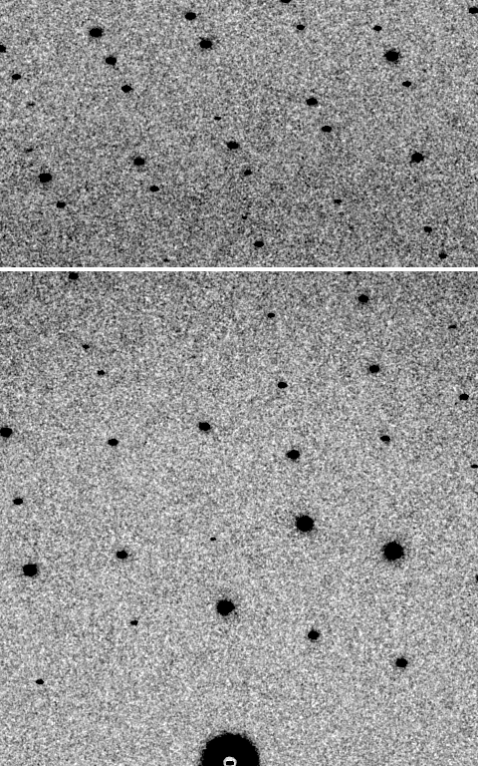
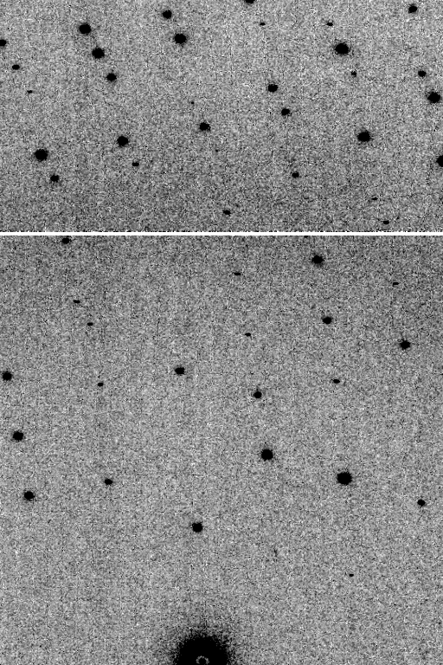
At-scale diffraction simulation
simulated
real
MLFSOM
Holton et al (2014) “R-factor gap", FEBS Journal 281, 4046-4060.

Slide 4

Systematic Error vs Random Noise

Slide 5
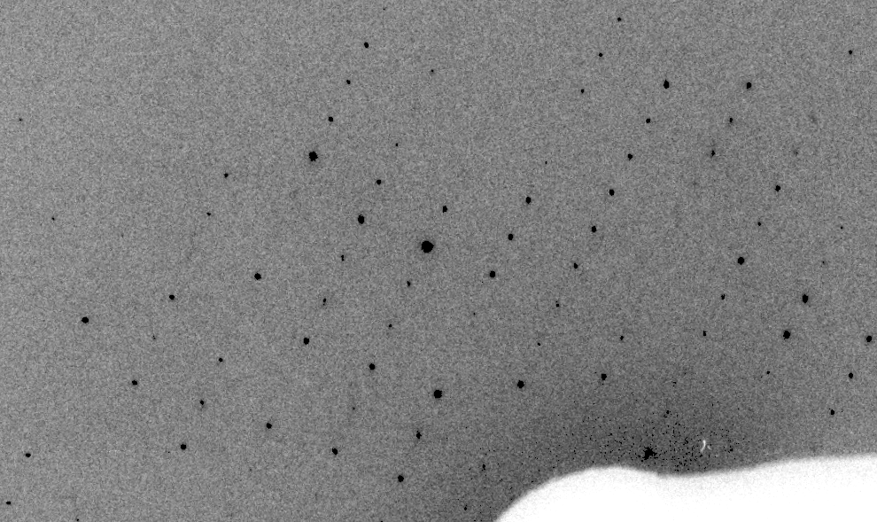
Real XFEL still
Lyubimov et al. (2016).
eLife 5, e18740.

Slide 6
XFEL: “fit” simulation to reality
Dispersion
Divergence
Mosaicity
Wavelength
Unit cell parameters (3)
Crystal orientation (3)
Mosaic domain size (3)
Beam center (2)
Beam direction (2)
Detector distance

Slide 7
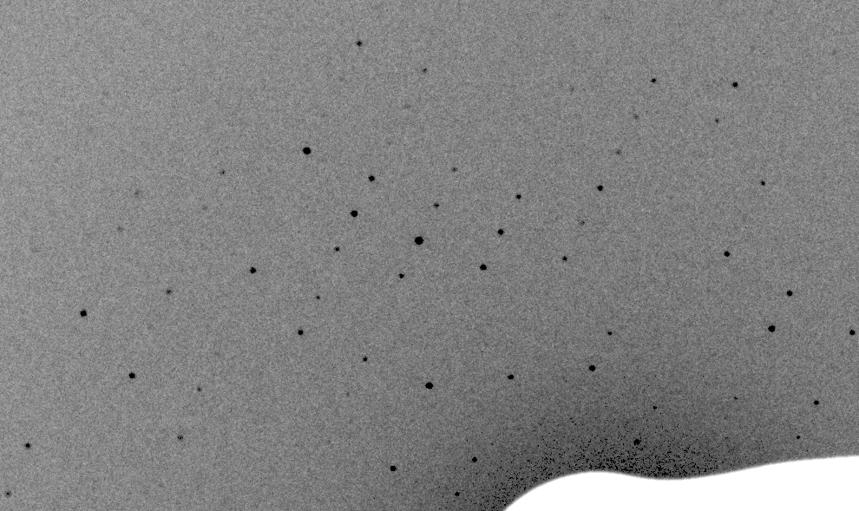
Simulation of XFEL still
Lyubimov et al. (2016).
eLife 5, e18740.

Slide 8
Real XFEL still
Lyubimov et al. (2016).
eLife 5, e18740.

Slide 9
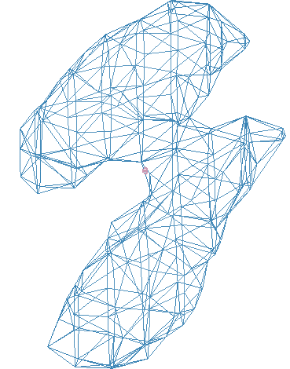
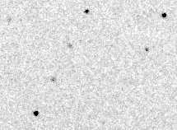
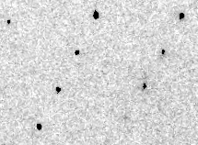
Simulation of XFEL still
phix
phiy
phiz
real
VS
phix
phiy
phiz

Slide 10
Fitting individual “mosaic domains”
Fraction pixels predicted
Best of
262,140 trials
Angle about y axis (°)

Slide 11
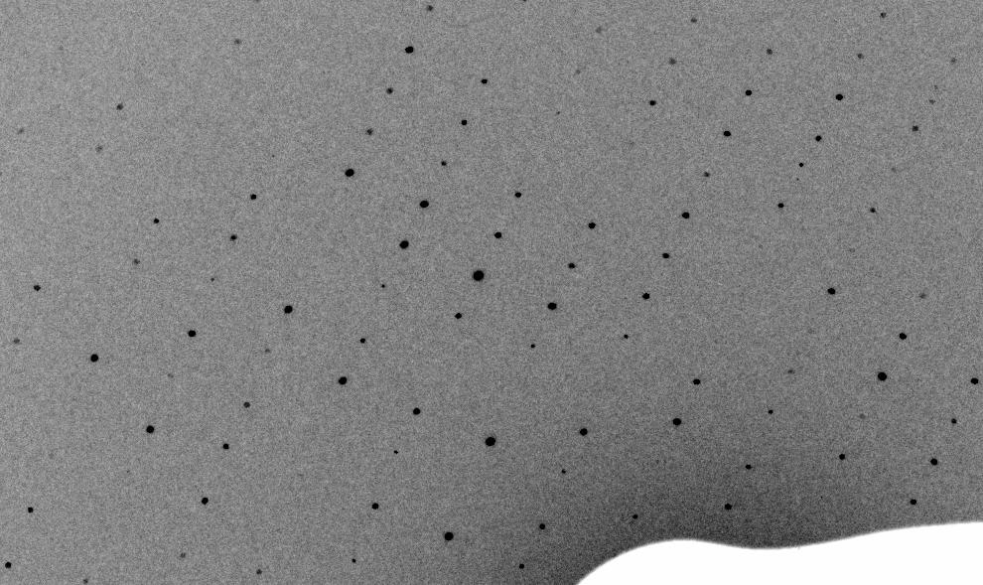
3-domain Simulation of XFEL still

Slide 12
Real XFEL still

Slide 13
1-domain Simulation of XFEL still

Slide 14
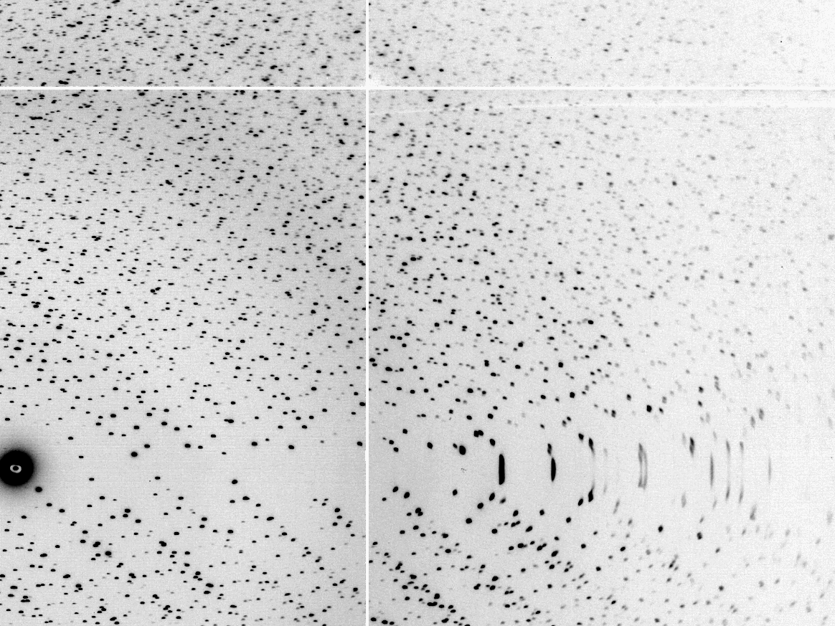
The “Lorentz zone”

Slide 15
Coming Soon in CCTBX / DIALS!
At-scale simulation coupled to
data processing
https://github.com/cctbx

Slide 16
Diffraction Simulators
1. MLFSOM
- rotation data with maximum realism in noise
2. nearBragg
- first-principles scattering from atoms in space
3. nanoBragg
- optimized for nanocrystal/single-particle stills
4. nonBragg
- non-crystalline, centrosymmetric (SAXS)

Slide 17
Diffraction Simulators
1. MLFSOM
- rotation data with maximum realism in noise
2. nearBragg
- first-principles scattering from atoms in space
3. nanoBragg
- optimized for nanocrystal/single-particle stills
4. nonBragg
- non-crystalline, centrosymmetric (SAXS)

Slide 18
What if…
we knew everything?
  how would we store it?
we had a hotter beam?
we had more coherence?
we had a perfect detector?
…
we knew what we are doing wrong?

Slide 19
What if…
we knew everything?
  how would we store it?
we had a hotter beam?
we had more coherence?
we had a perfect detector?
…
we knew what we are doing wrong?

Slide 20
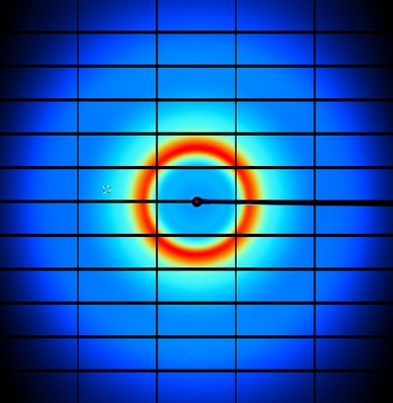
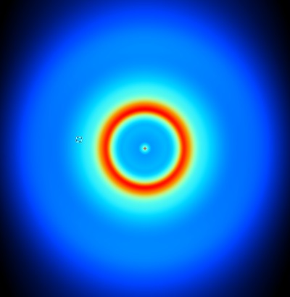
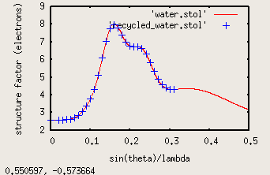
nonBragg extracts background
spot remover
Flux
Exposure
Density
Thickness
Gain, offset

Slide 21
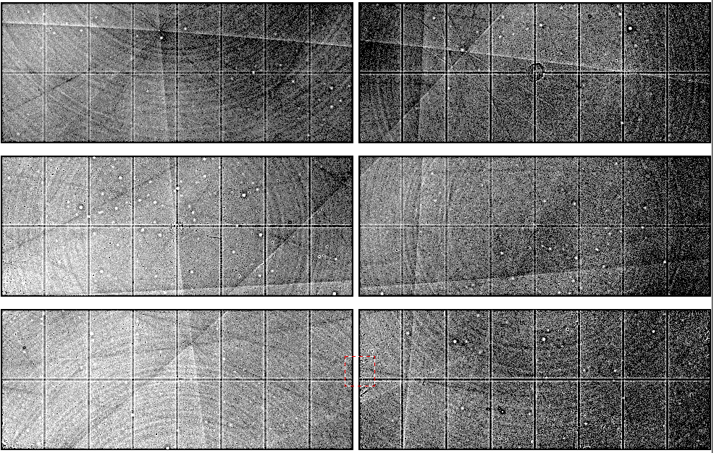
Pilatus: subtract smooth baseline
~3x10⁵ photon/pixel
Bragg
glitch
“tree rings”
Pick-up tool mark
oxygen
inclusions
1% high
average
1% low

Slide 22
Threshold of a revolution in phasing
Current
technology
Goal
Solve-able proteins (%)
Required signal-to-noise (I/σ)

Slide 23
Phasing success vs Figure of Merit
Adjusting:
Solvent content
Resolution
SDfac Sdadd
Cycles of dm
“mode”
“scheme”
NCS radius
NCS cycles
Phase blur
Correlation to final map
FOM from “dm”
http://cxidb.org/id54-SfjMJjaBny/id-54.html http://cxidb.org/id55-BWuBDSUrBy/id-55.html
Hunter et al. (2016)."Selenium anomalous phasing XFEL", Nature Comm. 7, 13388.

Slide 24
Diffraction Simulators
1. MLFSOM
- rotation data with maximum realism in noise
2. nearBragg
- first-principles scattering from atoms in space
3. nanoBragg
- optimized for nanocrystal/single-particle stills
4. nonBragg
- non-crystalline, centrosymmetric (SAXS)

Slide 25
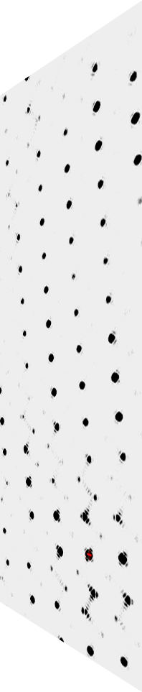
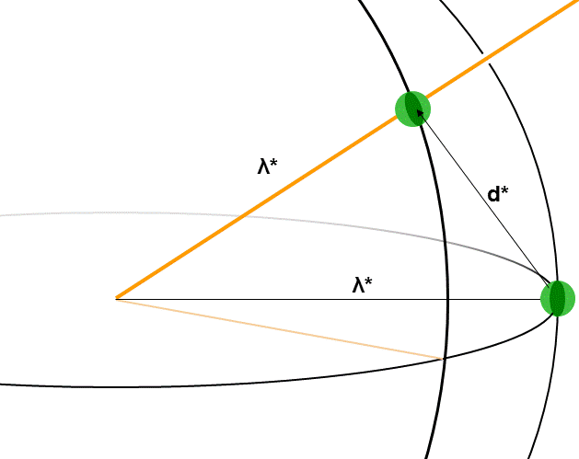
nanoBragg program
http://bl831.als.lbl.gov/~jamesh/nanoBragg/
Optimized for nanocrystals
Square or round
Takes h,k,l and F
Supports 1 unit cell
explicit “mosaicity”
arbitrary source
explicit “phi” steps

Slide 26
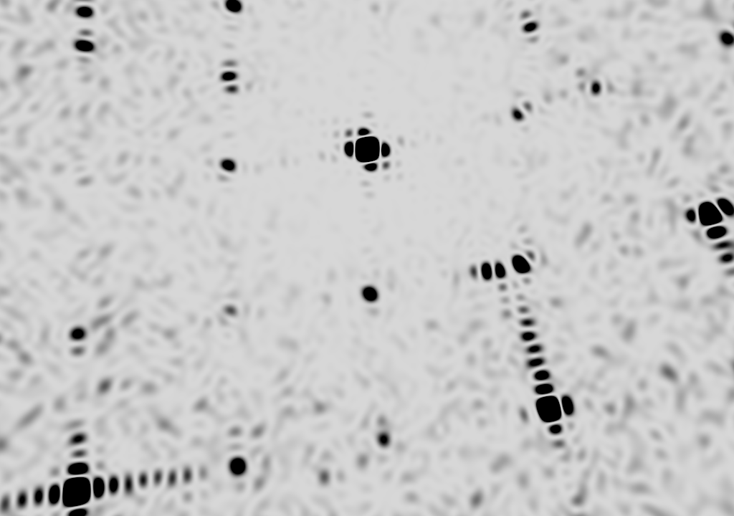
square

Slide 27
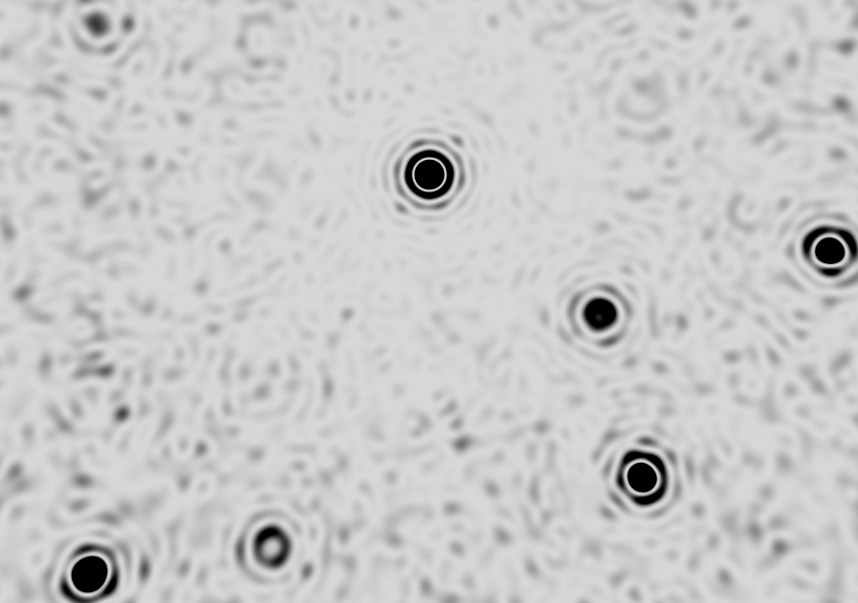
round

Slide 28
non-isomorphism
Another way to peek
between the spots:

Slide 29
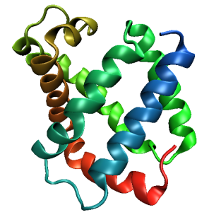
Same structure, different cell
0.5% cell change → 15%
Crick & Magdoff (1956) “theory method isomorphous replacement”, Acta Cryst. 9, 901-8.

Slide 30
Same structure, different cell
0.5% cell change → 15%
Crick & Magdoff (1956) “theory method isomorphous replacement”, Acta Cryst. 9, 901-8.

Slide 31
Same cell, rotated protein
0.5° rotation → 16%
Crick & Magdoff (1956) “theory method isomorphous replacement”, Acta Cryst. 9, 901-8.

Slide 32
Same cell, rotated protein
0.5° rotation → 16%
Crick & Magdoff (1956) “theory method isomorphous replacement”, Acta Cryst. 9, 901-8.

Slide 33
Uniform stretch
5% change → 0%

Slide 34
Uniform stretch
5% change → 0%

Slide 35
Non-isomorphism in lysozyme
Dear James
The story of the two forms of lysozyme crystals goes back to about 1964 when it was found that the diffraction patterns from different crystals could be placed in one of two classes depending on their intensities. This discovery was a big set back at the time and I can remember a lecture title being changed from the 'The structure of lysozyme' to 'The structure of lysozyme two steps forward and one step back'. Thereafter the crystals were screened based on intensities of the (11,11,l) rows to distinguish them (e.g. 11,11,4 > 11,11,5 in one form and vice versa in another). Data were collected only for those that fulfilled the Type II criteria. (These reflections were easy to measure on the linear diffractometer because crystals were mounted to rotate about the diagonal axis). As I recall both Type I and Type II could be found in the same crystallisation batch . Although sometimes the external morphology allowed recognition this was not infallible.
The structure was based on Type II crystals. Later a graduate student Helen Handoll examined Type I. The work, which was in the early days and before refinement programmes, seemed to suggest that the differences lay in the arrangement of water or chloride molecules (Lysozyme was crystallised from NaCl). But the work was never written up. Keith Wilson at one stage was following this up as lysozyme was being used to test data collection strategies but I do not know the outcome.
An account of this is given in International Table Volume F (Rossmann and Arnold edited 2001) p760.
Tony North was much involved in sorting this out and if you wanted more info he would be the person to contact. I hope this is helpful. Do let me know if you need more.
Best wishes
Louise

Slide 36
Non-isomorphism in lysozyme
Dear James
The story of the two forms of lysozyme crystals goes back to about 1964 when it was found that the diffraction patterns from different crystals could be placed in one of two classes depending on their intensities. This discovery was a big set back at the time and I can remember a lecture title being changed from the 'The structure of lysozyme' to 'The structure of lysozyme two steps forward and one step back'. Thereafter the crystals were screened based on intensities of the (11,11,l) rows to distinguish them (e.g. 11,11,4 > 11,11,5 in one form and vice versa in another). Data were collected only for those that fulfilled the Type II criteria. (These reflections were easy to measure on the linear diffractometer because crystals were mounted to rotate about the diagonal axis). As I recall both Type I and Type II could be found in the same crystallisation batch . Although sometimes the external morphology allowed recognition this was not infallible.
The structure was based on Type II crystals. Later a graduate student Helen Handoll examined Type I. The work, which was in the early days and before refinement programmes, seemed to suggest that the differences lay in the arrangement of water or chloride molecules (Lysozyme was crystallised from NaCl). But the work was never written up. Keith Wilson at one stage was following this up as lysozyme was being used to test data collection strategies but I do not know the outcome.
An account of this is given in International Table Volume F (Rossmann and Arnold edited 2001) p760.
Tony North was much involved in sorting this out and if you wanted more info he would be the person to contact. I hope this is helpful. Do let me know if you need more.
Best wishes
Louise

Slide 37
Non-isomorphism in lysozyme
Structure factor (e⁻)
Johnson’s ratio

Slide 38
Non-isomorphism in lysozyme
Structure factor (e⁻)
Johnson’s ratio

Slide 39
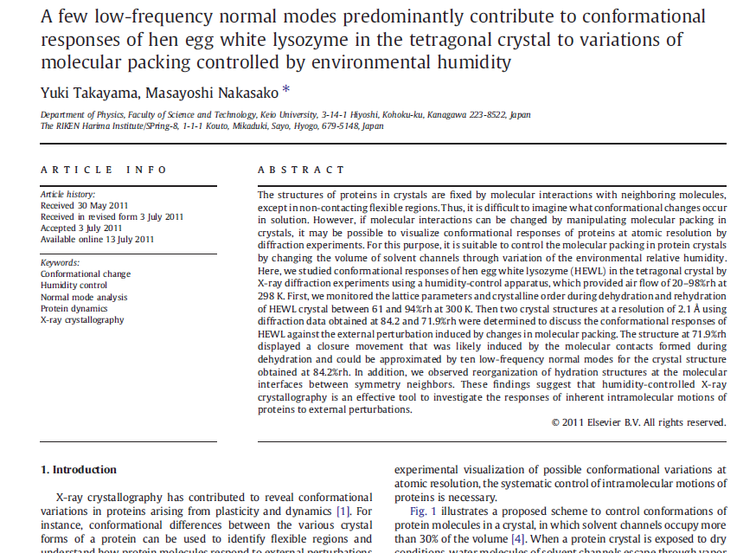

Slide 40
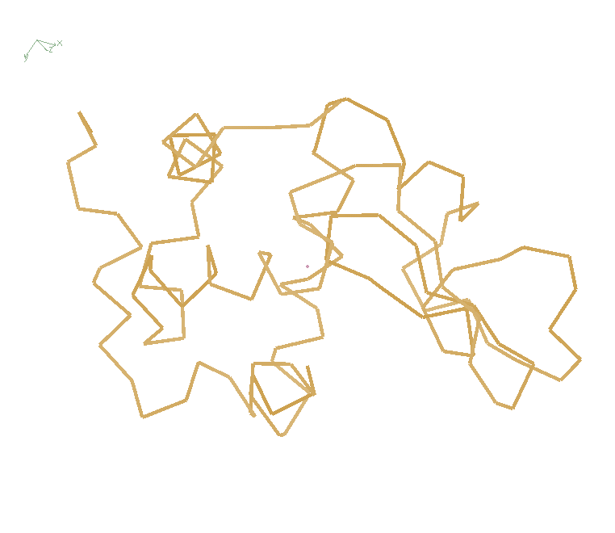
Non-isomorphism in lysozyme
RMSD = 0.18 Å
Δcell = 0.7 %
R_{iso} = 44.5%
3aw6
3aw7
RH: 84.2%
vs 71.9%

Slide 41
Dehydration: 1934
and 2017?
= 1.5 μL
100 μm
= 1.0 nL
2 mm
= 1.0 pL
10 μm
= 1.0 fL
1 μm

Slide 42
Hygrostatic gradients
high
water activity
low
jet
loop

Slide 43
X-ray Data Sets
Singular values & vectors
data
set
h,k,l | structure factors (F)
 | #1 | #2 | #3 | #4
5,3,4 | 523.7 | 559.8 | 579.9 | 603.2
5,4,4 | 168.2 | 166.6 | 177.2 | 196.1
5,5,4 | 34.9 | 26.4 | 19.2 | 17.3
6,1,4 | 305.7 | 301.1 | 298.1 | 296.3
6,2,4 | 353.0 | 353.9 | 356.2 | 366.9
6,3,4 | 300.9 | 285.3 | 273.5 | 259.4
6,3,5 | 223.8 | 226.3 | 234.6 | 251.4
… | … | … | … | …
h,k,l | 100% | 17 % | 13 % | 9 %
 | 1st | 2nd | 3rd | 4th
5,3,4 | -1.46 | -0.02 | 1.84 | -0.72
5,4,4 | -0.88 | -0.29 | -0.34 | 0.15
5,5,4 | -0.42 | -0.65 | 1.02 | 1.47
6,1,4 | -0.90 | -0.85 | 1.44 | -0.40
6,2,4 | -1.20 | -0.37 | 0.67 | 0.01
6,3,4 | -0.75 | 0.31 | 0.48 | 0.00
6,3,5 | -0.75 | -0.85 | 0.72 | -0.82
… | … | … | … | …
value
vector
Singular value decomp.
SVD
-0.68
-0.24
0.32 …
CC1
Data sets
Positioned
in
“Correlation
Space”
Correlation
Coefficients
CC1 CC2 CC3
CC2
data set #1
data set #2
data set #3
CC3

Slide 44
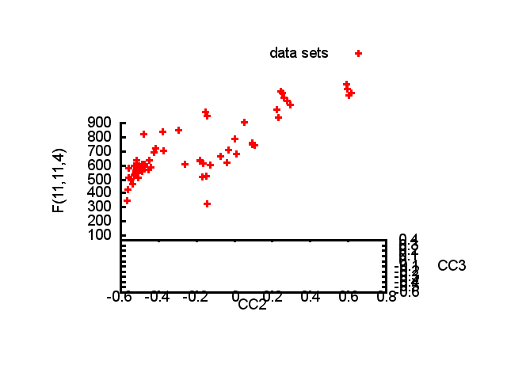

Slide 45
Structure factor (electrons)
Correlation to 2nd & 3rd singular vectors

Slide 46
Structure factor (electrons)
Correlation to 2nd & 3rd singular vectors

Slide 47
Structure factor (electrons)
Correlation to 2nd & 3rd singular vectors

Slide 48
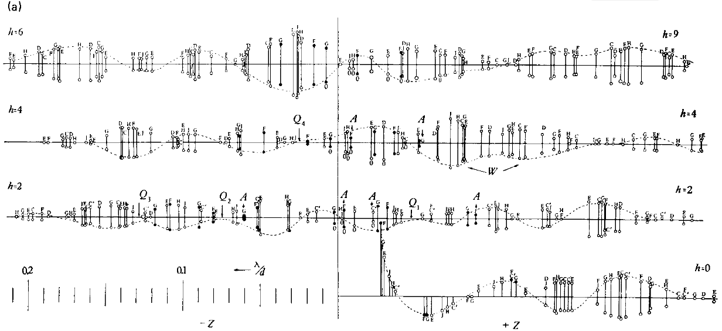
Bragg’s “minimum wavelength principle”
Perutz (1985). “Early Days of Cryst…” Methods in Enzymology, Vol. 114, 3-18.
Bragg & Perutz (1952)."external form haemoglobin I", Acta Cryst. 5, 277-283.

Slide 49
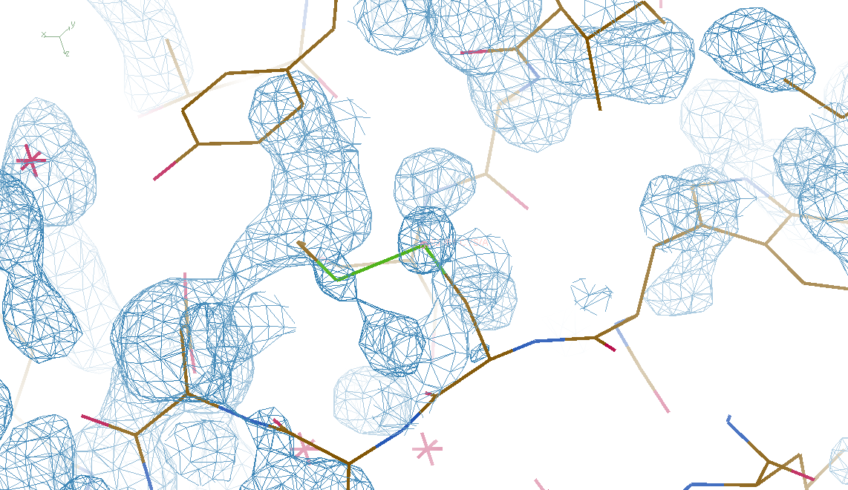
DMMULTI – fake data
4 deg rotation: 8 “xtals”: before
CC = 0.02

Slide 50
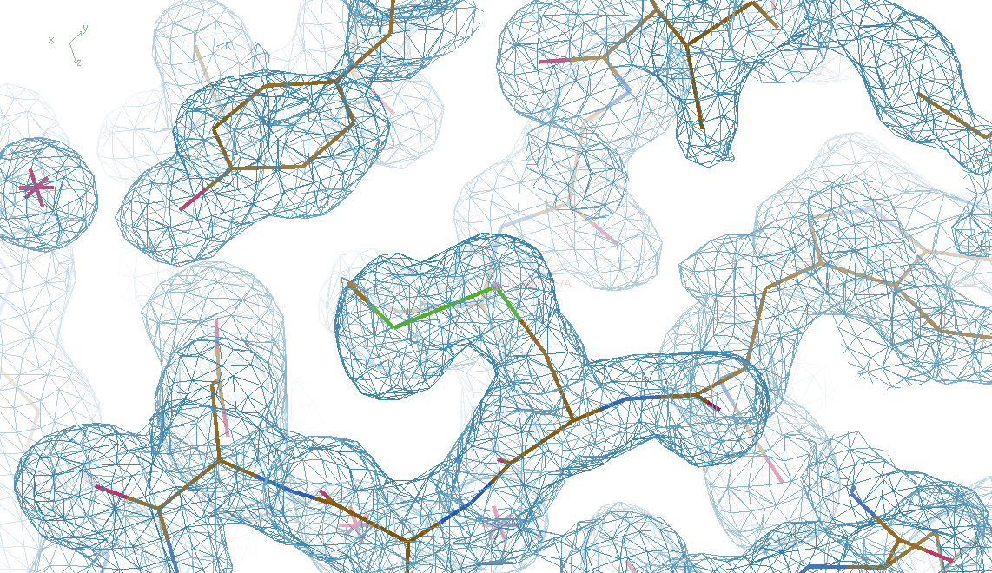
DMMULTI – fake data
4 deg rotation: 8 “xtals”: after
CC = 0.8

Slide 51
What if…
we knew everything?
  how would we store it?
we had a hotter beam?
we had more coherence?
we had a perfect detector?
…
we knew what we are doing wrong?

Slide 52
The number of photons scattered
before crystal is dead
is independent
of data collection time
1 um³ = 10⁵ photons (roomT)
1 um³ = 10⁶ photons (synch)
1 um³ = 10⁸ photons (XFEL)
(synch)
Henderson, 1990; Gonzalez & Nave, 1994; Glaeser et al., 2000; Sliz et al., 2003; Leiros et al., 2006; Owen et al., 2006; Garman & McSweeney, 2006; Garman & Nave, 2009; Holton, 2009

Slide 53
Self-calibrated damage limit
Where:
⟨I⟩_{DL} - average damage-limited intensity (photons/hkl) at a given resolution
10⁵ - converting R from μm to m, r_{e} from m to Å, ρ from g/cm³ to kg/m³ and MGy to Gy
r_{e} - classical electron radius (2.818 x 10⁻¹⁵ m/electron)
h - Planck’s constant (6.626 x 10⁻³⁴ J∙s)
c - speed of light (299792458 m/s)
f_{decayed} - fractional progress toward completely faded spots at end of data set
ρ - density of crystal (~1.2 g/cm³)
R - radius of the spherical crystal (μm)
λ - X-ray wavelength (Å)
f_{NH} - the Nave & Hill (2005) dose capture fraction (1 for large crystals)
n_{ASU} - number of proteins in the asymmetric unit
M_{r} - molecular weight of the protein (Daltons or g/mol)
V_{M} - Matthews’s coefficient (~2.4 Å³/Dalton)
H - Howells’s criterion (10 MGy/Å)
θ - Bragg angle
⟨ƒ_{a}²⟩ - number-averaged squared structure factor per protein atom (electron²)
⟨M_{a}⟩ - number-averaged atomic weight of a protein atom (~7.1 Daltons)
B - average (Wilson) temperature factor (Å²)
μ - attenuation coefficient of sphere material (m⁻¹)
μ_{en} - mass energy-absorption coefficient of sphere material (m⁻¹)
No flux
No symmetry
Holton & Frankel (2010) Acta D 66 393-408.

Slide 54
Bigger is better, but not by much
B = 20
B = 60
B = 0
B = 170
B = 330
B = 560
Resolution (Å)
B = 850
Crystal diameter (micron)

Slide 55
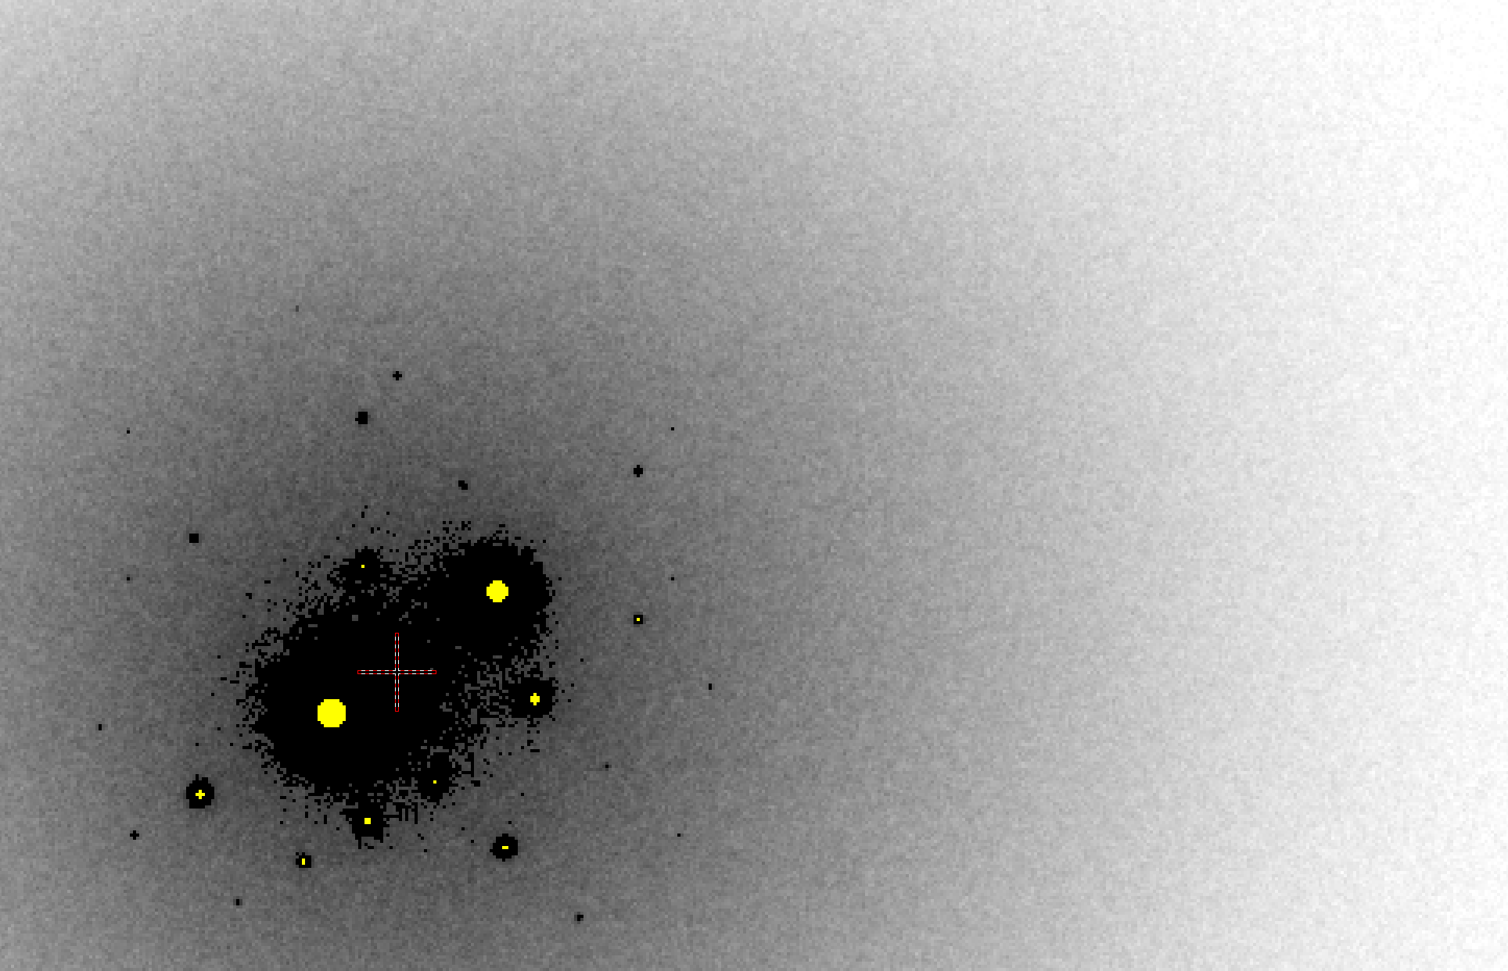
B factor from image analysis
B = 500

Slide 56
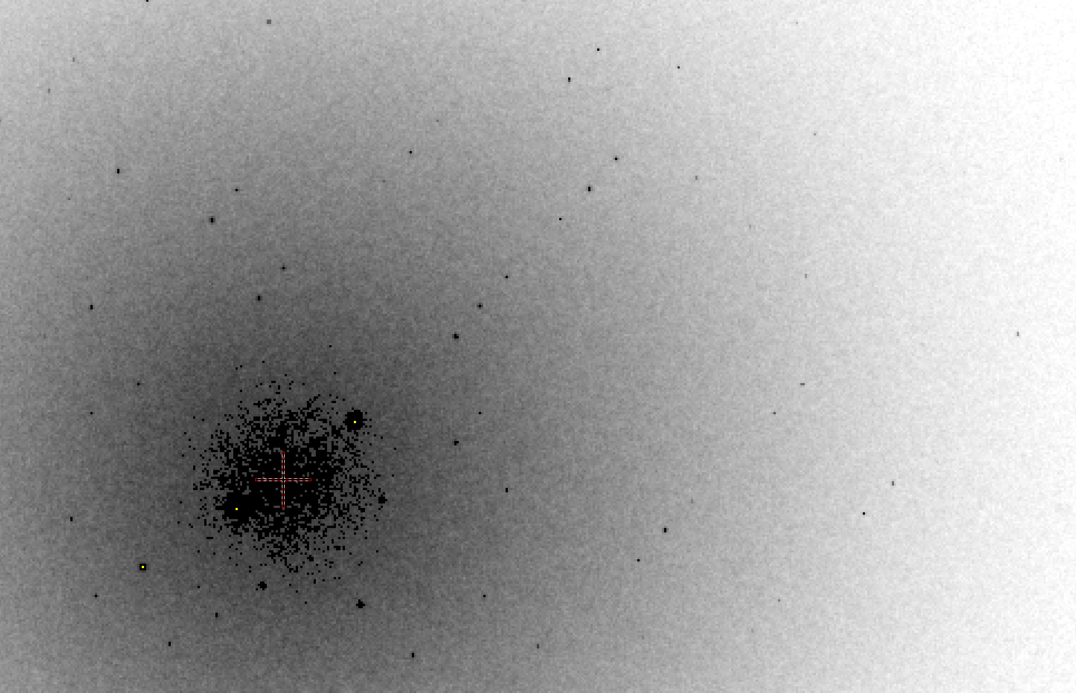
B factor from image analysis
B = 20

Slide 57
What if…
You only have a few small crystals?
Should you:
  Collect 360° from each?
  Collect 10° from each at 36x exposure?
  Glue 36 xtals together, then collect 360° ?
  Glue together and do 12960° ?
  http://bl1231.als.lbl.gov/~jamesh/dose_slice/results.html

Slide 58
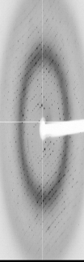
Dose slicing
unacceptable
damage
N
photons
crystal’s useful life
N
photons
unacceptable
read noise
N
photons

Slide 59
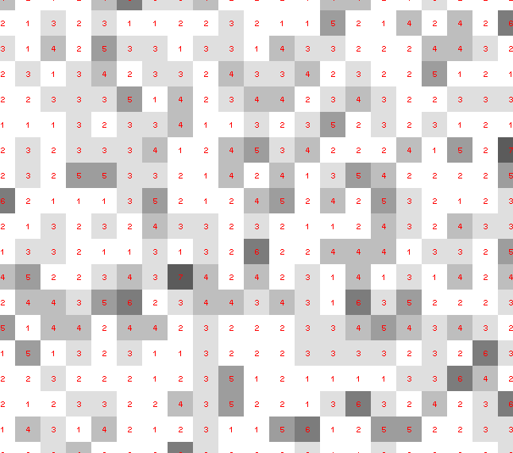
Dose slicing: is that a spot?

Slide 60
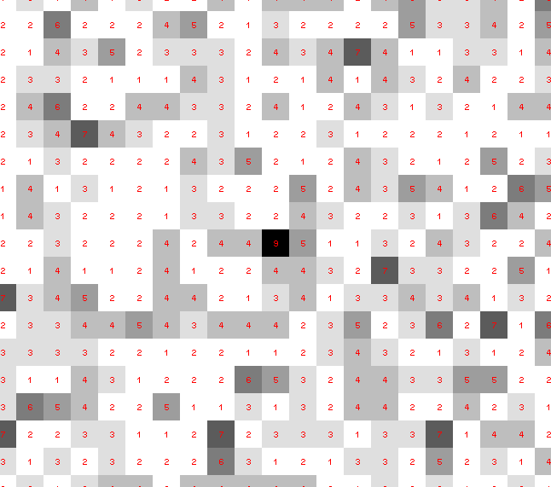
Dose slicing: is that a spot?

Slide 61
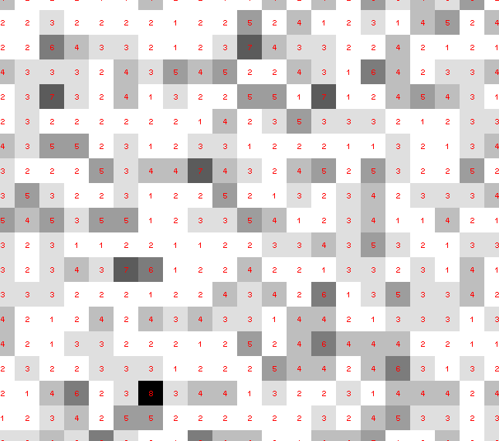
Dose slicing: is that a spot?

Slide 62
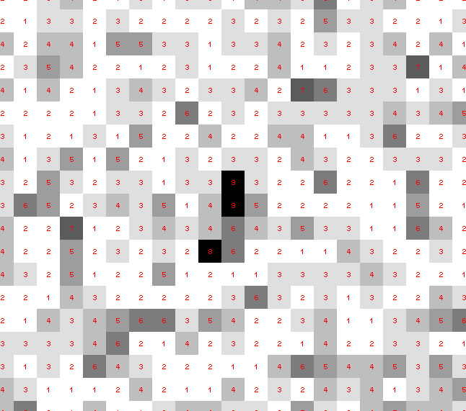
Dose slicing: is that a spot?

Slide 63
Dose slicing: is that a spot?

Slide 64
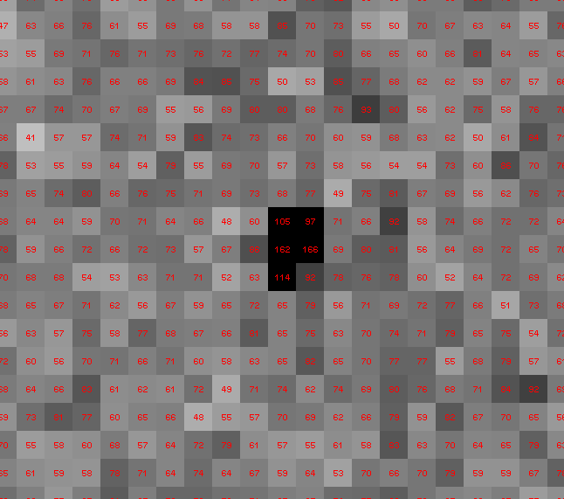
Dose slicing: is that a spot?

Slide 65
“true” resolution limit
CC vs right answer
Resolution (Å)

Slide 66
“true” resolution vs strategy
Dose slice collection scenario
fine | coarse | glue | Glue & fine
3.17700 | 3.14057 | 3.17604 | 3.12086
301,640,334 photons/xtal

Slide 67
processing procedure | resolution limit
 | fine | coarse | glue | glue&fine
XDS/XSCALE | 3.17700 | 3.14057 | 3.17604 | 3.12086
XDS/aimless | 3.16251 | 3.15922 | 3.16675 | 3.12162
XDS/noscale | 3.27289 | 3.15617 | 3.38929 | 3.12162
MOSFLM-defaults | x | x | x | x
MOSFLM-cheat | 3.19755 | 3.18166 | 3.20354 | 3.19755
HKL2000-defaults | x | x | x | x
HKL2000-expert | 3.21803 | 3.12646 | 3.11551 | 3.21803
HKL2000-cheat | 3.16119 | 3.10338 | 3.10338 | 3.16300
DIALS-defaults | x | x | 3.42125 | x
DIALS-expert | 3.10296 | 3.09547 | 3.07653 | 3.08465
d*Trek | ? | ? | 4.34076 | ?
EVAL15 | 3.14352 | 3.10383 | 3.09936 | 3.14105
EVAL15-sadabs | 3.13920 | 3.10797 | 3.10171 | 3.13700

Slide 68
Gaussian vs Poisson distributions
frequency
Long-term average:
1 photon/pixel
Number of counts/pixel

Slide 69
Central limit theorem fails on weak images
frequency
Expect: ~6
“9-sigma outliers”
On 6x10⁶ pixel detector
at 1 photon/pixel
Number of counts/pixel

Slide 70
Optimum resolution cutoff is:
Too optimistic: add nothing but noise
Too pessimistic: series-termination error
Happy medium?
Simulate:
  Random atoms, compute F²
  Add Gaussian noise, RMS = 1
  Truncate
  Subtract “right” map, RMS difference

Slide 71
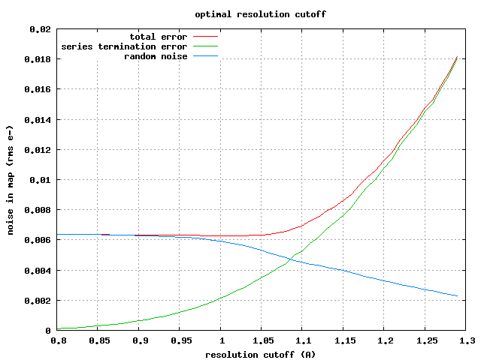

Slide 72
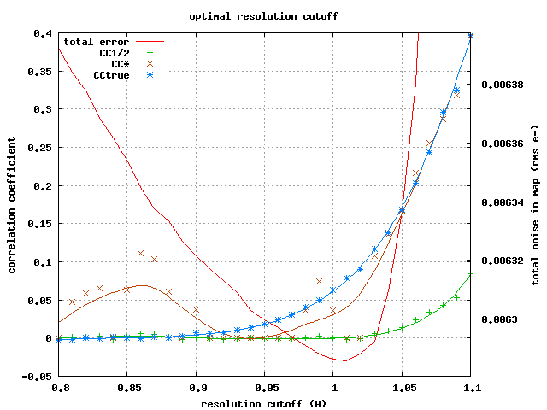

Slide 73
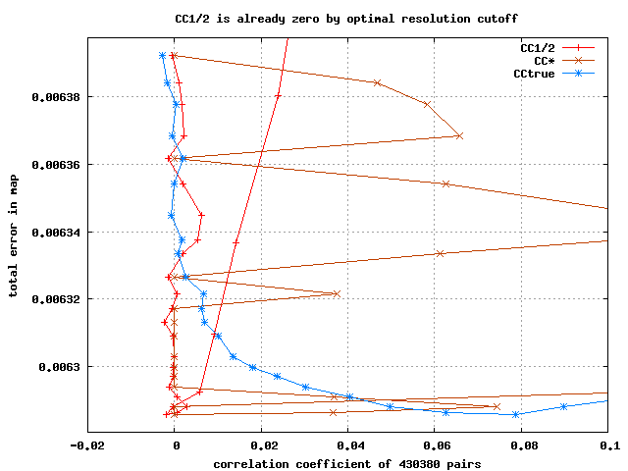

Slide 74
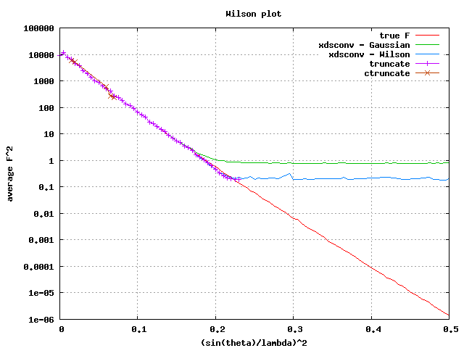

Slide 76
Optimum resolution cutoff is:
0.0 Å

Slide 77
Diffraction Simulators
1. MLFSOM
- rotation data with maximum realism in noise
2. nearBragg
- first-principles scattering from atoms in space
3. nanoBragg
- optimized for nanocrystal/single-particle stills
4. nonBragg
- non-crystalline, centrosymmetric (SAXS)

Slide 78
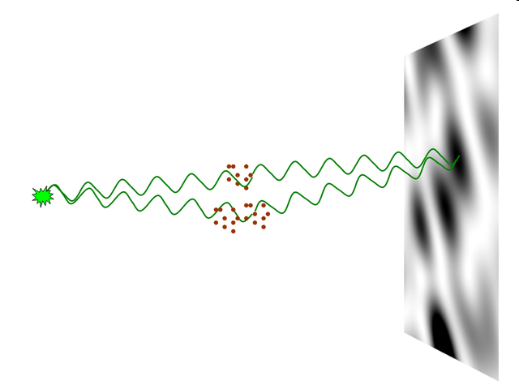
nearBragg program
http://bl831.als.lbl.gov/~jamesh/nearBragg/
“assumption-free” total scattering
no Fourier Transform
no unit cells
no “mosaicity”
arbitrary “atoms”
arbitrary “source”
coherent or not

Slide 79
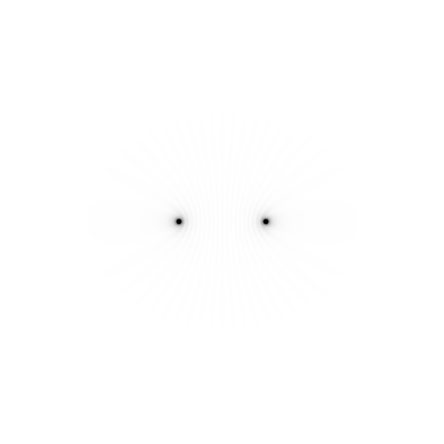
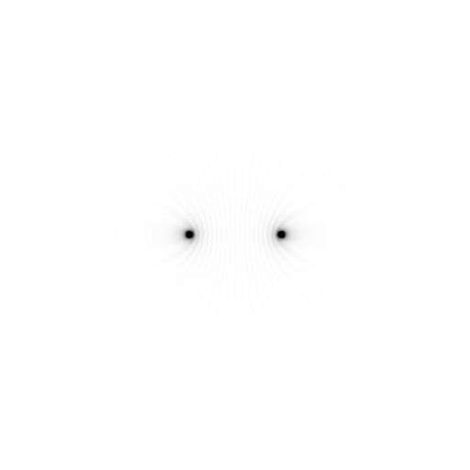
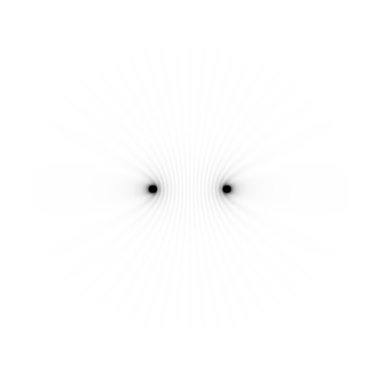
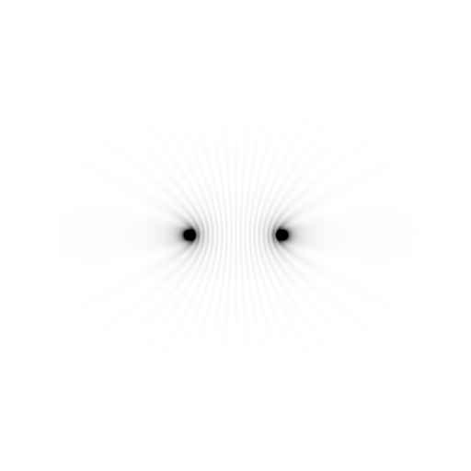
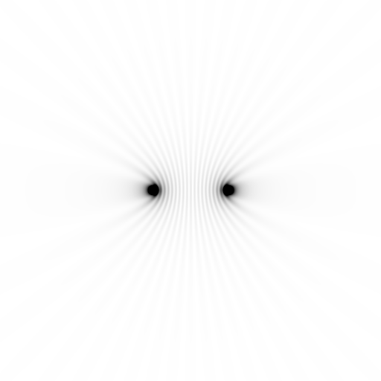
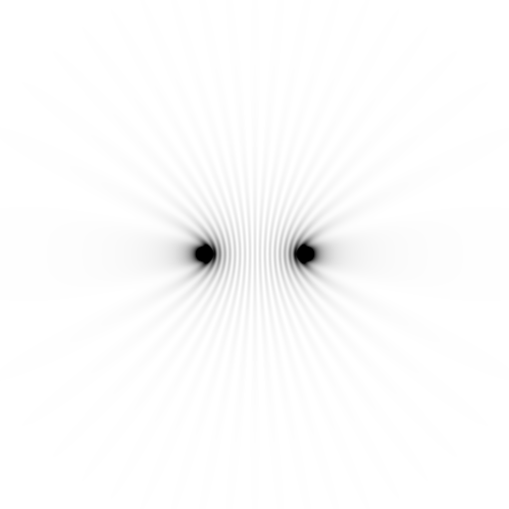
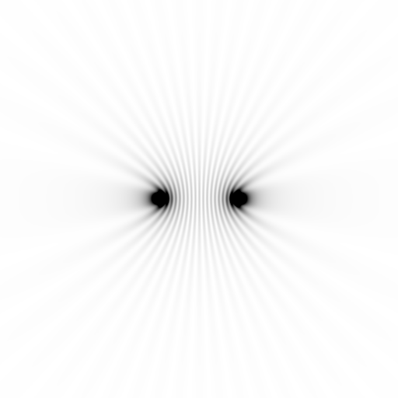
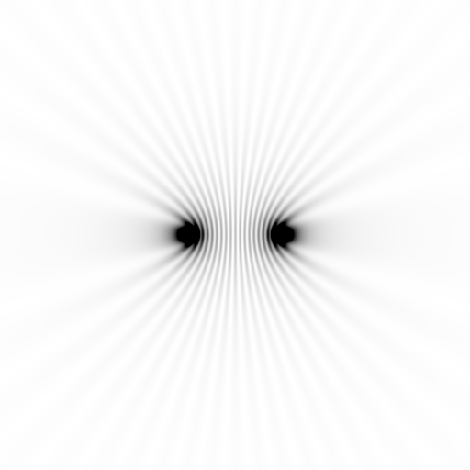
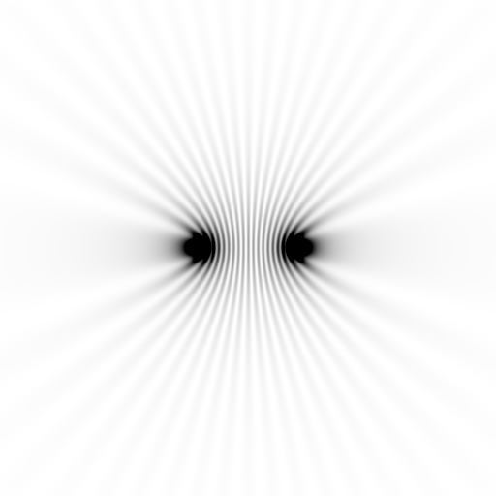
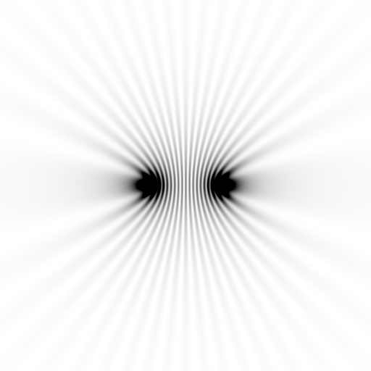
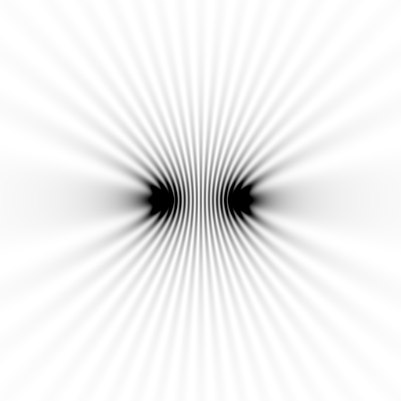
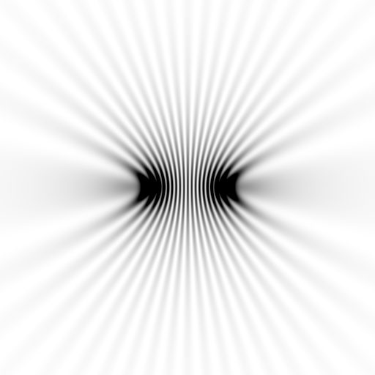
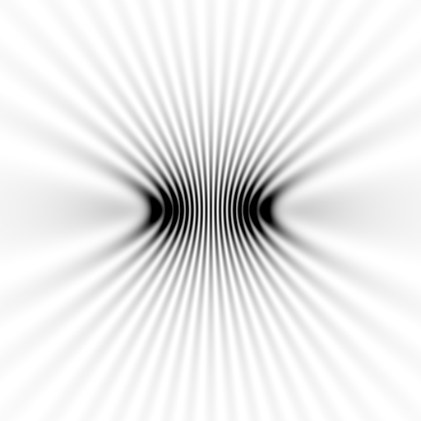














Slide 80



























Slide 81

Meaning of “coherence length”
http://bl831.als.lbl.gov/~jamesh/nearBragg/collision/

Slide 82

Meaning of “coherence length”
http://bl831.als.lbl.gov/~jamesh/nearBragg/collision/

Slide 83

Meaning of “coherence length”
http://bl831.als.lbl.gov/~jamesh/nearBragg/collision/

Slide 84
Meaning of “coherence length”
http://bl831.als.lbl.gov/~jamesh/nearBragg/collision/

Slide 85

Meaning of “Molecular Transform”
False color intensity
sample
detector

Slide 86

Meaning of “Molecular Transform”
False color intensity
sample
detector

Slide 87

Meaning of “Molecular Transform”
False color intensity
sample
detector

Slide 88

Meaning of “Molecular Transform”
False color intensity
sample
detector

Slide 89


Realistic single-particle prediction
10¹² photon/pulse
100 nm focus

Slide 90

Realistic single-particle prediction
10¹² photon/pulse
3 nm focus

Slide 91

lysozyme: real and reciprocal

Slide 92

lysozyme: thermal motion

Slide 93

Muybridge’s galloping horse (1878)
“Time-resolved” diffraction
Real space
reciprocal

Slide 94

Muybridge’s galloping horse (1878)
Average electron density
Real space
reciprocal

Slide 95















Getting around averaging:
Single-image model refinement?

Slide 96
“R-factor Gap” for macromolecules
Publication criterion for chemical crystallography:
R1 < 2*R_{sigma}
R1 = F_{o} vs F_{c} for I/σ(I) > 3
R_{sigma} = <σ(I)>/<I>
There are no PDB entries that pass this test!
Holton et al. (2014) "The R-factor gap", FEBS J. 281, 4046-4060.

Slide 97
What if…
we knew everything?
  how would we store it?
we had a hotter beam?
we had more coherence?
we had a perfect detector?
…
we knew what we are doing wrong?

Slide 98

MD simulation: 30 conformers from 24,000
Cerutti et al. (2010).J. Phys. Chem. B 114, 12811-12824.

Slide 99

Electron density from 24,000 conformers

Slide 100

2F_{sim}-F_{calc} and F_{sim}-F_{calc} maps
1.0 Å data
R_{cryst}= 0.137
R_{free} = 0.159
1 “sigma” 2F_{sim}-F_{c}
2.5 “sigma” F_{sim}-F_{c}

Slide 101

2F_{sim}-F_{calc} and (F_{sim} Φ_{sim}) - (F_{calc} Φ_{calc}) maps
1.0 Å data
R_{cryst}= 0.137
R_{free} = 0.159
1 “sigma” 2F_{sim}-F_{c}
F_{right} – (2F_{sim}-F_{c})

Slide 102
30 conformers from 24,000

Slide 103

How many conformers are there?
Answer: 2-14
R_{cryst} = 0.0441
R_{free} = 0.0516
vs F_{sim}

Slide 104

How many conformers are there?
Answer: 1-7
R_{cryst} = 0.1546
R_{free} = 0.1749
vs F_{obs}
1aho:
R_{cryst} = 0.1630
R_{free} = n/d

Slide 105

How many conformers are there?
All difference
features
are in
the solvent!
real data

Slide 106

Combined multi-conformer & explicit solvent
R_{work} = 0.0309
R_{free} = 0.0678
vs F_{sim}
Problem: diverges with more cycles

Slide 107
Status of macromolecular representation:
Even if we start with the “right answer”
it will blow up.
Half the error is in the solvent,
and 20%² - 14%² = 14%²

Slide 108
RISM model for “bulk” solvent
Method | R_{work} | R_{free}
Default refmac5: flat bulk solvent | .1784 | .1898
RISM – self-consistent density field based on electrostatics | .1640 | .1808
Explicit MD solvent, protein fixed | .1523 | .1690
RISM – protein fixed multi-conformer weighted | .1578 | .1739
Explicit – protein fixed multi-conformer weighted | .1440 | .1666

Slide 109

Crowded-atom refinement
Electron density
position

Slide 110
At-scale simulation
Partiality
  no spherical chickens
Phasing
  Threshold of a S-SAD revolution?
  Se at LCLS w 200,000 DM jobs
Non-isomorphism
  foe or friend? Get around averaging?
dose slicing
  how low can you go?
R-factor Gap
  The “right answer” is unstable
Resolution: optimum cutoff is 0 Å
http://bl831.als.lbl.gov/~jamesh/
powerpoint/Ringberg_xfel_2017.pptx

Slide 111

The Future of Structural Biology
We need
better
data
We need
better
models
grand challenge for the 21st century

Slide 112
URL Summary
http://bl831.als.lbl.gov/~jamesh/powerpoint/
Ringberg_xfel_2017.pptx
http://bl831.als.lbl.gov/xtalsize.html
http://bl831.als.lbl.gov/xtallife.html
Averaging is good for phasing
Averaging + disorder destroys resolution
Averaging + isomorphism = good for resolution
Humidity = isomorphism
Dose-slice with EIGER
The future = better models for “disorder”

Slide 113
Grand Challenges in Structural Biology
Phase Problem
Better detector calibration
non-isomorphism phasing?
Amplitude Problem
    Revolution in sample handling
    Get around averaging (better models)
R-factor Gap
    Better models for “disorder” (function)
    If we had right answer, it would blow up!

Slide 114
How to install: nearBragg
wget http://bl831.als.lbl.gov/
~jamesh/nearBragg/nearBragg.c
gcc –o nearBragg nearBragg.c –lm
./nearBragg
usage: nearBragg -file atom_list.txt
options:
-file filename.txt text file containing point scatterer coordinates in Angstrom relative to the origin.
-distance from origin to detector center in mm
-detsize detector size in mm. may also use -detsize_x -detsize_y
-detpixels detector size in pixels. may also use -detpixels_x -detpixels_y
-pixel detector pixel size in mm.

Slide 115
How to run: nearBragg for single particle
egrep “^ATOM|^HETAT” lysozyme.pdb |\
awk ‘{print substr($0,31,36)}’ |\
cat >! atoms.txt
wget bl831.als.lbl.gov/~jamesh/nearBragg/rotate.awk
./rotate.awk -v phix=10 -v phiy=20 -v phiz=30 atoms.txt >! rotated.txt
nearBragg –atoms rotated.txt -lambda 1 -distance 1000 -detsize 100 -fluence 1e32
(200s)
adxv intimage.img

Slide 116

How to run: nearBragg for single particle
egrep “^ATOM|^HETAT” lysozyme.pdb |\
awk ‘{print substr($0,31,36)}’ |\
cat >! atoms.txt
wget bl831.als.lbl.gov/~jamesh/nearBragg/rotate.awk
./rotate.awk -v phix=10 -v phiy=20 -v phiz=30 atoms.txt >! rotated.txt
nearBragg –atoms rotated.txt -lambda 1 -distance 1000 -detsize 100 -fluence 1e32
(200s)
adxv intimage.img

Slide 117

How to run: nearBragg for single particle
egrep “^ATOM|^HETAT” lysozyme.pdb |\
awk ‘{print substr($0,31,36)}’ |\
cat >! atoms.txt
wget bl831.als.lbl.gov/~jamesh/nearBragg/rotate.awk
./rotate.awk -v phix=10 -v phiy=20 -v phiz=30 atoms.txt >! rotated.txt
nearBragg –atoms rotated.txt -lambda 1 -distance 1000 -detsize 100 -fluence 1e32
(200s)
adxv noiseimage.img

Slide 118
How to run: nanoBragg for single particle
pdbset xyzin lysozyme.pdb xyzout bigcell.pdb << EOF
CELL 250 250 250 90 90 90
SPACEGROUP 1
EOF
phenix.fmodel bigcell.pdb high_resolution=10 k_sol=0.35 b_sol=46.5 mask.solvent_radius=0.5 mask.shrink_truncation_radius=0.16
mtz_to_P1hkl.com bigcell.pdb.mtz
nanoBragg –cell 250 250 250 90 90 90 –misset 10 20 30 -hkl P1.hkl -lambda 1 -distance 1000 -detsize 100 -fluence 1e32 -N 1
adxv noiseimage.img

Slide 119

How to run: nanoBragg for single particle
pdbset xyzin lysozyme.pdb xyzout bigcell.pdb << EOF
CELL 250 250 250 90 90 90
SPACEGROUP 1
EOF
phenix.fmodel bigcell.pdb high_resolution=10 k_sol=0.35 b_sol=46.5 mask.solvent_radius=0.5 mask.shrink_truncation_radius=0.16
mtz_to_P1hkl.com bigcell.pdb.mtz
nanoBragg –cell 250 250 250 90 90 90 –misset 10 20 30 -hkl P1.hkl -lambda 1 -distance 1000 -detsize 100 -fluence 1e32 -N 1
adxv noiseimage.img

Slide 120
How to run: nonBragg for SAXS
pdbset xyzin lysozyme.pdb xyzout bigcell.pdb << EOF
CELL 250 250 250 90 90 90
SPACEGROUP 1
EOF
phenix.fmodel bigcell.pdb high_resolution=10 k_sol=0.35 b_sol=46.5 mask.solvent_radius=0.5 mask.shrink_truncation_radius=0.16
mtz_to_stol.com bigcell.pdb.mtz
nonBragg -stol mtz.stol -lambda 1 -dispersion 0 \
-distance 1000 -detsize 100 -pixel 0.172 \
-flux 1e13 -thick 1.2 -MW 14000 -density 0.01
adxv noiseimage.img

Slide 121

How to run: nonBragg for SAXS
pdbset xyzin lysozyme.pdb xyzout bigcell.pdb << EOF
CELL 250 250 250 90 90 90
SPACEGROUP 1
EOF
phenix.fmodel bigcell.pdb high_resolution=10 k_sol=0.35 b_sol=46.5 mask.solvent_radius=0.5 mask.shrink_truncation_radius=0.16
mtz_to_stol.com bigcell.pdb.mtz
nonBragg -stol mtz.stol -lambda 1 -dispersion 0 \
-distance 1000 -detsize 100 -pixel 0.172 \
-flux 1e13 -thick 1.2 -MW 14000 -density 0.01
adxv noiseimage.img

Slide 122

Simulation of XFEL stills
Sauter (2015). JSR 22, 239.
Beam center from autoindexing

Slide 123

Simulation of XFEL stills
Color is
time
Sauter (2015). JSR 22, 239.
Beam center from autoindexing

Slide 124
Elastic deformation
= non-isomorphism

Slide 125
Elastic deformation
= non-isomorphism

Slide 126
Plastic deformation
= poor diffraction

Slide 127
Plastic deformation
= poor diffraction

Slide 128

How do you model solvent?
R_{work} = 0.0309
R_{free} = 0.0678
vs F_{sim}
Problem: diverges with more cycles

Slide 129
Phasing vs data volume
Correlation to final map
Anomalous Peak/RMS
Fraction of data (%)

Slide 130
Radiation Damage
World Records
MGy reaction reference
~45 global damage Owen et al. (2006)
5 Se-Met Holton (2007)
4 Hg-S Ramagopal et al. (2004)
4 R-C-COOH Garman et al. (2015)
3 S-S Murray et al. (2002)
1 Br-RNA Olieric et al. (2007)
~1? Cl-C ???
0.5 Mn in PS II Yano et al. (2005)
0.06 putidaredoxin Corbett et al. (2007)
0.02 Fe in myoglobin Denisov et al. (2007)
Holton (2009) J. Synchrotron Rad. 16 133-42

Slide 131
Predicting resolution limits
XFEL Resolution (Å)
Synchrotron Resolution (Å)

Slide 132

The R-factor Gap
Holton et al. (2014) "The R-factor gap", FEBS J. 281, 4046-4060.

Slide 133
X-ray scattering “rules”:
Optimum: support thickness = crystal thickness
1 μm crystal ≈ 1 μm water
≈ 1 μm plastic
≈ 0.1 μm glass
≈ 1000 μm air
~ 50 mm He
≈ 370 mm sat water vapor @ 4C

Slide 134
Can radiation damage be “outrun”?

Slide 135


Dose-rate effect at Room Temp?
Owen RL, Axford D, Nettleship JE, Owens RJ, Robinson JI, Morgan AW, Dore AS, Lebon G, Tate CG, Fry EE, Ren J, Stuart DI & Evans G (2012)."Outrunning free radicals in room-temperature macromolecular crystallography", Acta Cryst. D 68, 810-818.
Warkentin M, Badeau R, Hopkins JB, Mulichak AM, Keefe LJ & Thorne RE (2012)."Global radiation damage at 300 and 260 K with dose rates approaching 1 MGy s-1", Acta Cryst. D 68, 124-133.

Slide 136

Pilatus pile-up for RT MX? same photons, different speeds
SLOW
Sum of 193 shots with
193-fold attenuation

Slide 137

Pilatus pile-up for RT MX? same photons, different speeds
FAST
1 shot with
no attenuation

Slide 138

Pilatus pile-up for RT MX? same photons, different speeds

Slide 139
Do we expect this with protein?
Mosaic spread (η) < 0.02°
20°/s rotation
50x50x50 μm lysozyme crystal
I_{still} = 0.07*(F/mosaic)²
F=130 → 3e6 photons/s/spot
Max Eiger count rate = 3e6 photons/s/spot
35% of Fs > 130 (lysozyme @ 2.0 Å)
45% under-counting expected

Slide 140


What is a “streak camera”?

Slide 141
What is a “streak camera”?
0.1 mm/pixel
= 4 ms/pixel
25 mm/s

Slide 142


Slide 144
Individual spots at 768 kGy/s
Intensity (photons)
0
Dose (kGy)
Same xtal, different spots

Slide 145
Double-tap: no dark progression at 675 kGy/s
Intensity (photons)
Dose (kGy)

Slide 146

Xtal5_t1 graph

Slide 147
How much H₂ are we making?
Meents et al. (2010) claimed:
"400 molecules of H2 for every 12.5 keV photon“
= 3.3x10⁻⁷ mol/J
200 kGy to 100 um³ = 0.24 J
= 1.2x10⁻⁸ mol H₂
100 um³ of water = 6.7x10⁻⁸ mol
→ 18% of water has reacted!

Slide 148
Dose-rate dependence of damage
maximum useful dose (MGy)
dose rate (kGy/s)

