Slide 1
Solvent models from molecular dynamics
and other ways to lower your R_{free}

Slide 2
Acknowledgements
Robert Stroud James Fraser Nevan Krogan
Paul Adams John Tainer Greg Hura Nick Sauter
Aina Cohen Art Lyubimov Jeney Wierman
UCSF LBNL SLAC
ALS 8.3.1: TomAlberTron
NIH NIGMS R01 GM124149
NIH NIGMS P50 AI150476
NIH NIGMS P30 GM124169
NIH NIGMS R01 GM117126
DOE-BER Integrated Diffraction Analysis Technologies (IDAT)
Plexxikon, Inc.
NIH NIGMS P41 GM103393
NSF DBI-1625906
The Advanced Light Source is supported by the Director, Office of Science, Office of Basic Energy Sciences, Materials Sciences Division, of the US Department of Energy under contract No. DE-AC02-05CH11231 at Lawrence Berkeley National Laboratory.

Slide 3
R-factor Gap small vs macro molecules
Publication criterion for chemical crystallography:
R1 < 2*R_{sigma}
R1 = F_{o} vs F_{c} for I/σ(I) > 3
R_{sigma} = <σ(I)>/<I>
There are no PDB entries that pass this test!
Holton et al. (2014) "The R-factor gap", FEBS J. 281, 4046-4060.

Slide 4
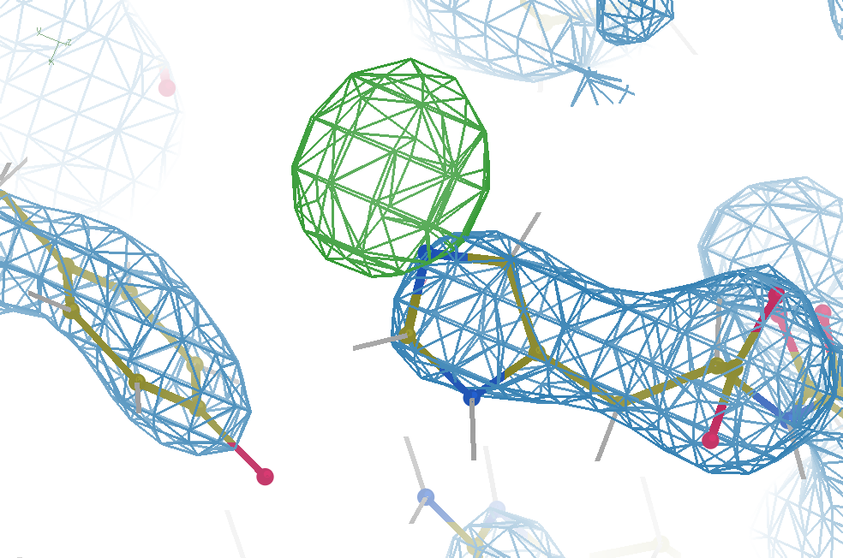
Why care about R factors?
simulation
R_{work} = 0.04
R_{free} = 0.05
d_{min} = 3.5 Å
6σ = 1 e⁻

Slide 5
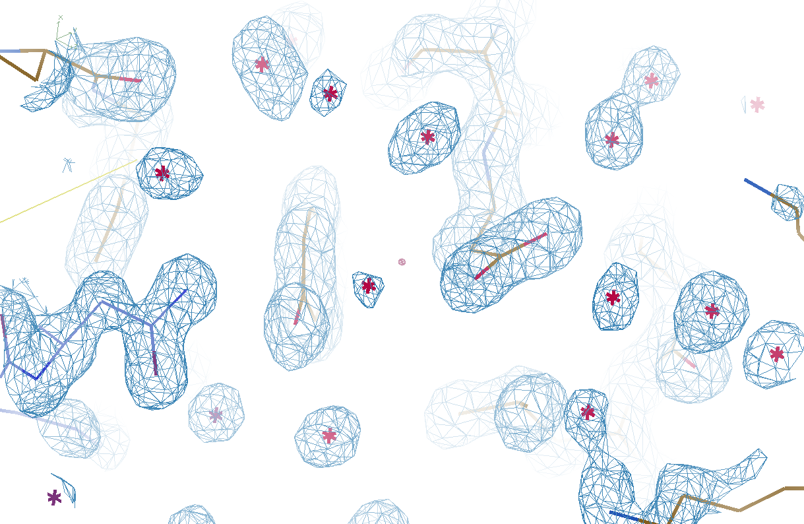
Which waters are real?

Slide 6
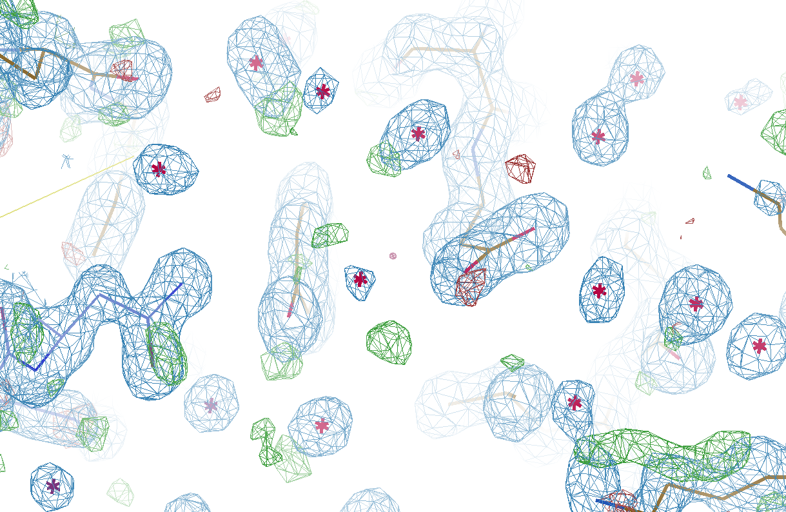
Which waters are real?

Slide 7
Is it real, or just “noise”?
Amplitude errors
Phase errors
Phase bias
Model bias
Evil

Slide 8
map error: simplest possible case
electron density (e⁻/Å³)
fractional coordinate

Slide 9
map error: simplest possible case
electron density (e⁻/Å³)
fractional coordinate

Slide 10
map error: simplest possible case
electron density (e⁻/Å³)
fractional coordinate

Slide 11
map error: simplest possible case
electron density (e⁻/Å³)
fractional coordinate

Slide 12
map error: simplest possible case
electron density (e⁻/Å³)
fractional coordinate

Slide 13
map error: simplest possible case
electron density (e⁻/Å³)
fractional coordinate

Slide 14
map error: simplest possible case
electron density (e⁻/Å³)
fractional coordinate

Slide 15
map error: simplest possible case
electron density (e⁻/Å³)
fractional coordinate

Slide 16
map error: 3-atom case
electron density (e⁻/Å³)
fractional coordinate

Slide 17
map error: 3-atom case
electron density (e⁻/Å³)
fractional coordinate

Slide 18
map error: 3-atom case
electron density (e⁻/Å³)
fractional coordinate

Slide 19
map error: 3-atom case
electron density (e⁻/Å³)
fractional coordinate

Slide 20
map error: 3-atom case
electron density (e⁻/Å³)
fractional coordinate

Slide 21
map error: 3-atom case
electron density (e⁻/Å³)
fractional coordinate

Slide 22
map error: 3-atom case
electron density (e⁻/Å³)
fractional coordinate

Slide 23
map error: 3-atom case
electron density (e⁻/Å³)
fractional coordinate

Slide 24
map error: 3-atom case
electron density (e⁻/Å³)
fractional coordinate

Slide 25
map error: 3-atom case
electron density (e⁻/Å³)
fractional coordinate

Slide 26
map error: 3-atom case
electron density (e⁻/Å³)
fractional coordinate

Slide 27
map error: asymmetric case
electron density (e⁻/Å³)
fractional coordinate

Slide 28
map error: asymmetric case
electron density (e⁻/Å³)
fractional coordinate

Slide 29
map error: asymmetric case
electron density (e⁻/Å³)
fractional coordinate

Slide 30
map error: asymmetric case
electron density (e⁻/Å³)
fractional coordinate

Slide 31
map error: asymmetric case
electron density (e⁻/Å³)
fractional coordinate

Slide 32
map error: asymmetric case
electron density (e⁻/Å³)
fractional coordinate

Slide 33
map error: asymmetric case
electron density (e⁻/Å³)
fractional coordinate

Slide 34
map error: asymmetric case
electron density (e⁻/Å³)
fractional coordinate

Slide 35
map error: asymmetric case
electron density (e⁻/Å³)
fractional coordinate

Slide 36
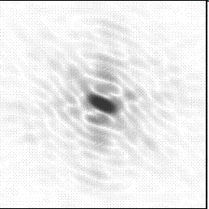
Molecular Replacement
correct structure and intensities
?
http://www.ysbl.york.ac.uk/~cowtan/fourier/coeff.html

Slide 37
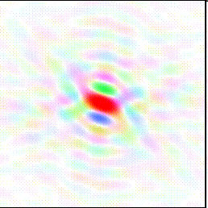
Molecular Replacement
Available model and intensities

Slide 38
Molecular Replacement
correct structure and intensities
?

Slide 39
Molecular Replacement
use something similar as a starting model

Slide 40
Model Building
current model is missing something

Slide 41
Model Building
phases from available model

Slide 42
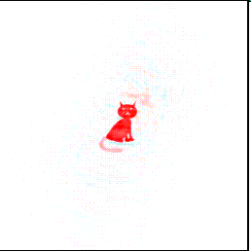
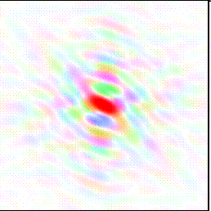
Model Building
missing bits show up, even if not in available model!

Slide 43
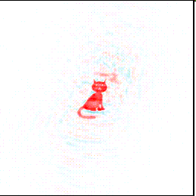
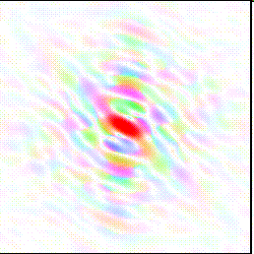
Model Building
missing bits show up better in F_{obs} + (F_{obs} - F_{calc}) map

Slide 44
“water shed” procedure
Occupancy refine waters – to convergence
For each water:
Eliminate water from model
Re-refine to convergence (with occ)
Each water = different CPU (use a cluster)
Control: keep all – same refi protocol
Sort results on R_{work}
Post-elim R better than control?
Yes: New reference – goto 1.
No: done
For speed: worst waters > 5 Å apart

Slide 45
Original
3si4
R_{work} = 0.17023
R_{free} = 0.19309

Slide 46
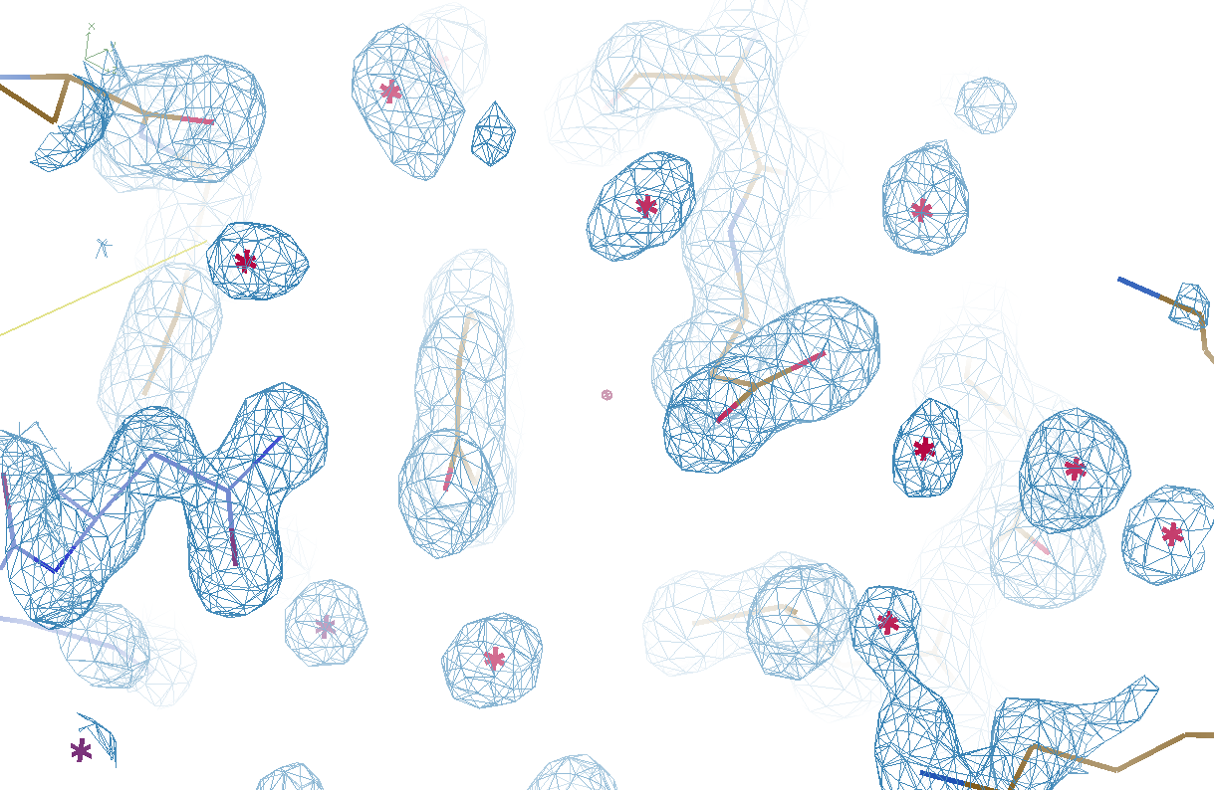
Watershed-ed
3si4
R_{work} = 0.17727
R_{free} = 0.19281

Slide 47
Refined
3si4
R_{work} = 0.17023
R_{free} = 0.19309
waters = 401

Slide 48
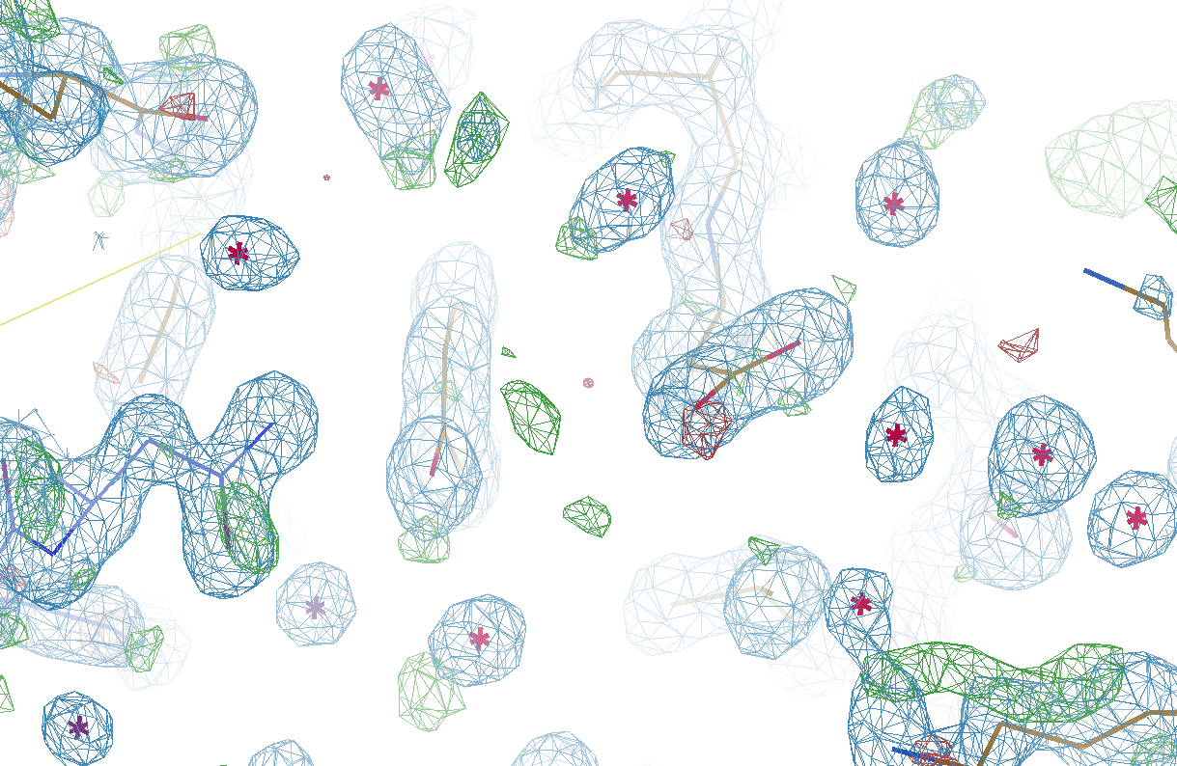
Watershed-ed
3si4
R_{work} = 0.17727
R_{free} = 0.19281
waters = 291

Slide 49
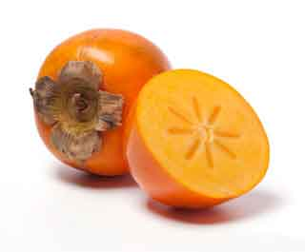
Got waters to shed?
https://github.com/fraser-lab/
holton_scripts/blob/master/watershed/
You will need:
refmac_opts.txt file
Contains all keywords for refmac run
Lots of CPUs! supports SMP, PBS, SGE
Next: why stop at water?
PRSMN

Slide 50
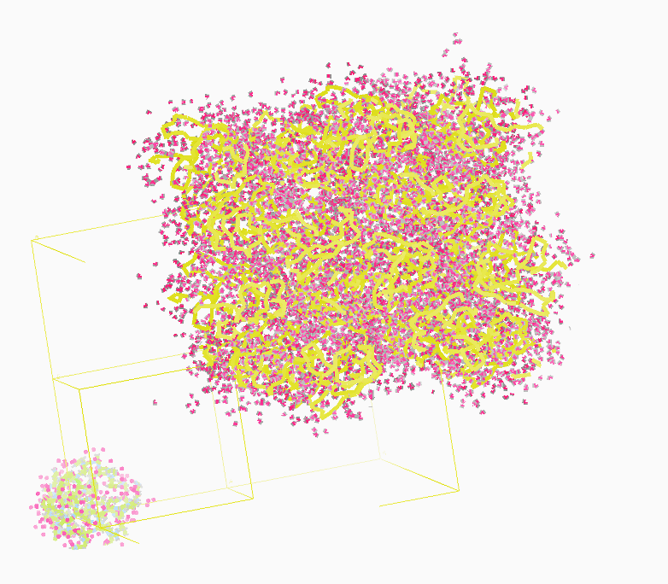
Molecular Dynamics Simulation
using
crystal’s lattice
1aho
Scorpion toxin
0.96 Å resolution
64 residues
Solvent: H₂0 + acetate
Cerutti et al. (2010).J. Phys. Chem. B 114, 12811-12824.

Slide 51
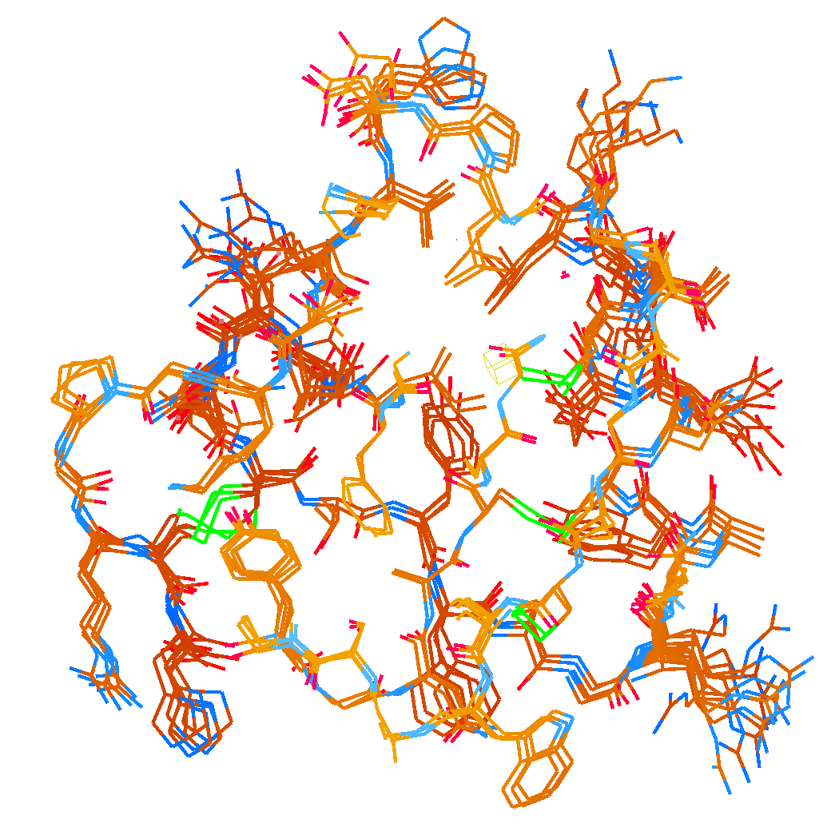
How many conformers are needed?
Answer: 2-14
R_{cryst} = 0.0441
R_{free} = 0.0516
vs F_{sim}

Slide 52
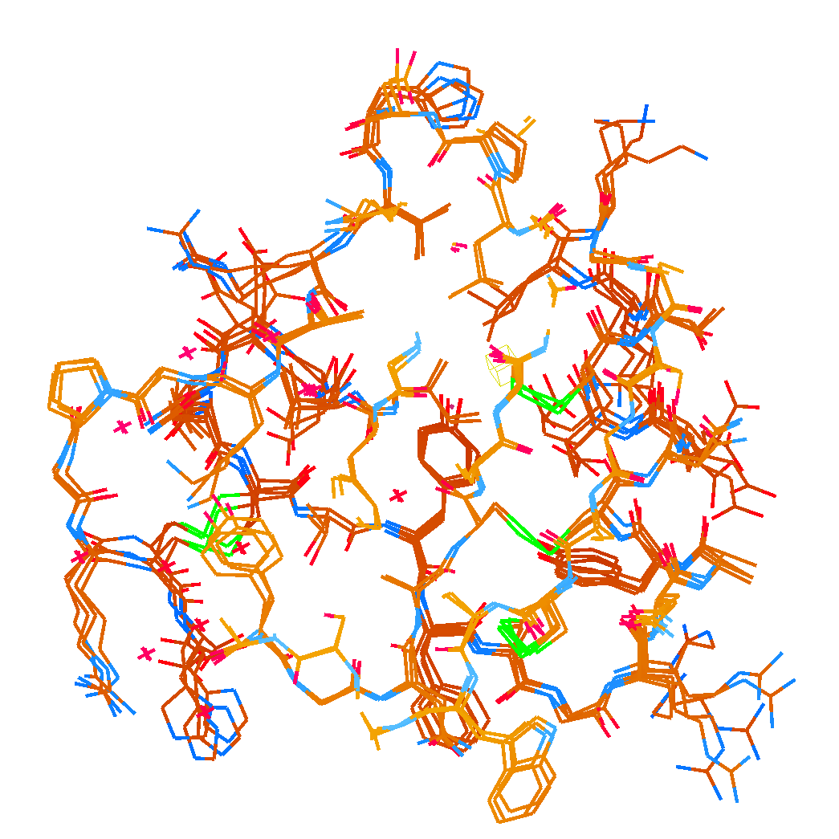
How many conformers are there?
Answer: 1-7
R_{cryst} = 0.1546
R_{free} = 0.1749
vs F_{obs}
1aho:
R_{cryst} = 0.1630
R_{free} = n/d

Slide 53
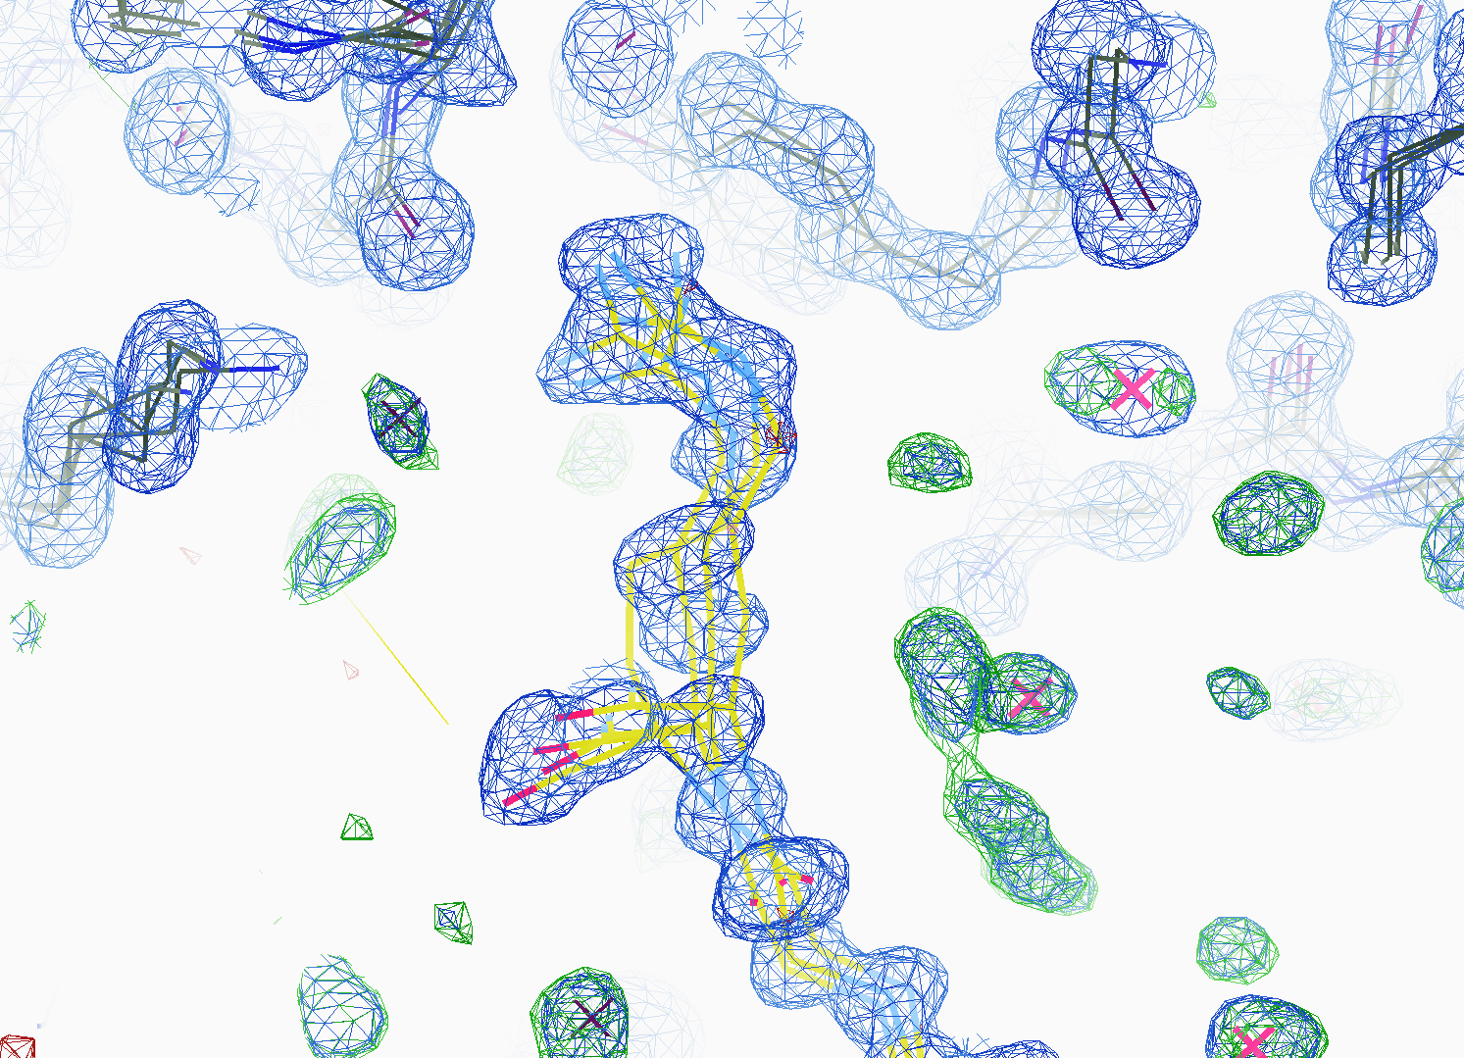
How many conformers are there?
All difference
features
are in
the solvent!
real data

Slide 54
Adding noise
14%² + 14%² = 20%²
R_{protein} + R_{solvent} ≈ R_{cryst}

Slide 55
Adding noise
0%² + 14%² = 14%²
R_{protein} + R_{solvent} ≈ R_{cryst}

Slide 56
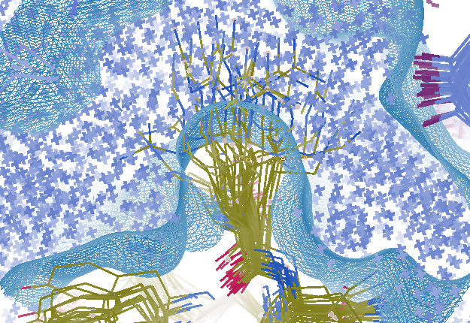
Combined multi-conformer & explicit solvent
R_{work} = 0.0309
R_{free} = 0.0678
vs F_{sim}
Problem: diverges with more cycles

Slide 57
Explicit solvent: refinement is unstable
R factor (%)
Phenix macro-cycle

Slide 58
Crowded-atom refinement

Slide 59
Crowded-atom refinement

Slide 60
How to stabilize refinement?
Do just 1 macro cycle
Apply overall scale factor to occupancies
Scale all changes back so that:
max XYZ shift <= 0.01 Å
Max occ shift <= 0.01
Max B shift <= 1
Repeat 1

Slide 61
Small steps = stable refinement
R factor (%)
Phenix macro-cycle

Slide 62
Status of macromolecular representation:
Even if we start with the “right answer”
it will blow up.
Need more sophisticated model

Slide 63
Solvent boundary problem

Slide 64
Solvent boundary problem

Slide 65
Solvent boundary problem

Slide 66
Solvent boundary problem

Slide 67
Current implementation

Slide 68
Better implementation?

Slide 69
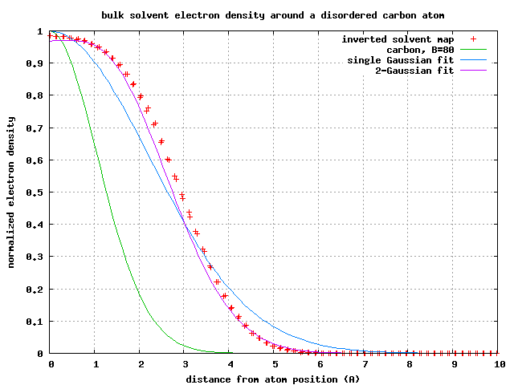
Average hard-shell bulk solvent
1-density (relative to bulk)
Distance from atom position (A)

Slide 70
Fuzzy solvent protocol:
1) For each residue
select one conformer
occupancy-weighted chance
2) For each water
occupancy = probability of appearing
3) Shift all atoms
Gaussian-random
RMS = sqrt(B/8)/π
4) Calculate bulk solvent mask
5) Average over lots of trials
optimize: vdwprobe ionprobe rshrink

Slide 71
Multi-conformer model

Slide 72
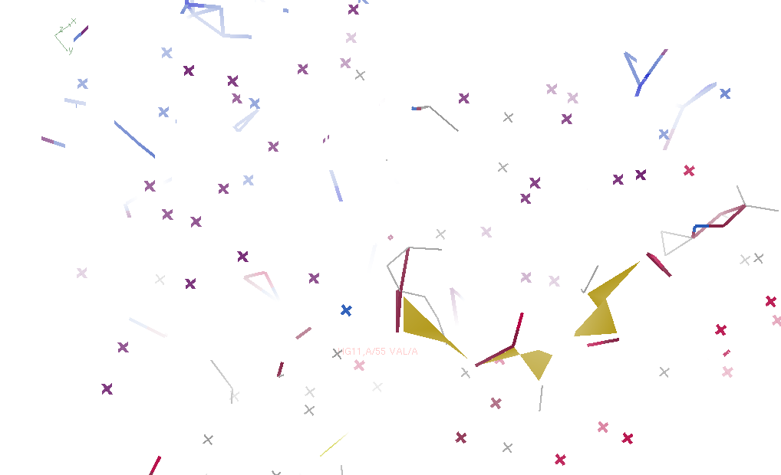
Jiggled pdb (one conformer)

Slide 73
Geometry minimized

Slide 74
Bulk solvent for 1 conformer

Slide 75
Trial 2

Slide 76
Trial 3

Slide 77
Trial 4

Slide 78
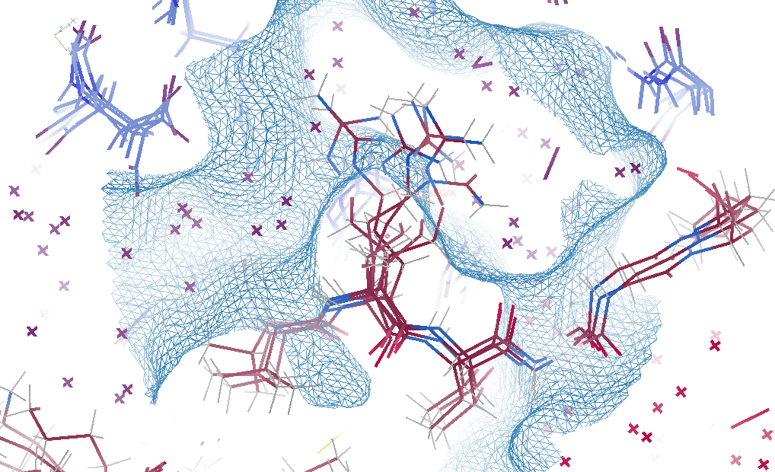
Average over 500 trials

Slide 79
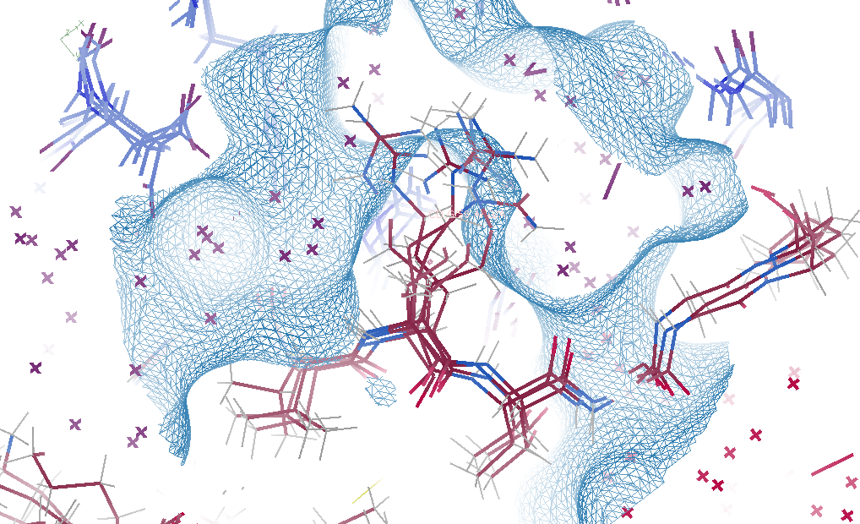
MD-derived solvent

Slide 80
Fuzzy bulk solvent (F_{sim})
Method | R_{work} | R_{free}
Default refmac5: flat bulk solvent 257 ordered waters | .0928 | .1188

Slide 81
Fuzzy bulk solvent (F_{sim})
Method | R_{work} | R_{free}
Default refmac5: flat bulk solvent 257 ordered waters | .0928 | .1188
Fuzzy solvent: mask averaged over 500 random fluctuations 569 ordered waters | .0628 | .0975

Slide 82
Fuzzy bulk solvent (F_{sim})
Method | R_{work} | R_{free}
Default refmac5: flat bulk solvent 257 ordered waters | .0928 | .1188
Fuzzy solvent: mask averaged over 500 random fluctuations 569 ordered waters | .0628 | .0975
Cheat: perfect solvent density 0 ordered waters | .0390 | .0498

Slide 83
Fuzzy bulk solvent (F_{sim})
Method | R_{work} | R_{free}
Default refmac5: flat bulk solvent 257 ordered waters | .0928 | .1188
Fuzzy solvent: mask averaged over 500 random fluctuations 569 ordered waters | .0628 | .0975
Cheat: perfect solvent density 0 ordered waters | .0390 | .0498
phenix.refine ordered_solvent optimize_mask | .1082 | .1470

Slide 84
Solvent models vs real data
Method | R_{work} | R_{free}
Default refmac5: flat bulk solvent | .1784 | .1898
RISM – protein fixed multi-conformer weighted | .1578 | .1739
Molecular dynamics average bulk solvent | .1440 | .1666
MD avg bulk solvent + watershed + 48 copies protein | .1059 | .1295

Slide 85
Super-cell formalism
using
Refmac5
amber18
1aho
Scorpion toxin
0.96 Å resolution
64 residues
Solvent: H₂0
+ NH₄⁺ CH₃COO⁻
2 x 2 x 3 x 4 = 48 monomers
3072 protein 8760 waters
84 ACY 36 NH4
Cerutti et al. (2010).J. Phys. Chem. B 114, 12811-12824.

Slide 86
Why SuperCell ?
Occupancy = 1
No conformer letters
No ambiguity in S-S bonds
No ambiguity in crystal contacts
More sampling in less time
X-ray equivalent “moves”

Slide 87
ASU -> supercell
Supercell -> ASU
mtz
expand to P1
reindex 2h,2k,3l
Fobs *= 12
pdb
Conf letter -> location
Random at first
GA selection
split & knit
mtz
reindex h/2,k/2,l/3
Change SG
Fobs /= 12
pdb
Reverse operation
resnum -> letter
align waters
Knit in this space

Slide 88
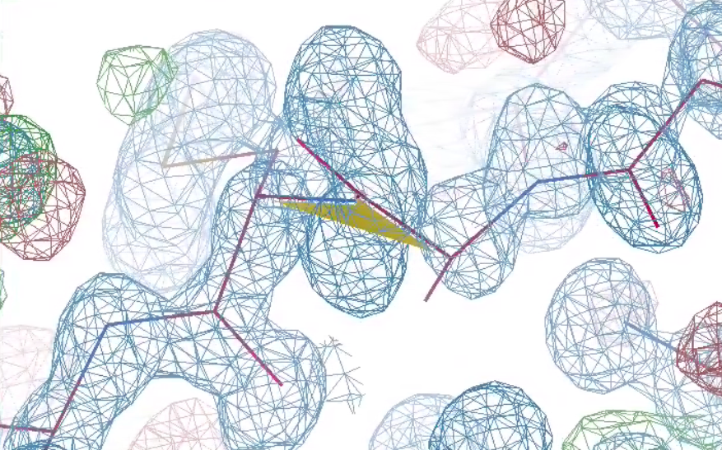
Worst peptide bond
R_{work} 10.59
R_{free} 12.95
bond 0.011 Å
angle 1.85°

Slide 89
Why does ensemble refinement suck? (3 parameters/observation and R_{work} still high!) The chains are “tangled”

Slide 90
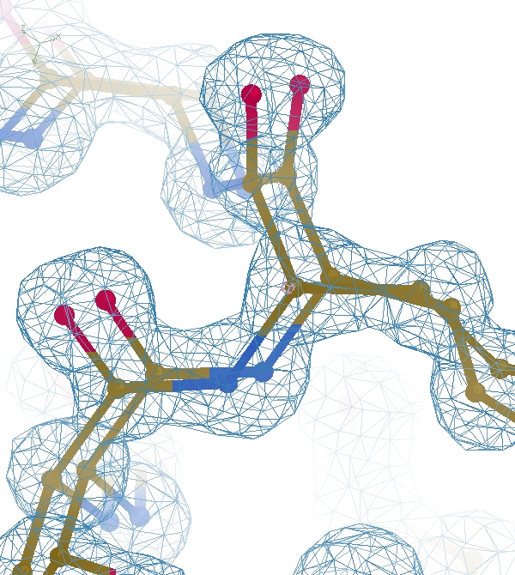

Slide 92
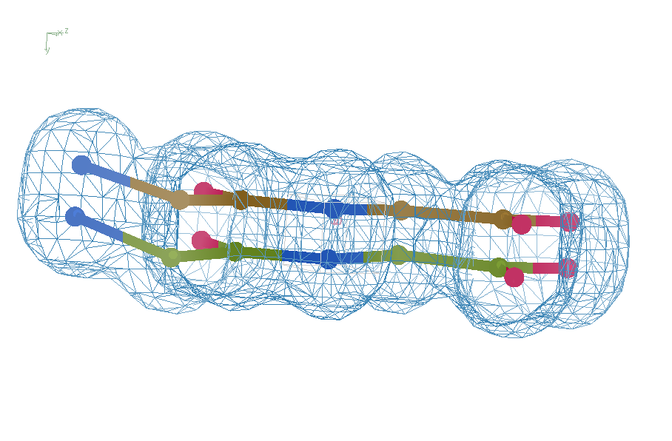
Right answer
R = 0.8%
rms bond = 0.0002

Slide 93
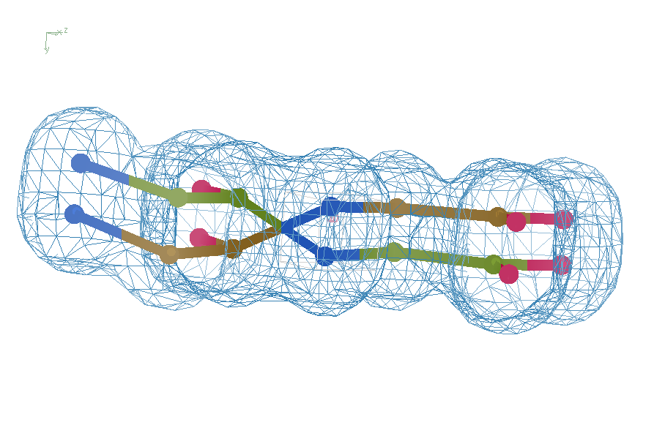
swap assignments
R = 0.8%
rms bond = 0.04

Slide 94
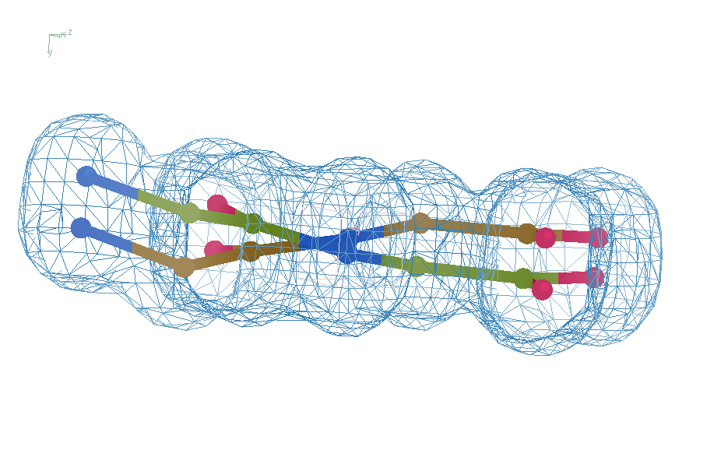
Refine – low x-ray weight
R = 14.3%
rms bond = 0.0002

Slide 95
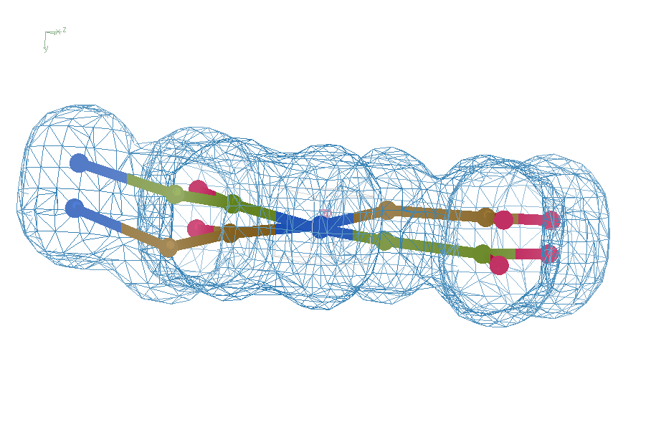
Refine – step 61
R = 6.8%
rms bond = 0.001

Slide 96
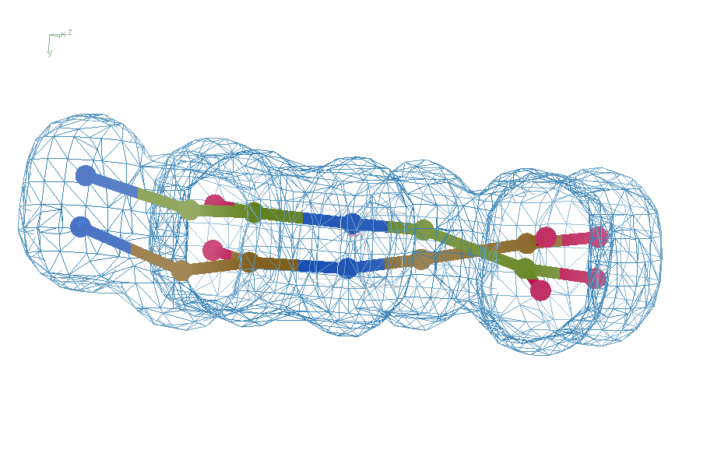
Refine – step 62
R = 5.7%
rms bond = 0.003

Slide 97
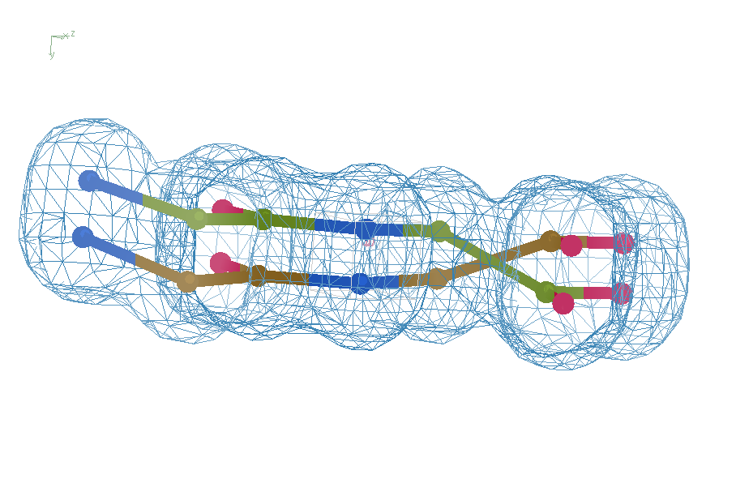
Refine – high x-ray weight
R = 1.2%
rms bond = 0.06

Slide 98
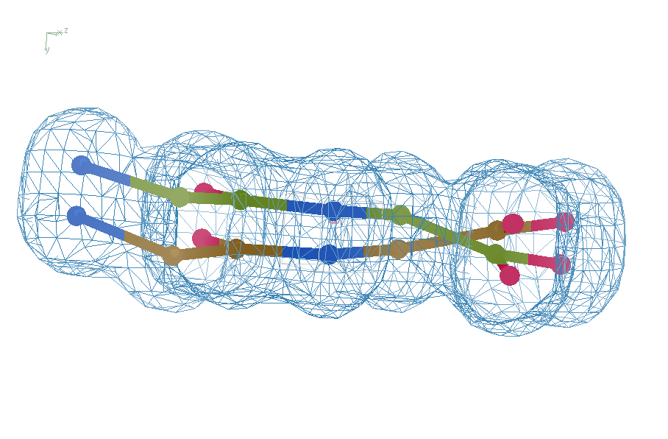
Final compromise
R = 7.07%
rms bond = 0.001

Slide 99
Right answer
R = 0.8%
rms bond = 0.0002

Slide 100
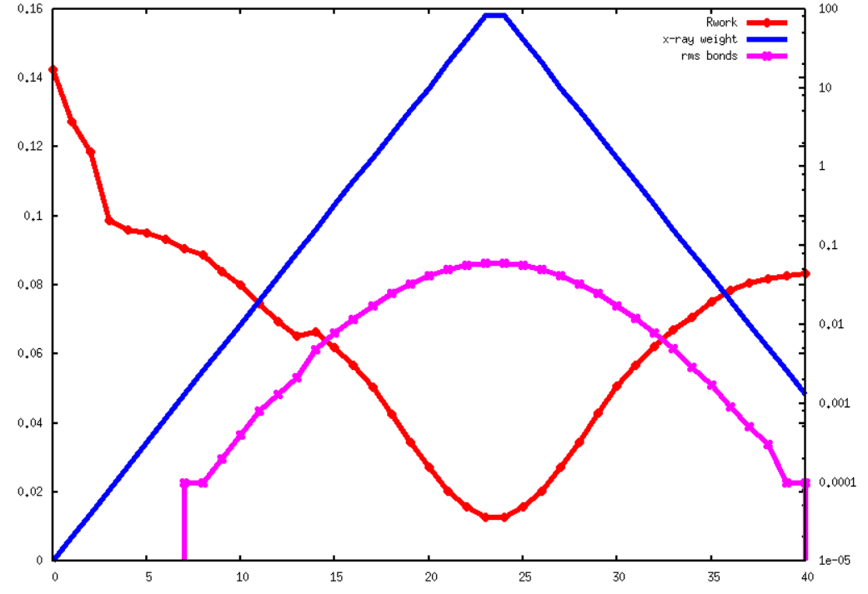
Good trick: ramp x-ray weight
100
10
1
0.1
0.01
10⁻³
10⁻⁴
10⁻⁵
16
14
12
10
8
6
4
2
0
R_{work}
X-ray weight / RMS bonds
Macro-cycle

Slide 101
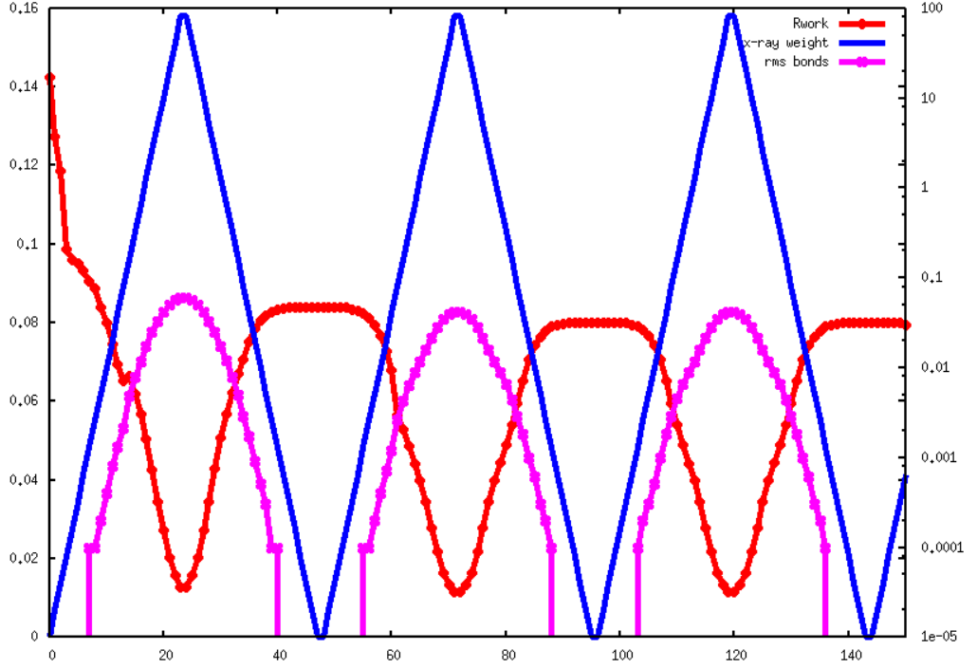
Good trick: ramp x-ray weight
100
10
1
0.1
0.01
10⁻³
10⁻⁴
10⁻⁵
16
14
12
10
8
6
4
2
0
R_{work}
X-ray weight / RMS bonds
Macro-cycle

Slide 102
“topoisomerase” strategy
Break down structure
Refine small, rigid groups
Rest of structure fixed – no bonds
Re-connect
Resolve clashes in supercell

Slide 103
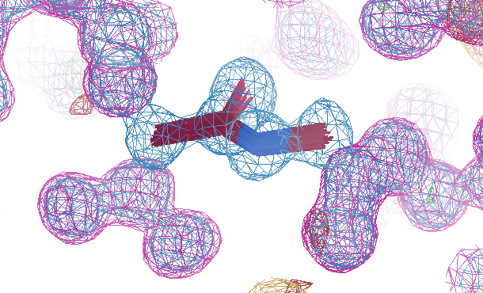
“partial structure”
Density + scale + B instead of atoms

Slide 104
Fragment preparation:
1) Select rigid fragments
peptide bond, triskelion, side chain
2) “parallelize”
average structure, shifted
3) Refine in isolation
all other atoms as density
4) pull-in errant conformations
threshold at 0.8 Å
5) Ramp x-ray weight up and down
6) Perform “knitting”

Slide 105
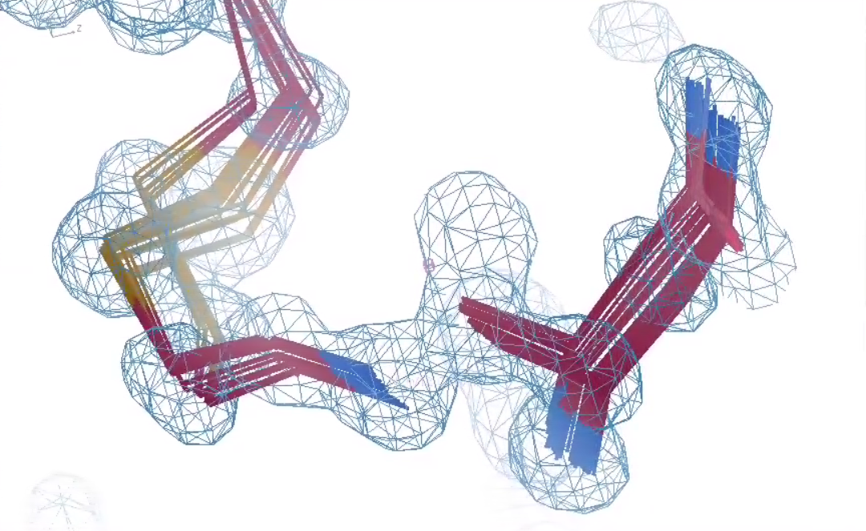
2⁴⁷ possibilities

Slide 106
triskelions

Slide 107
Peptide bonds

Slide 108
Peptide bonds

Slide 109
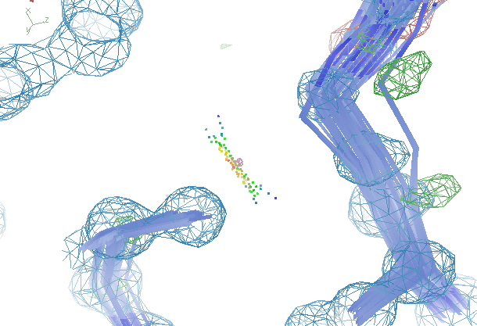
Resolve worst bumps first

Slide 110
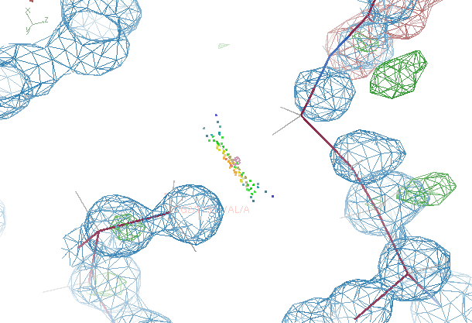
Resolve worst bumps first

Slide 111
“knitting” protocol:
1) RMSD for overlapping atoms
48 x 48 / 2 = 1152 pairs
2) VdW repulsion energy
weight against RMSD
3) Eliminate dead-ends
4) swap two assignments: better?
exhaustive and iterative
5) 3-way permutations
exhaustive and iterative
6) 10,000 4-way permutations
7) ~5 minutes total

Slide 112
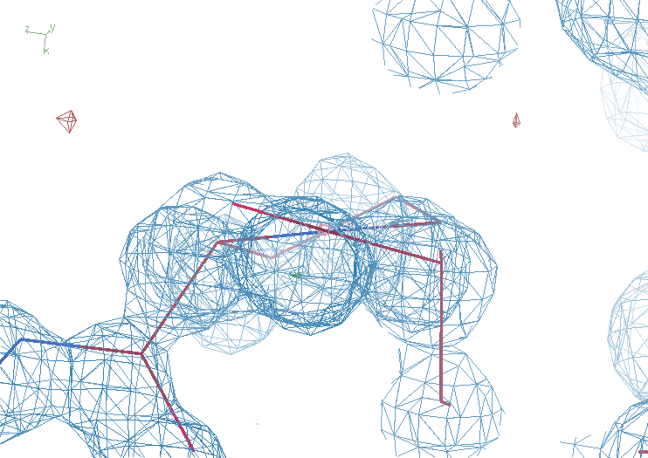
New worst peptide bond
R_{work} 11.81
R_{free} 13.46
bond 0.007 Å
angle 1.8°

Slide 113
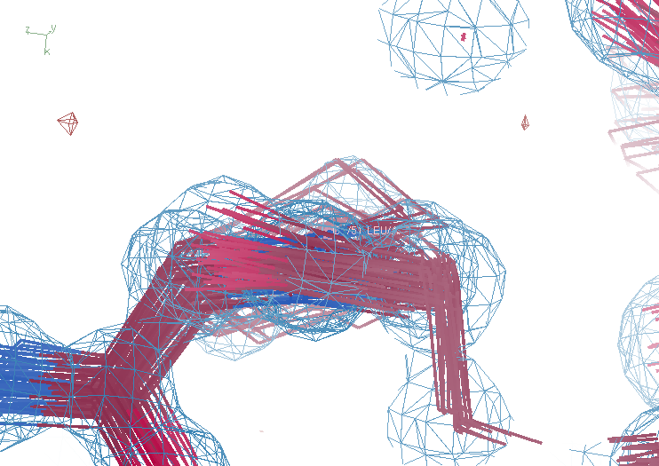
New worst peptide bond
R_{work} 11.81
R_{free} 13.46
bond 0.007 Å
angle 1.8°

Slide 114
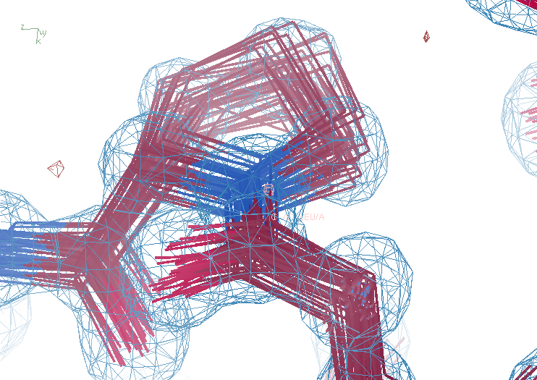
New worst peptide bond
R_{work} 11.81
R_{free} 13.46
bond 0.007 Å
angle 1.8°

Slide 115
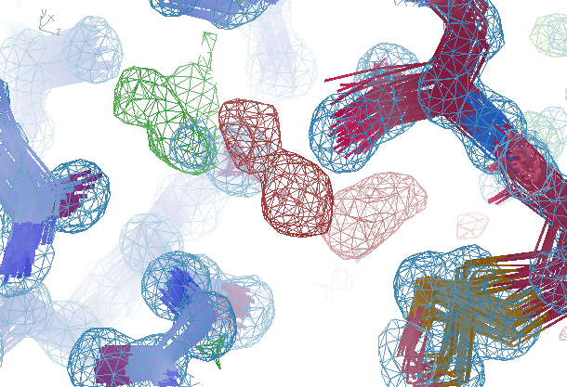
Biggest Fo-Fc peak -9.5 σ

Slide 116
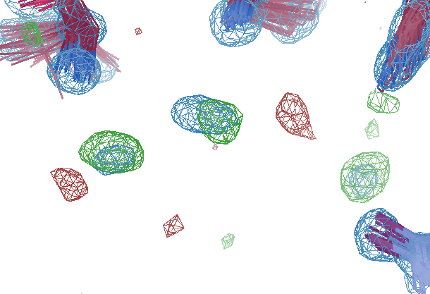
Most positive Fo-Fc peak +7.5 σ
R_{work} 11.71
R_{free} 13.46
bond 0.007 Å
angle 1.78°

Slide 117
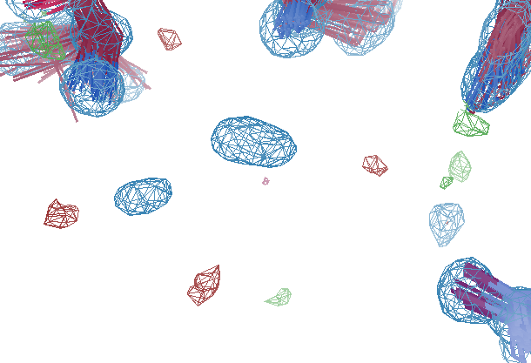
After solvent “touch-up”
R_{work} 11.10
R_{free} 12.97
bond 0.006 Å
angle 1.49°

Slide 118
Probability that it’s not noise
$$P\left(ρ\right)={\operatorname{erf}\left(\left|\frac{ρ}{σ\left(ρ\right)\sqrt{2}}\right|\right)}^{{V_{asu}}/{{2V}_{shan}}}$$
$$={\left(\frac{\sqrt{\left(B+9.5\right)log⁡(2)}}{π}\right)}^{3}$$
$$V_{shan}=d^{3}$$
P() probability
ρ electron density
σ(ρ) rms value of difference map
erf() error function – integral of a Gaussian
V_{asu} volume of asymmetric unit
V_{shan} volume of “Shannon voxel”
d true resolution
B Debye-Waller factor
9.484 intrinsic width of C atom
B = 8π²rms² exp(-x²) has rms = 1
fwhm = 2*sqrt(2*log(2))*rms

Slide 119
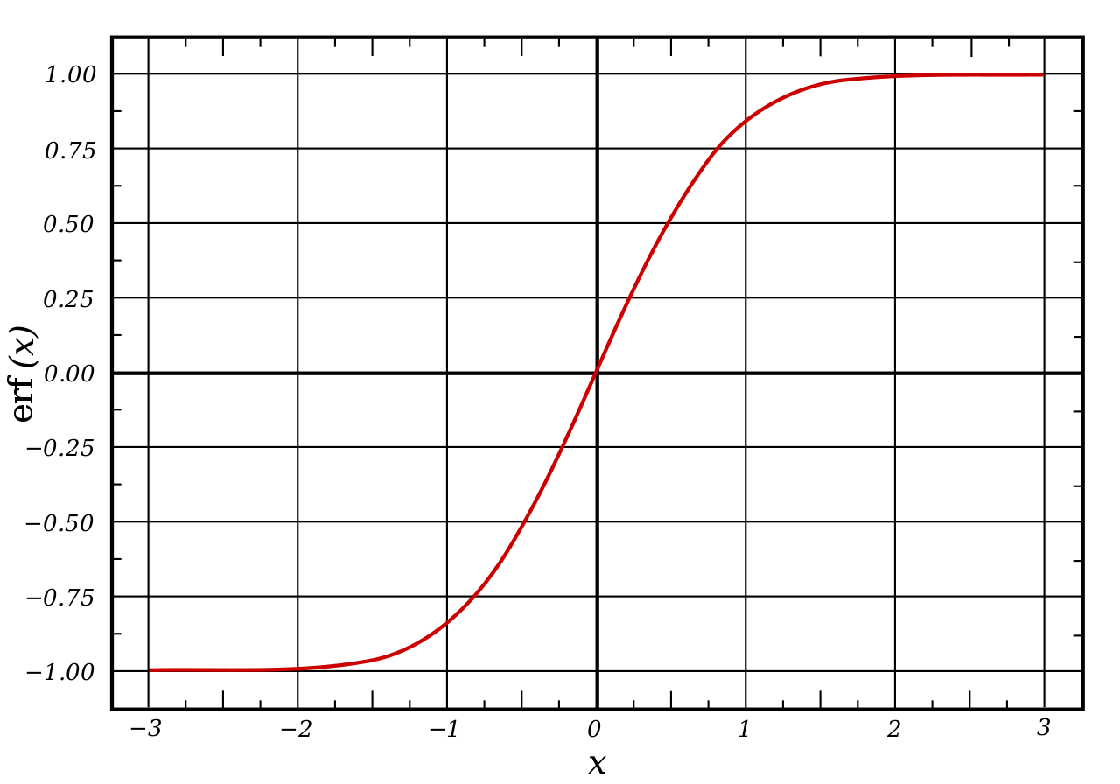
What is erf() ?

Slide 120
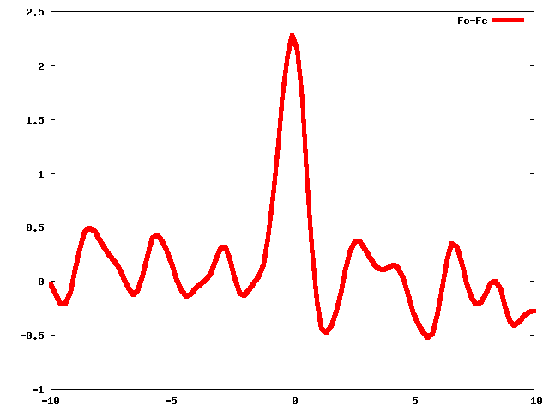
Solvent “touch-up”
Δ Electron density (e⁻/Å³)
position along x (Å)

Slide 121
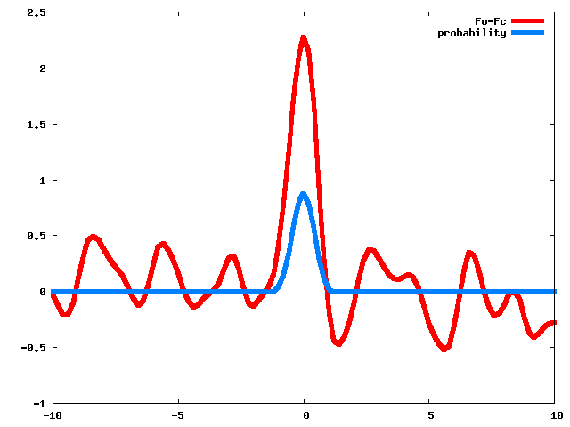
Solvent “touch-up”
Δ Electron density (e⁻/Å³)
position along x (Å)

Slide 122
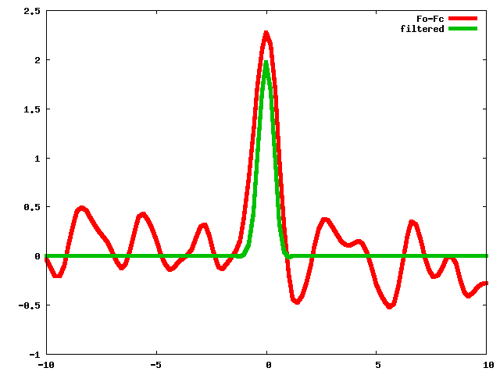
Solvent “touch-up”
Δ Electron density (e⁻/Å³)
position along x (Å)

Slide 123
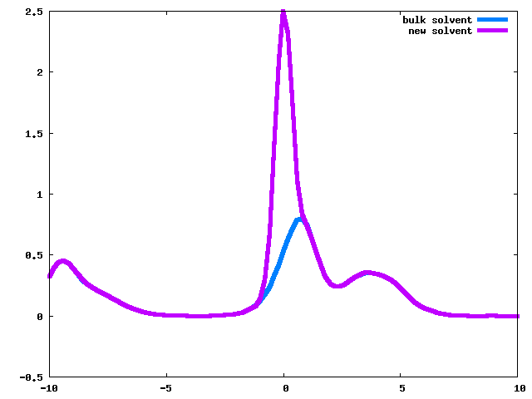
Solvent “touch-up”
Δ Electron density (e⁻/Å³)
position along x (Å)

Slide 124
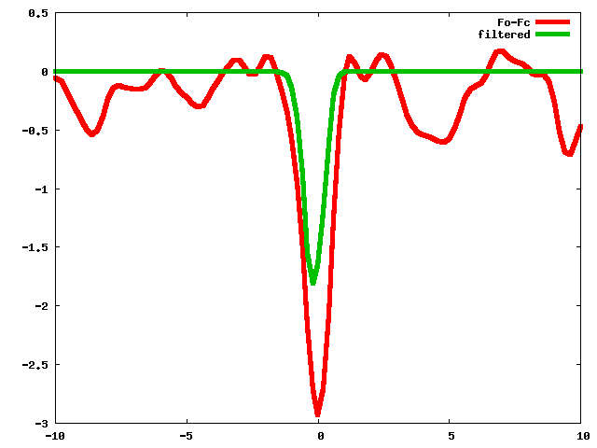
Solvent “touch-up”
Δ Electron density (e⁻/Å³)
position along x (Å)

Slide 125
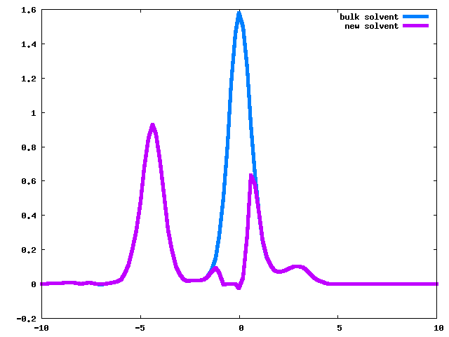
Solvent “touch-up”
Δ Electron density (e⁻/Å³)
position along x (Å)

Slide 126
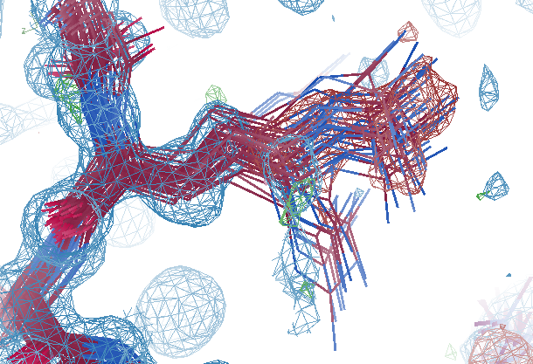
Biggest Fo-Fc peak -9.5 σ

Slide 127
Biggest Fo-Fc peak -9.5 σ

Slide 128
Current status:
R_{work} 11.10
R_{free} 12.97
bond 0.006 Å
angle 1.49°
Turn this back into atoms for AMBER

Slide 129
Best so far
R_{work} 11.94
R_{free} 21.13
bond 0.005 Å
angle 1.29°
8564 waters for AMBER

Slide 130
Model complexity vs R_{free}
Method of refinement | R_{work} | R_{free}
Refmac5: defaults, isotropic B | .1617 | .1797
3D-RISM solvent | .1578 | .1739
100 ns averaged MD solvent protein fixed | .1440 | .1666
2-8 conformers/residue Iterative solvent from restrained MD | .1089 | .1239
48-copy supercell refinement mixed MD & ordered + watershed + touchup | .0928 | .1161
frag-N-knit: remove clashes and torsion outliers | .1045 | .1262

Slide 131
Current status: old MD solvent clashes with new molecule need to rebuild 9000 waters

Slide 132
Closing the R-factor Gap
The solution exists
Watershed for ghosts
Touch-up solvent map
Supercell simplifies
ensembles are tangled
combination lock?
1 e⁻ at 6σ with 3.5 Å
Model need work
https://bl831.als.lbl.gov/~jamesh/powerpoint/Rfactorgap_update_2021a.pptx

Slide 134
Interpolation of structure factors: 2 1 2
Structure factor (e⁻)
Temperature (K)

Slide 135
Interpolation of structure factors: 2 1 2
Structure factor (e⁻)
Temperature (K)

Slide 136
Interpolation of structure factors: 10 11 3
Structure factor (e⁻)
Temperature (K)

Slide 137
Phe 113 conformer B
occupancy
Temperature (K)
Notes:
supercell density gives clue to diffuse scatter, but Bragg peaks are still relative to zero

Slide 138
Phe 113 conformer B
X position
Temperature (K)
Notes:
supercell density gives clue to diffuse scatter, but Bragg peaks are still relative to zero

Slide 139
Interpolation of atomic parameters
occupancy
Temperature (K)

Slide 140
How to do it? You will need:
CCP4 Suite
gnuplot installed
smooth_pdbs_multi.com
usage: smooth_pdbs_multi.com refined_00?.pdb CPUs=12 weight=1 in_states=100,200,250,300,310 out_states=100-300:10
ref= single PDB file containing all possible atoms
weight data weight in smoothing function
in_states specify "x" axis for smoothing as comma-separated list or start-end:step range.
out_states specify "x" axis for output files. default: same as inputs

Slide 141
Interpolation of atomic parameters
X coordinate
Temperature (K)

