Slide 1
Acknowledgements
Robert Stroud James Fraser
Paul Adams John Tainer Greg Hura Nick Sauter
Aina Cohen Art Lyubimov Sabine Hollatz
UCSF LBNL SLAC
ALS 8.3.1: TomAlberTron
NIH NIGMS R01 GM124149
NIH NIGMS P50 GM082250
NIH NIGMS P30 GM124169
NIH NIGMS R01 GM117126
Integrated Diffraction Analysis Technologies (IDAT)
Plexxikon, Inc.
Synchrotron Radiation Structural Biology Resource (SLAC)
The Advanced Light Source is supported by the Director, Office of Science, Office of Basic Energy Sciences, Materials Sciences Division, of the US Department of Energy under contract No. DE-AC02-05CH11231 at Lawrence Berkeley National Laboratory.

Slide 2
PowerPoint File available:
http://bl831.als.lbl.gov/
~jamesh/powerpoint/
Rapidata_raddam_2019.pptx

Slide 3
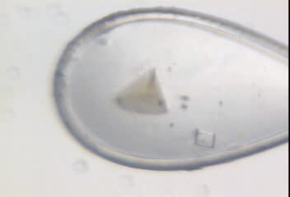
Radiation damage

Slide 4
Radiation damage

Slide 5
What you need to know:
Limits “data photons”
Caveat for active site
Can be corrected
Can be predicted
Cannot be prevented
Cannot be outrun

Slide 6
Where do photons go?
Protein
1A x-rays
Transmitted (98%)
beamstop

Slide 7
Elastic scattering

Slide 8
Elastic scattering

Slide 9

Where do photons go?
Protein
1A x-rays
elastic scattering (6%)
Transmitted (98%)
beamstop

Slide 10
Elastic scattering

Slide 11
Inelastic scattering

Slide 12
Where do photons go?
Protein
1A x-rays
elastic scattering (6%)
Transmitted (98%)
beamstop

Slide 13
Where do photons go?
Protein
1A x-rays
elastic scattering (6%)
Transmitted (98%)
beamstop
inelastic scattering (7%)

Slide 14
Where do photons go?
Protein
1A x-rays
elastic scattering (6%)
Transmitted (98%)
beamstop
inelastic scattering (7%)
Re-emitted (99%)
Absorbed (~0%)

Slide 15
Photoelectric absorption

Slide 16
Photoelectric absorption
e⁻
+

Slide 17
Secondary ionization
e⁻

Slide 18
Secondary ionization
+
e⁻
e⁻

Slide 19
Excitation
e⁻

Slide 20
Excitation
e⁻

Slide 21
Excitation
e⁻

Slide 22
Excitation

Slide 23
Electron attachment
e⁻

Slide 24
Electron attachment
-

Slide 25
Sample atoms

Slide 26
Sample atoms

Slide 27
Primary ionization
e⁻
+

Slide 28
Secondary ionizations
e⁻
e⁻
+
e⁻
e⁻
+
+
+
+
+
e⁻
e⁻

Slide 29
Ionization track
e⁻
e⁻
e⁻
e⁻
+
e⁻
+
+
+
e⁻
e⁻
+
+
+
+
+
e⁻
+
e⁻
e⁻

Slide 30
Ionization track
e⁻
e⁻
e⁻
e⁻
+
e⁻
+
+
+
e⁻
e⁻
+
+
+
+
+
e⁻
+
e⁻
e⁻

Slide 31
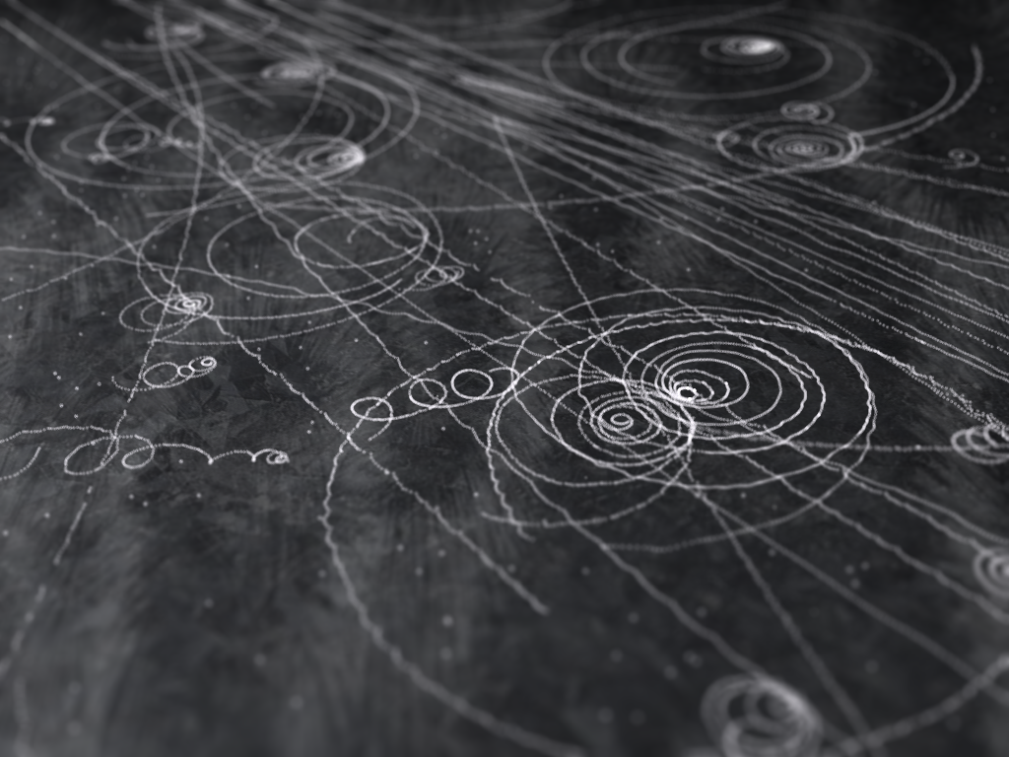
Ionization track

Slide 32
Ionization track

Slide 33
Ionization track
3 μm

Slide 34
Ionization track
Linear Energy Transfer

Slide 35
initial effects
e⁻
e⁻
e⁻
e⁻
+
e⁻
+
+
+
e⁻
e⁻
+
+
+
+
+
e⁻
+
e⁻
e⁻

Slide 36
initial effects
e⁻
e⁻
e⁻
e⁻
+
e⁻
+
+
+
e⁻
neutralization
e⁻
+
+
+
+
+
e⁻
+
e⁻
e⁻

Slide 37
initial effects
e⁻
e⁻
e⁻
e⁻
+
e⁻
+
+
neutralization
e⁻
+
+
+
+
+
e⁻
+
e⁻
e⁻

Slide 38
initial effects
e⁻
e⁻
e⁻
e⁻
+
neutralization
+
e⁻
+
+
+
+
+
neutralization
e⁻
e⁻

Slide 39
initial effects
e⁻
e⁻
e⁻
e⁻
+
+
e⁻
+
+
+
+
+
e⁻
attachment
e⁻

Slide 40
initial effects
e⁻
e⁻
e⁻
e⁻
+
+
e⁻
+
+
+
+
+
-
attachment
e⁻

Slide 41
initial effects
e⁻
e⁻
e⁻
attachment
e⁻
+
+
e⁻
+
+
+
+
+
-
e⁻
attachment

Slide 42
initial effects
e⁻
-
e⁻
e⁻
+
+
e⁻
+
+
+
+
+
-
-

Slide 43
initial effects
-
-
-
e⁻
+
+
+
+
+
+
-
-

Slide 44
initial effects
-
-
-
e⁻
solvation
+
+
+
+
+
+
-
-

Slide 45
initial effects
-
-
-
solvation
+
e⁻
+
+
+
+
+
-
-

Slide 46
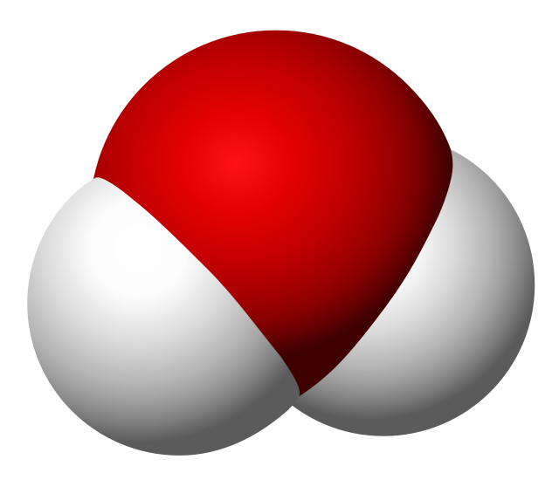
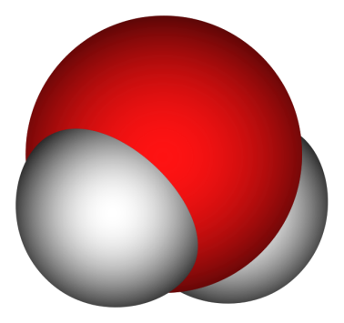
Solvated electron
e⁻

Slide 47
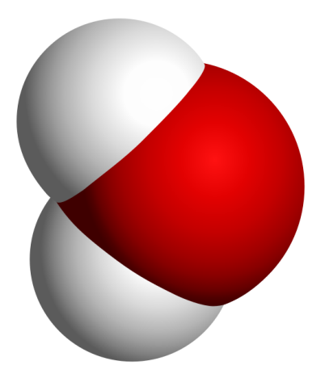
Solvated electron
e⁻

Slide 48
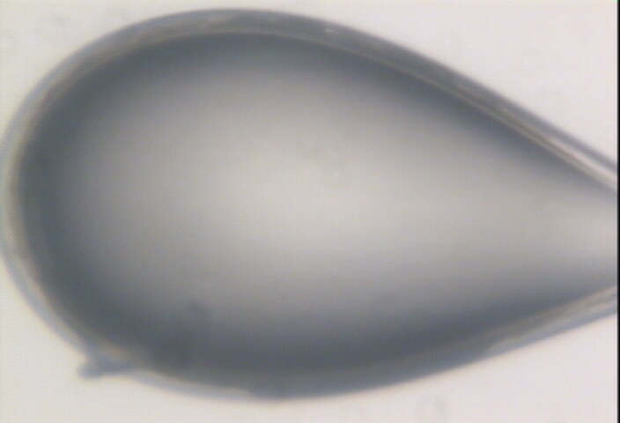

Slide 49
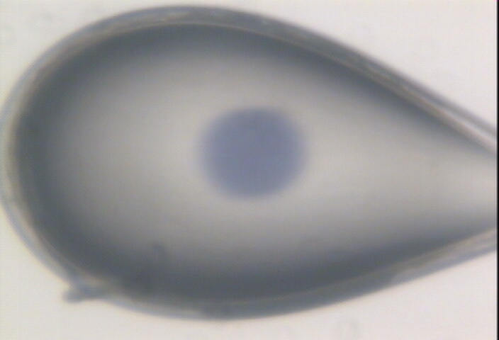

Slide 50
initial effects
-
-
-
+
e⁻
+
+
+
+
+
-
-

Slide 51
initial effects
-
-
-
+
e⁻
+
+
+
+
+
-
-

Slide 52
initial effects
-
-
+
e⁻
+
+
+
+
-
-

Slide 53
initial effects
e⁻
+
+
+
-
-

Slide 54
initial effects
e⁻
+
+
-

Slide 55
Excitation transfer

Slide 56
Excitation transfer
UV photon

Slide 57
Excitation transfer

Slide 58
Excitation transfer
r⁻⁶
Förster transfer

Slide 59
Excitation transfer

Slide 60
t = 0 s

Slide 61
t ≈ 10⁻¹⁴ s
e⁻
+
+
-

Slide 62
Timescales of radiation damage
Garret et. al. (2005) Chem. Rev. 105, 355-389

Slide 63
Timescales of radiation damage
XFEL
synch
bunch
Garret et. al. (2005) Chem. Rev. 105, 355-389

Slide 64
Ionization track
Heterogeneous reactions
Homogeneous reactions

Slide 65
Where do photons go?
Protein
1A x-rays
elastic scattering (6%)
Transmitted (98%)
beamstop
inelastic scattering (7%)
Re-emitted (99%)
Absorbed (~0%)

Slide 66
Where do photons go?
Protein
1A x-rays
elastic scattering (6%)
Transmitted (98%)
beamstop
inelastic scattering (7%)
Photoelectric (87%)
Re-emitted (99%)
Absorbed (~0%)

Slide 67
Where do photons go?
Protein
1A x-rays
elastic scattering (6%)
Transmitted (98%)
beamstop
inelastic scattering (7%)
Photoelectric (87%)
Re-emitted (99%)
Absorbed (~0%)
Re-emitted (~0%)
Absorbed (99%)

Slide 68
Where do photons go?
Protein
1A x-rays
elastic scattering (6%)
Transmitted (98%)
beamstop
inelastic scattering (7%)
Photoelectric (87%)
Re-emitted (99%)
Absorbed (~0%)
Re-emitted (~0%)
Absorbed (99%)
useful/absorbed energy: 7.3%

Slide 69
Rough values of energy quanta
1 MeV 100 GJ/mol Medical radiation therapy
100 keV 10 GJ/mol Medical imaging
10 keV 1 GJ/mol X-ray crystallography
1 keV 100 MJ/mol S and P K-edges
100 eV 10 MJ/mol “water window”
10 eV 1 MJ/mol C≡C bond
1 eV 100 kJ/mol C-C bond, visible light
100 meV 10 kJ/mol hydrogen bond
10 meV 1 kJ/mol heat (~300 K)

Slide 70
Types of radiation damage
Global
Specific

Slide 71
Types of radiation damage
Global
Specific
  depends on chemistry

Slide 72
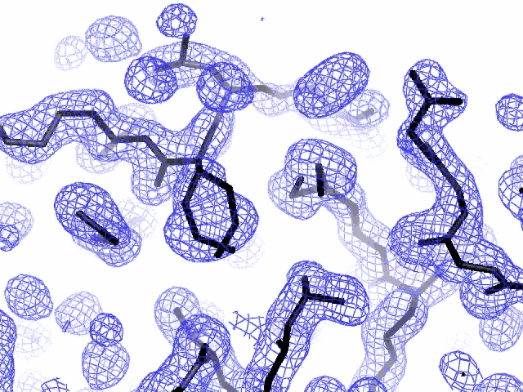
Specific damage
final, refined phases

Slide 73
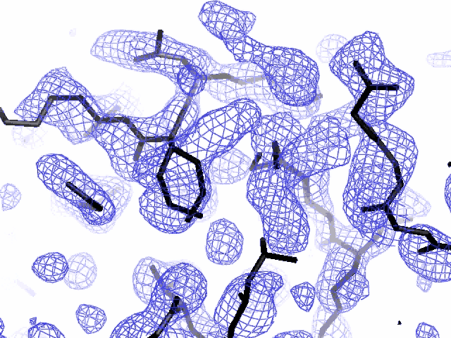
Specific damage
experimentally-obtained phases

Slide 74
Types of radiation damage
Global
Specific
  depends on chemistry
  destroys phasing signal

Slide 75
Holton, J. M. (2007) J. Synch. Rad. 14, 51-72.

Slide 76
1.0
fraction
unconverted
0.0
Holton, J. M. (2007) J. Synch. Rad. 14, 51-72.

Slide 77
what the is a MGy?
1 MGy = 10⁶ J/kg
http://bl831.als.lbl.gov/
damage_rates.pdf
Holton J. M. (2009) J. Synchrotron Rad. 16 133-42

Slide 78
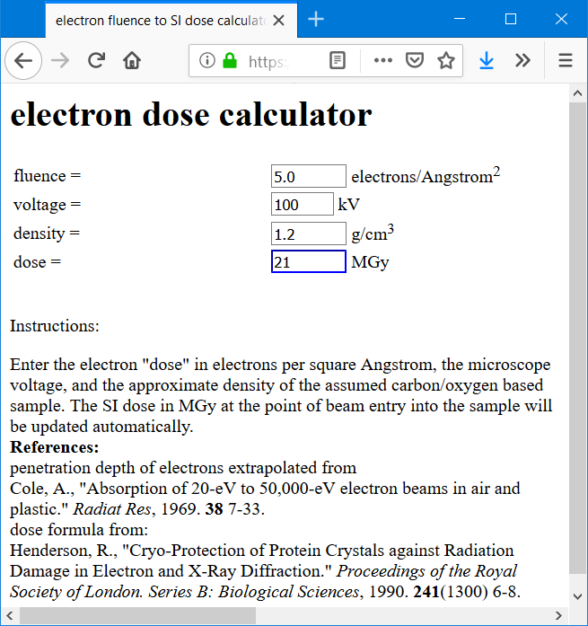
https://bl831.als.lbl.gov/~jamesh/dose2dose.html

Slide 79
MGy reaction reference
~45 global damage Owen et al. (2006)
10/Å global damage Howells et al. (2009)
5 Se-Met Holton (2007)
4 Hg-S Ramagopal et al. (2004)
4 R-C-COOH Garman et al. (2015)
3 S-S Murray et al. (2002)
1 Br-RNA Olieric et al. (2007)
~1? Cl-C ???
0.5 Mn in PS II Yano et al. (2005)
0.06 putidaredoxin Corbett et al. (2007)
0.02 Fe in myoglobin Denisov et al. (2007)
Radiation Damage World Records
Holton (2009) J. Synchrotron Rad. 16 133-42

Slide 80
What if I’m not on the list?
Rule of thumb:
is it a “good leaving group” ?
  Br
  COO⁻
  S-CH₂-
  CH₃
  H₂

Slide 81
Radiation damage

Slide 82
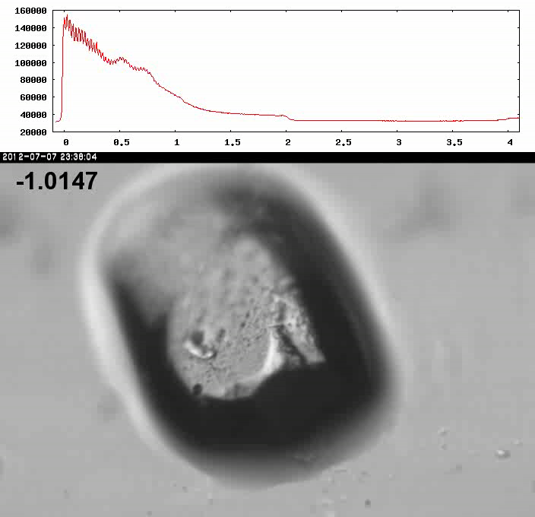
Xtal5_t1 graph

Slide 83
How much water are we burning?
Meents et al. (2010) claimed:
"400 molecules of H2 for every 12.5 keV photon“
= 3.3x10⁻⁷ mol/J
200 kGy to 100 um³ = 0.24 J
= 1.2x10⁻⁸ mol H₂
100 um³ of water = 6.7x10⁻⁸ mol
→ 18% of water has reacted!

Slide 84
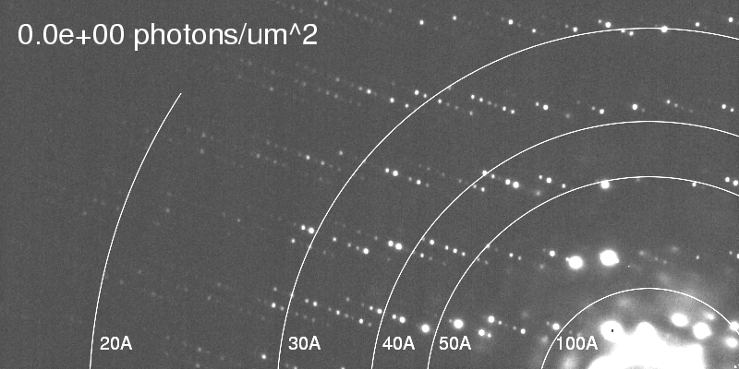
Global damage
Howells, et al. (2009) J. Electron Spectrosc. Relat. Phenom. 170, 4-12.

Slide 85
resolution dependence of global damage
10³
100
maximum tolerable dose (MGy)
10
1
1 2 3 5 7 10 20 40 70 100
resolution (Å)
Howells et al. (2009) J. Electron. Spectrosc. Relat. Phenom. 170 4-12

Slide 86
resolution dependence of global damage
10³
10 MGy/Å
100
maximum tolerable dose (MGy)
10
1
1 2 3 5 7 10 20 40 70 100
resolution (Å)
Howells et al. (2009) J. Electron. Spectrosc. Relat. Phenom. 170 4-12

Slide 87
How long will my crystal last?
synch line type flux beamsize flux density dose max xtal min site
ph/s μm ph/μm2/s rate lifetime lifetime
APS 5ID-B POWDER 5e12 1000x300 1.7e+07 8.25 kGy/s 61 m 4 m
APS 8-BM MAD 1e11 200 2.5e+06 858 Gy/s 9.7 h 39 m
APS 14-BM-C MONO 6e11 130x200 2.3e+07 11 kGy/s 46 m 3 m
APS 14-ID-B LAUE 7e13 15x20 2.3e+11 132 MGy/s 0.23 s 0.015 s
APS 17-BM POWDER 8e11 200 2.0e+07 8.72 kGy/s 57 m 3.8 m
APS 17-ID MAD 7e11 200 1.8e+07 9.87 kGy/s 51 m 3.4 m
APS 18-ID SAXS 2e13 50x150 2.7e+09 2.69 MGy/s 11 s 0.74 s
APS 19-BM MAD 6e+08 60x50 2.0e+05 77.3 Gy/s 4.5 d 7.2 h
APS 19-ID MAD 3e+10 100x20 1.5e+07 7.81 kGy/s 64 m 4.3 m
APS 21-ID-D MAD 5e12 50 2.0e+09 1.13 MGy/s 27 s 1.8 s
APS 21-ID-F MONO 1e12 50 4.0e+08 190 kGy/s 2.6 m 11 s
APS 21-ID-G MONO 1e12 50 4.0e+08 190 kGy/s 2.6 m 11 s
APS 22-BM MAD 7e12 40x80 2.2e+09 750 kGy/s 40 s 2.7 s
APS 22-ID MAD 7e12 40x80 2.2e+09 750 kGy/s 40 s 2.7 s
APS 23-BM-B MAD 2e11 200? 5.0e+06 2.47 kGy/s 3.4 h 13 m
APS 23-ID-B MAD 6e12 80x20 3.8e+09 2.11 MGy/s 14 s 0.95 s
APS 23-ID-D MAD 1e13 75x25 5.3e+09 3.01 MGy/s 10 s 0.66 s
APS 24-ID-C MAD 2.5e12 40x60 1.0e+09 357 kGy/s 84 s 5.6 s
APS 24-ID-E MONO 2.85e12 20x120 1.2e+09 563 kGy/s 53 s 3.5 s
APS 31-ID MAD 2.6e12 120x80 2.7e+08 105 kGy/s 4.8 m 19 s
NSLS-II 17-ID-1 MAD 5e12 7x5 1.4e+11 67 MGy/s 0.45 s 0.03 s
NSLS-II 17-ID-2 MAD 2e12 1x1 1.3e+12 626 MGy/s 0.048 s 0.0032 s
NSLS X3A MAD 3.8e10 200 9.5e+05 451 Gy/s 18 h 74 m
NSLS X3B EXAFS 9e11 200x700 6.4e+06 6.48 kGy/s 77 m 5.1 m
NSLS X4A MAD 2e10 300 2.2e+05 136 Gy/s 61 h 4.1 h
NSLS X6A MAD 1.5e12 100x500 3.0e+07 10.3 kGy/s 49 m 3.2 m
NSLS X8C MAD 1.1e10 200? 2.8e+05 204 Gy/s 41 h 2.7 h

Slide 88
Life-halving concentration
molar, at the Se edge based on RADDOSE
Na | 44
Mg | 27
P | 9
S | 7
Cl | 5
K | 3.3
Ca | 2.7
Fe | 1.0
Cu | 0.67
Zn | 0.58
As | 0.44
Se | 0.42
Br | 2.9
I | 0.47
Gd | 0.21
Ta | 0.13
Pt | 0.17
Au | 0.16
Hg | 0.16
U | 0.23

Slide 89
Life-halving concentration
molar, at the Se edge based on RADDOSE
Na | 44
Mg | 27
P | 9
S | 7
Cl | 5
K | 3.3
Ca | 2.7
Fe | 1.0
Cu | 0.67
Zn | 0.58
As | 0.44
Se | 0.42
Br | 2.9
I | 0.47
Gd | 0.21
Ta | 0.13
Pt | 0.17
Au | 0.16
Hg | 0.16
U | 0.23

Slide 90
660%

Slide 91
Can radiation damage be prevented?
Yes! By keeping dose low

Slide 92
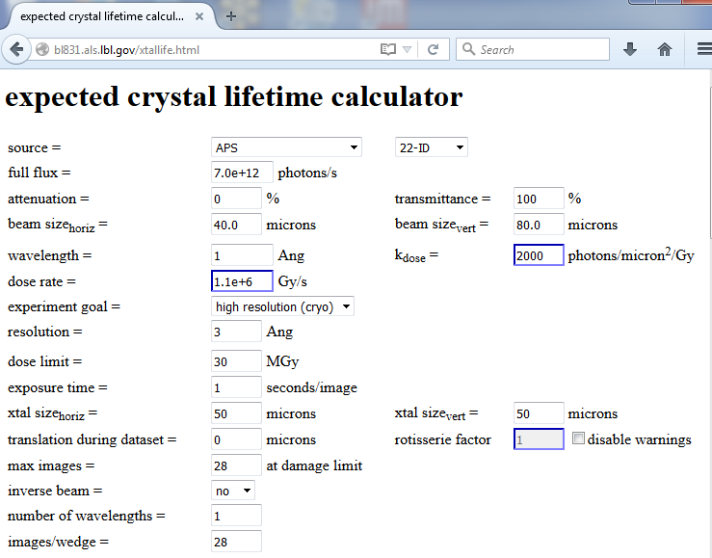

Slide 93
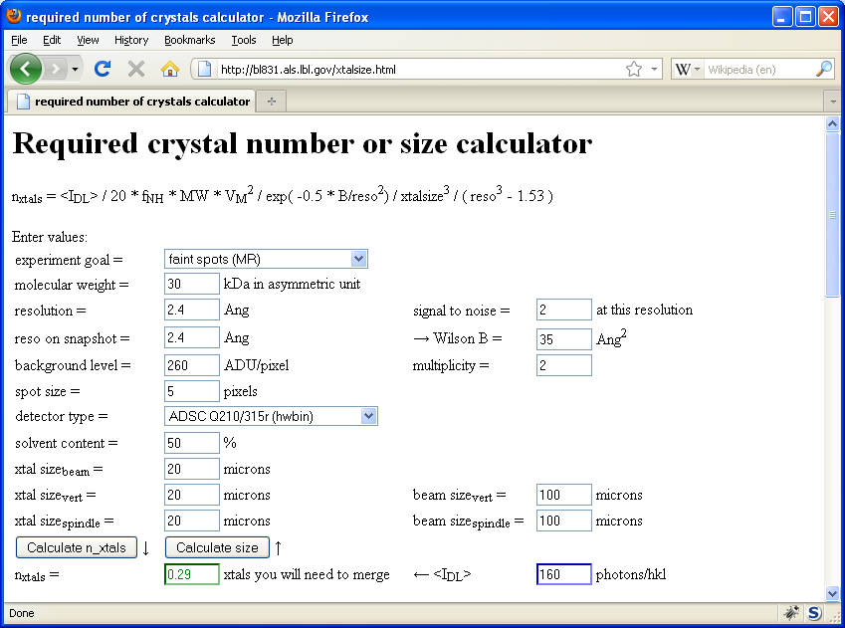
Holton & Frankel (2010) Acta D 66 393-408.

Slide 94
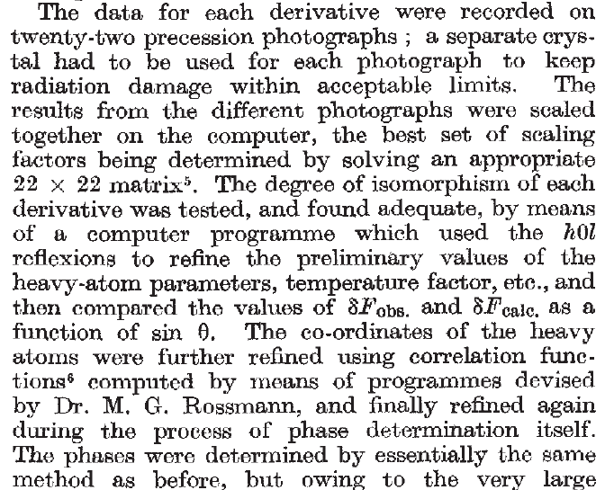
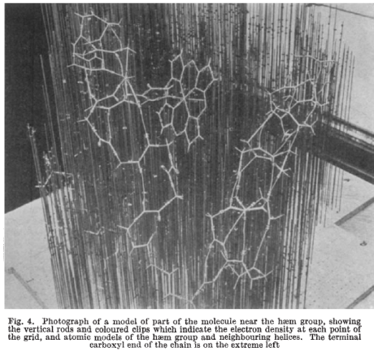
Multi-crystal strategies
Kendrew et al. (1960) "Structure of Myoglobin” Nature 185, 422-427.

Slide 95
Can radiation damage be “outrun”?

Slide 96
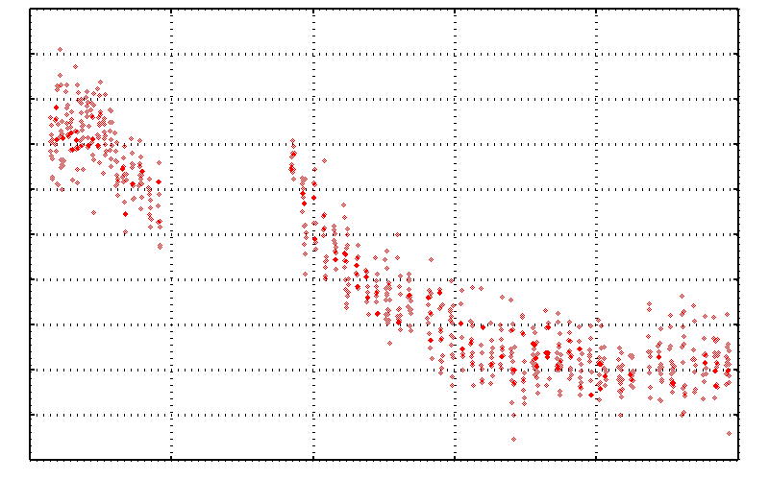
No Damage in the Dark!
4.6 5.0 5.4 5.8 6.2 6.6
Peak absorbance (electrons)
0 5 10 15 20 25
Experiment time (hours)

Slide 97
Double-tap: no dark progression at 675 kGy/s
Intensity (photons)
Time (seconds)

Slide 98
Dose-rate dependence of damage
maximum useful dose (MGy)
dose rate (kGy/s)

Slide 99
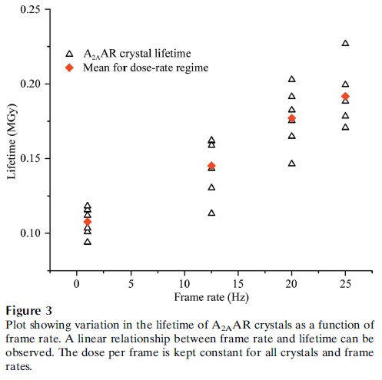
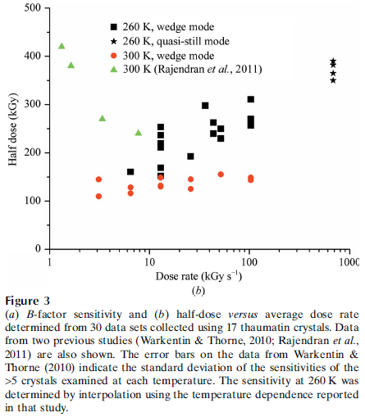
Dose-rate effect at Room Temp?
Owen RL, Axford D, Nettleship JE, Owens RJ, Robinson JI, Morgan AW, Dore AS, Lebon G, Tate CG, Fry EE, Ren J, Stuart DI & Evans G (2012)."Outrunning free radicals in room-temperature macromolecular crystallography", Acta Cryst. D 68, 810-818.
Warkentin M, Badeau R, Hopkins JB, Mulichak AM, Keefe LJ & Thorne RE (2012)."Global radiation damage at 300 and 260 K with dose rates approaching 1 MGy s-1", Acta Cryst. D 68, 124-133.

Slide 100
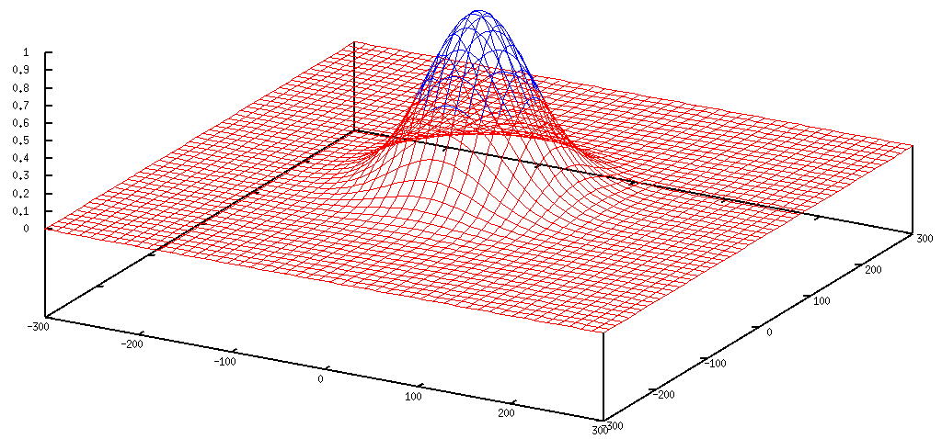
Gaussian beam
50% of flux
the other 50%

Slide 101
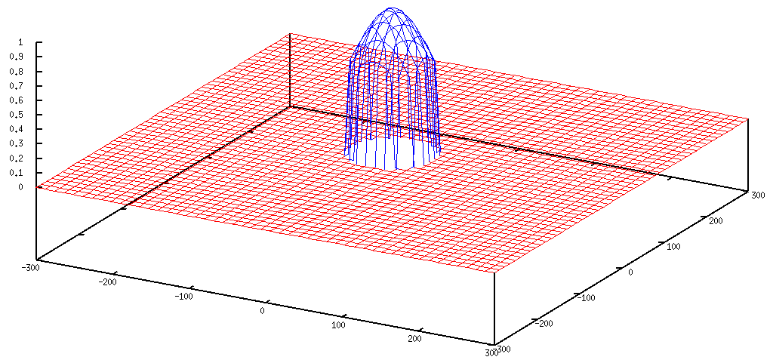
Collimated beam
100% of flux
0%

Slide 102
Tipping point for µfocus:
10 µm
~1 mrad =0.06°
~10 mm

Slide 103
Can radiation damage be “outrun”?
not really

Slide 104
Self-calibrated damage limit
Where:
⟨I⟩_{DL} - average damage-limited intensity (photons/hkl) at a given resolution
10⁵ - converting R from μm to m, r_{e} from m to Å, ρ from g/cm³ to kg/m³ and MGy to Gy
r_{e} - classical electron radius (2.818 x 10⁻¹⁵ m/electron)
h - Planck’s constant (6.626 x 10⁻³⁴ J∙s)
c - speed of light (299792458 m/s)
f_{decayed} - fractional progress toward completely faded spots at end of data set
ρ - density of crystal (~1.2 g/cm³)
R - radius of the spherical crystal (μm)
λ - X-ray wavelength (Å)
f_{NH} - the Nave & Hill (2005) dose capture fraction (1 for large crystals)
n_{ASU} - number of proteins in the asymmetric unit
M_{r} - molecular weight of the protein (Daltons or g/mol)
V_{M} - Matthews’s coefficient (~2.4 Å³/Dalton)
H - Howells’s criterion (10 MGy/Å)
θ - Bragg angle
⟨ƒ_{a}²⟩ - number-averaged squared structure factor per protein atom (electron²)
⟨M_{a}⟩ - number-averaged atomic weight of a protein atom (~7.1 Daltons)
B - average (Wilson) temperature factor (Å²)
μ - attenuation coefficient of sphere material (m⁻¹)
μ_{en} - mass energy-absorption coefficient of sphere material (m⁻¹)
No flux
No symmetry
No exposure time
Holton & Frankel (2010) Acta D 66 393-408.

Slide 105
The number of photons scattered
before crystal is dead
is independent
of flux & time
1 um³ = 10⁵ photons (roomT)
1 um³ = 10⁶ photons (synch)
1 um³ = 10⁸ photons (XFEL)
(synch)
Henderson, 1990; Gonzalez & Nave, 1994; Glaeser et al., 2000; Sliz et al., 2003; Leiros et al., 2006; Owen et al., 2006; Garman & McSweeney, 2006; Garman & Nave, 2009; Holton, 2009

Slide 106

Dose slicing
unacceptable
completeness
N
photons
crystal’s useful life
N
photons
unacceptable
read noise
N
photons

Slide 107

X-ray data are 3D!

Slide 108
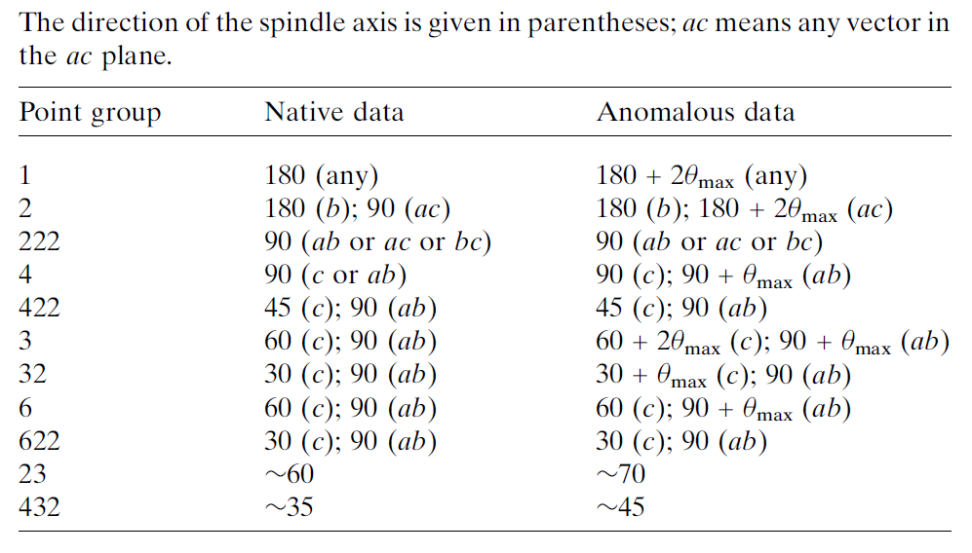
Data collection “strategy”
The “American Method”:
360° no matter what
(shoot first, questions later)
Dauter, Z. (1999). "Data-collection strategies." Acta Cryst. D 55(10): 1703-1717.

Slide 109
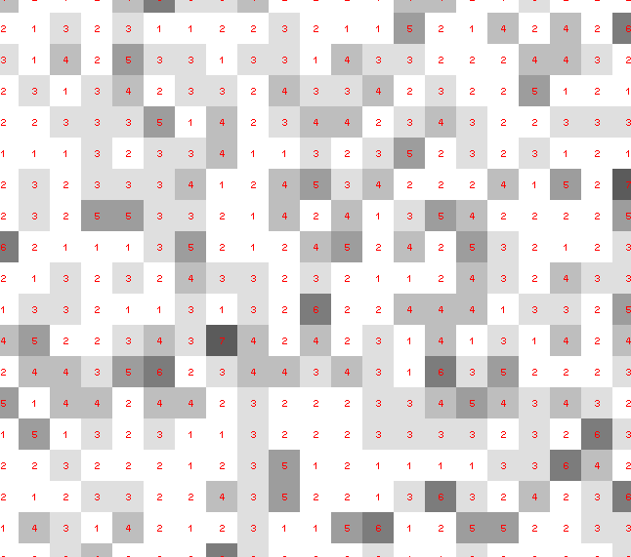
Dose slicing: is that a spot?

Slide 110
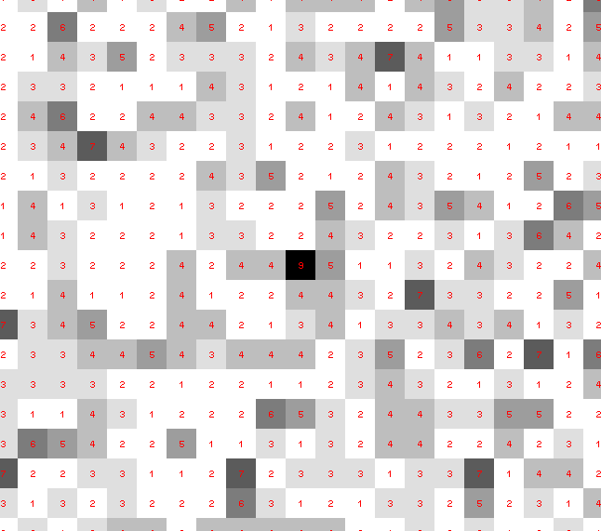
Dose slicing: is that a spot?

Slide 111
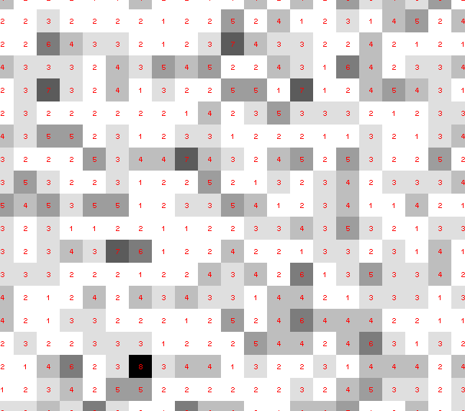
Dose slicing: is that a spot?

Slide 112
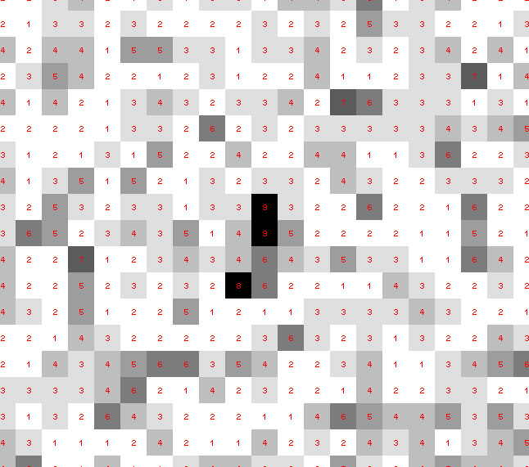
Dose slicing: is that a spot?

Slide 113
Dose slicing: is that a spot?

Slide 114
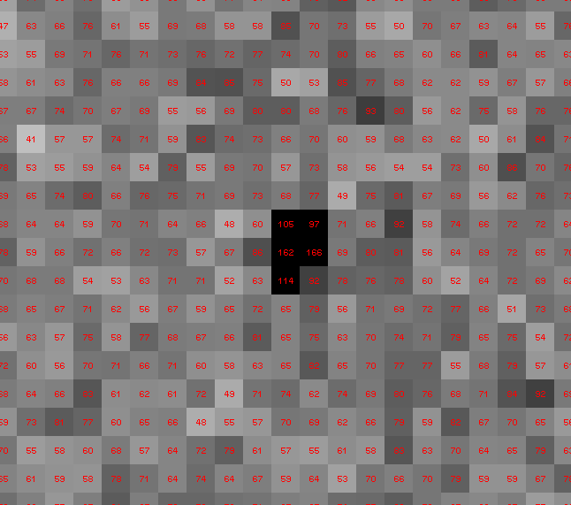
Dose slicing: is that a spot?

Slide 115
What if?
You only have a few small crystals…
Should you:
  Collect 360° from each?
  Collect 10° from each at 36x exposure?
  Glue 36 xtals together, then collect 360° ?

Slide 116
“true” resolution limit
CC vs right answer
Resolution (Å)

Slide 117
“true” resolution vs strategy
Dose slice collection scenario
fine | coarse | glue
3.17700 | 3.14057 | 3.17604
301,640,334 photons/xtal

Slide 118
processing procedure | resolution limit
 | fine | coarse | glue | glue&fine
XDS/XSCALE | 3.17700 | 3.14057 | 3.17604 | 3.12086
XDS/aimless | 3.16251 | 3.15922 | 3.16675 | 3.12162
XDS/noscale | 3.27289 | 3.15617 | 3.38929 | 3.12162
MOSFLM-defaults | x | x | x | x
MOSFLM-cheat | 3.19755 | 3.18166 | 3.20354 | 3.19755
HKL2000-defaults | x | x | x | x
HKL2000-expert | 3.21803 | 3.12646 | 3.11551 | 3.21803
HKL2000-cheat | 3.16119 | 3.10338 | 3.10338 | 3.16300
DIALS-defaults | x | x | 3.42125 | x
DIALS-expert | 3.10296 | 3.09547 | 3.07653 | 3.08465
d*Trek | ? | ? | 4.34076 | ?
EVAL15 | 3.14352 | 3.10383 | 3.09936 | 3.14105
EVAL15-sadabs | 3.13920 | 3.10797 | 3.10171 | 3.13700

Slide 119
Minimum exposure time:
~1 photon/pixel
  PAD w XDS, DIALS
~10 photon/pixel
PAD w HKL2k, MOSFLM
~30 photon/pixel
CCD detector

Slide 120
Can radiation damage be corrected?
Yes, if you have enough information

Slide 121
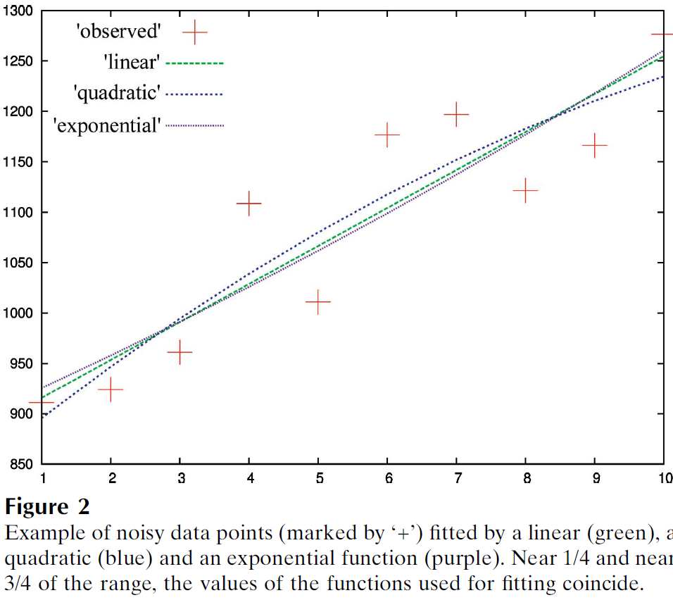
Zero-dose extrapolation (ZDE)
Diederichs, K. (2006). "Some aspects of quantitative analysis and correction of radiation damage." Acta Cryst. D 62(1): 96-101.

Slide 122
How to lose information
long exposures
  >1 photon/image = order of arrivals
Wide phi slice
  sum over angle
Large beams
  sum over area
Pink/divergent beam
  sum over lambda/angle
Background
  non-crystal stuff
Systematics
  Dose contrast

Slide 123
The Entropy Limit
bits
s
= log₂(N_{pixels}) * flux * t_{sample} * 1.2x10⁻⁵
minimum data rate with no information loss
N_{pixels} = 4150*4371 for Eiger
flux = photons/s onto the sample
t_{sample} = sample thickness in µm
1.2x10⁻⁵ = 10⁻⁴ cm/µm * cross section of oxygen (0.2 cm²/g)
* density of protein crystal (1.2 g/cm³ )
* ~1/2 of total scattering intersects detector
E.G. 34 GByte/s for 10¹³ photons/s and 100 µm thick

Slide 124
Optimal exposure time
Dose of dataset (MGy) <= half-reaction point

Slide 125
Types of radiation damage
Global
  scale factor
  B factor
  non-isomorphism
Specific
  depends on chemistry
  destroys phasing signal

Slide 126
Types of radiation damage
Global
  scale factor
  B factor
  non-isomorphism
Specific
  depends on chemistry
  destroys phasing signal

Slide 127
R_{iso} vs dose
R_{iso} (%)
change in dose (MGy)
data taken from Banumathi, et al. (2004) Acta Cryst. D 60, 1085-1093.

Slide 128
R_{iso} vs dose
R_{iso} ≈ 0.7 %/MGy
R_{iso} (%)
change in dose (MGy)
data taken from Banumathi, et al. (2004) Acta Cryst. D 60, 1085-1093.

Slide 129
anomalous signal
ΔF
F
√
# sites
MW (Da)
≈ 1.2 f”
World record!
ΔF/F = 0.5%
Wang, Dauter & Dauter (2006) Acta Cryst. D 62, 1475-1483.
Crick, F. H. C. & Magdoff, B. S. (1956) Acta Crystallogr. 9, 901-908.
Hendrickson, W. A. & Teeter, M. M. (1981) Nature 290, 107-113.

Slide 130
Optimal exposure time
Dose of dataset (MGy) <= anomalous signal (%)

Slide 131
Radiation Damage
http://bl831.als.lbl.gov/xtalsize.html
http://bl831.als.lbl.gov/xtallife.html
http://bl831.als.lbl.gov/~jamesh/powerpoint/Rapidata_raddam_2019.pptx
Know your dose! (MGy)
Avoid World Records
disorder dominates everything
“Attenu-wait”: dose slicing
Stay hydrated!

Slide 132
… but does it work for membrane proteins?
CCP4BB:
“We used it for a large membrane protein complex and diffraction improved from ~7 to 2.7 A. The crystal is fished out and put into mother liquor solution in the button, sealed with dialysis membrane and the button is then placed into about 5 mls of mother liquor with slightly higher PEG concentration. Then you just exchange outside buffer every day or so for solutions containing higher concentrations of PEG. We went from ~9 to 30 % PEG4000 in about a week. You can easily observe crystal under microscope and if it cracks - you went too far/too quickly with PEG and need to use a bit less next time. Also, this method allows you to control all other components of the dehydrating solution - we needed to decrease salt concentration at the same time as increasing PEG. You can also introduce/increase cryo-protectant concentration at the same time. With these crystals, otherwise excellent dehydration machines already mentioned did not work, possibly because the process had to be really slow.”
Efremov, R. G. & Sazanov, L. A. (2011)."Structure of the membrane domain of respiratory complex I", Nature 476, 414-420.
“To improve diffraction properties, crystals were slowly cooled to 4 C, placed into micro-dialysis buttons, and mother liquor was exchanged by dialysis for 0.1 M sodium acetate (pH 4.8), 0.15 M sodium tartrate (pH 5.0), 30% PEG4000, 0.1% sodium cholate and 12.5% glycerol over a period of 5 days.”

